Slide 1
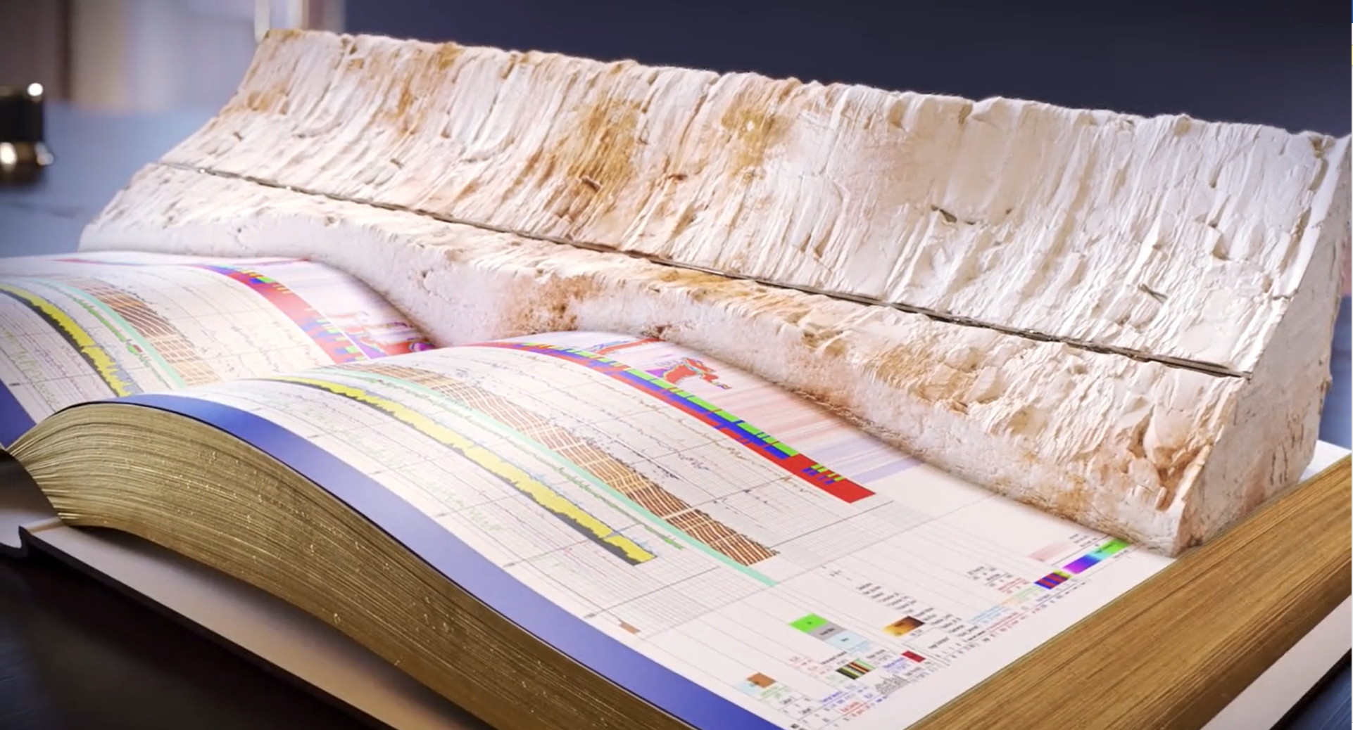

Gamma Ray Spectroscopy in Oilfield
Marie-Laure Mauborgne
SLB
CSG17 – July 17th 2023

Slide 2
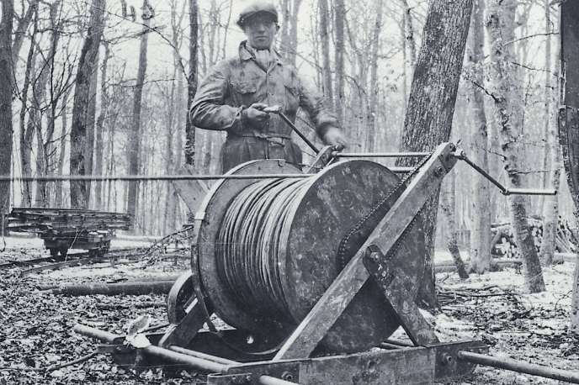
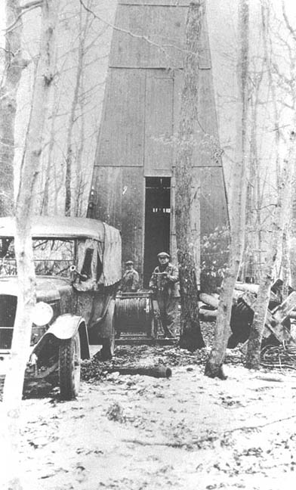
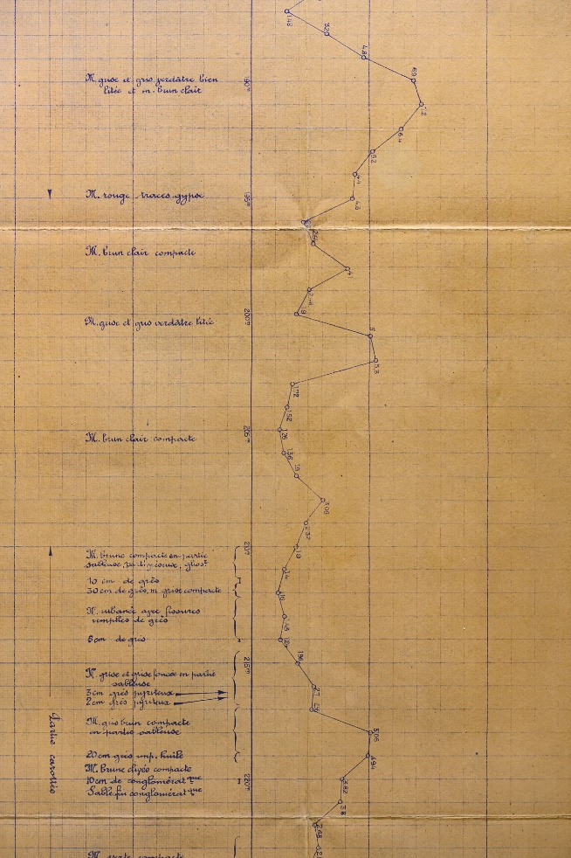
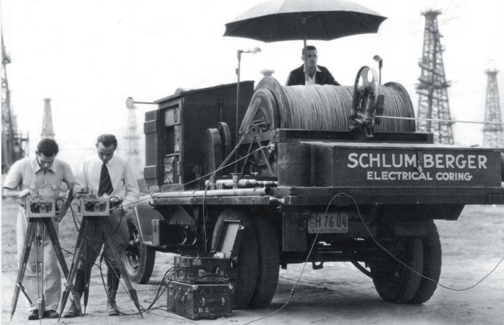
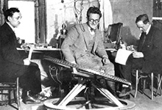
What is SLB?
(former Schlumberger)
Founded by a physicist and an engineer in 1926 to conduct the first geophysical measurements of rock formations

Slide 3

What is SLB?
(former Schlumberger)
Founded by a physicist and an engineer in 1926 to conduct the first geophysical measurements of rock formations
Now a global technology company driving innovation and transformation across the energy industry and beyond.
  98,000+ employees
    172 nationalities working in 120 countries
  71 research and engineering centers worldwide

Slide 4
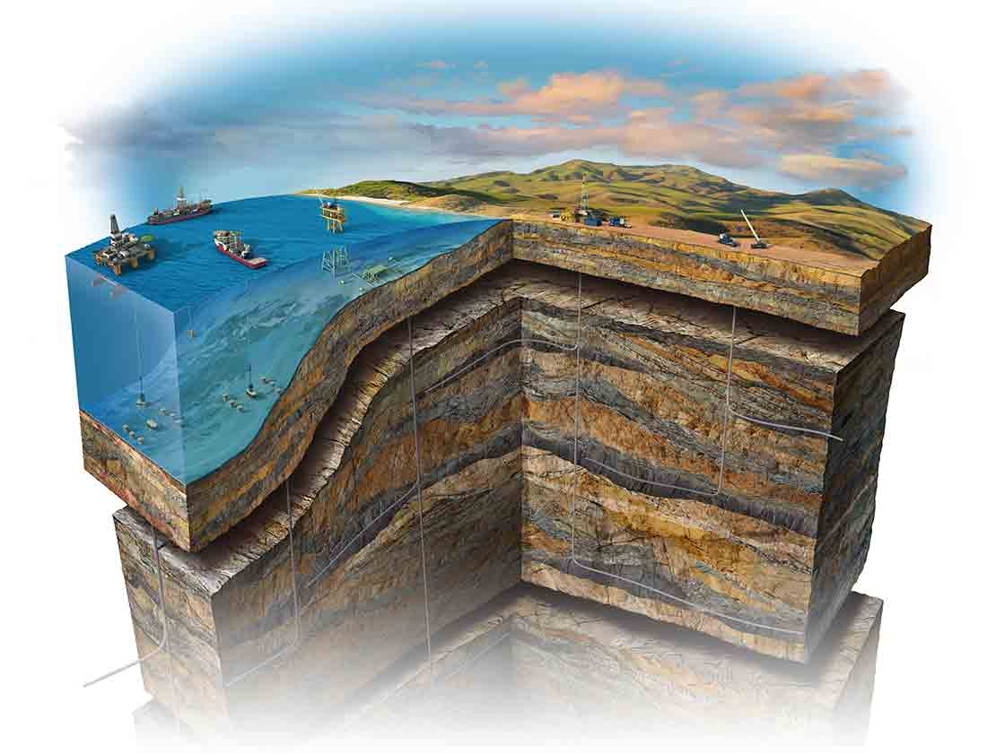
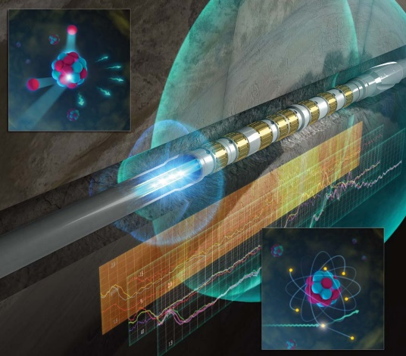
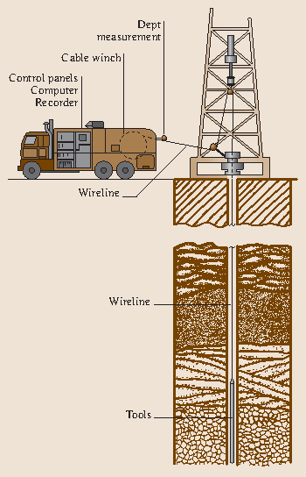
What We Do in Oil and Gas?
We develop tools and provide
hydrocarbon exploration measurements and data.
  Where are the hydrocarbons?
  What kind—oil or gas?
  How much can be extracted?
Use nuclear physics methods to measure
  Natural radioactivity
  Rock density
  Hydrogen index, porosity
  Rock matrix and pore fluid composition
  Wellbore diameter
Provide full characterization of the reservoir

Slide 5
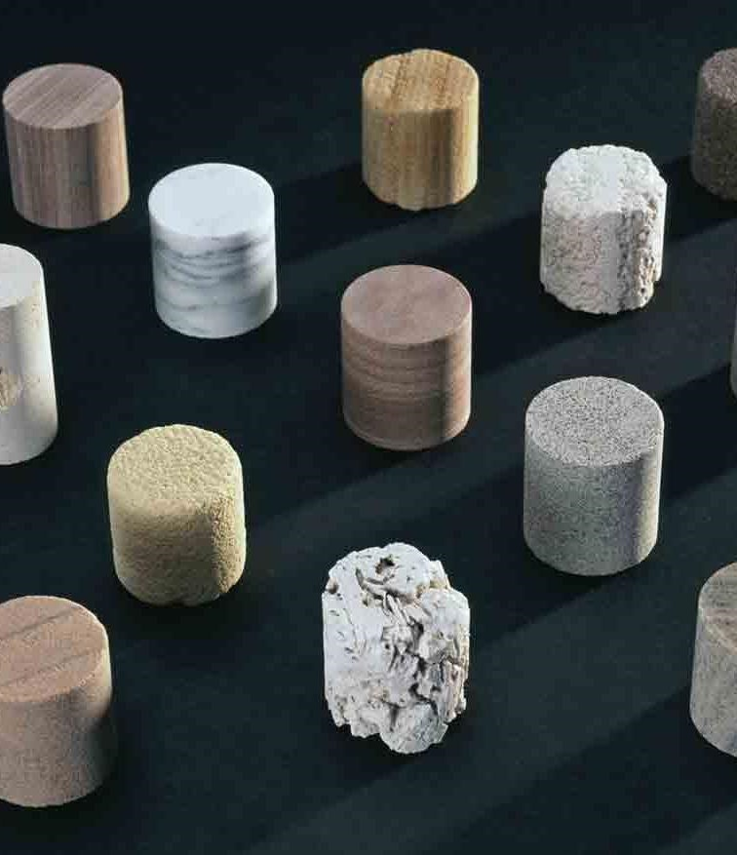
Rocks Are Composed of What?
Formation Rock = Matrix + Pores
Typical matrix materials
  In the reservoir —
  sandstone (SiO₂), limestone (CaCO₃), dolomite (CaMg(CO₃)₂)
  Everywhere else — “shale” (e.g., aluminosilicates)
Typical pore fluids
  Saltwater (NaCl brine)
  Hydrocarbons (oil or gas, C_{n}H_{m})

Slide 6
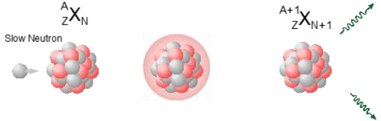
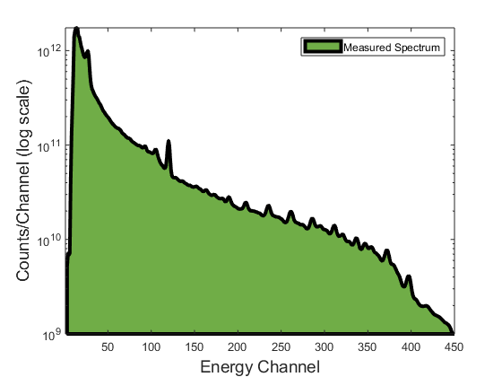
Measurement Principles
Spectral acquisition
Capture gamma ray spectrum
Scattering
Capture
Slow neutron
Gamma ray
Fast neutron
Notes:
-Measurement and processing happens in 4 main steps. First one is acquisition of capture gamma rays.
Spectroscopy relies on the analysis of gamma ray spectra. How are gamma rays produced and measured?
-Schematic view of the tool
-fast neutrons scattering, then capture by nuclei
-Capture gamma rays are characteristic of the emitting nucleus (characteristic energies)
-Detector converts gamma rays in UV light inside scintillation crystal,
Schematic view of the tool with the neutron generator and gamma ray spectroscopy detector. 14 MeV neutrons emitted by the generator, scatter off nuclei in formation, slow down until absorbed by a nucleus. After capture, nucleus in an excited state, decays to fundamental state by releasing excess energy in form of one or several gamma rays (capture gamma ray). Some of these gamma rays will reach the detector scintillation crystal in the tool, deposit some or all of their energy, which gets released by the crystal in form of UV light. These UV photons are then converted into electrons in the PMT photocathode, and the photoelectrons are multiplied in the same PMT to form a measurable electrical signal.
Electrical signal at detector output is proportional to the energy deposited by the incoming gamma ray.
A pulse height analyzer is used to produce and histogram of the amplitude of the electrical pulses coming from the detector, which provides the energy distribution of the detected gamma rays. This is called a gamma ray spectrum (capture spectrum here). This is the first step of the spectroscopy measurement.

Slide 7
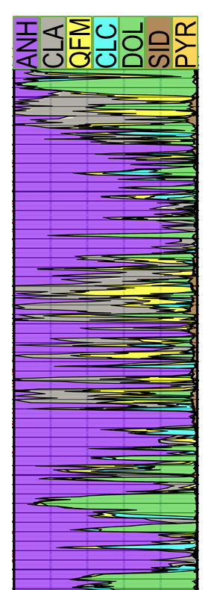
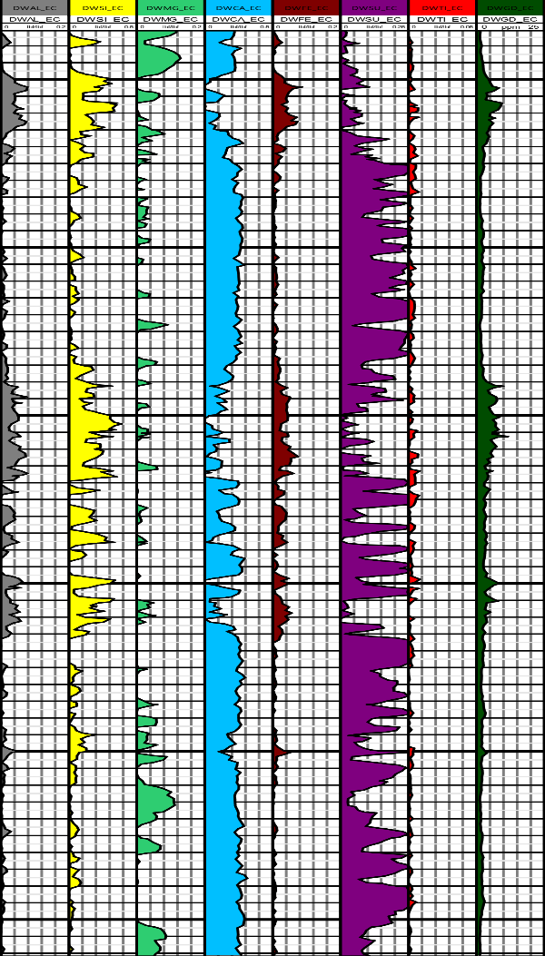
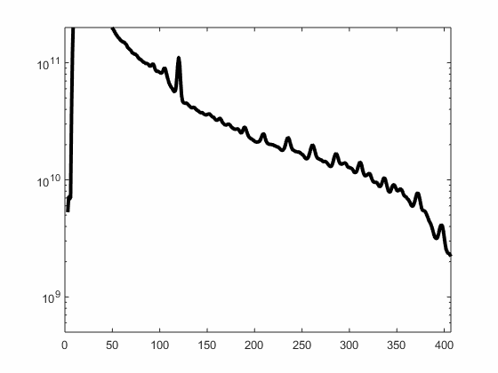
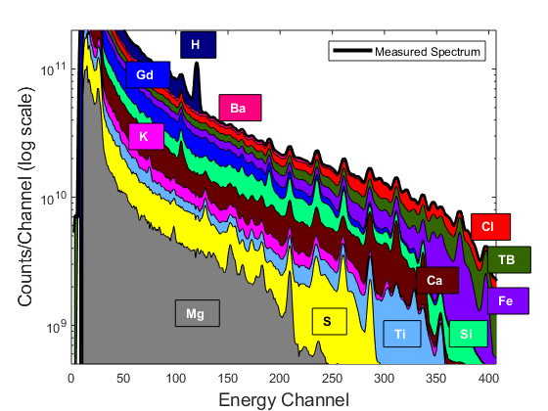
Measurement Principles
Spectral acquisition
Spectral stripping
Closure
Interpretation
Capture gamma ray spectrum
Elemental yields
Elemental weight fractions
Minerals
matrix properties
Al
Si
Mg
Ca
Fe
S
Ti
Gd
Notes:
-Reconstruction of measured spectrum using linear combination of elemental standard spectra
-What are standard spectra
-TB is special: composition match parts around detector to minimize environmental effects on TB spectrum shape
-All present elements need to be included for reconstruction
-Closure: sensitivities vary from one element to another. Some elements not measured. Considered in closure model. Not all elements can be measured, common associations known. Most elements exist in form of oxyde in sedimentary rocks, sum of the rock forming oxides is 1.
-Mineralogy: neural network model. Data=4000 rock samples from 50 different reservoirs. Each sample characterized in lab for elemental and mineral composition. Map dry weights and minerals.
Second step is decomposition of measured spectrum. Basic assumption is that gamma ray spectrum can be reconstructed as a linear combination of elemental gamma ray standards spectra. These standard spectra represent the response of the tool for one single element (Mg, Si, etc…). This decomposition is done using a weighted least square fit of the measured spectrum with the elemental standard spectra. At this step, temperature effects on the detector (resolution and linearity change) as well as tool-to-tool variations need to be accounted for. The spectral stripping provides the relative contribution of each individual elemental standard spectrum in the fit to the measured spectrum, AKA “spectral yields” which are unitless.
In a third step, the spectral yields are converted into actual element mass fractions, or Dry-Weights. This is done using a simplified geological model that relies on the assumption that all rock formations are composed of oxides, and it also relies on commonly observed mineralogical associations between the measured elements and elements that cannot be measured directly or accurately. The model used is called an oxide closure model, which type can be selected here depending on whether Mg is expected in the formation or not (WALK2 or Mgwalk). Those models have been derived from an analysis of thousands of rock samples from various locations and lithologies.
Finally, in a fourth step, the elemental dry-weight are used to determine the minerals weight and volumetric fractions, as well as the rock matrix properties, such as matrix density, matrix sigma, and matrix thermal and epithermal neutron responses. For this last step, a neural network-based model, described in detail in previous publications, is used to convert the elemental dry weights into the mineral weight and volumetric fraction and derive the matrix properties. This neural network has been trained on the large set of rock samples also used for deriving the closure model. It is worth saying that this new mineralogy model does not require any user input, therefore making the interpretation of the results easier and making them more consistent.

Slide 8
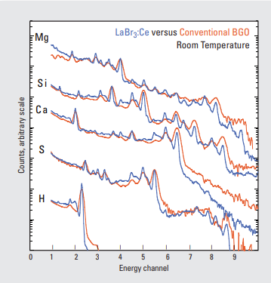
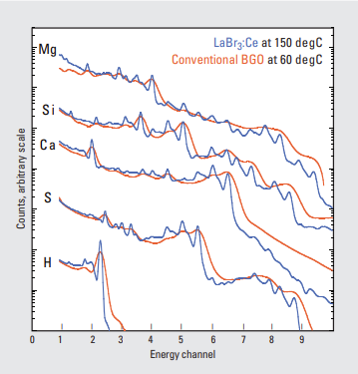
History of Gamma Ray Spectroscopy in
Oilfield
  1970s: Carbon Oxygen ratio (PNG, NaI)
  1980s: First capture spectroscopy tool (PNG, NaI)
  1990s: Capture spectroscopy improvement (AmBe, BGO)
Notes:
Herron, S.L. and Herron, M.M. 1996. Quantitative Lithology—An Application for Open and Cased Hole Spectroscopy. Paper E presented at the 1996 SPWLA Annual Logging Symposium.

Slide 9
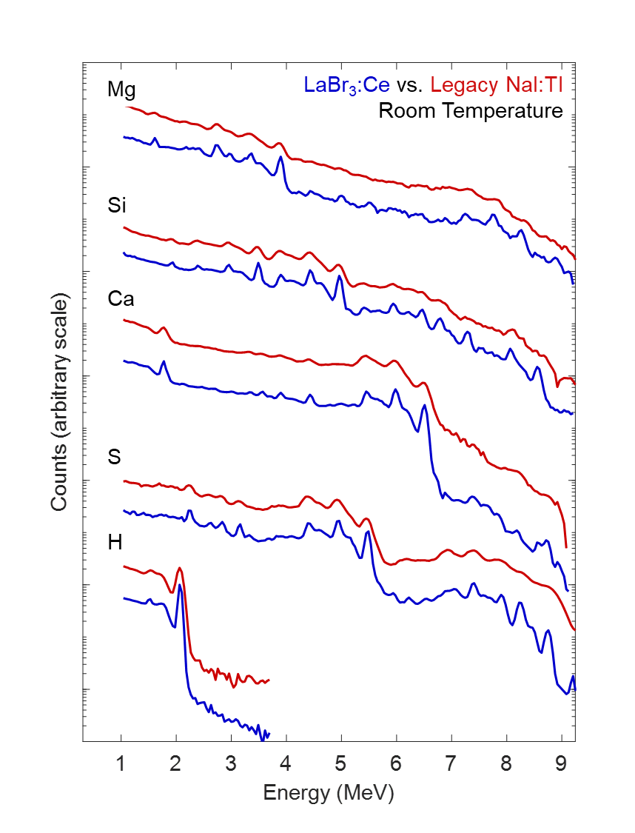
History of Gamma Ray Spectroscopy in
Oilfield
  1970s: Carbon Oxygen ratio (PNG, NaI)
  1980s: First capture spectroscopy tool (PNG, NaI)
  1990s: Capture spectroscopy improvement (AmBe, BGO)
2006: First capture spectroscopy tool while drilling (PNG, NaI)
  2012: Capture and inelastic spectroscopy improvement (PNG, LaBr₃)
2023: Capture spectroscopy improvement while drilling (PNG, LaBr₃)
Mg
LaBr₃:Ce vs. Legacy NaI:Tl
150degC
Si
Ca
S
H
Notes:
Herron, S.L. and Herron, M.M. 1996. Quantitative Lithology—An Application for Open and Cased Hole Spectroscopy. Paper E presented at the 1996 SPWLA Annual Logging Symposium.

Slide 10
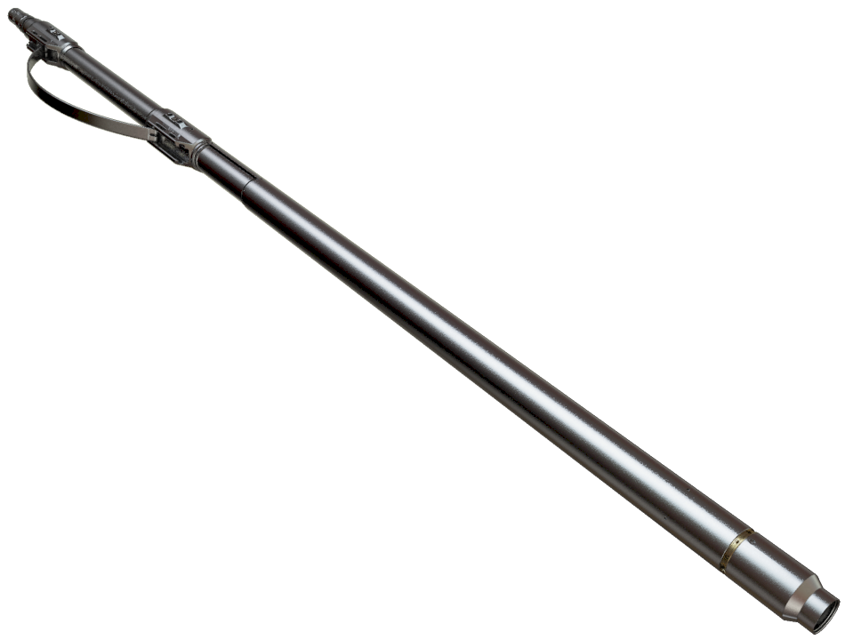
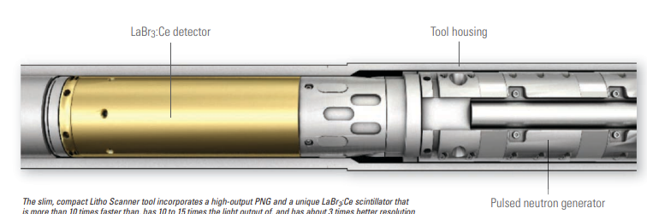
Tool Example—Spectroscopy Measurements
Diameter: 11.5 cm
Length: 3 m
Mass: 130 kg
Ratings: 175°C, 100 atm
Uses LaBr₃: Ce spectroscopy detector
Pulsed neutron generator, 3.6 × 10⁸ neutron/s nominal output
First (in the industry) in-situ measurement of
total organic carbon
Notes:
Count rate > 10Mcps

Slide 11
Why Do We Need (accurate) Modeling and Cross Sections?
Nuclear modeling is fundamental to well logging tool development
  Explore design choices quickly
  Balance mechanics, electronics, and physics without costly experimentation
  Complement and extend characterization measurements
Accurate modeling relies on accurate cross sections
  Adequate for gamma rays and neutrons transport
  Improvement needed for neutron-induced gamma rays
For spectroscopy, better cross sections would
  Improve standards derivation and interpretation algorithms
  Might allow for defining elemental standards directly from modeling

Slide 12
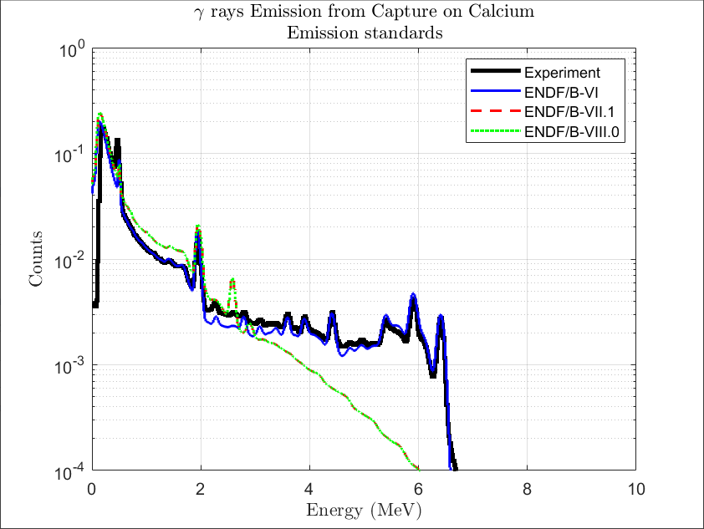
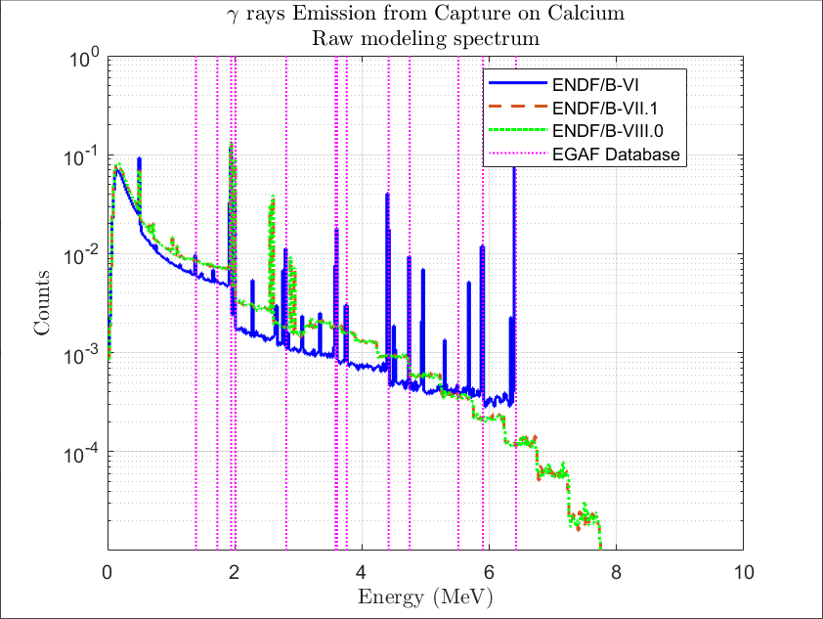
Calcium Capture Spectrum
  Calcium is an important element for geology evaluation.
    It was the first element for which we observed a regression cross section library
    No gamma ray lines above 3 MeV, extra line near 2.5MeV with unusual continuum shape
EGAF: “Database of prompt gamma rays from slow neutron capture for elemental analysis” Vienna : International Atomic Energy Agency, 2006

Slide 13
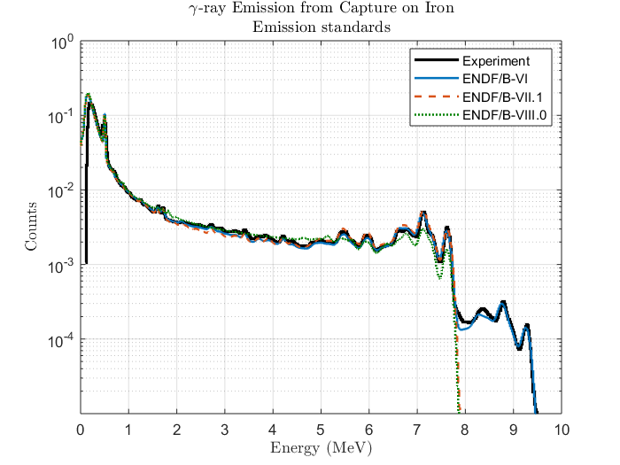
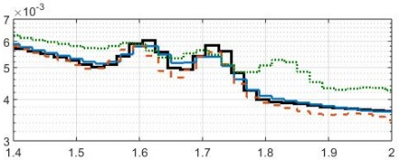
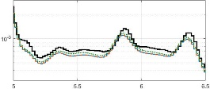
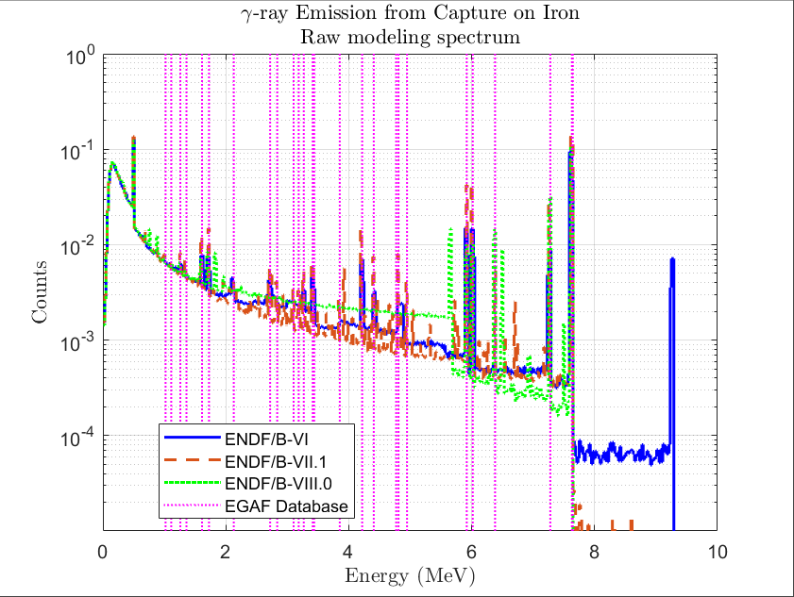
Iron Capture Spectrum
  Use of Fe-56 cross sections
  ENDF/B-VII.1 has the best match with experimental data and IAEA capture gamma-ray emission lines.
  ENDF/B-VIII.0 introduces new lines not observed experimentally nor reported in the literature.
EGAF: “Database of prompt gamma rays from slow neutron capture for elemental analysis” Vienna : International Atomic Energy Agency, 2006

Slide 14
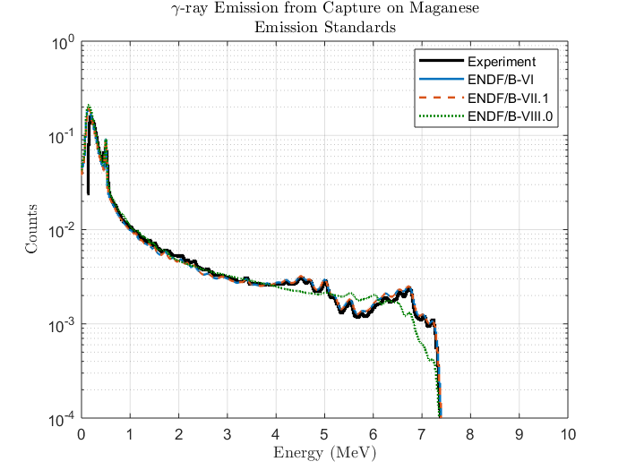
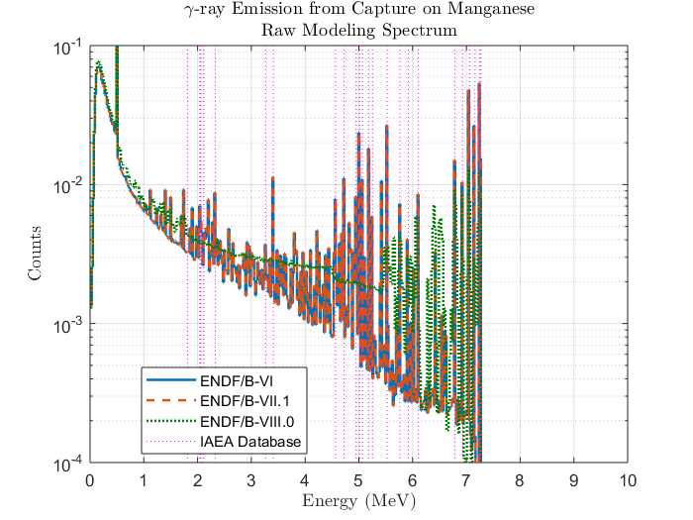
Manganese Capture Spectrum
  Only one isotope found in natural manganese
    Significantly of poorer quality in ENDF/B-VIII.0
    ENDF/B-VI and ENDF/B-VII.0 data in better agreement with our experimental results and IAEA capture gamma ray emission lines
EGAF: “Database of prompt gamma rays from slow neutron capture for elemental analysis” Vienna : International Atomic Energy Agency, 2006

Slide 15
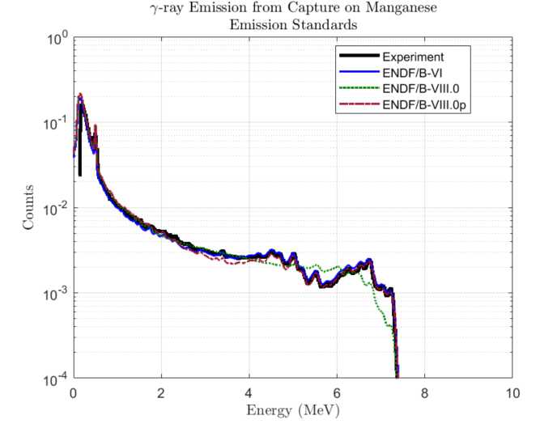
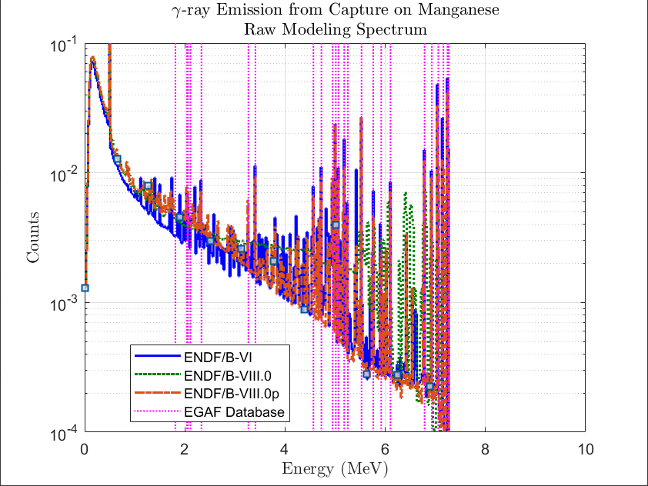
New Manganese Capture Cross Section
  Following the presentation of the results at CSEWG in 2019
  Update of the cross sections made by R. Capote and A. Trkov in red
  https://www-nds.iaea.org/publications/indc/indc-nds-0810.pdf
  Significant improvement in the capture spectrum
EGAF: “Database of prompt gamma rays from slow neutron capture for elemental analysis” Vienna : International Atomic Energy Agency, 2006

Slide 16
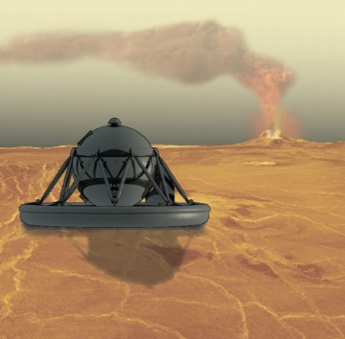
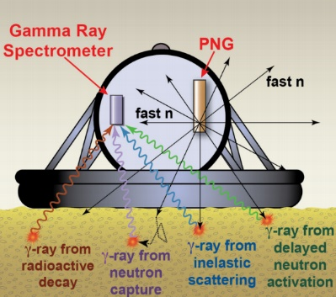
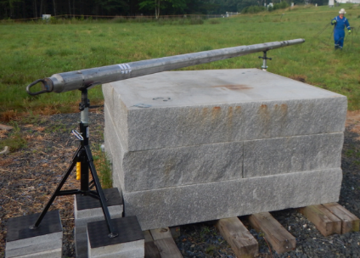
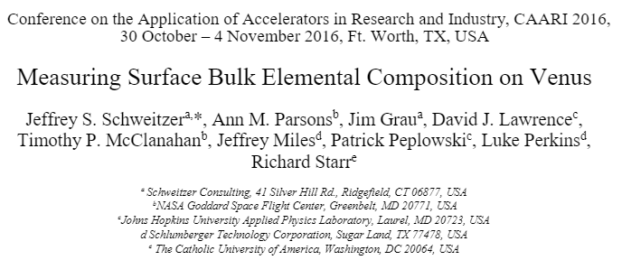
Hardware Outside of Oilfield
SLB-NASA Engagements
  Spectroscopy on Venus Lander to analyze its crust and search for water
  Venus surface: P = 92 atm; T = 462ºC
  Operational lifetime: 2-4 h max.
  First test performed at NASA Goddard Space Flight Center with an actual tool.
  Very good results with only minor tool modifications
Notes:
Bulk Elemental Composition Analyzer
IEEE 2016

Slide 17
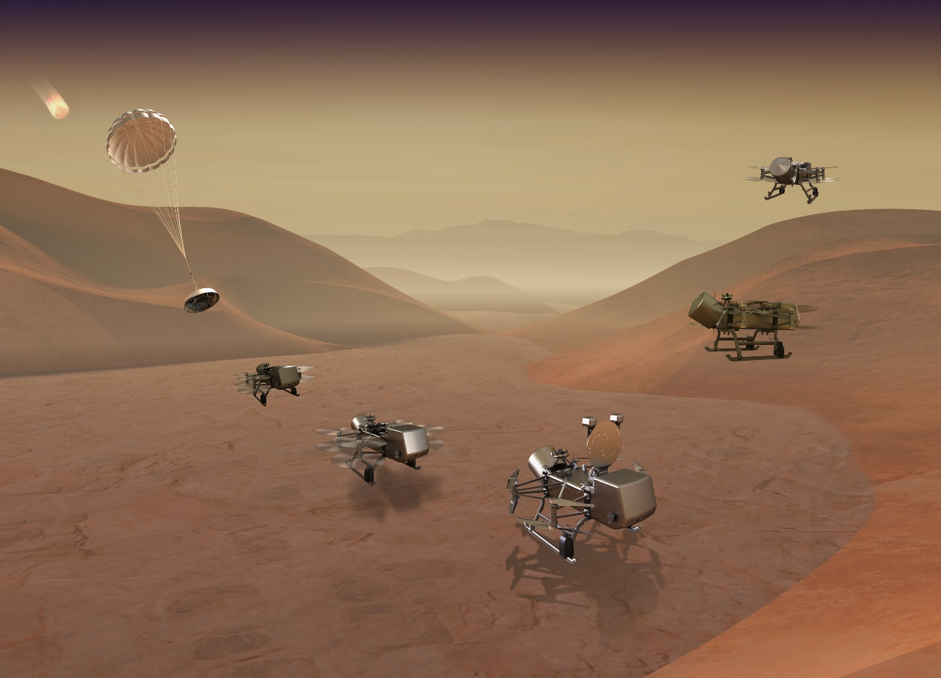
Schlumberger Space Engagements — Dragonfly
  In collaboration with Johns Hopkins Applied Physics Laboratory
  Explore Titan (Saturn's largest moon) with an instrumented, radioisotope-powered dual-quadcopter
  Provide pulsed neutron generator and expertise on gamma ray spectroscopy (capture and inelastic) to analyze the composition of the shallow subsurface

Slide 18
Conclusion
Oilfield and space applications share an interest in lithology measurements obtained from neutron-induced gamma-ray spectroscopy
  Improvements in crystal bring step change for the measurement
  Modeling is perfectly suited to help design such tools and understand their performance
  Accurate cross sections are necessary to improve modeling prediction

Slide 19
Related publications
A Step Change in Neutron-Induced Gamma Ray Spectroscopy: Using a High-Resolution LaBr₃:Ce Detector in an Integrated LWD Tool
  Haranger, F., Allioli, F., and Berheide, M.
  SPWLA 64th Annual Logging Symposium, Lake Conroe, Texas, USA, June 2023
  DOI: 10.30632/SPWLA-2023-0121
Impact of the ENDF/B-VIII.0 library on modeling nuclear tools for oil exploration
  Mauborgne, M.-L., Radtke, R. J., and Haranger, F. et al.
  International Conference on Nuclear Data for Science and Technology, Beijing, 2019
  China,
  DOI: 10.1051/epjconf/202023920007
Designing Tools for Oil Exploration Using Nuclear Modeling
  Mauborgne, M.-L., Allioli, F., and Manclossi, M. et al. 2017.
  International Conference Nuclear Data for Science and Technology, Bruges, Belgium, 2016
  DOI: 10.1051/epjconf/201714609036.
A New Capture and Inelastic Spectroscopy Tool Takes Geochemical Logging to the Next Level
  Radtke, R., Lorente, M., and Adolph B. et al.
  SPWLA 53rd Annual Logging Symposium, Cartagena, Colombia, 16-20 June 2012

