Slide 1
Machine learning applications for Small Angle X-ray Scattering data collection and analysis at EMBL-Hamburg
D. Franke, C.M. Jeffries, D. Molodenskiy, A.G. Kikhney, D.I. Svergun

Slide 2
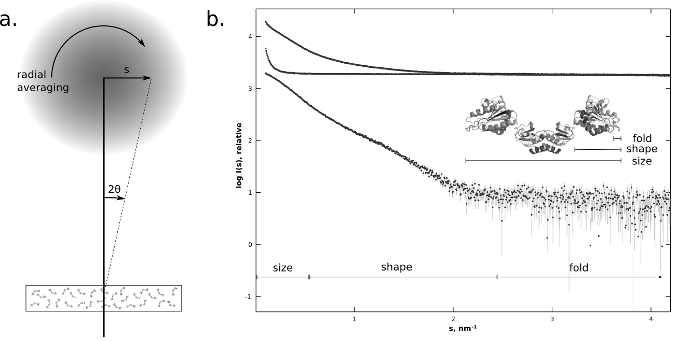
Small Angle X-Ray Scattering
SASBDB: SASDAM5
Notes:
If it where this simple, we wouldn’t be here …

Slide 3
Parameters of Interest for Biological SAXS
Radius of Gyration (R_{g})
Maximum extent/dimension (D_{max})
Molecular Weight (MW) and oligomeric state
Rough shape
… and more …
Analysis methods exist, but are involved and can be intimidating for novice users, mistakes are easily made
Experts are able to predict properties of a system from a quick glance at the scattering pattern

Slide 4
Supervised Machine Learning
Simulate data with known parameters of interest
Define features and labels
Train a supervised learner
… success?
Notes:
First self driving cars in 2010, IBM Watson plays Jeopardy in 2011, AlphaGo in 2016, Tensorflow 1.0 Feb. 2017, this work: largely done in 2014/1015

Slide 5
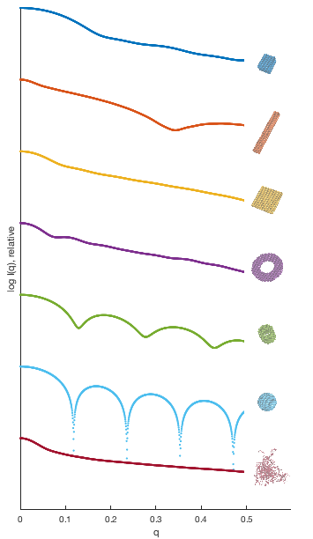
Generating Training Data and Labels
compact
extended
flat
ring
compact
compact-hollow
hollow sphere
~500.000 data sets
and associated labels
random chain
BODIES (Konarev et al., 2003), EOM (Tria et al., 2015)

Slide 6
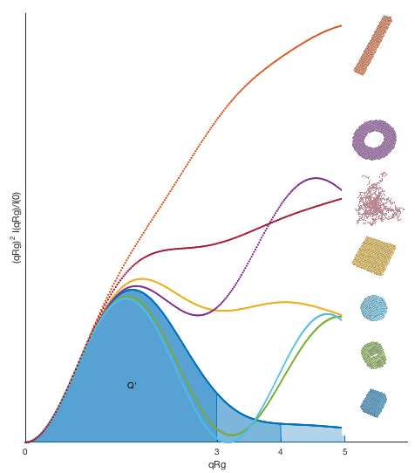
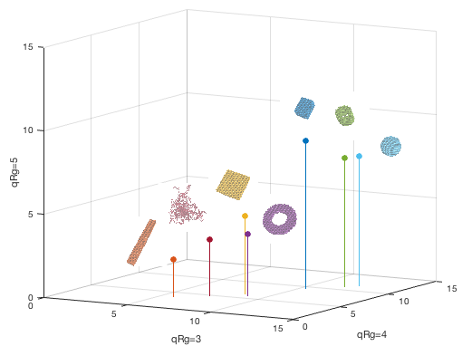
Data Transformation and Feature Extraction
Apparent Volume V’=2π/Q’ (Fischer et al., 2010) Integrate Q’ up to qRg=3,4,5:
Dimensionless Kratky Plot (Durand et al., 2010):

Slide 7
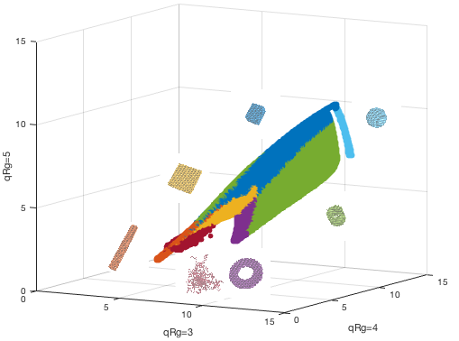
Source Data in V’
~500.000 data points
and associated labels
Not shown: random grid of unknowns
Note: no data augmentation applied

Slide 8
Learning: k Nearest Neighbours
Cross Validated Learning:
randomly split data, learn one part, look up the other
?

Slide 9
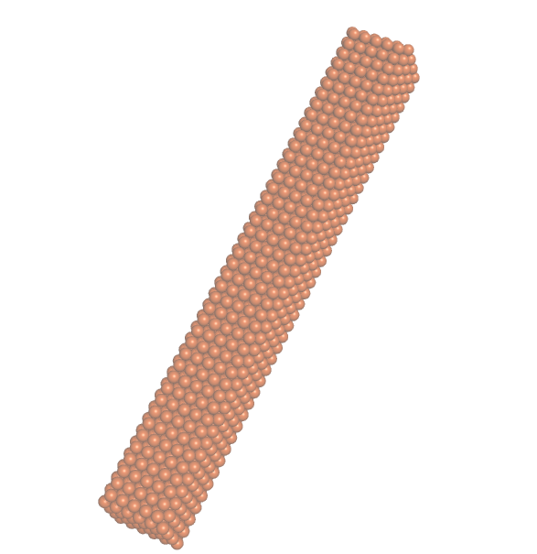
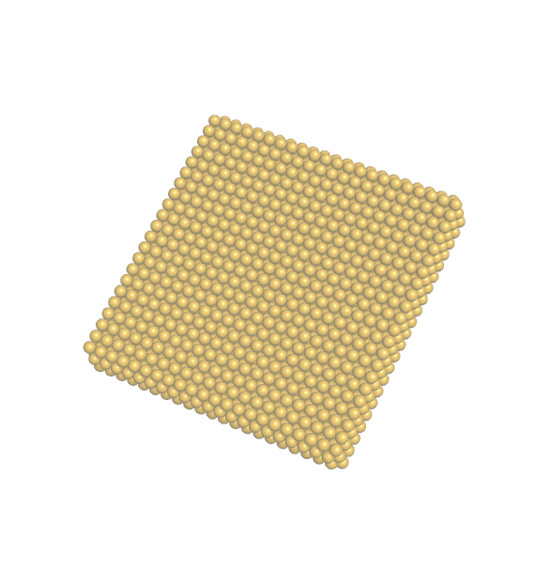
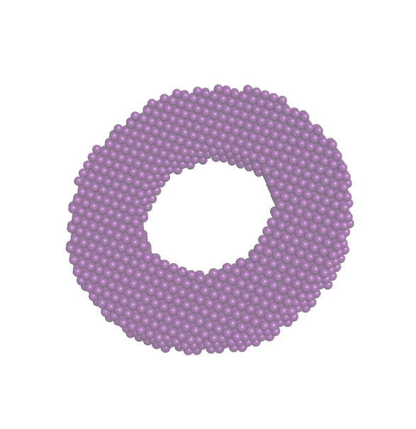
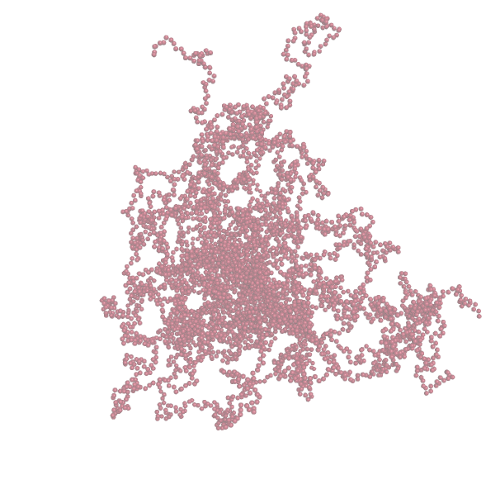
Cross Validated Performance
?
F1 | .99 | .95 | .97 | .95 | .98 | .91 | .99 | .96
MCC | .99 | .94 | .95 | .94 | .98 | .91 | .99 | .96
F1: Measure of test accuracy
MCC: Matthew’s Correlation Coefficient Range: 0.0 – 1.0 Bigger Is Better!
Powers, Journal of Machine Learning (2011)
Notes:
Precision:

Slide 10
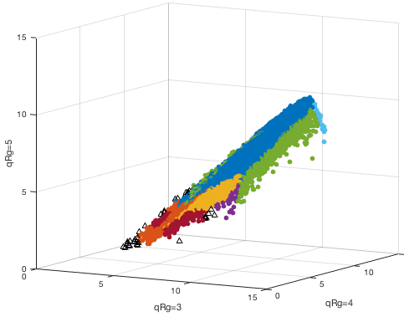
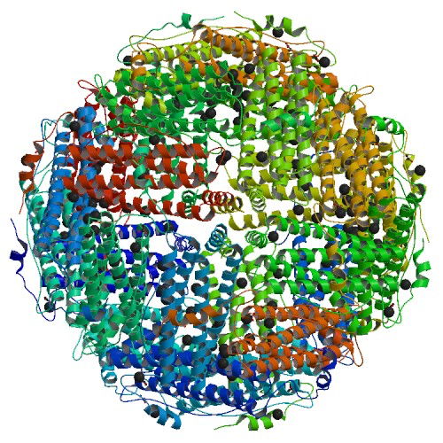
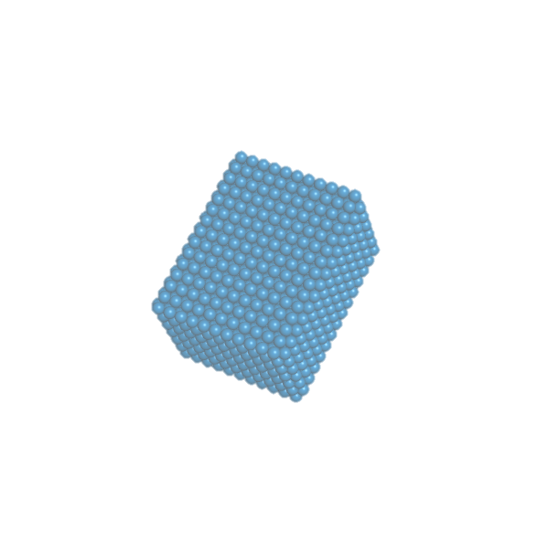
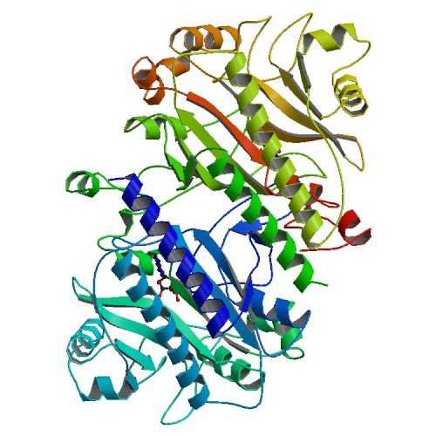
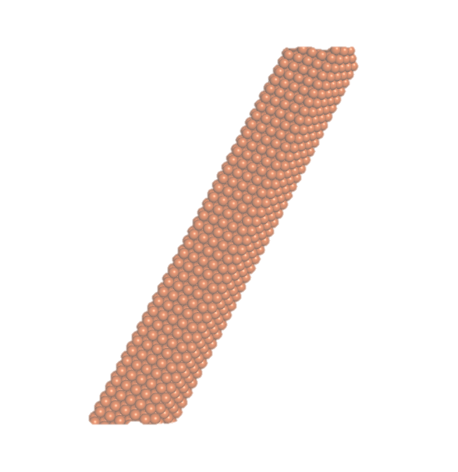
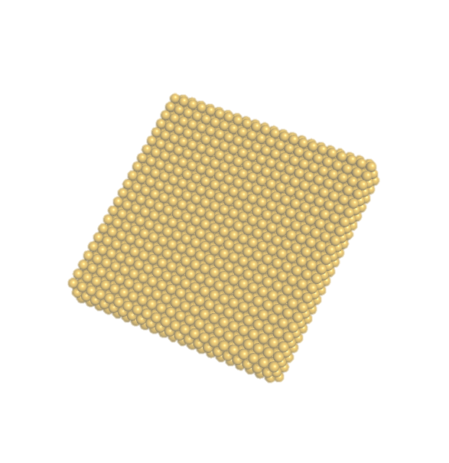
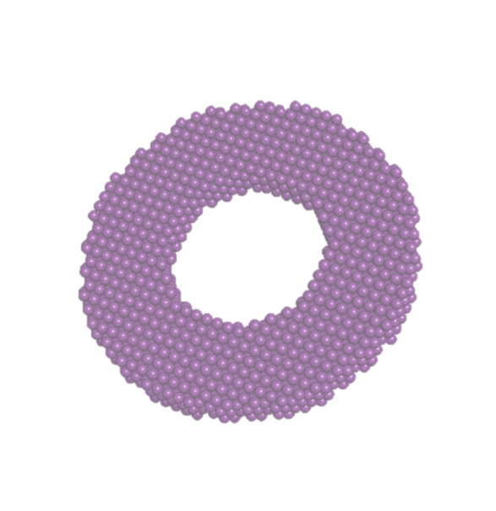
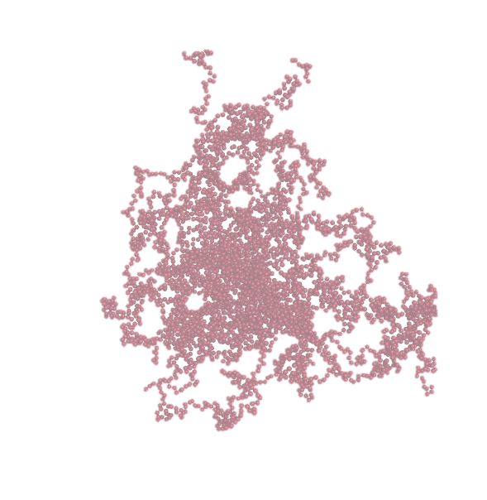
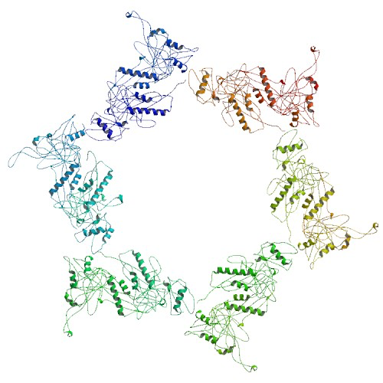
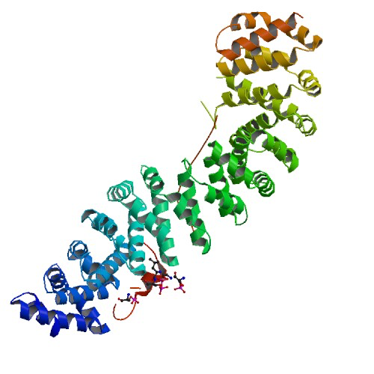
Application to the PDB
#
48
85.904
3.413
4.266
55
25.442
109
551
119.740*
3A68
?
12AS
2MII
3H3W
Total
1V18
* CRYSOL; minimum 50 amino acids, no nucleotides, connected

Slide 11
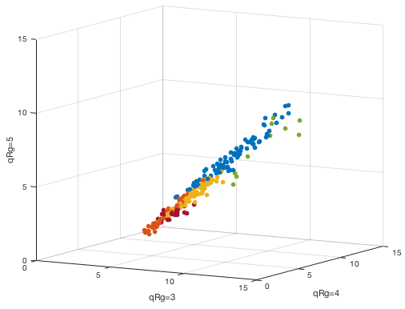
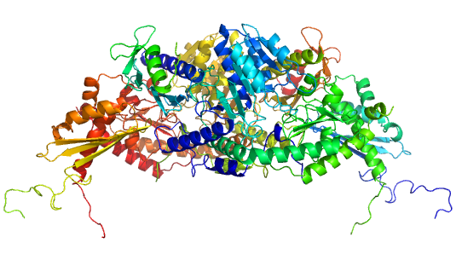
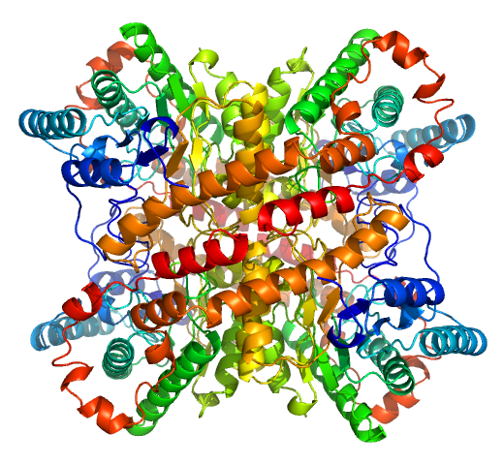
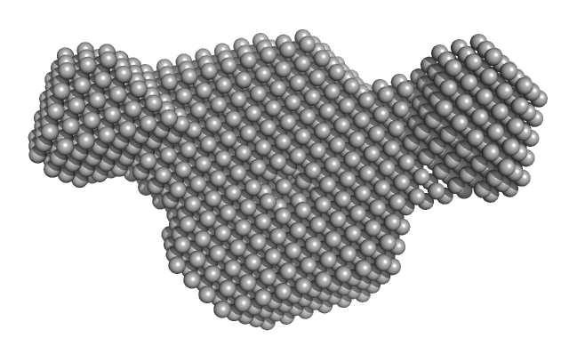
Application to Experimental Data
SASDA27
#
8*
85
55
66
0
10
0
33
257
?
SASDAB6
SASDA37
SASDAB5
Total
* not shown: wrong file format: 2; insufficient data: 6

Slide 12
PDB as Data Source
#
48
85.904
3.413
4.266
55
25.442
109
551
119.740*
3A68
?
12AS
3H3W
Total
1V18
* CRYSOL; minimum 50 amino acids, no nucleotides, connected

Slide 13
Results of Weighted kNN

Slide 14
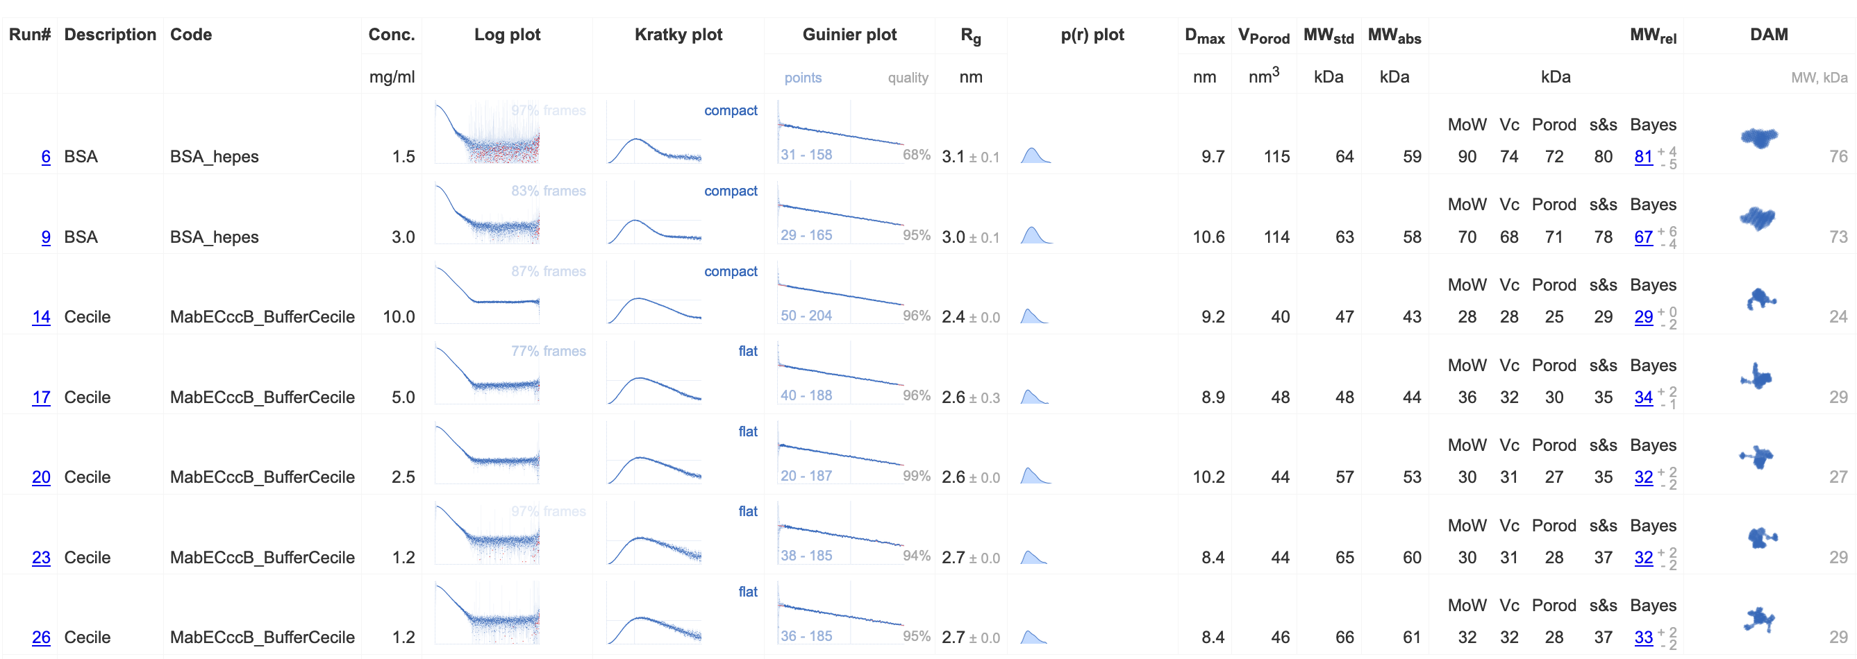
Availability
Included as DATCLASS in ATSAS-3.0.0 (Franke et al., 2017).
Included in automated data analysis pipeline SASFLOW at BioSAXS beamline P12.
https://www.embl-hamburg.de/biosaxs/software.html

Slide 15
Poster
Dima Molodenskiy
Al Kikhney
https://dara.embl-hamburg.de/gnnom.php

Slide 16
Thanks

