Slide 1
Deep Learning Methods On Neutron Scattering Data
P. Mutti, F. Cecillon, Le Goc, G. Song
Institut Laue-Langevin, Grenoble, France
Notes:
1

Slide 2
Summary
Apply machine learning to scientific data
Convolutional Neuron Network – tools and methods
Classifier and Predictor
Results and perspectives
Notes:
2

Slide 3
Use Case: Small Angle Neutron Scattering
The Swiss knife of material science: can deliver information on hard and soft matter, from crystals to biological structures
Long setup time but short measurements
Large demand and big variety of users’ experience
Notes:
3

Slide 4
Schematic Of A SANS Instrument
Notes:
4

Slide 5
A Multi-Parameter Space
Detector
Collimation
Wavelength
Instrument parameters
Geometry
Distance
Organization
Sample parameters
Temperature
Magnetic Field
Pressure
Angle
…
Environment parameters
Early prediction of material’s structure will help optimizing instrument’s parameters and increasing beam time productivity
Notes:
5

Slide 6
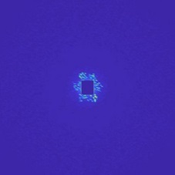
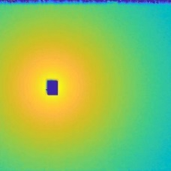
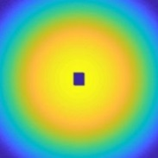
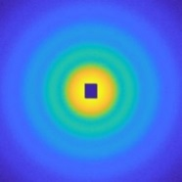
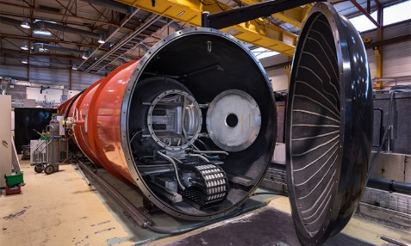
The Project’s Workflow
Recognized structure model (i.e. sphere, cylinder, Bragg glass etc. )
Trained classifier
Early experimental scattering image
…
Required scattering image type
Squeezing out the knowledge and the feeling from the brain of a scientist
?
or
Trained predictor
Optimized instrument setting
Notes:
6

Slide 7
The Project’s Workflow
Recognized structure model (i.e. sphere, cylinder, Bragg glass etc. )
Trained classifier
Early experimental scattering image
…
Required scattering image type
Using deep learning methods
?
or
Trained predictor
Optimized instrument setting
Notes:
7

Slide 8
Popular CNN Based Architectures
Performance in image recognition
# of layers
Models | Size | Top1-Accuracy | Depth
VGG16 | 528MB | 0.713 | 23
ResNet50 | 98MB | 0.749 | -
InceptionV3 | 92MB | 0.779 | 159
InceptionResNetV2 | 215MB | 0.803 | 572
MobileNetV2 | 14MB | 0.713 | 88
Accurate & fast
Most accurate
Fastest
Notes:
8

Slide 9
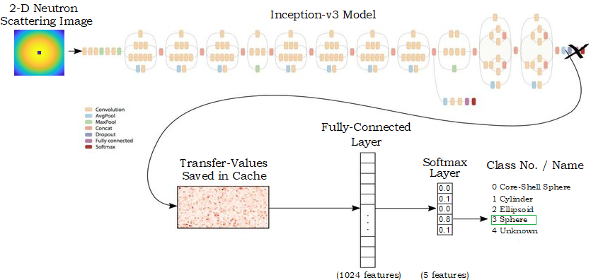
Transfer Learning on Pre-Trained Inception v3
Transfer learning:
- reuse the feature extraction part - re-train the classification part with our dataset.
Advantage of transfer learning:
- less computational resources
- less labeled training data
- less training time
Error rate approaches human performances
Notes:
9

Slide 10
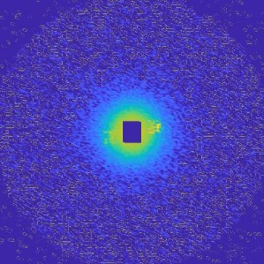
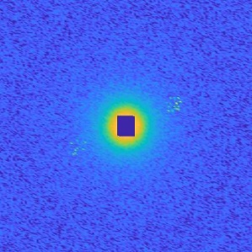
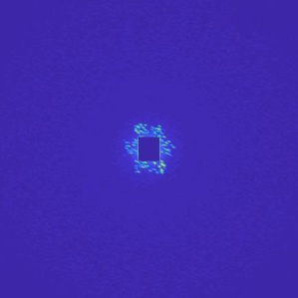
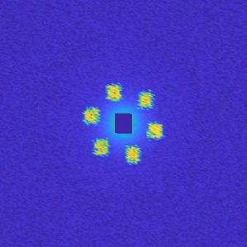
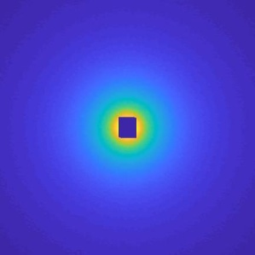
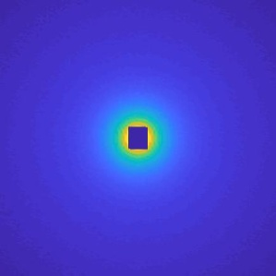
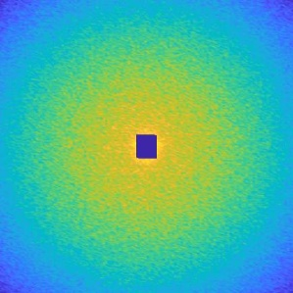
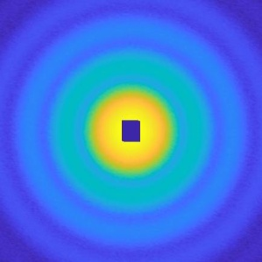
Generating Images For Training
The neuron network is trained using simulated SANS images
Simulation code GRASP – mix of analytical and monte-carlo approach
Advantages:
Include instrument resolution, background and sample environment effects
Possibility to control all instrument and sample parameters
Bragg glass
Sphere
Notes:
10

Slide 11
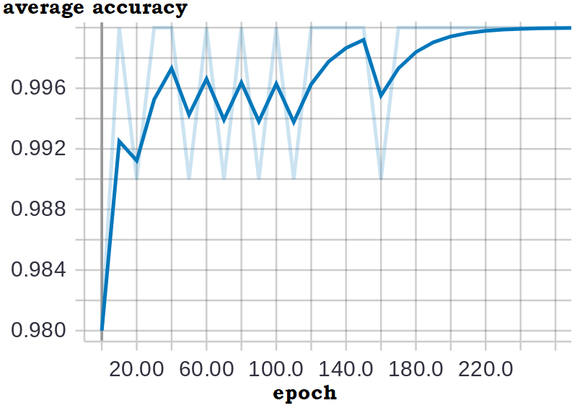
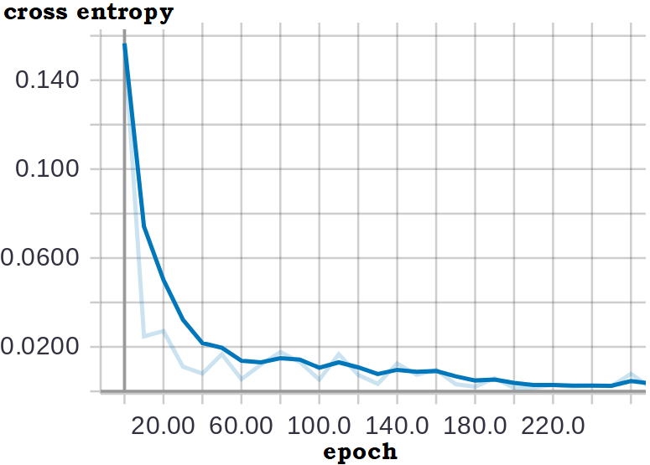
Training The Network
Training trail begins with the pre-trained model Inception-v3;
The initial weights are taken from the pre-trained weights based on ImageNet;
2000 images per each sample structure
Initial learning rate is 0.01;
The model is trained for 300 epochs;
For each training trail, 80% data are selected randomly for training, 10% data are used for testing and 10% data are used for validation.
After 200 epochs, the average accuracy is stable to 100%, which indicates all the simulated samples in the dataset are corrected recognized.
Notes:
11

Slide 12
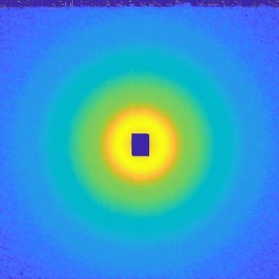
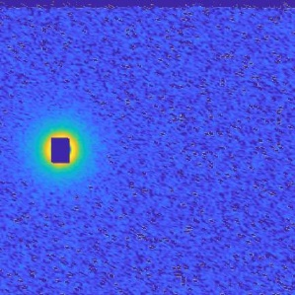
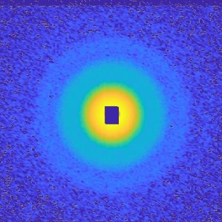
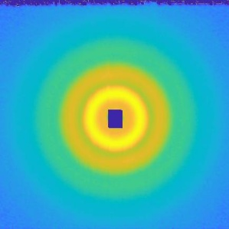
Performance On Real Data
Raw data from silica sample (spherical structure)
Sphere : 100%
Bragg glass : 0%
Sphere : 98.9%
Bragg glass : 1.1%
Sphere : 99.3%
Bragg glass : 0.7%
Sphere : 100%
Bragg glass : 0%
All images are correctly identified with 99% confidence level
Notes:
12

Slide 13
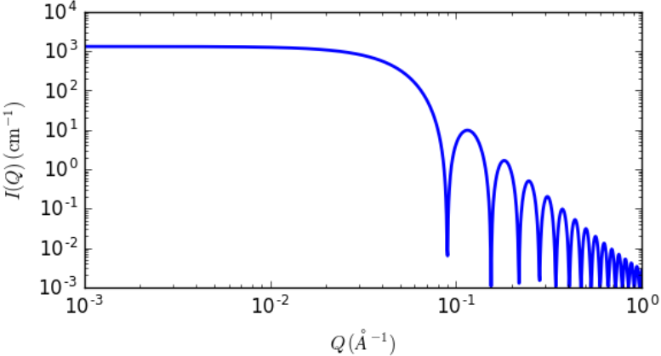
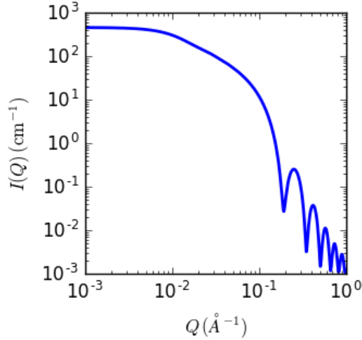
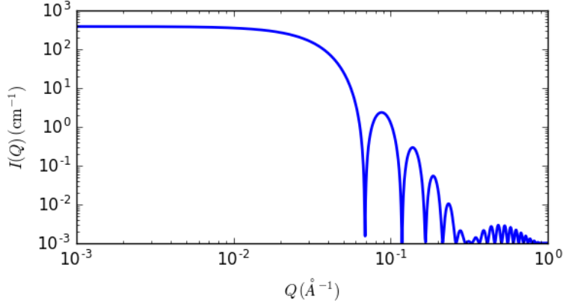
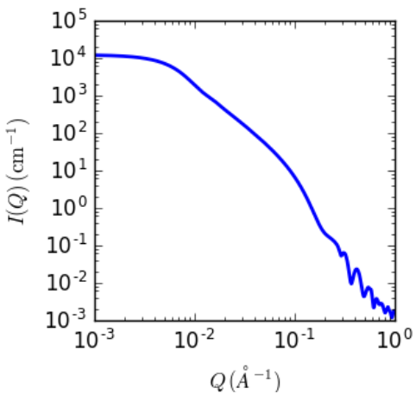
Increasing Complexity
Comparison of 4 different structure geometries
Sphere
Cylinder
Scattering pattern from sphere, cylinder,
core-shell sphere and ellipsoid structures
is very similar
Core-shell sphere
Ellipsoid
Recognition of the structure at an early stage will help a lot in choosing the best instrument setting to obtain a high quality scattering data.
Notes:
13

Slide 14
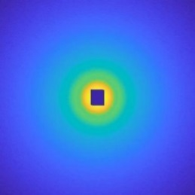
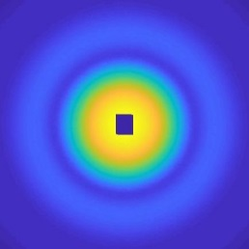
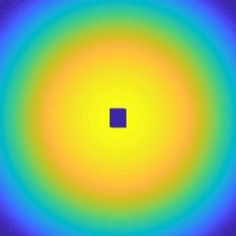
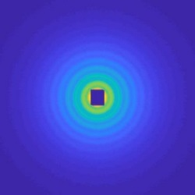
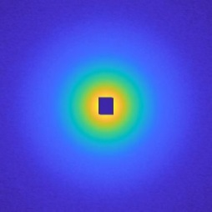
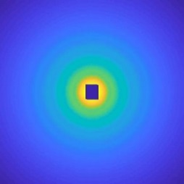
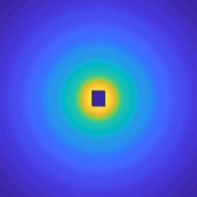
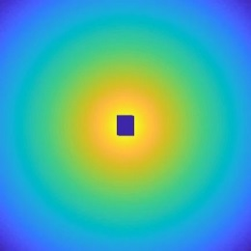
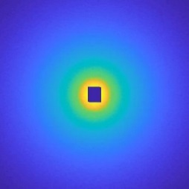
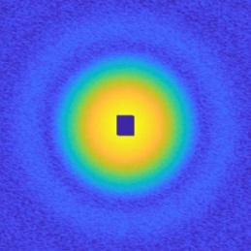
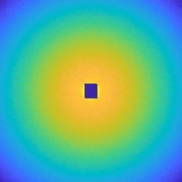
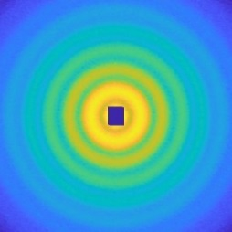
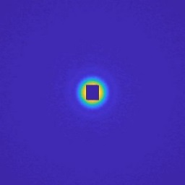
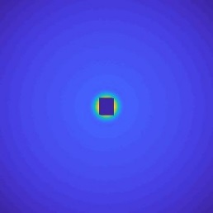
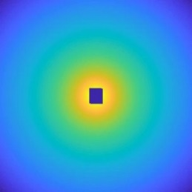
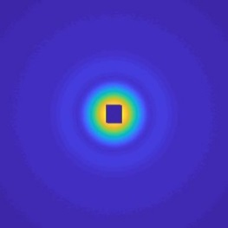
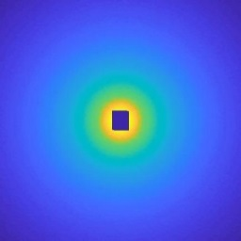
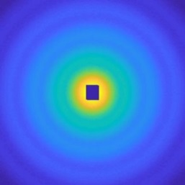
Generating New Datasets
sphere
ellipsoid
core-shell sphere
unknown
cylinder
10000 images per structure with random
combination of instrument parameters
Notes:
14

Slide 15
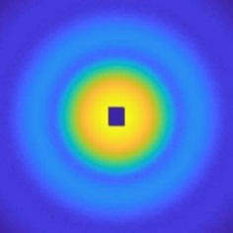
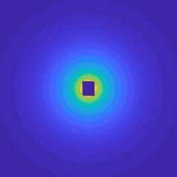
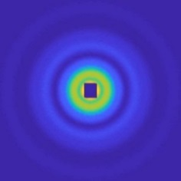
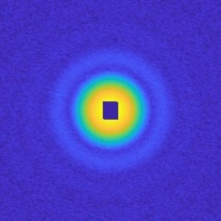
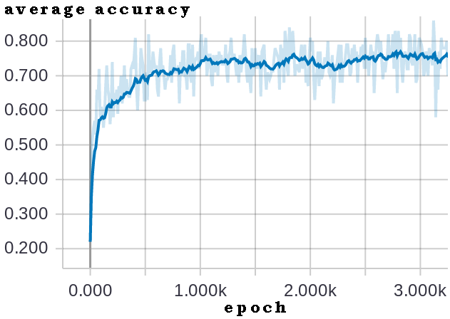
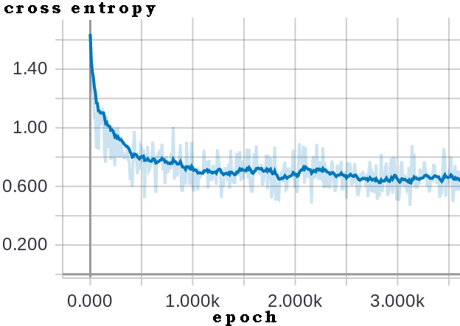
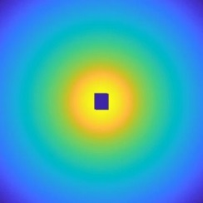
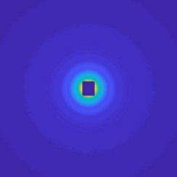
Results On Simulated Data
Training trail begins with the pre-trained model Inception-v3;
Cross-entropy loss function for the training and validation sets;
Batch size is 100;
The model is trained for 4000 epochs;
For each training trail, 80% data are selected randomly for training, 10% data are used for testing and 10% data are used for validation.
correct recognition
incorrect recognition
sphere
Core-shell sphere
cylinder
ellipsoid
After 1000 epochs, the average accuracy is stable around 73%.

Slide 16
Data Optimization And Fine Tuning
Data optimization: because of limited field of view of the instrument, in real experiment, sometimes we choose displace the neutron beam with a certain bias from the center, to obtain a larger field of view. 2000 simulated scattering images in this situation are added respectively to each class.
The model is optimized by stochastic gradient descent optimizer to find an optimal learning rate and batch size.
Example of sphere with certain bias from the center

Slide 17
Performance On Real Data
correct recognition
9 silica sphere: 8 image are recognized as sphere with an average confidence value of 92%
9 cylinder : 3 images are correctly recognized with an average confidence 63%
2 ellipsoid: 2 images are correctly recognized with an average confidence 43%.
2 core-shell sphere: 2 images are correctly recognized with an average confidence 67%.
sphere 98%
cylinder 65%
ellipsoid 45%
Core-shell sphere 67%
incorrect recognition
sphere
cylinder

Slide 18
Complete Workflow
Scattering image with initial choice of instrument setting
Recognized structure (i.e. sphere, cylinder, flux line bragg peak etc. )
Evaluated image quality (i.e. good guinier, one ring etc. )
Trained classifier I (CNNs)
Trained classifier II (CNNs)
…
sphere
ellipsoid
?
bad guinier
good guinier
or
Trained regression model
Desired scattering image type (i.e guinier for sphere etc.)
Desired image?
Generated new scattering image
Optimized instrument setting
Predicted radius of sample
No

Slide 19
Evaluation of Image Quality on Sphere Structure
Training setting:
7 image clusters are considered: bad guinier, good guinier, one ring, two or three rings, four and more rings with good resolution, four and more rings with bad resolution, background.
Each cluster contains 2000-8000 examples (database II).
Same method as classifier I.
Result on simulated data
Cluster | Precision(%) | Sensitivity(%) | F1-Score(%)
Bad guinier | 92 | 100 | 96
Good guinier | 95 | 94 | 95
One ring | 96 | 99 | 97
Two or three rings | 94 | 93 | 94
Four and more rings with good resolution | 100 | 95 | 98
Four and more rings with bad resolution | 91 | 93 | 98
Background | 97 | 95 | 97
The average accuracy is stable around 97,8%.

Slide 20
Prediction of Instrument Parameters
Result on simulated data
3 clusters are often desired:
Good guinier: monodispersity observation
Good multiple rings: polydispersity observation
Background
After 1 iteration of instrument’s parameters prediction:
Training setting:
Good guinier 82%
Database II;
Parameters of instrument: distance-collimation, wavelength;
Scattering image: 7 clusters;
Parameters from samples: radius (20-800 Å)
Training method: random forest
Optimized instrument setting
Trained regression model
.
.
.
Good multiple
rings 96%
Background 92%

Slide 21
Conclusions
Recognition accuracy is quite depending on the similarity among the material’s structure
Between models with big difference, high accuracy could be achieved even in low resolution
Among similar geometrical structures, the accuracy is influenced by the quality of the scattering images and by the field of view
The classifier trained only on simulated data is effective in recognizing structures from real experimental data
Once the classifier is trained, the structure recognition is real time

Slide 22
Perspectives
The performances on the neuron network need to be validated on more real experimental data
More sample structures need to be added, especially non crystalline one
Instrument parameters predictor in the workflow needs to be completed
Poster by Remi Perenon on crystal volume estimator with deep learning helpers

