Slide 1
Machine Learning in CryoEM
(in the last 10 years)
Biocomputing unit (Carazo/Sorzano)
Natl. Center Of Biotechnology (CSIC)
Instruct Image Processing Center

Slide 2
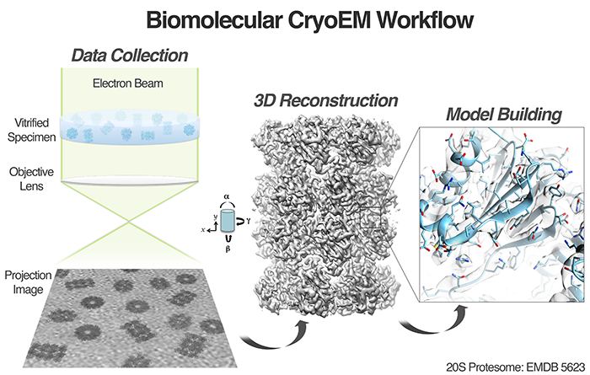
CryoEM

Slide 3
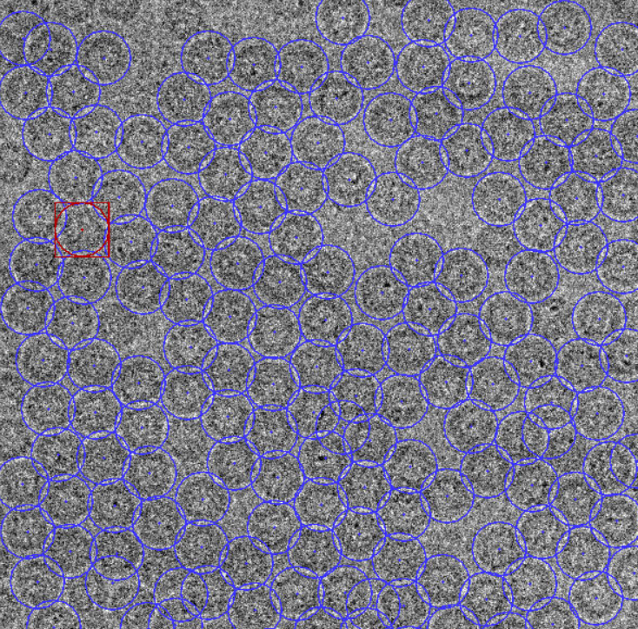
Particle picking
+SVM
Abrishami, V.; Zaldívar-Peraza, A.; de la Rosa-Trevín, J. M.; Vargas, J.; Otón, J.; Marabini, R.; Shkolnisky, Y.; Carazo, J. M. & Sorzano, C. O. S. Bioinformatics, 2013, 29, 2460-2468

Slide 4
Particle picking and particle pruning
Picker
Abrishami, V.; Zaldívar-Peraza, A.; de la Rosa-Trevín, J. M.; Vargas, J.; Otón, J.; Marabini, R.; Shkolnisky, Y.; Carazo, J. M. & Sorzano, C. O. S. Bioinformatics, 2013, 29, 2460-2468
Hoang, T. V.; Cavin, X.; Schultz, P. & Ritchie, D. W. BMC Structural Biology, 2013, 13, 25
Langlois, R.; Pallesen, J.; Ash, J. T.; Nam Ho, D.; Rubinstein, J. L. & Frank, J. J Struct Biol, 2014, 186, 1-7
Scheres, S. H. W. J. Struct Biology, 2015, 189, 114-122
Huber, S. T.; Kuhm, T. & Sachse, C J. Struct Biology, 2018, 202, 1-12
Heimowitz, A.; Anden, J. & Singer, A. J. Struct biology, 2018 , 204 , 215-227
Al-Azzawi, A.; Ouadou, A.; Tanner, J. J. & Cheng, J. Genes, 2019, 10, 10.3390/genes10090666
Al-Azzawi, A.; Ouadou, A.; Tanner, J. J. & Cheng, J. BMC bioinformatics, 2019, 20, 326
Wang, W. L.; Yu, Z.; Castillo-Menendez, L. R.; Sodroski, J. & Mao, Y. BMC bioinformatics, 2019, 20, 169
Features
Shape, moments, histogram, basis expansión, texture
Subspace analysis
PCA, other dimensionality reduction
Classifier
SVM, LDA, Naive Bayes, …
Pruning
Norousi, R.; Wickles, S.; Leidig, C.; Becker, T.; Schmid, V. J.; Beckmann, R. & Tresch, A. J. Struct Biology, 2013, 182, 59-66
Vargas, J.; Abrishami, V.; Marabini, R.; de la Rosa-Trevín, J. M.; Zaldivar, A.; Carazo, J. M. & Sorzano, C. O. S. J. Structural Biology, 2013, 183, 342-353

Slide 5
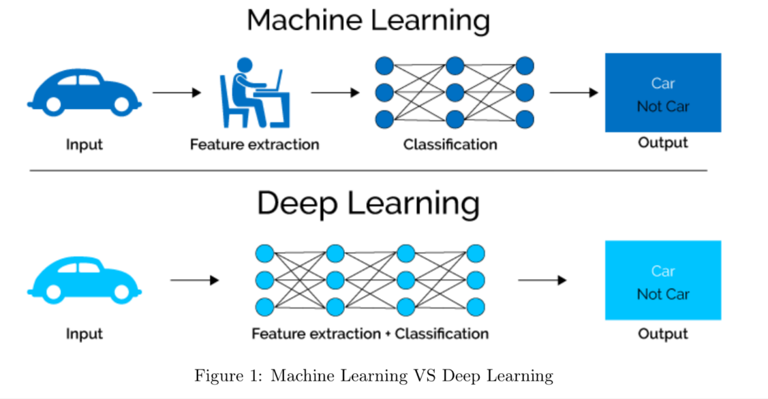
Particle picking and particle pruning
Picker
Wang, F., Gong, H., Liu, G., Li, M., Yan, C., Xia, T., ... & Zeng, J. (2016). J. Struct Biology, 195(3), 325-336.
Zhu, Y., Ouyang, Q., & Mao, Y. (2017). BMC bioinformatics, 18(1), 348.
Al Azzawi, A; Ouadou, A.; Tanner, J.J.; Cheng, J. Bioarxiv, 10.1101/763839, 2019
Bepler, T.; Morin, A.; Rapp, M.; Brasch, J.; Shapiro, L.; Noble, A. J. & Berger, B. Microscopy and Microanalysis, 2019, 25, 986-987
Masoumzadeh, A. & Brubaker, M. Proc. 30th British Machine Vision Conference, 2019
Tegunov, D. & Cramer, P. Nature methods, 2019, 16, 1146-1152
Wagner, T.; Merino, F.; Stabrin, M.; Moriya, T.; Antoni, C.; Apelbaum, A.; Hagel, P.; Sitsel, O.; Raisch, T.; Prumbaum, D.; Quentin, D.; Roderer, D.; Tacke, S.; Siebolds, B.; Schubert, E.; Shaikh, T. R.; Lill, P.; Gatsogiannis, C. & Raunser, S. Communications biology, 2019, 2 , 218
Yao, R.; Qian, J.; Huang, Q. Bioinformatics (2019), in press
Zhang, J.; Wang, Z.; Chen, Y.; Han, R.; Liu, Z.; Sun, F. Zhang, F. BMC bioinformatics, 2019, 20, 41
Pruning
Sanchez-Garcia, R.; Segura, J.; Maluenda, D.; Carazo, J. M. & Sorzano, C. O. S. IUCrJ, 2018, 5, 854-865

Slide 6
Particle picking and pruning
Is it a real need or
just because we can?

Slide 7
Micrograph denoising
Ouyang, J.; Liang, Z.; Chen, C.; Fu, Z.; Zhang, Y. & Liu, H. BMC structural biology, 2018, 18, 18

Slide 8
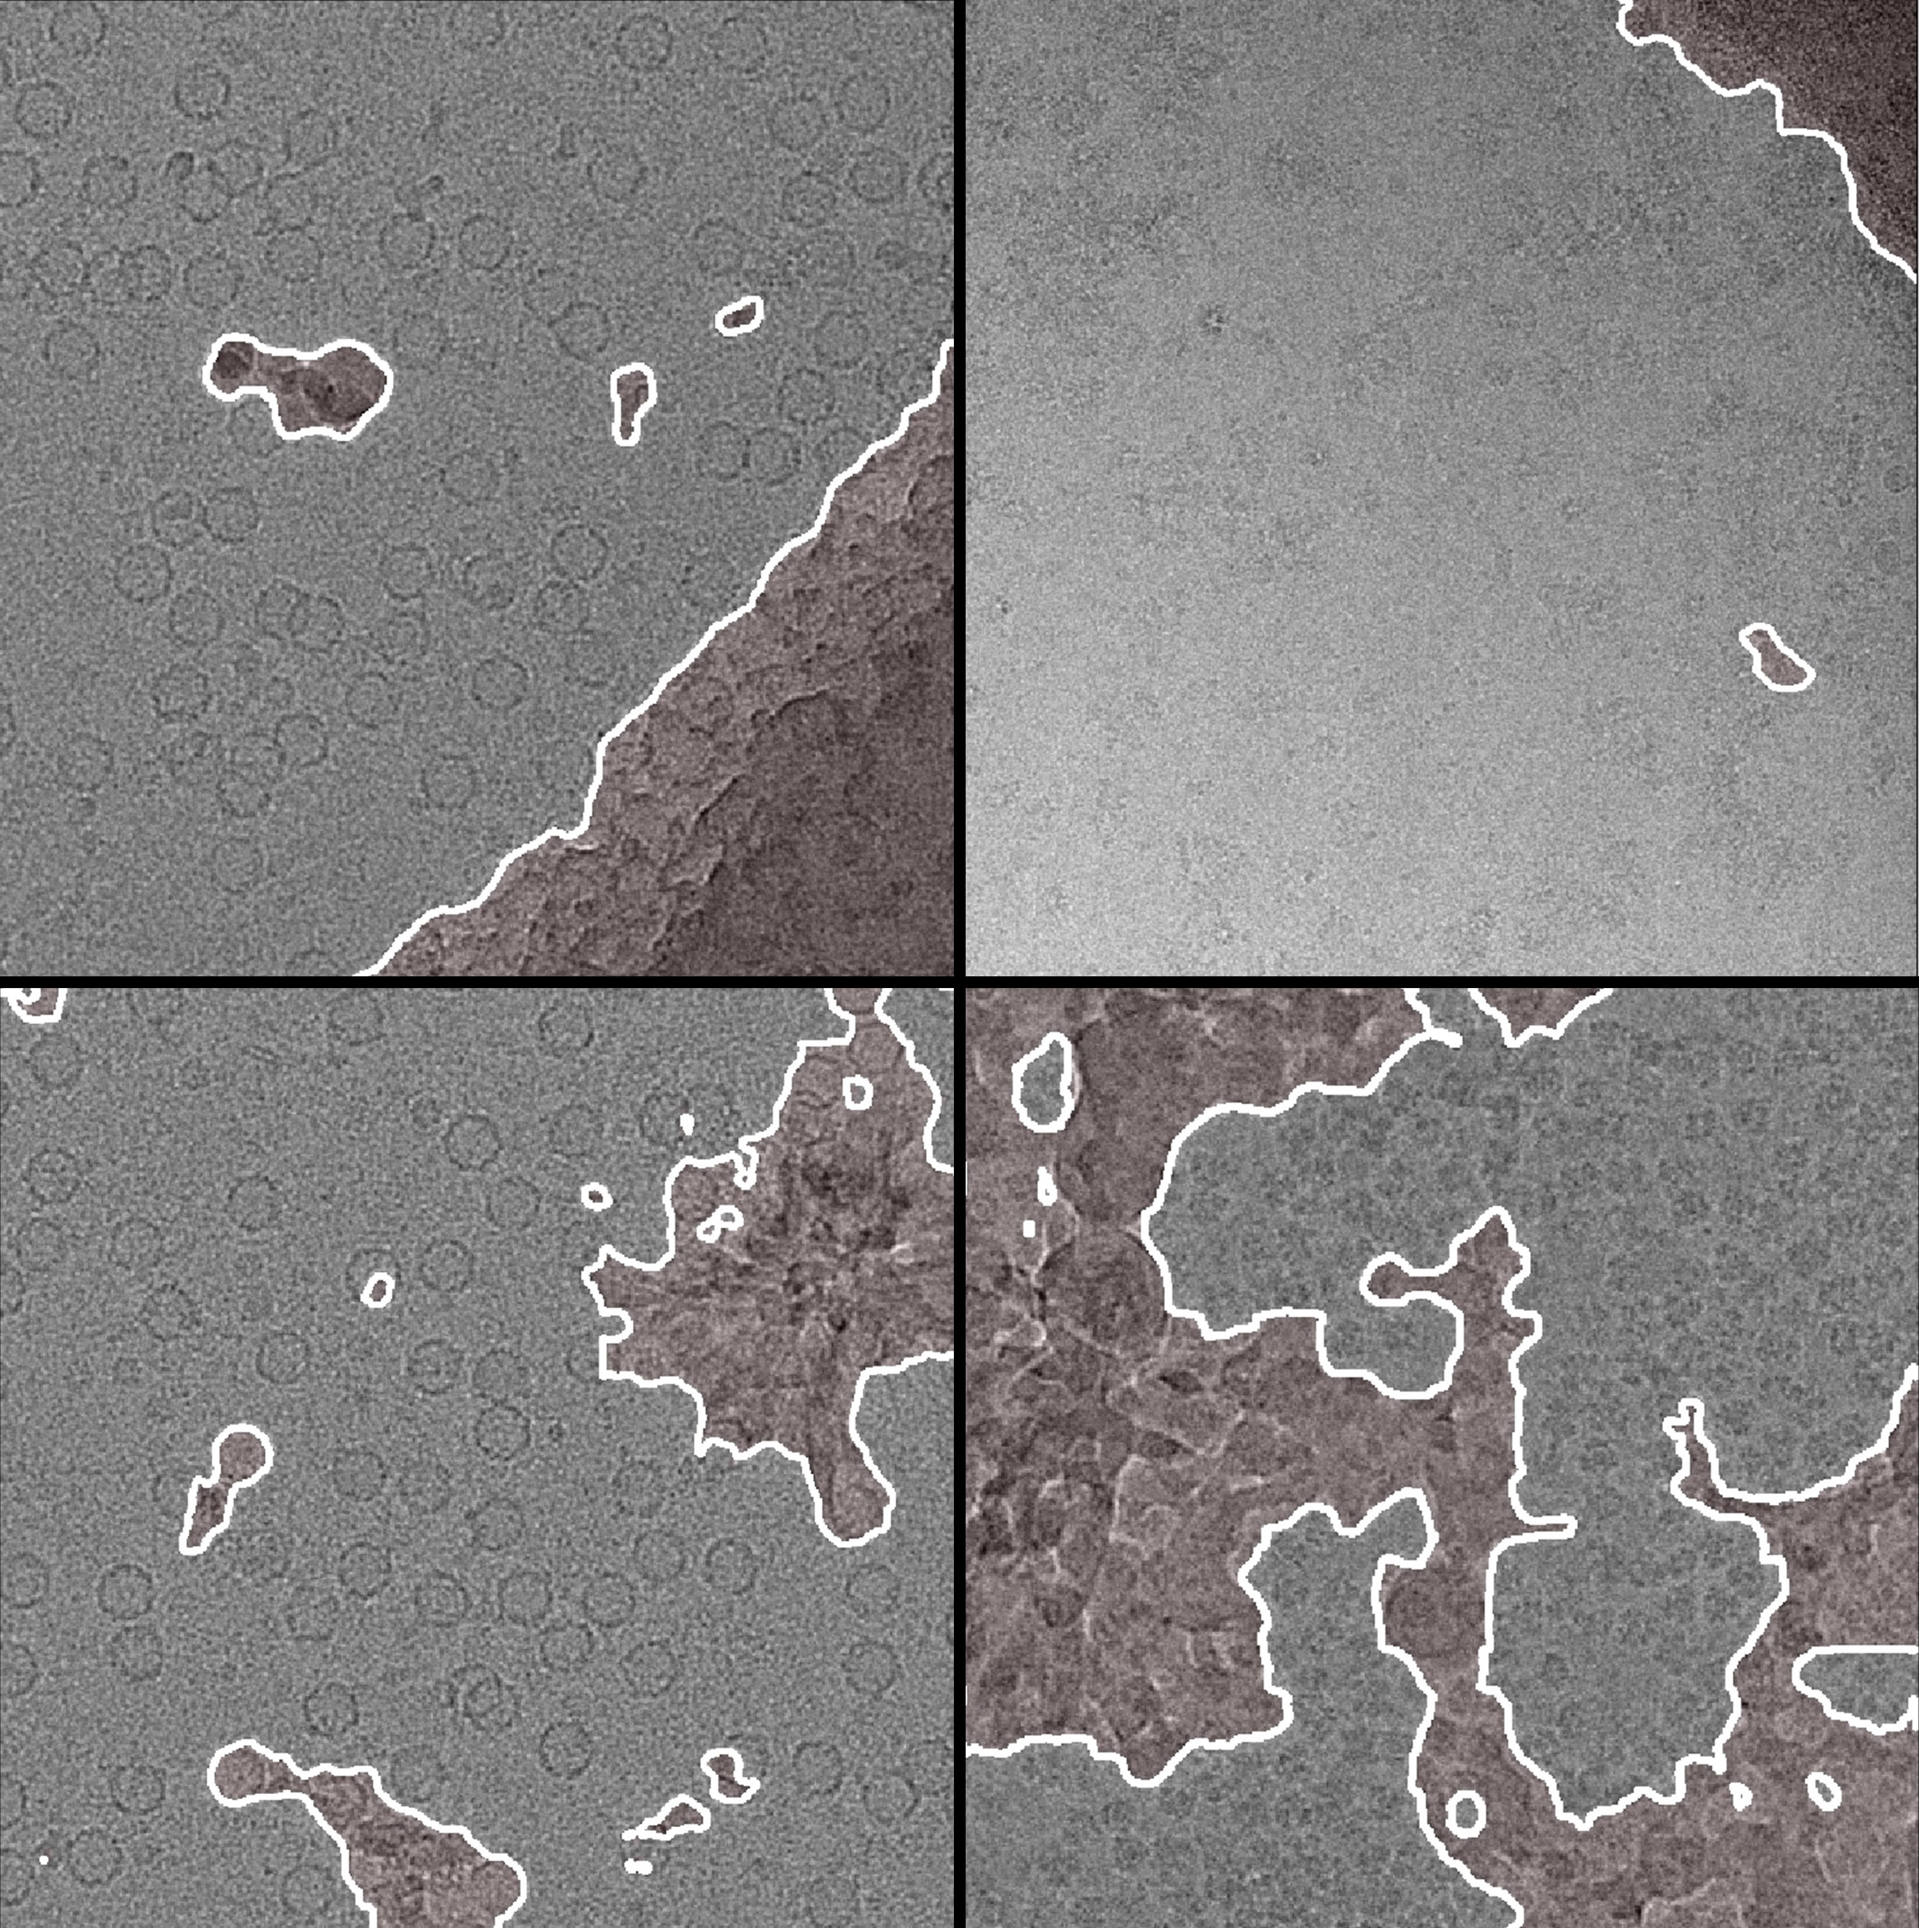
Micrograph Cleaner
R. Sánchez-García, J. Segura, D. Maluenda, C.O.S. Sorzano, J.M. Carazo. Contamination Cleaner: a python package for cryo-EM micrograph segmentation using deep learning. (submitted)

Slide 9
2D Classification
Wu, J.; Ma, Y.-B.; Congdon, C.; Brett, B.; Chen, S.; Xu, Y.; Ouyang, Q. & Mao, Y. PloS one, 2017, 12 , e0182130

Slide 10
2D Classification
Sorzano, C. O. S.; Bilbao-Castro, J. R.; Shkolnisky, Y.; Alcorlo, M.; Melero, R.; Caffarena-Fernández, G.; Li, M.; Xu, G.; Marabini, R. & Carazo, J. M. J. Struct Biology, 2010, 171, 197-206
Singer, A.; Zhao, Z.; Shkolnisky, Y. & Hadani, R. SIAM J. Imaging Sci., 2011, 4, 723-759
Yang, Z.; Fang, J.; Chittuluru, J.; Asturias, F. J. & Penczek, P. A. Structure, 2012, 20, 237-247
Sorzano, C. O. S.; Vargas, J.; de la Rosa-Trevín, J. M.; Zaldívar-Peraza, A.; Otón, J.; Abrishami, V.; Foche, I.; Marabini, R.; Caffarena, G. & Carazo, J. M. Proc. Intl. Work-Conference on Bioinformatics and Biomedical Engineering, IWBBIO, 2014, 950
Zhao, Z. & Singer, A. J. Structural Biology, 2014, 186, 153-166
Huang, C. & Tagare, H. IEEE Trans Image Process, 2015, 25, 893-906
Kimanius, D.; Forsberg, B. O.; Scheres, S. H. & Lindahl, E. eLife, 2016, 5, e18722
Reboul, C. F.; Bonnet, F.; Elmlund, D. & Elmlund, H. Structure, 2016, 24, 988-996
Bhamre, T., Zhao, Z. & Singer, A. 14th IEEE International Symposium on Biomedical Imaging, 2017
Wu, J.; Ma, Y.-B.; Congdon, C.; Brett, B.; Chen, S.; Xu, Y.; Ouyang, Q. & Mao, Y. PloS one, 2017, 12 , e0182130
Boumal, N.; Bendory, T.; Lederman, R. R. & Singer, A. Proc. 52nd Annual Conf. Information Sciences and Systems (CISS), 2018, 1-6
Shuo, Y.; Zhang, B.; Shen, H. & Yang, Y. Proc. Chinese Automation Congress (CAC), 2018 , 1303-1308
Topics:
Attraction
Distance metrics
Many classes
Speed

Slide 11
Homogeneous angular assignment
Navdeep Jaitly, Marcus A. Brubaker, John L. Rubinstein and Ryan H. Lilien. Bioinformatics (2010) 26 (19): 2406-2415
Sanz-García E, Stewart AB, Belnap DM. J Struct Biol. 2010 Aug;171(2):216-22
Singer A.; Coifman R. R.; Sigworth F. J.; Chester D. W. & Shkolnisky Y. J Struct Biology, 2010, 169 (3), 312-322.
Singer A. & Shkolnisky Y. SIAM Journal on Imaging Sciences, 2011, 4 (2), 543-572.
Dimitrios Giannakis, Peter Schwander, and Abbas Ourmazd. Optics Express, 20, 12,12799-12826 (2012)
Shkolnisky Y. and Singer A. SIAM Journal on Imaging Sciences, 2012, 5 (3), 1088-1110.
Scheres, S. H. W. A Bayesian view on cryo-EM structure determination. J. Molecular Biology, 2012, 415, 406-418
Elmlund H, Elmlund D, Bengio S. Structure. 2013 Aug 6;21(8):1299-306.
Lyumkis, D.; Vinterbo, S.; Potter, C. S. & Carragher, B. J Struct Biol, 2013, 184, 417-426
Wang L.; Singer A. & Wen Z. SIAM Journal on Imaging Sciences, 2013, 6 (4), 2450-2483.
Vargas J, Alvarez-Cabrera AL, Marabini R, Carazo JM, Sorzano COS. Bioinformatics. 2014 Jun 27
Joubert, P. & Habeck, M. Biophys J, 2015, 108, 1165-1175
T. Bhamre, T. Zhang, A. Singer, 12th IEEE International Symposium on Biomedical Imaging (ISBI 2015).
C.O.S. Sorzano, J. Vargas, J.M. de la Rosa-Trevín, J. Otón, A.L. Álvarez-Cabrera, V. Abrishami, E. Sesmero, R. Marabini, J.M. Carazo. J. Structural Biology, 189: 213-219 (2015)
Pragier, G.; Greenberg, I.; Cheng, X. & Shkolnisky, Y. IEEE Trans. computational imaging, 2016, 2, 323-334
Michels, Y. & Baudrier, É. 2016 IEEE Intl. Conf. on Image Processing (ICIP), 2016, 3189-3193
Cossio, P.; Rohr, D.; Baruffa, F.; Rampp, M.; Lindenstruth, V. & Hummer, G. Computer Physics Communications, 2017, 210, 163-171
Greenberg, I. & Shkolnisky, Y. J. Struct biology, 2017, 200, 106-117
Hu, M.; Yu, H.; Gu, K.; Wang, Z.; Ruan, H.; Wang, K.; Ren, S.; Li, B.; Gan, L.; Xu, S.; Yang, G.; Shen, Y. & Li, X. Nature methods, 2018 , 15 , 1083-1089
Reboul, C. F.; Eager, M.; Elmlund, D. & Elmlund, H. Protein science, 2018, 27, 51-61
Sorzano, C. O. S.; Vargas, J.; de la Rosa-Trevin, J. M.; Jimenez-Moreno, A.; Melero, R.; Martinez, M.; Conesa, P.; Vilas, J. L.; Marabini, R. and Carazo, J. M. J. Structural Biology, 2018, 204, 329-337
Sorzano, C. O. S.; Vargas, J.; Vilas, J. L.; Jiménez-Moreno, A.; Mota, J.; Majtner, T.; Maluenda, D.; Martínez, M.; Sánchez-García, R.; Segura, J.; Otón, J.; Melero, R.; del Cano, L.; Conesa, P.; Gómez-Blanco, J.; Rancel, Y.; Marabini, R. & Carazo, J. M. Applied Analysis and Optimization, 2018
Zehni, M.; Donati, L.; Soubies, E.; Zhao, Z. J.; Do, M. N. & Unser, M. Society for Imaging Science and Technology, 2019, 133-1
Topics:
Attraction
Global minimum
Initial volume
Speed

Slide 12
Homogeneous angular assignment

Slide 13
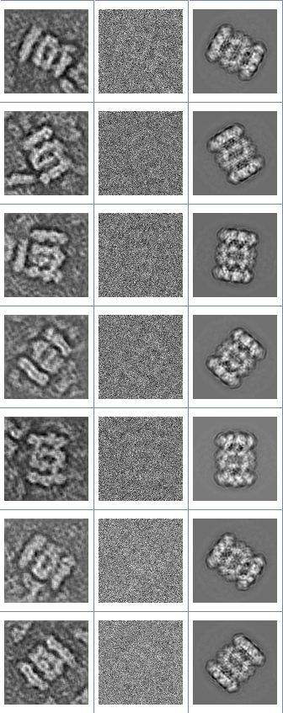
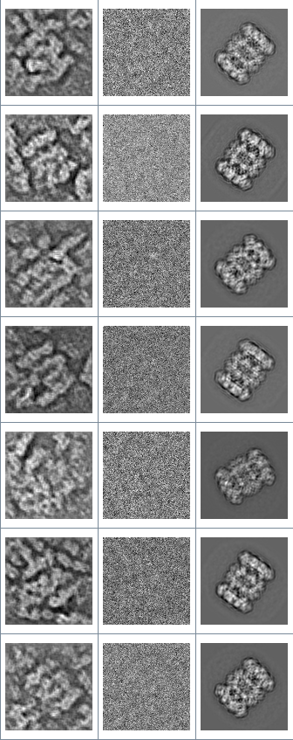
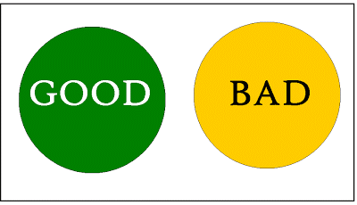
Deep denoising
It can be used to:
Pruning
Angular assignment
Check angular assignment

Slide 14
Homogeneous 3D reconstruction
M. Li, G. Xu, C.O.S. Sorzano, F. Sun, C. Bajaj. J. Structural Biology, 176: 259-267 (2011)
Vonesch C.; Wang L.; Shkolnisky Y. & A. Singer. 8th IEEE International Symposium on Biomedical Imaging (ISBI’11), 2011.
Gopinath A, Xu G, Ress D, Oktem O, Subramaniam S, Bajaj IEEE Trans Med Imaging. 2012 Dec;31(12):2241-52
Kucukelbir, A.; Sigworth, F. J. & Tagare, H. D. J Struct Biol, 2012, 179, 56-67
Sindelar, C. V. & Grigorieff, N. J. Structural Biology, 2012, 180, 26-38
Elmlund H, Elmlund D, Bengio S. Structure. 2013 ;21(8):1299-306
Wang L.; Shkolnisky Y. & Singer A. arXiv:1307.5824, 2013.
Kunz, M. & Frangakis, A. S. J Struct Biol, 2014, 188, 107-115
Abrishami, V.; Bilbao-Castro, J. R.; Vargas, J.; Marabini, R.; Carazo, J. M. & Sorzano, C. O. S. Ultramicroscopy, 2015, 157, 79-87
Dvornek, N. C.; Sigworth, F. J. & Tagare, H. D. J Struct Biol, 2015, 190, 200-214
Moriya, T.; Acar, E.; Cheng, R. H. & Ruotsalainen, U. J Struct Biol, 2015, 191, 318-331
Xu, G.; Li, M. & Chen, C.. Computational Science and discovery, 2015, 8, 014002
Ye, K. & Lim, L. H. Arxiv, 2016
Bartesaghi, A.; Aguerrebere, C.; Falconieri, V.; Banerjee, S.; Earl, L. A.; Zhu, X.; Grigorieff, N.; Milne, J. L. S.; Sapiro, G.; Wu, X. & Subramaniam, S. Structure, 2018
Levin, E.; Bendory, T.; Boumal, N.; Kileel, J. & Singer, A. Proc. IEEE 15th Int. Symp. Biomedical Imaging, 2018, 1569-1573
Michels, Y.; Baudrier, E.; Mazo, L. 25th IEEE Intl. Conf. on Image Processing (ICIP), 2018, 1178-1182
Zhu, D.; Wang, X.; Fang, Q.; Van Etten, J. L.; Rossmann, M. G.; Rao, Z. & Zhang, X. Nature communications, 2018 , 9 , 1552
Havelkova, E. Fac. Mathematics and Physics, Charles University, Fac. Mathematics and Physics, Charles University, 2019
Wilkinson, M.; Kumar, A. & Casañal, A. Acta Crystallographica Section D: Structural Biology, International Union of Crystallography, 2019 , 75
Topics:
Accuracy
Constraints
Basis functions
Bayesian
Ewald sphere correction
Speed

Slide 15
3D Classification
Elmlund, D.; Davis, R. & Elmlund, H. Structure, 2010, 18, 777-786
Maxim Shatsky, Richard J. Hall, Eva Nogales, Jitendra Malik, Steven E. Brenner, J Struct Biol. 2010 170(1): 98–108
Scheres, S. H. W. A Bayesian view on cryo-EM structure determination. J. Molecular Biology, 2012, 415, 406-418
Zheng, Y.; Wang, Q. & Doerschuk, P. C. J. Optical Society of America. A, Optics, image science, and vision, 2012, 29, 959-970
Wang Q, Matsui T, Domitrovic T, Zheng Y, Doerschuk PC, Johnson JE. J. Structural Biology (2013)
Lyumkis D, Brilot AF, Theobald DL, Grigorieff. J Struct Biol. 2013 Jul 17. pii: S1047-8477(13)00185-8.
Jin Q, Sorzano COS, de la Rosa-Trevín JM, Bilbao-Castro JR, Núñez-Ramírez R, Llorca O, Tama F, Jonić S. Structure. 2014 4;22(3):496-506
Dashti, A.; Schwander, P.; Langlois, R.; Fung, R.; Li, W.; Hosseinizadeh, A.; Liao, H. Y.; Pallesen, J.; Sharma, G.; Stupina, V. A.; Simon, A. E.; Dinman, J. D.; Frank, J. & Ourmazd, A. Proc Natl Acad Sci U S A, 2014, 111, 17492-17497
Chen, B.; Shen, B. & Frank, J. J Struct Biol, Department of Biology, 2014, 188, 267-273
J. Andén, E. Katsevich, A. Singer, 12th IEEE International Symposium on Biomedical Imaging (ISBI 2015)
Bai, X.-C.; Rajendra, E.; Yang, G.; Shi, Y. & Scheres, S. H. Elife, 2015, 4
E. Katsevich, A. Katsevich, A. Singer, SIAM Journal on Imaging Sciences, 8 (1), pp. 126-185 (2015). SIIMS
Klaholz, B. P. Open Journal of Statistics, 2015, 5, 820
Liao, H. Y.; Hashem, Y. & Frank, J. Structure, 2015, 23, 1129-1137
Tagare, H. D.; Kucukelbir, A.; Sigworth, F. J.; Wang, H. & Rao, M. J Struct Biol, 2015, 191, 245-262
Gong, Y. & Doerschuk, P. C. IEEE International Conference on Image Processing (ICIP), 2016, 3161-3165
Rawson, S.; Iadanza, M. G.; Ranson, N. A. & Muench, S. P. Methods, 2016, 100, 35-41
Shan, H.; Wang, Z.; Zhang, F.; Xiong, Y.; Yin, C.C. & Sun, F. Protein Cell, 2016, 7, 46-62
C.O.S. Sorzano, A.L. Álvarez-Cabrera, M. Kazemi, J.M. Carazo, S. Jonic. Biophysical J. 110: 1753-1765 (2016)
C.O.S. Sorzano, A. Martín-Ramos, F. Prieto, R. Melero, J. Martín-Benito, S. Jonic, J. Navas-Calvente, J. Vargas, J. Otón, V. Abrishami, J.M. de la Rosa-Trevín, J. Gómez-Blanco, J.L. Vilas, R. Marabini, J.M. Carazo. J. Structural Biology, 195: 123-128 (2016)
Punjani, A.; Rubinstein, J. L.; Fleet, D. J. & Brubaker, M. A. Nature methods, 2017
Schilbach, S.; Hantsche, M.; Tegunov, D.; Dienemann, C.; Wigge, C.; Urlaub, H. & Cramer, P. Nature, 2017, 551
Andén, J. & Singer, A. SIAM Journal on Imaging Sciences, 11(2), pp. 1441-1492, 2018.
Haselbach, D.; Komarov, I.; Agafonov, D. E.; Hartmuth, K.; Graf, B.; Dybkov, O.; Urlaub, H.; Kastner, B.; Lührmann, R. & Stark, H. Cell, 2018, 172, 454-464.e11
Nakane, T.; Kimanius, D.; Lindahl, E. & Scheres, S. H. eLife, 2018, 7
Solernou, A.; Hanson, B. S.; Richardson, R. A.; Welch, R.; Read, D. J.; Harlen, O. G. & Harris, S. A. PLoS computational biology, 2018, 14, e1005897
Zhang, C.; Cantara, W.; Jeon, Y.; Musier-Forsyth, K.; Grigorieff, N. & Lyumkis, D. Ultramicroscopy, 2019 , 203 , 170-18
Topics:
Global mínimum
Bayesian approach
Variance and Covariance
Focused classification
Continuous heterogeneity
Stability

Slide 16
3D Classification
Zhong, ED; Bepler, T; David, JH; Berger, B. Arxiv, 1909.05219, 2019

Slide 17
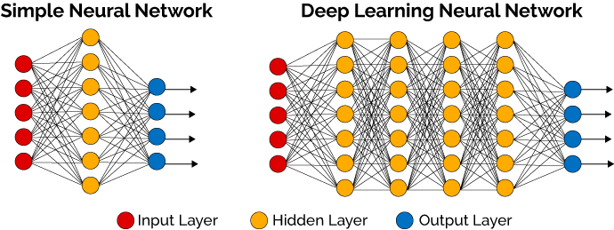

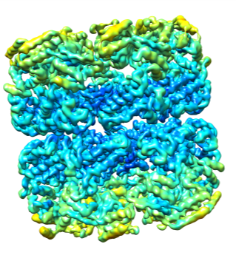
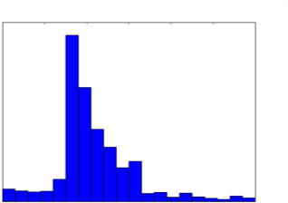
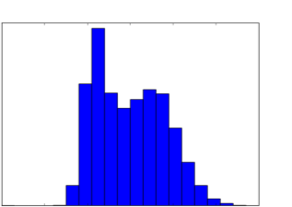
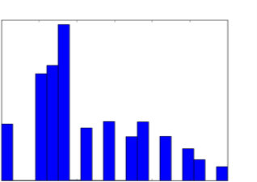
DeepRes
bank of filters
train the network
set of PDBs
MonoRes
DeepRes-unsharp
E. Ramírez-Aportela, J. Mota, P. Conesa, J.M. Carazo, C.O.S. Sorzano. DeepRes: A New Deep Learning and aspect-based Local Resolution Method for Electron Microscopy Maps. IUCR J 6: 1054-1063 (2019)
Counts
Counts
2 3 4 5 6 7 8
2 3 4 5 6 7 8
Resolutions (Å)
Resolutions (Å)
ResMap
DeepRes-sharp
Counts
Counts
2 3 4 5 6 7 8
2 3 4 5 6 7 8
Resolutions (Å)
Resolutions (Å)

Slide 18
Conclusions
 | Particles | 2D Clustering | 3D Hom. Angular | 3D Recons. | 3D Classification | Total
2010 | 0 | 1 | 3 | 0 | 2 | 6
2011 | 0 | 1 | 2 | 2 | 0 | 5
2012 | 0 | 1 | 3 | 3 | 2 | 9
2013 | 4 | 0 | 3 | 2 | 2 | 11
2014 | 1 | 2 | 1 | 1 | 3 | 8
2015 | 1 | 1 | 3 | 4 | 6 | 15
2016 | 1 | 2 | 2 | 1 | 5 | 11
2017 | 1 | 2 | 2 | 0 | 2 | 7
2018 | 3 | 2 | 4 | 4 | 3 | 16
2019 | 10 | 0 | 1 | 1 | 1 | 13
Total | 21 | 12 | 24 | 18 | 26 | 101
2 methods/(year*topic)
Second half faster than first half.
10% Deep learning

Slide 19
Conclusions
Real need or because we can?
  Both
  10k → 1M particles
  I want it all, and I want it now
Resolution revolution
  DDD Cameras → Methods
Classical machine learning over deep learning
2D Clustering | 3D Hom. Angular | 3D Recons | 3D Classification
Attraction
Distance metrics
Many classes
Speed
Attraction
Global minimum
Initial volume
Speed
Accuracy
Constraints
Basis functions
Bayesian
Ewald sphere correction
Speed
Global mínimum
Bayesian approach
Variance and Covariance
Focused classification
Continuous heterogeneity
Stability

Slide 20
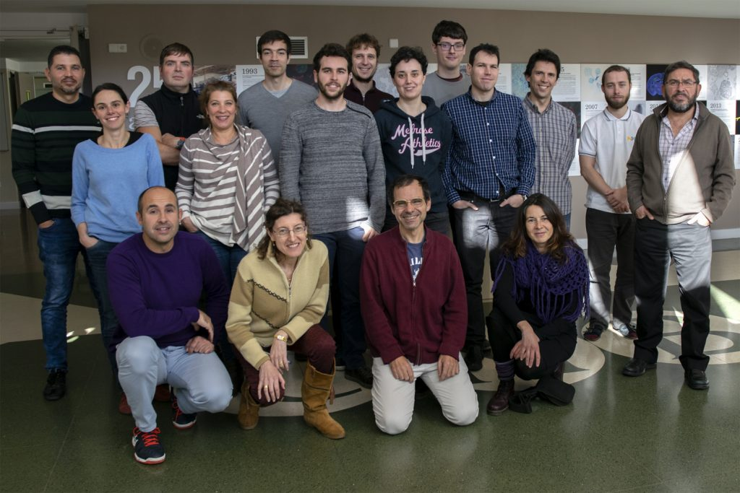



Thanks

