Slide 1
Machine Learning for an XFEL accelerator
Nov. 13, 2019
D. Ratner
SLAC National Accelerator Laboratory

Slide 2
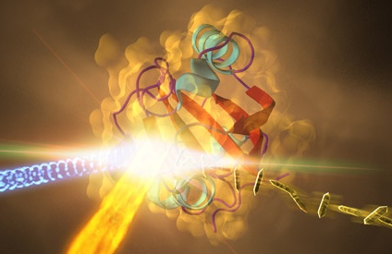



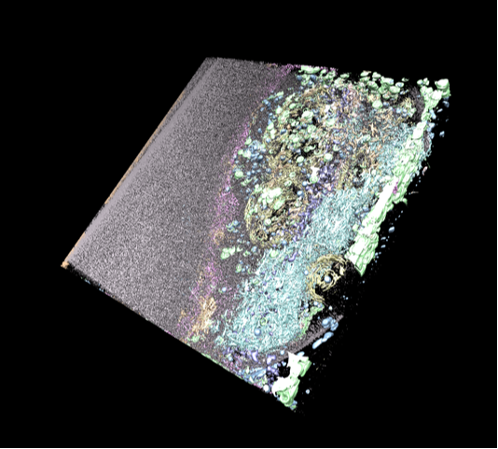


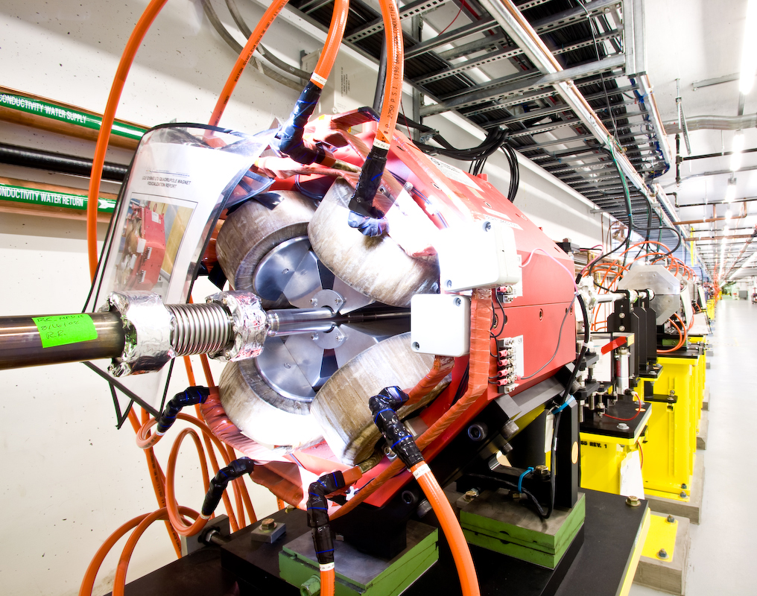
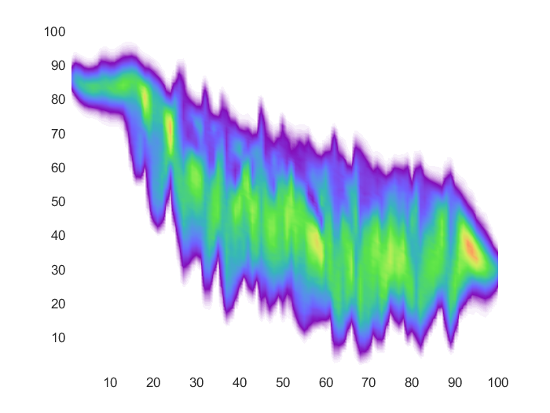
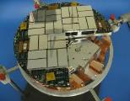

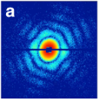
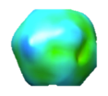
Machine learning at SLAC
New machine learning initiative focusing on ML for facilities
People involved:
ML experts
Software engineers
Domain scientists
Students
Visitors
Stanford/SV
ML applications:
Computer vision
Neural networks
Bayesian optimization
Gaussian processes
Anomaly/breakout detection
Reinforcement-learning
Predictive control
Edge-ML
LCLS-II
Critical Need:
Big facilities
Big data rate
Cryo-
EM
Offline
data analysis
Online Control of Facilities
Accelerator control
Accelerator diagnostics
Megapixel detector
X-ray diffraction
image
Intensity map from multiple pulses
Interpretation of structure / dynamics

Slide 3
Outline
Online optimization of accelerators
Surrogate modeling
Data analysis: ghost imaging

Slide 4
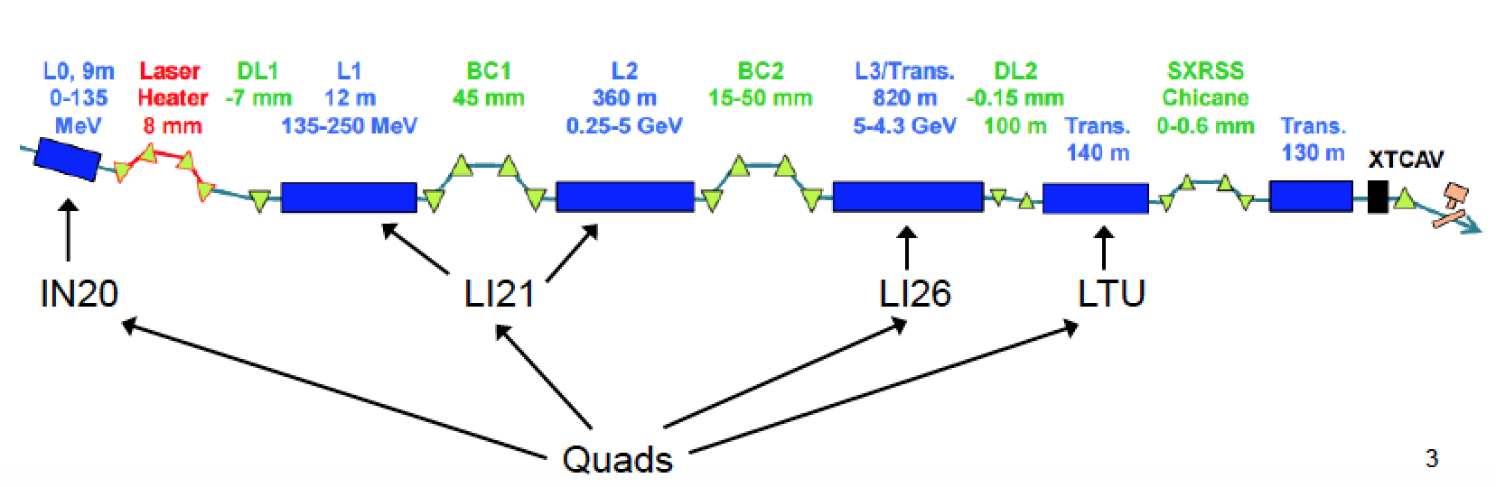
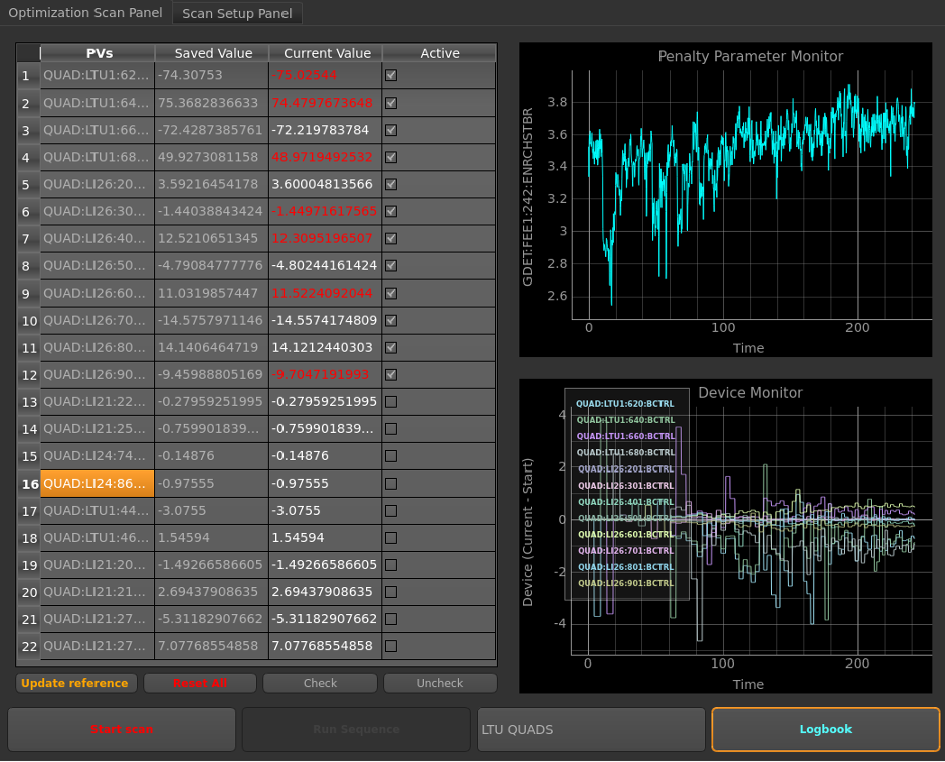
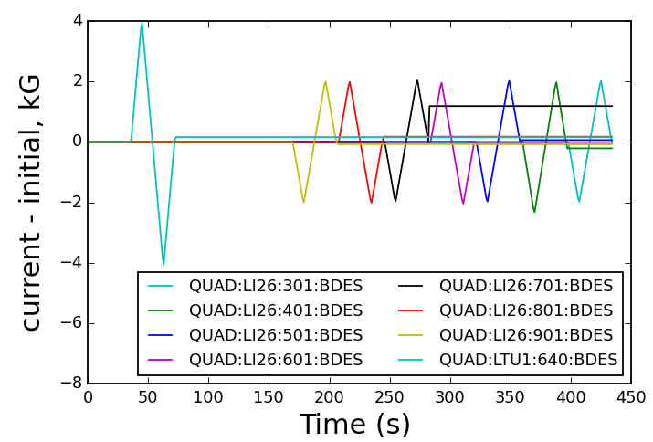
Optimization
Online tuning:
XFELs are instabilities ➔ very sensitive to initial conditions
In total 500 hours/year on single task of quad tuning
Automate (e.g. simplex)
Ocelot

Slide 5
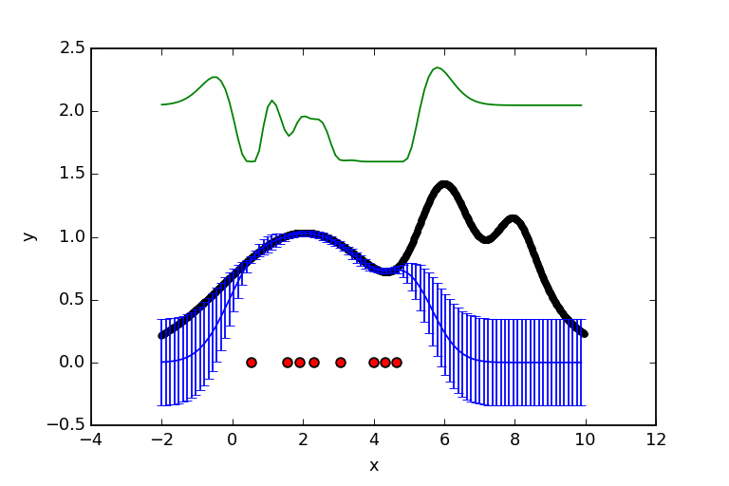
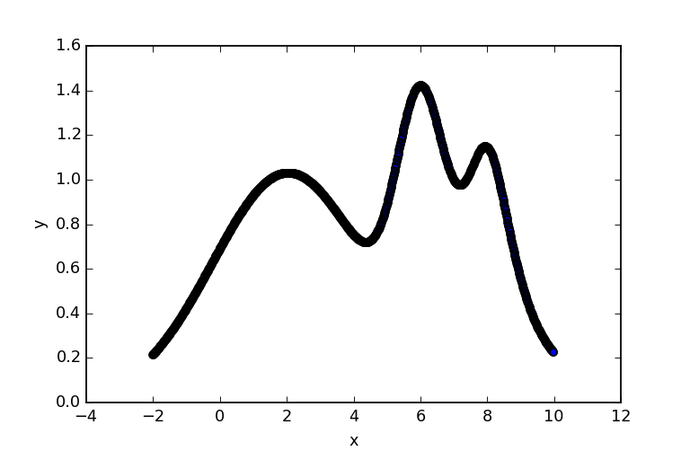
Optimization: Bayesian optimization
Model-based optimization
Advantage 1: Balance “exploitation vs. exploration”
➔ Find global maximum
Bayesian optimizer
Acquisition point
Gradient optimizer
Acquisition
function
Ground truth
Posterior
M. McIntire

Slide 6
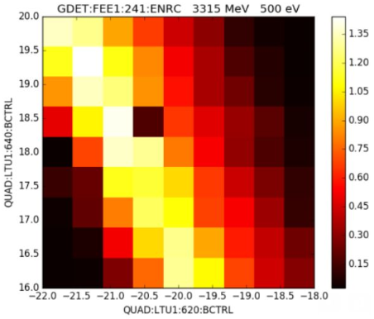
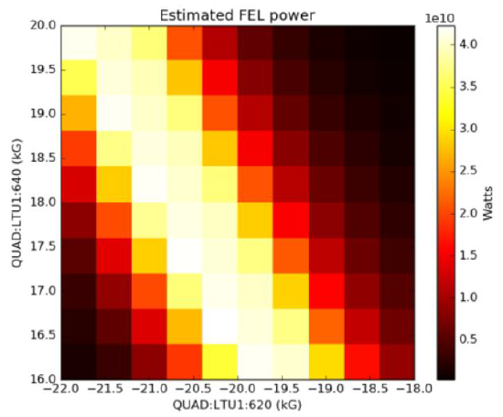
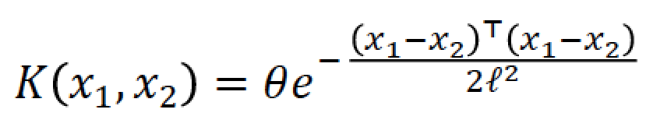
Optimization: Bayesian optimization
Model-based optimization
Advantage 2: Existence of model enables use of physics, archived data
Instance based learning ➔ similarity function
x₂
FEL vs quads (i.e. strong focusing)
Measured
Modeled
x₁
x*
Quad 2
x₃
Quad 1
Quad 1
Joe Duris

Slide 7
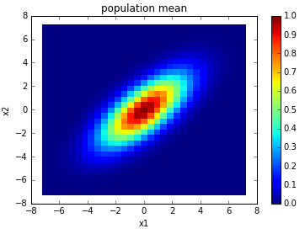
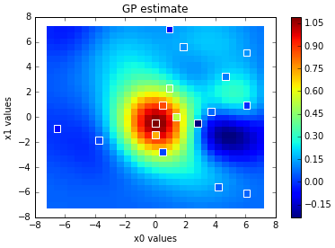
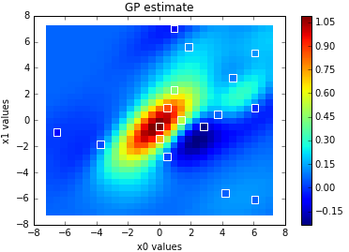
Optimization: Bayesian optimization
Model-based optimization
Advantage 2: Existence of model enables use of physics, archived data
Instance based learning ➔ similarity function
Model,
no correlation
Model,
w/ correlation
Groundtruth
ρ = 0
ρ = 0.7
Joe Duris

Slide 8
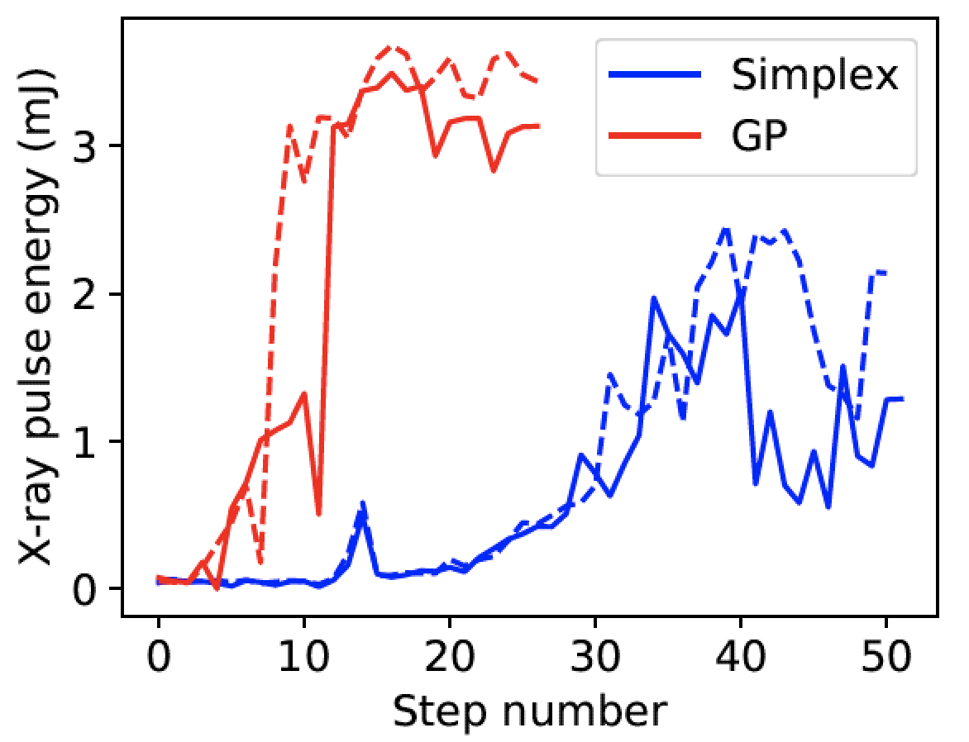
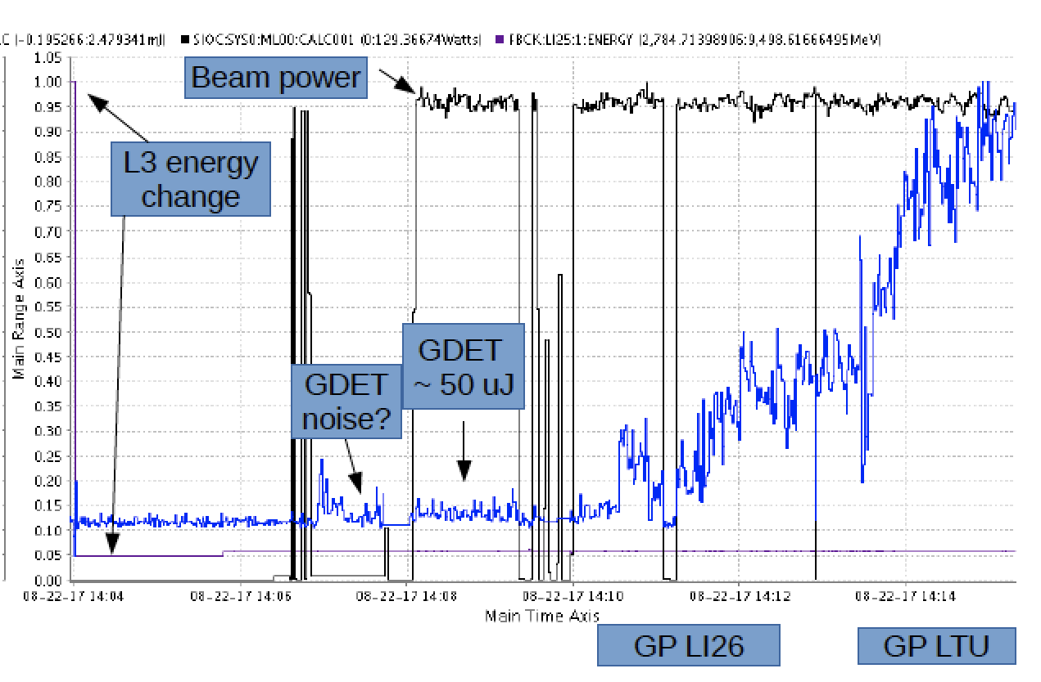
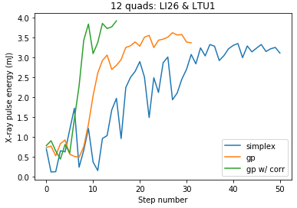
Optimization: Bayesian optimization
Model-based optimization
Upshot: ➔ Faster tuning (factor of 4 vs. simplex)
➔ More robust tuning (e.g. tune from noise)
Example 1: Fast tuneup in high dimensions
Example 2: tuning quadrupoles from pure noise
12 parameters
4 parameters
Joe Duris
Bayesian Optimization of a FEL, Duris et al., arXiv:1909.05963

Slide 9
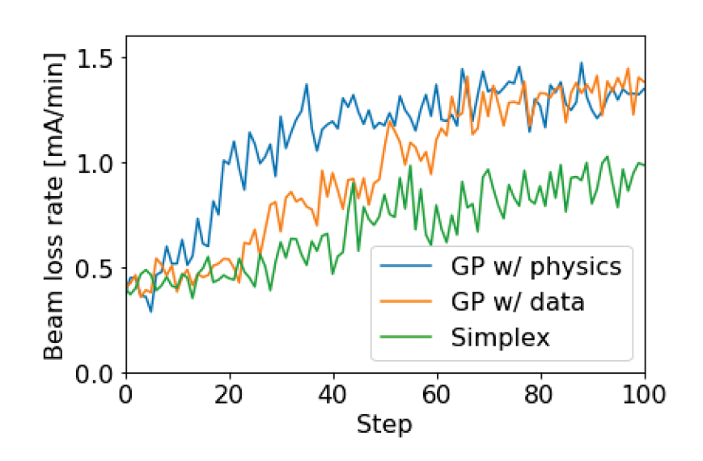
Optimization: Bayesian optimization
Model-based optimization
Upshot: ➔ Faster tuning (factor of 4 vs. simplex)
➔ More robust tuning (e.g. tune from noise)
Example 3: Tune-up at SSRL
Easy to extend to new facilities
Tuning beam size at SSRL
Adi Hanuka

Slide 10
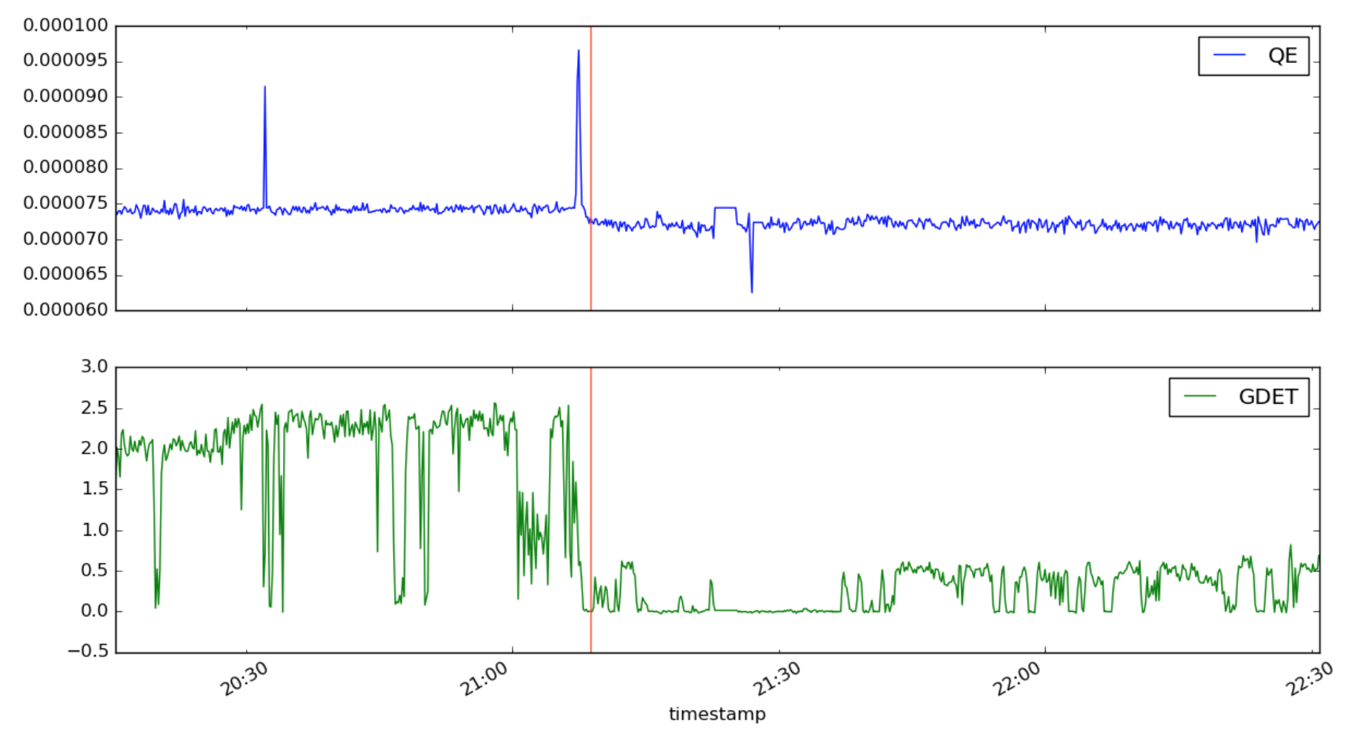
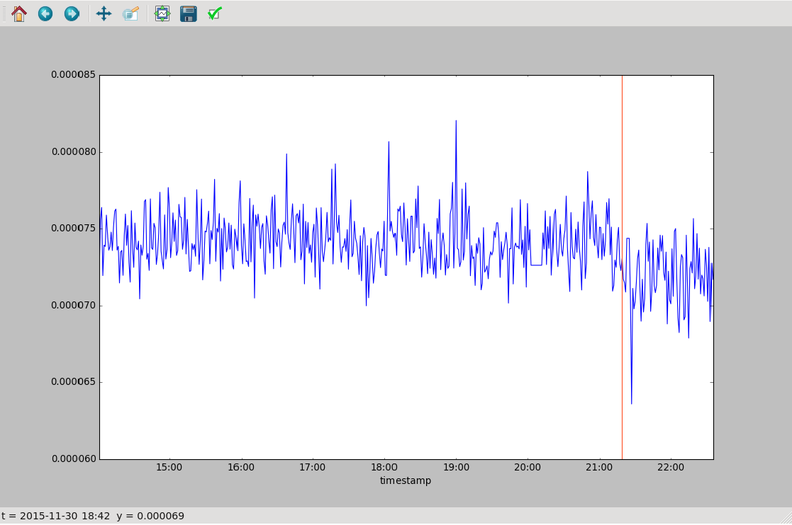
Optimization: Prognostics
Anomaly/Breakout detection
Failure prediction
Root-cause analysis
Fault recovery
Example: Recover from fault that caused ~5 hours of downtime
zoom
Cathode QE
FEL Pulse
Energy
D. Sanzone
Time

Slide 11
Outline
Online optimization of accelerators
Surrogate modeling
Data analysis: ghost imaging

Slide 12
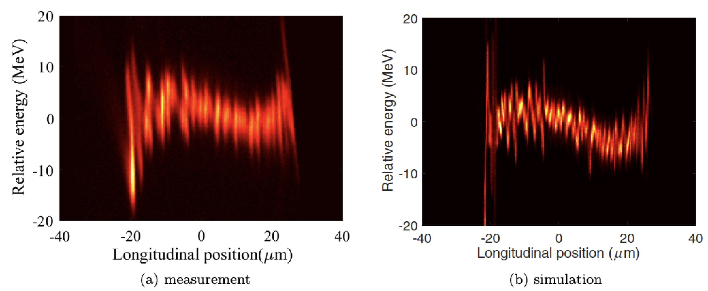
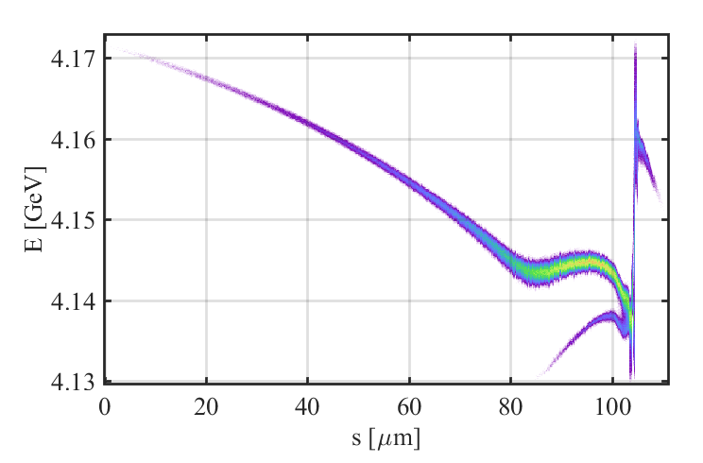
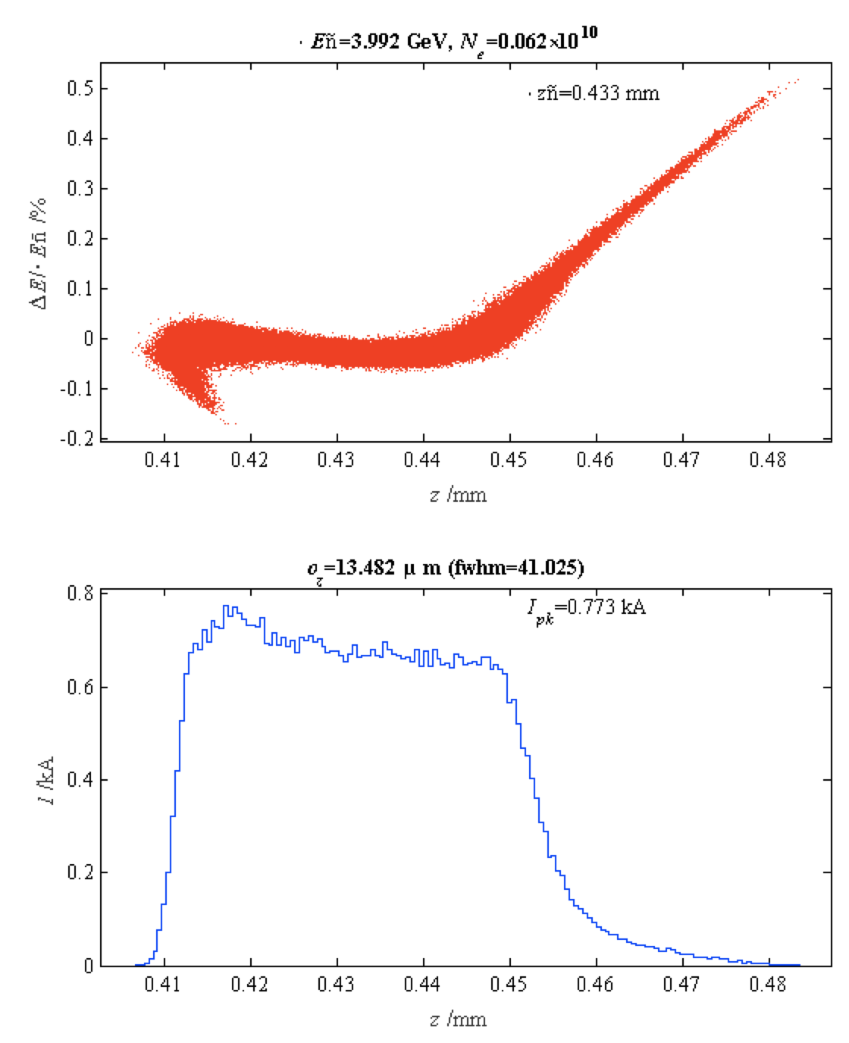
Surrogate Models: Accelerator models
High fidelity physics simulations are remarkable:
J. Qiang
LCLS microbunching instability
measurement
simulation
…but also slow. (e.g. hours on NERSC)
How can we best support design of a new machine?
LCLS-II simulations, Y. Ding

Slide 13
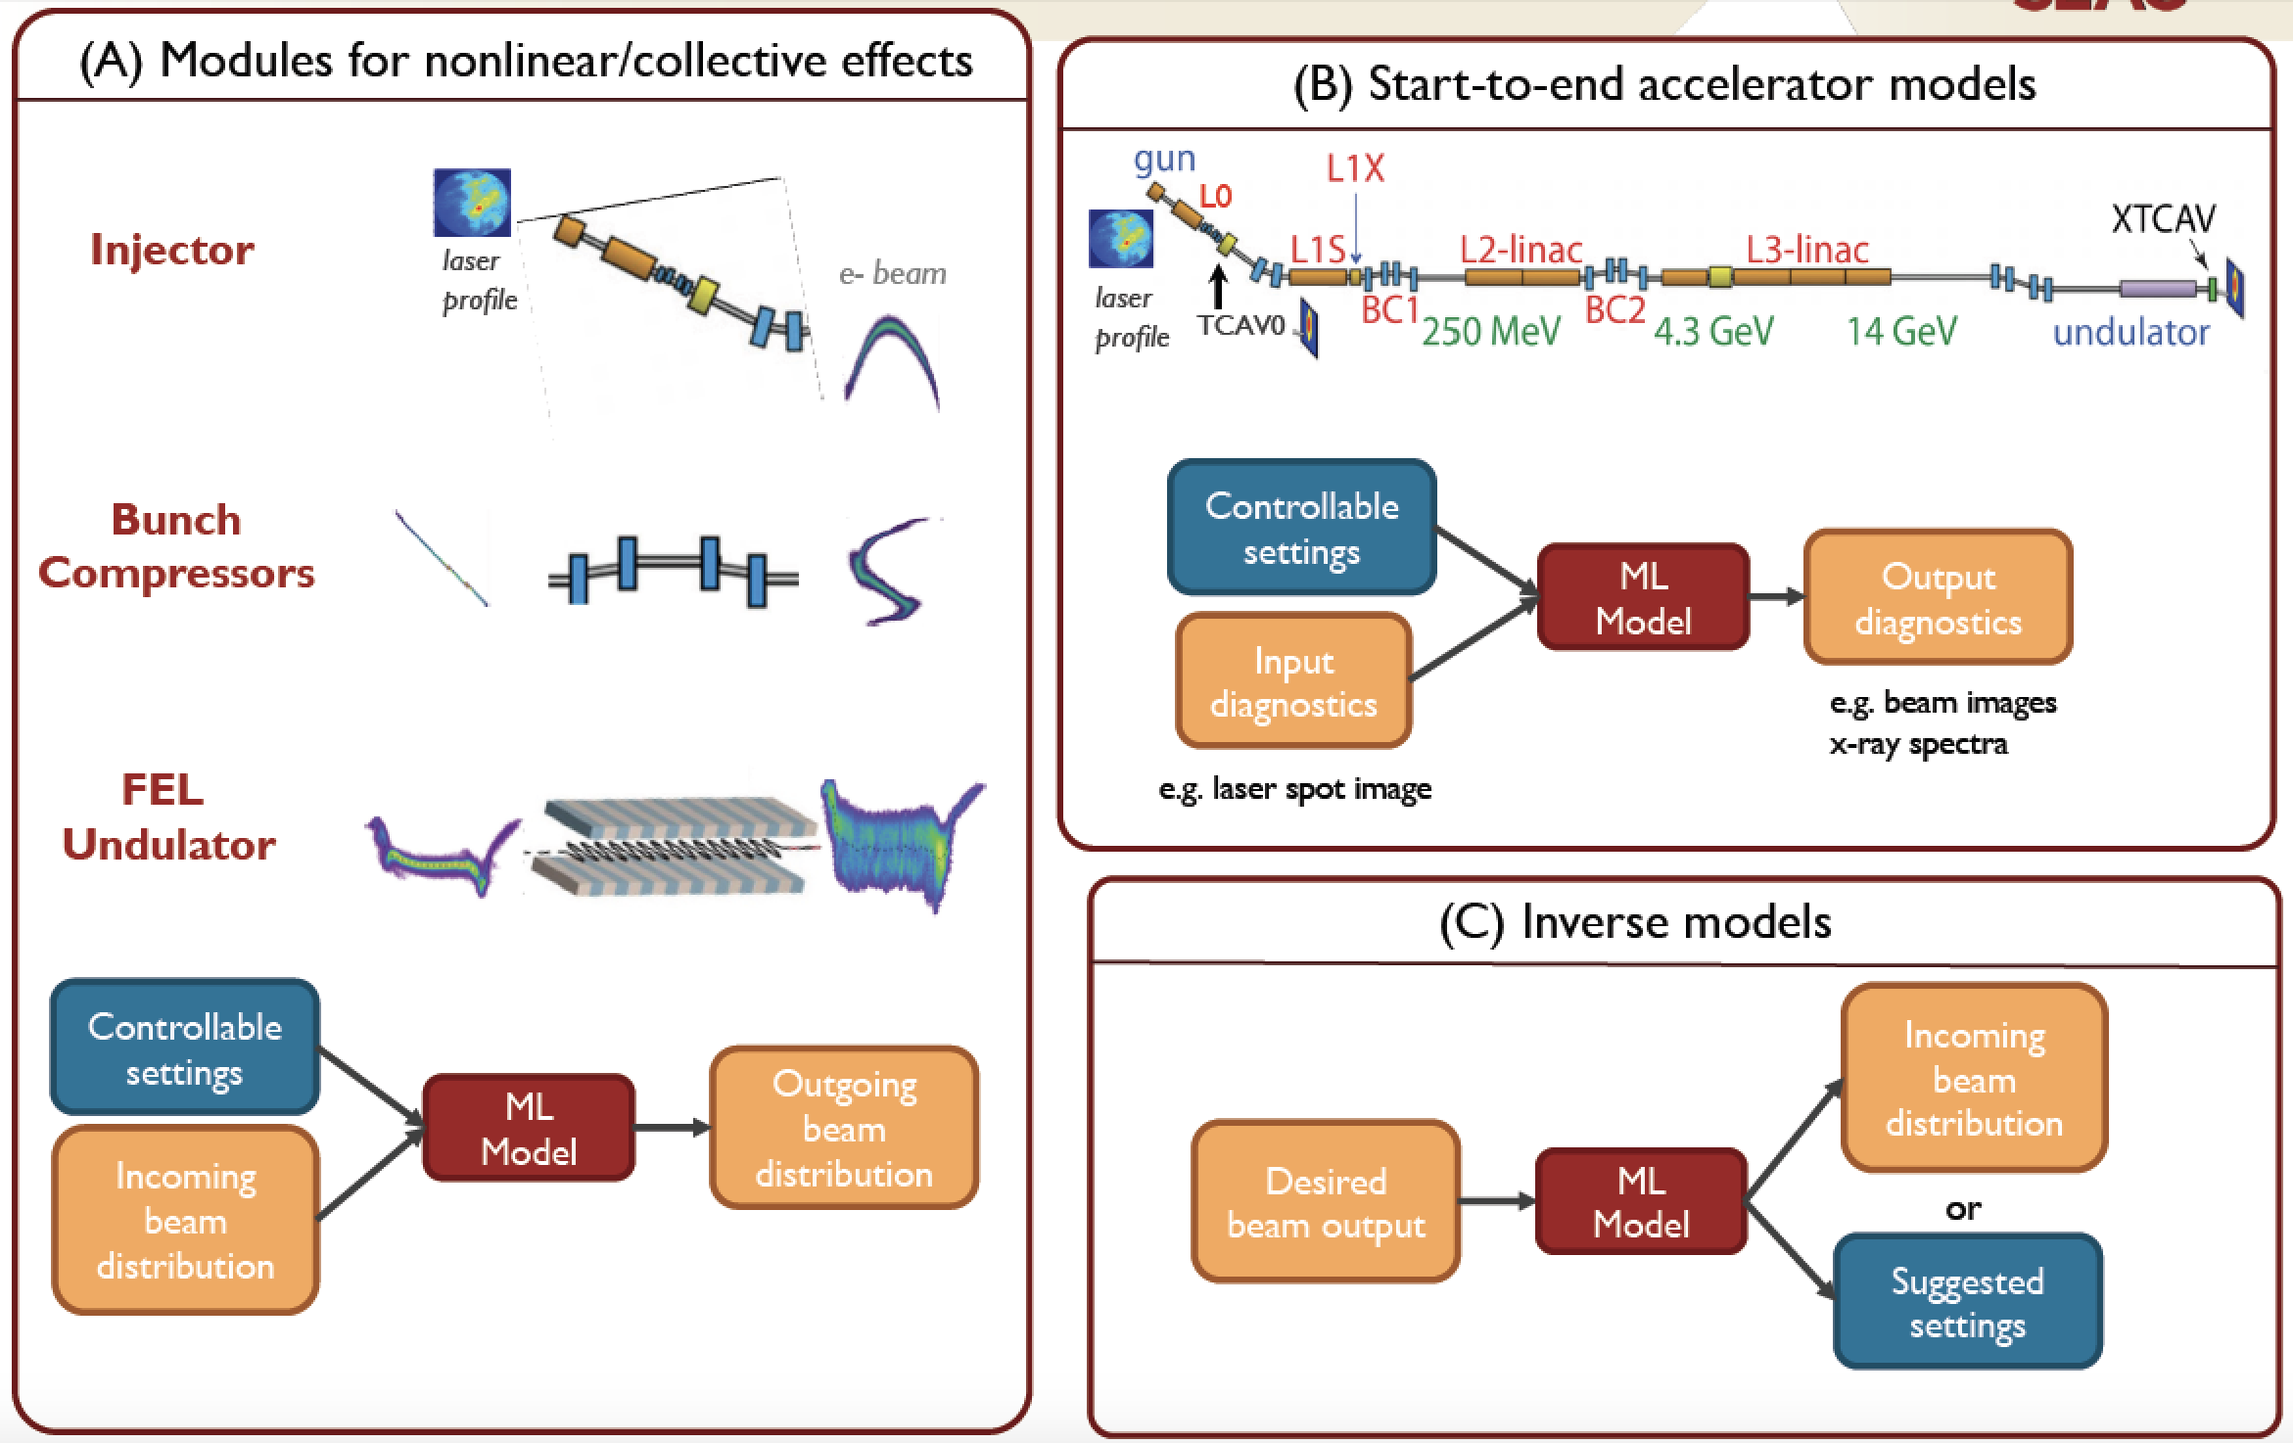
Surrogate Models: Accelerator models
Auralee Edelen

Slide 14
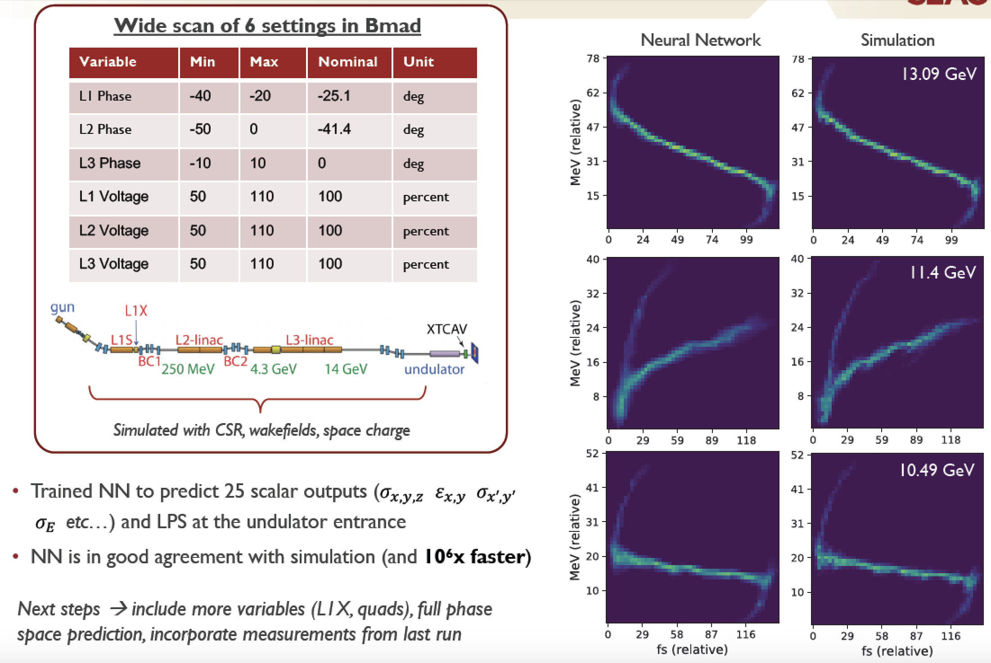
Surrogate Models: Collective effects
Auralee Edelen
Notes:
Genesis simulations provide users very accurate prediction of X-ray pulses for preparing for shifts and testing analysis methods. However, each simulation takes ~1000s of CPU-seconds. For users who require large numbers of examples, e.g.crystallography or statistical methods like ghost imaging, Genesis is too slow.
Generative adversarial networks (GANs) use two networks: the “discriminator” tries to identify if an example is real (i.e. Genesis), or fake (i.e. the “generator”). The generator tries to fool the discriminator. As the two networks fight, the generator makes more and more realistic examples. Images at right show a generated fake XTCAV image (upper right) and the associated X-ray profile (lower right, green). The blue curve is what the old XTCAV algorithm would have estimated from the fake example, showing that the generated example is reasonable.

Slide 15
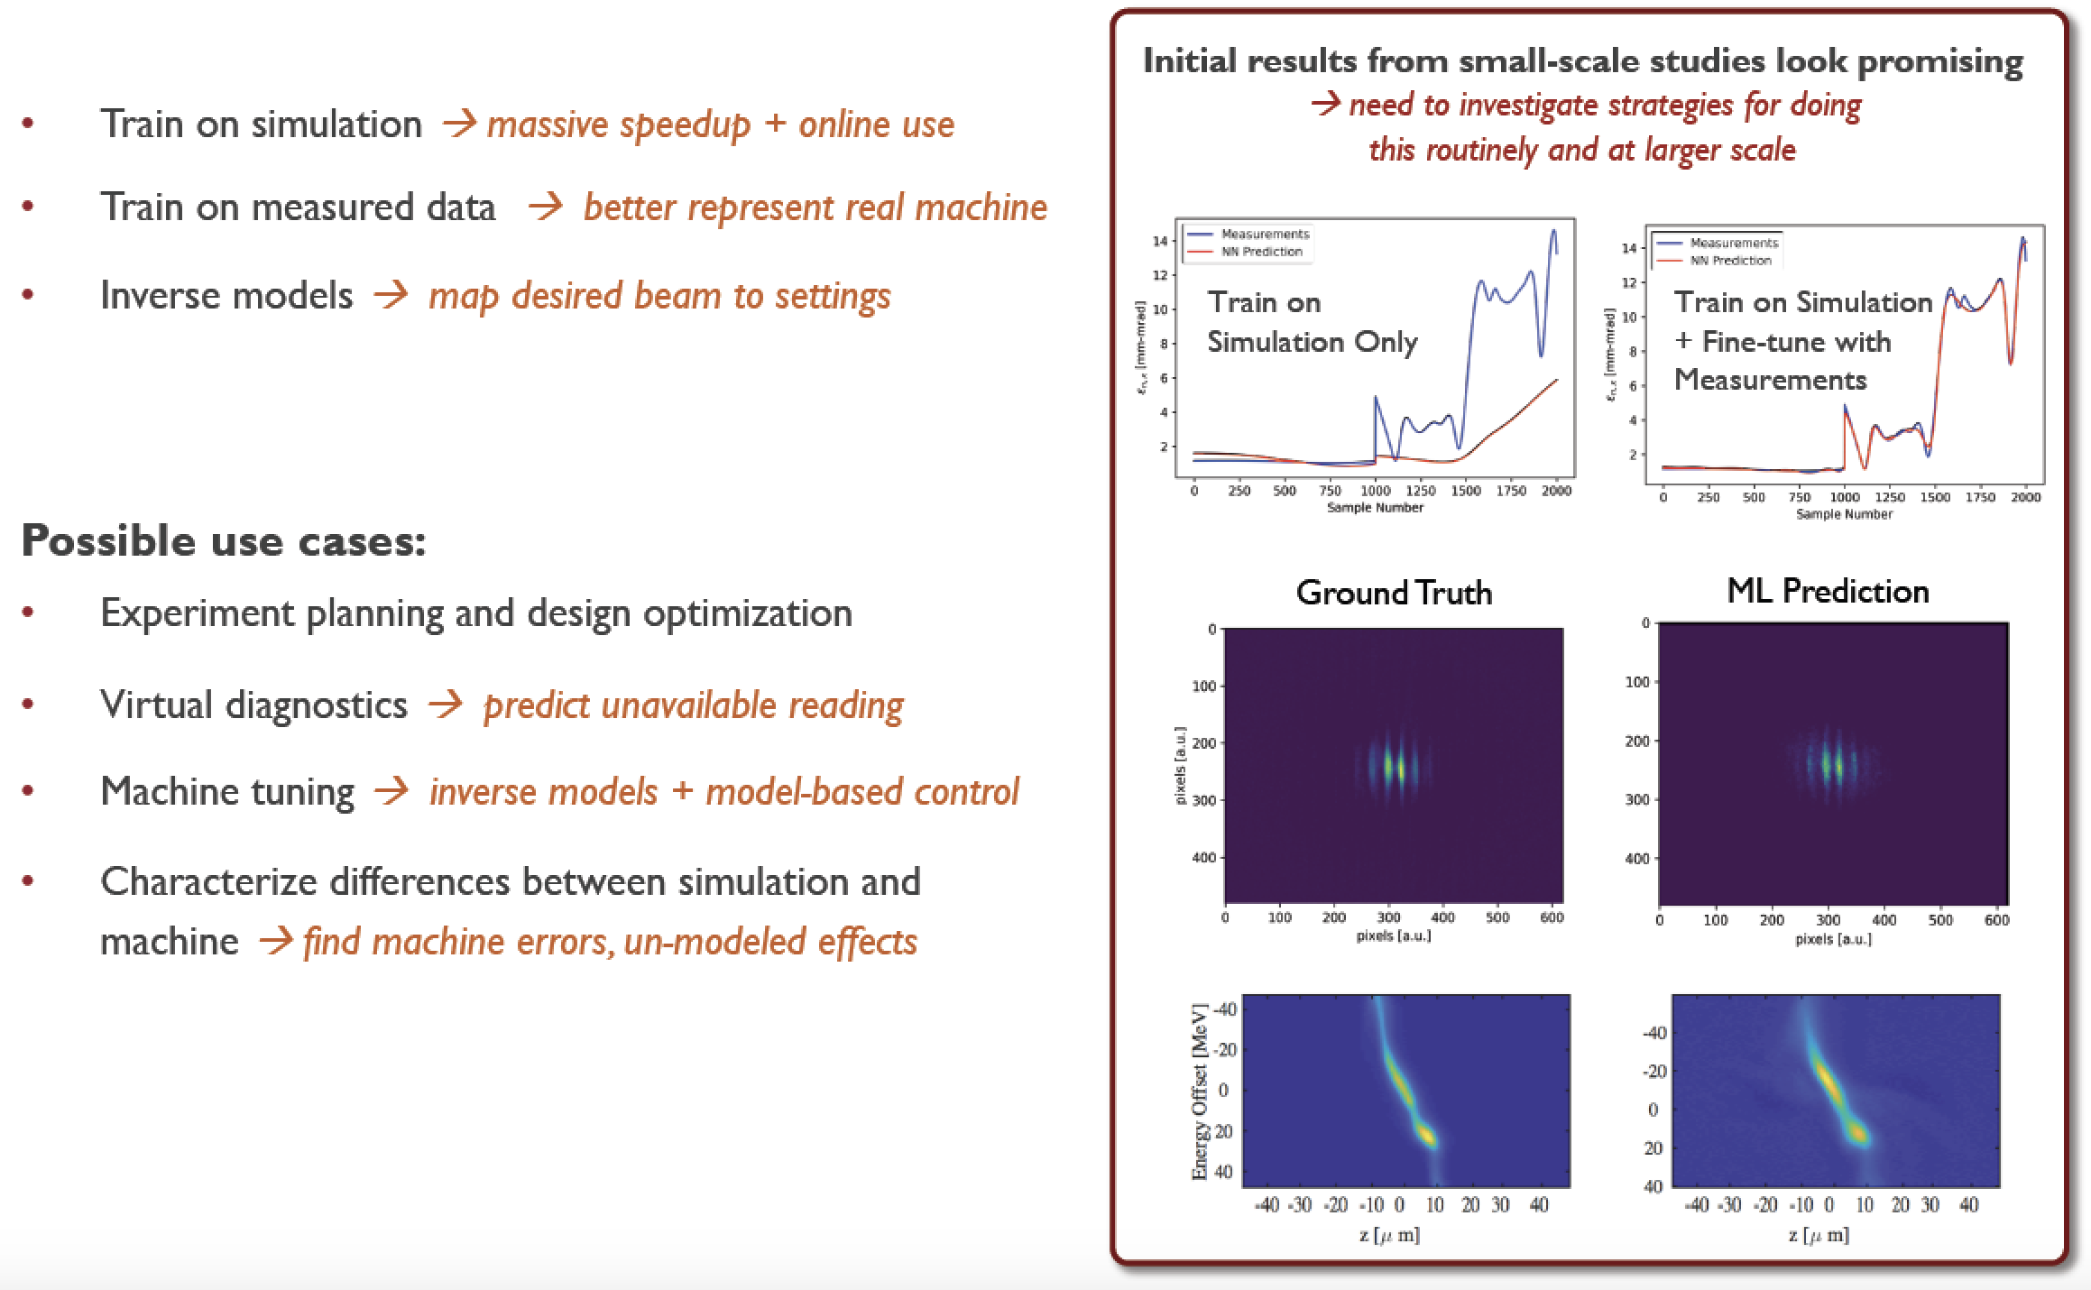
Surrogate Models: Update from data
Auralee Edelen

Slide 16
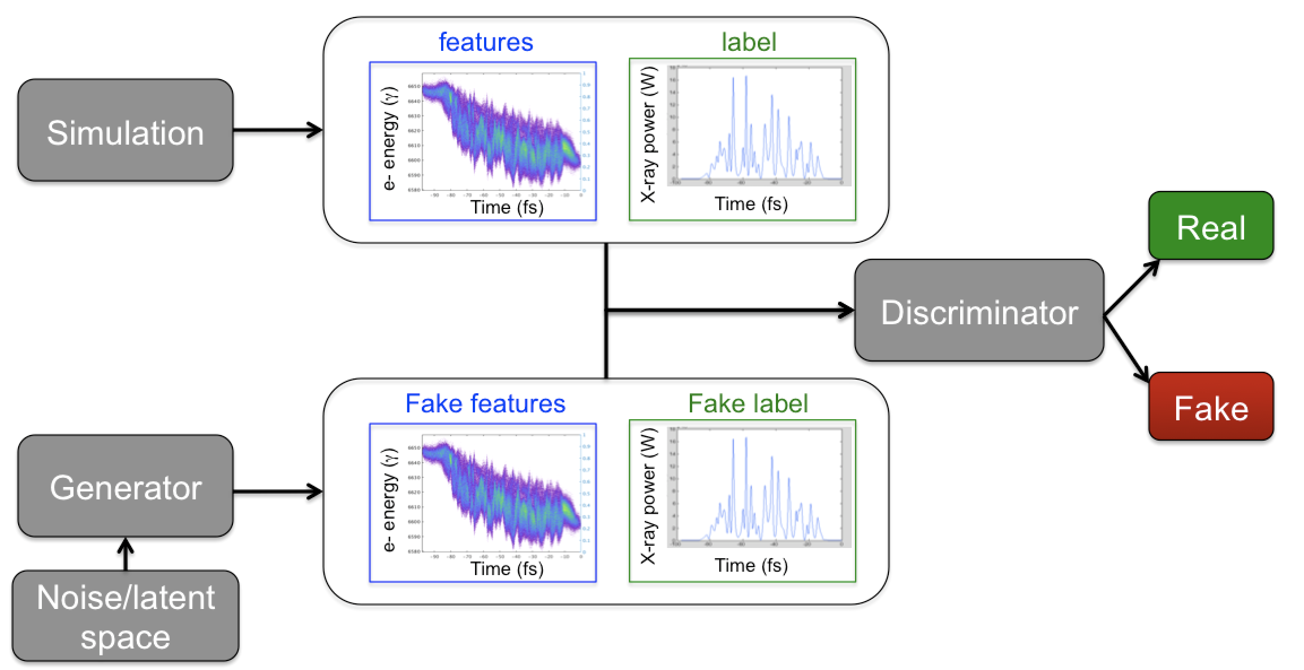
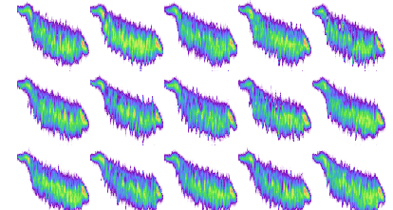
Surrogate Models: FEL simulations
Modeling collective effects from shot noise
Generative adversarial network (GAN)
Genesis:
~1000 cpu-sec
GAN (neural net):
~0.001 gpu-sec
Benefit: Provide users with rapid pulse generator
(1 million times faster than Genesis)
X. Ren
Notes:
Genesis simulations provide users very accurate prediction of X-ray pulses for preparing for shifts and testing analysis methods. However, each simulation takes ~1000s of CPU-seconds. For users who require large numbers of examples, e.g.crystallography or statistical methods like ghost imaging, Genesis is too slow.
Generative adversarial networks (GANs) use two networks: the “discriminator” tries to identify if an example is real (i.e. Genesis), or fake (i.e. the “generator”). The generator tries to fool the discriminator. As the two networks fight, the generator makes more and more realistic examples. Images at right show a generated fake XTCAV image (upper right) and the associated X-ray profile (lower right, green). The blue curve is what the old XTCAV algorithm would have estimated from the fake example, showing that the generated example is reasonable.

Slide 17
Outline
Online optimization of accelerators
Surrogate modeling
Data analysis: ghost imaging

Slide 18
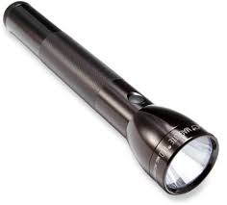
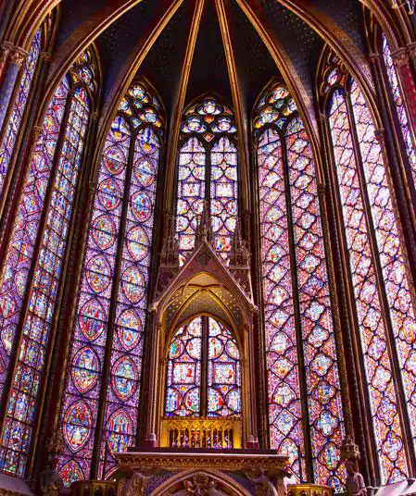
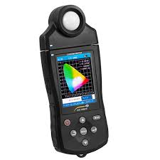
Data Analysis: Ghost imaging / Single-pixel camera
So what is ghost imaging anyway?
Riddle: How can I take a picture with a spectrometer?
Answer: Have a friend with a flashlight

Slide 19
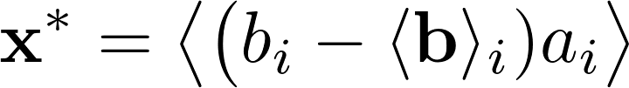
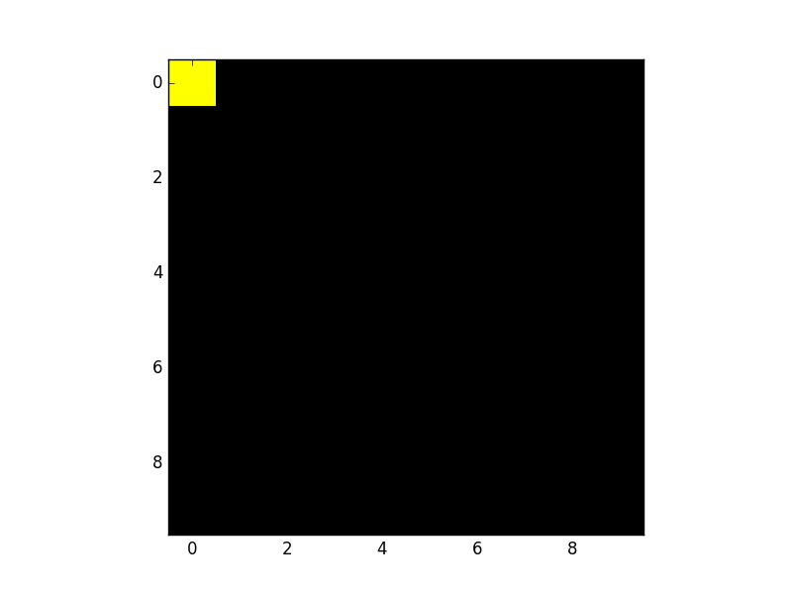
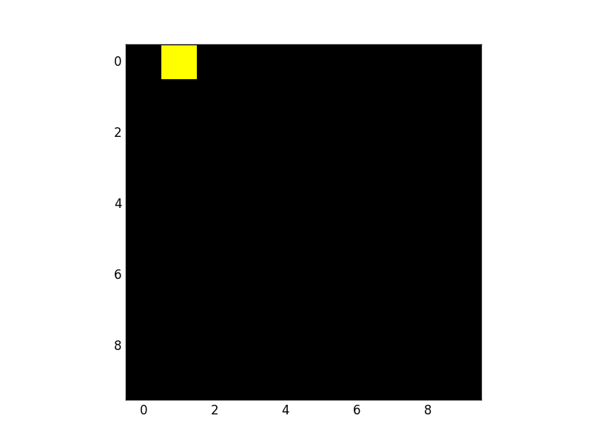
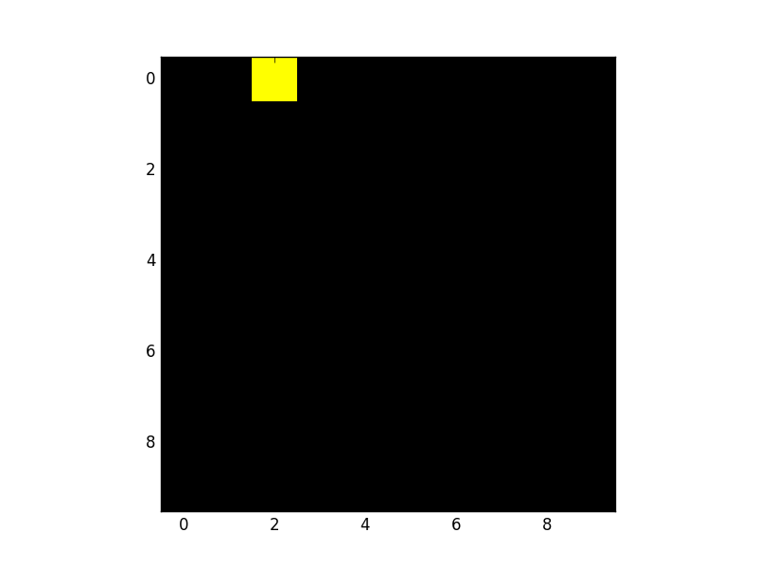
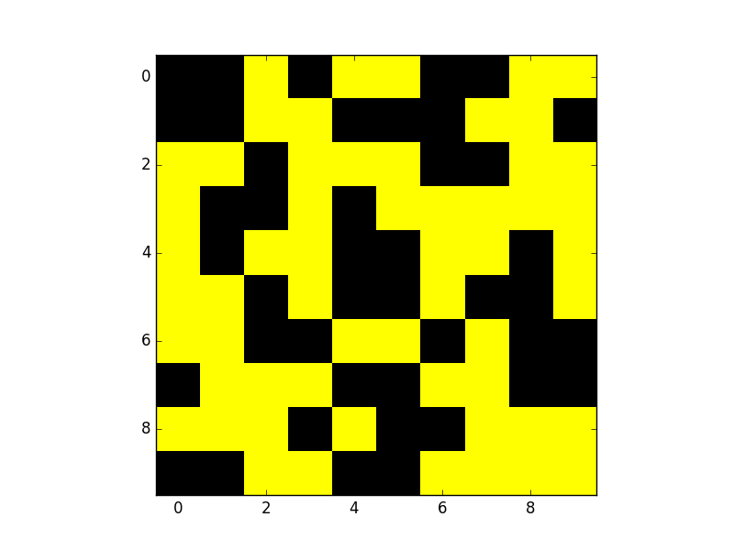
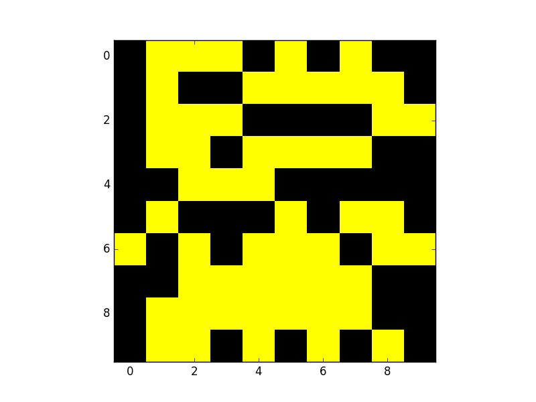
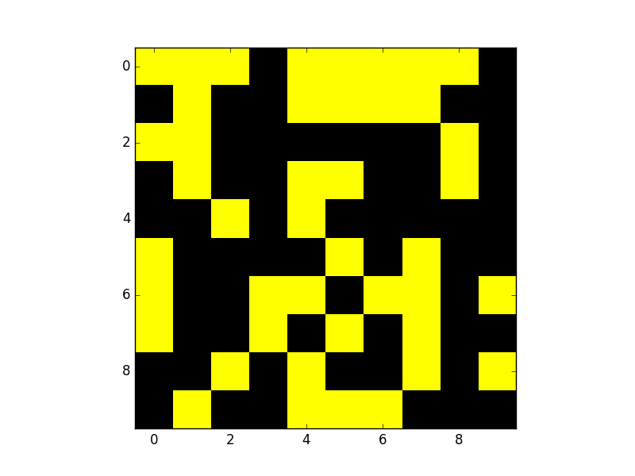
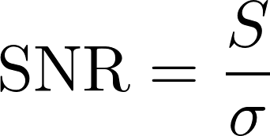
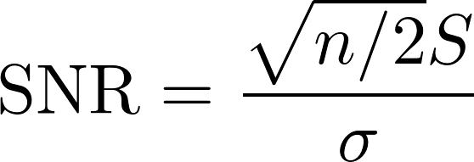

Data Analysis: Ghost imaging / Single-pixel camera
Classic GI formalism:
Raster scan
Ghost imaging
“Fellgett’s” (or Multiplex) advantage
Reconstructed Target, x*
Radiation, a
b = [ 5037,
4783,
4891, … ]
Bucket measures total transmission
Target, x
TJ Lane, D Ratner, arXiv preprint arXiv:1907.12178, 2019

Slide 20
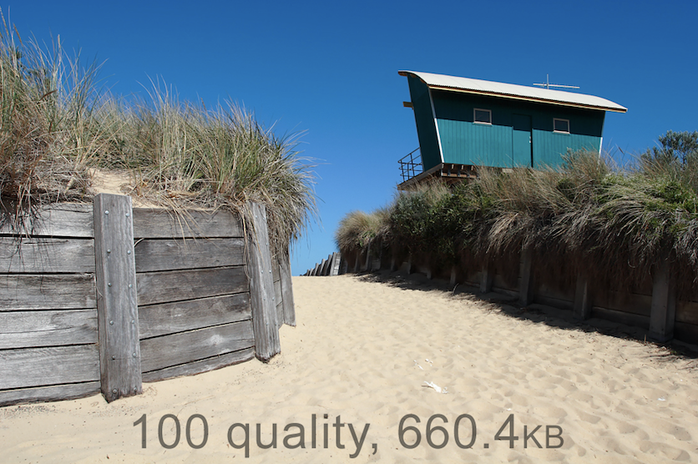
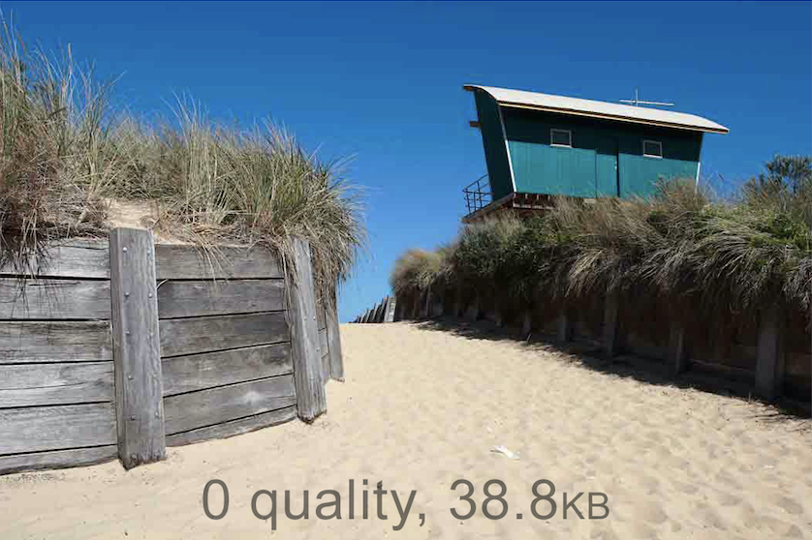
Data Analysis: Compressive sensing
Compressive sensing concept:
Why record 660k points if only 39k needed?
Wikimedia
Trick: Use “prior” information to reconstruct the sample
e.g. Sky is uniform blue ➔ minimize “total variation” of image

Slide 21
Data Analysis: Ghost imaging / Single-pixel camera
Classic GI formalism:
Compressive sensing formalism:
Solve with e.g. ADMM, Plug & Play, etc.
Matrix of all patterns
raster
GI
Measurement is easier than control!
b
=
a
x
Reconstructed Target, x*
Radiation, a
b = [ 5037,
4783,
4891, … ]
Bucket measures total transmission
Target, x
TJ Lane, D Ratner, arXiv preprint arXiv:1907.12178, 2019

Slide 22
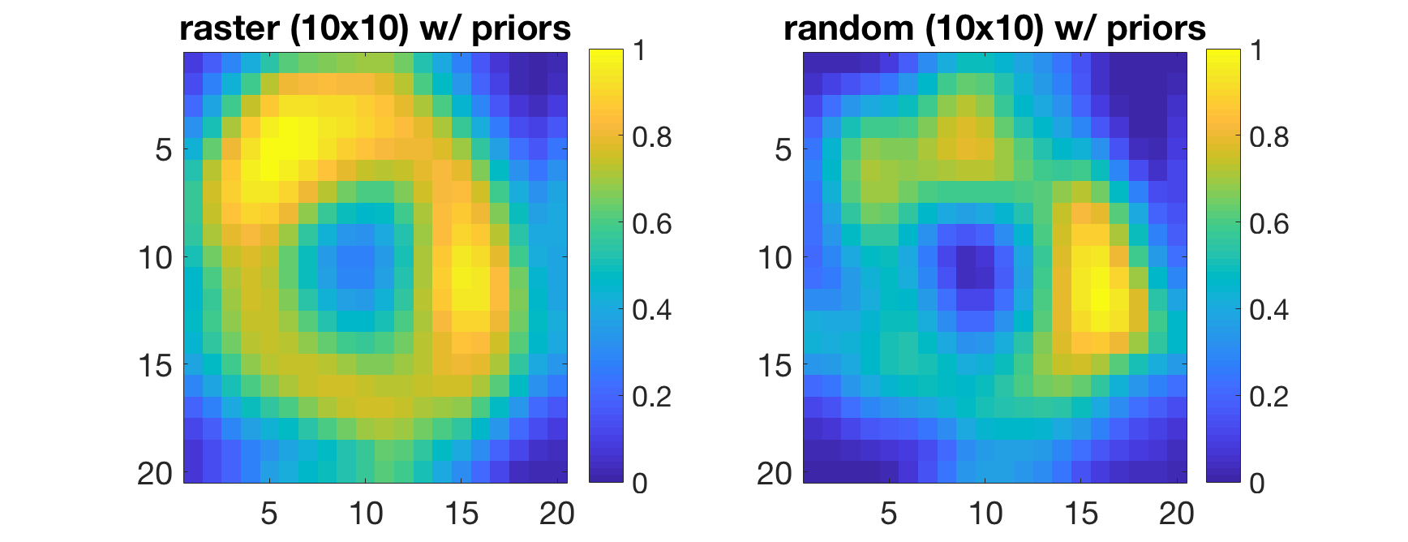
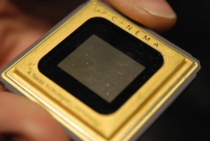
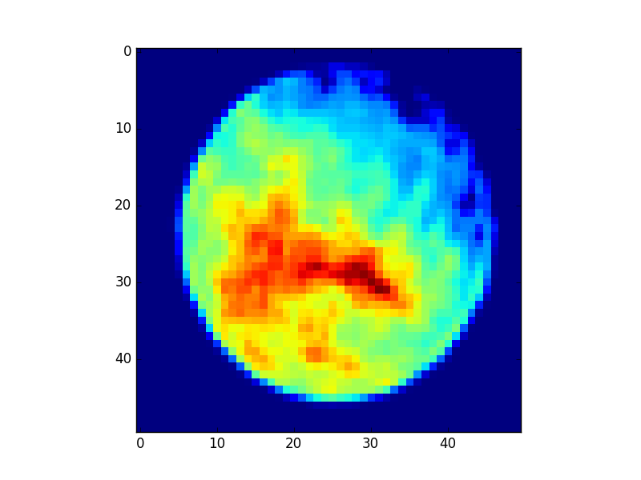

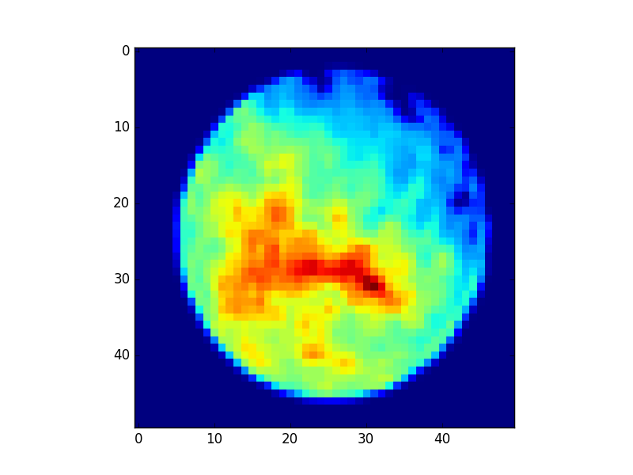





Data Analysis: cathode ghost imaging
photocathode quantum efficiency
Ground truth
Reconstruction
Cathode laser
target
Cathode
DMD
Natural laser jitter
Simulated
Ground truth
Real data
(no ground truth)
Reconstruction
Day 1
Day 3
Siqi Li
K. Kabra, et al., arXiv preprint arXiv:1910.11926, 2019

Slide 23




Data Analysis: Pump-probe ghost imaging
Ghost imaging in the time domain
target
Pump X-ray
Array of buckets (B)
Target (x)
Sample, CO
e-
Probe X-ray
Electron energy (eV)
A. Picon
Delay (fsec)
Time
System (CO) evolves after absorbing X-ray, changing electron energies
Incident radiation (P)
τ
“Pump-probe” scan of delay, τ
D Ratner et al., Physical Review X, 9, (1), 011045

Slide 24
Data Analysis: Pump-probe ghost imaging
Ghost Imaging Summary
Felgett’s/Multiplex Advantage: Boost signal to noise ratio
Compressive sensing: converge to solution faster using priors
‘Measurement is easier than control’: Use what nature gives you for easier, faster, higher resolution measurements
Sample dose reduction is NOT an advantage
Felgett’s advantage does NOT work for Poisson detectors

Slide 25






Data Analysis: Pulse reconstruction
How can we measure femtosecond X-rays?
Before lasing
e- energy (γ)
Electron phase space
After lasing
e- energy (γ)
Spectrum
Maxwell, Timothy J., et al. International Society for Optics and Photonics, 2014.
Power (W)
Time (fs)

Slide 26




Data Analysis: Pulse reconstruction
Computer vision
Aphex34 https://commons.wikimedia.org/w/index.php?curid=45679374
Stanford CS231n
D. Mendez

Slide 27

Data Analysis: Pulse reconstruction
XTCAV Analysis
Before lasing
XTCAV
e- energy (γ)
After lasing
energy
e- energy (γ)
time
ML model
Ground truth
Power (W)
Old algorithm
X. Ren
Time (fs)

Slide 28
Data Analysis: Pulse reconstruction
XTCAV Analysis
Before lasing
Slippage dominates in saturation
e- energy (γ)
After lasing
e- energy (γ)
Ground truth
ML model
Power (W)
Old algorithm
X. Ren
Time (fs)

Slide 29


Data Analysis: Pulse reconstruction
Full beam reconstruction
Measure amplitude of power/spectrum: can I recover phase?
Measure Power
Pulse #1
Guess
Field
F(t),F(w)
…
10⁶-10⁹ times
Measure Spectral power
Pulse #n
Input
Hidden layers
Measure Power
Output
Guess
Field
F(t),F(w)
Measure Spectral power
Only solve once!

Slide 30


Data Analysis: Pulse reconstruction
Full beam reconstruction
Measure amplitude of power/spectrum: can I recover phase?
Input Power
Power
Phase
Input power
Power ground truth
Phase prediction
Phase GT
Power prediction
Input
Hidden layers
Measure Power
Output
Guess
Field
F(t),F(w)
Measure Spectral power
Xiao Zhang
Only solve once!

Slide 31


Data Analysis: Pulse reconstruction
Full beam reconstruction
Measure amplitude of power/spectrum: can I recover phase?
Input Power
Power
Phase
Input power
Power ground truth
Phase prediction
Phase ground truth
Power prediction
Input
Hidden layers
Measure Power
Output
Guess
Field
F(t),F(w)
Measure Spectral power
Xiao Zhang
Only solve once!

Slide 32


Department of Energy Round Table:
ML for control of X-ray, Neutron, and Nano-facilities
Four panels:
Online control
Data Acquisition
Modeling/Simulations
Multimodal analysis

Slide 33


Conclusion
ML Mantra:
Orders of magnitude/new science,
That which can be automated, should be automated.
That which cannot be meaningfully automated should not be automated.
Ge Wang
(Stanford)

Slide 34
Conclusion
Many other topics for ML and accelerators:
virtual diagnostics, anomaly/breakout detection, in-the-loop experimental control, physics for/from ML, UQ …
We’re hiring for ML at SLAC!
https://ml.slac.stanford.edu/
Thanks to collaborators
E. Cropp, J. Cryan, J. Duris, A. Edelen, A. Hanuka, K. Kabra, A. Kennedy, T. J. Lane, S. Li, A. Lutman, G. Marcus, P. Musumeci, X. Ren, G. Stupakov, G. Wetzstein, X. Zhang

Slide 35





Surrogate Models: FEL simulations
Training Pipeline
Unlabeled data
Labeled Training Set
Genesis Simulation
Convolutional neural network (CNN) recovers X-ray power with smaller errors than current state-of-art
Experiment
Training Set
CNN
Feed Training Data
The generative adversarial network (GAN) generates labeled images
➔ Augment training for CNN or other data-hungry algorithms
Data Augmentation
GAN
X. Ren
Notes:
Genesis simulations provide users very accurate prediction of X-ray pulses for preparing for shifts and testing analysis methods. However, each simulation takes ~1000s of CPU-seconds. For users who require large numbers of examples, e.g.crystallography or statistical methods like ghost imaging, Genesis is too slow.
Generative adversarial networks (GANs) use two networks: the “discriminator” tries to identify if an example is real (i.e. Genesis), or fake (i.e. the “generator”). The generator tries to fool the discriminator. As the two networks fight, the generator makes more and more realistic examples. Images at right show a generated fake XTCAV image (upper right) and the associated X-ray profile (lower right, green). The blue curve is what the old XTCAV algorithm would have estimated from the fake example, showing that the generated example is reasonable.

Slide 36






Data Analysis: Pump-probe ghost imaging
Spectral ghost imaging
Note that we never actually need power, only autocorrelation!
Spectral power:
From Wiener-Khinchin theorem:
Time dynamics!
HXSSS
Electron bins
Electron energy (eV)
X-ray spectra
A. Picon
Delay (fsec)

Slide 37



Data Analysis: Pump-probe ghost imaging
Spectral ghost imaging
Note that we never actually need power, only autocorrelation!
Spectral power:
From Wiener-Khinchin theorem:
For Gaussian wave-packets
Siegert relation:
Pearson correlation coefficient, A⁽²⁾ and A⁽¹⁾
(limit of infinite pulse, proper normalization)
0
FEL’s have second relation:
G. Stupakov

Slide 38

Data Analysis: Pump-probe ghost imaging
Spectral ghost imaging
Note that we never actually need power, only autocorrelation!
Spectral power:
From Wiener-Khinchin theorem:
Empirically still works for 1st order autocorrelation
➔ Two advantages: Spectrometers are cheap, resolution only affects
Ground truth
A_{p}, high res
A_{p}, low res
A_{f}, low res
Delay
Delay
Delay
Delay

Slide 39



Gaussian Process Optimizer
Gaussian process: instance based learning method
Covariance function:
prior mean
observations
new point to predict
new point
taken from M. Ebner, GP for Regression

Slide 40


Gaussian Process Optimizer
Gaussian process: instance based learning method
Covariance function:
prior mean
observations
new point to predict
new point
Prediction of new point:
Variance of new point:
taken from M. Ebner, GP for Regression

Slide 41
Gaussian Process Optimizer
Gaussian process: instance based learning method
Covariance function:
prior mean
observations
new point to predict
new point
Acquisition function:

Slide 42
Optimization: Bayesian optimization
Gaussian processes
Covariance function:
observations
prior mean
new point to predict
new point
Prediction of new point:
Variance of new point:
Acquisition function (UCB):
M. Ebner,
GP for Regression

