Slide 1
Scientific Machine Learning Benchmarks
Jeyan Thiyagalingam
Scientific Machine Learning (SciML) Group
Rutherford Appleton Laboratory, STFC
t.jeyan@stfc.ac.uk
ILL, 13th November, 2019

Slide 2
Benchmarking
Process for comparing or assessing or evaluating different products or solutions
Has existed for a long time in the computing community (and other domains of sciences)
Here, we are interested on benchmarking for machine learning focused on science

Slide 3
Scientific Machine Learning Benchmarks
Motivated by specific scientific challenges from different domains
Particle physics – Particle classification
Material sciences – Small X-Ray Scattering, denoising EM images
Life sciences – Cell segmentation, CryoEM particle picking
Environmental, earth and space sciences
Etc
Anchored to the datasets generated by large-scale experimental facilities
Large
Real
Open
Contains one or more baselines, machine learning-based solution(s)

Slide 4
Scientific Machine Learning Benchmarks
Motivated by specific scientific challenges from different domains
Particle physics – Particle classification
Material sciences – Small X-Ray Scattering, denoising EM images
Life sciences – Cell segmentation, CryoEM particle picking
Environmental, earth and space sciences
Etc
Anchored to the datasets generated by large-scale experimental facilities
Large
Real
Open
Contains one or more baselines, machine learning-based solution(s)

Slide 5
Scientific Machine Learning Benchmarks
Motivated by specific scientific challenges from different domains
Particle physics – Particle classification
Material sciences – Small X-Ray Scattering, denoising EM images
Life sciences – Cell segmentation, CryoEM particle picking
Environmental, earth and space sciences
Etc
Anchored to the datasets generated by large-scale experimental facilities
Large
Real
Open
Contains one or more baselines, machine learning-based solution(s)

Slide 6
Objectives of the ML Benchmarking Process
To provide useful insight into evaluating ML ecosystems
Hardware architectures (GPU, CPU, TPU, embedded GPU)
Software frameworks (PyTorch, Tensorflow, Keras, etc)
Machine learning techniques (DNNs, SVM, Decision Trees, etc)
Network and storage components
Evaluate based on multiple performance metrics:
Runtime, energy, learning and inferencing performance
Easy to use and extend:
Just works without hefty installation process
Easily extensible by end users / manufacturers
Scoped for evaluating performance on multiple fronts:
Classification/regression
Supervised/unsupervised
Little data/big data,
Time constrained/unconstrained
Resilience against incorrect data
Different data modalities image / text
Minimum data (quality vs quantity)

Slide 7
Objectives of the ML Benchmarking Process
To provide useful insight into evaluating ML ecosystems
Hardware architectures (GPU, CPU, TPU, embedded GPU)
Software frameworks (PyTorch, Tensorflow, Keras, etc)
Machine learning techniques (DNNs, SVM, Decision Trees, etc)
Network and storage components
Evaluate based on multiple performance metrics:
Runtime, energy, learning and inferencing performance
Easy to use and extend:
Just works without hefty installation process
Easily extensible by end users / manufacturers
Scoped for evaluating performance on multiple fronts:
Classification/regression
Supervised/unsupervised
Little data/big data,
Time constrained/unconstrained
Resilience against incorrect data
Different data modalities image / text
Minimum data (quality vs quantity)

Slide 8
Objectives of the ML Benchmarking Process
To provide useful insight into evaluating ML ecosystems
Hardware architectures (GPU, CPU, TPU, embedded GPU)
Software frameworks (PyTorch, Tensorflow, Keras, etc)
Machine learning techniques (DNNs, SVM, Decision Trees, etc)
Network and storage components
Evaluate based on multiple performance metrics:
Runtime, energy, learning and inferencing performance
Easy to use and extend
Just works without hefty installation process
Easily extensible by end users / manufacturers
Scoped for evaluating performance on multiple fronts:
Classification/regression
Supervised/unsupervised
Little data/big data,
Time constrained/unconstrained
Resilience against incorrect data
Different data modalities image / text
Minimum data (quality vs quantity)

Slide 9
Objectives of the ML Benchmarking Process
To provide useful insight into evaluating ML ecosystems
Hardware architectures (GPU, CPU, TPU, embedded GPU)
Software frameworks (PyTorch, Tensorflow, Keras, etc)
Machine learning techniques (DNNs, SVM, Decision Trees, etc)
Network and storage components
Evaluate based on multiple performance metrics:
Runtime, energy, learning and inferencing performance
Easy to use and extend
Just works without hefty installation process
Easily extensible by end users / manufacturers
Scoped for evaluating performance on multiple fronts:
Classification/regression
Supervised/unsupervised
Little data/big data,
Time constrained/unconstrained
Resilience against incorrect data
Different data modalities image / text
Minimum data (quality vs quantity)

Slide 10
Objectives of the ML Benchmarking Process
To provide useful insight into evaluating ML ecosystems
Hardware architectures (GPU, CPU, TPU, embedded GPU)
Software frameworks (PyTorch, Tensorflow, Keras, etc)
Machine learning techniques (DNNs, SVM, Decision Trees, etc)
Network and storage components
Evaluate based on multiple performance metrics:
Runtime, energy, learning and inferencing performance
Easy to use and extend
Just works without hefty installation process
Easily extensible by end users / manufacturers
Scoped for evaluating performance on multiple fronts:
Classification/regression
Supervised/unsupervised
Little data/big data,
Time constrained/unconstrained
Resilience against incorrect data
Different data modalities image / text
Minimum data (quality vs quantity)
CNN, ResNet, mxNet, ESN, RNN, LSTM, FRCNN, etc
CNN+LSTM
Ensemble methods

Slide 11
Benchmarking for ML – Similar Efforts

Slide 12
Example Datasets
Astronomy datasets from SDSS, DES, LSST, SKA, …
Particle Physics LHC datasets from ATLAS, CMS, DUNE, …
Large Scale Facilities datasets – DLS, ISIS and CLF
Environmental datasets from JASMIN
Datasets from Culham Centre for Fusion Energy

Slide 13
This talk …
Reports a work in progress
The suite & results are evolving
Covers examples from:
Material Sciences: Small Angle X-Ray Scattering- Particle shape identification and shape characterisation
Life Sciences: Cryo-Electron Microscopy- Motion correction and denoising
Environmental Sciences: Remote Sensing- Cloud masking from satellite imagery (with some detailed results)
We are expanding this to cover a number of problems from other domains
Astronomy: Photo-Z- Photometric Red Shift Estimation
Materials: EM-Denoise- Denoising EM images
And others

Slide 14
Example 1: Small Angle X-Ray Scattering

Slide 15
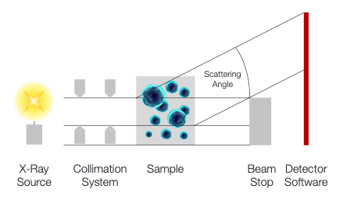
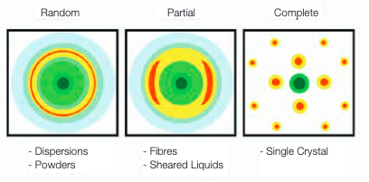
Small Angle X-Ray Scattering (SAXS)
An X-Ray beam is scattered through the sample
The beam is diffracted based on the atomic arrangement of the sample

Slide 16
SAXS – Overall Scientific Challenge

Slide 17
SAXS – Benchmark Challenges
Particle shape identification:
Given an i/q values, can we identify the basis shape?
Given an i/q values, can we identify the basis shapes?
Particle shape parameterisation
Given an i/q values, can we parameterise the basis shapes ?

Slide 18
Example 2: Life Sciences Noise Filtering & Motion Correction on Cryo-EM Data

Slide 19
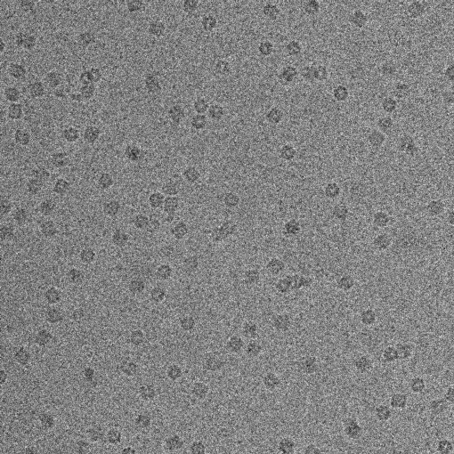
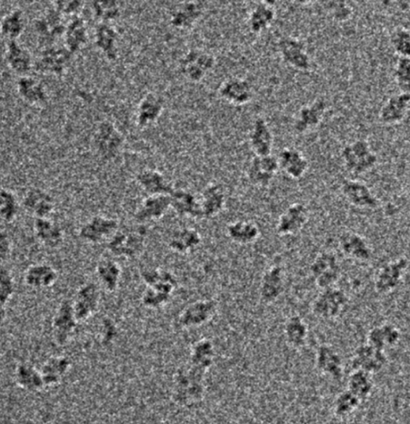
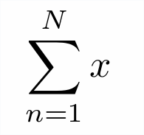
Cryo-EM Motion Correction
Particles move under beam (Beam-induced motion)
Perform motion correction to improve the SNR
Mixed with ML-based deformable image registration and particle tracking (using Kalman filtering)

Slide 20
Cryo-EM Denoising
The problem is to remove noise from cryo-EM images so that:
Overall SNR /particle picking performance is improved, and
In the absence of any known ground truth
Conventional notion of ‘training’ DNNs do not just work or at least is not effective

Slide 21
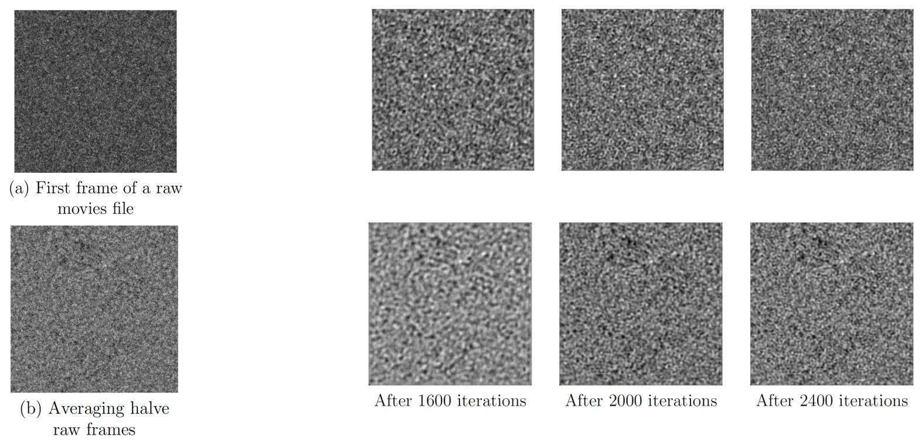
Cryo-EM Denoising
The problem is to remove noise from cryo-EM images so that
Overall SNR /particle picking performance is improved, and
In the absence of any known ground truth

Slide 22
CryoEM Noise Filtering & Motion Correction
Performance basis
Denoising per frame
Denoising over a set of averaged frames
Denoising over motion corrected frames (which requires priors)
Evaluation in the absence of any ground truth is challenging

Slide 23
Example 3: Sentinel Cloud (Detailed)

Slide 24
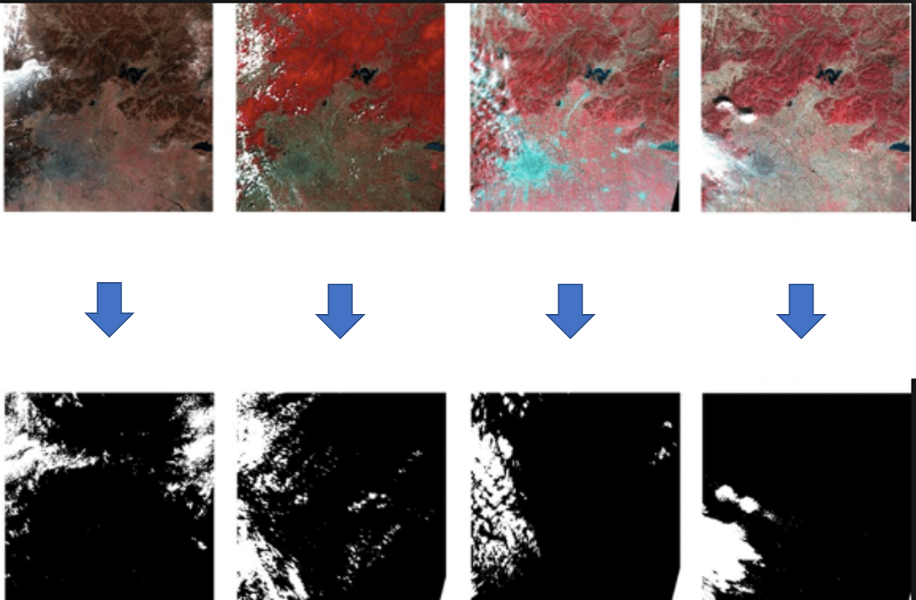
Sentinel Satellite Data: Cloud Masking
Identifying cloud from satellite imagery is a core activity in environmental sciences
Task 1: Each pixel (1200x1500x9) requires classification
Task 2: Take the overall results further to estimate surface temperature

Slide 25
Cloud Identification: Some Challenges
Varying conditions throughout the year
Lack of good, robust and efficient cloud masking algorithms
There are no spatial or time-invariant algorithms
Data from multiple sensors (SLSTR, OLCI, MODIS, AASTR …)

Slide 26
Manual Evaluation - Night

Slide 27
Manual Evaluation - Day

Slide 28
Accuracy vs Location (using UNet)

Slide 29
Performance of one of models

Slide 30
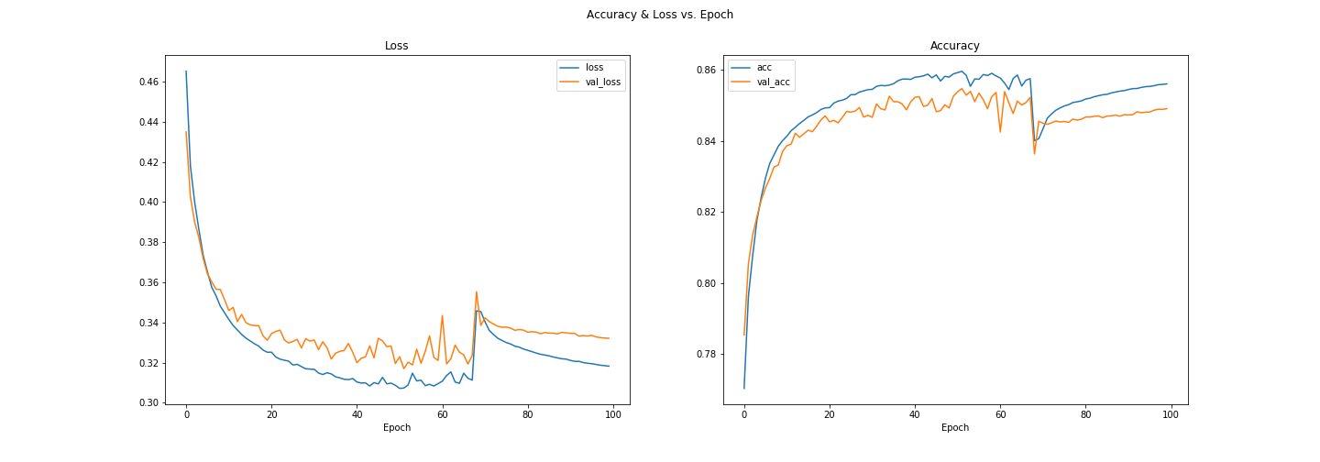
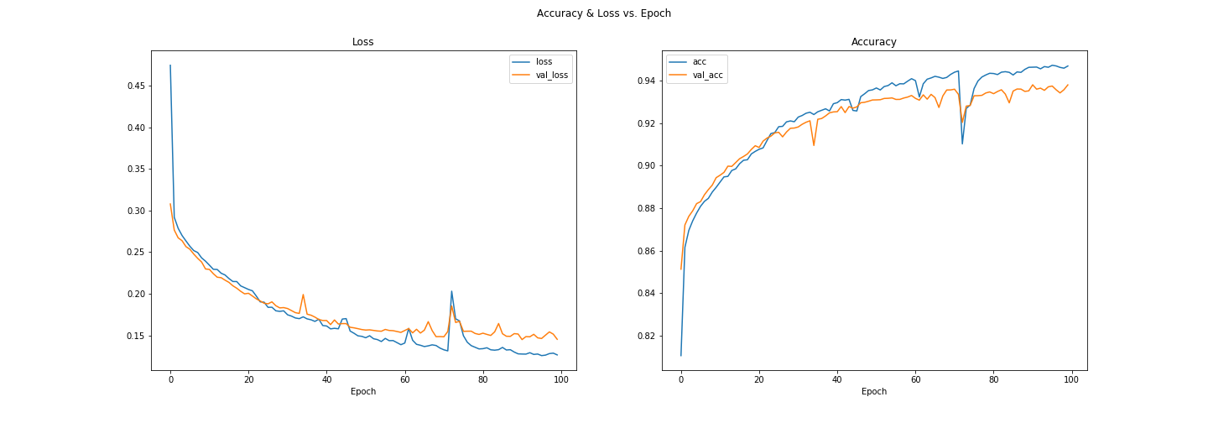
Different ML Configurations Compared
UNet-128
UNet-512

Slide 31
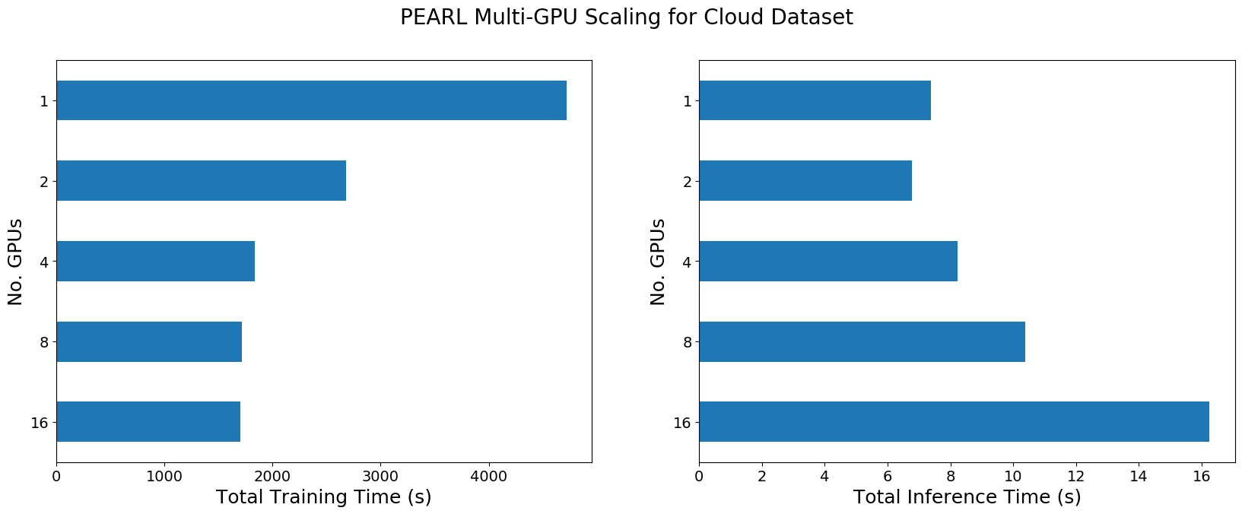
Performance Results
Evaluated on DGX2 (V100, 1.5TB RAM)

Slide 32
End-to-End Benchmarking

Slide 33
Focus on End-to-End Benchmarking
We have not (so far) looked into the end-to-end aspects of benchmarking
But our workloads have significant challenges at either end of the training and inferencing
Very large datasets imply:
In-memory and out-of-core data transformations
Storage aspects
Large amount of data transfers across nodes during learning / training
Complex data wrangling and transformations
These aspects need to be covered too

Slide 34
Challenges
Distribution of datasets ?
Formulation of single, projected performance metric
Instead of reporting 100 different (potentially) confusing metrics we prefer one single number
Ideally, folded / projected / integrated over multiple dimensions
Can be controversial - the importance or significance varies – how do we capture all?
F1 vs runtime or Accuracy vs runtime or Accuracy vs runtime vs average energy
Difficulty in measuring
Some of the metrics are difficult to measure: power or energy
How we do stabilize the results over stochastic nature of the results? Will the community ever learn to love pdfs?
And more…
If you would like to contribute to the benchmark suite, please contact us

Slide 35
Acknowledgements
SAXS: Tim Snow (Diamond)
Sentinel Cloud: Samuel Jackson & Caroline Cox (RALSpace)
CryoEM-Correct & CryoEM-DeNoise: Jason Yeung, Jaehoon Cha, Daiyun Huang, Jola Mirecka, Tom Burnley, Yuriy Chaban (Diamond)
Photo-Z: Connor Pettitt, Ben Henges (UCL), Ofer Lahav (UCL)
EM-Denoise: Patrick Austin & Keith Butler
Tony Hey

