Slide 1
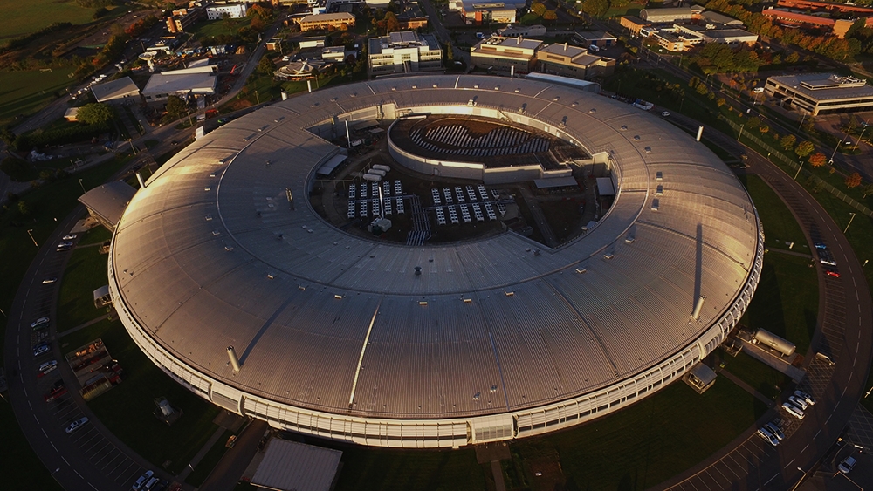
Machine Learning at Diamond Light Source: Past, Present and Future
Dr Mark Basham
Data Analysis Group
Diamond Light Source

Slide 2
Artificial Intelligence at Diamond Light Source: Past, Present and Future
Dr Mark Basham
Data Analysis Group
Diamond Light Source

Slide 3
Introduction
Brief overview, please look at the slides online for people to contact and references
I have tried to talk about the things which are in use, both developed at, and used by Diamond.

Slide 4
Past – Optimisation

Slide 5
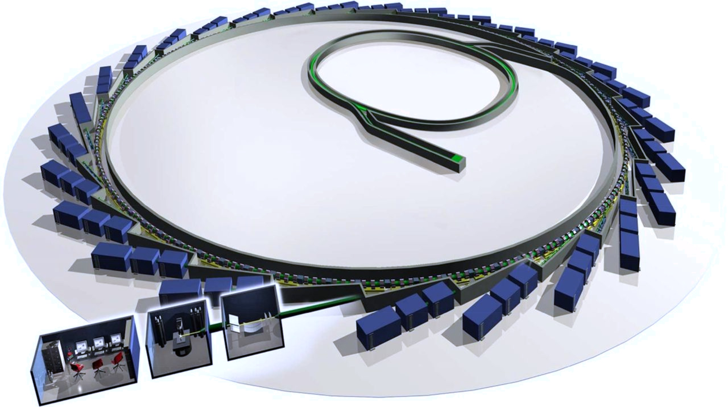
Multi-Objective Optimization
Algorithms available in the DLS code:
  MOPSO particle swarm optimizer
  MOGA (NSGAII) genetic algorithm
  MOSA simulated annealing
  RCDS single objective search
Optimization at Diamond Light Source
  Test-1: BTS transfer line + Storage Ring
  Test-2: Storage Ring
LINAC
transfer Lines (LTB/BTS)
Booster
Storage Ring (SR)

Slide 6
Multi-Objective Optimization
Algorithms available in the DLS code:
  MOPSO particle swarm optimizer
  MOGA (NSGAII) genetic algorithm
  MOSA simulated annealing
  RCDS single objective search
Optimization at Diamond Light Source
  Test-1: BTS transfer line + Storage Ring
  Test-2: Storage Ring

Slide 7
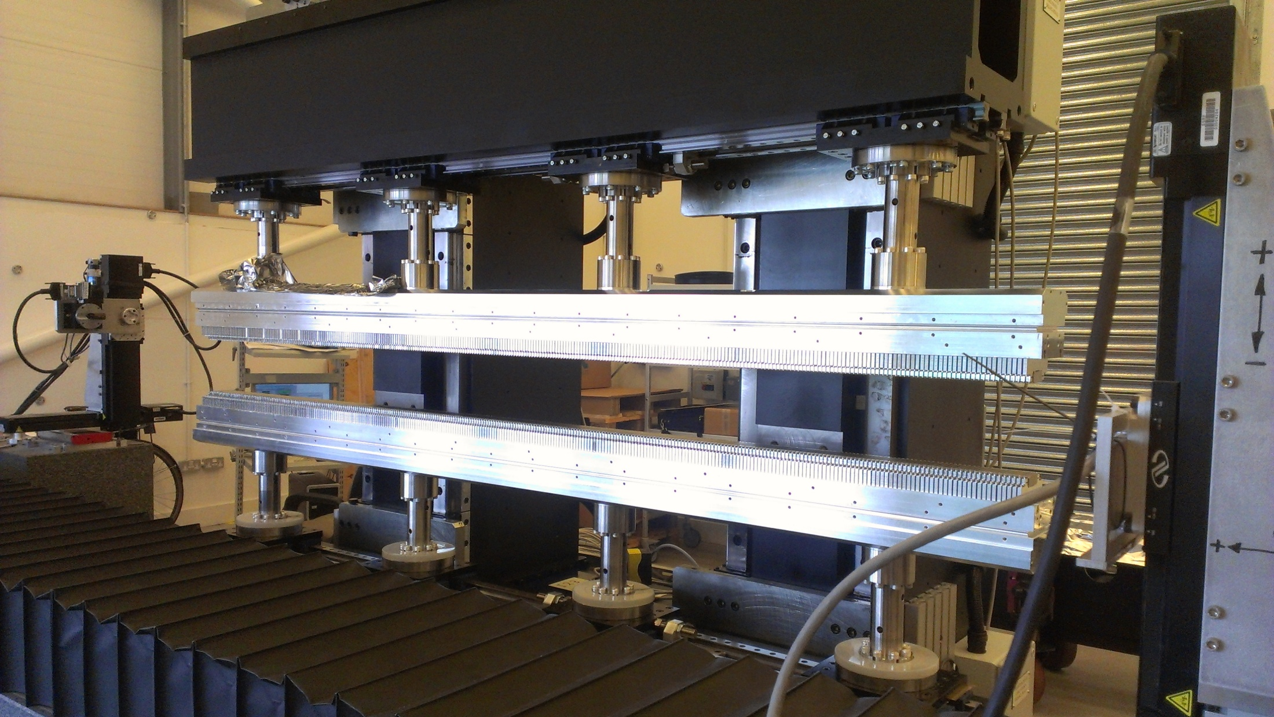
Insertion Devices Sorting and Shimming

Slide 8
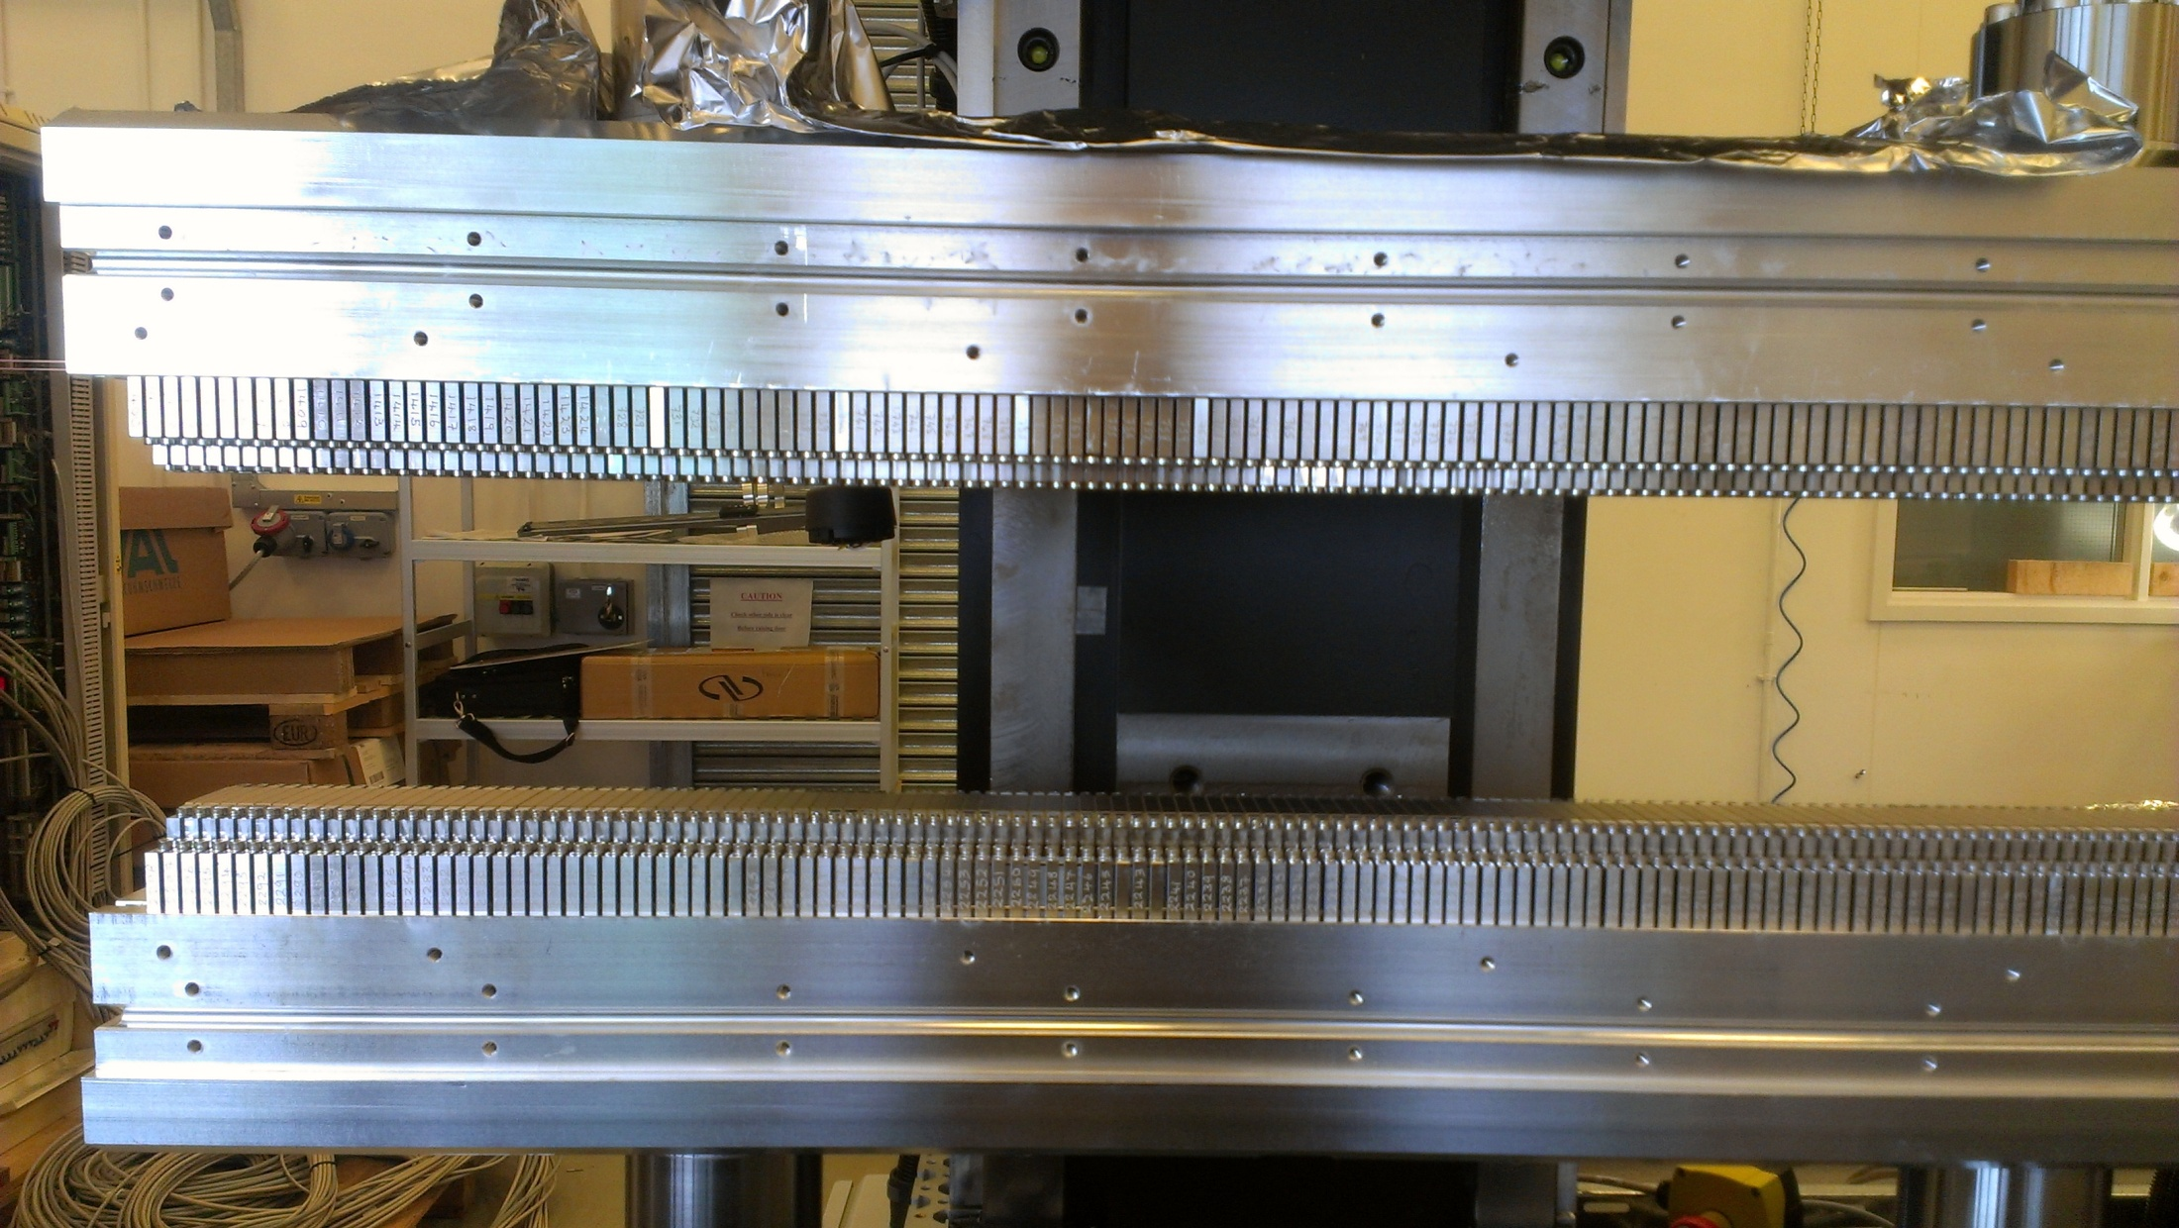
Insertion Devices Sorting and Shimming
320 Magnets
Top and Bottom Arrays

Slide 9
Insertion Devices Sorting and Shimming
Brute force not possible.
Original code used Simulated annealing with a component weighted objective function
New code uses Artificial Immune Systems, with a Single objective function.
https://github.com/DiamondLightSource/Opt-ID

Slide 10
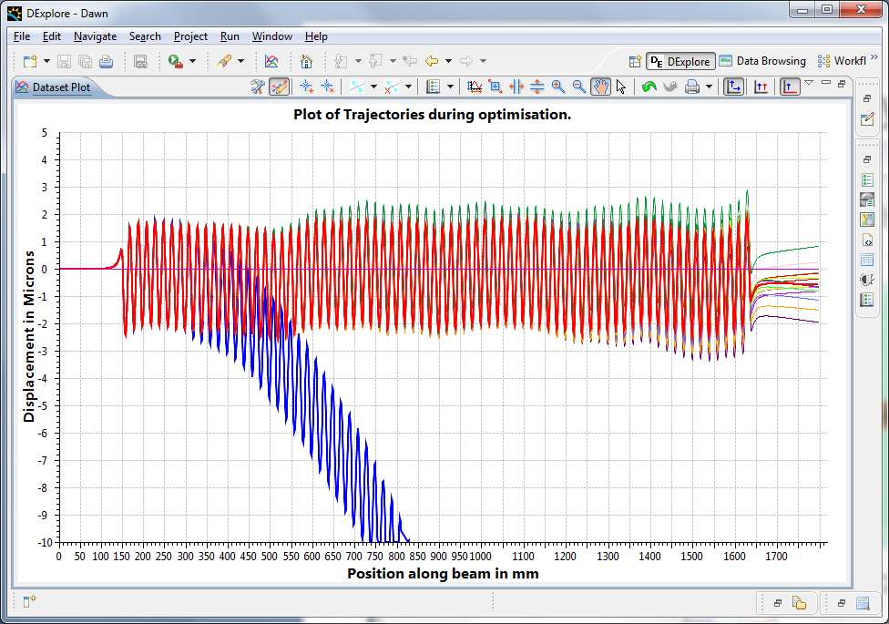
A Full Size array
Calculated Trajectories

Slide 11
Present – Machine Learning

Slide 12
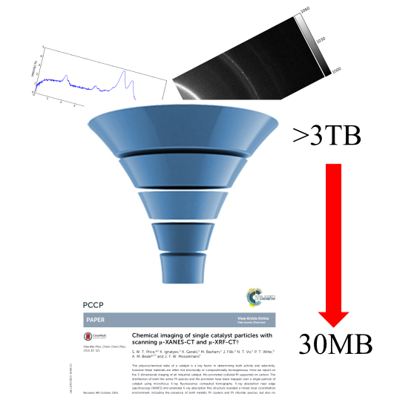
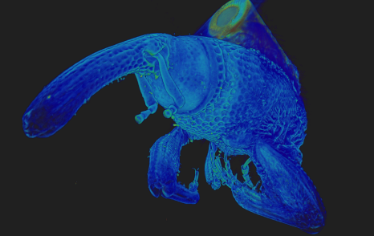
The data challenge.

Slide 13


Segmentation of Volume Data
Luengo, Imanol, et al. "SuRVoS: Super-region volume segmentation workbench." Journal of structural biology 198.1 (2017): 43-53.
Darrow, Michele C., et al. "Volume segmentation and analysis of biological materials using SuRVoS (Super-region Volume Segmentation) Workbench." JoVE (Journal of Visualized Experiments) 126 (2017): e56162.

Slide 14
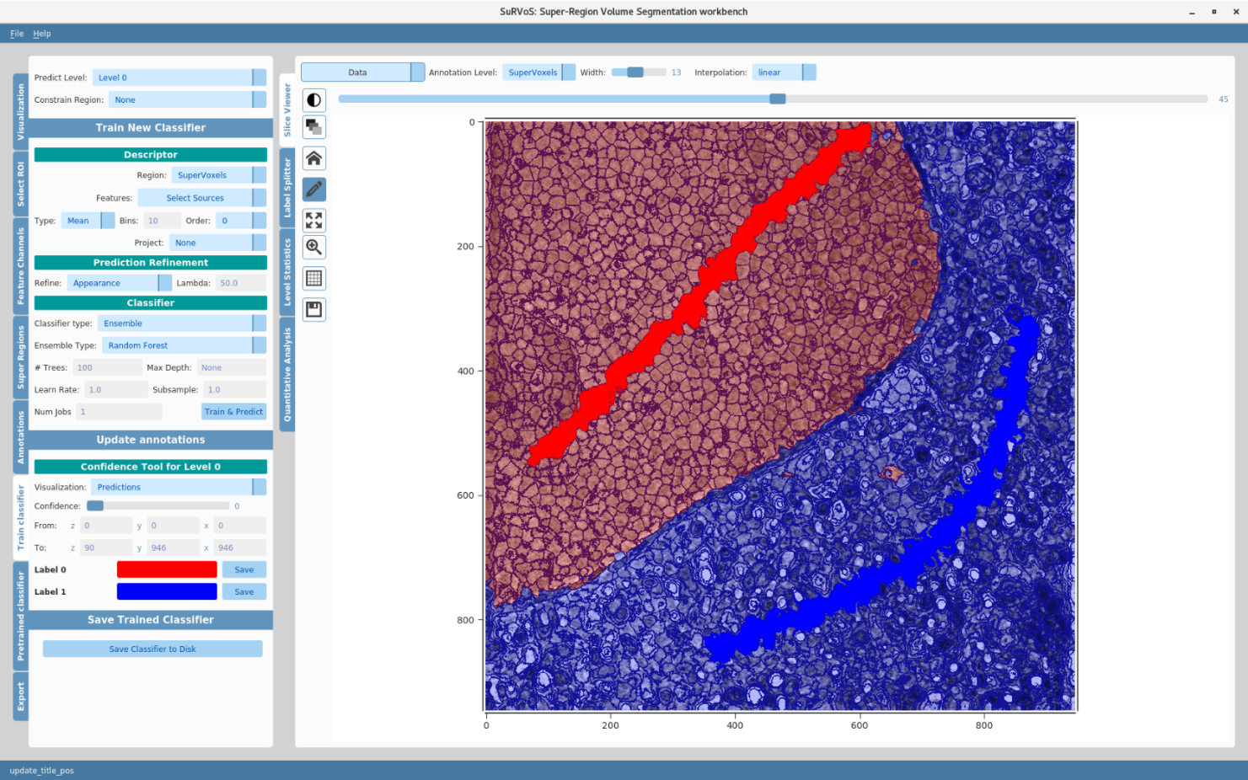
SuRVoS
Tools
Visualisation
Plugins

Slide 15
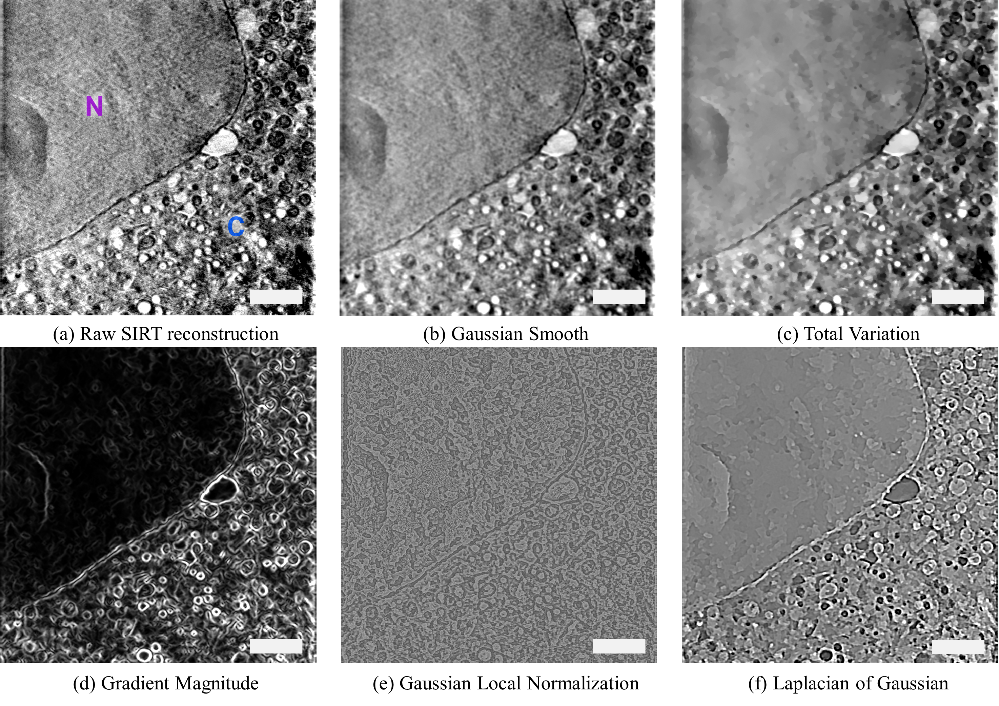
1. Extract Features
Notes:
Local normalisation – unify the mean and standard deviation in a local area
Features can be stacked, they are GPU optimised and run on the entire volume

Slide 16
2. Generate Super-Regions
Over-segmentation with boundary adherence
153,600
elements
200
elements
Notes:
Once you have denoised your data and extracted features, the next step is to generate super-regions
This greatly reduces the complexity of segmenting imaging data

Slide 17
Super-Regions
Over-segmentation with boundary adherence
153,600
elements
200
elements
Notes:
Based upon Simple Linear Iterative Clustering
K-means local clustering of the pixels
Given the required superpixel size, the image is split into an appropriately sized grid and iterative local k-means is applied searching for the pixels that belong to each superpixel

Slide 18
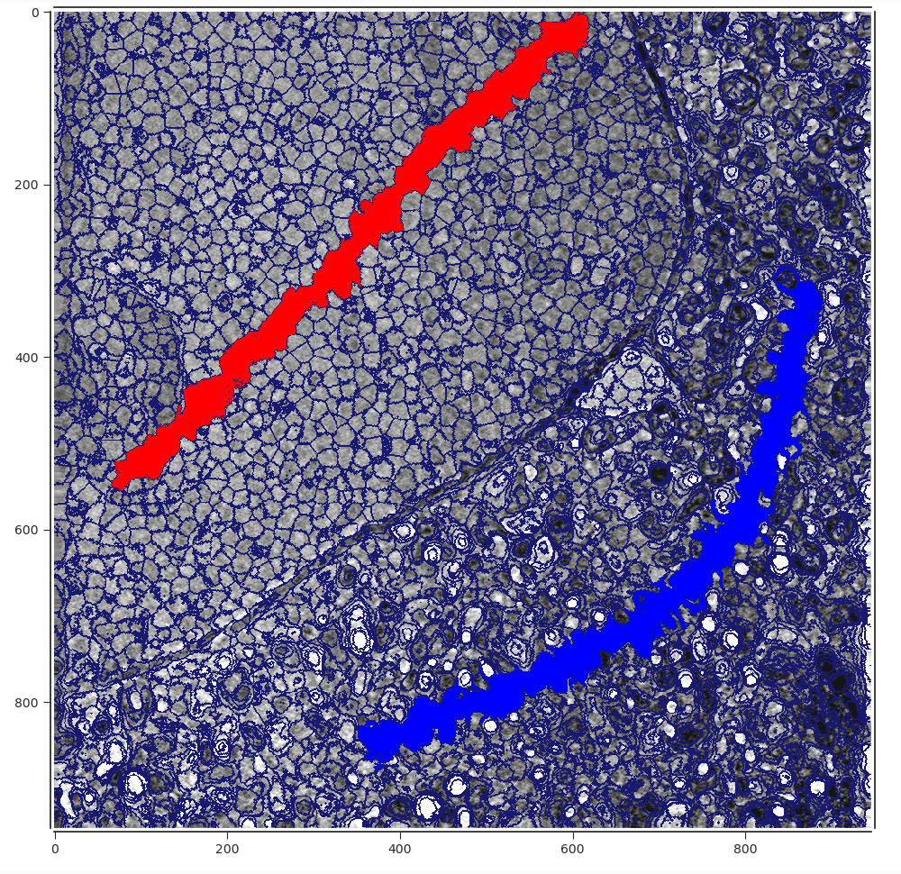
3. Annotate the data
Supervoxel labels are needed to train a model to segment the volume
These can be provided through use simple drawing tool
Notes:
To train a machine learning model, you need some labels
Since you are annotating supervoxels, annotations are in 3D

Slide 19
4. Train a Model
Process of training a classifier in order to predict supervoxel classes
  Features extracted from the data are concatenated into a matrix, X
  Used to train the classifier in conjunction with the labels from annotations, Y
D
0.5 | 0 | 0.1 | …
…
0
1
…
-1
0
N: Number of supervoxels
D: Number of features
X: Descriptor matrix
Y: Class type for each supervoxel
X =
N
Y =
N
Notes:
You have features, supervoxels and labels. Now train a classifier! Generally some sort of decision tree e.g random forest, boosted forest though can use an SVM
Standard scikit learn classifiers

Slide 20
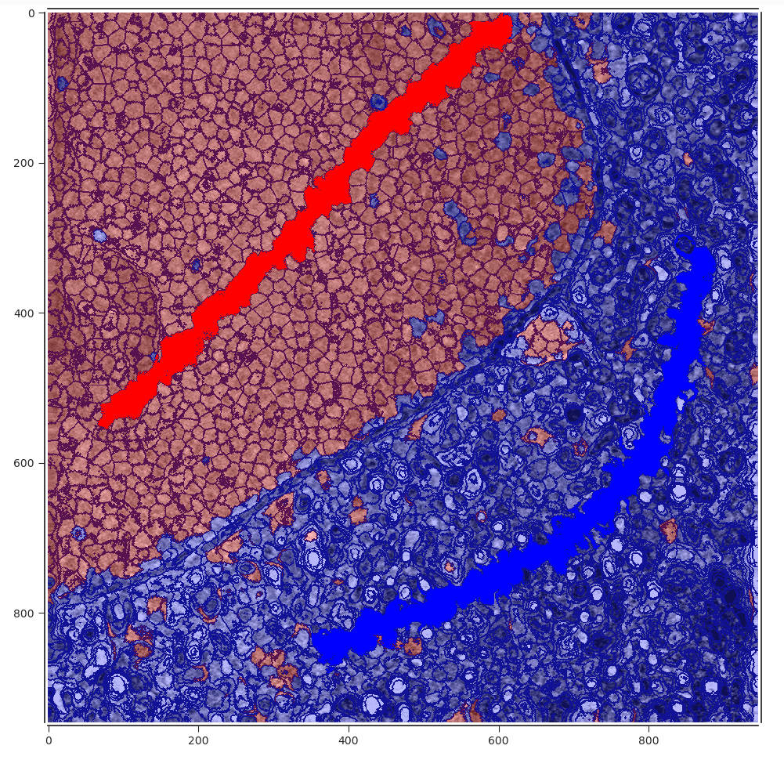
5. Predict Labels
Trained model is used to predict classes for the unknown labels
Notes:
Labels are predicted for the whole volume
As can be seen, this isn’t perfect

Slide 21
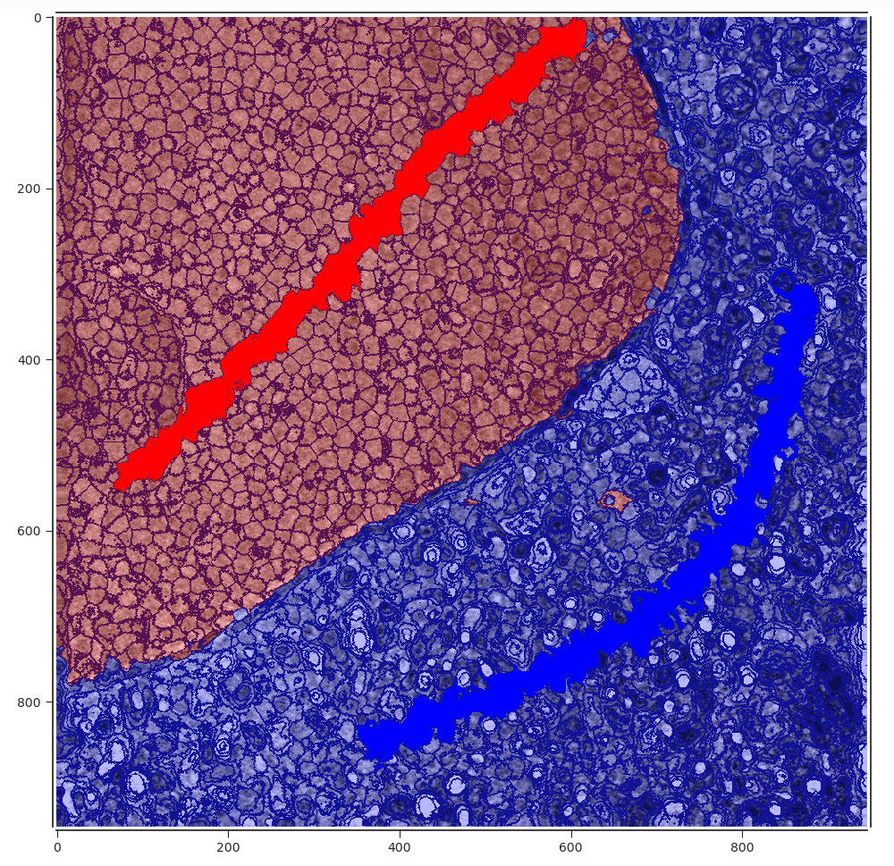
6. Refine Predictions
Adds spatial consistency to the predictions
Uses minimisation of a Markov Random Field energy function
Notes:
Predictions are refined with context of where they are. For example, the red supervoxel in the schematic should probably be blue

Slide 22
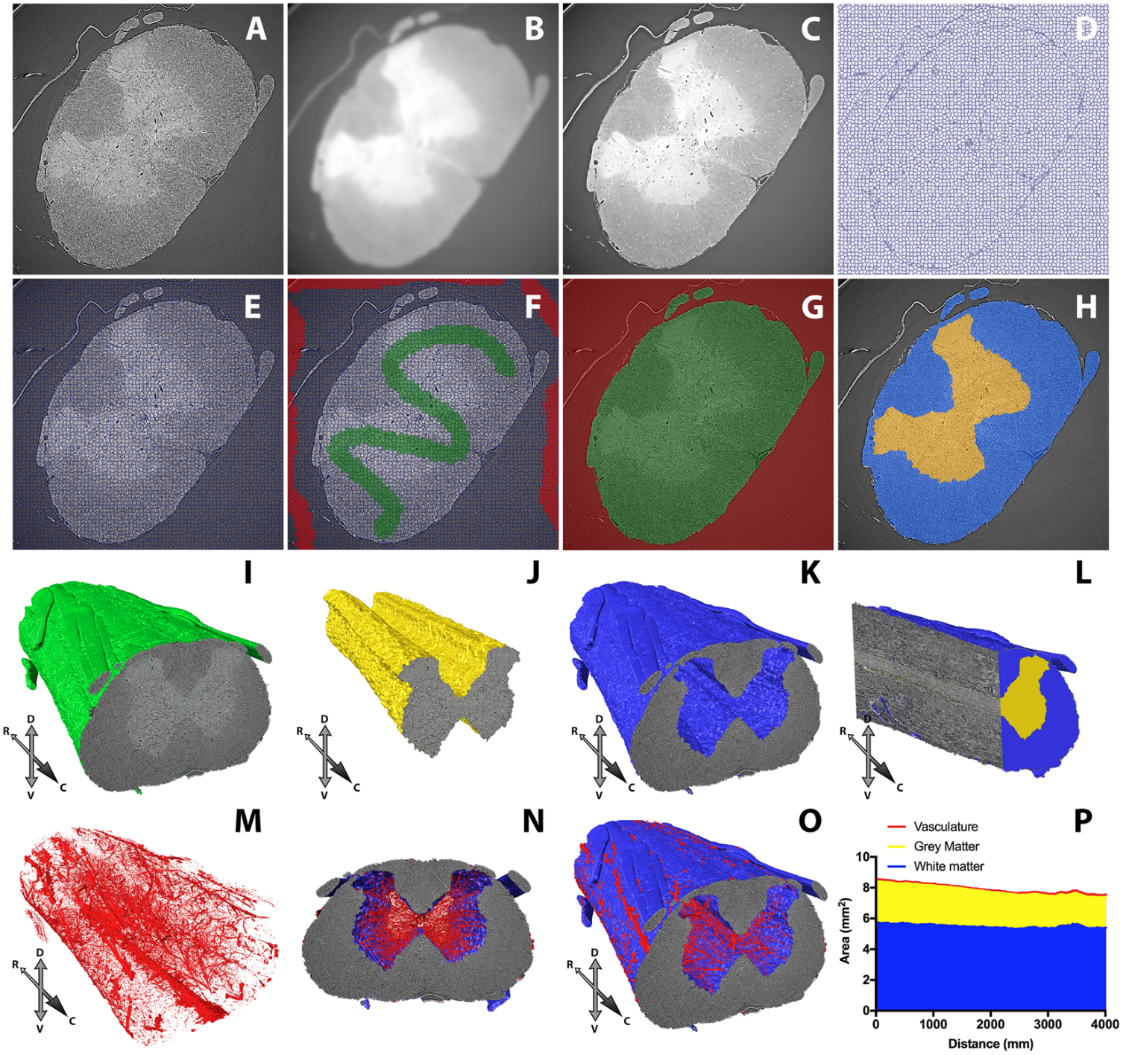
Strotton, M.C., Bodey, A.J., Wanelik, K. et al. Optimising complementary soft tissue synchrotron X-ray microtomography for reversibly-stained central nervous system samples. Sci Rep 8, 12017 (2018) doi:10.1038/s41598-018-30520-8

Slide 23
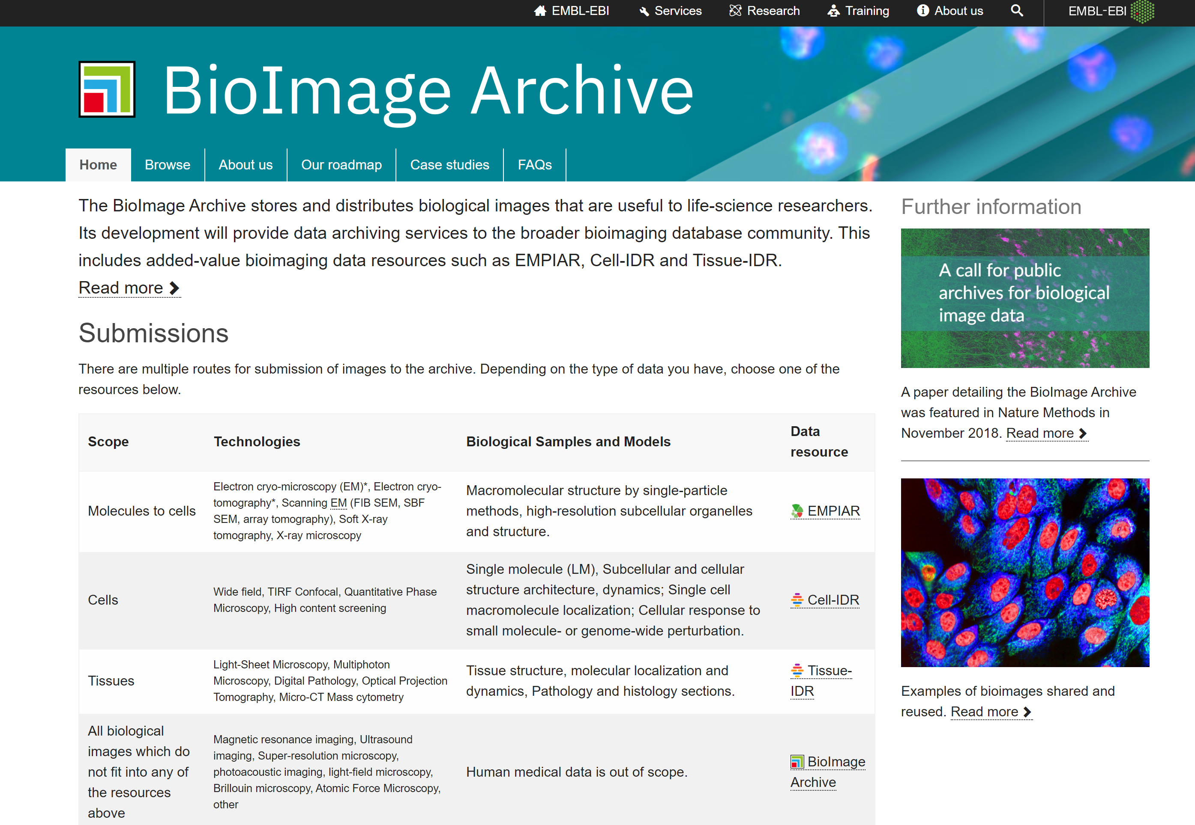
Aside - Available Images

Slide 24


Improving Particle Picking in CryoEM by Applying Deep Models

Slide 25
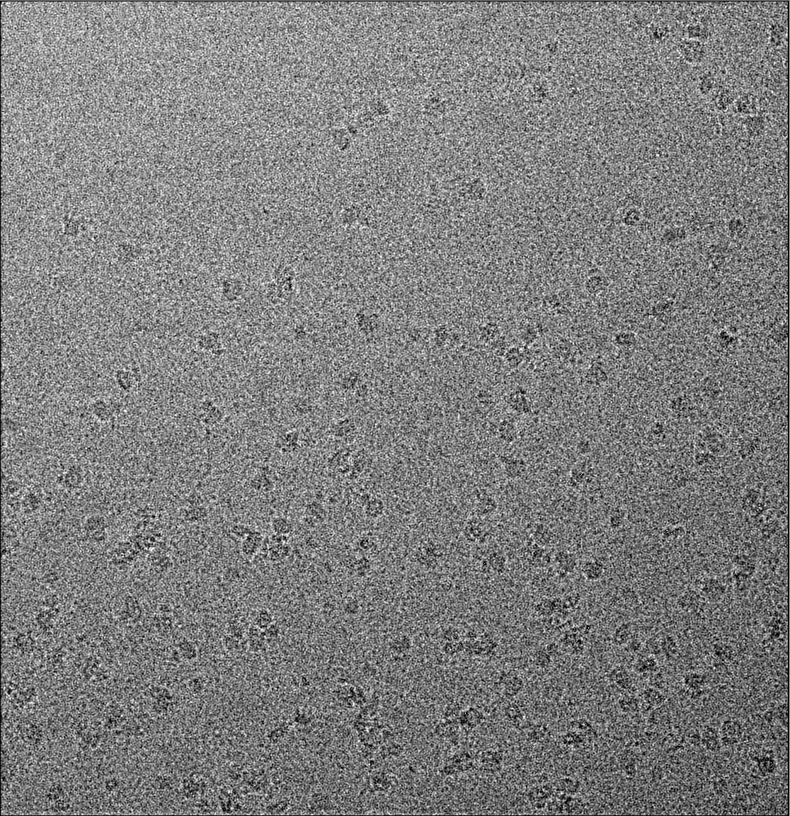
CryoEM Micrograph
Proteins

Slide 26
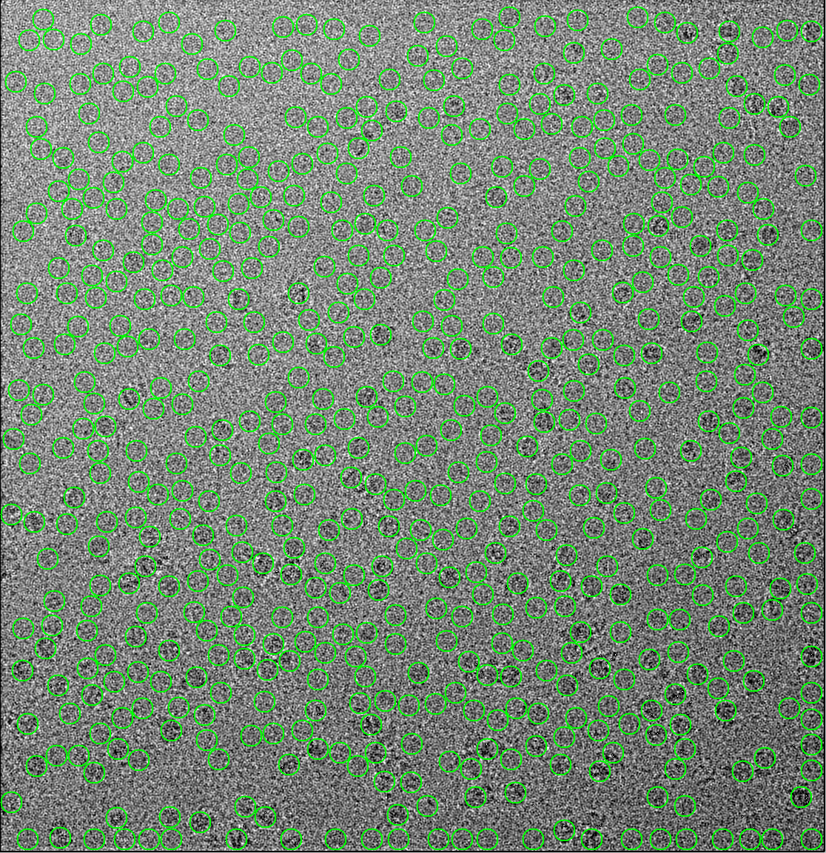
Indiscriminate Laplacian Picker

Slide 27
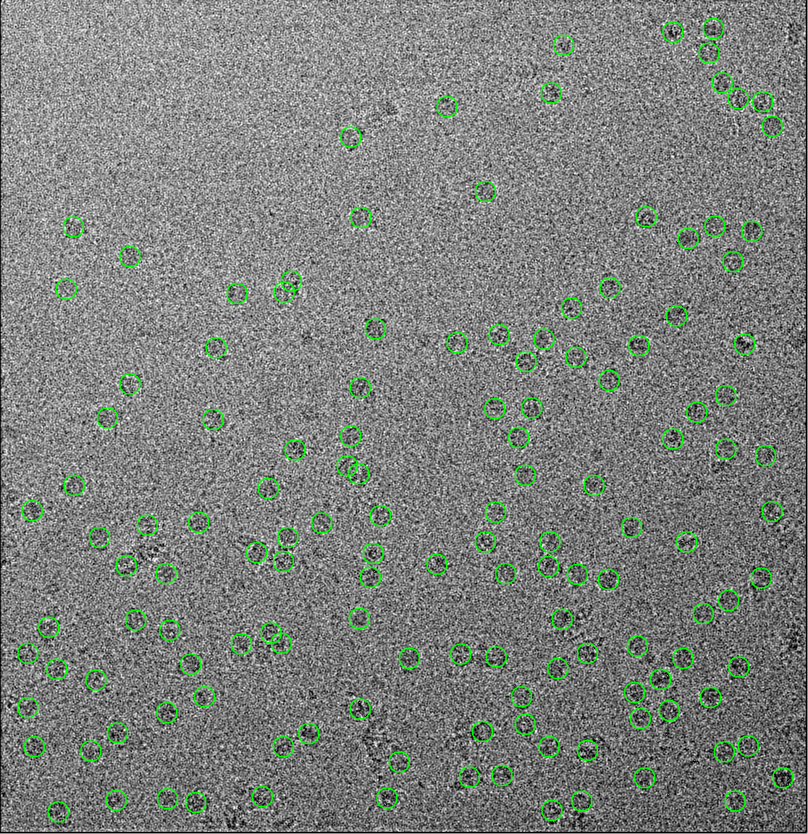
Deep Learning Picker (crYOLO)

Slide 28
Aside – Diamond Data Policy
Diamond shall use reasonable endeavours to preserve the confidentiality of Experimental Data during the Embargo Period.
After the Embargo Period, Diamond may make Experimental Data available on an open access basis under a CC-BY-4.0 licence.

Slide 29
Aside – Diamond Data Policy
Subject to the section 'Where and how long with the Experimental Data be stored' above, during the Embargo Period (3 years from the date on which the User Generated Data is produced at Diamond), access to the Experimental Data will be restricted to the Experimental Team, and Diamond Employees and authorised Diamond service providers, for support and other facility related purposes.

Slide 30
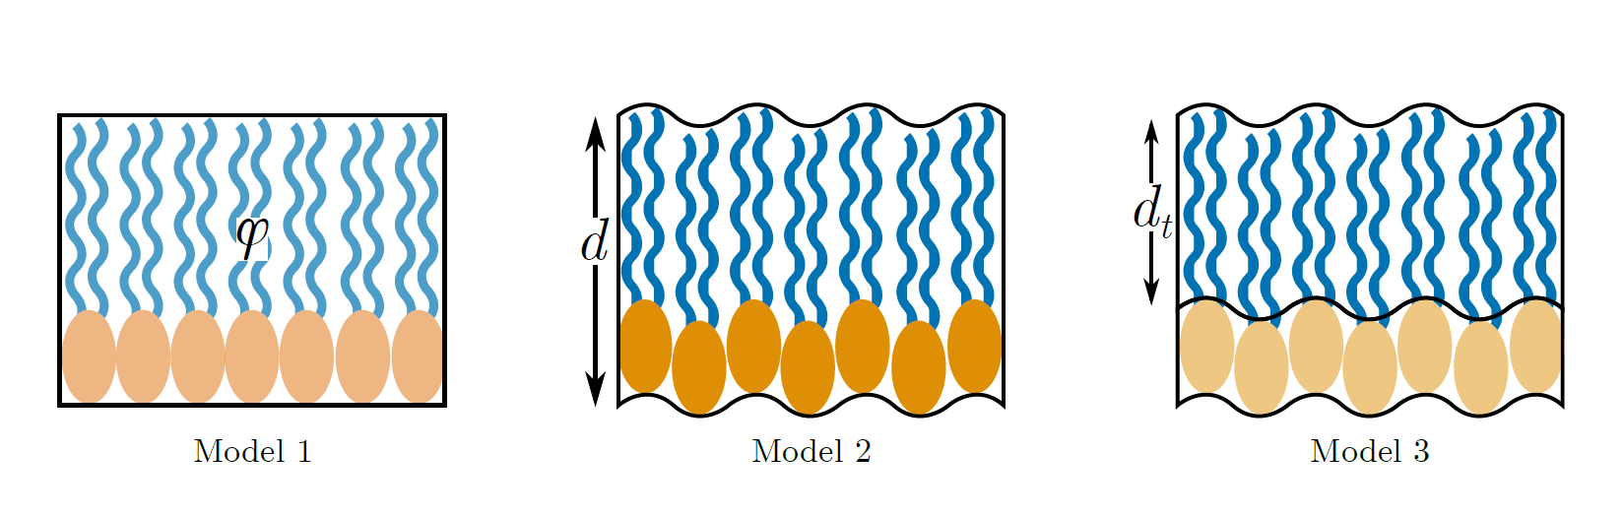
Bayesian Model Selection to guide analysis of Reflectometry
McCluskey, Andrew; Arnold, Tom; Cooper, Joshaniel F. K.; Snow, Tim (2019): Using Bayesian Model Selection to Advise Neutron Reflectometry Analysis from Langmuir-Blodgett Monolayers. ChemRxiv. Preprint. https://doi.org/10.26434/chemrxiv.10028978.v1

Slide 31
Aside – Groups and NeXuS
The inaugural meeting of what has now become ORSO (Open Reflectivity Standards Organisation) took place at the end of October.
Formats, NeXus is there for use, and although not necessarily a nice format for human users, its great for the machines!

Slide 32
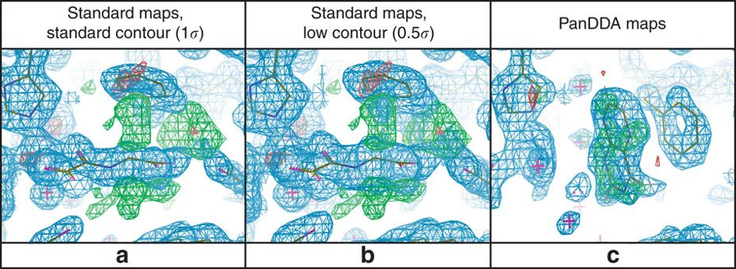
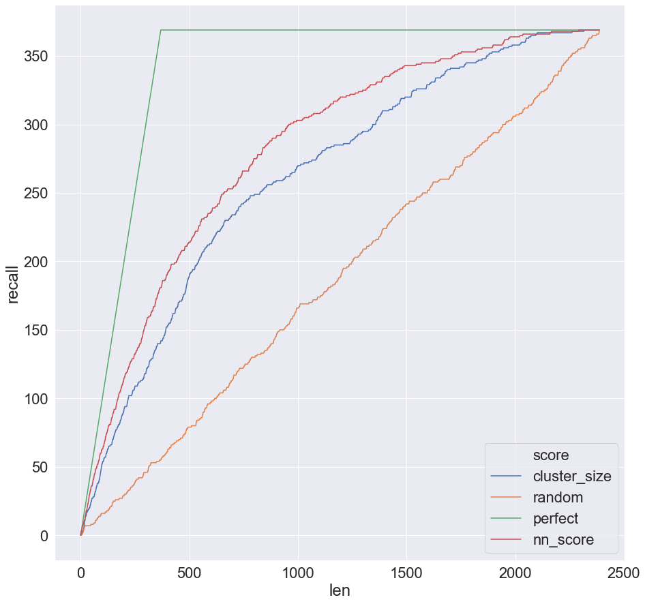
Convolutional neural networks outperform PanDDA for event ranking
Less wasted time with researchers looking at bad events
Mean map (location)
Hit
Z map (scale)
Neural Network
Event map (observation)
Not hit
Preliminary evidence this finds hits scientists missed
Patric Collins, Current work with I02-1
Pearce, N., Krojer, T., Bradley, A. et al. A multi-crystal method for extracting obscured crystallographic states from conventionally uninterpretable electron density. Nat Commun 8, 15123 (2017) doi:10.1038/ncomms15123

Slide 33


Melanie Vollmar – VMXm
12/11/2019 – 17:40
Title: Machine Learning and Artificial Intelligence in MX
Predicting experimental phasing and molecular replacement success – shallow learning
Identifying traceable/buildable electron density maps from experimental phasing – cNN
Due November/December 2019:
Vollmar, M., Parkhurst, J. M., Jaques, D., Baslé, A., Murshudov, G. N., Waterman, D. and Evans, G. (2019) IUCrJ, The predictive power of data processing statistics, submitted

Slide 34
Future

Slide 35
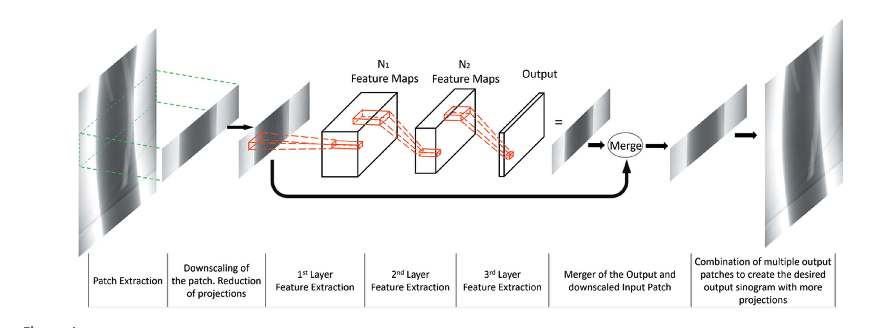
Custom trained U-Net for infilling data
Bellos, Dimitrios, et al. "A convolutional neural network for fast upsampling of undersampled tomograms in X-ray CT time-series using a representative highly sampled tomogram." Journal of synchrotron radiation 26.3 (2019).
Bellos, Dimitrios, et al. BMVC 2019

Slide 36
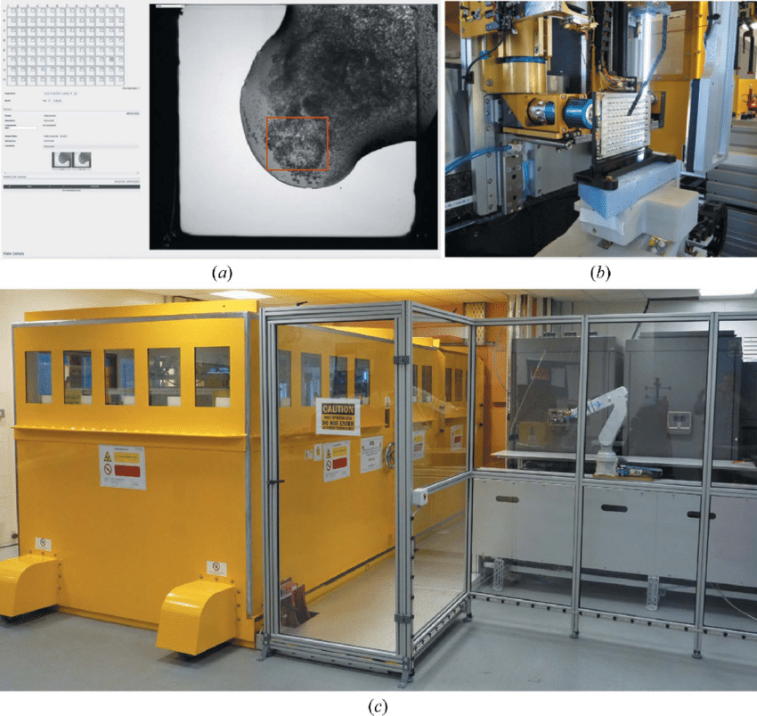

Marco for Crystal Identification on VMXi
Olly King, Data Analysis Group

Slide 37
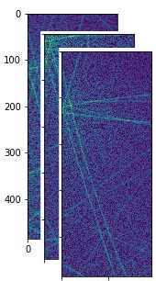
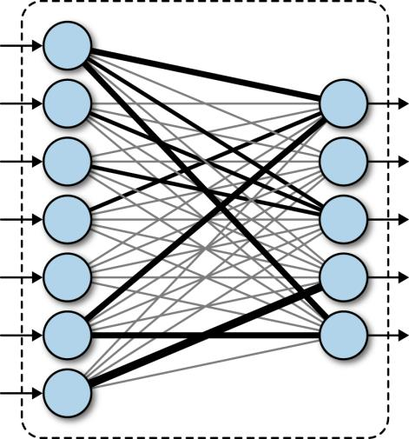
CNNs for Diffuse Multiple scattering
Trained from 250,000+ simulated patterns
Feature maps
32@486x194
Feature maps
64@242x96
Fully connected
Layers
Identify lattices
present
3x3 kernel
3x3 kernel
16 nodes
8 nodes
Gareth Nesbit, Keith Butler - arxiv.org/abs/1910.07631

Slide 38
Back to the data problem?

Slide 39
Back to the data problem?
“Just rent an army!”*
T. Hey - 12-11-2019
*Probbable misquote

Slide 40
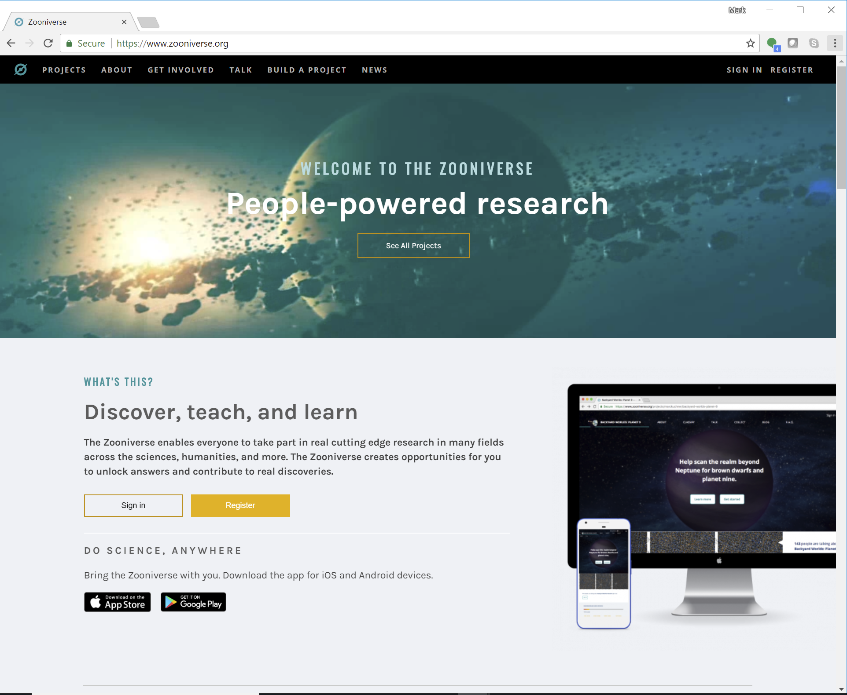
Zooniverse!
www.zooniverse.org

Slide 41
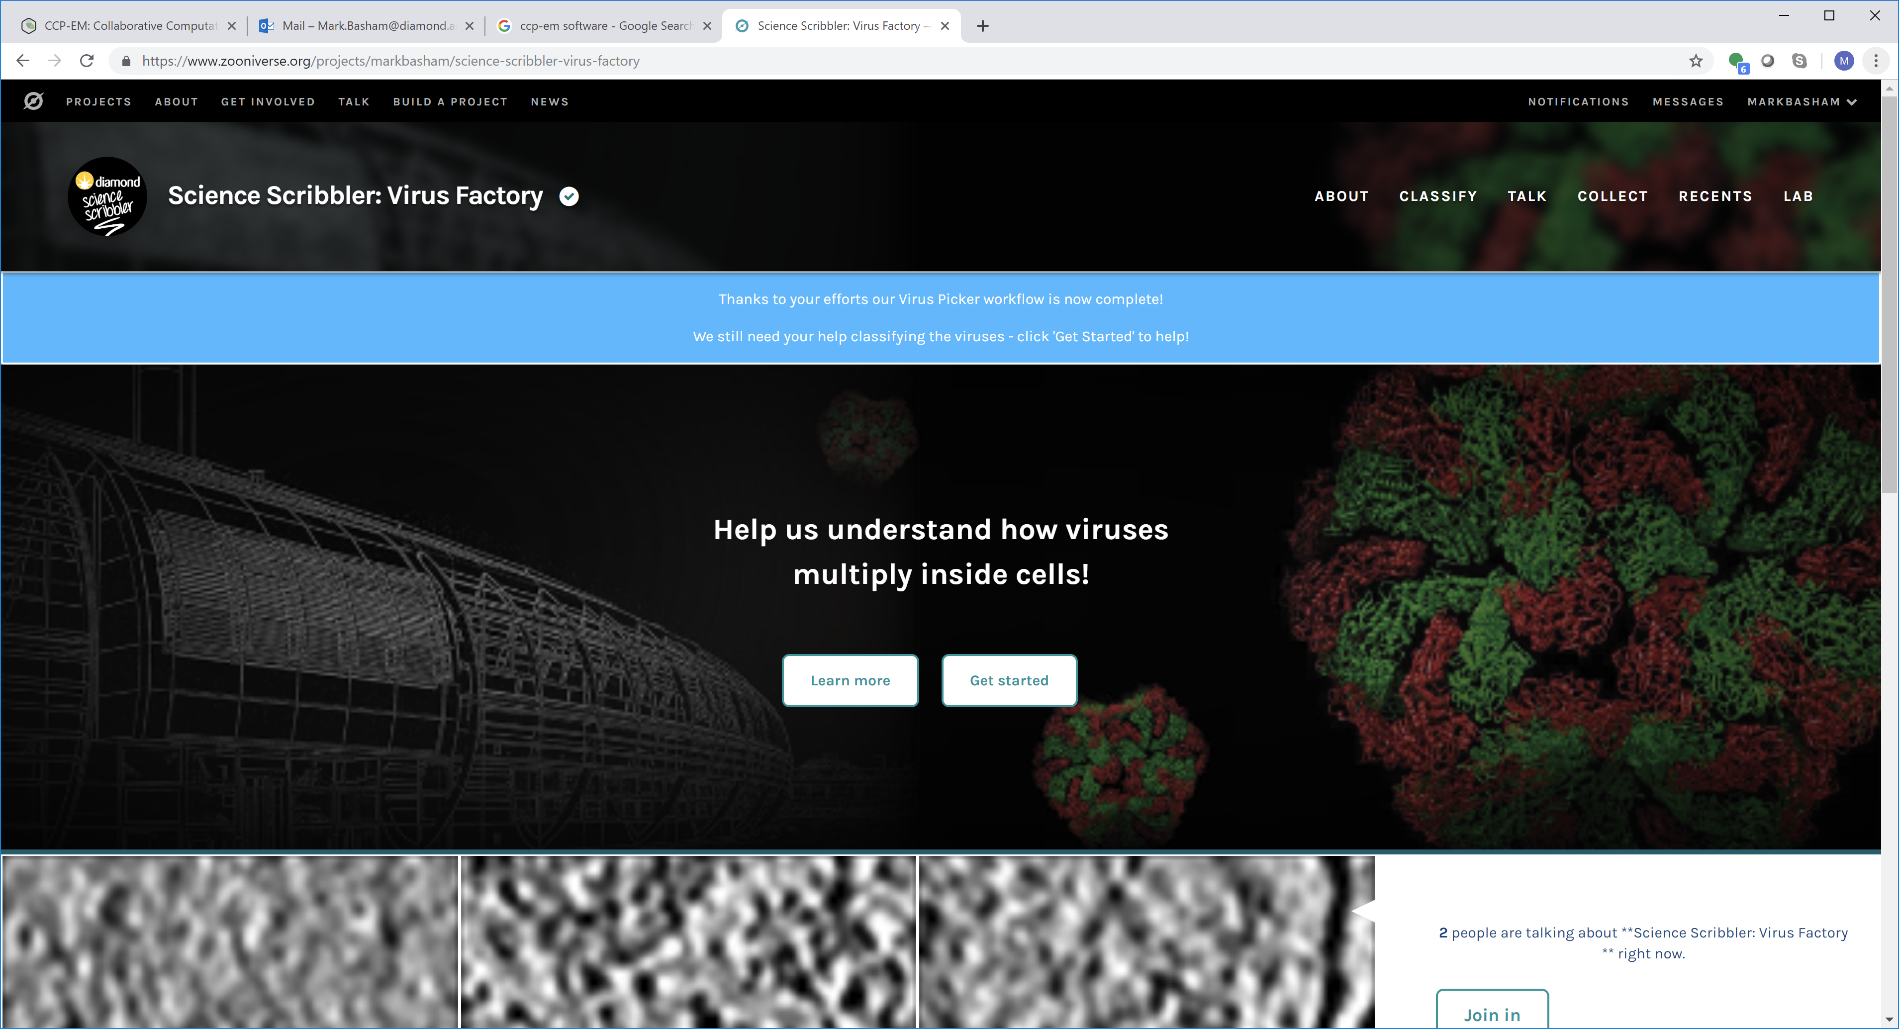
Science Scribbler
Olly King, Avery Pennington, Win Tun : Data Analysis Group
https://www.zooniverse.org/projects/msbrhonclif/science-scribbler

Slide 42
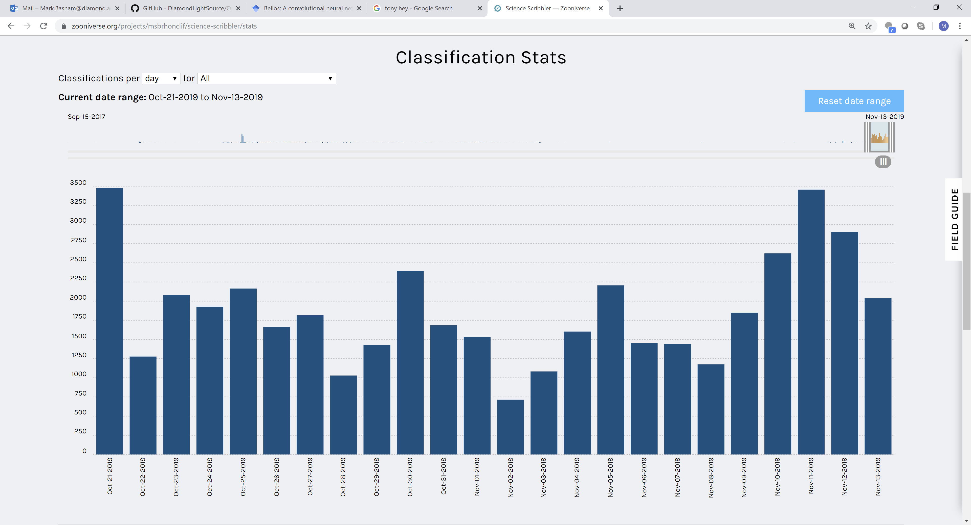
Science Scribbler

Slide 43
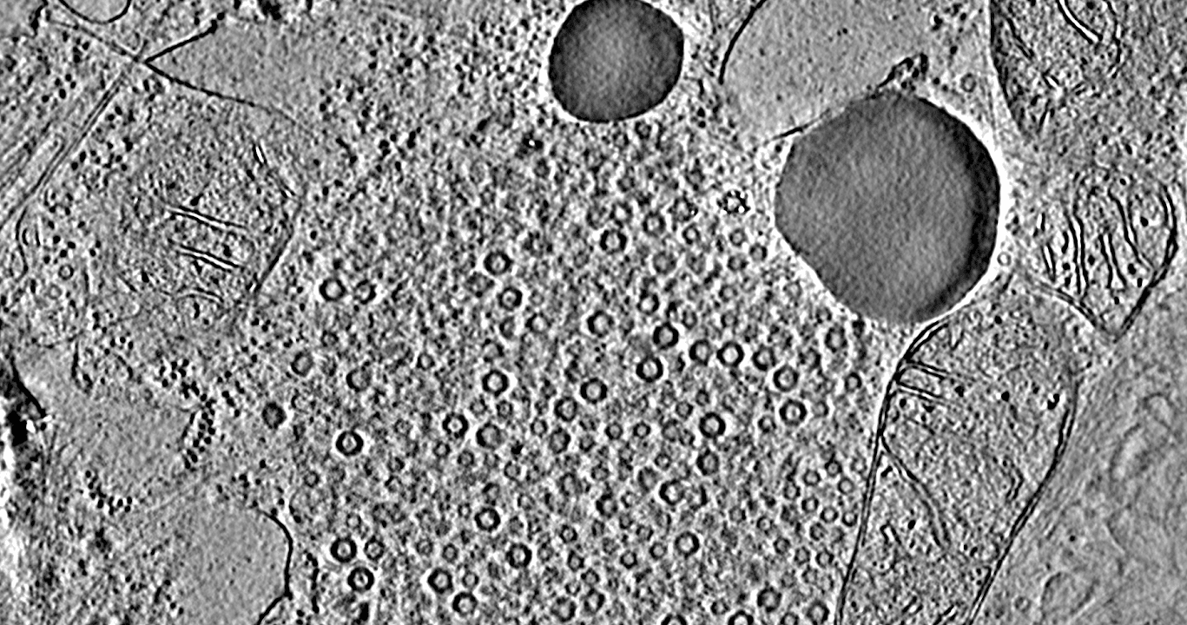
The public are untrained. (No Free Lunch)

Slide 44
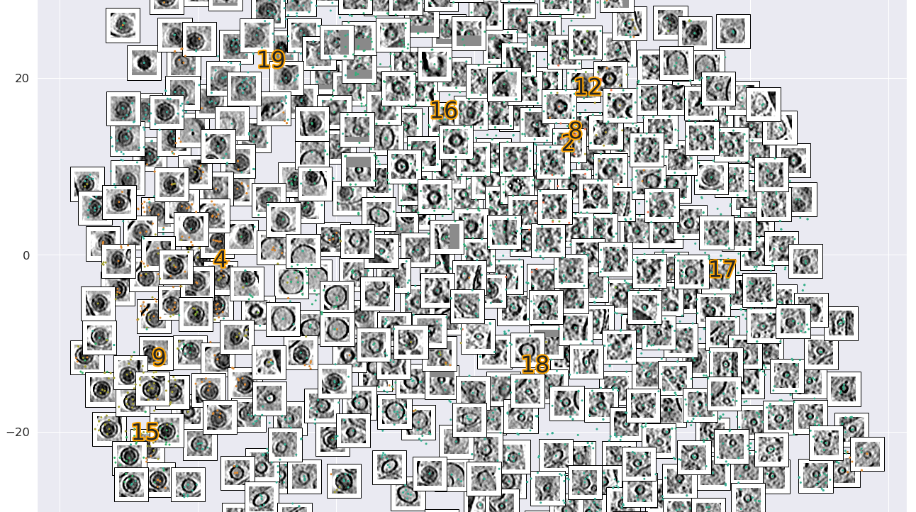
Unsupervised cluster with Deep features
Avery Pennington: Data Analysis Group

Slide 45
Expert Labeling

Slide 46
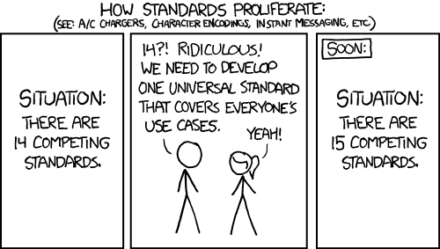
Conclusions
There are lots of exciting opportunities, and larger and faster data collections at facilities and labs are driving the increased necessity for realising these opportunities.
Collaboration is really key to bring the right people together
Data is critical, and there are already ways to make this better but they do cost effort.

Slide 47
Thank You
mark.basham@diamond.ac.uk

