Slide 1
Deriving the big picture from huge spatial datasets: How to make a little training data go a long way
  Joel Saltz MD, PhD
  Chair and Professor Department of Biomedical Informatics
  Director Center for Engineering Driven Medicine
  Professor Department of Pathology
  Cherith Endowed Chair
  Stony Brook University
  Artificial Intelligence Workshop
  November 12-14 2019

Slide 2
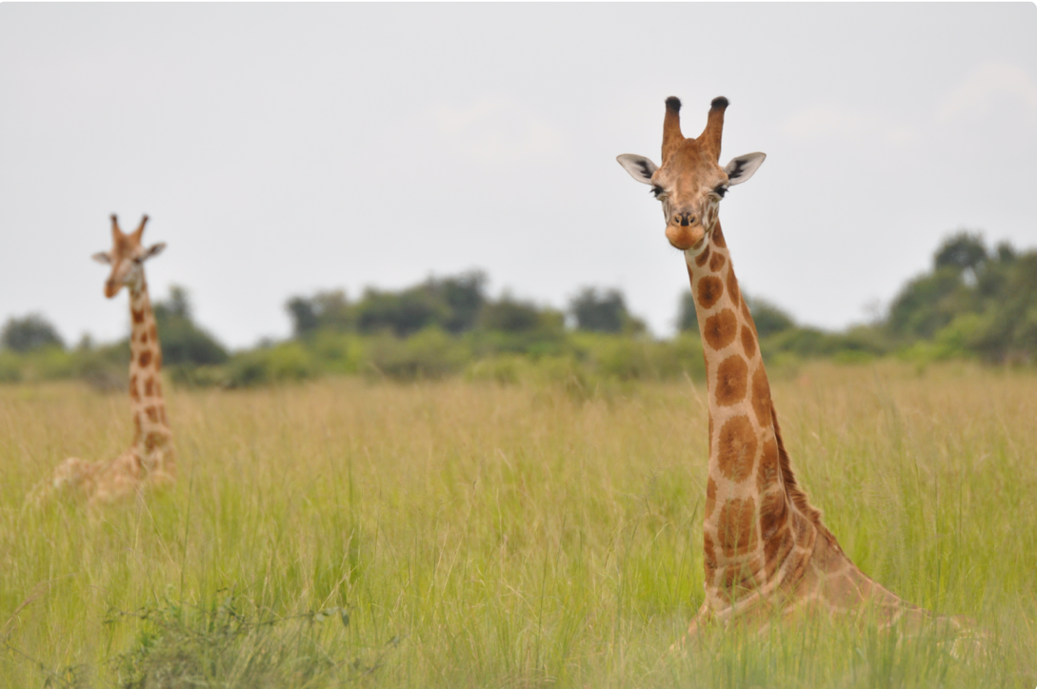
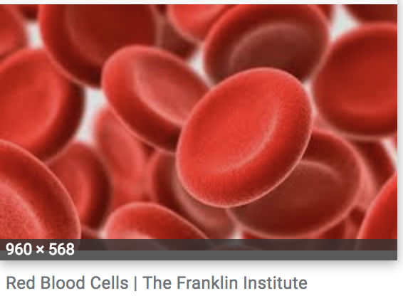
Quiz: AI related ratio = height giraffe/diameter RBC
vs

Slide 3
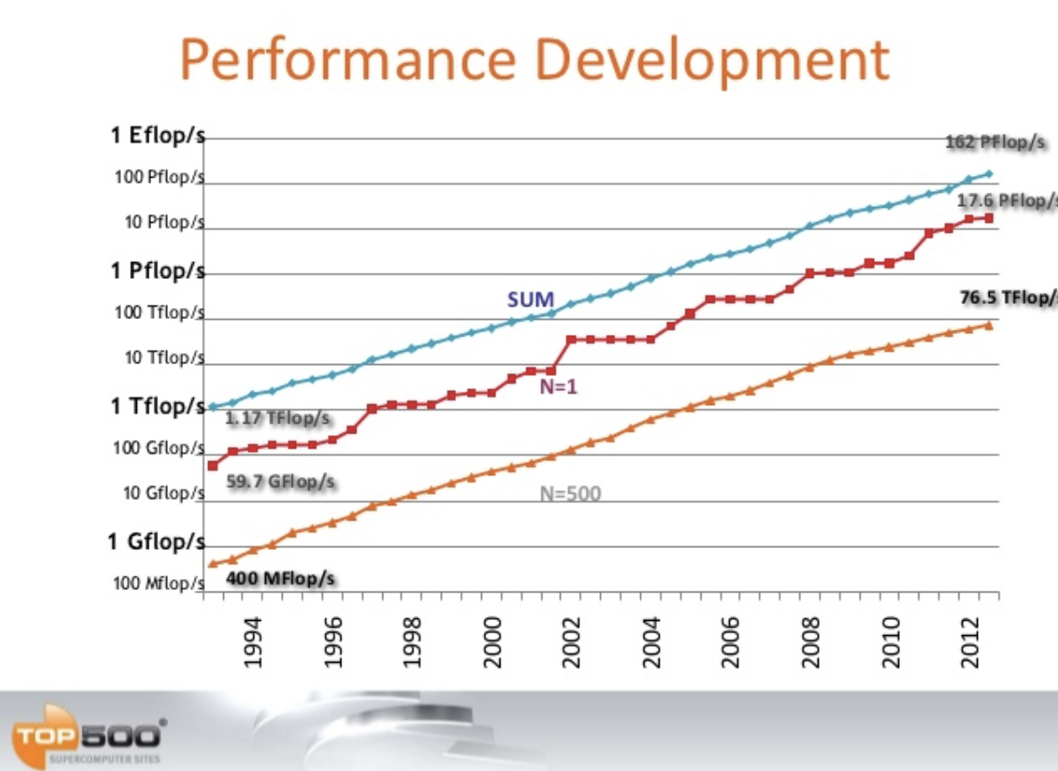

25 Years
Answer: Worlds fastest supercomputer 2019/Worlds fastest supercomputer 1994
Jack Dongarra

Slide 4
Artificial Intelligence and Pathology

Slide 5
Artificial Intelligence and Pathology
Classify: Generate human classifications corresponding to each image – examples - Gleason Group, Glioma, NSCLC classifications
Find and Assign Label: Identify, classify and spatially characterize objects – cell nuclei, tumor regions, tissue infiltrated with lymphocytes

Slide 6
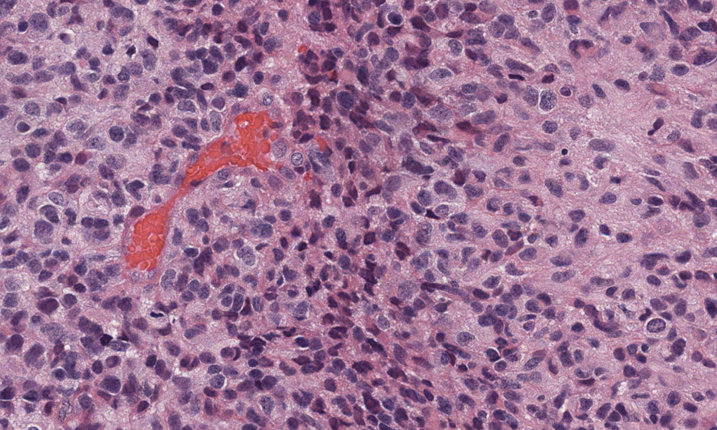
Pathology Image

Slide 7
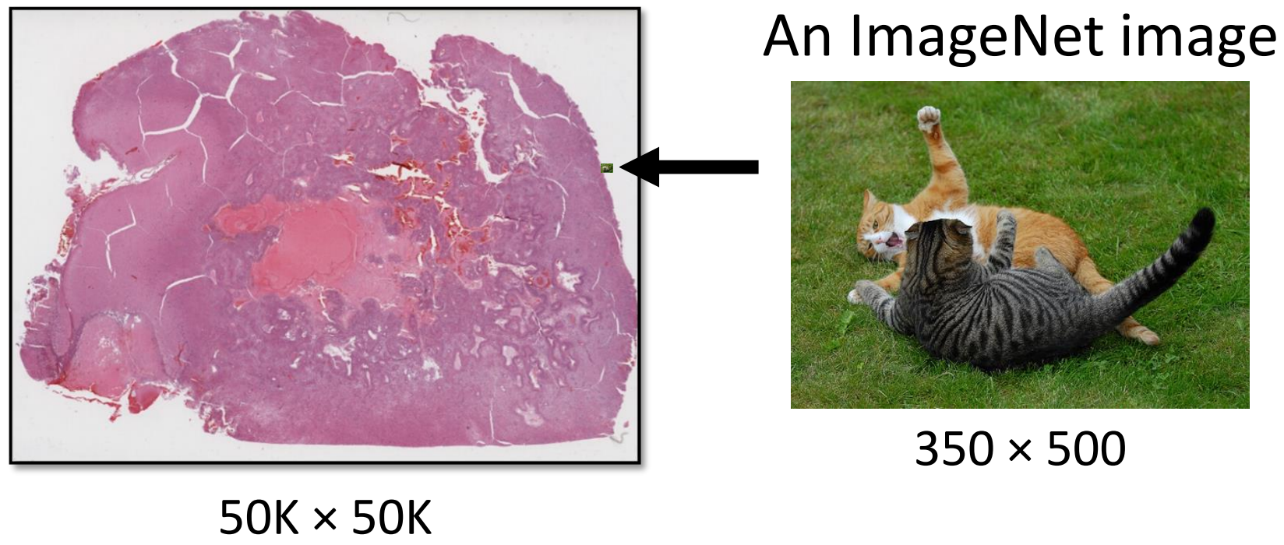
Whole Slides are Large

Slide 8
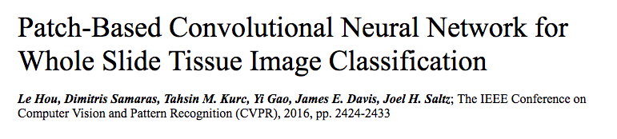
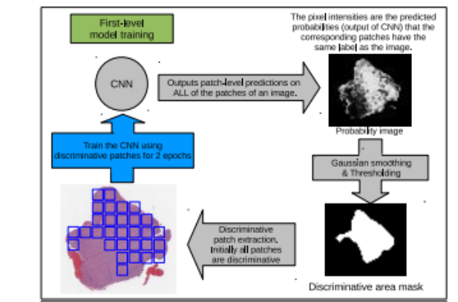
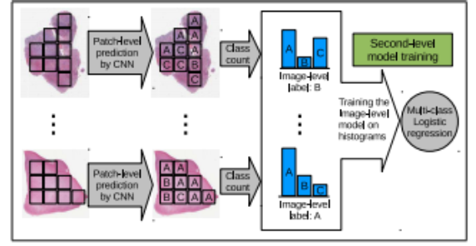
Whole slide Pathologist classifications are used for training

Slide 9
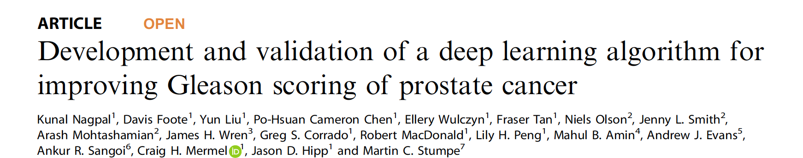
Markups from 912 slides - 900 pathologist hours to annotate
Gleason Grade Group and region level Gleason Pattern annotations
Validation dataset: 331 slides from 331 patients. Three Pathologists reviewed + followed by GU expert

Slide 10
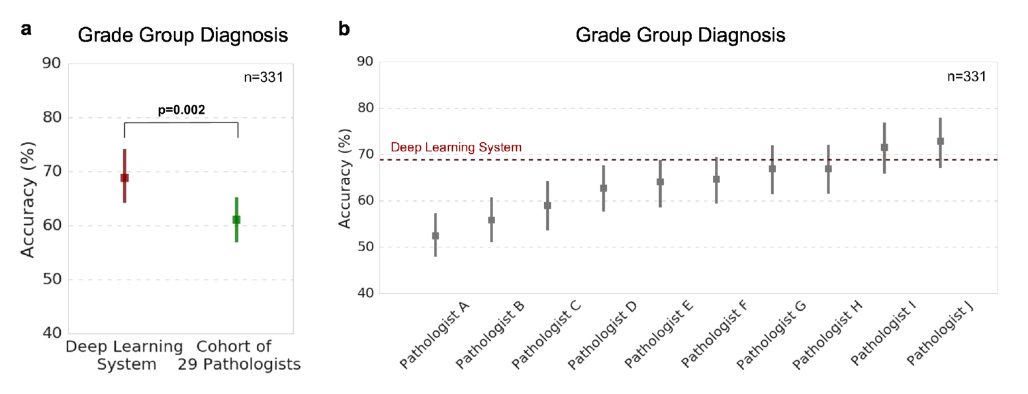
Inter-observer variability and Digital Pathology Classification

Slide 11
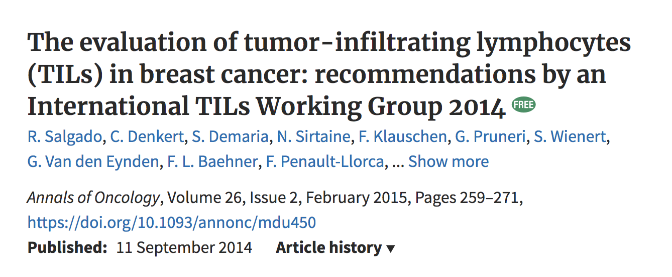
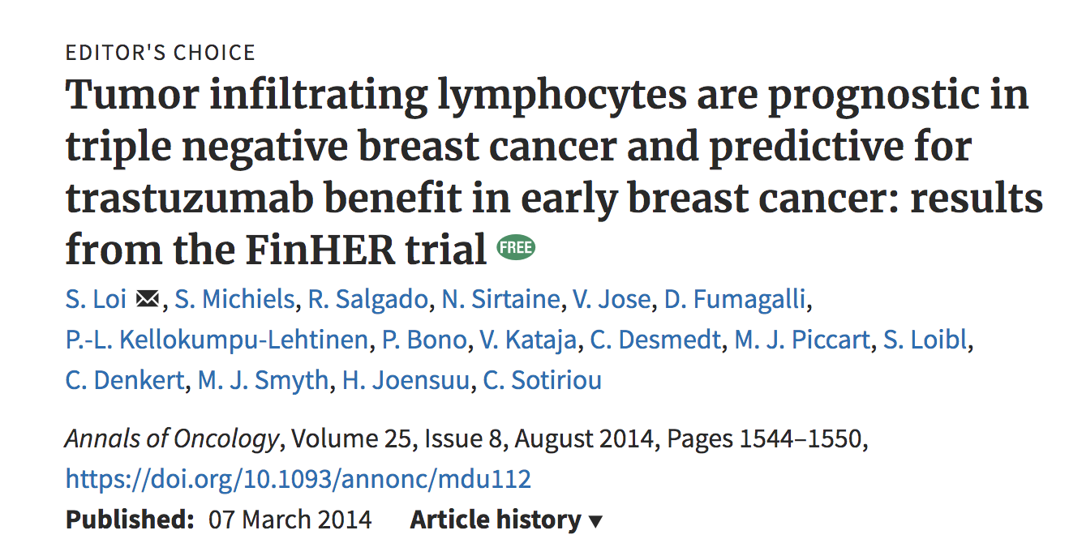
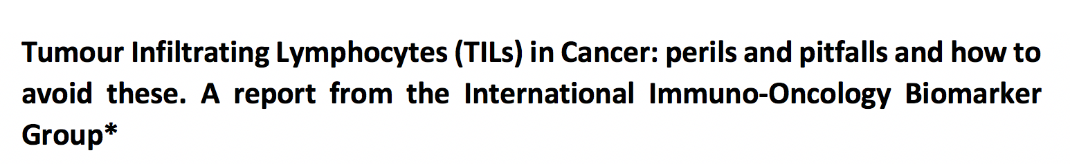
Active ongoing collaborations with Immuno-Oncology Biomarker Group and FDA

Slide 12
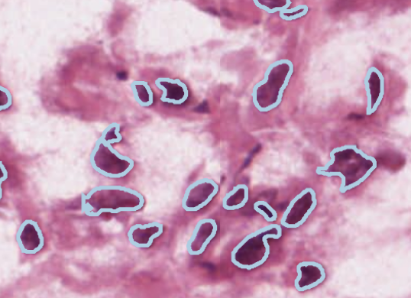
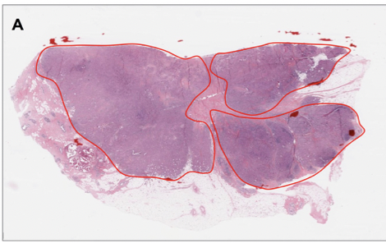
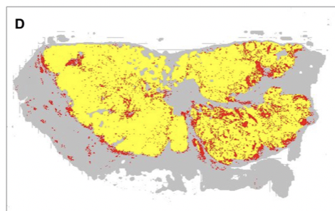
Find and Assign Label:
Tissue Characterization for every patient
Every diagnostic WSI contains vast amounts of information
Tumor. TILs and cells

Slide 13
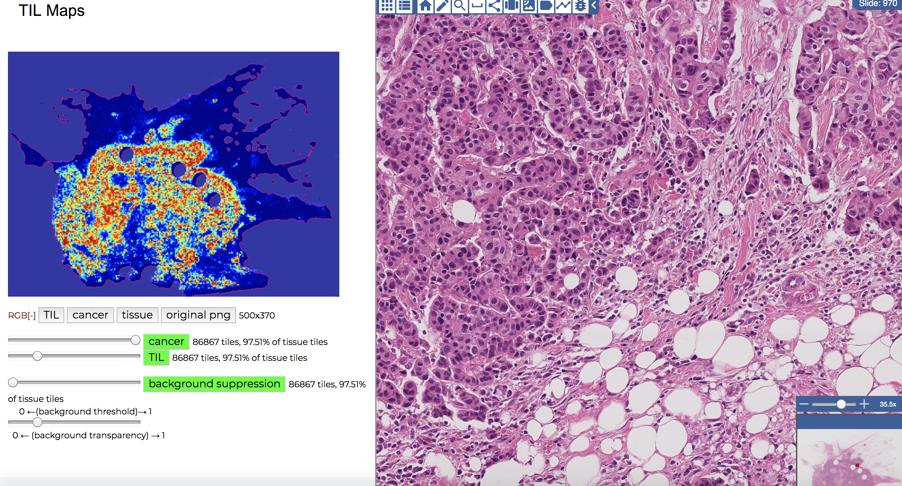
Can select portion of TIL map and zoom into corresponding region of whole slide image

Slide 14
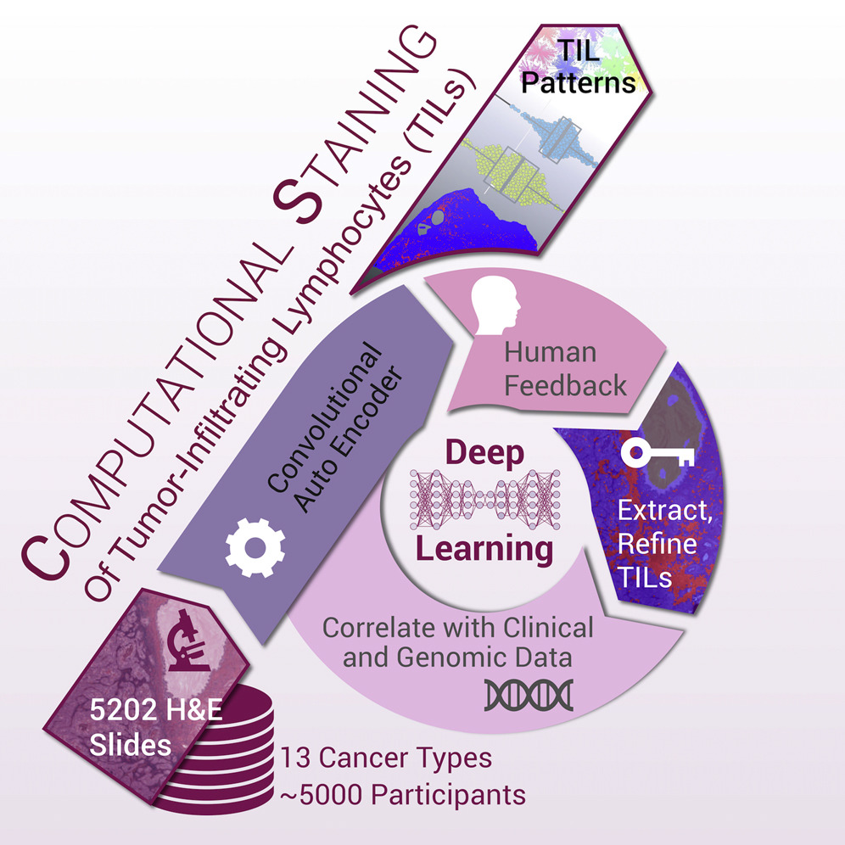
Deep learning based computational stain for staining tumor infiltrating lymphocytes (TILs)
TIL patterns generated from 4,759 TCGA subjects (5,202 H&E slides), 13 cancer types
Computationally stained TILs correlate with pathologist eye and molecular estimates
TIL patterns linked to tumor and immune molecular features, cancer type, and outcome
Spatial organization and molecular correlation of tumor-infiltrating lymphocytes
using deep learning on pathology images. Saltz et al, Cell reports 2018
The immune landscape of cancer. Thorsson et al, Cell Immunity 2018

Slide 15
Methods and tools for integrating pathomics data into cancer registries
Saltz, Sharma, Foran and Durban
Tissue stained with Hematoxylin and Eosin (H&E), slides created for virtually all cancer patients
Pathologist reports describe findings
Pathomics quantitatively characterize cells and tissue
Pathomic features include spatial characterization of tumor and stroma; shapes, textures of nuclei; classifications of cell type and quantitative characterization of lymphocytic infiltration
Potential for Deep Biological Cancer insights gathered from existing specimens for all SEER cancer patients

Slide 16
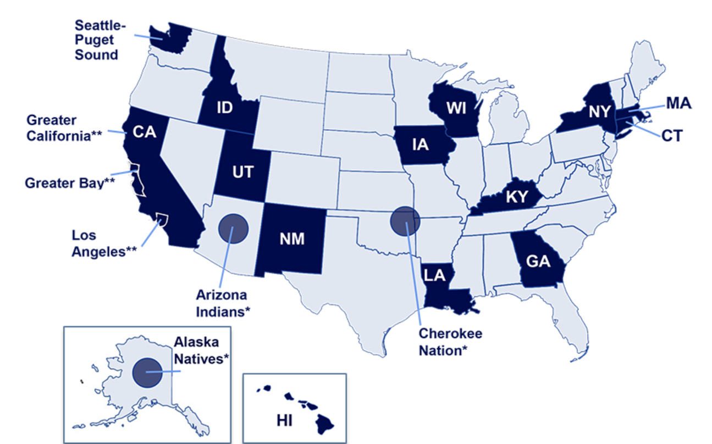
Computable Cancer Phenotype Information from Whole Slide Images
Enhance SEER registry data with Pathomics
The New Jersey State Cancer Registry, Georgia and Kentucky State Cancer Registries
Prostate Cancer, Lymphoma and NSCLC
Creation of population cohorts containing linked Pathomics and clinical attributes
Response to checkpoint inhibitor therapy

Slide 17
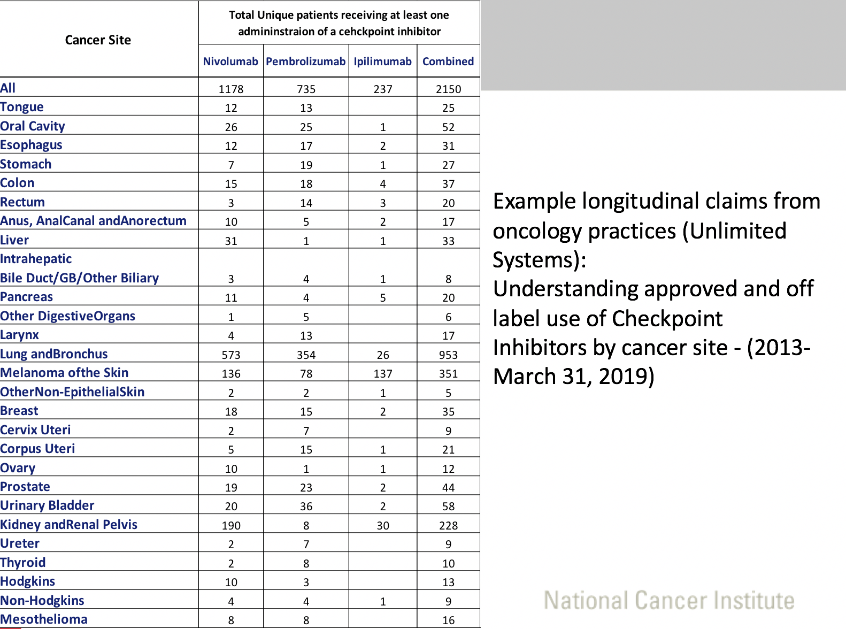
Value of Pathomics
Treatment and clinical course by linked claims data
Real World Study: Tumor immune map for each patient
Lynne Penberthy, NCI

Slide 18
Virtual Tissue Repository (VTR)
Collaboration between SEER, NCI CBIIT, Emory and Stony Brook
Problem:
  Current tissue-based research often performed on limited population enrolled in clinical trials
Objectives:
  Provide infrastructure for tissue & data collection on a population level
  Enable use of community-based tissue specimens for biomedical research

Slide 19
SEER-Linked Virtual Bio-Repository: Benefits
Population based – permitting comparison of subsets
Available across a broad spectrum of healthcare facilities/pathology labs (not just academic centers)
Access to rare cancers & exceptional outcomes
Linked to long-term outcomes
Existing annotation with clinical & demographic data
Potential for custom annotation
Renewable with > 450,000 incident cases annually

Slide 20
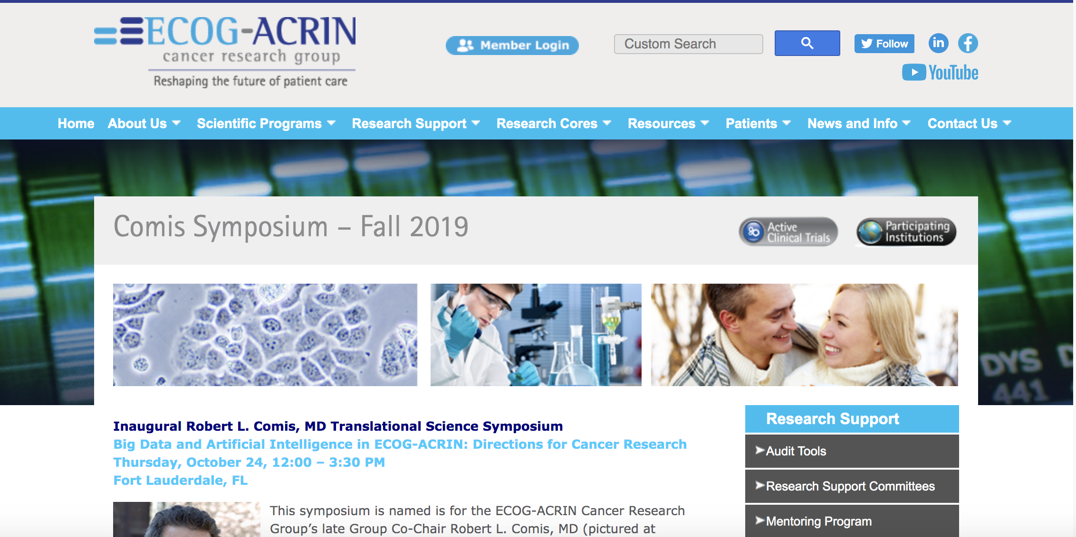

Slide 21
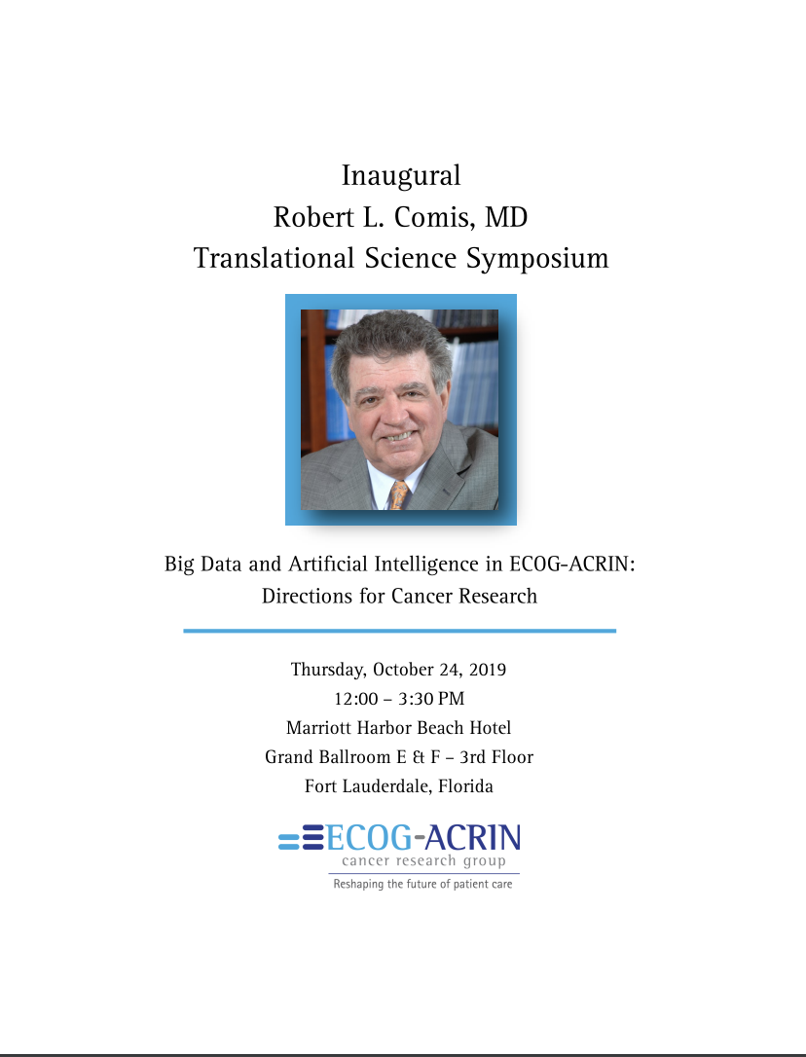

Slide 22
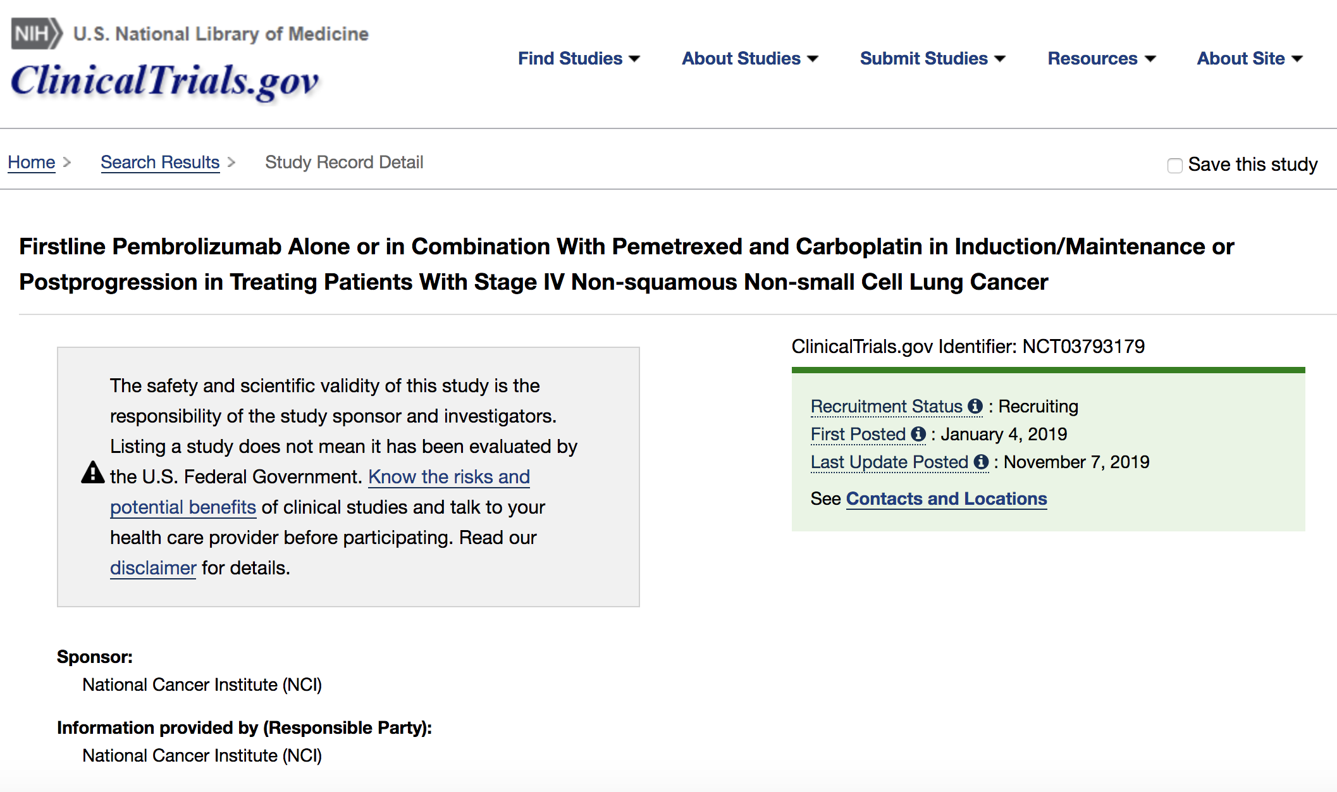

Slide 23
ECOG-ACRIN
Pathomics analyses for planned, accruing and legacy studies
Examples:
  Tumor/TIL
  Nuanced Pathology subtyping
  Reduce inter-observer variability in studies
ECOG-ACRIN – carry out statistical characterization of impact of inter-observer variability on study results!

Slide 24
Analogous Application Domains

Slide 25
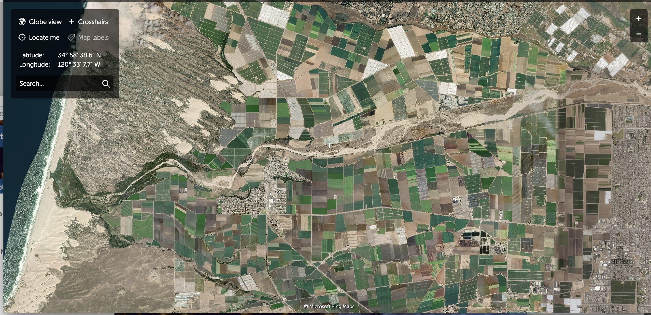
Satellite Sensor Data

Slide 26
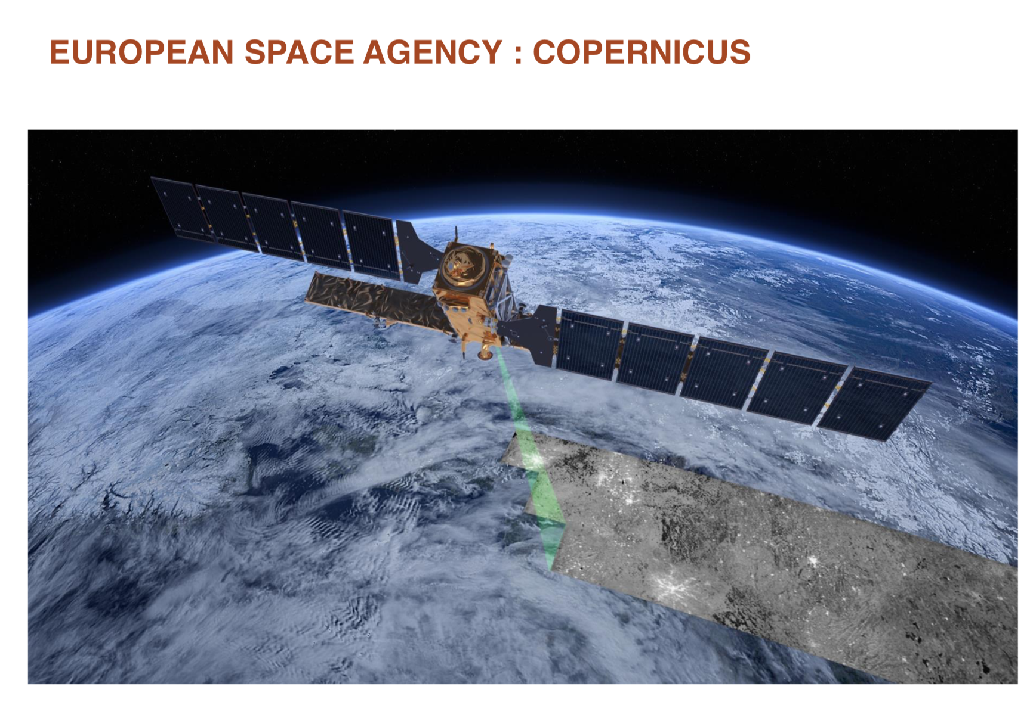
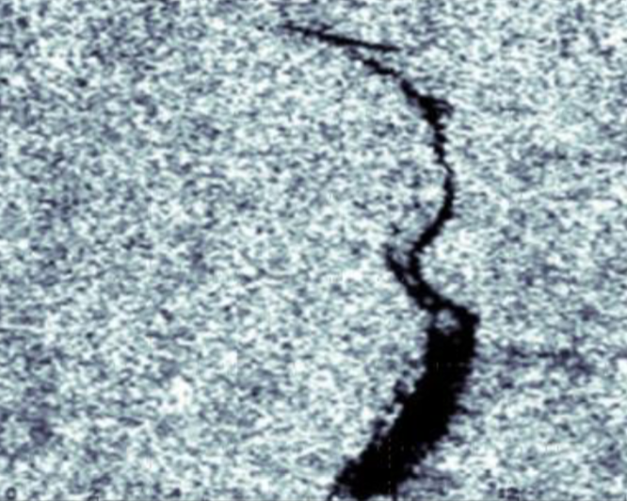
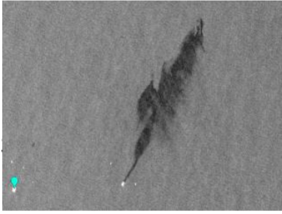
Detection of oil leaks and spills (Serge Petiton from U. de Lille and TOTAL)

Slide 27
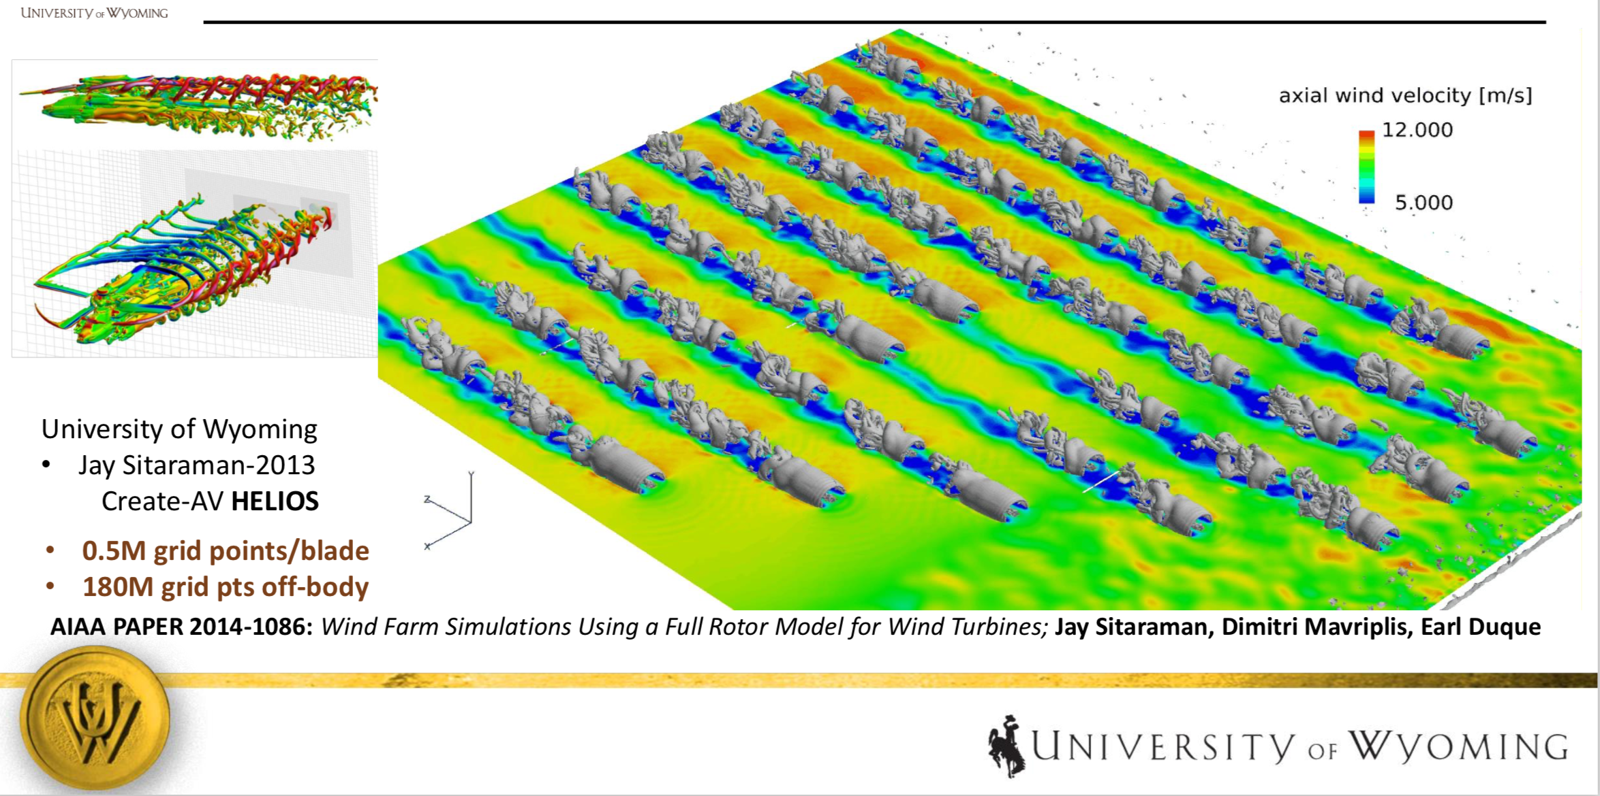
Wind Farm Simulation – Dimitri Mavriplis

Slide 28
The importance of leverage in Training

Slide 29
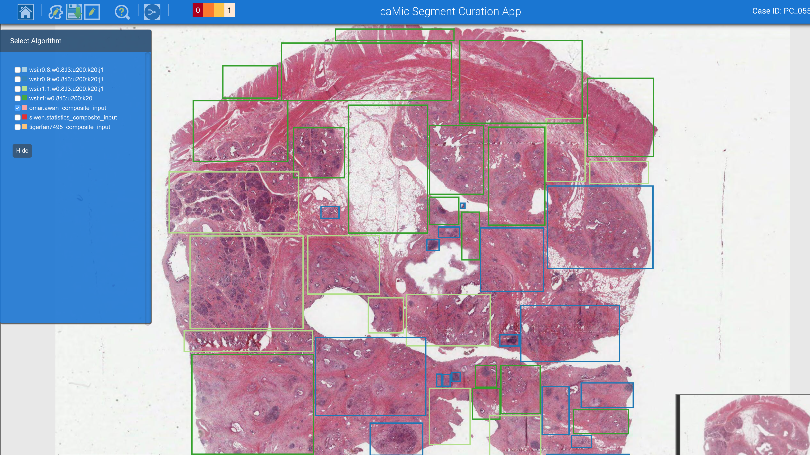
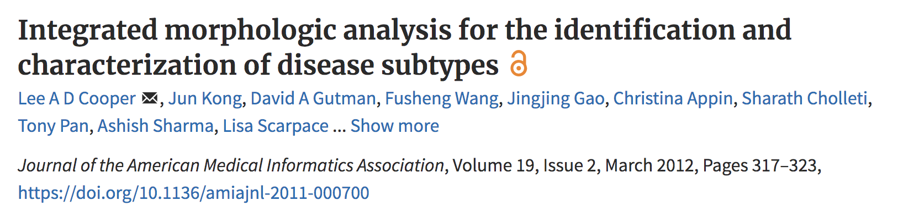
Nuclear Segmentation - Old Days – pre-2017
Curation of Segmentation Results
QuIP Segmentation Curation Web Application
  User interactively marks up regions and selects results from best analysis run for each region.
  Selections are refined through review processes supervised by an expert Pathologist
Curation of Segmentation Results

Slide 30
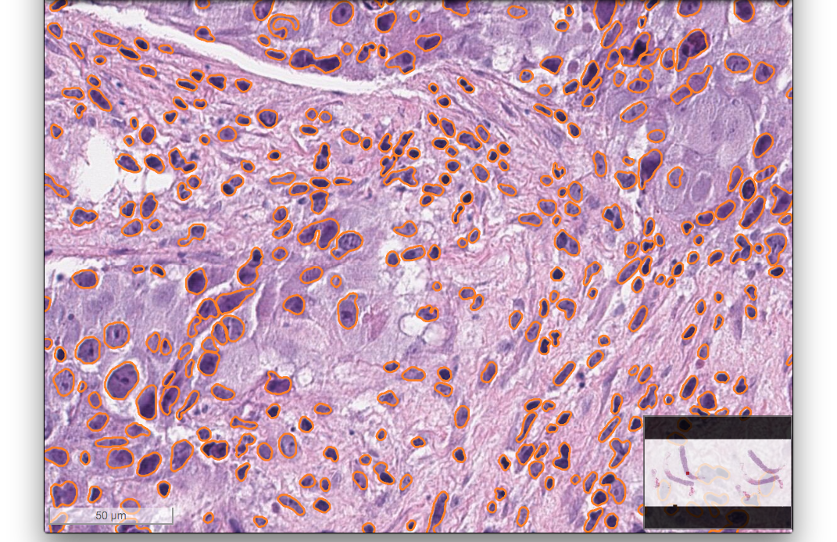
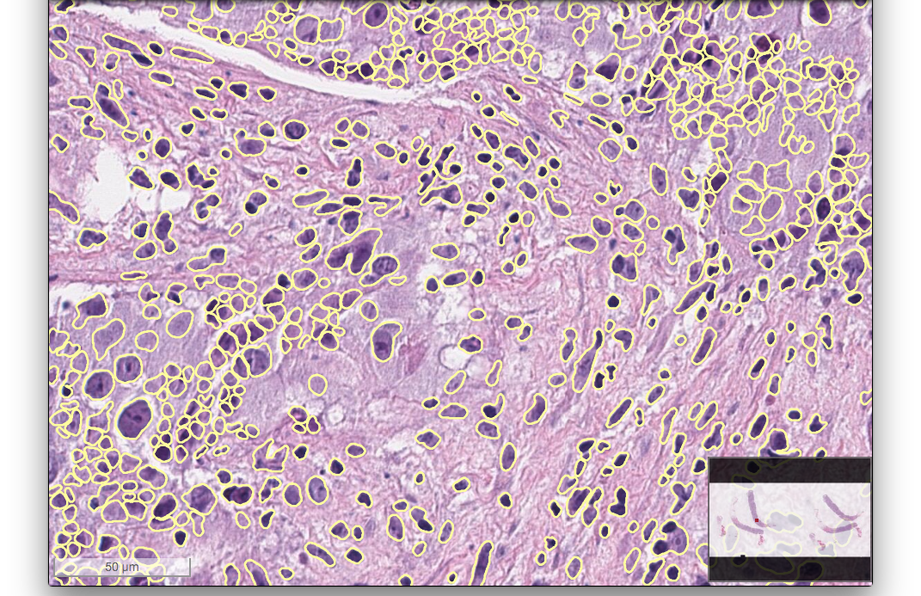
Huge Progress in Nuclear Segmentation Since 2017
Previous algorithm had many parameters. Required manual adjustment or post-segmentation curation process.
Choice of parameters could lead to significantly different (and bad) segmentation results.

Slide 31
Nucleus-level Deep Learning Training: Challenges
Manual annotation is expensive:
Images are huge
Billions to trillions of nuclei per dataset
Large heterogeneity:
Years of pathology training to understand hundreds of cancer types

Slide 32
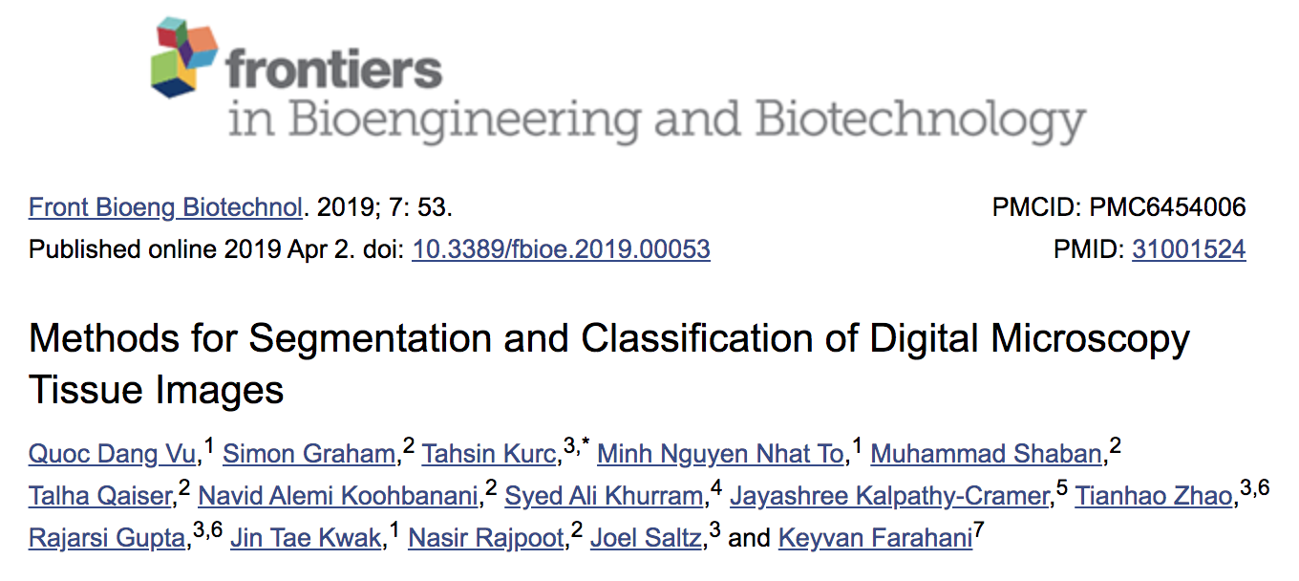
MICCAI 2017 Challenge in Imaging & Digital Pathology
Segmentation of Nuclei in Digital Pathology Images
Segmentation of nuclei in tissue images- Lung, Head and Neck, two types of brain tumor (GBM, LGG).
The training set and the test set each consisted of 32 image tiles with 8 tiles from each cancer type.

Slide 33
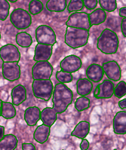
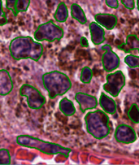
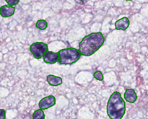
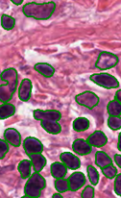
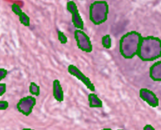
Nucleus Segmentation

Slide 34
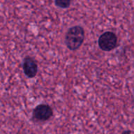
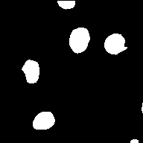
Nucleus Segmentation
CNN
Robust Histopathology Image Analysis: to Label or to Synthesize?
Hou et al., CVPR 2019

Slide 35
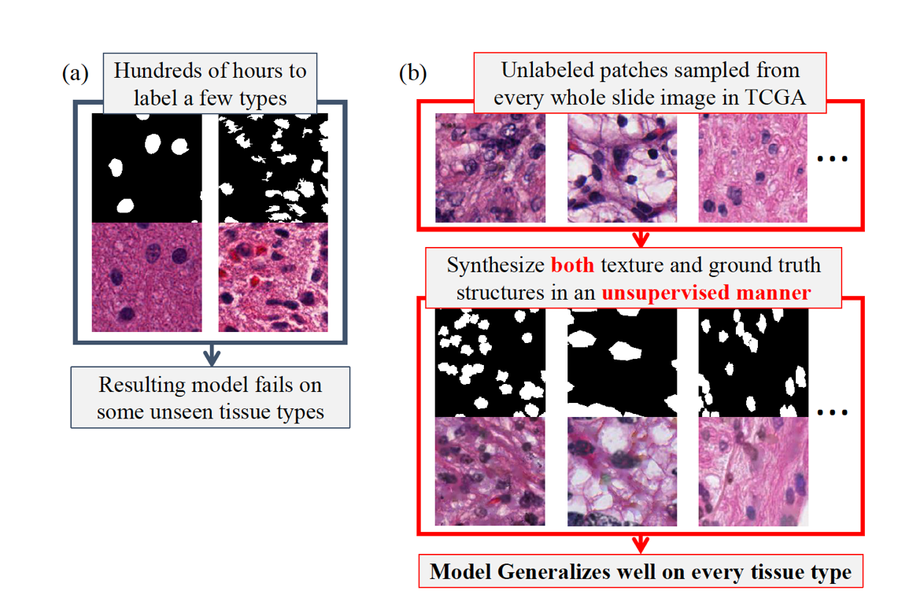


CVPR ‘19 GAN based nuclear segmentation – tissue synthesis and training augmentation
10 billion Nuclei from 13 TCGA tumor types

Slide 36

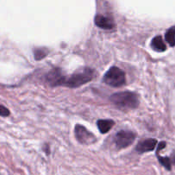
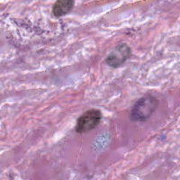
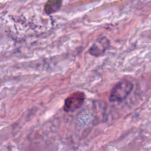
Workflow
Sample a mask, from a predefined distribution
Nuclear mask
Texture Painting
Sample weight
Segmentation CNN
Real patch of any type
0.353
Initial synthetic patch
Refined synthetic patch
GAN
Synthesis module
Segmentation learning module

Slide 37
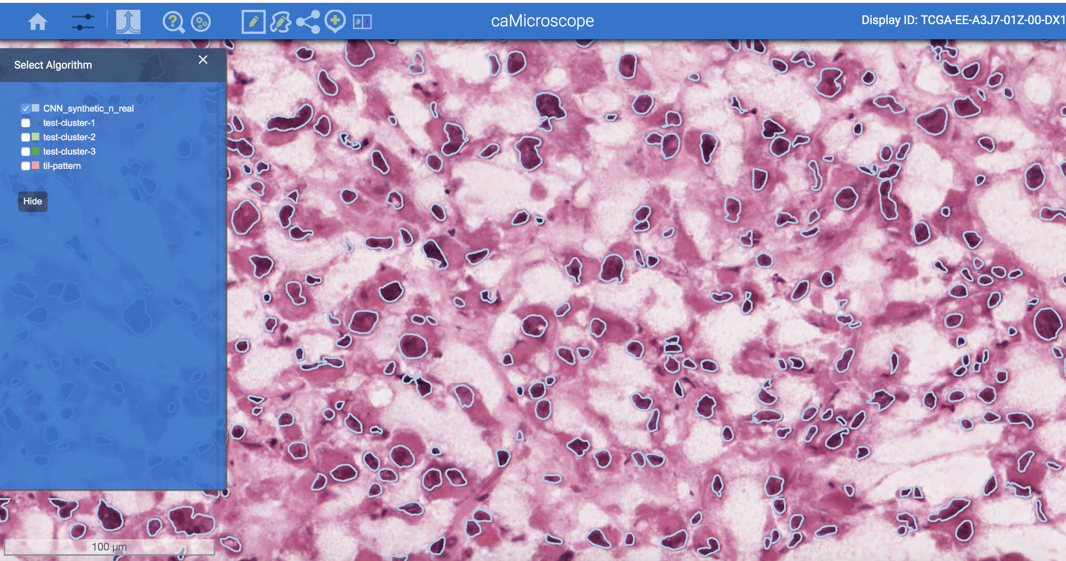

Slide 38
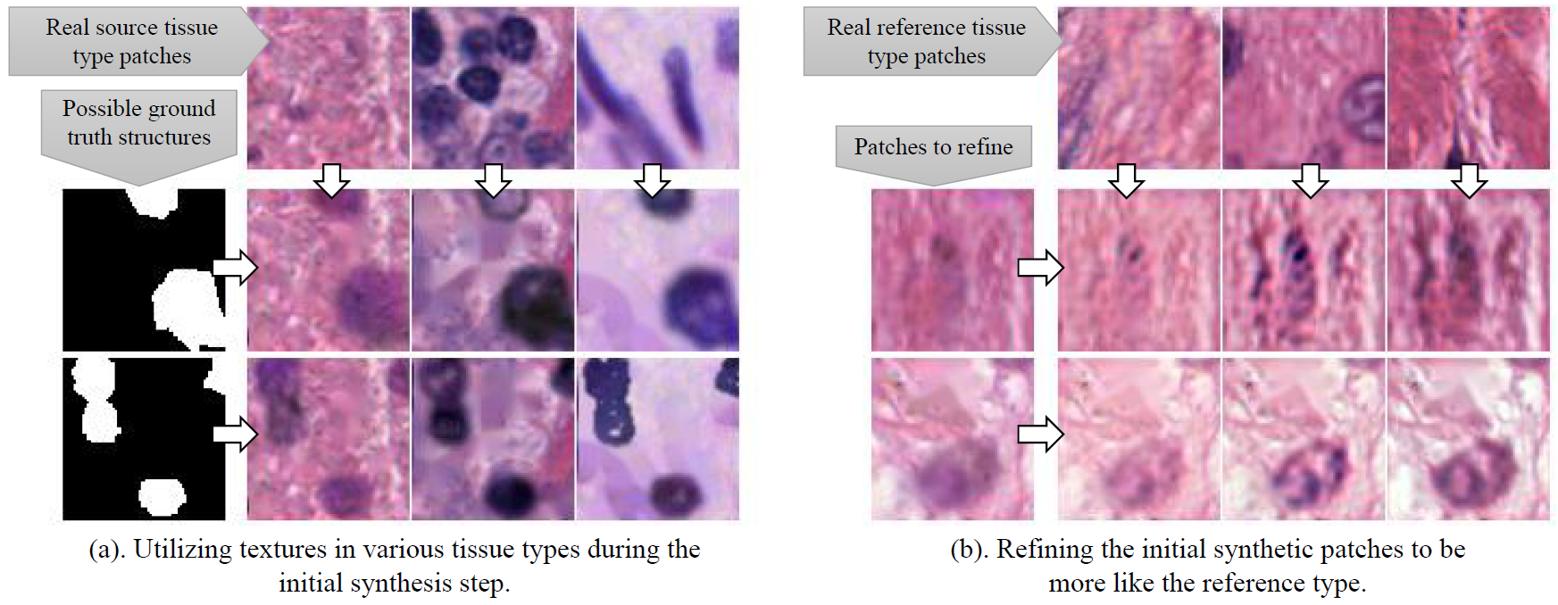
Synthesizing Different Tissue Types

Slide 39
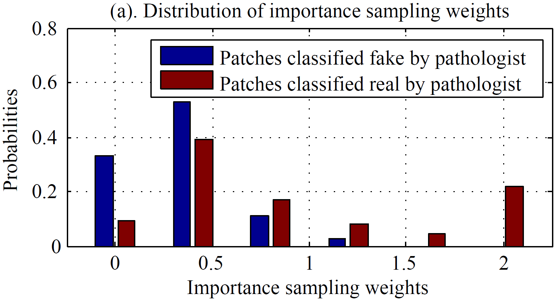
Realistic or not → useful or not
A pathologist thought 64% of the synthetic patches were real
Patches appeared real to pathologists have higher weights

Slide 40
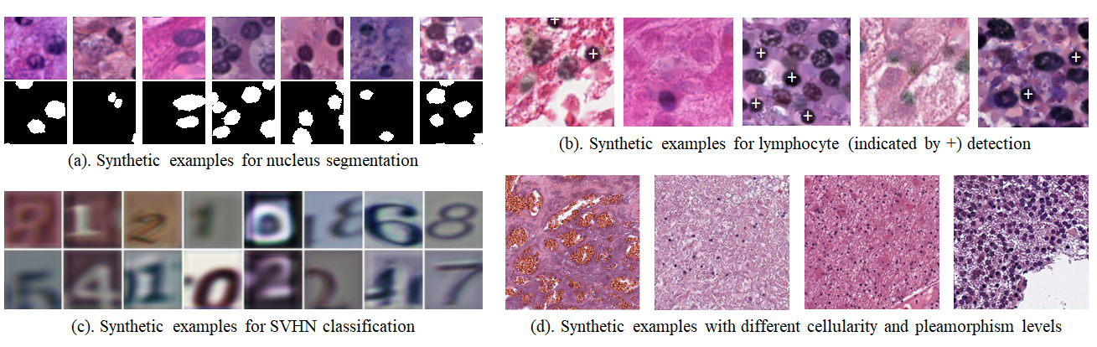
Our method is general
Image synthesis pipeline is general
The importance sampling formulation is general:
Applicable when you train on domain A but want to minimize generalization loss on domain B

Slide 41
Examples of Weights
0.15
0.31
0.69
1.18
1.63
2.54

Slide 42
Results – across cancer type generalization
Methods | DICE avg.
U-net on real labeled data | 0.8010
U-net on large-scale synthetic data | 0.8401
U-net on real + synthetic data | 0.8678
MICCAI 2018 nucleus segmentation dataset:
18 training and 18 testing patches

Slide 43
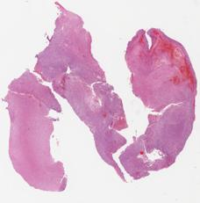

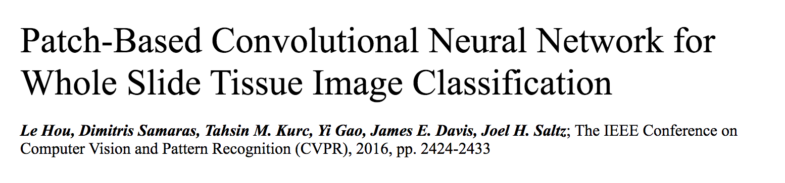
One Label per Gigapixel Image
What’s the:
Cancer Subtype?
Grade?

Slide 44


Contrast to Engineered Feature Approach
2005-2010
BISTI/NIBIB Center for Grid Enabled Image Analysis - P20 EB000591, PI Saltz
Engineered features designed to capture each component of Shimada Neuroblastoma classification

Slide 45

How to run CNNs on gigapixel images?
An ImageNet image
350 × 500
50K × 50K

Slide 46

Heterogeneity: category shared by two patches in each column

Slide 47

CNN on patches? Not all patches are discriminative.
Grade IV
Grade II
Grade II
Grade IV
Grade IV Tumor

Slide 48
An Iterative Approach
Train a CNN on discriminative patches
Identify discriminative patches

Slide 49
Train a CNN with all patches
Training Patches
CNN

Slide 50


Identify discriminative patches
Training Patches
CNN
Smoothed probability map
Discriminative Patch Identification

Slide 51
EM Formulation
Training Patches
CNN
Expectation Maximization
M-step
E-step
Smoothed probability map
Discriminative Patch Identification

Slide 52
From Patch to Image
…
Voting?
Max-pooling?
Histogram of
Patch-level Classes

Slide 53
Patch-level Prediction Fusion
…
Logistic Regression
Grade IV
Glioma
Histogram of
Patch-level Classes

Slide 54


Brain
Le Hou, Dimitris Samaras, Tahsin Kurc, Yi Gao, Liz Vanner, James Davis, Joel Saltz

Slide 55


Label super resolution
Pathology images are huge.
Manually annotating each pixel is too costly.
Ground truth labels mostly available at lower resolutions.

Slide 56

Label super resolution
Label super resolution
Label super resolution

Slide 57

Lymphocyte (a type of immune cell) segmentation given low-resolution heatmaps
High resolution label
Low resolution label

Slide 58
Lymphocyte (a type of immune cell) segmentation given low-resolution heatmaps
High resolution label
Low resolution label
Model the predicted label counts as Gaussian distribution.
KL divergence
Model the ground truth label counts as Gaussian distribution.

Slide 59

Lymphocyte (a type of immune cell) segmentation given low-resolution heatmaps

Slide 60

Specify where objects are located -> Semantic Segmentation
Input: Percent pixels in each patch belonging to a category
Output: High resolution semantic segmentation

Slide 61

Input image with low resolution labels – generates a high resolution image – “Super resolution”

Slide 62

Labels from the Multi-Resolution Land Characteristics Consortium - https://www.mrlc.gov/tools

Slide 63

Ground truth vs Super-resolution and High Resolution Models

Slide 64
Quantitative results: satellite image segmentation
Low resolution labels (30x30 meters) across the entire US:
Developed, Open Space; Barren Land; Cultivated Crops; etc.
High resolution labels (1x1 meter) on Chesapeake bay:
Water; Tree; Field; Impervious Surface.
Results of training on Maryland, test on Northern Chesapeake:
 | High resolution CNN (HR) | Label super resolution (LSR) | LSR + HR
IoU (higher better) | 0.672 | 0.820 | 0.824

Slide 65

Using Machine Learning to Critique Segmentation Results
Automatically select low & high gain values for each tissue region
Investigate machine learning algorithms:
  Random Forests
  Support Vector Machine
  Convolutional Neural Network
Investigate impact of active learning process
PhD Thesis – Si Wen co supervised by Joel Saltz and Tahsin Kurc
65/15

Slide 66
Uncertainty Quantification …. Used to Guide Segmentation Curation
Curation of Segmentation Results
QuIP Segmentation Curation Web Application
  User interactively marks up regions and selects results from best analysis run for each region.
  Selections are refined through review processes supervised by an expert Pathologist

Slide 67
Consortia
NCI Quantitative Imaging for Pathology (QuIP): Stony Brook, Emory, MD Anderson, Institute for Systems Biology, Oak Ridge
NCI SEER Pathology: Stony Brook, Emory, Rutgers, University of Kentucky (three Cancer registries)
Cancer Imaging Archive: Arkansas, Stony Brook, Emory (Stony Brook leads Pathology component)
Virtual Tissue Repository: Led by NCI SEER; Stony Brook, Emory
NCI ECOG-ACRIN

Slide 68




Stony Brook Deep Learning Pathology Faculty
Dimitis Samaras, Tahsin Kurc, Raj Gupta, Chao Chen

Slide 69
QuIP ITCR Team
Stony Brook University
Joel Saltz
Tahsin Kurc
Raj Gupta
Dimitris Samaras
Erich Bremer
Fusheng Wang
Tammy DiPrima
Le Hou
NCI / DCEG
Jonas S Almeida
Emory University
Ashish Sharma
Ryan Birmingham
Nan Li
University of Tennessee Knoxville
Jeremy Logan
Scott Klasky
Harvard University
Rick Cummings
ITCR/IMAT Supplement
Richard Levinson
Raj Gupta
Tahsin Kurc
Joel Saltz
Han Le
Maozheng Zhao
Dimitris Samaras

Slide 70
SEER UG3 Team
Rutgers
  David J. Foran PhD
  Evita Sadimin, MD
  Wenjin Chen, PhD
  Doreen Loh M.S.
  Jian Ren, Ph.D
  Christine Minerowicz, MD
Rutgers SEER/ NJ State Cancer Registry
  Antoinette Stroup, PhD
  Adrian Botchway, CTR
  Gerald Harris, PhD
University Kentucky; Kentucky SEER Registry
  Eric B. Durbin, DrPH, MS
  Isaac Hands, MPH
  John Williams, MA
  Justin Levens
Stony Brook
  Joel Saltz MD, PhD
  Tahsin Kurc PhD
  Dimitris Samara PhD
  Erich Bremer
  Le Hou
  Shahira Abousamra
  Raj Gupta
  Han Le
  Bridge Wang
Emory
  Ashish Sharma PhD
  Ryan Birmingham
  Nan Li
Georgia SEER Registry
  Kevin Ward MPH, PhD

Slide 71


Fred Prior, PhD
Jonathan Bona, PhD
Kirk Smith
Lawrence Tarbox, PhD
Mathias Brochhausen, PhD
Roosevelt Dobbins
Tracy Nolan
William Bennett
Ashish Sharma, PhD
Annie Gu
Mohanapriya Narapareddy
Monjoy Saha, PhD
Pradeeban Kathiravelu, PhD
Joel Saltz, MD, PhD
Erich Bremer
Rajrisi Gupta MD
Tahsin Kurc, PhD
Tammy DiPrima
TJ Fitzgerald, MD
Fran Laurie
The PRISM Team

Slide 72
Funding
U24CA180924, U24CA215109, NCIP/Leidos 14X138 and HHSN261200800001E, UG3CA225021-01 from the NCI; R01LM011119-01 and R01LM009239 from the NLM, Stony Brook Mount Sinai Seed Funding, Pancreatic Cancer Action Network
This research used resources provided by the National Science Foundation XSEDE Science Gateways program and the Pittsburgh Supercomputer Center BRIDGES-AI facility

