Slide 1
Towards automated analysis of neutron reflectivity data
Predicting scattering length density and depth of "polymer" samples
Daniil Mironov, Rebecca Mackenzie, Jos Cooper

Slide 2
Outline
Neutron reflectivity
Current practices
Results
Conclusions
Applying machine learning

Slide 3
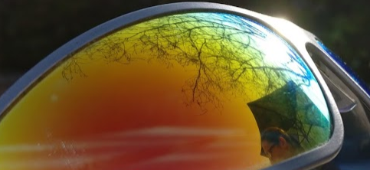
Neutron Reflectivity
Different angles and wavelengths give different reflectivities:
The same is true for neutrons. However ...

Slide 4
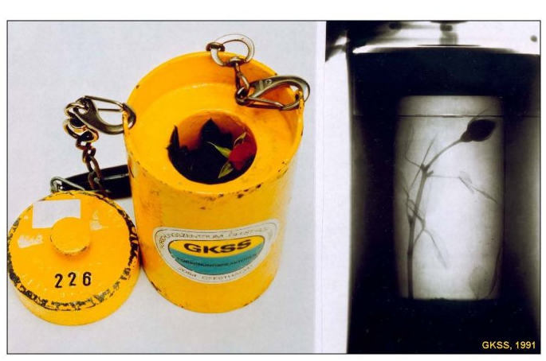
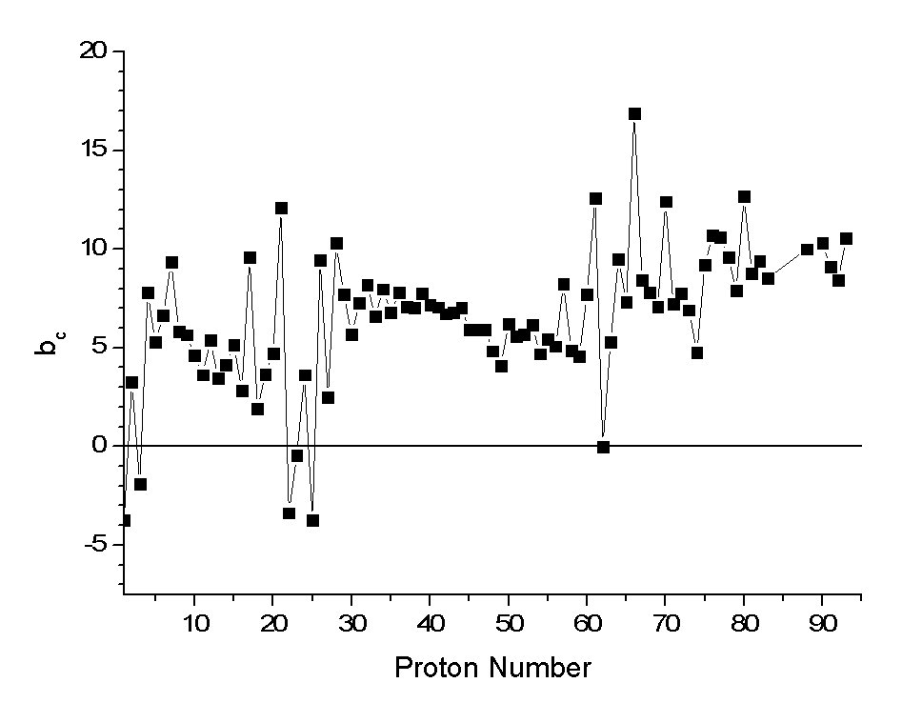
Neutrons can see into everything

Slide 5
Thin Films
Film 2
Film 1
Substrate

Slide 6
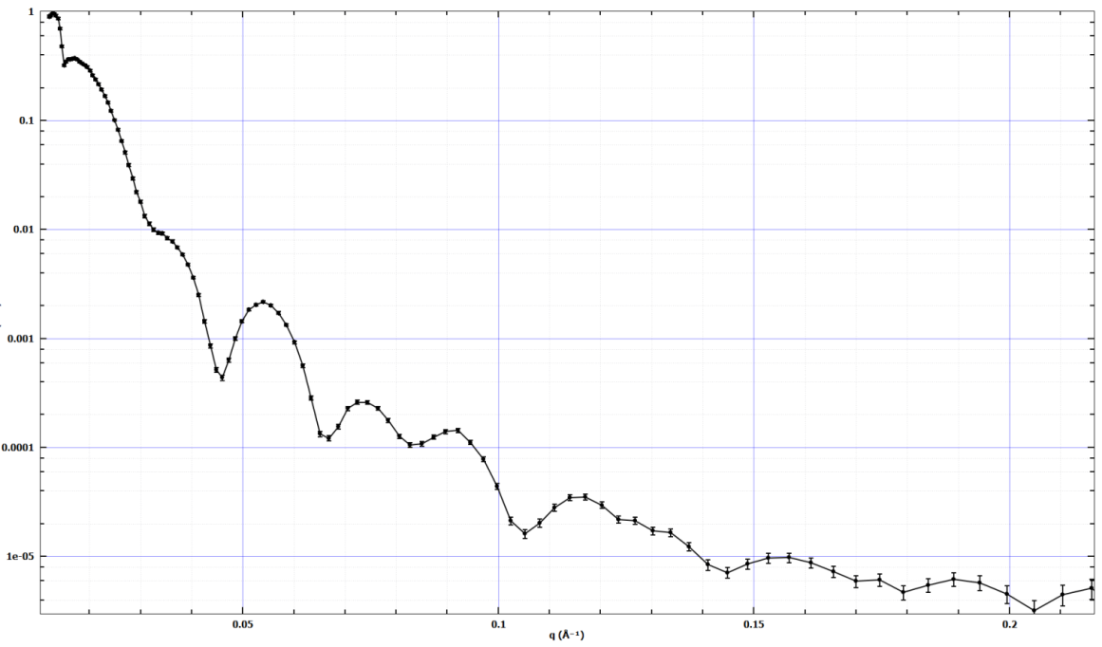
Reflect Neutrons

Slide 7
Thickness
t₂
t₁

Slide 8
Density
ρ₂
ρ₁

Slide 9
Interfacial Roughness
R₃
R₂
R₁

Slide 10
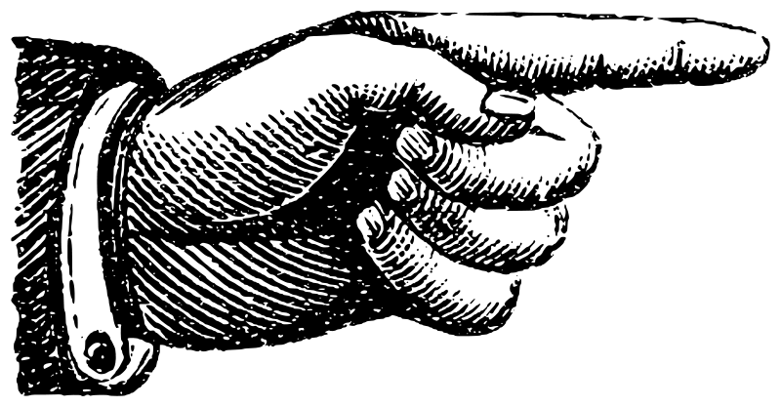
Current Practices
Instrument
Raw Data
Data Reduction
Reduced Data
Fit Model to Data
Data in Analysis
Software
Model

Slide 11
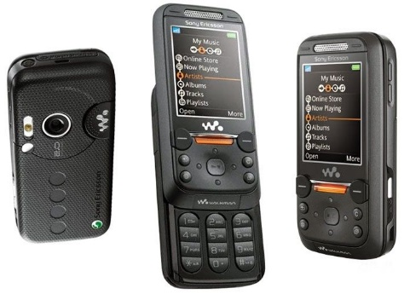
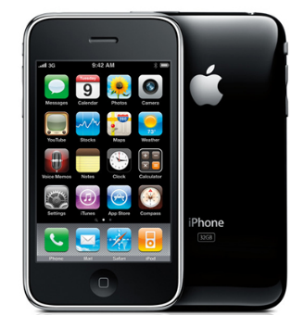
Aims
Automate everything from output of reduced data into the analysis software
Not final fitting to the model
Too hard to get “details”
On experiment analysis, and lower barrier to entry

Slide 12
Data
Simulating Si/air experiment with GenX; one- and two-layer samples, to a .h5 file:
Training: 40,000
Validation: 20,000
Test: 20,000
1st Layer Depth | 1st Layer SLD | 2nd Layer Depth | 2nd Layer SLD
t1 | SLD1 | t2 | SLD2

Slide 13
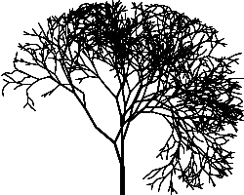
Applying Machine Learning
Random forest
Overfits quickly, no learning

Slide 14
Applying Machine Learning
Random forest
Overfits quickly, no learning
Deep neural network (DNN)
Limited input representations

Slide 15
Applying Machine Learning
Random forest
Overfits quickly, no learning
Deep neural network (DNN)
Limited to 1-D inputs
Interpolated across to fixed Q range, with fixed number of points

Slide 16
Applying Machine Learning
Random forest
Overfits quickly, no learning
Deep neural network (DNN)
Limited input representations
Convolutional neural network (CNN)
Large, not typically used for regression tasks

Slide 17
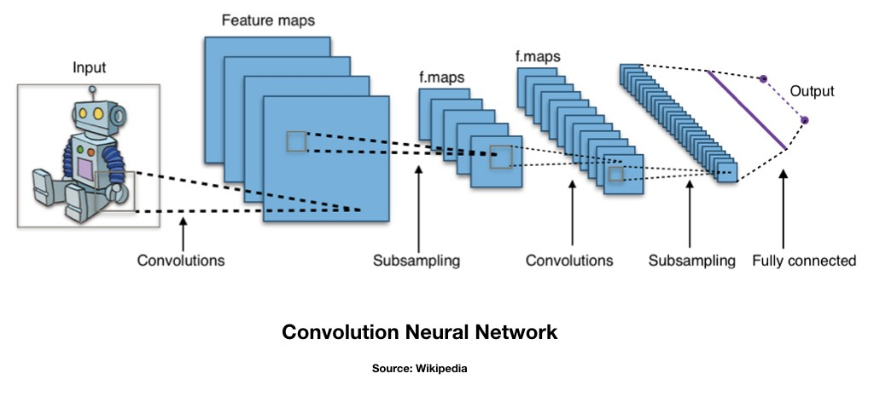
CNN
N x 2
Explicit Q
Smaller (300, 2)
N x N
Images of curves
Implicit Q
Large (300, 300, 1)

Slide 18
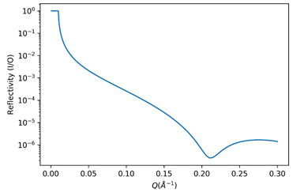
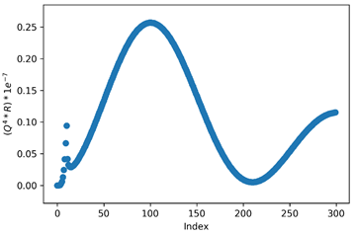
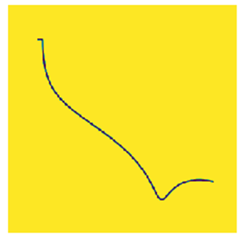
Take 300 X,Y coordinates.
Array of shape (300, 2)
"Raw" to CNN
In simulated data, all interpolated to same X
Array of shape (300, 1)
"Interpolated" to DNN
Array of shape (300, 300, 1)
"Image" to CNN

Slide 19
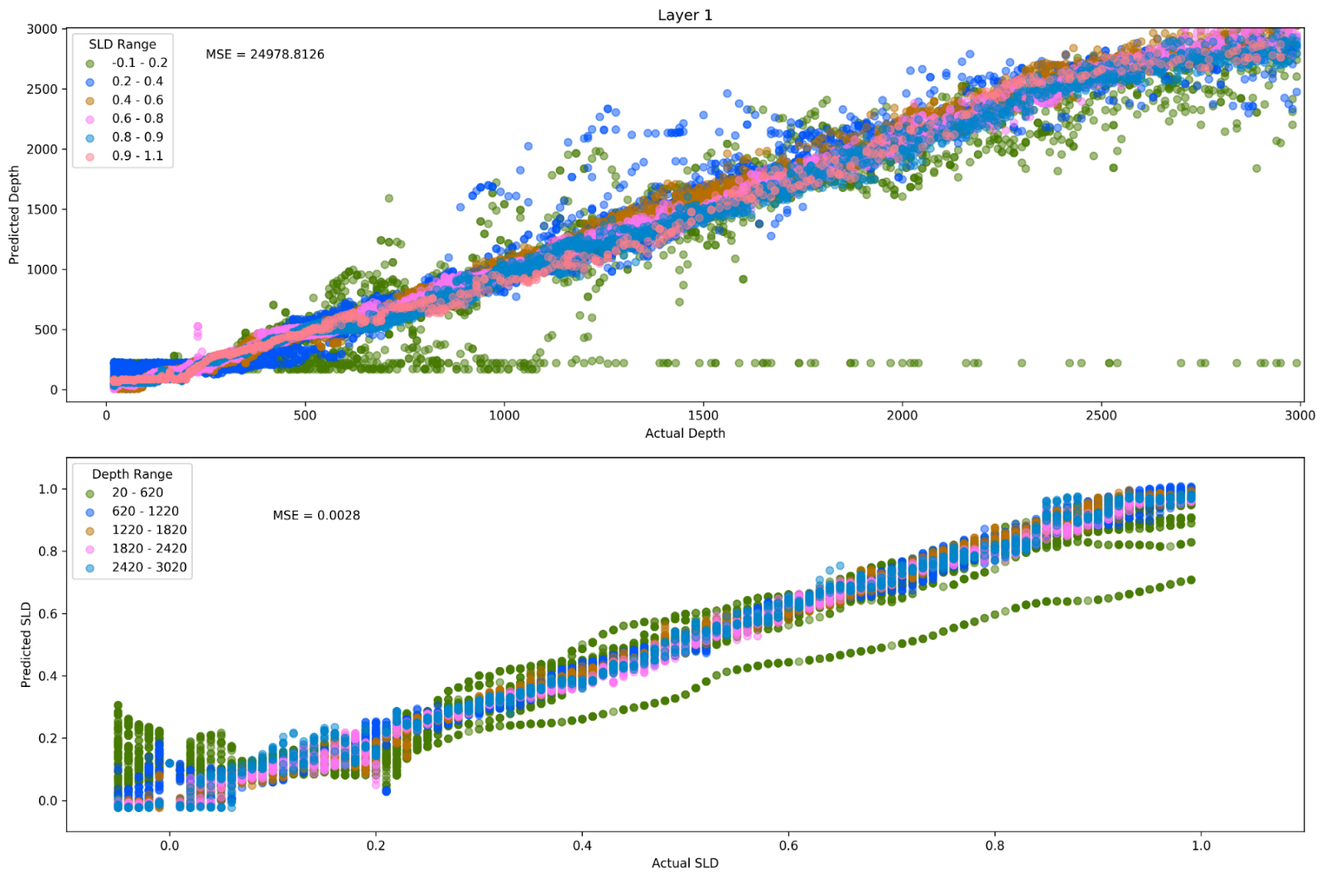
1 Layer Results
Samples with low depth, or SLD are harder to predict.

Slide 20
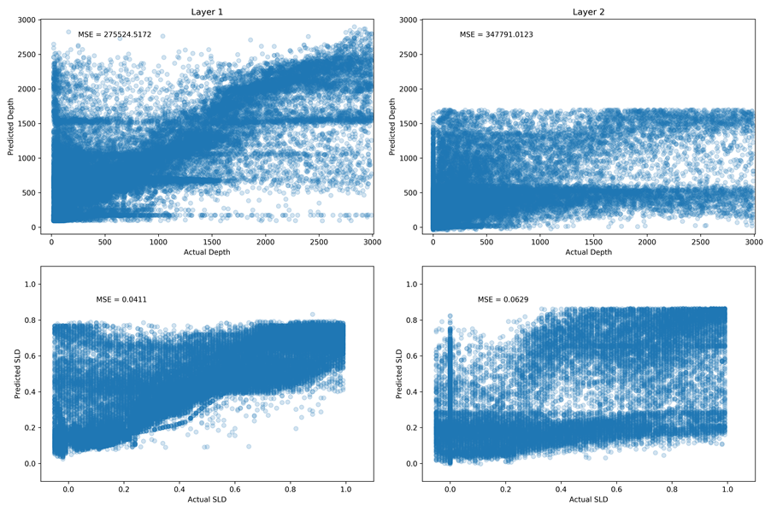
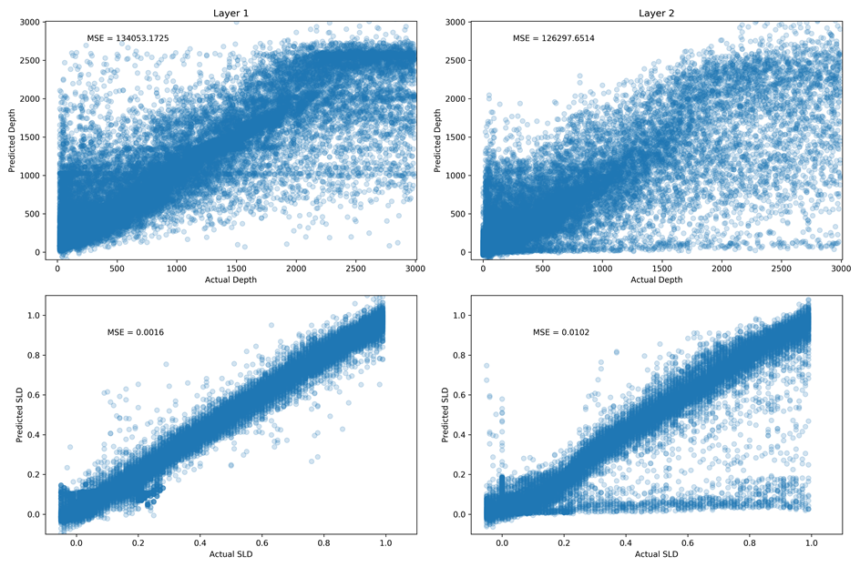
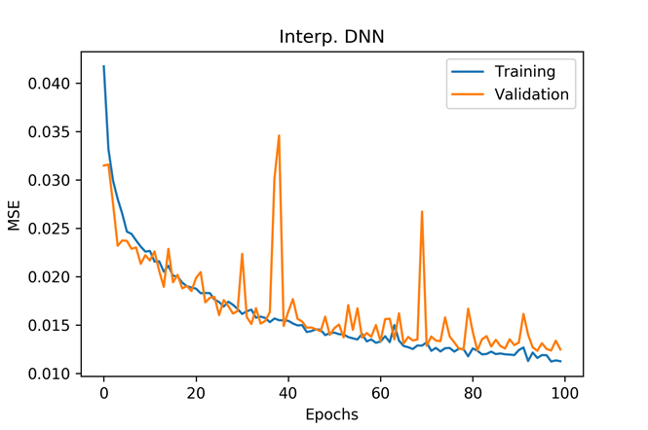
"Interpolated" training results
DNN with (300, 1) input, 11 layers
MSE
Layer 1
Layer 2
"Interp": 0.0125
Depth
SLD
CNN
DNN

Slide 21
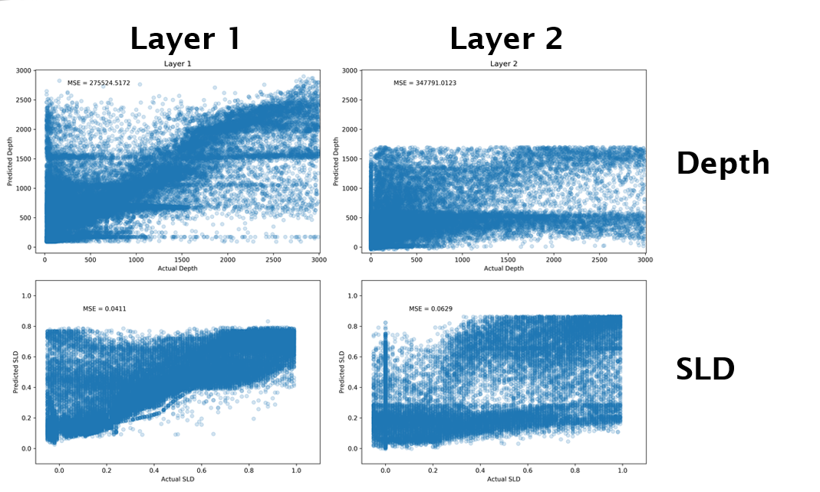
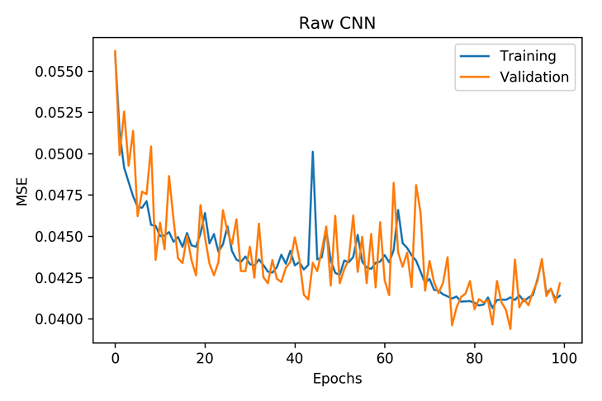
"Raw" training results
CNN with (300, 2) input
MSE
"Interp": 0.0125
"Raw": 0.0423
CNN
DNN

Slide 22
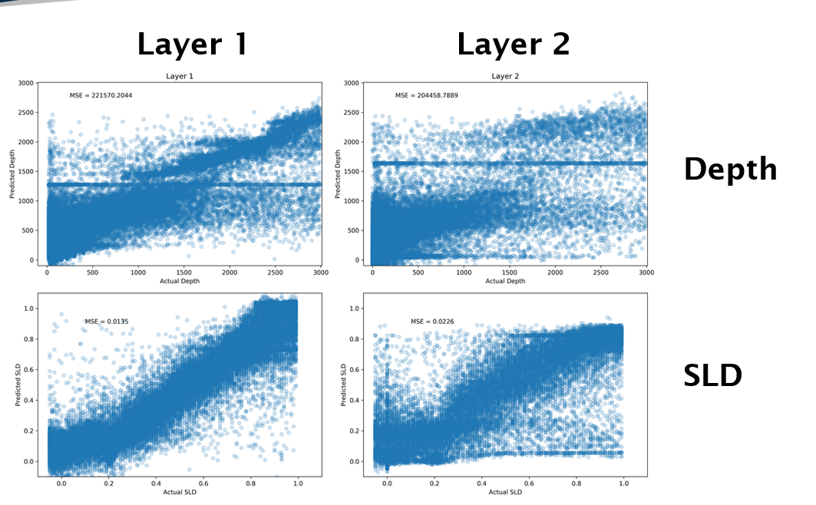
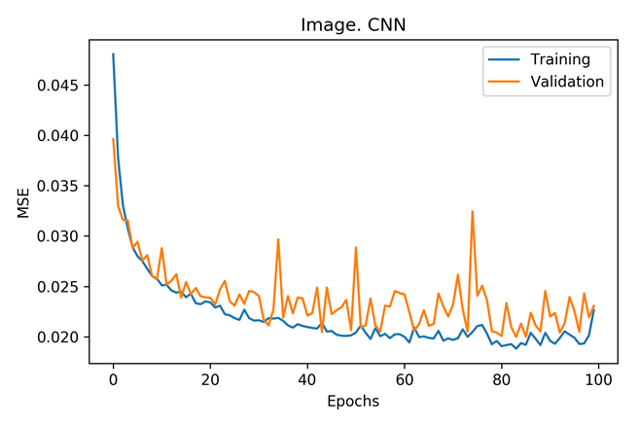
"Image" training results
CNN with (300, 300, 1) input, 4 Conv. Layers + DNN
MSE
"Interp": 0.0125
"Raw": 0.0423
"Image": 0.0225
CNN
DNN

Slide 23
Results
DNN performs the best BUT…
Will struggle with interpolating over values which don’t exist (in real data)
Not so generalizable e.g. multi contrast data, uncertainties?
An image is easier to use, and can be plotted onto the same axis regardless of the experiment length/ X values
Hence we proceed with "image" CNN, and improve upon it
Training for longer?
Training for depth and SLD separately?
CNN
DNN

Slide 24
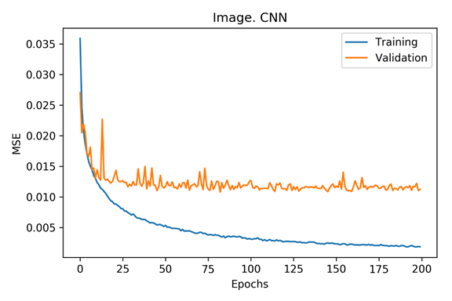
Lowering the learning rate and training for more epochs
Significant amount of overfitting, but validation performance is still better (0.015 < 0.020) from previous effort
This is without any regularisation
CNN
DNN

Slide 25
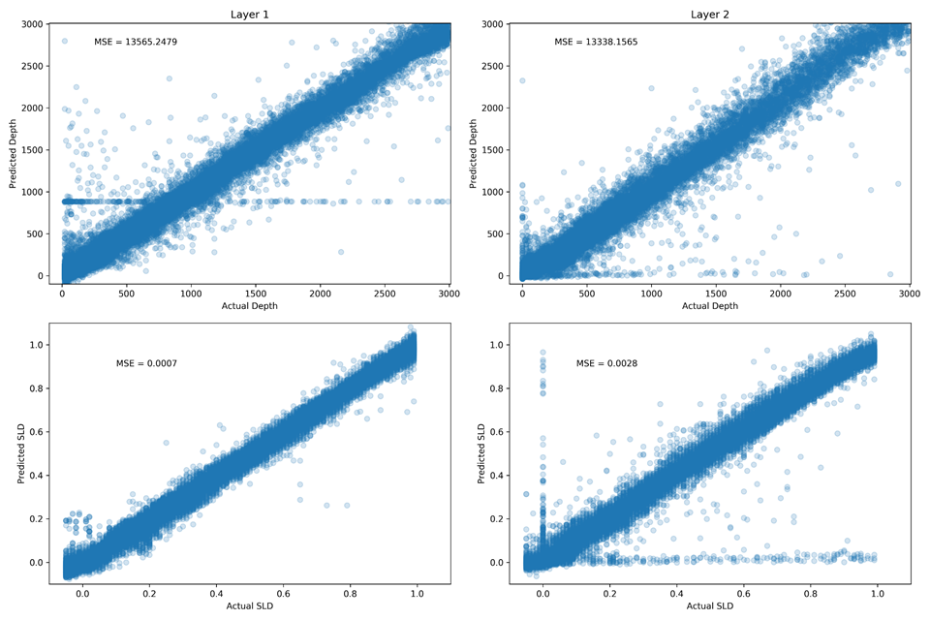
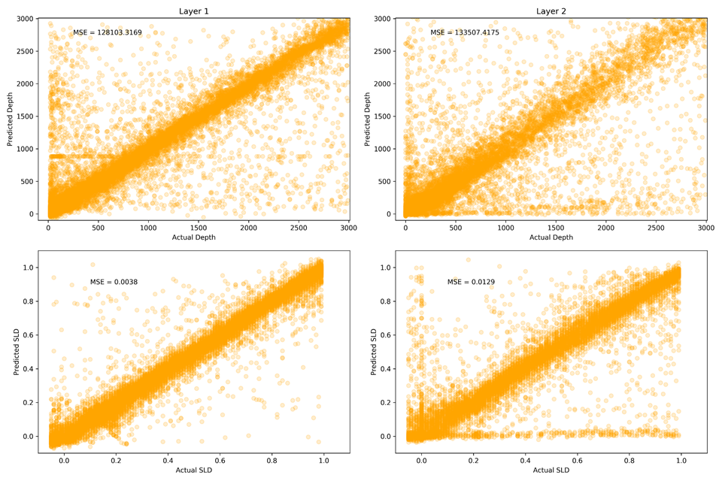
Training Testing

Slide 26
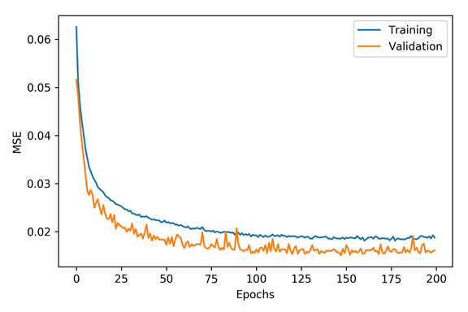
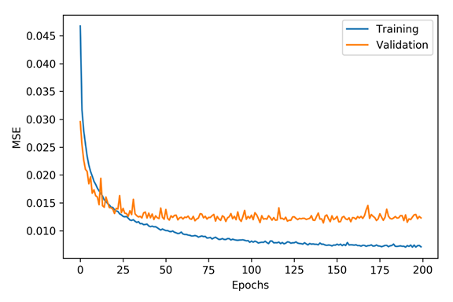
Dropout 0.25, learning rate 0.001
Dropout 0.1, learning rate 0.001
Overfitting has decreased
Better, but validation higher than training – dropout too high?
CNN
DNN

Slide 27
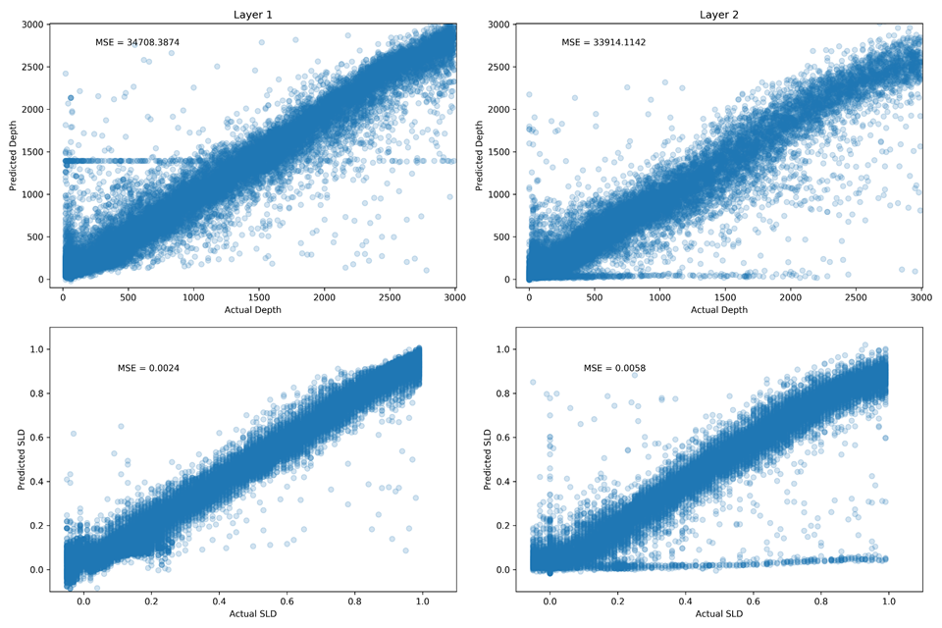
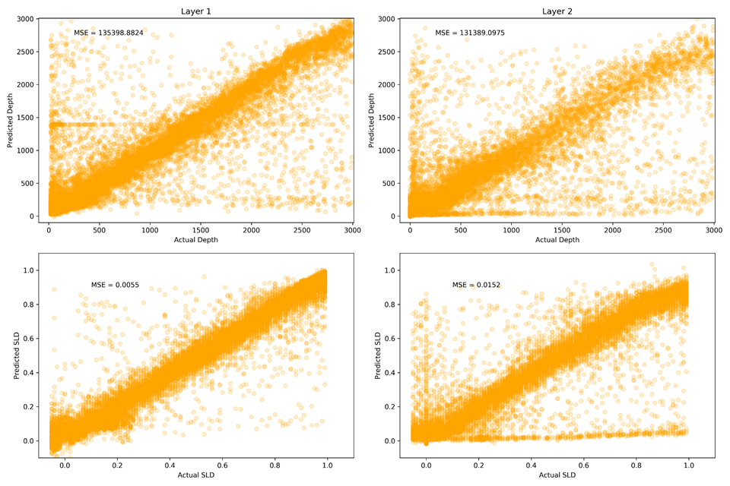
Training Testing

Slide 28
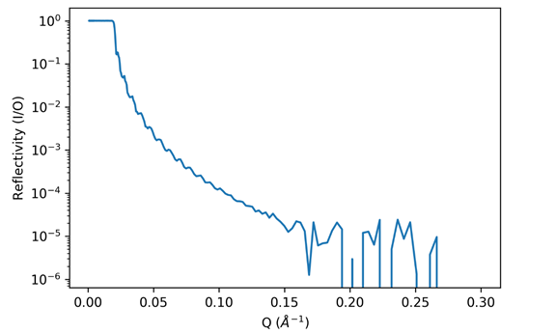
What if we add noise?
So far we have trained on, and tested on, perfect data.
Can our model still predict if we test on noisy data?
CNN
DNN

Slide 29
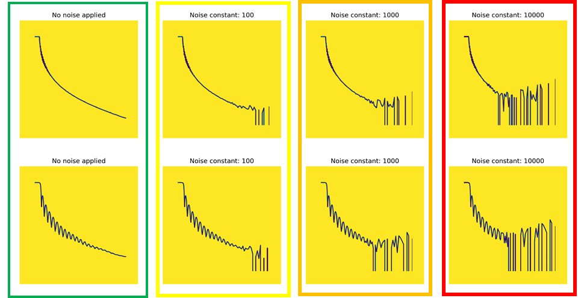
Val 0
No noise applied
Val 100
Noise const. = 100
Val 1000
Noise const. = 1000
Val 10000
Noise const. = 10000

Slide 30
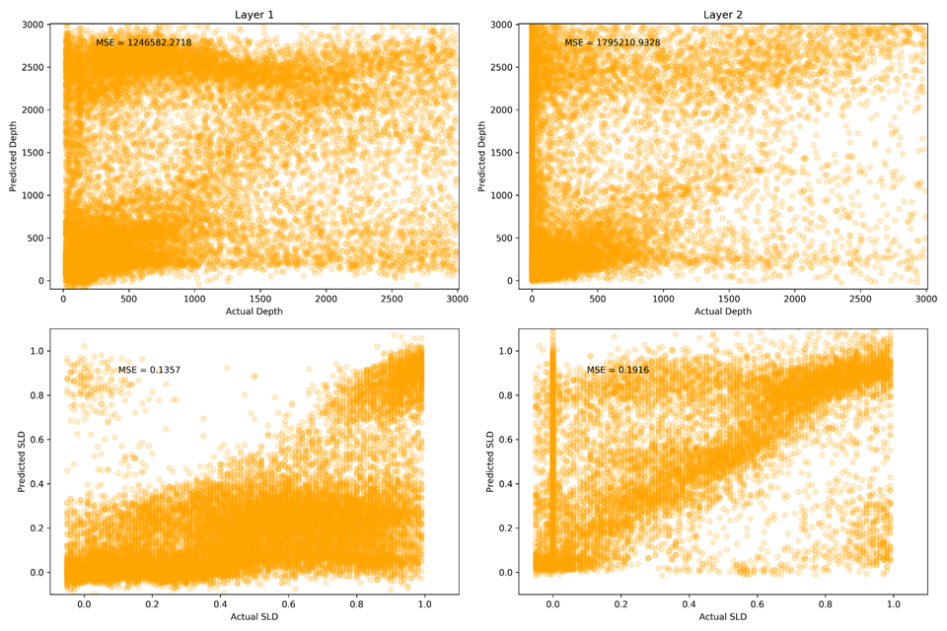
Val 100 data

Slide 31
Conclusions
Having tried random forest, DNN, and “raw” CNN, we decided on an “image” CNN
We can suggest values pertinent to the sample for one- to two-layer samples
MSE does not indicate end point utility of result
Addition of noise to test set reduces performance, so for the future:
Include noisy data in training + perform data augmentation on input batch for robustness
Make the network Bayesian to move away from point estimate based predictions → Error bounds on prediction
Input Priors

Slide 32
(Adding noise and background)
Background – From sample/instrument
Flat rate
Noise – From counting statistics
Experiment duration
Can apply both separately (variable)

Slide 33
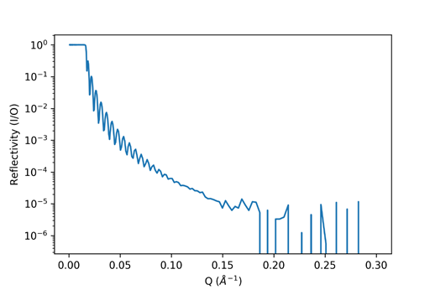
Example Data
X-layer sample
After the noise and background, we can:
Convert to RQ^4 (remove Fresnel decay)
Convert to .npy
Normalise (globally)
1st Layer Depth | 1st Layer SLD | 2nd Layer Depth | 2nd Layer SLD
t1 | SLD1 | t2 | SLD2

Slide 34
The modelling question
Using this reflectivity profile:
Predict these four values:

Slide 35
Data Representation
How do we "represent" our simulated values?
A list of x,y coordinates, interpolated to the same N: "raw" (300, 2)
A list of reflectivity values, interpolated to the same Q (and thus N): "interpolated" (300, 1)
An image of the reflectivity plot: "image" (300, 300, 1)

Slide 36
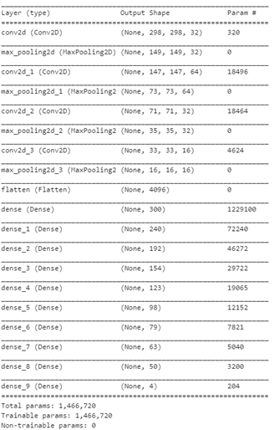
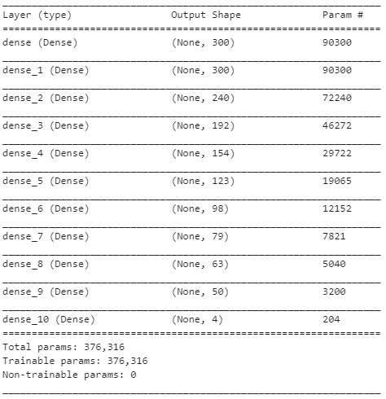
CNN
Models
DNN

Slide 37
Model hyperparameters
ReLu (Recitifed Linear Unit) activations on all layers except output
Mean squared error loss
Linear output function (4 output neurons)
Adam optimiser, starting with learning rate of 0.001
Batch size = 1
100 epochs as default

Slide 38
Adding two-layer samples
Training, validation, and test data is a 50:50 split of one:two- layer samples
Each dataset is shuffled
CNN
DNN

