Slide 1


PaNOSC WP3 ILL Workshop
Welcome and status reports
18th September, 2019
This project has received funding from the European Union’s Horizon 2020 research and innovation programme under grant agreement No. 823852

Slide 2
Summary
Agenda
Practical information
Dinner plan
Report from WP4
Current Status from each site

Slide 3
Agenda
Wednesday 18/09/2019
  Welcome & status reports
  Report From ExPaNDS
  Internal milestones
  API Endpoints
  Returned data structure
  Search and query formulation
  Thoughts on federated search demonstrator/result aggregation
  Ties to optional EOSC services (WP6)
  Summary
Thursday 19/09/2019
  Harvesting by EOSC repos, OAI-MPH
  NeXus show and tell summary
  API Validators
  Catalogue integration
  Wrap up
Full timetable available here : https://workshops.ill.fr/event/218/timetable

Slide 4
Practical information
Registration
  Please fill in the form
WiFi
  SSID: EPN_Visitors
  Login: panoscwp3
  Password: Grenoble2019
Lunch
  Wednesday: Salle d’hôtes/Guest Room – ground floor next to canteen entrance
  Thursday: Normal canteen paid for by PaNOSC (show your badge at the till), Reserved table on ground floor
Meeting notes GoogleDoc
  https://tinyurl.com/panosc-ill-wp3
  Please add your notes!

Slide 5
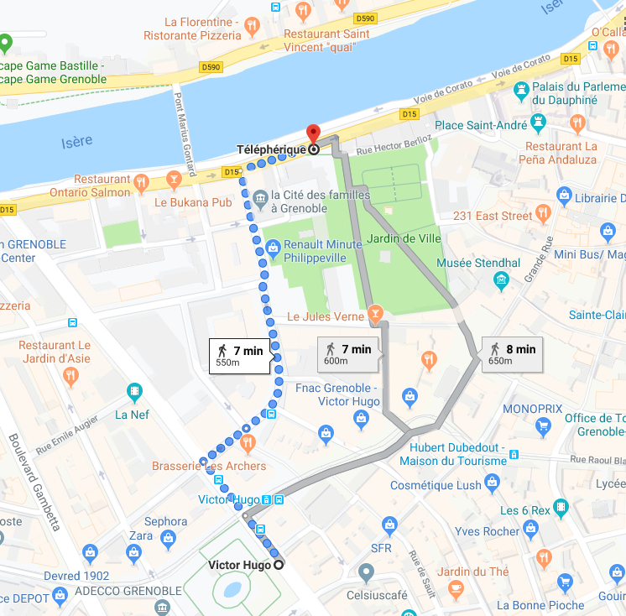
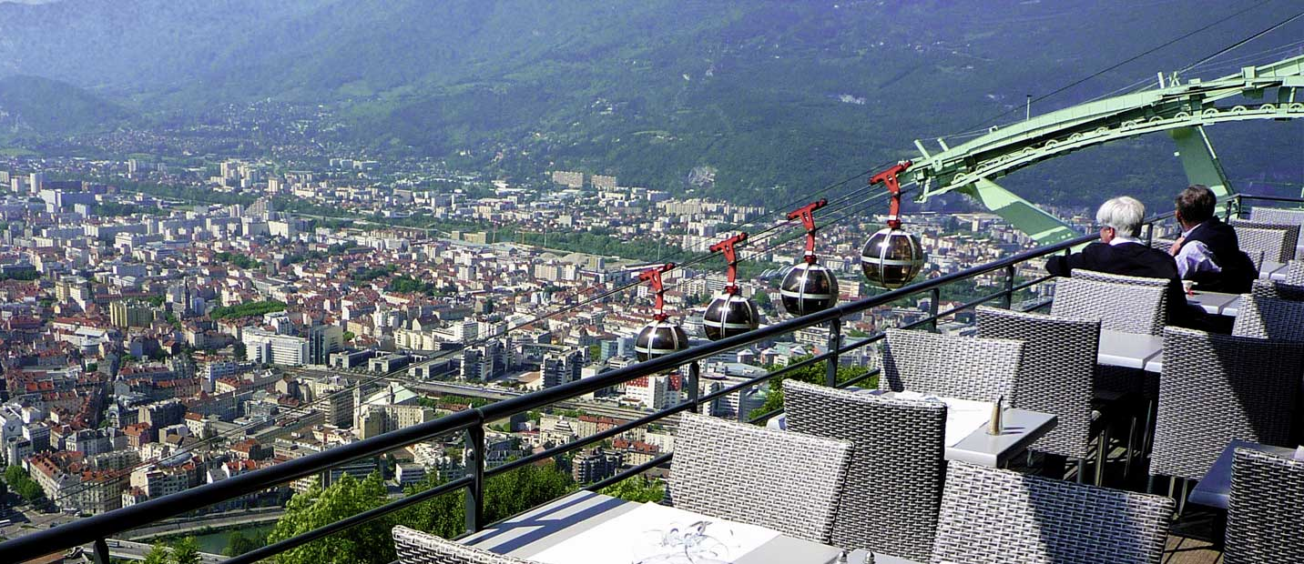
Dinner Plan
O2 Restaurant booked at the Bastille
  8pm
Téléphérique (cable car) access
  Group booking
  Meet at the téléphérique stairs at 7:30pm
  Walking distance from Victor Hugo tram stop

Slide 6
Report from WP4
Meeting at EuXFEL, Hamburg in June
  Meeting notes can be found at https://tinyurl.com/euxfel-wp4
Agreement on plan for common data analysis portal
  Remote Desktop and Jupyter Notebook analysis environments available at all sites
  Single entry point for analysis services for scientific users including data search
Integration of WP3 API
  User searches for data associated with their proposals
  Combine efforts for WP3 API Demonstrator and WP4 Portal
Milestones fixed
  https://confluence.panosc.eu/display/wp4/Milestones
  User interface design (November 2019)
  Architecture (February 2020)
  Basic version with data search from WP3 (March 2021)

Slide 7
Current status and site reports

