Slide 1
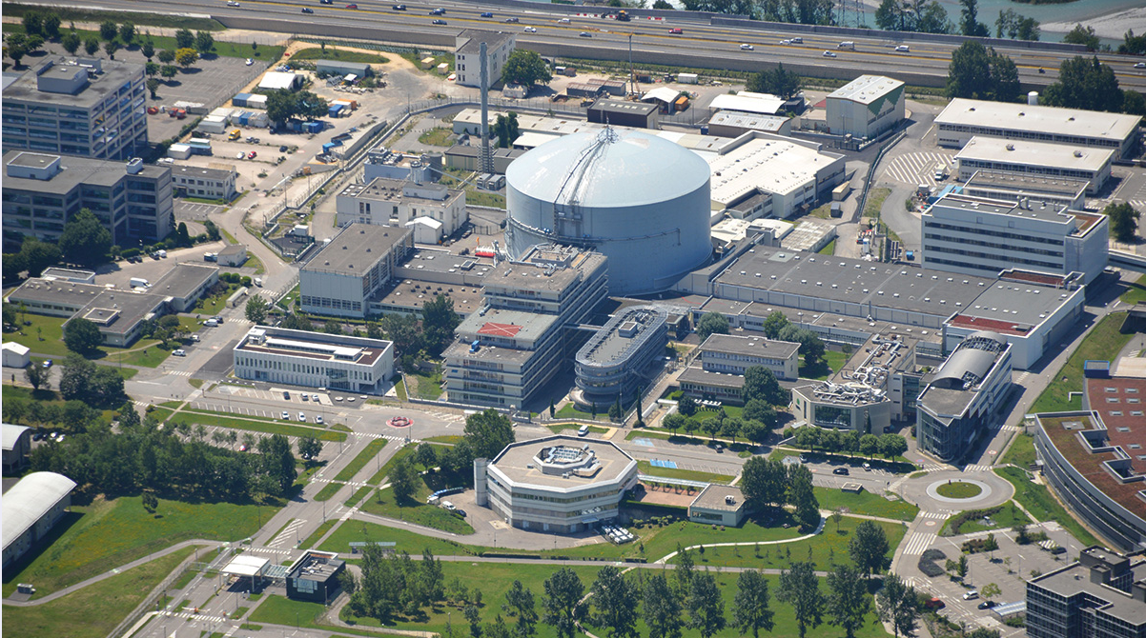
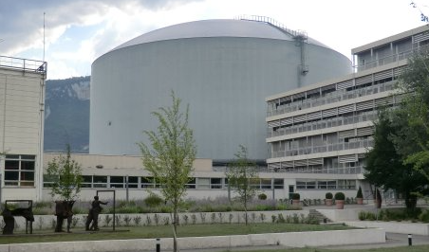
The H1-H2 guide system

Slide 2
Neutron extraction from the reactor
43 user instruments at ILL
12 horizontal beam tubes for neutron extraction

Slide 3
Neutron extraction from the reactor
H1-H2
43 user instruments at ILL
12 horizontal beam tubes
Zirkaloy or aluminum
Two are used for neutron guides:
H1-H2 for ILL 7
H5 for ILL 22
H5

Slide 4
ILL guide systems: H1-H2 and H5
H1-H2:
22 Instruments
5 technical positions
H5:
8 Instruments
H5 ➔ ILL 22
H1-H2 works
H1-H2 ➔ ILL 7

Slide 5
3 areas of work for H1-H2
1 - Inpile part: ~3.5m inside the reactor core
2 - Swimming pool part: ~6m to get inside the casemate
3 - Reactor wall part: seismic reinforcments
1
2
3

Slide 6
H1-H2 dismounting – 2.5 months

Slide 7
H1-H2 dismounting – 2.5 months

Slide 8
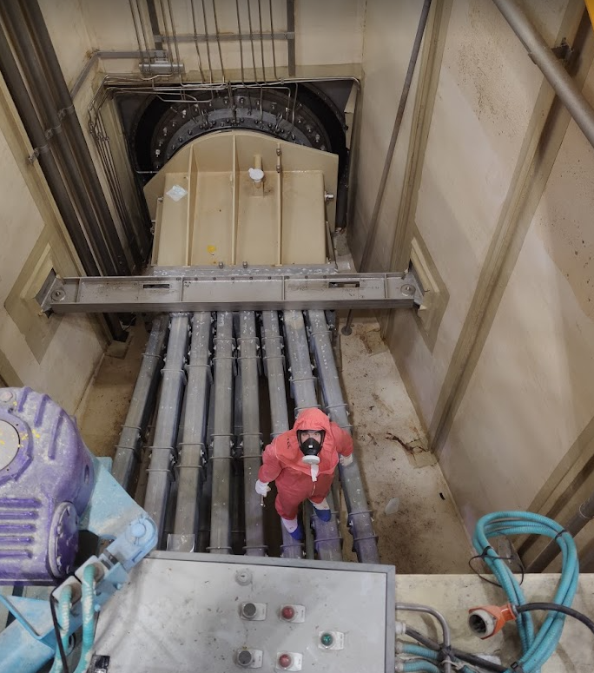
H1-H2 dismounting – 2.5 months

Slide 9
H1-H2 dismounting – 2.5 months

Slide 10
H1-H2 dismounting – 2.5 months
Guides were in good condition!

Slide 11
3 areas of work for H1-H2
1 - Inpile part: ~3.5m inside the reactor core
2 - Swimming pool part: ~6m to get inside the casemate
3 - Reactor wall part: seismic reinforcments
1
2
3

Slide 12
Reactor wall = 3rd barrier
Concrete
Steel
2005:
Membrane
Seismic proof housing
Non seismic proof housing
Reactor building
Ring space
Outside world
Casemate might fall on membrane
Second housing is not anti-seismic
Casemate might fall on housing

Slide 13
Reactor wall = 3rd barrier
Comparison of 2005 and 2018 solutions
Concrete
Steel
2005:
Membrane
Seismic proof housing
Non seismic proof housing
2023:
Membrane
Seismic proof housings
Non seismic proof housing
Reactor building
10cm
10cm
Ring space
Outside world

Slide 14
Reactor wall = 3rd barrier = no science gain
Housings are now modified to comply to seismic regulation
Surrounding casemates still have to be adapted ➔ previewed for 2024/25

Slide 15
3 areas of work for H1-H2
1 - Inpile part: ~3.5m inside the reactor core
2 - Swimming pool part: ~6m to get inside the casemate
3 - Reactor wall part: seismic reinforcments
1
2
3

Slide 16
The H1-H2 beam tube
Biggest aluminum beam tube
Has to be regularly exchanged (~15 years)
Long and tedious work for reactor and guide teams
Opportunity to adapt guide system

Slide 17
The inpile part
Pink housing
Upper guides: cold H1 guides
Lower guides: thermal H2 guides
Guides are slid into the beam tube
Guides are made of Boron-free Floatglass ➔ long lifetime

Slide 18
H1-H2 guides since 2006
Millennium program
Upgrade to m=2 in pile
New H112 guide (finalized in 2010)
H17 guide: 200×80mm²
H14, H15, H23 and H24: 200×45mm²
H112
H113
H14
H15
H16
H17
H18
H25
H24
H23
H22
H21

Slide 19
Guide changes in H1/H2 in 2023
Endurance program
H21: guide is not renewed
Endurance guides:
H24: 200×45 ➔ 200×60, m=2 ➔ m=3
H15: 200×45 ➔ 200×70, m=2 ➔ m=3
“Upgrade”:
H17 m=3
H18 m=1 ➔ m=2 on side walls
H23 m=3 on all walls
Correction of vertical filling:
H112: m=2 ➔ m=2.5 on top/bottom
H14: m=2 ➔ m=2.3 on top/bottom
H112
H113
H14
H15
H16
H17
H18
H25
H24
H23
H22
H21
Please note: only H24 and H15 change their geometry!

Slide 20
The new Pink housing

Slide 21
The new Pink housing
Challenge: Get the guides at the right height!

Slide 22
3 areas of work for H1-H2
1 - Inpile part: ~3.5m inside the reactor core
2 - Swimming pool part: ~6m to get inside the casemate
3 - Reactor wall part: seismic reinforcments
1
2
3

Slide 23
Swimming Pool part
Guides are installed in aluminum housings
33 different vacuum tests to be validated
Work under a lot of pressure ➔ right on the critical path
Guides are made from N-BK7 instead of N-ZK7 ➔ increased lifetime expected

Slide 24
Remounting of casemate installations
And then all casemate guides …

Slide 25
Result of exchange – H15 and H24
D10
XtremeD
IN13
H24 and H15 projects can be realized (see talks of B. Giroud and Ch. Dewhurst)

Slide 26
Flux measurments
Initial flux re-established
Passage m=2
Degradation

Slide 27
H2 guides
2023
H22➔m=2
H25➔m=2
Problem with H25 flux ➔ under examination

Slide 28
H15 guide
Source insert
2006
Passage to m=3 + new geometry
Degradation
2006

Slide 29
Result of flux measurment
All guides have gained in flux in ILL 5 (~20% or more) with the exception of H25 (problem?)
Almost all guides have changed their coating and/or their geometry in the last 30 years ➔ long term observation is difficult
New guides have a significant leap to higher flux as expected in ILL 5 ➔ see talks of Benjamin and Charles for ILL 7

Slide 30
Summary
H1-H2 guide system start has been successfully replaced
Reactor wall guides are conform to seismic demands
H15 and H24 projects can now receive neutrons as previewed
The 2005 fluxes have been recovered and are expected to remain stable for the next 10-15 years

