Slide 1
INSTITUT LAUE LANGEVIN – THE EUROPEAN NEUTRON SOURCE
ENDURANCE
Innovative Neutron Guide Replacements at ILL: H16, H24, H15
Charles Dewhurst, B. Giroud, G. Manzin, J. Beaucour

Slide 2
Instruments in User Program – ILL 7 Guide Hall
SHARP+
D17
FIGARO
IN5
D007
D11
SAM
DALI
LADI
PF1b
D33
IN12
S18
D1b
SALSA
ILL Instruments
CRG Instruments ENDURANCE
D23
D10+
FIPPS
IN16b
IN22
IN13
XtremeD

Slide 3
Instruments in User Program – ILL 7 Guide Hall
SHARP+
D17
FIGARO
IN5
D007
D11
H15 guide
SAM
DALI
LADI
H141 guide
H16 guide
PF1b
D33
IN12
H24 guide
S18
D1b
SALSA
H112 guide
ILL Instruments
CRG Instruments ENDURANCE
D23
D10+
FIPPS
IN16b
IN22
IN13
XtremeD

Slide 4
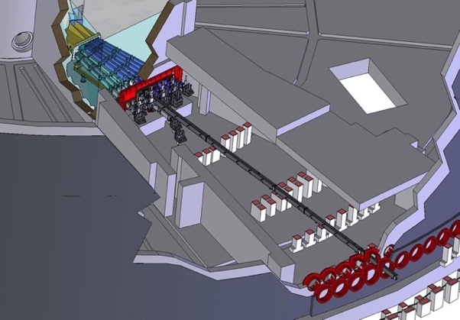
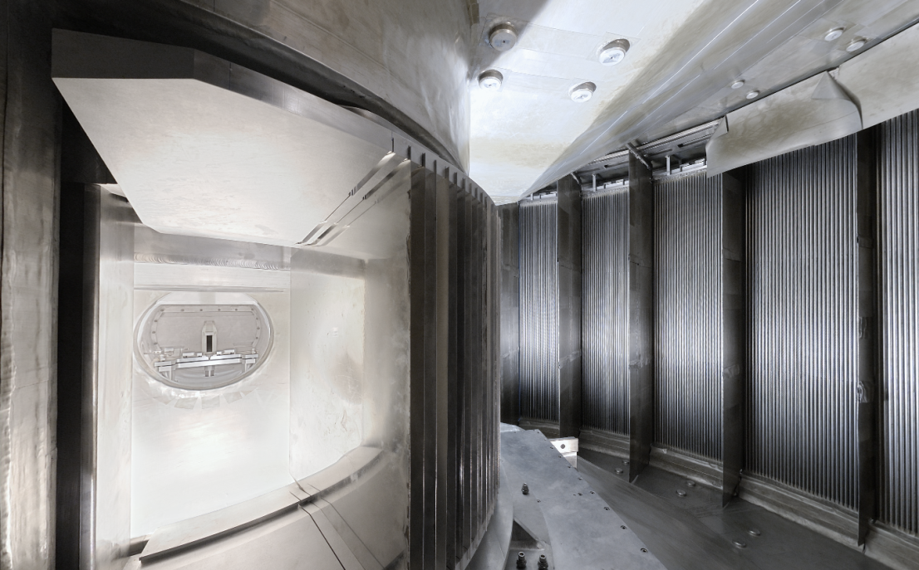
IN5 – H16:
Cold-neutron TOF spectrometer
Cold-neutron TOF spectrometer
Massive upgrade in Millennium programme (2005)
Large PSD detector, choppers & linear converging guide
Guide upgraded again in Endurance programme (2019)

Slide 5
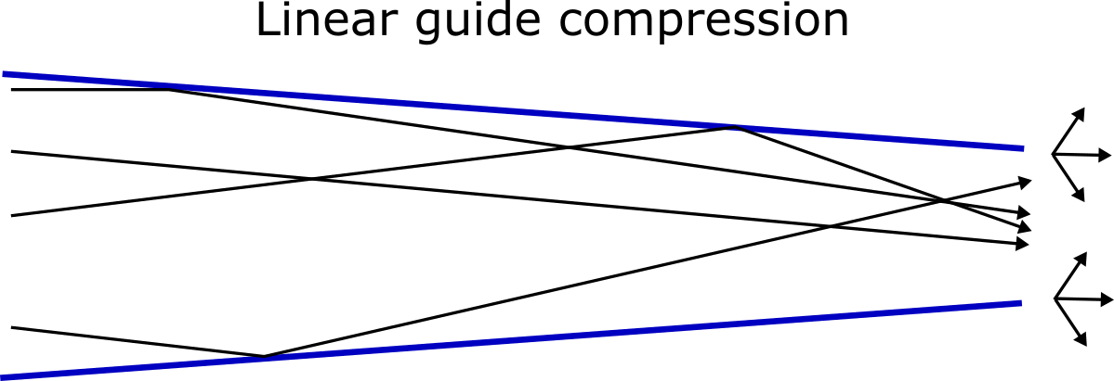
IN5 – H16:
Cold-neutron TOF spectrometer
Old H16 guide: Curved, m=1, 30 x 200 mm
Old IN5 converging guide (2005):
x: 30 mm -> 14 mm, m = 1 -> m = 2
y: 200 mm -> 53 mm, m = 1 -> m = 3
Decreased spatial filling -> increased divergence
Correlation between position & divergence
Abrupt guide angle change at entrance
Need a ‘long’ guide for complete transformation
No focussing

Slide 6
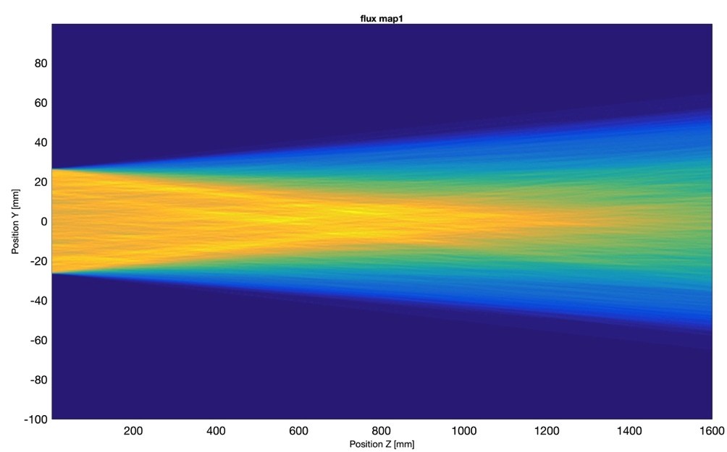
IN5 – H16:
Cold-neutron TOF spectrometer
Old H16 guide: Curved, m=1, 30 x 200 mm
Old IN5 converging guide (2005):
x: 30 mm -> 14 mm, m = 1 -> m = 2
y: 200 mm -> 53 mm, m = 1 -> m = 3
Decreased spatial filling -> increased divergence
Correlation between position & divergence
Abrupt guide angle change at entrance
Need a ‘long’ guide for complete transformation
No focussing

Slide 7
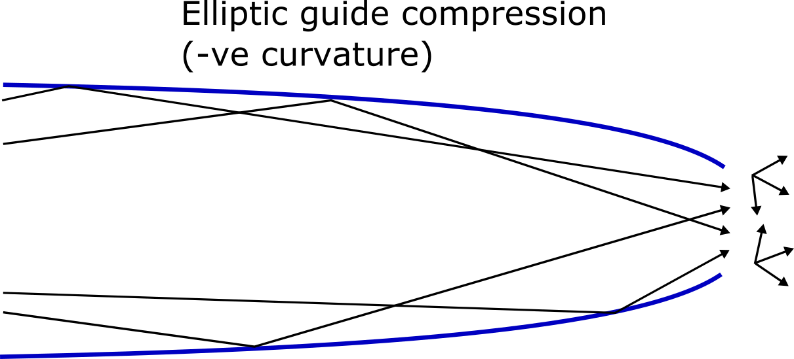
IN5 – H16:
Cold-neutron TOF spectrometer
150 mm
50 mm
15 m
Decreased spatial filling & increased divergence
Strong correlation between position & divergence determined by exit tangents
Correlation between position & divergence
No abrupt guide angle change at entrance
High m coatings
Don’t even need all available guide!
New H16 guide: Curved m=2, 30 x 200 mm
New IN5 converging guide:
x: 30 mm -> 15 mm, m = 2 -> m > 2
y: 150 mm -> 50 mm, m = 2 -> m = 6

Slide 8
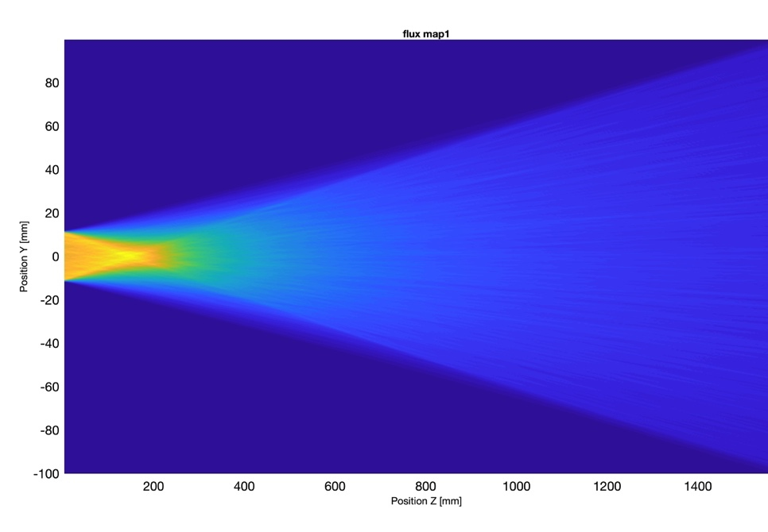
IN5 – H16:
Cold-neutron TOF spectrometer
150 mm
50 mm
15 m
Decreased spatial filling & increased divergence
Strong correlation between position & divergence determined by exit tangents
Correlation between position & divergence
No abrupt guide angle change at entrance
High m coatings
Don’t even need all available guide!
New H16 guide: Curved m=2, 30 x 200 mm
New IN5 converging guide:
x: 30 mm -> 15 mm, m = 1 -> m > 2
y: 150 mm -> 50 mm, m = 1 -> m = 6

Slide 9
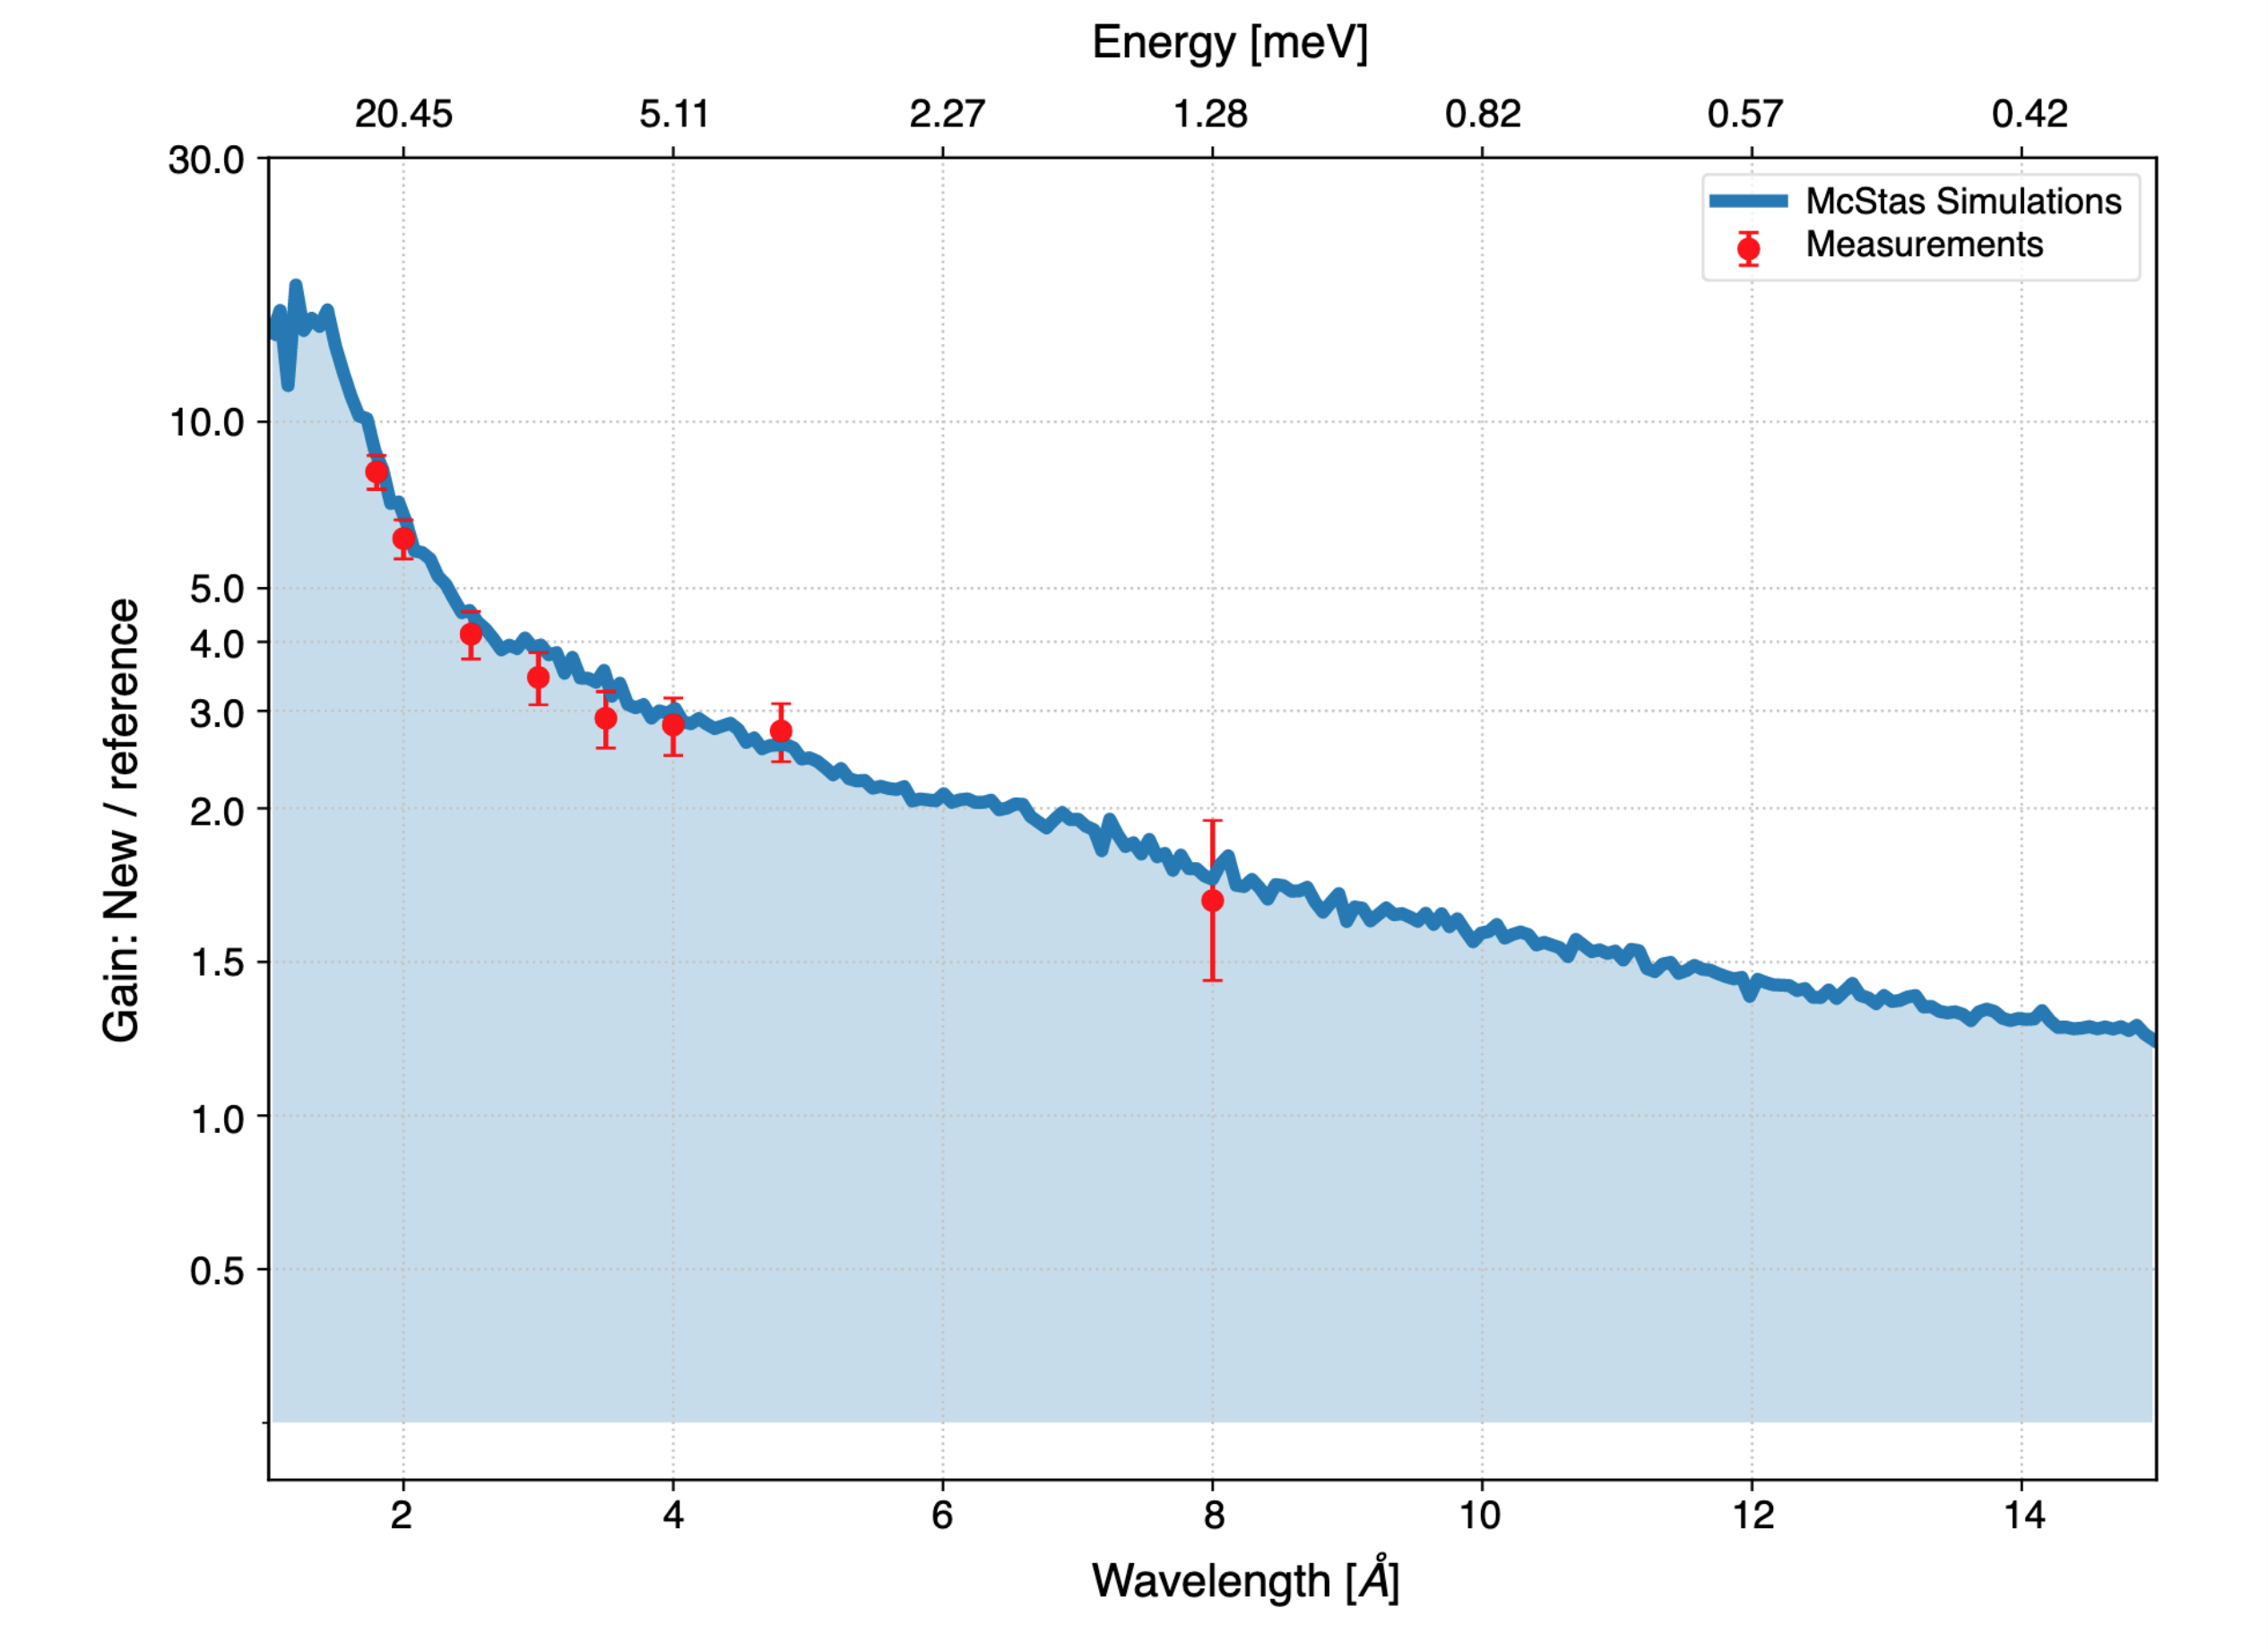
IN5 – H16:
Cold-neutron TOF spectrometer
Flux gain vs wavelength
150 mm
50 mm
15 m
Cold-neutron TOF spectrometer
Guide upgraded again in Endurance programme (2019)
New double elliptically focussing guide
Best use of phase space; huge gains in intensity – in particular at short wavelengths; focussing onto much smaller samples.
J. Ollivier et al. J. Neutron Research 20, 123 (2019)

Slide 10
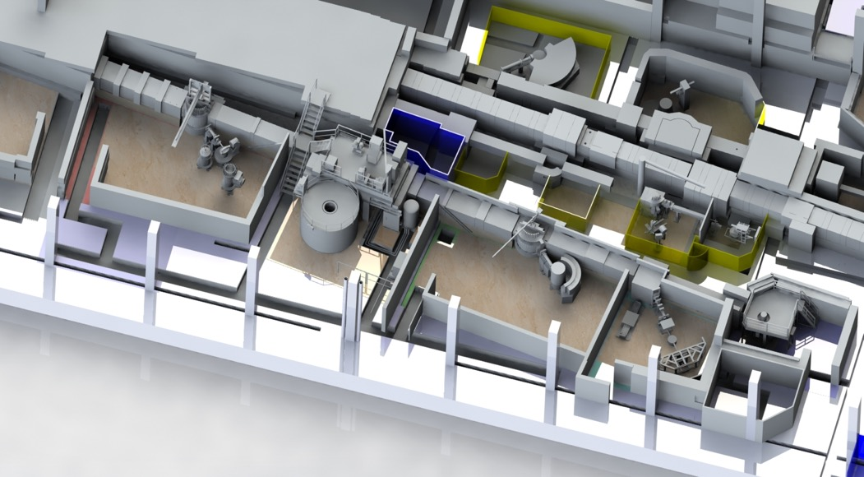
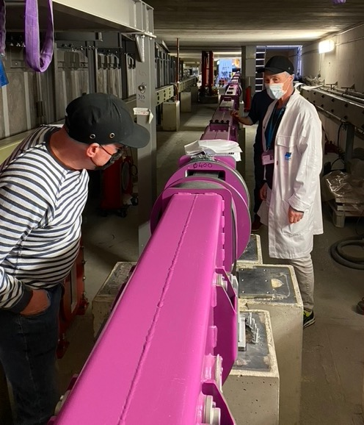
H24 thermal-neutron guide + instruments: D10+, IN13+, XtremeD, CT2, FIPPS
H24 Instrument layout
FIPPS
D10+
IN13
XtremeD
CT2
Dedicated end-of-guide positions for all instruments with m = 2 divergence
Common-curved-trumpet design exploiting two radii of curvature expanding the guide over 22 m
Split into two branches H241 (R = 14000 m), H242 (R=8000 m)

Slide 11
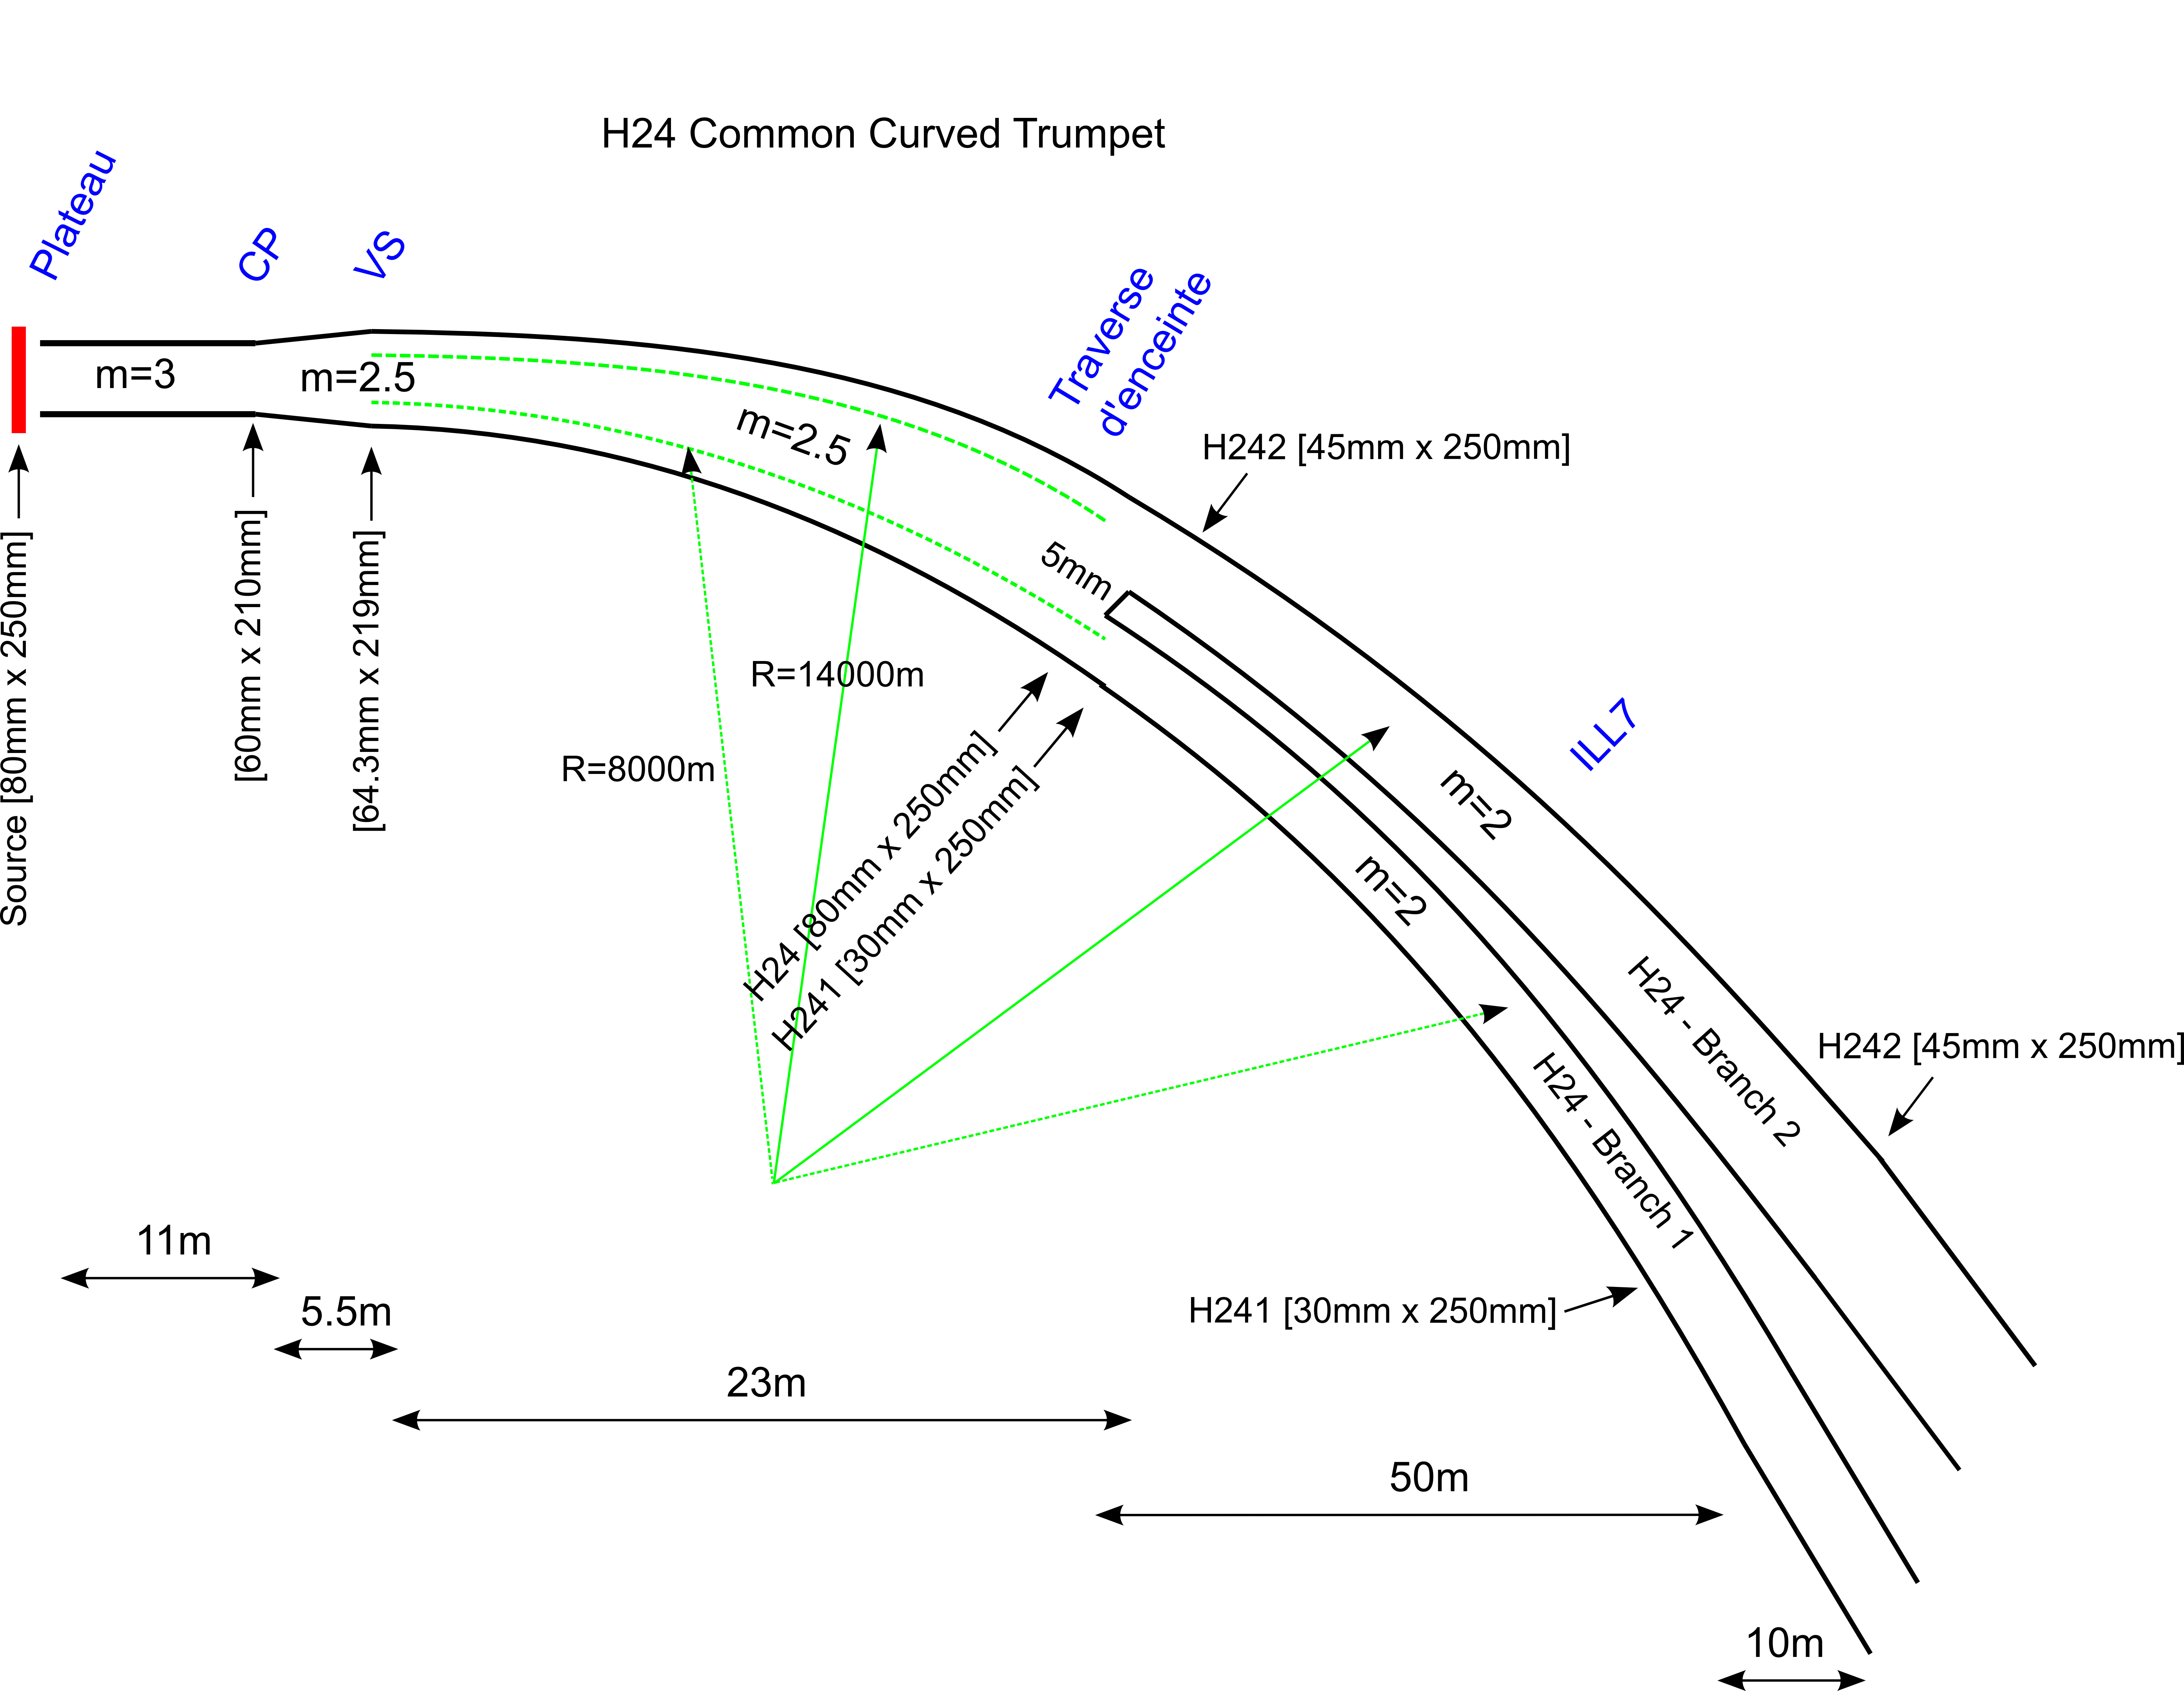
H24 thermal-neutron guide + instruments: D10+, IN13+, XtremeD, CT2, FIPPS
Dedicated end-of-guide positions for all instruments with m = 2 divergence
Common-curved-trumpet design exploiting two radii of curvature expanding the guide over 22 m
Split into two branches H241 (R = 14000 m), H242 (R=8000 m)

Slide 12
H24 thermal-neutron guide + instruments: D10+, IN13+, XtremeD, CT2, FIPPS
Enlarged spatial filling & reduced divergence
Correlation between position & divergence:
Centred on exit tangent at extremities
Abrupt guide angle change at entrance & possible 'blind spot'
Incomplete phase-space transformation

Slide 13
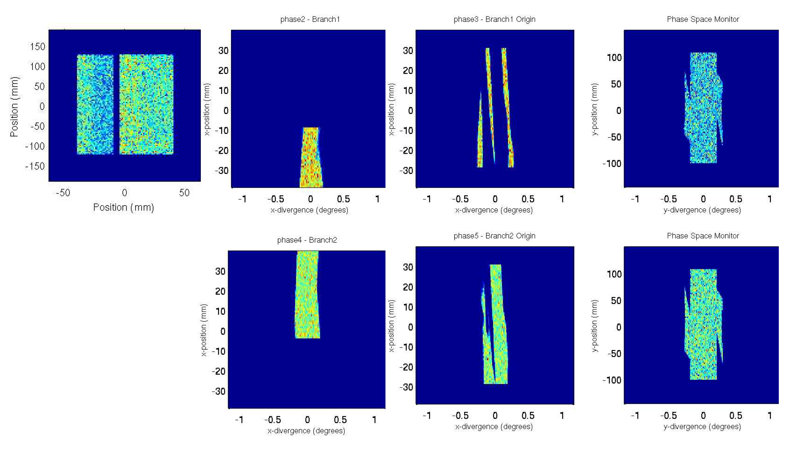
Endurance Instruments H24 thermal-neutron guide + instruments: D10+, IN13+, XtremeD, CT2, FIPPS
@ 1 Å
Neutrons preferentially on the outer walls – both branches
Guides not fully filled
Divergence missing on the inner walls
Required incoming divergence, m = 3

Slide 14
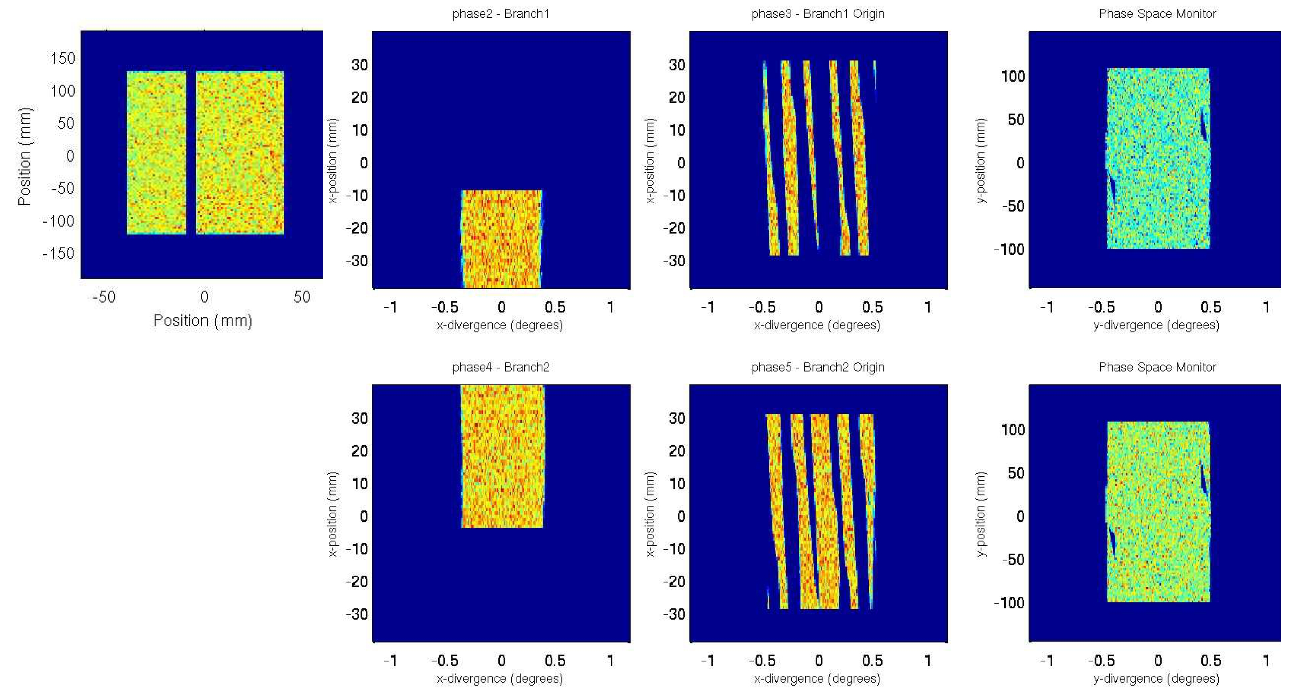
Endurance Instruments H24 thermal-neutron guide + instruments: D10+, IN13+, XtremeD, CT2, FIPPS
@ 2 Å ->
Both branches fully filled up to m = 2 divergence
Requires incoming source divergence m = 2.6

Slide 15
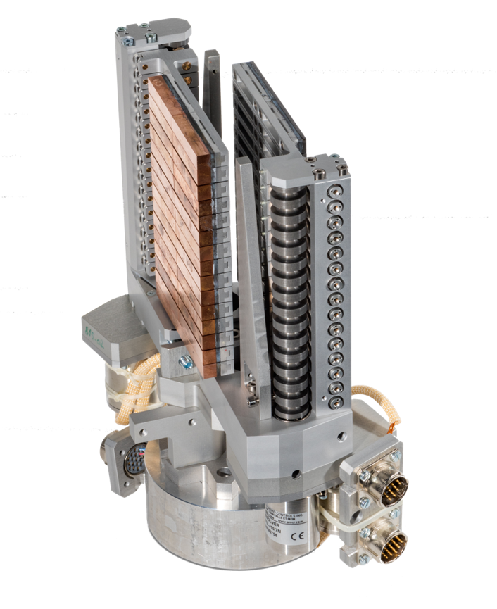
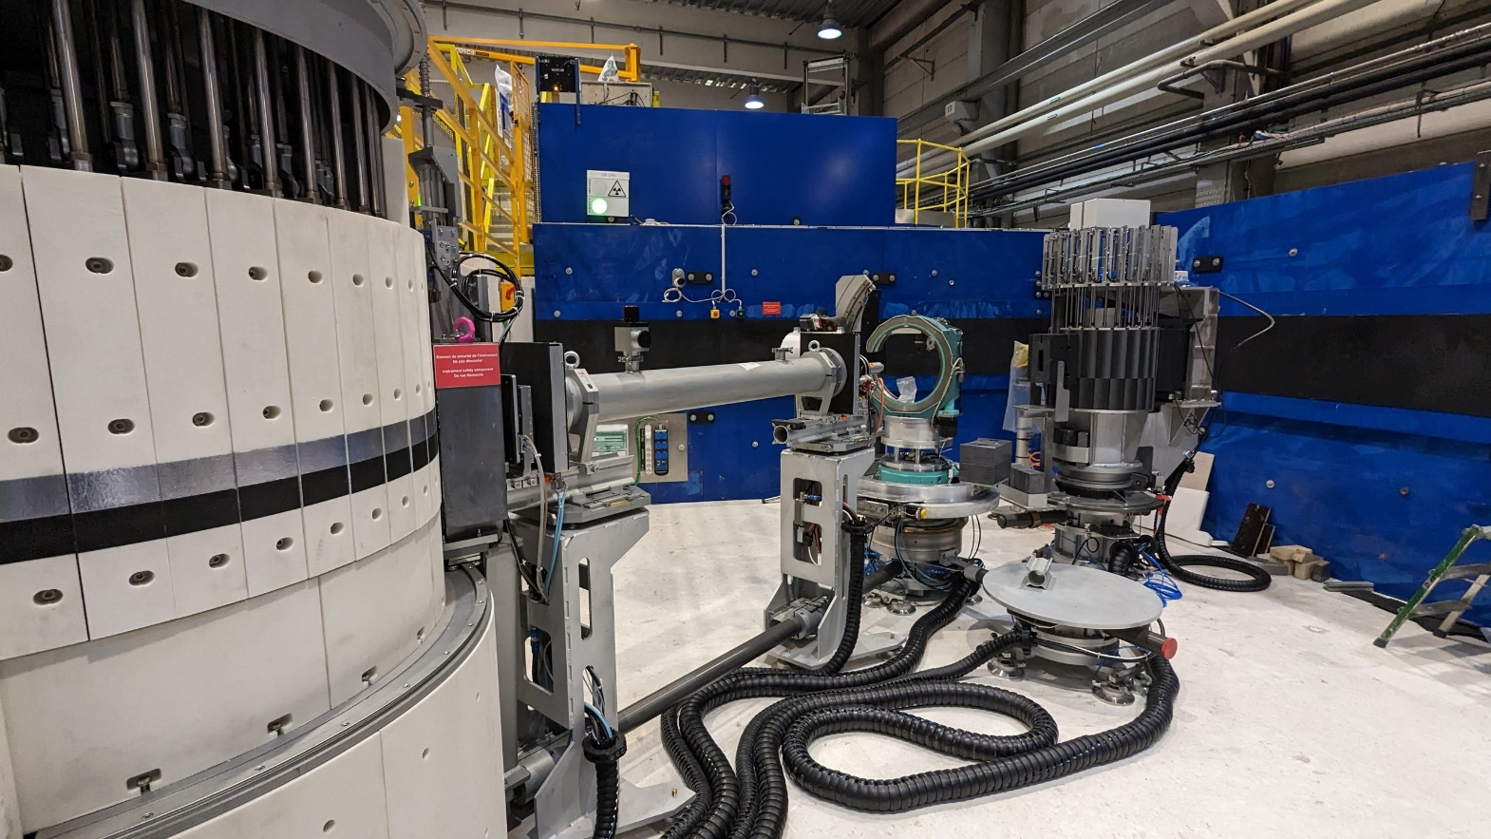
Endurance Instruments D10+: thermal single-crystal diffractometer – Commissioned & in user operation
Overall gains in performance of more than x10
x 3.3 flux in guide
x 6.6 flux on sample @ 1.2 Å
x 1.8 detector efficiency
Double-faced Cu / HOPG monochromator
B. Ouladdiaf, N. Katcho, P. Decarpentrie

Slide 16
Endurance Instruments H15 cold-neutron guide + instruments: T3, D(00)7, D11+, SAM, SHARP+
Vercors side instrument layout
SAM
T3
D11
D(00)7
SHARP+
Dedicated end-of-guide positions for all instruments with optimised divergence
Highly complex guide – both optically and engineering
optimised end-of-guide positions with dedicated optics for new instrumentation: T3, D(00)7, D11, SHARP+, SAM

Slide 17
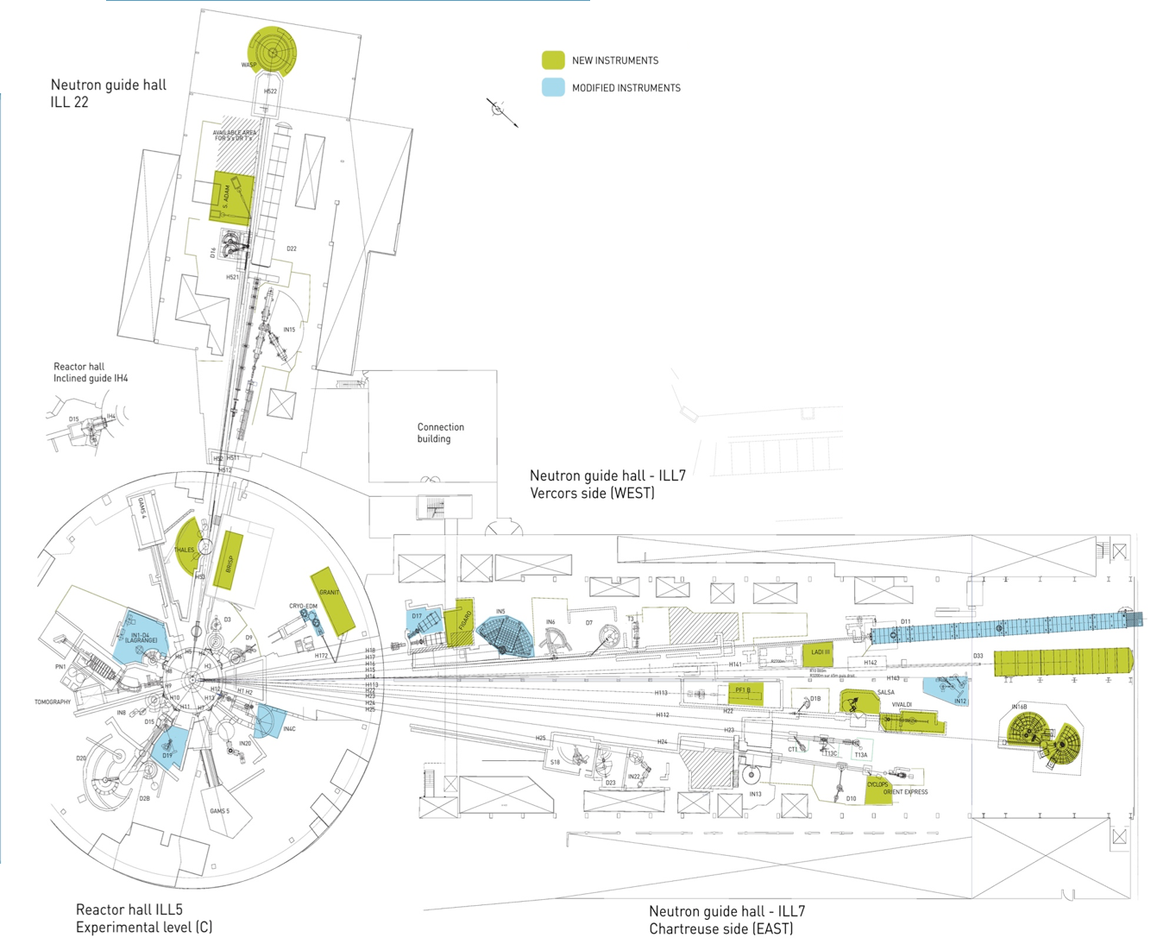
Endurance Instruments H15 cold-neutron guide + instruments: T3, D(00)7, D11+, SAM, SHARP+
Plan A
Seven dedicated end-of-guide positions from a single H15 source guide!
It is possible, but how?
This is crazy! (i.e. extremely expensive and highly complex)
GAPS
T3
D7+
RAMSES
X
D11
SAM
H15

Slide 18
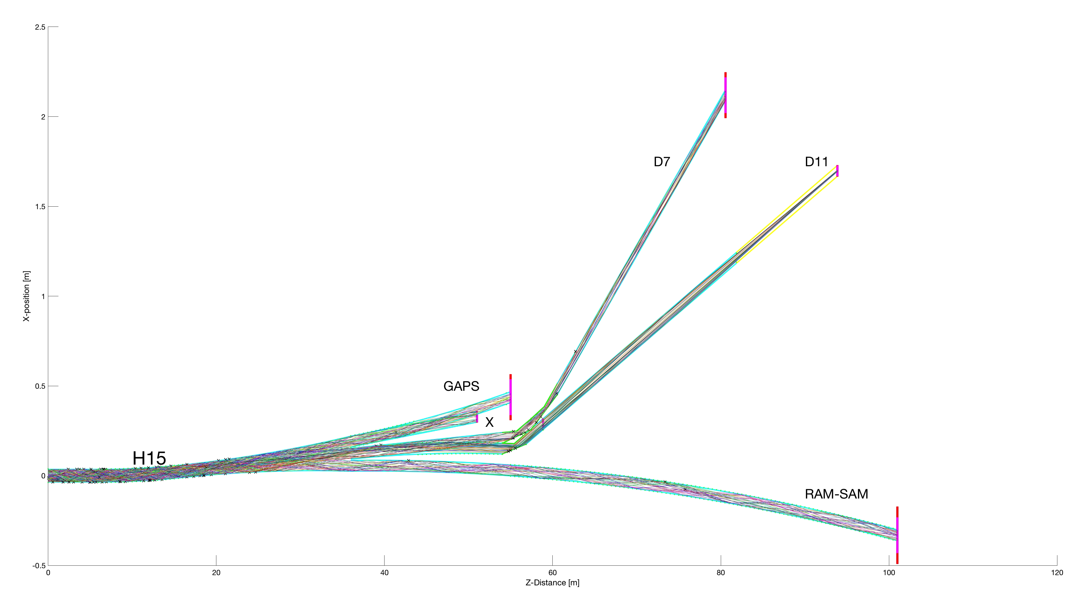
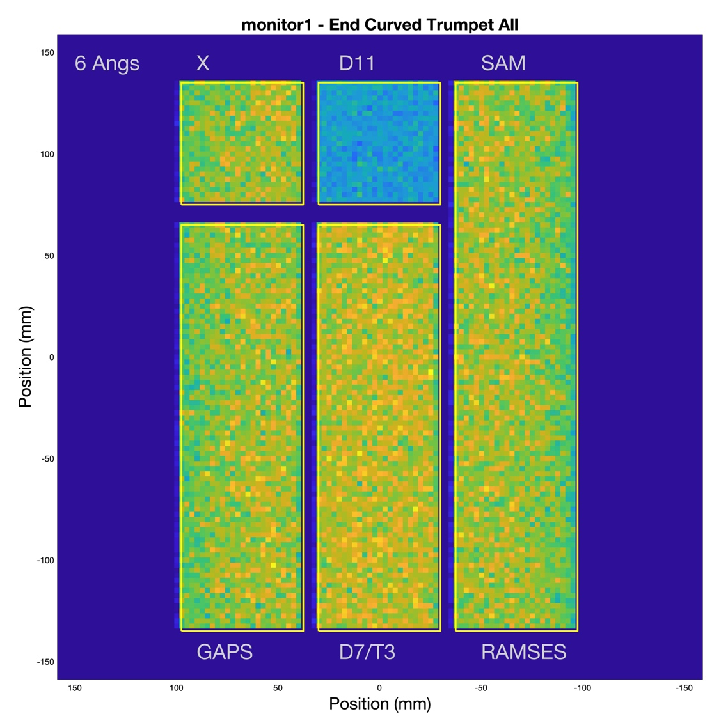
Endurance Instruments H15 cold-neutron guide + instruments: T3, D(00)7, D11+, SAM, SHARP+
Seven dedicated end-of-guide positions from a single H15 source guide!
It is possible, but how?
This is crazy! (i.e. extremely expensive and highly complex)
Notes:
As you can see from the 'simulation trace' of the H15 guide geometry it is an extremely complicated guide - both optically and in terms of engineering.
Again, the idea is to take what was a simple single neutron guide and split it into many high performance individual guide branches.
That way each instrument can optimise its guide and end-of-guide optics.
e.g.
SANS - fairly simple m=1 small guide requirements
BUT
spectrometers like D007 and SHARP+ will have large, m=2 guide cross-sections and will use focussing guide optics to fully optimise the instruments,

Slide 19
Endurance Instruments H15 cold-neutron guide + instruments: T3, D(00)7, D11+, SAM, SHARP+
Enlarged spatial filling & reduced divergence
Correlation between position & divergence:
Centred on exit tangent at extremities
Abrupt guide angle change at entrance & possible 'blind spot'
Incomplete phase-space transformation
Notes:
As you can see from the 'simulation trace' of the H15 guide geometry it is an extremely complicated guide - both optically and in terms of engineering.
Again, the idea is to take what was a simple single neutron guide and split it into many high performance individual guide branches.
That way each instrument can optimise its guide and end-of-guide optics.
e.g.
SANS - fairly simple m=1 small guide requirements
BUT
spectrometers like D007 and SHARP+ will have large, m=2 guide cross-sections and will use focussing guide optics to fully optimise the instruments,

Slide 20
Endurance Instruments H15 cold-neutron guide + instruments: T3, D(00)7, D11+, SAM, SHARP+
Enlarged spatial filling & reduced divergence
Enhanced correlation between position & divergence determined by exit tangents
Phase space not fractured
Notes:
As you can see from the 'simulation trace' of the H15 guide geometry it is an extremely complicated guide - both optically and in terms of engineering.
Again, the idea is to take what was a simple single neutron guide and split it into many high performance individual guide branches.
That way each instrument can optimise its guide and end-of-guide optics.
e.g.
SANS - fairly simple m=1 small guide requirements
BUT
spectrometers like D007 and SHARP+ will have large, m=2 guide cross-sections and will use focussing guide optics to fully optimise the instruments,

Slide 21
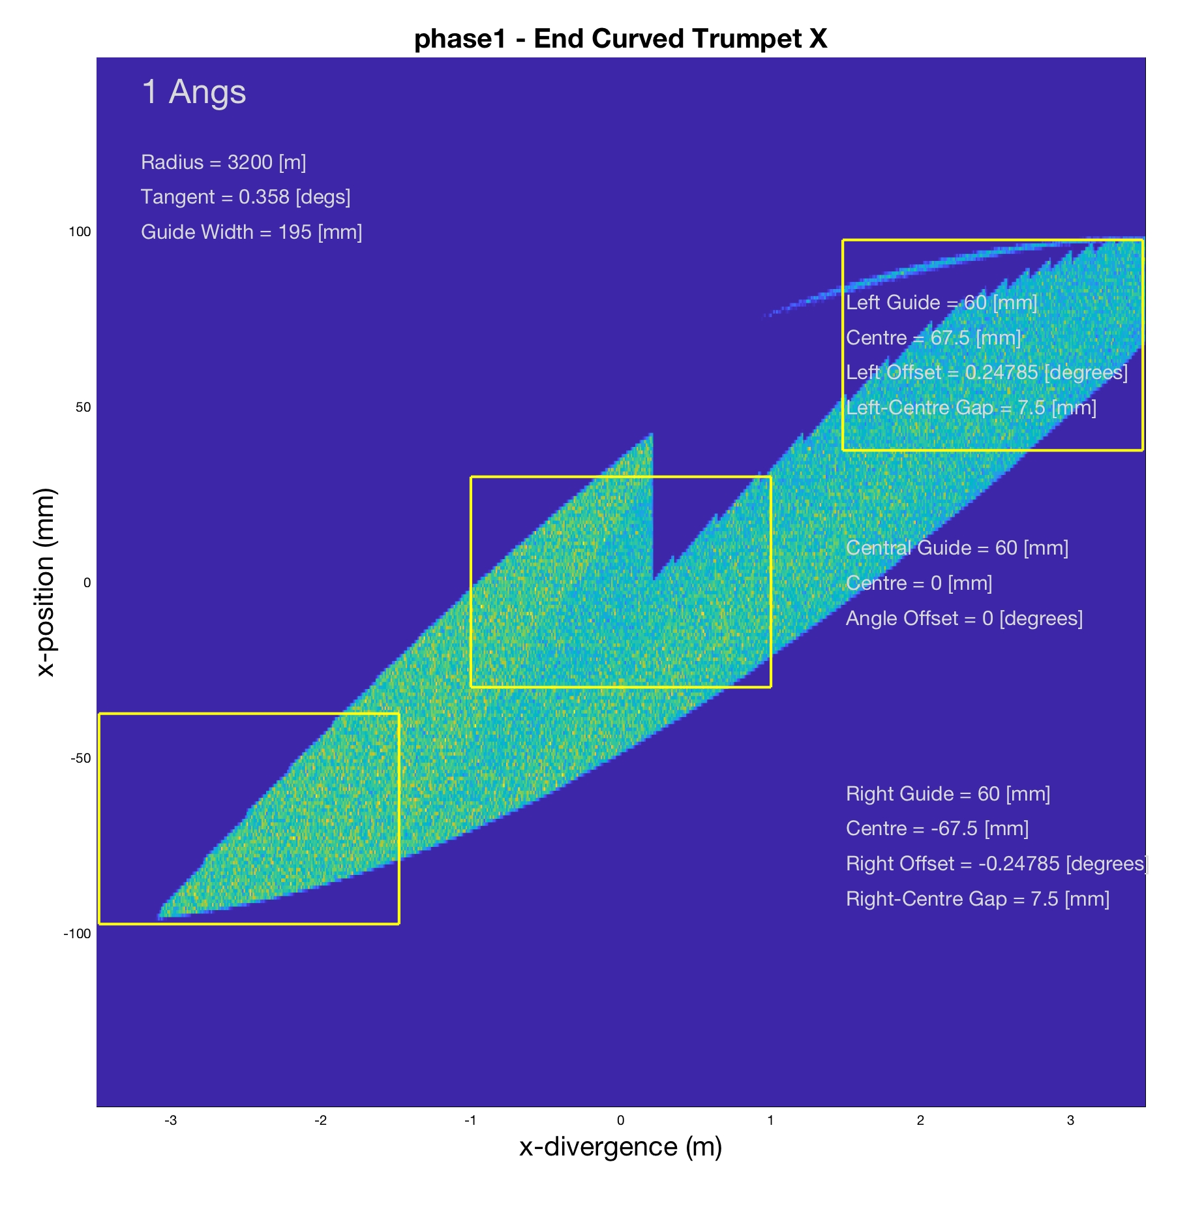
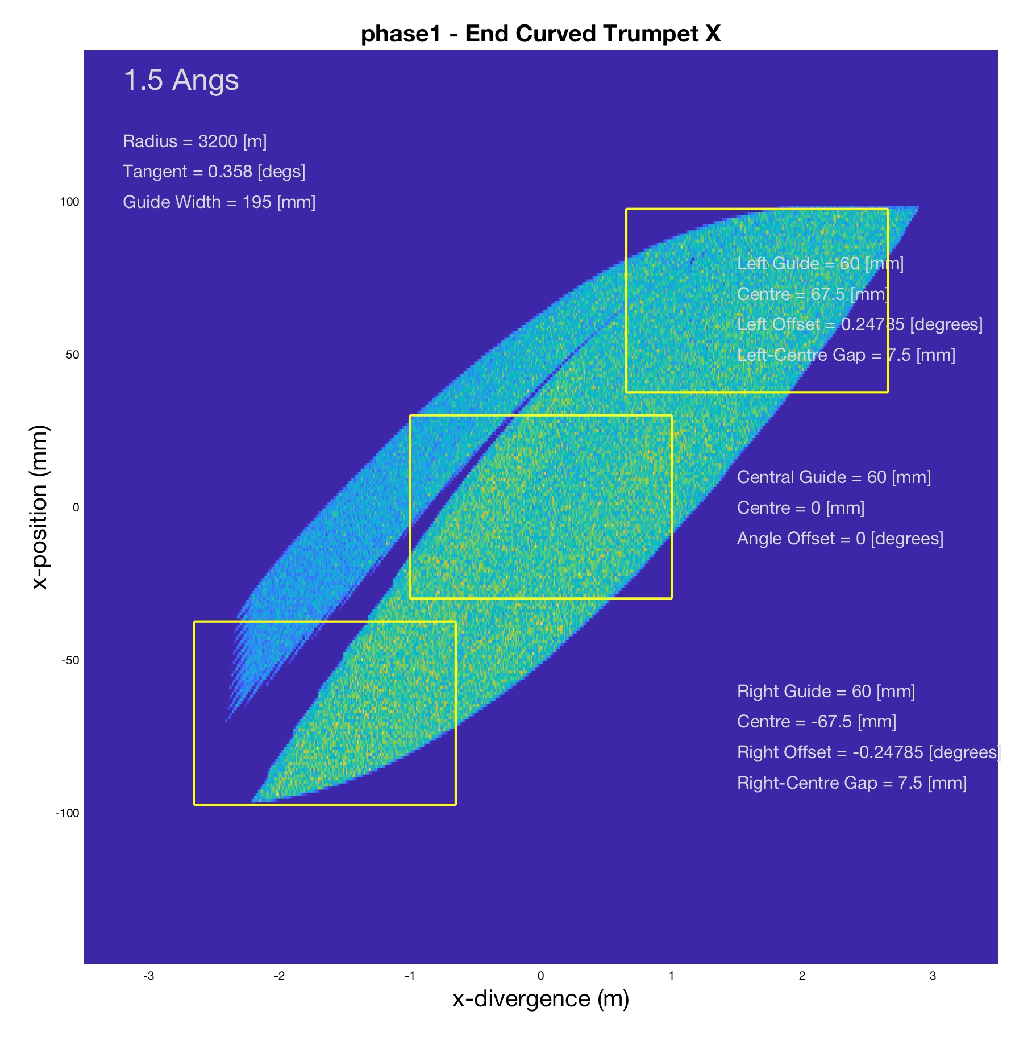
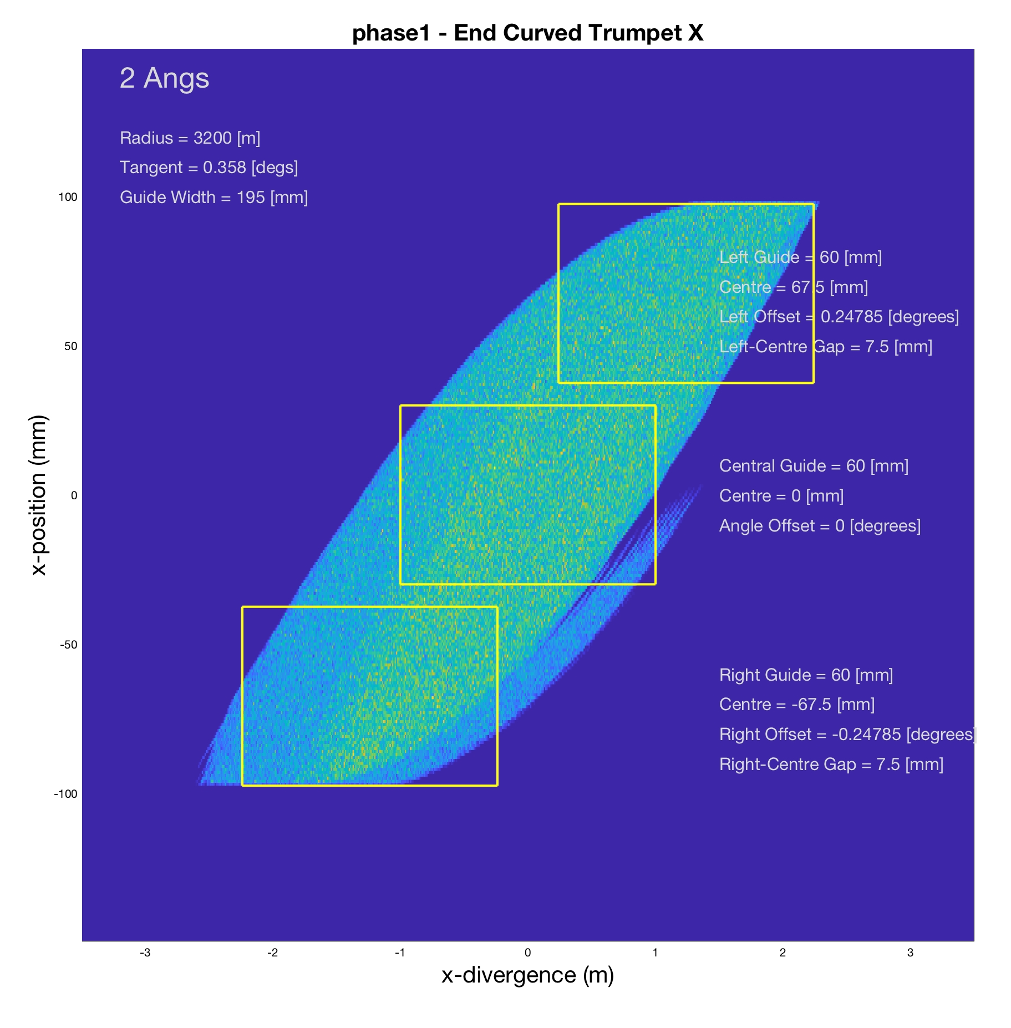
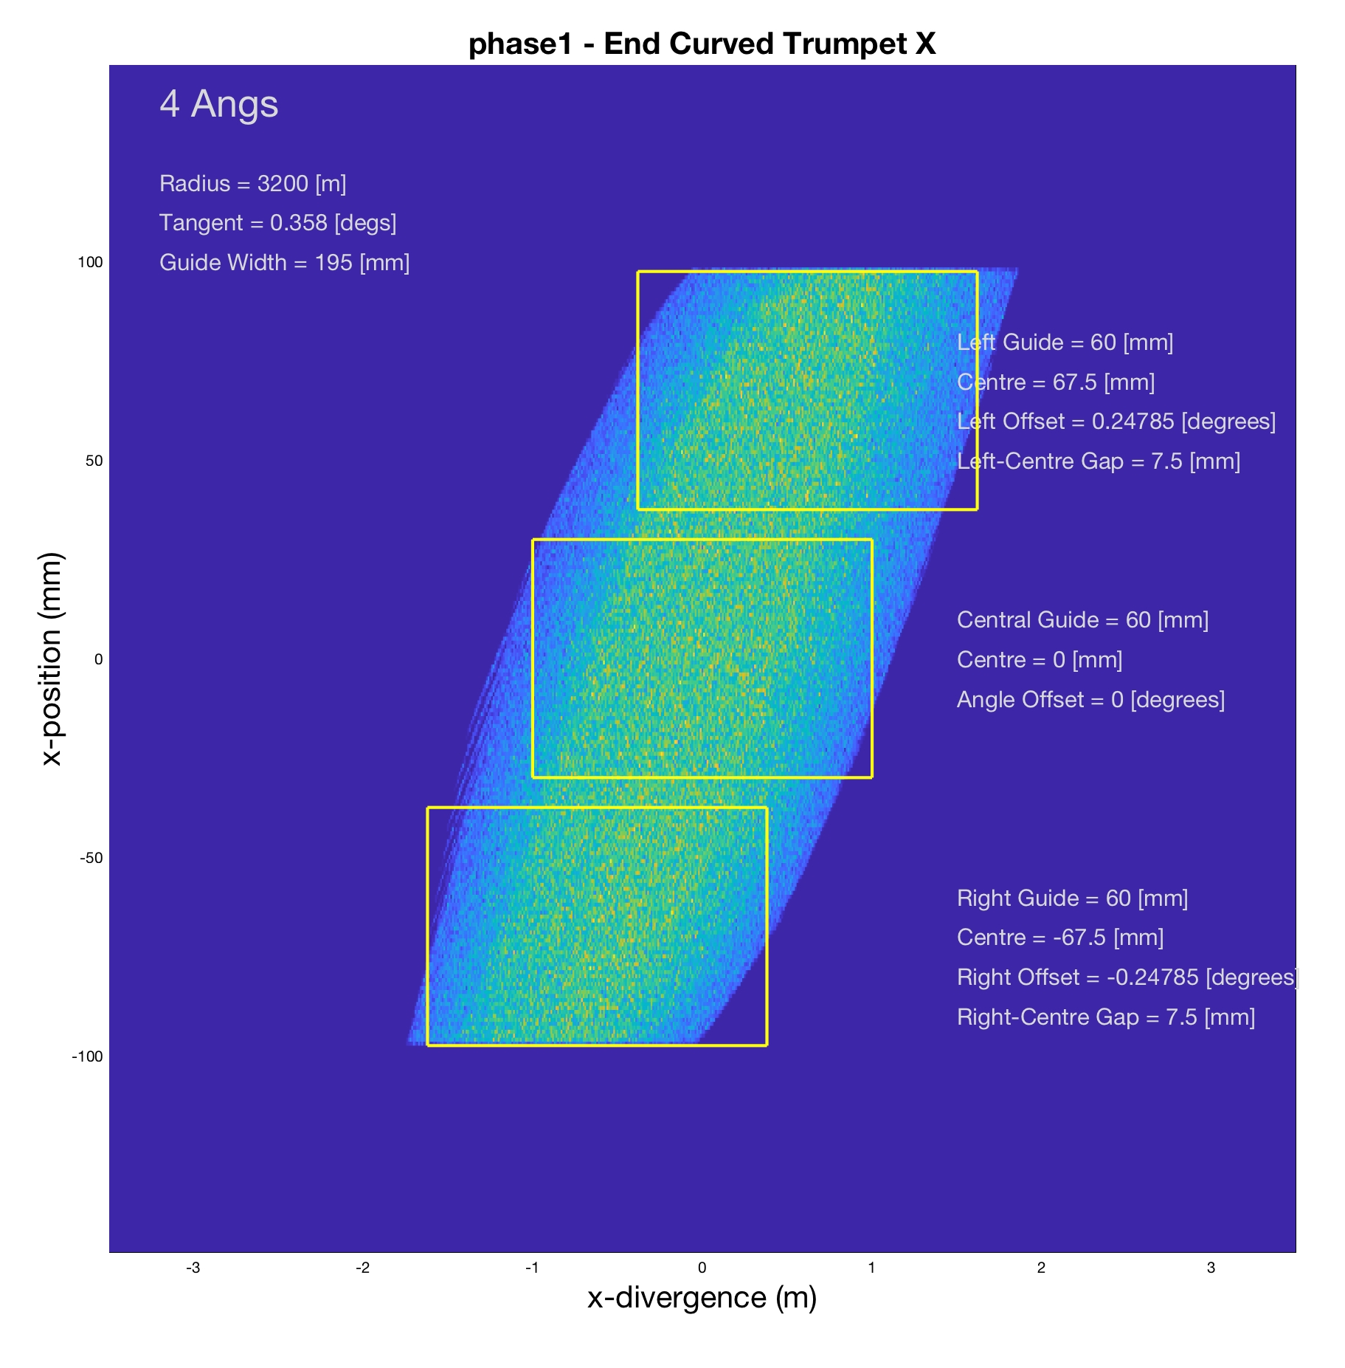
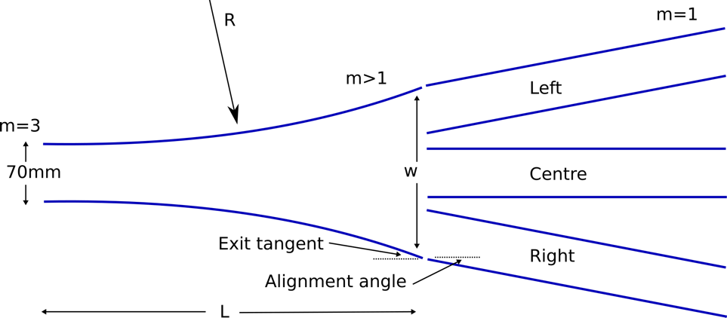
Endurance Instruments H15 cold-neutron guide + instruments: T3, D(00)7, D11+, SAM, SHARP+
H15 Monte-Carlo simulations
Enhanced correlation between position & divergence determined by exit tangents
Position guide branches centred on phase-space

Slide 22
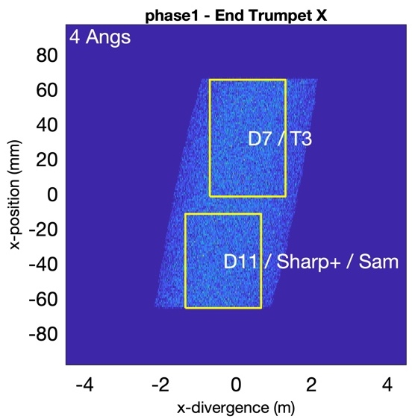
Endurance Instruments H15 cold-neutron guide + instruments: T3, D(00)7, D11+, SAM, SHARP+
2 m
D11
SHARP+
D(00)7
Elliptical focussing
Curved converging guide
D11 collimation
Polarising deflector
D007 / T3
Curved guide
T3
H15
SAM
Curved guide
Trumpet
Primary guide split
Deflector D11
100 m
Plan B: ‘Simplified’ multi-branch H15 guide
Drop GAPS & Instrument X
opposing-curved ‘trumpet’ (m=4) spatially expands the guide to to split into multiple branches
Engineering more reasonable but still highly complex
Financially more reasonable …..but still extremely expensive ~ 11 M€ ….guide only
Optimised end-of-guide positions & dedicated optics for new instrumentation: T3, D(00)7, D11, SHARP+, SAM

Slide 23
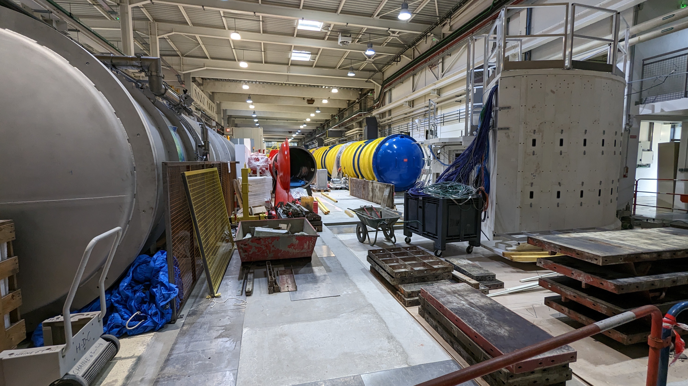
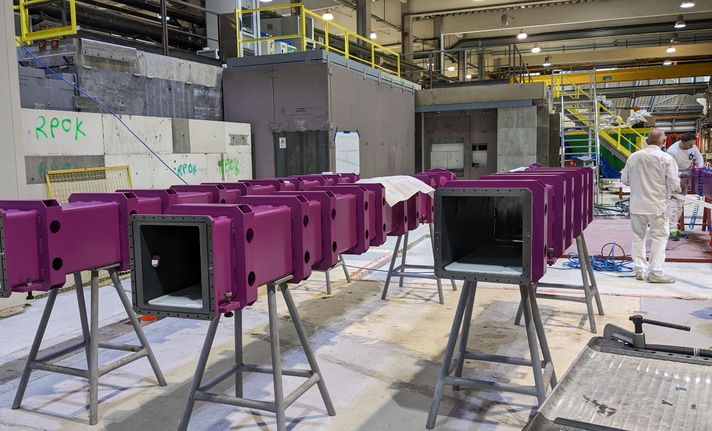
Endurance Instruments H15 cold-neutron guide + instruments: T3, D(00)7, D11+, SAM, SHARP+
March 2023
H15 guide installation continues during 2023
commissioning during 1st half 2024; project proceeds as planned
C. Dewhurst, B. Giroud, G. Manzin, J. Beaucour
Notes:
As I said: As of now, and as planned, mid-way though construction and due to be completed by the second half of 2024.
On the left you can see:
- D33,
- detector tube for SAM recently delivered
- relocated D11 detector tube in its new final position
- secondary spectrometer for SHARP+
Work continues in the guide hall on the mounting of the new H15 instruments and 'out-of-casemat' guide components during the reactor cycles of 2023

Slide 24
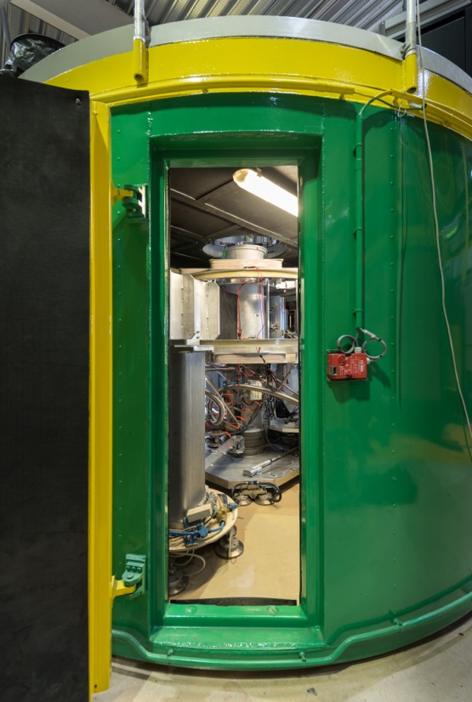
H15 Endurance Instruments D007: permanently-polarized diffuse-scattering diffractometer and spectrometer
new primary spectrometer with a dedicated guide
in-guide polarizing deflector
large focussing monochromator
evacuated flight path
expected flux gain > x10 D7
will allow for polarisation-analysis TOF spectroscopy
magnetic dynamics
quasielastic scattering
A. Wildes, L. Mangin-Thro, G. Manzin
Notes:
D007
When relocated onto the new H15 guide
- fully renewed primary spectrometer
- mostly renewed secondary spectrometer - including new PSD detectors
D007 should expect more than an order of magnitude in flux
This is very important because despite D007 being primarily a polarisation / analysis diffuse diffractometer with its chopper system it can also act as a spectrometer.
- the order of magnitudue in flux now makes polarisation / analysis spectroscopic studies realistic
- entirely unique at ILL
- But highly complimentary with the polarisation / analysis options such as PASTIS3 being installed on spectrometers such as IN20 and PANTHER.

Slide 25
Endurance: Neutron Guides
H16 (IN5) - double elliptic focusing (2019)
H24 (D10+, IN13, XTREMD, CT2, FIPPS) - common curved trumpet (2023)
H112 (IN16b) - variable focusing guide (2023)
H15 (T3, D007, D11, SAM, SHARP) - opposing curved trumpet (2024)
….with the associated gains on our instrument suite ~ x10
thank you for your attention
Notes:
D007
When relocated onto the new H15 guide
- fully renewed primary spectrometer
- mostly renewed secondary spectrometer - including new PSD detectors
D007 should expect more than an order of magnitude in flux
This is very important because despite D007 being primarily a polarisation / analysis diffuse diffractometer with its chopper system it can also act as a spectrometer.
- the order of magnitudue in flux now makes polarisation / analysis spectroscopic studies realistic
- entirely unique at ILL
- But highly complimentary with the polarisation / analysis options such as PASTIS3 being installed on spectrometers such as IN20 and PANTHER.

