Slide 1
Design and expected performance of the neutron guide systems at Breazeale Reactor at Penn State University
Márton Markó
Alex Szakál, Kenan Ünülü, Péter Kárpáti

Slide 2
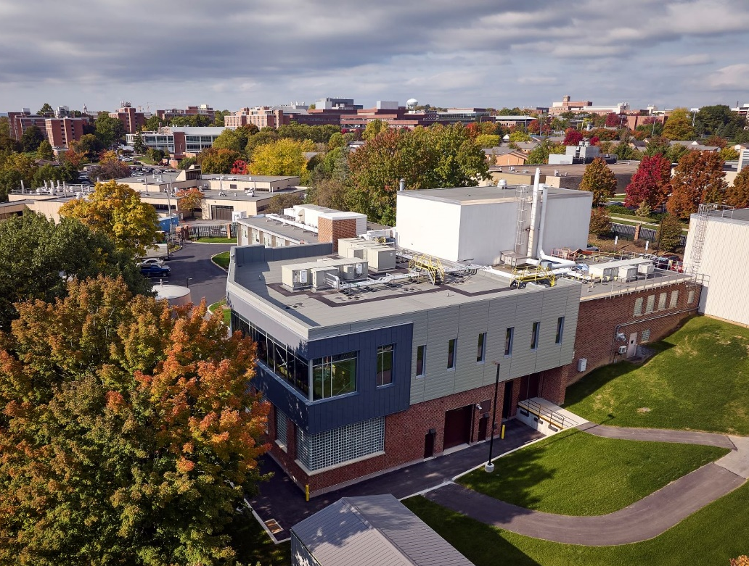
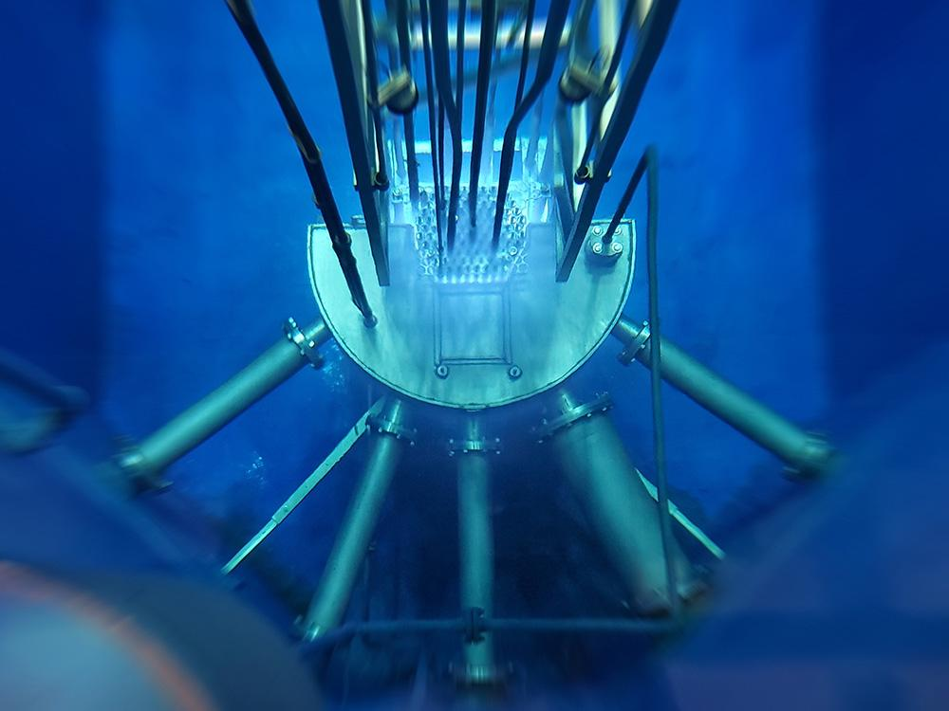
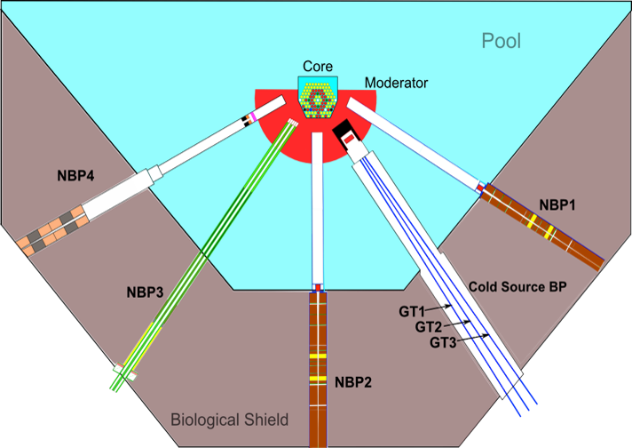
GOAL
Breazeale Reactor
1MW research reactor
built in 1955
Reconstructed in 2020
Under installation:
Cold source
Guide system

Slide 3
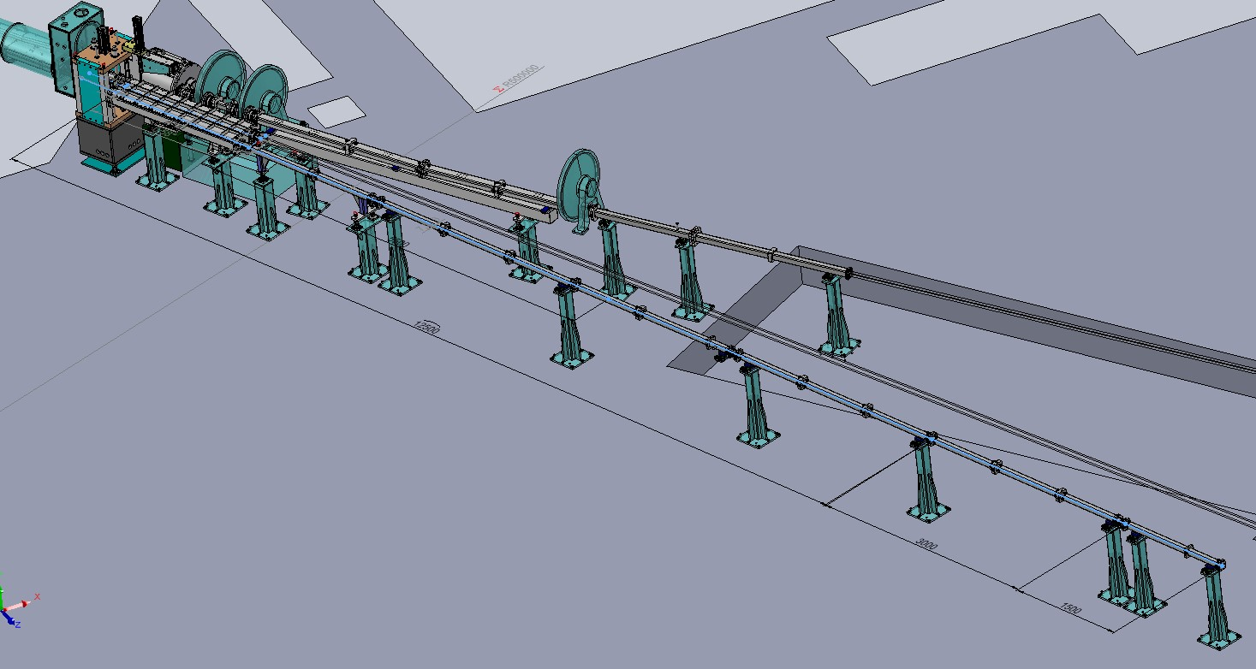
GOAL
GOAL OF THE NEUTRON GUIDE SYSTEM
3 + 1 COLD INSTRUMENTS:
PGAA & NDP:
SANS
(V16 from Berlin)
TBD
3 NEUTRON GUIDES

Slide 4
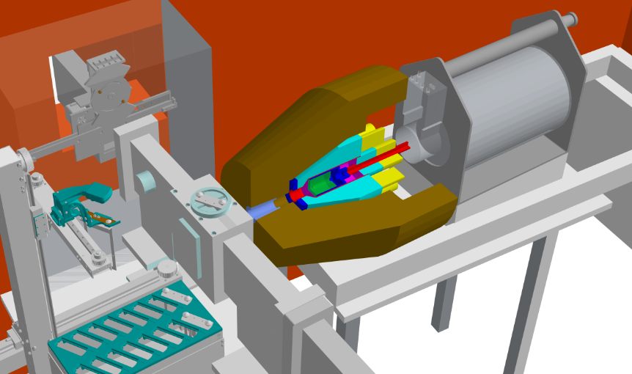
INSTRUMENTAL NEEDS
PGAA & NDP:
  White beam
  Thermal equivalent intensity
  ∼ cm sample
  Low bacground: γ, n, and other particles
    Moderate divergence
Neutron beam
Detector
Sample
Vacuum chamber

Slide 5
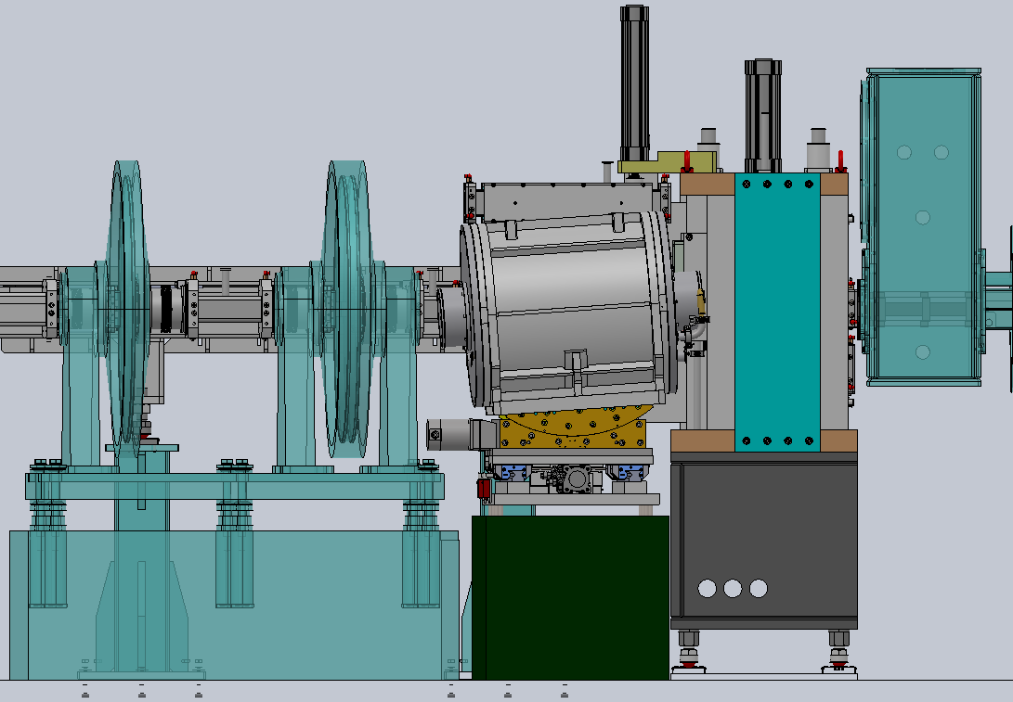
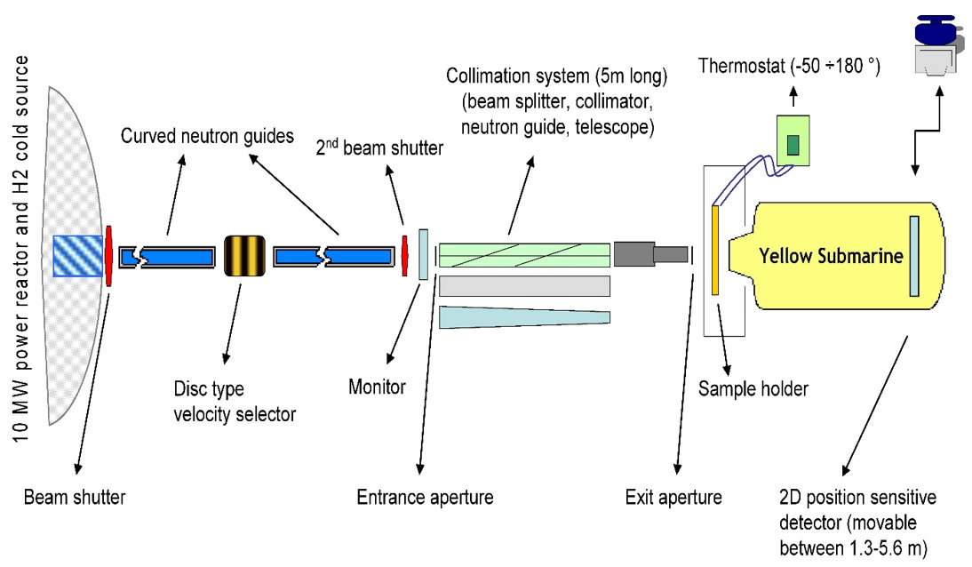
INSTRUMENTAL NEEDS
SANS:
  Moderate wavelength resolution (3-20 %)
  Divergence: 0.3º – 1.2 º
  Beam spot: 2-8 cm total width
  0.5 - 2cm sample size
  λ_{min} = 3Å
TOF mode: choppers
CW mode: velocity selector

Slide 6
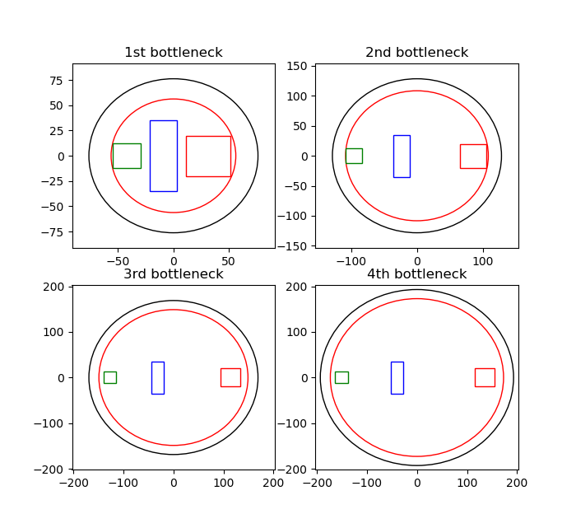
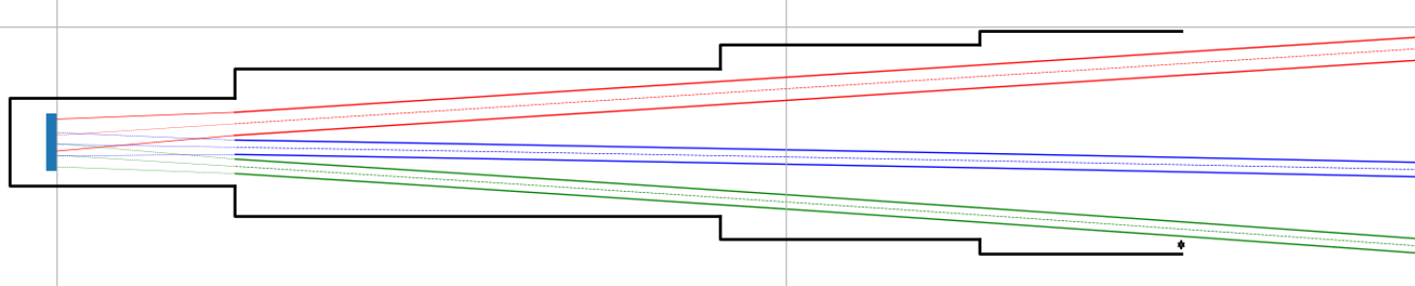
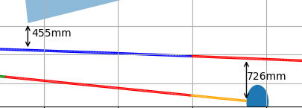
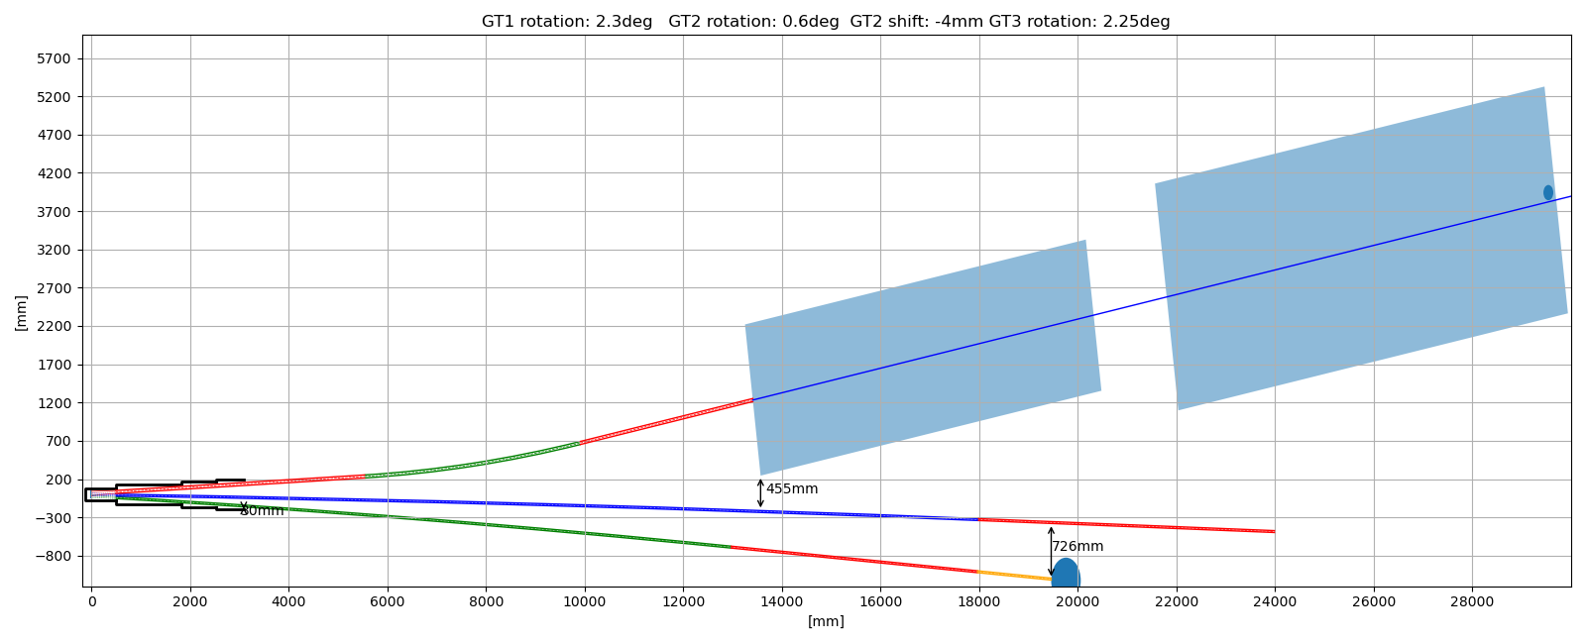
CONSTRAINTS
CONSTRAINTS
In-pile section with vacuum jacket
Guide hall
SANS collimator house
PGAA / NDP background

Slide 7
DESIGN – GENERAL OVERVIEW
Guide cross-sections
Guide Shapes
  GT1: SANS: 4X4cm
  GT2: Middle guide: 2.5 X 10 cm
  GT3: PGAA & NDP: 2.5 X 2.5 cm
  SANS: straight – bender – straight - focusing
  Middle guide: curved – straight – flight tube
  PGAA & NDP: curved - straight

Slide 8
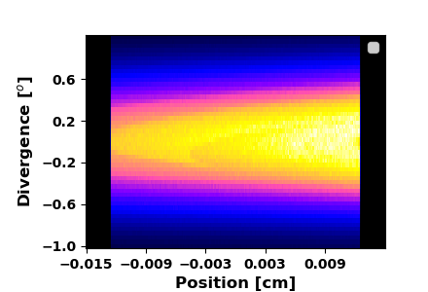
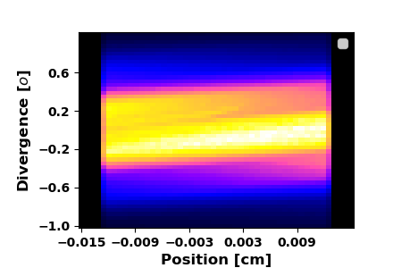
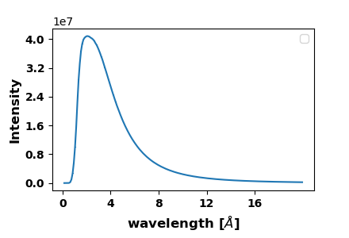
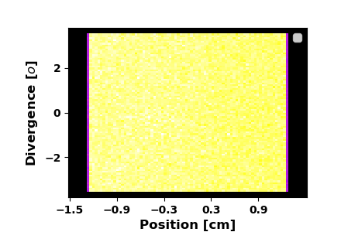
DESIGN GT2 guide
GT2 middle guide
  Will be built later
  Designed for high intensity
  70 X 25 mm (h,w)
  Curved guide: 17.5m, m=3
  R = 1120 m
  Straight guide: 7m, m=3
  flux: 9.8e7 n/s/cm²
Phase space: curved guide
Phase space: at the end

Slide 9
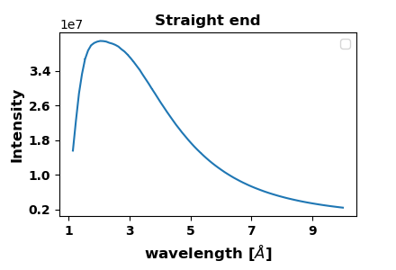
DESIGN GT2 guide
GT2 middle guide
  Will be built later
  Designed for high intensity
  70 X 25 mm (h,w)
  Curved guide: 17.5m, m=3
  R = 1120 m
  Straight guide: 7m, m=3
  flux: 9.8e7 n/s/cm²
Phase space: curved guide
Phase space: at the end

Slide 10
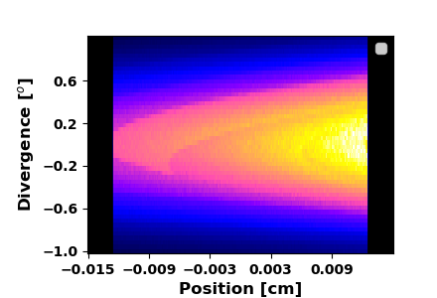
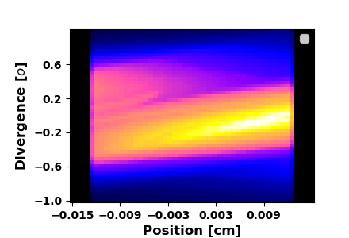
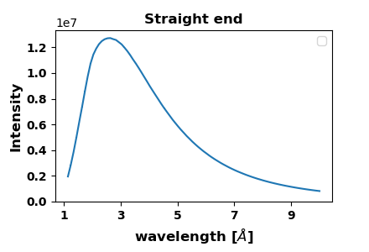
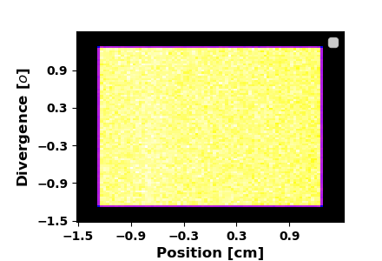
DESIGN GT3: PGAA / NDP
GT3 PGAA & NDP
  25 X 25 mm (h,w)
  Curved guide: 12.5m, m=3
  Straight guide: 3m, m=3
  R = 500 m
  Flight tube: 1.5m
  I_{tot} : 8.3e7 n/s
  I_{therm.eq}: 2.3e8 n/s

Slide 11
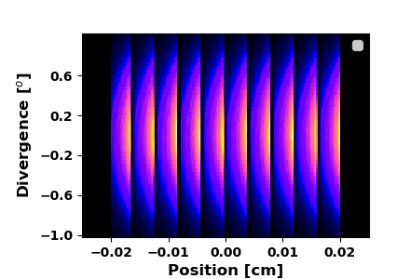
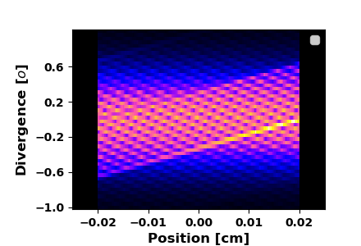
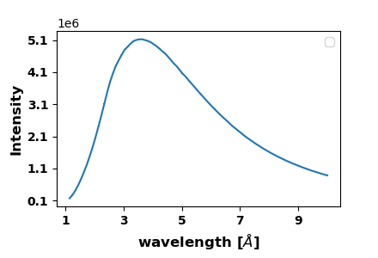
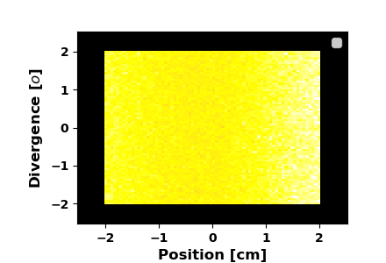
DESIGN GT1 SANS
GT1 SANS
  40 X 40 mm (h,w)
  Straight guide: 5m, m=3
  Bender: 4.4 m, 10 ch.
  m=3.5, m=2, R=37m
  Straight guide: 3.5 m, m=1.2
  3 X 2m focusing guide m = 1.5
  flux: 1.7e7 n/s/cm²

Slide 12
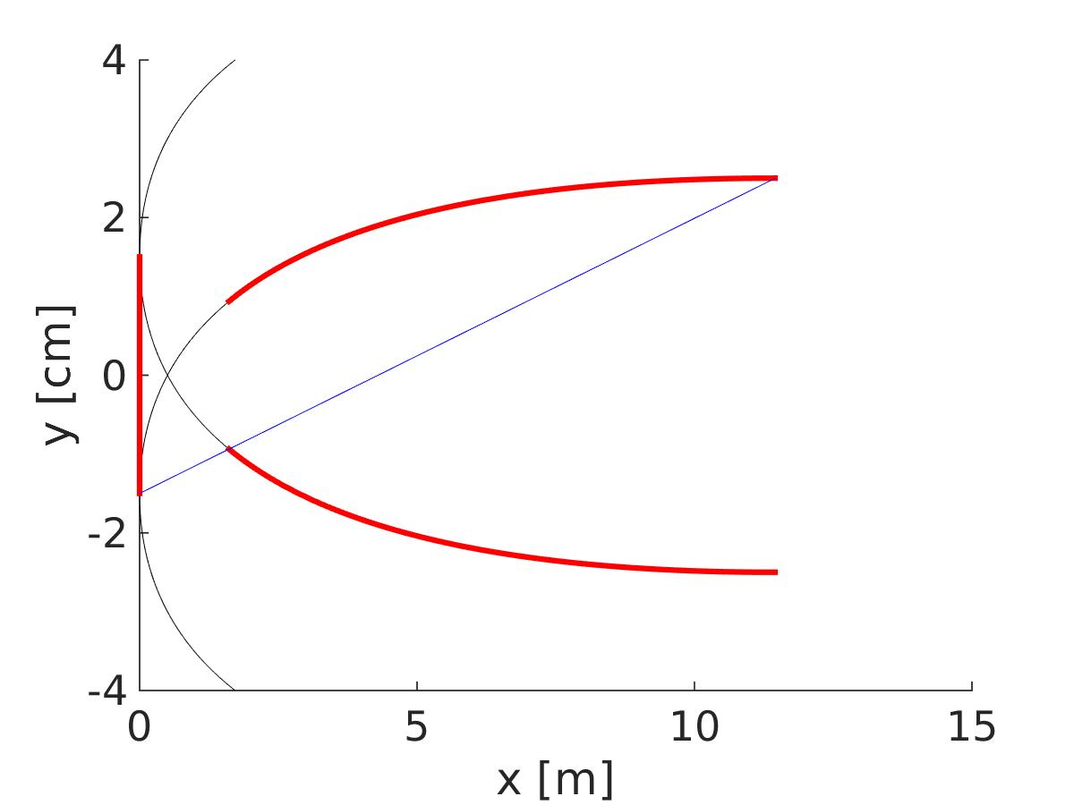
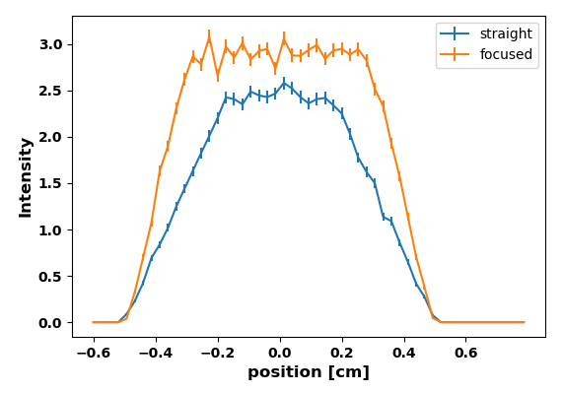
DESIGN GT1 SANS
SANS Collimation section
    Sample – detector distance:
7.7m : 0.3º
1.7m : 1.2º
    Straight / focusing guides
    in collimation section
Intensity gain = 1.4
centre shift: 0 whithin error
FWHM (GE} 0.51 cm 0.545 cm
N. Stüßer,T.Hofmann NIM A 727(2013)84–89

Slide 13
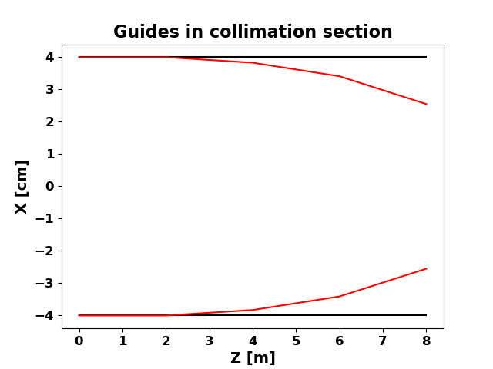
DESIGN GT1 SANS
SANS Collimation section
    Sample – detector distance:
7.7m : 0.3º
1.7m : 1.2º
    Straight / focusing guides
    in collimation section
Intensity gain = 1.4
centre shift: 0 whithin error
FWHM (GE} 0.51 cm 0.545 cm

Slide 14
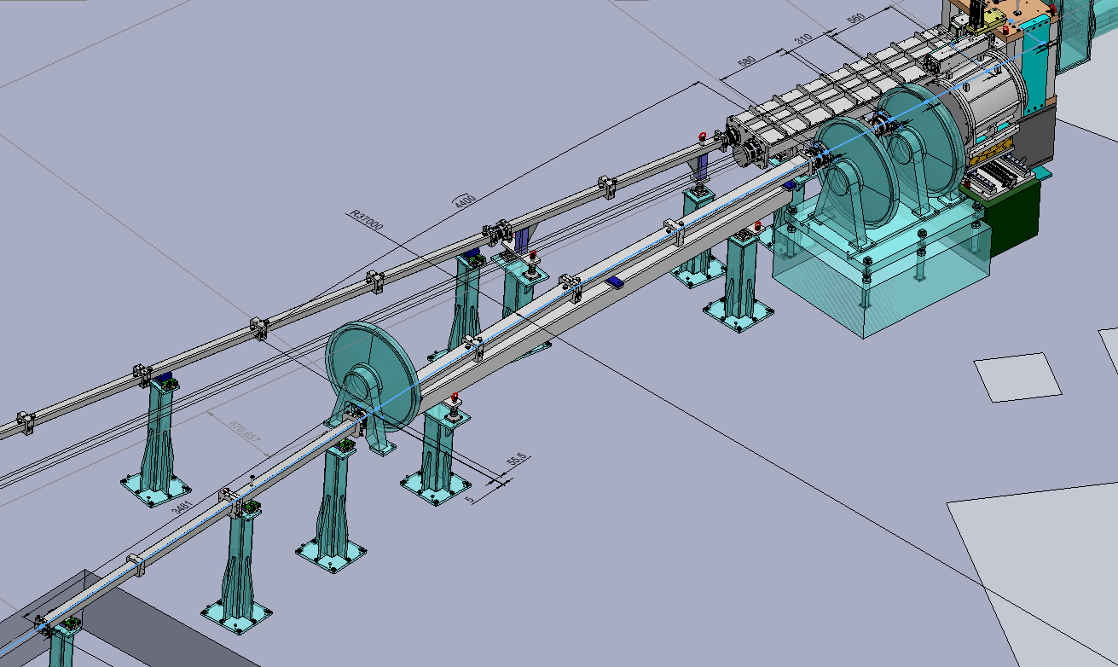
DESIGN GT1 SANS
Chopper system:
1. ch: 0m 11.1º
2. ch: 0.05m 22.2º
3. ch: 0.6m 26.32º
4. ch: 5.1m 60º
Detector: 18.3m - 23.4m

Slide 15
DESIGN GT1 SANS
3 (+∞) Chopper modes
 | A (HR) | B (HI) | C (HWB)
Pulse shaping | CH #1 | CH #3 | CH # 2 double speed
Frame overlap | CH #3 | CH #2 | CH #3
Wavelength Band | CH #4 | CH #4 | CH #4
 | A (HR) | B (HI) | C (HWB)
Wavelength band [Å] | 5.8 | 5 | 7.4
Intensity [1e4 n/cm/s] | 3.7 | 5.2 | 4
f [1/s] | 20.1 | 29.4 | 36.7

Slide 16
DESIGN GT1 SANS
3 (+∞) Chopper modes
 | A (HR) | B (HI) | C (HWB)
Pulse shaping | CH #1 | CH #3 | CH # 2 double speed
Frame overlap | CH #3 | CH #2 | CH #3
Wavelength Band | CH #4 | CH #4 | CH #4
 | A (HR) | B (HI) | C (HWB)
Wavelength band [Å] | 5.8 | 5 | 7.4
Intensity [1e4 n/cm/s] | 3.7 | 5.2 | 4
f [1/s] | 20.1 | 29.4 | 36.7

Slide 17
Analitical / MC calcuations
Calculation ws simulation:
Real FWHM
GE FWHM (from variance) simulation
GE FWHM (from variance) from calculation

Slide 18

DESIGN GT1 SANS
Possible resolution / wawelength map for different tilt angle
Velocity selector
For continuous mode
with relaxed resolution
8% resolution from 6Å
18% at 2Å
(40 % at 1.2Å)

Slide 19
Thanks to
Kenan Ünülü (PSU)
Alex Szakál (CER, BNC)
Péter Kárpáti (CER, BNC)
Daniel Clemens (HZB)
László Szentmiklósi (CER, BNC)
László Almásy(CER, BNC)
MIRROTRON company

Slide 20
Thank you for your attention!

