Slide 1
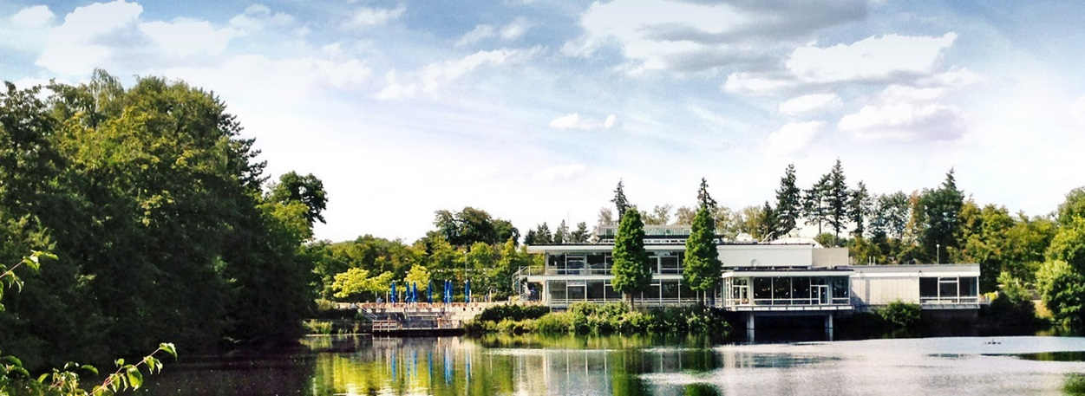


The new versions 3.5 and 4.0 of the vitess simulation package
6th International Workshop
Neutron Delivery Systems, NDS 2023
Grenoble, 11 - 14 Oct 2022
K. Lieutenant
F. Beule
J. Voigt
P. Zakalek
Z. Ma

Slide 2
Aim and Features of Vitess
Aims
  Simulation of neutron scattering instruments
  Virtual neutron scattering experiments
Options
  GUI
  Modular structure
  Polarisation included
  Absolute flux values calculated
  …

Slide 3
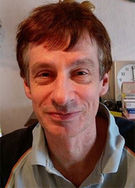

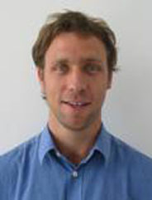
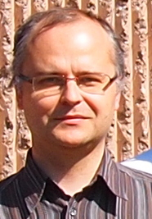
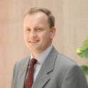
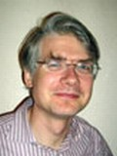
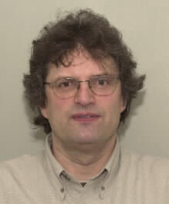
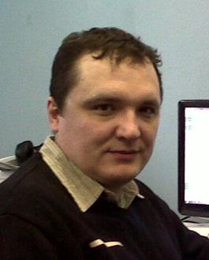
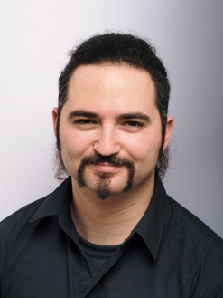
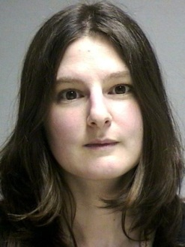
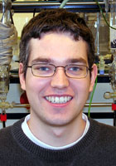
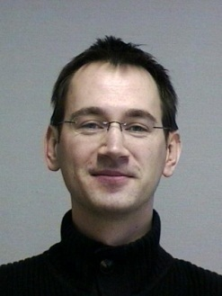
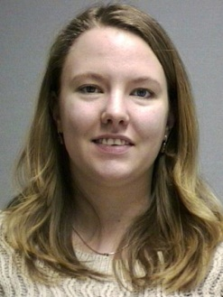
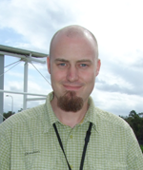
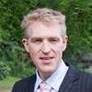
VITESS Team
Current developer team (FZJ, since 2019)
Klaus Lieutenant Fabian Beule Paul Zakalek Jörg Voigt
First developers (1999 – 2005) ESS Upgrade phase (2011 – 2014)
Geza Zsigmond Dietmar Wechsler Friedrich Streffer Michael Fromme Sergey Manoshin Daniil Nekrassov Carolin Zendler
Contributing authors
  Andreas Houben Mirko Boin Jennifer Schulz Phillip Bentley Dickon Champion

Slide 4
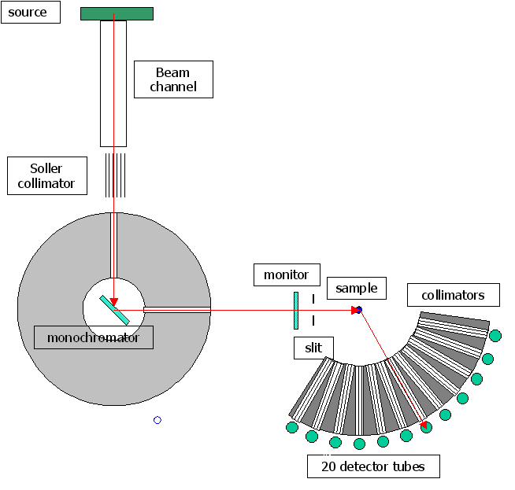
Realization by Monte Carlo Simulations
Basic Idea: Random choice of parameters instead of scanning through parameter space
free parameters:
wavelength λ
initial position x,y
initial direction v_{hor}/v, v_{vert}/v
dir. after monochr. θ_{m}, φ_{m}
scattering direction θ_{s}, φ_{s}

Slide 5
Modules representing Components in vitess 3.4
Sources
reactor
SPSS
LPSS
Space + Windows
space
slit
window/ beamstop
multiple windows
grid
beamstop
Choppers
disc
Fermi str.
Fermi curv.
vel.select
Monochr.
new
old
Modules f. Polaris.
³He-polar.
coil flipper
prec. field
quadr.field
pol. mirror
SM-polar.
grad. flipper
rot. field
res. Drabkin
Samples
elast. isotr.
powder
SANS
reflectom.
environm.
inelastic
NXS
S(Q)
sngl.crys.
Collimator
simple coll.
Soller coll.
radial coll.
Optics / Transport
guide
bender
SM ensemb
lens
ellipt. mirror
ideal guide
Various
detector
capture flux
5

Slide 6
Modules for Data Evaluation
Monitor 1
Time
Wavelen
y-/z-pos
div-y/-z
Mon1D
MonBrill
Monitor 2
y-pos z-pos
div-y div-z
TOF λ
λ div_y/-z
y div-y
z div-z
k-y
k-z
rad
div-rad
Mon2D
MonPol 1
Time
Wavelen
y-/z-pos
div_y/-z
MonPol 2
y-pos z-pos
Evaluate
elast
elast2
inelast
runtime
elast_sans
Geometr.
frame
Trajector.
writeout
spin_reset
capt_flux
visualize

Slide 7
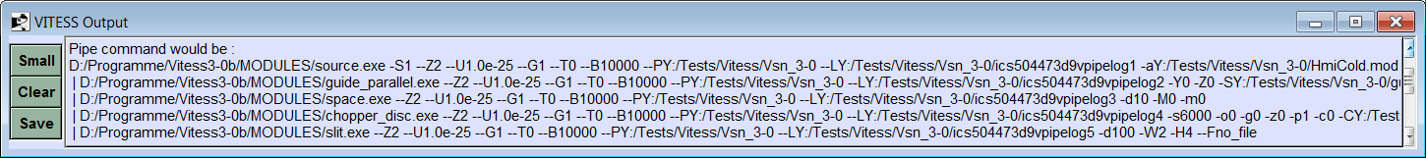
Concept of VITESS
graphical user interface
parameters
parameters
parameters
parameters
source
module 2
monitor
module n
sim_data
param.file
param. file
I(par)
log_file
instrument.inf

Slide 8
New features in Vitess 3.5 and 4.0
General
  Reflectivity curves for supermirror coating updated 3.5
  Code tided up 3.5
  Safe connection between GUI and kernel 3.5
  Blow up of width and height in the visualization 3.5 or 4.0
  New visualization tool (GR from FZ Jülich) 3.5 or 4.0
  New GUI (Qt) 4.0
Instrument simulations for HBS
  Source module for CANS 3.5
  Rotating monochromator 3.5
  Improved import and export of neutron trajectories 3.5
Virtual experiments at MLZ
  Improved reflectometer sample 3.5
  Monitor update during run 3.5
  Instrument saved as YAML file 4.0
  Avoiding parameters from file 4.0

Slide 9
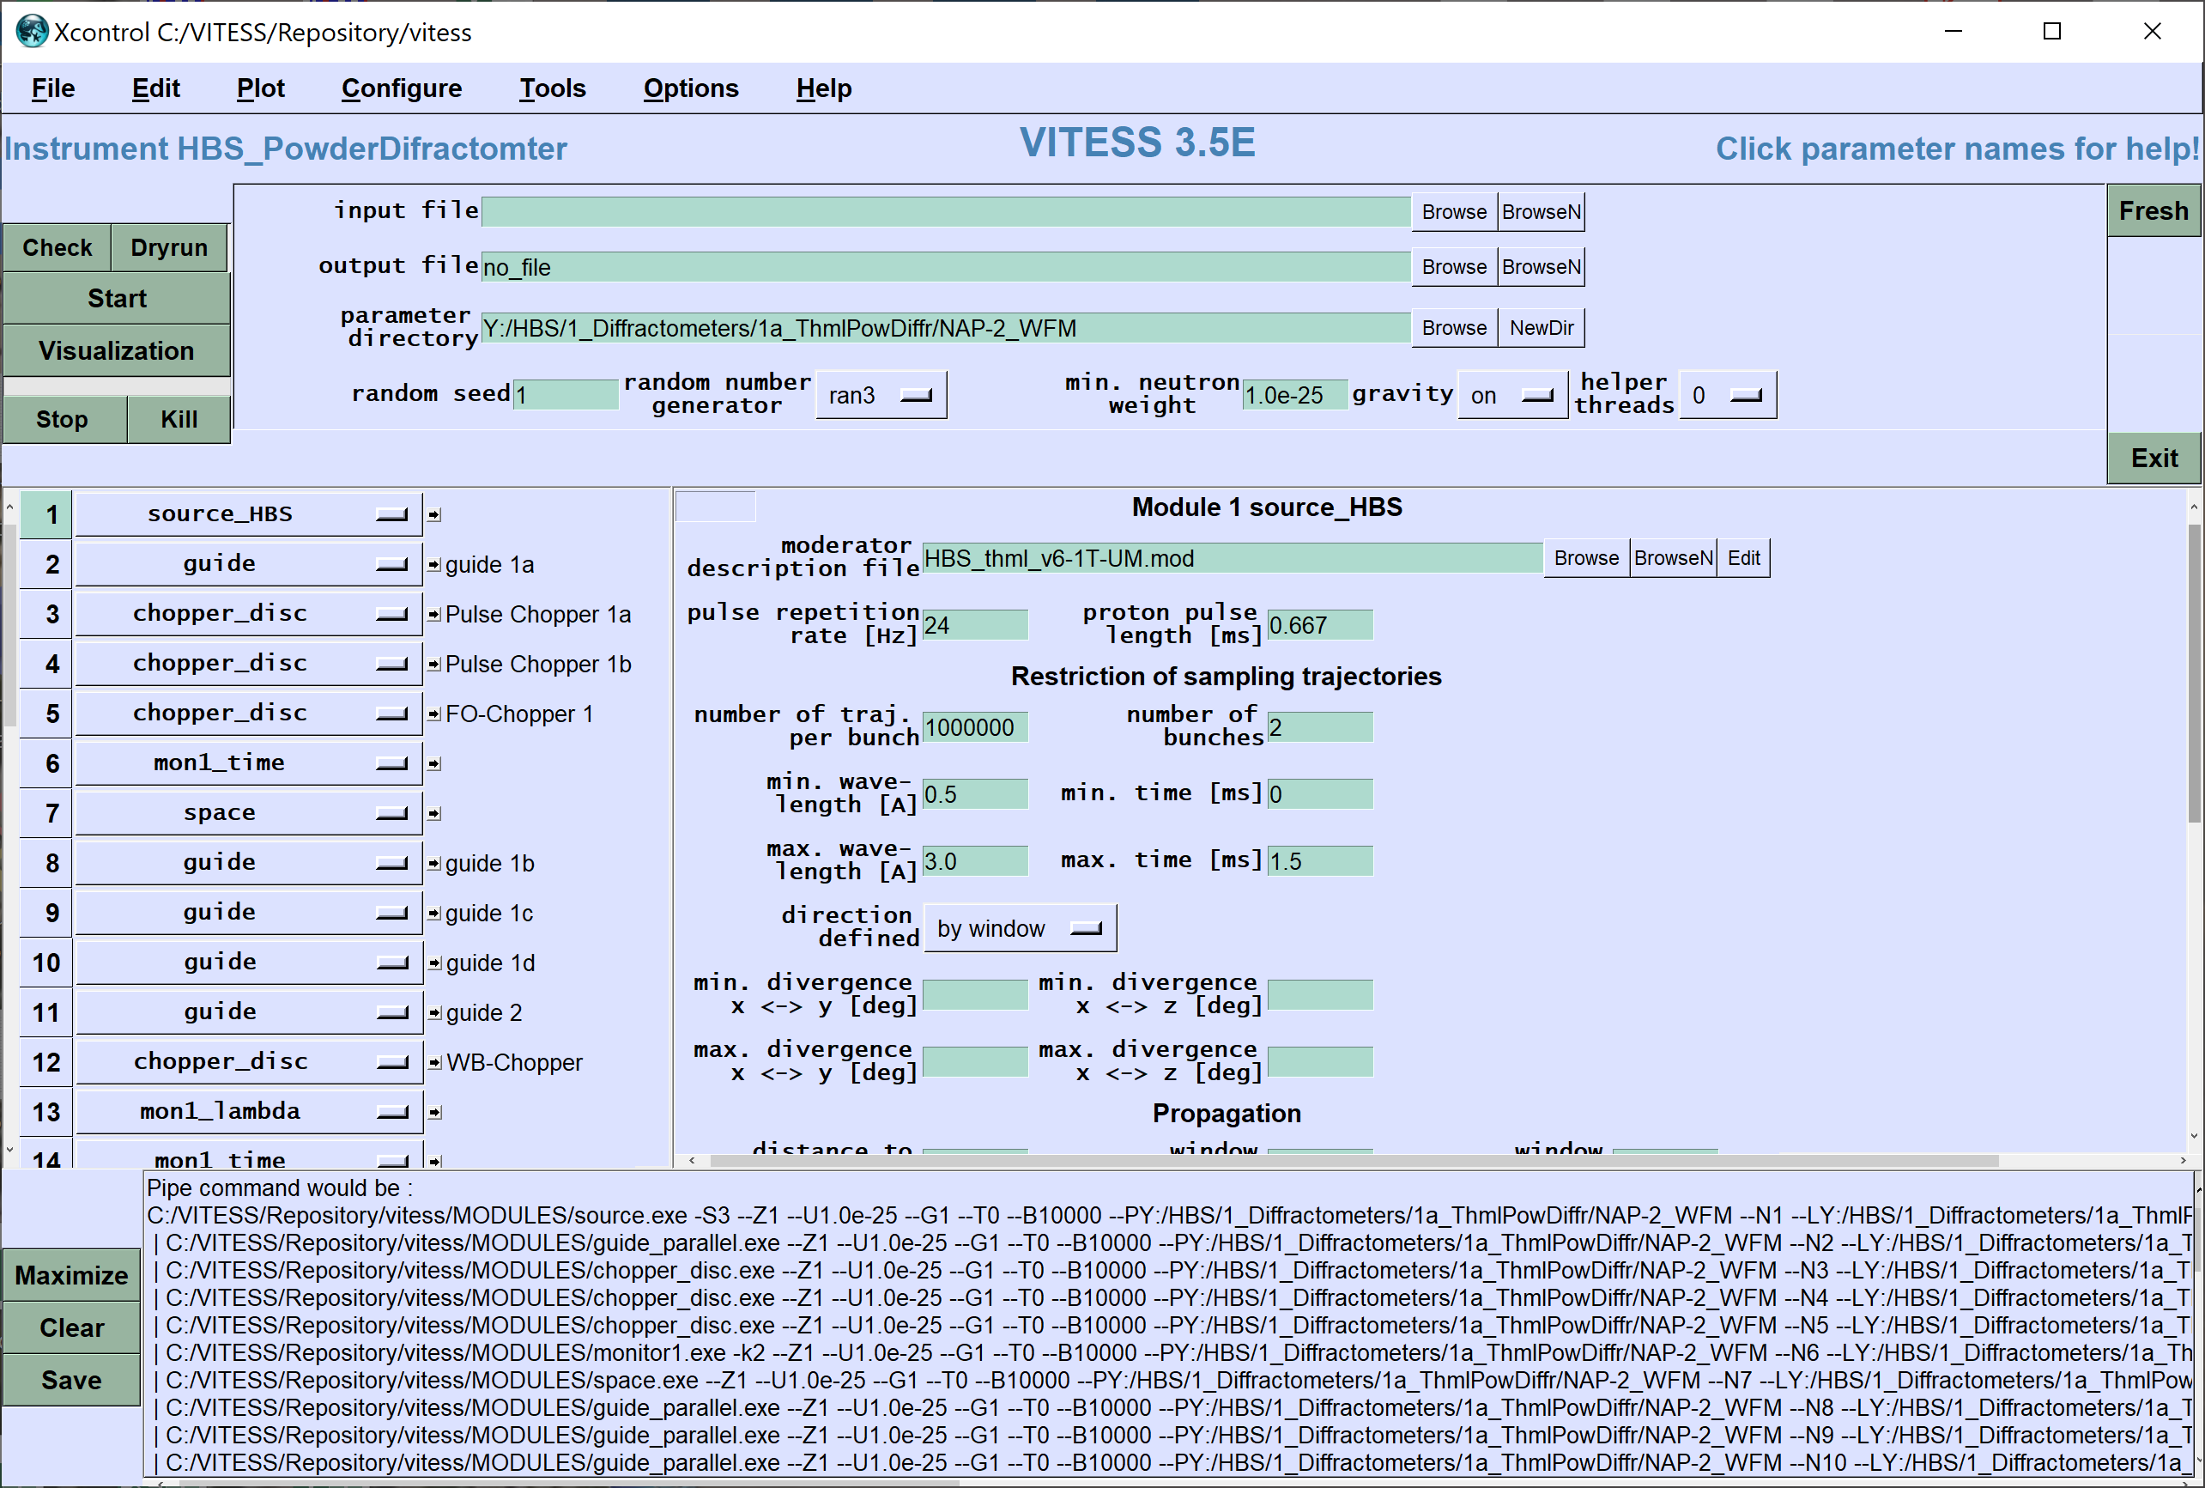
GUI of VITESS

Slide 10
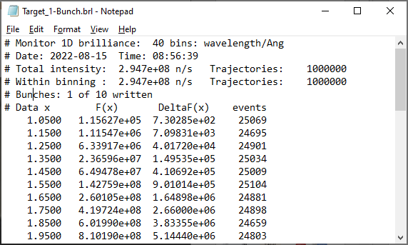
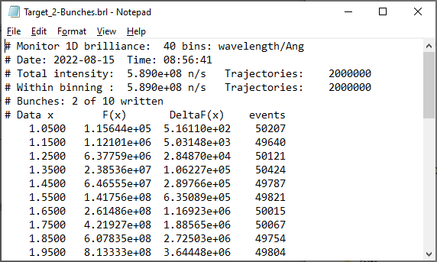
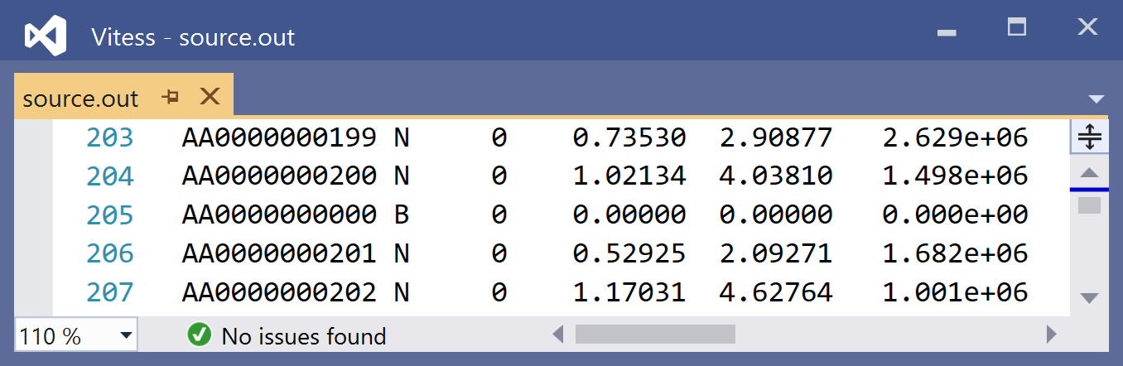
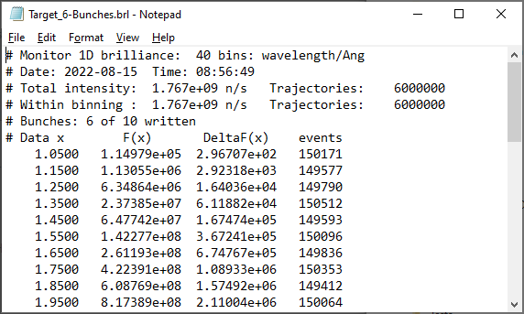
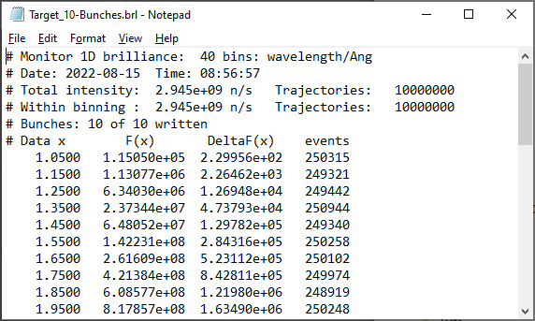
Updating of monitor output
Simulation split into a number of bunches,
e.g. 10 x 1 Mio trajectories
All monitor outputs are updated after each bunch
Estimated intensity in the monitor channels roughly constant by considering the fraction of the simulated trajectories
Update triggered by special ‘trajectory’

Slide 11
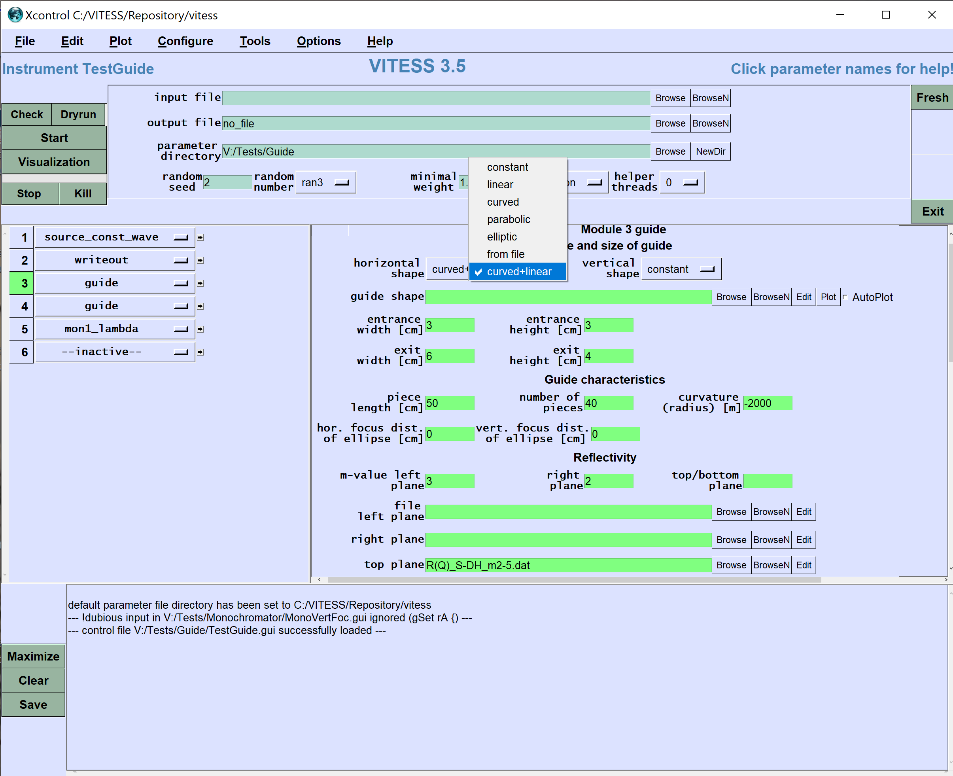
guide

Slide 12
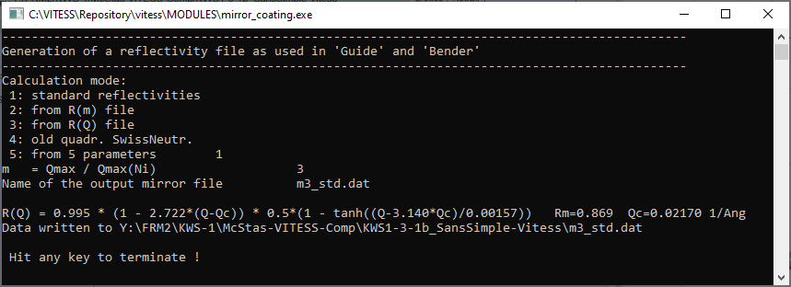


Coating described by m-value
R₀ = 0.995
W = 0.00157 Å⁻¹
m = m_{nom}+0.14
R_{cut} = Min(R₀,1.096 – 0.0758 m)
R₀
R_{cut}
$$α=\frac{R_{0}−R_{cut}}{(m−1)Q_{c,Ni}}$$
$$R=R_{0}(1−α(Q−Q_{c,Ni})\frac{1}{2}tanh⁡\frac{Q−Q_{c,Ni}}{W}$$

Slide 13
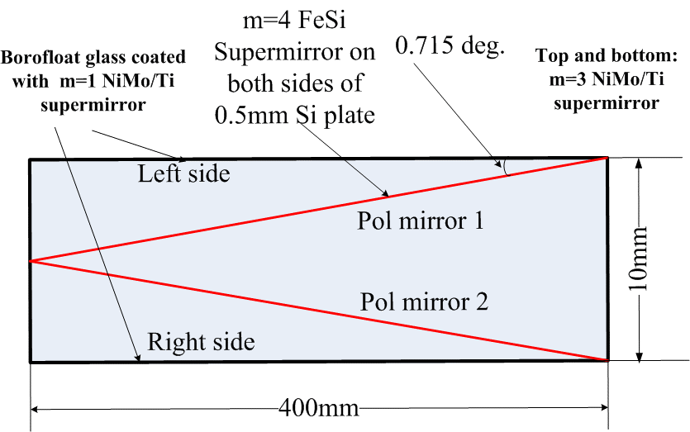
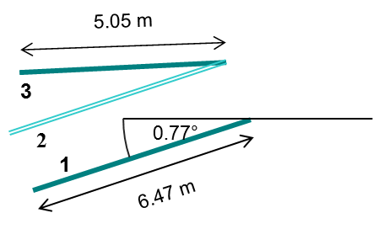
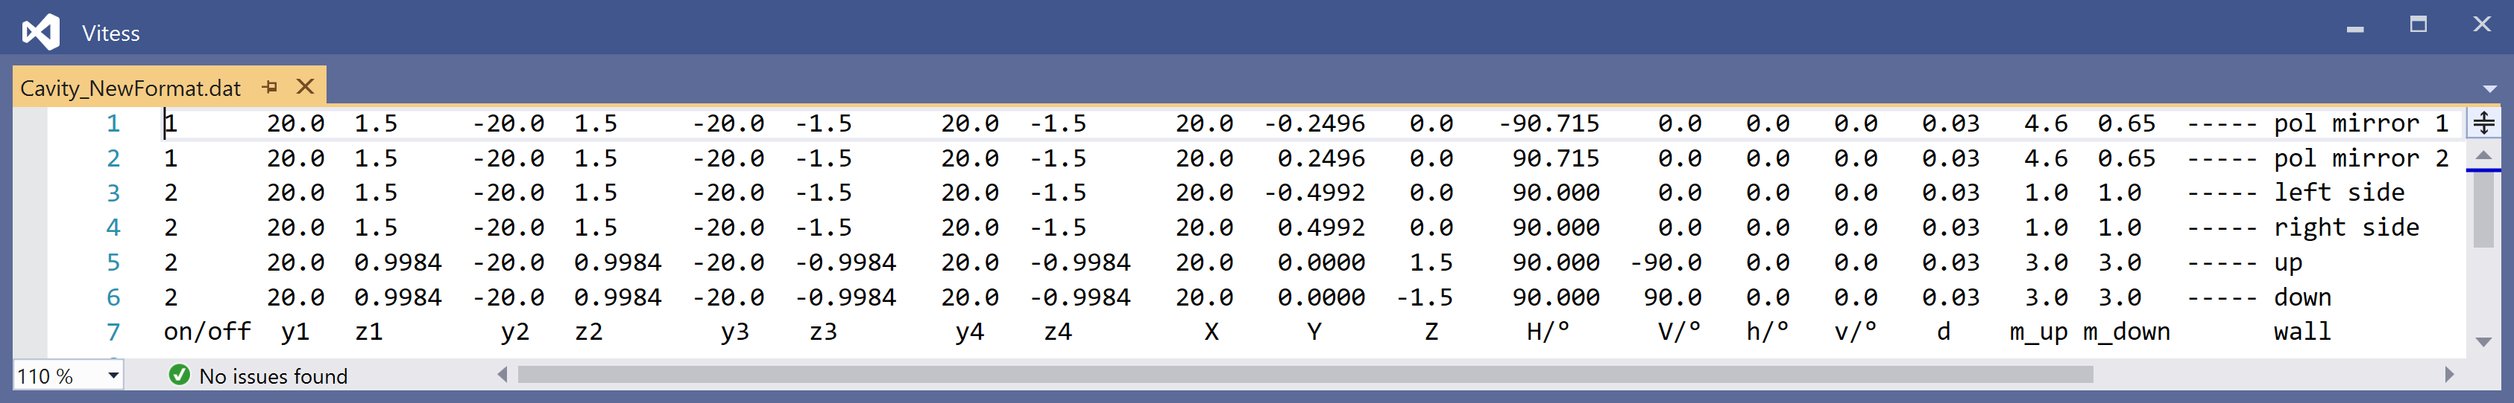

Sm ensemble

Slide 14
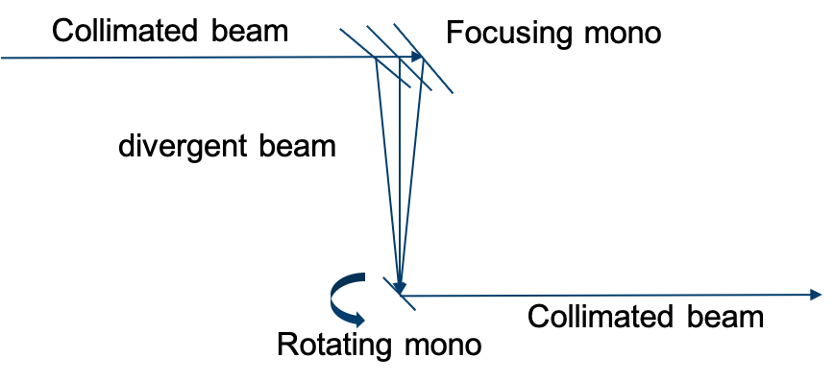
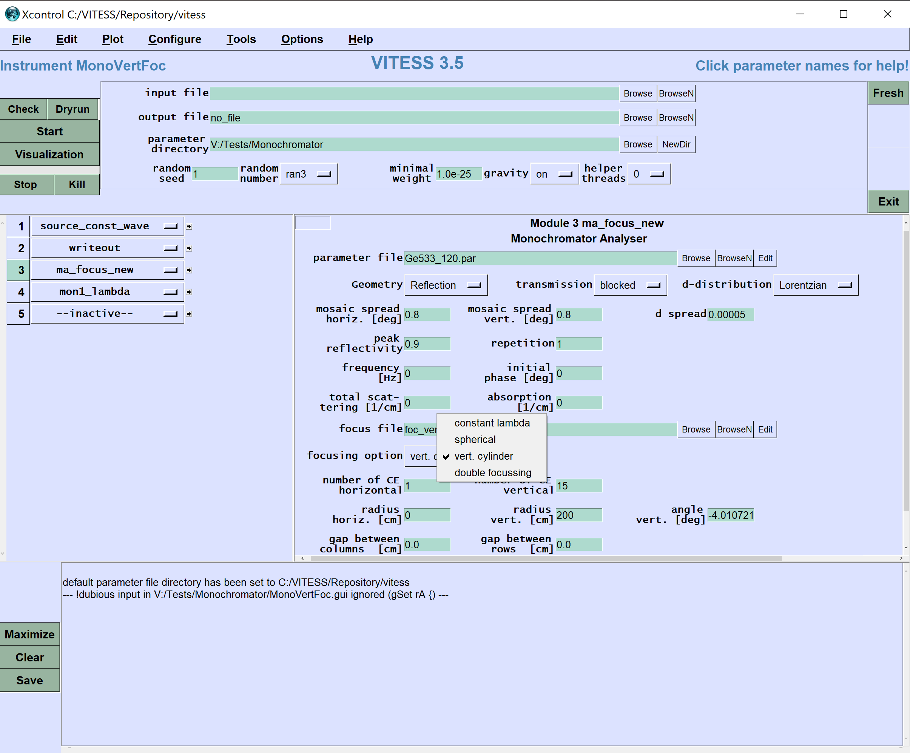
rotating monochromator

Slide 15
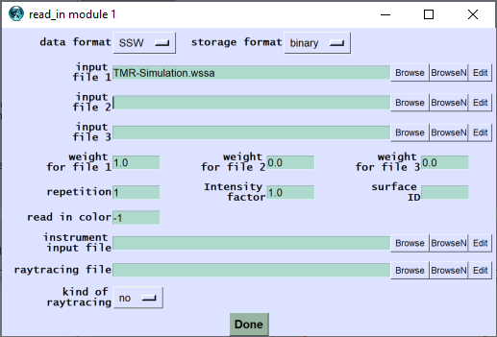
Reading and writing of Mcnp data
Simulation of the TMR unit
using MCNP or any other program
Determination of source characteristics
Simulation of shielding, radiation background, …
using MCNP etc
MCPL
WSSA
MCPL
MCPL
read_in
monitor
guide
writeout
VITESSMcStas
VITESSMcStas
Simulation of instrument part M
using VITESS or McStas
Data evaluation
Simulation of instrument part N
using VITESS or McStas
Binary and Ascii files can be read and written now
VITESSMcStas

Slide 16
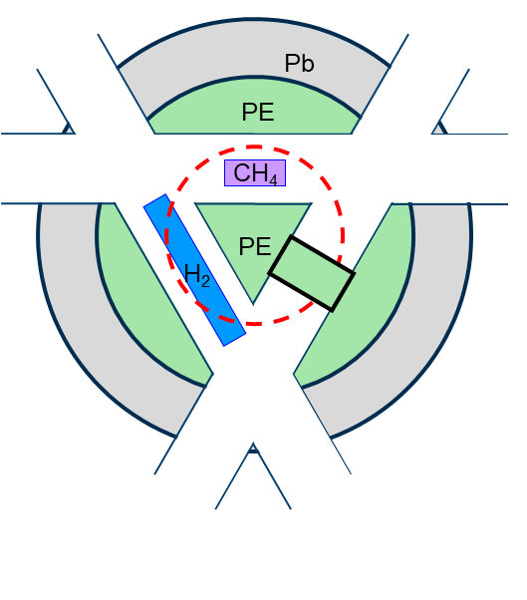
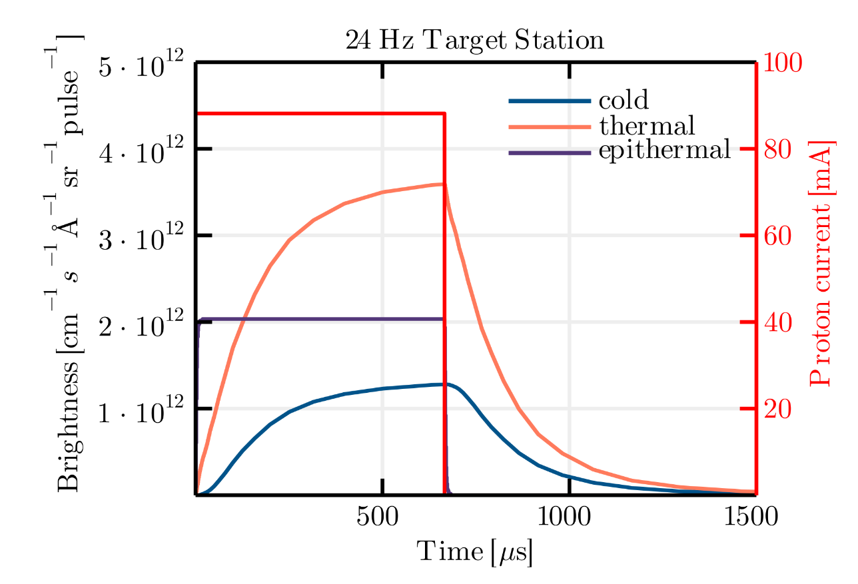
Example: Reading Mcnp data of HBS simulation
Top view
Ta
VITESSMcStas

Slide 17
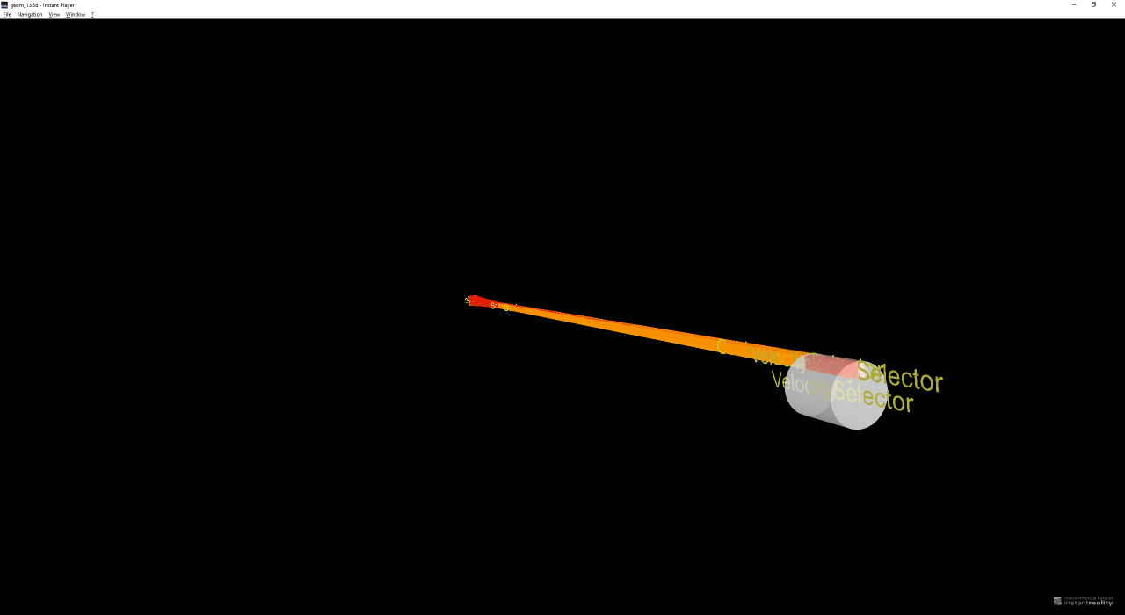
Visualization completed

Slide 18

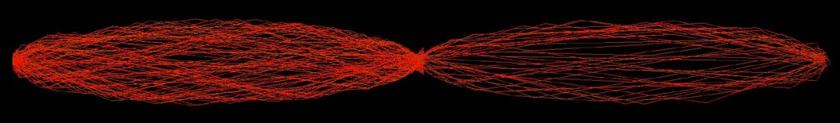
Blow-up
Neutron scattering instruments are often very long, especially on long pulse sources. The length can be a factor of 1000 larger than width and height. This makes a visualization in 1:1:1 scale quite useless
A blow-up factor for width and height enables trajectory visualization
50 trajectories inside a double elliptic neuton guide of 2x50 m length and 100 mm maximal width, visualized in 1:1:1 scale
Same trajectories visualized by a blow-up factor of 100 perpendicular to the beam direction.

Slide 19
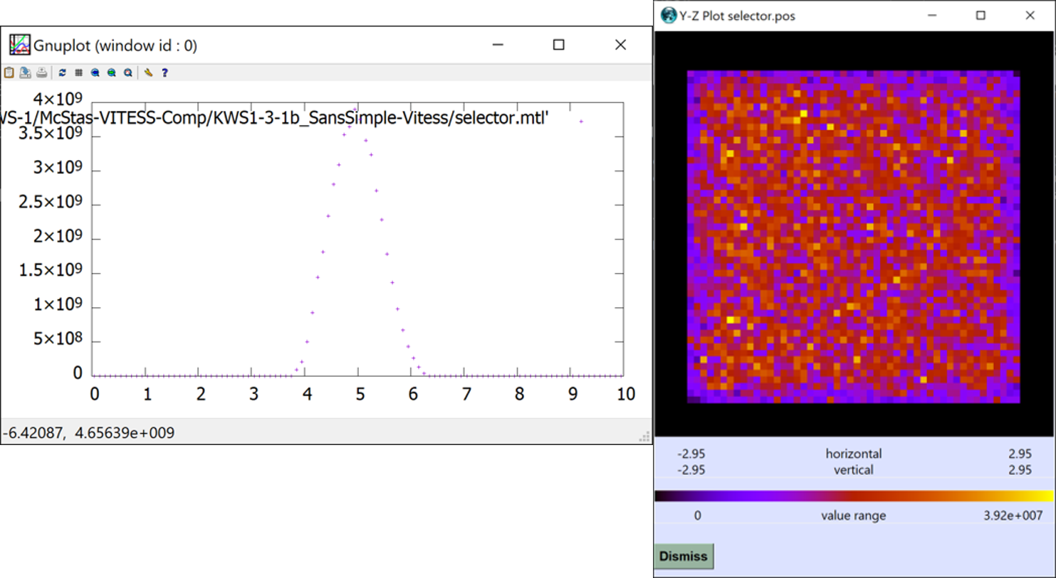
Visualization by GR graphics
Instrument simulations for HBS

Slide 20
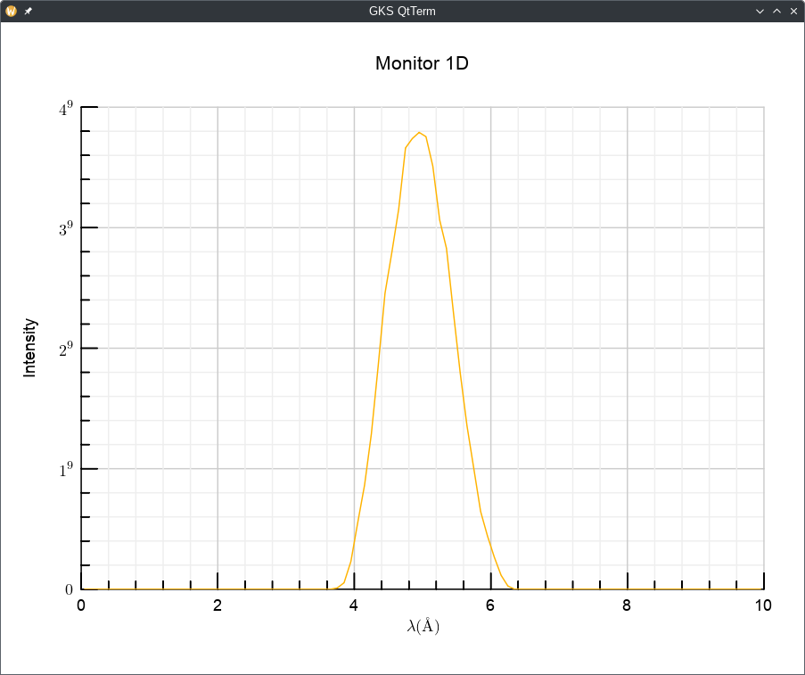
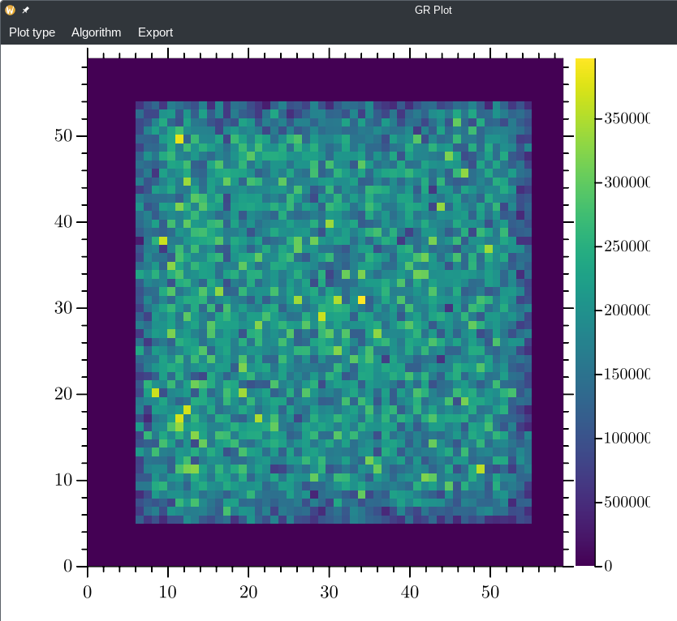
Visualization by GR graphics
Instrument simulations for HBS

Slide 21
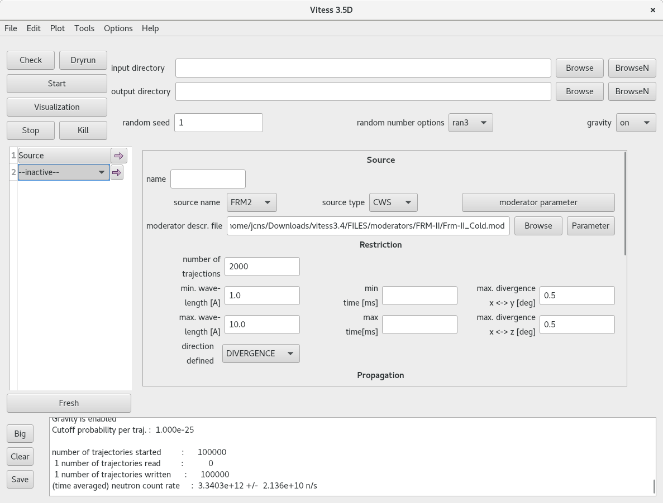
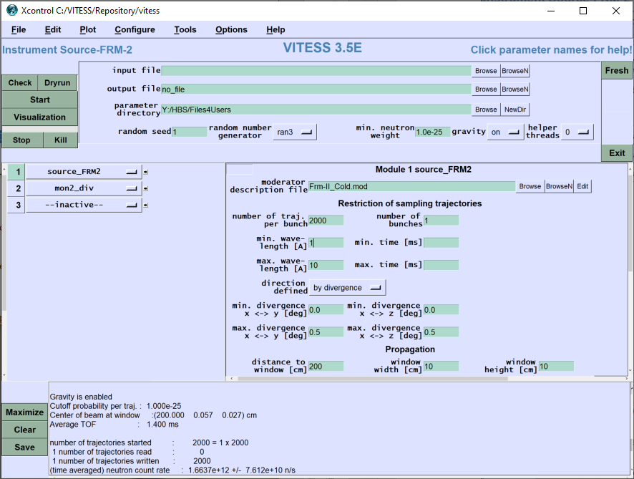
GUI of VITESS 4.0 using Qt

Slide 22
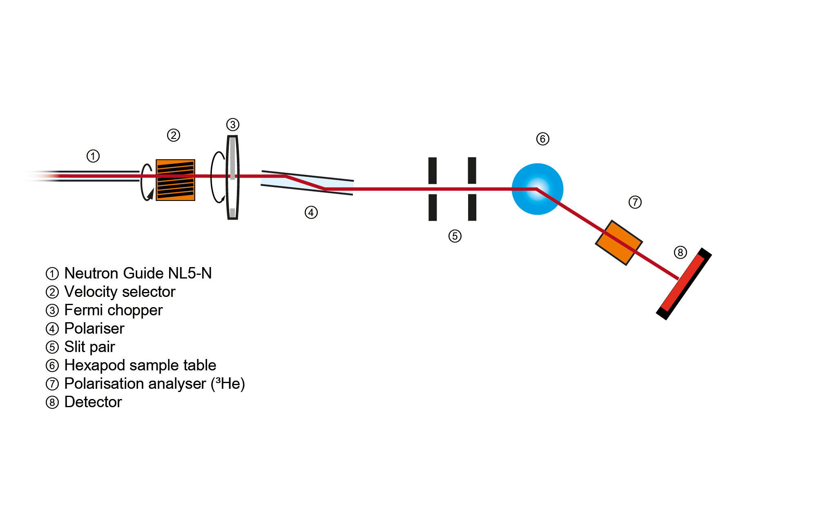
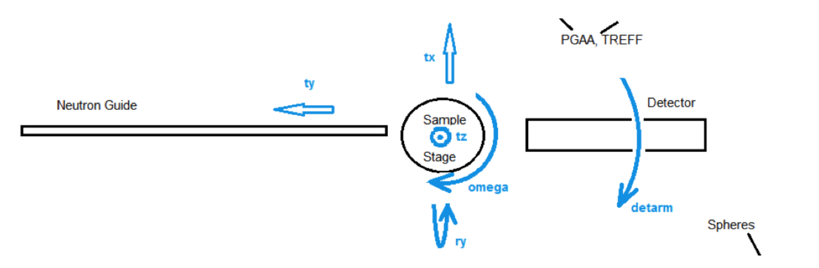
Virtual experiments at mlz (example maria)
Goals
  Training of the instrument operation for new users
  Assessment of proper instrument settings for a sample of interest
  Estimation of required beamtime
  Replacement of real experiments in case of reactor failure
Requirements
  Describe MARIA with all details in a VITESS simulation
  Enable all movements and settings
  Enable continuous monitor output
  Include simulation in NICOS
  Web application

Slide 23
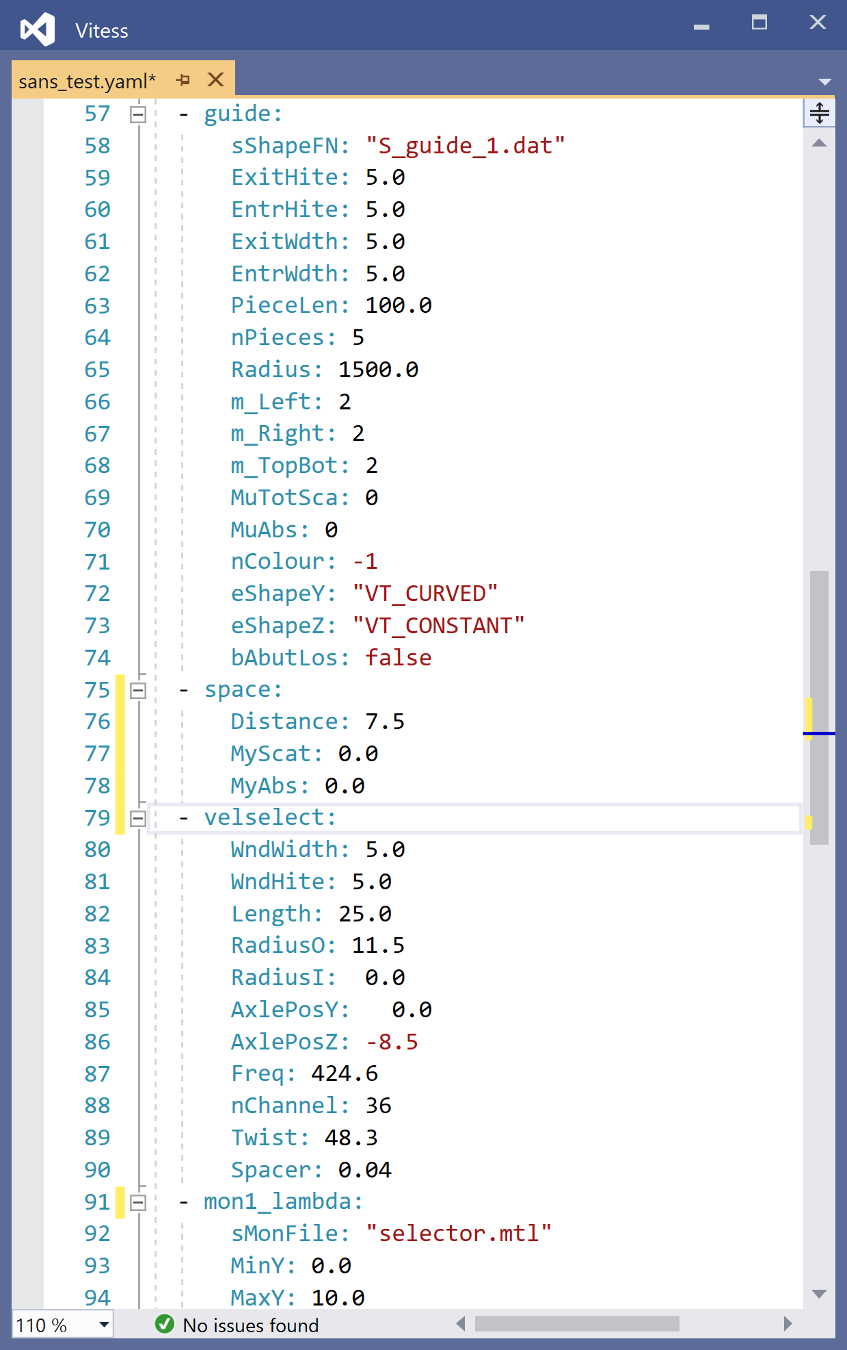
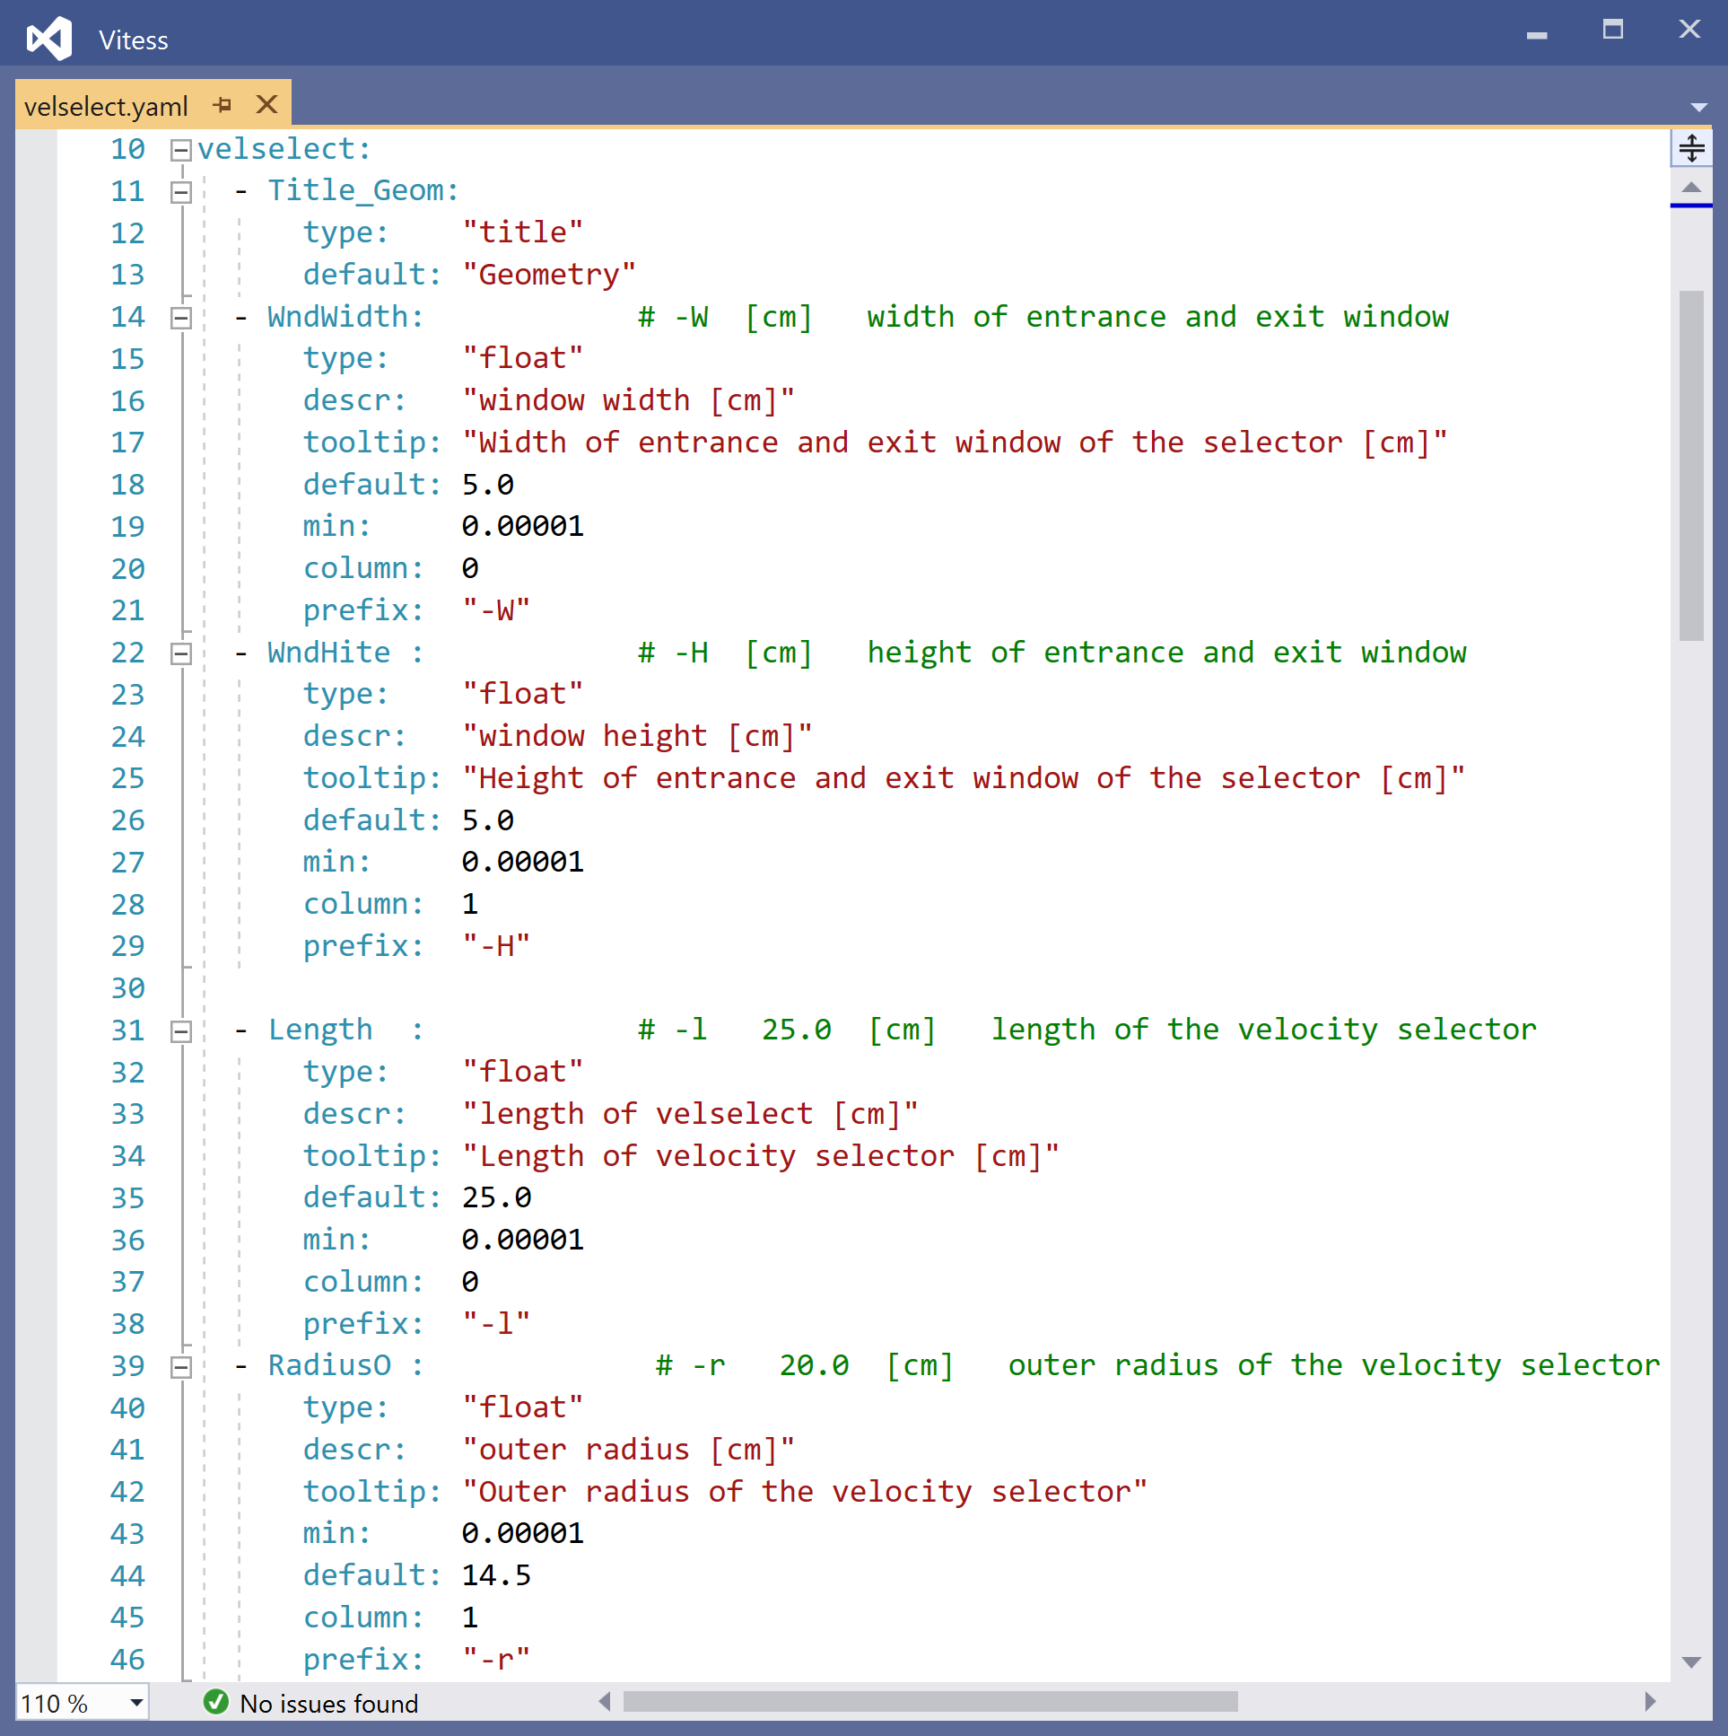
yaml files to store instruments and define gui
Part of a SANS instrument
Module ‘velselect’

Slide 24
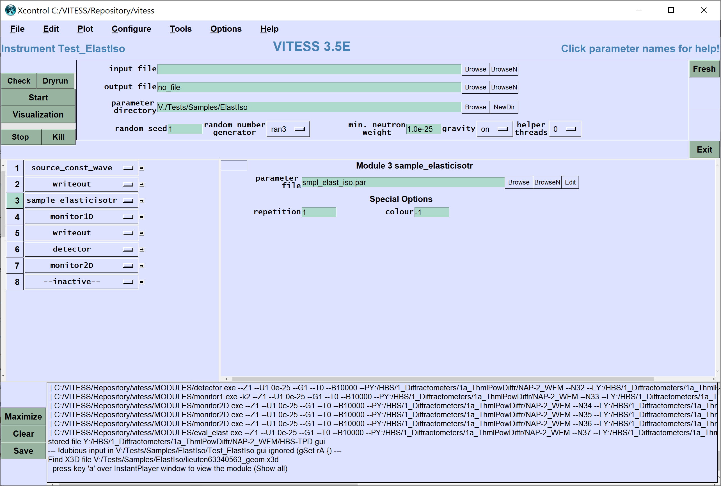
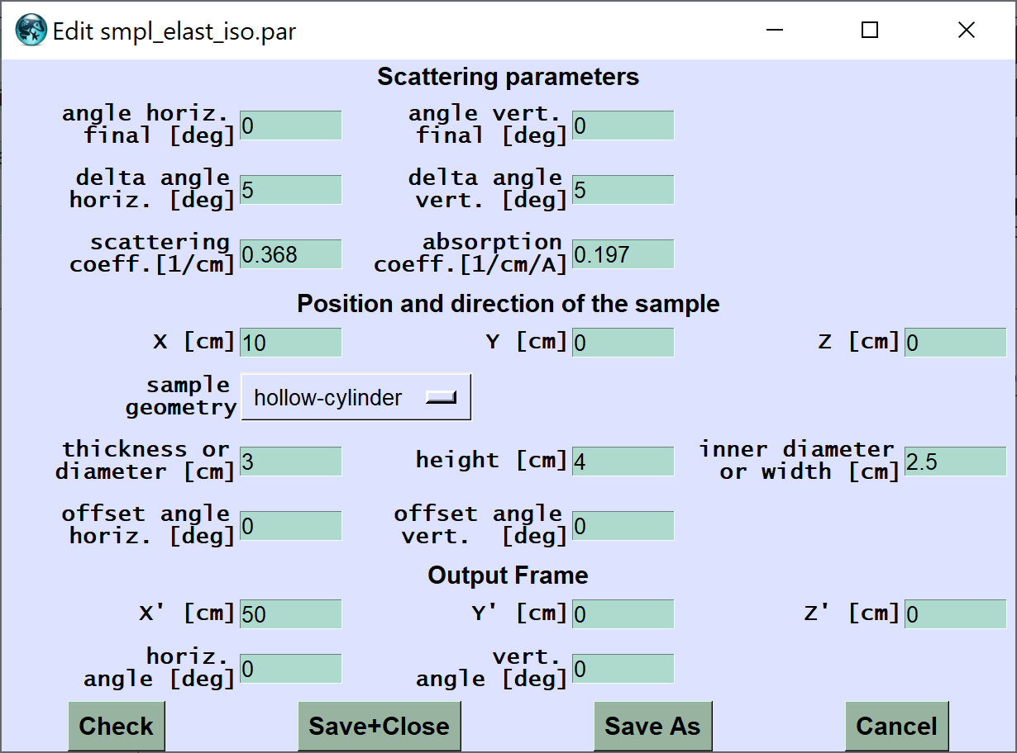
Less Parameters from file in vitess 4
Parameters in files are difficult to control by NICOS or in numerical optimization

Slide 25
Status 3.5 and 4.0
VITESS 3.5
  Programming finished
  Function test finished
  2 problem left with instrument visualization
  Blow-up has to be tested still
  Planned Release: July 2023
VITESS 4.0
  GUI completed
  Kernel completed
  Code to ensure unique component name has to be implemented
  Updating monitor files during run has to be improved
  Intensive testing necessary
  Planned Release: in September 2023

Slide 26
Modules representing Components in vitess 3.4
Sources
reactor
SPSS
LPSS
Space + Windows
space
slit
window/ beamstop
multiple windows
grid
beamstop
Choppers
disc
Fermi str.
Fermi curv.
vel.select
Monochr.
new
old
Modules f. Polaris.
³He-polar.
coil flipper
prec. field
quadr.field
pol. mirror
SM-polar.
grad. flipper
rot. field
res. Drabkin
Samples
elast. isotr.
powder
SANS
reflectom.
environm.
inelastic
NXS
S(Q)
sngl.crys.
Collimator
simple coll.
Soller coll.
radial coll.
Optics / Transport
guide
bender
SM ensemb
lens
ellipt. mirror
ideal guide
Various
detector
capture flux
26

Slide 27
Modules representing Components in vitess 3.5
Sources
reactor
SPSS
LPSS
Space + Windows
space
slit
window/ beamstop
multiple windows
grid
beamstop
Choppers
disc
Fermi str.
Fermi curv.
vel.select
Monochr.
new
old
Modules f. Polaris.
³He-polar.
coil flipper
prec. field
quadr.field
pol. mirror
SM-polar.
grad. flipper
rot. field
res. Drabkin
Samples
elast. isotr.
powder
SANS
reflectom.
environm.
inelastic
NXS
S(Q)
sngl.crys.
Collimator
simple coll.
Soller coll.
radial coll.
Optics / Transport
guide
bender
SM ensemb
lens
ellipt. mirror
ideal guide
Various
detector
capture flux
filter 2D
27

Slide 28
Modules representing Components in vitess 4.0
Sources
simple src
CW source
pulsed src
ESS source
ISIS source
Space + Windows
space
slit
window
beamstop
Choppers
disc
Fermi str.
Fermi curv.
vel.select
Monochr.
new
Modules f. Polaris.
SM-polar.
Samples
elast. isotr.
powder
SANS
reflectom.
environm.
inelastic
S(Q)
sngl.crys.
Collimator
simple coll.
radial coll.
Optics / Transport
guide
SM ensemb
Various
detector
filter 2D
28

Slide 29
Modules representing Components in vitess 4.1
Sources
simple src
CW source
pulsed src
ESS source
ISIS source
Space + Windows
space
slit
window
multiple windows
grid
beamstop
Choppers
disc
Fermi str.
Fermi curv.
vel.select
Monochr.
new
old
Modules f. Polaris.
³He-polar.
coil flipper
prec. field
quadr. field
pol. mirror
SM-polar.
grad. flipper
rot. field
cylindr. field
res. Drabkin
Samples
elast. isotr.
powder
SANS
reflectom.
environm.
inelastic
NXS
S(Q)
sngl.crys.
Collimator
simple coll.
virtual coll.
radial coll.
Optics / Transport
guide
bender
SM ensemb
lens
ellipt. mirror
ideal guide
simpl. guide
twist. guide
prism
Various
detector
capture flux
filter 2D
29

Slide 30
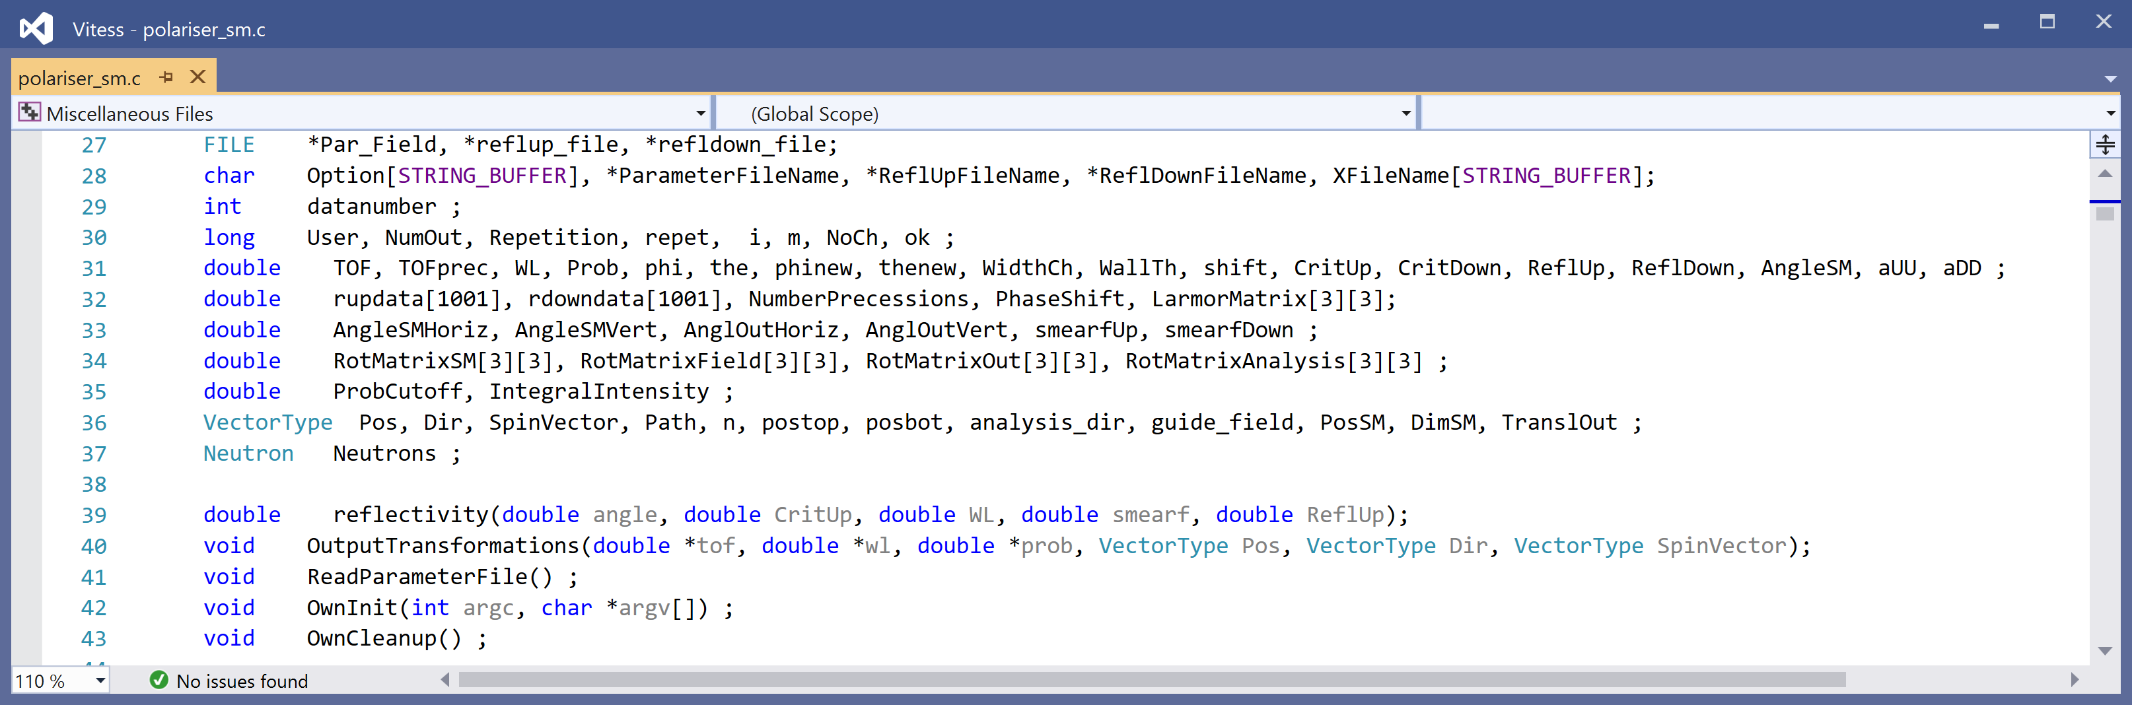
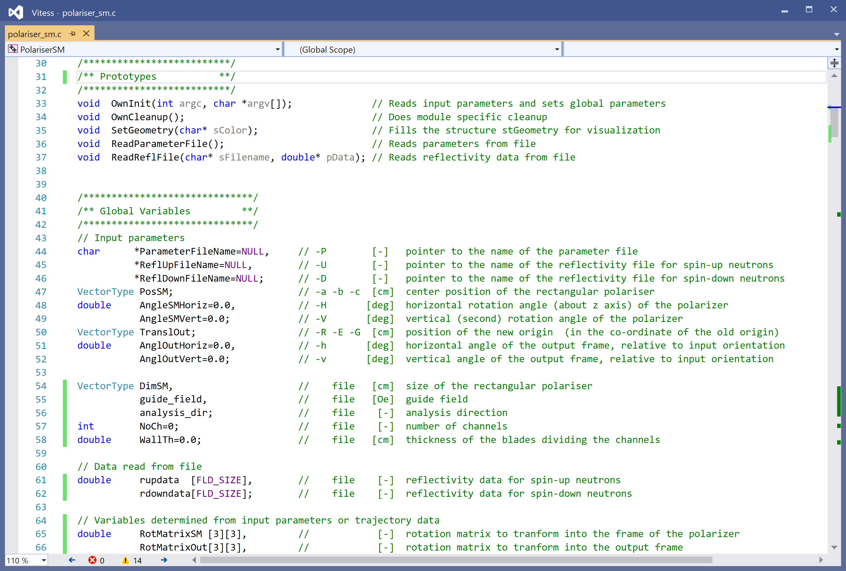
Tiding up
Vsn 3.4
Vsn 3.5

Slide 31
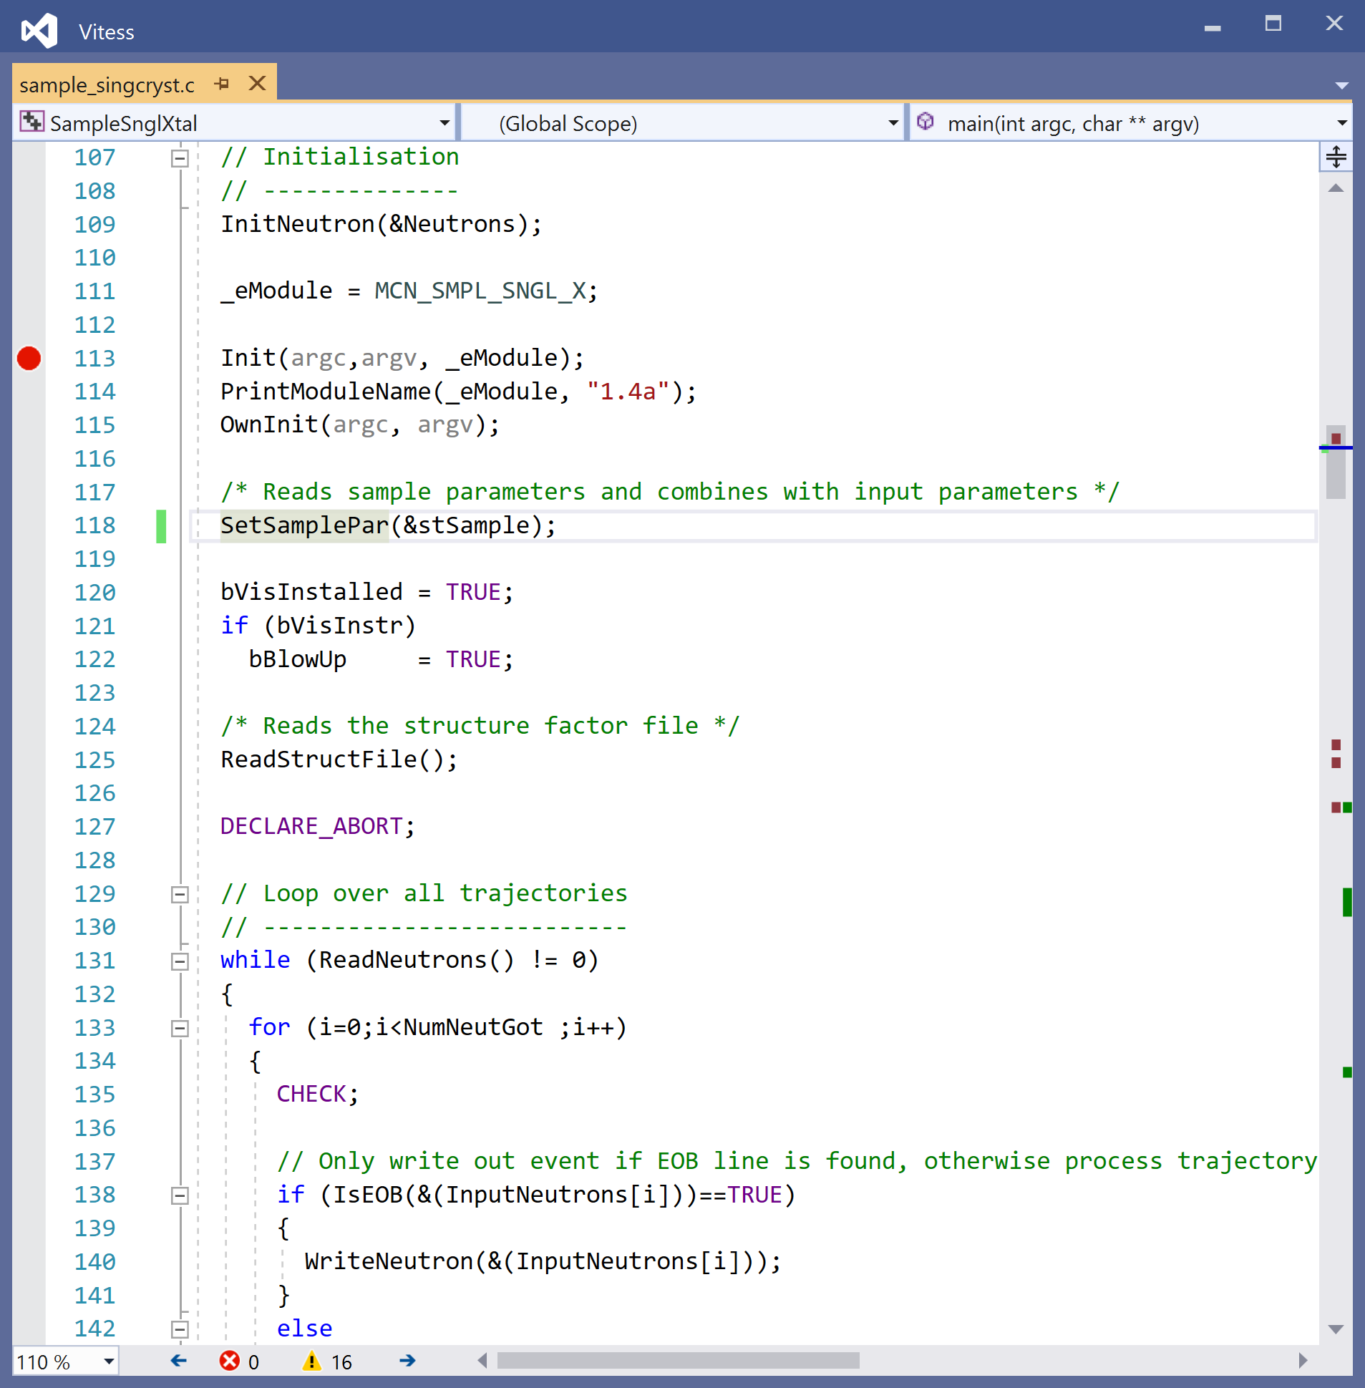
Tiding up
Vsn 3.5

Slide 32
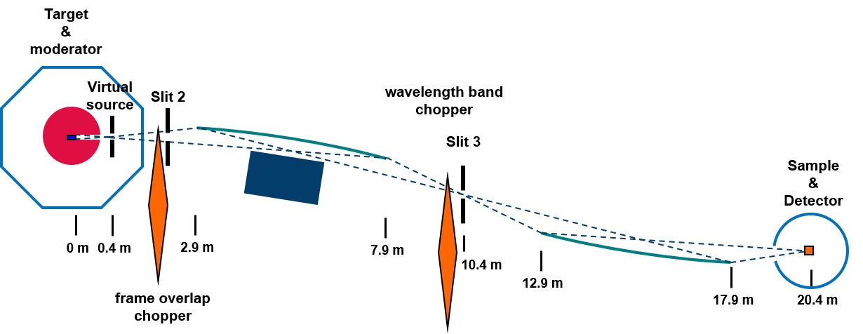

Single crystal diffractometer
Applications
  Single crystals of proteins and other biological molecules (Laue diffraction)
Concept and Requirements
  TOF diffractometer using whole pulse
  Medium resolution Δλ/λ < 3%
  High flux in 1 x 1 mm²
  Low background
  Variable divergence and ‘clean’ distribution
Choices
  TS 1, LH₂ moderator
  Medium frequency (96 Hz, 250 µs pulse)
  20.4 m total length
  SELENE optics (no direct line of sight)
  Large detector coverage (3° - 170° ?)
Characteristics
  Bandwidth: 2 Å, standard: 2 – 4 Å
  d-range : 1.0 – 76 Å
  λ-resolution: 1.3% - 2.4%
  Estimated flux at sample: 4·10⁷ n/(cm²s)
Staff
  Design: Tobias Schrader
  Simulations: Zhanwen Ma
TOF-Laue diagram for myoglobin
Ma et al., publication in preparation

Slide 33
Plans for the future
Union Module: combining several components in 1 module to enable
  Multiple scattering
  Parallel components
  …..
1000 minor improvements
Transition to C++
Thank you for your attention

Slide 34



The Pipe Command and Export in version 3
Instrument can be exported from GUI to
  Batch file
  Perl script
  Python script
  Shell script
  Tcl script
  Grid shell sript
This can be edited to
  Calculate parameters
  Run a series
  Run an optimization

Slide 35
Structure of Functions and Classes
main
C functions
of a module
Powder
SANS
mon2D
Source
application specific
C functions
Sample
Src_modchar
Matrix
Init
Intersection
mathmatrix
general (complex)
C functions
Softabort
General
mathvector
Message
basic
C functions and classes
class
functions
35

Slide 36



Gui – kernel connection
Vsn 3.5

Slide 37



Gui – kernel connection
GUI
Kernel

Slide 38
Less Parameters from file in vitess 4
So they are reduced to the minimum
Current kernel can handle both ways of input

Slide 39




Hbs source In vitess and mcstas
Example: parameters of the thermal source at the 1st target station (96 Hz)
McStas component: Source_pulsed

Slide 40


Disordered materials diffractometer
Application
  PDF measurements on liquids, amorphous materials and nano-particles
Concept and Requirements
  TOF diffractometer using whole pulse
  Medium resolution by long instrument
  Short min. wavelength for high Q-values
Choices
  TS 3, D₂O moderator
  Frequency (96 Hz, 167 µs neutron pulse)
  85 m length
  Detector range: 10° - 140°
Characteristics
  Bandwidth: 0.69 Å, standard 0.1 – 0.79 Å
  Resolution: 1.3% - 7.8%
  Q-range : 1.9 – 118 Å⁻¹
  Estimated flux at sample: 10⁷ n/(cm²s)
Staff
  Design: Mikhail Feygenson
  Simulations: Zhanwen Ma
Strong flux gain by short distance between moderator and guide
Z. Ma et al., Nucl. Instrum. Methods Phys. Res. A 1008 (2021) 165479.

Slide 41
Status of vitess 3.5
Sources
reactor
SPSS
LPSS
Space + Windows
space
slit
window/ beamstop
multiple windows
grid
beamstop
Choppers
disc
Fermi str.
Fermi curv.
vel.select
Monochr.
new
old
Modules f. Polaris.
³He-polar.
coil flipper
prec. field
quadr.field
pol. mirror
SM-polar.
grad. flipper
rot. field
res. Drabkin
Samples
elast. isotr.
powder
SANS
reflectom.
environm.
bug
inelastic
NXS
S(Q)
sngl.crys.
not yet tested
vis. missing
Collimator
simple coll.
Soller coll.
radial coll.
vis. test miss.
Optics / Transport
guide
bender
SM ensemb
lens
complete
ideal guide
ellipt. mirror
Various
detector
capture flux
filter 2D
41

Slide 42
Parameter set transferred
Data set of each trajectory
Right-handed system
x: along the beamline
y: to the left
z: (vertically) up
ID
criterion ‘ray tracing’
‘colour’
Time of flight t [ms]
wavelength λ [Å]
intensity p [n/s]
location of neutron x [cm]
location of neutron y [cm]
location of neutron z [cm]
flight direction v_{x}/|v| = cos α
flight direction v_{y}/|v| = cos β
flight direction v_{z}/|v| = cos γ
Spin S_{x}
Spin S_{y}
Spin S_{z}
z
y
x
view from moderator towards sample

Slide 43


Hbs source In vitess & Mcstas
VITESS Source and Moderator Parameters
HBS Source in McStas

Slide 44
Instruments presented in the TDR
The TDR will comprise performance studies of 27 instruments installed on the three target stations.
Based on these results, it will be chosen at a later stage, which instruments will be built in which order.
3 Analytics Instruments
4 Imaging Instruments
Prompt gamma neutron activation analysis
TOF prompt gamma neutron activation analysis
Neutron depth profiling
Cold imaging instrument
Refractive imaging instrument
Thermal imaging instrument
Epithermal imaging instrument
6 Diffractometers
Single crystal diffractometer
Disordered materials diffractometer
Thermal powder diffractometer
Engineering diffractometer
Diffuse elastic scattering
Polarized diffuse neutron spectrometer
8 Spectrometers
Neutron resonance spin echo instrument
Neutron spin echo spectrometer
Backscattering spectrometer
Cold chopper spectrometer
Thermal chopper spectrometer
X-TOF spectrometer
Inverted Geometry spectrometer
(Vibrational spectrometer)
6 Large Scale Structure Instruments
Specular reflectometer (using SELENE optics)
Off-specular reflectometer
Hi Throughput SANS
SANS with GISANS option
SANS with VSANS option
(LoQ diffractometer)
Simulated using VITESS
Simulated using McStas

Slide 45
pulse shape and peak brilliance of the hbs
96 Hz 24 Hz
1.6% duty cycle
τ_{proton} : 167 µs
τ_{neutron}: 252 µs
τ_{proton} : 667 µs
τ_{neutron}: 665 µs
First target-moderator simulations showed that HBS will have about the same peak brilliance as FRM-2

Slide 46

Hbs floor PLan
TS 2
24 Hz
TS 1
96 Hz
TS 3
96 Hz?
46

Slide 47


The hbs performance
Time averaged brilliance of the two moderators

