Slide 1
An Update on the Development of a Cold Neutron Source and Cold Neutron Beam Facilities at the Penn State Breazeale Reactor
Kenan Ünlü, Daniel Beck
Penn State University
Radiation Science and Engineering Center
6th International workshop on NEUTRON DELIVERY SYSTEMS (NDS 2023)
Institut Laue-Langevin - GRENOBLE - France
10th - 12th July 2023

Slide 2
The Pennsylvania State University
Established in1855 as Land Grand University
Campuses: (2022)
University Park (48,765 students)
24 Other Campuses
World Campus
Total Enrollment: 88,116 students (Fall 2022)
73,159 undergraduate
14,957 graduate
Operating Budget: $8.6 Billions (2022-2023)
R&D Expenditure: $1.034 Billions
Ranking (2022):
U.S. News & World Report
Best Global University: 80th
National Public University: 31st

Slide 3
Radiation Science & Engineering Center
In 1990, Penn State established the Radiation Science and Engineering Center (RSEC), a university-wide facility to promote research, education, and varied applications of radiation science and nuclear engineering.
The RSEC falls under the Vice President for Research and the College of Engineering at Penn State.

Slide 4
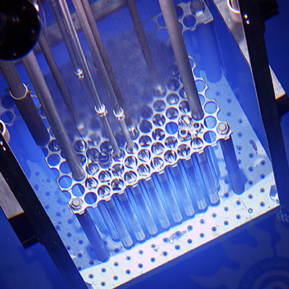
Radiation Science & Engineering Center
Breazeale Nuclear Research Reactor
1 MW TRIGA
3 x10¹³ n/cm² sec thermal neutron
flux at core center
Gamma Irradiation Facilities
In-Pool irradiators
Gamma Cell 220 Dry Irradiator
(6,000 Curie Co-60, 0.5 MRads/hour)
Hot Cells
Radiation Detection & Measurement Labs
Neutron Beam Laboratory
Radionuclear Applications Laboratory
Radiochemistry Laboratory
Nuclear Security Education Laboratory

Slide 5
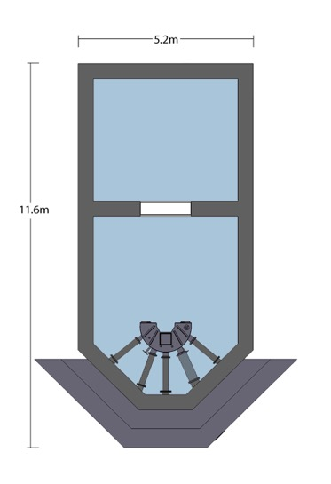
PSBR Core and Beam Ports (1965 - 2018)

Slide 6
PSBR New Neutron Beam Ports

Slide 7
PSBR New Core/Moderator Assembly and New Beam Port Installations (2018)

Slide 8
PSBR New Core/Moderator Assembly and New Beam Port Installations (2018)

Slide 9
PSBR New Core/Moderator Assembly and New Beam Port Installations (2018)

Slide 10
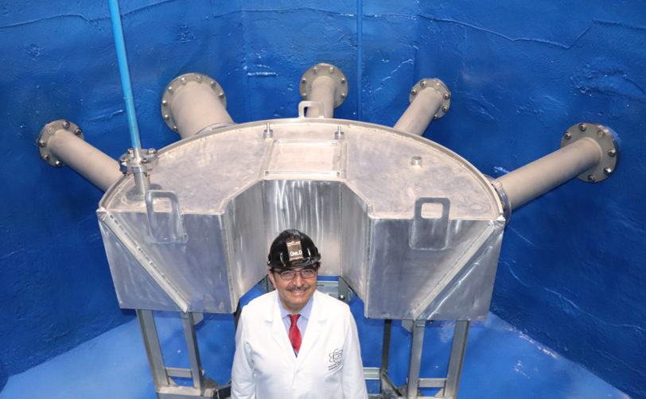
PSBR New Core/Moderator Assembly and New Beam Port Installations (2018)

Slide 11
PSBR New Core/Moderator Assembly and New Beam Port Installations (2018)

Slide 12
PSBR New Neutron Beam Ports
NBP1 : Triple Axis Student Spectrometer
(Epithermal Beam Facility)
NBP2 : Thermal Neutron Beam Port for
Exploratory Research Projects
NBP3 : Neutron Transmission
(Service Activities)
NBP4 : Neutron Imaging Facility
GT1 : Small Angle Neutron Scattering
GT2 : TOF Neutron Depth Profiling
GT3 : Prompt Gamma Activation Analysis

Slide 13
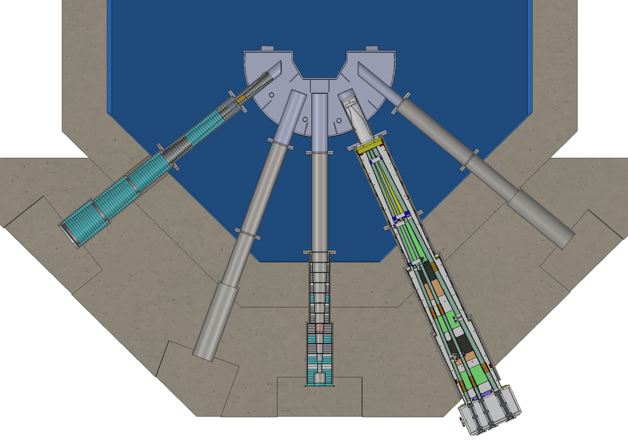
PSBR – Neutron Beam Ports

Slide 14
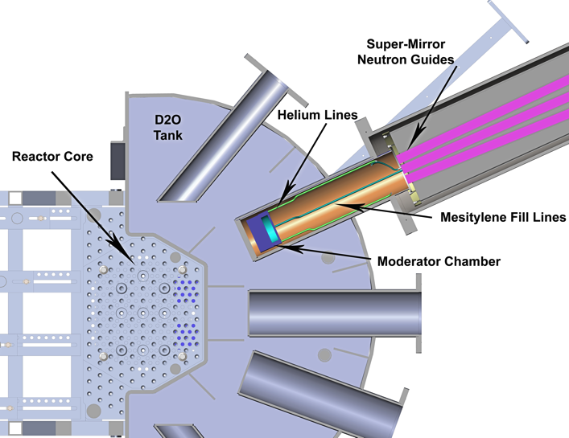
PSBR Cold Neutron Source (2019)

Slide 15
PSBR – Cold Neutron Source
A third generation of mesitylene moderated university research reactor
cold neutron source (CNS) has been built and factory tested and will
be installed at the Penn State Breazeale Reactor in July/August 2023.
10 cm diameter, 2.5 cm thick mesitylene moderator chamber
Moderator Chamber is in D₂O Tank very close to the
reactor core.
Cryomech Helium Cryoregrigerator with AL325 Cold Head
Cold Head cooling capacity 60 W at 20 K.
Cold Helium Circulating System integrated into Cold Head
Three straight supermirror in-pile neutron guides close to
the moderator chamber.
Three supermirror out-of-pile straight, curved neutron guides
and/or beam benders extend to experiment locations.

Slide 16
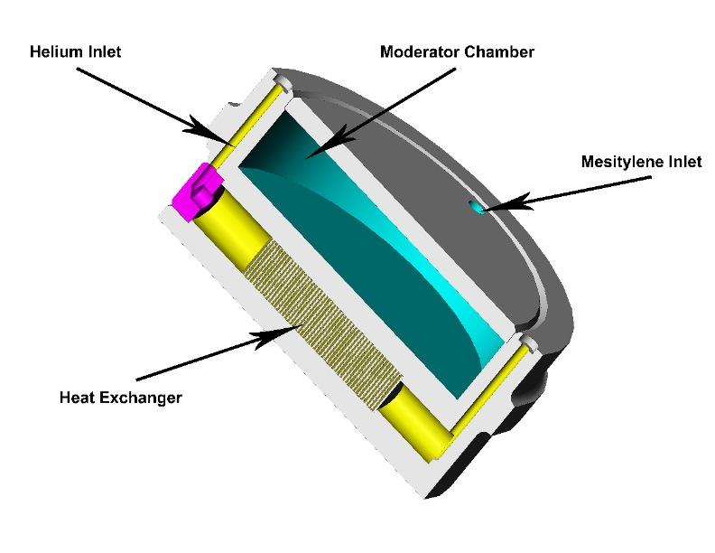
PSBR - Cold Neutron Source

Slide 17
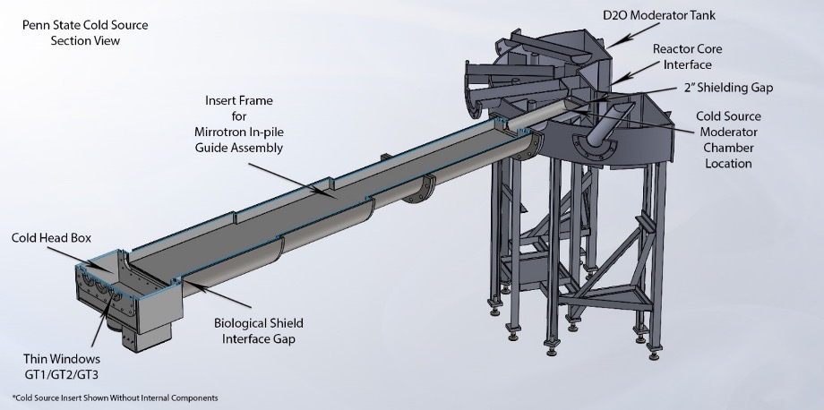
PSBR - Cold Neutron Source

Slide 18
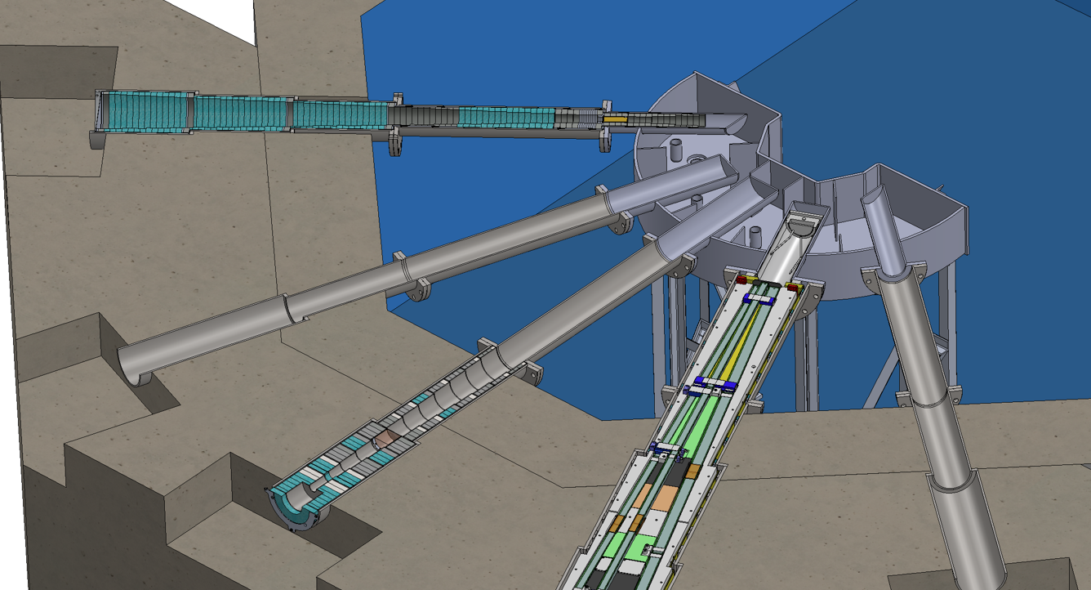
PSBR - Cold Neutron Source

Slide 19
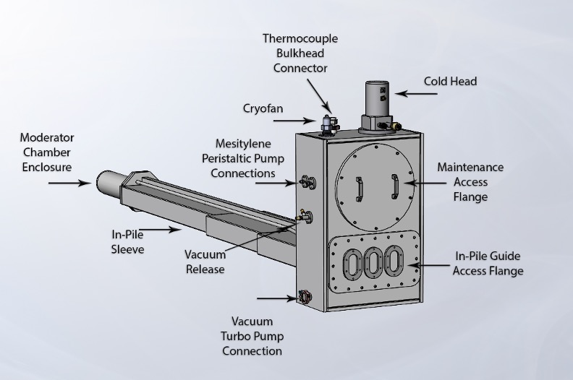
PSBR - Cold Neutron Source

Slide 20
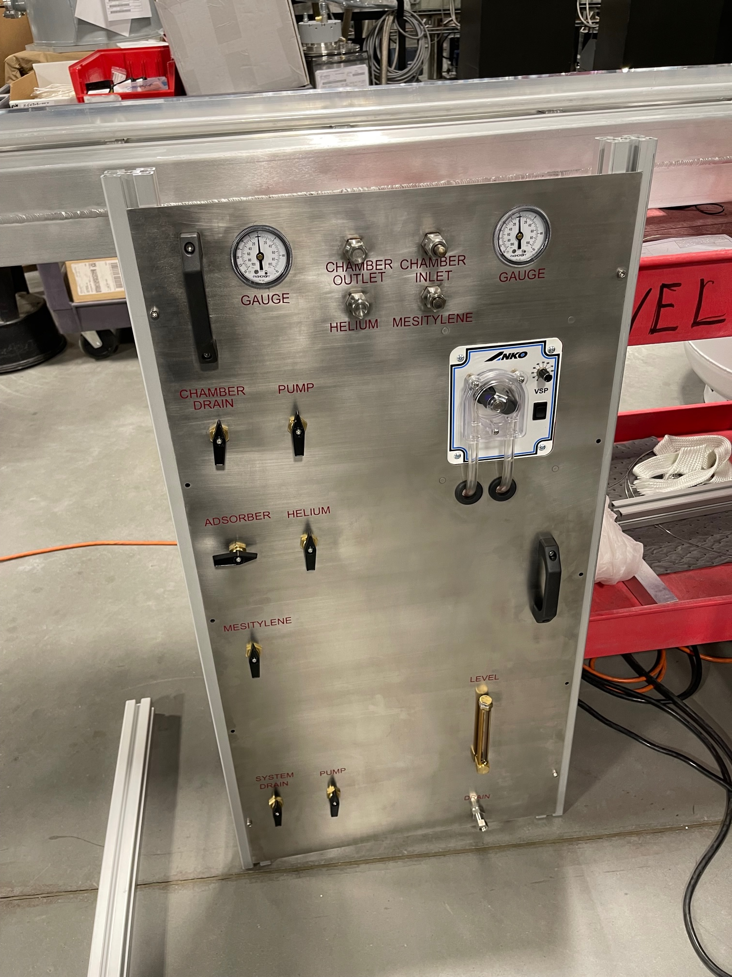
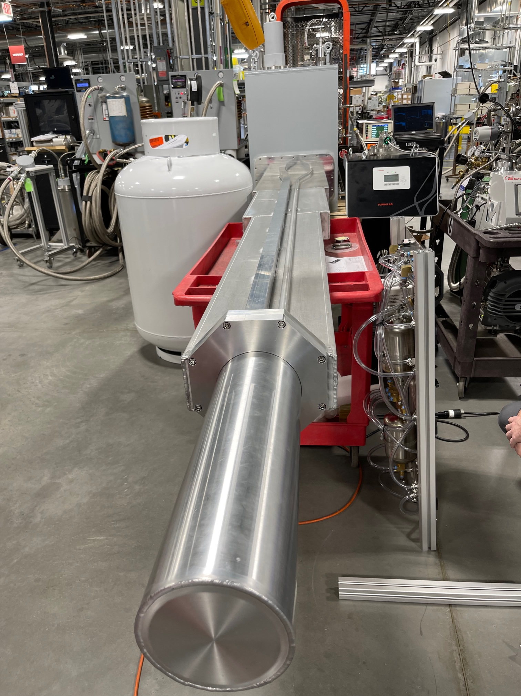
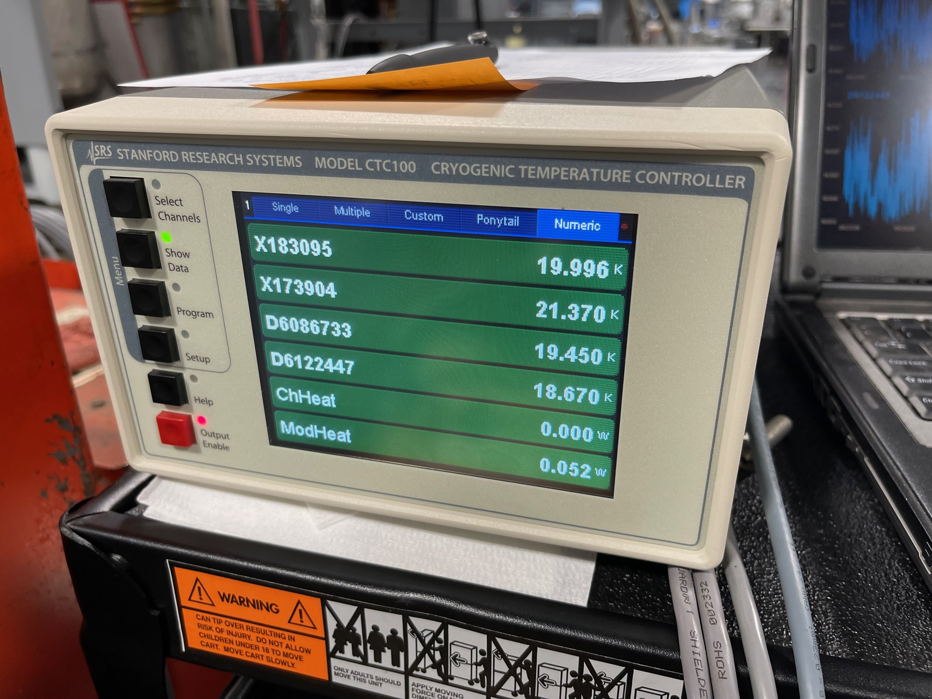
PSBR - Cold Neutron Source

Slide 21
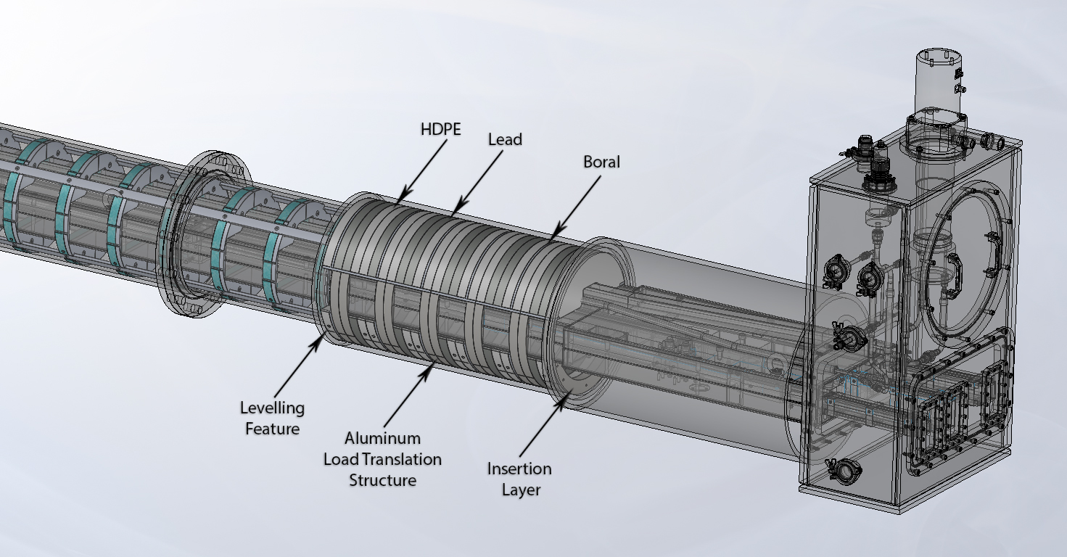
PSBR - Cold Neutron Source

Slide 22
Moderating Materials

Slide 23
Mesitylene
C₆ H₃ (CH₃)₃
1, 3, 5 - trimethylbenzene
Freezing point : 228.3 K
Boiling point : 437.0 K
Ignition point : 823.0 K
Density : 0.865 gr/cm³ (liq)
0.928 gr/cm³ (sol)

Slide 24
Mesitylene Properties
hydrogenous
liquid at room temperature
can be left free-standing at room or cold temperature.
Not present a hazardous fire situation (i. p. = 823 K)
causes no increase in pressure like other moderators due to change in state from solid or liquid to gas
has energy loss mechanism to allow moderation to very low energies (low potential barrier to rotation)

Slide 25
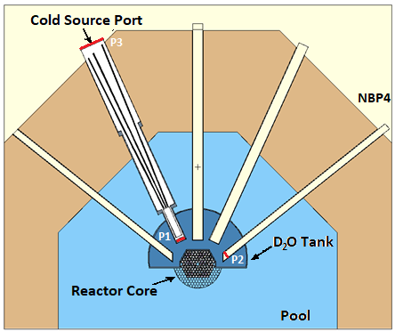
Empty PSBR Cold Neutron Beam Port Flux Measurements

Slide 26
Empty PSBR Cold Neutron Beam Port Entry Flux Measurements (P1)
The aluminum sample holder with a diameter of 4 inches (left). A pattern of aluminum-gold activation foils where bare foils are shown with blue and cadmium covered foils with red colors (right).
Measured Thermal Neutron Flux at #3: 2.24 x 10¹² n/cm²/sec
Measured Resonance Flux at #3: 4.44 x 10¹⁰ n/cm²/sec

Slide 27
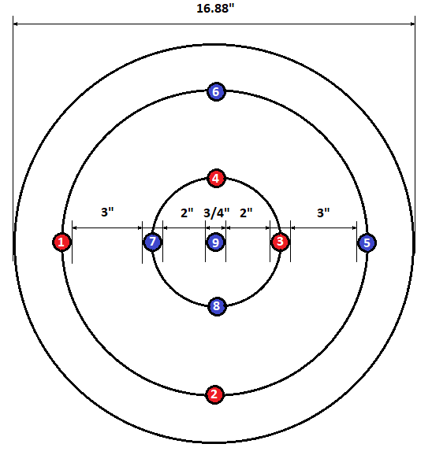
Empty PSBR Cold Neutron Beam Port Exit Flux Measurements (P3)
Measured Thermal Neutron Flux at #9: 1.03 x 10⁹ n/cm²/sec
Measured Resonance Flux at #9: 1.02 x 10⁷ n/cm²/sec

Slide 28
Radiation Science & Engineering Center Update
One of the new technique that will be installed at PSU cold neutron beamline is the Small Angle Neutron Scattering. Due to closure of HZB-Berlin research reactor, Germany, their VSANS facility was available. HZB administration decided to donate the SANS facility instrument to PSU. All components of HZB BERII VSANS are dismantled and will be shipped to PSU in August 2023.
A new supermirror neutron guide system for in-pile and out-of-pile sections (straight, parabolic and beam bender) of the SANS beamline as well as two other cold neutron beam lines design were completed. In-pile section of the neutron guides are delivered, and out-of-pile neutron guides are being manufactured now will be installed in part in October/November 2023 and fully installed in July/August 2024.

Slide 29
HZB BER II VSANS and RSEC Layout

Slide 30
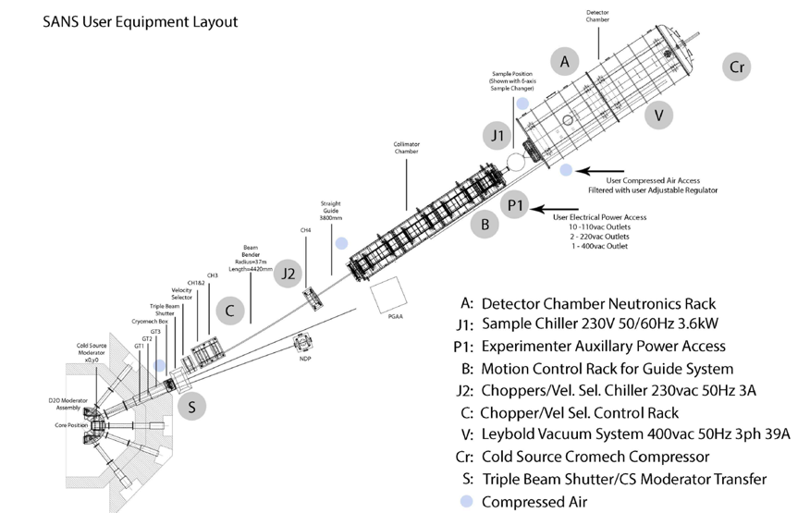
HZB BER II VSANS and RSEC Layout

Slide 31
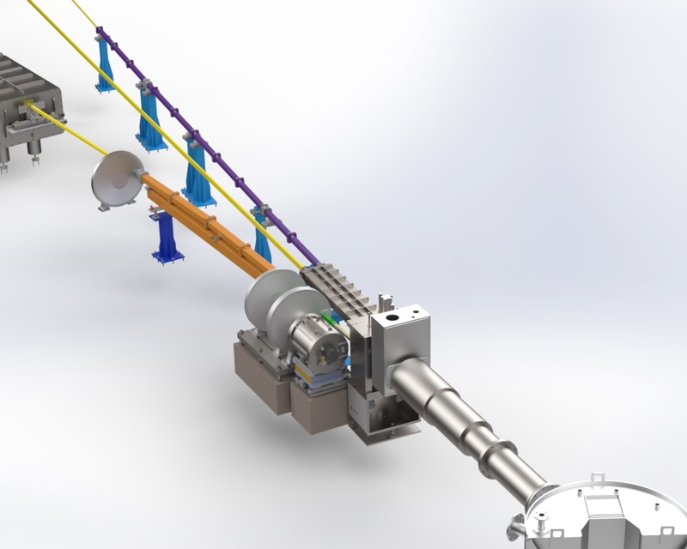
RSEC

Slide 32
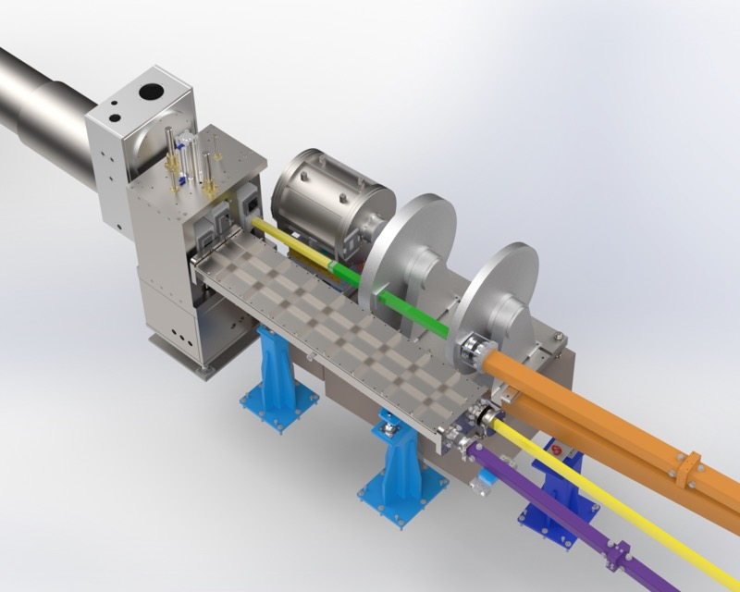
RSEC

Slide 33
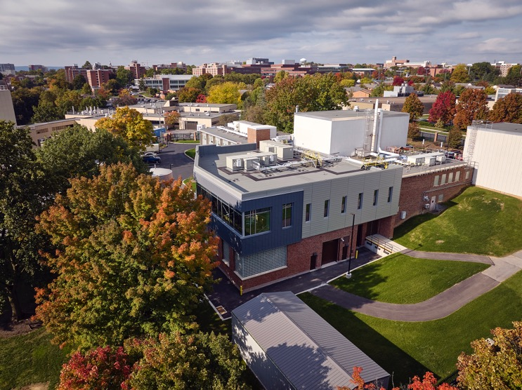
RSEC Expansion (2022)
PSU College of Engineering and RSEC + DOE NEUP
L. Weiss (SVPR), J. Schwartz & A. Atchley (Dean COE) - 2021
$9M COE, $1M RSEC, $306K DOE NEUP

Slide 34
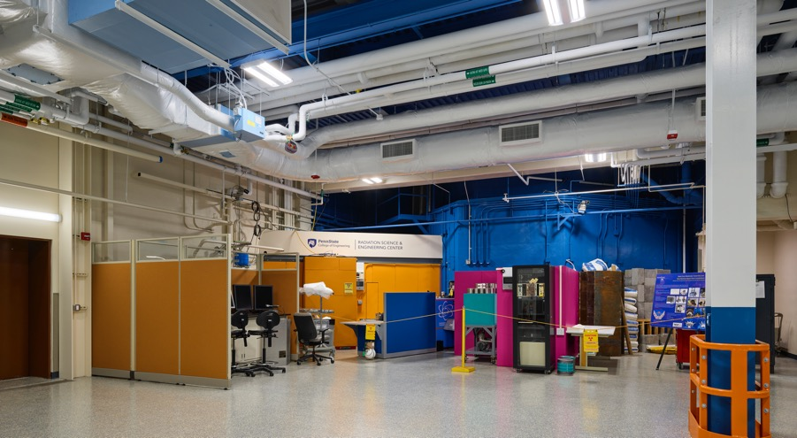
Neutron Beam Hall (2022)

Slide 35
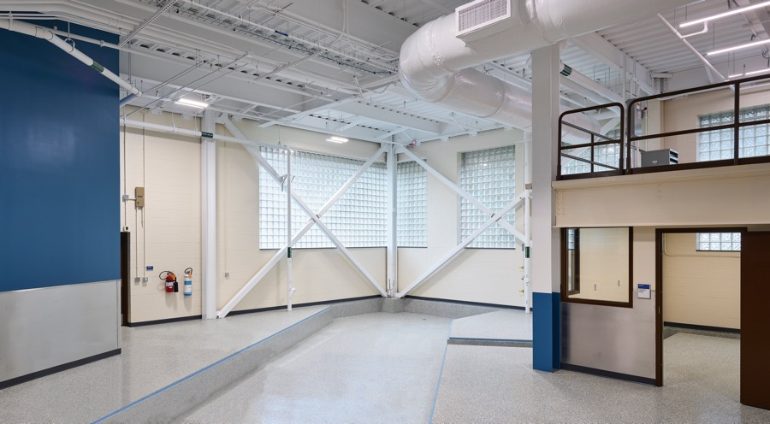
Neutron Beam Hall (2022)

Slide 36
Conclusions
A third generation mesitylene based cold neutron source with circulating liquid helium cooling system was designed, manufactured, factory tested and will be installed at Penn State Breazeale Nuclear Reactor (PSBR) in August 2023.
Mesitylene based cold neutron source is ideal for small and medium scale (<2 MW) research reactors.
Three supermirror neutron guides (straight, curved and/or beam bender) will transmit cold neutrons to experimental locations for Small Angle Neutron Scattering (SANS), Neutron Depth Profiling and Prompt Gamma Activation Analysis facilities.
One of the cold neutron beam is designated for SANS. HZB BER II VSANS instrument and other materials donated to Penn State.
RSEC building expansion project was completed with new expanded Neutron Beam Hall. Expansion project was funded by PSU COE and RSEC.
PSBR will be the only university research reactor with SANS capability in the USA.

