Slide 1

Investigation of Pancake-like Moderator-Reflector Structure for the High Brilliance Neutron Source (HBS)
Junyang Chen
Forschungszentrum Jülich
12.07.2023

Slide 2
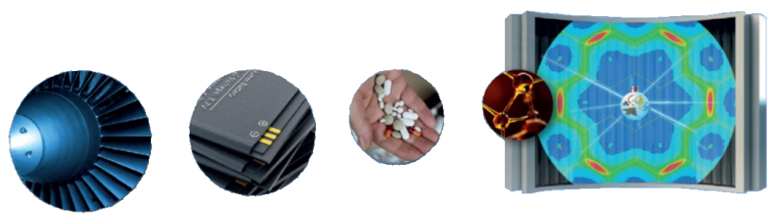
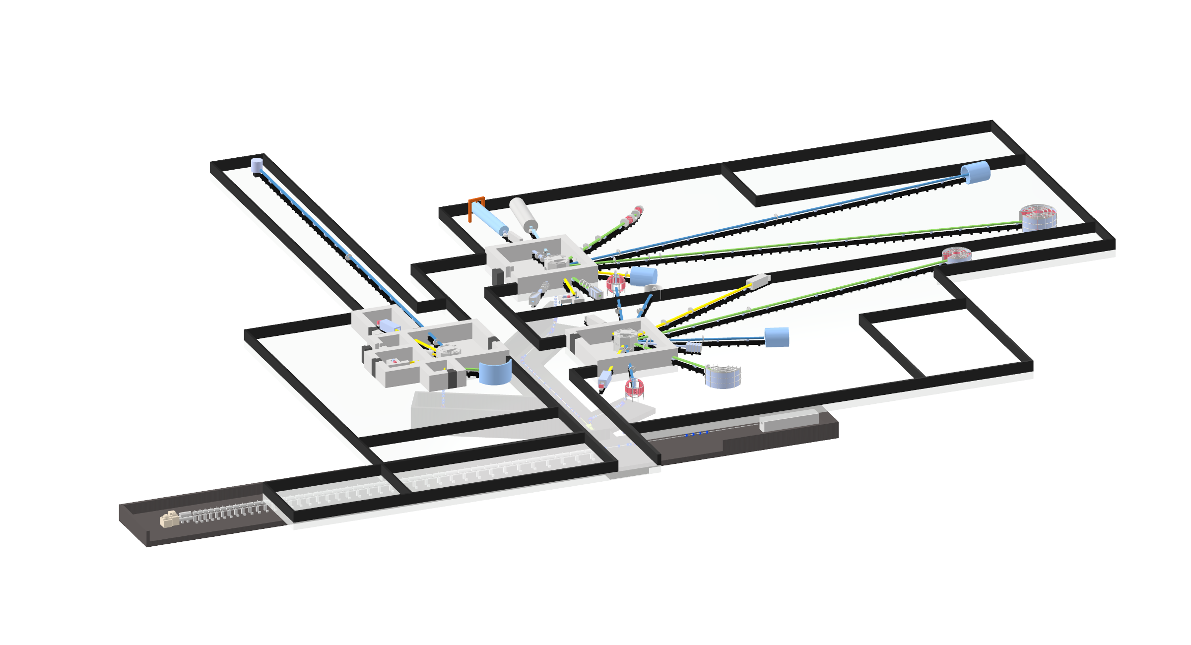
High Brilliance Neutron Source (HBS))
Background
Need for neutron-scattering facilities :
growing
Some existing reactor-based sources :
decommissioned
Wide application of neutron
Basic paradigm
Produce less but more efficiently
Save cost
HBS layout

Slide 3
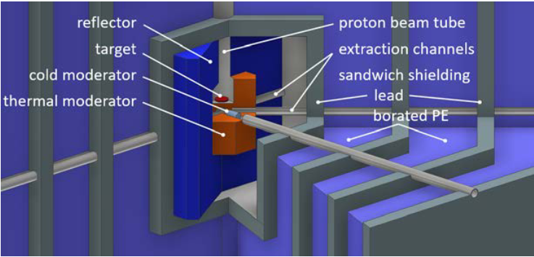
High Brilliance Neutron Source (HBS))
Main features
Key component to “more efficiently”
Moderator-Reflector
1)Moderator : decrease neutron energy
2)Reflector : reflecting escaping neutron
Neutron transfer system
Proton energy : 70 MeV
Proton beam power : 100 kW
Three target station : 24 Hz, 96 Hz, 96 Hz
10-12 instruments for each target stations
Optimal time structure and energy structure : fulfill the needs of each individual instrument

Slide 4
HBS Moderator-reflector : Confinement and Extraction
Proton beam (low energy)
Proton beam (high energy)
Target
Target
Extraction channel inside cloud with specific moderator
Small Neutron cloud with high density
Optimal energy with high brilliance
Low energy
Small target
Single tube is ideal case

Slide 5
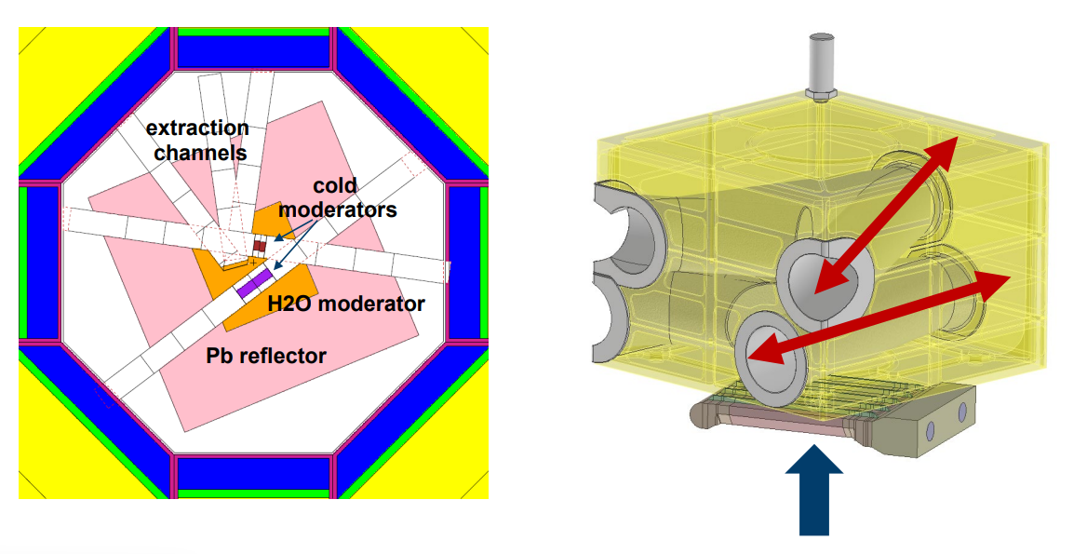
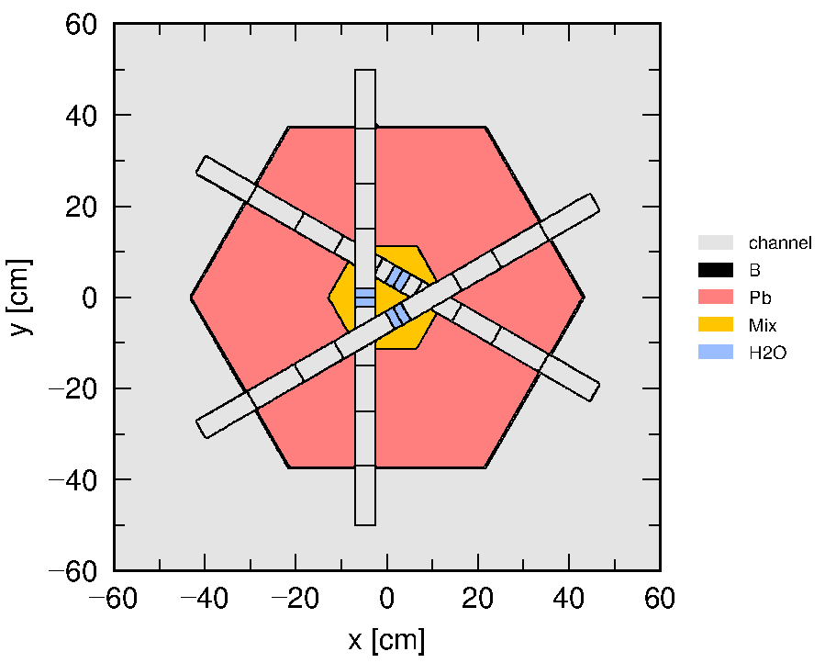
Multiple channel Extraction
Extraction:
Specific moderator in the channel
Diameter of channel should be larger (6 cm)
Mean free path of thermal neutron
in water : 0.5-1 cm
Multiple channels
Losing moderator material
Dilute neutron cloud

Slide 6
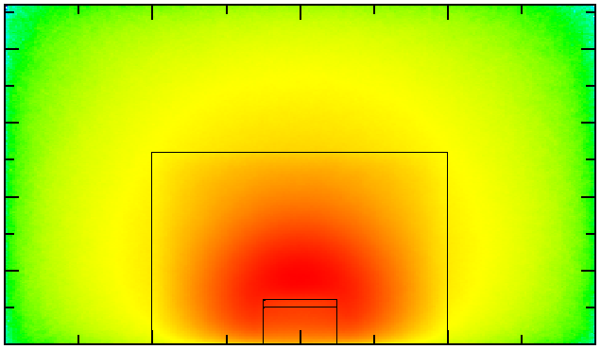
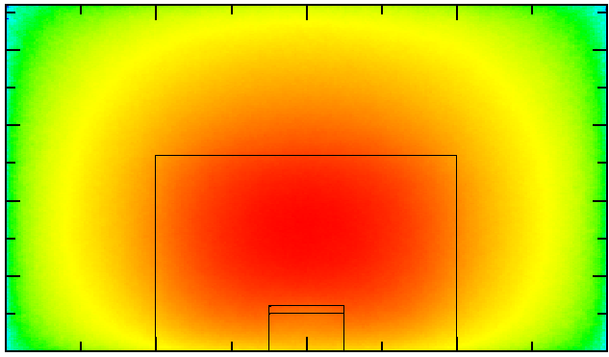
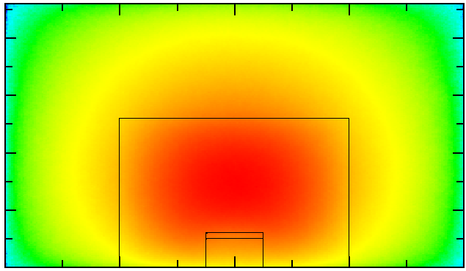
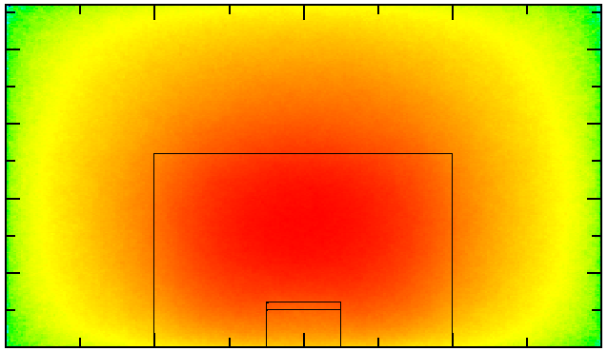
Confinement in water
Thermal neutron cloud distribution
Thermal moderator: water
High scattering cross section
High energy loss per collision
Fill in the space to confine neutron cloud
Pb
Pb
H₂O
D₂O
Pb
Pb
Be
Graphite

Slide 7
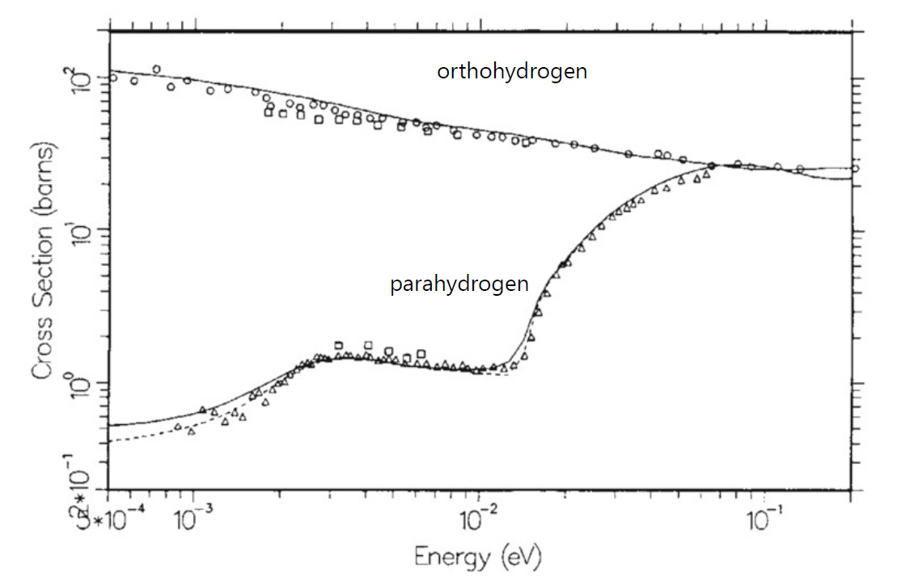
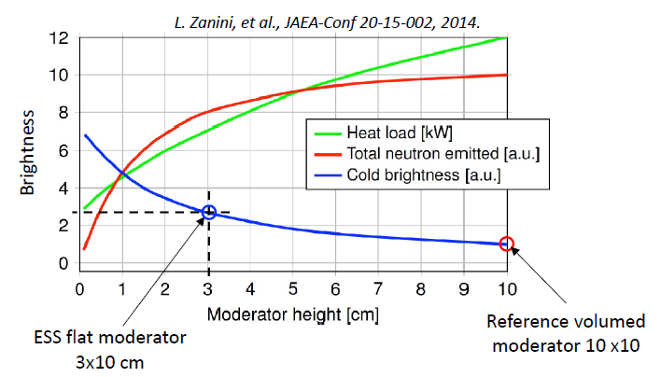
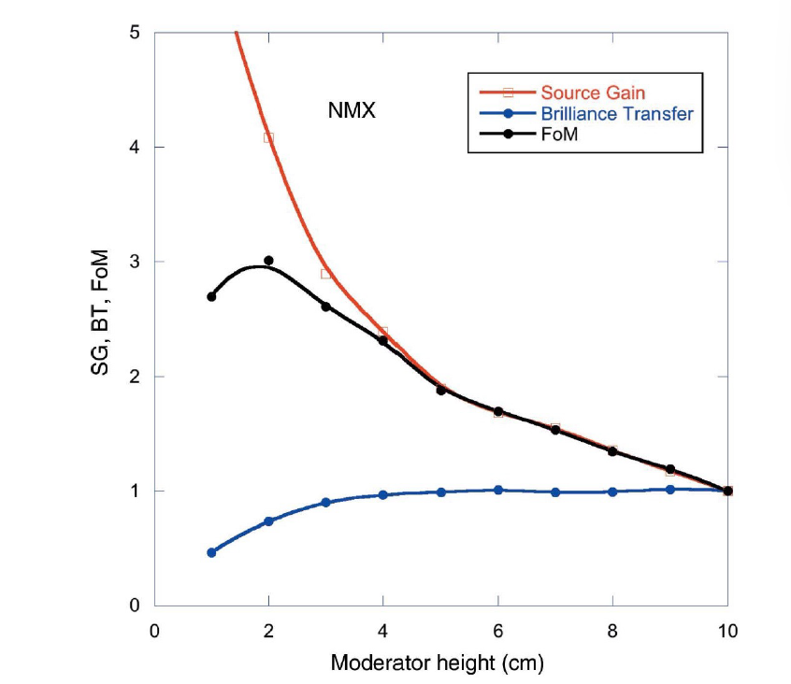
Low dimensional moderator
Cold moderator material : paraH₂ (20k)
Low dimensional moderator
Suitable dimension to avoid decreasing brilliance transfer
L. Zanini, et al., JAEA-Conf 20-15-002, 2014
L. Zanini, ESS Seminar, 2023

Slide 8
Pancake structure
neutron
neutron
Without gap inside moderator
Premoderator
Cold moderator
Moderator /Reflector
High brilliance

Slide 9
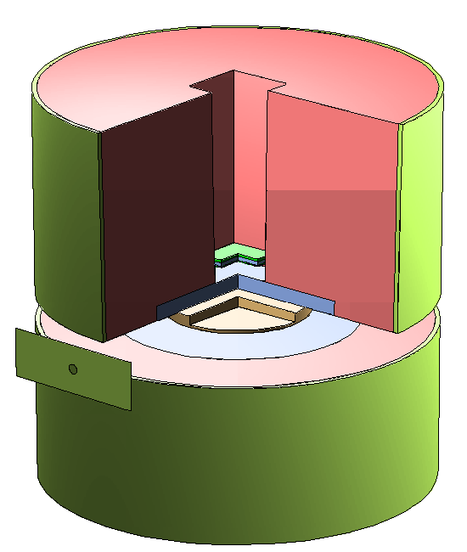
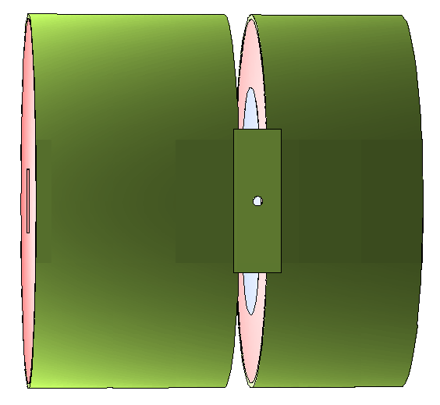
Tally for brightness
target
Pb
water
Point detector
1m
parahydrogen
Circular slit; Boron (thickness 0.01cm, density 200g/cm³)

Slide 10
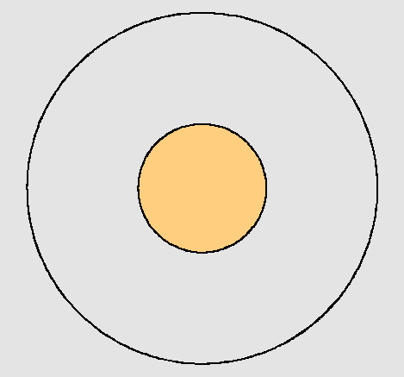
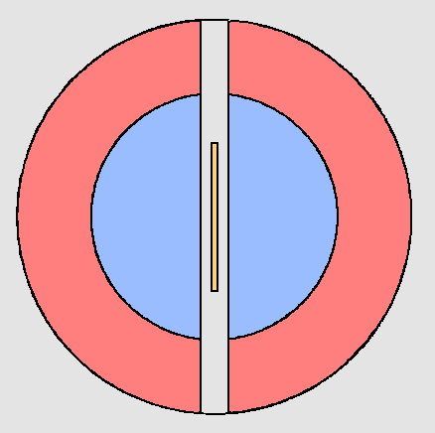
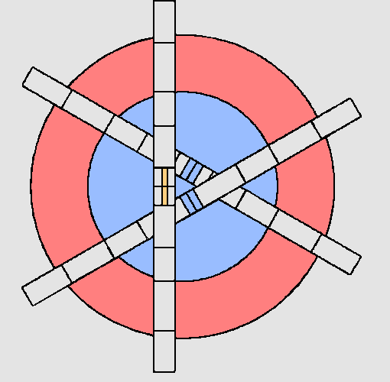
Shortage of Pancake structure
parahydrogen
parahydrogen
water
parahydrogen
Pancake
Single tube
Triangle channel
Center paraH₂ :
dilute thermal neutron cloud
Pancake problem
Top layer
Only cold neutron

Slide 11
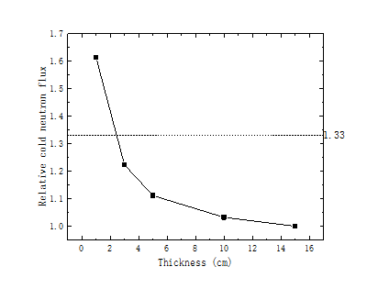
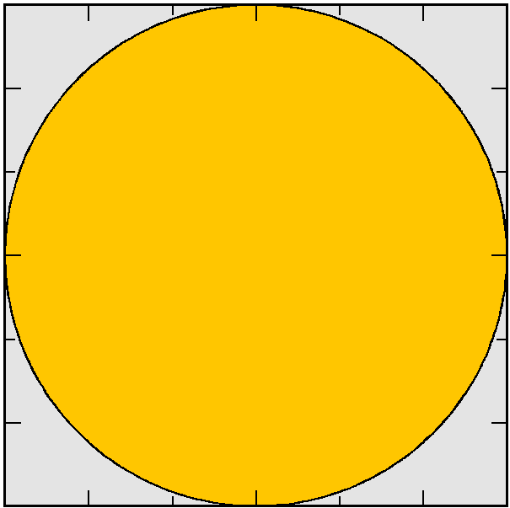
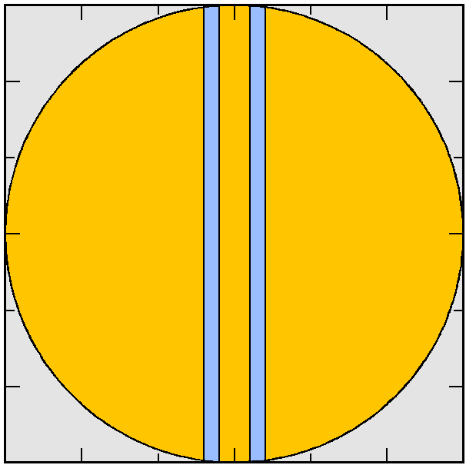
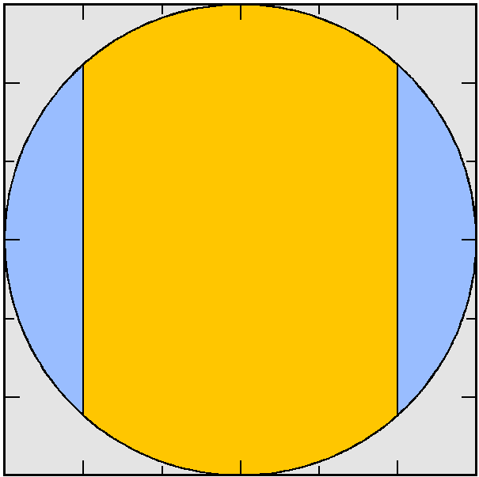
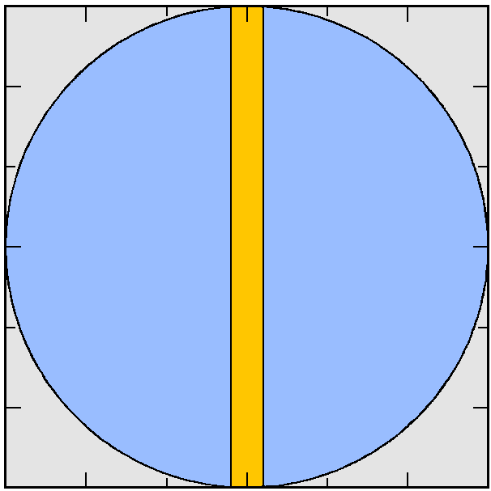

Water inside parahydrogen pancake
neutron
Without water
Water inside the parahydrogen can increase the cold neutron flux by 1.33
Transverse
section
Thickness
Water
Parahydrogen (20K)

Slide 12
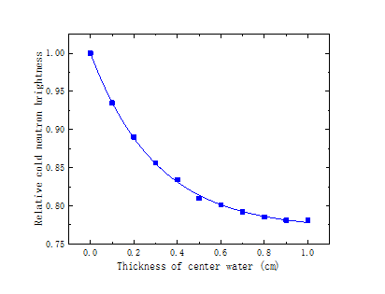
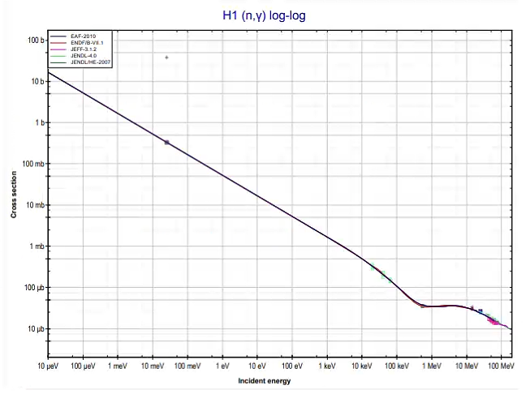
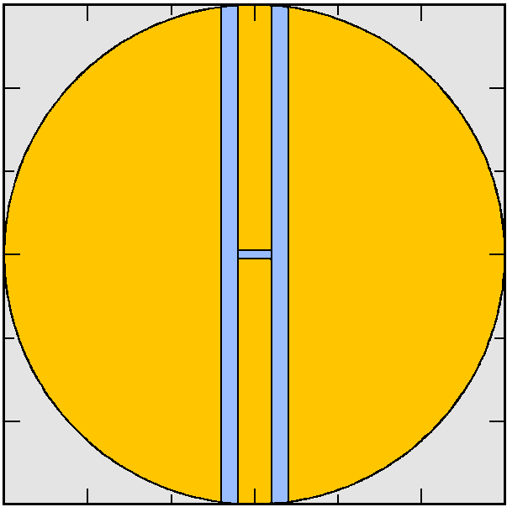
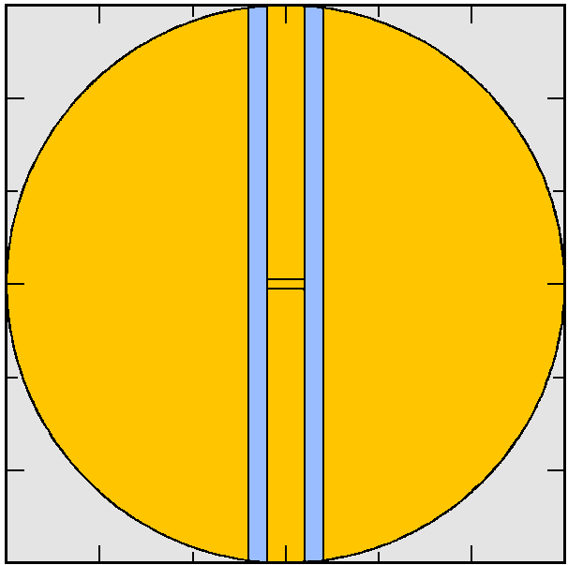

Absorption effect of water for cold neutron
Tally point
Absorption cross section of H
$$e^{−t/0.3}$$
Cold neutron absorbed by center water
Exponential decay for increasing thickness of center water

Slide 13
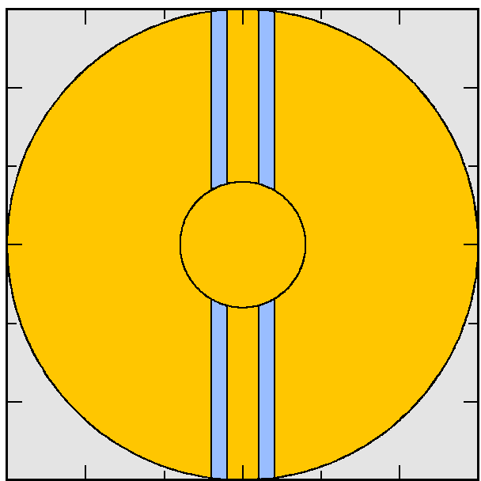
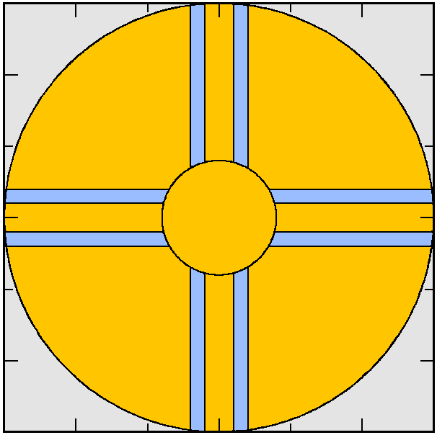


Multiple extraction for one dimension
1
2
Circular parahydrogen is in the center
Different parahydrogen channels are separated by water
Different parahydrogen channels correspond to different instruments
3
4
Water
Parahydrogen (20K)

Slide 14




Water surrounding pancake
1. Single Pancake
2. Water surrounding: moderating and reflecting escaping neutron
5 Gap : vacuum space
3. Water inside: increasing cold neutron flux
4. Water filling: increasing feeding thermal neutron

Slide 15
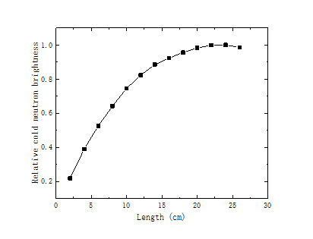
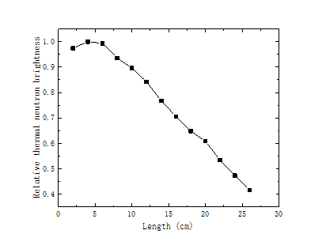
Different effect of thermal and cold moderator
Thermal neutron feeding
Thermal neutron feeding
Cold moderator
Thermal moderator
Thermal neutron feeding
Thermal neutron feeding
Water : 1) confine thermal feeding neutron cloud
2) provide thermal neutron to instruments
Large and fill in the space
Small and close to center

Slide 16

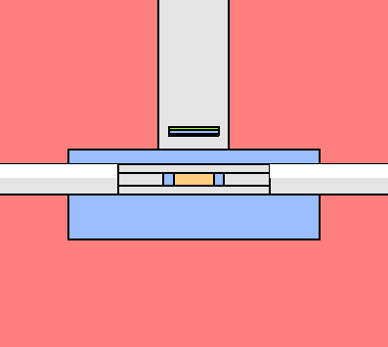
Thermal neutron extraction
Pb
12 extraction channels
8 channels for cold neutron
4 channels for thermal neutron

Slide 17
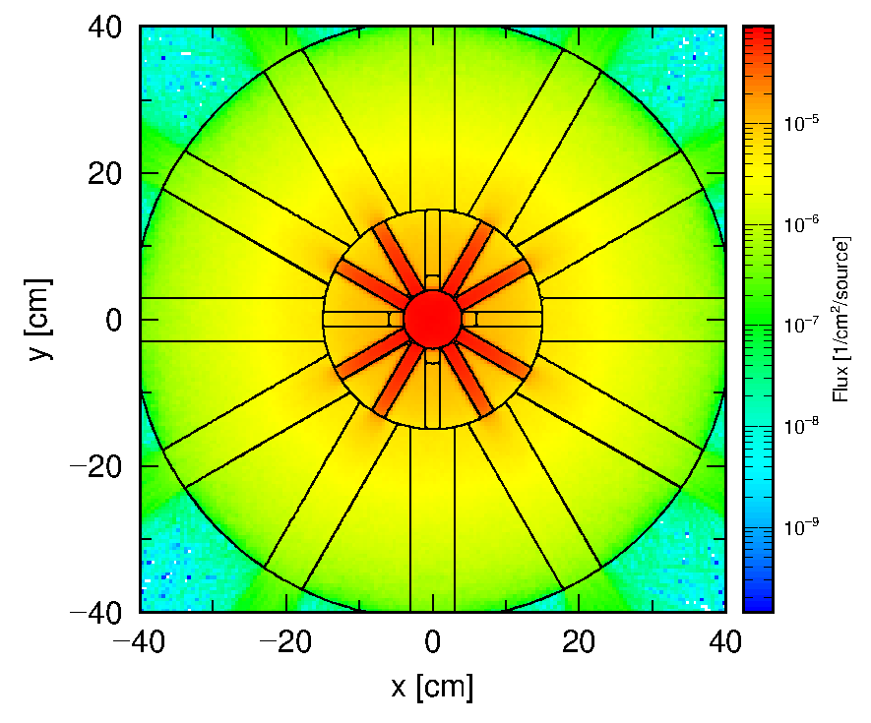
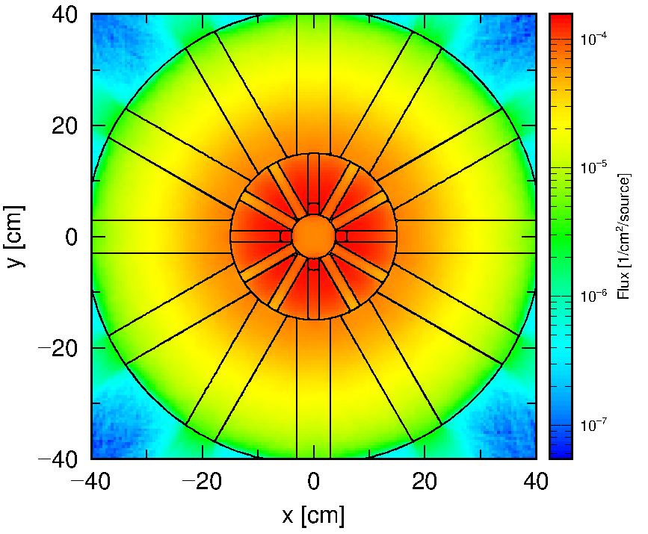
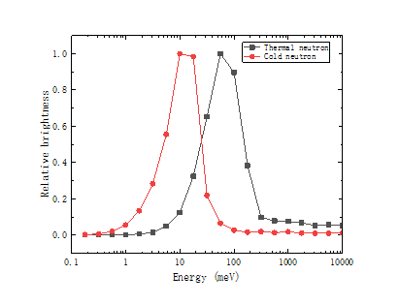
Result
Cold neutron flux distribution
Thermal neutron flux distribution
Cold neutron brightness : at least 24 % increased (compared with triangle channel)
Thermal neutron brightness : at least 20 % increased (compared with triangle channel)
Provide neutron up to 12 instruments

Slide 18
Outlook
Bi-spectral extraction
Influence of engineering problem for neutronics
1) Container between cold moderator and water
2) Neutronic influence of cooling circuit
Compatibility with neutron delivery system

Slide 19
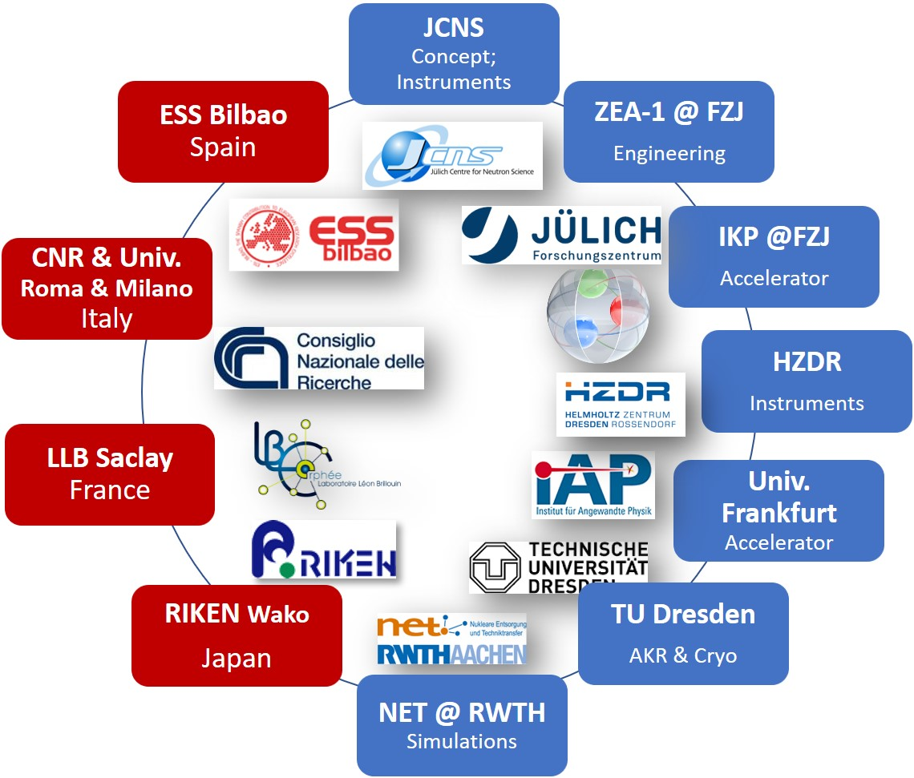



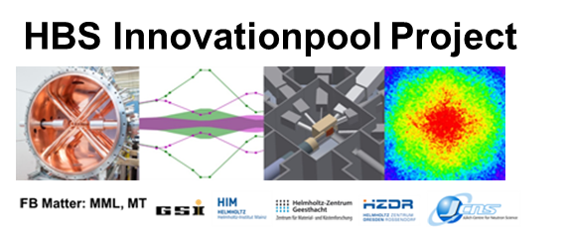



Thanks to HBS Team
J. Baggemann
Th. Brückel
T. Cronert (†)
Q. Ding
P.-E. Doege
T. Gutberlet
J. Li
K. Lieutenant
Z. Ma
E. Mauerhofer
N. Ophoven
U. Rücker
N. Schmidt
A. Schwab
J. Voigt
P. Zakalek
- Core group:
design, verification,
instrumentation
ZEA-1:
Y. Bessler
R. Hanslik
R. Achten
F. Löchte
M. Strothmann
- Engineering
IKP-4:
O. Felden
R. Gebel
A. Lehrach
M. Rimmler
R. Similon
- Nuclear physics
INM-5:
B. Neumaier
- Radio isotopes
S. Böhm
J.P. Dabruck
R. Nabbi
- Nuclear simul.
C. Lange
T. Langnickel
Ch.Haberstroh
M. Klaus
S. Eisenhut
- AKR-2, liquid H₂
H. Podlech
O. Meusel
- Accelerator
W. Barth
- Accelerator
/ HIM

