Slide 1
N-beams with intrinsic structures (in space or) in time –
methods and some possible applications
R. Gähler¹, T. Keller², R. Golub³
1) ILL – Grenoble (retired)
2) FRM2 + MPI Festkörperforschung Stuttgart
3) Univ. North Carolina

Slide 2
Aim: μs-short n-pulses far downstream of any device;
The method relies on the MIEZE-principle, using 2 RF-flippers
Int
ω ≈ 0 - MHz
RF-flippers M₁+M₂
M₁(ω₁)
M₂(ω₂)
t
several meters
z
≈ cm
P
A
Int
many similarities to OCT !
t

Slide 3
Simple analogy for a time interferometer (MIEZE):
Two cars and have same E_{kin} before passing A at time t₀.
Both should arrive at D at time t_{D}, but here is faster than
Energies may only be changed at A and C!
A
C
D
Reversal of
energy change at C
Arrival at D at same time
but with different E_{kin}
Slow down at A
Speed up at A

Slide 4
How to realize this for neutrons?
Two states of a neutron and have same E_{kin} before A at time t₀.
Both should arrive at D at time t_{D}, but here E_{kin} is higher for state
than for state , superposition of + generates beats in time at D.
Change in energy by state-reversal in time-dependent B-fields!
A
C
D
Reversal of energy change at C
Energy change higher than at A
Time delay at C: spin echo time τ_{NSE}
Arrival at D at same time
but with different E_{kin}
causing beats in time
Slow down at A
Speed up at A
Energy changes very small wrt E₀ !

Slide 5
How to slow down (speed up) one state against the other?
Pure static B₀ fields only cause lead/lag of states; no change in E_{kin}!
B₀
z
E_{kin}
E₀
z

Slide 6
How to slow down (speed up) one state against the other?
Additional proper RF-fields B_{rf} can change E_{kin} of states!
B₀+
B_{rf}
z
E_{kin}
E₀
z

Slide 7
How to make a time-interferometer out of this?
How to modulate in time (or in space) a polychromatic continuous neutron–beam with the signal plane far downstream of the modulating device ?
The modulation relies on the Mach-Zehnder (MZ) principle from light interferometry. The MZ-signal position neither depends on wavelength nor on beam divergence.
Consequently the signal appears also in the classical regime (negligible diffraction), and also for neutron beams of fairly large divergence.
Interferometry in n-scattering

Slide 8
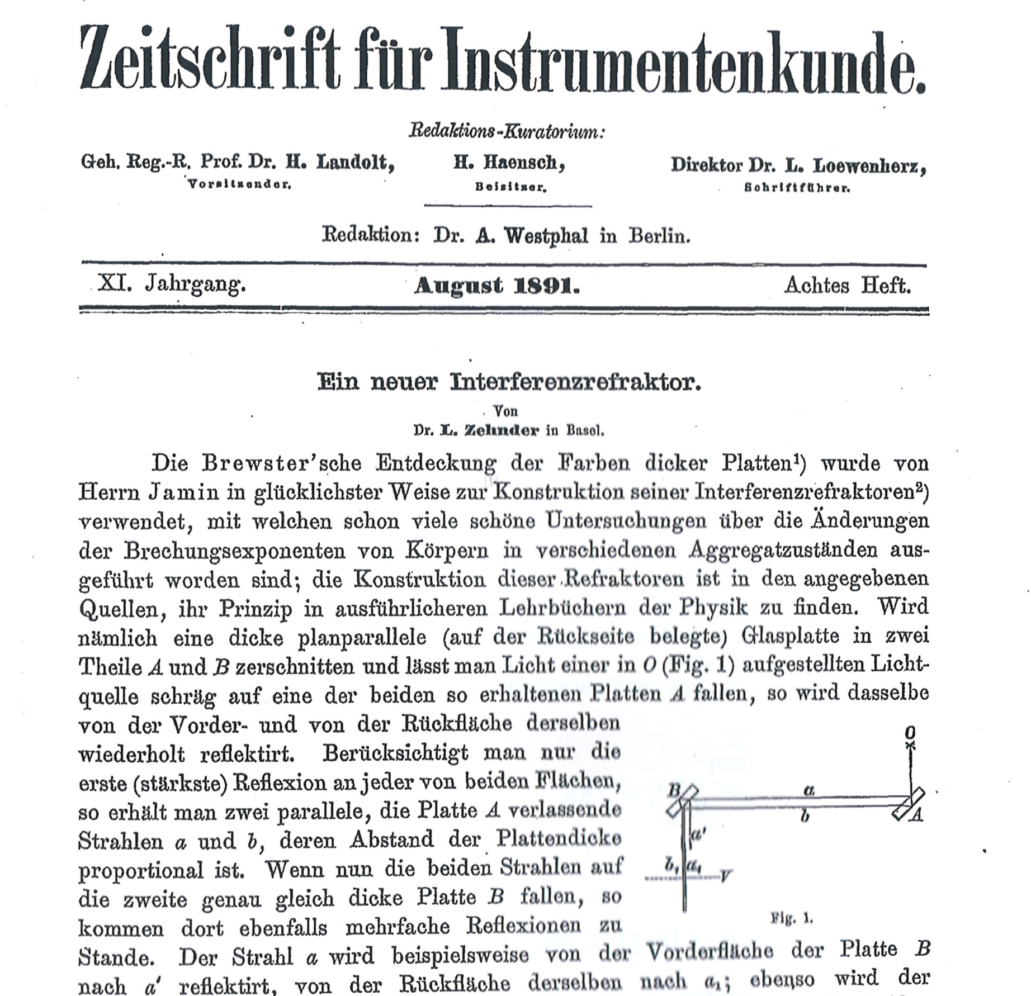
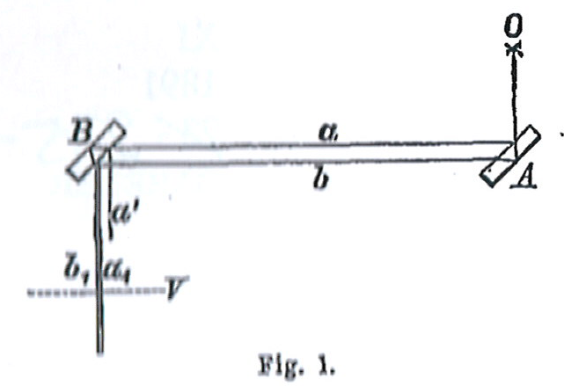
Light source
The Jamin interferometer with its small beam
separation a-b  2 cm, determined by the
thickness of the glass plates A and B;
Problems:
flatness and variation of n in glass;
a’: one of the suppressed beams
Image (interference a₁, b₁)
viewed by telescope

Slide 9
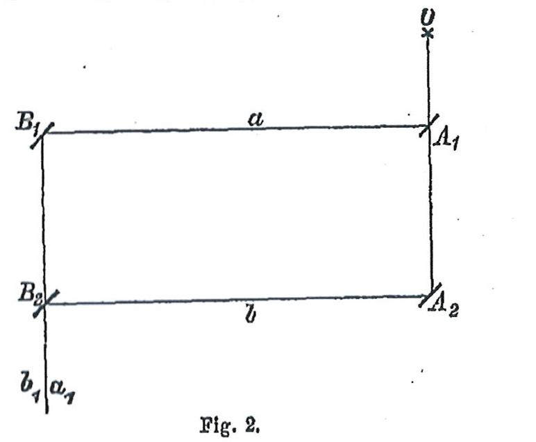
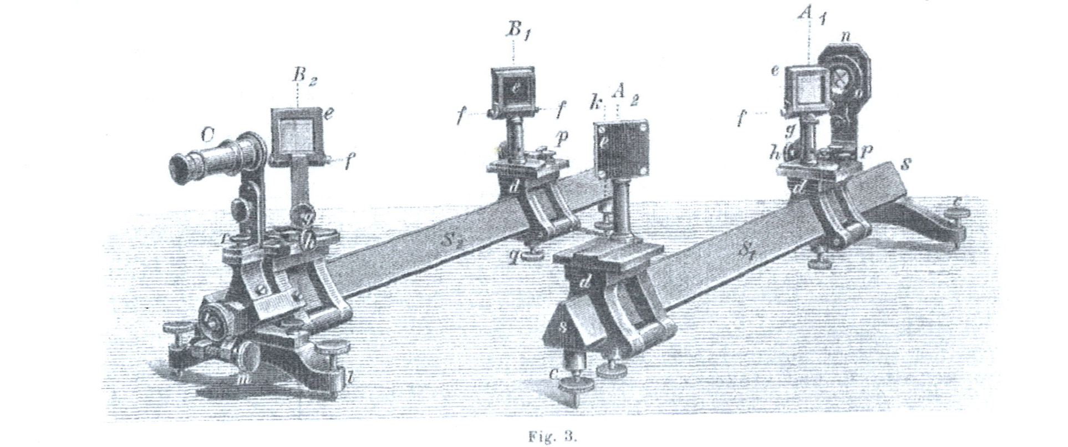
The “Zehnder-Interferometer”
Interferometry in n-scattering

Slide 10
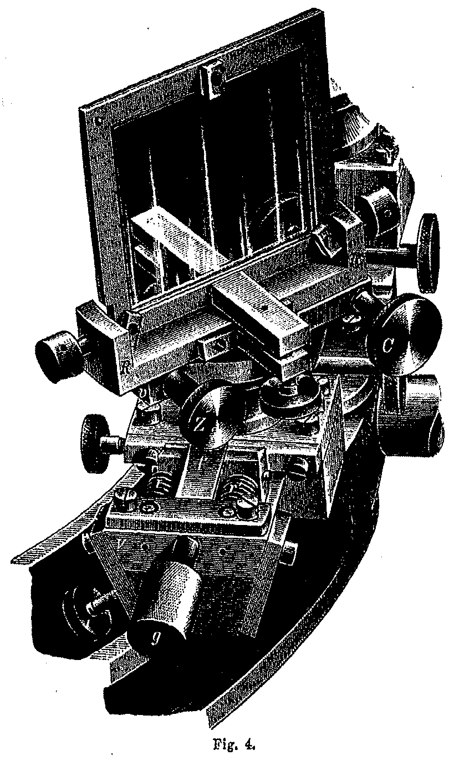
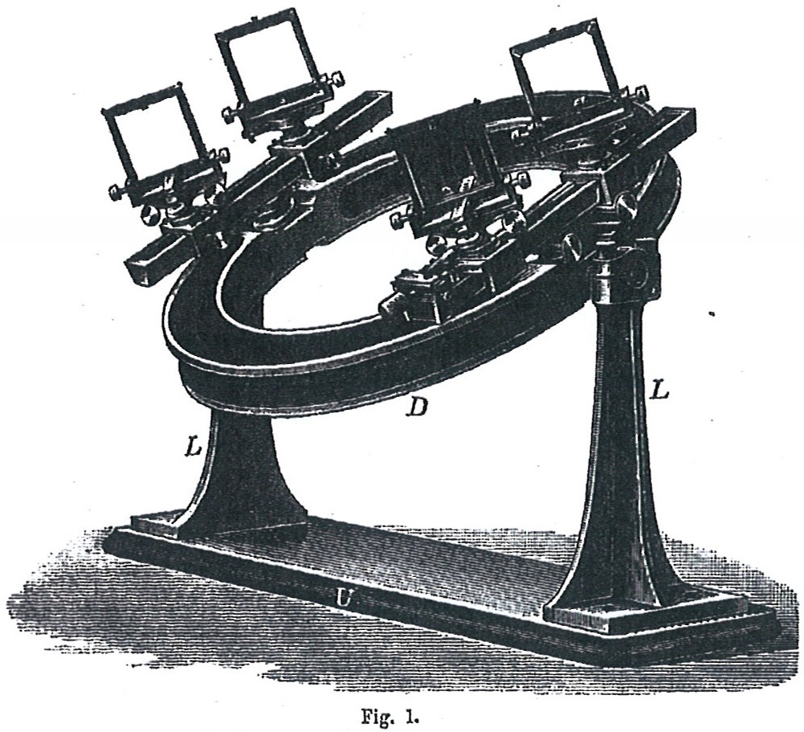
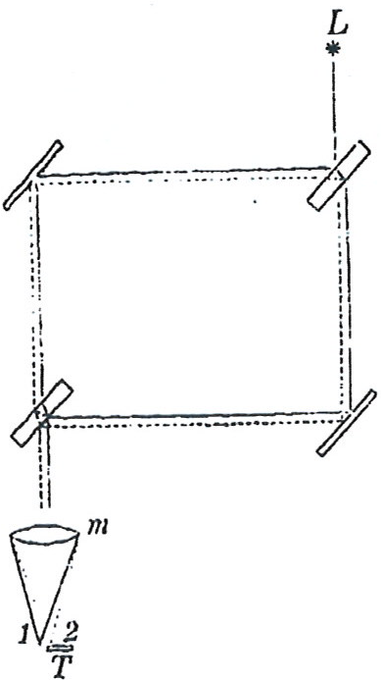
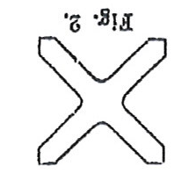
The “Mach-Interferometer”
Interferometry in n-scattering

Slide 11
The Mach-Zehnder (MZ) 3-grating version
G_{i} = 2π/d_{i}
G_{i}: reciprocal lattice vectors;
|G_{1,2}| « | k₀ |
d₂
L₂
θ₂=G₂/k₀
d₁
k₀+G₁
k₀+G₁-G₂=
k₀-(G₂-G₁)
plane of observation
G_{d} = 2π/d_{d} = G₂-G₁
d_{d} = periodicity of
interference pattern
x_{s}
k₀
θ₃= θ₂-θ₁=
(G₂-G₁)/k₀
θ₁=G₁/k₀*
x
L₁
G_{i} = 2π/d_{i}; |G_{i}| « |k₀|;
X_{s}= G₁/k₀·L₁ = (G₂-G₁ )/k₀·L₂;
G₁·L₁ = (G₂-G₁ )·L₂ = G_{d}·L₂;
z
* Consider only 1. order diffraction
The 3-grating version is best suited for radiation of low phase space density, as:
G_{d} does not depend on |k₀|; (white fringe contrast);
Position of maxima does not depend on input divergence;
The gratings may be phase- or absorption gratings;
The system works for negligible diffraction (λ«d); geometrical optics;
X_{s} is the spatial resolution, if the system is applied in measuring spatial correlations;
Interferometry in n-scattering

Slide 12
The MZ “3-grating version in time” ▪ MIEZE / TISANE
ω_{i} = 2π/t_{i}
ω_{i} = ‘grating frequency’;
ω_{1,2} « ω₀
t_{s}
‘θ_{s}’= ω_{s}/ω₀
plane of observation
ω_{d} = 2πt_{d} = ω_{s}- ω_{c}
ω_{d} = frequency of
interference pattern
t₁
ω₀+ω_{c}
T_{s}
ω₀-(ω_{s}- ω_{c})
k₀; ω₀
‘θ_{d}’= θ_{s}-θ_{c}
= (ω_{s}- ω_{c})/ω₀
‘θ_{c}’=ω_{c}/ω₀*
L₁; (T₁)
L₂ ; (T₂)
d
t-t₀
c
T_{s}= ω_{c}/ω₀·T₁ = (ω_{s}-ω_{c})/ω₀·T₂;
ω_{c}·T₁ = (ω_{s}- ω_{c})·T₂ = ω_{d}·T₂;
z
s
* Consider only ‘1. order diffraction’
v=const. ω_{c}·L₁ = (ω_{s}- ω_{c})·L₂ = ω_{d}·L₂;
This is the ‘TISANE condition’;
TISANE is an ‘induced’ 3-grating MZ-interferometer time, working in the classical regime;
The t-modulation of the sample ω_{s} is made externally, it needs to be ‘PLL-locked’ with the chopper- and the detector-frequencies ω_{c} and ω_{d};
Interferometry in n-scattering

Slide 13
Quantum-mechanical picture of MIEZE principle
L₁
L₂
Coherent
frequency splitting
Reversal of coherent
frequency splitting
D
E
S
ω₀ + (ω_{S} - ω_{E})
total energy
k₀+Δk_{E}=k₀+ω_{E}/v;
ω₀ + ω_{E}
k₀+Δk_{S}=k₀+(ω_{S}-ω_{E})/v
+ ω_{E}
+ω_{S}
E₀
modulation plane
i(k₀x - ω₀t)
e
Ψ₀ =
- ω_{E}
k₀-Δk_{E}=k₀-ω_{E}/v;
ω₀ - ω_{E}
ω₀ - (ω_{S} - ω_{E})
+i(Δk_{E}L₁ - Δk_{S}L₂)
-i(ω_{S} - ω_{E}) t
Δ k_{E} = ω_{E}/v;
Ψ =
e
e
detector
-i(Δk_{E}L₁ - Δk_{S}L₂)
+i(ω_{S} - ω_{E}) t
Ψ₀
e
e
Δ k_{S} = (ω_{S} - ω_{E})/v;
For ω_{E}L₁ = (ω_{S} - ω_{E})L₂ , Ψ gets independent on v. ⇒ beats in time with ω_{D} = (ω_{S} - ω_{E})
Det

Slide 14
*The MZ 3-grating version in time in the classical limit (FOTOF)
Choppers at C and at S
Intensity.
L₁
L₂
t_{c}
overlap for duty cycles > 50% (for L₁=L₂)
k₀; ω₀
t_{d}
t-t₀
t
C
t_{s}
S
D
z
Triangular intensity at d as function of time,
if both duty cycles at C and S are the same;
From geometry:
L₁/t_{C} = L₂/t_{D} and L₂/t_{S} = (L₁+L₂)/t_{C};
1/t_{D} = 1/t_{S} – 1/t_{C}; ω_{D} = (ω_{S}- ω_{C});
From Mach-Zehnder:
ω_{c}·L₁ = (ω_{s}- ω_{c})·L₂ = ω_{D}·L₂;
Interferometry in n-scattering

Slide 15
Longitudinal modulation of a polychromatic continuous neutron beam
Continuous, somewhat divergent,
polychromatic (10%) cold beam
modulation plane
P
A/B
I(t)
instrument
z
Modulator:
1 polarizer + 2 RF flippers + 1 analyser (or buncher)
Angles of trajectories wrt z-axis
need to be conserved for high ν
I(t)
I(t)
ν ≈ 0 – 10 MHz
I ₀
0
0
Non-perfect spinflip
t
t
Modulators off
Modulators on

Slide 16
Why does it need quite good straight guides?
I(t)
modulation plane
For ν_{D} = 1 MHz and L₂ =10 m, the propagation time for L₂
should be constant within Δt₂ = 10⁻⁷ sec, corresponding to an
angular change of Δγ ≈ 10⁻²γ for v_{n} = 1000 m/s;
L₂
A
D
distorted reflection
Δγ
regular reflection
γ = 1°

Slide 17
Quantum-mechanical view of bunching; no classical view exists!
The variation of Δk = k₁ - k₂ due to ω_{f} is not cancelled
by the MIEZE condition and leads to an extra phase
difference dϕ between both waves at the detector.
ω
ω₀ + ω_{D} + ω_{B}
ω₀ - ω_{D} + ω_{B}
⇒ sin (θ+dϕ)
ω_{B}
⇒ cos (θ-dϕ)
ω₀ + ω_{D}
ω₀ - ω_{D}
θ = (ω_{S} - ω_{E})t = ω_{D}t;
-ω_{B}
This determines ω_{B}.
ω₀ + ω_{D} - ω_{B}
ω₀ - ω_{D} - ω_{B}
m
1
π
d
ϕ
=
ω
B
ω
D
L
2
=
8
h
ω
3
/
2
4
0
k₁
k₂
k
k₁ - k₂ depends on ω_{B} !
Bunching more easy for slow neutrons

Slide 18
The green box for beam modulation in time:
analyzer or high-power Stern-Gerlach
energy shifter*
RF π-flippers
modulation plane
2I₀⋅sin²ω_{D}t
I₀

*

ω_{E}
ω_{S}
ω_{B}
polarizer
‘phase-locked’
free-running
*causing a lead/lag of both spin states
* magnetic screen

Slide 19
Three possible szenarios:
A: Do nothing downstream of S:
Spins at D will rotate with
ϕ_{D} = 2(ϕ_{S} - ϕ_{E});
ϕ_{D}: [0 – 10 MHz]
B: Place polarizer downstream of S:
Intensity will oscillate at D with
ω_{D} = 2(ω_{S} - ω_{E});
ω_{D}: [0 – 10 MHz]
typical value
C: Place buncher downstream of S:
Intensity will oscillate with
but with twice the intensity compared to B.
ω_{D} = 2(ω_{S} - ω_{E});
ω_{D}: [0.1 – 10 MHz]
This is a very efficient system to create time structures for continuous polychromatic neutron beams.

Slide 20
Applications of time-modulated beams
Increase of energy resolution in TOF
Lock-in techniques for n-scattering
Interaction of excitations with the n-intensity wave
Suppression of background and multiple scattering
Decay time in n-induced reactions (time resolution: ms – μs)
Spin-dependent reactions and phenomena
MISANS (SANS with high energy resolution) or SANS with μs t - resol.
SPAN-like NRSE spectrometer with very high resolution
Holography without reference wave
Multi - MIEZE setups (?)
Tomography with isotope sensitivity

Slide 21
A: Increase of energy resolution in TOF
Resolution of standard TOF:
Example IN5 at 6 Å at max. chopper speed:
6Å ▪ 2.2 meV; t_{f} = 6.1ms; Δt_{f} = 55µs for l=4 m and ΔE = 40µeV
n-guide upstream
TOF spectrometer
MIEZE
MIEZE coils
Modulation plane
A MIEZE/Bunching system at ω_{D} = 200 kHz (typ. value) in front of the spectrometer can modulate the elastic line (or inelastic line) with 5 µs resolution.
I
MIEZE on
MIEZE off
Tolerable path length differences: Δl ≤ 2mm!
Works on inelastic lines as well, as Δv/v ≈ 0.01;
Sacrifices only a factor 2+ε in countrate;
With modulation plane at the sample, S(q,t) for small ℏω and S(q,ω) for larger ℏω is measured.
t

Slide 22
B: Lock-in techniques for n-scattering; ω-range: 0 – MHz!!
modulation plane at the sample position of an instrument;
‘stroboscopic’ illumination of the sample with frequency ω;
measurement of the response function of the sample as function of ω and Δϕ;
ω-range: 0 – MHz;
* Examples:
A; linear systems:
E-field induced changes in membranes
Pressure-induced changes in polymers
light induced changes in photoactive proteins
B-field induced changes in mag. materials
dynamics of ferrofluids
oscillatory shear in liquids
B; nonlinear systems:
effects in system far off equilibrium
developed turbulences
n-intensity at sample sin²ωt or sin⁴ωt
scattering properties* of sample
no high time resolution of detector required!
Δϕ
t

Slide 23
C: Interaction of excitations with the n-intensity wave
c = λ⋅ν holds for the n-intensity wave and for low frequency acoustic phonons
The velocity and wavelength of the intensity wave may be matched and phase-locked to very low frequency longitudinal acoustic phonons (up to 10 MHz), excited externally.
λ
intensity wave
λ
c
‘coherence length’ of the intensity wave: l_{c} = λ_{n}/Δλ_{n}⋅ λ
≈ 100 μm
≈ 10⁴
What to do with that ??

Slide 24
D: Suppression of background and multiple scattering;
modulation plane at the detector position of an instrument; suppression of multiple scattering for large containers and small samples;
total signal
intensity
background signal
time
true signal from sample scattering
The distribution of flight times due to multiple scattering is much wider than
the same distribution for single scattering at the sample, which can be calculated. Sample scattering is obtained from the total signal by subtraction.

Slide 25
E: Decay times in n-induced reactions (time resolution T_{d}: ms – μs)
How to measure decay times in n-induced reactions?
10⁻⁹
10⁻⁶
10⁻³
1
time [s]
In beam irradiation + coincidence methods Δt (prompt γ’s – delayed γ’s)
In pile irradiation + fast handling systems
Here, coincidence methods can be problematic

Slide 26
Decay time in n-induced reactions (time resolution T_{d}: ms – ns)
Solution: In beam irradiation by an intensity-modulated beam
rate equation:
dN/dt = - λN + A(cosωt+1); [rate of change = - decay rate + production rate]
Solution:
ω sin ωt + λ cos ωt
sin (ωt + ϕ)
N(t) = C e^{–λt} + A / λ + A
λ² + ω²
= A 1/λ +
λ ω
; ϕ = arc tan λ/ω;
λ² + ω²
dies out rapidly
constant level
N(t)
ω = 0.2 λ
ω = λ
ω = 5 λ
λ = ln2/T_{d};
ω = 2π/T_{m};
λ = ω ▪ T_{m} /T_{d} = 9.06
T_{m} : {1s -0.1µs}
⇒ T_{d} : {0.1s -10ns}
0
t

Slide 27
F: Spin-dependent reactions and phenomena
Measurements of asymmetries in β-decay
Spin dependent nuclear reactions
Parity violation experiments
Most of these effects are subtle and require difference measurements: “ spin↑ - spin↓ “
By omitting the analyser in MIEZE, the spin direction will rotate with time in zero field in any plane with any frequency from 0 Hz -10 MHz;
The frequency of spin-rotation ω_{D} does not occur in the electronics; ω_{D}= ω_{S} - ω_{E} ;
This rotation zone is far downstream from the last beam component;
The rotation zone can be moved in beam direction;
For a beam of Δv/v, the length of the rotation zone is
l₀ ≈
v² 2π
; l₀ (typ) {mm – m};
Δv ω_{D}
l₀
MIEZE
walls outside
precession zone;
No t-signal from there!
detectors locked to ω_{D}

Slide 28
G: SANS + MIEZE: SANS with high energy resolution or high time resolution
detector with space-
and time resolution
polariser
n
E
S
sample
L₁
L₂
selector
Δλ/λ ≈10%
or pulsed source
coils in magnetic screen
³He polariser
or buncher
Intensity varies sinusoidally with a frequency up to ≈ MHz. Its contrast is a measure of the quasielastic scattering.
Alternative: Choosing the modulation plane at the sample, generates a SANS machine with time resolution of μs. This does not require a detector with high t-resolution, but only varying the signal phase at the sample!

Slide 29
H: High resolution spinecho for quasielastic scattering
magnetically screened area
Coil B and C;
annular shape ∅ 1m
non-polarizing mirror
sample
Coil E
1. arm
beam divergence ≈ 1.5 º
polarizing mirror
Fast detector
(szintillator + PM)
up to 180 analyzing units
length of each unit ≈ 4m;

Slide 30
I: Neutron Holography without reference wave
λ
i

Slide 31
Multi-MIEZE with common detection plane
n
P
C_{e1}
C_{s1}
A
C_{e2}
C_{s2}
A
C_{e3}
C_{s3}
A
Common plane of detection
for all stages
stage 1
stage 2
stage 3
Transmission function: T₁ × T₂ × T₃ = T_{total}
n
Polarizing lenses
P
C_{e1}
C_{e1}
C_{e1}
C_{e1}
C_{e1}
C_{e1}
non-polarizing lenses
D

Slide 32
The signal as function of the number N of stages:
T_{total}
Measured signal
in spectrometry
Coherence function
N
ω_{d}
1
ω₀
ω₀
k
S(q,t)
2
2ω₀
ω₀ 2ω₀
⇓
⇓
3
4ω₀
ω₀ 2ω₀ 4ω₀
k
4
8ω₀
ω₀ 2ω₀ 4ω₀ 8ω₀
S(q,ω)
intensity
You may generate
pulses with 10 ns width
time

Slide 34
Aim: μs-short n-pulses far downstream of any device;
a) One Chopper:
t
Spread due to Δλ
t
t
z
Δt_{min} ≈ 5 μs
b) Two Choppers, or crystal + chopper:
Small divergence, low intensity,
Signal broadens in time as z increases;
Remedy: interferometric methods

