Slide 1
STS Standardized Optic Housings and Supports Overview
Peter Torres
Cameron Hart
Institut Laue–Langevin, ILL
July 11, 2023

Slide 2
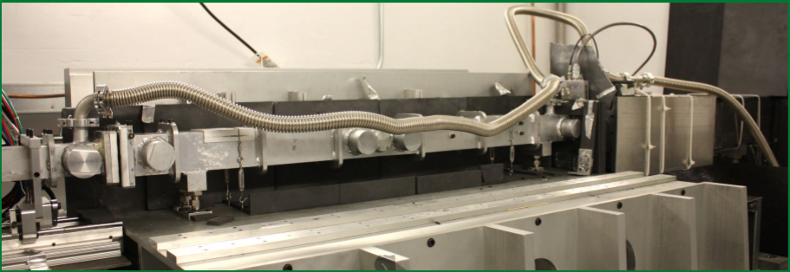
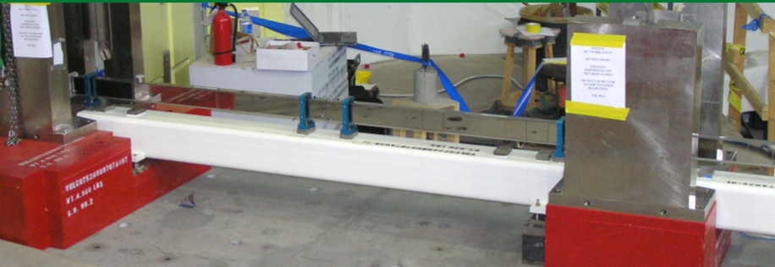
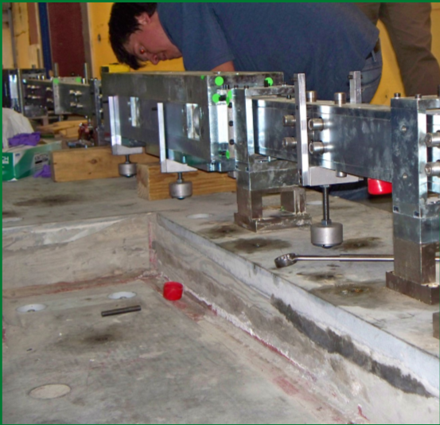
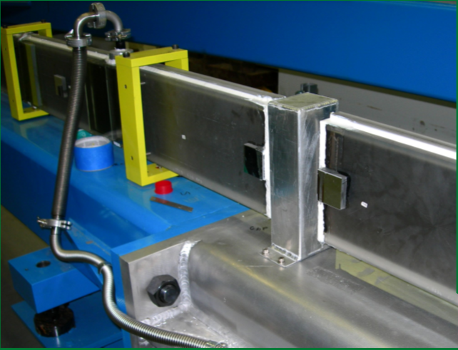
What are we trying to accomplish & Why?
Past guide designs at SNS & HFIR
  Have varying degrees of vacuum performance
  Guide & guide housings both procured from the guide vendor
  Some guides used the glass as the vacuum boundary
  Beam line specific, with different interfaces
This STS Standardized Scheme:
  Will have consistent vacuum performance across all beamlines and will have a centralized vacuum source that all the guide are connected to
  Guide and guide housings will be procured from separate sources and assembled on site at ORNL
  Housing will be the vacuum boundary
  Provides consistent interfaces across different beamlines
  Support structure will be consistent across instrument suite
*Pictures of SNS & HFIR Guides show wide variety of housing designs

Slide 3
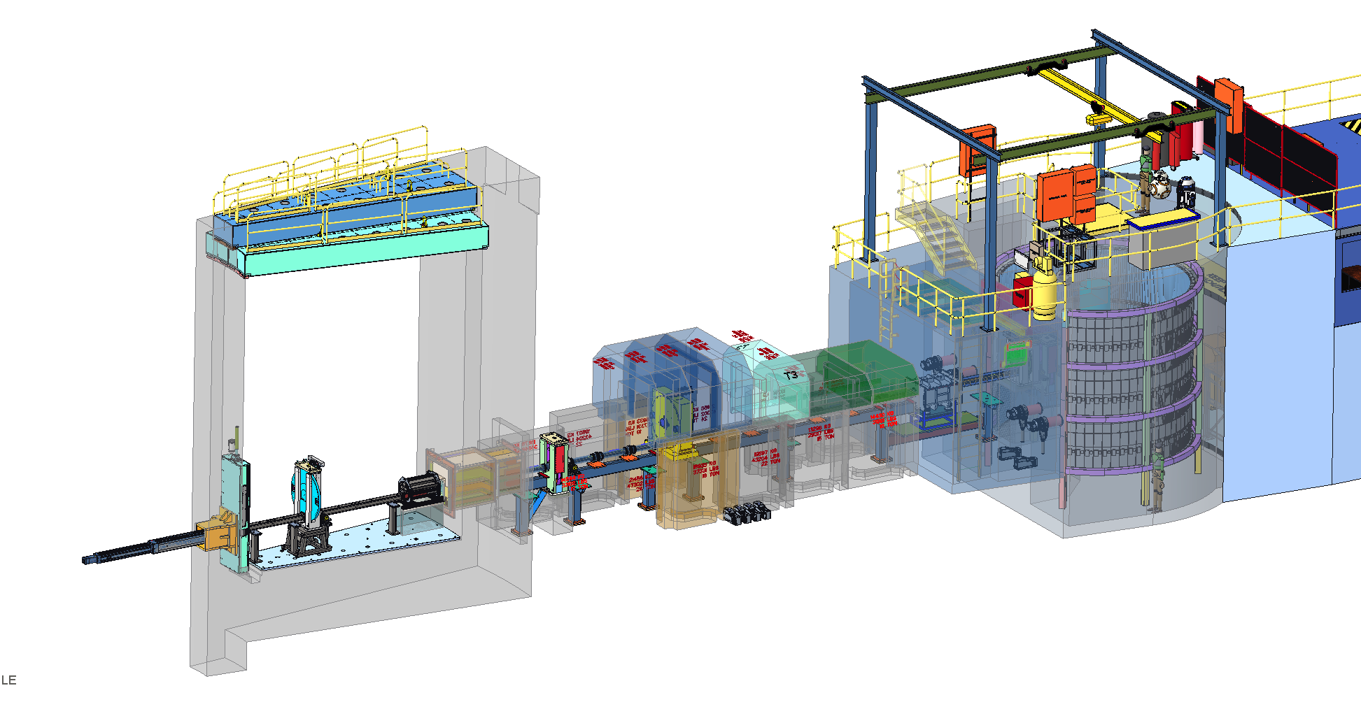
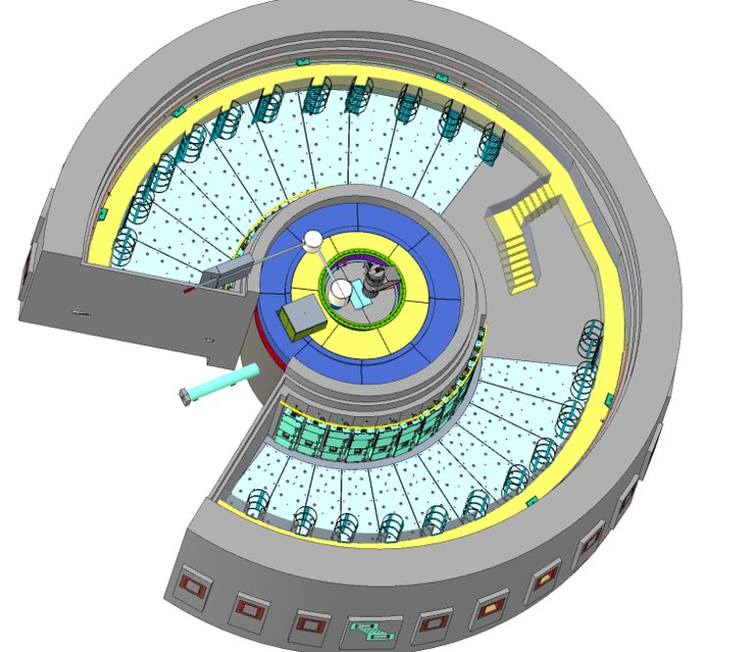
Main Systems of the STS Optics Designs
Standardization components fall into 3 categories
  Monolith Insert Optics
  In-Bunker Optics
  Out-of-Bunker Optics (Ex-Bunker)
3
Out-of-Bunker Optics Housings
(Ex-Bunker)
2
1
STS Bunker
In-Bunker Optics Housings
Monolith Insert Optics
Instrument Layout of Optics
Bunker

Slide 4
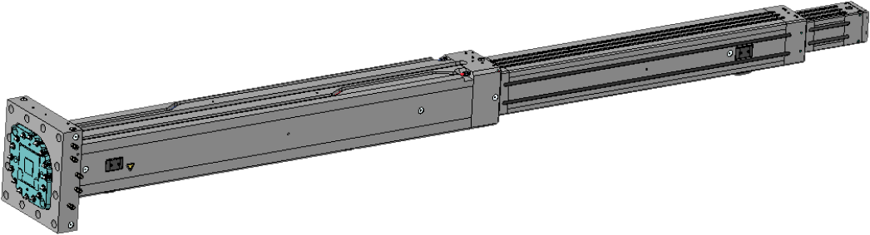
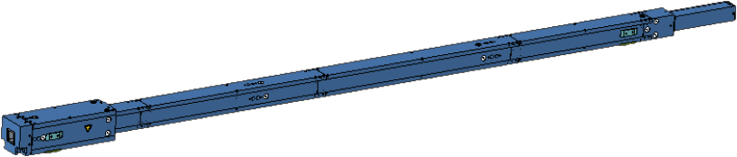
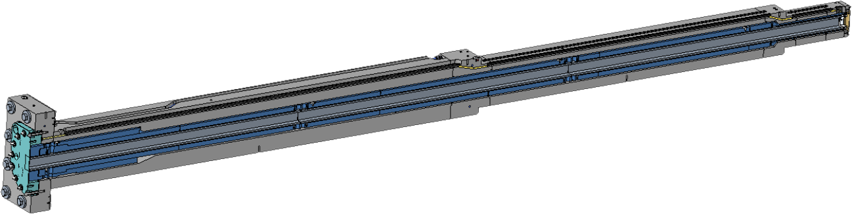
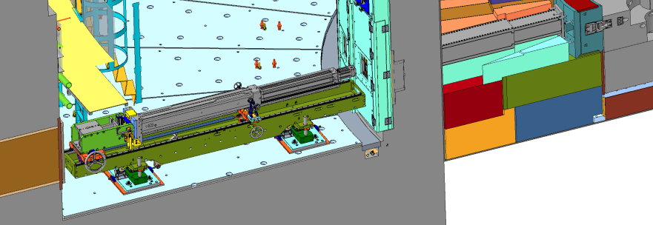
Main Components of the Monolith Insert Optics (Not the focus of presentation)
1
Monolith Insert
Monolith modules are comprised of:
- Monolith Inserts
- Optics Modules
- Target Nozzle Extensions
Monolith Inserts provide Helium environment. The Inserts are within the core vessel and its vacuum environment.
Optics Modules provide structure to house, support and locate guides.
Optics Module
Optics Module inside Monolith Insert
Cold Handler
STS Bunker
Nozzle
Installation of the Monolith Insert

Slide 5
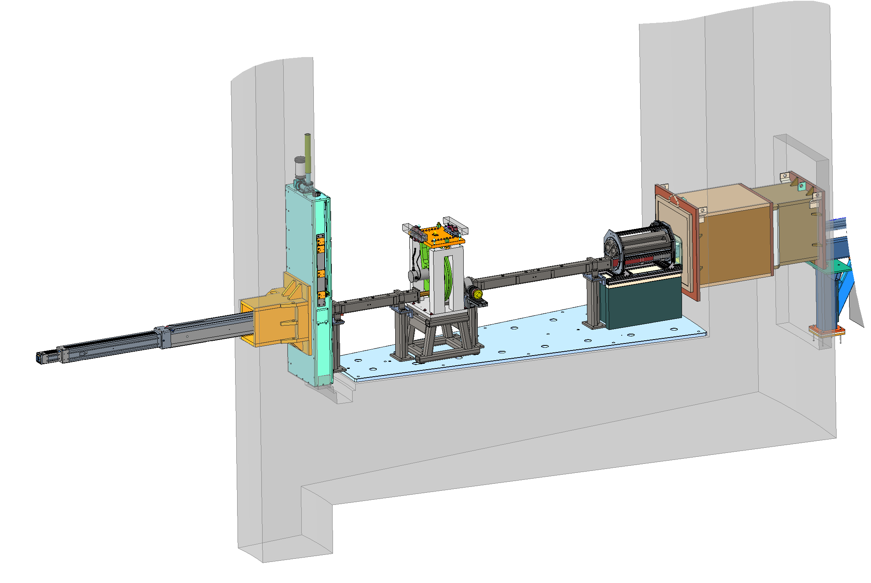
Main Components of the In-Bunker Optics Housing & Support System
2
The in-bunker optics system is comprised of:
  Pedestals
  Optics Housings
System Details
  All in-bunker and ex-bunker housings share a common vacuum that does not include choppers/shutters
  Guide vacuum is also shared across all instruments
Large Double Disk F-Chopper (15Hz)
Beam Elevation of:
Upper Moderator – 1.18m
Lower Moderator – 0.96m
Shutter
Pedestal
Monolith Insert
Maintenance Shield
Bunker Wall Insert (BWI)
Standard In-Bunker
Optics Housing
Beam Monitor
~13.7m
~11.4m
∼Δ2.3m
0
~5.2m
∼Δ6.2m

Slide 6
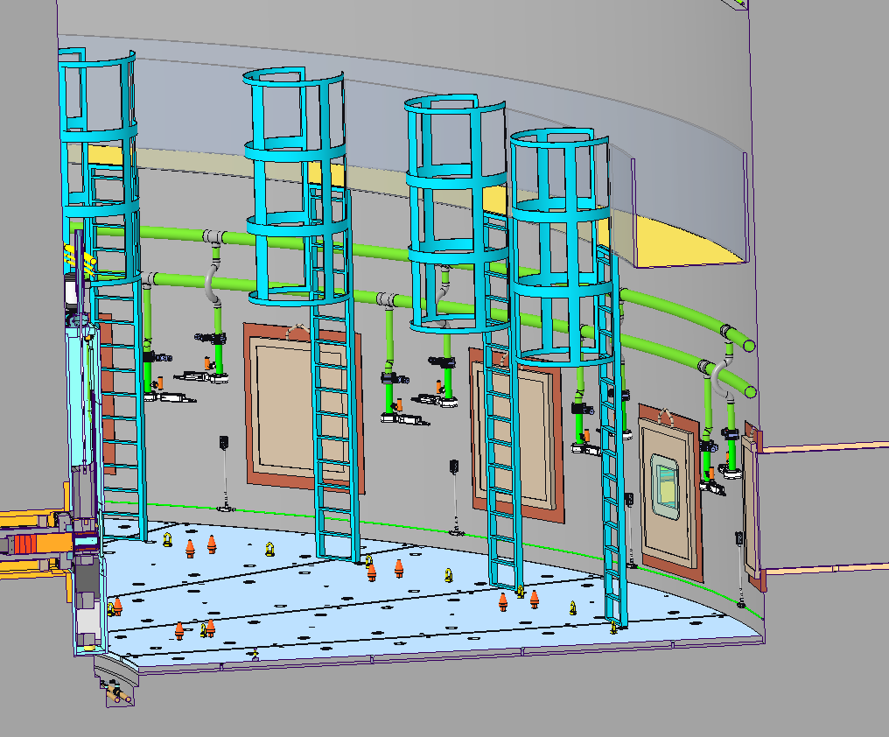
Vacuum Connections for Standardized Housings
Vacuum connections will be provided to each beamline via manifold connections on the bunker wall
All of a beamline’s in-bunker and ex-bunker housings share a common vacuum that does not include choppers/shutters
Vacuum will be shared across instruments with the ability to isolate certain beamlines for maintenance, installation, etc.
Vacuum System Manifolds
Vacuum Isolation Valves
In-Bunker Vacuum Manifolds Connections

Slide 7
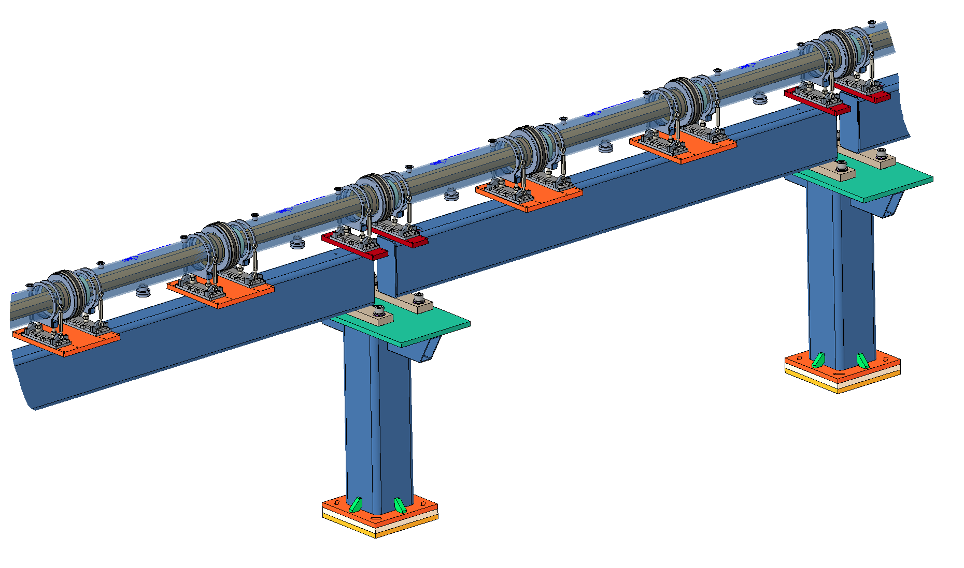
Main Components of the Ex-Bunker Optic Housings & Support System
3
The Ex-Bunker optics system is comprised of:
  Pedestals
  Girder
  Optics Housings
Girders span between the pedestal intervals to minimize local settlement errors
  Max span of concept is 4m
All in-bunker and ex-bunker housings share a common vacuum but does not include choppers/shutters
Vacuum is also shared across all instruments
Section
Element
3. Optics
Housing
2. Girder
Beam Elevation of:
Upper Moderator – 1.91m
Lower Moderator – 1.70m
1 m
1. Pedestal
3 m
Example of Long Spans of Ex-Bunker Guide Housings

Slide 8
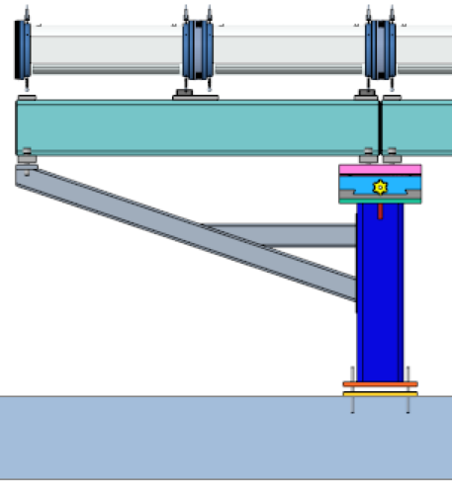
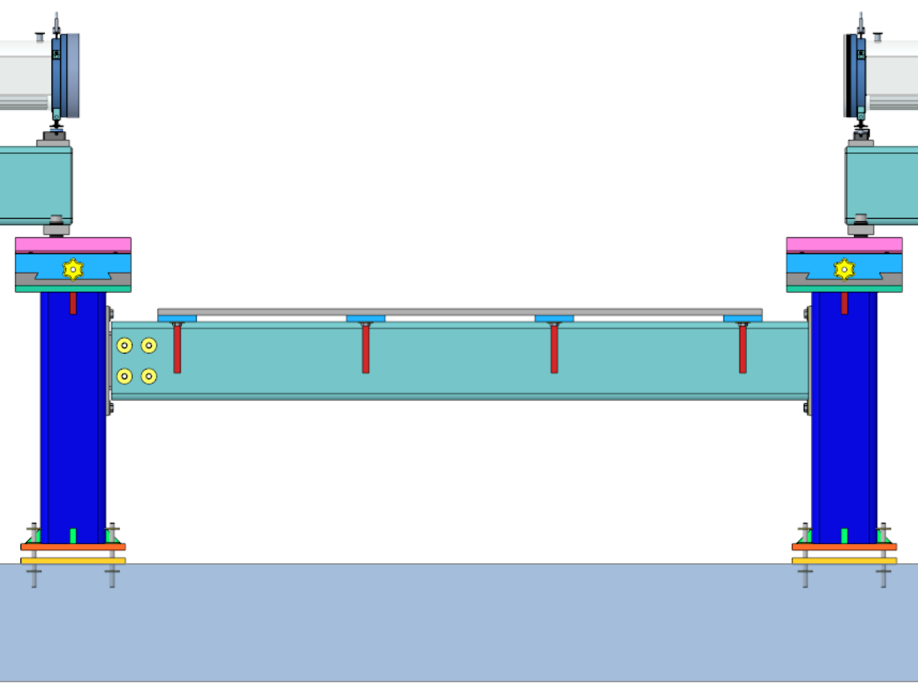
Ex-Bunker Optic Support System Accessories
3
Cantilever Support
Inter-Pedestal Support Platform
Instrument Building Floor
Instrument Building Floor
A short girder and arm able to extend the optic support system beyond a single pedestal
A platform spanned between two pedestals to provide an isolated base to build unique optical components upon
  i.e. small vacuum vessels

Slide 9
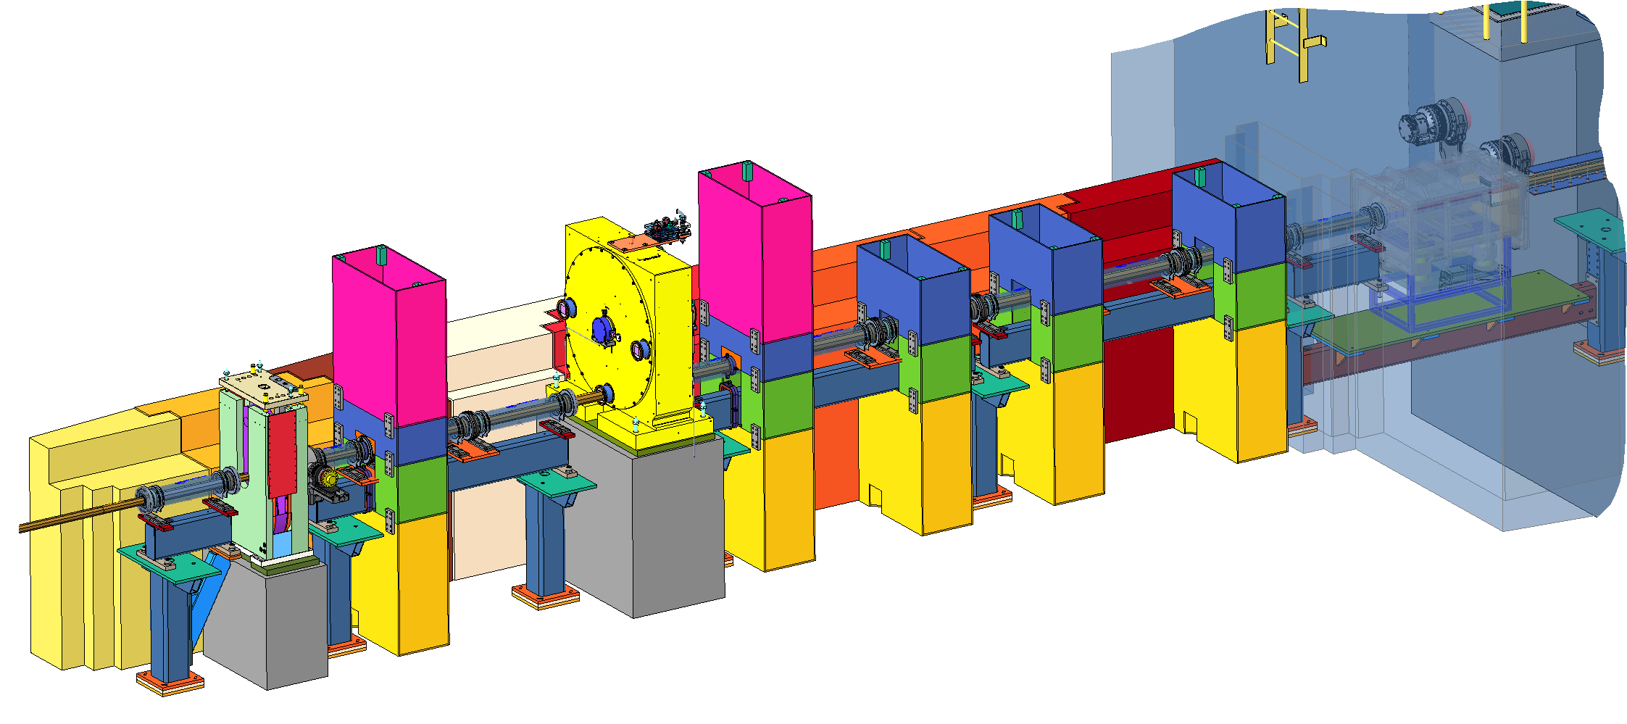
Ex-Bunker Integration with Instrument Shielding and Choppers
3
Standard
Ex-Bunker Guide Housings
Baffle
T₀-Chopper
Baffle
P- Chopper
Shield Blocks
Girder
Pedestal
Beam Monitor
Example of Short Spans of Ex-Bunker Guide Housings
Bunker Wall

Slide 10
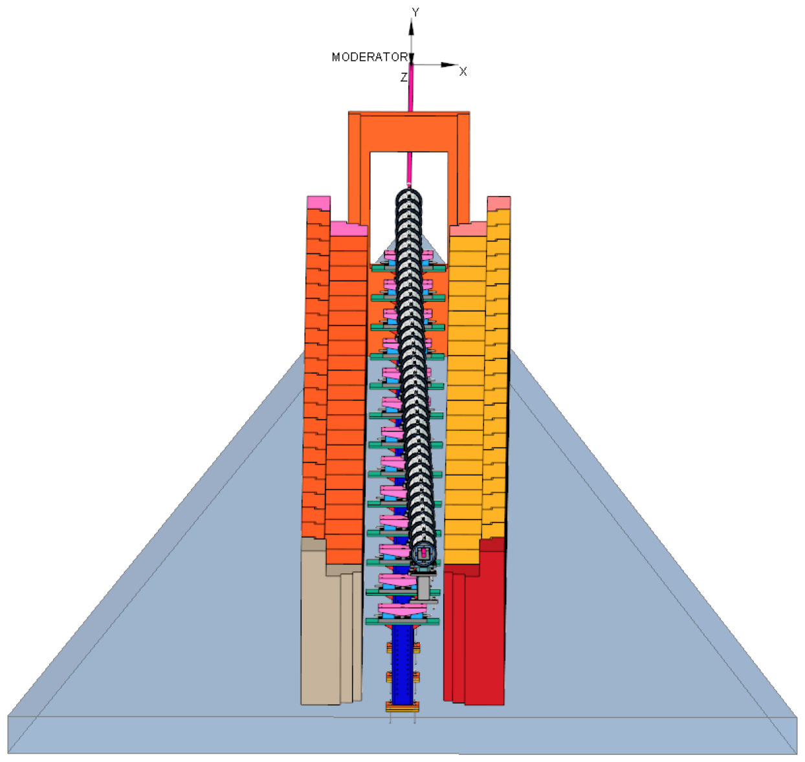
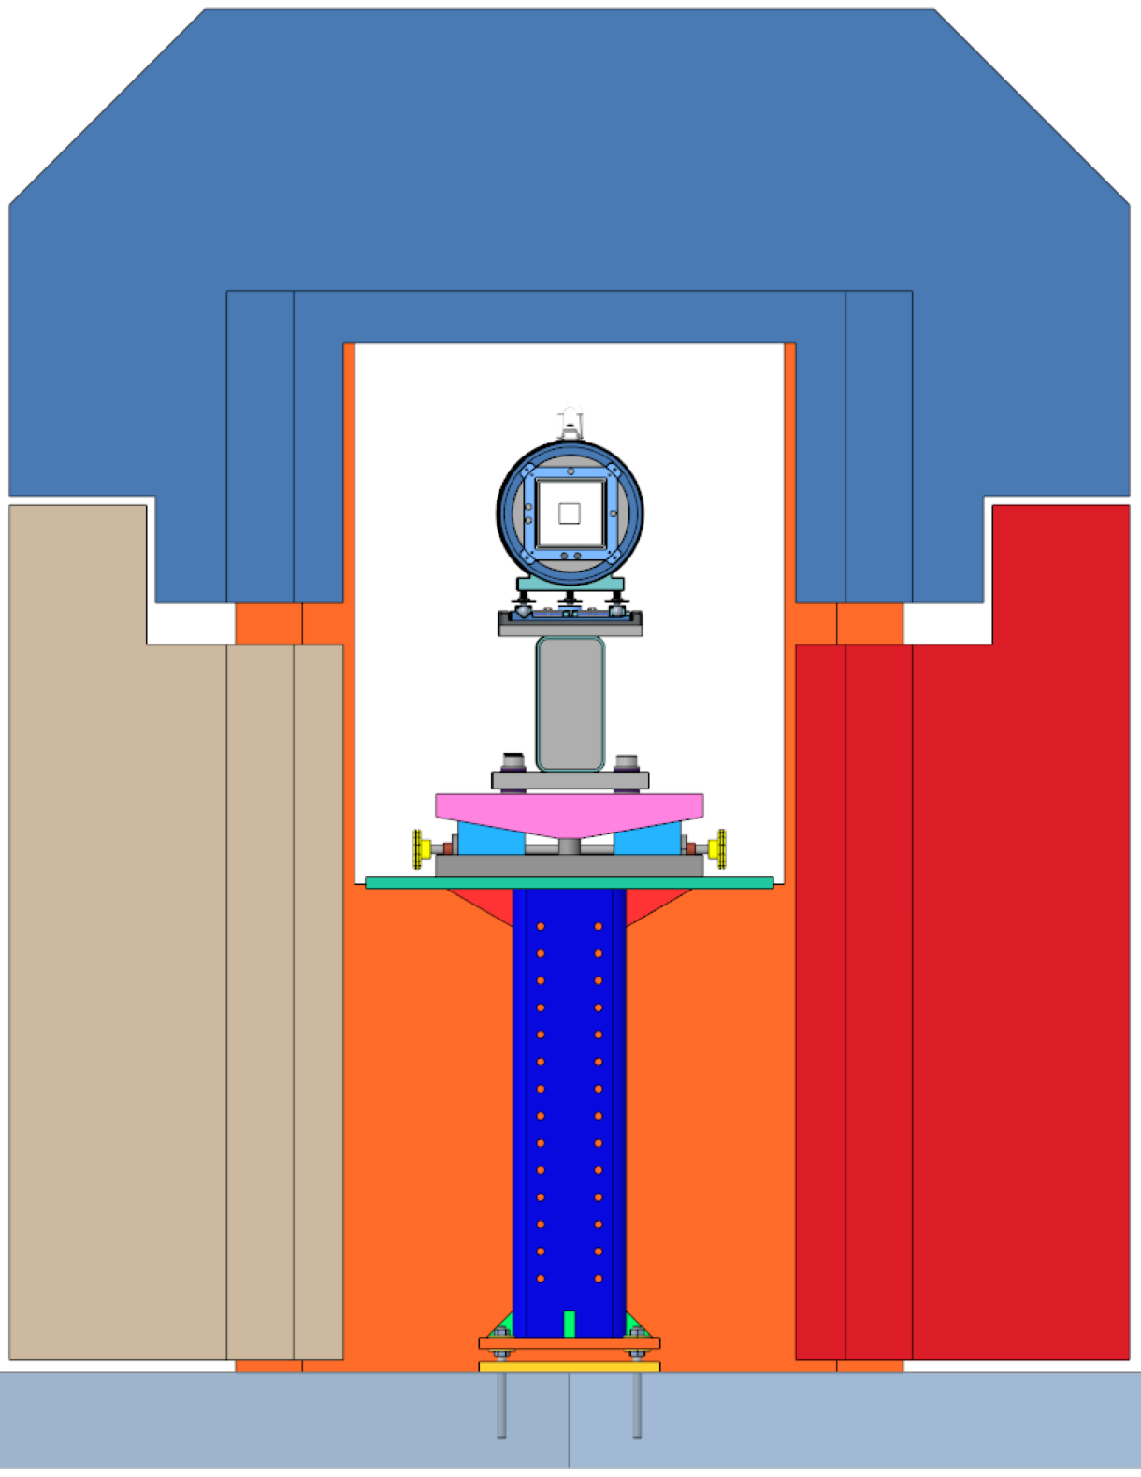
System Integration of Ex-Bunker Standardized Components
3
Isolate the instrument optical components from adjacent loading
This is accomplished by utilizing standard shaped shielding blocks stacked to create a tunnel which the optics support system transports the beam within
The standard optics support system design works for both straight and curved beamlines
Bunker Wall
Transport Shielding
Instrument Floor
Cross Section of Transport Section
36 m long Transport Section of a curved beamline
(top blocks of transport shielding not shown)

Slide 11
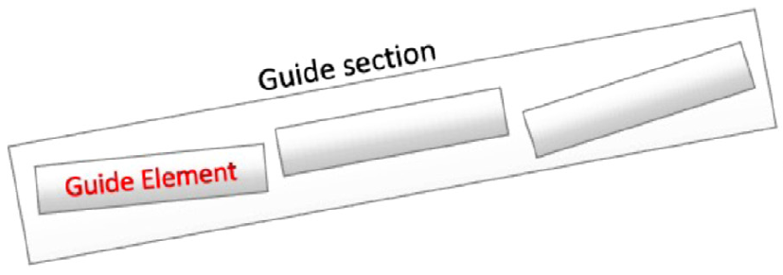
STS Beamline Alignment Requirements
We performed a systematic analysis on guide misalignments for each of the first 3 instruments
Preliminary studies conclude that:
  Smaller STS moderators / beams affect significantly the guide misalignments
  STS optical systems are prone to be more sensitive to guide misalignments than FTS ones
  Monte Carlo simulations set preliminary thresholds at:
  1) 3 mm for systematic misalignment occurring at the Section joints
  2) 50 𝜇m for transverse misalignment between Guide Sections
  3) 20 𝜇m for transverse misalignment between Guide Elements
Studies also demonstrated that not all instruments have the same sensitivity
  Straight beamline: CHESS (octagonal guide)
  2 mm systematic, 80 𝜇m transverse (elements and sections)
  Straight beamline: PIONEER (Elliptical and Tapered Guide System)
  2 mm systematic, 20 𝜇m transverse (elements), 100 𝜇m transverse (sections)
  Curved beamline: QIKR (benders and tapered guide)
  20 𝜇m transverse (elements and sections)
Further investigations are being performed to determine final requirements
Section Joint
Girder
Pedestal

Slide 12
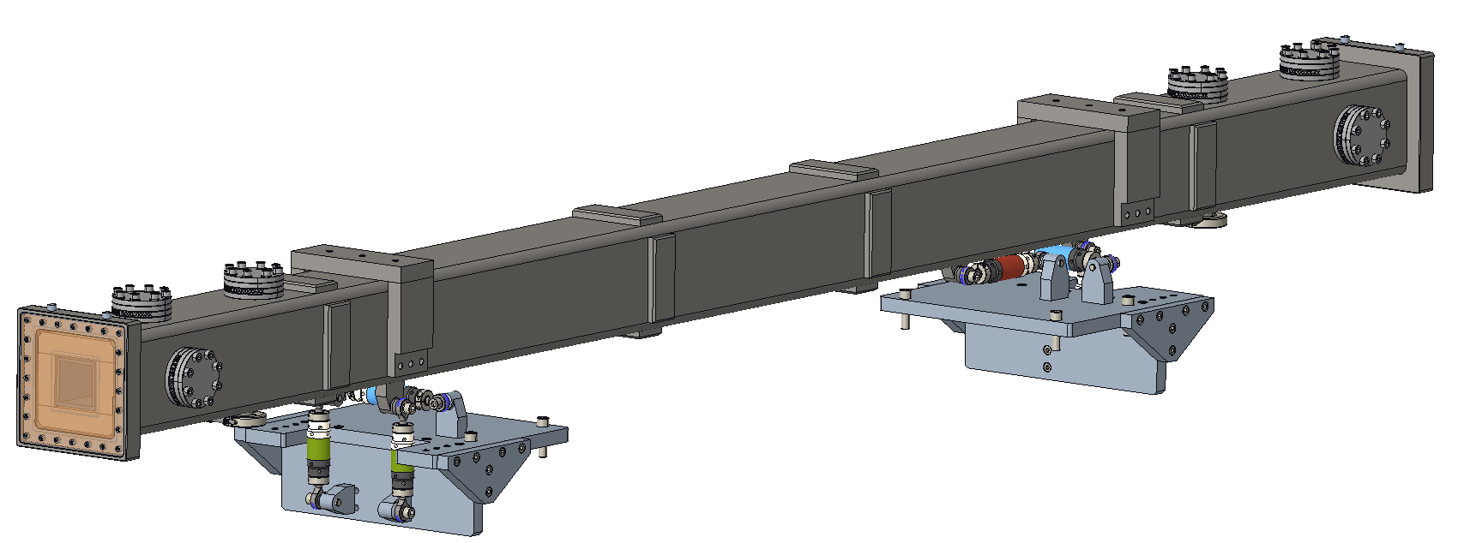
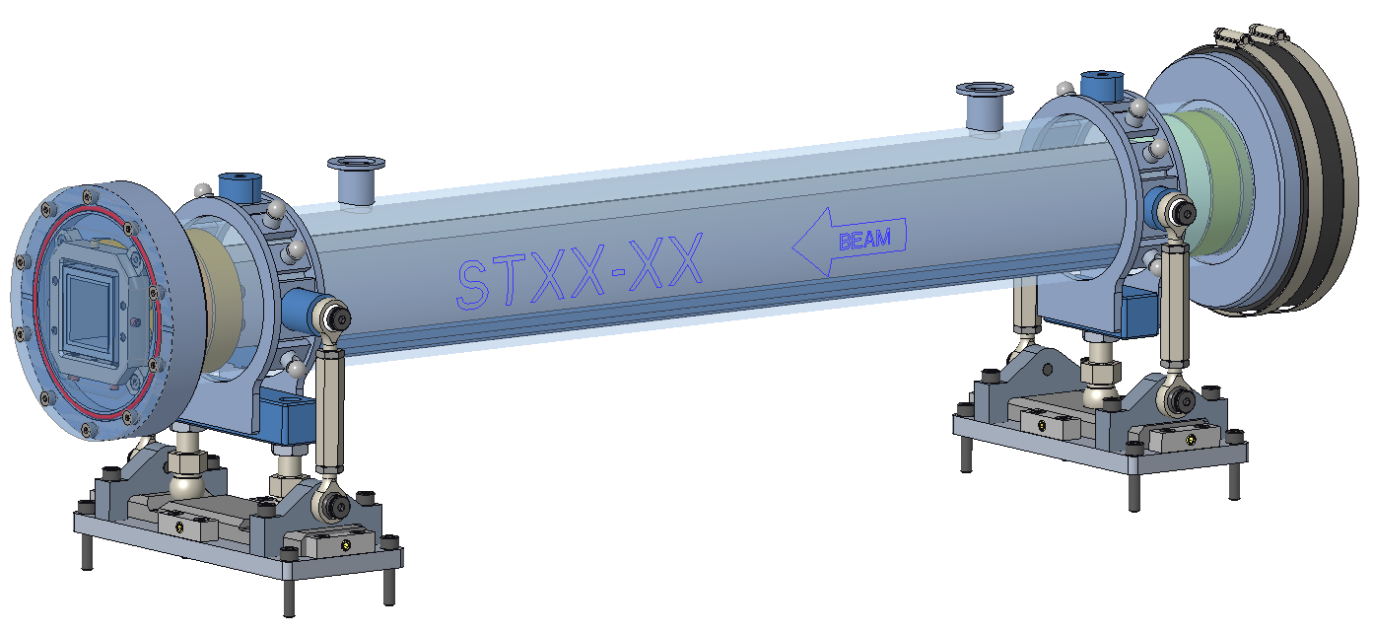
In Bunker vs. Ex-Bunker Std. Guide Housing Design Choice Differences
In-Bunker Guide Housings:
  Neutronic studies indicated a more collimated guide housing is needed in the bunker. Full length thick shielding was provided to limit cross talk between instrument and decrease the necessary bunker wall thickness
  Material of housing parts must tolerate bunkers higher radiation environment
  Design must be customized to work with different lengths and guide cross-sections however design assumes no vacuum connection between 2 housings (ie. Bellows)
  The design allows for multiple guide sections to be located and aligned in a single housing
  Spans lengths derived by the radii of the inner and outer bunker walls and beamline elements such as choppers
Ex-Bunker Guide Housings:
  Decreasing the vacuum housing cost was a main driver
  Lower radiation levels outside of the bunker allows more material options
  Design includes anti-streaming provisions, but full length is not necessary
  Scalable to fit different cross-sections and adjustable in length (standard guide length is 1m)
  Designs allow housings to be sequenced for any given span of instrument length
In-Bunker Standard Guide Housing System
(3-meter length)
Ex-Bunker Standard Guide Housing System
(1-meter length)

Slide 13
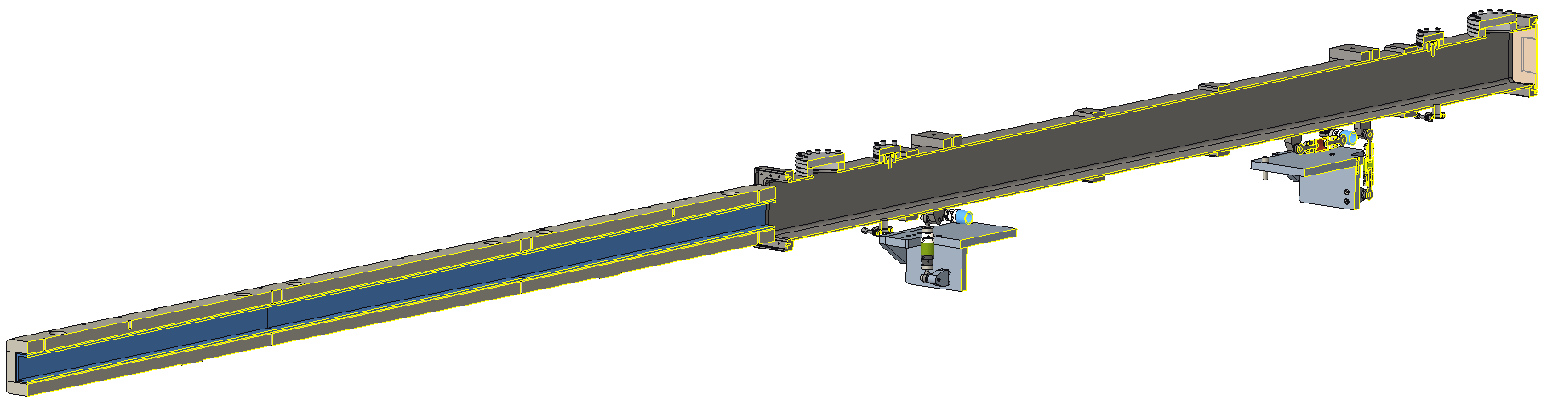
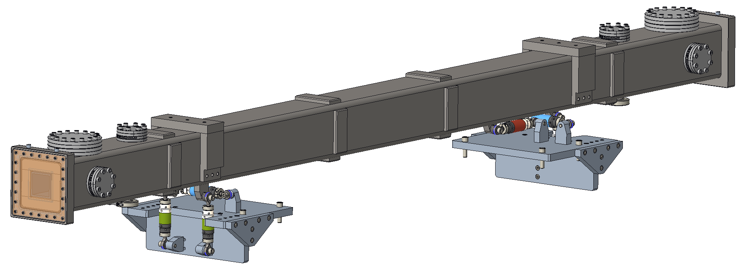
In-Bunker Housing Overview
Vacuum Housing Assy
OPTIC SHIELDING ASSEMBLY
25mm A36 Steel Plates bolted together around optics
In-Bunker Housings are comprised of two sub-assemblies:
  Optic Shielding Assembly
  Vacuum Housing Assembly
Full-length thick steel walls are used to self-shield & minimize the impact of neutron effects on the bunker wall
Length can be customized to reduce vacuum breaks and fit multiple beam guides into a single housing
Overall component structure is the same for all in-bunker housing, but can be adapted for different size, shape, and number of guides
Supported by a 6-Strut structure to allow for fine alignment and providing a rigid structure to support a large weight (450 kg or 1000 lbf)
Beam
Guide
Optic x3
Side Cross-section Exploded View
(concept shown accommodates 3 beam guides)
Fiducialization Ports
Lifting Provision
Stiffeners
Clamping Port
Fiducials
VACUUM HOUSING ASSEMBLY
Off-the-shelf tubing
6” x 3/16” wall A500 carbon steel
Cross section varies as needed to fit the guide housing
Beam Window
6-Strut System
Vacuum Inlet

Slide 14
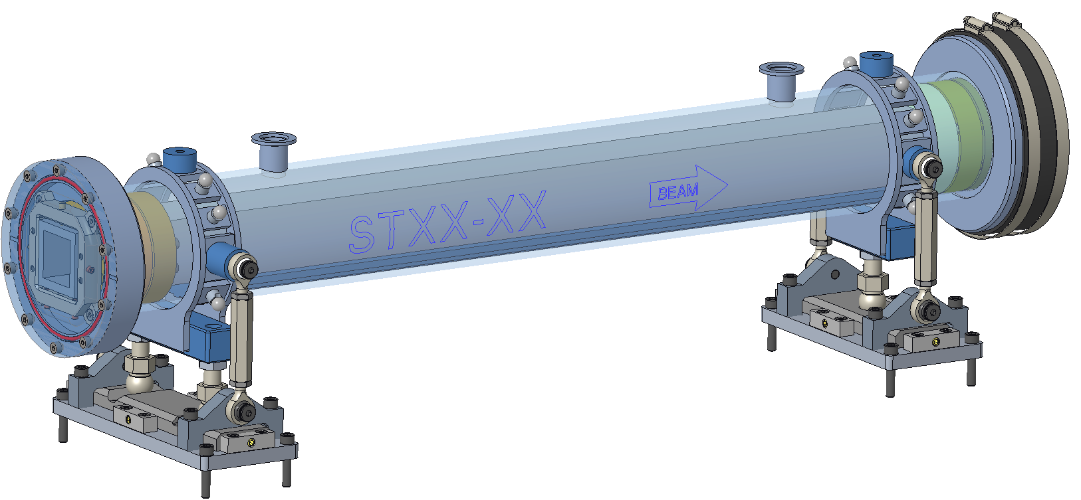
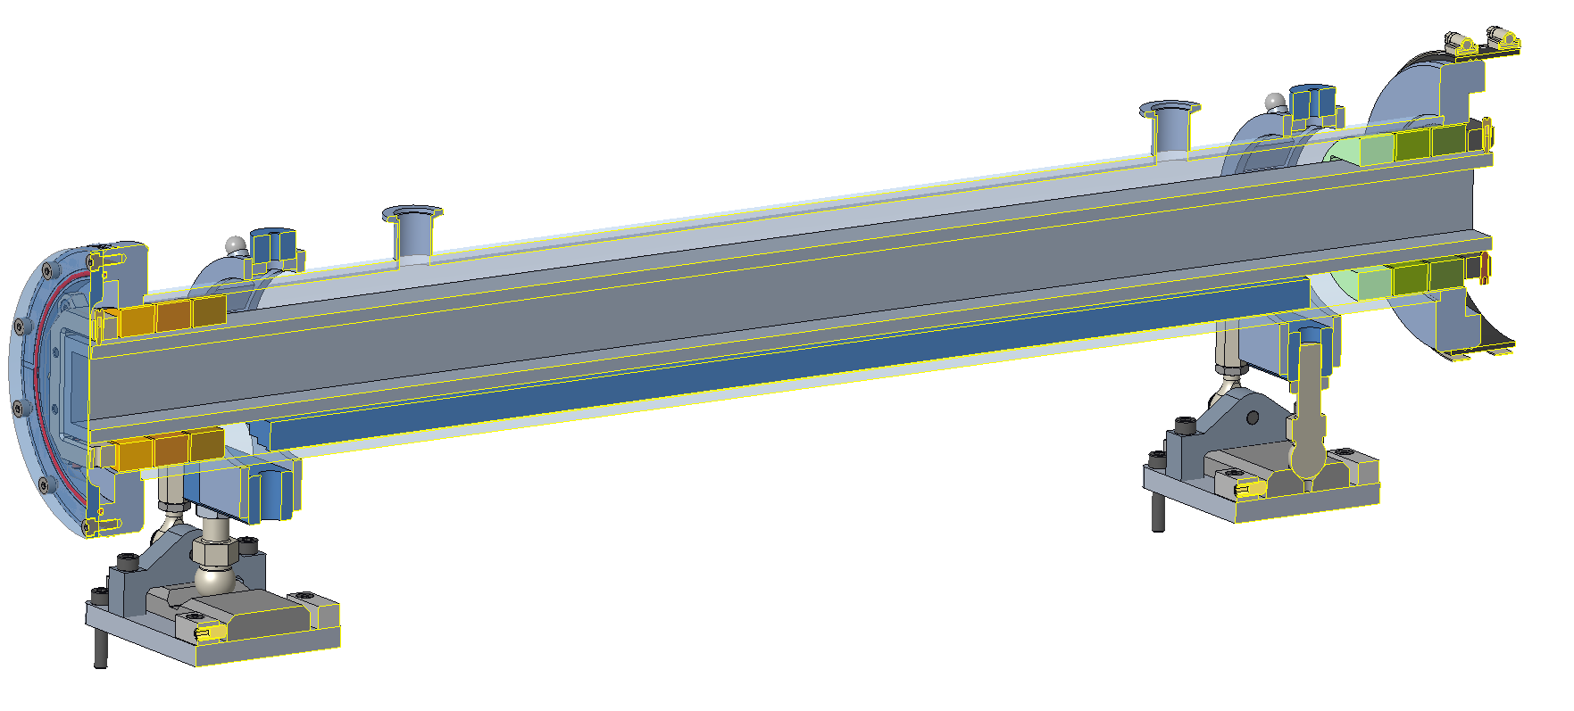
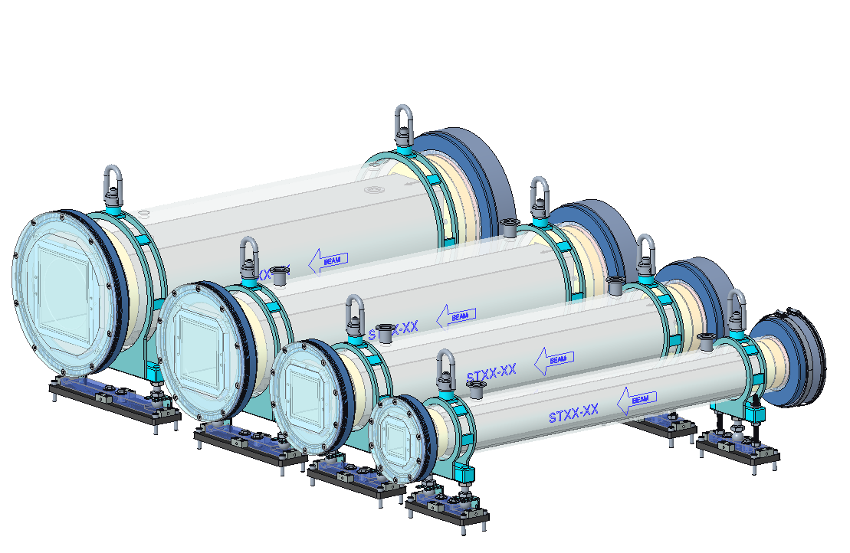
The Ex-Bunker Optics Housing Overview
Vacuum Port Hookup
Ex-Bunker guide housings:
  Are constructed out of SCH40 aluminum pipe (off the shelf pipe thickness is good for vacuum)
  Available in 4 standard housing diameters (4”, 6”, 8”, & 10”)
  Are adjustable in length and design is practical from 0.5m – 2.0m (standard guide length is 1m)
Elastomer seals & hose clamps used to maintain vacuum boundary across multiple ex-bunker housings
Provisions included for anti-streaming features
Tie-downs included to restrain housings
Provisions included for guide installation into housing
Lifting Feature
4” Aluminum Pipe Housing
Neutron Window (Vacuum Barrier)
SAM Fiducial Nests
Restraint Location
Kinematic Alignment Positioner
Elastomer Seal w/ Hose Clamps
Housing Flanges
50mm x 50mm Neutron Guide (gray)
Guide Installation Provisions
Anti-Streaming Disks
4 Standard Housing Diameters Available

Slide 15
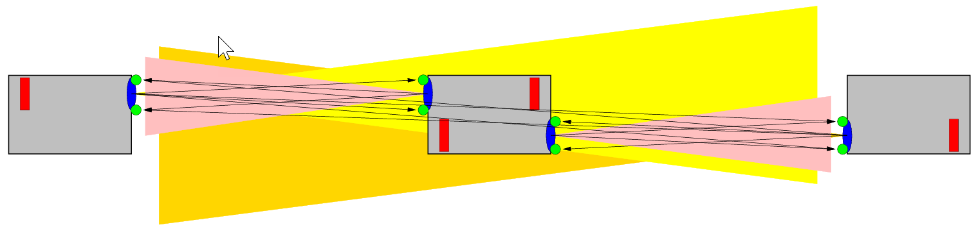
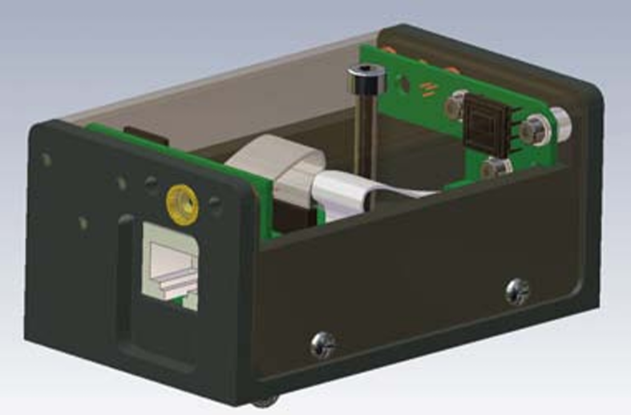
Detecting Systematic Misalignment: Monitoring System Survey
Wire Positioning Systems
End-point to end-point stretched wire reference
Not compatible with choppers and other large optical components that would interrupt wire straight line path
  Require multiple wire systems in series
High cost
Stretched wire complexity
  Delicate wire
  Catenary effects
Laser Based Angle Monitor
Line-of-sight based system
Can include choppers in the system
Low cost
Provides redundant measurements of a single point
BCAM Sensor
3 sensors w/ overlapping FOVs
Wire interrupts Laser Array for positioning,
Orthogonal Arrays provide for position in 2 Dimensions
BCAM sensor (OpensourceInstruments.com)
Keyence 2 Axis LS-9030

Slide 16
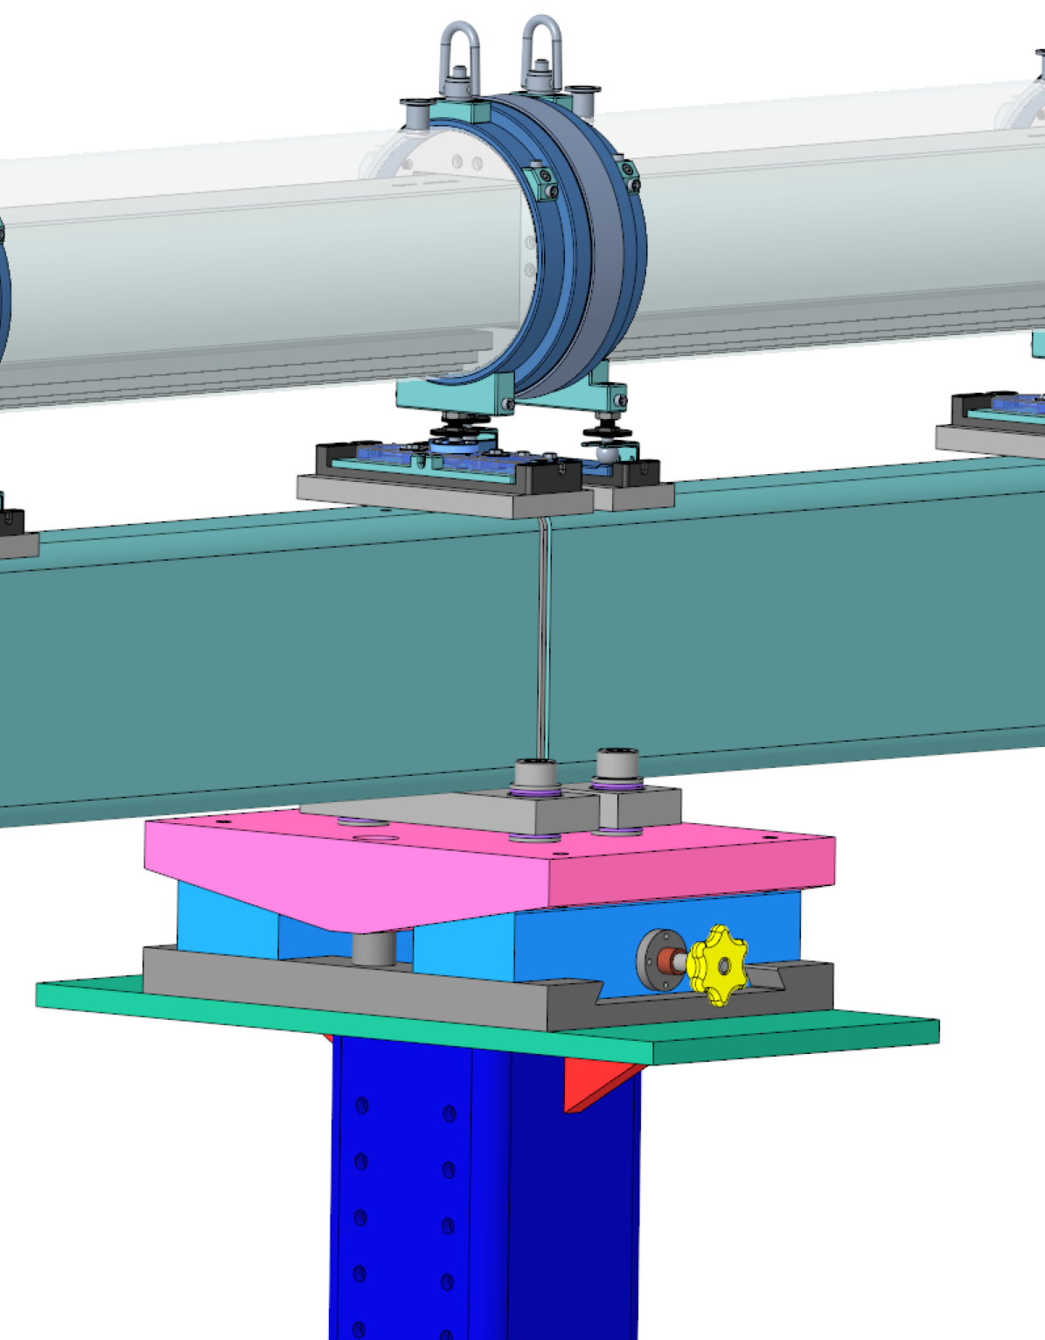
Compensating for Systematic Misalignment
Vertical Jack Compensation Concept
What should be the response to detection of a systematic misalignment?
  Removal of the shielding and realignment by SAM?
    Precision action to realign adjacent girders at the support point
  In situ compensation:
    Remove shielding and perform a counter gross movement? (manual Y translation)
    - or -
    Perform a remote counter gross movement? (motorized Y translation)
    In either in-situ case above the goal would be to bring the instrument’s performance (Brilliance Transfer metric) close to its initial performance.
Jack, common point of vertical compensation for two adjacent girders
Pedestal, Point of Systematic Deflection

Slide 17
Summary
STS proposes to use 2-styles of standardized optics housings to fulfill the specific requirements in its respective installation location
  In-Bunker
  Ex-Bunker
Each housing is adaptable for size, length, shape, & number of guides
Alignment requirements of providing 20 μm for each guide element of 1-meter length is achievable with the designs
Installation of the optic and the optic housing is very user friendly for each housing design
Vacuum boundaries and connections have been detailed
Each housing allows for many adaptations for specific configuration needs of a beamline
Support and monitoring have been well detailed
In-Bunker Standard Guide Housing System
(3-meter length)
Ex-Bunker Standard Guide Housing System
(1-meter length)

Slide 18
Acknowledgments
Second Target Station, STS Contributors
ORNL Spallation Neutron Source, SNS Contributors
Van Graves, Instrument Systems Engineering Manager
Cristina Boone, Lead Beamline Engineer
Scott Dixon, Mechanical Designer
Gabriele Sala, Instrument Scientist
Peter Torres, Lead Beamline Engineer
Doug Bruce, SAM Lead Engineer
Jeremy Price, Vacuum Systems Engineering Lead
Amy Jones, Instrument Engineering Lead
Bill M^{c}Hargue, Neutron Chopper Engineer

