Slide 1
TOPAS Installation
philip.chater@diamond.ac.uk

Slide 2
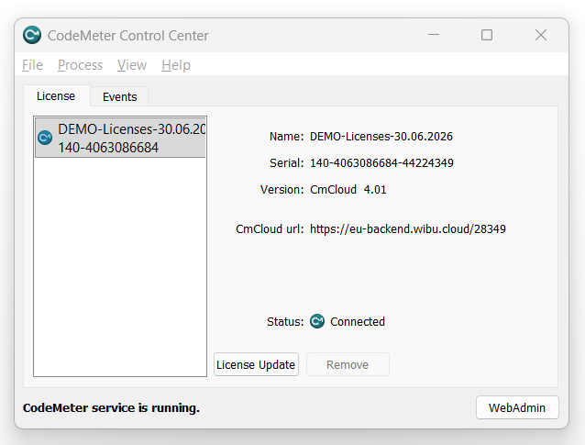
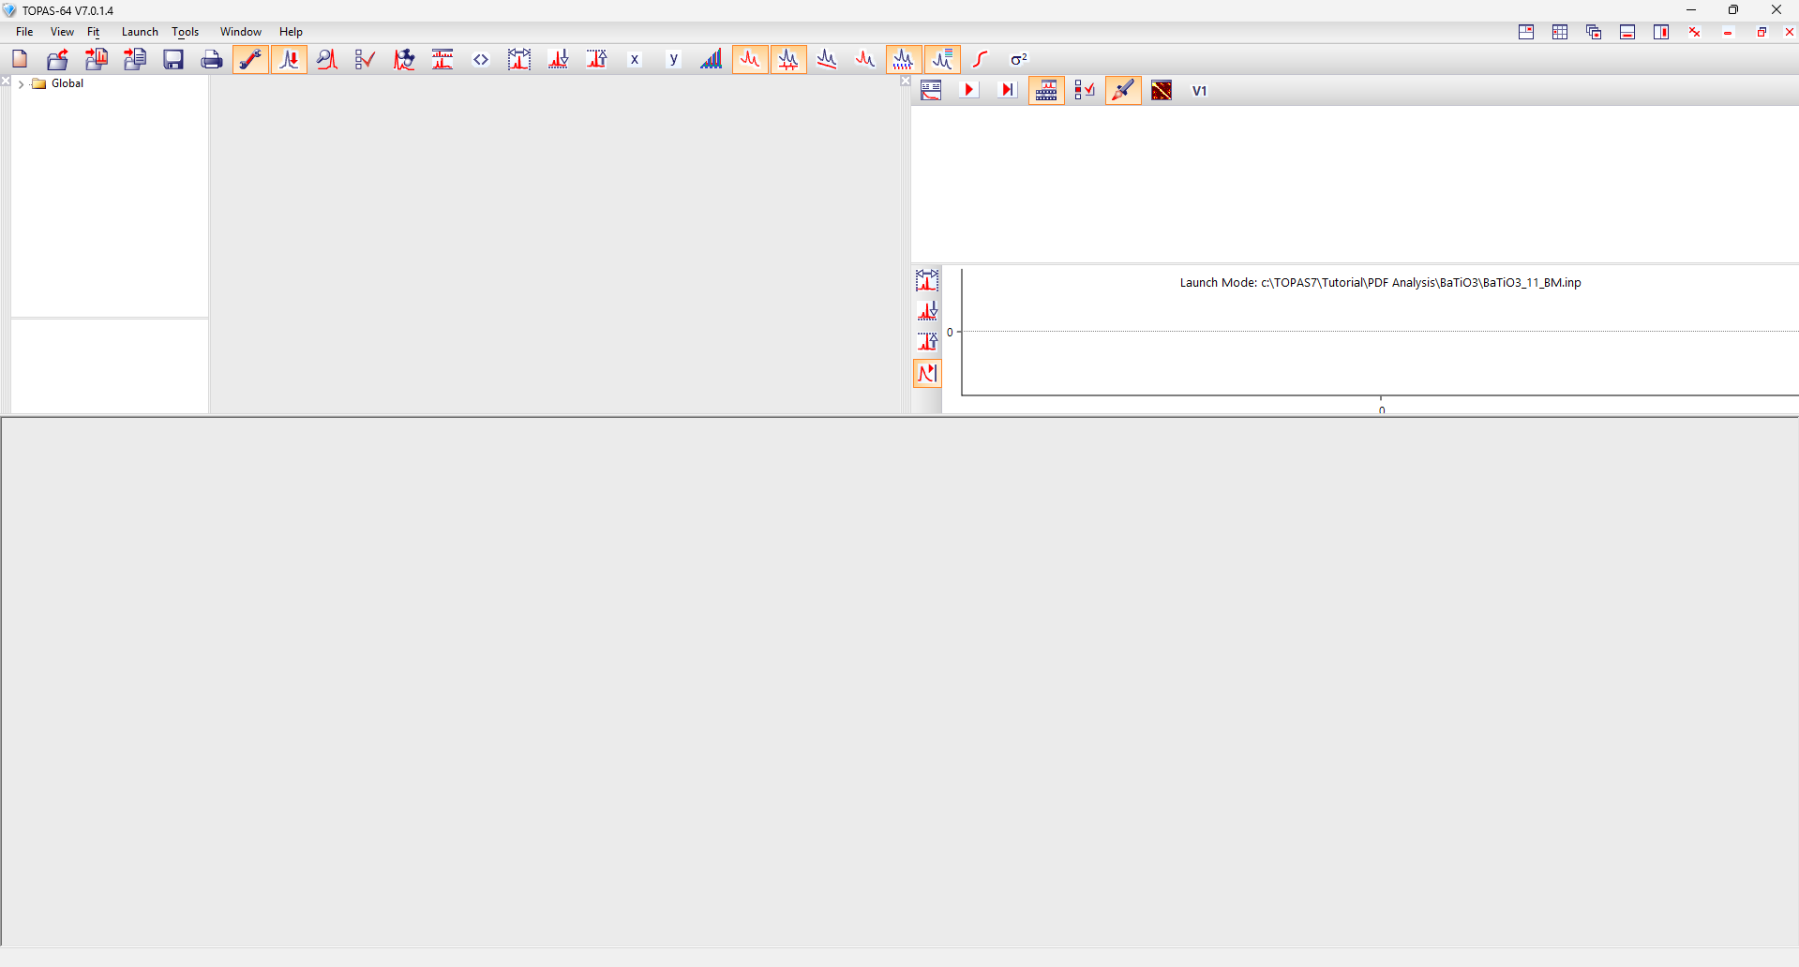
Installation instructions 1/2
Download TOPAS and associated files from this link, password “(Sr1-xPrxTiO3)” (with the parentheses)
Extract the folder to your computer
Install TOPAS and CodeMeter (administrator rights required)
Run DIFFRAC.TOPAS-V7.0.1.4.exe and install to the default directory, C:\TOPAS7
Run CodeMeterRuntime_840a.exe and install
Install the demo license for TOPAS
Open CodeMeter Control Center
Drag and drop the license file 140-4063086684.wbc into the License box on the left
Open Topas.exe (in C:\TOPAS7) to check that it runs
If you get a “License not found” error, click “Retry”
You should see this TOPAS window

Slide 3
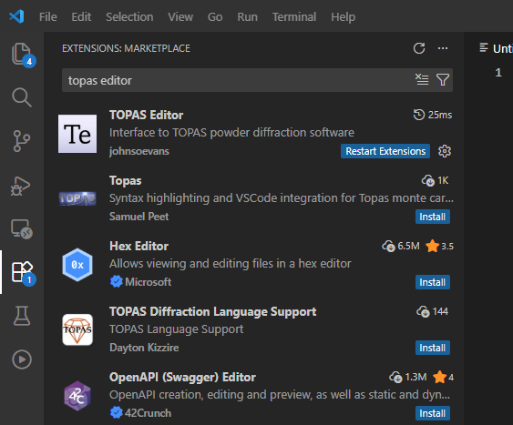
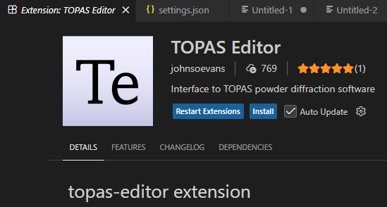
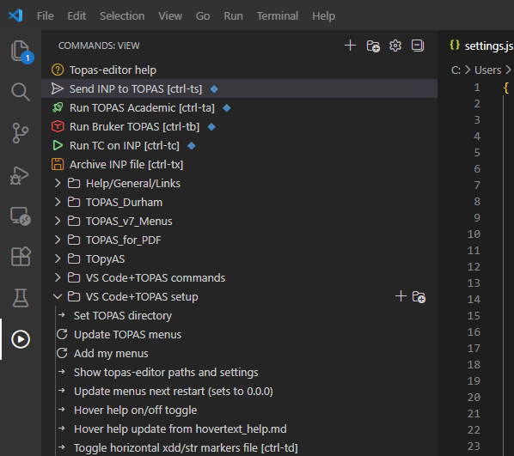
Installation instructions 2/2
Update TOPAS macros
Download the latest version of pdf.inc into C:\TOPAS7 (replacing any previous versions)
Edit C:\TOPAS7\local.inc to say #include pdf.inc (i.e. remove the ' from the start of the line '#include pdf.inc)
Install VS Code and set it up for TOPAS
Install VS Code from https://code.visualstudio.com/download
Open VS Code, click on “Extensions” and search for “topas editor”
Install TOPAS Editor
Select Light or Dark theme
Set the TOPAS directory

Slide 4



Acknowledgements
Michael Wharmby
Mike Evans
TOPAS license providers
Alan Coelho
TOPAS author
John Evans
TOPAS editor and wiki

