Slide 1





Whole-nanoparticle-ensemble refinements of compositionally complex systems from X-ray pair distribution function data via the Reverse Monte Carlo method
Tobias Mølgaard Nielsen
ADD 2026
14.01.2026

Slide 2
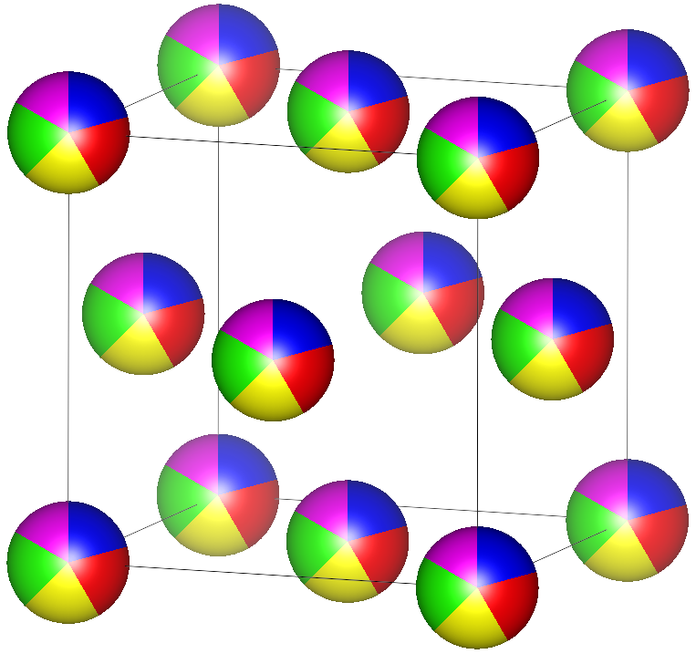
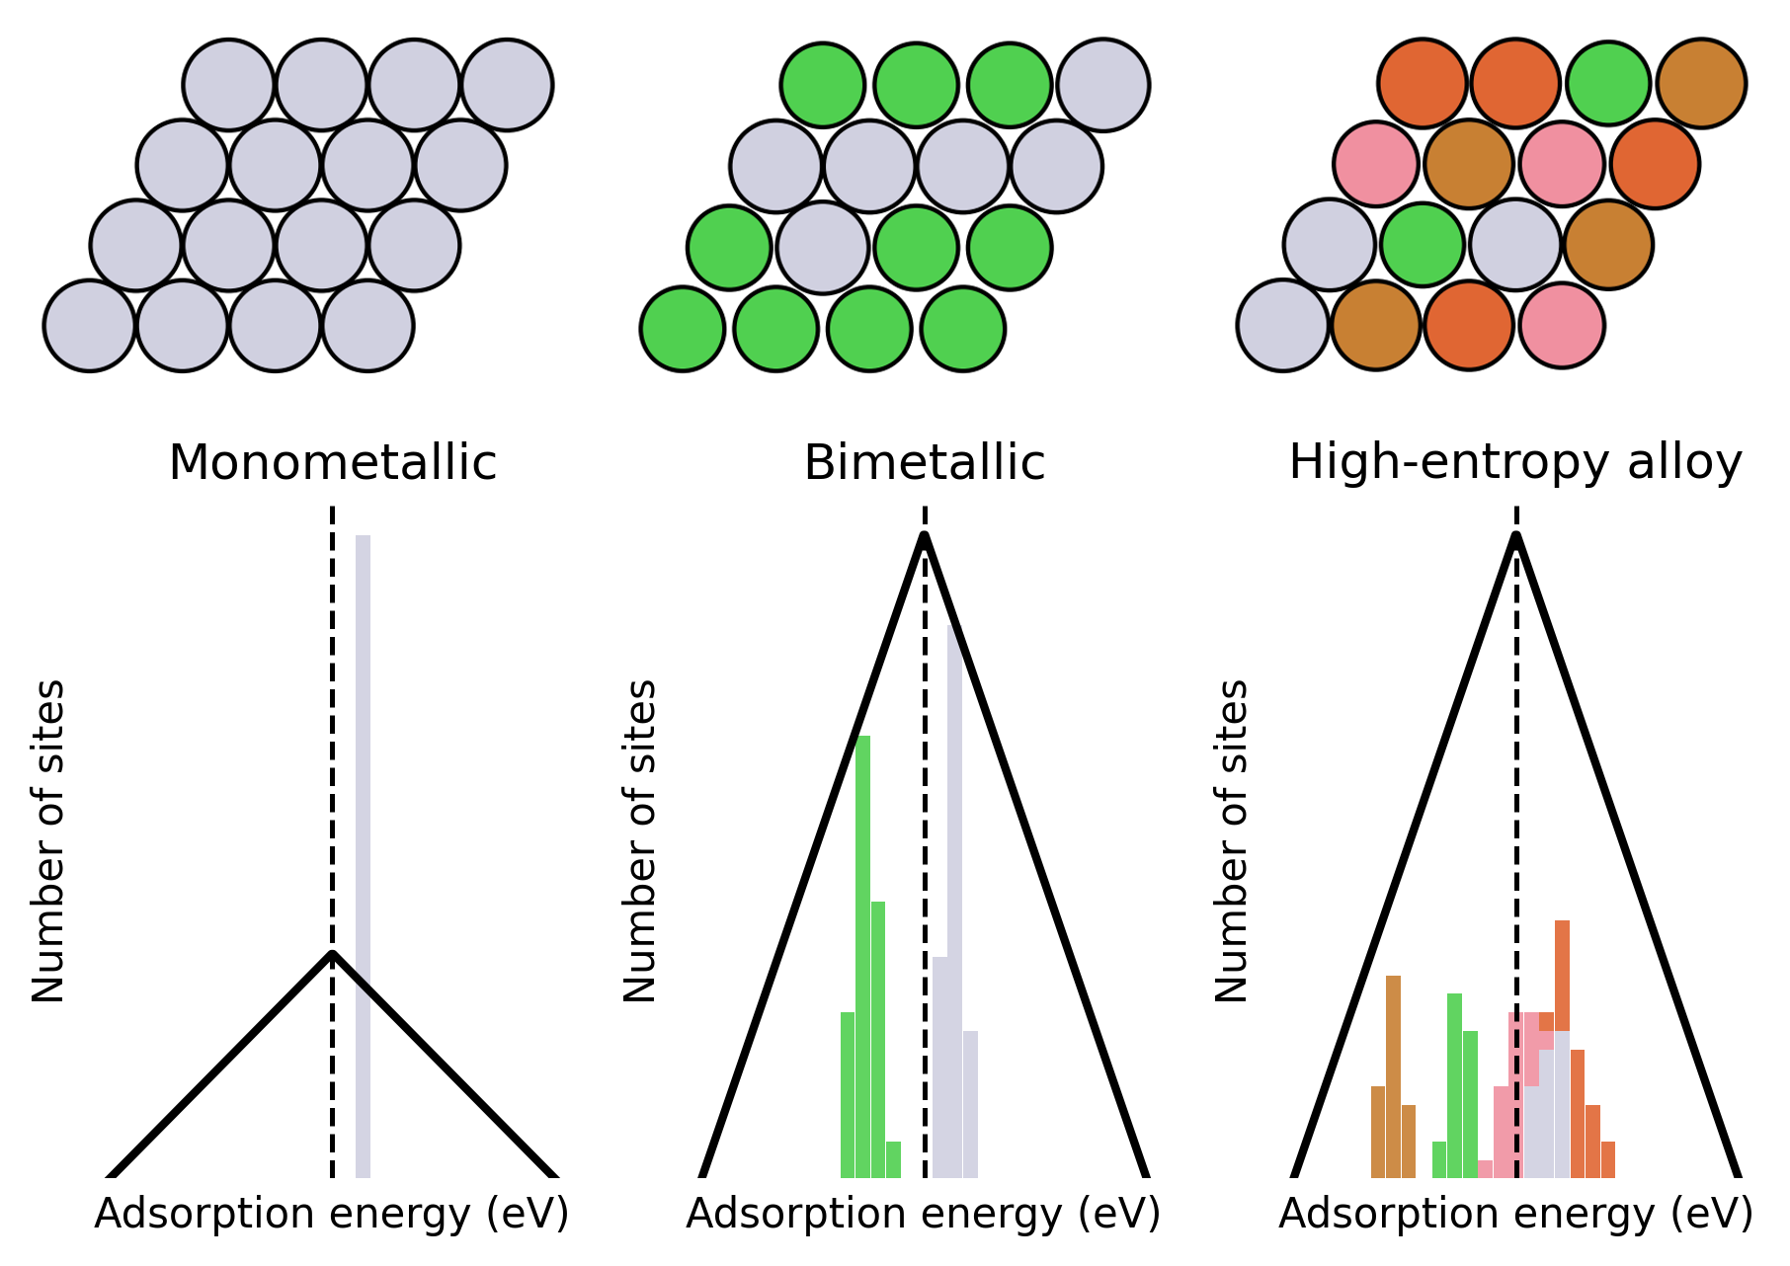
Compositionally complex systems
Solid solution of 5 or more elements
Emerging catalyst materials
High-entropy alloy (HEA)

Slide 3



Compositionally complex systems
Solid solution of 5 or more elements
Emerging catalyst materials
These materials are complex
Detailed structural characterisation remains a challenge
Subtle structural features affect properties
Chemical short-range order
Spatial compositional heterogeneities
Deviations from homogeneity affect comparability with theoretical predictions
High-entropy alloy (HEA)

Slide 4
Compositionally complex systems
Solid solution of 5 or more elements
Emerging catalyst materials
These materials are complex
PDF is a strong tool
Detailed structural characterisation remains a challenge
Subtle structural features affect properties
Chemical short-range order
Spatial compositional heterogeneities
Deviations from homogeneity affect comparability with theoretical predictions
Excellent for nanomaterials
Great for local structural features
Small-box modelling not suitable for spatially varying effects
Large-box methods lacking for multimetallic nanoparticles
High-entropy alloy (HEA)

Slide 5
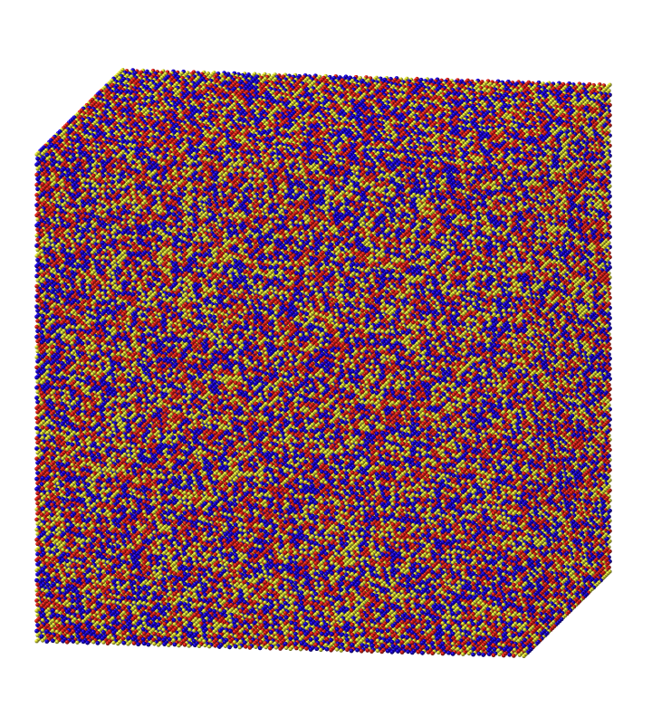


Reverse Monte Carlo modelling
Large-box Reverse Monte Carlo (RMC) modelling
vs
Supercell of thousands of atoms
Random atomic moves
Atom translations
Atom-type swaps
Moves accepted based on improvement of fit quality

Slide 6
Reverse Monte Carlo modelling
Large-box Reverse Monte Carlo (RMC) modelling
for nanoparticles
Supercell of thousands of atoms
Random atomic moves
Atom translations
Atom-type swaps
Moves accepted based on improvement of fit quality

Slide 7
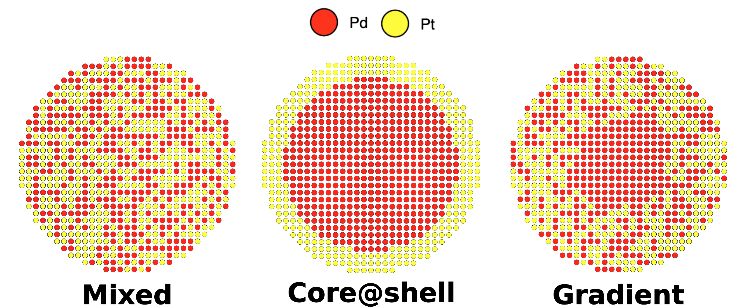
Reverse Monte Carlo modelling
Compositional order based on kinetics experiments
Large-box Reverse Monte Carlo (RMC) modelling
for nanoparticles
Supercell of thousands of atoms
Random atomic moves
Atom translations
Atom-type swaps
Moves accepted based on improvement of fit quality
Chemical short-range order
Spatial compositional heterogeneities

Slide 8

Reverse Monte Carlo modelling
Only atom translations
Large-box Reverse Monte Carlo (RMC) modelling
for nanoparticles
Supercell of thousands of atoms
Random atomic moves
Atom translations
Atom-type swaps
Moves accepted based on improvement of fit quality
Best fit
Chemical short-range order
Spatial compositional heterogeneities

Slide 9

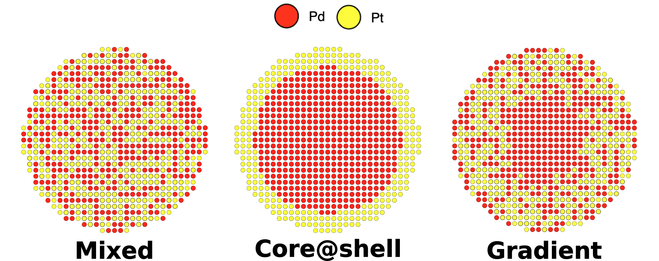
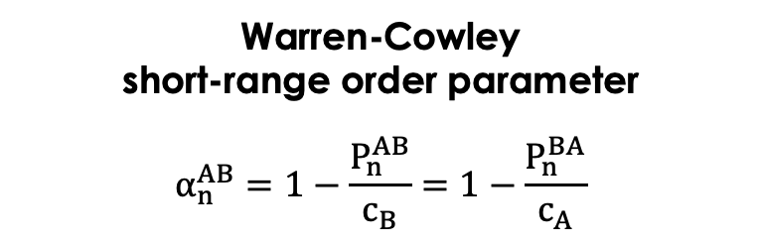
Reverse Monte Carlo modelling
Large-box Reverse Monte Carlo (RMC) modelling
for nanoparticles
Supercell of thousands of atoms
Random atomic moves
Atom translations
Atom-type swaps
Moves accepted based on improvement of fit quality
Atom translations Atom swaps
Warren-Cowley
short-range order parameter
$$α_{n}^{AB}=1−\frac{P_{n}^{AB}}{c_{B}}=1−\frac{P_{n}^{BA}}{c_{A}}$$
Chemical short-range order
Spatial compositional heterogeneities

Slide 10
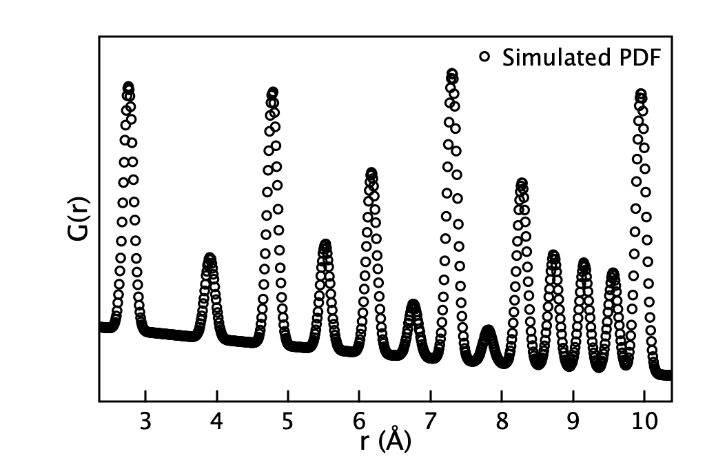


Testing the method
Refining against simulated PDFs PdPt
Refine against simulated PDF
Simulate PDF

Slide 11
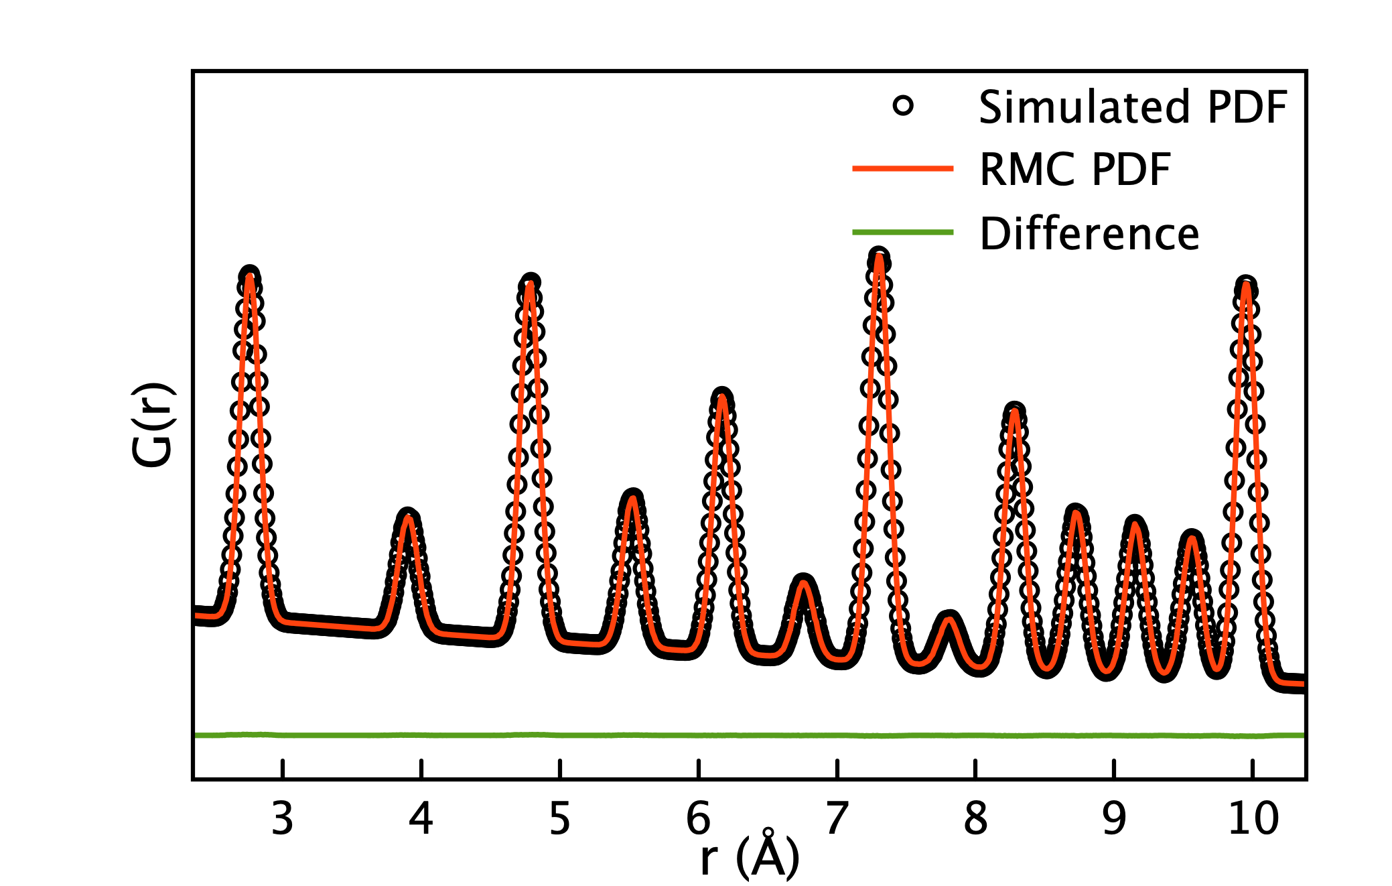
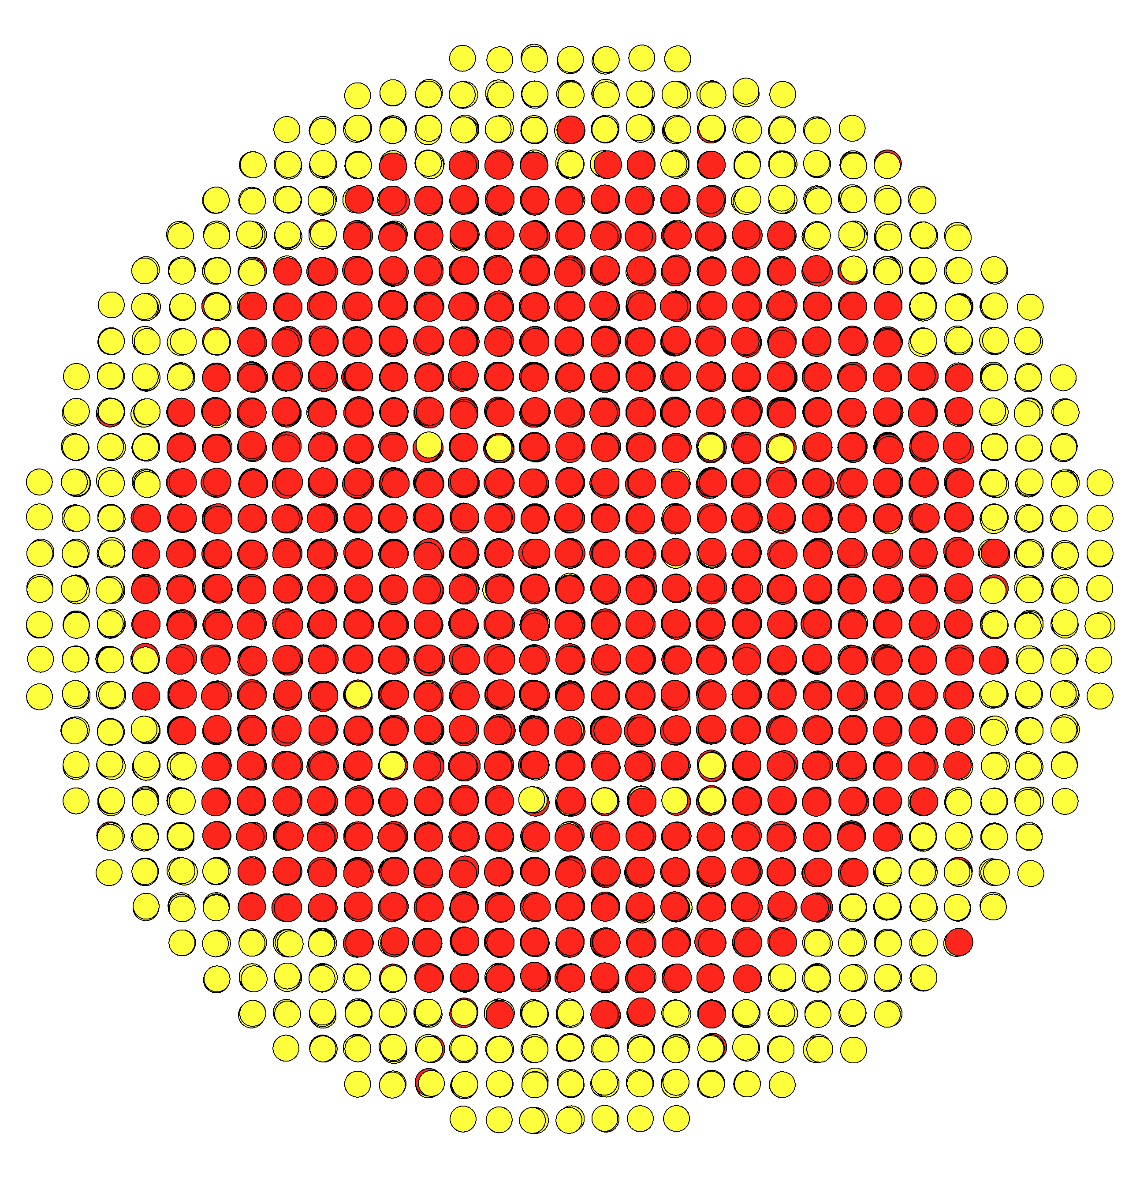
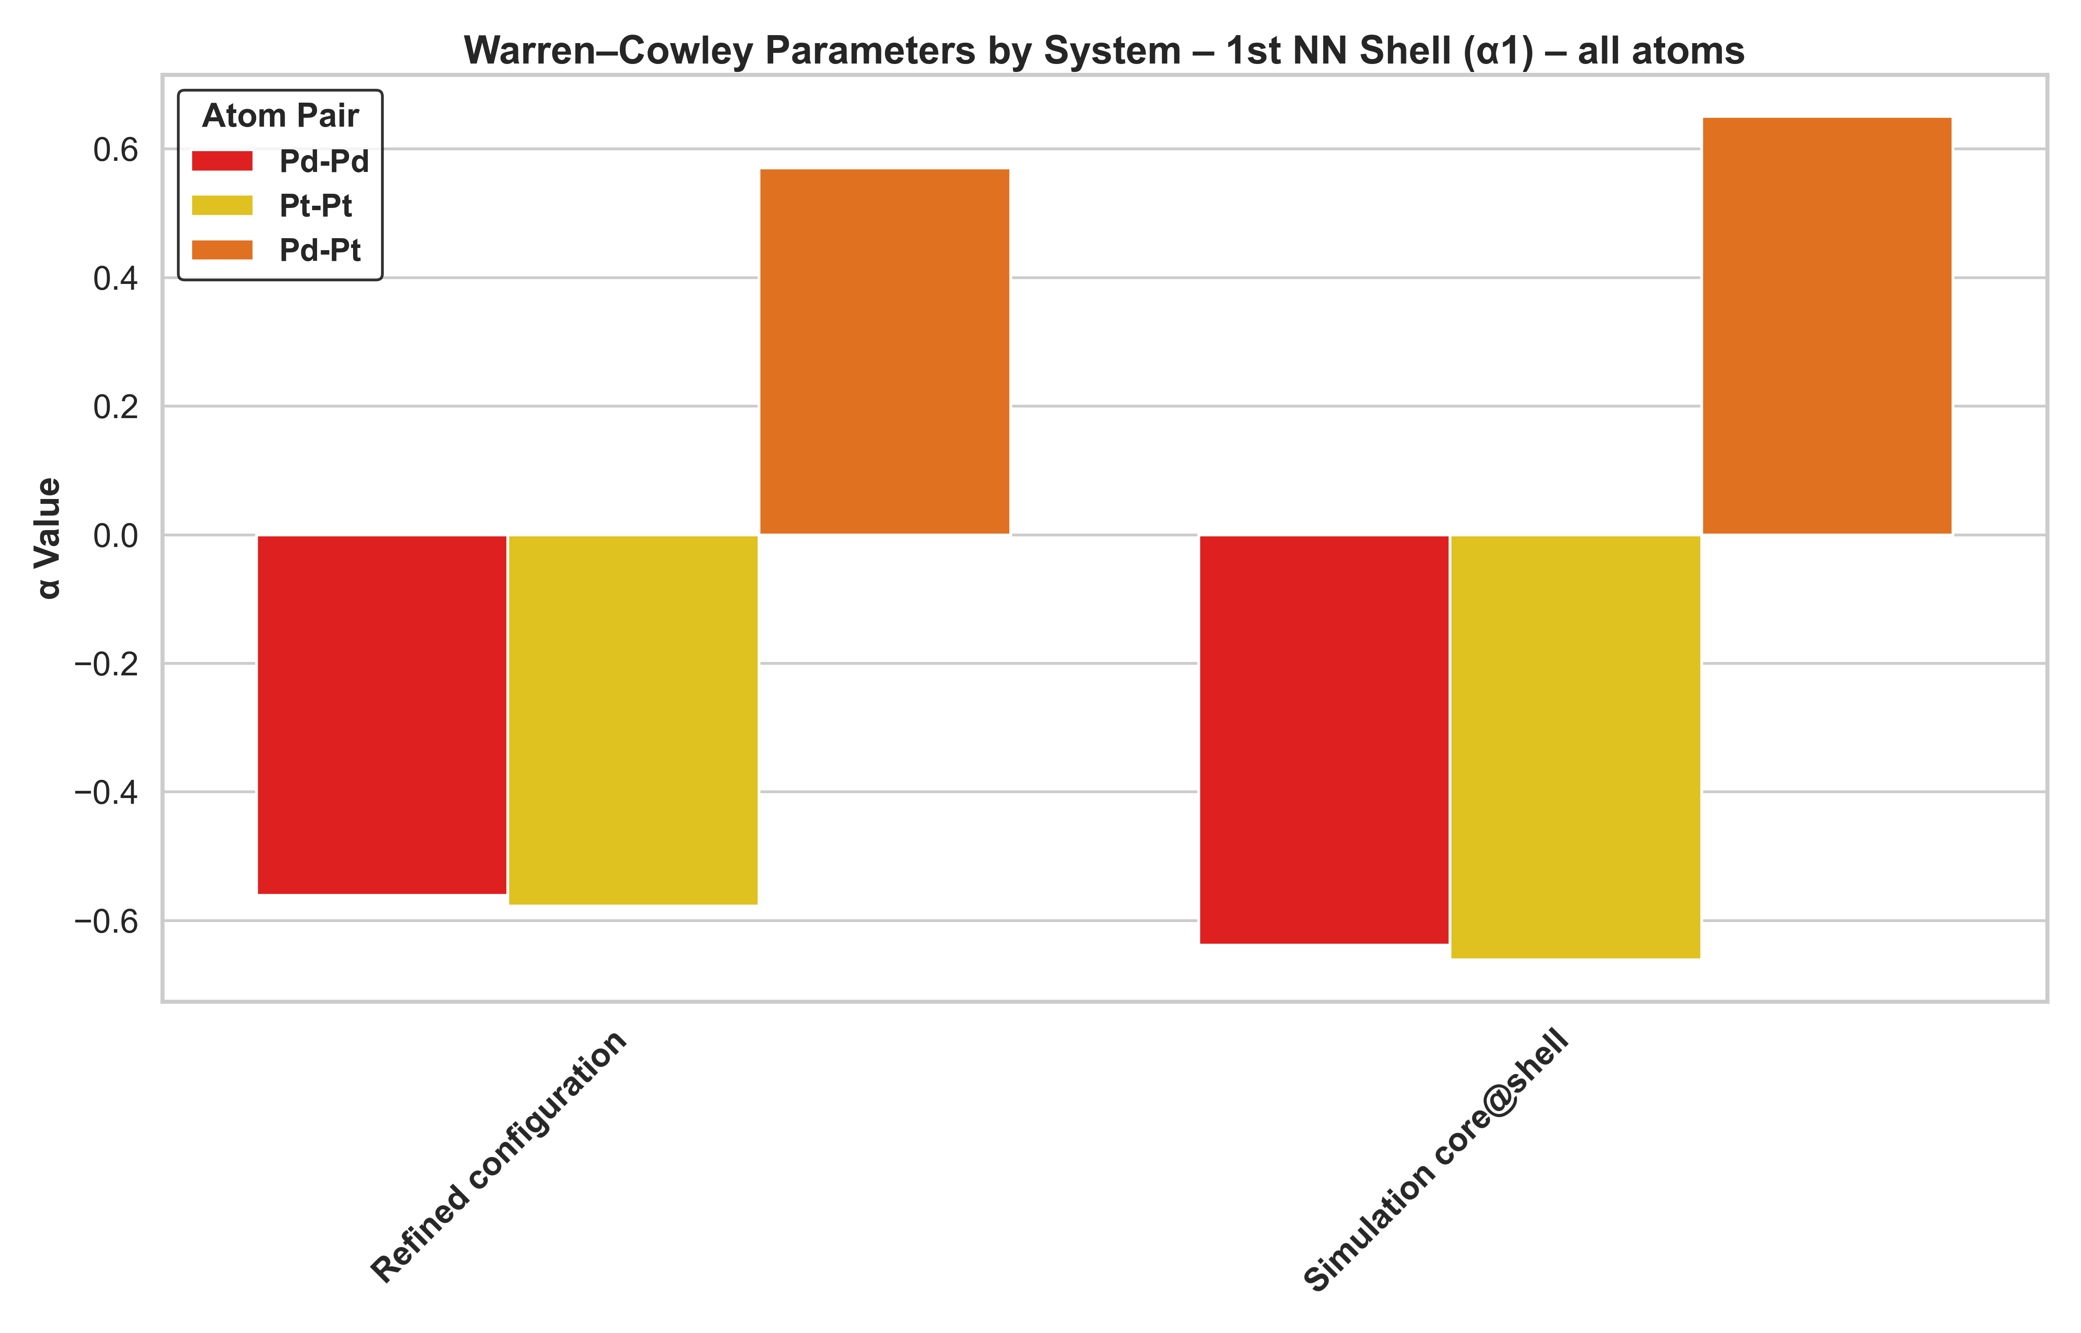
Testing the method
Refining against simulated PDFs
PdPt
Refine against simulated PDF
Refined

Slide 12
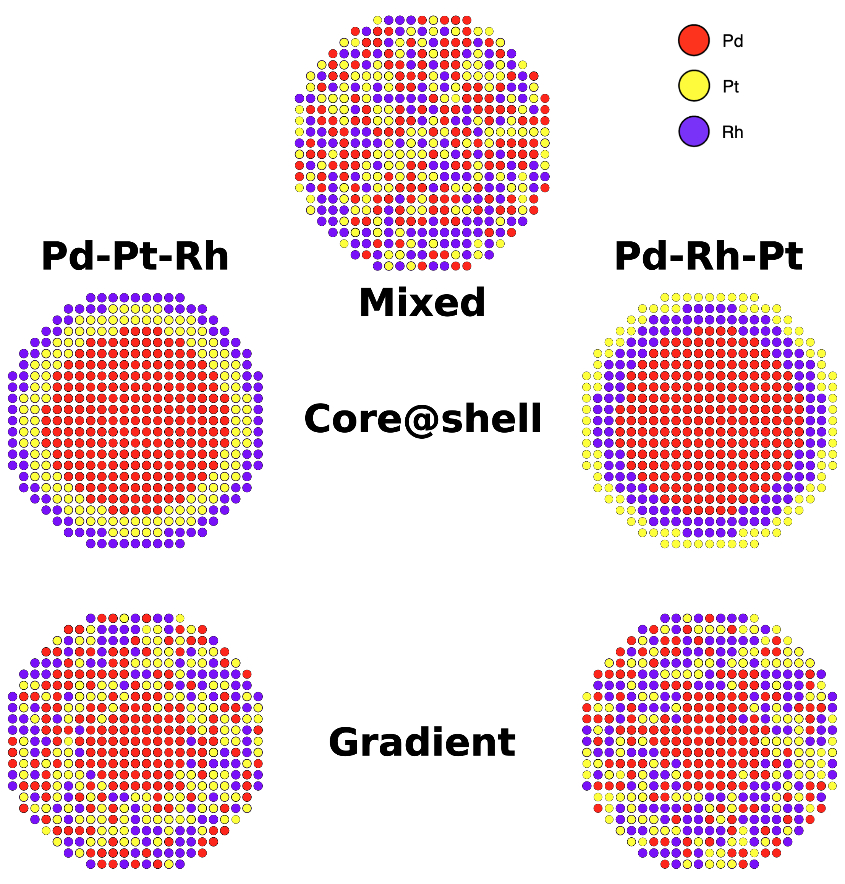
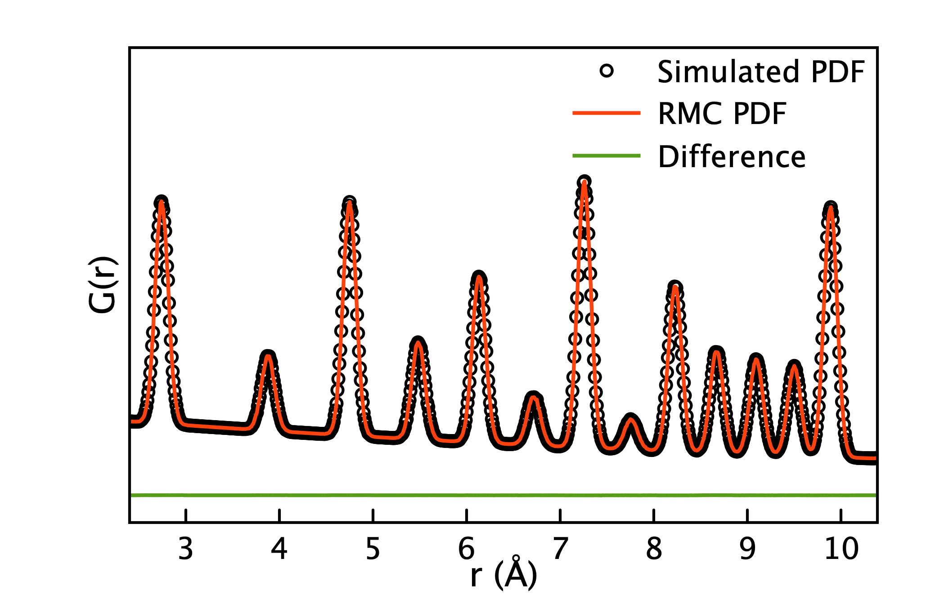
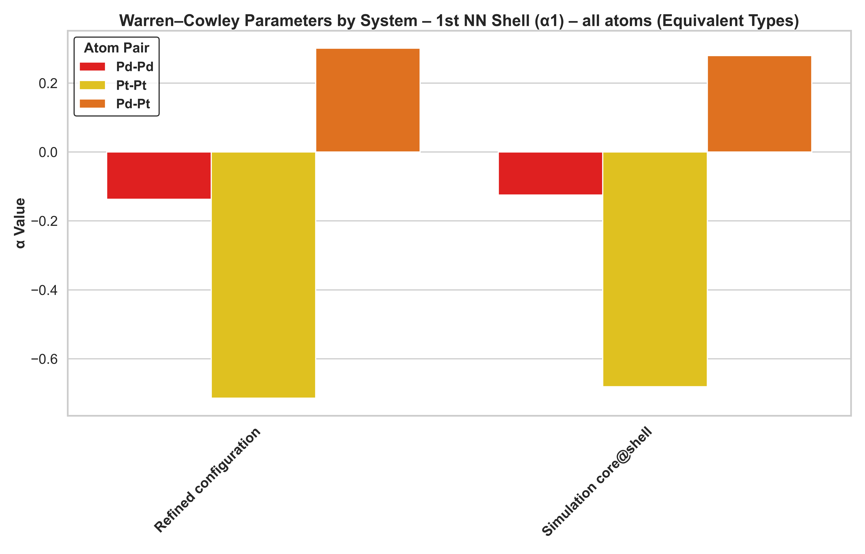
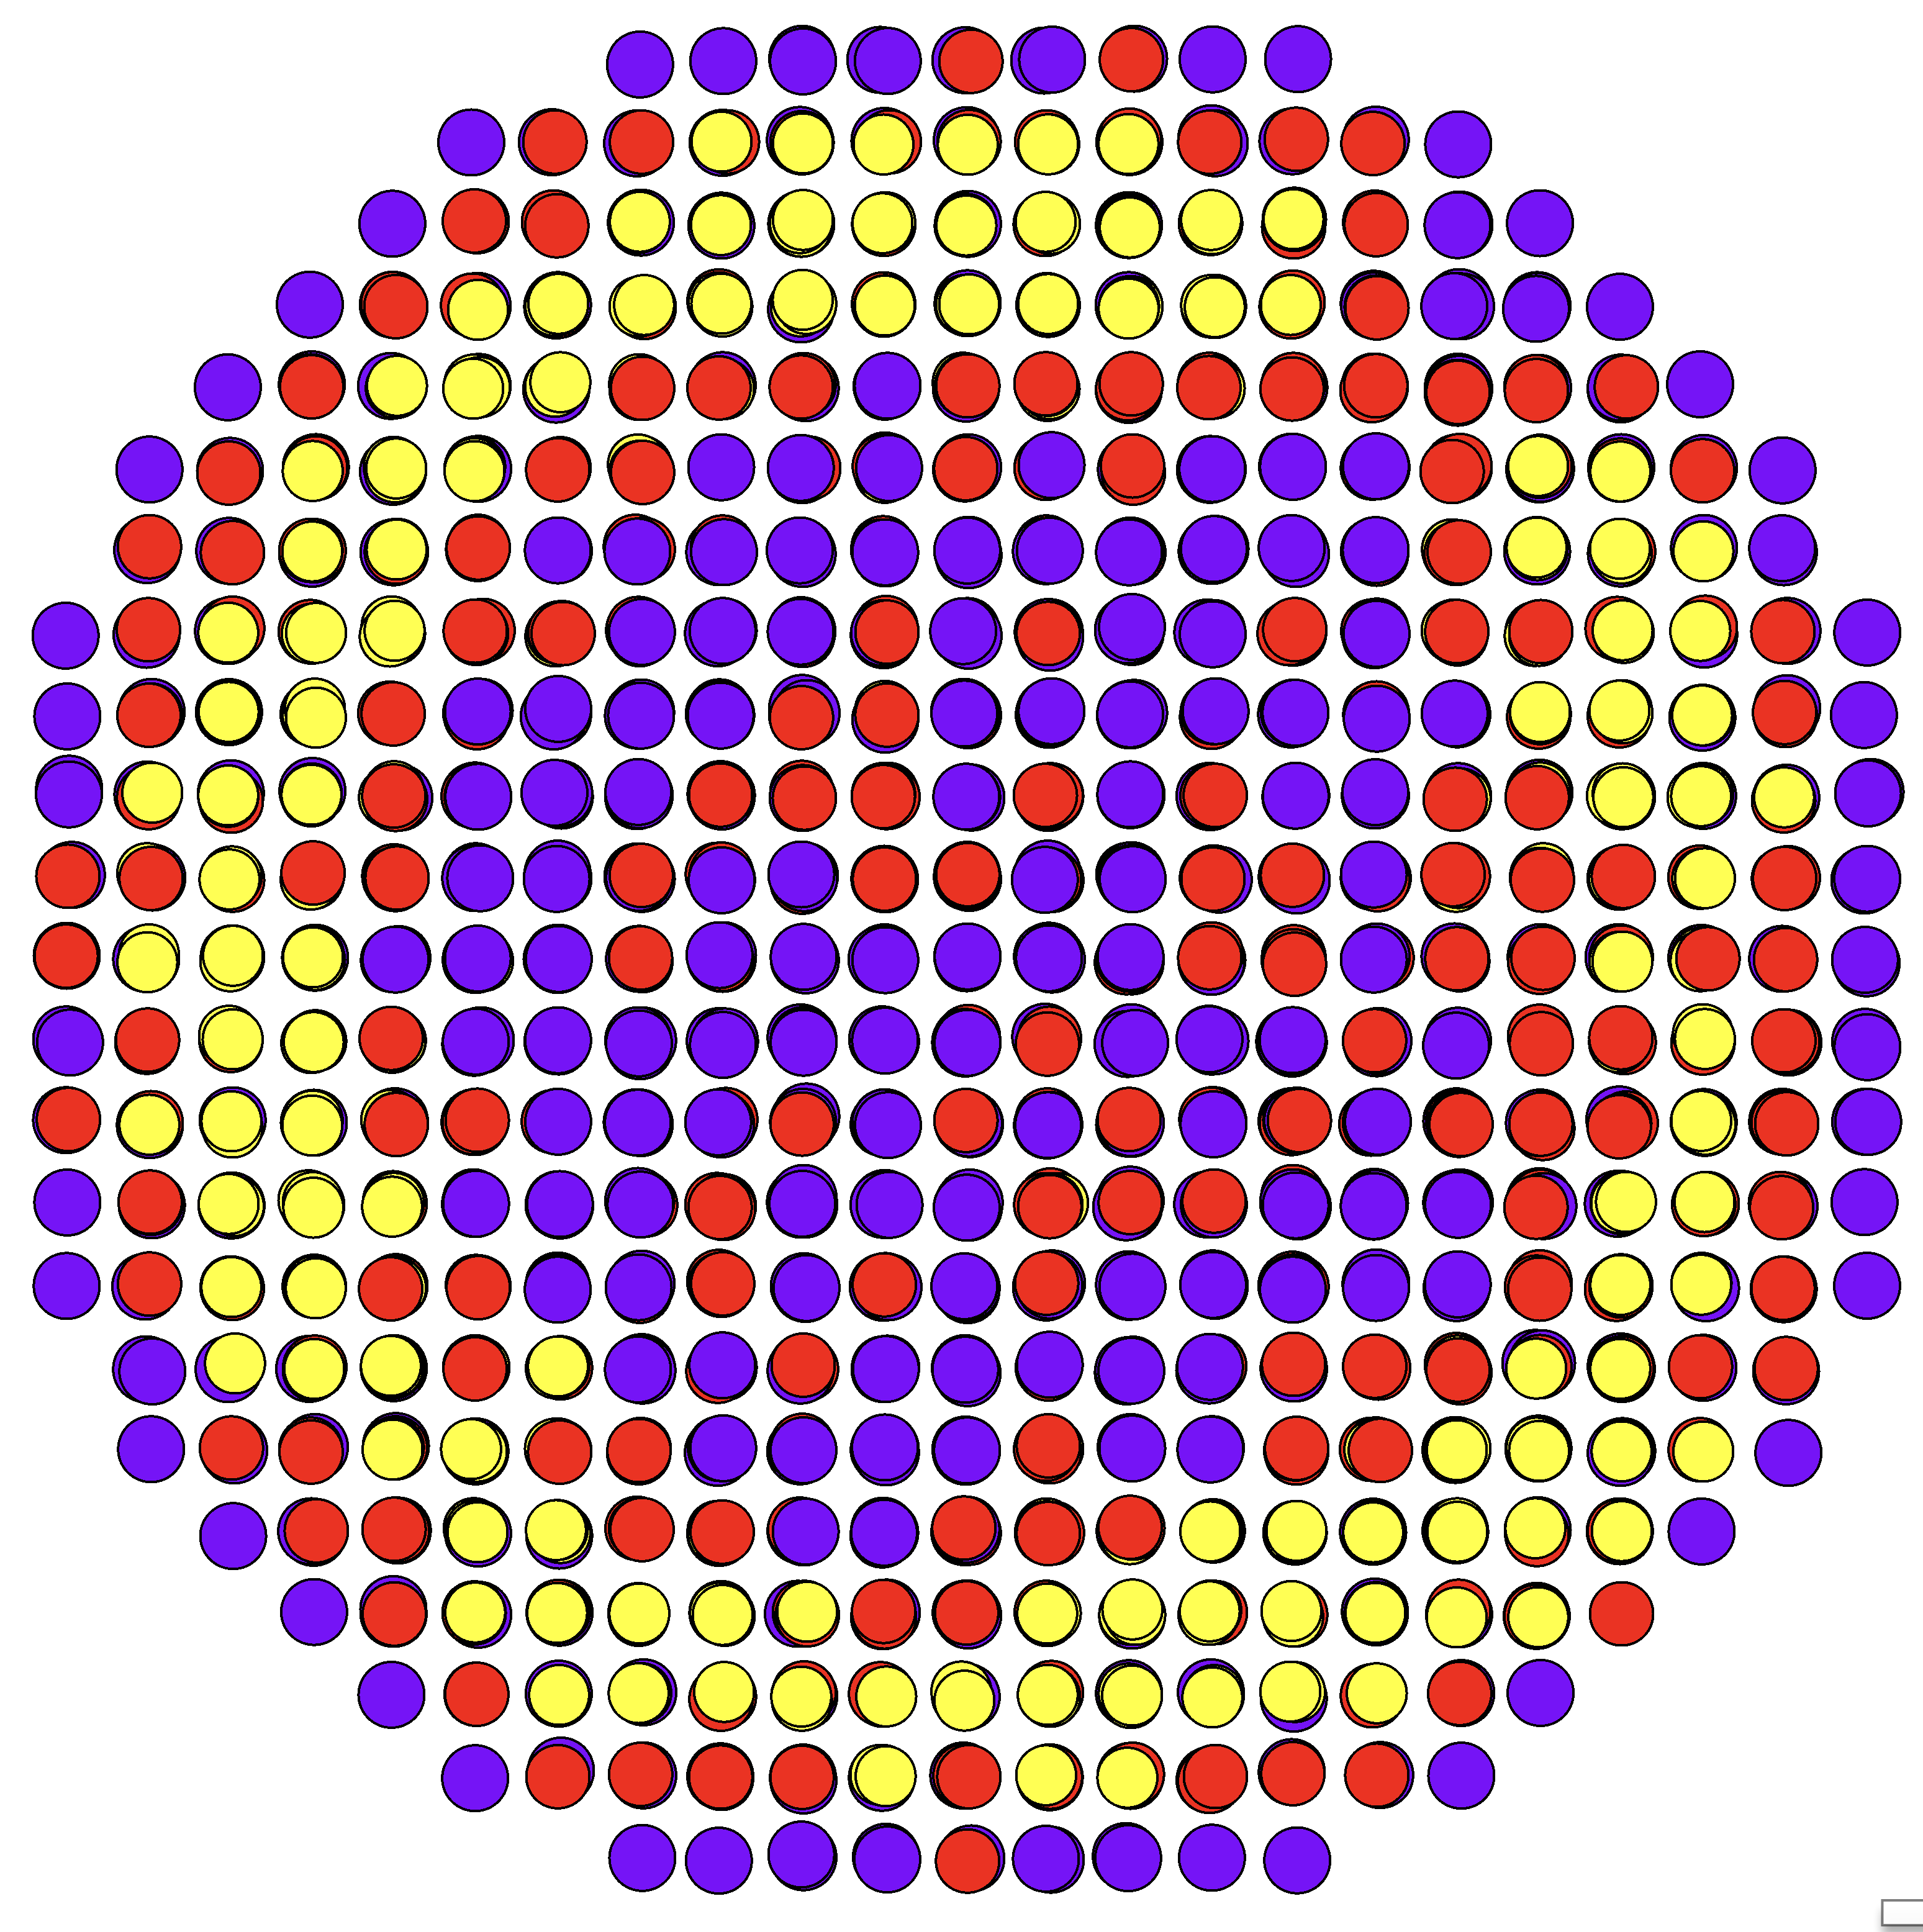
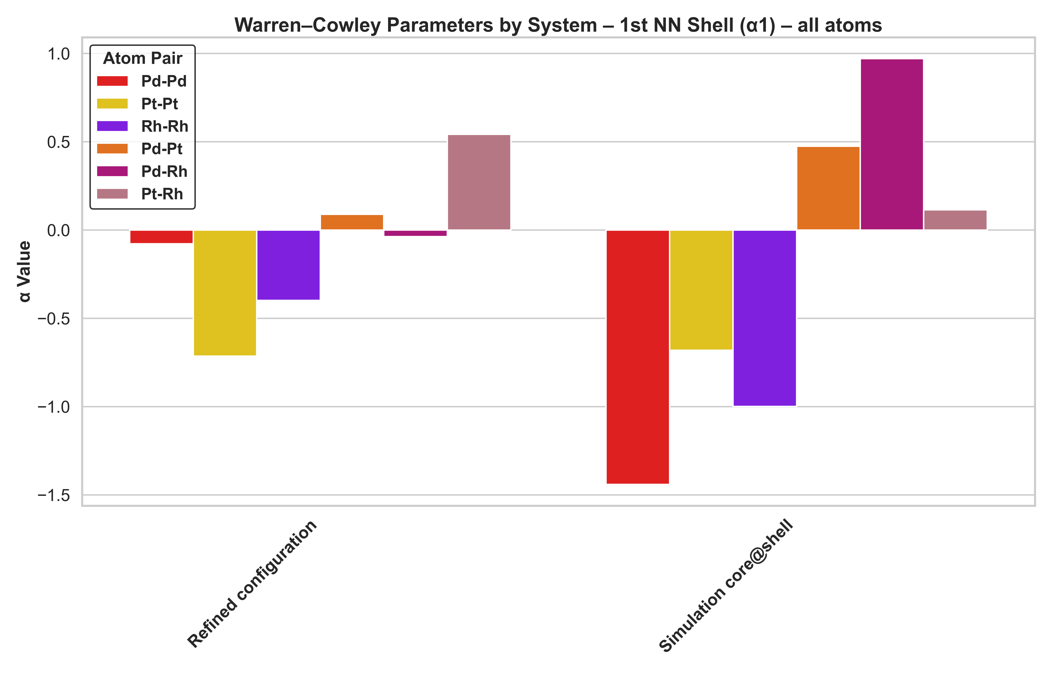
Testing the method
Refining against simulated PDFs PdPtRh
Simulated refinement results
Refine against simulated PDF of core@shell
RMC able to reproduce compositional ordering
Contributions of neighbouring elements difficult to separate
WC analysis of pseudo-binaries helpful
Refined
Treat Rh as Pd
PDF simulation core@shell

Slide 13
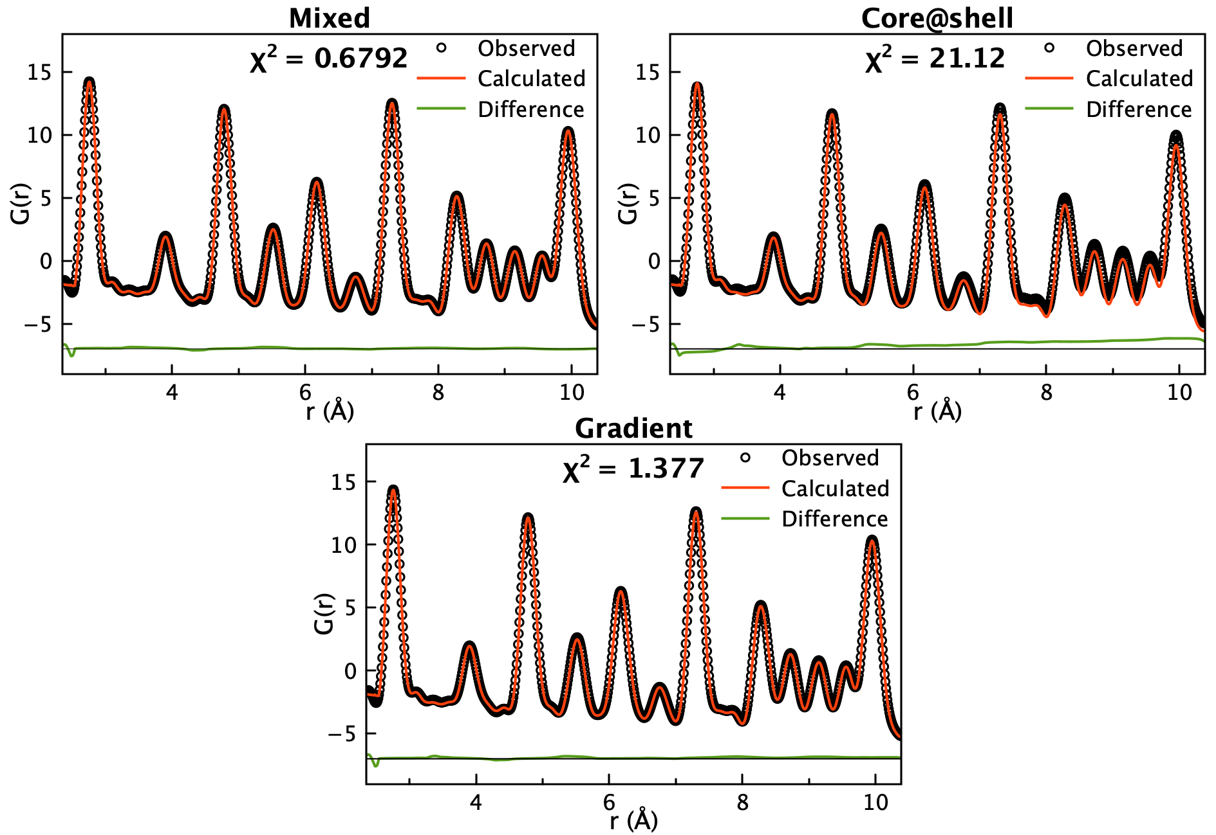
Experimental refinement results
PdPt
Only atom translations

Slide 14
Experimental refinement results
PdPt
Only atom translations
Best fit

Slide 15
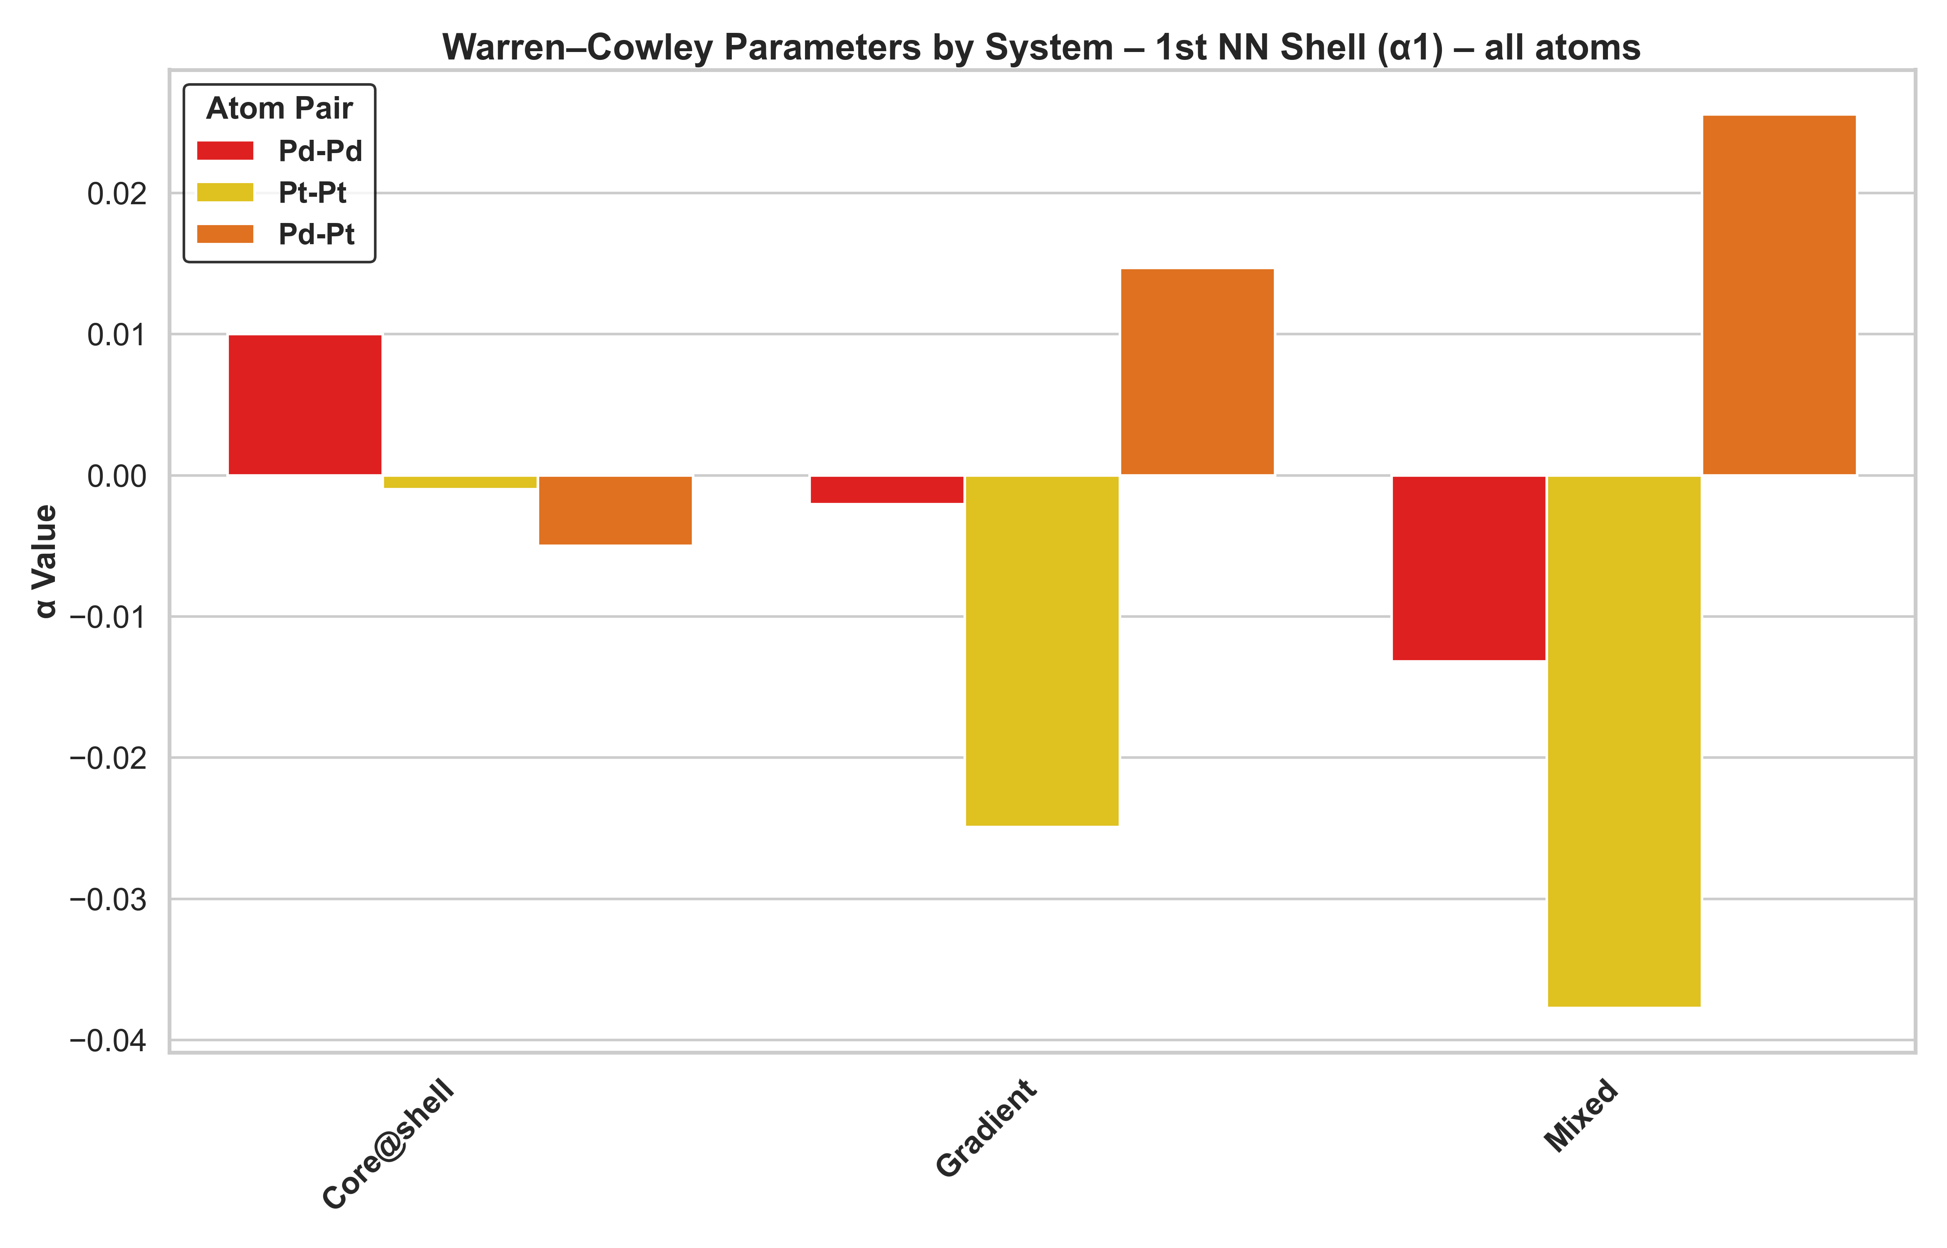
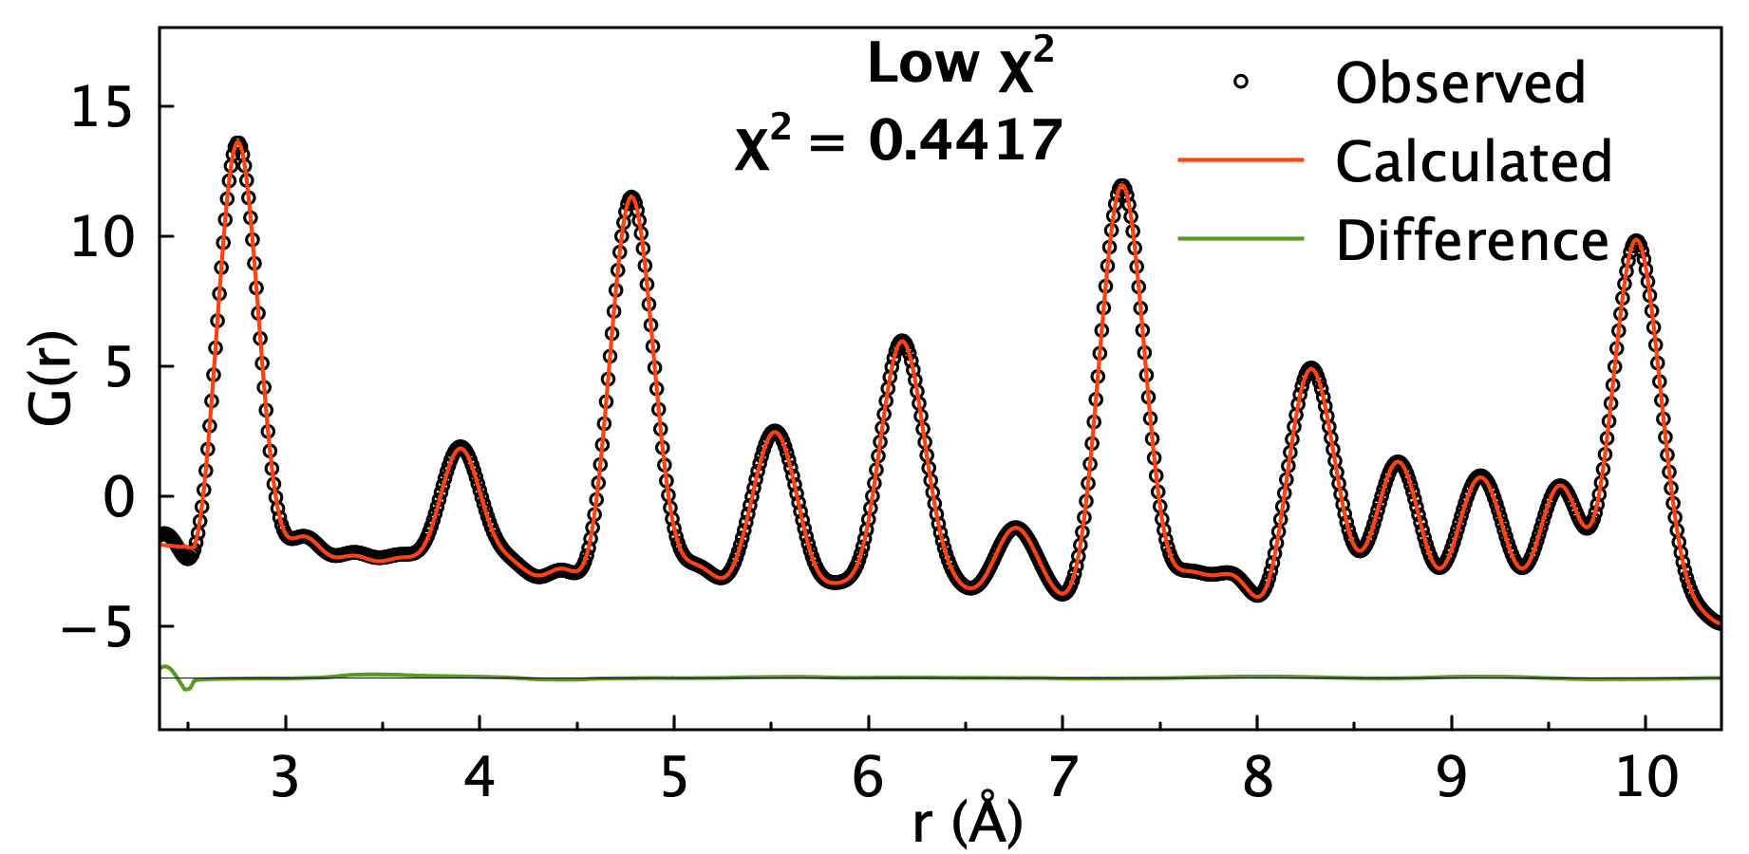
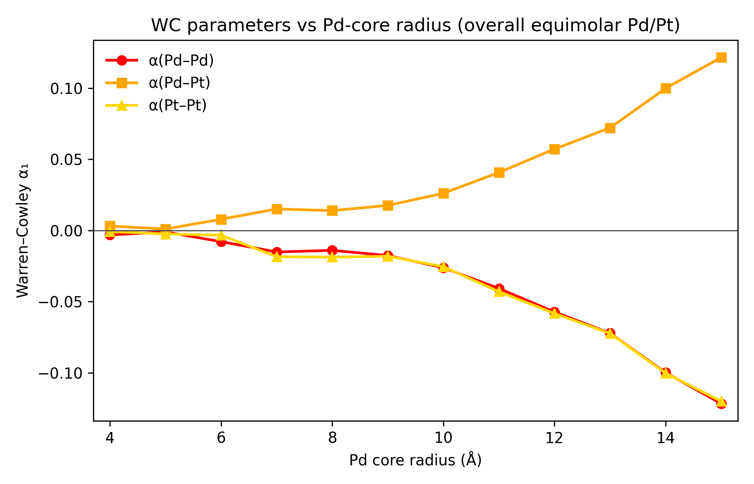
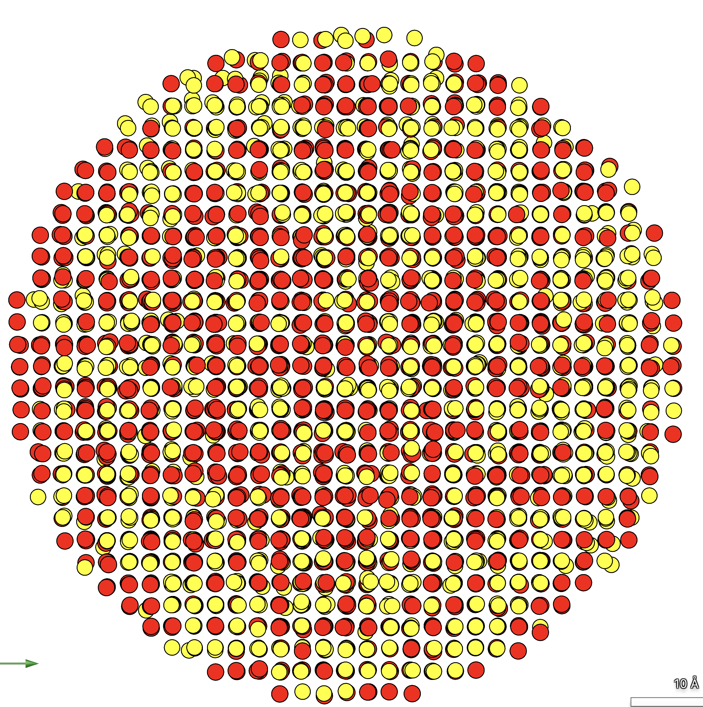
Experimental refinement results
PdPt
Atom translations
Atom swaps

Slide 16
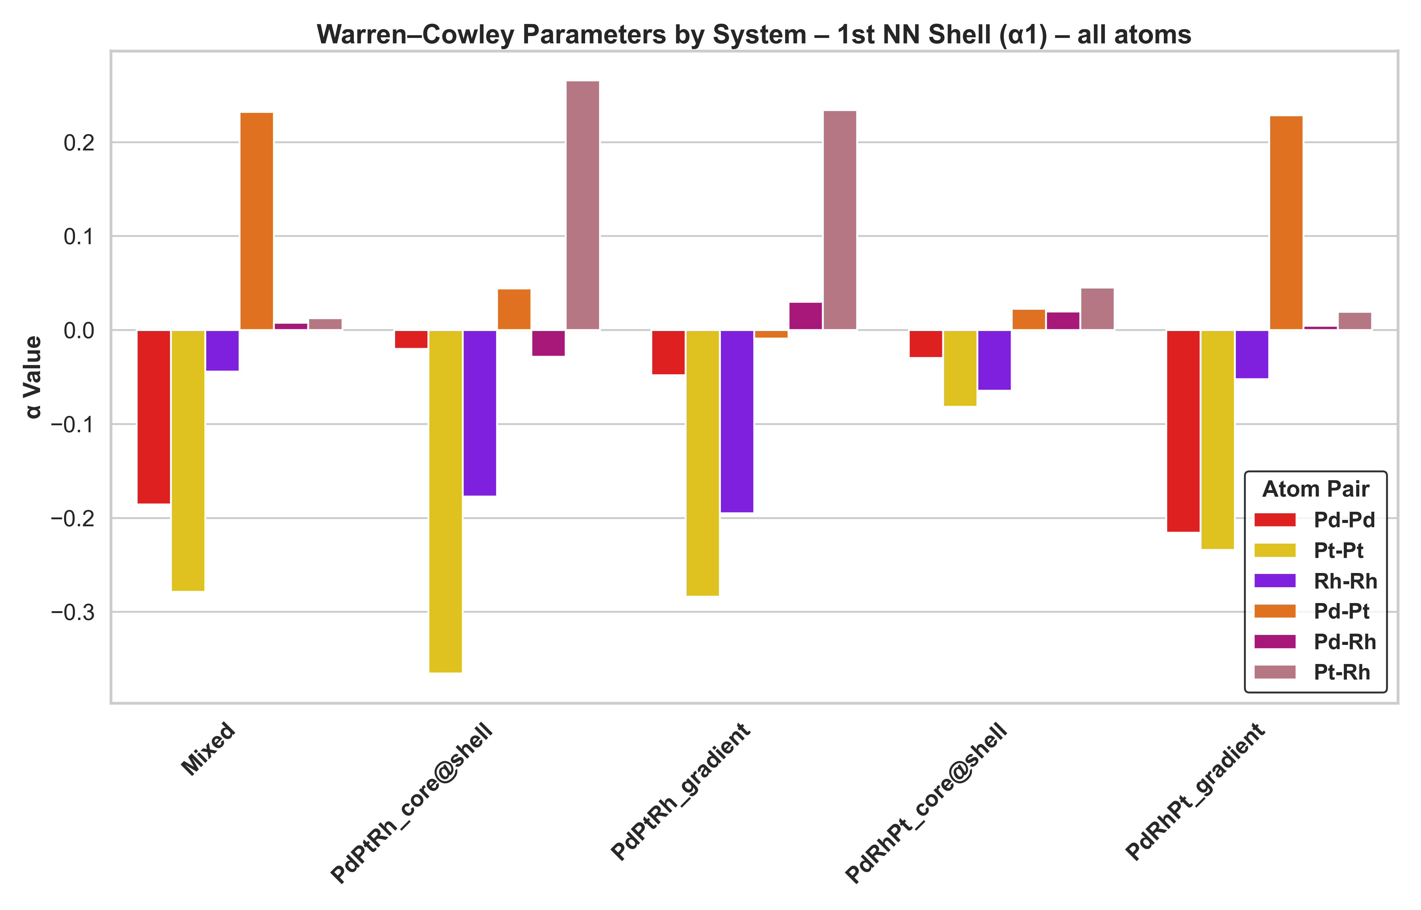

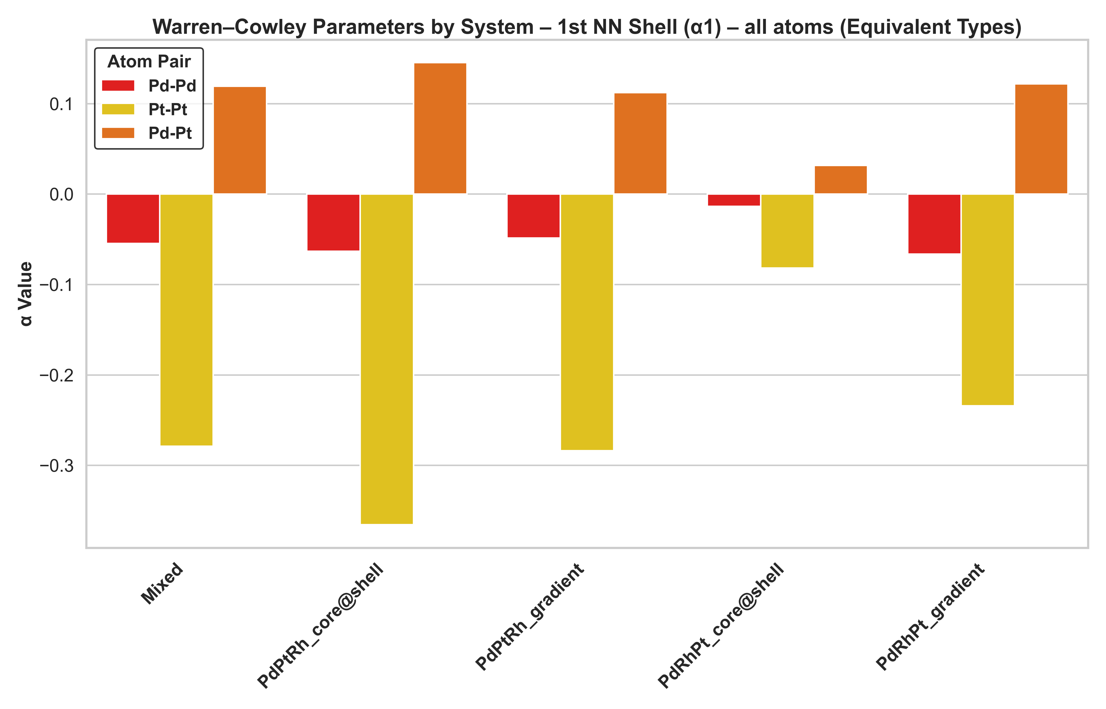
Experimental refinement results
PdPtRh
Atom translations
Atom swaps

Slide 17
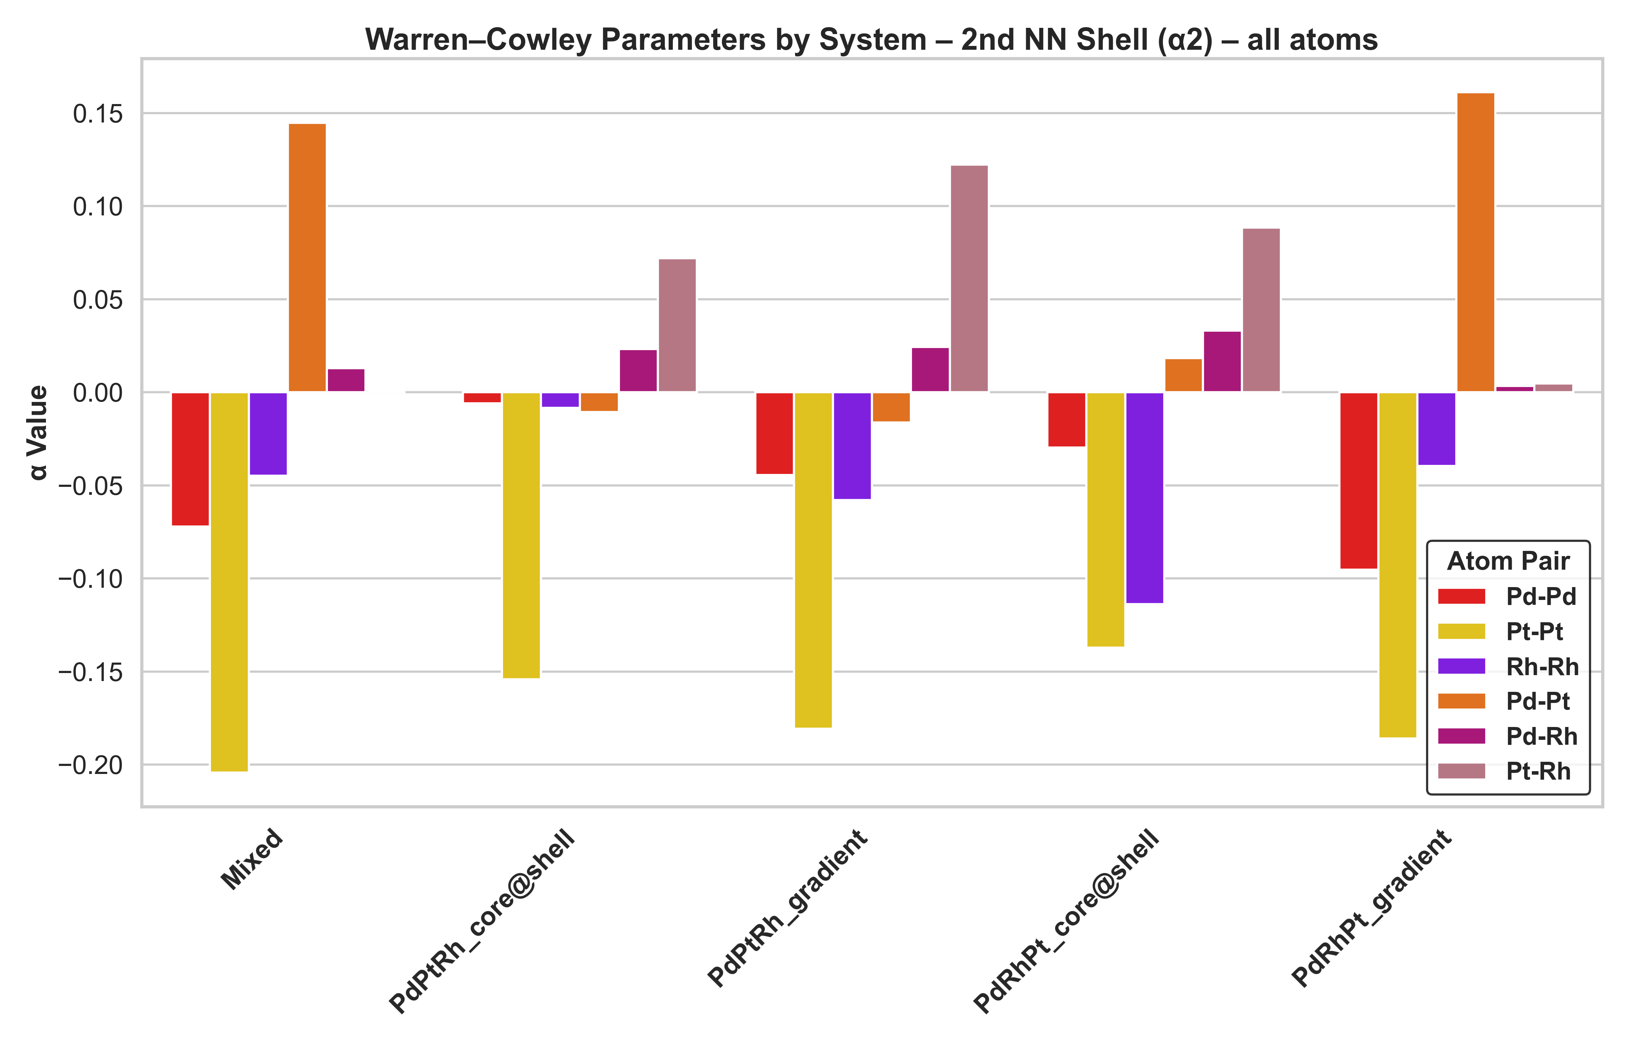
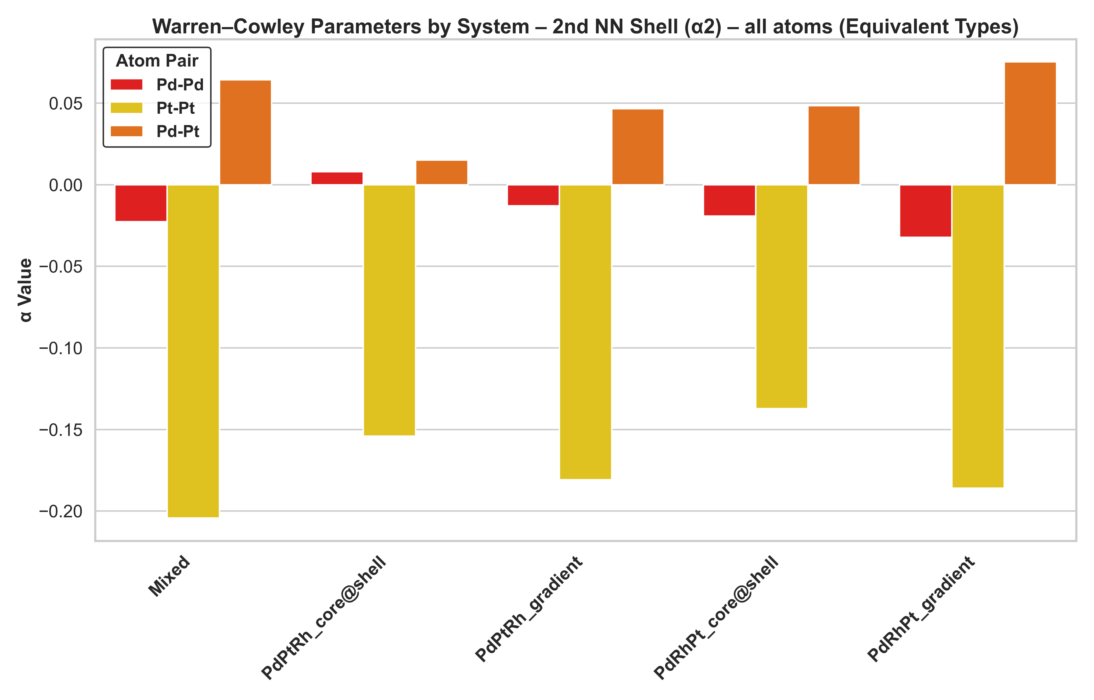
Experimental refinement results
First nearest neighbour shell
PdPtRh
Second nearest neighbour shell
Atom translations
Atom swaps

Slide 18
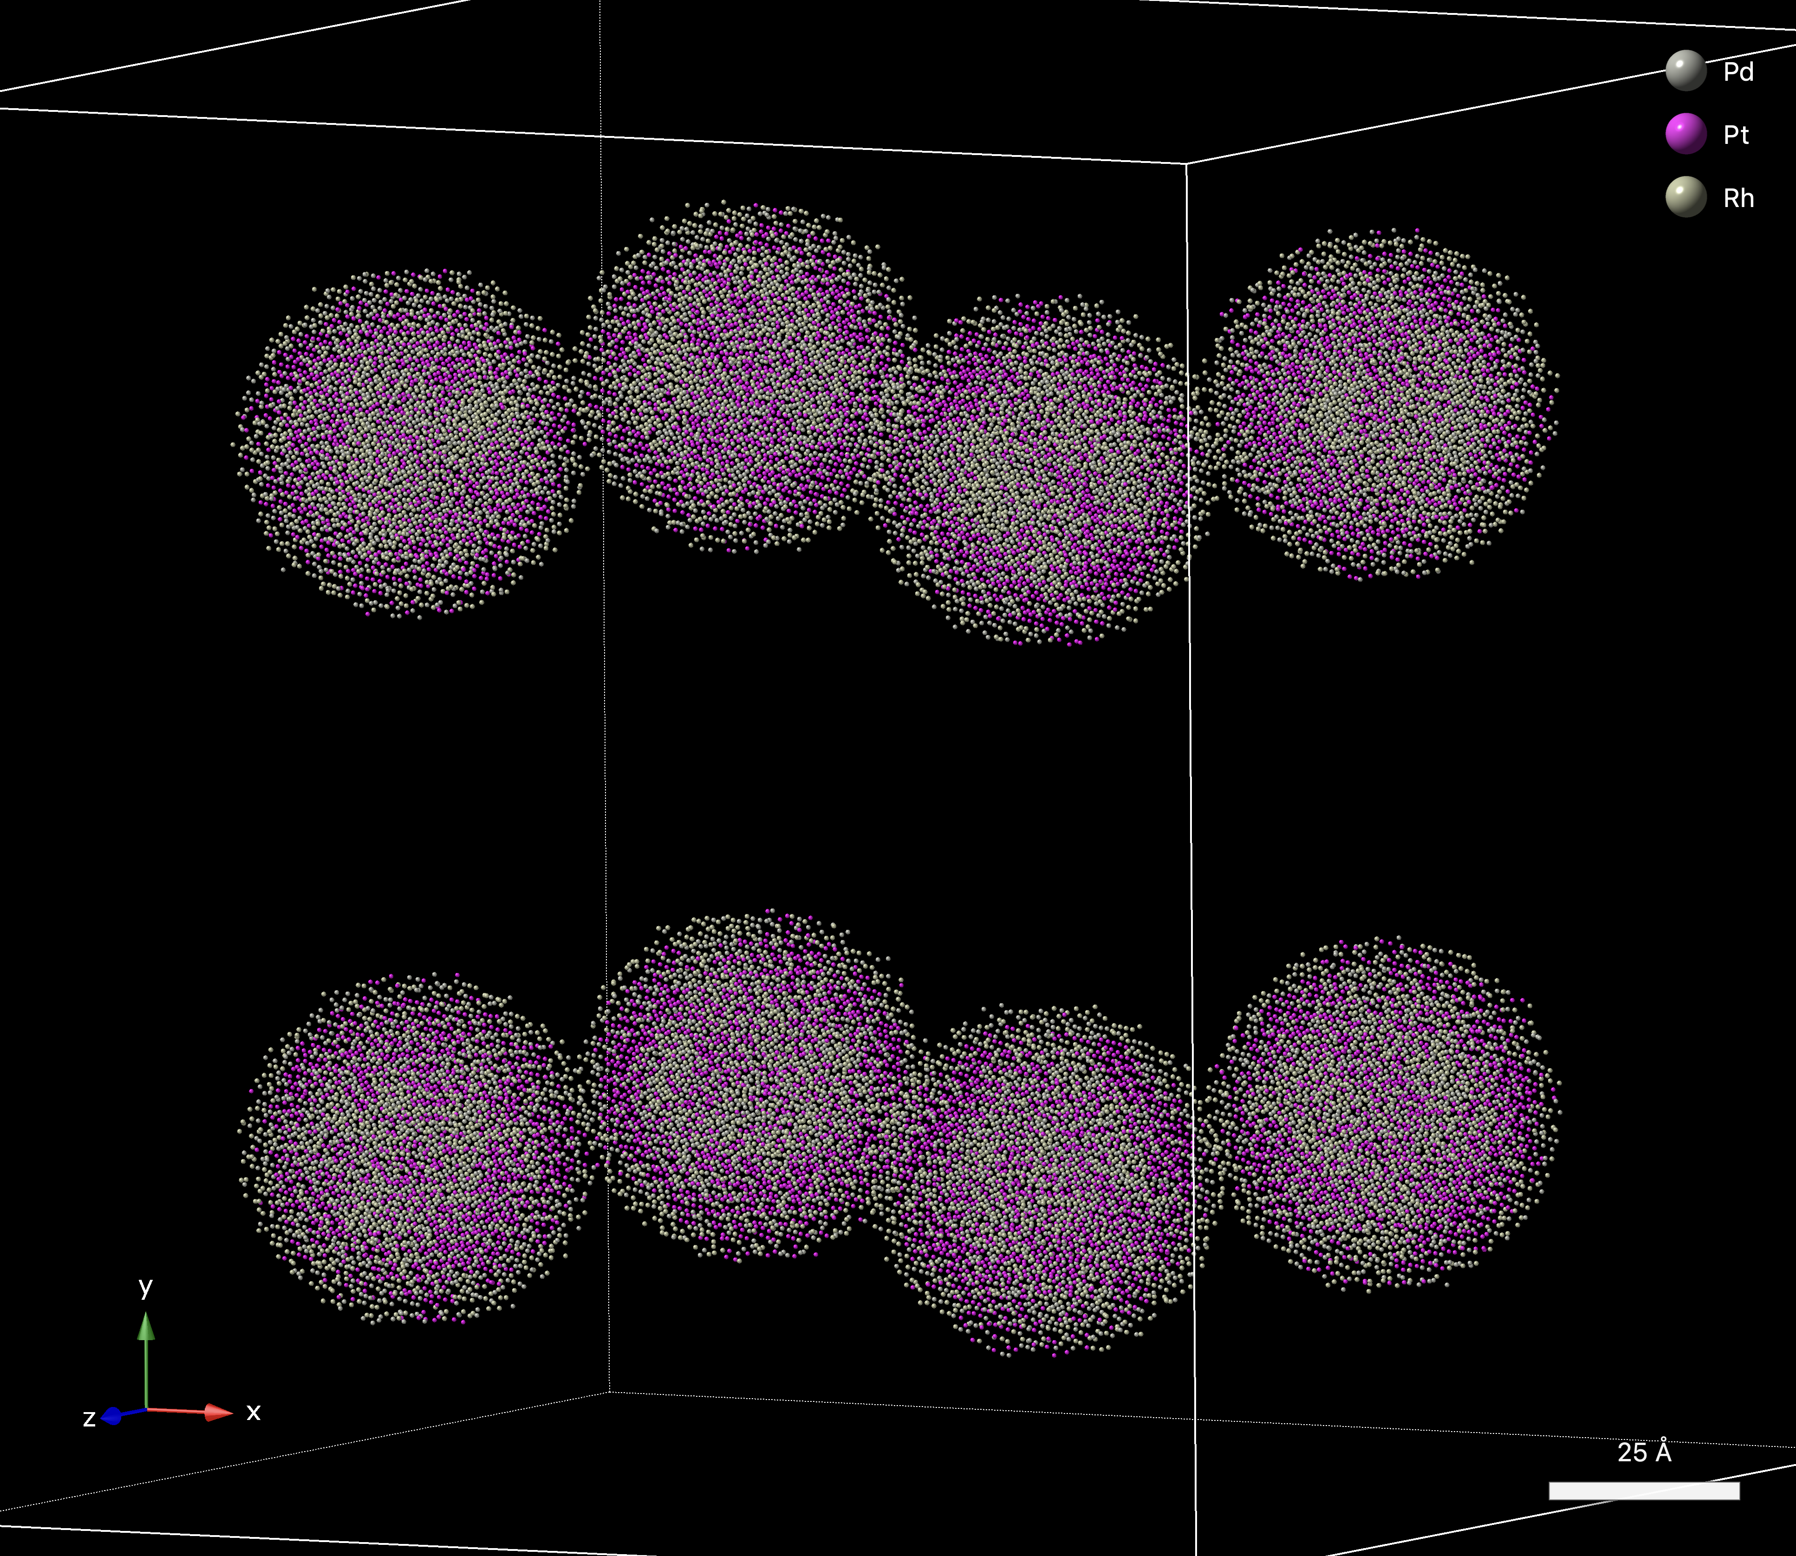
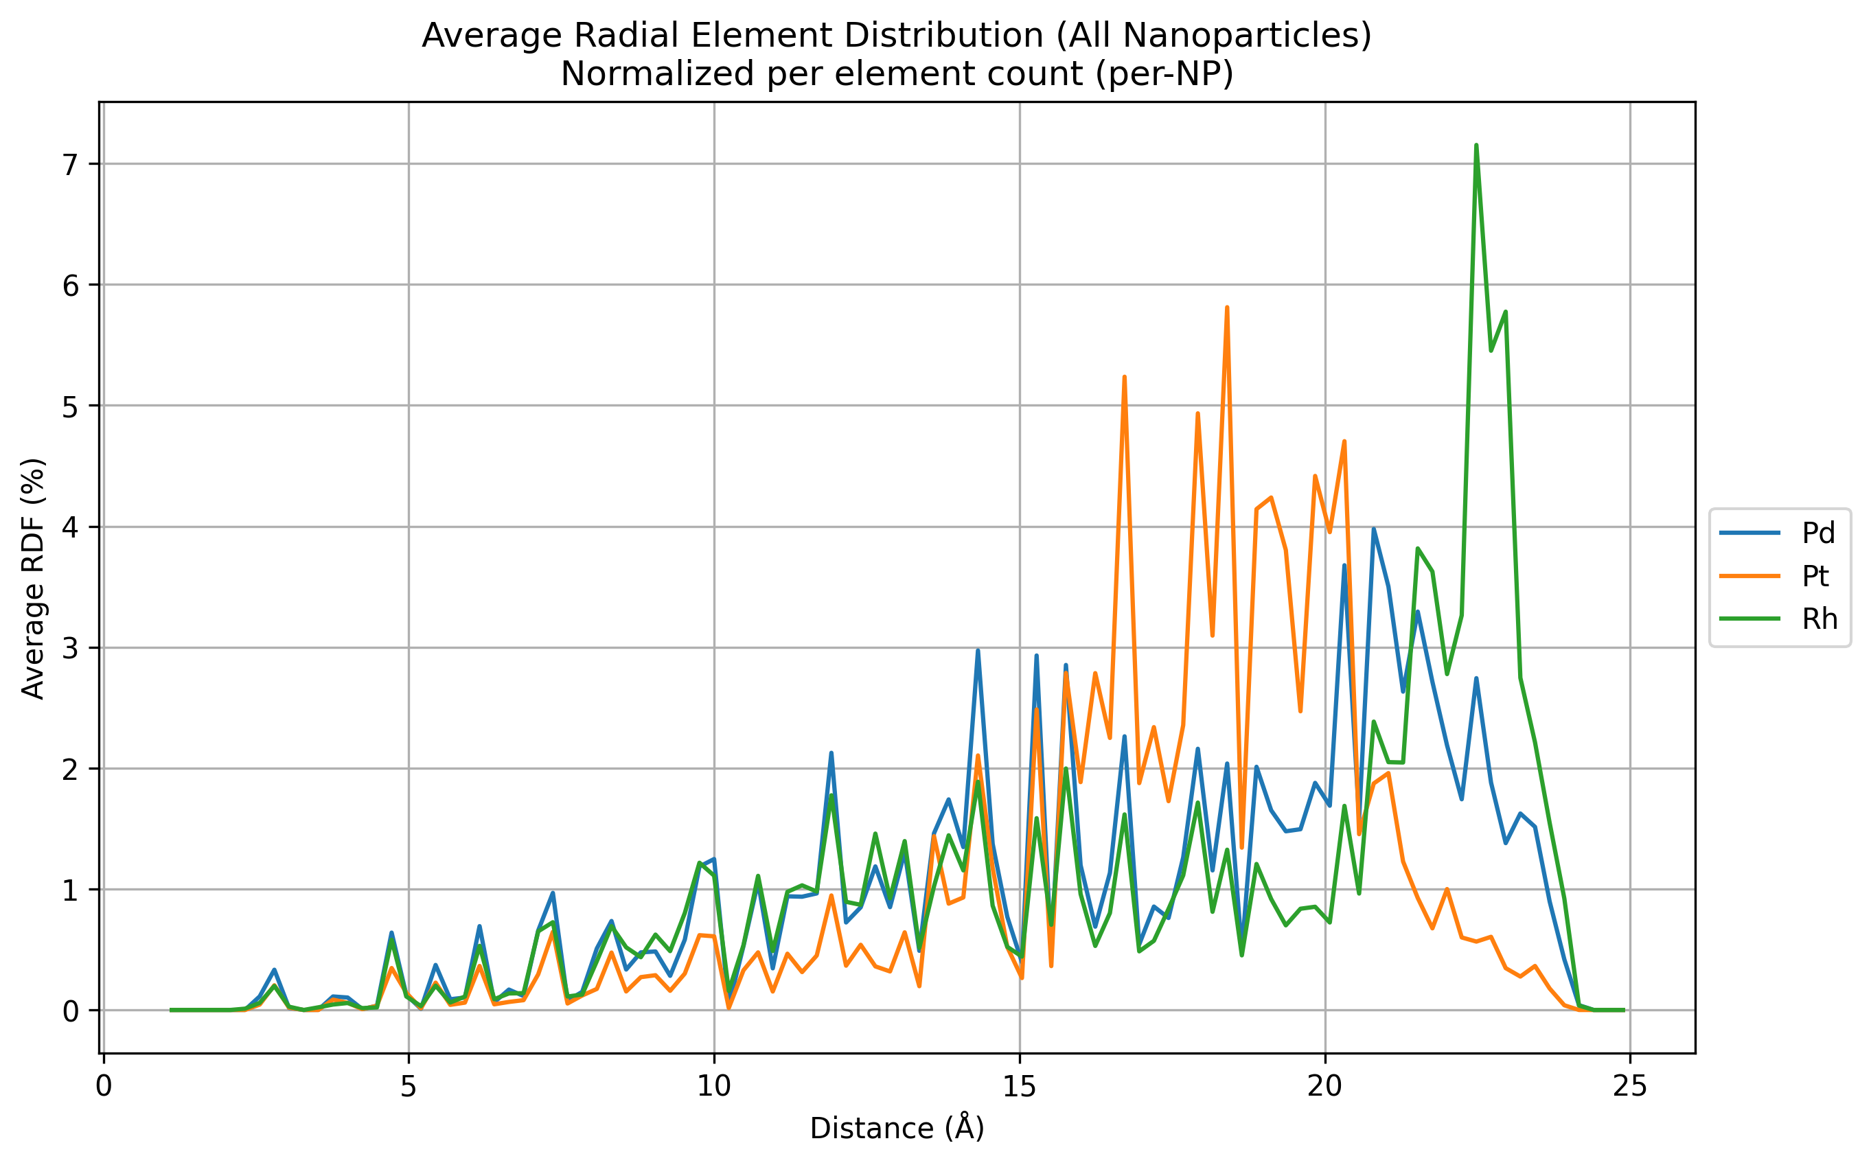
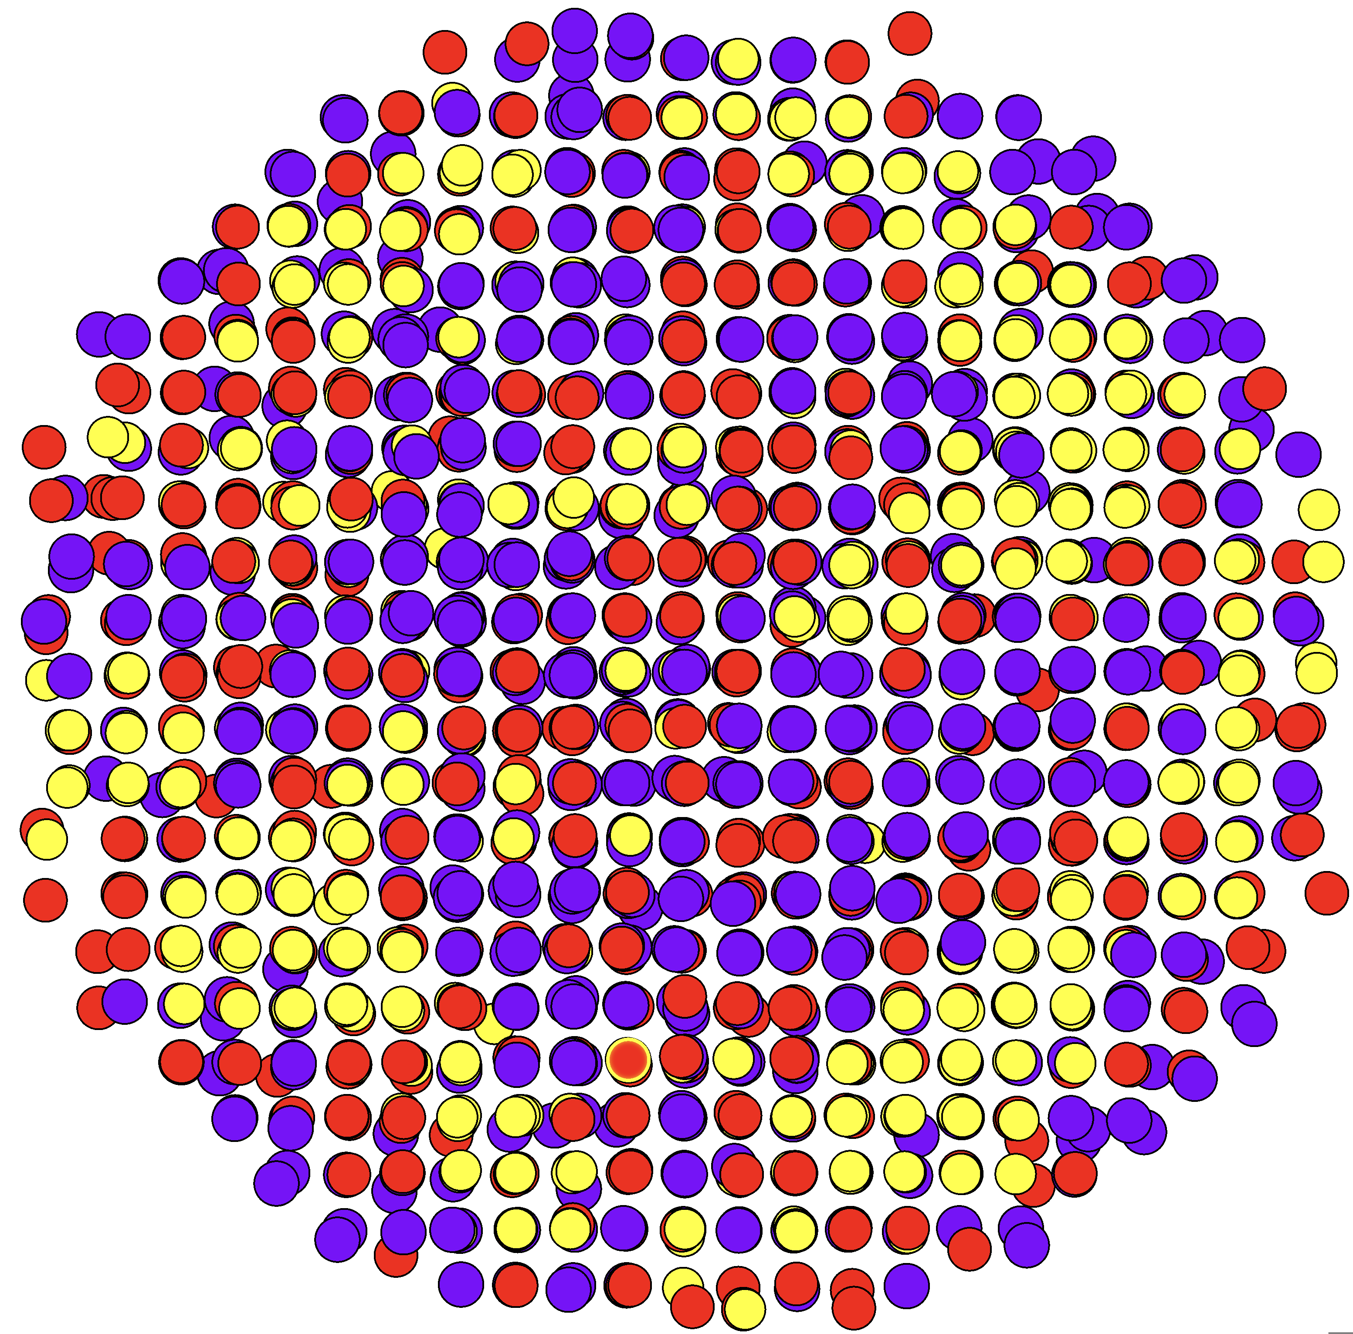
Experimental refinement results
PdPtRh
Atom translations
Atom swaps
Starting
Minimum in refinement space where Pt forms a shell-like architecture
Decreased Pt-content in outer layer observed for all starting configurations
Refined

Slide 19
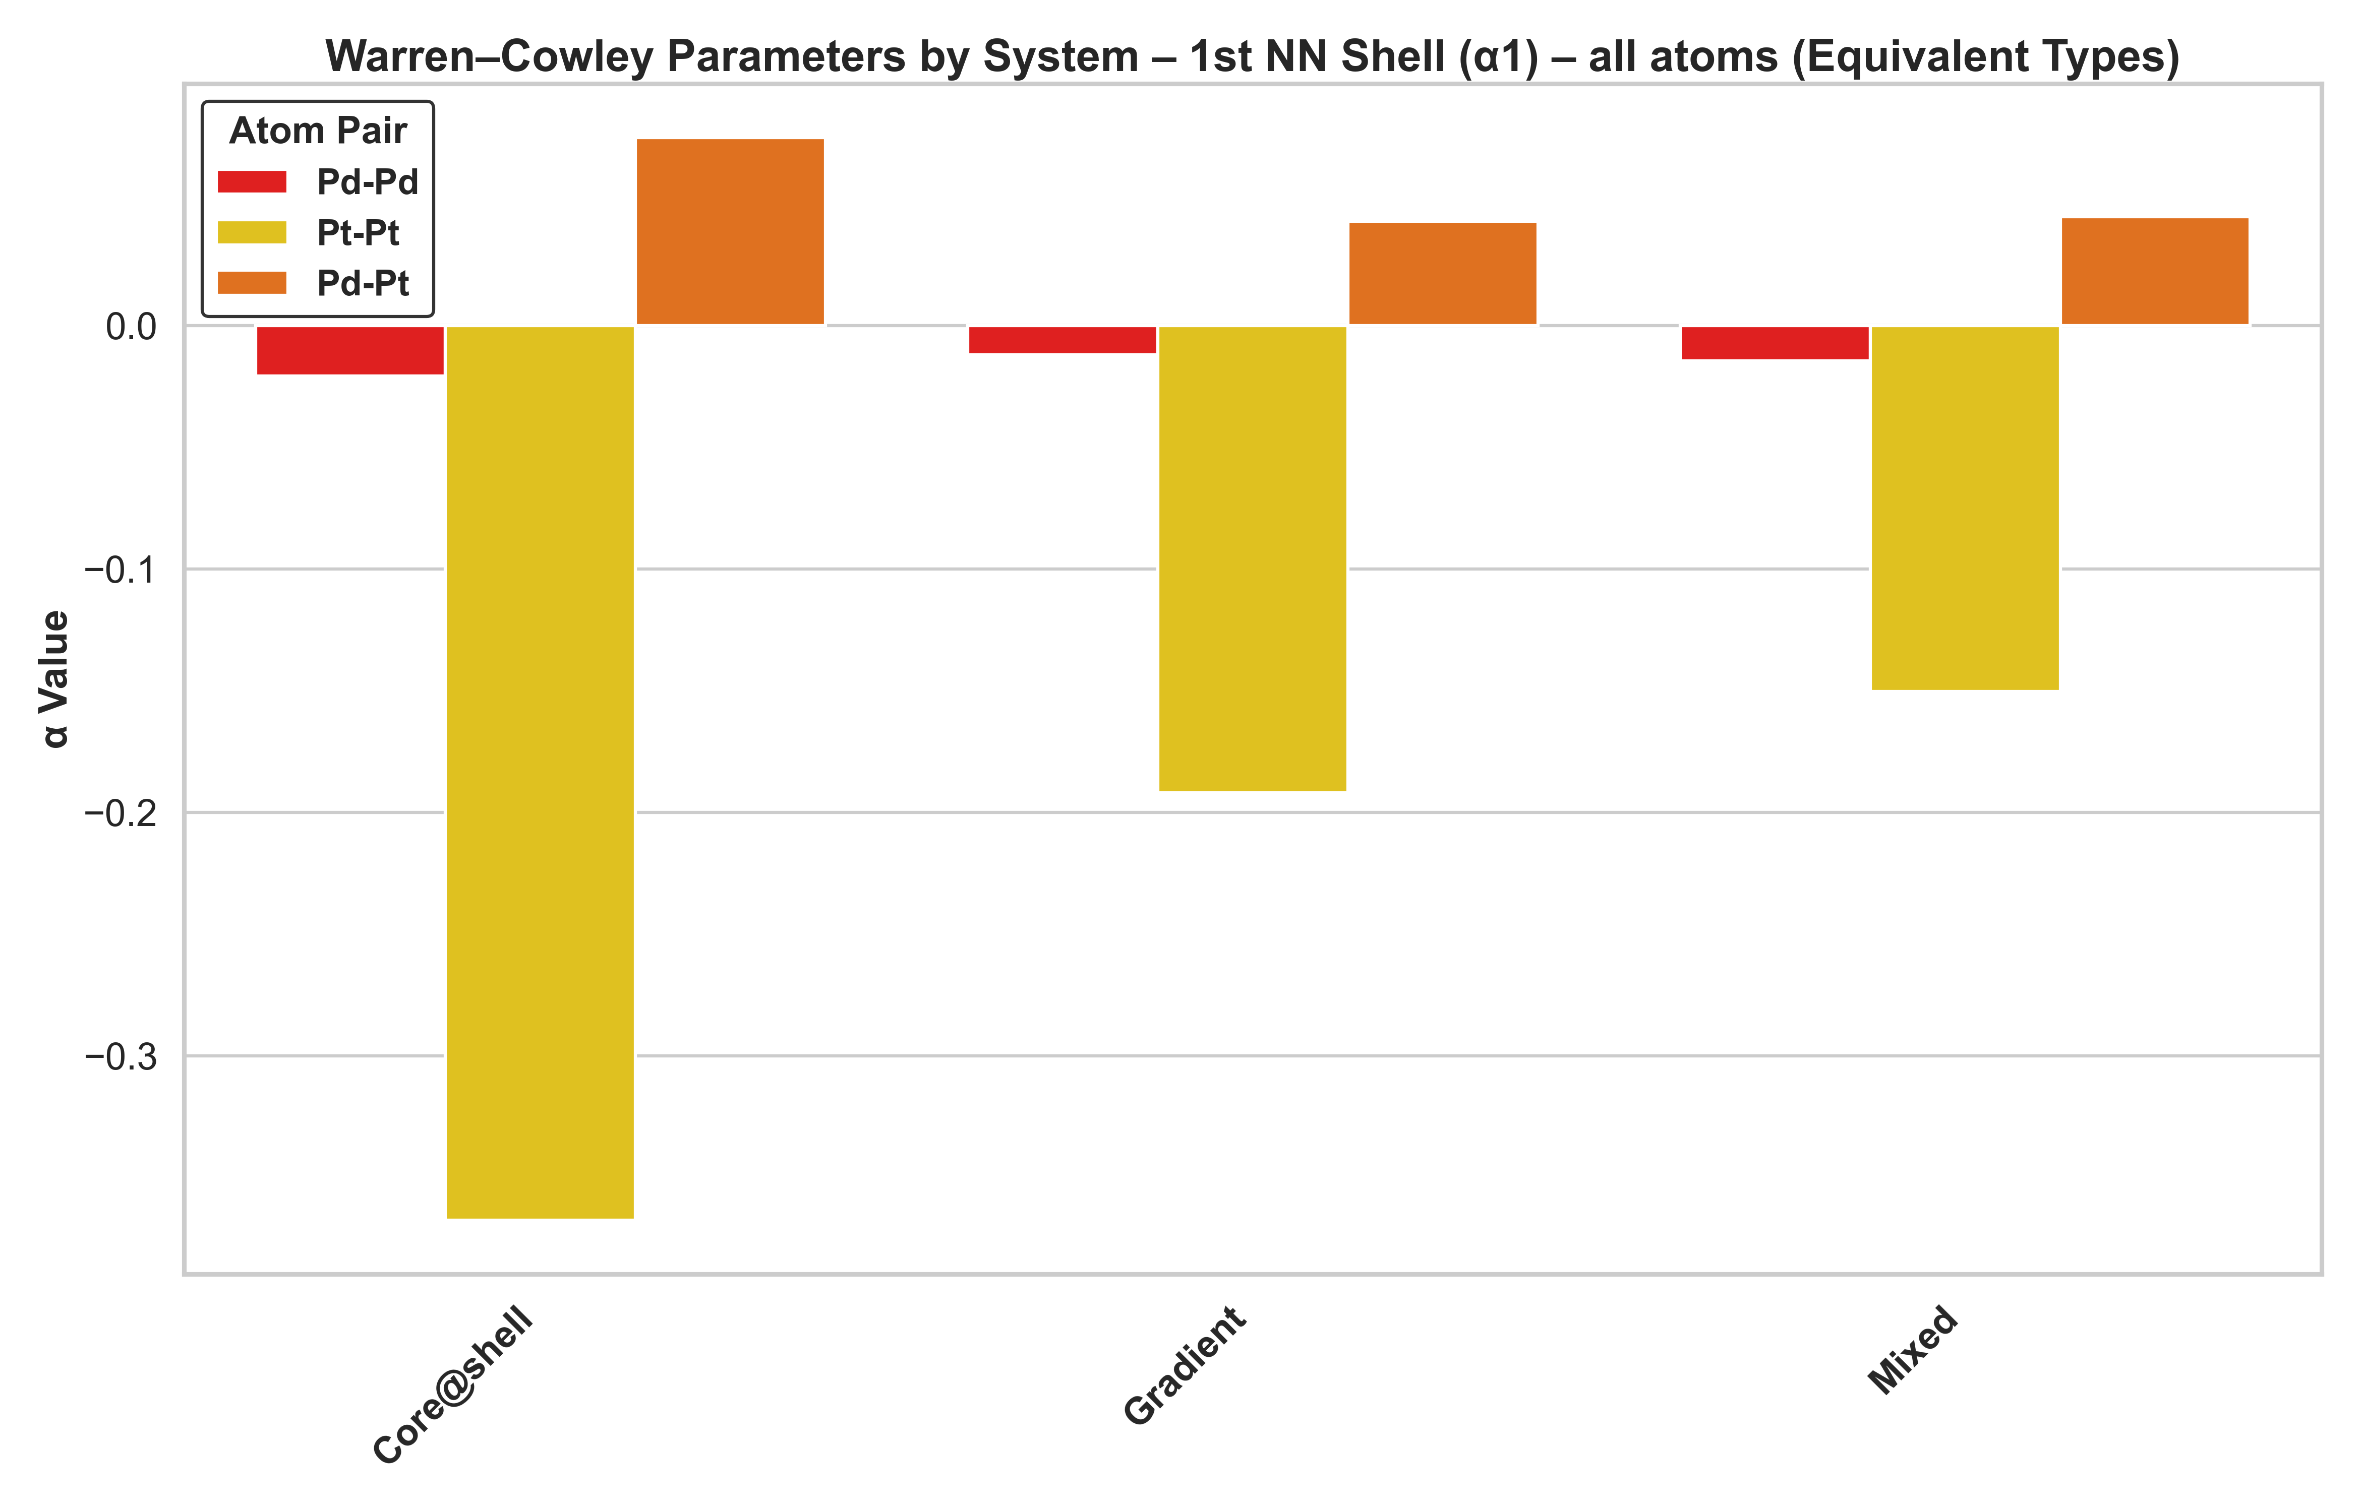
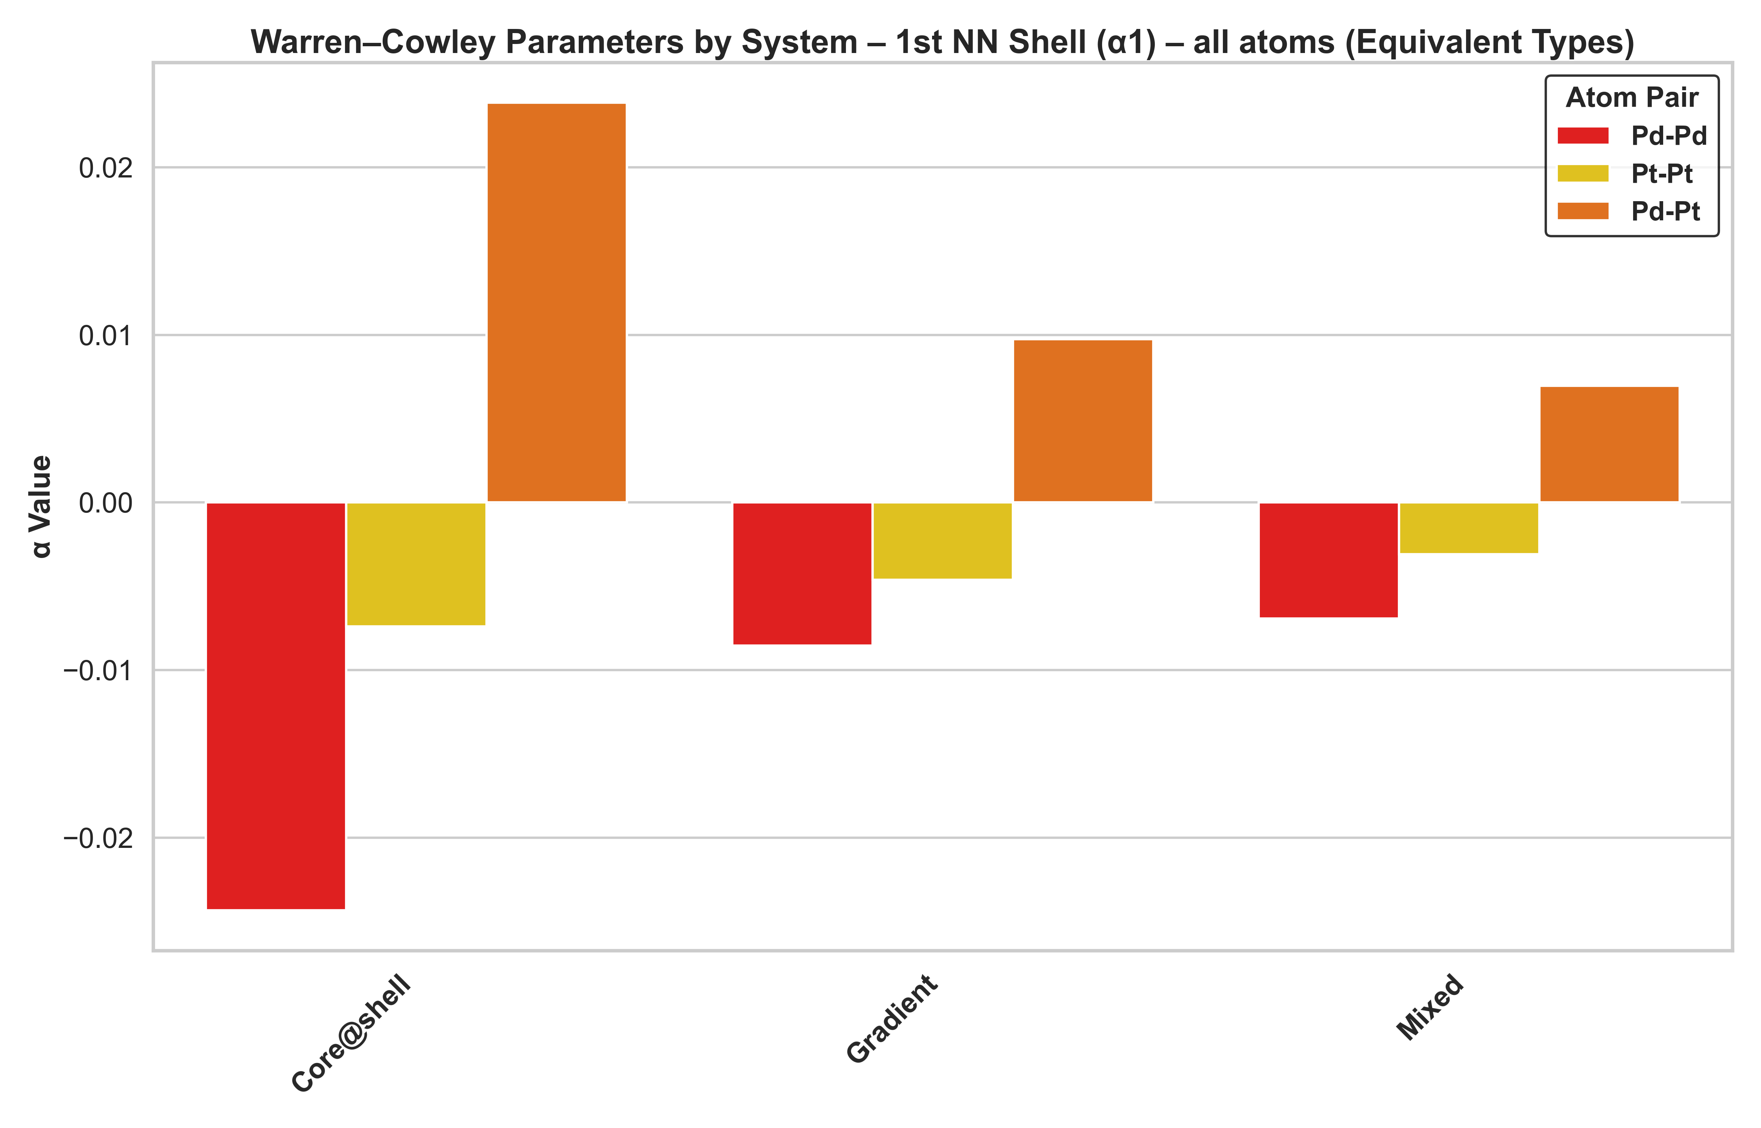
Increasing the complexity
PdPtRhRu & PdPtRhRuIr
PdPtRhRu
PdPtRhRuIr

Slide 20
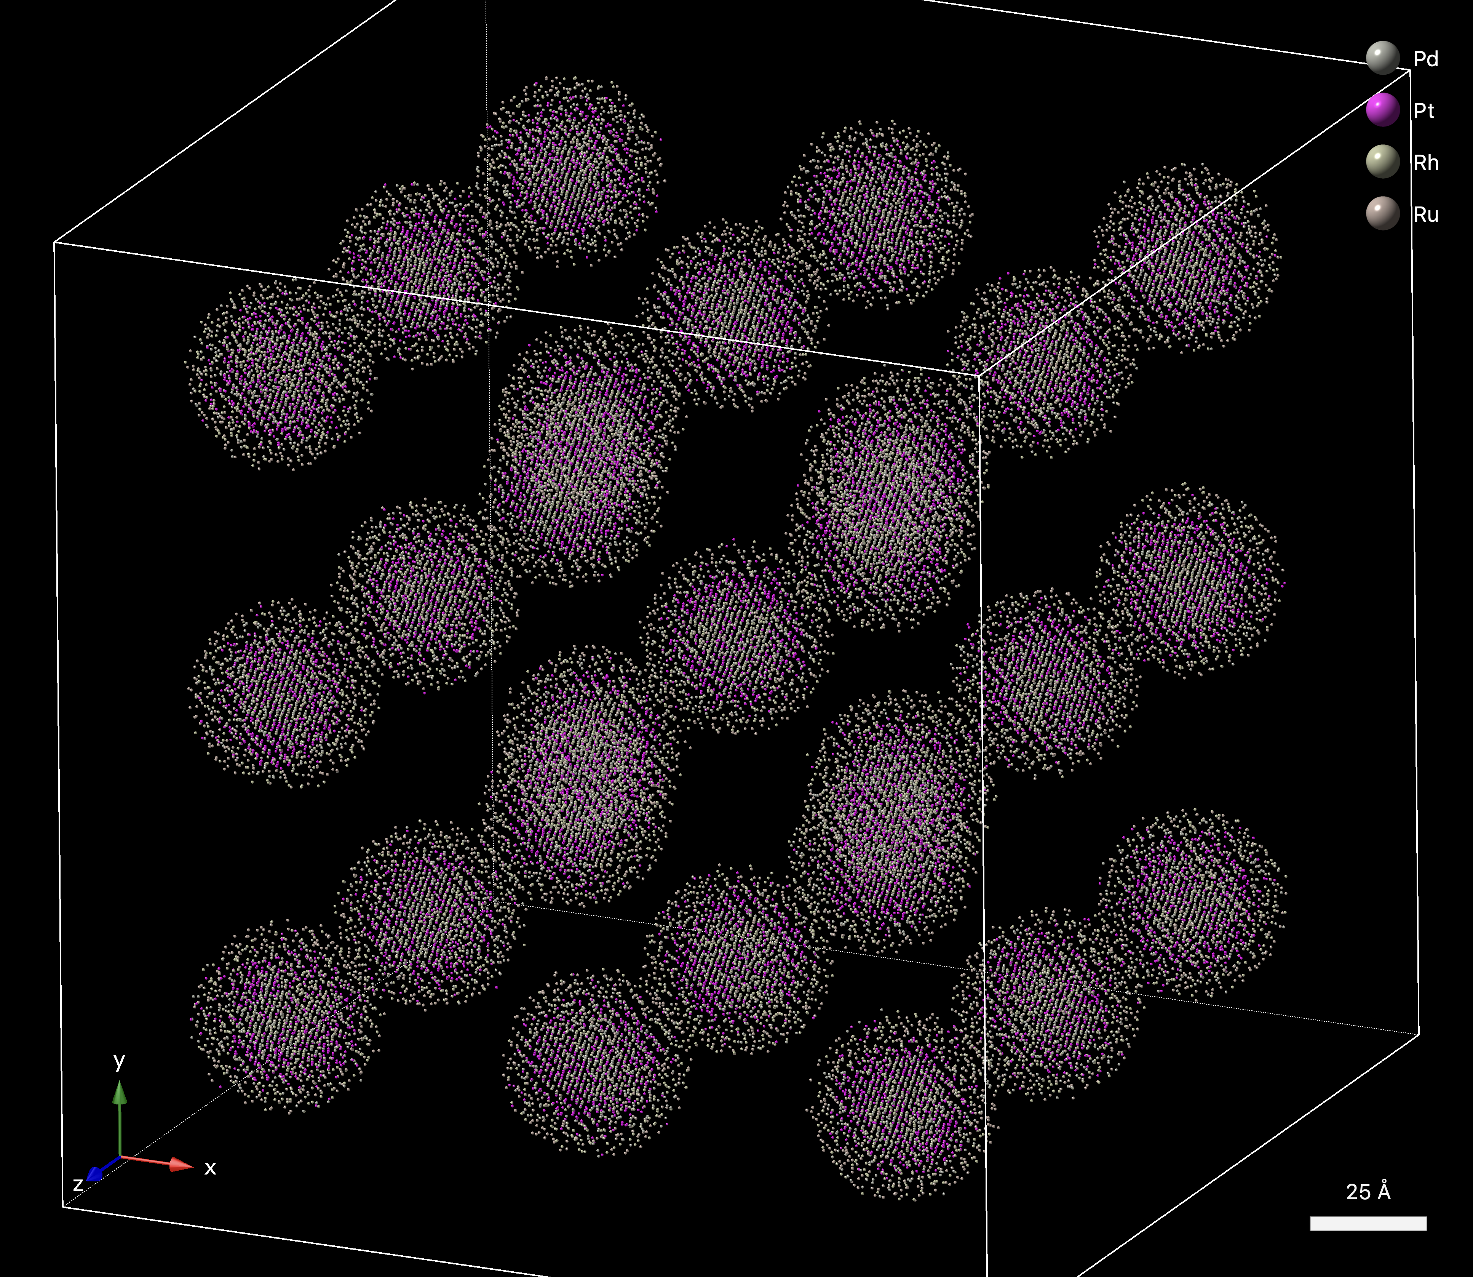
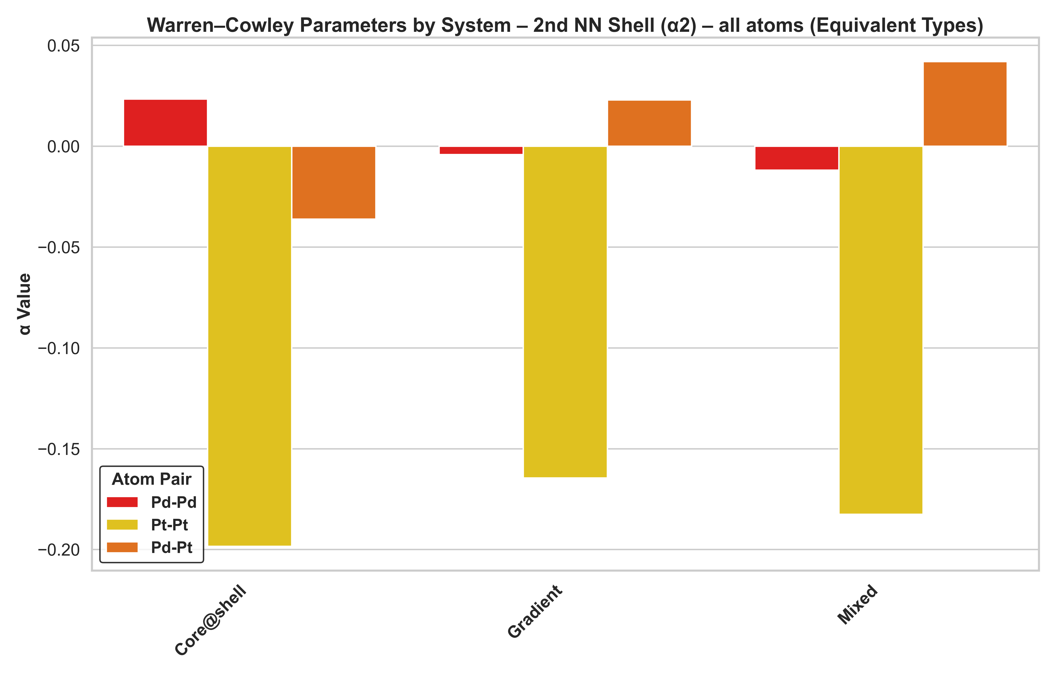
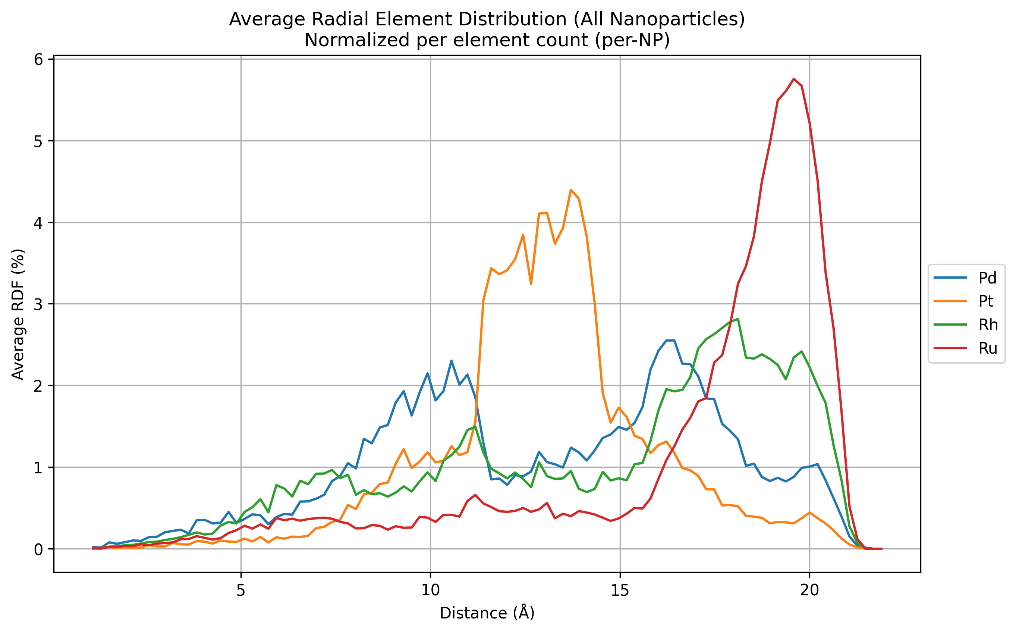
Increasing the complexity
PdPtRhRu

Slide 21
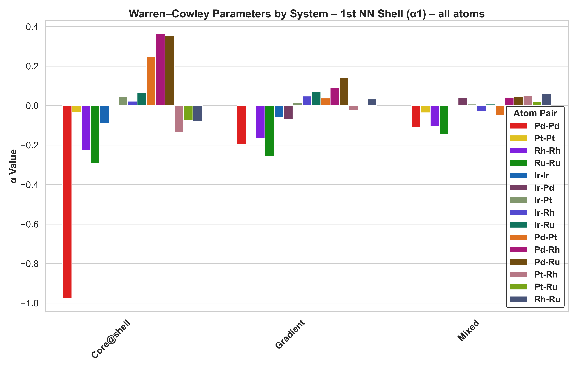
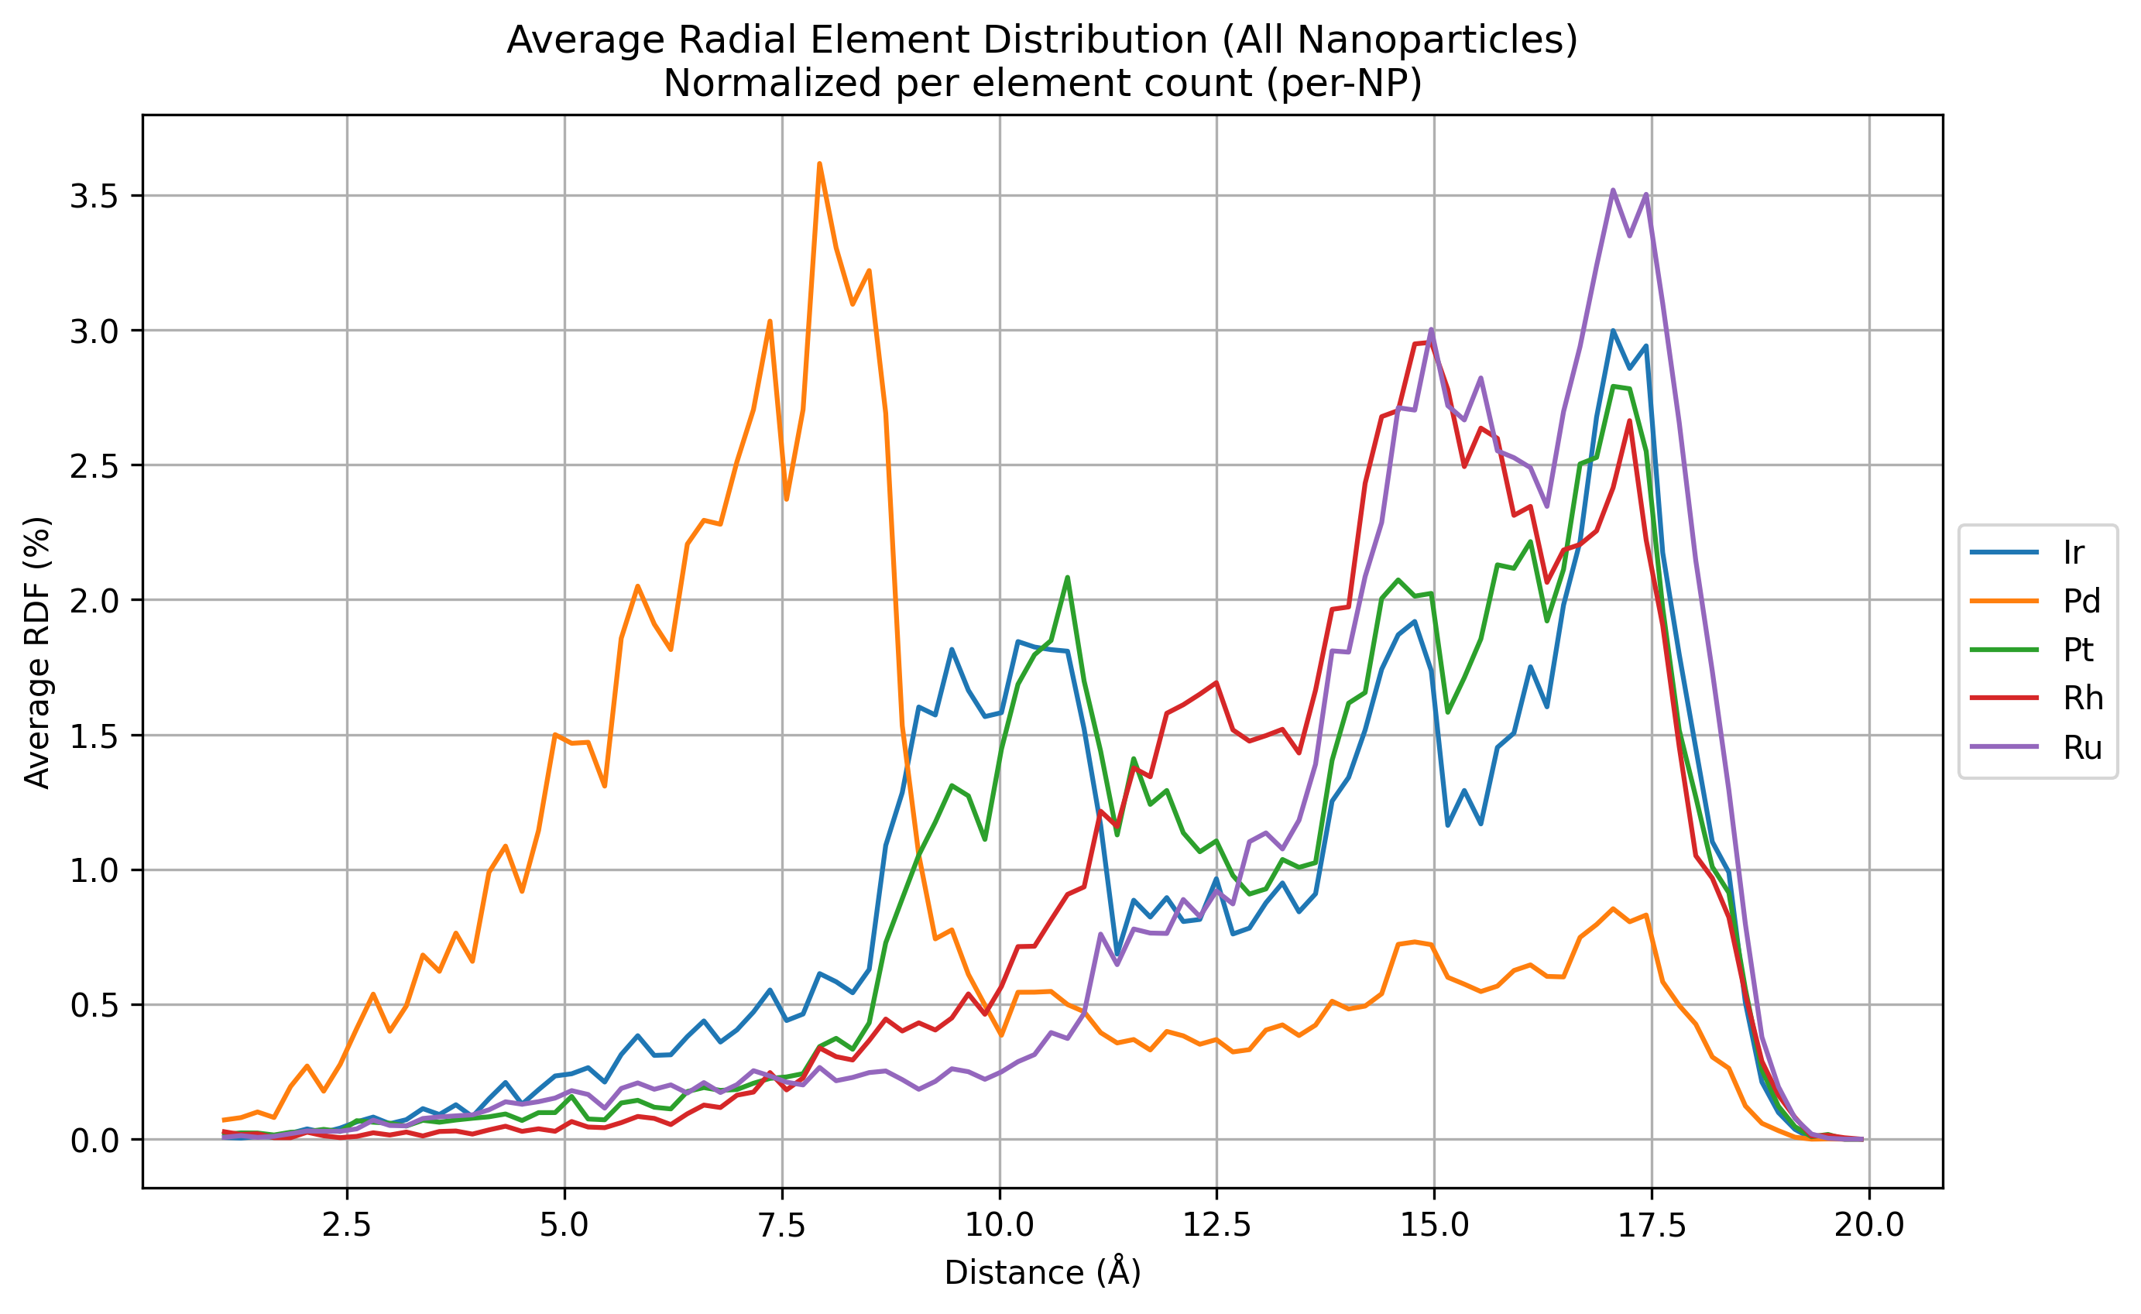
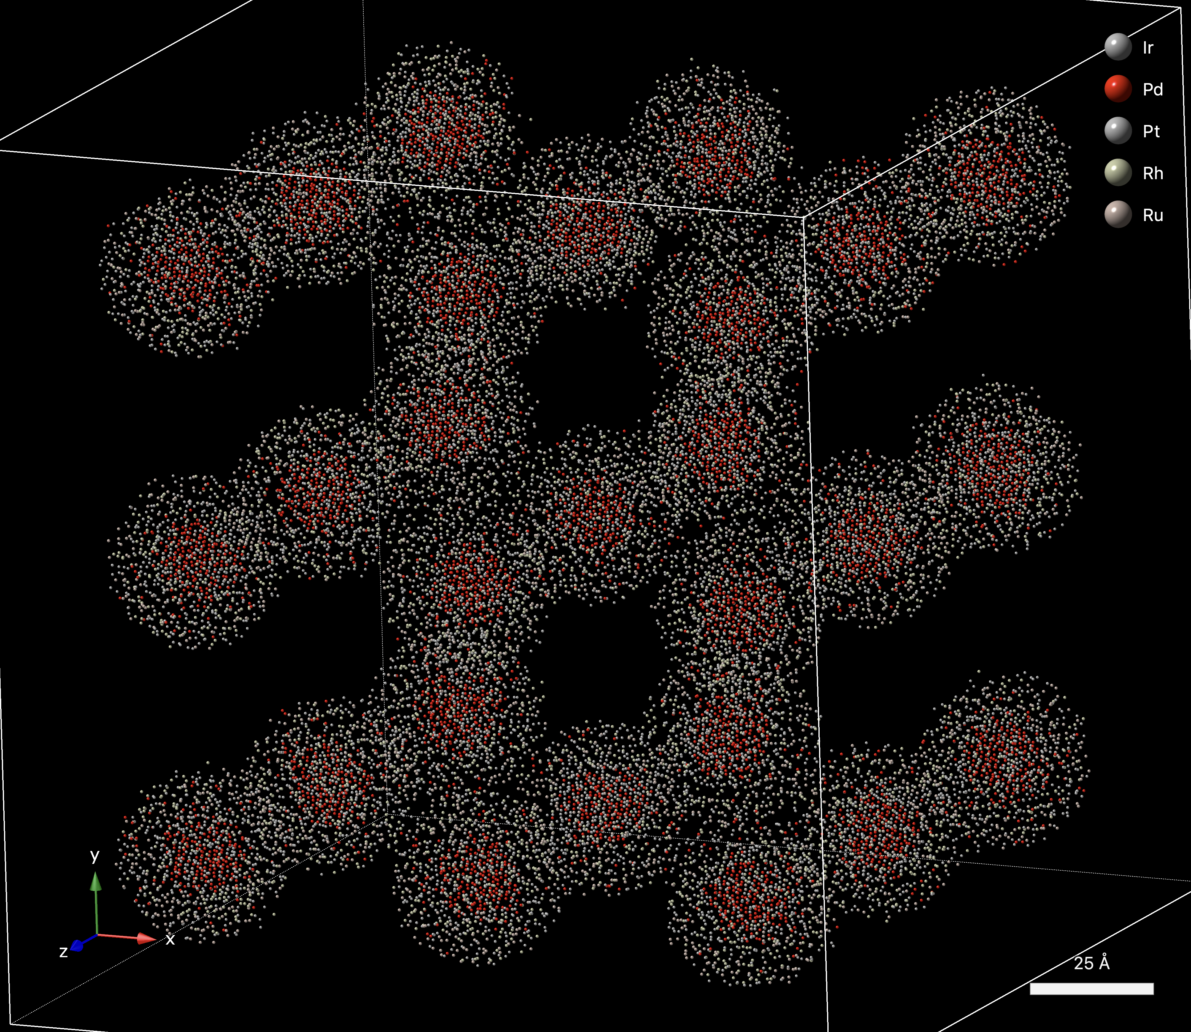
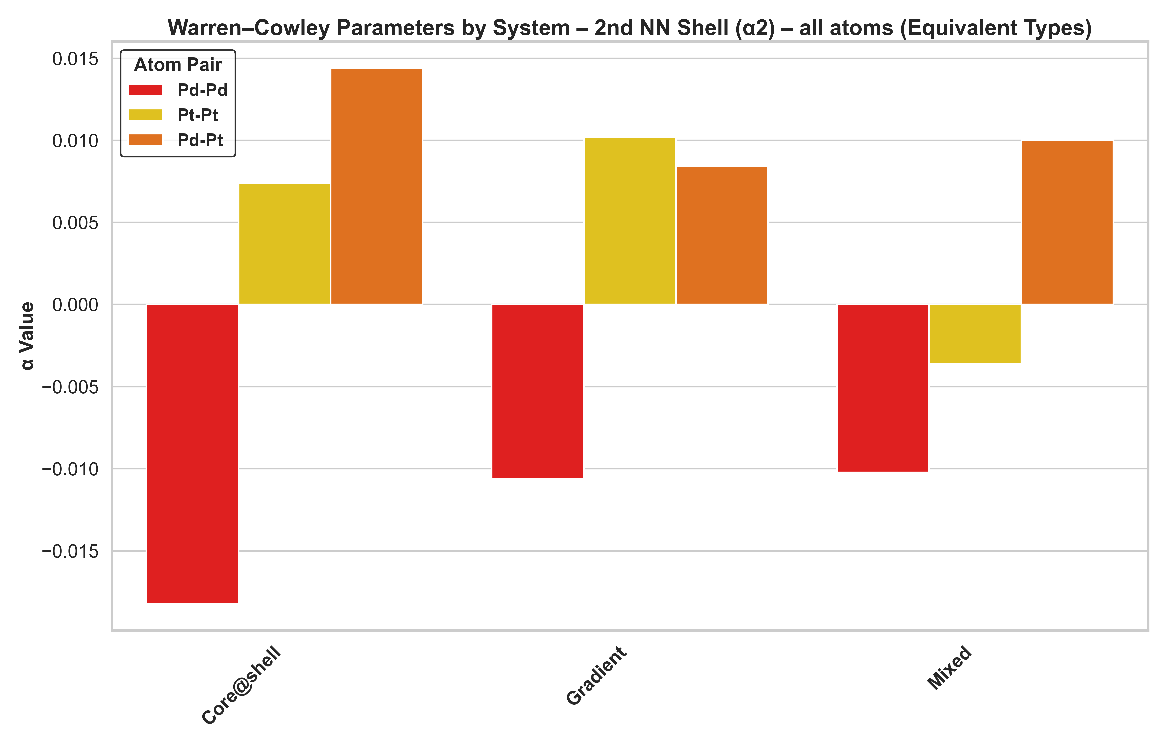
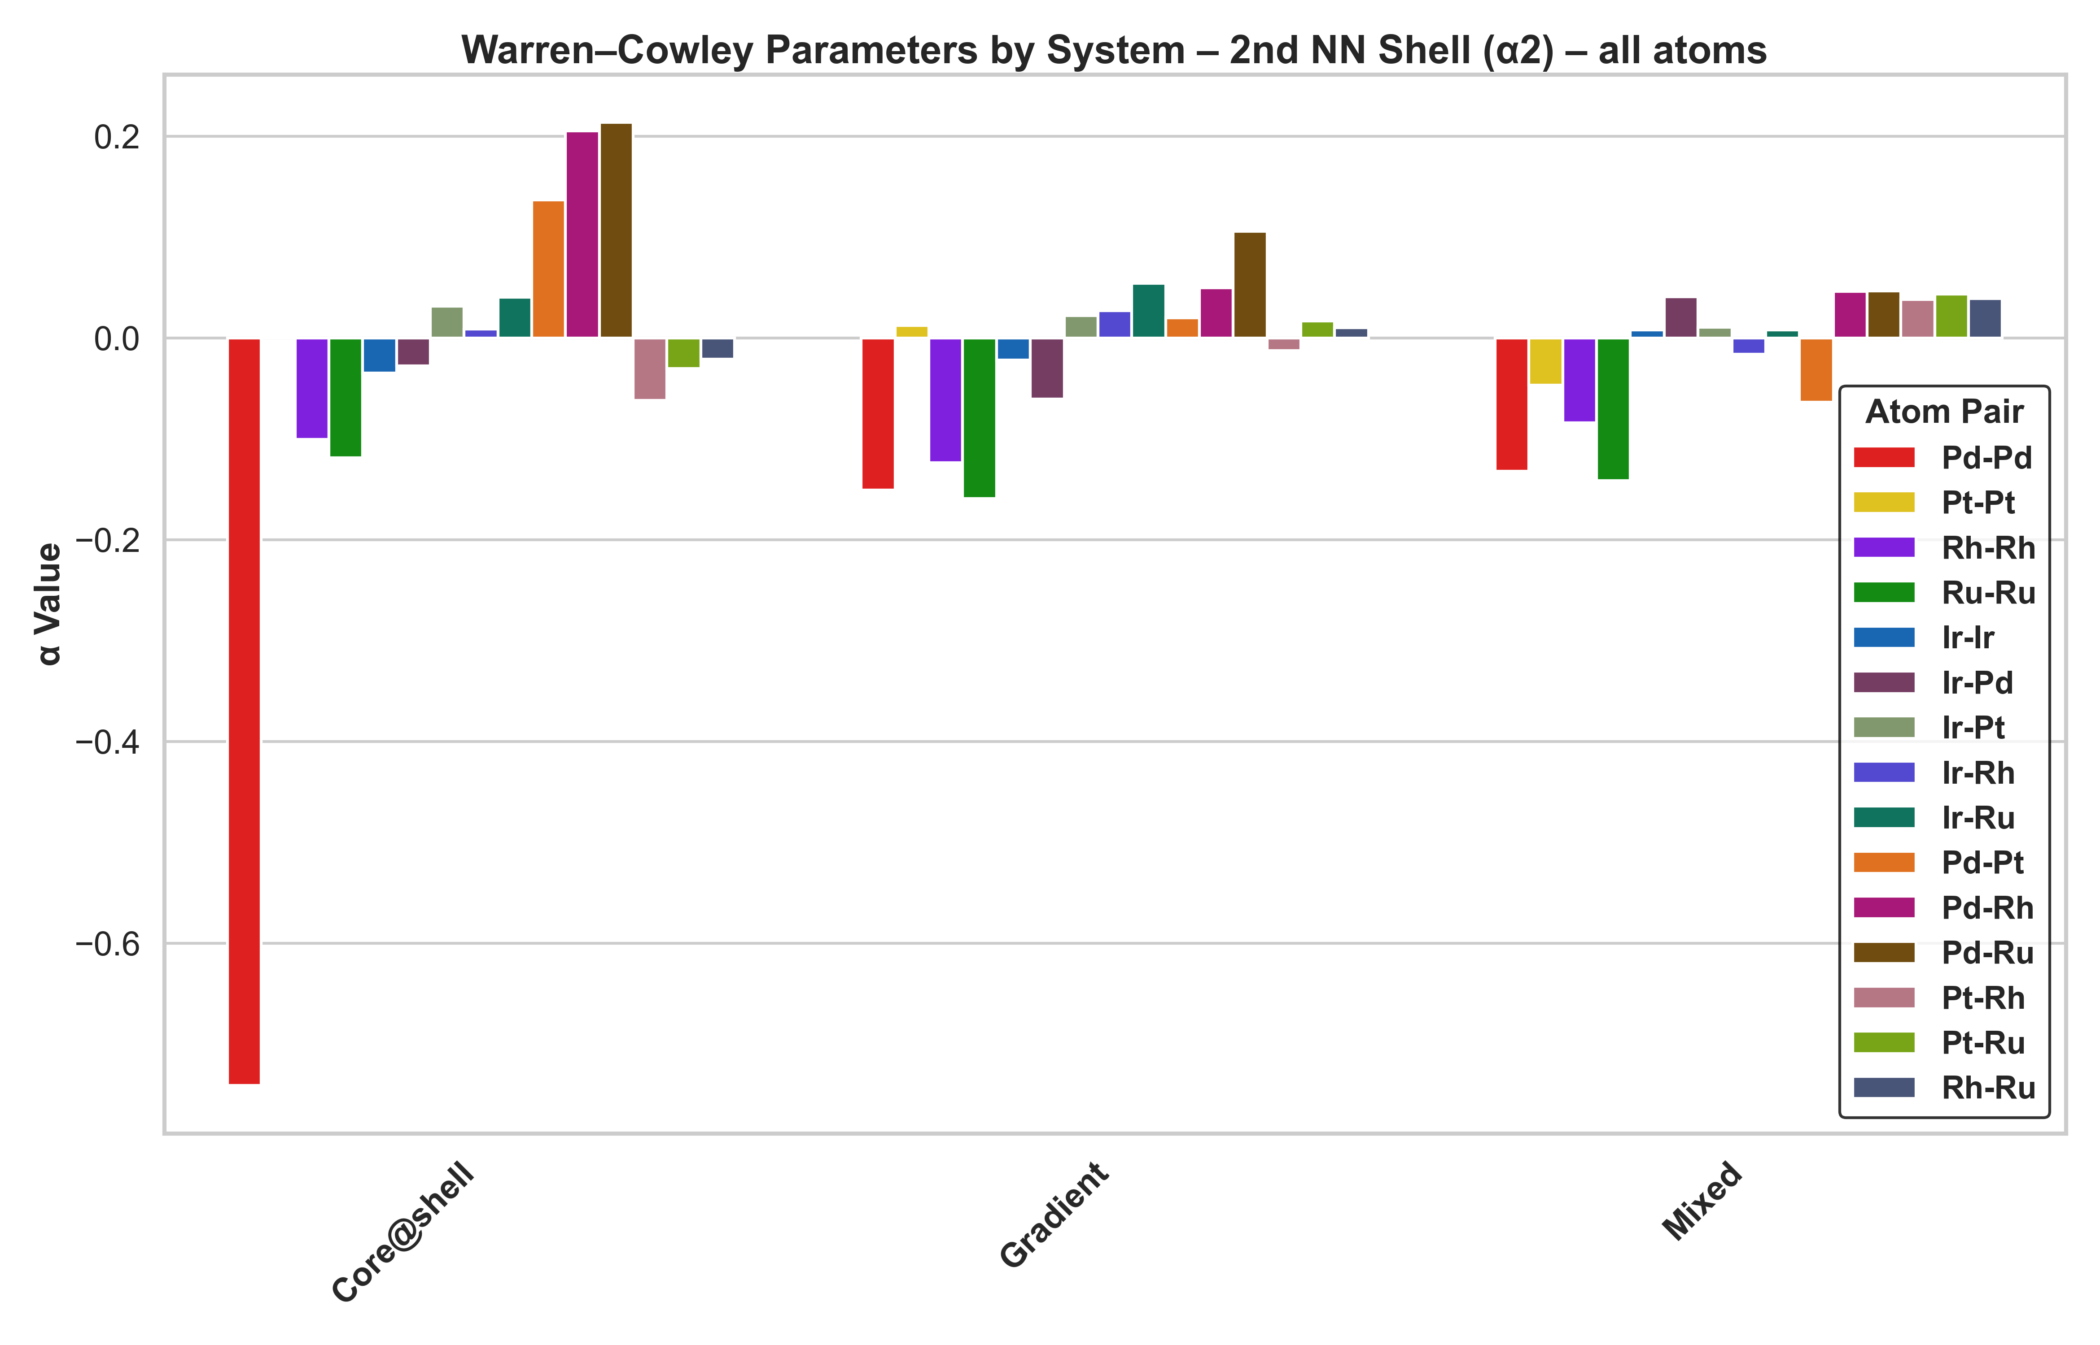
Increasing the complexity
PdPtRhRuIr

Slide 22
In summary
The challenges
The presented work
Subtle structural features affect properties
Chemical short-range order
Spatial compositional heterogeneities
Deviations from homogeneity affect comparability with theoretical predictions
RMC methodology able to identify chemical short-range order and potential core@shell-ish behaviour
Even for 3 nm sized nanoparticles
Effects eluding conventional techniques
Separation of atoms of similar Z difficult with X-rays

Slide 23








Thank you for listening!

Slide 24
Element | Neutron coherent scattering length (fm)
Ir | 10.6
Pd | 5.9
Pt | 9.6
Ru | 7.0
Rh | 5.9

