Slide 1
FASEM – Advanced School on Neutron & Synchrotron Techniques, driven by French–Swedish synergies
Biennial advanced school training the next generation of users of large-scale facilities (neutron & synchrotron), supporting European scientific sovereignty.
Strengthens French–Swedish collaboration with the support of the Ambassade de France en Suède, while engaging the wider European photon & neutron community.
Complements the HERCULES School with a short, thematic format and online access, reaching a broader international audience.
Fosters collaboration across academia, research infrastructures, and industry, including engagement with emerging scientific communities.
Notes:
FASEM – Advanced School on Neutron & Synchrotron Techniques, driven by French–Swedish synergies
Biennial advanced school welcoming 30 in-person PhD students and open online participation, training the next generation of users of large-scale facilities and supporting European scientific sovereignty.
Strengthens French–Swedish scientific collaboration in partnership with the Ambassade de France en Suède, while supporting the broader European neutron and photon research communities.
Complements the HERCULES School with a short, thematic format that includes online access, making advanced training accessible to a wider international audience.
Fosters scientific exchange and collaboration, including engagement with emerging and developing scientific communities.
Connects academia, research infrastructures, and industry, promoting knowledge transfer and new collaborative opportunities.

Slide 2

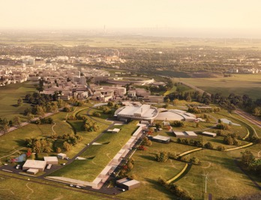
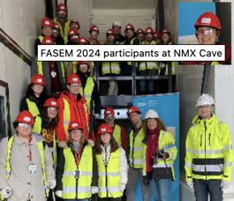
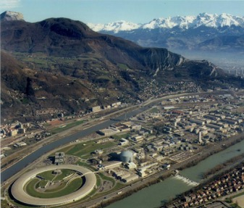
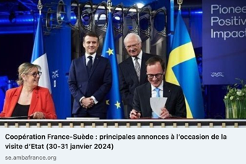
FASEM - Advanced school !
French-Swedish Academy for Scattering Experiments and Modeling
    June 2019: Materials & Environment (see Indico)
    January 2024: Life Science
MAXIV
ESS
ESRF
ILL
Evolution since 2019
From experiments to data analysis
Hybrid format enabling wider participation
Broader ecosystem: academia, research infrastructures & industry
    March 16 to 20, 2026 @ ILL (FR): Energy Applications / Energy Materials
Notes:
Les trois grandes thématiques d’applications seraient (avec une année un focus sur une thématique) :
Sciences de la vie (biologie, biophysique, pharmacologie, etc.)
Environnement (nouveaux matériaux, infrastructures, textiles, pollution et dépollution de l’eau etc.)
Energies renouvelables et décarbonées (dont le nouveau nucléaire)

Slide 3
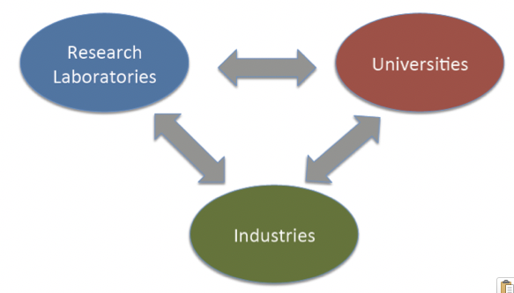
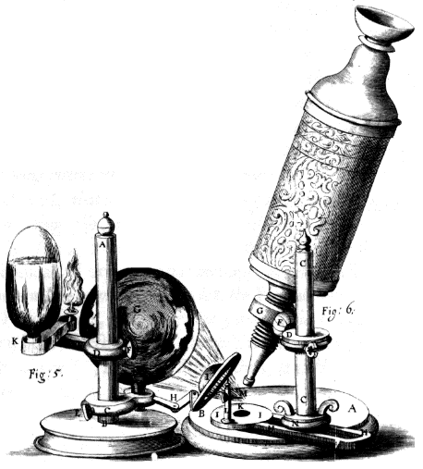
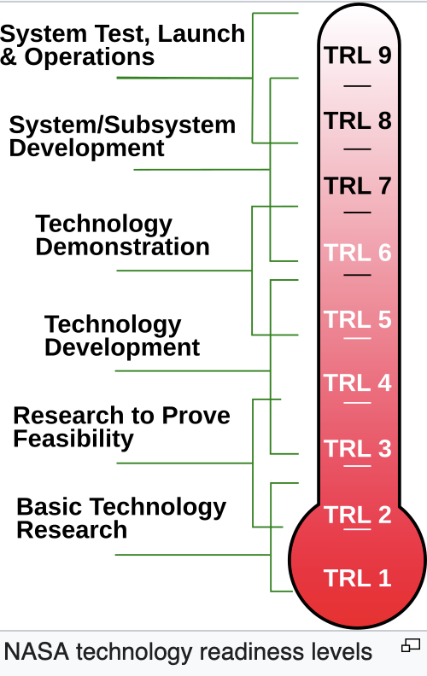
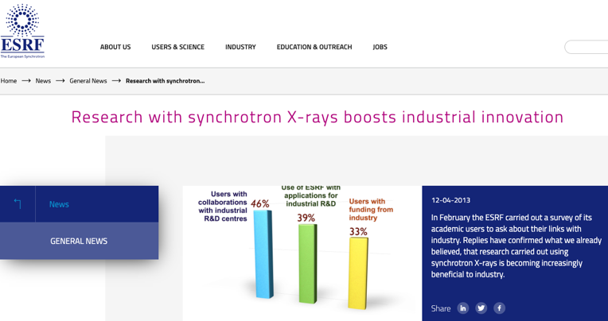
Triangle of knowledge
INDUSTRIAL
economy
INFORMATION
economy
MOLECULAR (NBIC)
economy
Organization
(society)
The Adaptive
Enterprise
Nanotechnology
Biotechnology
Information technology
Cognitive science
Materials
New media
IT services
Portals
Business
(maturity)
Economic value added
Chips
Operating systems
WWW
Technology
(growth)
Solid state physics
Information theory
Science
(gestation)
1750s
1850s
1950s
2050s
Year
It's Alive - The Coming Convergence of Information, Biology, and Business Christopher Meyer 2003
Notes:
Research Infrastructure (RI) and industries, supported by the enlightened organizations and education, can generate a sustainable environment to serve this purpose
Engineering – solution drive – how Science why
Paradigm -"pattern, example, sample"^{[1]}from the verb -exhibit, represent, expose"^{[2]} and that from παρά (para), "beside, beyond"^{[3]} and -"to show, to point out".^{[4]}
In rhetoric, the purpose of paradeigma is to provide an audience with an illustration of similar occurrences. This illustration is not meant to take the audience to a conclusion, however it is used to help guide them there.
WW2; DNA discovery, sputnik launch; transistor invention, IC invention, desktop computer
→ Knowledge based economy
Courbes des developments des paradigmes / exemple / modele / courant technologique
Utilisant l’innovation et les developments scientifiques comme programmes/support/fondations
Releve le defi ! De la competivite europeenne afin de gerer de nouveaux emplois
Revolution technologique – industrielle – boulversement technologique
Information economy: data-driven society – societe dirigee par de large quantite de donnee
Provide foundation in new areas – apporte / fournisse les fondations
Use platfom to base the technology, dvp, INNOvation
Ex:
Nano bio information and cognitive → material research ..
Take the challenge now – european competiveness -- > new job

Slide 4
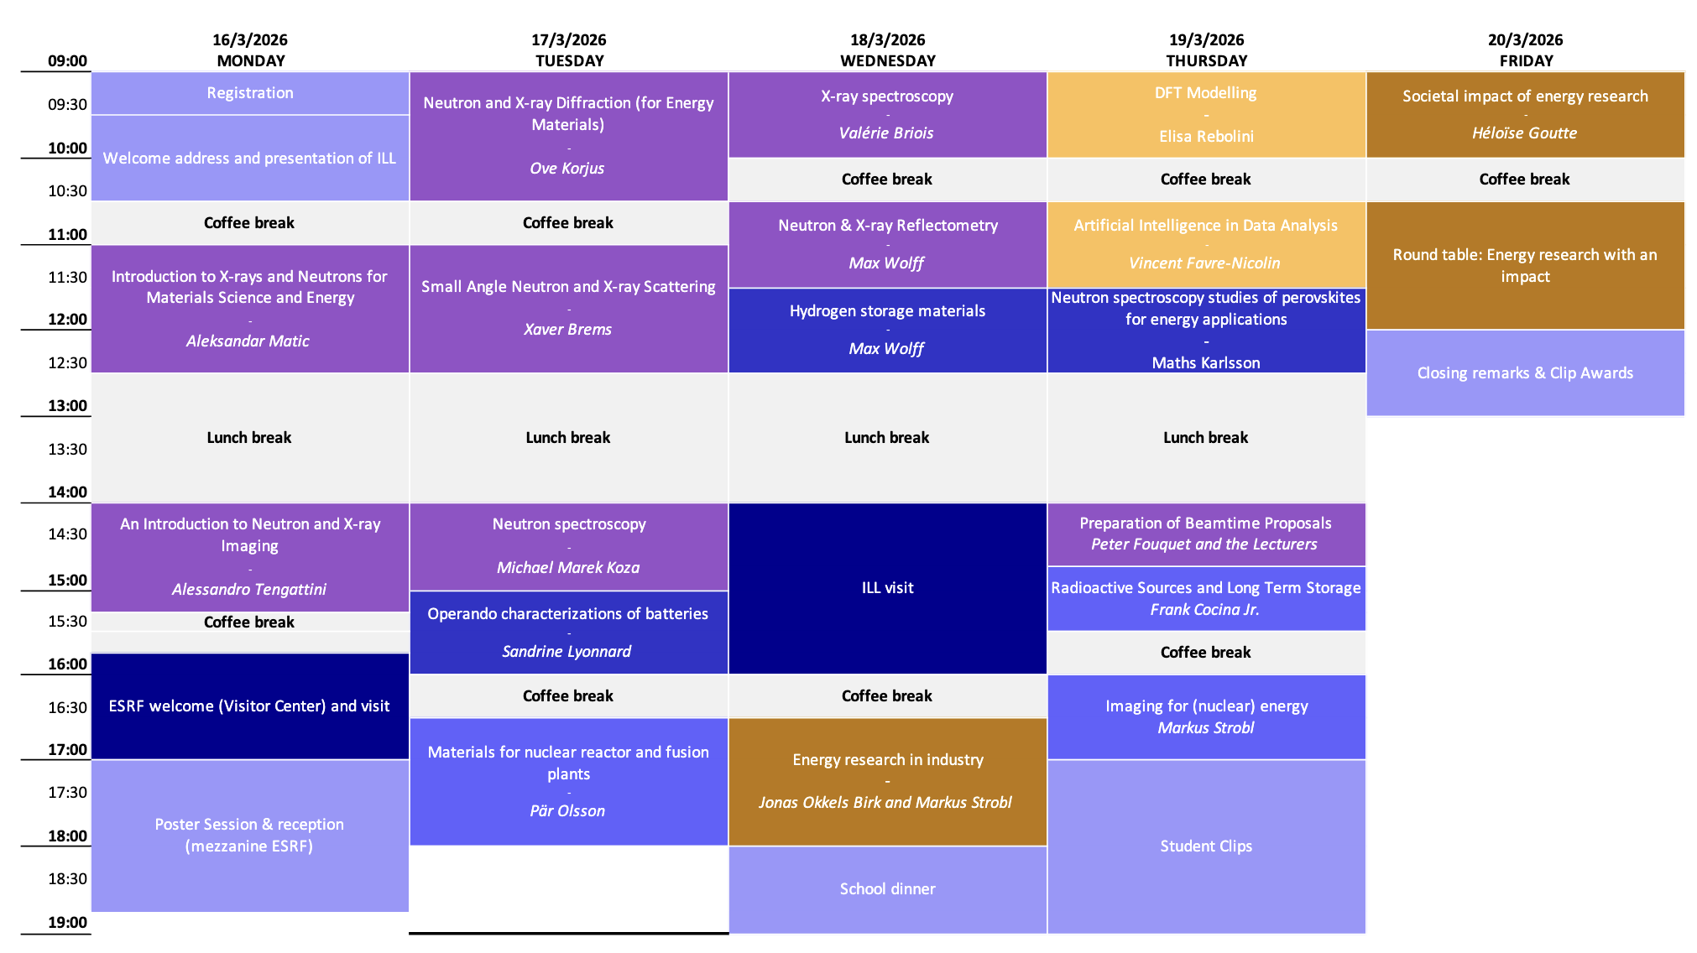

Agenda – FASEM2026

