Slide 1

Closing remarks & Poster & Clip Awards

Slide 2
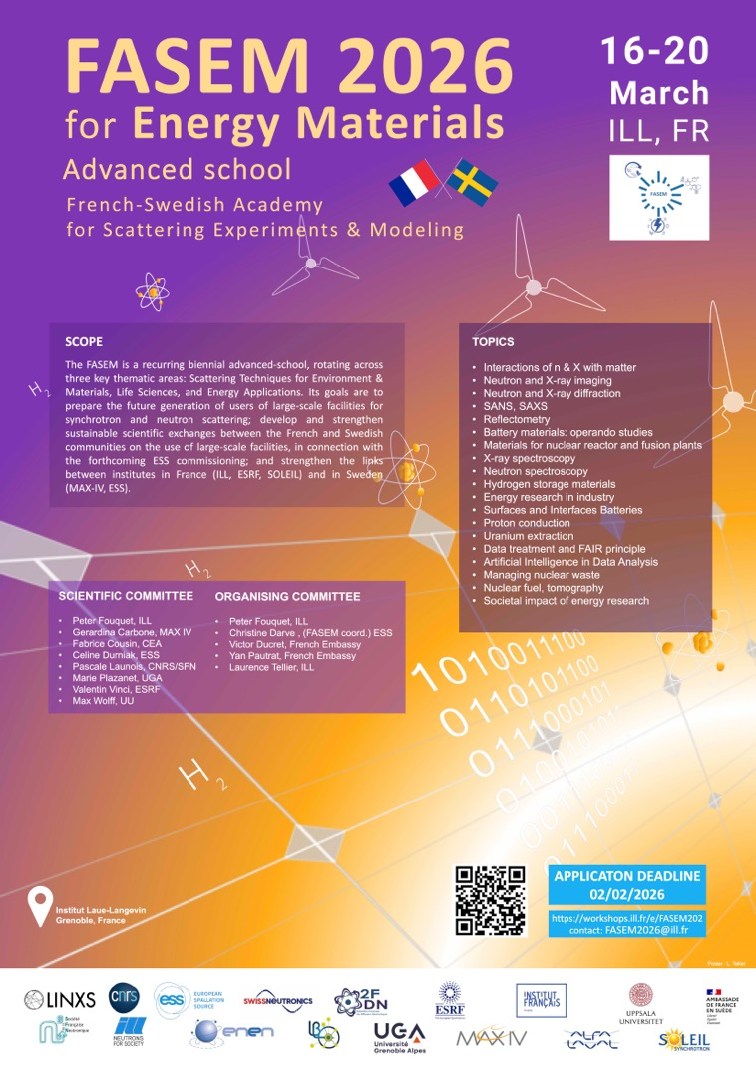
FASEM – Advanced School on Neutron & Synchrotron Techniques, driven by French–Swedish synergies
Biennial advanced school training the next generation of users of large-scale facilities (neutron & synchrotron), supporting European scientific sovereignty.
Strengthens French–Swedish collaboration with the support of the Ambassade de France en Suède, while engaging the wider European photon & neutron community.
Complements the well-established (35!) HERCULES School with a short, thematic format and online access, reaching a broader international audience.
Fosters collaboration across academia, research infrastructures, and industry, including engagement with emerging scientific communities.
Notes:
FASEM – Advanced School on Neutron & Synchrotron Techniques, driven by French–Swedish synergies
Biennial advanced school welcoming 30 in-person PhD students and open online participation, training the next generation of users of large-scale facilities and supporting European scientific sovereignty.
Strengthens French–Swedish scientific collaboration in partnership with the Ambassade de France en Suède, while supporting the broader European neutron and photon research communities.
Complements the HERCULES School with a short, thematic format that includes online access, making advanced training accessible to a wider international audience.
Fosters scientific exchange and collaboration, including engagement with emerging and developing scientific communities.
Connects academia, research infrastructures, and industry, promoting knowledge transfer and new collaborative opportunities.

Slide 3
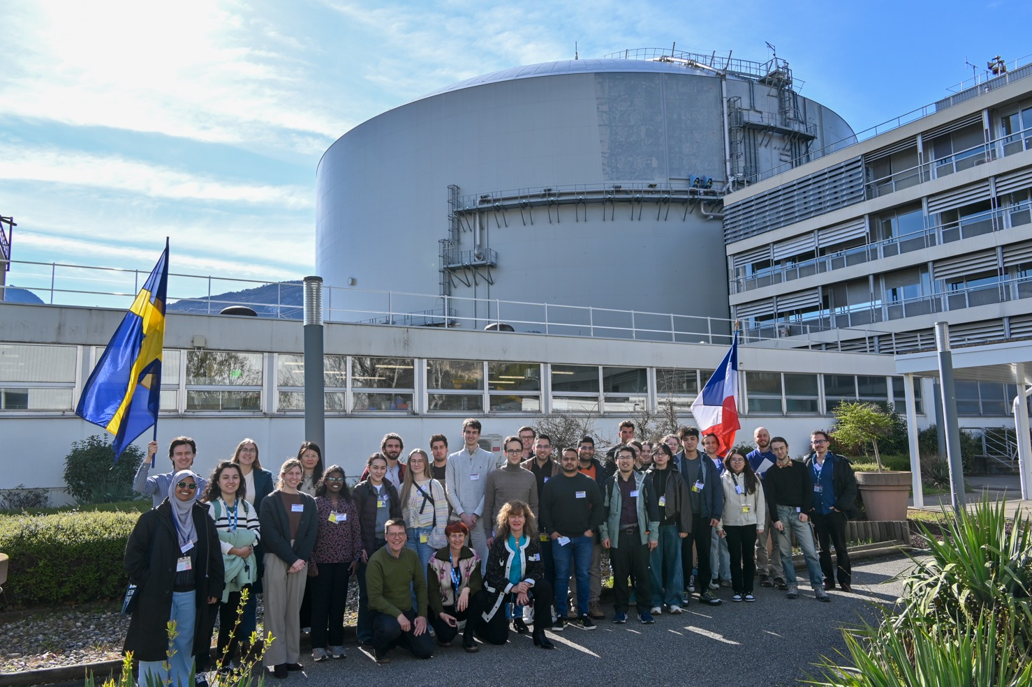

Slide 4

FASEM – Advanced School on Neutron & Synchrotron Techniques, driven by French–Swedish synergies
Topics
Neutron and X-ray Techniques
Battery and Hydrogen Materials
Nuclear Materials and Fuel Cycle
Simulations and AI in Energy Research
Industrial Applications and Societal Impact
20 Professors
152 Candidates registered by February 2, 2026
30 selected in-persons
9 countries: Allemagne, Australie, Danemark, Espagne, France, Italie, Royaume-Uni, Suède, Suisse
22 institutes
Many participants on-line from more than 37 Countries thanks to Open-Access !
Notes:
Biennial advanced school welcoming 30 in-person PhD students and open online participation, training the next generation of users of large-scale facilities and supporting European scientific sovereignty.
Strengthens French–Swedish scientific collaboration in partnership with the Ambassade de France en Suède, while supporting the broader European neutron and photon research communities.
Complements the HERCULES School with a short, thematic format that includes online access, making advanced training accessible to a wider international audience.
Fosters scientific exchange and collaboration, including engagement with emerging and developing scientific communities.
Connects academia, research infrastructures, and industry, promoting knowledge transfer and new collaborative opportunities.

Slide 5
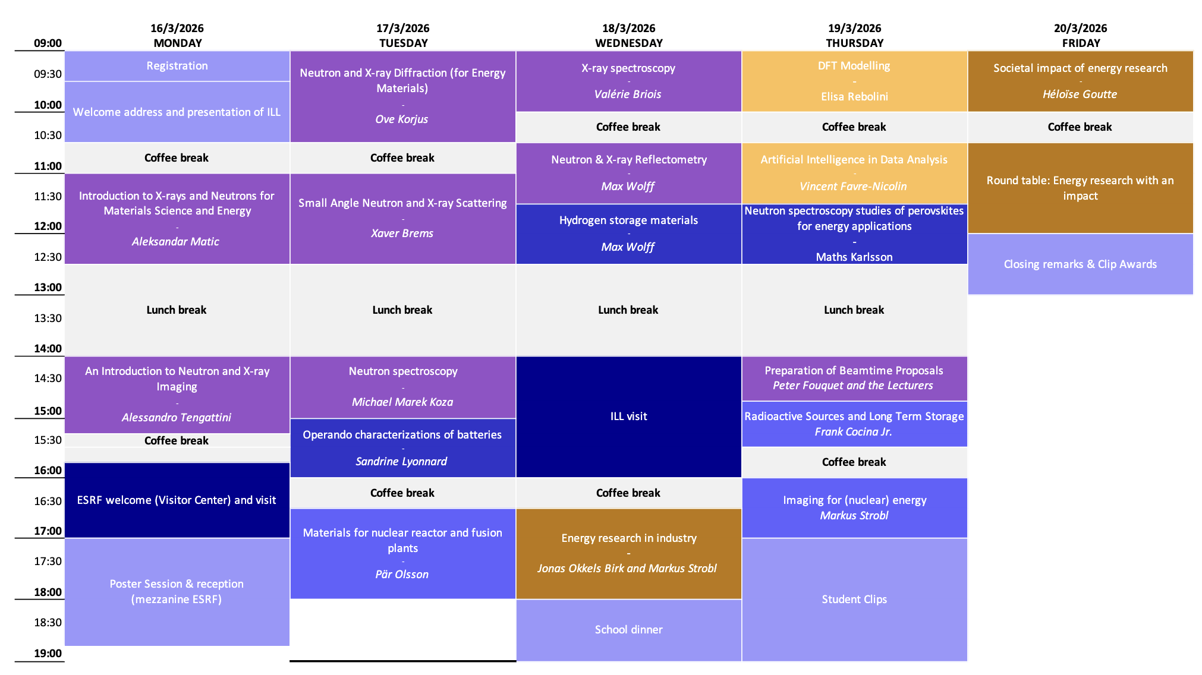

Agenda

Slide 6

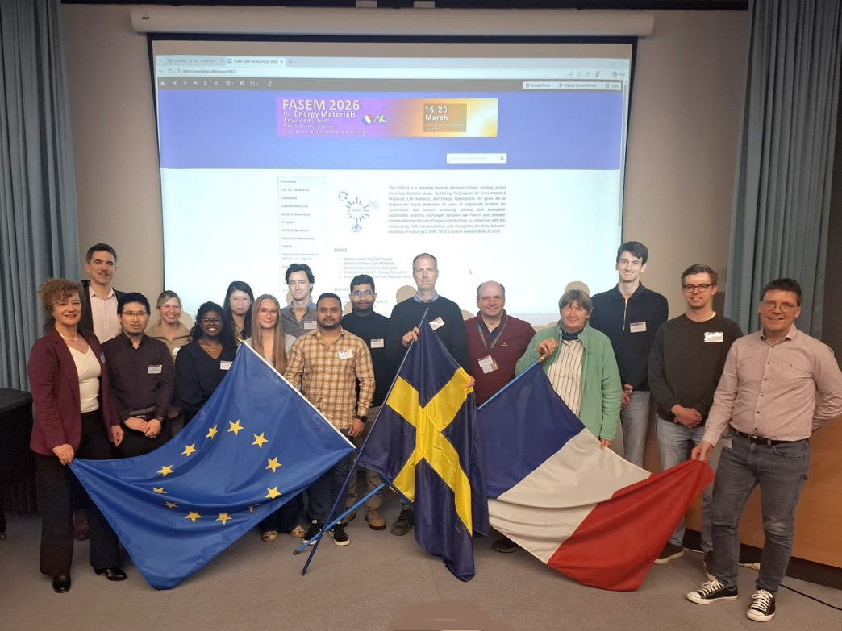

Sponsoring
Special thanks to :
Andreas | Erlandsson
Anjali | Vijayan
Erika | Magnusson
Hugo | Mårtensson
huifang | Yang
Jugo | Okabe
Juliana | Avtarovski
Marcus | Liljenberg
Pardeep Kumar | Tanwar
Sagar | Jathar
“Swedish” students sponsored:

Slide 7

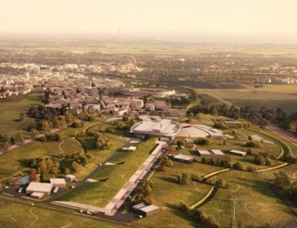
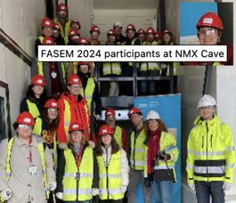
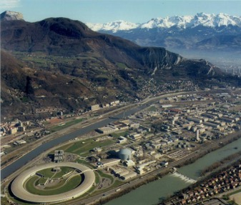
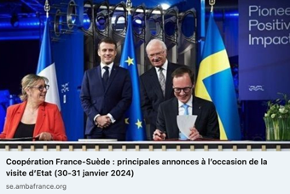
FASEM-Advanced school !
French-Swedish Academy for Scattering Experiments and Modeling
June 2019: Materials & Environment (see Indico)
March 2024: Life Science
MAXIV
ESS
ESRF
ILL
Evolution since 2019
From experiments to data analysis
Hybrid format enabling wider participation
Broader ecosystem: academia, research infrastructures & industry
March 16 to 20, 2026 @ ILL (FR): Energy Applications / Energy Materials
Notes:
Biennial advanced school training the next generation of users of large-scale facilities (neutron & synchrotron), supporting European scientific sovereignty.
Strengthens French–Swedish collaboration with the support of the Ambassade de France en Suède, while engaging the wider European photon & neutron community.
Complements the well-established (35!) HERCULES School with a short, thematic format and online access, reaching a broader international audience.
Fosters collaboration across academia, research infrastructures, and industry, including engagement with emerging scientific communities.

Slide 8
Poster & Clip Awards

Slide 9
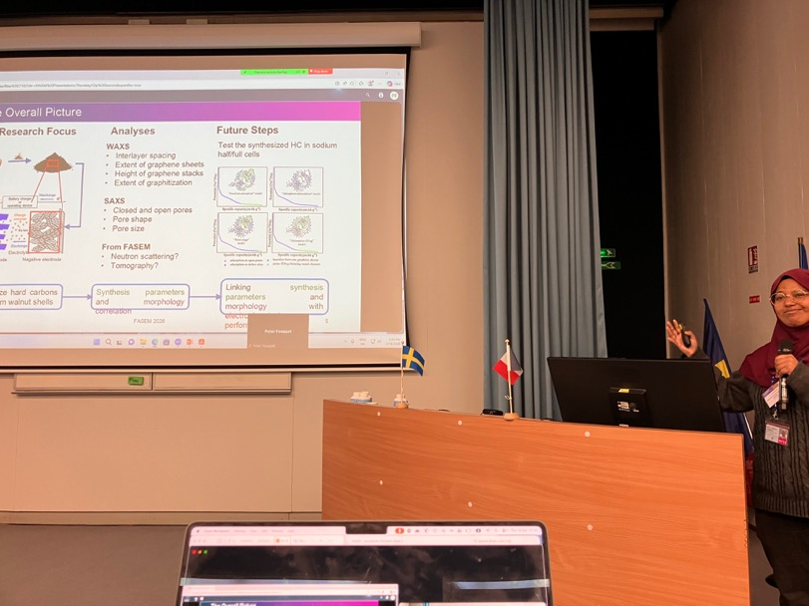
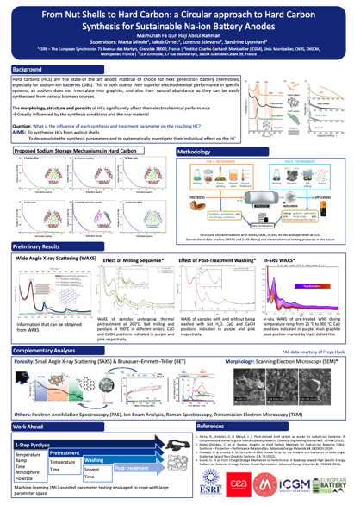
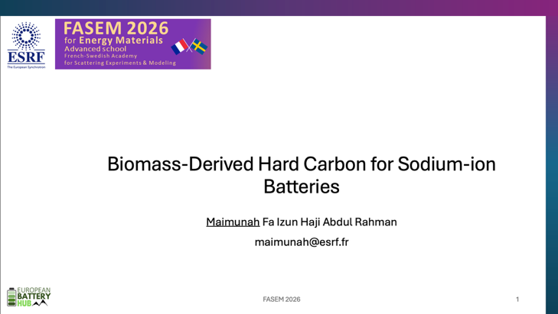
Best Poster & Clips
1st Prize :
Maimunah Fa Izun Haji Abdul Rahman

Slide 10
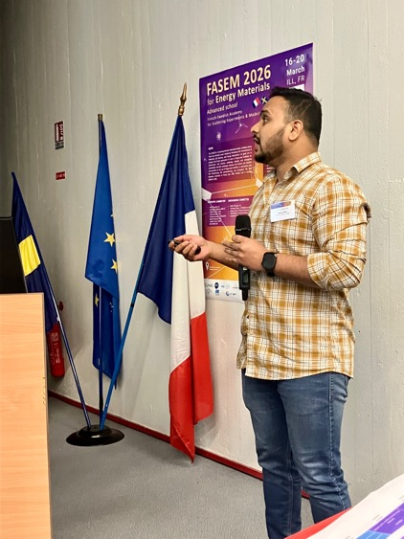
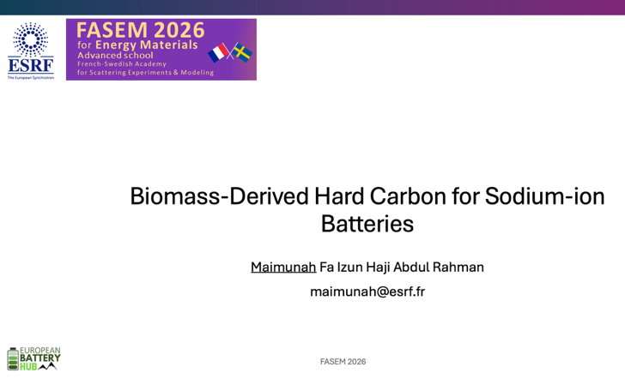
Best Poster & Clips
2nd Prize :
Sagar Jathar

Slide 11
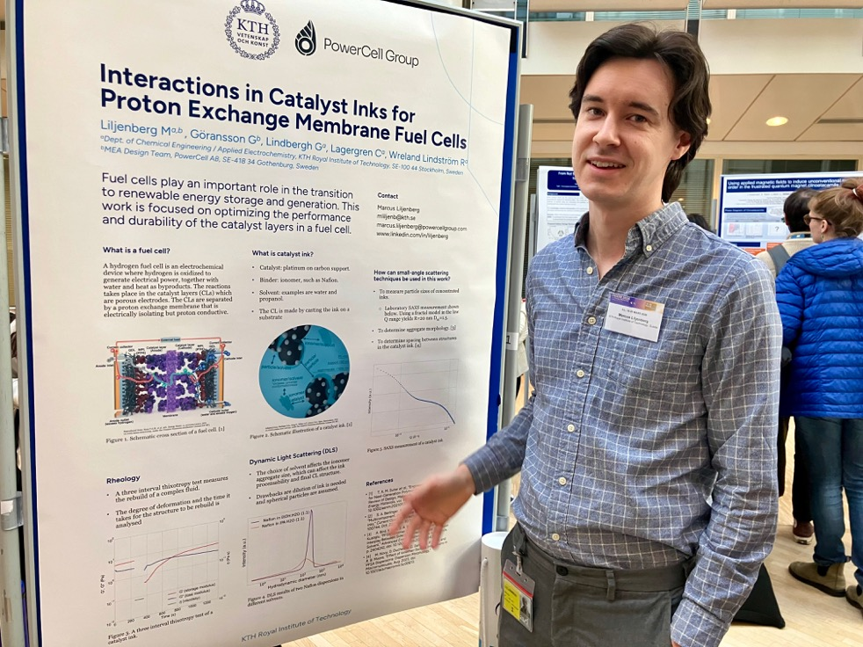
Best Poster & Clips
3rd Prize :
Marcus Liljenberg
“Interactions in Catalyst Inks for Proton Exchange Membrane Fuel Cells”

Slide 12
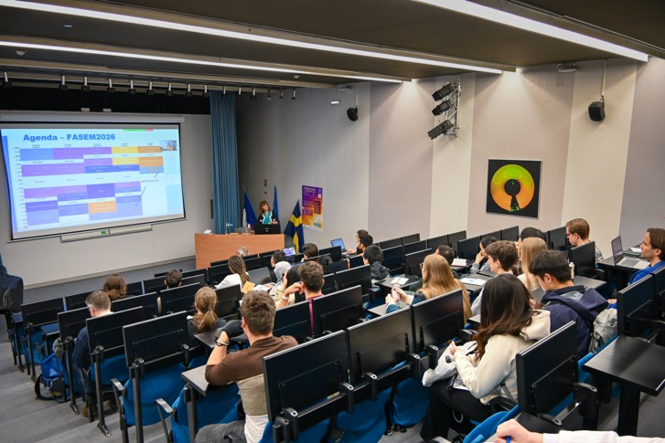
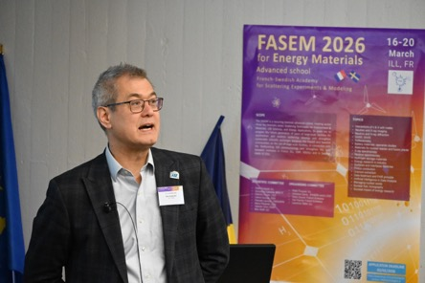
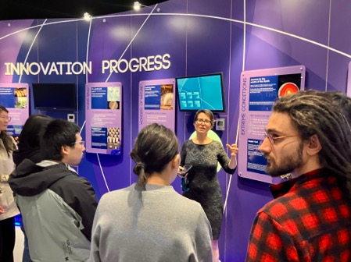
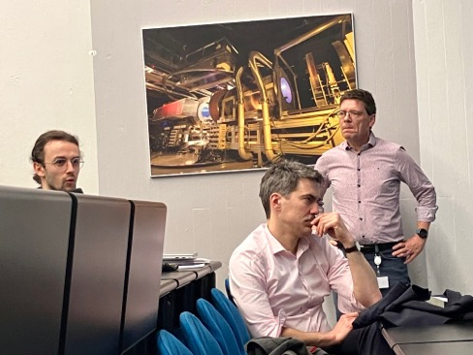
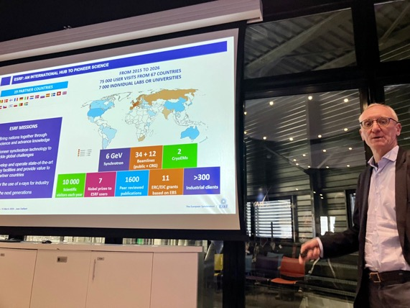
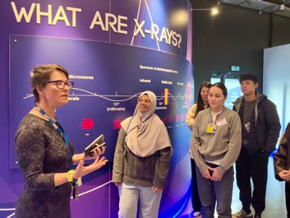
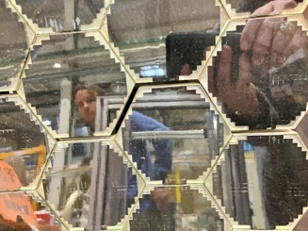
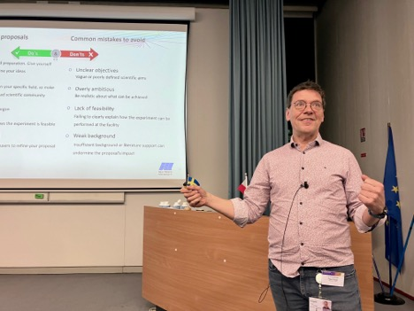
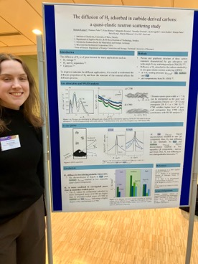
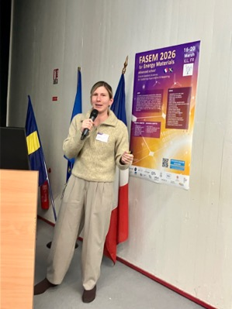
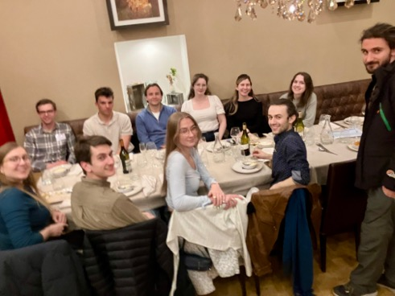
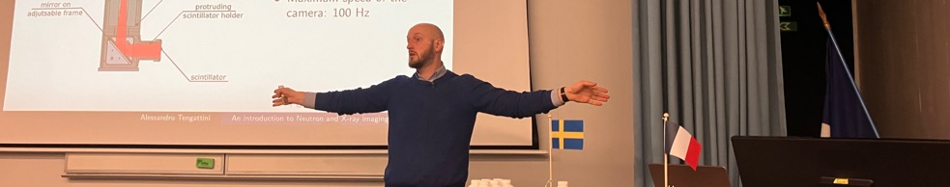
FASEM in pictures
https://cloud.ill.fr/index.php/s/djKR7n4KfRZFD3Z?path=%2FFriday%2FPhotos

Slide 13
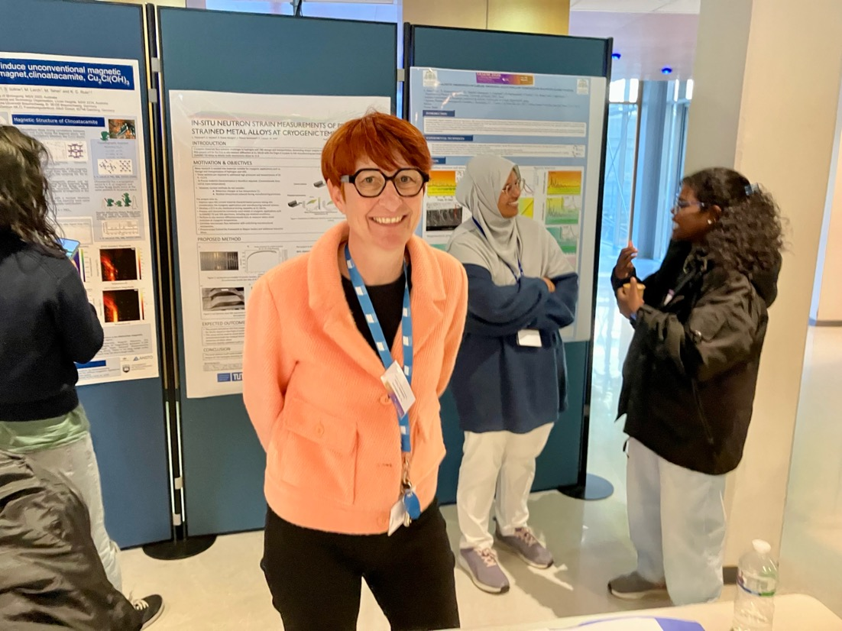
A special “Merci” !!

