Slide 1

Medium spin states in the ⁸⁷Se isotope produced in neutron induced fission of ²³³U and ²³⁵U targets
Katarzyna Gajewska
VII th. Workshop on Nuclear Fission and Spectroscopy of Neutron-Rich Nuclei, Chamrousse 2026

Slide 2
Outline
Scientific motivation
Investigation of neutron-rich ⁸⁶⁻⁸⁸Se isotopes in the context of the evolution of deformed structures
Experiment at Institute Laue-Langevin (Grenoble)
Thermal neutron-induced fission reaction of ²³³U and ²³⁵U with FIPPS instrument
Analysis, results and interpretation
Identification of new states in the isotopes of interest together with spin determination
Interpretation based on Hartree-Fock-Bogoliubov calculations
Future perspectives

Slide 3
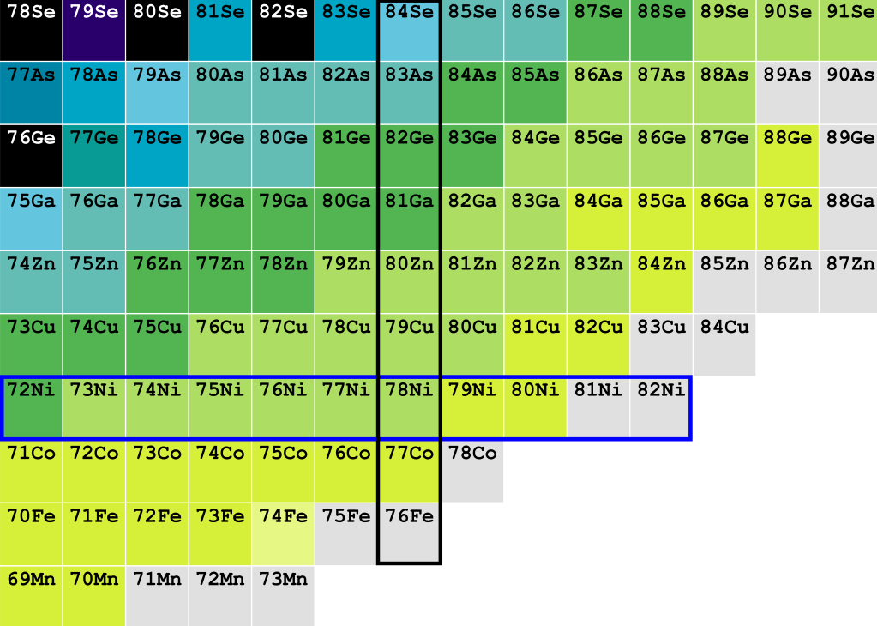
Scientific motivation
Our area of analysis
N = 50
K. Rezynkina et al., PHYSICAL REVIEW C 106, 014320 (2022).
Prolate deformations in ground states of ^{85,87}As nuclei
Z = 28
M. Lettmann et al., PHYSICAL REVIEW C 96, 011301(R) (2017).
Indication of triaxiality in ^{84,86,88}Ge nuclei
R. Taniuchi et al., Nature 569, 53–58 (2019).
Doubly-magic character of ⁷⁸Ni nucleus

Slide 4
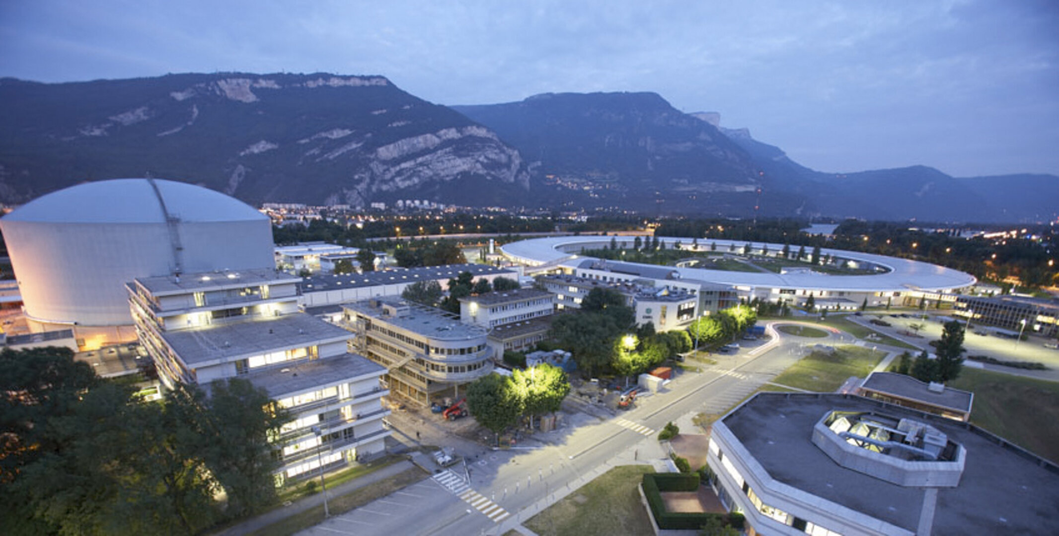
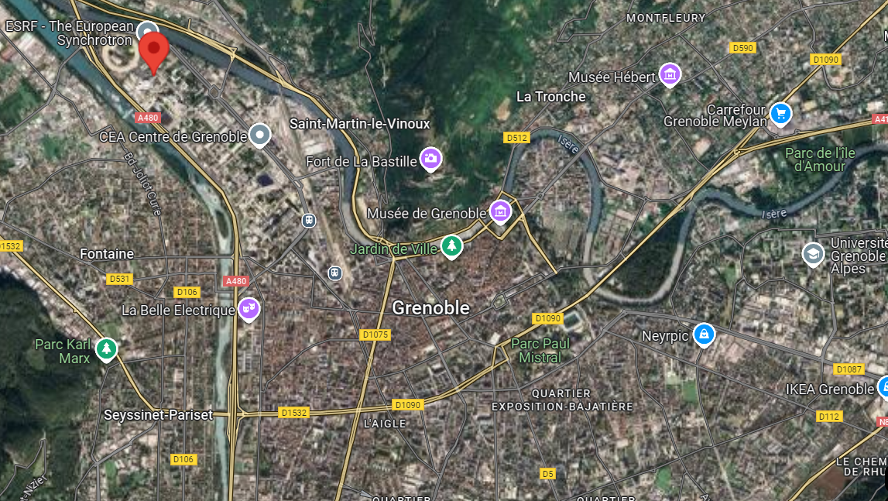
Experiment
Institute Laue-Langevin in Grenoble (France)
Reactor
https://www.ill.eu
High flux of thermal neutron induced fission experiments of ²³⁵U and ²³³U targets
FIPPS instrument consisted of 16 HPGe clover detectors with BGO shielding
~50 days of measurements with each target
Neutron line

Slide 5
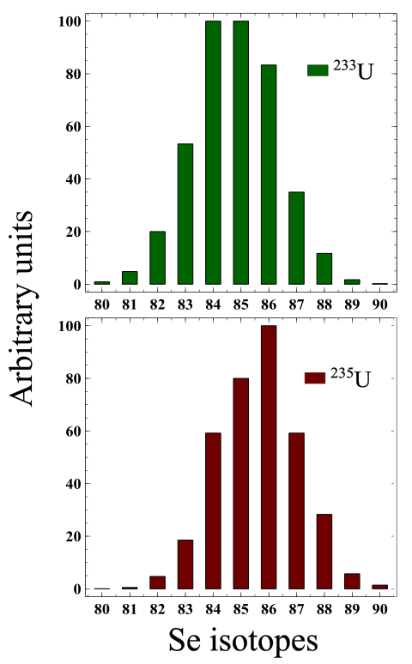
Experiment
Institute Laue-Langevin in Grenoble (France)
Reactor
https://www.ill.eu
Neutron induced fission experiments of ²³⁵U and ²³³U targets
FIPPS instrument consisted of 16 HPGe clover detectors with BGO shielding
~50 days of measurements with each target
Neutron line

Slide 6
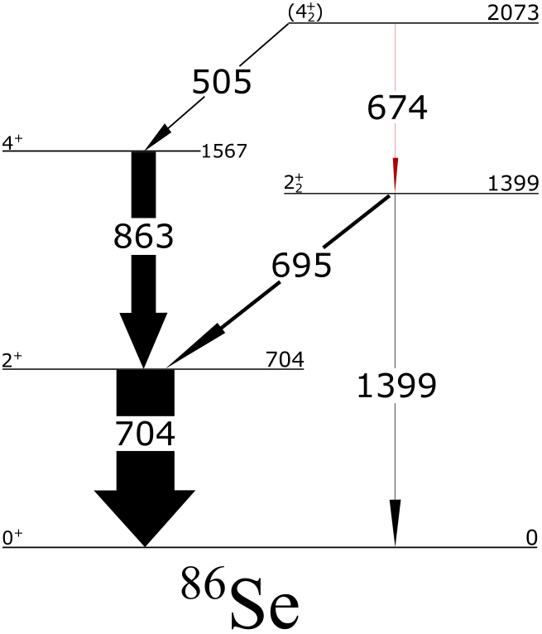
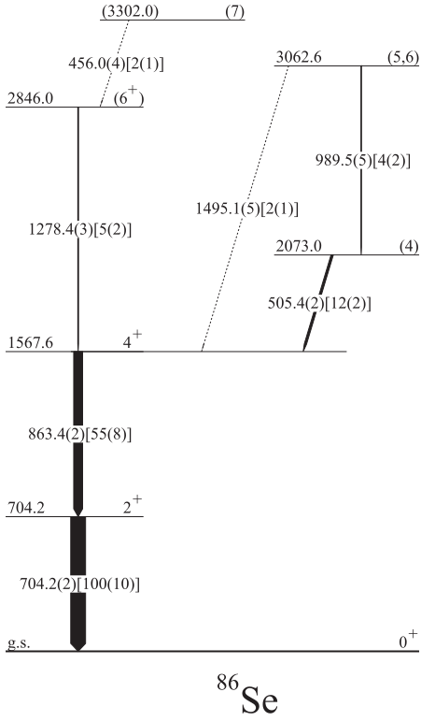
Results – ⁸⁶Se
Confirmation of all known lines from ²⁴⁸Cm, ²⁵²Cf fission experiments
M. Czerwiński et al., PHYSICAL REVIEW C 88, 044314 (2013)

Slide 7
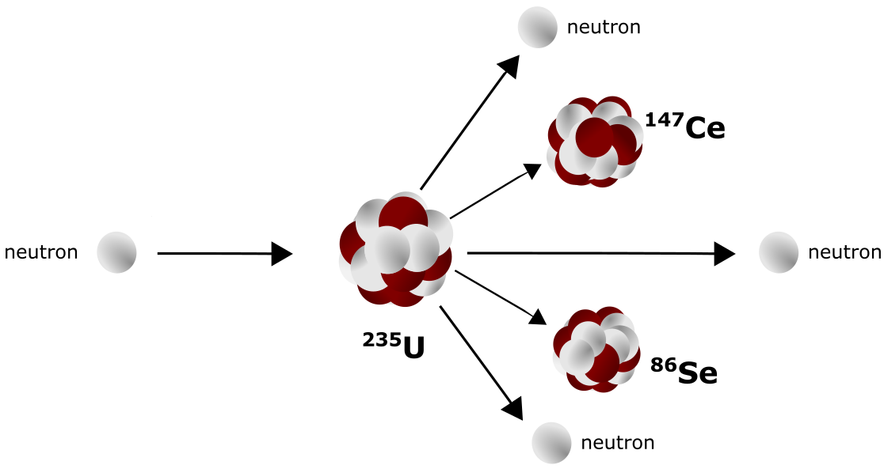
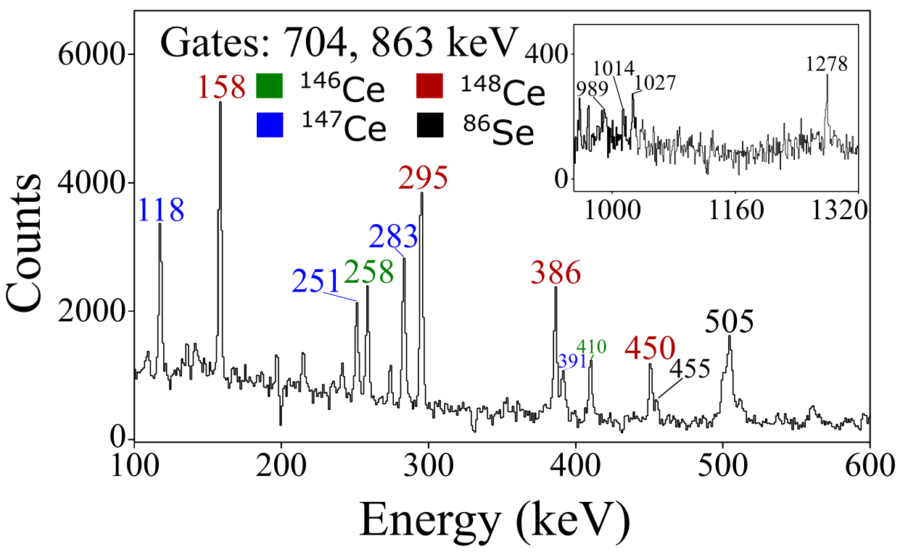
Results – ⁸⁶Se
Confirmation of all known lines from ²⁴⁸Cm, ²⁵²Cf fission experiments

Slide 8
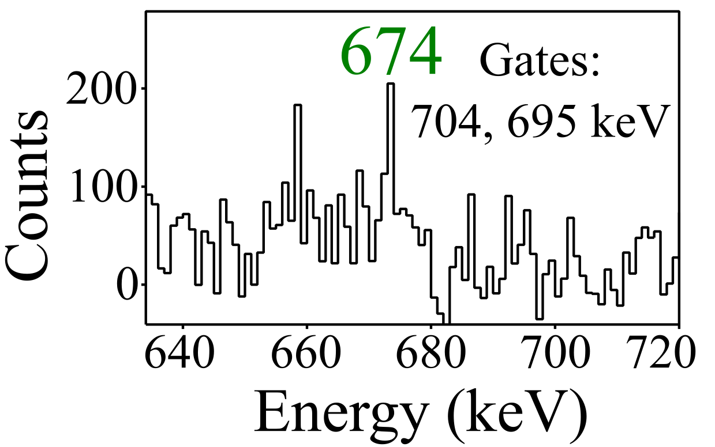
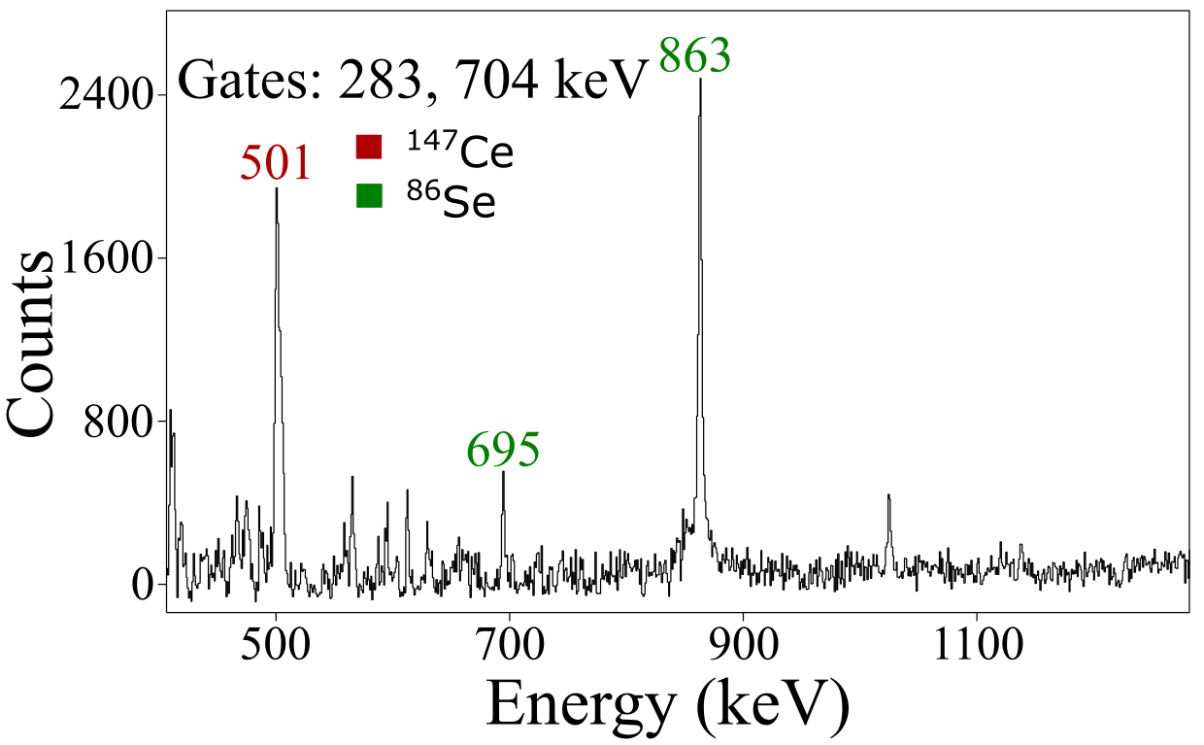
Results – ⁸⁶Se
Confirmation of all known lines from ²⁴⁸Cm, ²⁵²Cf fission experiments
Identification of 674-keV line

Slide 9
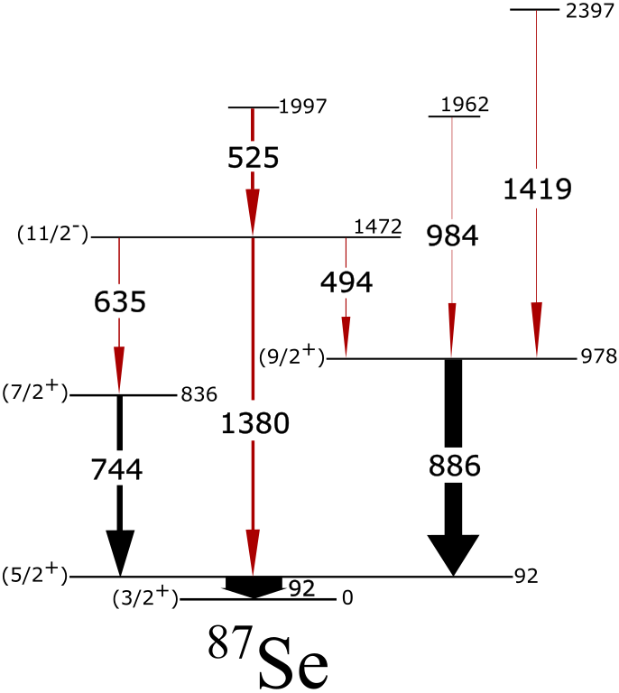
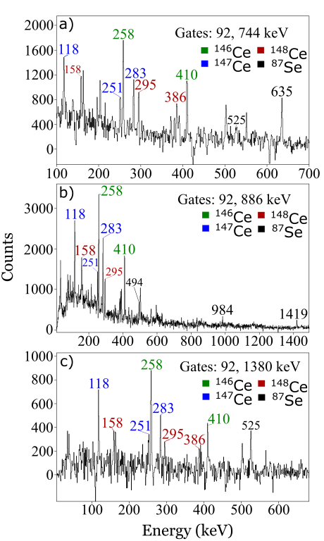
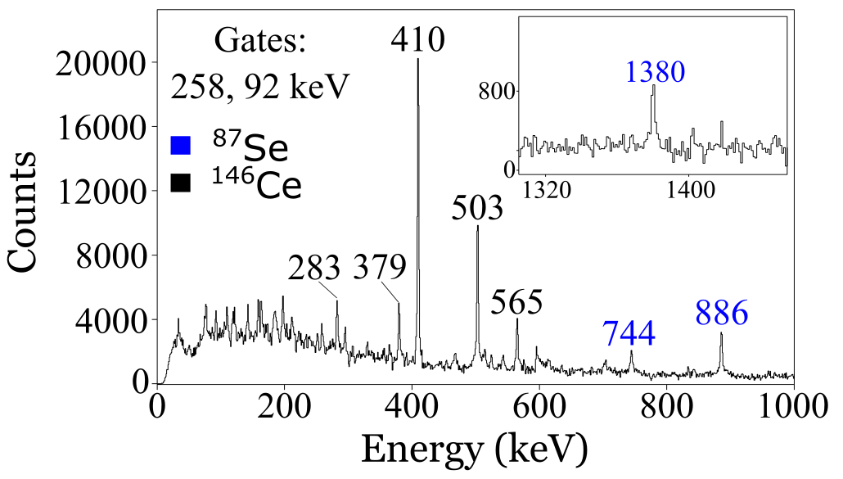
Results – ⁸⁷Se
Identification of 6 new transitions
Obtaining:
Exact energy values
Transitions intensities
spins based on Angular correlation method

Slide 10
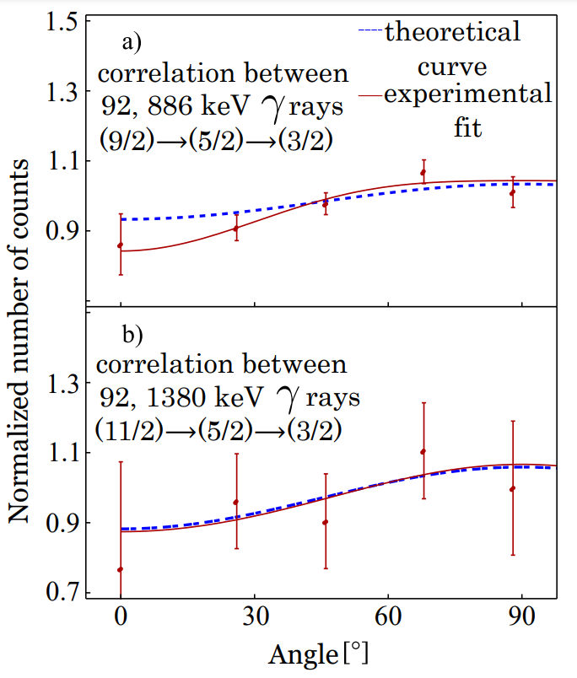
Results – ⁸⁷Se
Energy (keV) | γ Intensity
92.0(2) | 100
885.9(2) | 31.1(32)
744.4(2) | 10.3(21)
525.4(3) | 6.0(12)
1380.3(3) | 5.5(10)
635.2(3) | 2.4(6)
494.3(3) | 1.8(4)
1419.2(4) | 1.4(4)
984.5(4) | 0.9(2)
Identification of 6 new transitions
Obtaining:
Exact energy values
Transitions' intensities
spins based on Angular correlation method

Slide 11
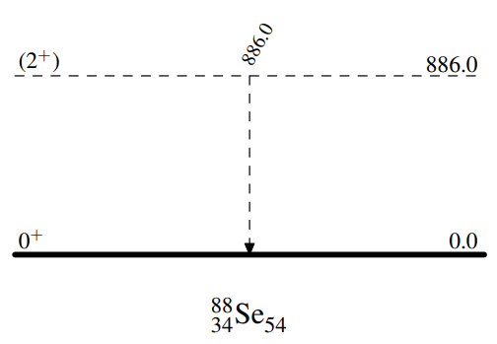
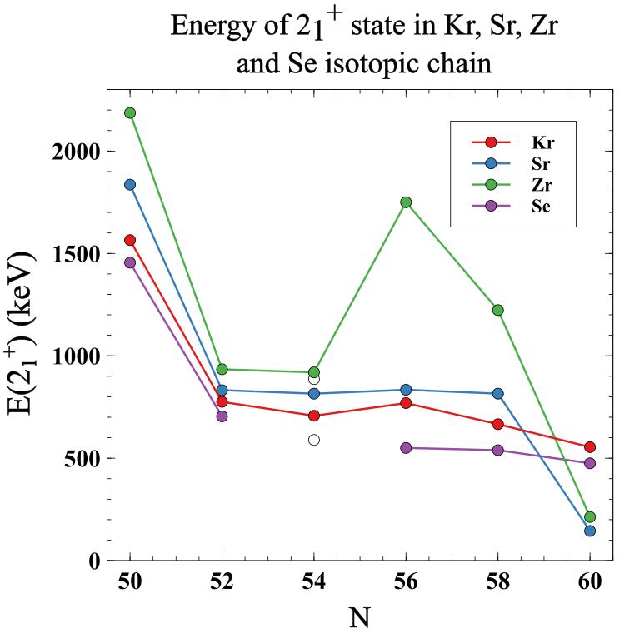
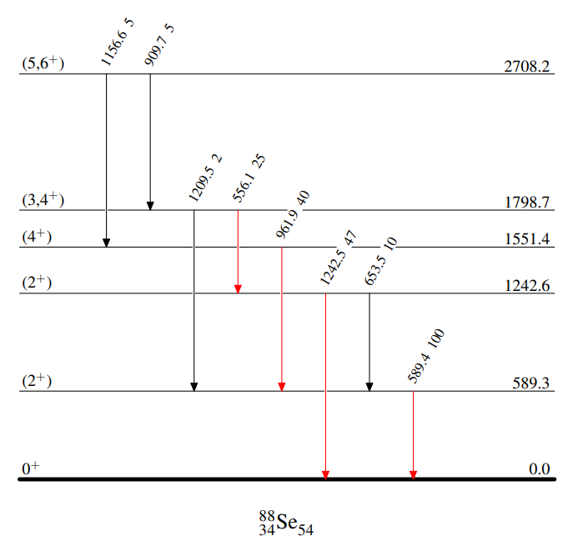
Results – ⁸⁸Se
E. F. Jones et al., Phys. Rev. C 73, 017301 (2006) 21.
S. Chen et al., Phys. Rev. C 95, 041302(R) (2017).
I. N. Gratchev et al., Phys. Rev. C 95, 051302(R) (2017).
https://www.nndc.bnl.gov

Slide 12
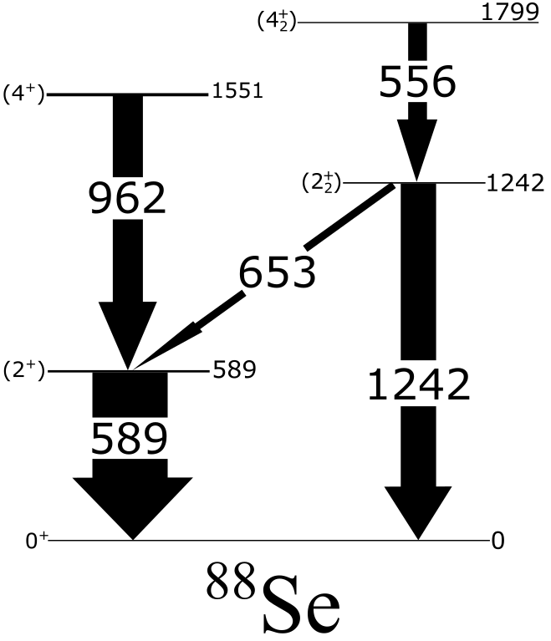
Results – ⁸⁸Se
E. F. Jones et al., Phys. Rev. C 73, 017301 (2006) 21.
Confirmation of 589-keV line as a 2₁⁺→ 0⁺ g.s. transition
S. Chen et al., Phys. Rev. C 95, 041302(R) (2017).
I. N. Gratchev et al., Phys. Rev. C 95, 051302(R) (2017).
https://www.nndc.bnl.gov

Slide 13
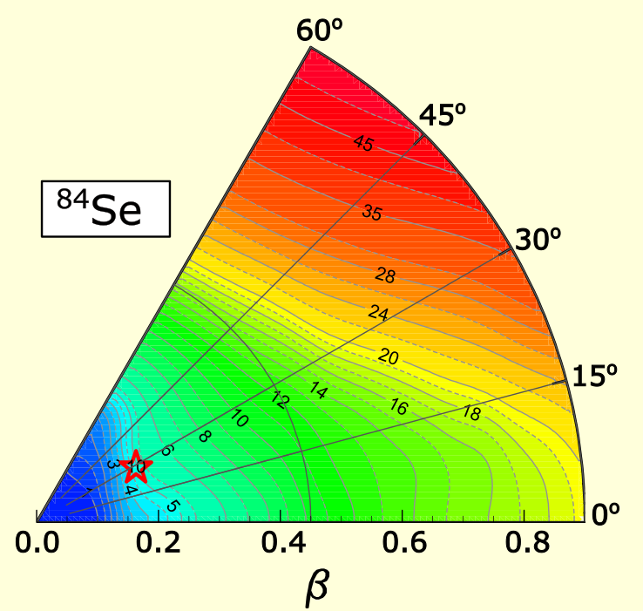
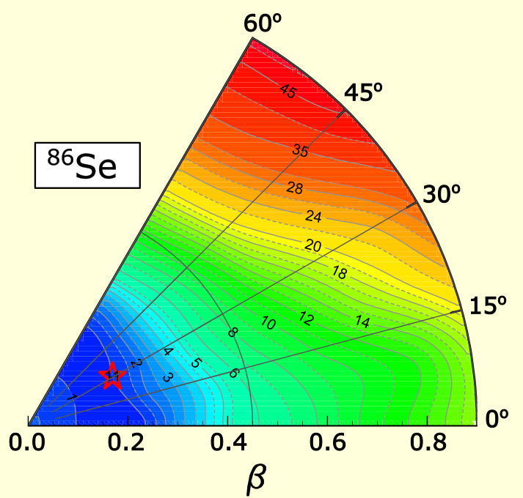
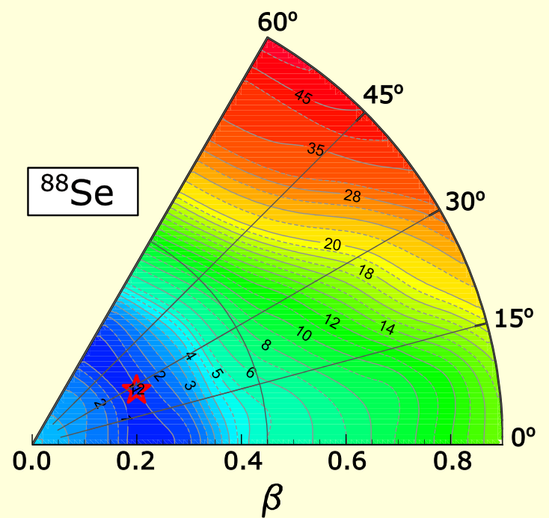
Results
Interpretation based on HFB calculations
S. Hilaire and M. Girod, Eur. Phys. J. A 33, 237 (2007).
J. F. Berger, M. Girod, and D. Gogny, Comput. Phys. Commun.63, 365 (1991).
J. Dechargé and D. Gogny, Phys. Rev. C 21, 1568 (1980).
https://www-phynu.cea.fr

Slide 14
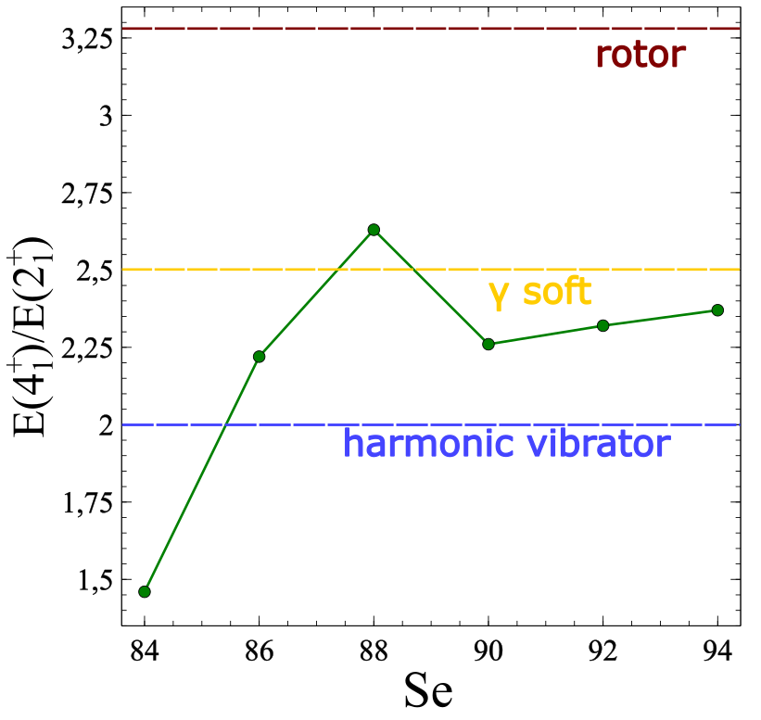
Results
Interpretation based on HFB calculations
S. Hilaire and M. Girod, Eur. Phys. J. A 33, 237 (2007).
J. F. Berger, M. Girod, and D. Gogny, Comput. Phys. Commun.63, 365 (1991).
J. Dechargé and D. Gogny, Phys. Rev. C 21, 1568 (1980).
https://www-phynu.cea.fr

Slide 15
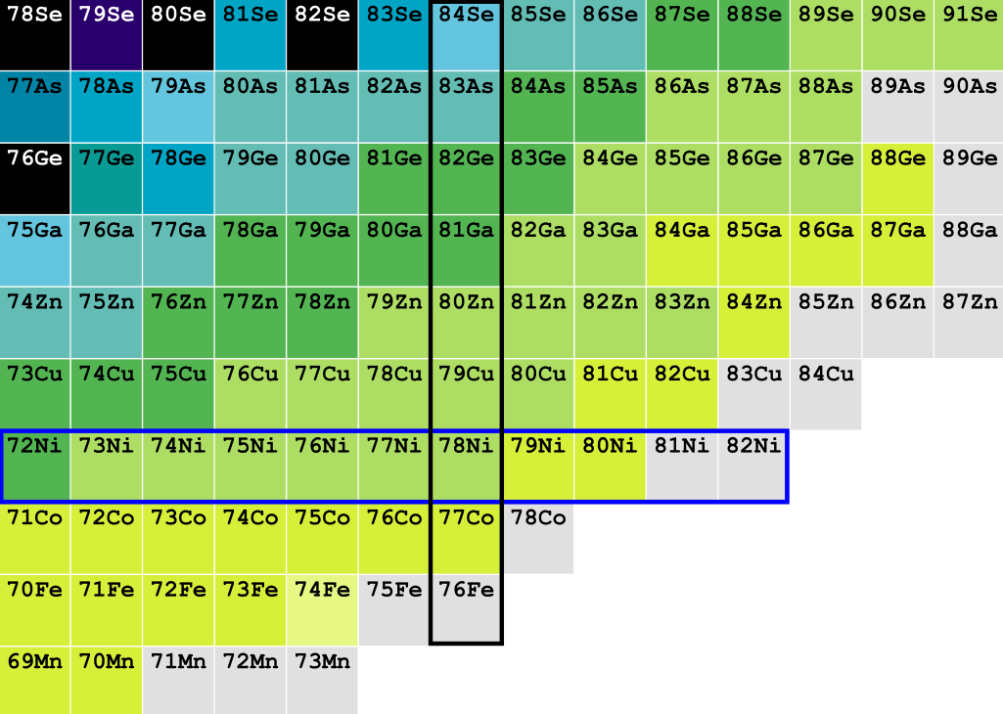
Summary
Study of evolution of the neutron–rich Se isotopes
Experiment using FIPPS instrument at ILL (Grenoble, France)
Thermal neutron-induced ²³³U and ²³⁵U fission
Se
Identification of 7 new transitions in ⁸⁶⁻⁸⁸Se isotopes
Interpretation of results based on HFB calculations
Future perspectives:
- clarifying the possible isomeric state in ⁸⁷Se
- determination of spins in ^{86,88}Se isotope
- going further in the neutron-rich isotopic chain

Slide 16



Thank you for your attention
Collaboration group
Ł. W. Iskra¹, B. Fornal¹, J. Wilson², N. Cieplicka-Oryńczak¹
¹ Institute of Nuclear Physics, PAN, 31-342 Krakow, Poland
² Laboratory of the Physics of the two infinities Irène Joliot-Curie, 91400 Orsay, France
S. Leoni^{3,4}, S. Bottoni^{3,4}, F. C. L. Crespi^{3,4}, G. Colombi^{3,5}
³ INFN sezione di Milano via Celoria 16, 20133, Milano, Italy
⁴ Dipartimento di Fisica, Università degli Studi di Milano, I-20133 Milano, Italy
C. Michelagnoli⁵, M. Jentschel⁵, F. Kandzia⁵, Y.H. Kim⁵, U. Köster⁵, E. Ruiz-Martinez⁵
⁵ ILL, 71 Avenue des Martyrs, 38042 Grenoble CEDEX 9, France

