Slide 1
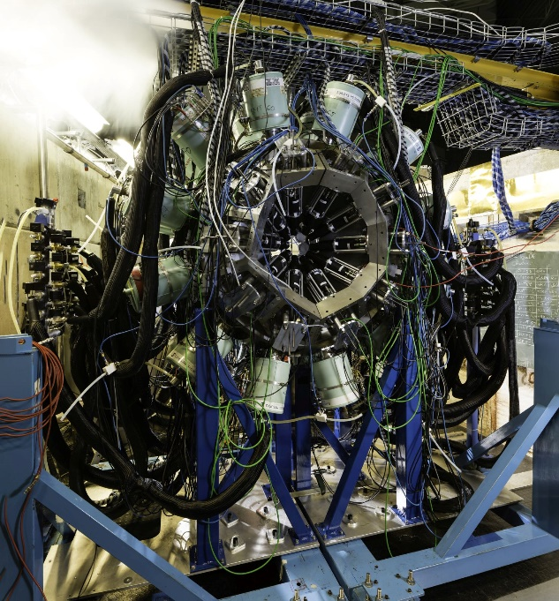
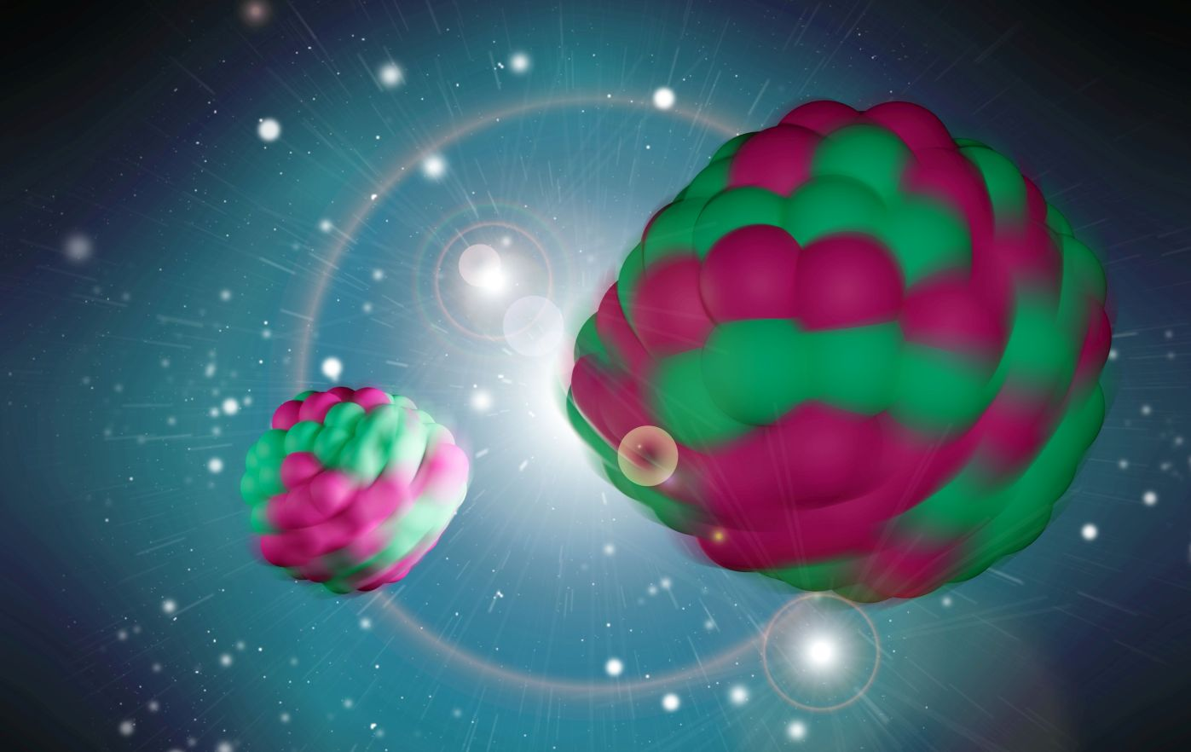
Fission studies with the nu-Ball2 array
J.N. Wilson, IJC Lab
Jonathan Wilson, Giorgia Pasqualato, Corentin Hiver, IJC Lab, Orsay
Dorthea Gjestvang, Henrich Haug, Sunniva Siem, University of Oslo
Carole Chatel, GSI
Natalia Dzysiuk, University of Kyiv
Julia Fischer, University of Köln
Gamma-ray spectroscopy of fission fragments with state-of-the-art techniques
S. Leoni, C. Michelagnoli, J. N. Wilson La Rivista del Nuovo Cimento 45 461–547 (2022)

Slide 2
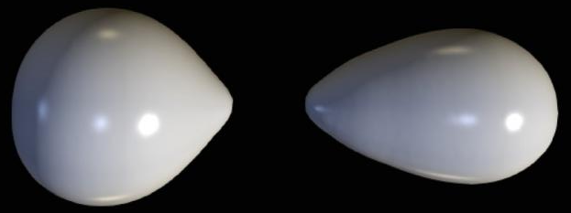
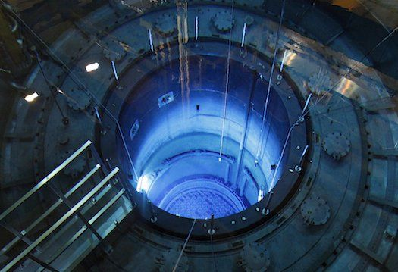
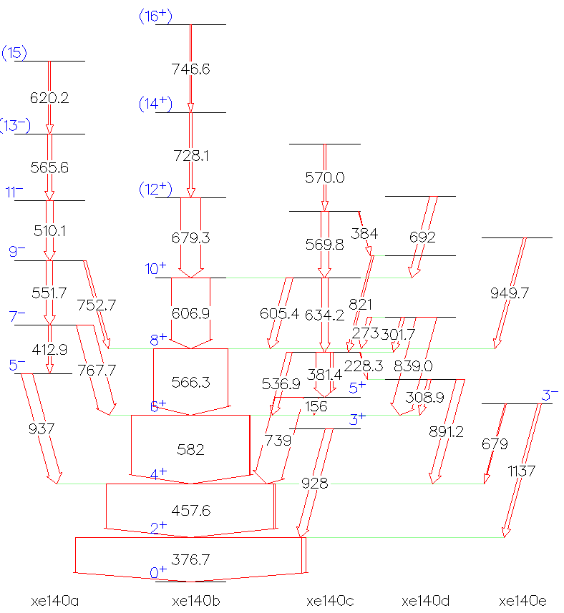
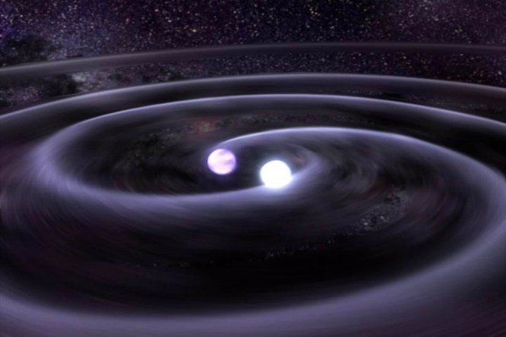
Nuclear fission in context
Energy
Applications
Nuclear
Fission
Nuclear
Structure
Fission is the ultimate test for nuclear theory since this dynamical phenomenon contains within it all of nuclear physics
Astrophysical
Applications

Slide 3
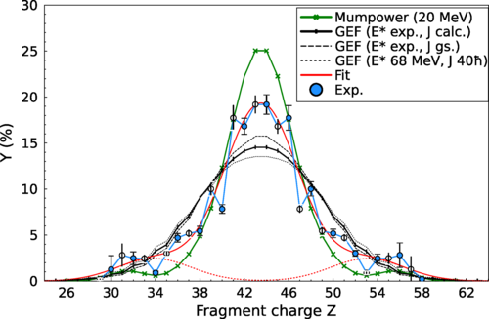
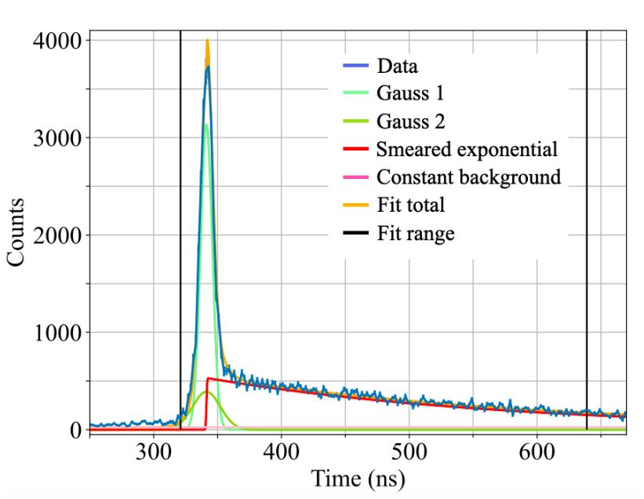
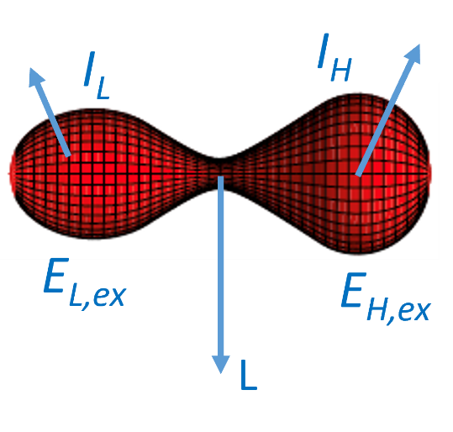
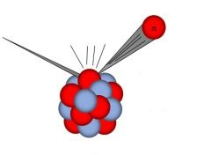
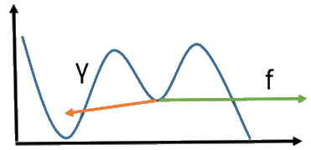
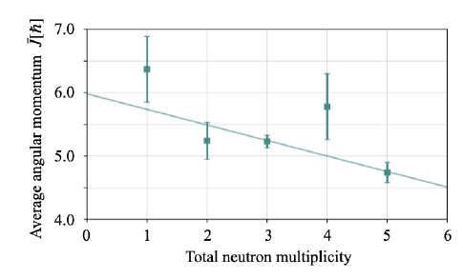
What can we learn from the gamma ray spectroscopy of fission?
Nuclear structure of fission fragments (J. Fischer)
Fission yields (K. Miernik, P. Garczynski, S. Liu)
Fragment spin distributions and angular momenta
Isomeric yield ratios
Indirect neutron multiplicity measurements
High energy gamma ray emission (M. Ciemala)
Directional Correlations (H.Haug , N. Dzysiuk)
(When fission could occur, but doesn’t!)
Gamma decay of fission shape isomers (C. Hiver, N. Jovancevic)
Inelastic neutron scattering (C. Chatel)

Slide 4
What can we learn from the gamma ray spectroscopy of fission?
Nuclear structure of fission fragments (J. Fischer)
Fission yields (K. Miernik, P. Garczynski, S. Liu)
Fragment spin distributions and angular momenta
Isomeric yield ratios
Indirect neutron multiplicity measurements
High energy gamma ray emission (M. Ciemala)
Directional Correlations (H.Haug, N. Dzysiuk)
(When fission could occur, but doesn’t!)
Gamma decay of fission shape isomers (C. Hiver, N. Jovancevic)
Inelastic neutron scattering (C. Chatel)

Slide 5
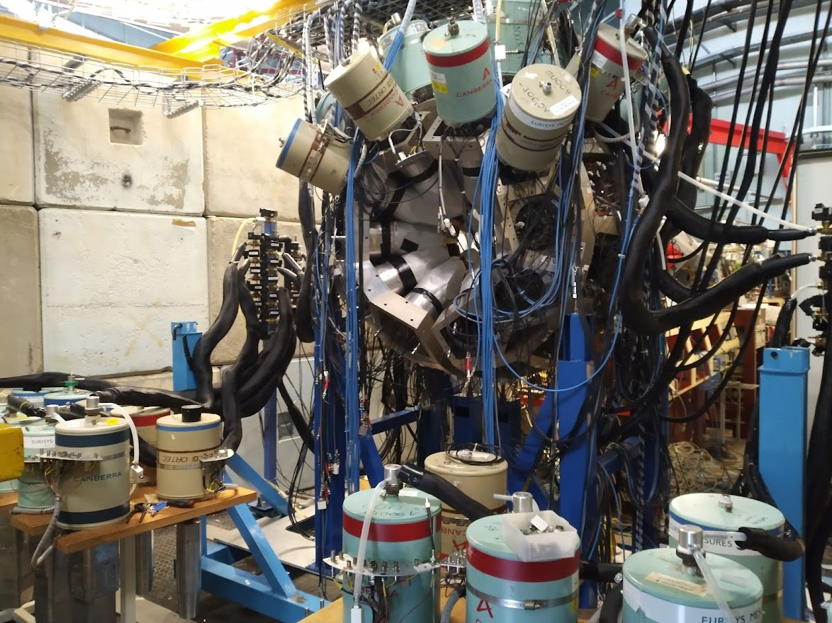
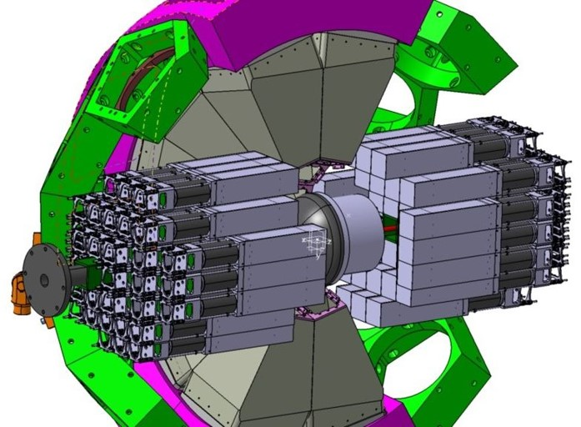
The nu-Ball2: Hybrid γ-ray spectrometer at ALTO
Study of: nuclear fission, neutron rich isotopes, lifetimes/nuclear moments
Innovations
Hybrid Spectrometer (Ge/BGO/LaBr3/PARIS)
high resolution, high efficiency
Different geometries and couplings
Calorimetry for reaction studies/selection
Fully digital, 200 channels, including BGO
Modes Triggered or Triggerlesss
12 experiments. 2900 hours beam time
(2022 – 2023) ,155 international users
nu-Ball2 under construction 03/03/22
Coupled Devices
TFGIC (European Commission, JRC Geel)
DSSD silicon detectors (HIL Warsaw)
LICORNE neutron source (ALTO)
CORSET FF detector (Dubna)
OUPS plunger (IJC Lab)
OPSA charged particle detctor (IJC Lab)
Gamma detectors
28 Clover Ge’s(GammapoolEU consortium)
15 Coaxial Ge’s (UK/France loan pool)
36 FATIMA LaBr3 (FATIMA collaboration)
72 PARIS phoswich (PARIS collaboration)

Slide 6
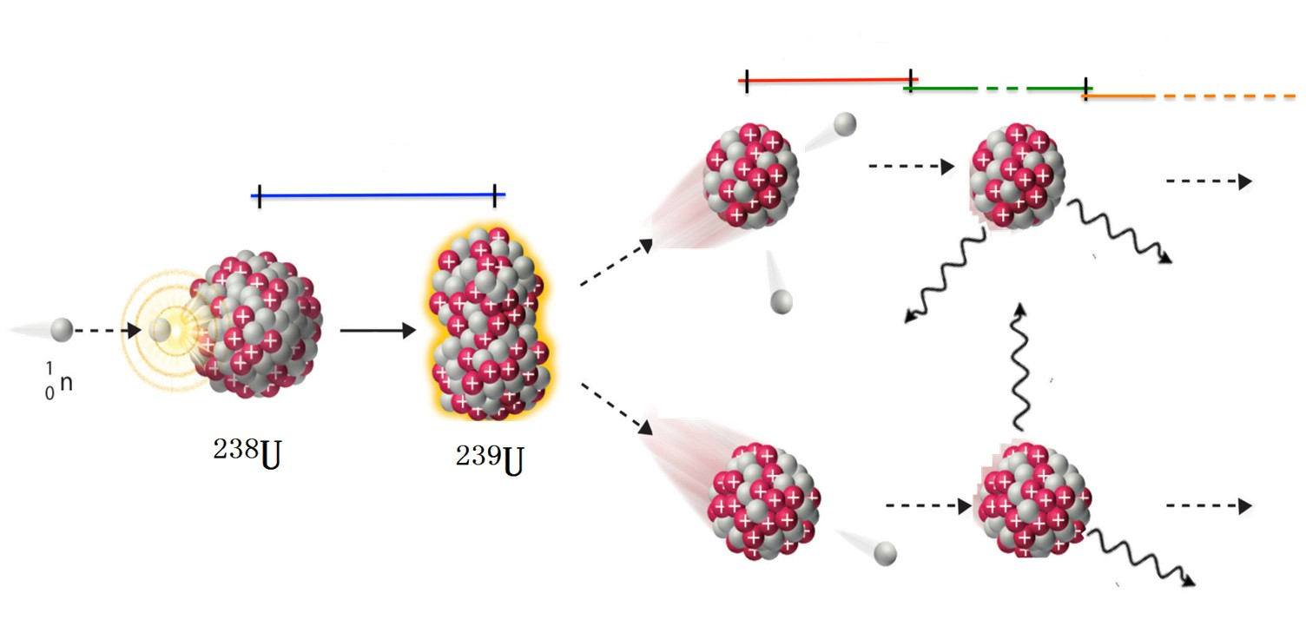
The de-excitation process in fission
10⁻¹⁸ – 10⁻¹⁴ s
10⁻¹⁴ – 10⁻⁹ s
10⁻³ – ∞ s
10⁻²¹ – 10⁻²⁰ s
Post scission
Beta decay
Pre-scission
_
Fragment
Kinetic Energy
Prompt
neutrons
Prompt
gamma rays
β, ν, γ
decay
~160 MeV
~6 MeV
~8 MeV
~20 MeV

Slide 7
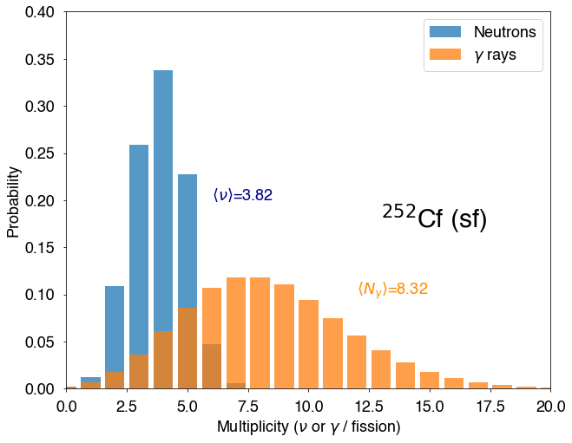
Prompt neutron and gamma multiplicity distributions
7 MeV each
Q=TKE + TXE
Total Kinetic Energy (TKE):
Coulomb repulsion of fragments
(180 MeV)
Total Excitation Energy (TXE):
Remaining energy available for prompt emission (25-30 MeV)
1 MeV each
On average
21 MeV for neutrons
8 MeV for gammas

Slide 8
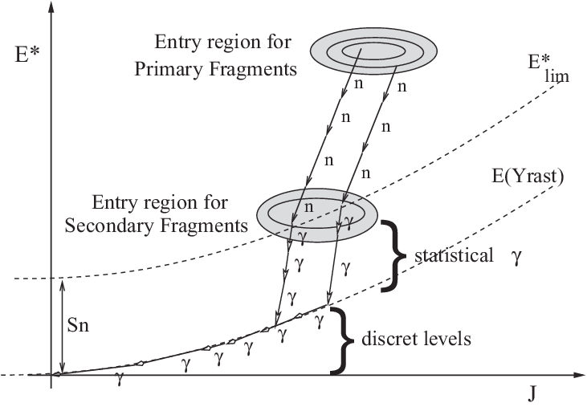
Fission fragment decay
O. Litaize and O. Serot, Phys. Rev. C 82, 054616 (2010)

Slide 9
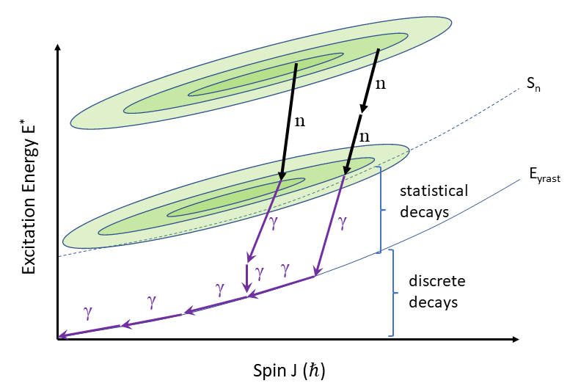
Fission fragment decay
Primary fragment entry
distribution
Secondary fragment entry
distribution
Excitation energy evacuated by neutrons
Angular momentum evacuated by gammas
(mostly!)
<M_{γ}> (one fragment) ~ 3.5 - 4
<ν> (one fragment) ~ 1 - 2

Slide 10
Measurement of fragment spin distributions and average spins

Slide 11
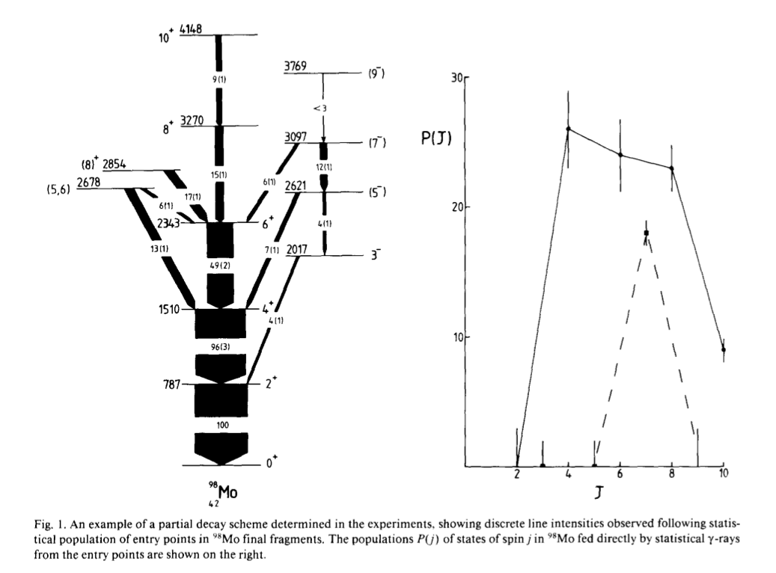
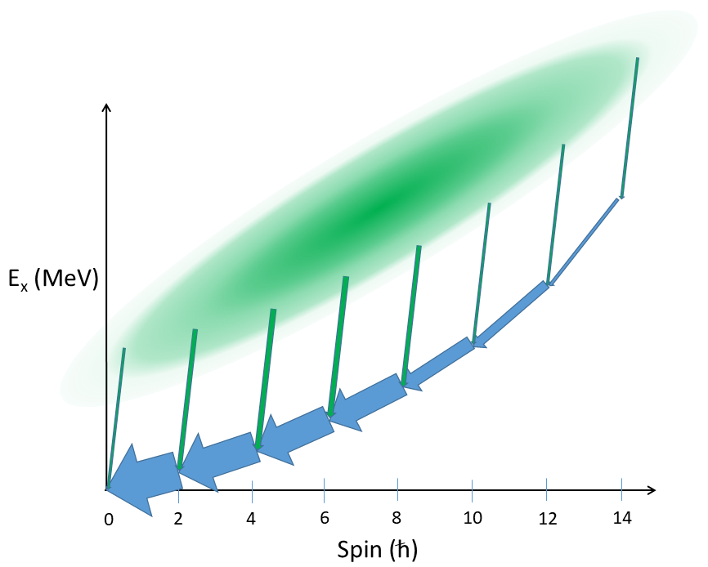
The Manchester Spin Method (MSM)
.
Y. Abdelrahman et al. Phys. Lett. B 199 4 504 (1987)
S₁₄
S₁₂
S₁₀
S₈
S₆
S₄
S₀
S₂

Slide 12
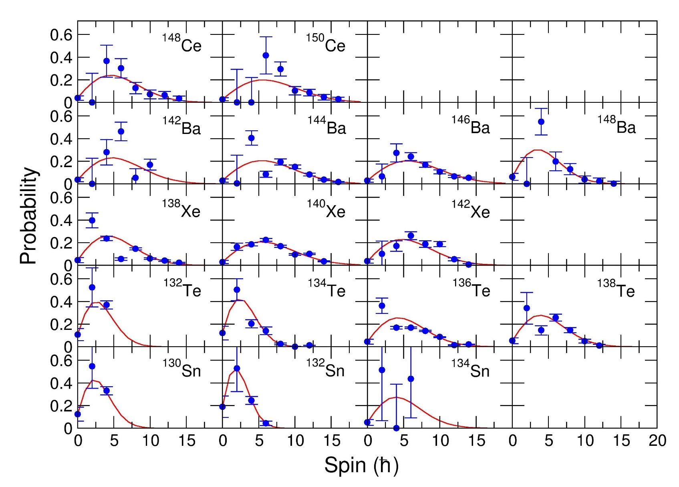
Examples of measured side-feeding distributions
Fit distributions with 1 parameter
Spin cutoff parameter σ²
²³⁸U(n,f) heavy fragments
“An Attempt to Calculate the Number of Energy Levels of a Heavy Nucleus”, H. A. Bethe Phys. Rev. 50, 332 (1936)

Slide 13
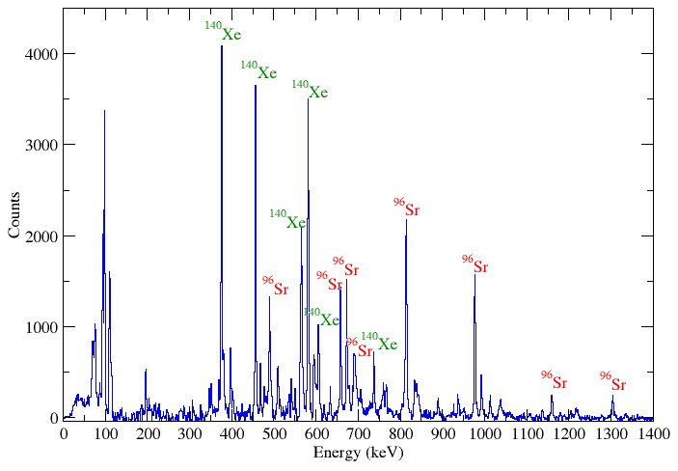
ν-Ball2/FATIMA/LICORNE: ²³⁸U(n,f) data quality
Triple gamma coincidences: Double gate on transitions from fragments
Ge-Ge-Ge, Ge-LaBr3-LaBr3, Ge-Ge-BGO
Double gate on
376 keV/814 keV
Selects ¹⁴⁰Xe/⁹⁶Sr
pair
Indirect measurement of neutron multiplicities
Control for the number of neutrons emitted
Study of the angular momentum carried by neutrons
D. Gjestvang, H. Haug, J.N. Wilson, J. Randrup et al., submitted to PRC
1.6 x 10⁹
Ge-Ge-Ge
coincidences

Slide 14
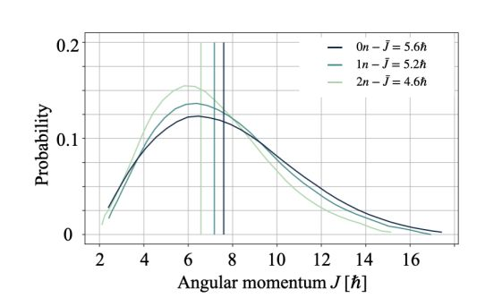
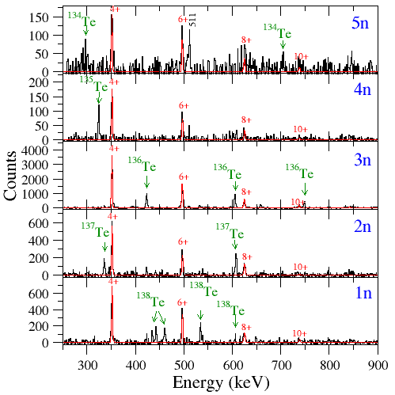
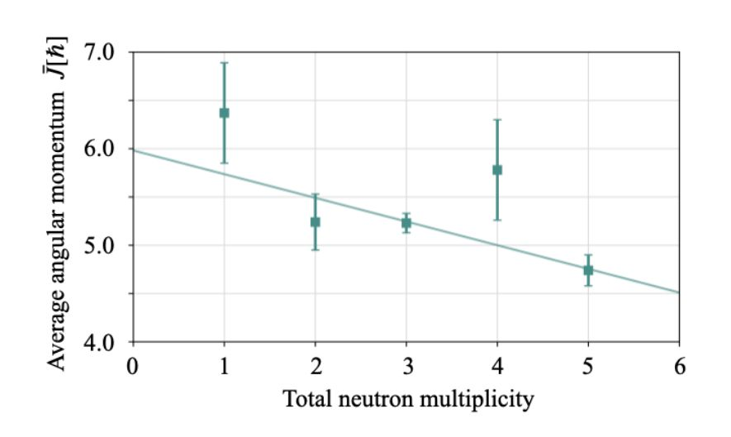
¹⁰²Zr
¹⁴⁰Xe

Slide 15
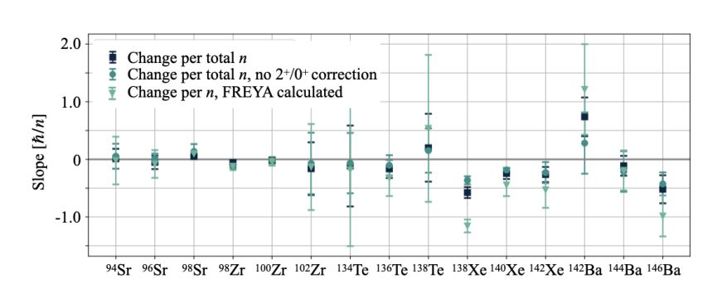
Average angular momentum removal per neutron vs fragment
D. Gjestvang, H. Haug et al., Submitted to Phys. Rev. C

Slide 16
Gamma ray Directional Correlations

Slide 17
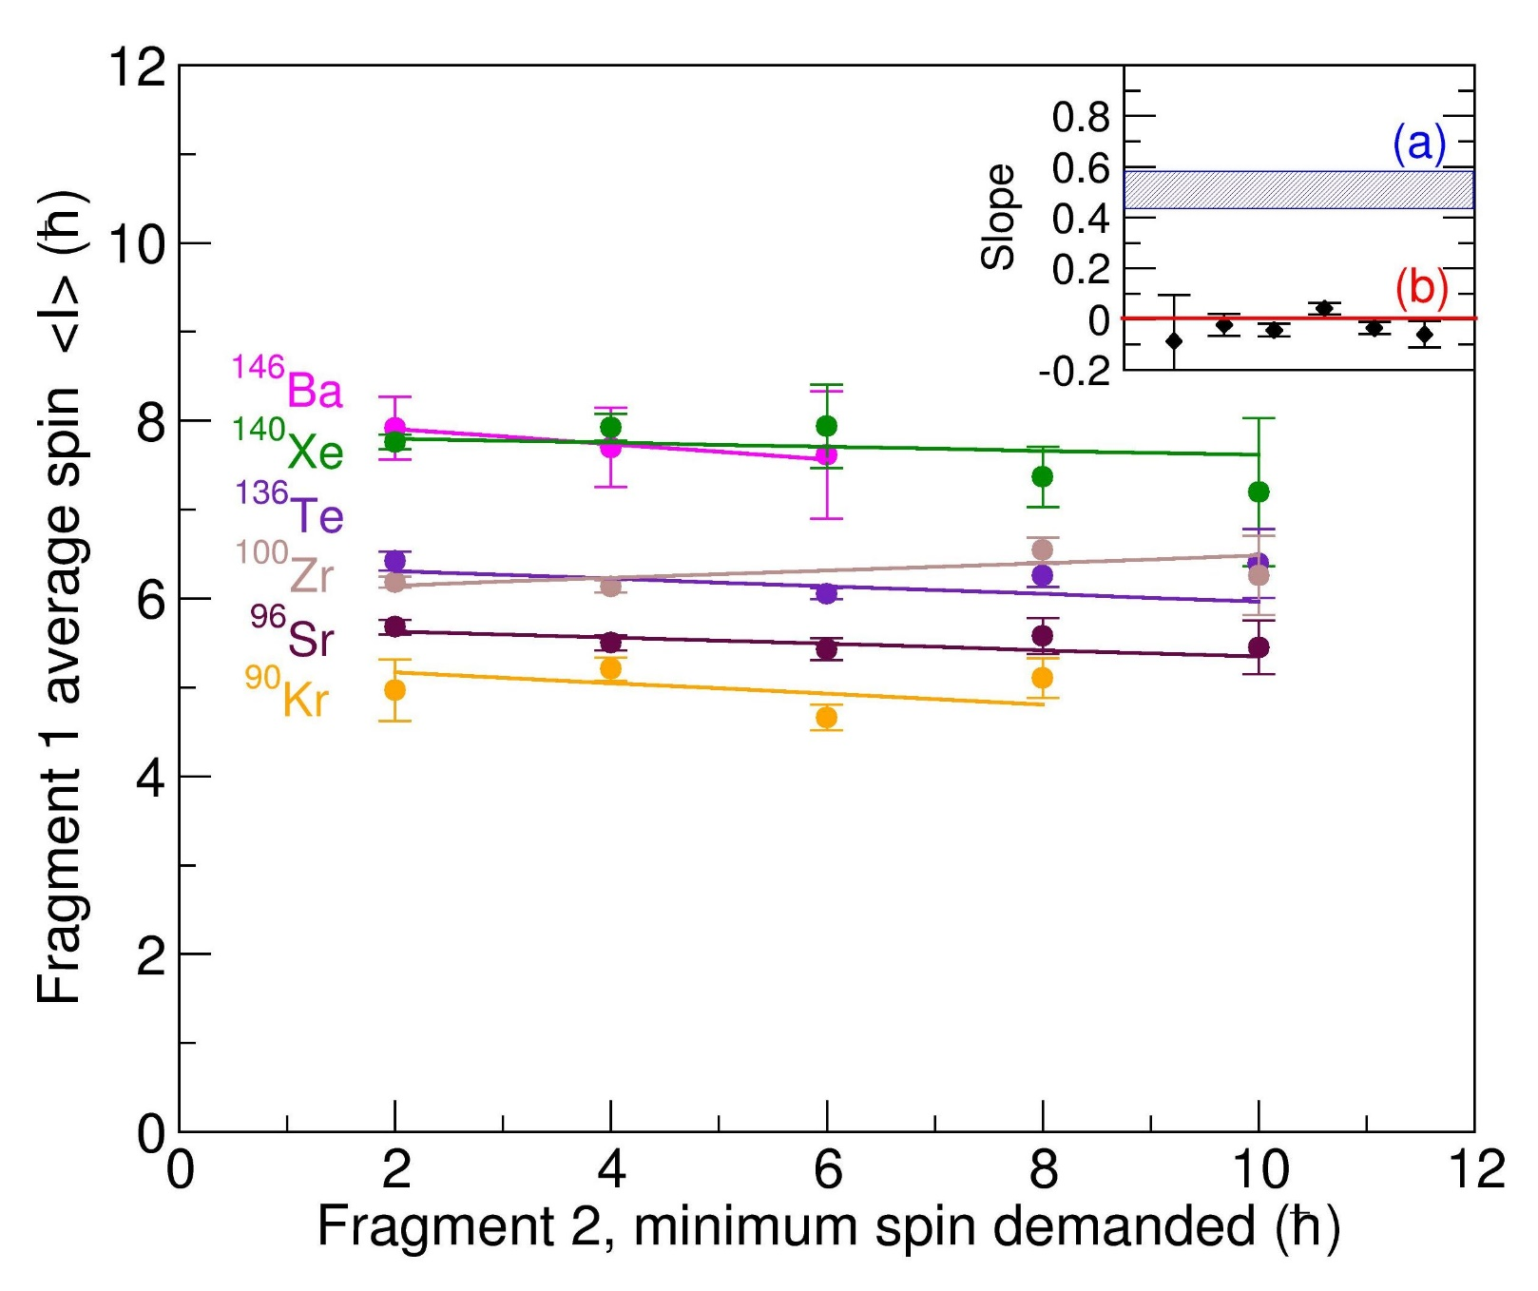
Correlation between fragment spin magnitudes
Correlated spins (Pre-scission)
Uncorrelated spins
J.N. Wilson et al. Nature 590 566 (2021)

Slide 18
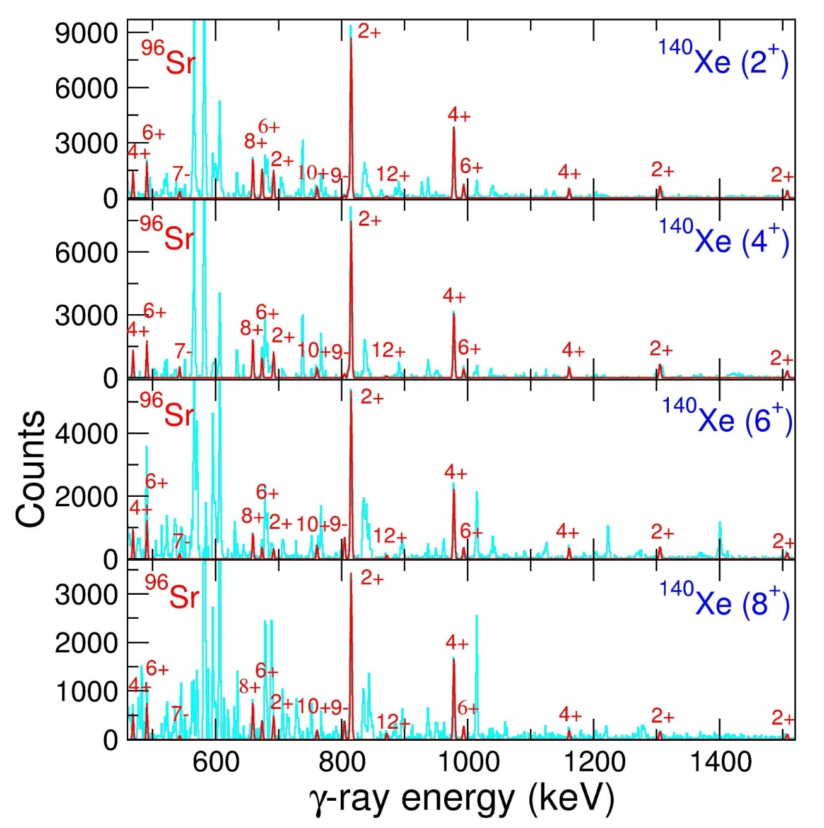
⁹⁶Sr partner γ’s with increasing ¹⁴⁰Xe spin conditions
Increasing spin demanded in ¹⁴⁰Xe
Event-by-event fragment partner correlations
J.N. Wilson et al. Nature 590 566 (2021)

Slide 19

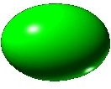

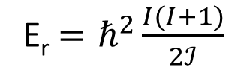
Correlation between fission fragment spin magnitudes
Correlated spins
Uncorrelated spins
${\vec{S}}_{1}+{\vec{S}}_{2}+{\vec{S}}_{o}=0$
E_{r} $=ℏ^{2}\frac{I(I+1)}{2ℐ}$
J.N. Wilson et al. Nature 590 566 (2021)

Slide 20
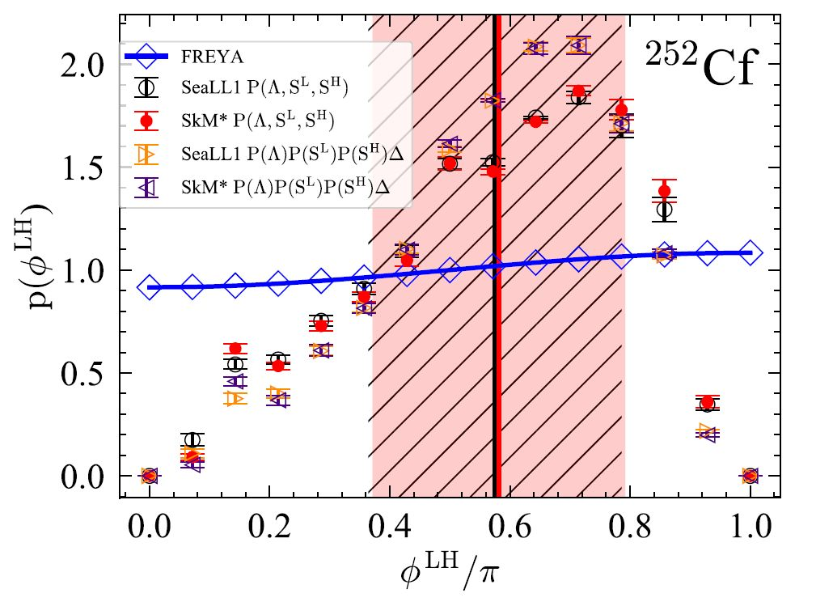

Correlation between the fragment spin directions?
TDDFT
A. Bulgac et al., Phys. Rev. Lett. 128, 022501 (2022)
J. Randrup and R. Vogt, Phys. Rev. Lett.127, 062502(2021)
I_{H}
I_{L}
I_{H}
I_{L}
E_{L,ex}
E_{H,ex}
E_{L,ex}
E_{H,ex}
L
L
Theoretical predictions strongly disagree !!
Image courtesy of S. Aberg

Slide 21
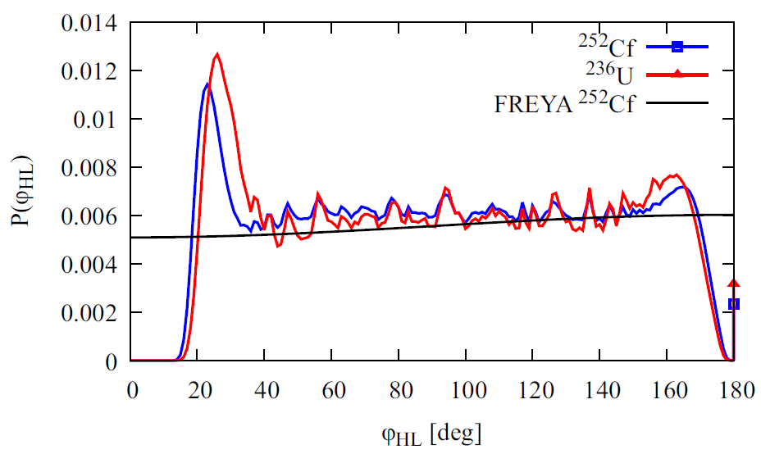
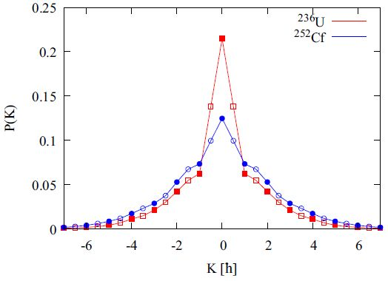
Correlation between the fragment spin directions?
TDDFT approach
G. Scamps et al., Phys. Rev. C 108, L061602 (2023)
Theoretical predictions strongly disagree !!

Slide 22
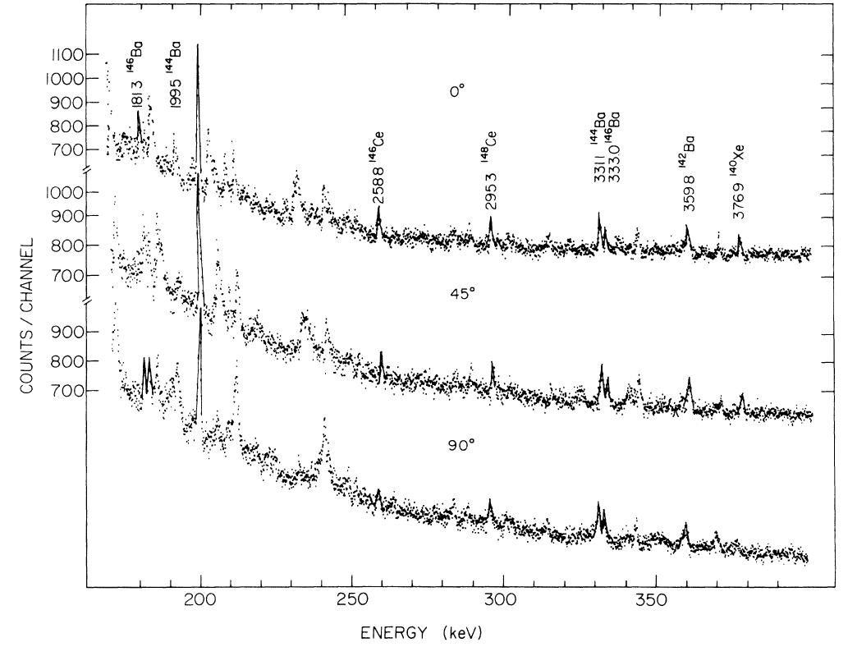
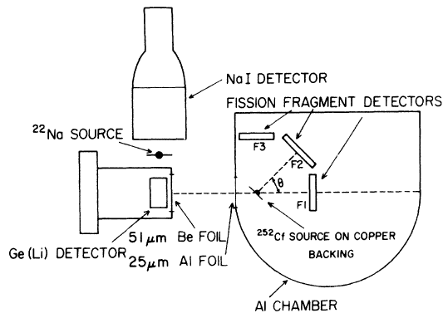
Angular distributions of prompt fission gamma rays
²⁵²Cf(SF)
A. Wolf and E. Cheifetz, Phys. Rev. C 13 5 1952 (1976)

Slide 23

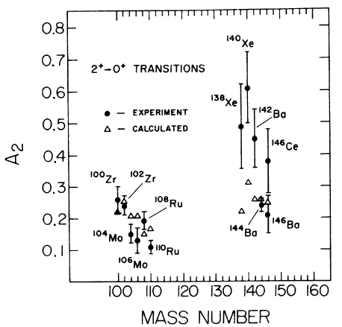
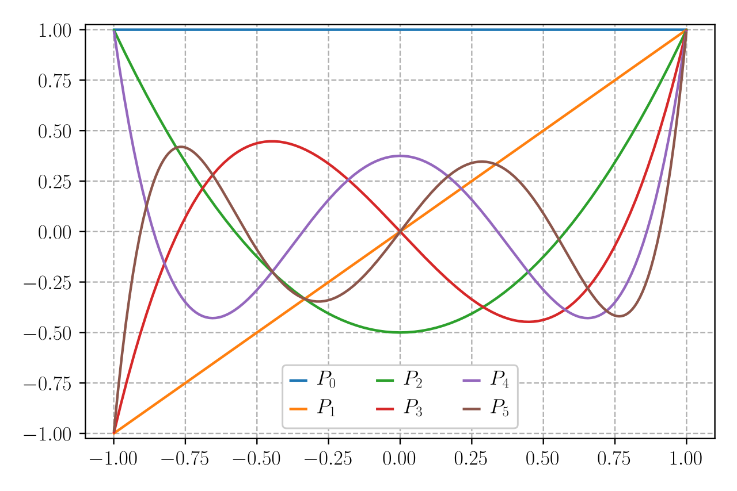
Angular distributions of prompt fission gamma rays
Legendre polynomials
Cos (theta)
Conclusion: Fragment spin is perpendicular to the fission axis
(See talk of Henrik Haug)
A. Wolf and E. Cheifetz, Phys. Rev. C 13 5 1952 (1976)

Slide 24
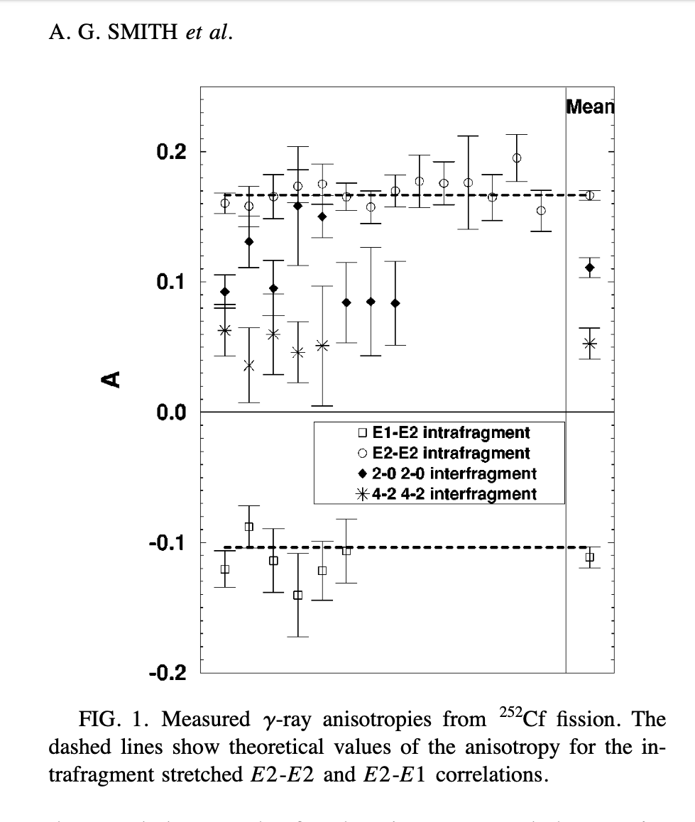

Angular correlations between partner fragment gamma rays
Anisotropies
Natalia Dzysiuk,
University of Kyiv
I_{L}
I_{H}
E_{L,ex}
E_{H,ex}
L
4⁺
4⁺
2⁺
2⁺
0⁺
0⁺
Light fragment
Heavy fragment
A.G. Smith et al., Phys. Rev. C 60, 064611 (1999)

Slide 25
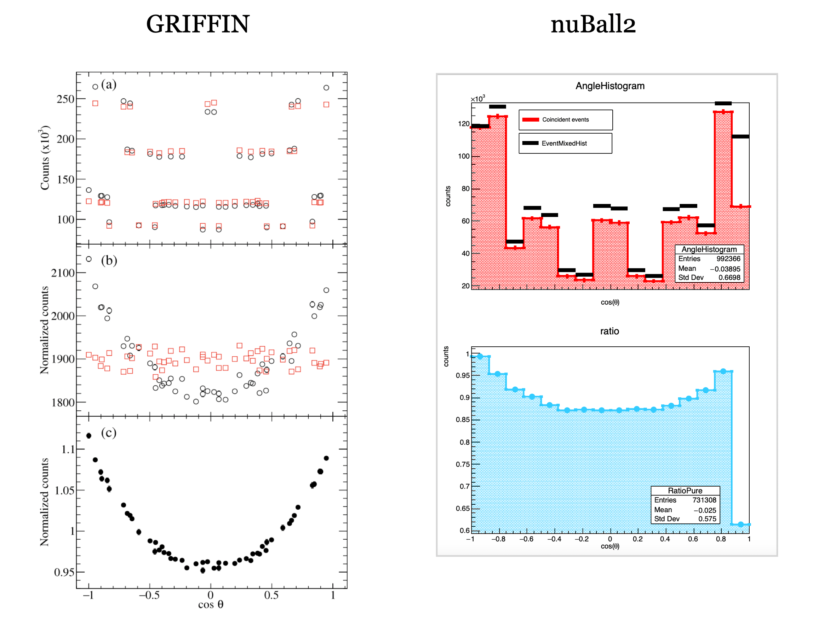
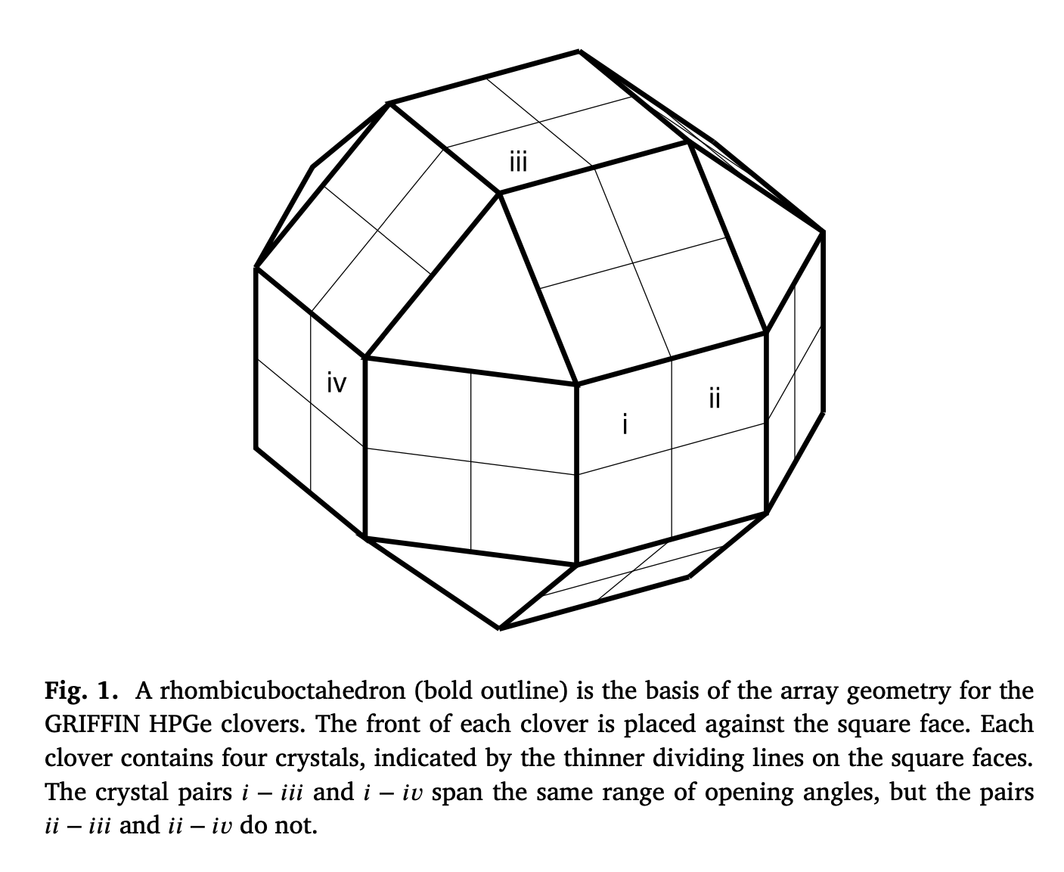
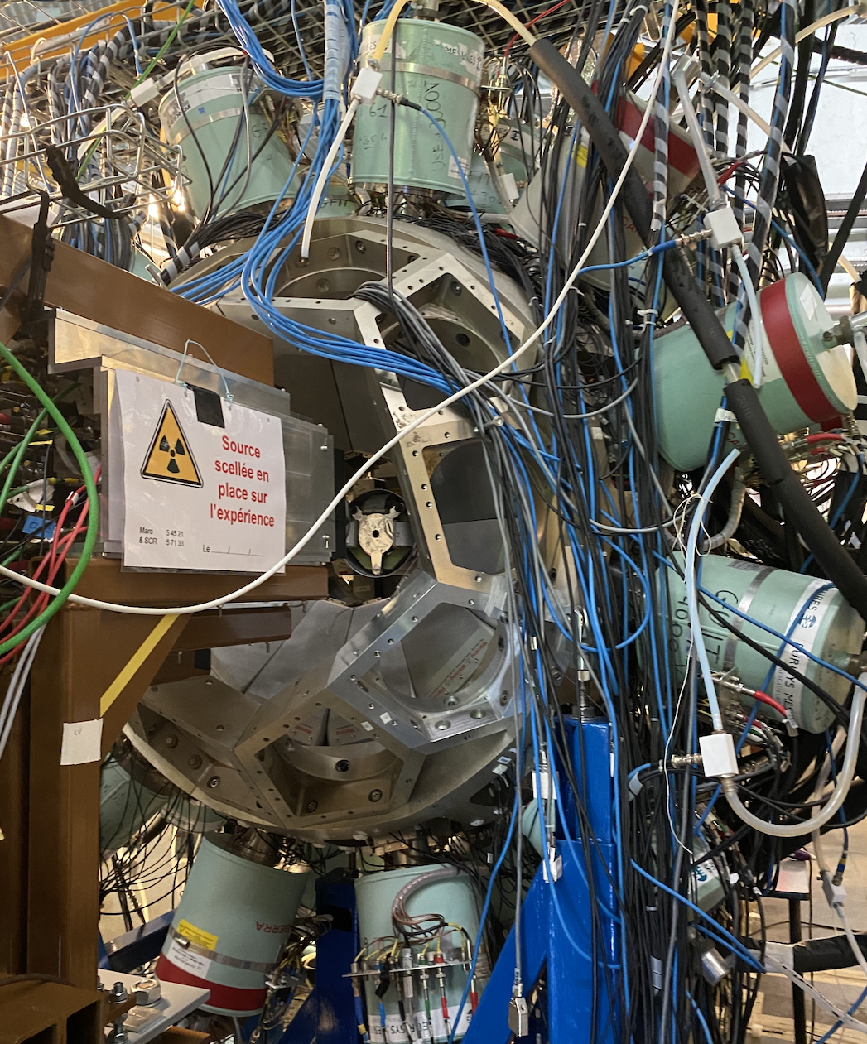

Reference method
GRIFFIN
$ν$-Ball2
R
B
G
B
16 clovers = 64 crystals
48 minimal N of angles
24 clovers = 96 crystals
72 minimal N of angles
J.K. Smith et al., NIM A, 922, 47-63 (1999)

Slide 26
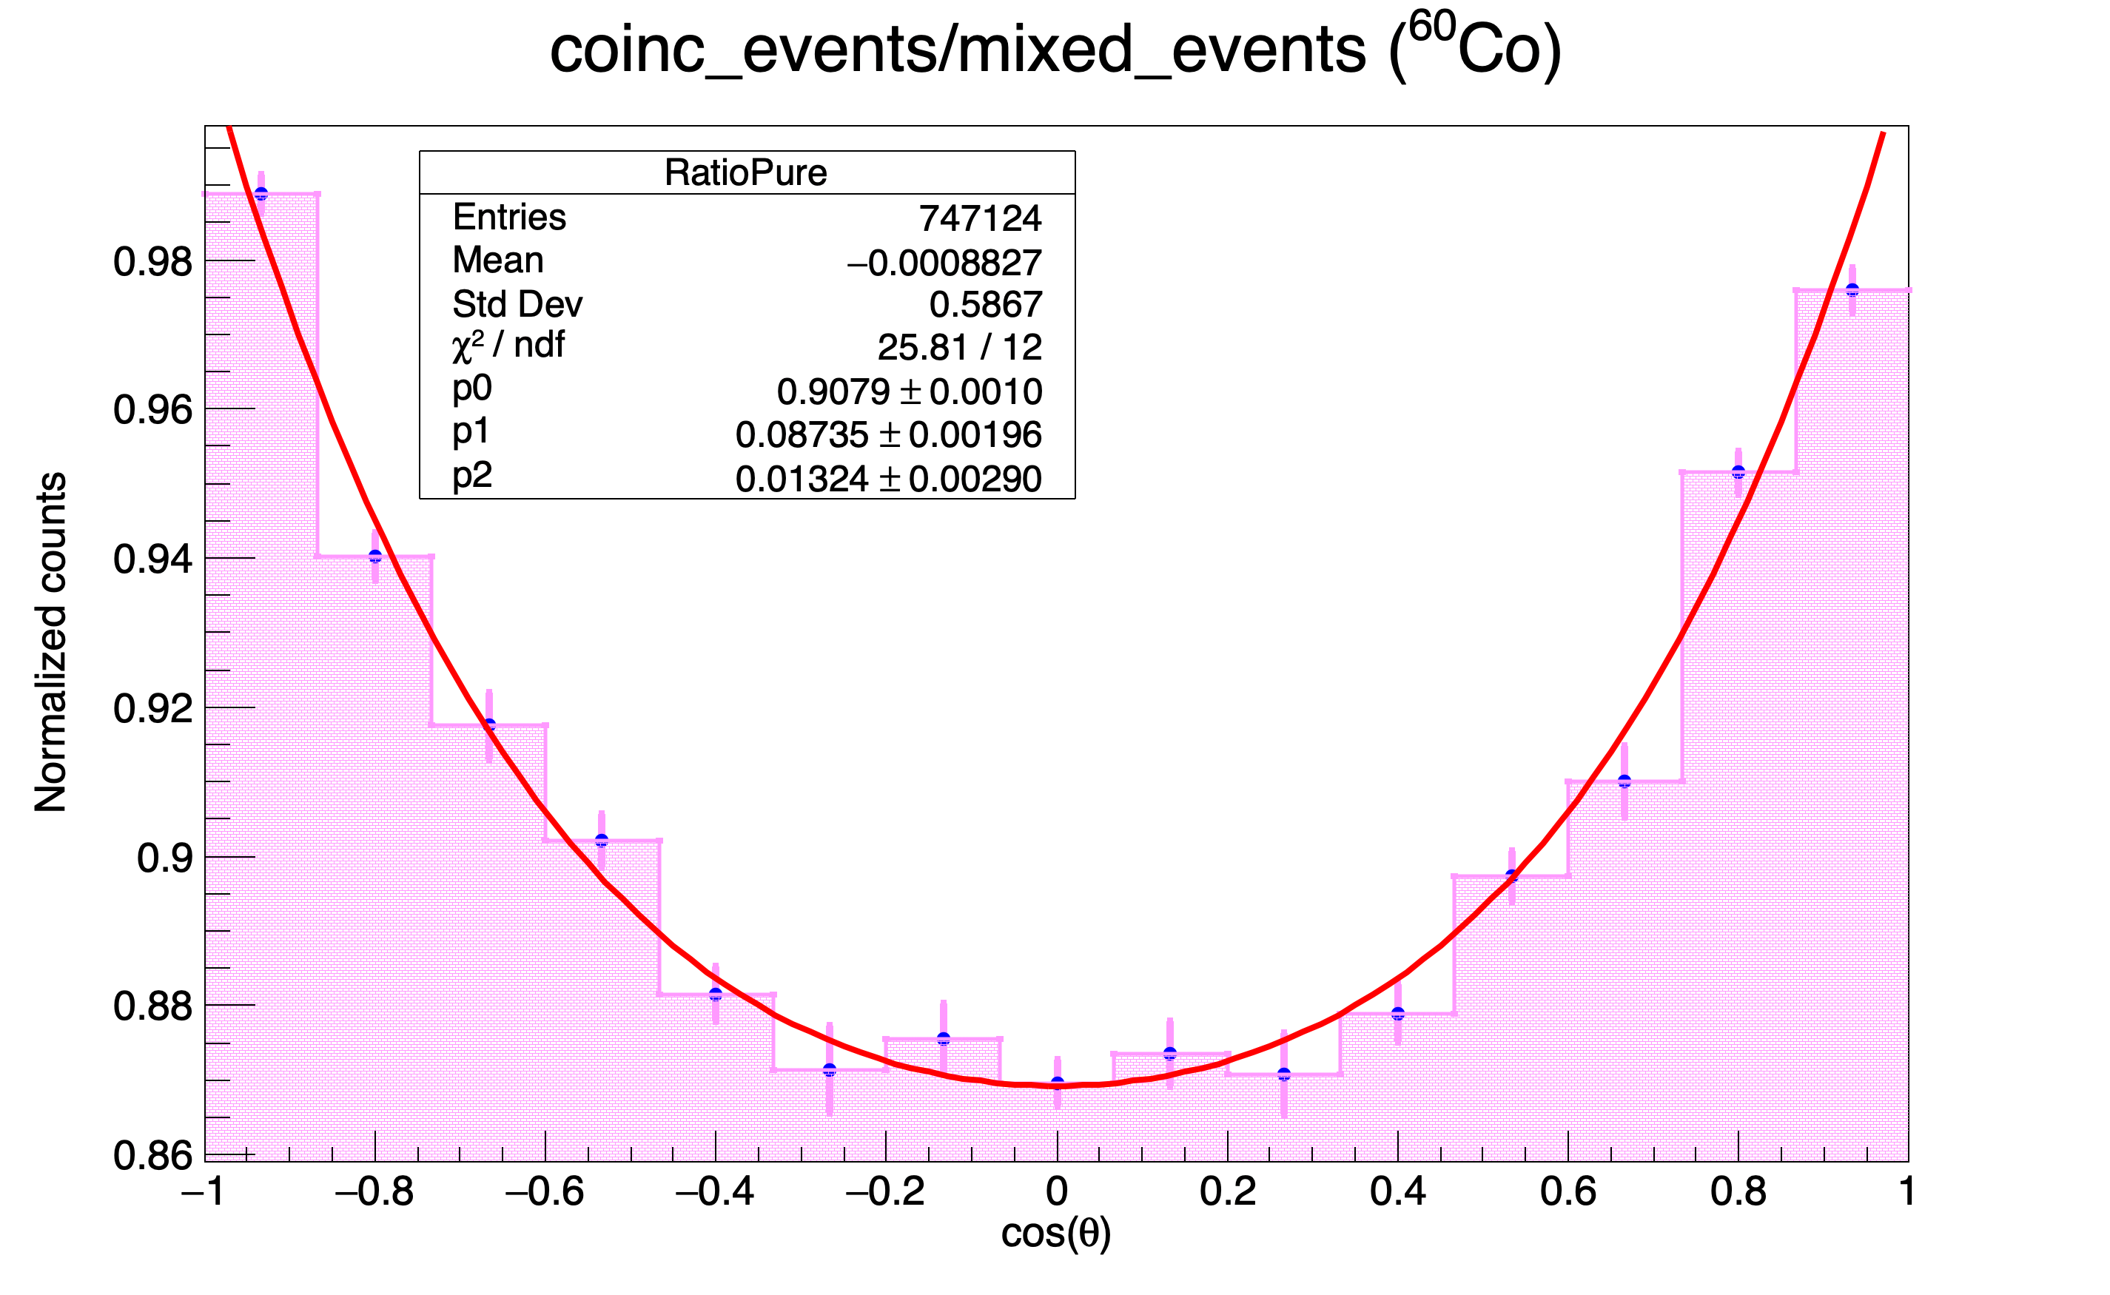
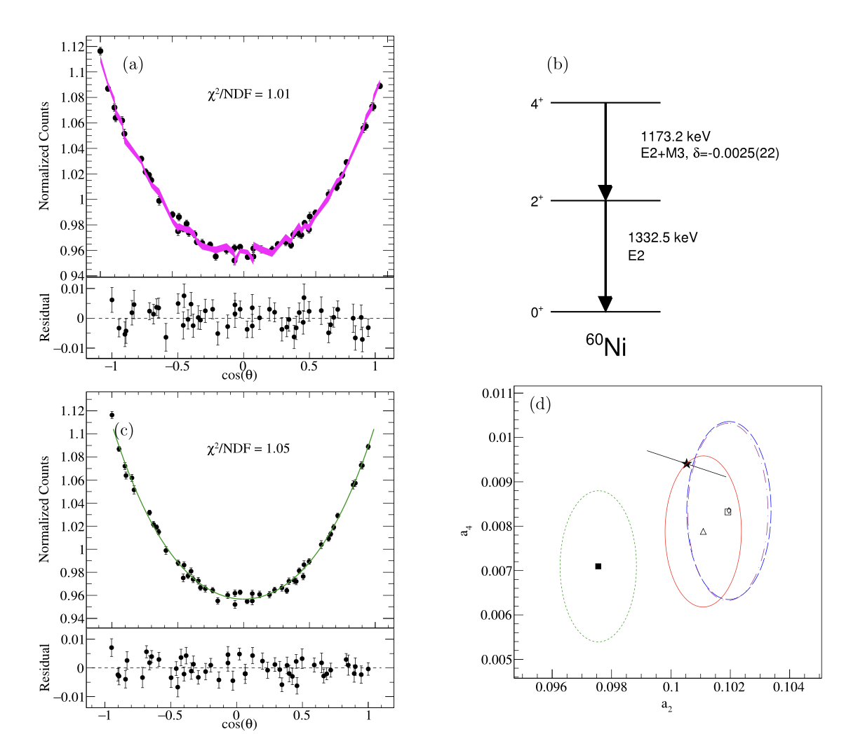
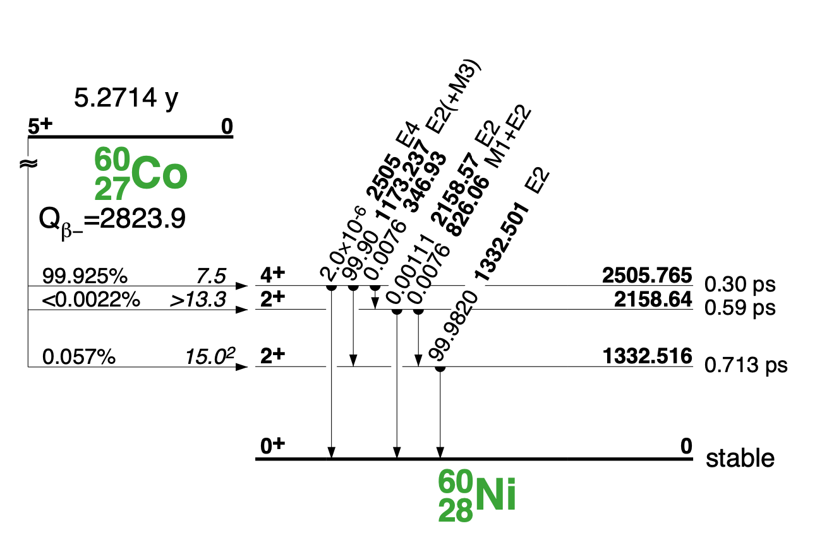
Validation with 60Co
$$W(θ)=1+1/8⋅cos^{2}(θ)+1/24⋅cos^{4}(θ)$$

Slide 27
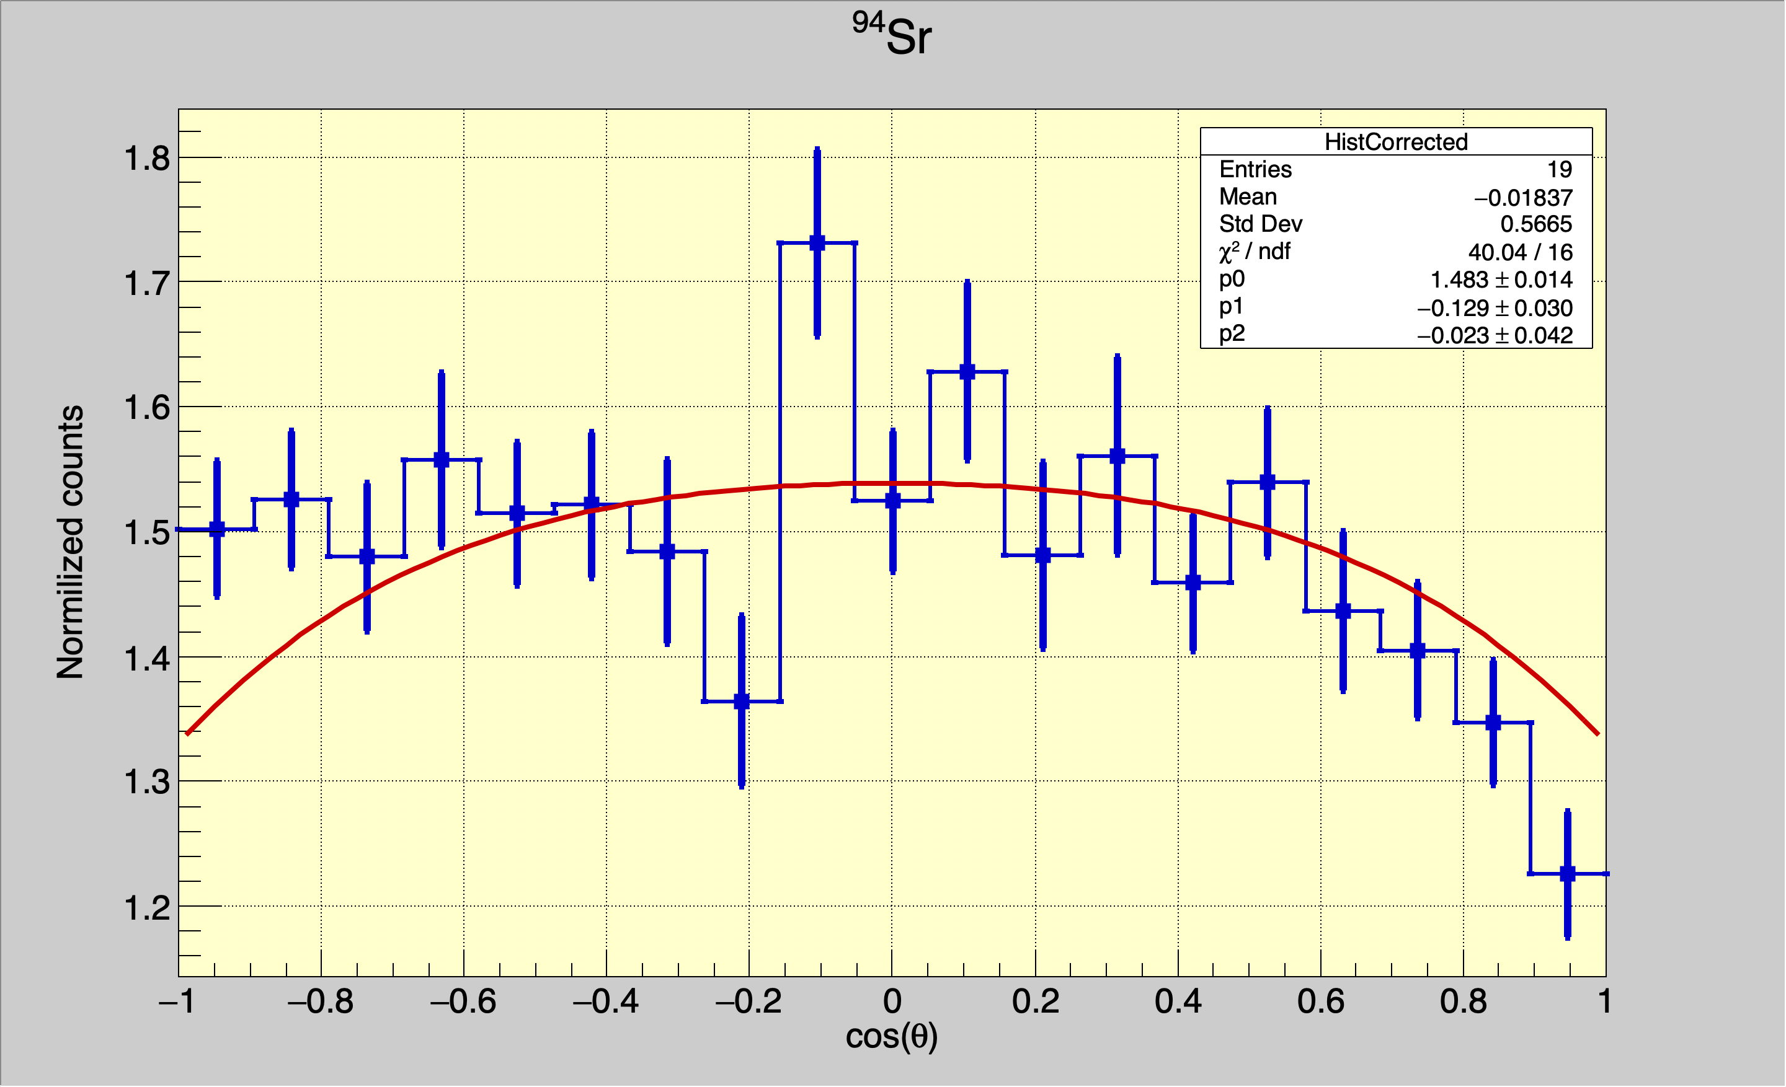
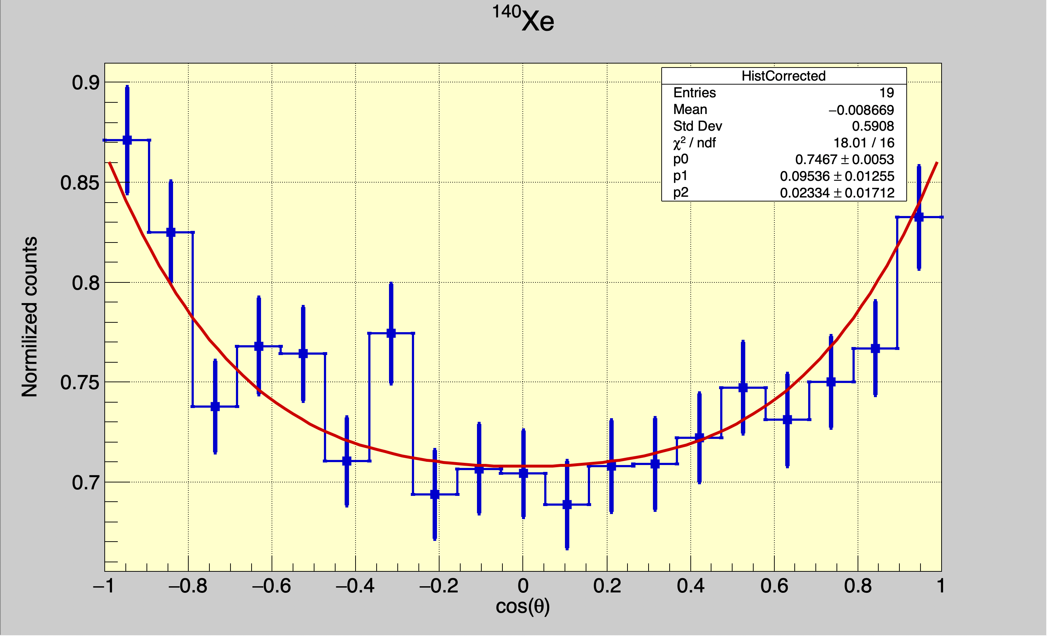
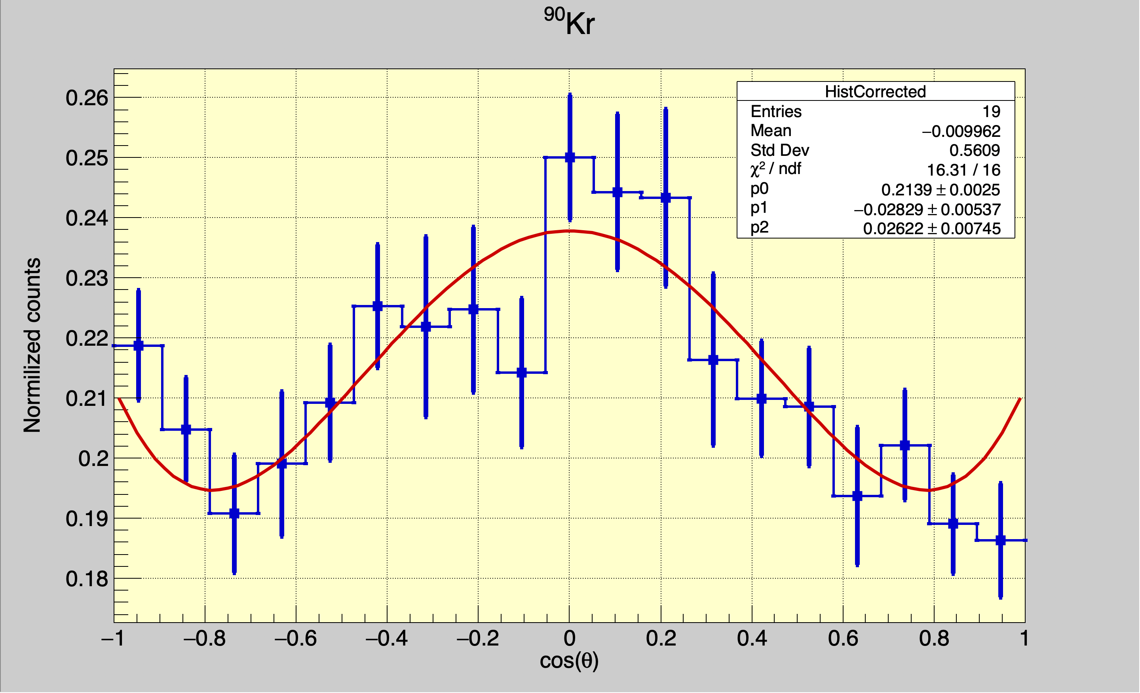
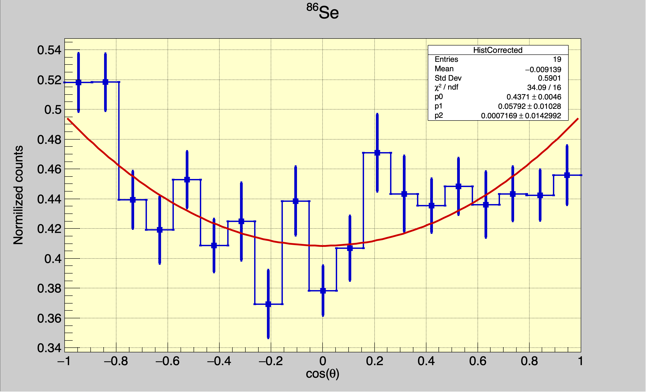




Gamma ray angular correlations: Two gammas from one fragment
1089 keV / 837 keV
457 keV / 377 keV
$3^{−}→2^{+}→0^{+}$
$4^{+}→2^{+}→0^{+}$
655 keV / 707 keV
863 keV / 704 keV
$2^{+}→2^{+}→0^{+}$
$4^{+}→2^{+}→0^{+}$

Slide 28
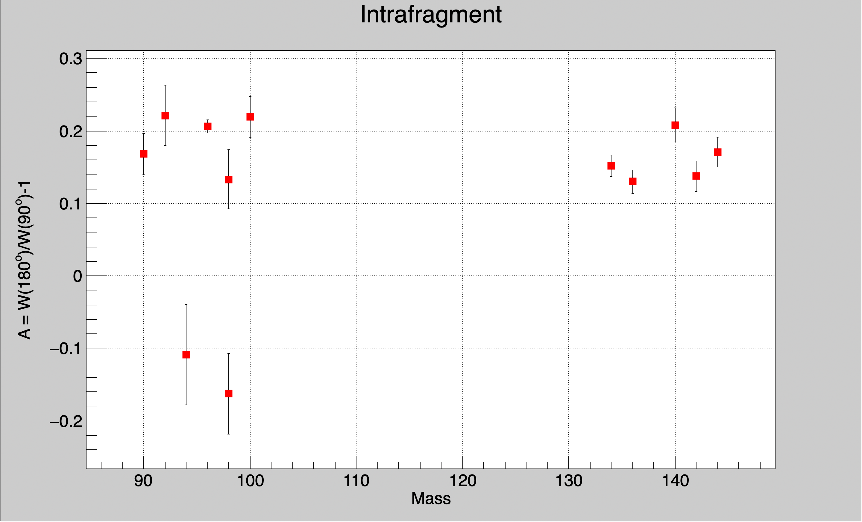
Anisotropy of gamma-ray angular distributions within one fragment
A.G. Smith et al. average

Slide 29
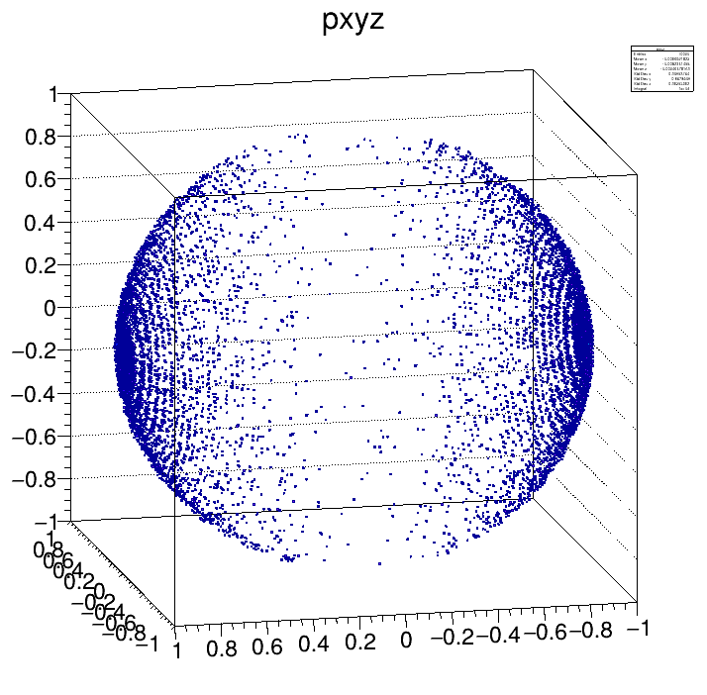


I₁
I₂
I₁
I₂
(1) I is aligned perfectly in the plane perpendicular to the fission axis. No components along the axis.
(2) I has some components along the fission axis
Small angular correlation between gammas from partner fragment is expected
No angular correlation between gammas from partner fragment is expected

Slide 30


Gamma ray angular correlations between fragment partners
PRELIMINARY

Slide 31

Anisotropy of gamma-ray angular distributions between fragment partners
A.G. Smith et al. average
PRELIMINARY

Slide 32
Future Possibilities

Slide 33



Ionisation chamber + ²⁵²Cf + Gammasphere
Expt: 4 kBq fission, 10 days
Ionisation chamber: Only theta, no phi
Courtesy of S. Marin and N. Giha, University of Michigan

Slide 34


Mass – Eγ correlations
Mass A
Doppler correction is mandatory. But Doppler broadening is significant!

Slide 35

Solving the Doppler broadening problem
Monte-Carlo simulations of Doppler broadening in HPGe arrays coupled to IC + ²⁵²Cf(SF) source
Current GS data
Sources of broadening:
Precision on γ-ray θ and φ (array granularity)
Precision of fission axis θ and φ
v/c fragments (3-5%)
Neutron emission
HPGe intrinsic resolution
Ideal array + IC

Slide 36

Future possibilities with SiC radiation hard semiconductor detectors
Masses and TKE obtained via the 2E method
Silicon Carbide semiconductor sandwich
KE1/KE2=A2/A1
(ΔM = 4)
Can survive 10¹³ heavy ions!
(5 orders of magnitude better than Si)
E
ΔE
SiC
SiC
FF
FF
+ AGATA?
Courtesy of C. Nociforo, GSI
100um
3um
²⁵²Cf(SF)
Both fragments stop within 1-2 ps
Collaboration: L. Gaudefroy, A. Franchetau (CEA)
S. Tudisco (INFN Catania), C. Nociforo (GSI)

Slide 37

Simulation of different fission axis angles

Slide 38

Simulation of neighbouring Z’s

Slide 39


Gammasphere data for delayed gammas (100ns – 4 us)
A
E1
Log(t)
¹⁶⁴Gd 4+ (580ns)
E2
A=95
A=164

Slide 40














The nu-Ball2 collaboration, July (2024)
IJC Lab, CEA DAM
Subatech, CENBG, IPHC,
GANIL, LPC Caen
University of Milano
INFN Legnaro
IFJ-PAN Krakow
University of Warsaw
University of Oslo
JRC-Geel
Leuven
University of Surrey, NPL
University of Manchester
TU Darmstadt
IFK- Koln
University of Novi Sad
University of Madrid
IFIC Valencia
ELI-NP, Bucharest
University of Sofia
Riken

Slide 41

Angular momentum “modes”
Beware of overuse of the word « mode »!!
Spontaneous fission: a mode of decay
Description of the shell effects governing the mass partition (e.g. S1 mode, S2 mode, Super-long mode, etc.)
3) A zoology of fragment spin directions after scission (bending mode, wobbling mode, etc.)
4) A kind of vibrational mechanism via which fragment spin is generated

Slide 42


Monte-Carlo code: scission to yrast spin propagation
Spin dispersions from scission to yrast
Conclusion: dispersions can slightly weaken spin correlations at scission but do not destroy them

Slide 43


Appearance of Angular momentum in fission
It’s a baby!

