Slide 1





Angular Momentum in Fission through Isomeric Ratio measurements with the Lohengrin spectrometer
Anna Skouloudaki^{1,2}, A. Chebboubi¹, G. Kessedjian¹, M. Diakaki², O. Serot¹, D. Bernard¹, U. Koester³, J.M. Daugas³, P. Mutti³, O. Meplan⁴, C. Sage⁴
¹ CEA, DES, IRESNE, DER, SPRC, Cadarache, Physics Studies Laboratory, 13108 Saint-Paul-lès-Durance, France
² National Technical University of Athens, Iroon polytechniou 9, Zografou Campus 15780, Athens, Greece
³ Institut Laue-Langevin, 38042 Grenoble Cedex 9, France
⁴ LPSC, Université Grenoble-Alpes, CNRS/IN2P3, 38026 Grenoble Cedex, France

Slide 2
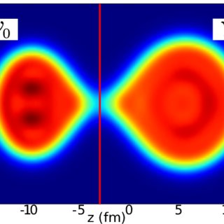
Contents
Motivation
Isomeric Ratios of Fission Products as observables of Angular Momentum through ²⁴¹Am(2n_{th},f)
Analysis Process
Preliminary results of ¹⁰⁰Nb and perspectives
Number of Particles in Fission Fragments, 2019, M. Verriere, T. Kawano, N. Schunck
Notes:
Neutron induced fission reaction

Slide 3
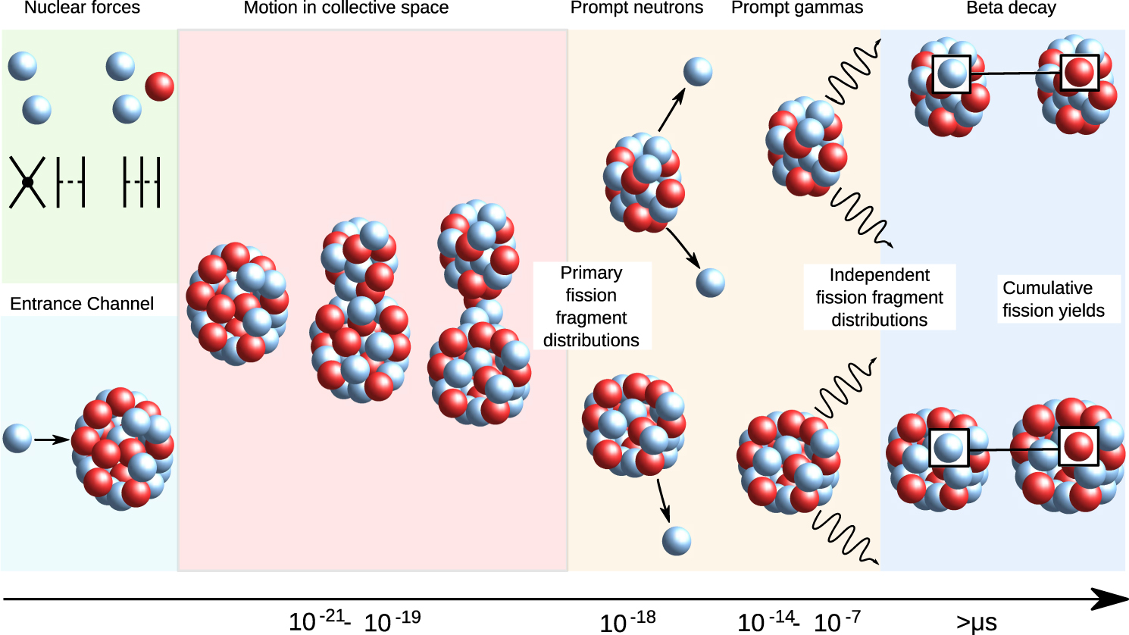
Motivation: Angular momentum generation mechanism of Fission Fragments
M. Bender et al., Future of nuclear fission theory, J. Phys. G: Nucl. Part. Phys. 47 113002 (2020)
Notes:
Fission process

Slide 4
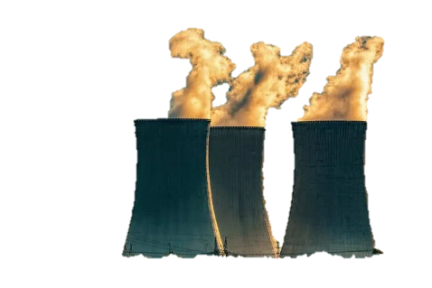
Motivation: Angular momentum generation mechanism of Fission Fragments
Applications:
Open questions:
the general properties of the Angular Momenta (AM)
the mechanism(s) behind their generation and correlation of the angular momentum of the two fission fragments
Angular Momentum
PFNS
PFGS
Nuclear Reactor modeling
criticality calculations
Radioprotection, shielding
Angular momentum generated around scission point
M. Bender et al., Future of nuclear fission theory, J. Phys. G: Nucl. Part. Phys. 47 113002 (2020)
Notes:
To date, despite this diversity of approaches, none of the currently existing models can describe the angular-momentum generation mechanism with satisfactory accuracy

Slide 5
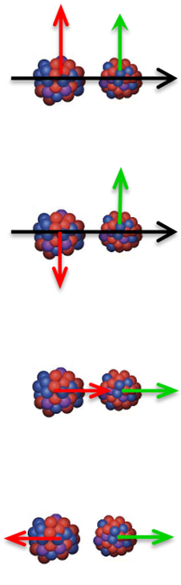
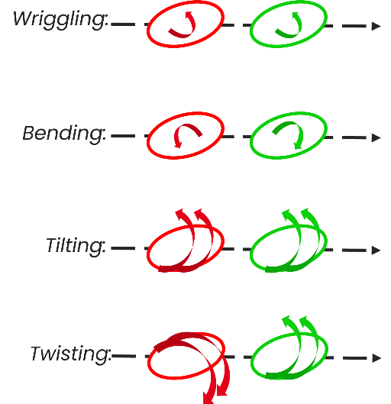
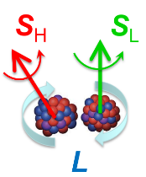
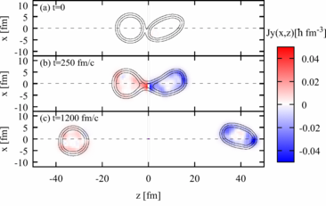
Motivation: Angular momentum generation mechanism of Fission Fragments
Competing theories
J. Randrup et al., Generation of Fragment Angular Momentum in Nuclear Fission, EPJ WoC, 284,04004 (2023)
Angular momentum generated around scission point
G. Scamps, Microscopic description of the torque acting on fission fragments, Phys. Rev. C 106, 054614 (2022)
M. Bender et al., Future of nuclear fission theory, J. Phys. G: Nucl. Part. Phys. 47 113002 (2020)
Notes:
different collective modes
Microscopic
AM governed only by structural effects, or whether itis also influenced already at the moment of scission due to fragment deformation and other dynamical effects

Slide 6
Motivation: Angular momentum generation mechanism of Fission Fragments
µs Isomers
M. Bender et al., Future of nuclear fission theory, J. Phys. G: Nucl. Part. Phys. 47 113002 (2020)
Notes:
Since the angular momentum is quickly carried away by the γ-rays, the experimental study of the generation mechanism necessarily involves detailed observation of the prompt γ-ray emission or IS

Slide 7
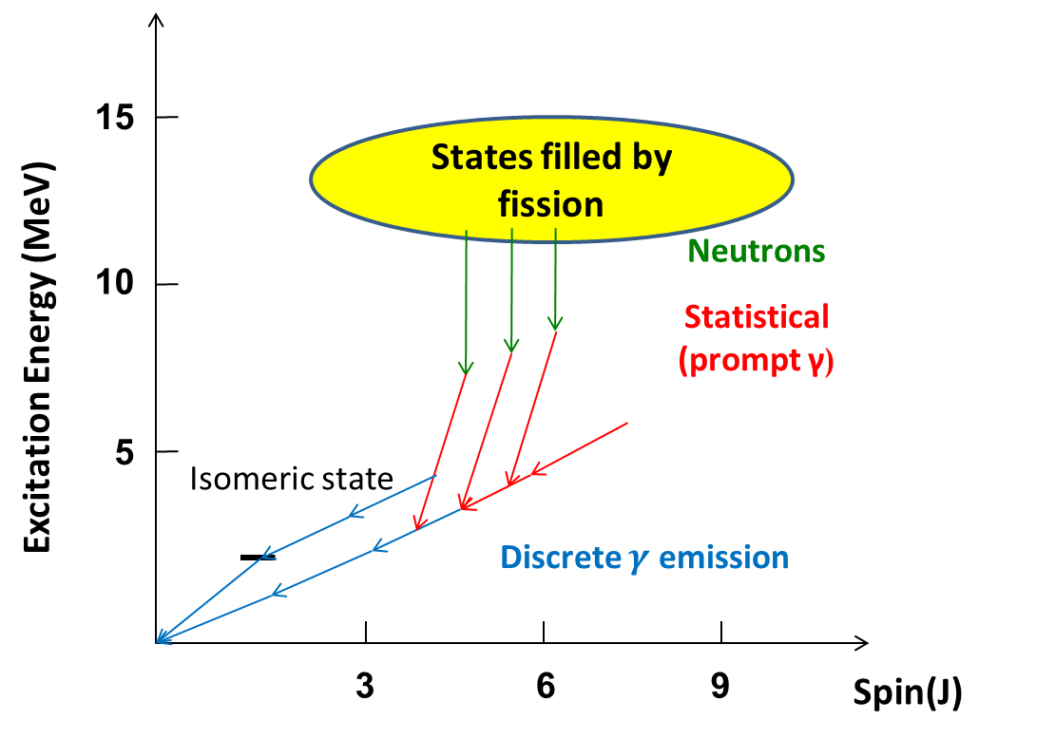
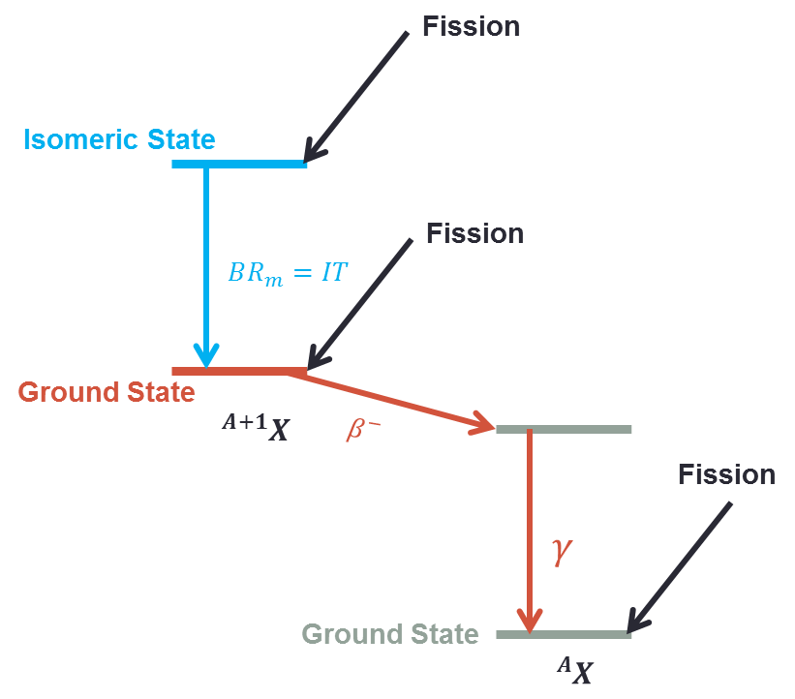
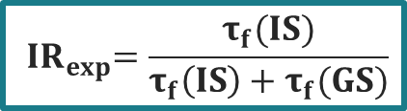
Motivation: Angular momentum generation mechanism of Fission Fragments
J. Randrup et al., Generation of Fragment Angular Momentum in Nuclear Fission, EPJ WoC, 284,04004 (2023)
$${ IR}_{exp}=\frac{τ_{f}(IS)}{τ_{f}\left(IS\right)+τ_{f}(GS)}$$
µs Isomers
Investigation of fission product isomeric ratios and angular momenta of 132Sn populated in the 241Pu(nth,f) reaction, A. Chebboubi, EPJ Web of Conferences 256, 00011 (2021)
M. Bender et al., Future of nuclear fission theory, J. Phys. G: Nucl. Part. Phys. 47 113002 (2020)
Notes:
A nucleus is excited and wants to drop to the ground state. But quantum selection rules (strongly hindered by quantum mechanical selection rules) make the "path down" very unlikely. So it gets “stuck” in a metastable state
IR = ratio of the production rate
The IR is very sensitive to the structure of the states above the metastable state, that’s why it is a very good indicator.

Slide 8
Goals
Isomeric Ratios measurements
$${IR}_{exp}\left({KE}_{FF}\right)$$
Isomeric Ratios measurements
〖𝐈𝐑〗_𝐞𝐱𝐩 (〖𝐊𝐄〗_𝐅𝐅 )
FIFRELIN decay
$\overline{IR}\left(E_{FF}^{∗}\right)$
FIFRELIN decay
(𝐈𝐑) ̅(𝐄_𝐅𝐅^∗ )
Extraction of the angular momentum
$$J_{FF}(E_{FF}^{∗})$$
Extraction of the angular momentum
𝐉_𝐅𝐅 (𝐄_𝐅𝐅^∗)
Through experimental campaigns and interpretation, coupled with theoretical models, we aim to:
constrain the different models of generation of the angular momentum of fission fragments
find a possible correlation with excitation energy, through Isomeric Ratio (IR) measurements.
Fission modelling with FIFRELIN, O. Litaize, O. Serot, L. Berge, The European Physical Journal A 51, 177 (2015)

Slide 9
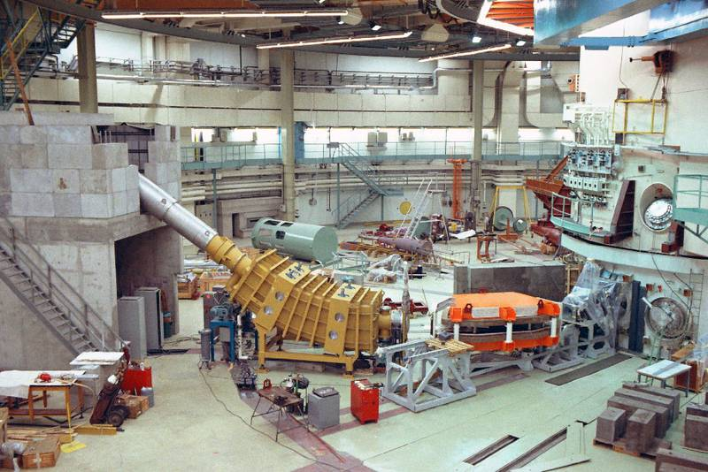
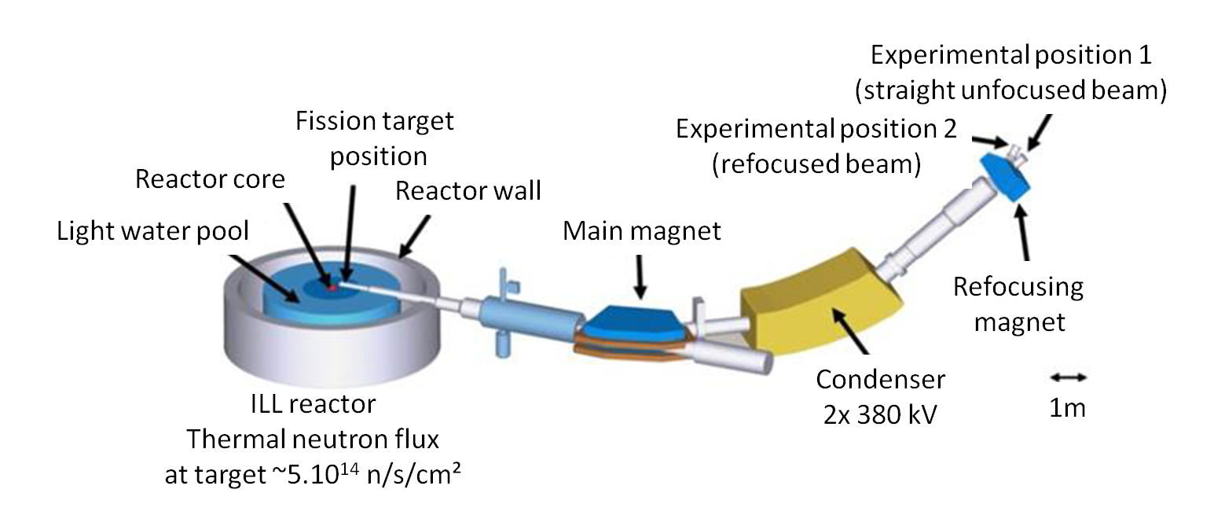
Experimental setup of LOHENGRIN spectrometer in ILL
Isomeric Ratios measurements
$${IR}_{exp}\left({KE}_{FF}\right)$$
Isomeric Ratios measurements
〖𝐈𝐑〗_𝐞𝐱𝐩 (〖𝐊𝐄〗_𝐅𝐅 )
FIFRELIN decay
$\overline{IR}\left(E_{FF}^{∗}\right)$
FIFRELIN decay
(𝐈𝐑) ̅(𝐄_𝐅𝐅^∗ )
Extraction of the angular momentum
$$J_{FF}(E_{FF}^{∗})$$
Extraction of the angular momentum
𝐉_𝐅𝐅 (𝐄_𝐅𝐅^∗)
J. M. Daugas, Session 9, 3/11/2026, FISSION 2026 workshop

Slide 10
Experimental setup of LOHENGRIN spectrometer in ILL
Choice of$\vec{B}$ and $\vec{E}$
Choice of 𝐁 ⃗ and 𝐄 ⃗
Selection of $A/{q }$and ${E_{K}}/{q }$
Selection of 𝐀⁄(𝐪 )and 𝐄_𝐊⁄(𝐪 )
Only isotopes of chosen $A/{q }$ are deflected into the exit slit
Only isotopes of chosen 𝐀⁄(𝐪 ) are deflected into the exit slit
²⁴¹Am
J. M. Daugas, Session 9, 3/11/2026, FISSION 2026 workshop
Notes:
$→$ selection of the Mass over Ionic Charge $A/{q }$and Kinetic Energy over Ionic Charge ${E_{K}}/{q }$ ratios
Contamination-trajectory by charge changing
Not straitforward, higher intensity-lower resolution (9 shutters, 0,5MeV/shutter)
thermal neutron flux of about 5 ⇥ 1014 n/cm2/s near the core of the ILL high-flux reactor. The total length of LOHENGRIN is 23 m and has a high mass resolution (A/∆A 400) [10], which is dependent on target size

Slide 11
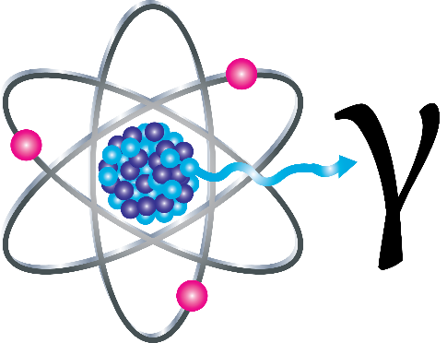
Experimental setup of LOHENGRIN spectrometer in ILL
Choice of$\vec{B}$ and $\vec{E}$
Choice of 𝐁 ⃗ and 𝐄 ⃗
Selection of $A/{q }$and ${E_{K}}/{q }$
Selection of 𝐀⁄(𝐪 )and 𝐄_𝐊⁄(𝐪 )
Only isotopes of chosen $A/{q }$ are deflected into the exit slit
Only isotopes of chosen 𝐀⁄(𝐪 ) are deflected into the exit slit
²⁴¹Am
Mass spectrometry
Gamma spectroscopy
J. M. Daugas, Session 9, 3/11/2026, FISSION 2026 workshop
Notes:
choice of magnetic and electric fields
$→$ selection of the Mass over Ionic Charge $A/{q }$and Kinetic Energy over Ionic Charge ${E_{K}}/{q }$ ratios
$→$ the particles of a chosen A/q value are deflected into the exit slit. With selected KE
Mass separation
Contamination-trajectory by charge changing
Not straitforward, higher intensity-lower resolution (9 shutters, 0,5MeV/shutter)

Slide 12
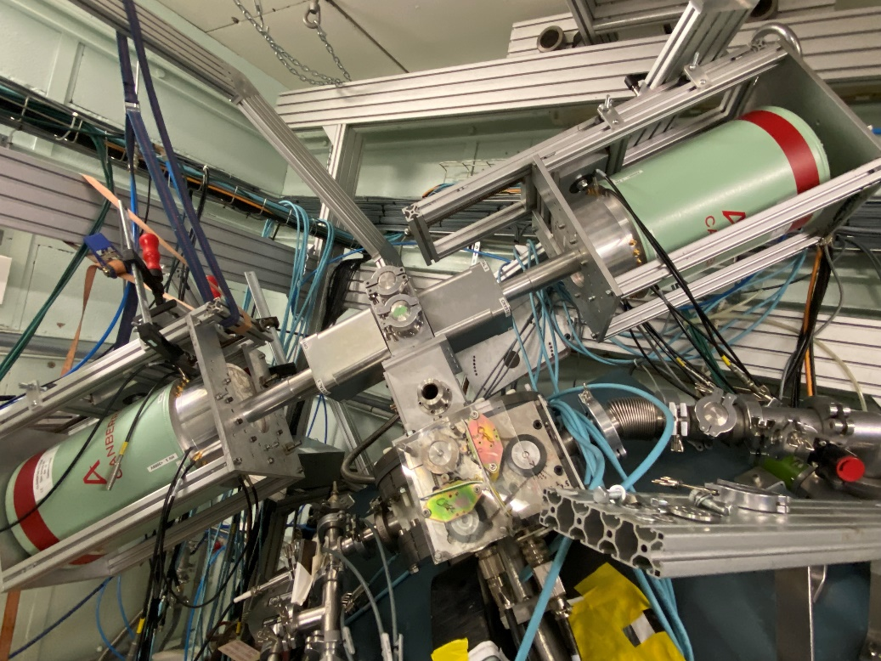

Experimental setup of LOHENGRIN spectrometer in ILL
Implantation foil
HPGe 2
Ionisation chamber
Separation grid
HPGe 1
Incident Fission Product $(A/{q })$
Entrance Window foil
Fission Product
Photon
Notes:
Direction

Slide 13
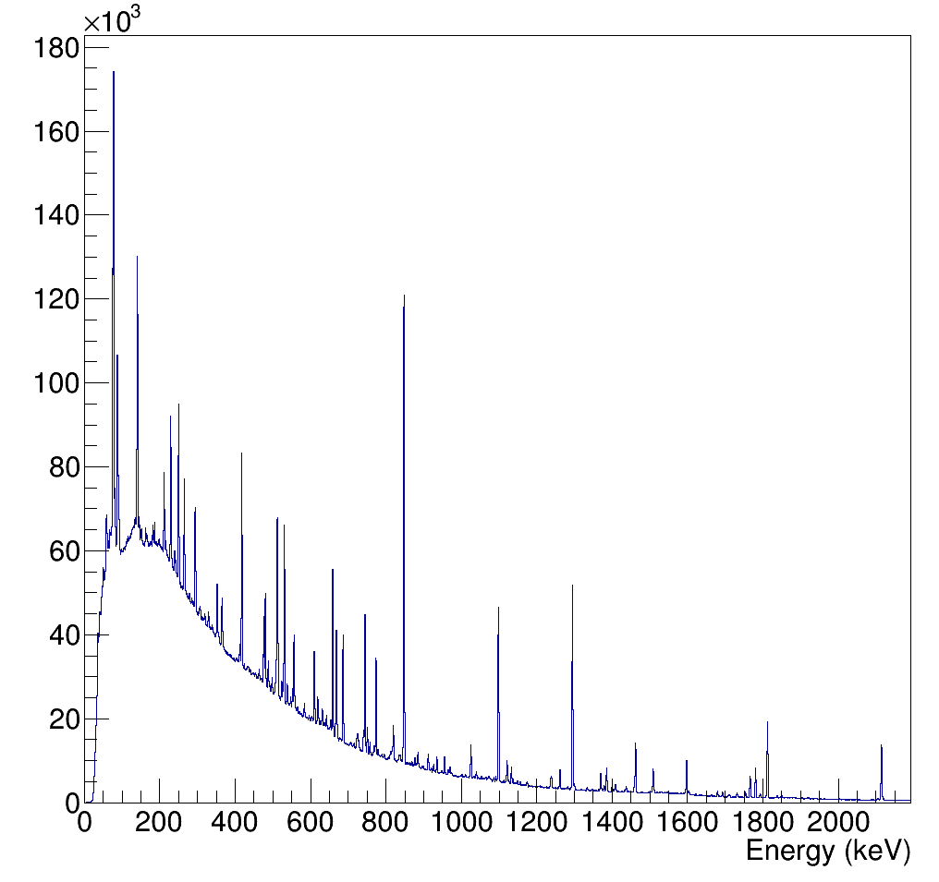

Analysis - ¹⁰⁰Nb from ²⁴¹Am(2n_{th},f)
Delayed $γ$-Spectrum without selection
Notes:
Arise a question

Slide 14
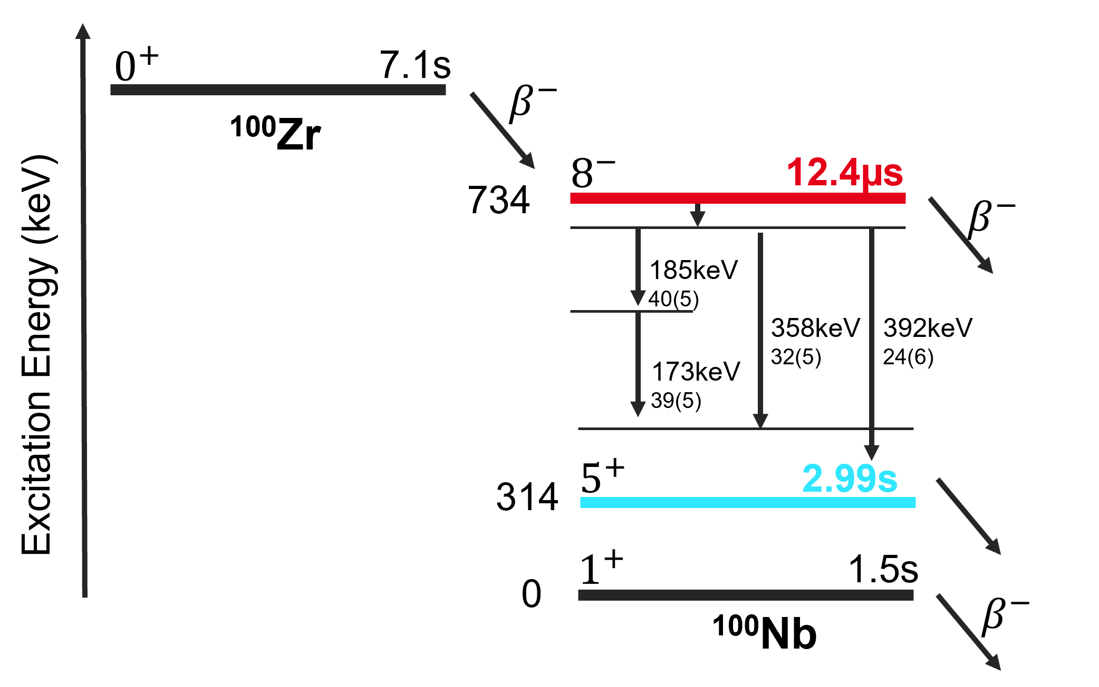
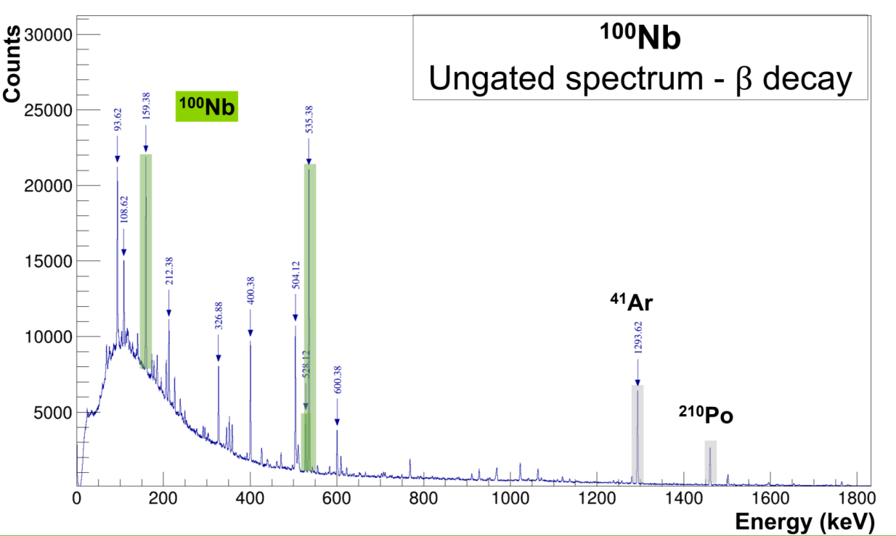

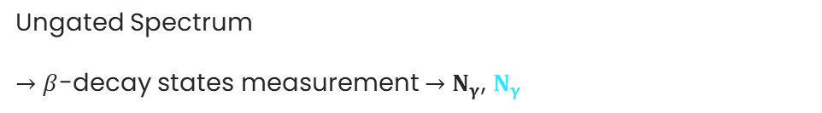
Analysis - ¹⁰⁰Nb from ²⁴¹Am(2n_{th},f)
Delayed $γ$-Spectrum without selection
LOHENGRIN: mass separator
Ungated Spectrum
$→$ $β$-decay states measurement $→$ $N_{γ}$, $N_{γ}$
$$Δt_{meas}≅1.5 h$$
Mass, KE
Filter
Notes:
Arise a question

Slide 15
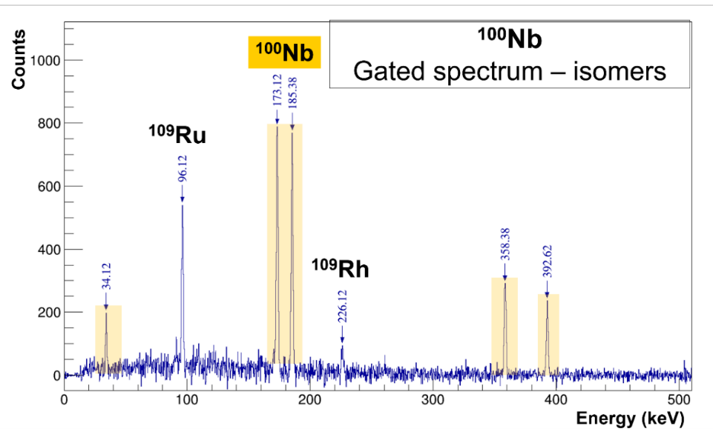
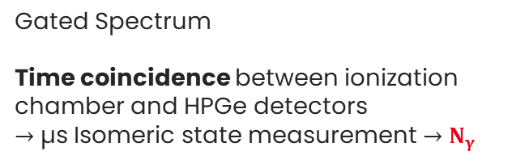

Analysis - ¹⁰⁰Nb from ²⁴¹Am(2n_{th},f)
Delayed $γ$-Spectrum without selection
LOHENGRIN: mass separator
Ungated Spectrum
$→$ $β$-decay states measurement $→$ $N_{γ}$, $N_{γ}$
Gated Spectrum
Time coincidence between ionization chamber and HPGe detectors
$→$ µs Isomeric state measurement $→$ $N_{γ}$
$$Δt_{meas}≅1.5 h$$
Mass, KE
Filter
$$Δt_{Gate}≅40 μs$$
Time Coincidence
Filter
Notes:
Arise a question

Slide 16
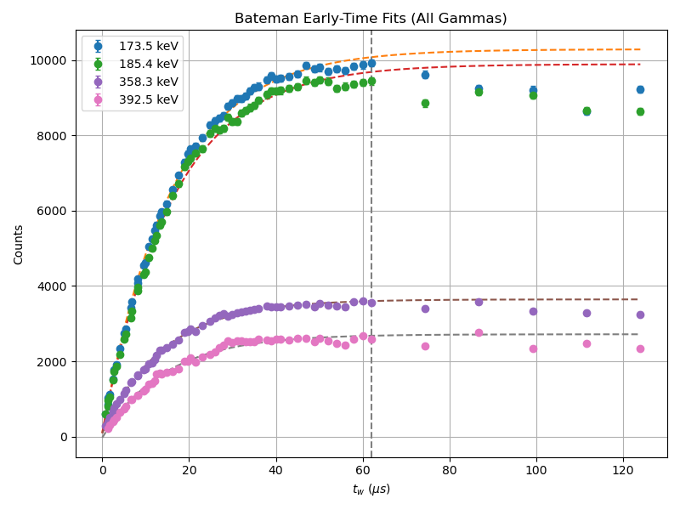

Analysis - $Δt_{Gate}$- ¹⁰⁰Nb
For which $Δt_{Gate}$is the $t_{1/2}$ of the isomeric level re-produced ?
$Δt_{Gate}≅60 μs$ $≅$ 5*$t_{1/2,ms}$

Slide 17
Analysis - $Δt_{Gate}$- ¹⁰⁰Nb
For which $Δt_{Gate}$is the $t_{1/2}$ of the isomeric level re-produced ?
$Δt_{Gate}≅60 μs$ $≅$ 5*$t_{1/2,ms}$
t₁/₂ = 10.54 ± 0.10 µs
χ² / ndf = 2.14
p-value = 2.145e-06

Slide 18
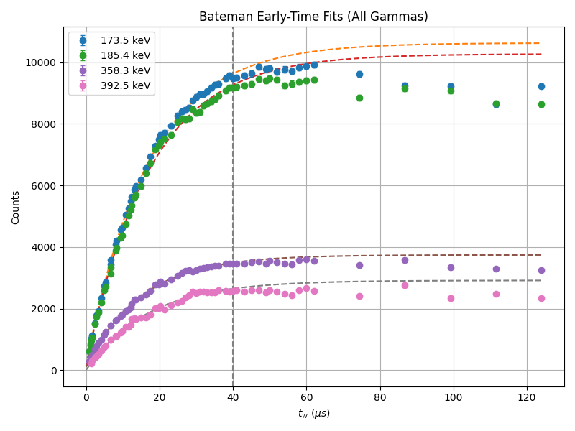

Analysis - $Δt_{Gate}$- ¹⁰⁰Nb
For which $Δt_{Gate}$is the $t_{1/2}$ of the isomeric level re-produced ?
$Δt_{Gate}≅60 μs$ $≅$ 5*$t_{1/2,ms}$
$Δt_{Gate}≅40 μs$ $≅$ 3*$t_{1/2,ms}$
t₁/₂ = 10.54 ± 0.10 µs
χ² / ndf = 2.14
p-value = 2.145e-06
t₁/₂ = 11.97 ± 0.22 µs
χ² / ndf = 1.35
p-value = 6.427e-02

Slide 19
Analysis - $Δt_{Gate}$
Event
Short Gate (µs)
Notes:
Data sorting software

Slide 20
Analysis - $Δt_{Gate}$
Event
Short Gate (µs)
Event
Rejected
Long Gate (µs)
overlap
Importance of data sorting

Slide 21
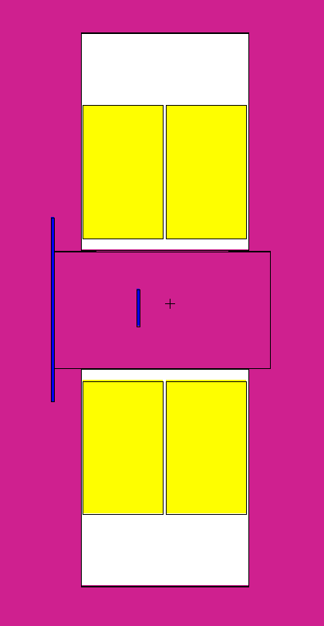

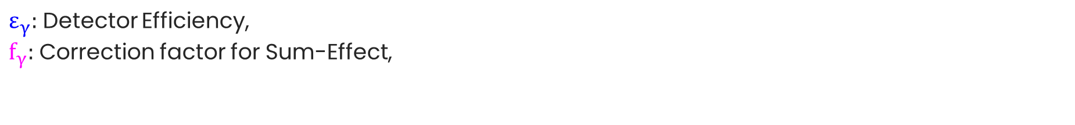
Analysis - ¹⁰⁰Nb from ²⁴¹Am(2n_{th},f)
$$N_{γ}→N_{d}=\frac{N_{γ}}{ε_{γ}{×I}_{γ}×f_{γ}} \underset{→}{Average} \overline{N_{d}} \underset{→}{\begin{aligned}Bateman Equation \\ Resolution\end{aligned}}τ_{f}\underset{→}{}{ IR}_{exp}=\frac{τ_{f}(IS)}{τ_{f}\left(IS\right)+τ_{f}(GS)}$$
IR: Isomeric Ratio, IS: Isomeric State, GS: Ground State
$ε_{γ}:$ Detector Efficiency,
$f_{γ}:$ Correction factor for Sum-Effect,
will be derived from ${\text{TrueCoinc}}^{1}$ and Monte Carlo Simulation ${\text{MCNP}\text{6}}^{2}$ (in progress).
HPGe 1
IC
HPGe 2
1. Sudar, S. (2002). 'TrueCoinc' software utility for calculation of the true coincidence correction (IAEA-TECDOC--1275). International Atomic Energy Agency (IAEA)
2. D.B. Pelowitz et al., Tech. Rep. LA-CP-13-00634, LosAlamos National Laboratory, Los Alamos, NM, USA, 2013

Slide 22
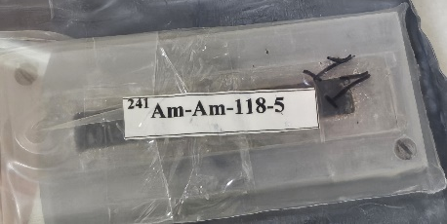
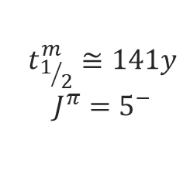





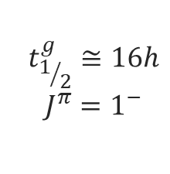
²⁴¹Am(2n_{th},f) mechanism
fission
0
$${{BR}_{m}}^{i}$$
$$t_{1/2}^{m}≅141y$$
$$J^{π}=5^{−}$$
²⁴¹Am + n
^{242m}Am
1
+ n
^{243*}Am
$$t_{1/2}≅433y$$
$${BR}_{IT}$$
$${1−BR}_{m}$$
2
$$t_{1/2}^{g}≅16h$$
$$J^{π}=1^{−}$$
+ n
^{243*}Am
^{242g}Am
$${\text{β}}^{\text{−}}$$
The branching ratio of ²⁴¹Am is spectrum dependent
$i$ : ${BR}_{m}=0.093$
Am-241 thermal neutron capture cross section and neutron capture resonance integral from reactor activation and oscillation measurements, G. Žerovnik, G. Noguère et al., EPJ Web of Conferences 284, 01042 (2023), ND2022
Notes:
These two competing states, which differ strongly in both half-life and angular momentum, undergo fission independently after capturing a second neutron and forming the compound nucleus 243*Am

Slide 23
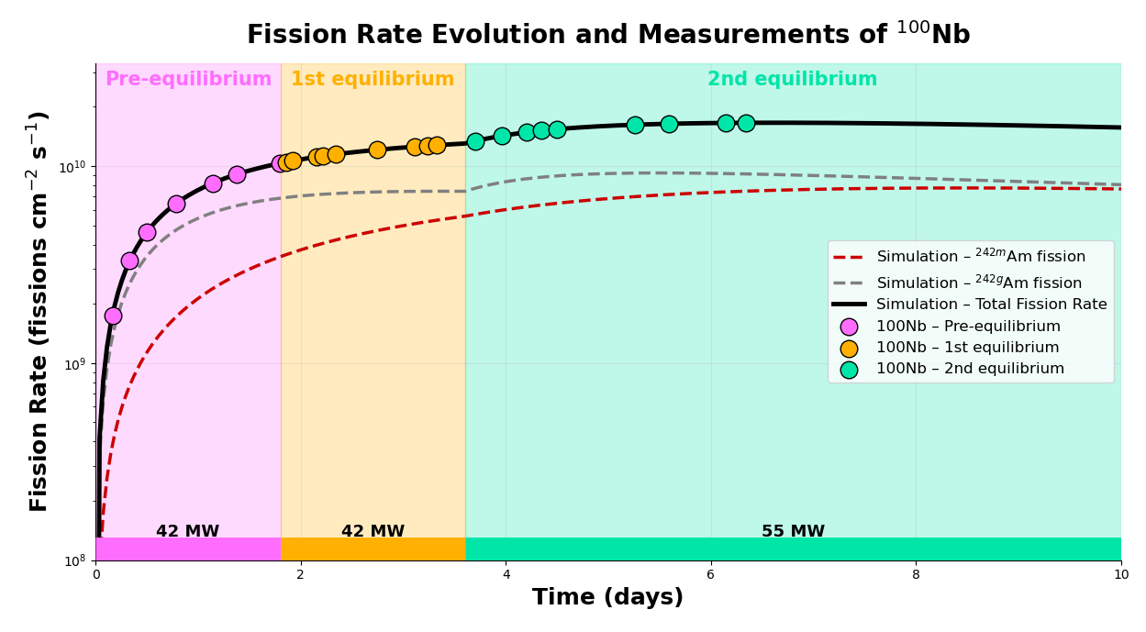
Preliminary Results - ¹⁰⁰Nb from ²⁴¹Am(2n_{th},f)
Notes:
the reactor power varied over the time of the measurements, it is possible to determine the relative contributions of fission originating from the metastable and ground states of242Am as a function of time.

Slide 24

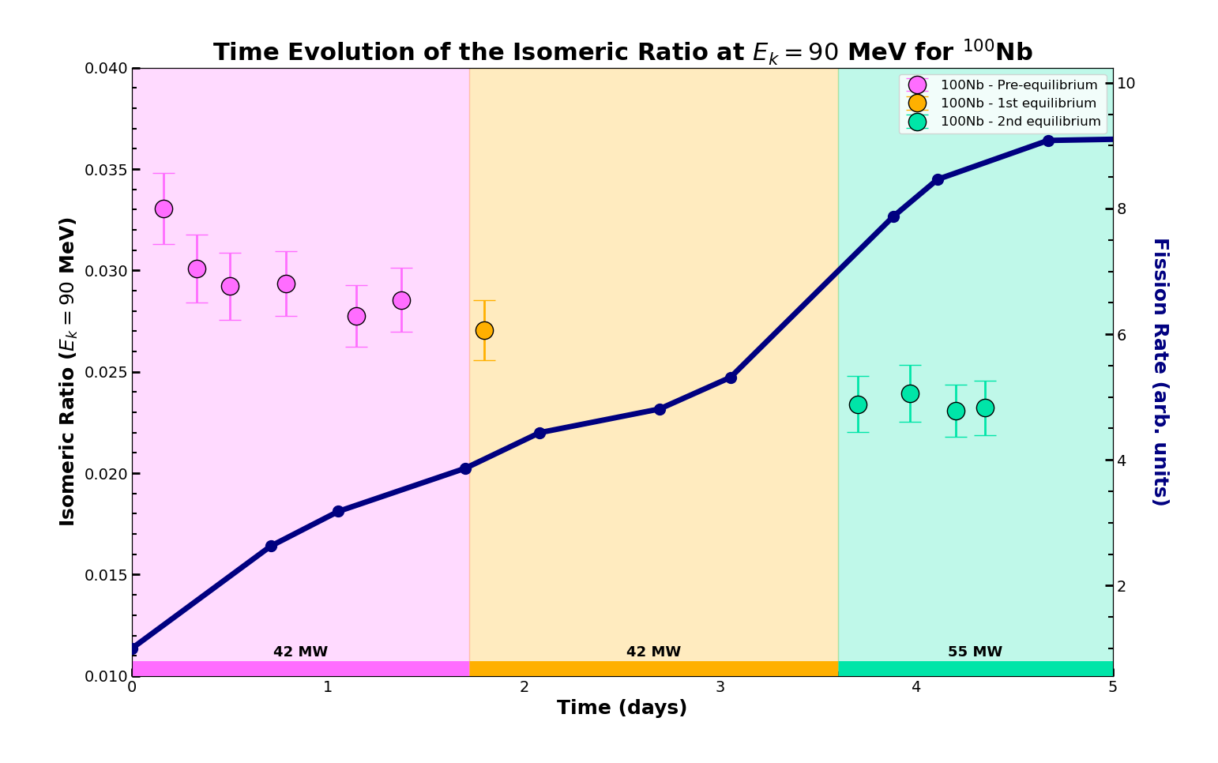
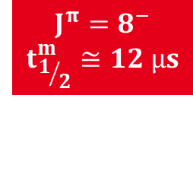
Preliminary Results - ¹⁰⁰Nb from ²⁴¹Am(2n_{th},f) IR(t)
Preliminary
$$J^{π}=8^{−}$$
$$t_{1/2}^{m}≅12 µs$$

Slide 25
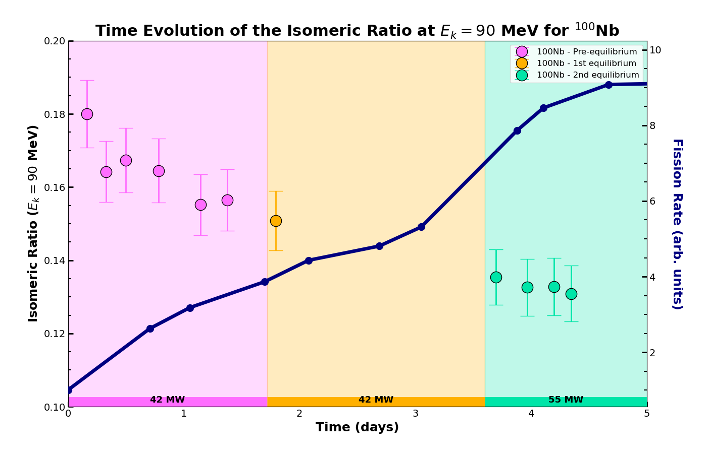
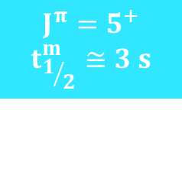
Preliminary Results - ¹⁰⁰Nb from ²⁴¹Am(2n_{th},f) IR(t)
Preliminary
$$J^{π}=5^{+}$$
$$t_{1/2}^{m}≅3 s$$

Slide 26
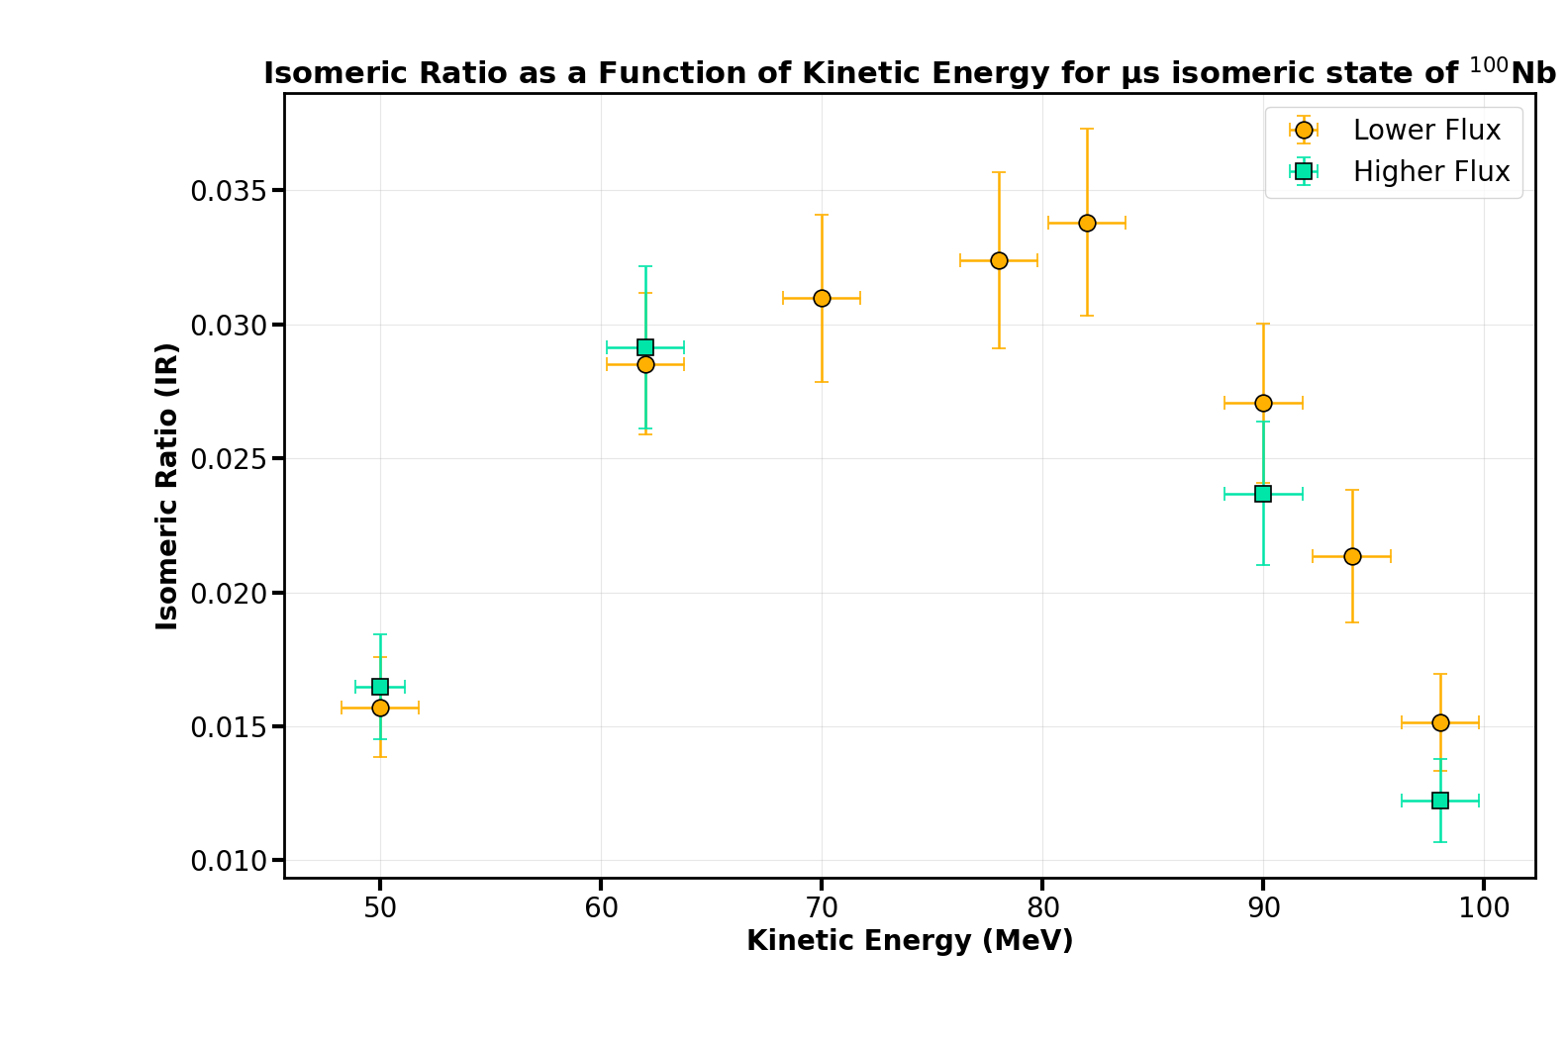
Preliminary Results - ¹⁰⁰Nb from ²⁴¹Am(2n_{th},f) IR(KE)
Preliminary
$$J^{π}=8^{−}$$
$$t_{1/2}^{m}≅12 µs$$

Slide 27
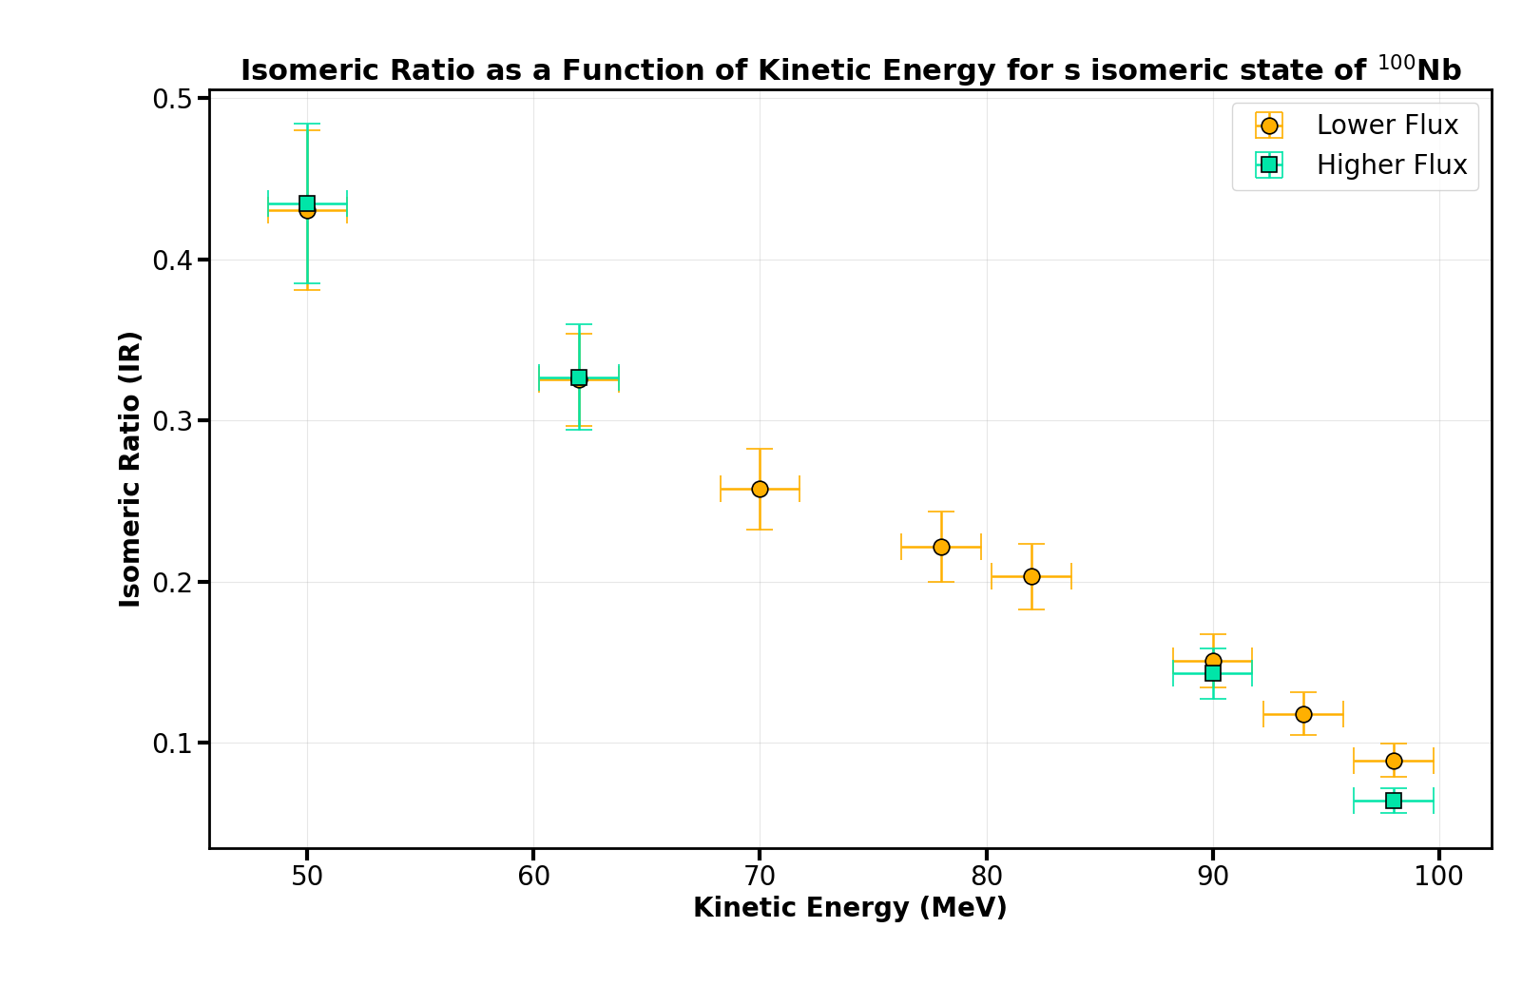
Preliminary Results - ¹⁰⁰Nb from ²⁴¹Am(2n_{th},f) IR(KE)
Preliminary
$$J^{π}=5^{+}$$
$$t_{1/2}^{m}≅3 s$$

Slide 28



Future prospects
Absolute efficiency & correction factors
Consistent analysis of the ²⁴¹Am(2n_{th},f) experiment
Comparison with the FIFRELIN code
$$IR(KE)$$
$$J_{FF}(E^{∗})$$
Finalise the MCNP6 simulation and compute the correction factors
Consistent analysis for the 13 masses in total measured during this experiment
Notes:
We aim to determine the angular-momentum distribution of the fission fragments (as afunction of their kinetic energy), by combining the measured IRs with FIFRELIN calculations. The absoluteefficiency of the detection system, including corrections for summing effects, was quantified using detailedMonte Carlo simulations implemented in MCNP6. This analysis will ultimately enable the exploration ofangular-momentum generation mechanisms in fission

Slide 29
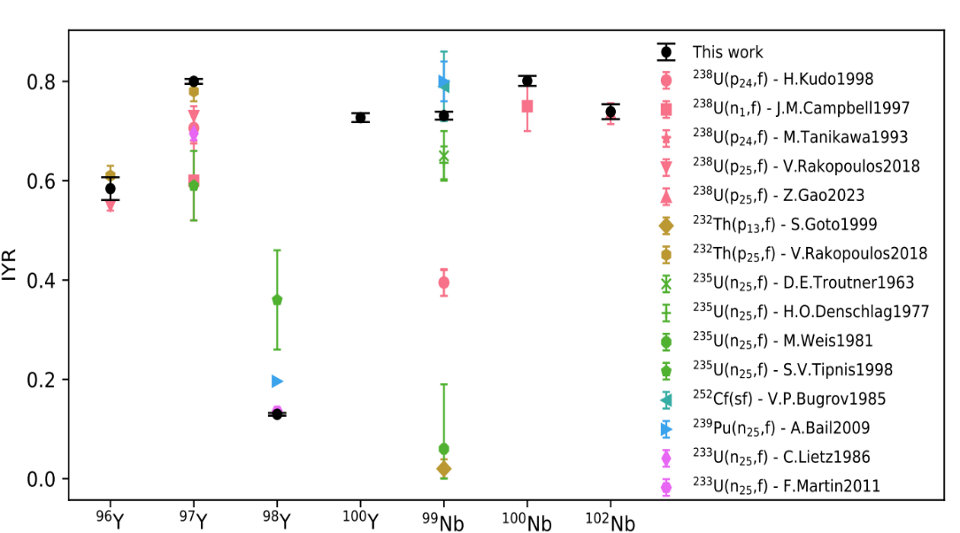
Future prospects
Absolute efficiency & correction factors
Consistent analysis of the ²⁴¹Am(2n_{th},f) experiment
Comparison with the FIFRELIN code
$$IR(KE)$$
$$J_{FF}(E^{∗})$$
Finalise the MCNP6 simulation and compute the correction factors
Consistent analysis for the 13 masses in total measured during this experiment
²³²Th(a,f) – S. Pomp 2025
Upcoming experiment ²³⁷Np(2n_{th},f) &
Analysis of existing data for ^{239, 241}Pu(n_{th},f)
Isomeric yield ratios and mass spectrometry of Y and Nb isotopes in the neutron-rich N=60 region: The unusual case of 98Y, Physics Letters B, Cannarozzo, Pomp et al.
Notes:
We aim to determine the angular-momentum distribution of the fission fragments (as afunction of their kinetic energy),
This analysis will ultimately enable the exploration ofangular-momentum generation mechanisms in fission

Slide 30
Thank you for your attention !

Slide 31
Back-up

Slide 32
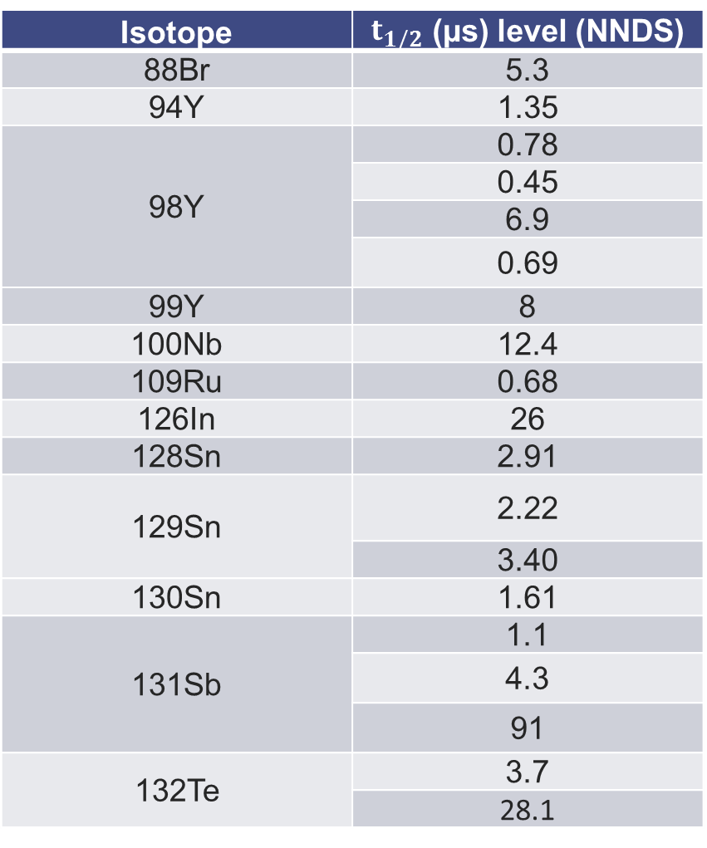
Isotopes measured at Lohengrin experiment – Oct. 2025
Isotope | $t_{1/2}$ (µs) level (NNDS)
88Br | 5.3
94Y | 1.35
98Y | 0.78
 | 0.45
 | 6.9
 | 0.69
99Y | 8
100Nb | 12.4
109Ru | 0.68
126In | 26
128Sn | 2.91
129Sn | 2.22
 | 3.40
130Sn | 1.61
131Sb | 1.1
 | 4.3
 | 91
132Te | 3.7
 | 28.1

Slide 33
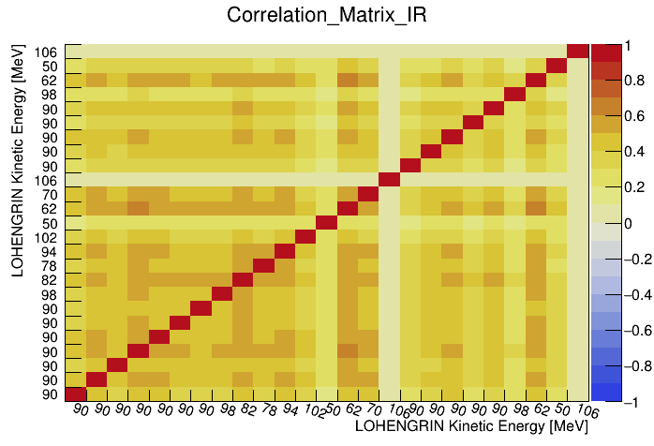
Correlation Matrix IR(KE)

Slide 34
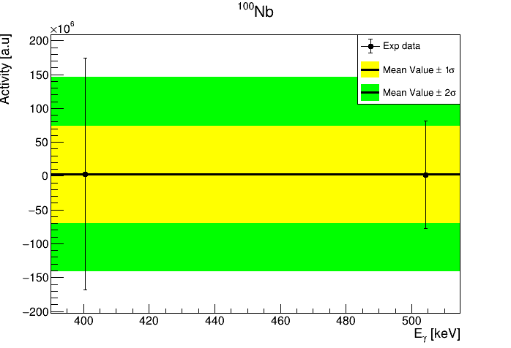
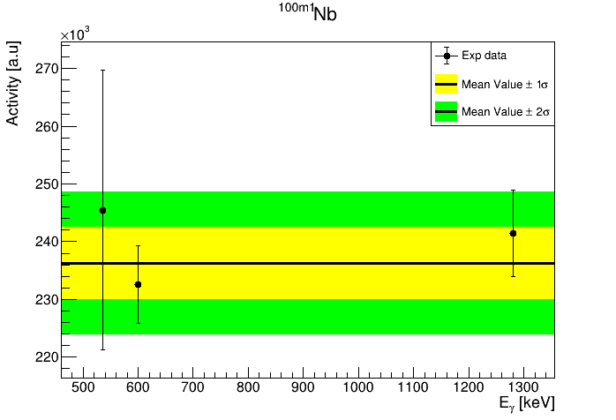
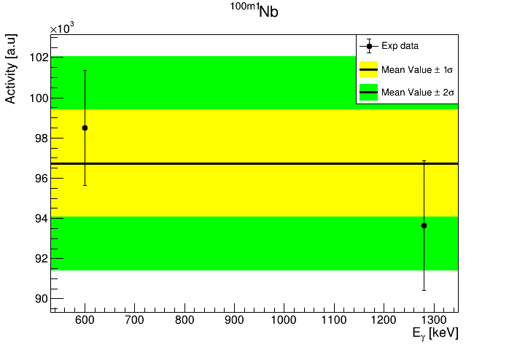
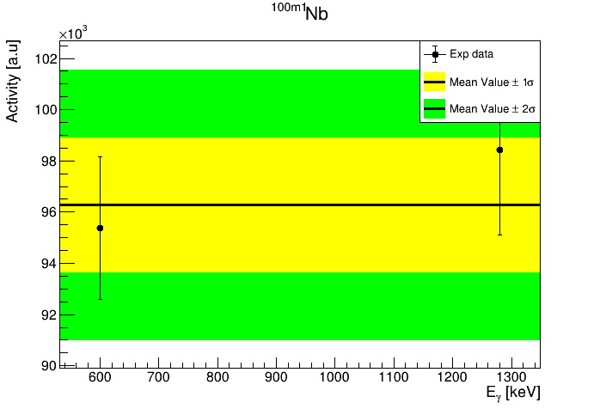
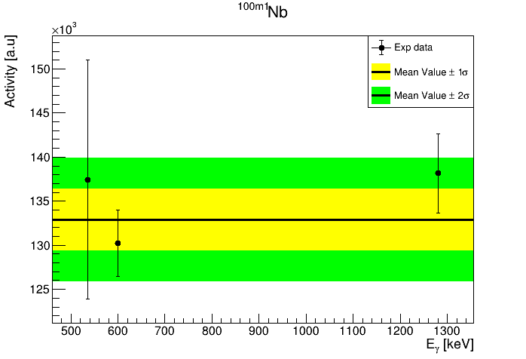
Analysis

Slide 35
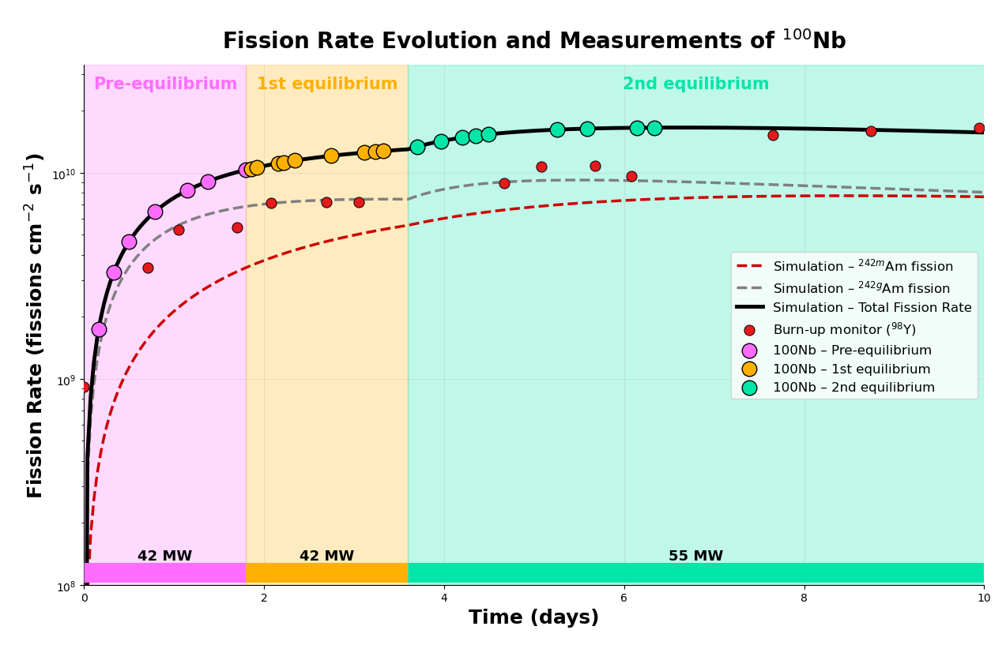
Comparison with theoretical model (Bateman Eq.)

Slide 36

The Bateman Equation
$$\frac{{dN}_{0}}{dt}=−a_{0}×N_{0}$$
$$\frac{{dN}_{1}}{dt}=−a_{1}×N_{1}+{BR}_{m}×{CS}_{c,0}×F×N_{0}$$
$$\frac{{dN}_{2}}{dt}=−a_{2}×N_{2}+{(1−BR}_{m})×{CS}_{c,0}×F×N_{0}+{BR}_{IT}×λ_{1}×N_{1}$$
${\text{Where} a}_{i}=λ_{i}+ {(CS}_{f,i}×F)+{(CS}_{c,i}×F)$
$$λ_{i} :due to the decay$$
$$F :Flux$$
$${CS}_{f,i} :Cross Section due to fission$$
$${CS}_{c,i} :Cross Section due to capture$$
negligible

Slide 37
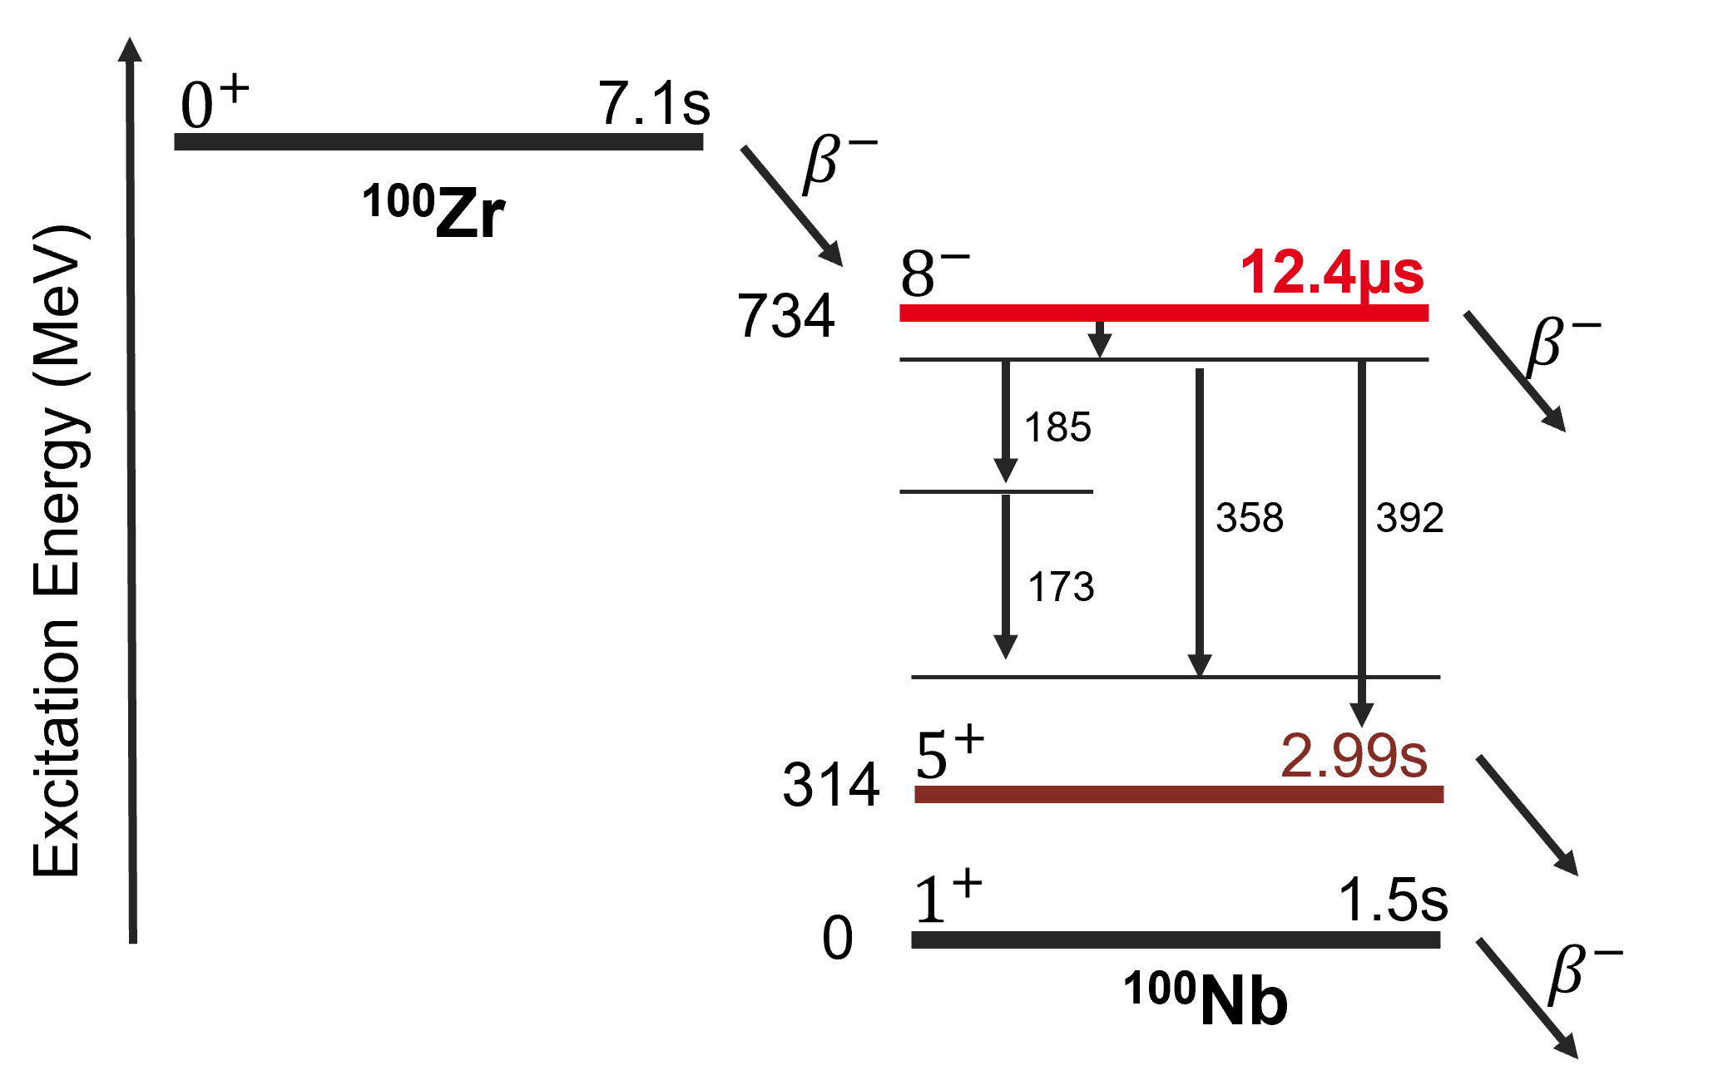
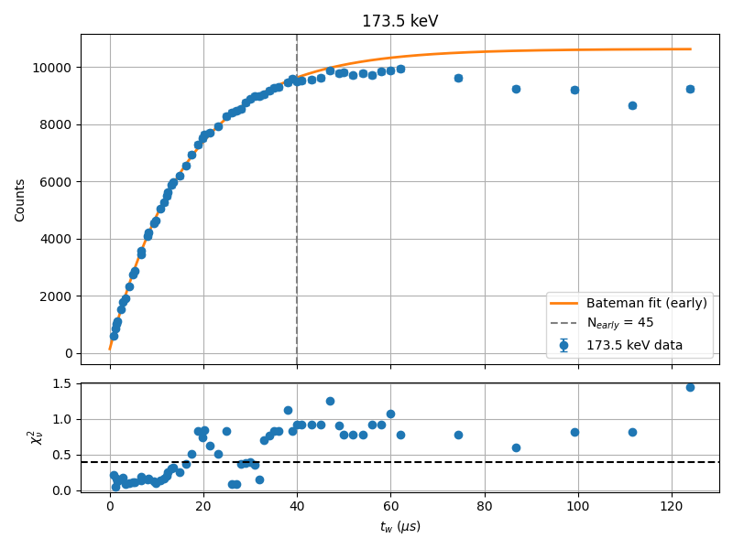
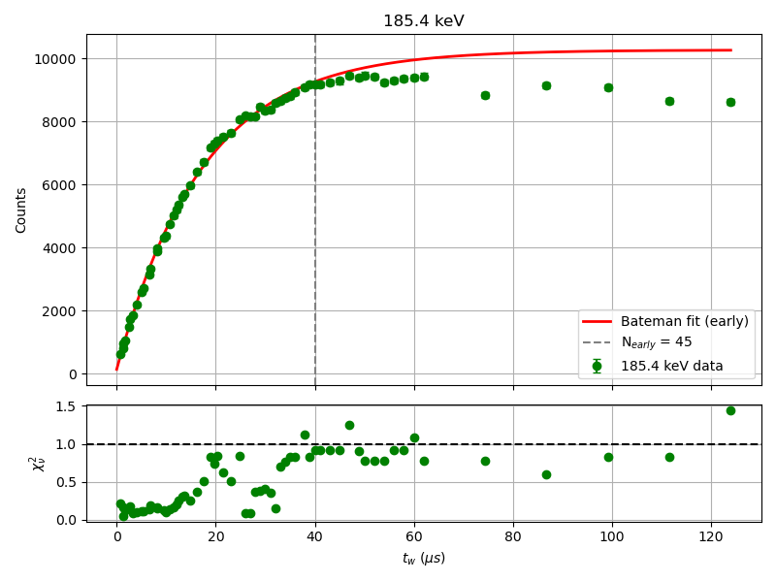

Analysis - $Δt_{Gate}$- ¹⁰⁰Nb
For which $Δt_{Gate}$is the $t_{1/2}$ of the isomeric level re-produced ?
$Δt_{Gate}≅40 μs$ $≅$ 3*$t_{1/2,ms}$
t₁/₂ = 11.97 ± 0.22 µs
χ² / ndf = 1.35
p-value = 6.427e-02
t₁/₂= 12.27 ± 0.21 µs
χ² / ndf = 3.06
p-value = 9.947e-11
Importance of data shorting

Slide 38
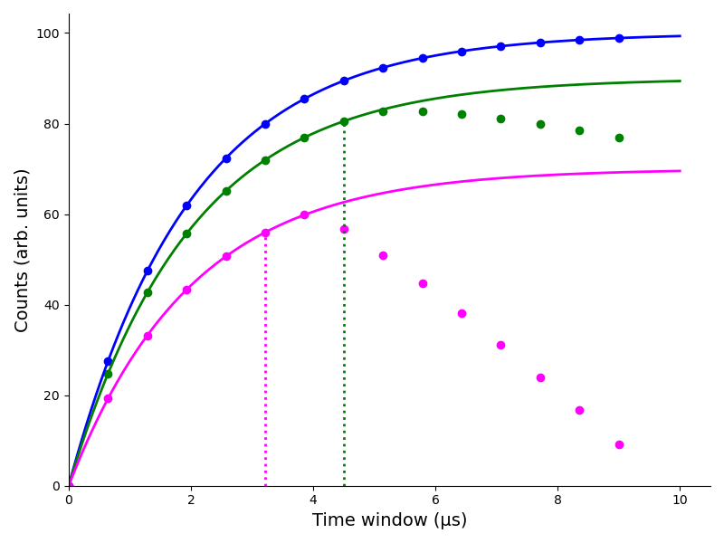
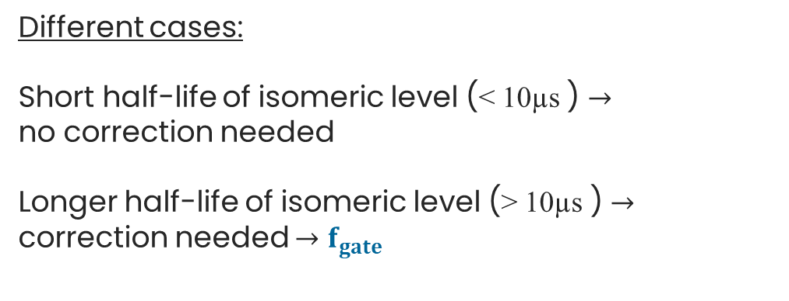
Analysis - $Δt_{Gate}$
Different cases:
Short half-life of isomeric level (< 10µs ) $→$
no correction needed
Longer half-life of isomeric level (> 10µs ) $→$
correction needed $→$ $f_{gate}$
Fully controled analysis

Slide 39

¹⁰⁰Nb

Slide 40


Theory…
$$Q=E_{int}+V_{Coul}+V_{Def}$$
F. Gonnenwein et al., Angular Momenta of near-spherical fission fragments, Int. J Mod. Phys. E, 16,2,410-424 (2007)

Slide 41

Theory…
$$Q=E_{int}+V_{Coul}+V_{Def}$$
F. Gonnenwein et al., Angular Momenta of near-spherical fission fragments, Int. J Mod. Phys. E, 16,2,410-424 (2007)

Slide 42


Investigation of fission product isomeric ratios and angular momenta of 132Sn populated in the 241Pu(nth,f) reaction

Slide 43



FIFRELIN: connecting experiment with theory
Isomeric Ratios measurements ${IR}_{exp}\left(KE\right)$
Isomeric Ratios measurements 〖𝐈𝐑〗_𝐞𝐱𝐩 (𝐊𝐄)
FIFRELIN decay
$\overline{IR}\left(E^{∗}\right)$
FIFRELIN decay
(𝐈𝐑) ̅(𝐄^∗ )
Extraction of the angular momentum
$$J_{FF}(E^{∗})$$
Extraction of the angular momentum
𝐉_𝐅𝐅 (𝐄^∗)
FIFRELIN (FIssion FRagments Evaporation modeLINg), used only as de-excitation code
Input parameters: $A, Z, E^{∗},J^{π}$
For particular ${(E}^{∗},J^{π})$combination: Models and experimental level schemes are used to create the nuclear schemes of the fission fragments
$→$ calculate the ${IR}_{FIF}{(E}^{∗},J^{π})$
For comparison with experimental results, they are averaged by:
$$IR_{FIF}\left(E^{∗},J_{cutoff}\right)=\sum_{J}{\sum_{π}{P\left(π\right)P\left(J\right)IR_{FIF}\left(E^{∗},J^{π}\right)}}, with:$$
$P\left(J\right)∝\left(2J+1\right)\exp\left(−\frac{{\left(J+\frac{1}{2}\right)}^{2}}{J_{cutoff}^{2}}\right),\text{spin} \text{cut}\text{−}\text{off} J_{cutoff} \text{is} \text{a} \text{free} \text{parameter}$
$P\left(π\right)=\frac{1}{2}$
GOAL: extract the $J_{cutoff}\left(KE\right)$ to reproduce experimental data
O. Litaize, O. Serot, L. Berge, The European Physical Journal A 51, 177 (2015)

Slide 44





Analysis
$$N_{γ}→N_{d}=\frac{N_{γ}}{ε_{γ}{×I}_{γ}×f_{γ}} \underset{→}{Average} \overline{N_{d}} \underset{→}{\begin{aligned}Bateman Equation \\ Resolution\end{aligned}}τ_{f}\underset{→}{ToF}{ IR}_{exp}=\frac{τ_{f}(IS)}{τ_{f}\left(IS\right)+τ_{f}(GS)}$$
$$f_{gate}±σ_{f_{gate}}$$
$ε_{γ}$: Detector Efficiency,
$f_{γ}:$ Correction factor for Sum-Effect,
$f_{gate}:$ Correction factor for coincidence time gate,
IR: Isomeric Ratio, IS: Isomeric State, GS: Ground State
will be derived from ${\text{TrueCoinc}}^{1}$ and Monte Carlo Simulation ${\text{MCNP}\text{6}}^{2}$ (in progress):
HPGe 1
IC
HPGe 2
⁶⁰Co+ ¹³⁷Cs efficiency run
Experimental Data
MCNP6
1. Sudar, S. (2002). 'TrueCoinc' software utility for calculation of the true coincidence correction (IAEA-TECDOC--1275). International Atomic Energy Agency (IAEA)
2. D.B. Pelowitz et al., Tech. Rep. LA-CP-13-00634, LosAlamos National Laboratory, Los Alamos, NM, USA, 2013
Notes:
agreement

Slide 45



Analysis: Sum-effect -TrueCoinc
Expected output:
https://www.mirion.com/discover/knowledge-hub/articles/education/true-coincidence-summing
Compute the Sum-effect correction factors using TrueCoinc
Input: ENSDF files for decay
Olivier Meplan, LPSC, Université Grenoble-Alpes, CNRS/IN2P3, 38026 Grenoble Cedex, France

Slide 46

MCNP6 – ⁶⁰Co+ ¹³⁷Cs run
NPS 1e7
points$→$bins: Gaussian Energy Broadening (GEB) + same binning with experimental
GEB parameters based on specific crystal response
GEB a b c which defines FWHM: $FWHM\left(E\right)=a+b\sqrt{E+cE^{2}}$, ¹³⁴Te + ⁹⁶Y runs used

Slide 47

MCNP6 – ⁶⁰Co+ ¹³⁷Cs run

Slide 48


MCNP6 – ⁶⁰Co+ ²⁰⁷Bi run
NPS 1e8

Slide 49

MCNP6 – ⁶⁰Co+ ²⁰⁷Bi run
NPS 1e8

Slide 50




Upcoming

Slide 51


New output:
t_Gate (µs) | Coincidence Entries-Ge_5 | Duration (s) | Duration (µs) | Entries/t_Gate | Rate (Hz)
12.4 | 58470 | 1.74E-05 | 1.74E+04 | 4.72E+03 | 3.36E+09
24.8 | 96360 | 2.98E-05 | 2.98E+04 | 3.89E+03 | 3.23E+09
26 | 99944 | 3.10E-05 | 3.10E+04 | 3.84E+03 | 3.22E+09
28 | 105815 | 3.30E-05 | 3.30E+04 | 3.78E+03 | 3.21E+09
29 | 108726 | 3.40E-05 | 3.40E+04 | 3.75E+03 | 3.20E+09
30 | 111684 | 3.50E-05 | 3.50E+04 | 3.72E+03 | 3.19E+09
31 | 114665 | 3.60E-05 | 3.60E+04 | 3.70E+03 | 3.19E+09
32 | 117598 | 3.70E-05 | 3.70E+04 | 3.67E+03 | 3.18E+09
34 | 123232 | 3.90E-05 | 3.90E+04 | 3.62E+03 | 3.16E+09
35 | 126204 | 4.00E-05 | 4.00E+04 | 3.61E+03 | 3.16E+09
36 | 128944 | 4.10E-05 | 4.10E+04 | 3.58E+03 | 3.14E+09
38 | 134597 | 4.30E-05 | 4.30E+04 | 3.54E+03 | 3.13E+09
39 | 137503 | 4.40E-05 | 4.40E+04 | 3.53E+03 | 3.13E+09
40 | 140332 | 4.50E-05 | 4.50E+04 | 3.51E+03 | 3.12E+09
41 | 143035 | 4.60E-05 | 4.60E+04 | 3.49E+03 | 3.11E+09
42 | 145812 | 4.70E-05 | 4.70E+04 | 3.47E+03 | 3.10E+09
43 | 148626 | 4.80E-05 | 4.80E+04 | 3.46E+03 | 3.10E+09
44 | 151395 | 4.90E-05 | 4.90E+04 | 3.44E+03 | 3.09E+09
45 | 154118 | 5.00E-05 | 5.00E+04 | 3.42E+03 | 3.08E+09
46 | 156883 | 5.10E-05 | 5.10E+04 | 3.41E+03 | 3.08E+09
47 | 159625 | 5.20E-05 | 5.20E+04 | 3.40E+03 | 3.07E+09
48 | 162326 | 5.30E-05 | 5.30E+04 | 3.38E+03 | 3.06E+09
49 | 165048 | 5.40E-05 | 5.40E+04 | 3.37E+03 | 3.06E+09
50 | 167823 | 5.50E-05 | 5.50E+04 | 3.36E+03 | 3.05E+09
52 | 173226 | 5.70E-05 | 5.70E+04 | 3.33E+03 | 3.04E+09
54 | 178638 | 5.90E-05 | 5.90E+04 | 3.31E+03 | 3.03E+09
56 | 184156 | 6.10E-05 | 6.10E+04 | 3.29E+03 | 3.02E+09
58 | 189722 | 6.30E-05 | 6.30E+04 | 3.27E+03 | 3.01E+09
60 | 195126 | 6.50E-05 | 6.50E+04 | 3.25E+03 | 3.00E+09
62 | 200454 | 6.70E-05 | 6.70E+04 | 3.23E+03 | 2.99E+09
$×$3
$×$4

Slide 52

Target evolution

Slide 53




Analysis - $Δt_{Gate}$- ¹⁰⁰Nb
t₁/₂ = 11.06 ± 0.10 µs
χ² / ndf = 2.14
p-value = 2.145e-06
t₁/₂= 11.15 ± 0.10 µs
χ² / ndf = 3.91
p-value = 2.987e-16
t₁/₂ = 9.83 ± 0.15 µs
χ² / ndf = 1.31
p-value = 6.427e-02
t₁/₂= 10.09 ± 0.18 µs
χ² / ndf = 3.34
p-value = 4.996e-15
Notes:
Statistical analysis

Slide 54



Analysis - $Δt_{Gate}$- ¹⁰⁰Nb
t₁/₂ = 11.79 ± 0.16 µs
χ² / ndf = 1.35
p-value = 6.427e-02
t₁/₂= 12.00 ± 0.16 µs
χ² / ndf = 3.06
p-value = 9.947e-11
t₁/₂ = 10.39 ± 0.22 µs
χ² / ndf = 1. 16
p-value = 2.163e-01
t₁/₂= 11.64 ± 0.31 µs
χ² / ndf = 2.11
p-value = 5.271e-5
Notes:
Statistical analysis

Slide 55




⁸⁸Br
$t_{1/2}$= 5.3 ± 0.3 µs (IAEA)
vs
Fit experimental data with function $f=A+B∗(1−e^{−λt}$):
110.9 keV: λ = 1.2019e-01 ± 1.0444e-03 $t_{1/2}$ = 5.77 ± 0.05
Quality of the fit: χ² / ndf = 1.71, p-value = 1.5e-01
159.2 keV: λ = 1.2877e-01 ± 1.0513e-03 $t_{1/2}$ = 5.38 ± 0.04
Quality of the fit: χ² / ndf = 1.81, p-value = 1.2e-01
☺

Slide 56

¹²⁹Sn

Slide 57





¹²⁹Sn
$t_{1/2}$= 3.4 ± 0.2 µs (IAEA)
vs
Fit experimental data with function $f=A+B∗(1−e^{−λt}$):
382.5 keV: λ = 2.1553e-01 ± 3.5996e-03 $t_{1/2}$ = 3.22 ± 0.05
Quality of the fit: χ² / ndf = 1.34, p-value = 2.5e-01
570.4 keV: λ = 2.1413e-01 ± 8.4292e-03 $t_{1/2}$ = 3.24 ± 0.13
Quality of the fit: χ² / ndf = 4.45, p-value = 1.3e-03
382.5 keV: λ = 1.8592e-01 ± 8.2569e-03 $t_{1/2}$ = 3.73 ± 0.17
Quality of the fit: χ² / ndf = 16.75, p-value = 9.7e-14
570.4 keV: λ = 2.0176e-01 ± 1.0225e-02 $t_{1/2}$ = 3.44 ± 0.17
Quality of the fit: χ² / ndf = 14.14, p-value = 1.5e-11
KE = 62
KE = 74
Correct central value but not always good fit
+more points needed
+more points needed

Slide 58



¹³¹Sb – Study Case
Ground State: $t_{1/2}=23.03 min$
Metastable States: (IAEA, NNDS)
$E_{level}=2165.6 keV,t_{1/2}=1.1 µs$
$E_{level}=1687.2 keV,t_{1/2}=4.3 µs$
$E_{level}=1676.1 keV,t_{1/2}=91 µs$
Lifetime measurements in 131131Sb at LOHENGRIN
S. Bottoni et al
¹³¹Sb

Slide 59








¹³¹Sb
Python Script Weighted Fit:
λ = 1.1524e+00 ± 2.7269 1/µs
$t_{1/2}$ = 0.60 ± 1.42 µs
Quality of the fit: χ² / ndf = 0.35, p-value = 9.1e-01
$${2∗t}_{1/2}$$
$${3∗t}_{1/2}$$
$${4∗t}_{1/2}$$
$${5∗t}_{1/2}$$
$${11∗t}_{1/2}$$
Not well formed peak

Slide 60




¹³¹Sb
12 first points
Python Script Weighted Fit:
λ = 1.6562e-01 ± 3.2601e-02 1/µs
$t_{1/2}$ = 4.19 ± 0.82 µs
Quality of the fit:
χ² / ndf = 0.46, p-value = 9.1e-01
All points
Python Script Weighted Fit:
λ = 1.9555e-01 ± 2.9853e-02 1/µs
$t_{1/2}$ = 3.54 ± 0.54 µs
Quality of the fit:
χ² / ndf = 7.88, p-value = 1e-015

Slide 61




¹³¹Sb
Python Script Weighted Fit:
λ = 1.2091e-02 ± 4.0769e-04 1/µs
$t_{1/2}$ = 57.33 ± 1.93 µs
Quality of the fit:
χ² / ndf = 1.60, p-value = 1.3e-01
Python Script Weighted Fit:
λ = 1.2000e-02 ± 5.8706e-04 1/µs
$t_{1/2}$= 57.76 ± 2.83 µs
Quality of the fit:
χ² / ndf = 4.1, p-value = 1.7e-04

Slide 62


¹³¹Sb

Slide 63


Analysis - ¹⁰⁰Nb from ²⁴¹Am(2n_{th},f)
Ungated Spectrum
$→$ Ground state measurement $→$ $N_{γ}$
$$Δt_{meas}≅1.5 h$$

Slide 64




Analysis - ¹⁰⁰Nb from ²⁴¹Am(2n_{th},f)
Ungated Spectrum
$→$ $β$-decay states measurement $→$ $N_{γ}$, $N_{γ}$
$$Δt_{meas}≅1.5 h$$
Gated Spectrum
Time coincidence between ionization chamber and
HPGe detectors
$→$ µs Isomeric state measurement $→$ $N_{γ}$
$$Δt_{Gate}≅40 μs$$

Slide 65








$$0^{+}$$
7.1s
$$β^{−}$$
¹⁰⁰Zr
$$8^{−}$$
12.4µs
734
$$β^{−}$$
Excitation Energy (keV)
185keV 40(5)
358keV 32(5)
392keV
24(6)
173keV 39(5)
$$5^{+}$$
2.99s
314
$$1^{+}$$
1.5s
0
$$β^{−}$$
¹⁰⁰Nb

Slide 66




Experimental setup of LOHENGRIN spectrometer in ILL
Choise of$\vec{B}$ and $\vec{E}$
Choise of B ⃗ and E ⃗
Selection of $A/{q }$and ${E_{K}}/{q }$ ratios
Selection of A⁄(q )and E_K⁄(q ) ratios
Only the isotopes of chosen $A/{q }$ are deflected into the exit slit
Only the isotopes of chosen A⁄(q ) are deflected into the exit slit
$$\vec{B}$$
$$\vec{E}$$
$${E_{K}}/{q }$$
$$A/{q }$$
^{RED magnet}
²⁴¹Am
Study opportunities with the LOHENGRIN fission fragment separator, Jean Michel Daugas, Session 9
Notes:
choice of magnetic and electric fields
$→$ selection of the Mass over Ionic Charge $A/{q }$and Kinetic Energy over Ionic Charge ${E_{K}}/{q }$ ratios
$→$ the particles of a chosen A/q value are deflected into the exit slit. With selected KE
Mass separation
Contamination-trajectory by charge changing
Not straitforward, higher intensity-lower resolution (9 shutters, 0,5MeV/shutter)

Slide 67


Motivation: Angular momentum generation mechanism of Fission Fragments
Wriggling:
Bending:
Tilting:
Angular momentum generated at scission
Twisting:
M. Bender et al., Future of nuclear fission theory, J. Phys. G: Nucl. Part. Phys. 47 113002 (2020)
J. Randrup et al., Generation of Fragment Angular Momentum in Nuclear Fission, EPJ WoC, 284,04004 (2023)
Notes:
At scission, the nucleus can undergo different collective modes—wriggling, bending, tilting, and twisting. Each of these shape dynamics contributes differently to the spin distribution of the fragments.
These motions generate intrinsic angular momentum at the moment the nucleus splits, leading to the observed fragment and the orbital angular momentum L.
At scission, the Collective motion of this system transforms into:
Fragment spin
Relative angular momentum
Excitation energy

Slide 68




Comparison with FIFRELIN

Slide 69





Slide 70


Comparison with FIFRELIN

Slide 71




Comparison with FIFRELIN

Slide 72










Bayesian $J_{cutoff}$

