Slide 1
Fission Yield Analysis of Neutron-Induced Fission on Th-232
S. Liu^{1,2}, J. N. Wilson^{1,3}, D. Thisse³, N. Jovancevic³, R. Canavan³, M. Rudigier³ and M. Lebois³
(1) Laboratoire de Physique des 2 Infinis Irène Joliot-Curie (2) Xi’an Jiaotong University (3) Nu-Ball 1 Collaboration

Slide 2
CONTENTS
Introduction
Data Analysis & Yield Reconstruction Strategies
Conclusion

Slide 3
Motivation for Studying Th-232 Fission Yields
Upcoming experiment: Th-232(n,f) at NFS (5–40 MeV, planned at July)
Applied Motivation
Fundamental Motivation
Fill the data gap (5–40 MeV, yields & spins)
Measure En-dependence of fission observables
²³²Th is key thorium cycle nucleus, but since it is a fertile nucleus isotopic yield data are lacking
Look at the energy dependence of isotopic yields
Probe of the energy sorting mechanism, and also evolution of angular momentum effects
The ALTO ~2 MeV Th-232(n,f) data
Measured Th-232(n,f) isotopic yields with 2 MeV neutrons from LICORNE coupled to thorium
Acts as a preparatory work for the NFS campaign
Study Th-232 background characteristics
Analysis of isomer contributions and decay components
Develop and validate the analysis method needed for the high-energy NFS data.

Slide 4
Advantages & Challenges for γ-ray Spectroscopy
Advantages
Access to mass and charge yields in direct kinematics
γ–γ (and γ–γ–γ) coincidences provide strong selectivity to isolate specific fragments from the global fission background
HPGe high intrinsic energy resolution
Challenges
It is confined to even-even fragments. Odd-even and odd–odd nuclei have fragmented, complex decay paths and poorer statistics
Need to account for all intensity feeding the ground state, which is sometimes difficult
Coincidence spectroscopy requires at least two known γ rays
Precision is limited since we miss direct feeding of 0+ and 2+ states
New analysis method: Ratio based yield
A new fission fragment yield reconstruction method is proposed for the first time.
Based on the well characterized Cf-252 (sf) yield data and the gamma transitions, we build up a coefficient between real yield and selected transitions.
This ratio is used to reconstruct the Th-232 (n,f) fission fragment yield.
Key assumption: spin distribution of a given fragment doesn’t change significantly with the fissioning system.

Slide 5
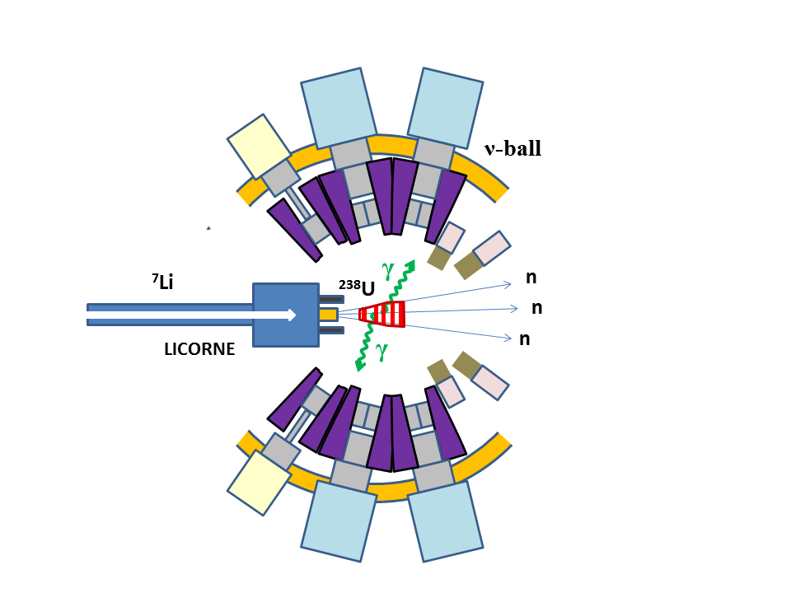
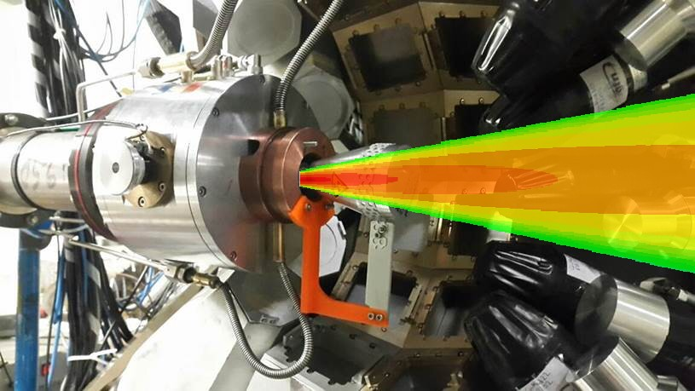
Experimental Design & Setup
LICORNE/ν-ball coupling principle
Primary beam 2 x 10¹¹ /s
Target
Secondary beam 2 x 10⁷ /s
Sample
⁷Li (16 MeV)
H₂
1.5 MeV neutrons
10⁵ fissions/s
²³²Th
~100 g
3 x 10²⁰ atoms/cm²
high-flux, quasi-monoenergetic, and strongly directional
Expt. | Target mass | ⁷Li Current | E_{n} | Fission Rate | Time | Data | Total Fissions
²³²Th(n,f) | 129 g | 80 nA | 1.7 MeV | 26 kHz | 19 days | 80 Tb | 4.0×10¹⁰

Slide 6
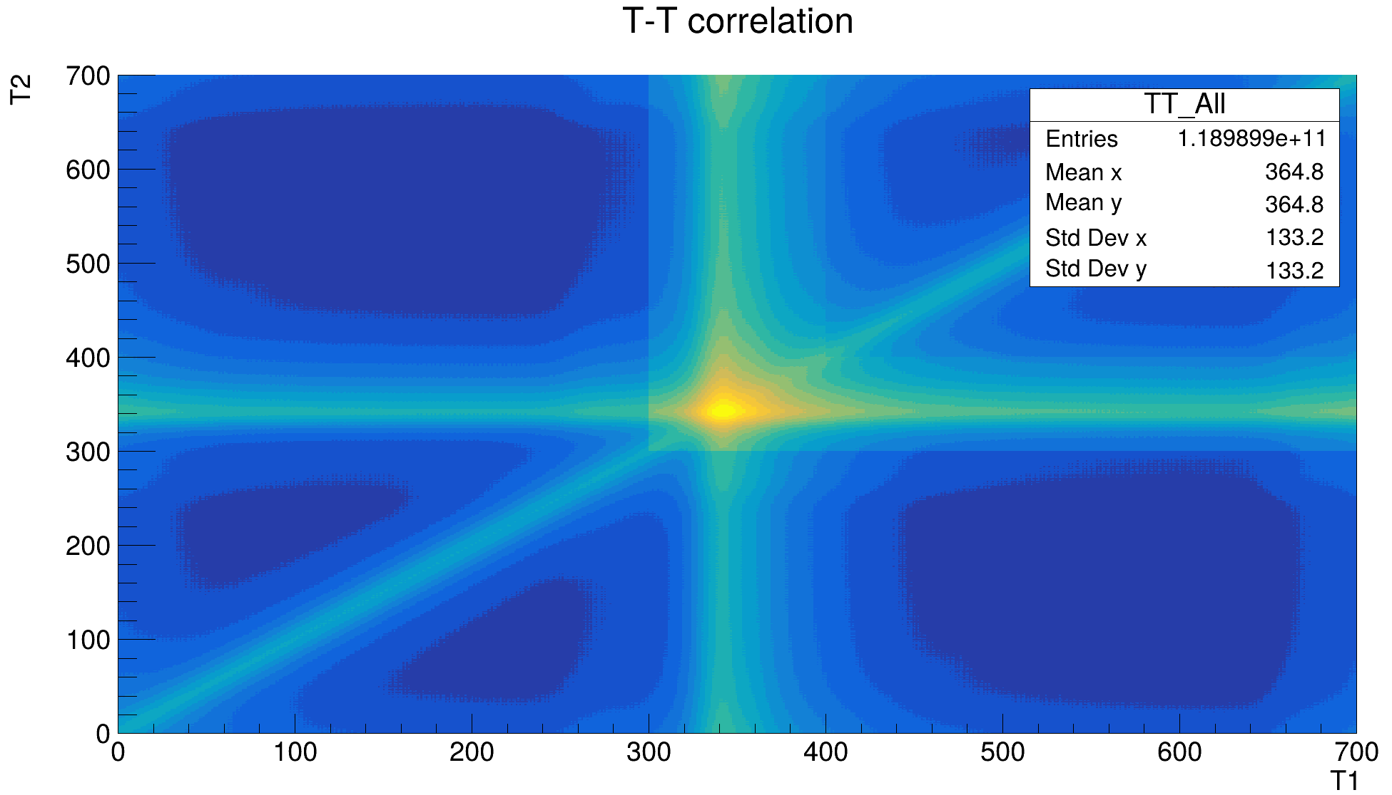
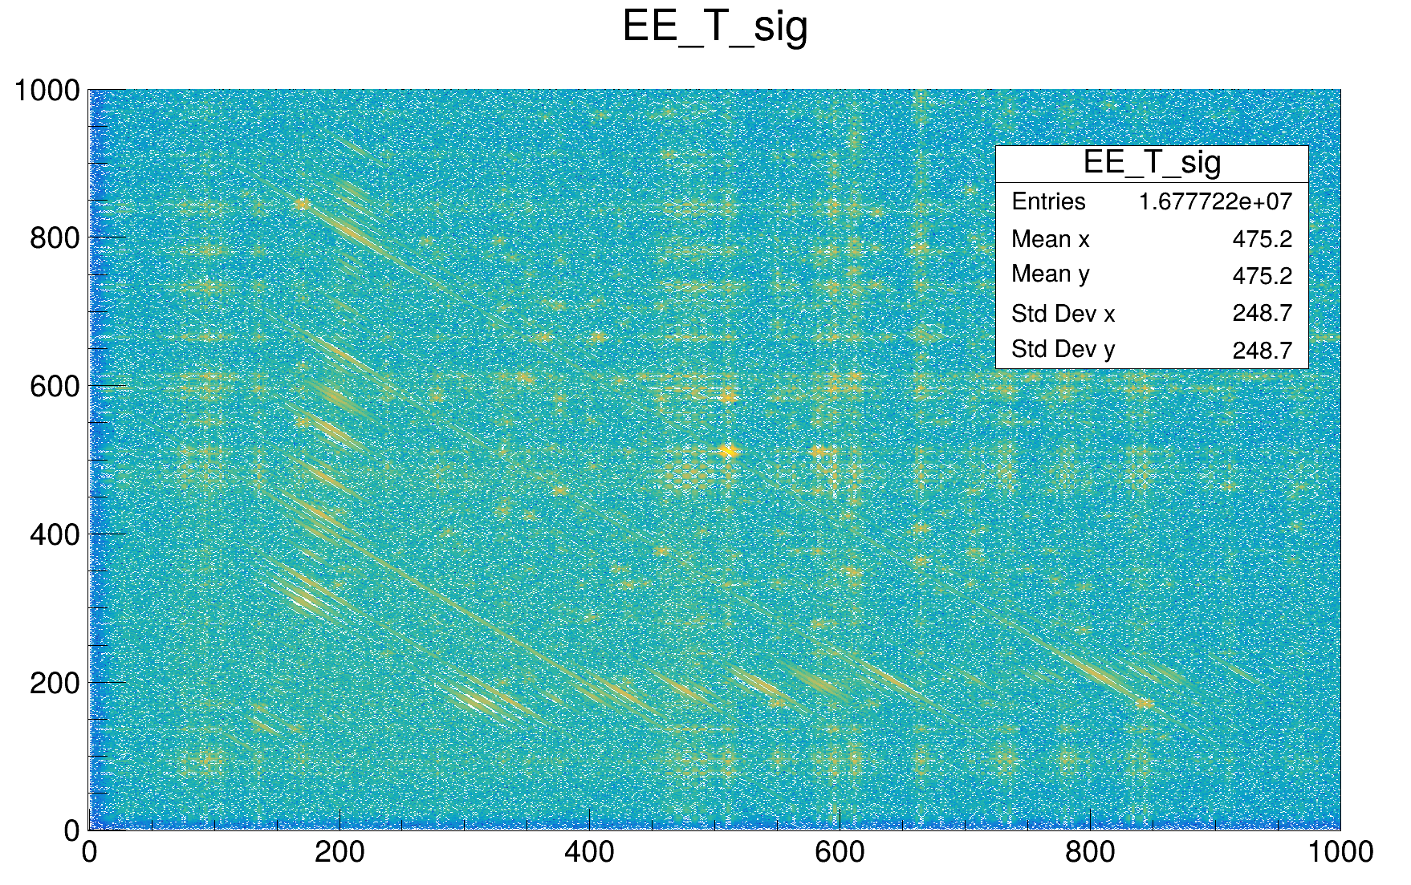
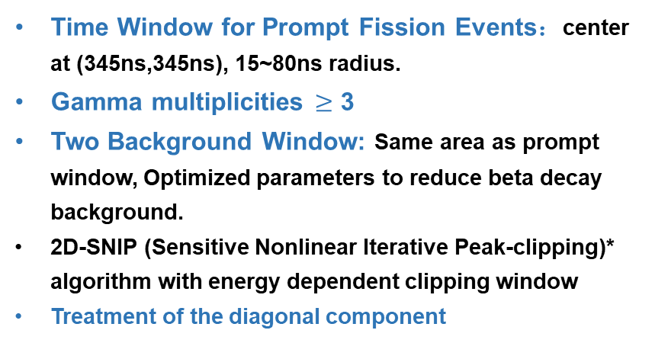
Data Analysis & Background Subtraction
Time Window for Prompt Fission Events：center at (345ns,345ns), 15~80ns radius.
Gamma multiplicities $≥$ 3
Two Background Window: Same area as prompt window, Optimized parameters to reduce beta decay background.
2D-SNIP (Sensitive Nonlinear Iterative Peak-clipping)* algorithm with energy dependent clipping window
Treatment of the diagonal component
DET1
Fission
DET2
*: Morháč et al., Applied Spectroscopy, 2008

Slide 7

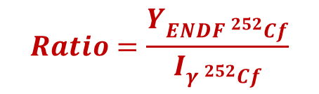
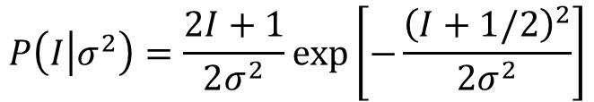
Yield Reconstruction Strategies
Conventional γ-spectroscopy method
Cf-252-based transition-ratio method
Level-scheme construction & transition-intensity extraction
Using the well-characterized Cf-252 spontaneous-fission dataset, we determine, for each major isotope, the ratio:
A comprehensive level scheme is constructed for each fission fragment whenever possible.
Transition intensities are extracted using RadWare γ-ray analysis tools (peak fitting, coincidence gating, intensity balancing).
Corrections applied to the raw transition intensities
Ground-state side-feeding correction (0⁺ feeding). The basic form of the probability distribution used for the extrapolation is:
$$Ratio=\frac{Y_{{ENDF }^{252}Cf}}{I_{{γ }^{252}Cf}}$$
$$P\left(I\left|σ^{2}\right.\right)=\frac{2I+1}{2σ^{2}}\exp\left[−\frac{{\left(I+1/2\right)}^{2}}{2σ^{2}}\right]$$
Th-232 fission yields are derived based on the same transitions and ratios:
Long-lived isomer correction: Using the known half-lives, the missing delayed component is re-added to the transition intensities to recover the full yield contribution.
$$Y_{{}_{}^{232}{Th}}=I_{γ {}_{}^{232}{Th}}∗Ratio$$

Slide 8
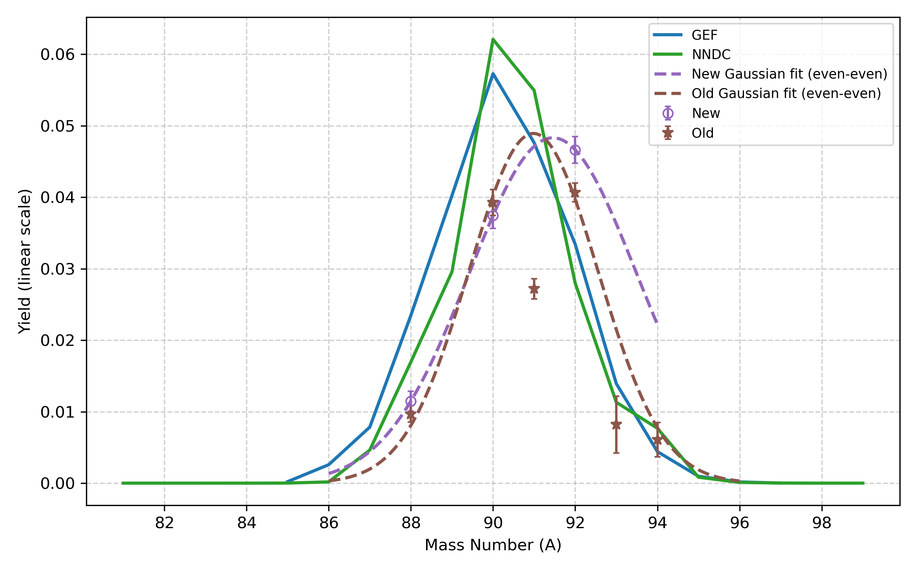
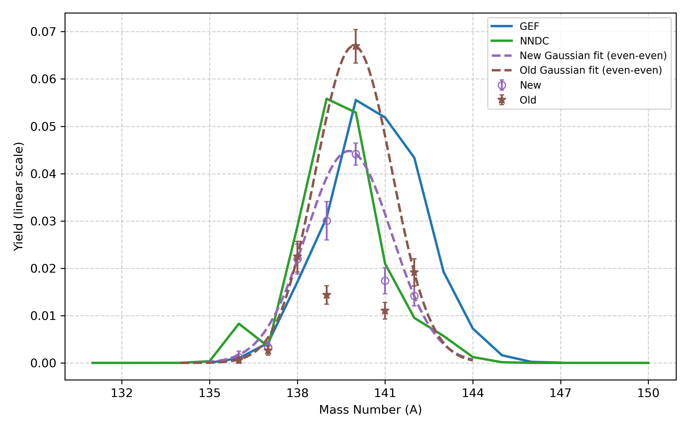
Yield Results – Major Pairs
Kr–Xe pair:
New (purple): yields obtained with the Cf-252 ratio–based normalization,
Old (brown): yields from the conventional γ-spectroscopy method.
ENDF
ENDF
Kr (Z=36)
Xe (Z=54)
Notes:
For odd-A fragments, the conventional spectroscopy results (exp2) clearly underestimate the yields. This is a direct consequence of the incomplete or uncertain level schemes in these nuclei, which leads to missing intensity in the γ-based reconstruction. In contrast, the ratio-based method (exp1) is much less affected by these spectroscopic limitations.
Compared to the NDC/GEF predictions, both experimental methods show a systematic shift of the Kr–Xe pair:
the Xe fragment appears to be more neutron-deficient (i.e. more neutron emission than predicted),
while the Kr partner tends to retain more neutrons than expected from the models.

Slide 9
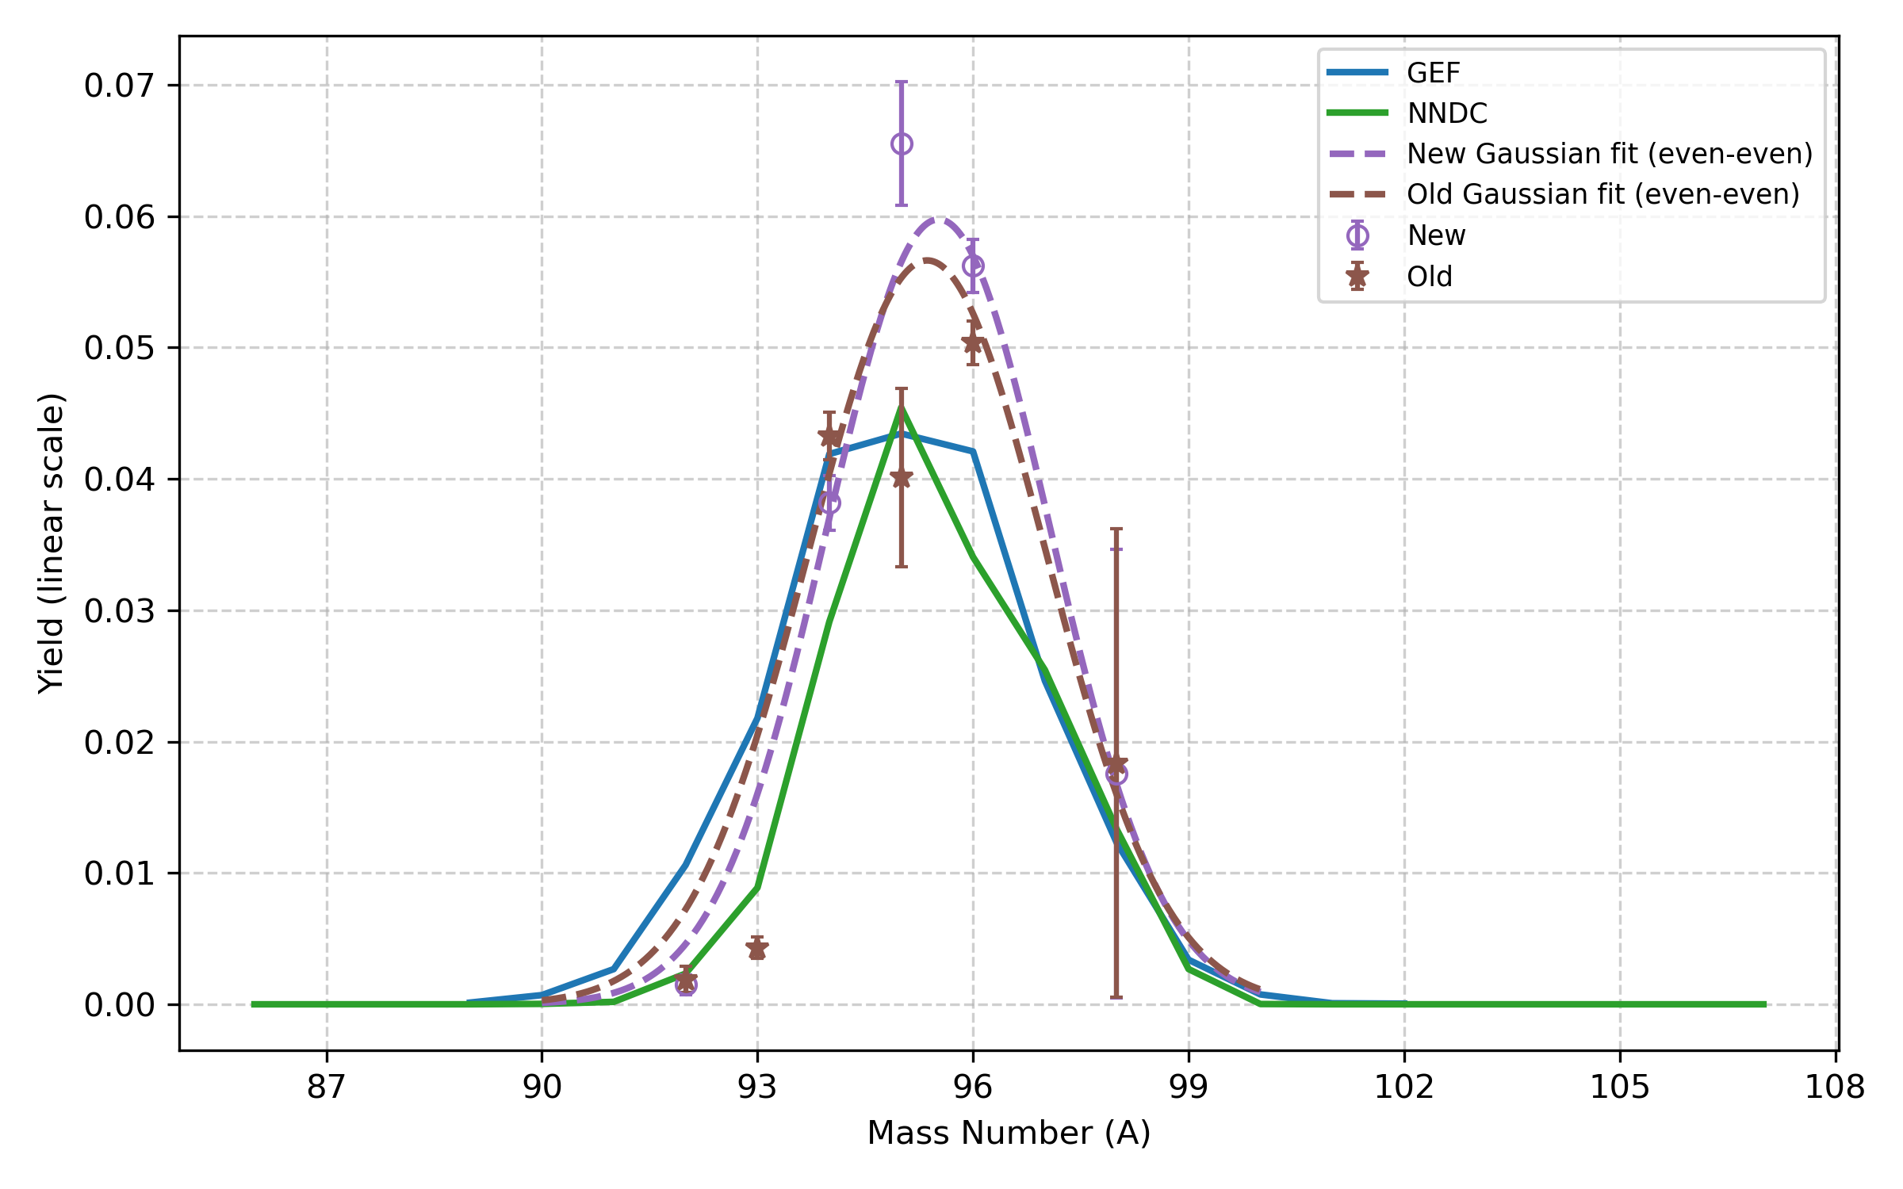
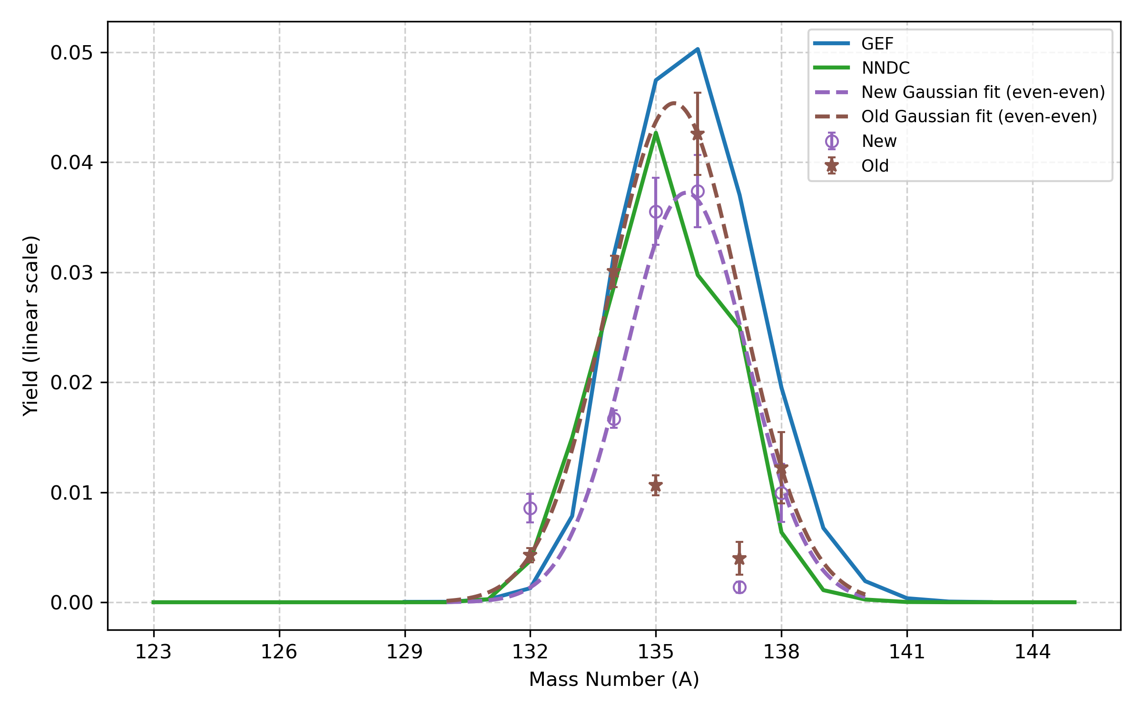
Yield Results – Major Pairs
Sr–Te pair:
New (purple): yields obtained with the Cf-252 ratio–based normalization,
Old (brown): yields from the conventional γ-spectroscopy method.
ENDF
ENDF
Sr (Z=38)
Te (Z=52)
Notes:
As observed in other fragment groups, the ratio-based method provides a more reliable reconstruction of the odd-A isotopes, whereas the conventional γ-spectroscopy yields systematically underestimate these nuclei due to incomplete or uncertain level schemes.
In the Sr–Te region, the two experimental methods follow a broadly similar shape; however, the isotope Te-137 shows a noticeable deviation. This discrepancy is likely connected to background-subtraction issues in the Th-232 dataset

Slide 10
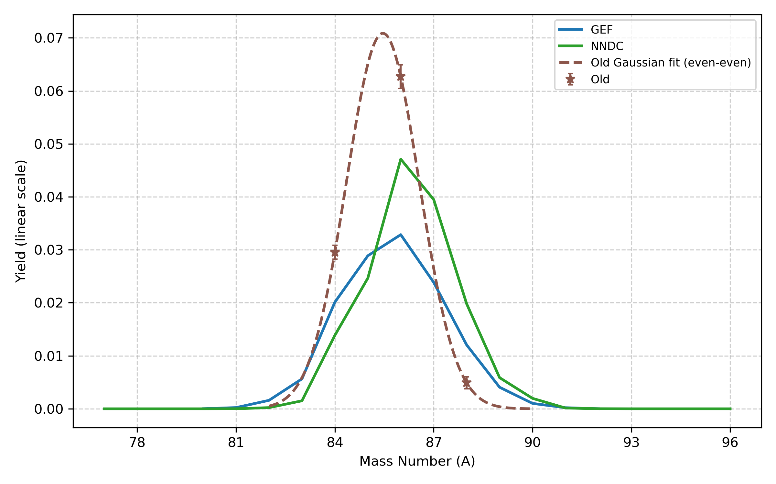
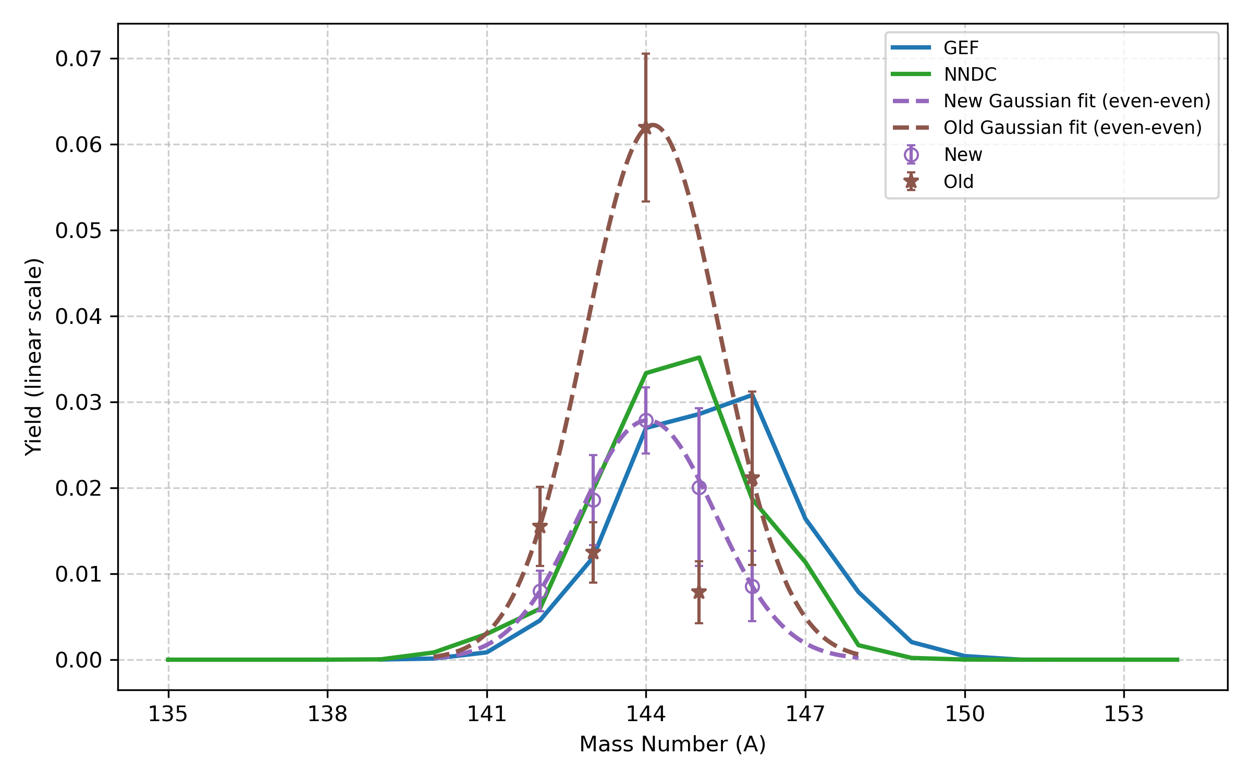
Yield Results – Major Pairs
Se–Ba pair:
New (purple): yields obtained with the Cf-252 ratio–based normalization,
Old (brown): yields from the conventional γ-spectroscopy method,
ENDF
ENDF
Se (Z=34)
Ba (Z=56)
Notes:
Although Se isotopes are not observed in the Cf-252 dataset and therefore cannot be treated within the ratio-based scheme, the Ba side of the pair still provides a clear illustration of the issue: the conventional γ-spectroscopy method shows a strong underestimation for odd-A fragments, consistent with what is observed in other fragment groups.
This also highlights one of the intrinsic limitations of the ratio-based method: the fission-fragment distributions of Cf-252 and Th-232 do not overlap perfectly, particularly on the light-mass side.

Slide 11
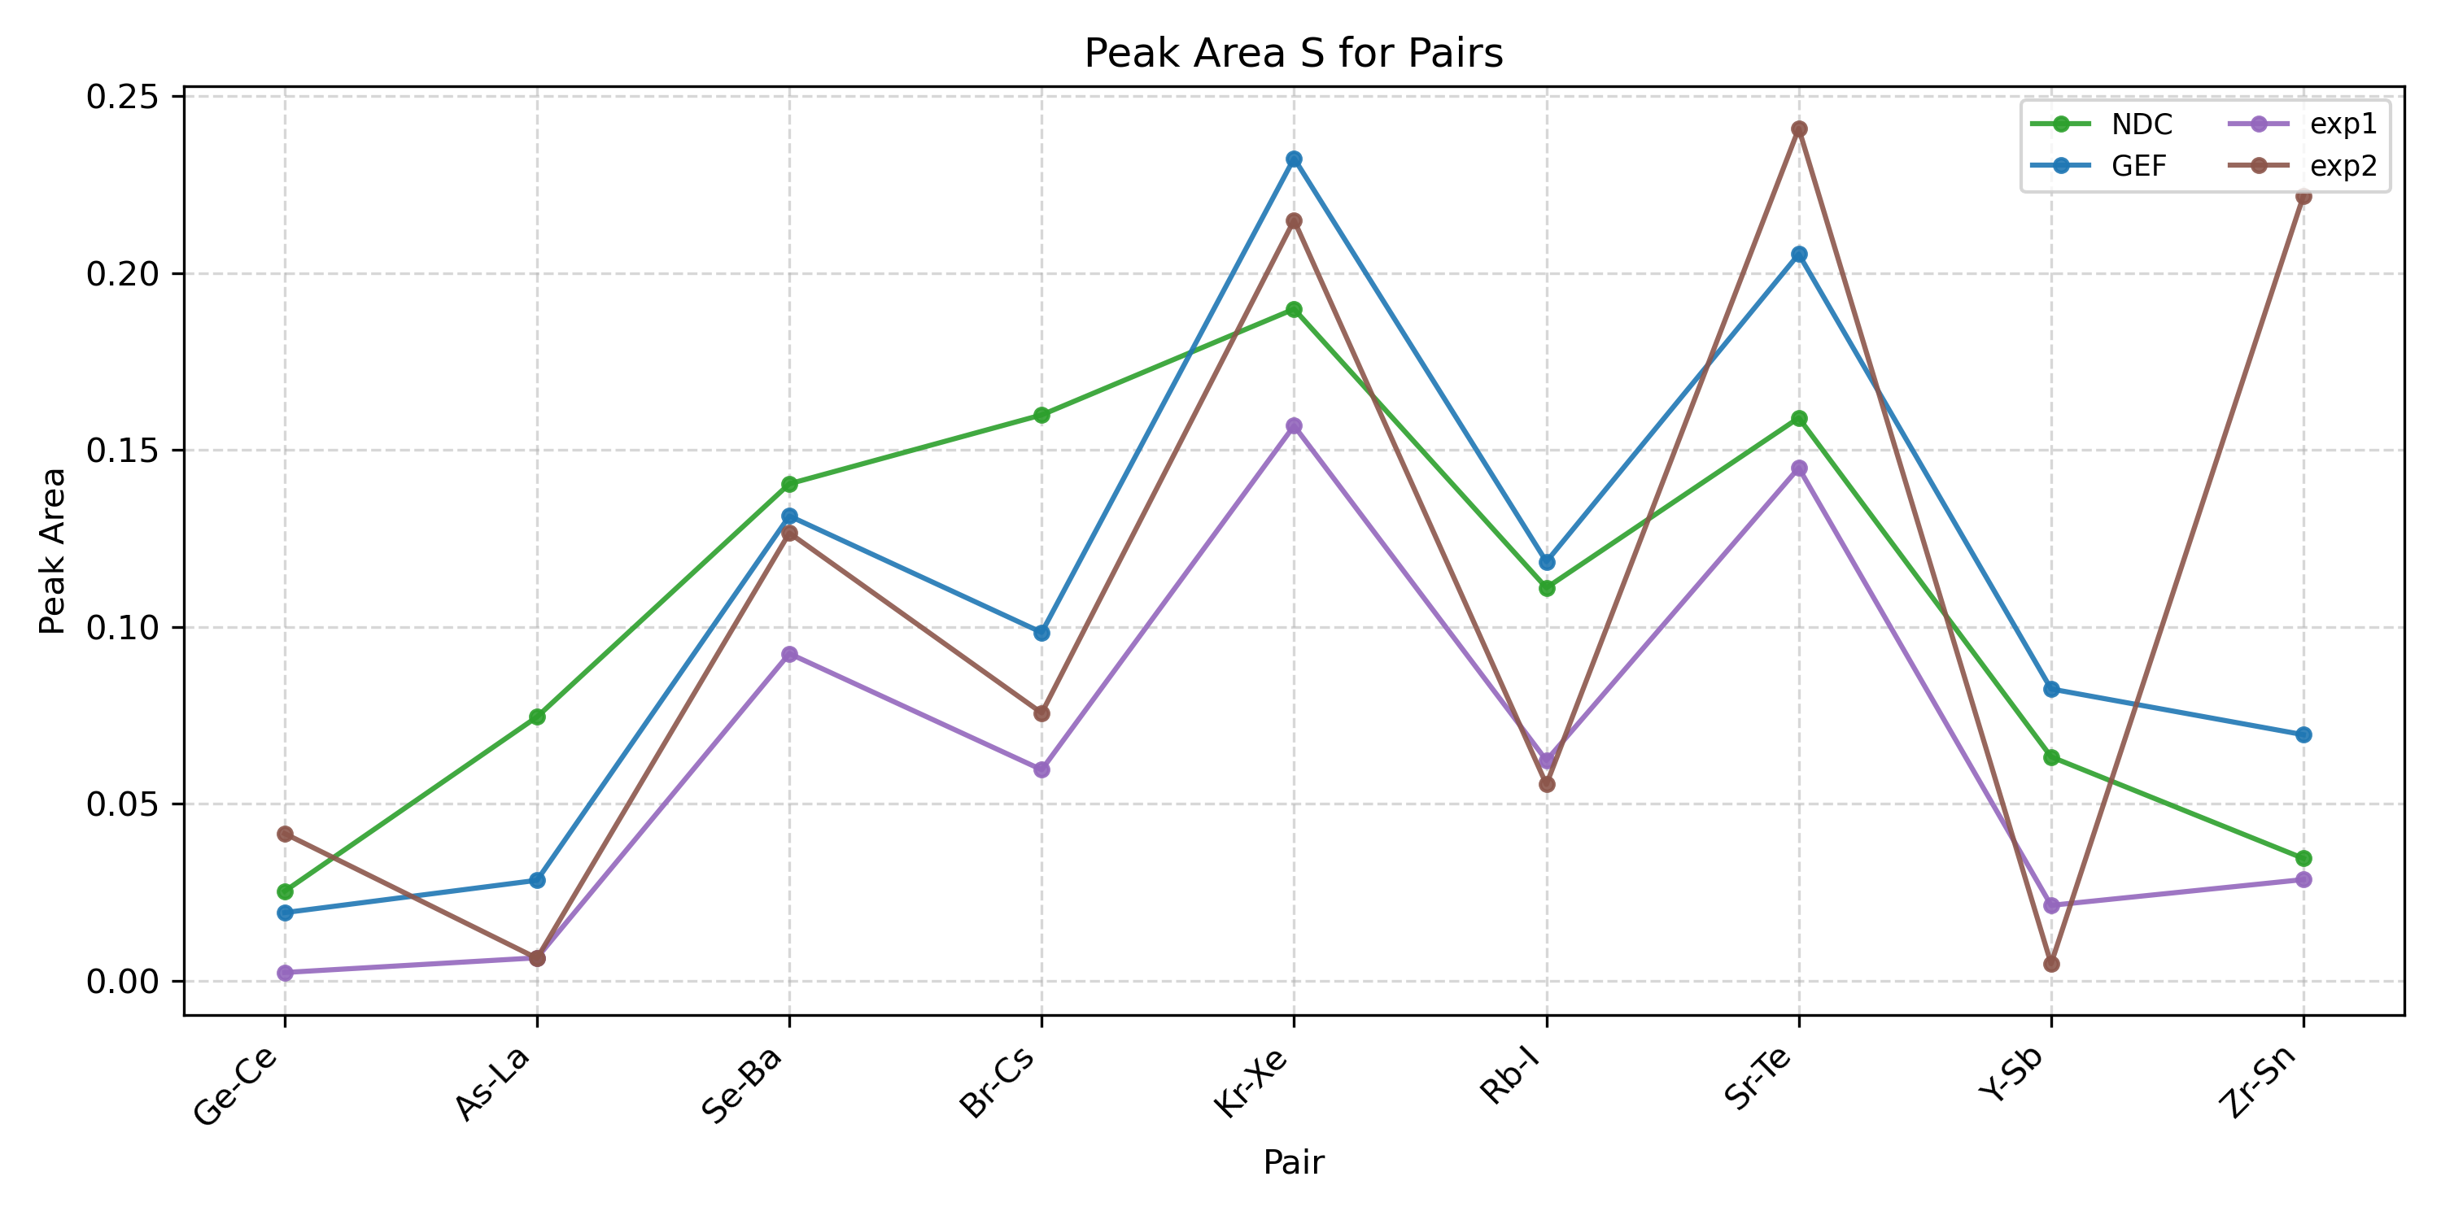
Yield Results – Global fit of fragment-pair distributions
All fragment pairs are fitted consistently on a pair-by-pair basis. For a given pair, the peak width and peak area are taken to be common to both fragments, while the peak position are treated as free fit parameters.
In cases with insufficient data (e.g. missing information on the light fragment), the peak width is interpolated from neighbouring fragment pairs, and only the remaining parameters are fitted.
ENDF
exp1 (purple): yields obtained with the Cf-252 ratio–based normalization,
exp2 (brown): yields from the conventional γ-spectroscopy method.
The resulting distributions clearly exhibit a pronounced odd–even staggering in the Th-232(n,f) system, and this staggering pattern is consistently visible in all data sets (evaluations, model predictions, and both experimental reconstructions.

Slide 12
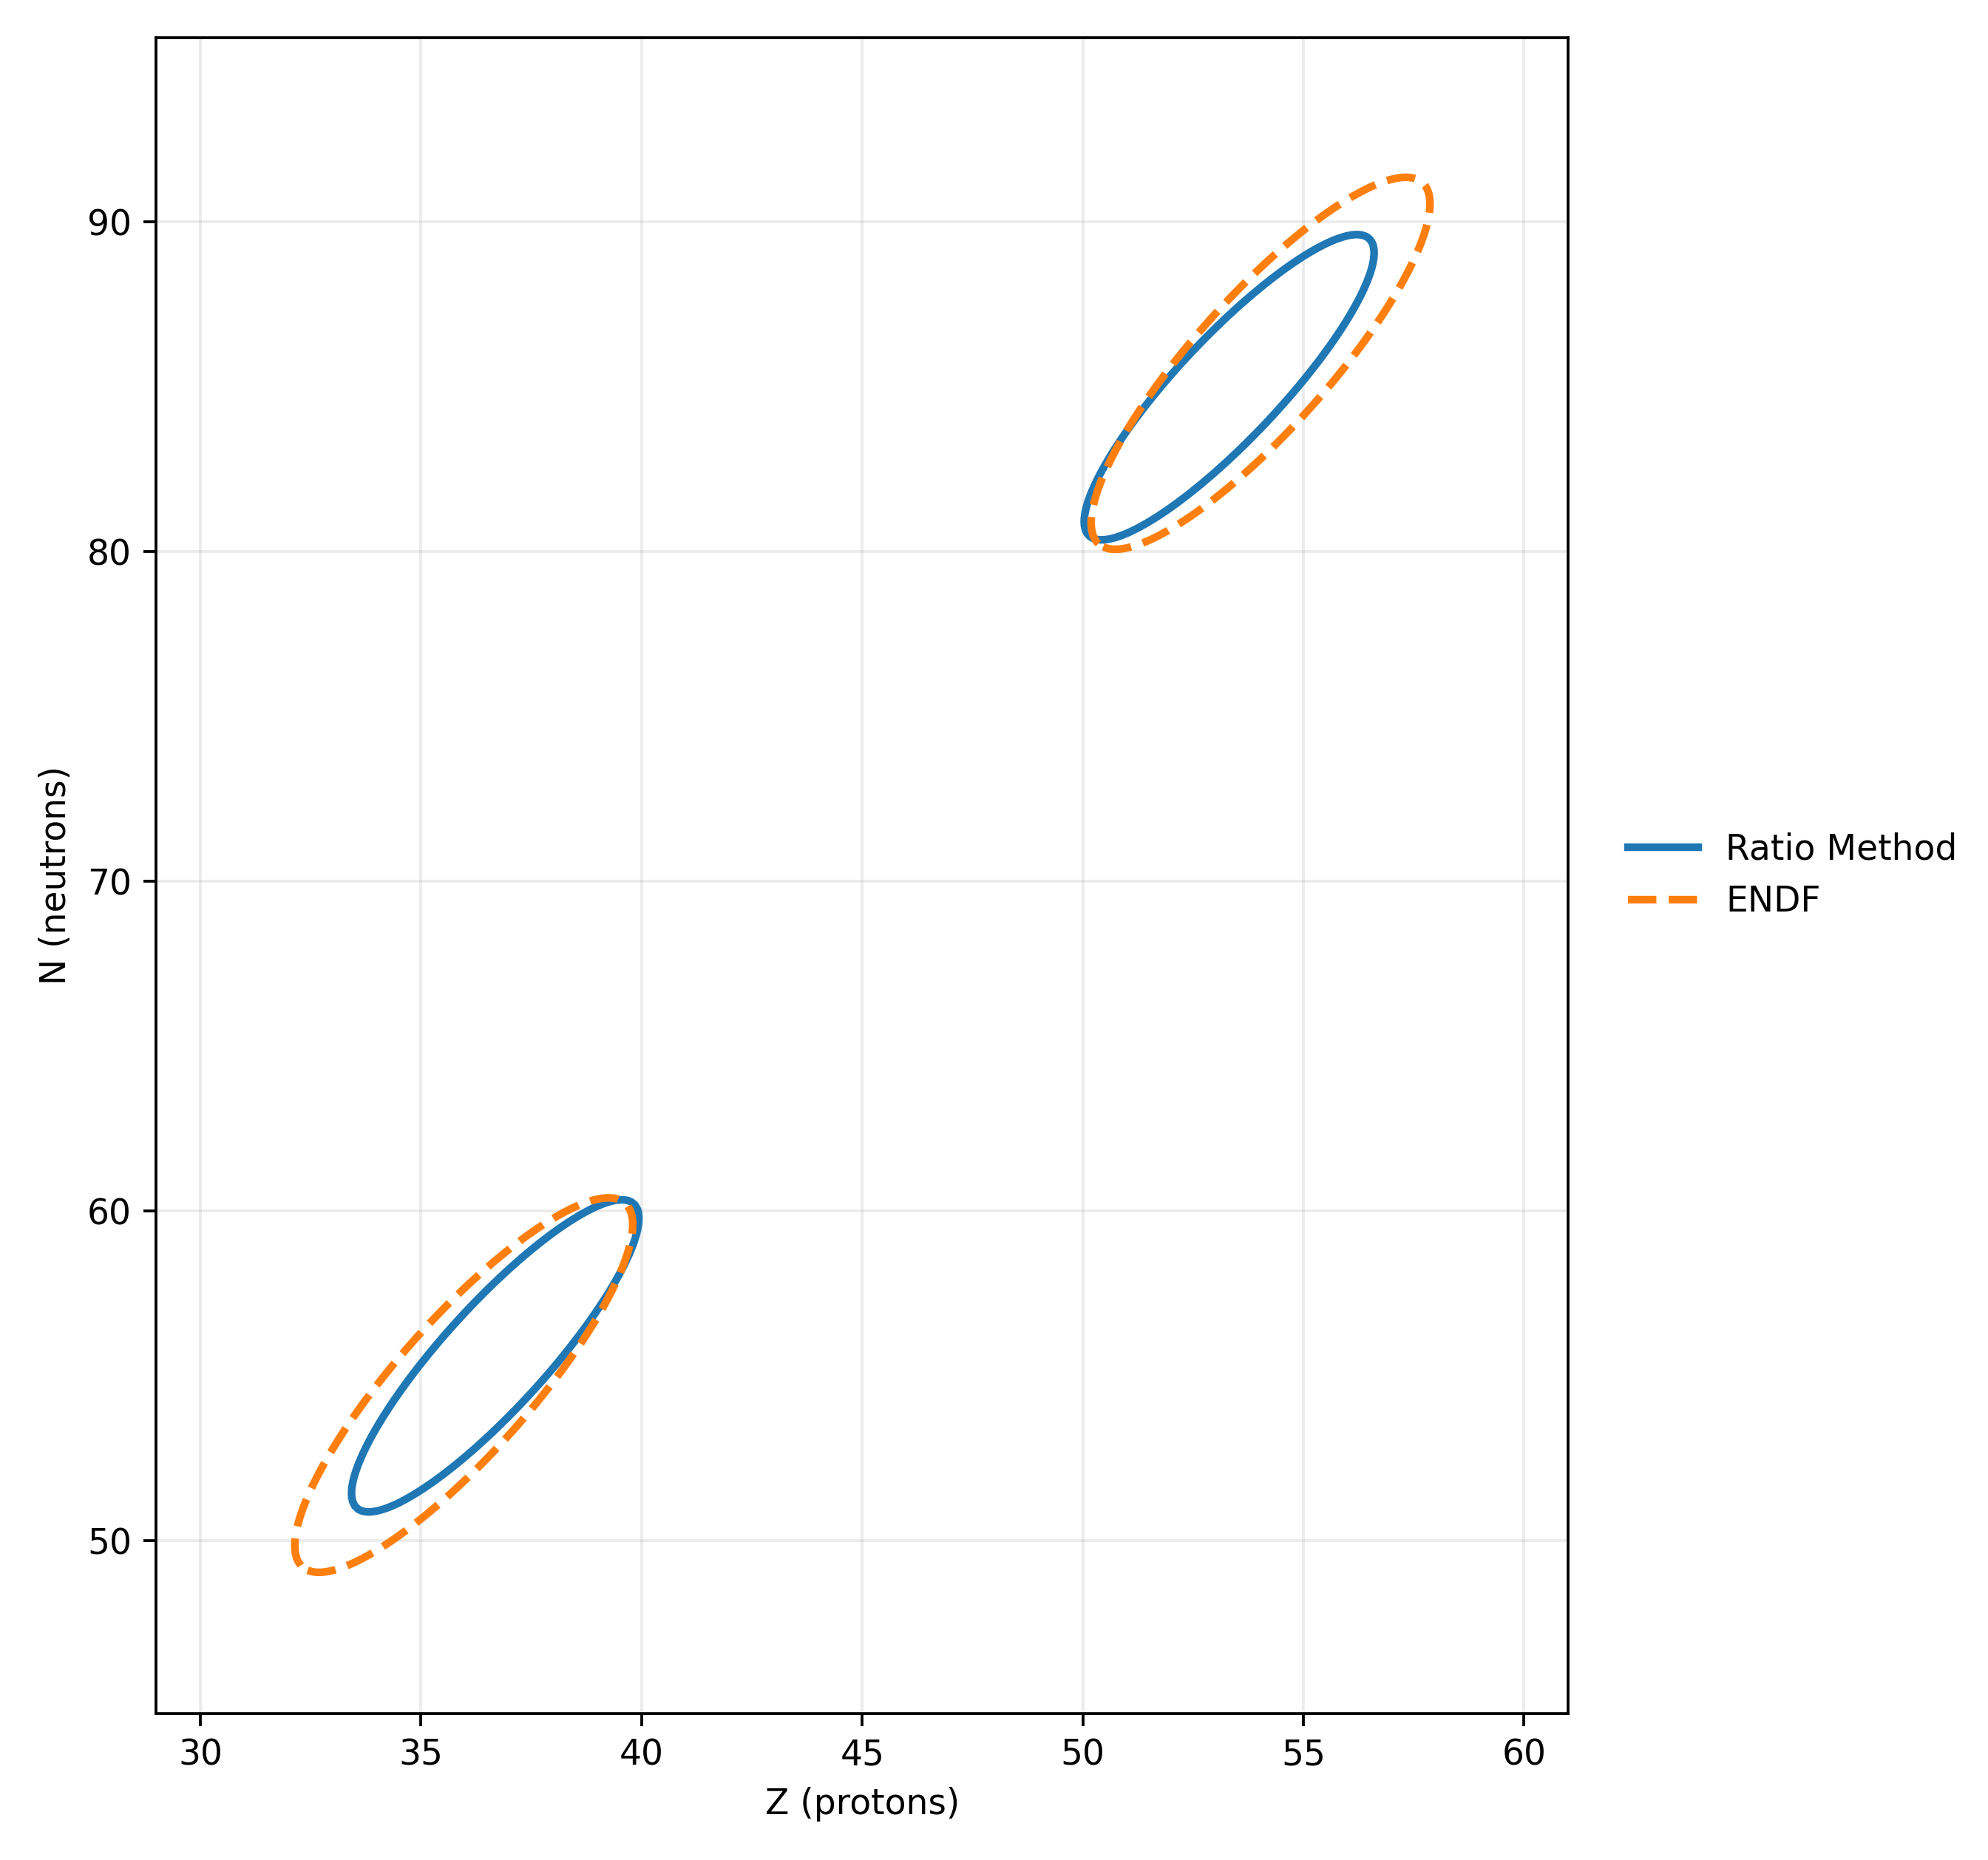
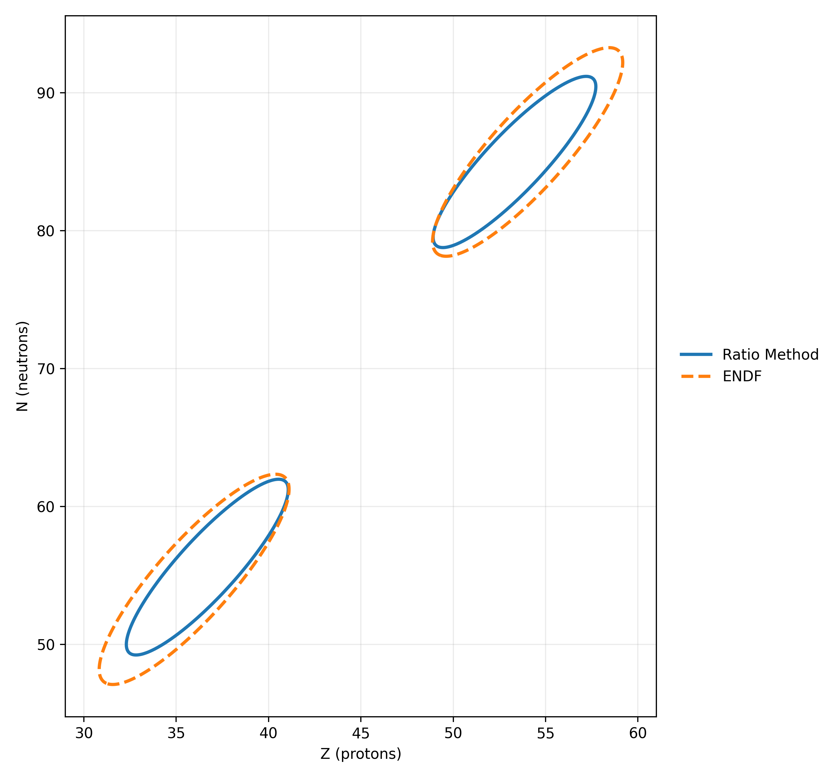

Yield Results – Global fit of fragment-pair distributions
Global Yield Estimation via 2D Gaussian Fit*
Odd Z
Even Z
Constrained fit
Light and heavy fragment groups share the same $σ_{Z}$ and correlation $ρ$, i.e. only the centroids $\left(σ_{N}^{L} , μ_{N}^{L}\right)$and $\left(μ_{Z}^{H},σ_{N}^{H} , μ_{N}^{H}\right)$are independent, $μ_{Z}^{L}=90−μ_{Z}^{H}$.
This reduces the number of free parameters and forces a symmetric shape for the two Gaussians in the Z–N plane.
The figure shows the 2.5σ contour of the fitted two-dimensional Gaussian distribution.
*: by M. Krzysztof (to be published)

Slide 13
Conclusion
Implemented a new technique based on ratio with ²⁵²Cf which links for the first time gamma ray measurements with the gold standard from direct techniques
Measured ²³²Th isotopic yields (~2MeV) with two complementary methods:
Conventional γ-spectroscopy (RadWare, side-feeding and isomer corrections) with even-Z nuclides.
Cf-252–based transition ratios, which allows odd-Z yield reconstruction.
For key fragment pairs (Kr–Xe, Sr–Te, Se–Ba), experimental yields are globally consistent in magnitude with ENDF/GEF, but some show systematic shifts, indicating differences in neutron emission and clear odd–even staggering.
Performed global fits in the Z–N plane using 2D Gaussian fit.

Slide 14
Thanks for listening!

Slide 15
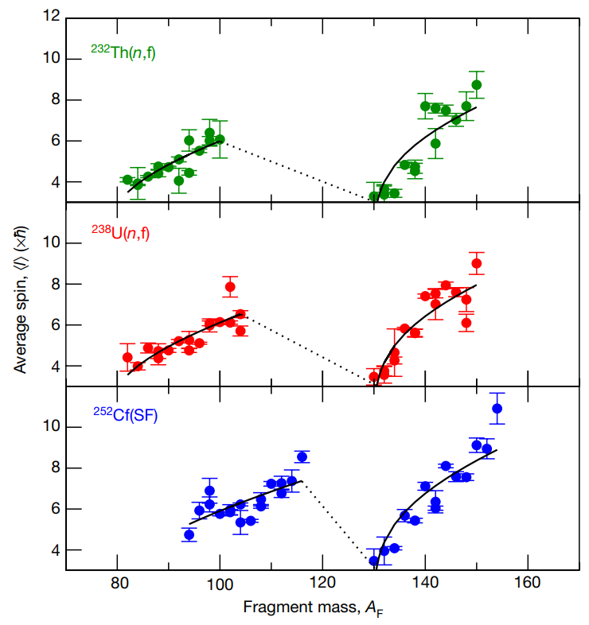
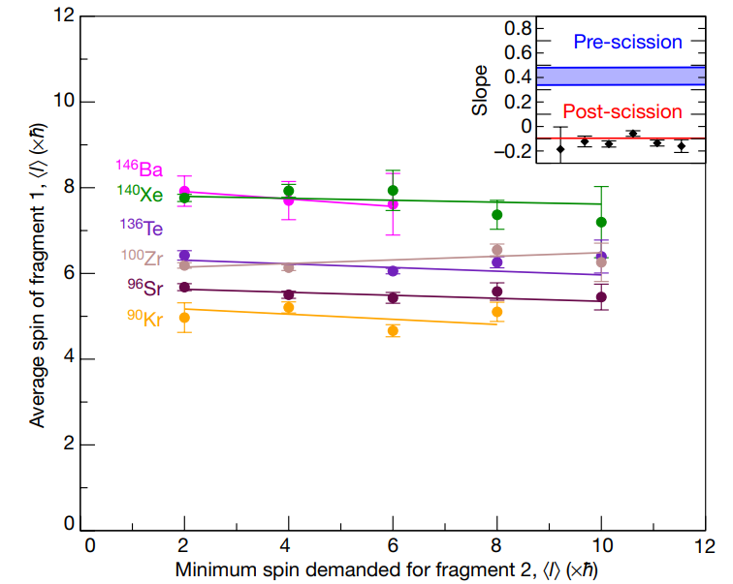
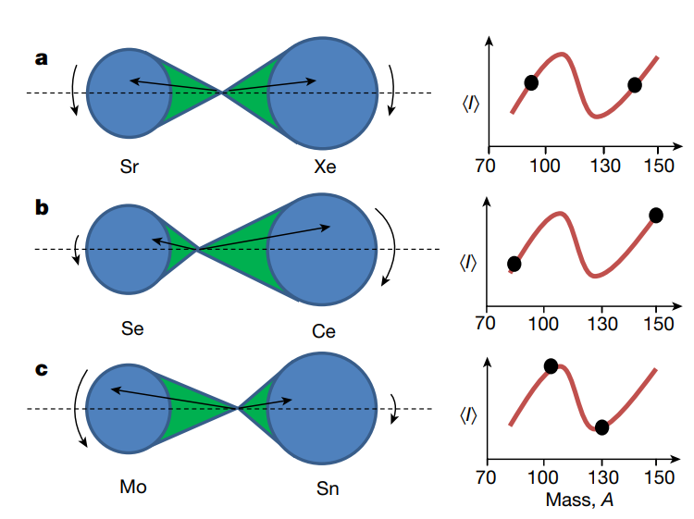
Backup
Correlation between fragment spins, J.N. Wilson, 2021
Schematic diagram of post-scission angular momentum generation, 2021
Dependence of average spin on fragment mass, J.N. Wilson, 2021

Slide 16
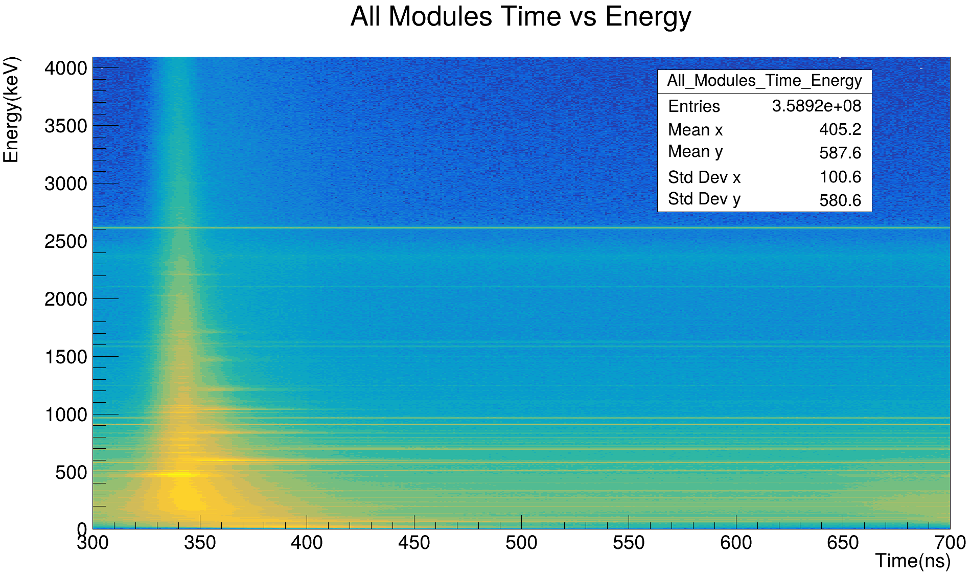
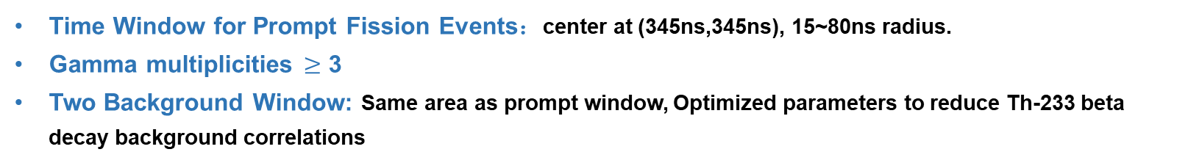
Backup
Time Window for Prompt Fission Events：center at (345ns,345ns), 15~80ns radius.
Gamma multiplicities $≥$ 3
Two Background Window: Same area as prompt window, Optimized parameters to reduce Th-233 beta decay background correlations

Slide 17
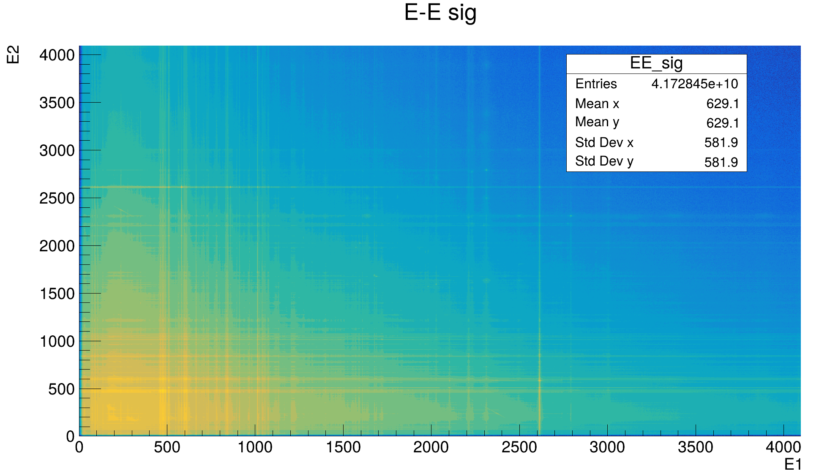
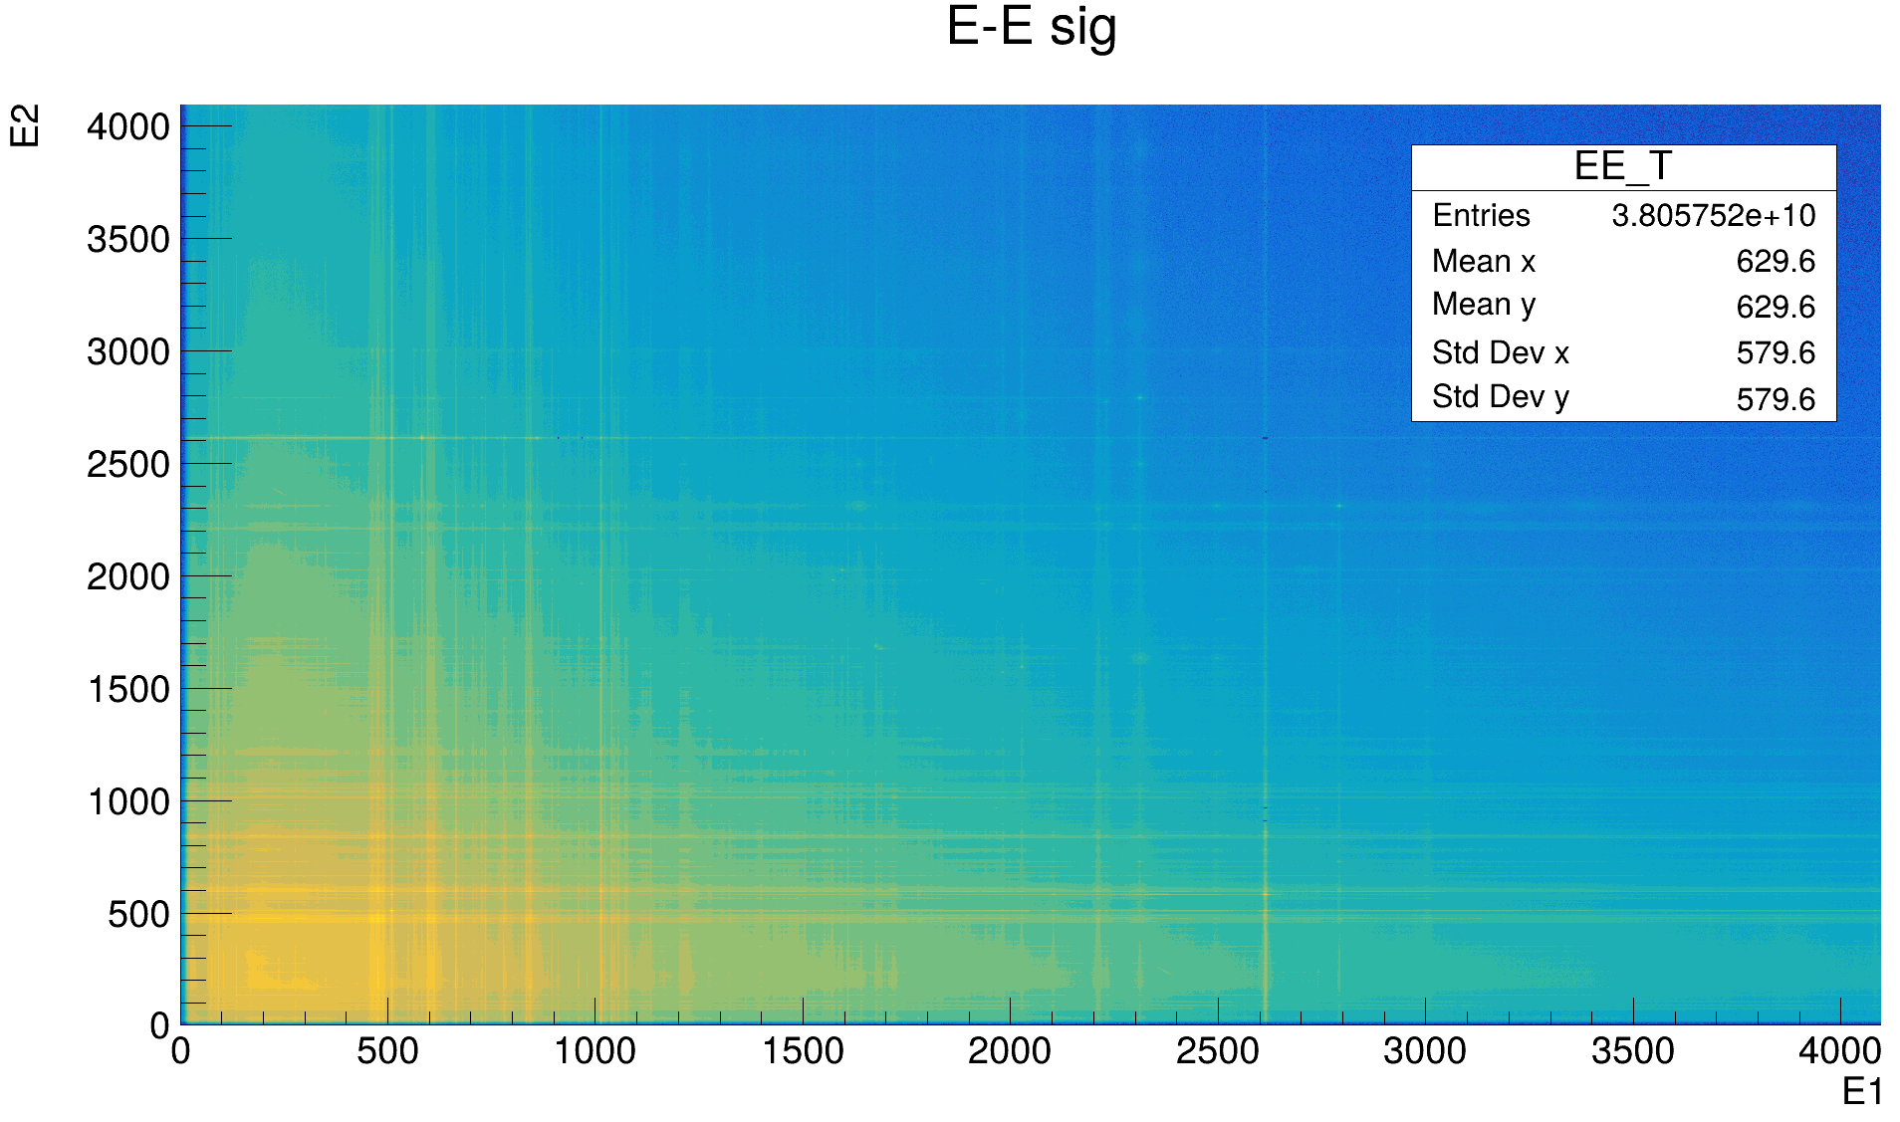
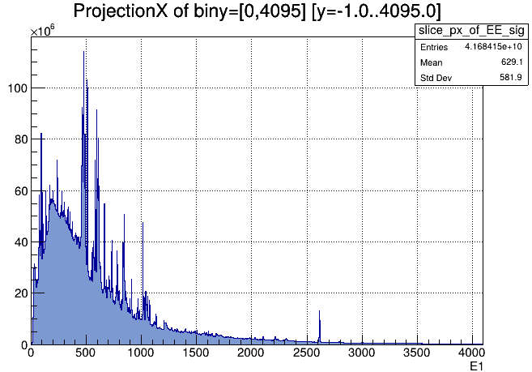
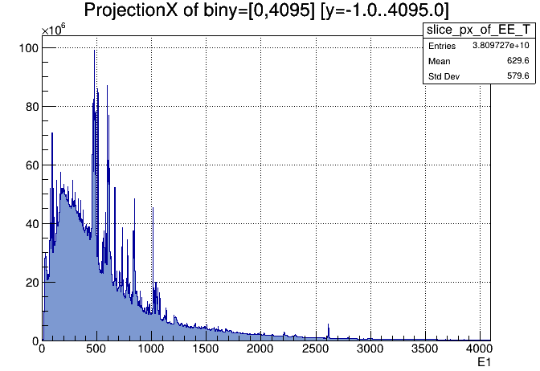
Backup
By reducing the decay-gated time window, the 2.6 MeV decay γ peak from the ²³²Th chain is strongly suppressed, demonstrating efficient removal of the thorium decay background.

Slide 18
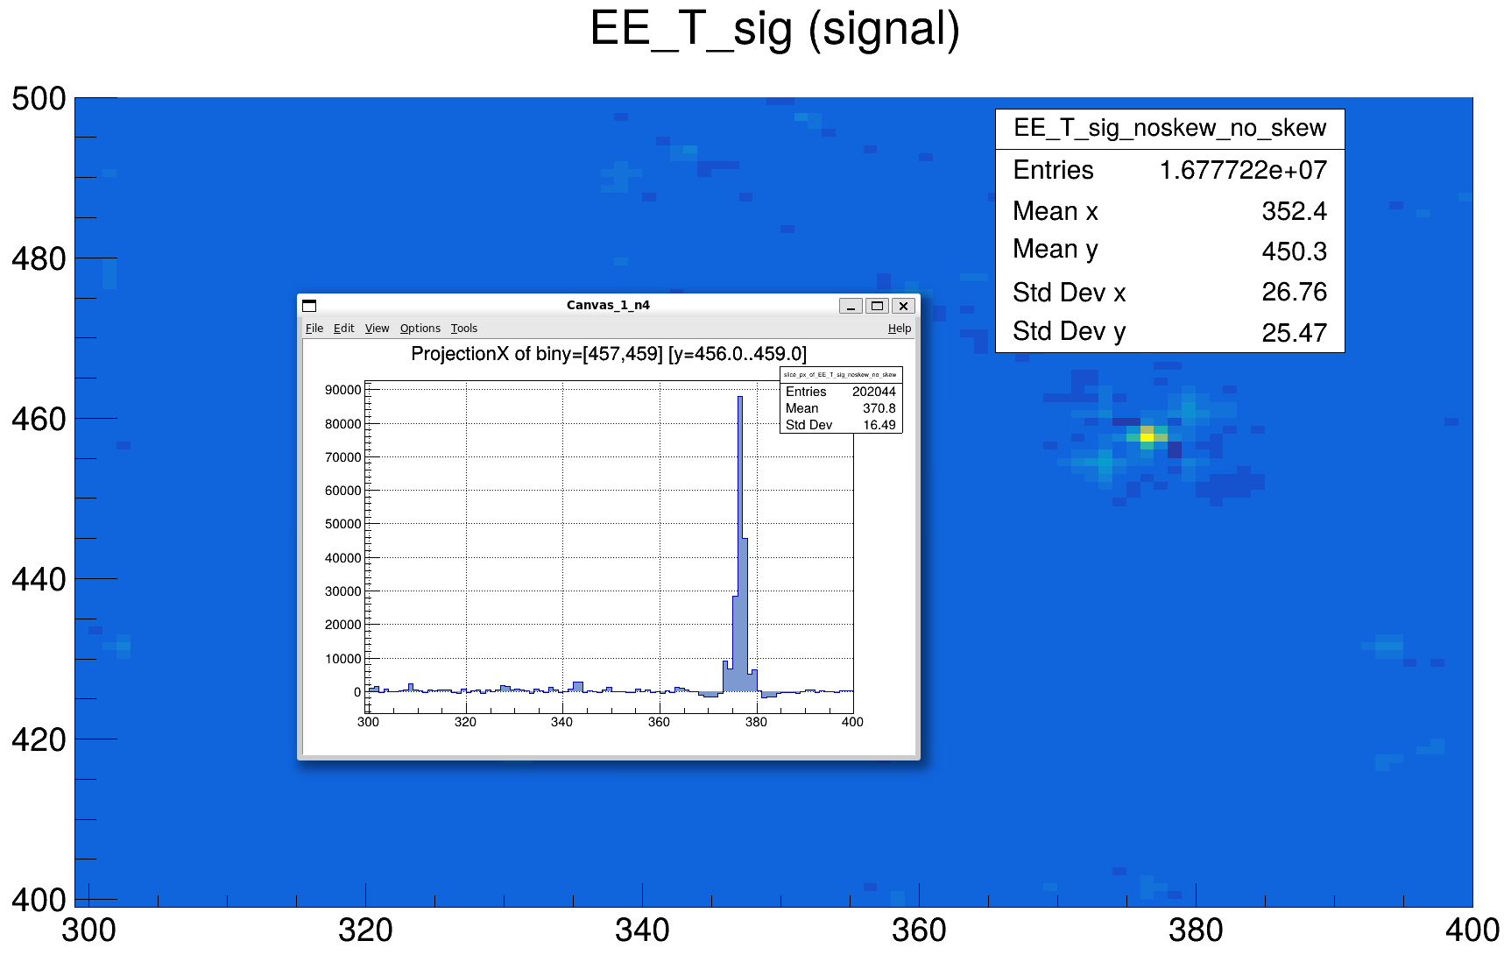
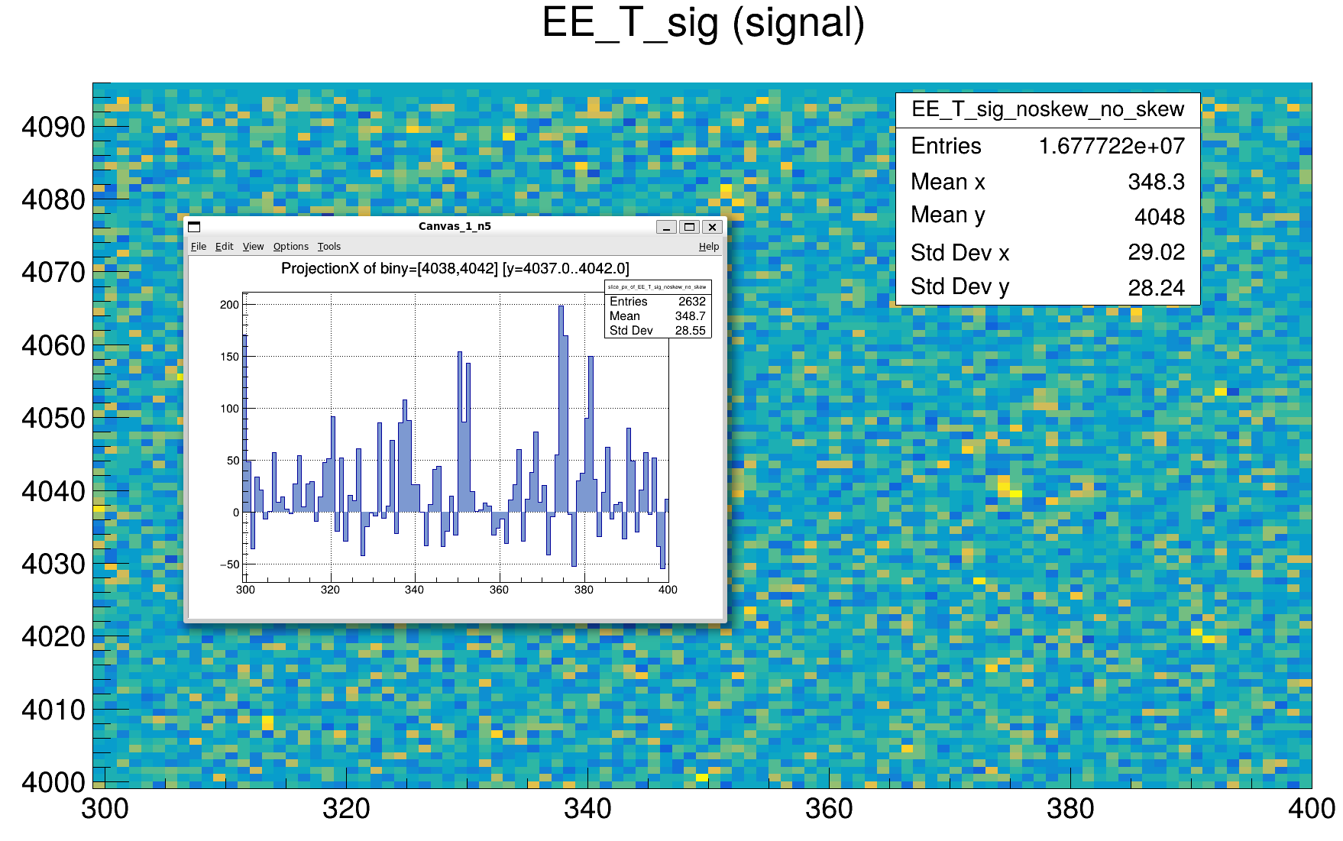
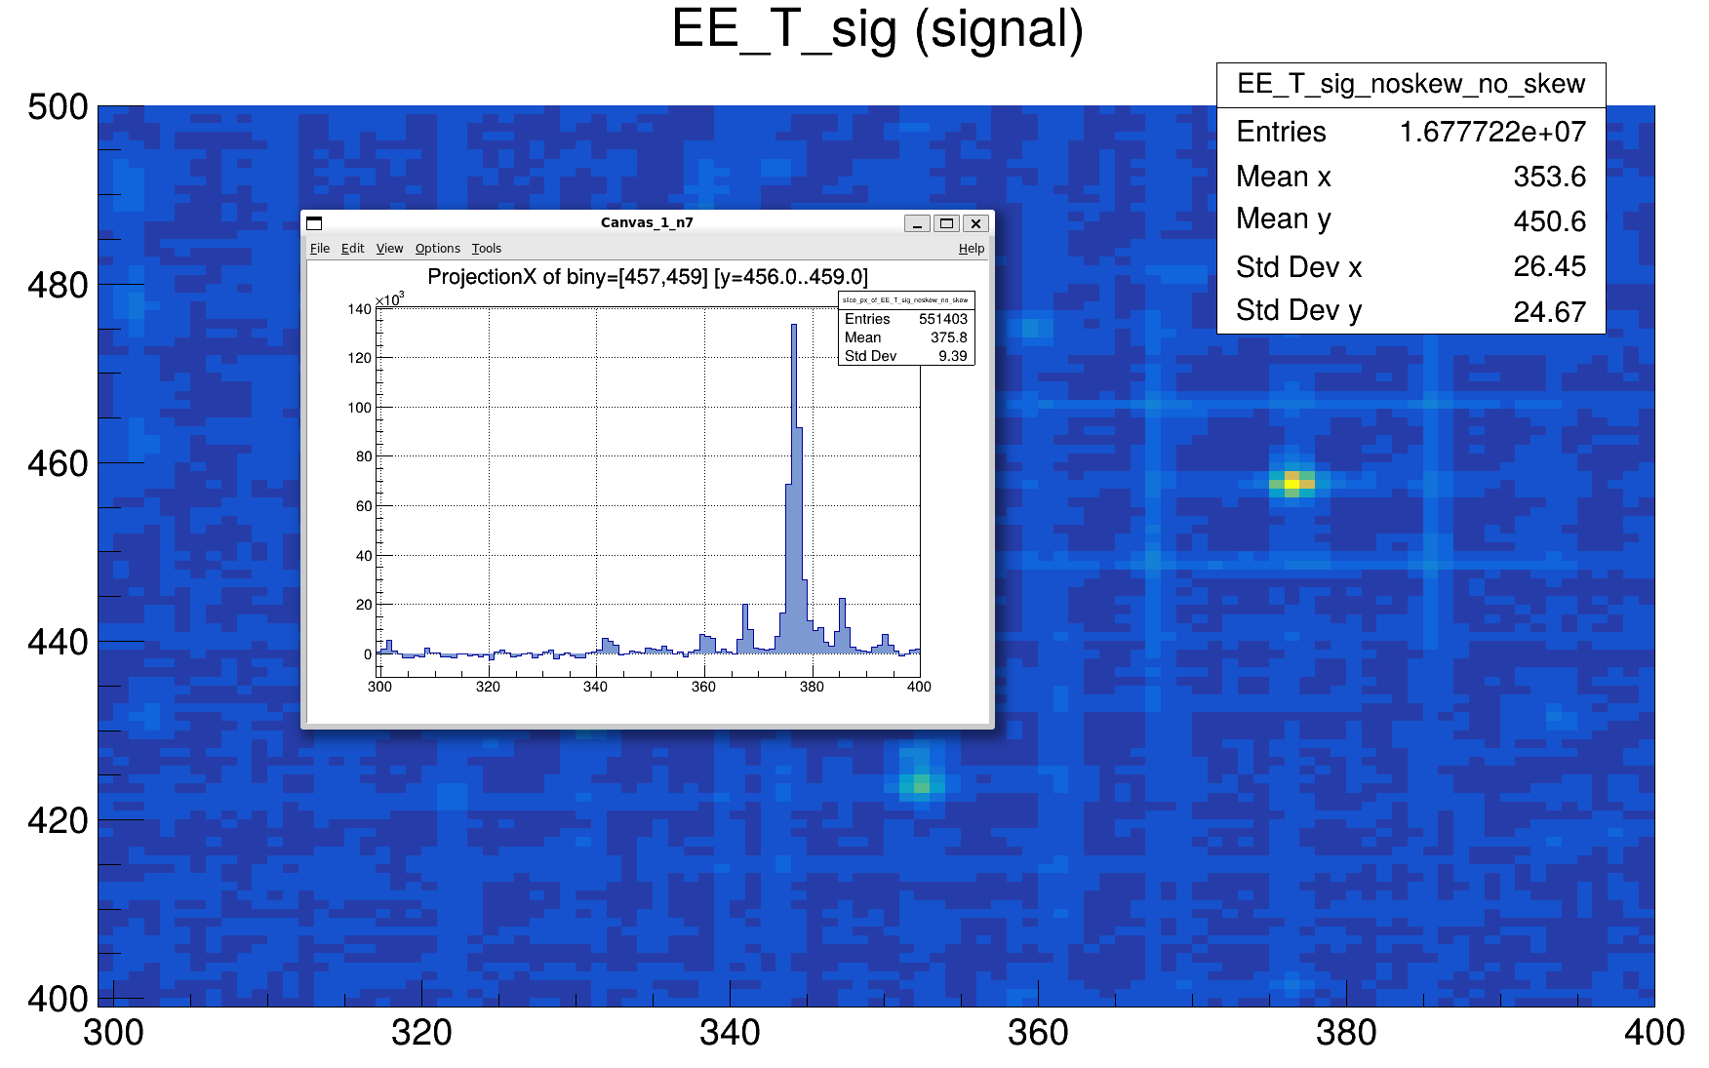
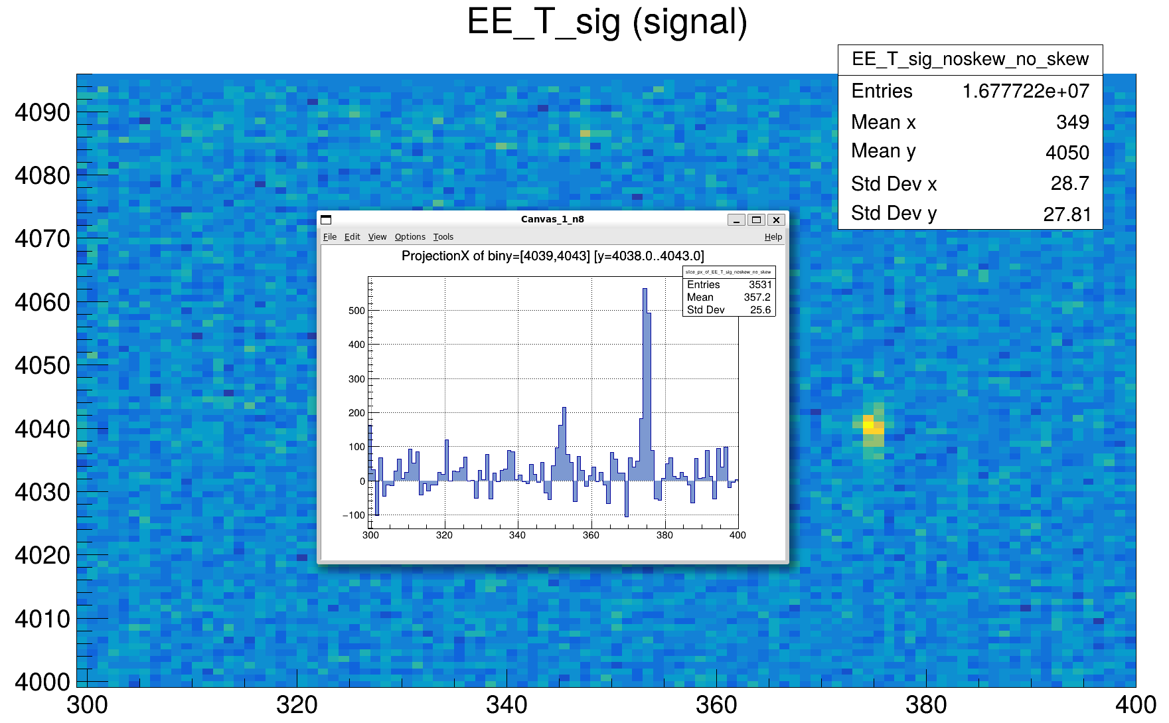
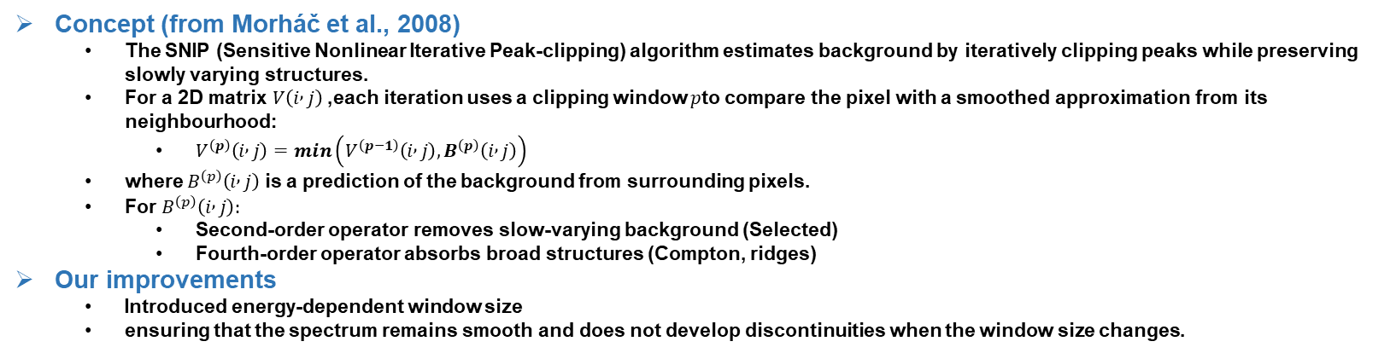
Backup
Window = 3, suitable for low energy
Window = 9, suitable for high energy
clean and well-defined peak
buried peak
background misidentified as a peak
clean and well-defined peak
Concept (from Morháč et al., 2008)
The SNIP (Sensitive Nonlinear Iterative Peak-clipping) algorithm estimates background by iteratively clipping peaks while preserving slowly varying structures.
For a 2D matrix $V\left(i , j\right)$, each iteration uses a clipping window $p$to compare the pixel with a smoothed approximation from its neighbourhood:
$V^{\left(p\right)}\left(i , j\right)=min\left(V^{\left(p−1\right)}\left(i , j\right),B^{\left(p\right)}\left(i , j\right)\right)$
where $B^{\left(p\right)}\left(i , j\right)$ is a prediction of the background from surrounding pixels.
For $B^{\left(p\right)}\left(i , j\right):$
Second-order operator removes slow-varying background (Selected)
Fourth-order operator absorbs broad structures (Compton, ridges)
Our improvements
Introduced energy-dependent window size
ensuring that the spectrum remains smooth and does not develop discontinuities when the window size changes.

Slide 19
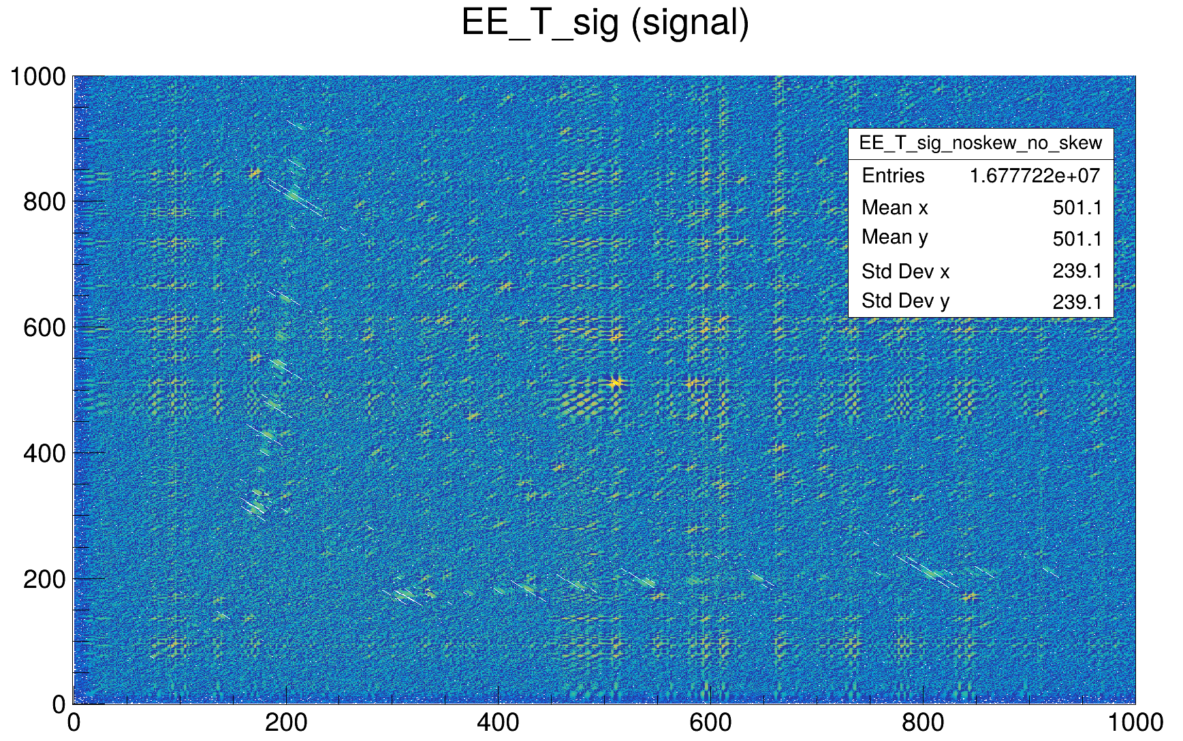
Backup
Residual diagonal after 2D-SNIP
After applying 2D-SNIP, the main remaining background structure appears along the E₁ + E₂ = constant diagonal.
These events correspond to single-γ Compton scattering, where one γ triggers two detectors.
In the γ–γ matrix, such events form a straight line with slope –1, indicating constant total γ energy.
Treatment of the diagonal component
The γ–γ matrix is decomposed diagonal by diagonal (each constant-sum line).
For each diagonal slice, a separate 1D background-smoothing subtraction is performed.
This removes the Compton-scattering contribution while preserving true γ–γ coincidence peaks.
DET1
Fission
DET2

Slide 20
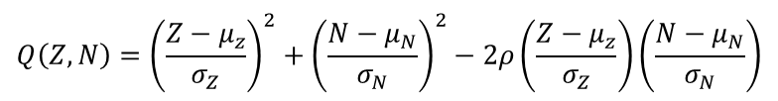




Backup
Global Yield Estimation via 2D Gaussian Mixture Fit
The ratio-based method cannot provide yields for all isotopes because Cf-252 and Th-232 fragment distributions do not fully overlap.
To recover missing yields and obtain a global, model-independent estimate, we follow the approach of M. Krzysztof (to be published) and perform a global fit of all fragments in the Z–N plane.
$$f\left(Z,N|μ_{z},μ_{N},σ_{Z},σ_{N},ρ\right)=\frac{1}{2πσ_{Z}σ_{N}\sqrt{1−ρ^{2}}}\exp\left[−\frac{Q\left(Z,N\right)}{2\left(1−ρ^{2}\right)}\right]$$
1.Bivariate Gaussian for one fragment group
$$Q\left(Z,N\right)={\left(\frac{Z−μ_{z}}{σ_{Z}}\right)}^{2}+{\left(\frac{N−μ_{N}}{σ_{N}}\right)}^{2}−2ρ\left(\frac{Z−μ_{z}}{σ_{Z}}\right)\left(\frac{N−μ_{N}}{σ_{N}}\right)$$
2. Two-component mixture
$$f_{mix}\left(Z,N\right)=\frac{1}{2}f_{light}\left(Z,N\right)+\frac{1}{2}f_{heavy}\left(Z,N\right)$$
$$ℒ\left(θ\right)=\prod_{i}{w_{i}f_{mix}\left(Z_{i},N_{i}|θ\right)}, w_{i}=\frac{Y\left(Z_{i},N_{i}\right)}{\sum{Y}}$$
3. Parameter Determination: Maximum log-Likelihood
$$\max\left\{\ln{ℒ\left(θ\right)}\right\}→\left(μ_{z},μ_{N},σ_{Z},σ_{N},ρ\right)$$

Slide 21

Motivation for Studying Th-232 Fission Yields
Growing interest in thorium-based reactor technologies
Thorium-based molten salt reactors have gained substantial attention in recent years as a promising option within Generation-IV reactor concepts. Their intrinsic safety properties, high fuel utilization, and proliferation resistance make thorium an appealing alternative to uranium-based fuel cycles
Industrial progress demonstrates practical feasibility
Recent developments—such as demonstrations of the Th-232 → U-233 breeding process in prototype thorium reactors (e.g., China’s MSR research program)—have further highlighted the industrial relevance of thorium fuel
Fission yields play a crucial role in reactor performance
Accurate fission product yields are essential for
predicting decay heat and radiotoxicity
ensuring safety margins and long-term operation reliability
Current knowledge of Th-232 fission yields is still limited
Experimental data for neutron-induced fission of Th-232 remain scarce
Th-232 is not a fissile nuclide, which is hard to directly measure the isotopic yield
http://www.xinhuanet.com/photo/20251101/2b9aded50ca4452e80aaf8a7f48d4b12/c.html

Slide 22
Conclusion
Methodological conclusions
Cf-252–based approach as a powerful complement The Cf-252–based ratio method provides more accurate yield reconstruction for many specific isotopes (in particular those well populated in Cf-252(sf)), and can serve as an alternative or complement to the conventional spectroscopy approach.
Limitations from incomplete coverage Because the fission fragment distributions of Cf-252 (sf) and Th-232 (n,f) do not completely overlap, the yields of some fragments, especially those in the light-fragment region, are absent.
Increasing potential with more data As more experimental data and better evaluations become available, the applicability and reliability of the ratio-based method will steadily improve, giving it strong prospects for future use in fission-yield studies.
Hybrid strategies in the presence of missing data Conventional spectroscopy (e.g., even–even fragments or global fits) can be used to supplement missing nuclides, leading to a more complete set of fragment yields.

Slide 23
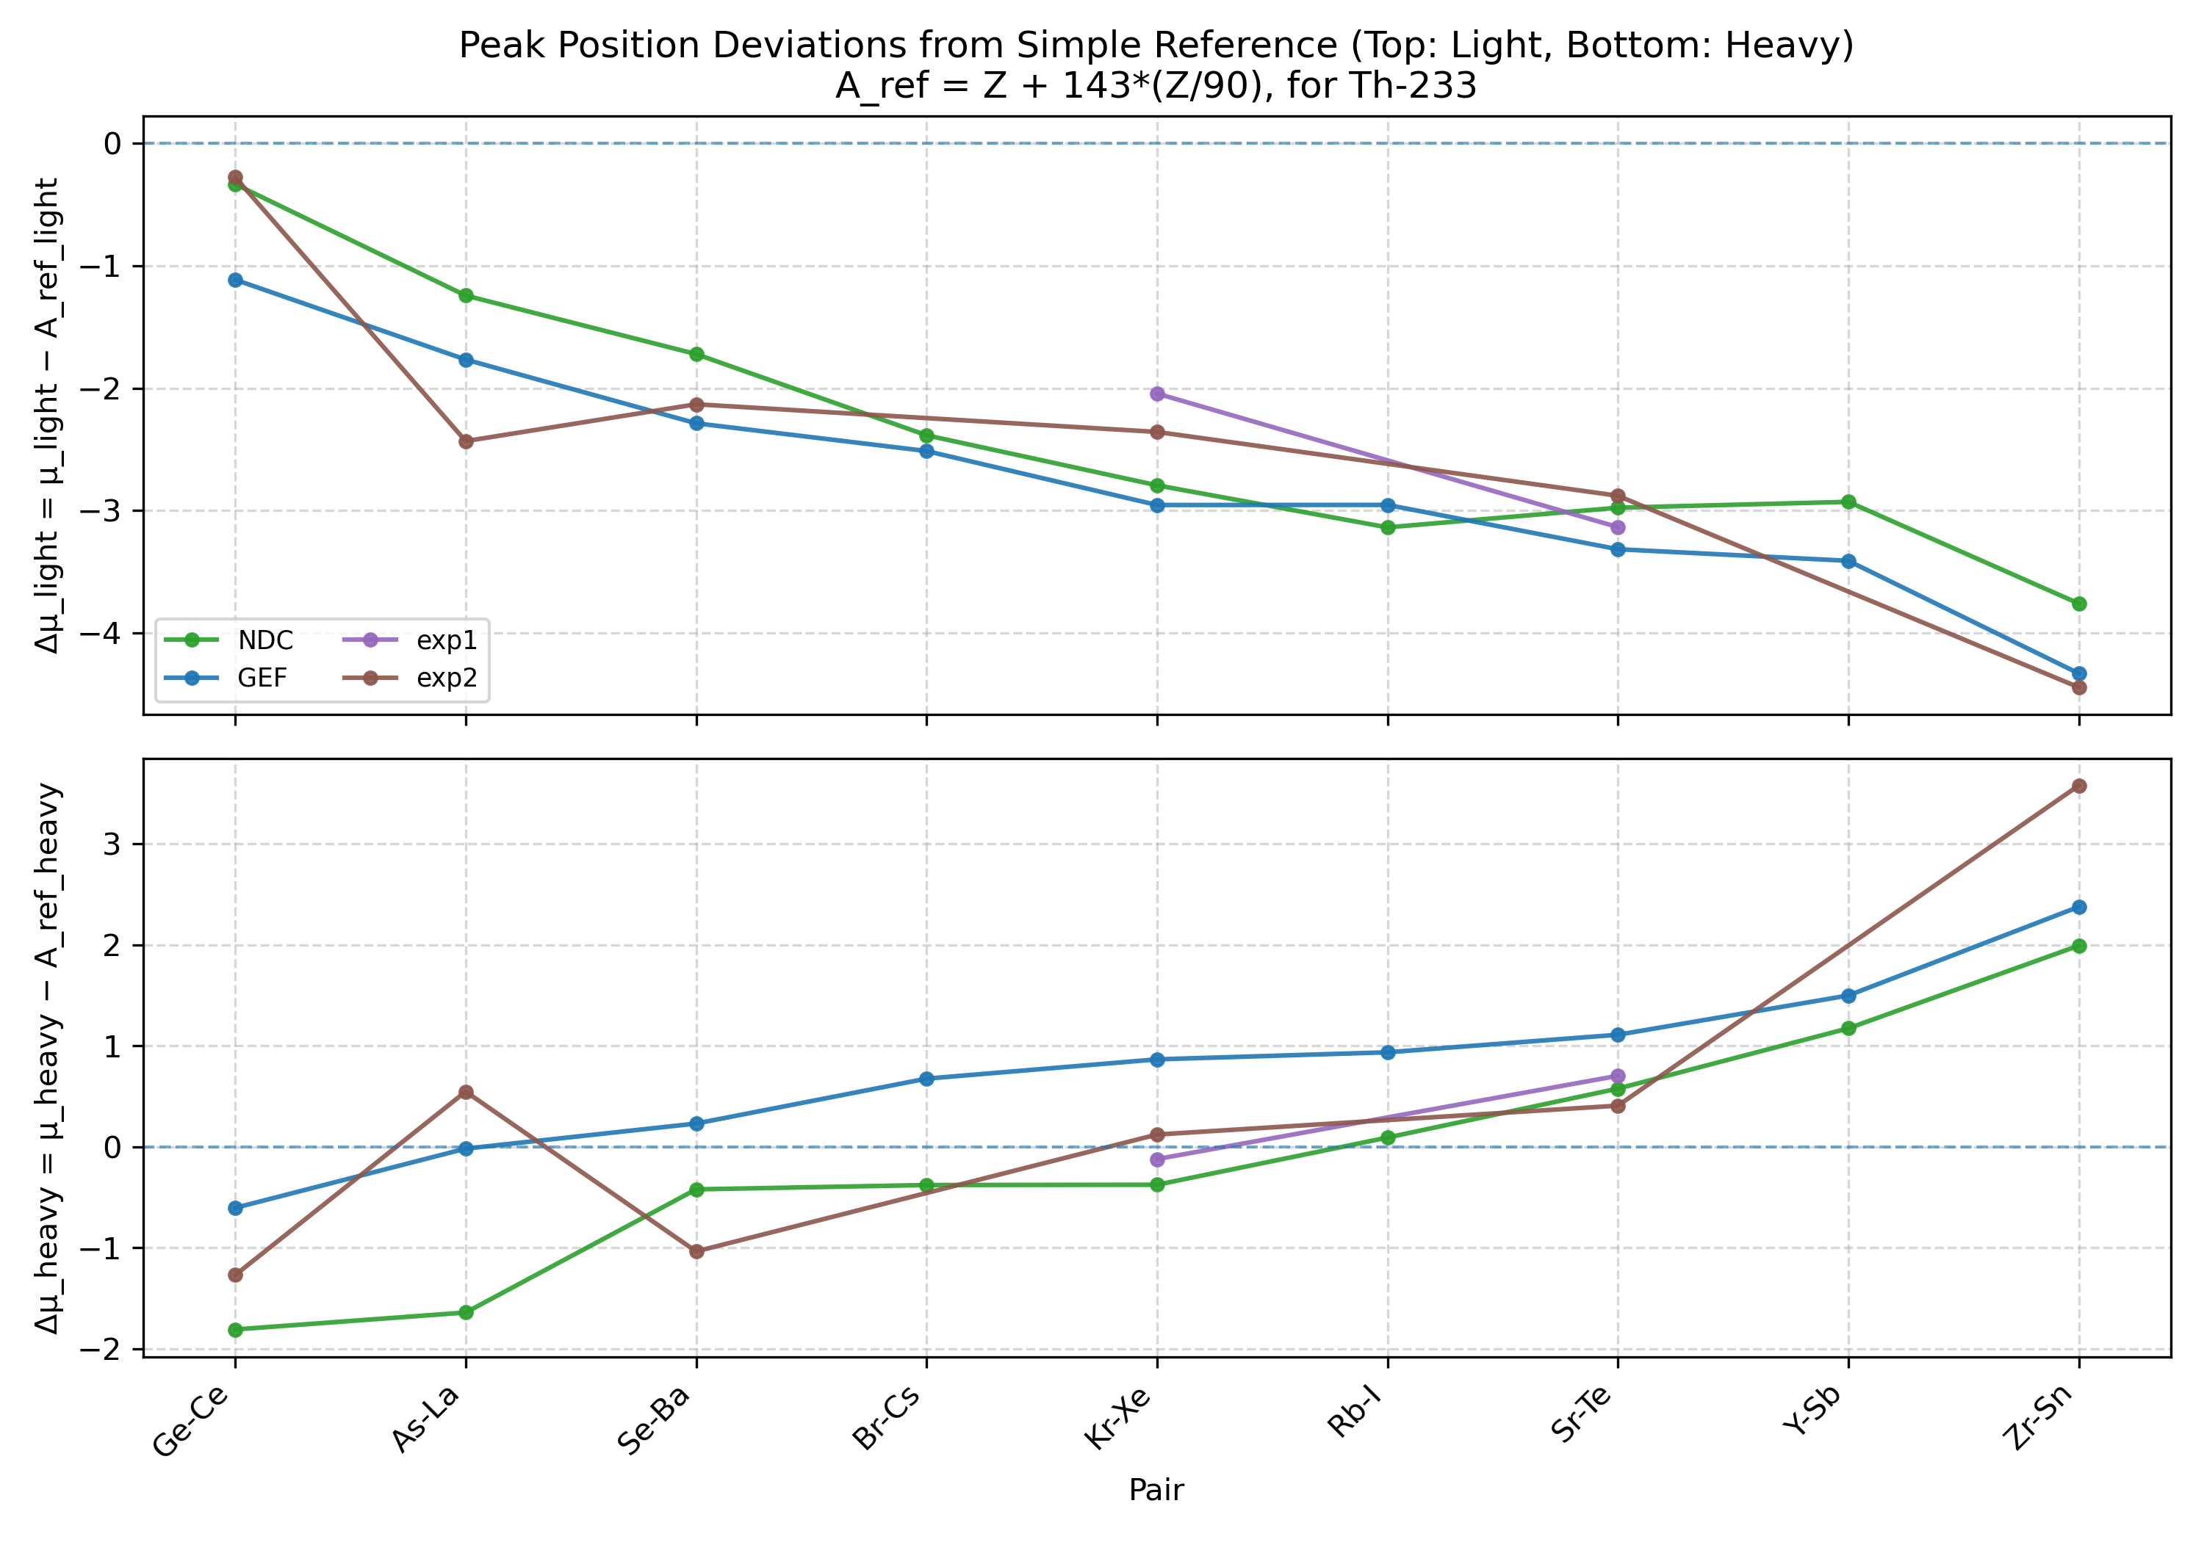
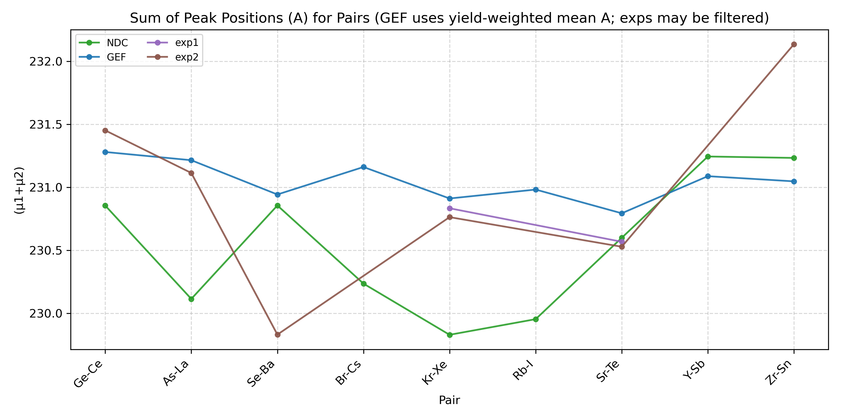
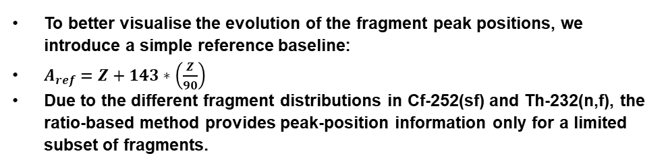
Yield Results – Global fit of fragment-pair distributions
Peak positions of individual fragments
To better visualise the evolution of the fragment peak positions, we introduce a simple reference baseline:
$A_{ref}=Z+143∗\left(\frac{Z}{90}\right)$
Due to the different fragment distributions in Cf-252(sf) and Th-232(n,f), the ratio-based method provides peak-position information only for a limited subset of fragments.
Sum of peak positions for fragment pairs
The second plot shows the sum of the peak positions for each fragment pair, which approximates the reconstructed total mass of the fission system.
Again, because of the restricted overlap between Cf-252 and Th-232 fragment yields, the ratio-based method can only provide complete peak-position information for two fragment pairs over the full range.

