Slide 1





Neutron rich nuclei and fission studies at the IGISOL facility
Primary author: PENTTILÄ, Heikki (University of Jyvaskyla)
Co-authors: KANKAINEN, Anu (University of Jyvaskyla); JOKINEN, Ari (University of Jyvaskyla); MOORE, Iain (University of Jyvaskyla); REPONEN, Mikael (University of Jyvaskyla); ERONEN, Tommi (University of Jyvaskyla); VIRTANEN, Ville (University of Jyvaskyla); GROUP, and the IGISOL (University of Jyvaskyla)
Work has received funding from the Euratom Research and Training Program 2014-2018 under Grant No. 847594 (ARIEL) and under Grant No. 847552 (SANDA)

Slide 2
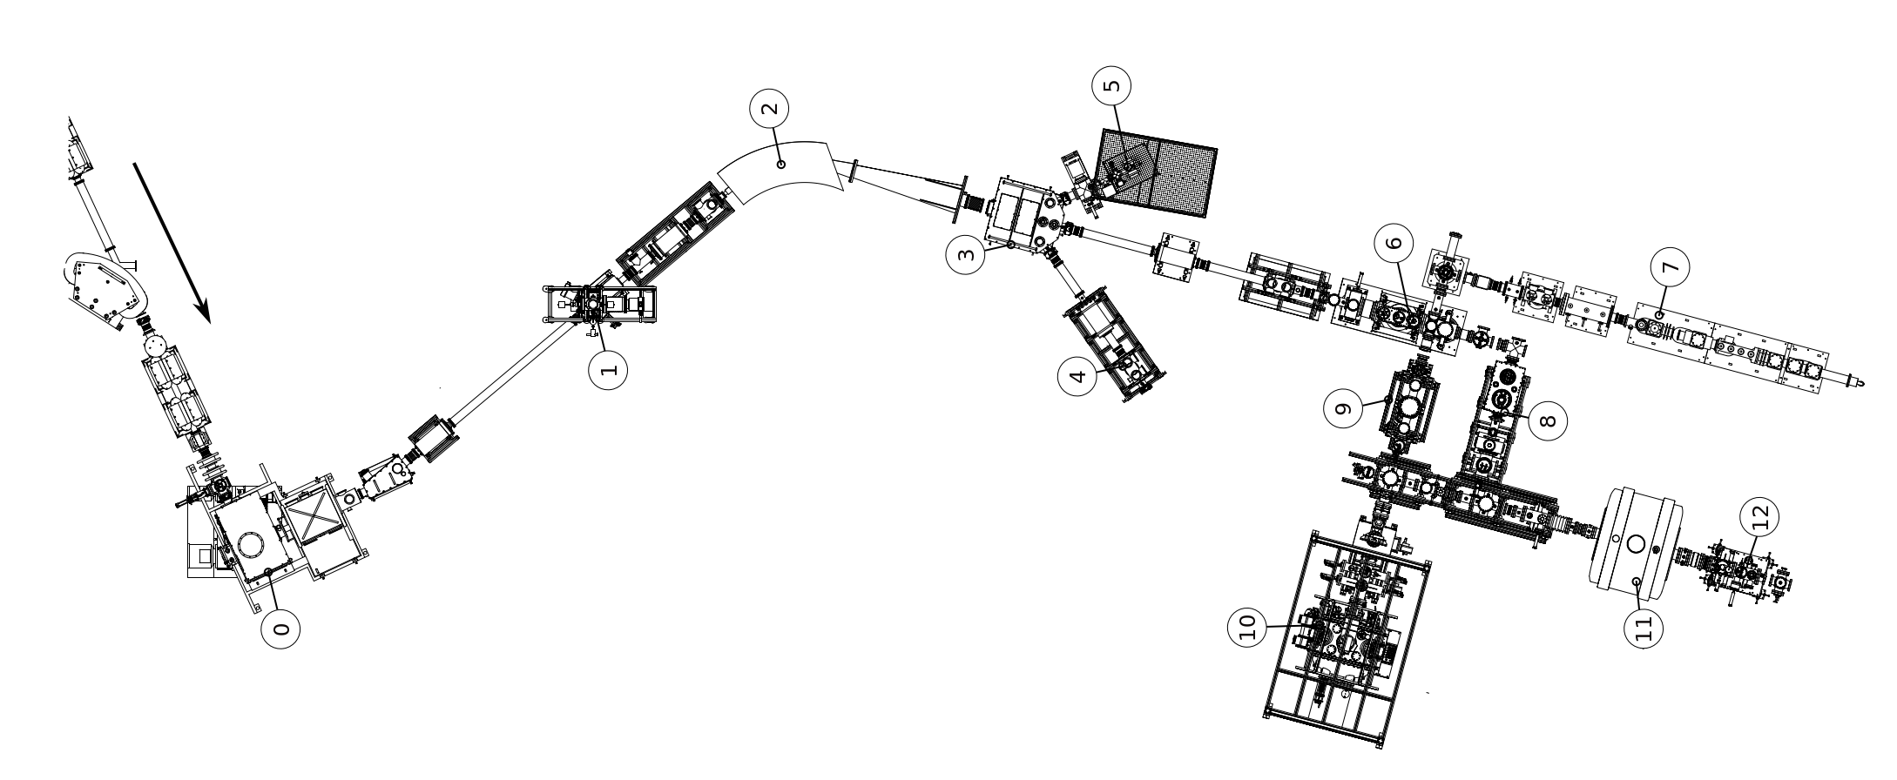
IGISOL facility in the JYU-ACCLAB in the University of Jyväskylä
3
6
7
4
8
2
5
10
9
13
Target chamber
Off-line ion source
Dipole magnet
Switchyard
Decay spectroscopy line (currently occupied by SEASON)
Atom trap
7.RFQ cooler/buncher
8. Collinear laser line
9. RAPTOR
10. MR-ToF-MS
11. MORA
12. JYFLTRAP
13. Decay station
1
11
12

Slide 3
Why the ion guide method fits to be used to determine the independent fission yields?
Ions of any element can be produced
Does not mean that efficiency was the same for all elements
Up to ~100 MeV
Charge state is concentrated (1+)
The fission products are (mostly) primary products directly from fission
Only place where the beta decay daughters of fission products can get in the detected beam is in the ion guide, not after the dipole magnet

Slide 4
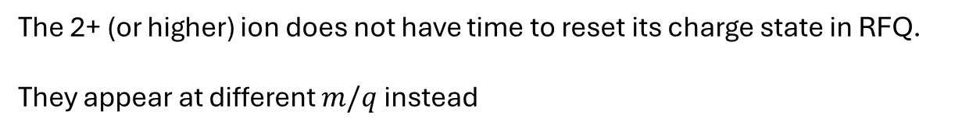

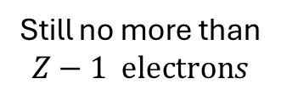



Why the $β$ decay products of the dipole magnet mass separated ions disappear?
+1
+2
$${}_{}^{A}Z$$
$$β$$
$${}_{}^{A}{Z+1}$$
$$Z−1 \text{electron}s$$
Still no more than
$$Z−1 \text{electron}s$$
A 1+ ion in RFQ cooler, for example
The 2+ (or higher) ion does not have time to reset its charge state in RFQ.
They appear at different $m/q$instead

Slide 5
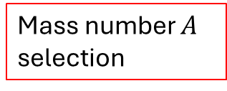
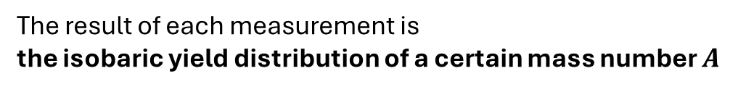
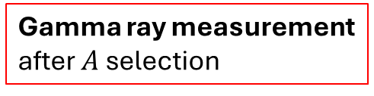
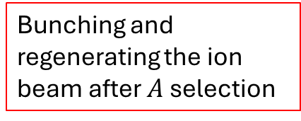
How the independent fission yields are determined?
6
Bunching and regenerating the ion beam after $A$ selection
3
4
7
8
Mass number $A$
selection
2
5
10
9
Gamma ray measurement after $A$ selection
13
1
11
12
More dedicated mass analysis of 1+ ions:
Time of flight
More dedicated mass analysis of 1+ ions:
Mass filtering or PI-ICR
The result of each measurement is
the isobaric yield distribution of a certain mass number $A$

Slide 6
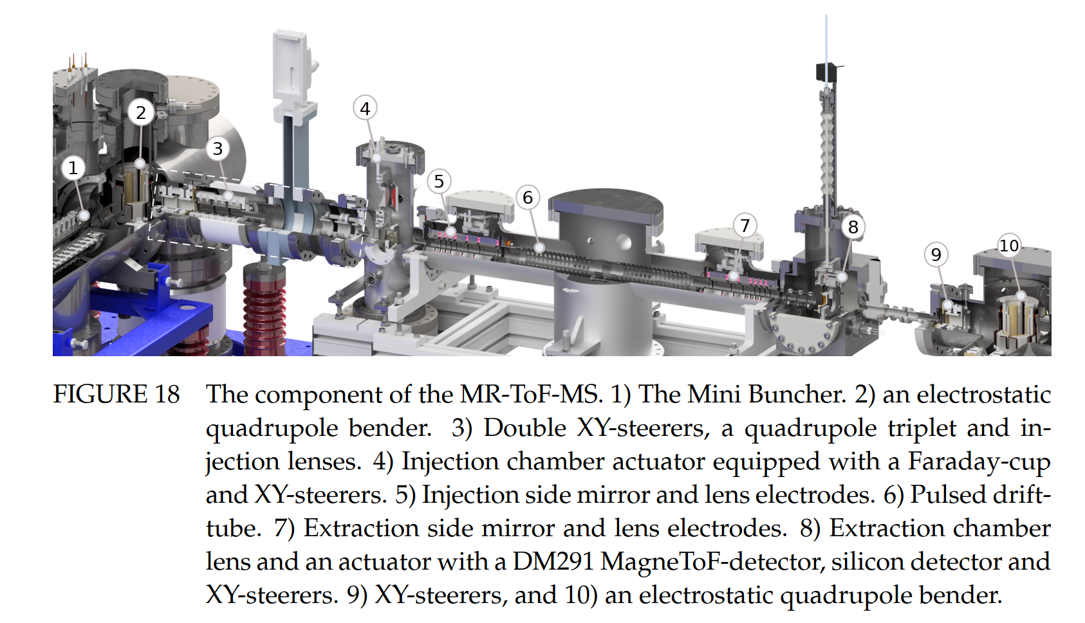
Example: isobaric yields with multireflection time of flighth mass separator: MR-TOF-MS
170
470
170
Ville Virtanen, PhD Thesis, JYU 2025 https://jyx.jyu.fi/jyx/Record/jyx_123456789_106005?sid=209819217

Slide 7
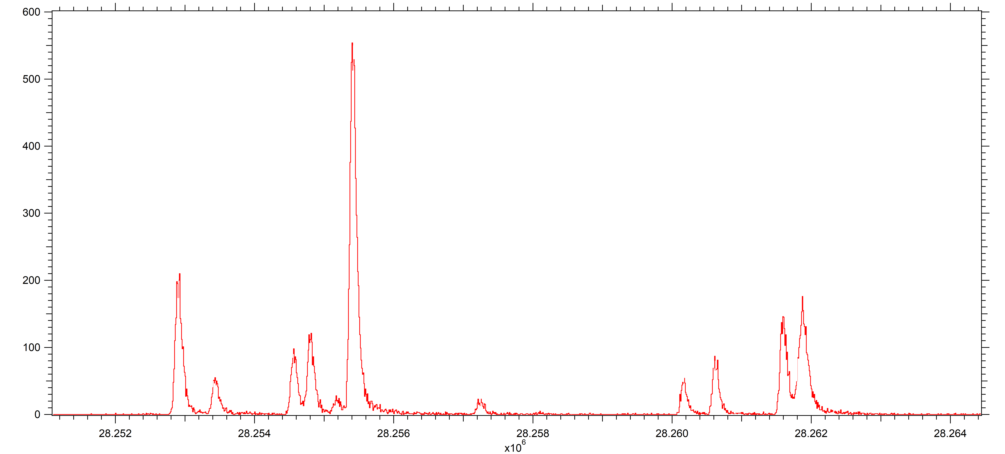
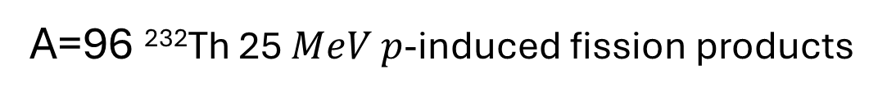
0 1 2 3 4 5 6 7 8 9 10 11 µs
A=96 ²³²Th 25 $MeV$ $p$-induced fission products
Time of flight / ms

Slide 8
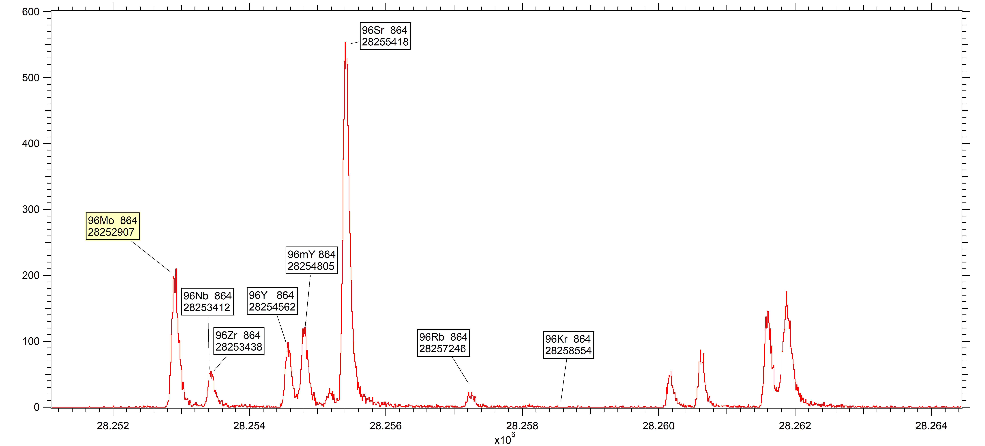
0 1 2 3 4 5 6 7 8 9 10 11 µs
A=96 ²³²Th 25 $MeV$ $p$-induced fission products
Rounds in MR-TOF
Time of flight / ms

Slide 9
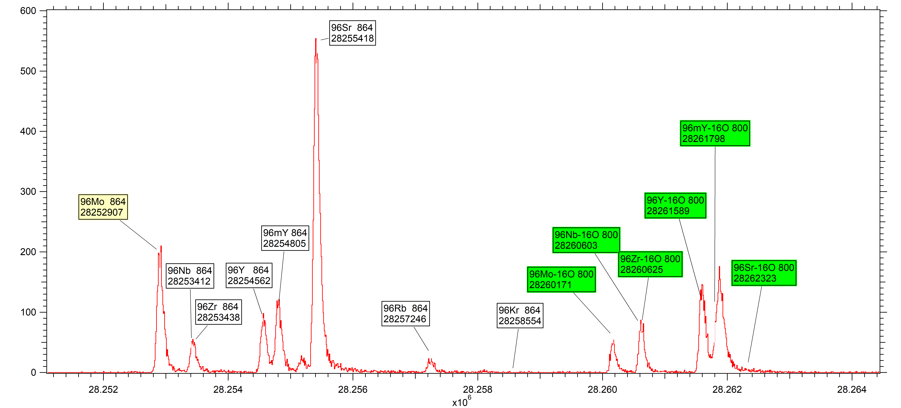
0 1 2 3 4 5 6 7 8 9 10 11 µs
A=96 ²³²Th 25 $MeV$ $p$-induced fission products
Rounds in MR-TOF
Time of flight / ms

Slide 10
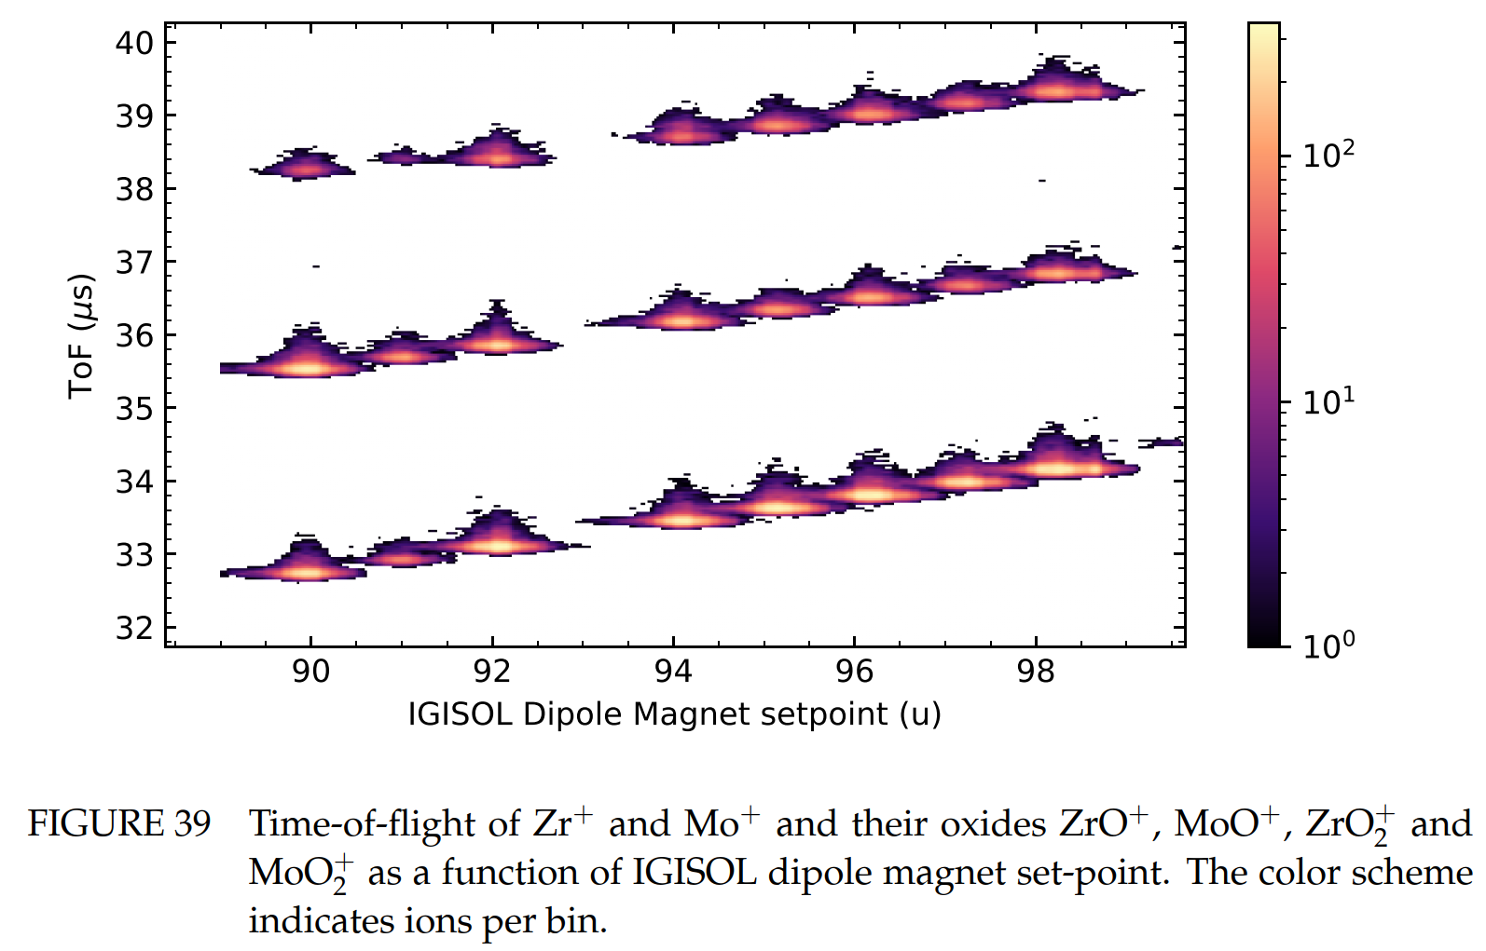
Oxidization of refractory elements (studied with stable isotopes)
This oxidisation takes place in
the RFQ cooler buncher,
not in the ion guide
(or discharge source in this case)
Ville Virtanen, PhD Thesis, JYU 2025 https://jyx.jyu.fi/jyx/Record/jyx_123456789_106005?sid=209819217

Slide 11
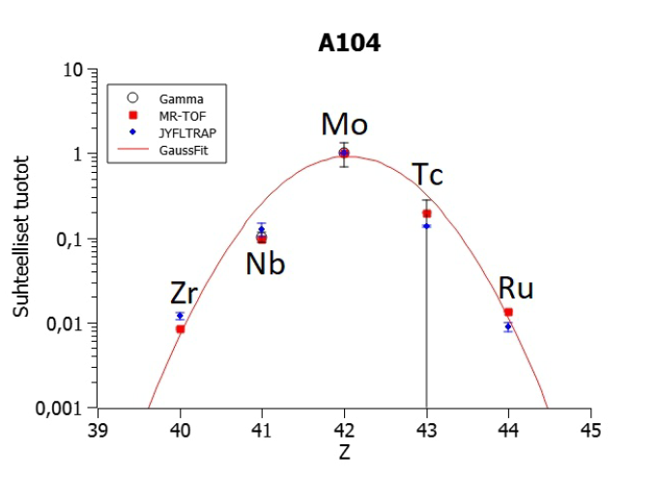
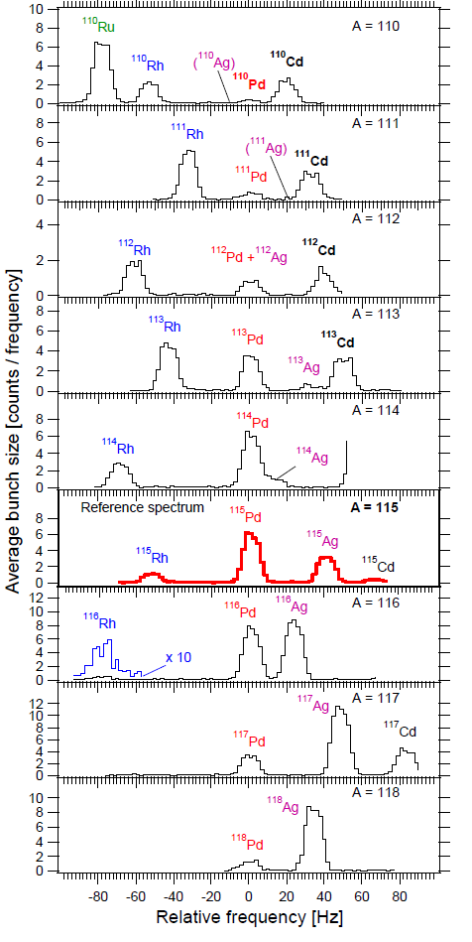
How the independent isotopic fission yields are extracted from the measured distributions
120
Fit results for Pd
2
χ
= 0.36343
<A> = 114.8 ± 0.072003
100
W = 2.8086 ± 0.058443
Y = 100 ± 0.38865
80
60
40
20
0
108
110
112
114
116
118
120
Isobaric yield distributions do not significantly depend of the technique they are determined
Element-dependent (chemical) effects in transmission are same for all isotopes of the same element
Yield measurement is anyway always
a ratio measurement
between isotopes of the same element.
The accurate mass distribution need to come elsewhere.

Slide 12
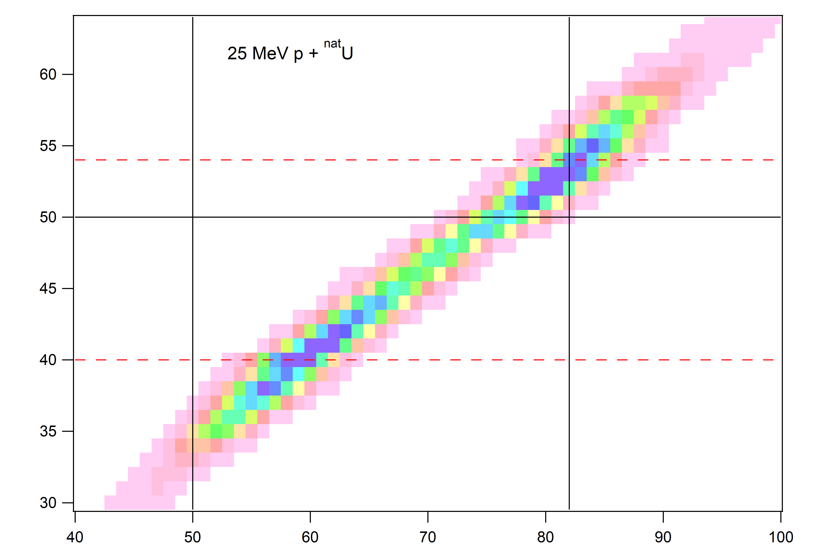

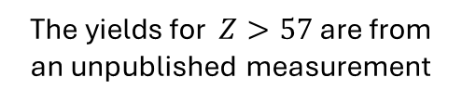

EPJA, 52 (2016) 104.
/10.1140/epja/i2016-16104-4
$$E∗(cn)=31.5 MeV$$
The yields for $Z>57$are from an unpublished measurement

Slide 13
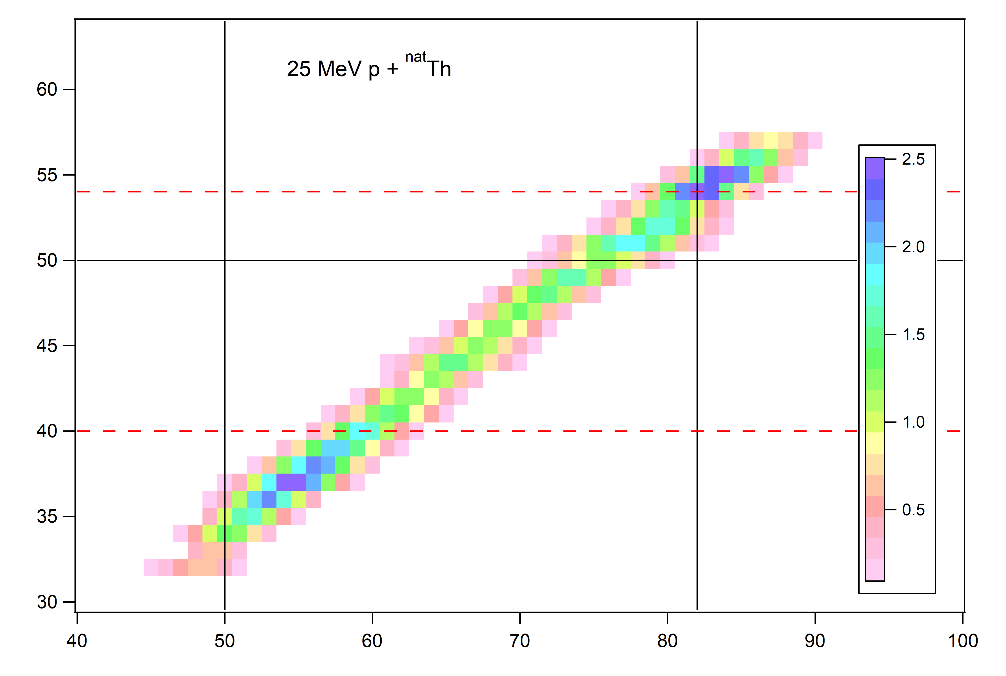

There are 2023 data for this – MR-TOF and PI-ICR –
but the analysis is still in progress
$$E∗(cn)=29 MeV$$
Dmitry Gorelov, PhD Thesis, JYU 2015 https://jyx.jyu.fi/jyx/Record/jyx_123456789_48273

Slide 14
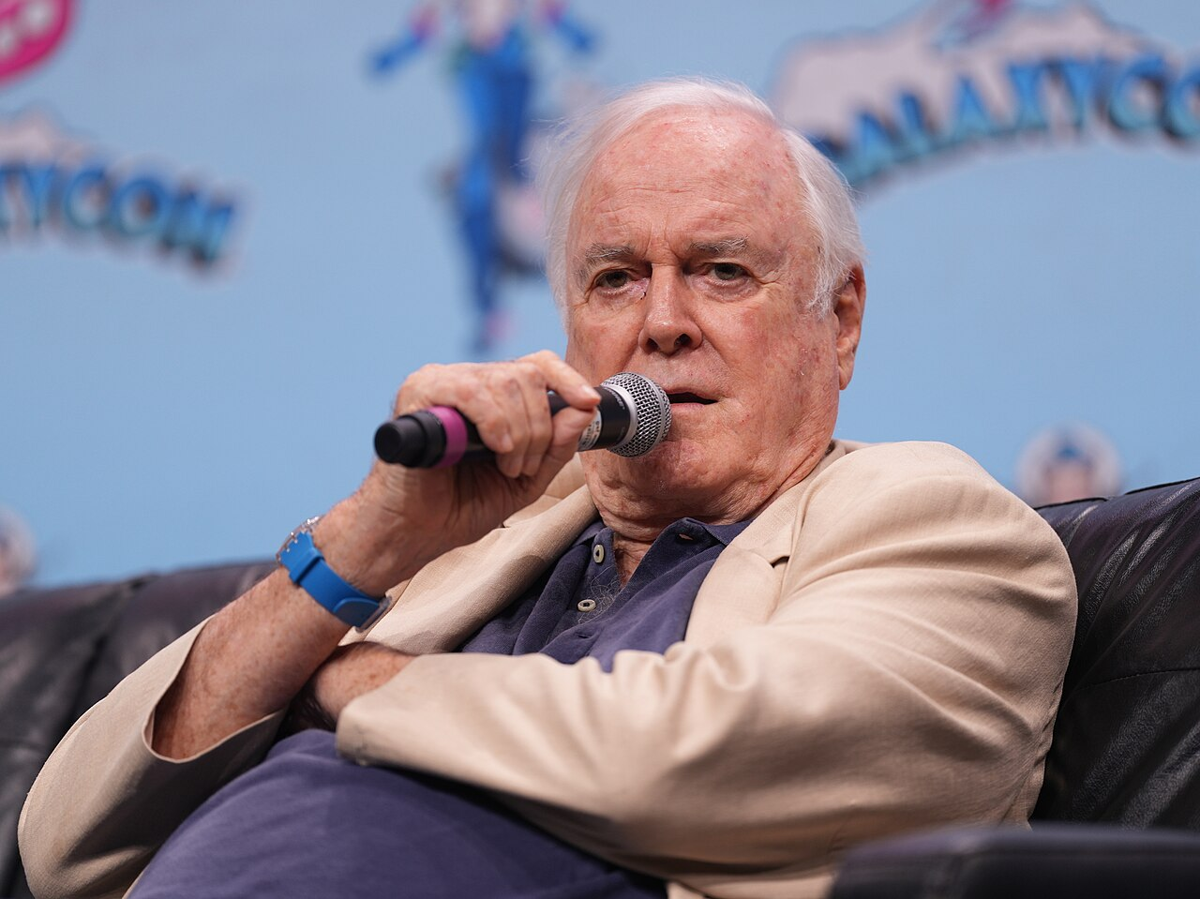
And then for something completely different
CC BY-SA 2.0 John Manard - https://www.flickr.com/photos/145739041@N05/54020963437/

Slide 15
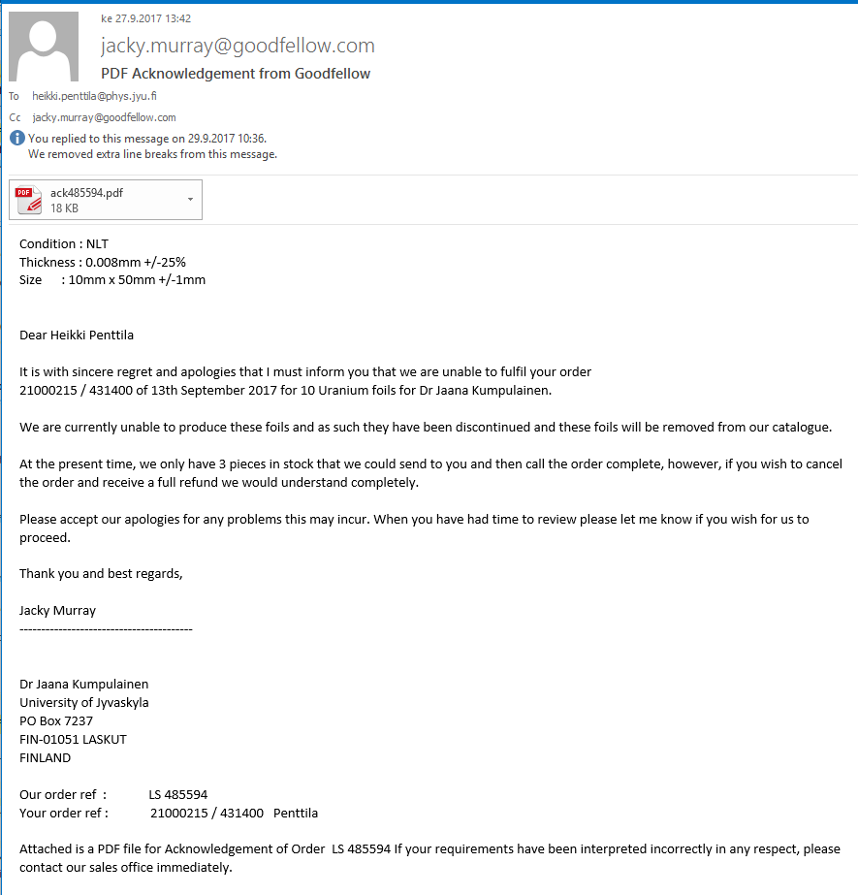
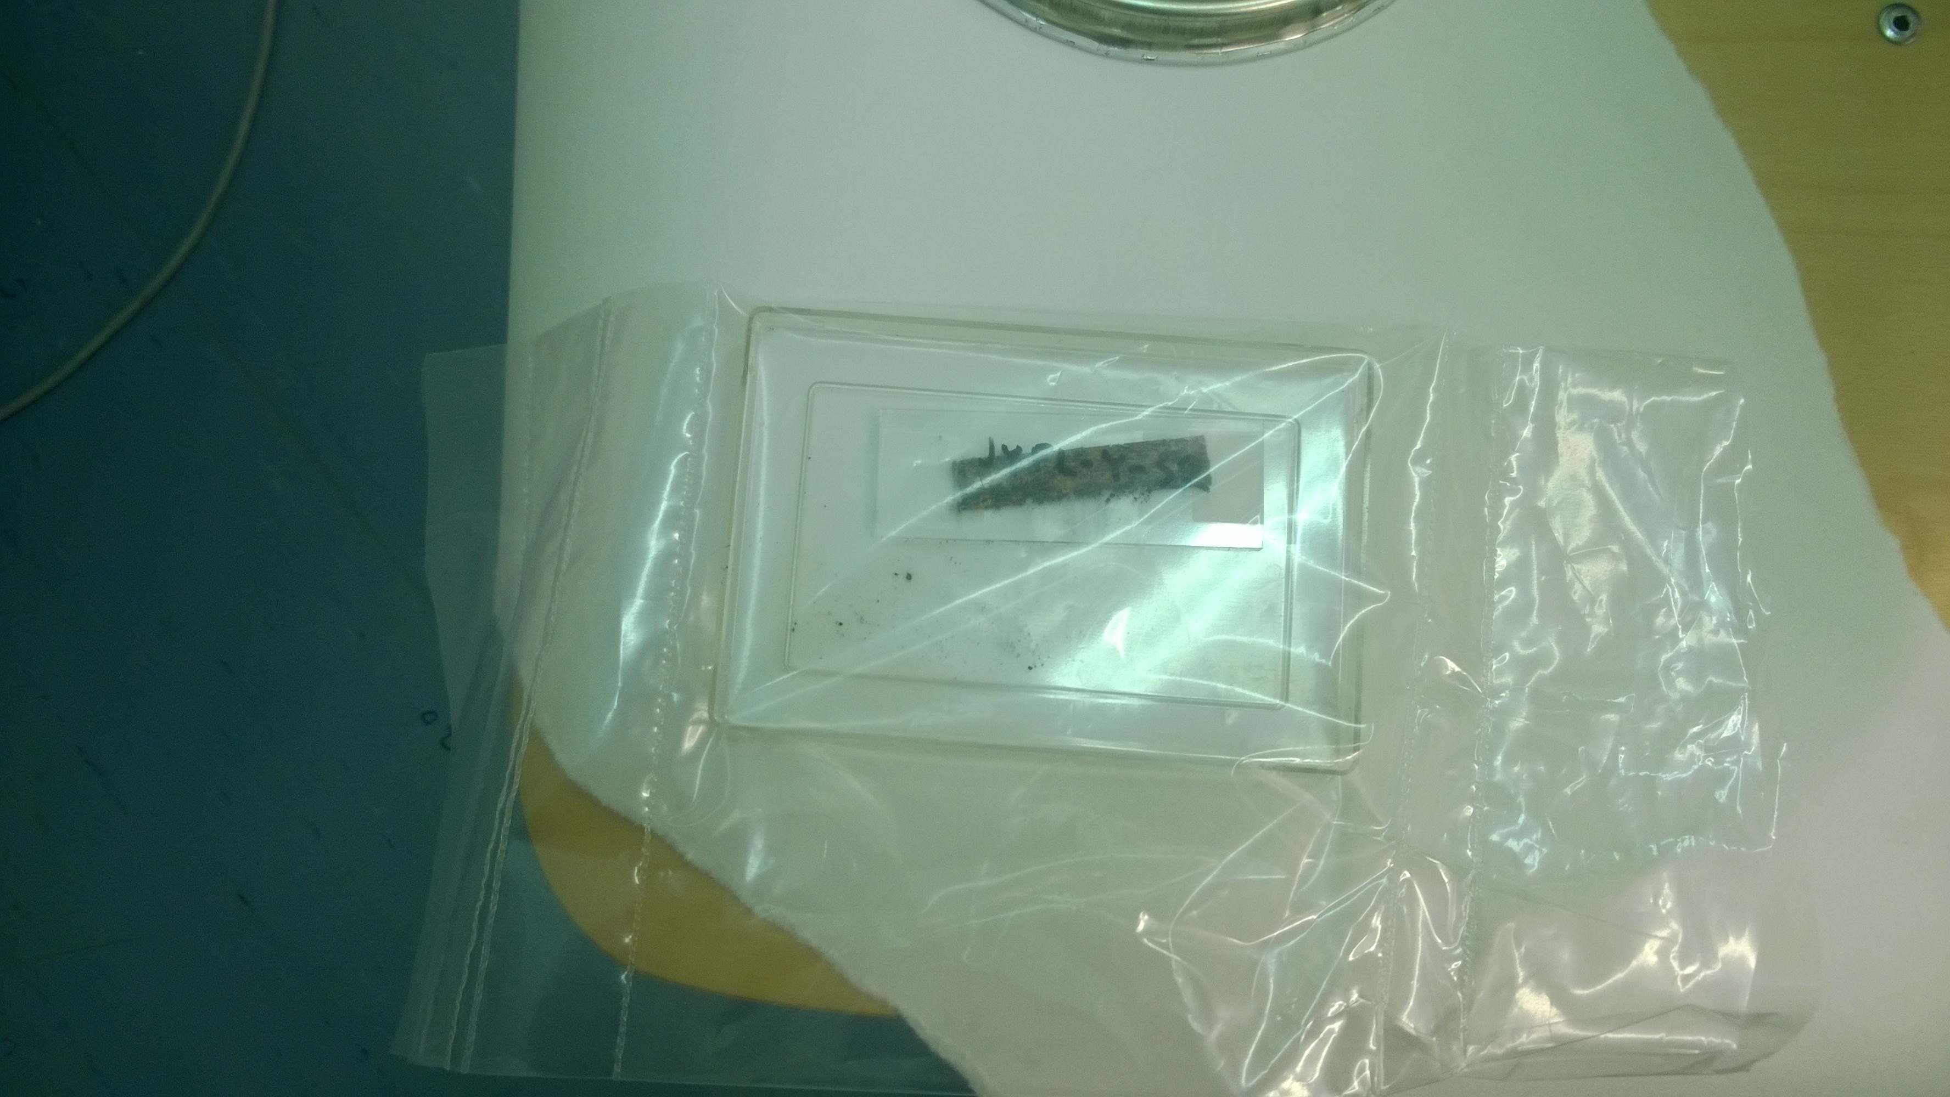
We need thin uranium foils and this is the crap we got from some company before they entirely gave up

Slide 16
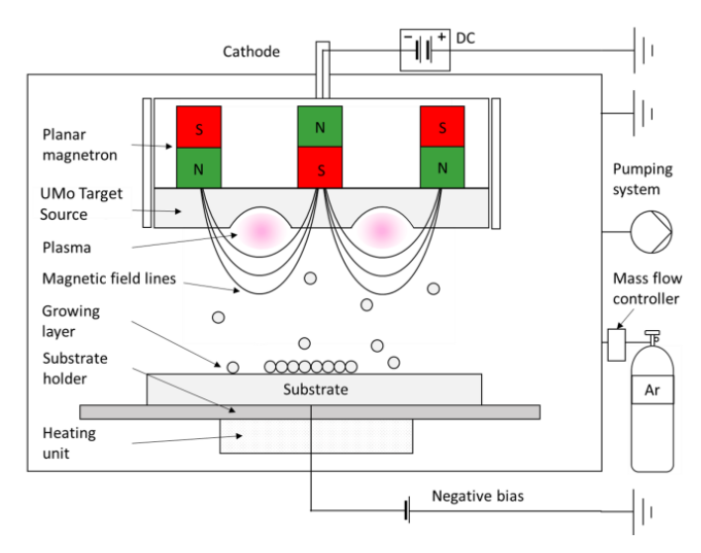
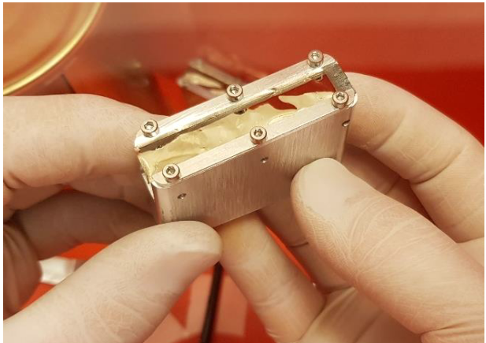
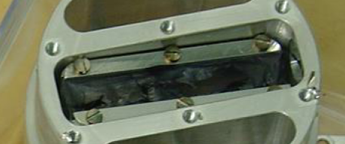
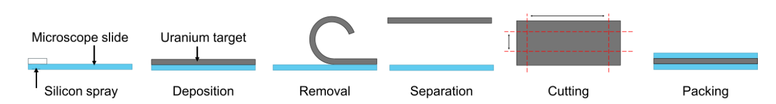
Sputtered uranium targets from FRM II neutron source fuel element laboratory
Yes, it IS uranium!
Well… UMo8 anyway
Rolled target
H. Penttilä, B. Baumeister, C. Schwarz, C. Steyer, J. Mausz, W. Petry
Proceedings of the The European Research Reactor Conference (RRFM) 2021 ISBN 978-92-95064-36-2
https://www.euronuclear.org/scientific-resources/conference-proceedings/
Forschungs-Neutronenquelle Heinz Maier-Leibnitz (FRM II), Technische Universität München (TUM), Garching b. München – Germany

Slide 17
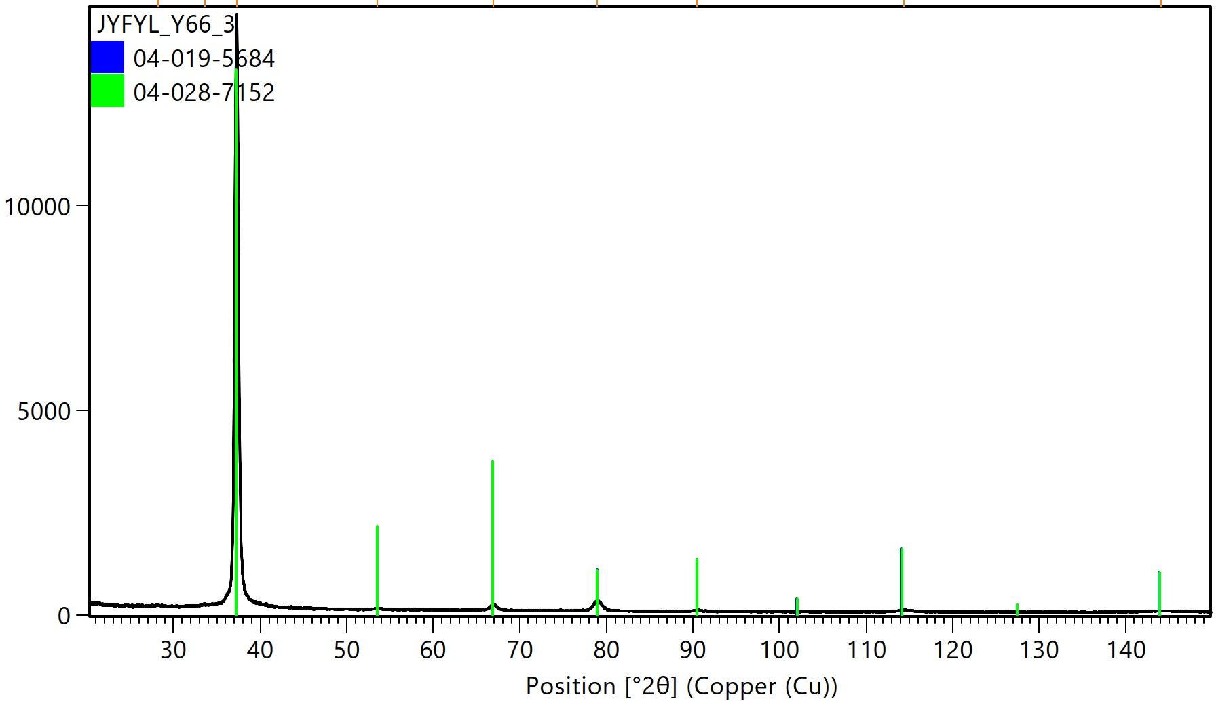
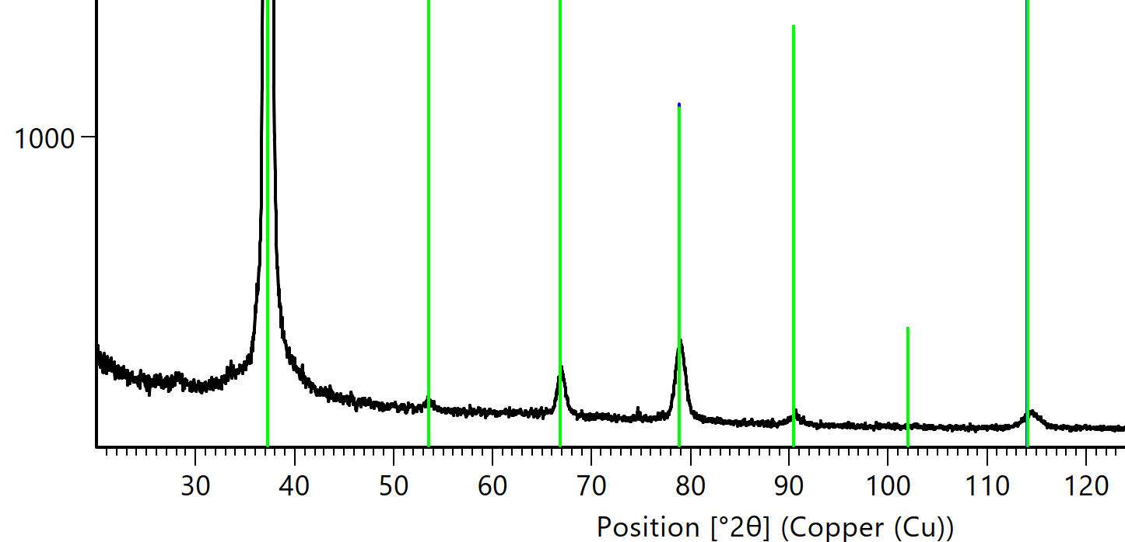
What could possibly be the stucture of such a shiny piece of uranium
X-ray diffraction measurement (JYU, Dept. of Chemistry)
Bragg peak positions in reference measurements
Diagnosis:
Body centered cubic

Slide 18
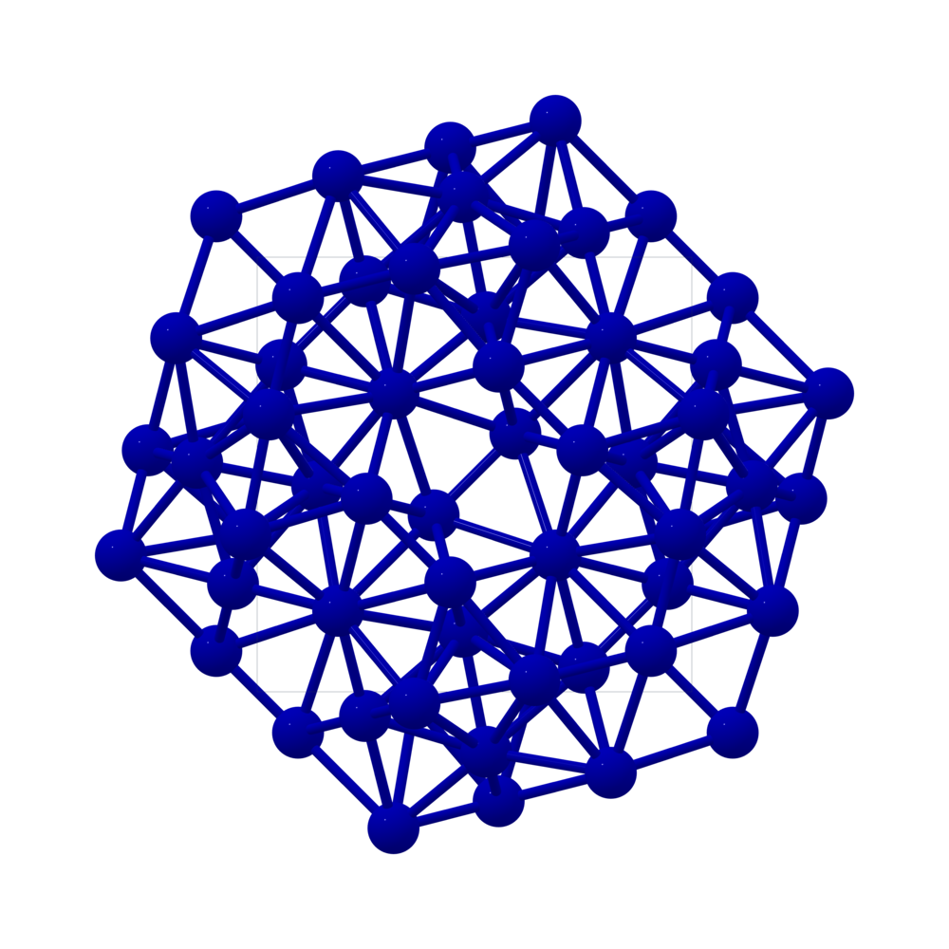
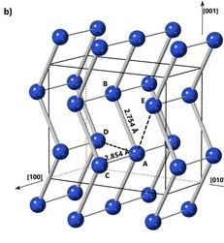
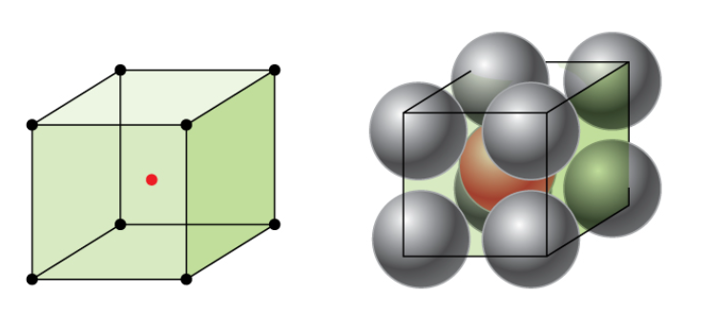
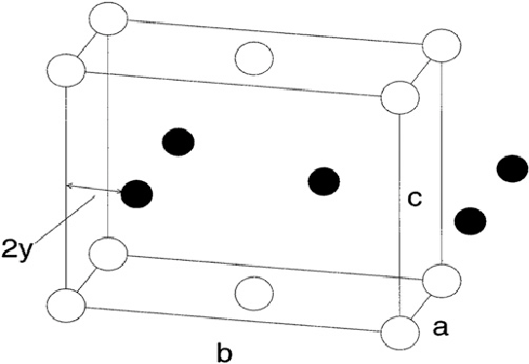
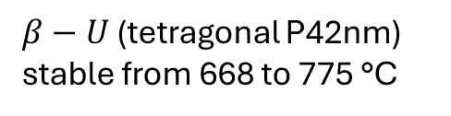


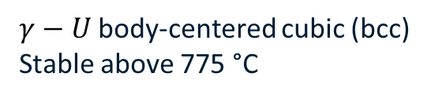
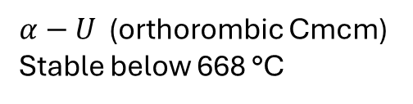
A very short reminder of the allotropic forms of uranium
$β−U$ (tetragonal P42nm) stable from 668 to 775 °C
$$γ$$
$$α$$
$γ−U$ body-centered cubic (bcc)
Stable above 775 °C
$α−U$ (orthorombic Cmcm)
Stable below 668 °C

Slide 19
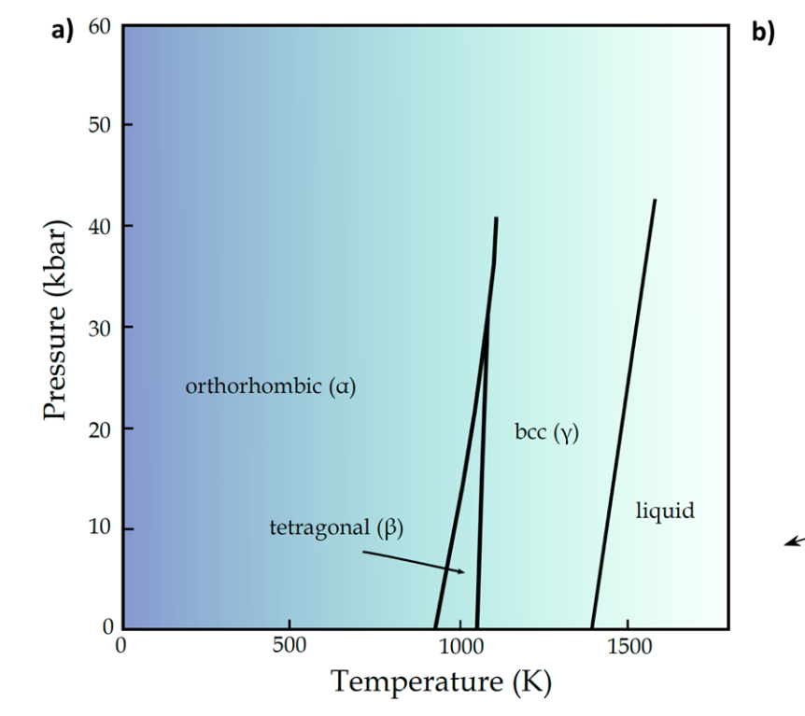
Allotropic forms of uranium
Phase diagram
Adv. Phys. 43 (1994), pp. 1–111
$γ−U$ body-centered cubic (bcc)
Stable above 775 °C
$α−U$ (orthorombic Cmcm)
Stable below 668 °C

Slide 20
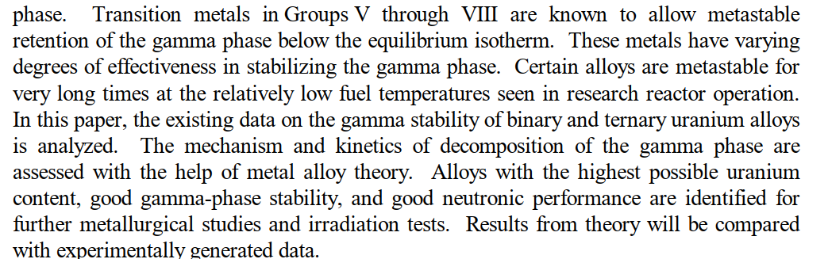
As every one knows, molybdenium stabilises the structure of uranium
Relatively low here = 250 °C
Hofman, G L (1998). Design of high density gamma-phase uranium alloys for LEU dispersion fuel applications..
But where the sputtered targets get the bcc structure?

Slide 21
The Bragg peak data was from some reference samples, where those samples came from?
The reference samples were made by ”splat quenching”

Slide 22
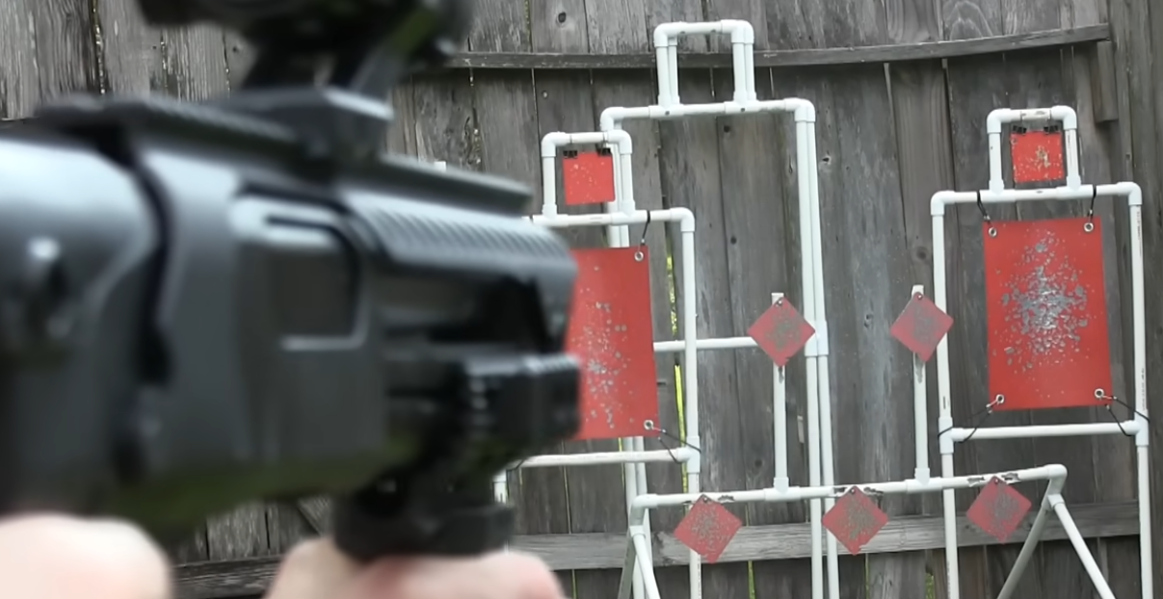
What an earth is splat quenching?

Slide 23
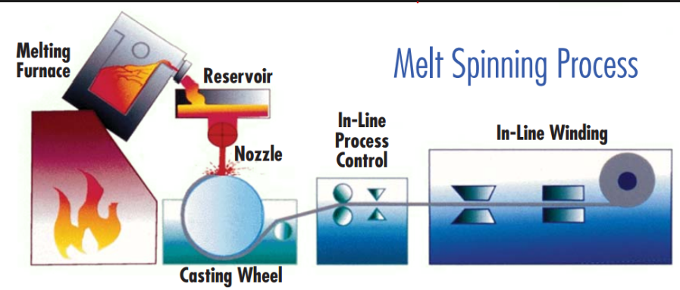
Splat quenching
https://metallicglassconsulting.com/what-is-metallic-glass/rapid-quenching-techniques/

Slide 24

Thank you for your attention!
Coffee or questions?

