Slide 1
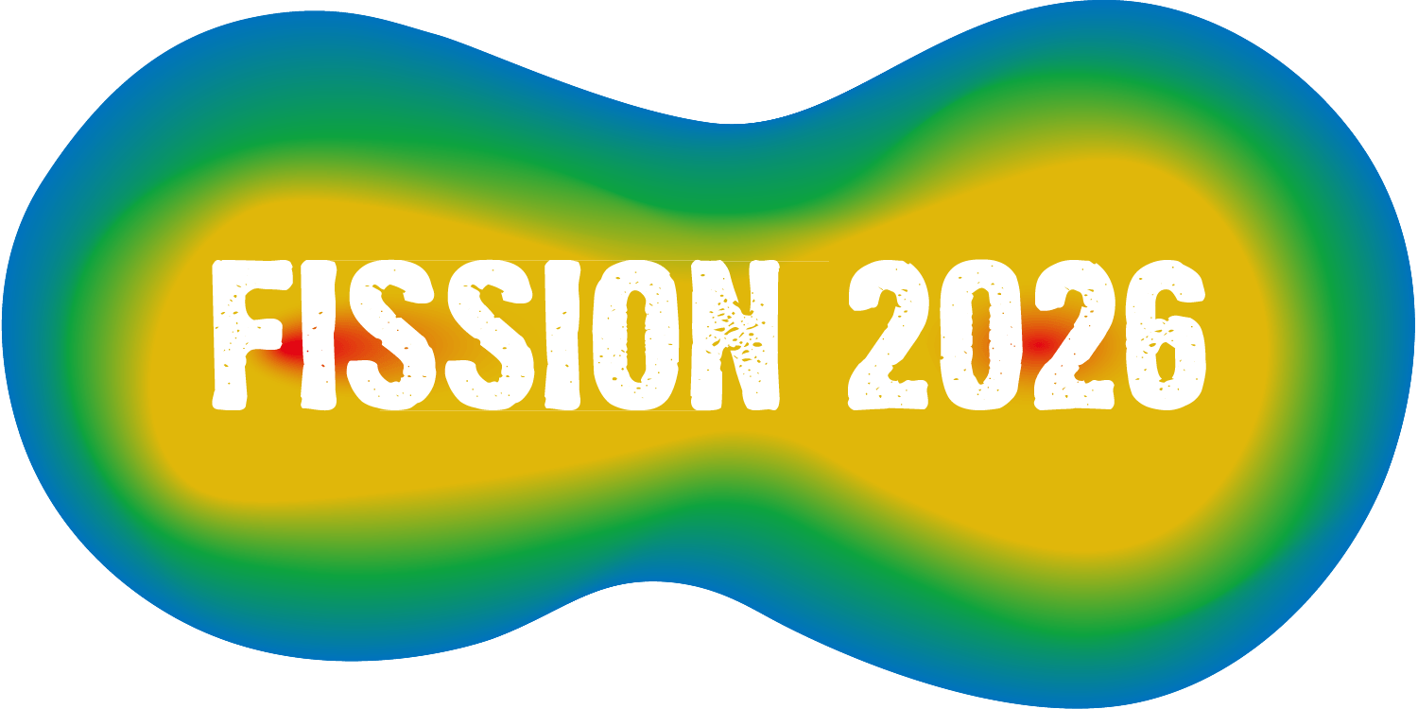
Multi-phonon γ vibration study from AGATA+Gammasphere complimentary setup
Enhong Wang
Shandong University (China) and Vanderbilt University (US)
Mojahed Abushawish (IP2I), J.H. Hamilton (Vanderbilt), A. Navin (GANIL), S. Bhattacharyya (VECC, HBNI), J. Dudouet(IP2I), G. Bhat (GDC-S), J.A. Sheikh (KU,IUST), S. Jehangir (IUST), S. Sun (Shandong U), S.Y. Wang (Shandong U), Q. Bin (Shandong U), C.F. Jiao (SYSU), O. Stezowski(IP2I), Y.X. Luo (LBNL), J.O. Rasmussen (LBNL), S.J. Zhu (THU), A.V. Ramayya (Vanderbilt) et al.

Slide 2
Talk plan
Introduction
  1 phonon γ vibrational band
  2 phonon γ vibrational band
Motivation
  Search for odd-odd case: 2 valence nucleons+vibration+rotation
Experimental setup
  Spontaneous fission with Gammasphere
  Induced fission with VAMOS++, AGATA and EXOGAM
Results and discussion
  Level scheme, lifetime, systematics, theoretical calculations
Summary

Slide 3
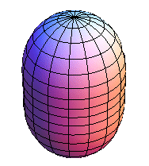
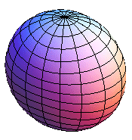
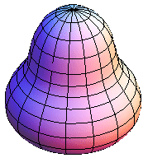
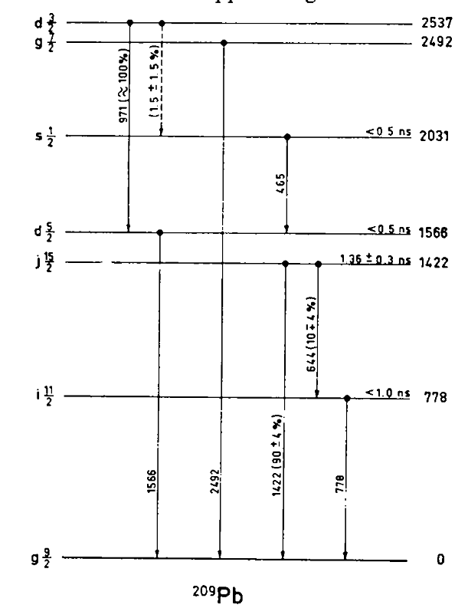
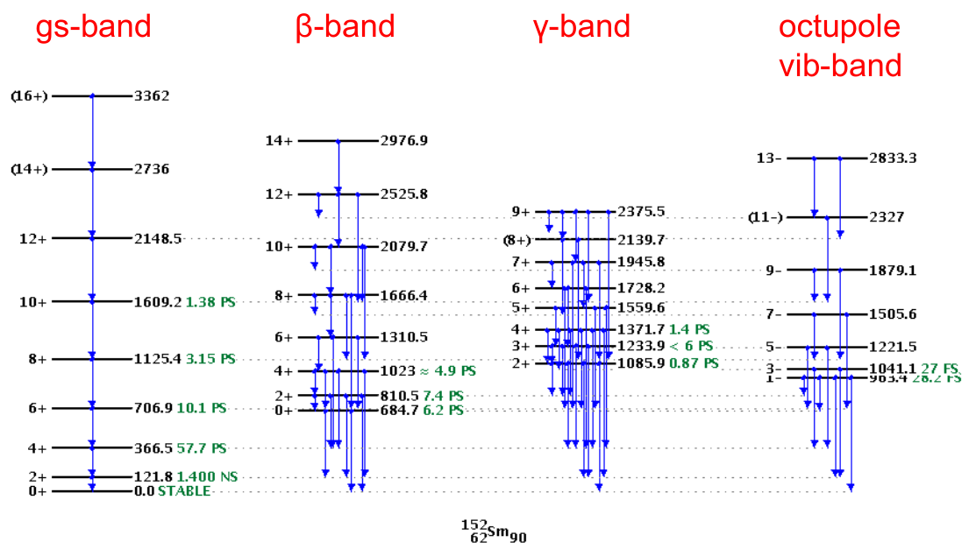
Surface vibration in deformed nuclei
Various nuclear motion
Surface oscillation E*~ several MeV (L=2,3,...)
Single particle
Collective
  Surface vibration (quarupole, octuple, hexadecupole...)
  Rotation
  Fission
  Giant resonance
  Scissors mode
  Pygmy resonance
rotation
n_{β}=1, 0⁺, 2⁺, 4⁺...
n_{γ}=1, 2⁺,3⁺,4⁺...
1⁻,3⁻,5⁻...
β vibration
γ vibration
controversial
Nucl. Phys. A129, 113 (1969)
NNDC

Slide 4
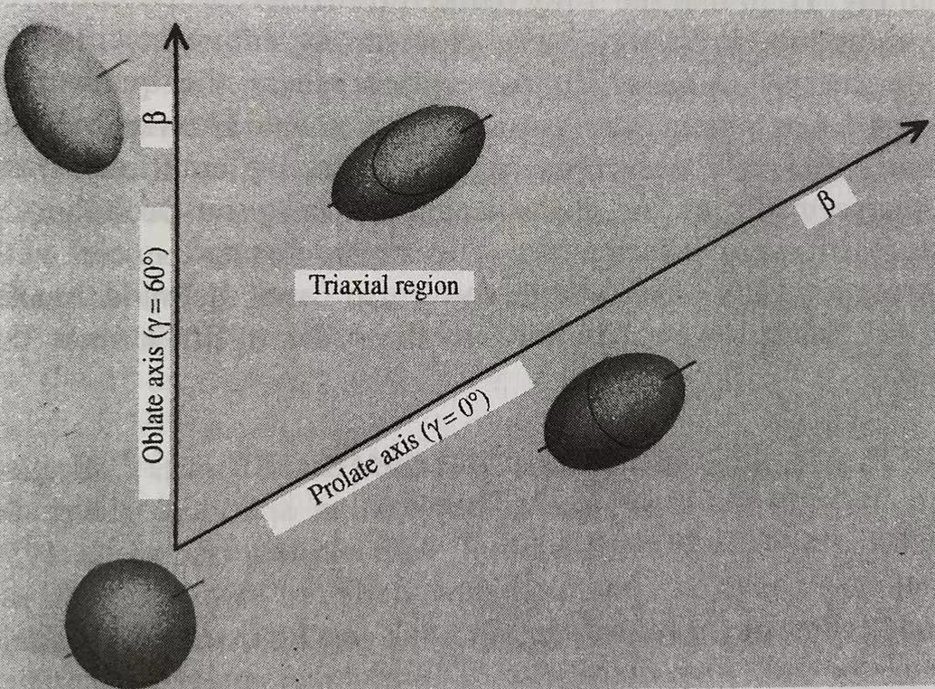
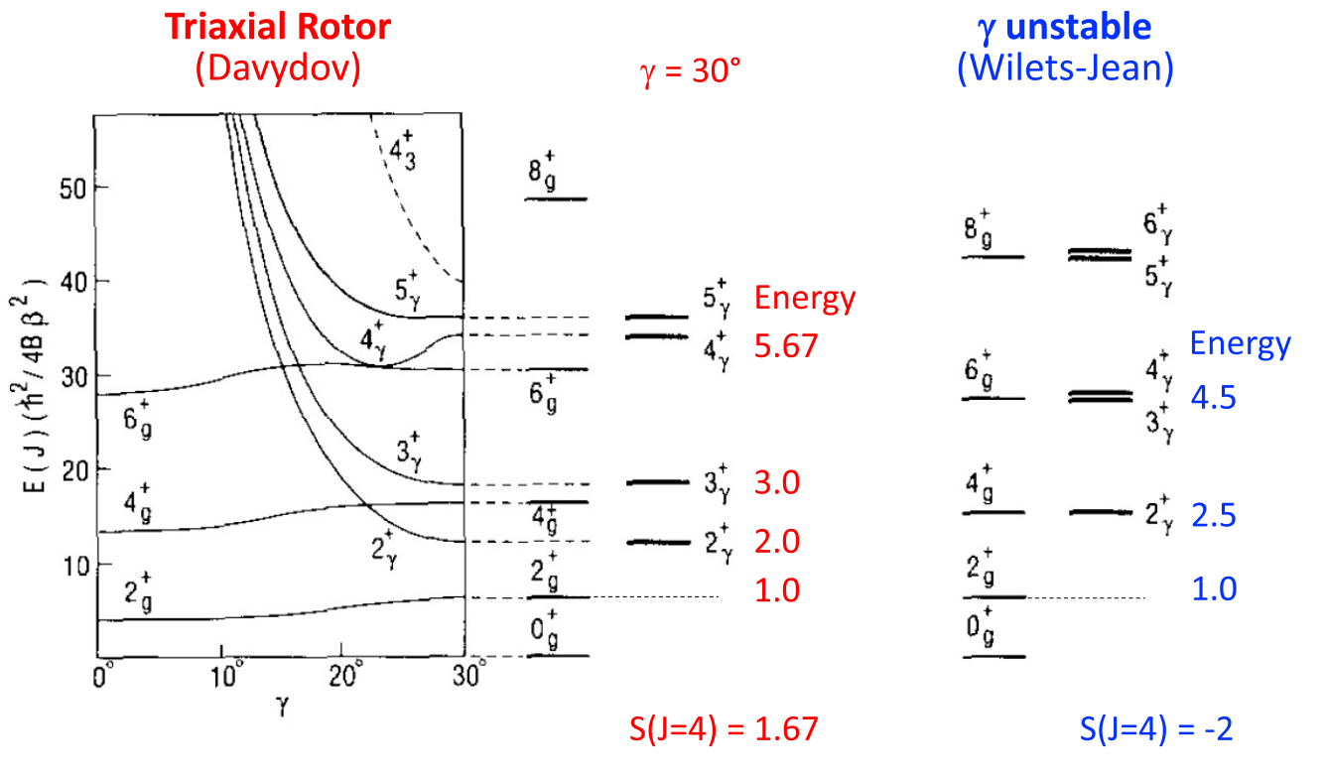
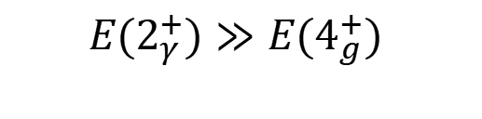
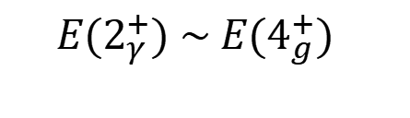

One phonon γ vibrational band
Band structure is related to triaxiality and γ softness
Modern atomic and nuclear physics. F.J. Yang and J. H. Hamilton
γ band energy
axial
triaxial
stiff triaxial
Phys. Lett. B 260(3),265(1991) and
La Rivista del Nuovo Cimento Vol. 45, 461, (2022)
Phonon angular momentum 2 along the symmetry axis
Strong transitions 1γ to 0γ bands having a large E2 component

Slide 5
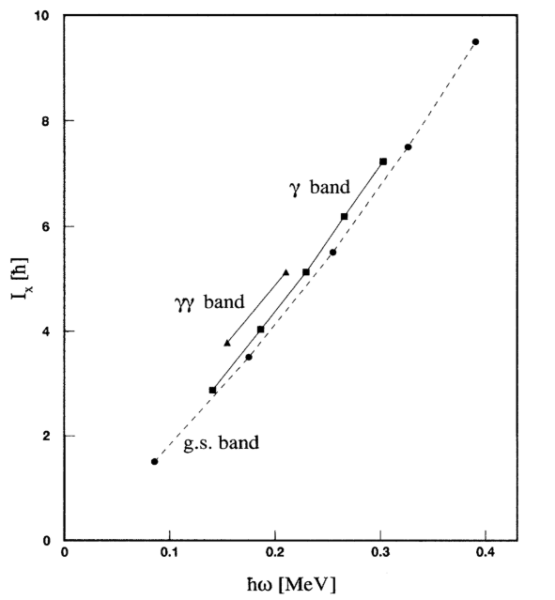
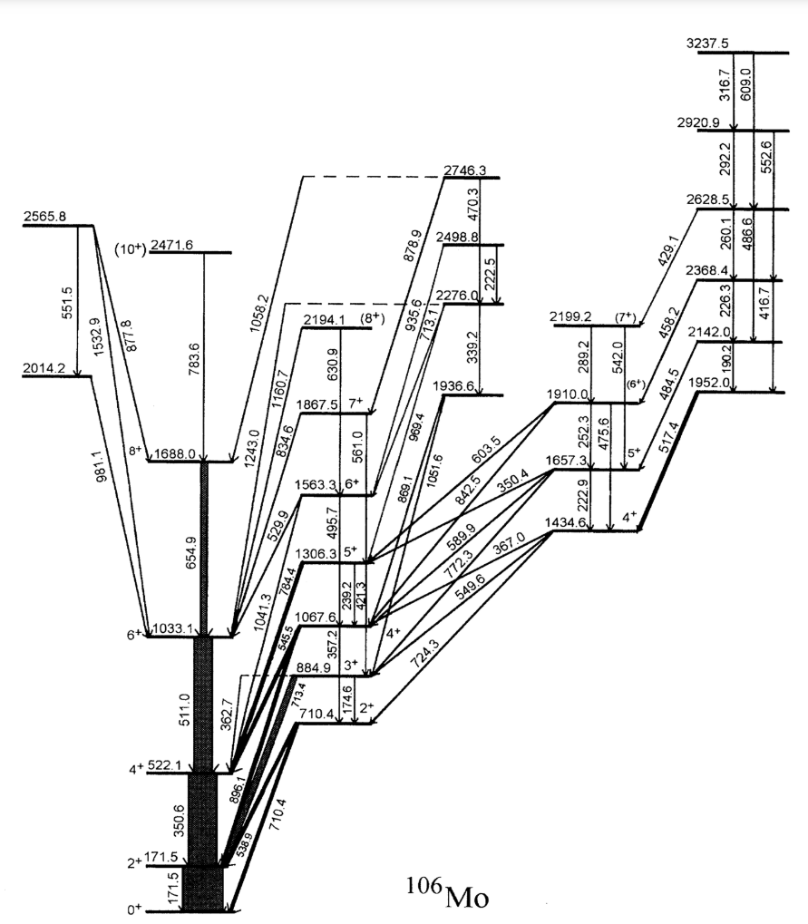


Two phonon γ vibrational band in even-even nuclei
Collective dynamics of many-body systems
Highlights the nonlinear, correlated, and anharmonic nature of nuclear system
First observed in ¹⁶⁸Er (PRL 66, 691 (1991)). First harmonic in ¹⁰⁶Mo (PRL 75, 2280 (1995)). Other regions A~130, 230...
Fingerprints and identification of 2γ bands
1γ to 0γ, 2γ to 1γ allowed E2 2γ to 0γ forbidden
g.s.
1γ
2γ
Similar inertia J⁽²⁾ and rotational parameter
J⁽²⁾=ΔI_{x}/Δℏω
PRL 75, 2280 (1995)
PRL 75, 2280 (1995)

Slide 6
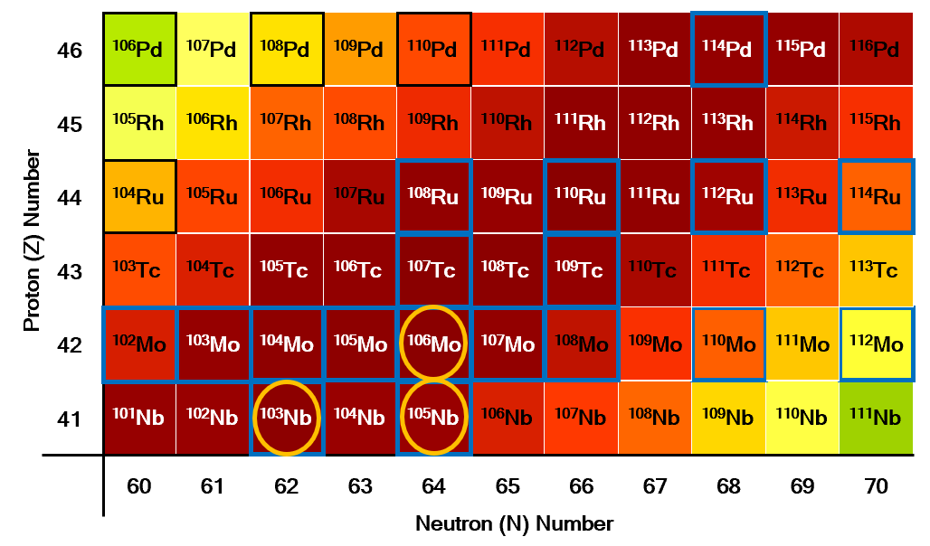
How about odd-odd nuclei?
Odd A: single particle+collective vib.+collective rot.
2 phonon γ vibrational bands
3 phonon γ vibrational bands
Our collaboration
¹⁰³Mo IJMPE 26, 1750030 (2017)
¹⁰⁵Mo PRC 74, 054301 (2006)
¹⁰⁷Mo PRC 96, 034319 (2017)
^{104,106}Mo PRC 104, 064318 (2021)
¹⁰³Nb PLB 675, 420 (2009)
¹⁰⁵Nb PRC 88, 054311 (2013)
^{108,110,112,114}Ru PLB 670, 307 (2009); PRC 83, 054317 (2011)
¹¹⁴Pd IJMPE 25, 1650064 (2016)
...
Other groups
¹⁰⁶Mo Phys. Rev. Lett. 75, 2280 (1995)
¹¹⁰Mo Phys. Rev. C 101, 044311 (2020)
^{112,114}Mo T. Sumikama in INPC2025
Increasing triaxiality
Nb, Tc, Rh: candidates for odd-odd multi-phonon γ vibrationals
No specific theoretical description currently
Spherical → Sudden large prolate → Oblate
Degree of redness represents production yields in the spontaneous fission of ²⁵²Cf
How do the valence proton and neutron change the shape of odd-odd nuclei?
Is it possible to form multi-phonon γ vibrational bands in odd-odd nuclei?
¹⁰⁴Nb is an excellent case

Slide 7
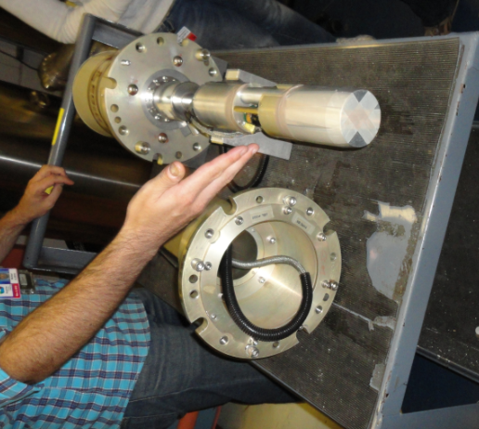
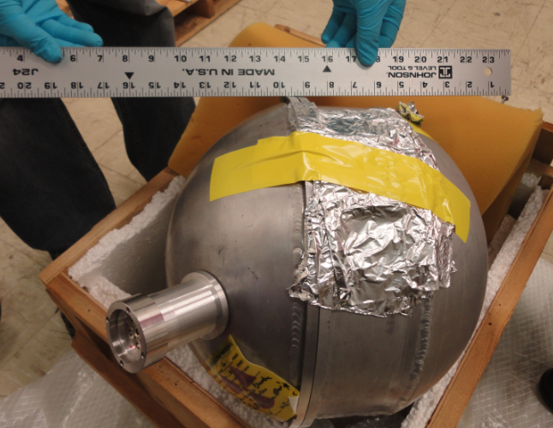

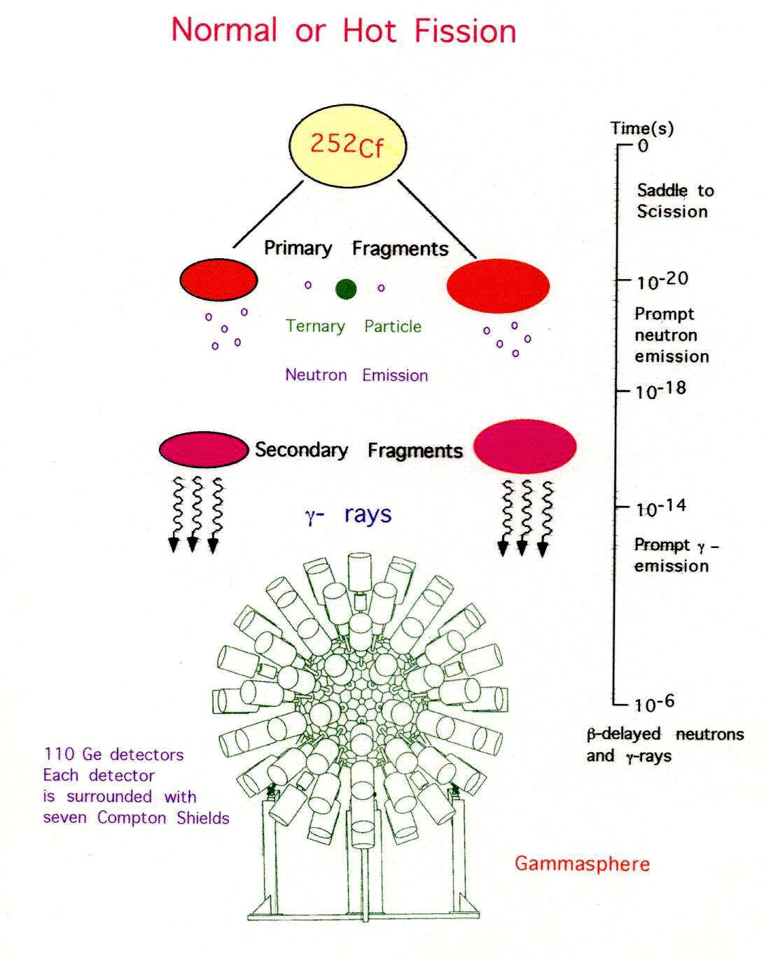
Spontaneous fission with high fold γ−ray setup
High γ fold
High statistics
High angular momentum
High difficulty of data analysis
²⁵²Cf Source of 62 μCi sandwiched between two 10mg/cm² Fe in a 7.62 cm PE ball
High angular momentum for both fission partners
Gammasphere Detector Array with 101 Compton-suppressed Ge Detectors
~1μs coincidence time window
5.7x10¹¹ triple coincidences + 10¹¹ four-fold coincidences
γ−γ angular correlation
g factor
Over 3000 γ-rays from hundreds of nuclei

Slide 8

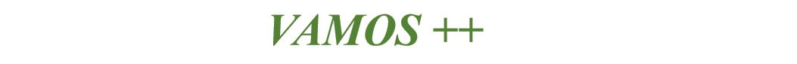
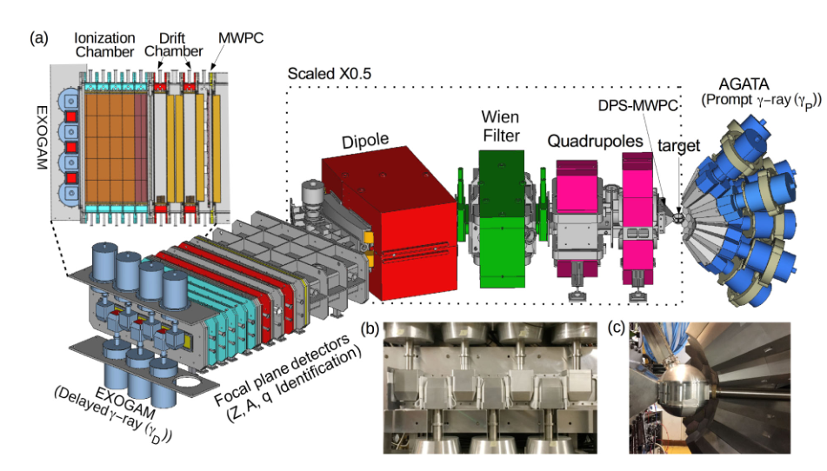
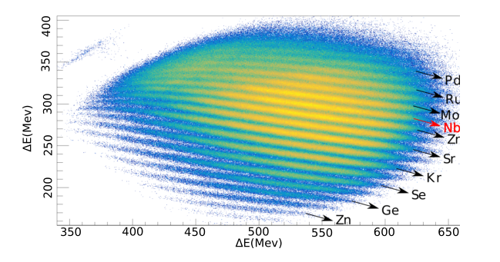
Induced fission with A, Z identification setup
e661 and e680 experiments at GANIL
A, Z identification
Fission induced by fusion and transfer reactions
  ²³⁸U@ 6.2MeV/u + ⁹Be (1.85mg/cm²)
Experimental setup:
  AGATA (prompt γ-ray)
  VAMOS++ (fragments identification)
  EXOGAM (delayed γ-ray in 1-200 µs)
Eur Phys J A 53: 1-8 (2017)

Slide 9
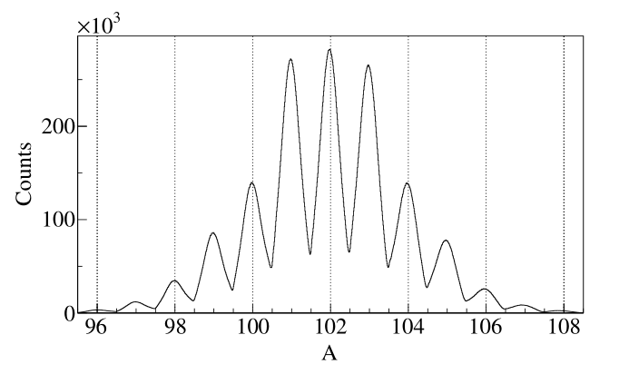
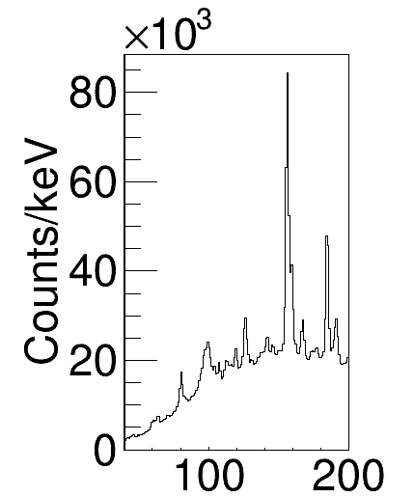
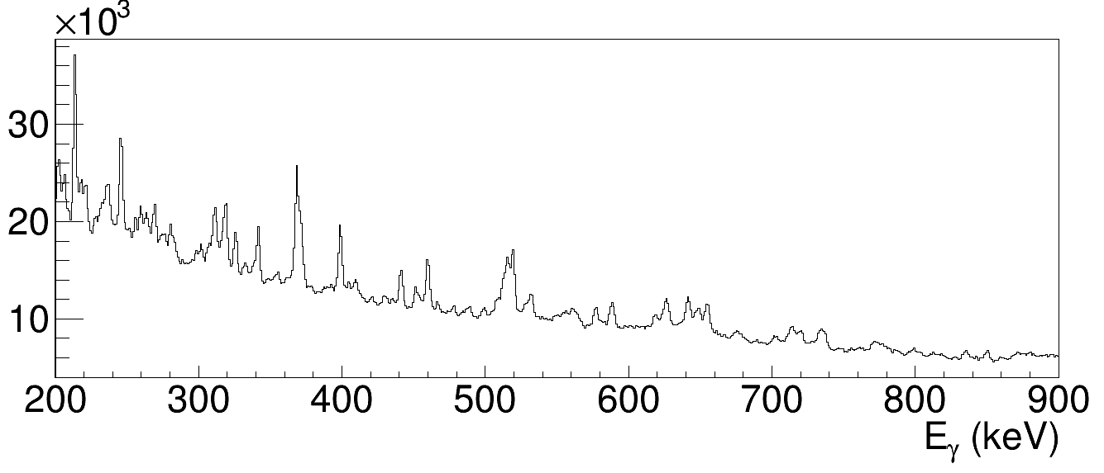
Isotope identification
Identification of Nb
Z from ΔE/E
²³⁸U+⁹Be data
VAMOS++ and AGATA
More details on odd-A and other Nb isotopes in Jeremie's talk this morning and M. Abushawish et al., Phys. Rev. C 113, 014308 (2026).
⬜
⬜
¹⁰⁴Nb
⬜ known new
*
⬜
*
*
⬜
*
*
*
⬜
*
*
*
*
⬜
⬜
*
⬜
*
⬜
*
*
*
*
⬜
*
*
*
*
⬜
*
*
⬜
*
⬜
*
*
*
⬜
*
*
*
*

Slide 10
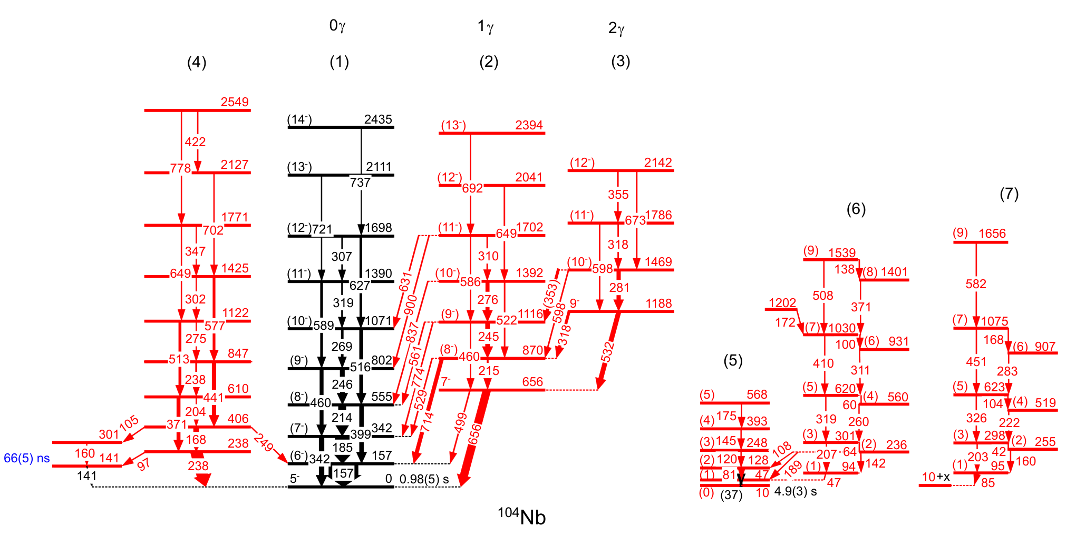
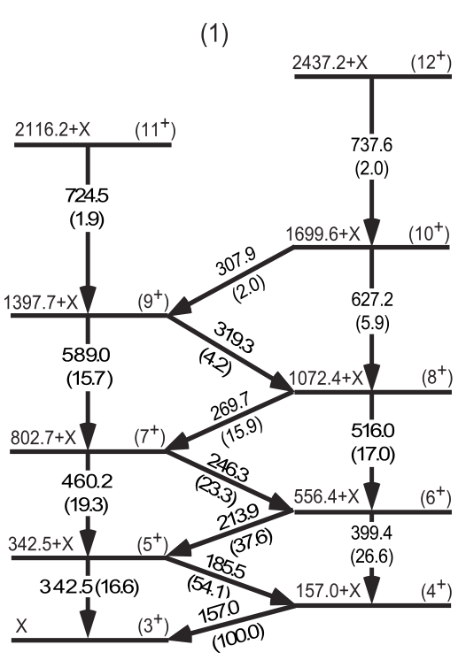
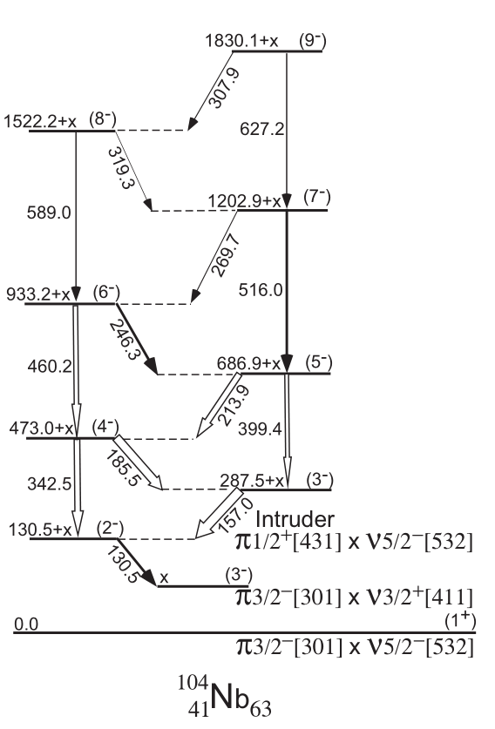

Results on ¹⁰⁴Nb
Previous results
New results
band 1
band 2
1γ
band 3
2γ
0γ
Phys Rev C 78, 014313 (2008)
5⁻ ground + low spin 10 keV isomer are assigned from
1) Mass measurement, M. Hukkanen et al. Phys. Lett. B 856, 138916 (2024)
2) ¹⁰⁴Nb β−decay, S. Nandi et al. Phys. Scr. 100, 075302 (2025)
3) ¹⁰⁴Mo B. M. Musangu et al., Phys. Rev. C 104, 064318 (2021)
Phys Rev C 89, 044326 (2014)

Slide 11
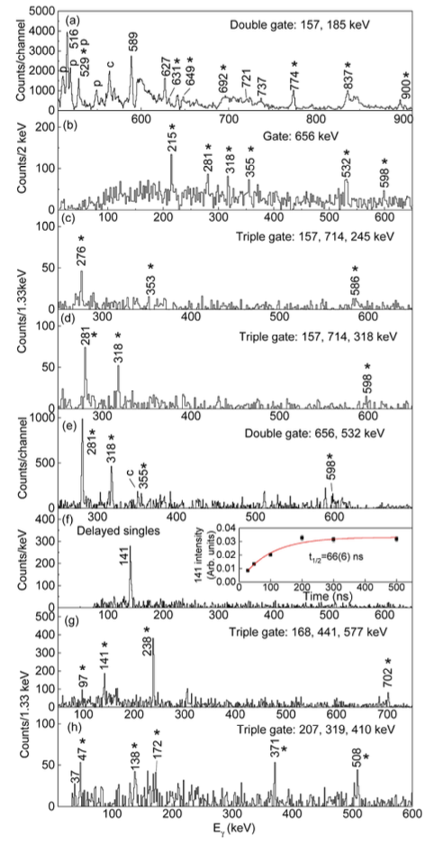
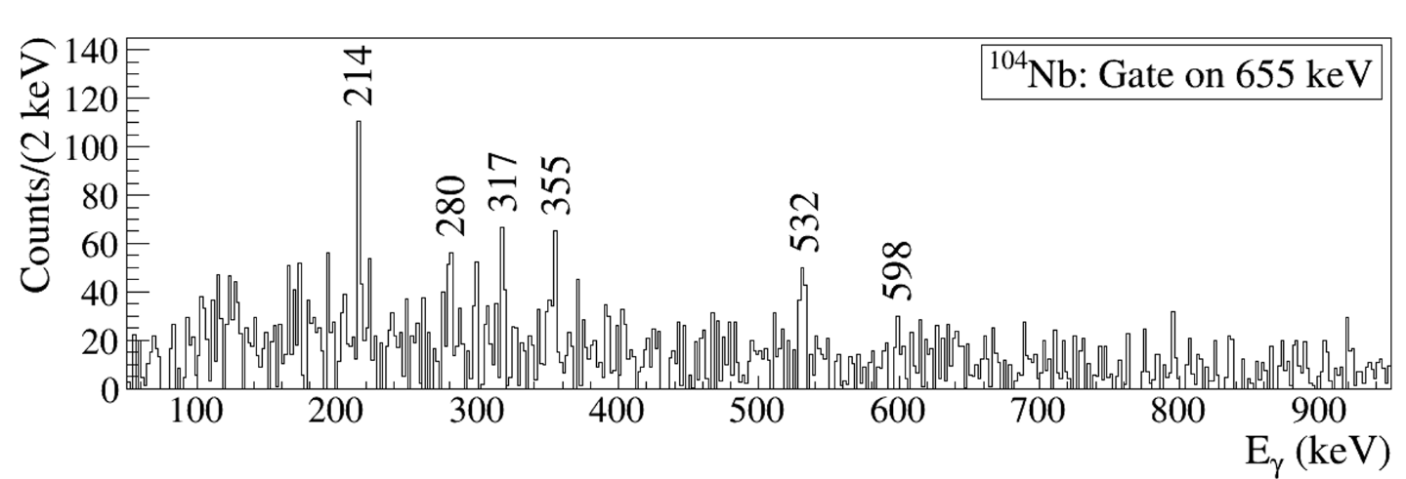
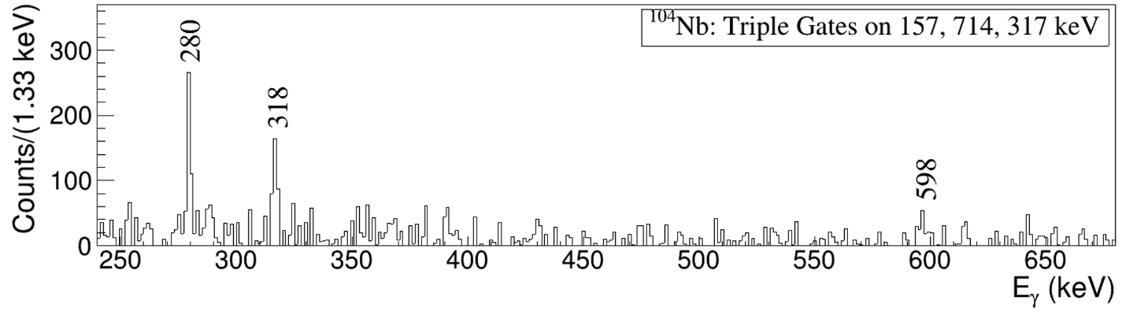
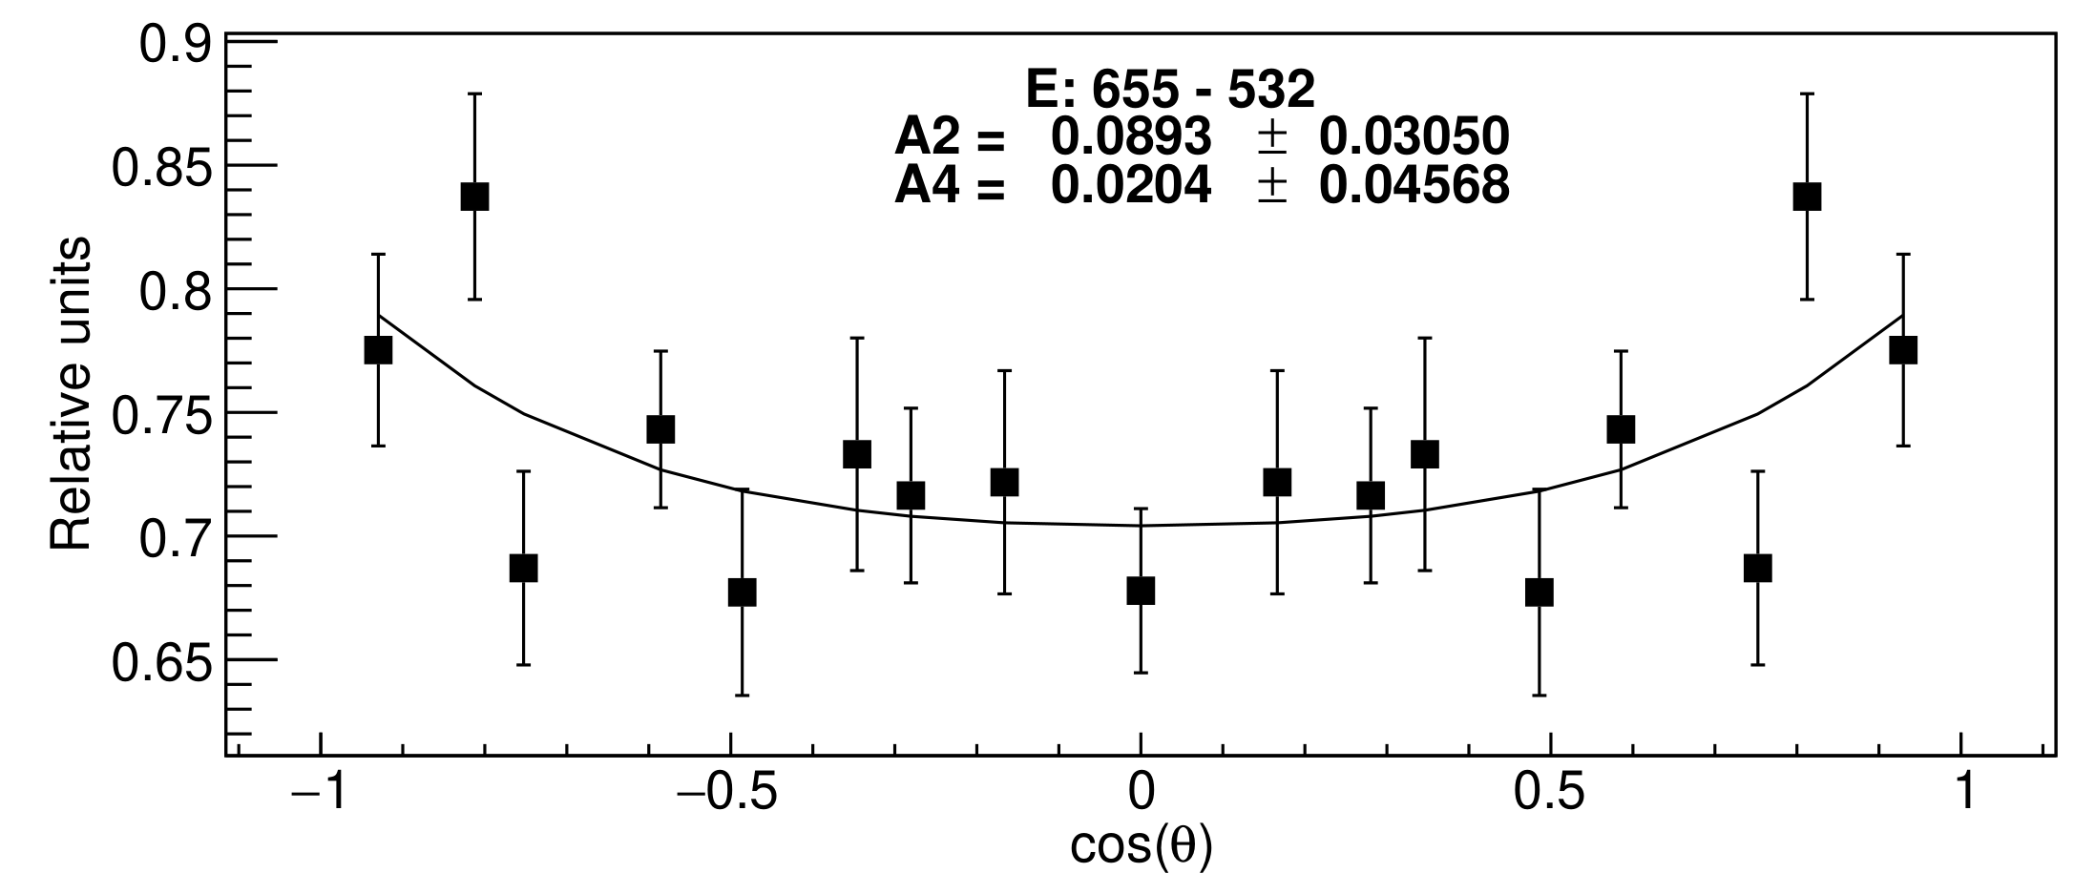
Coincidence spectra and angular correlations
band 1
0γ
band 2 new
1γ
band 3 new
2γ
²³⁸U+⁹Be data
²⁵²Cf data
Th. Q-Q
A2=0.10
A4=0.00
Phys. Rev. Lett. 136, 072501 (2026)

Slide 12
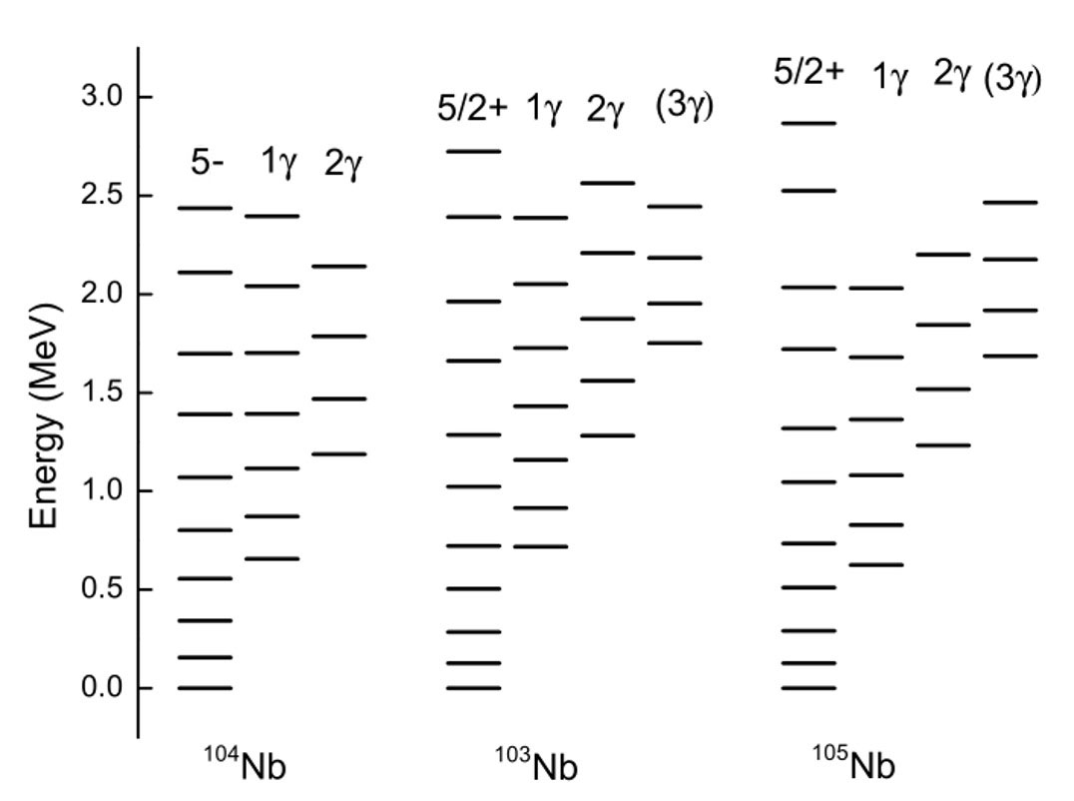
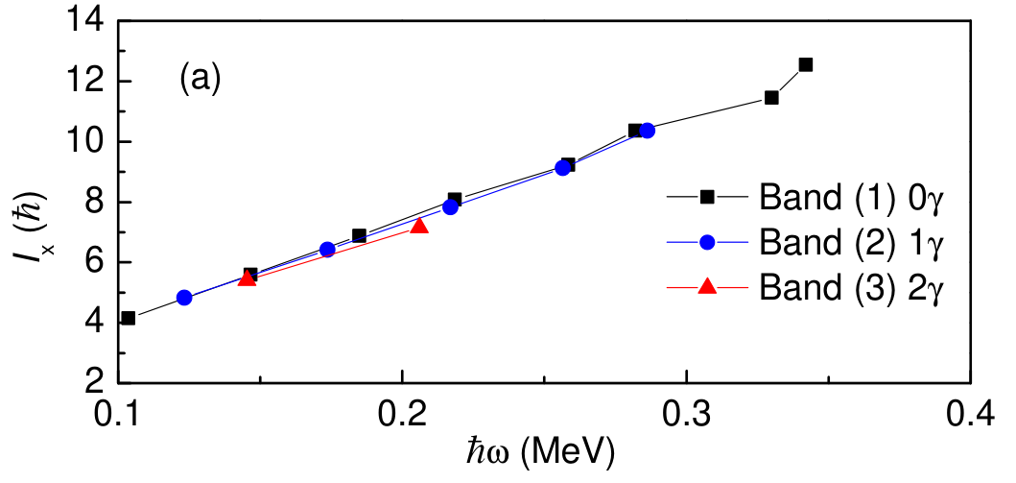
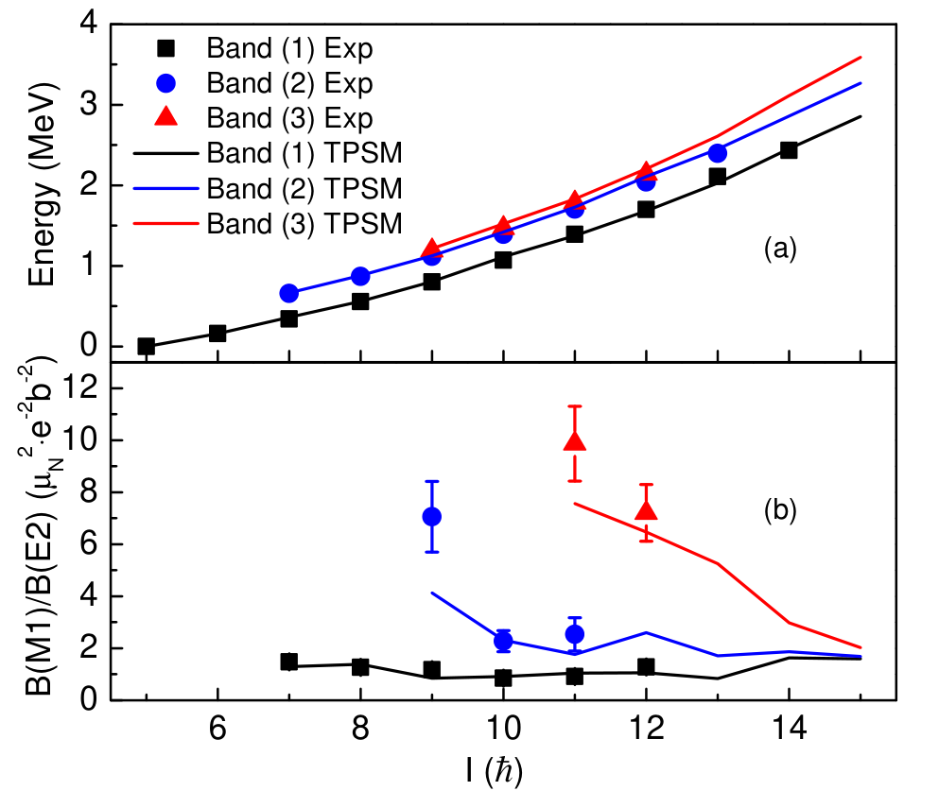
Systematics and TPSM calculations
Exp energy levels
2Δ_{n}
2Δ_{p}
J⁽²⁾ (slope) are close for 0γ, 1γ and 2γ
ε=0.32
ε’=0.19
Pairing gap 2Δ_{n}~ 2.1 MeV, 2Δ_{p}~1.7MeV
No 4 qp states
Exp p and n with K both up to 5/2
p 5/2⁺[422], 5/2⁻[303], 3/2⁻[301]
n 5/2⁻[532], 3/2⁺[411], 5/2⁺[413], 1/2⁺[411]
Bands 2 and 3 with K=7 and 9 are not 2qp
Level energies and B(M1)/B(E2) are well reproduced
Phys. Rev. Lett. 136, 072501 (2026)

Slide 13
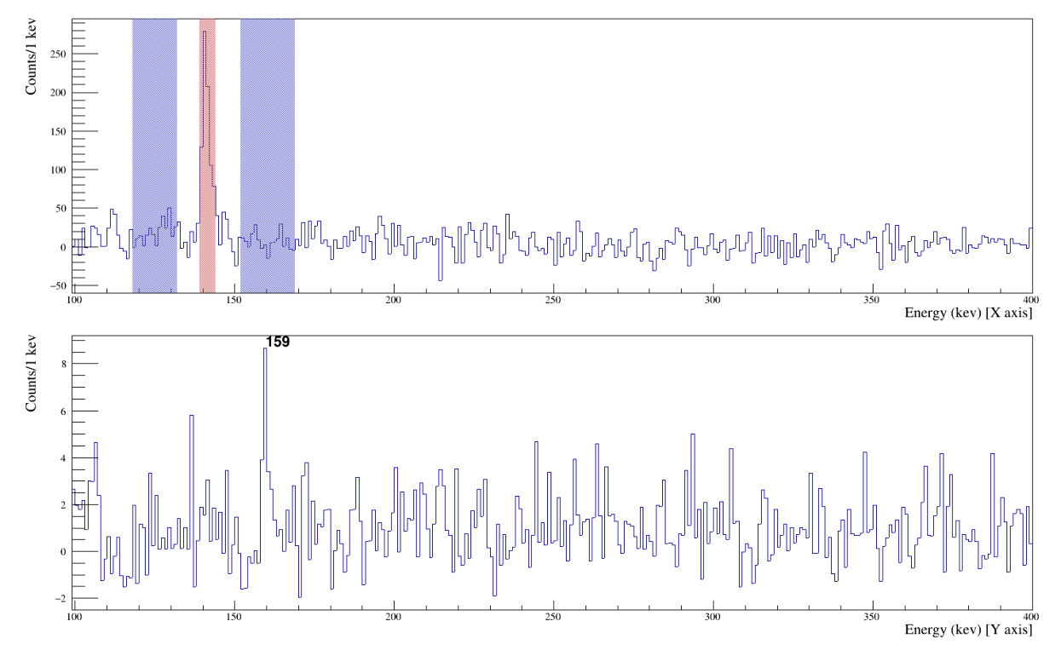
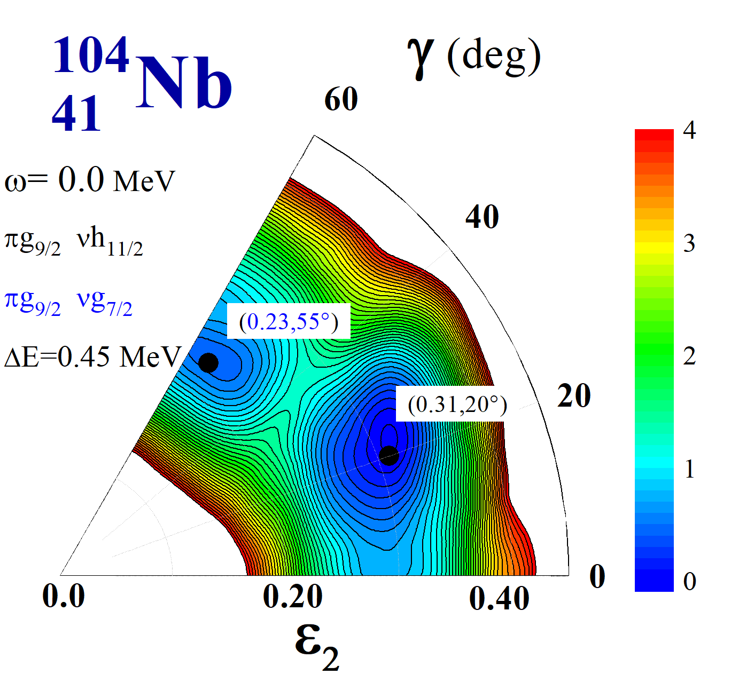
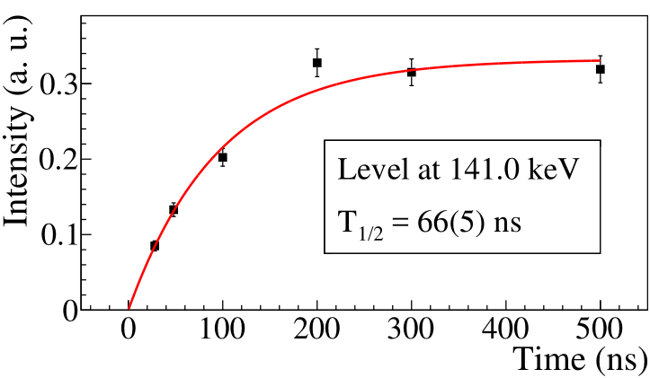
Lifetime measurements and oblate isomer
gate on delayed 141
prompt
E1 or M1
ICC=0.07(7)
E1=0.04, M1=0.09
97 is E2
²³⁸U+⁹Be data
141 keV E1(M1) isomeric transition indicates strong hindrance.
Cranking model with the shell correction method
²⁵²Cf data

Slide 14
Summary
Transitions in ¹⁰⁴Nb have been unambiguously identified; new bands have been discovered up to high spin
Lifetime has been measured; an oblate shape isomer is proposed
Spins and parities are tentatively assigned
Two new bands are assigned to 1 and 2 phonon γ vibrational bands coupled to the known band
Triaxial projected shell model calculations well reproduce the multi phonon γ vibrational bands
The complicated multi quasiparticles + multi phonon vibration + rotation mode shed light on self-consistent unified microscopic model description

Slide 15
Thanks

