Slide 1
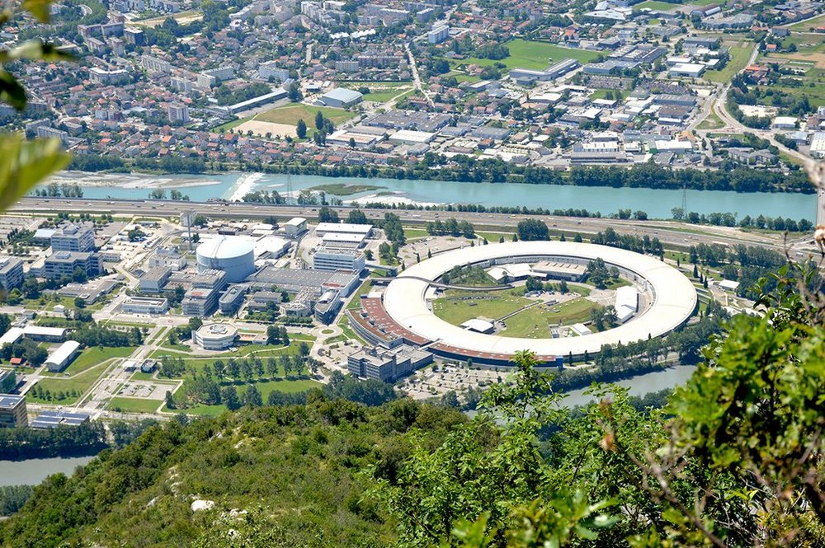


Measurement of the lifetime of excited states in exotic nuclei produced via ²³⁵U neutron-induced fission.
Basile MASSIMINO, 1st year Master student
Institut Laue Langevin
Nuclear and Particle Physics group

Slide 2
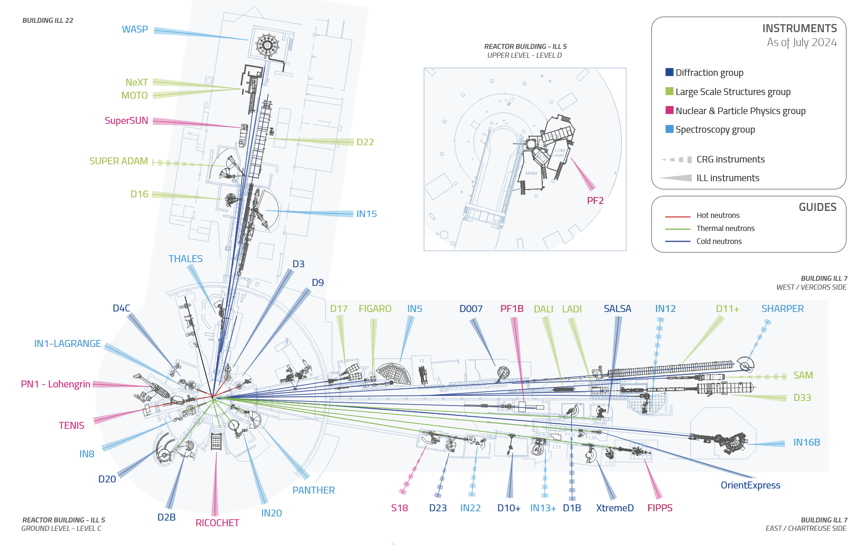
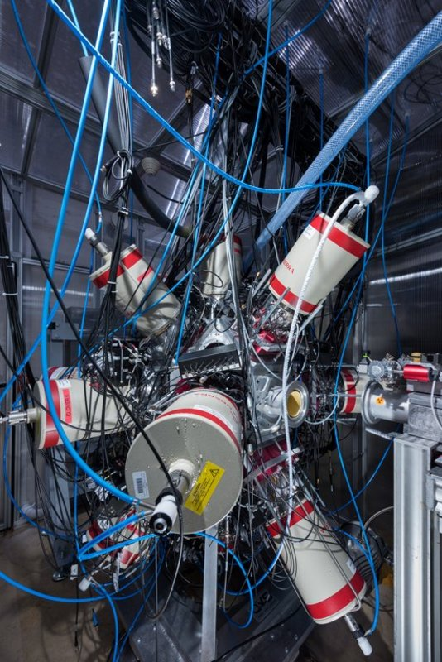
ILL instruments: FIPPS

Slide 3
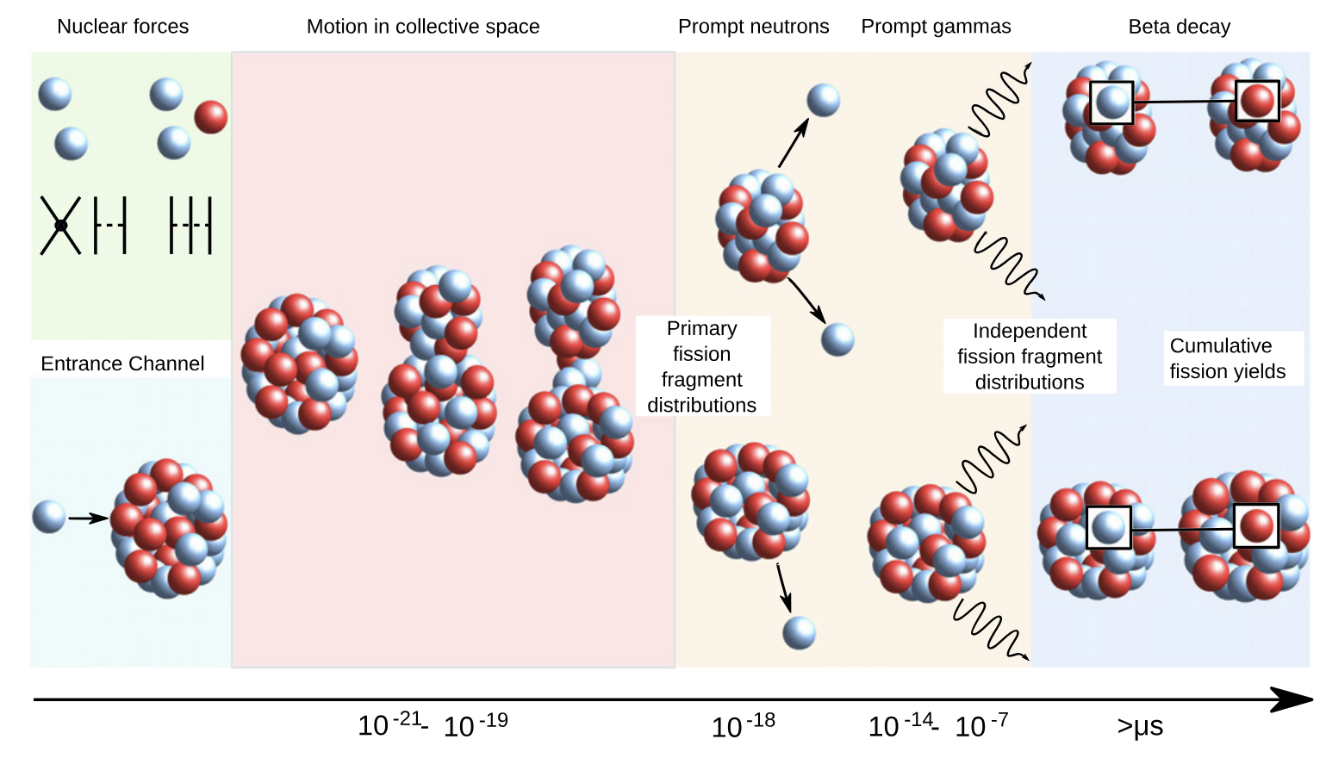
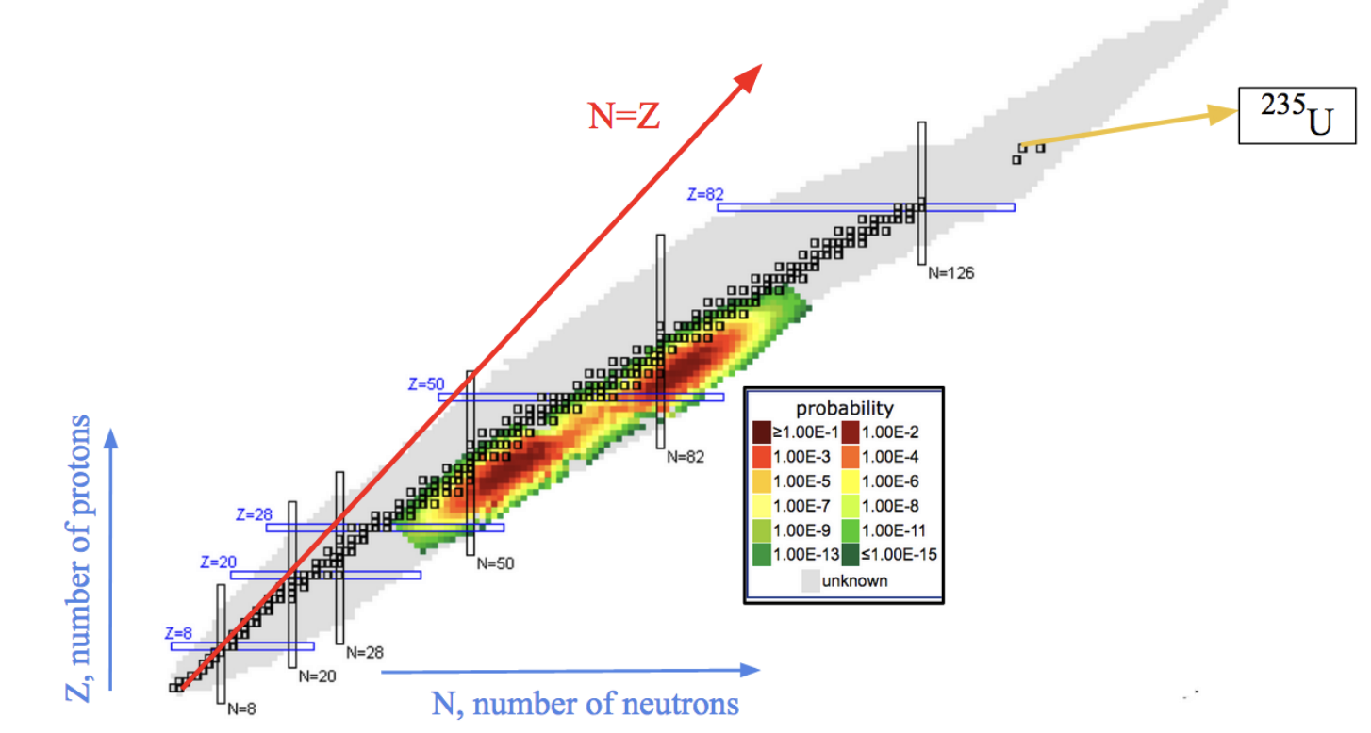
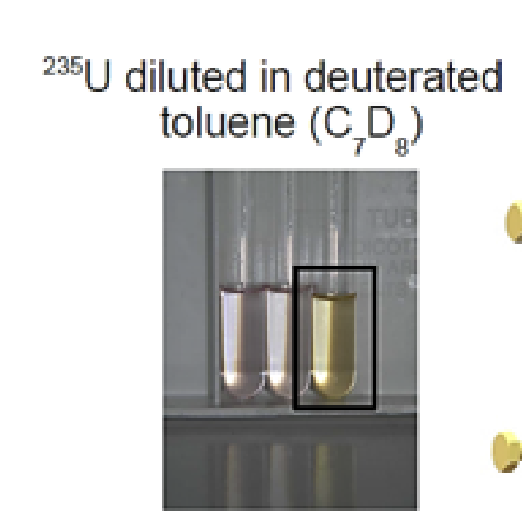
About fission
Fission-tagging allows us to select prompt gammas and disregard the delayed gamma from daughter nuclei.

Slide 4
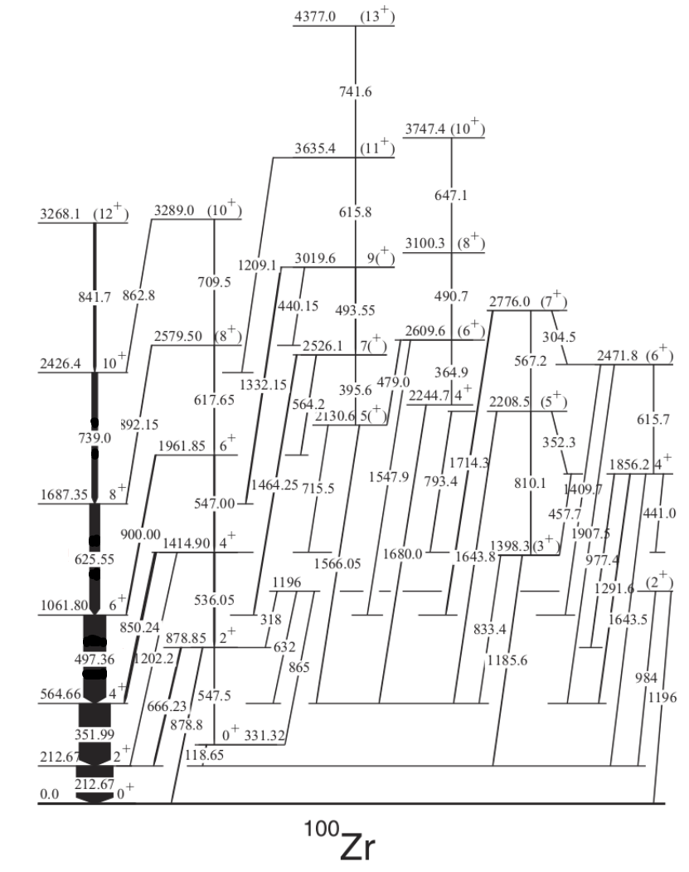
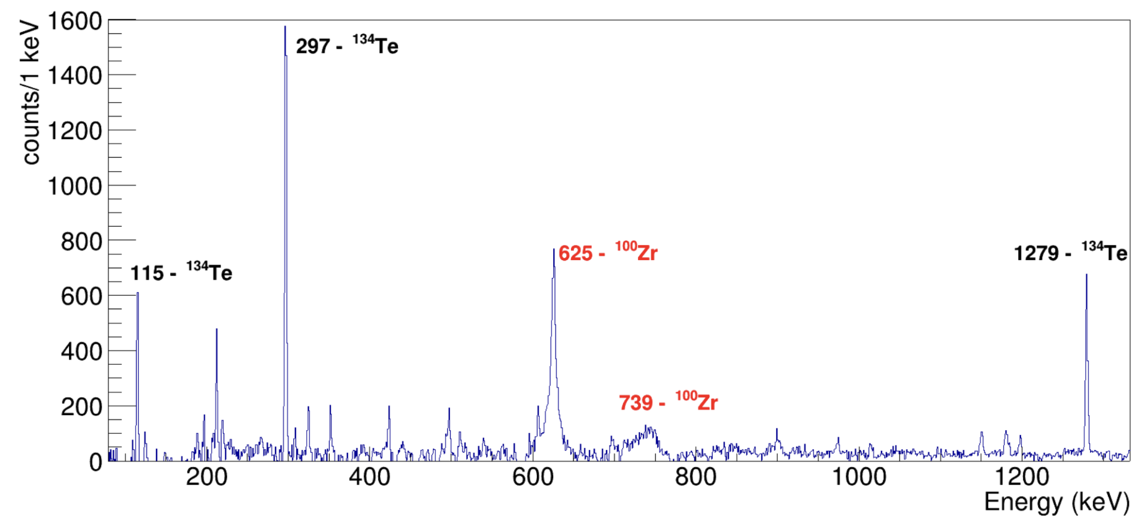
Nuclear structure of ¹⁰⁰Zr
γ ray spectrum of ²³⁵U (n,IF) in coincidence with the 6⁺ → 4⁺ → 2⁺ → 0⁺ transitions in ¹⁰⁰Zr

Slide 5
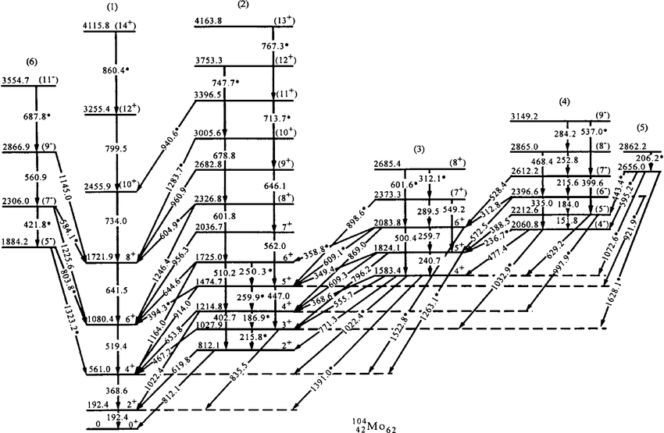
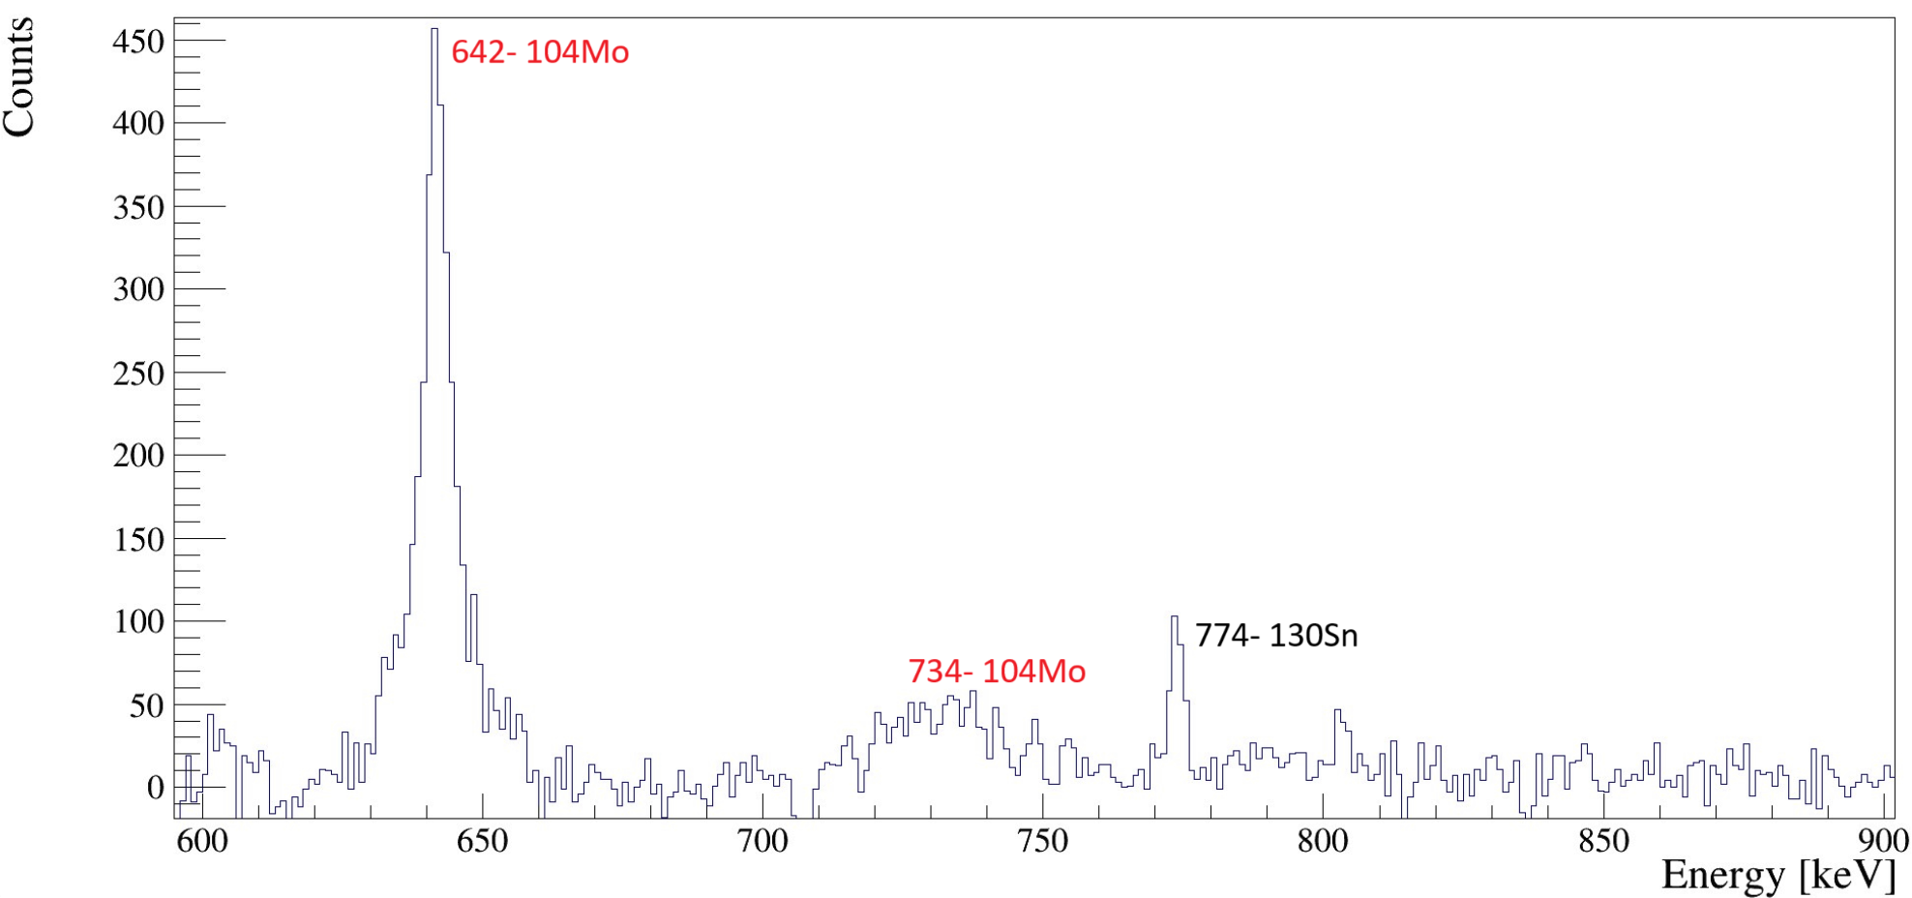
Nuclear structure of ¹⁰⁴Mo
γ ray spectrum of ²³⁵U (n,IF) in coincidence with the 6⁺ → 4⁺ → 2⁺ → 0⁺ transitions in ¹⁰⁴Mo
Doppler-broadened peaks

Slide 6
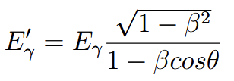
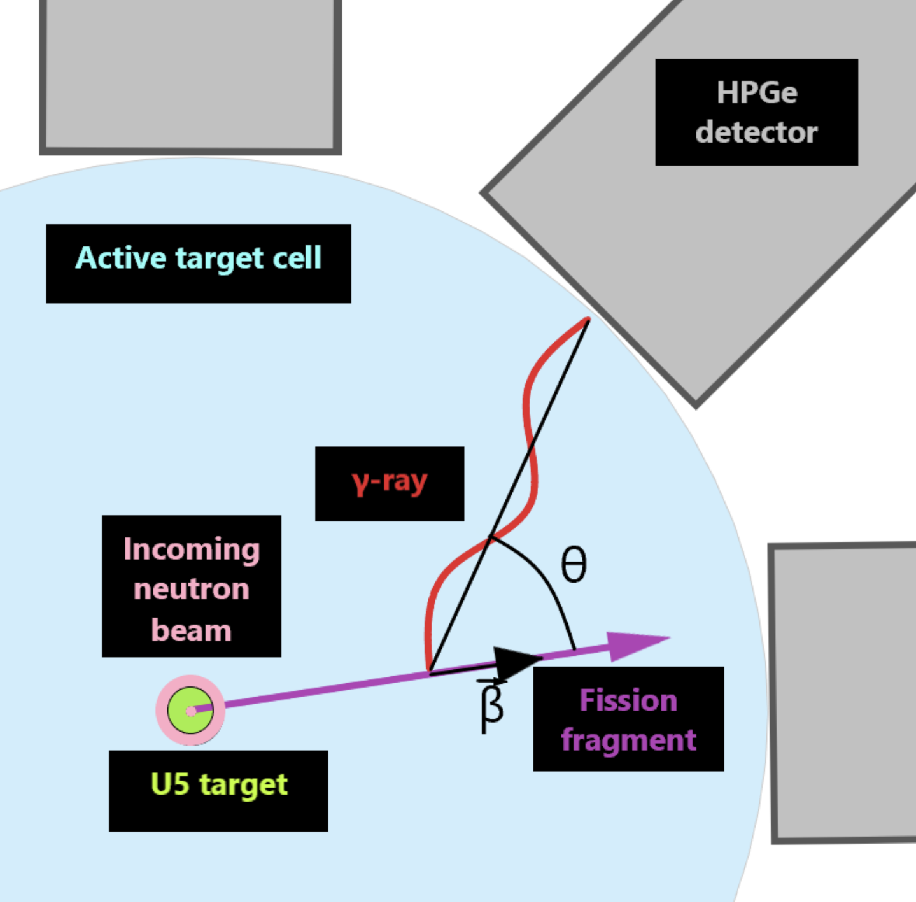
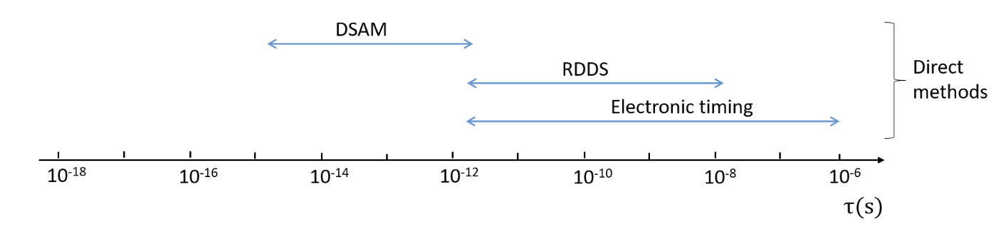
Doppler-shift Attenuation Method
Shorter lifetime ⇔ Wider peak
Effective range: 100 fs ~2 ps

Slide 7
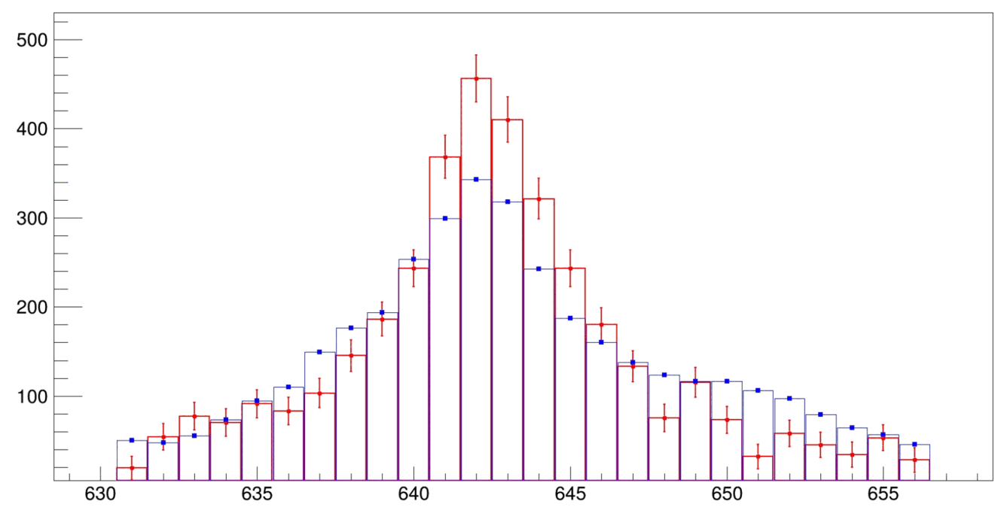
Animation depicting the evolution of the simulated (singles) spectrum with increasing τ.
Exp data
Simulation (singles)

Slide 8
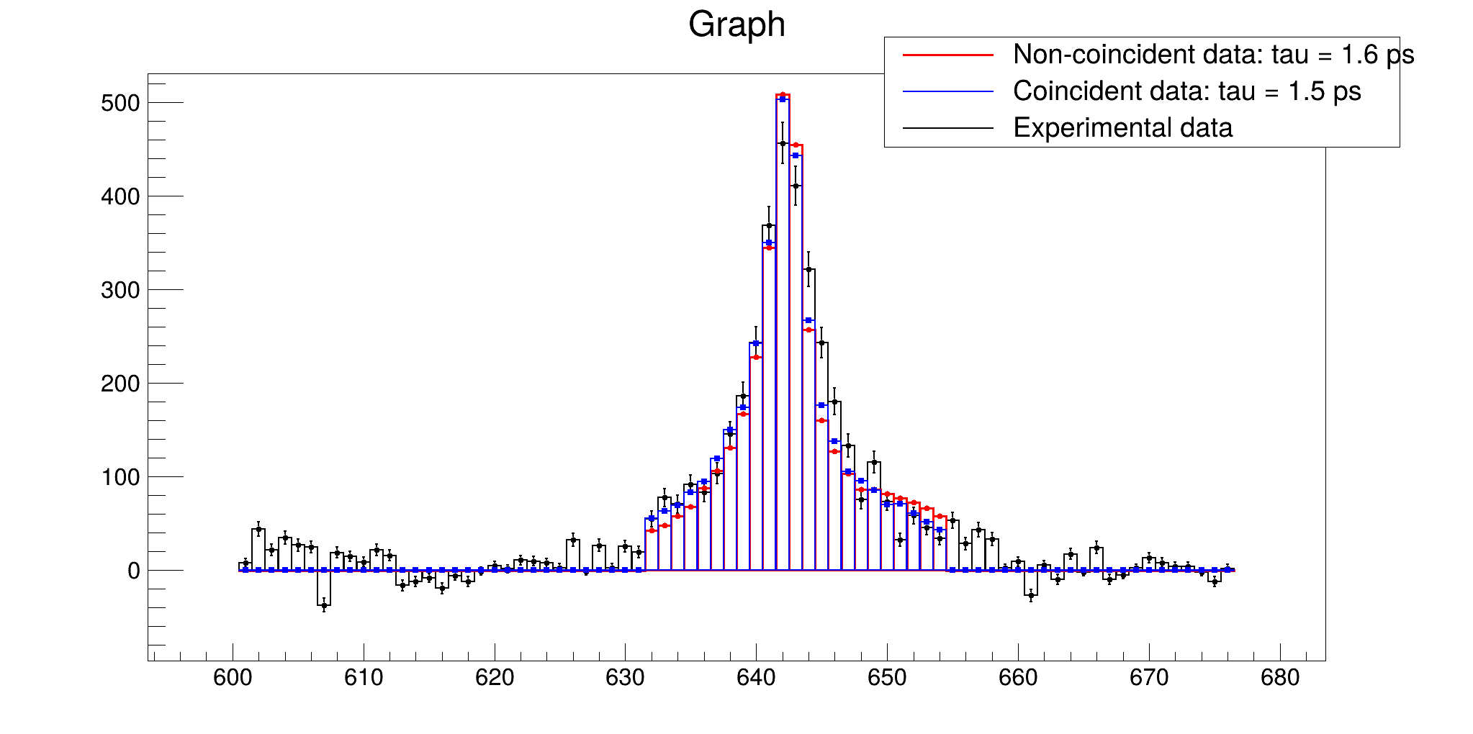
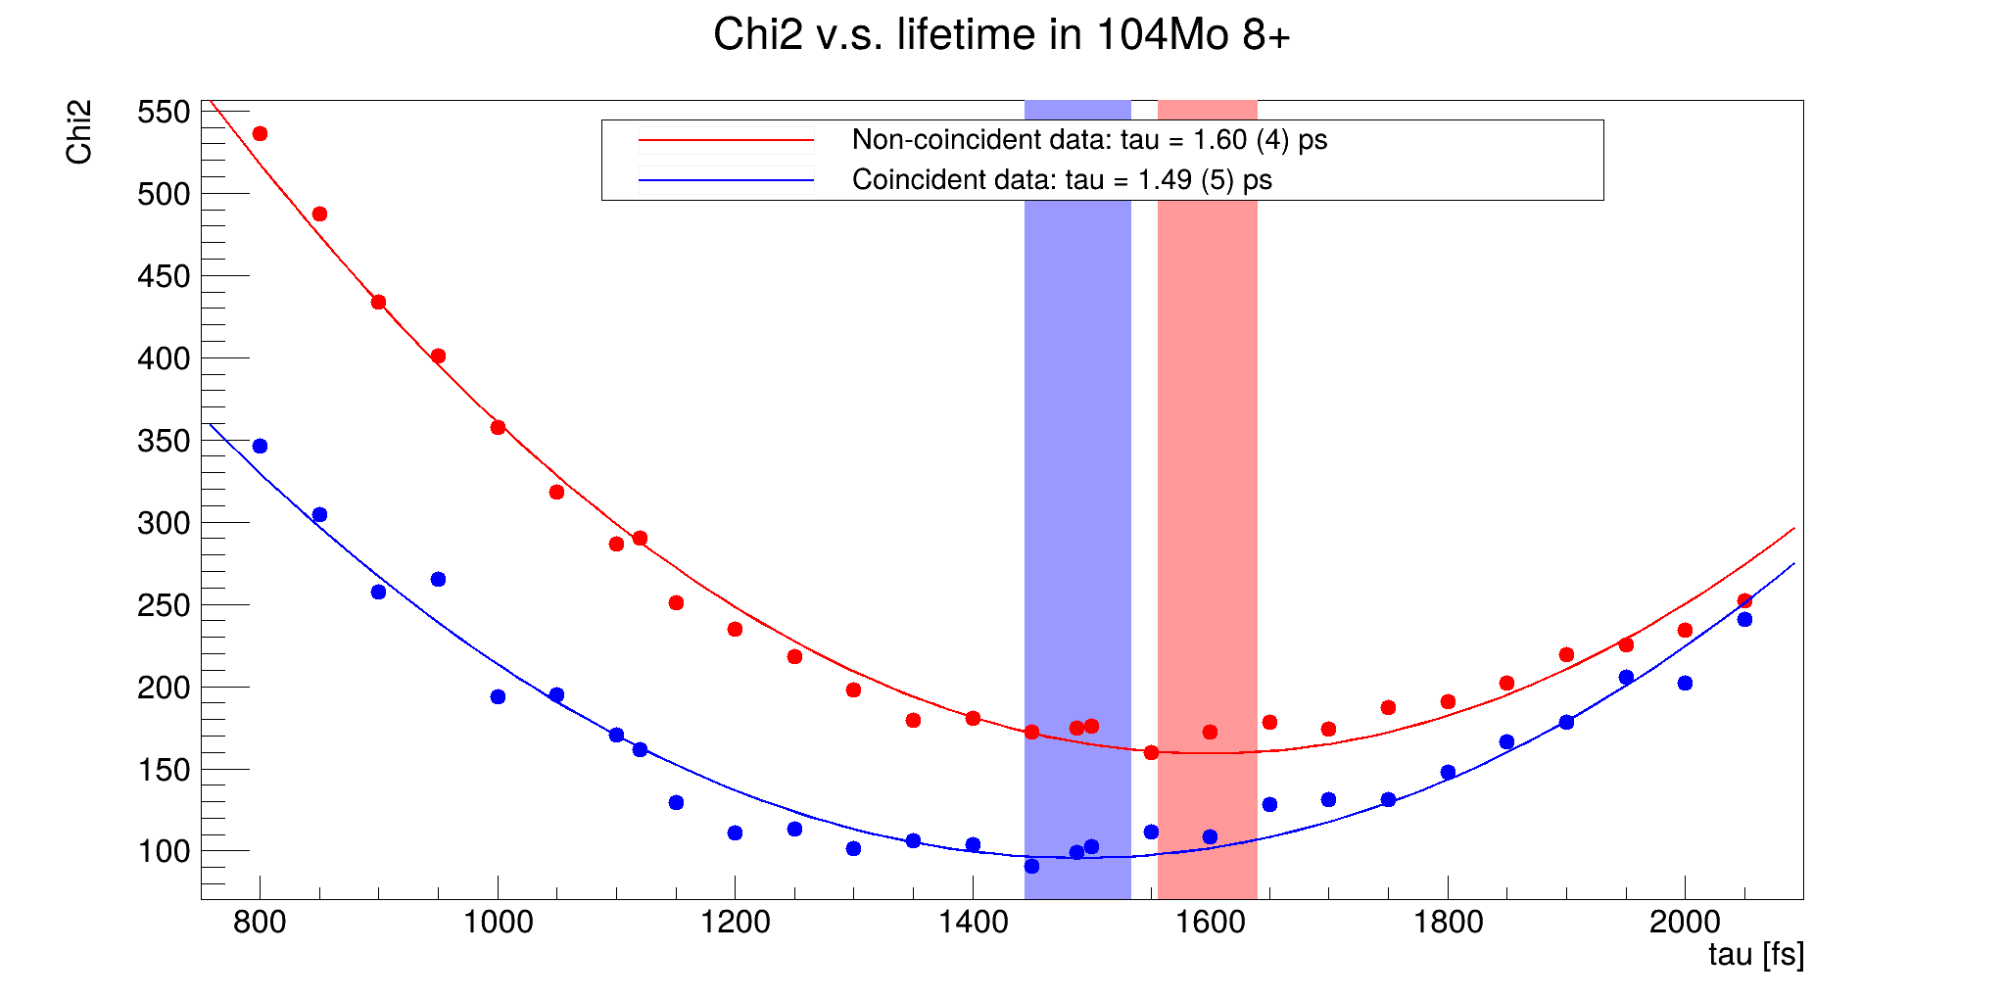
Analysis process & results
¹⁰⁴Mo 8⁺ state 642 keV
We run simulations using different lifetimes. Using the χ² law, we are able to determine the most likely lifetime value.

Slide 9
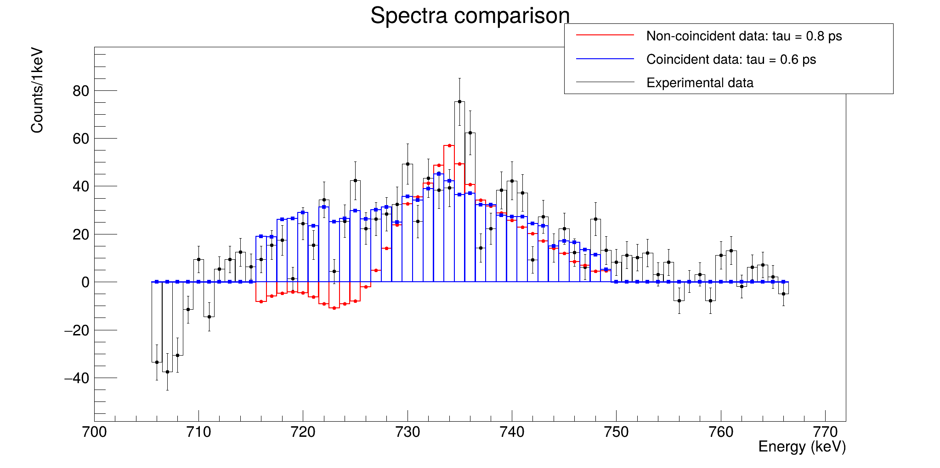
¹⁰⁴Mo 10⁺ state 734 keV

Slide 10
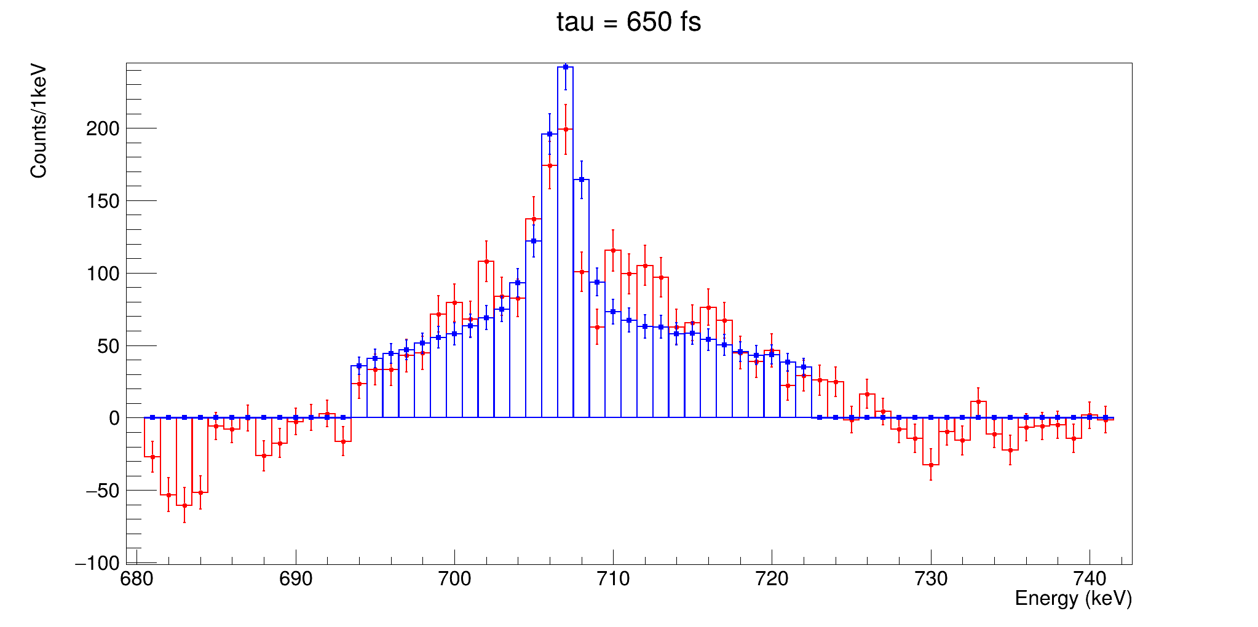
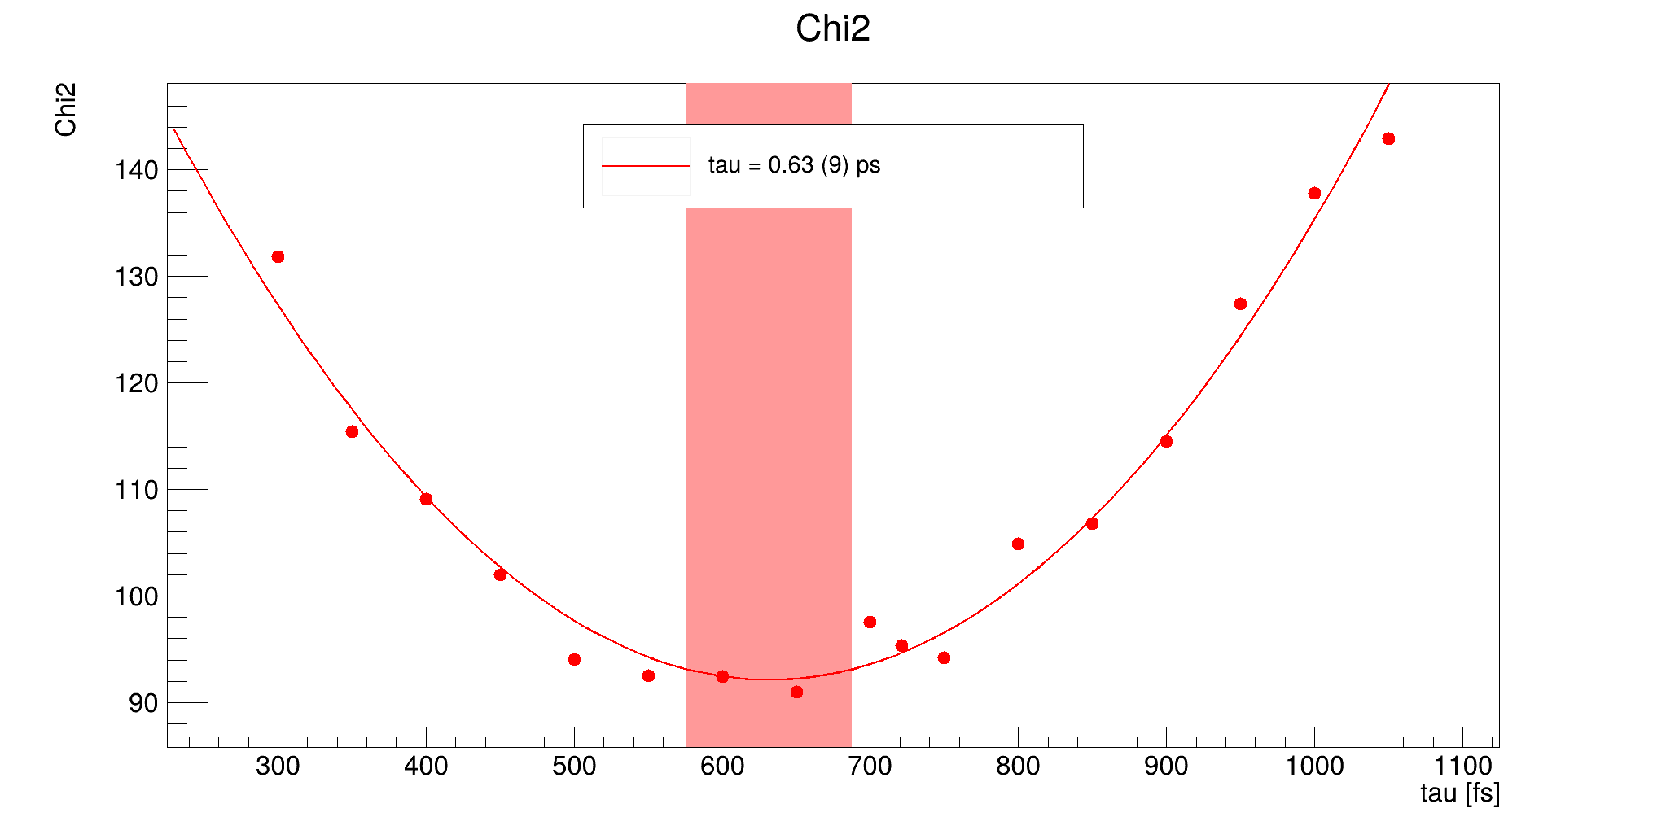
¹³⁴Te (6)⁺ state 706 keV
No coincidence study has been done since only prompt coincidences have been analysed so far with simulations (the lifetime of the lower lying state is 164 ns)

Slide 11
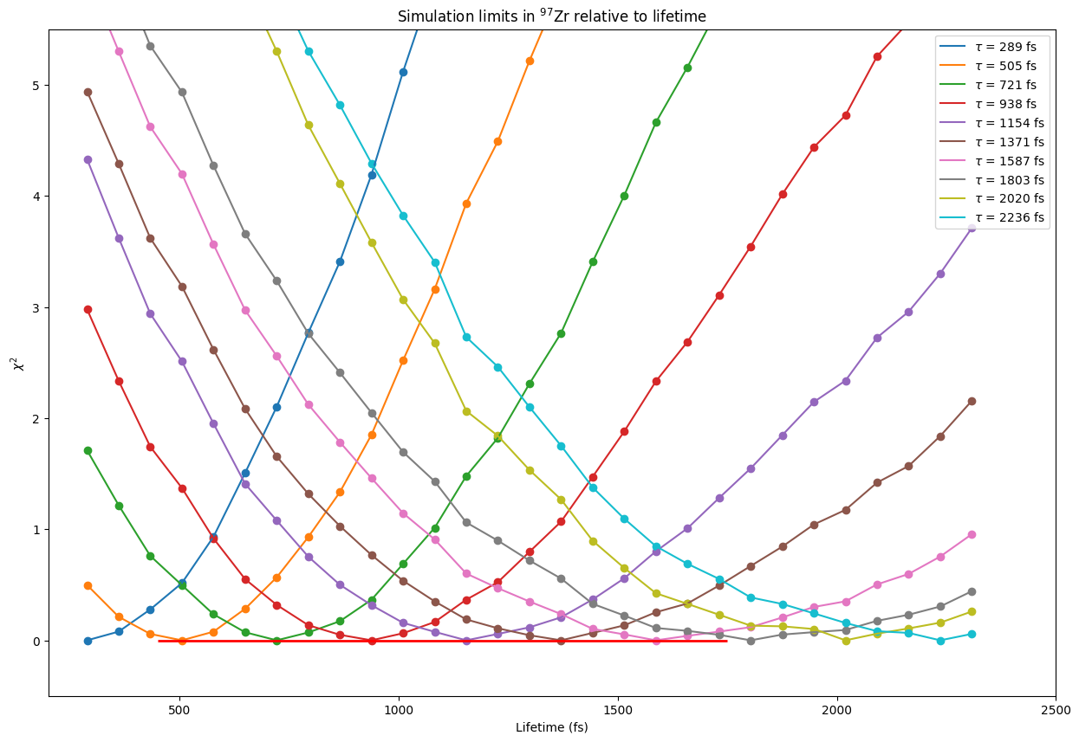
Test of measurement sensitivity via simulations: ⁹⁷Zr 19/2⁻
Taking simulations done with different lifetimes as a reference, we test the sensitivity of the analysis:

Slide 12
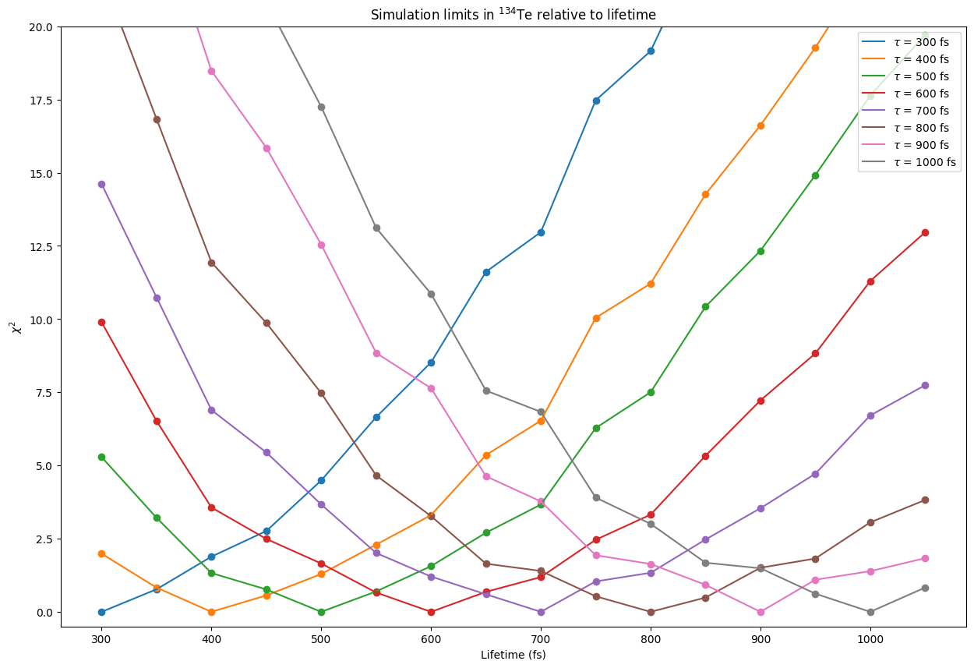
Test of measurement sensitivity via simulations: ¹³⁴Te (6)⁺
A heavier nucleus has a shorter effective range because it is slowed down faster.

Slide 13
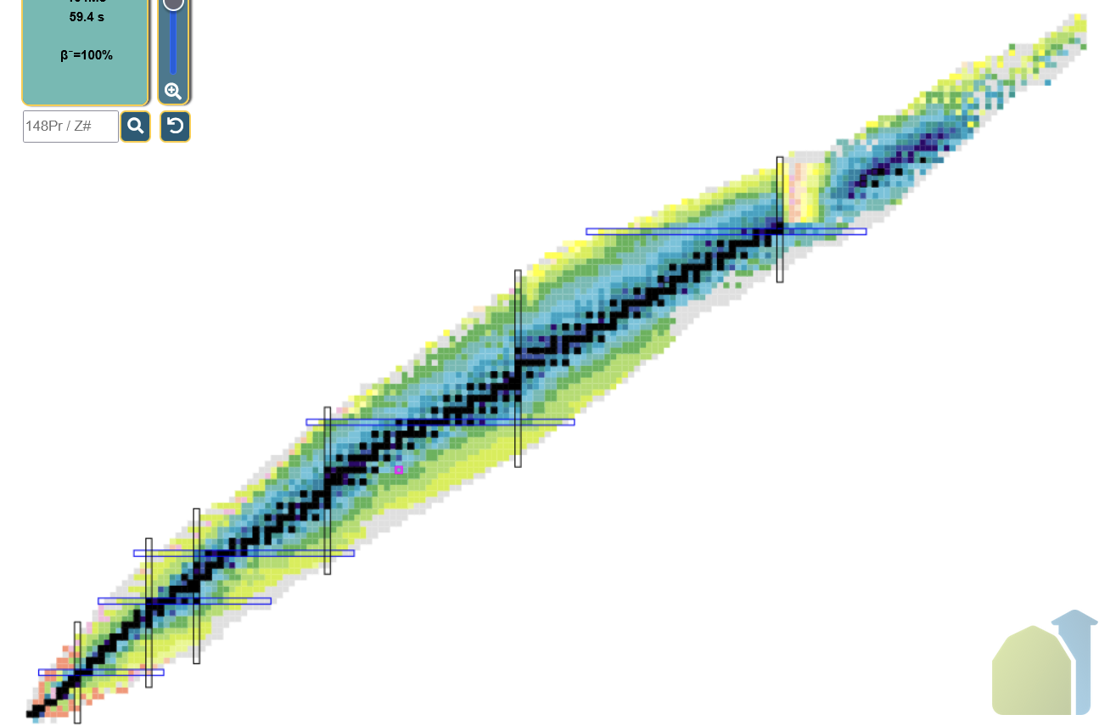
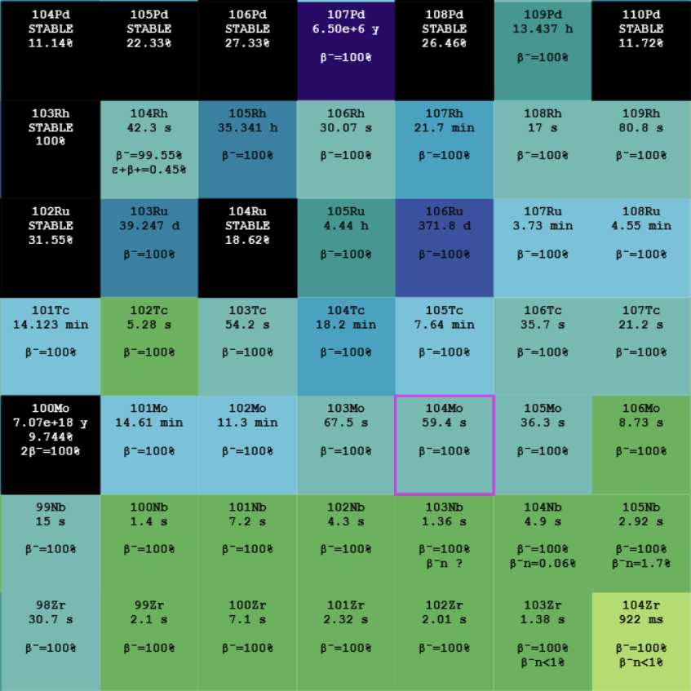
Conclusion & outlooks
The region of the nuclear chart that I have studied is just a small one. Further experiments could widen that area of study.
The implementation of the coincidence method into the previous analysis process will help to reduce the effect of contamination, and could increase the precision of future results.
Future ideas
Other methods for comparative values
New active targets to widen time range
Z
N
Thank you to Caterina and the ILL for giving me this opportunity, and thank you for your attention !

Slide 14
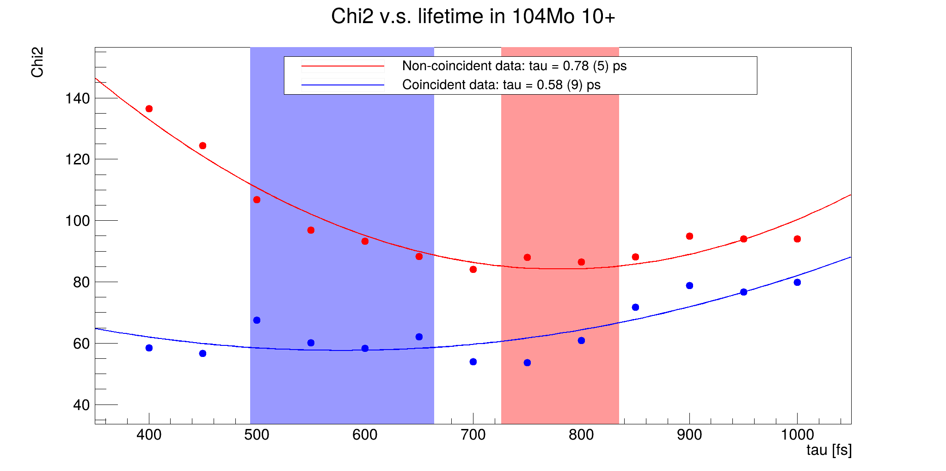
¹⁰⁴Mo 10⁺ state 734 keV chi²

Slide 15
¹⁰⁴Mo 8⁺ state 642 keV lifetime comparaison

Slide 16
¹⁰⁴Mo 8⁺ state 642 keV chi²

Slide 17
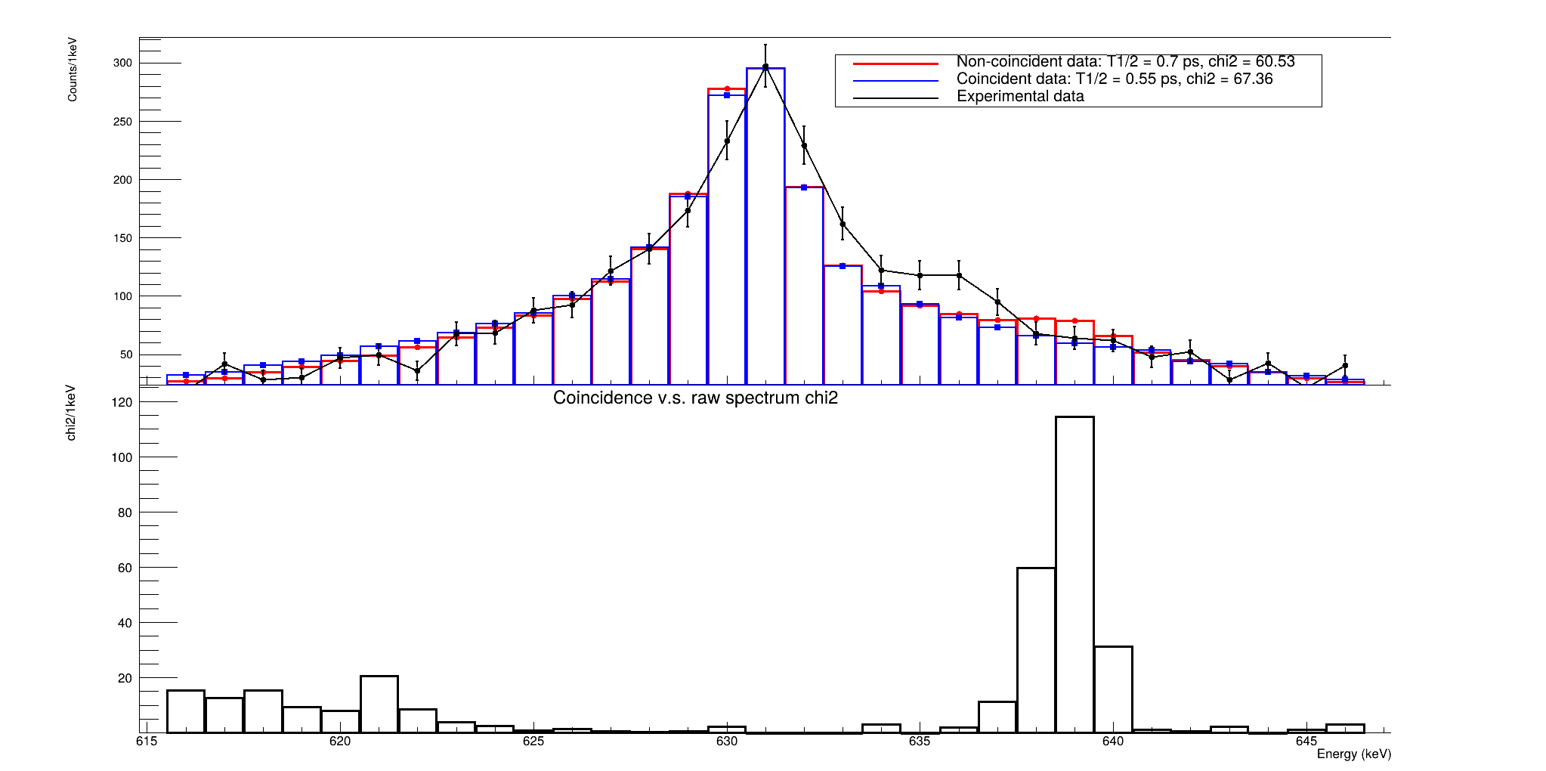
¹⁰²Zr 8⁺ state 630 keV lifetime comparaison
Both the experimental spectrum and the simulated (singles) one show a “bump”, but at a different nominal energy, GIVE INTERPRETATIONS

Slide 18
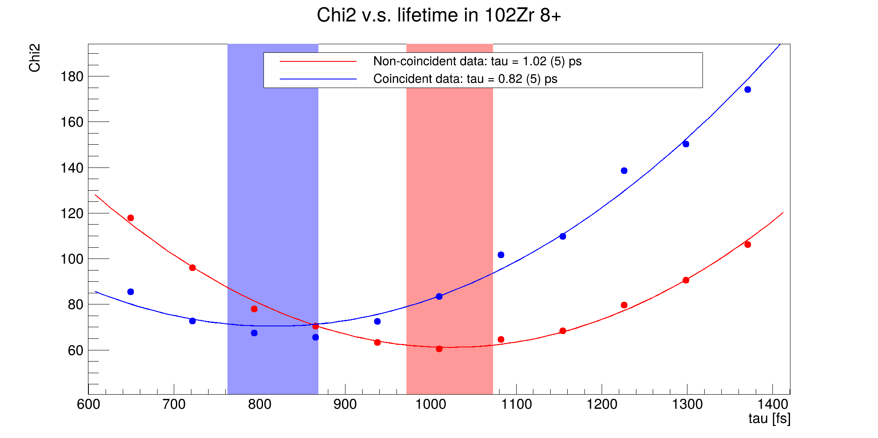
¹⁰²Zr 8⁺ state 630 keV chi²

Slide 19
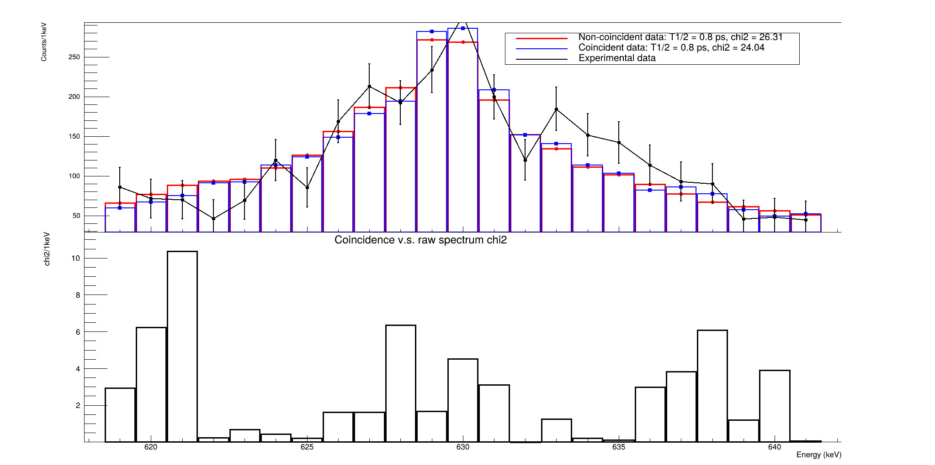
¹⁰¹Zr 19/2⁺ state 629 keV lifetime

Slide 20
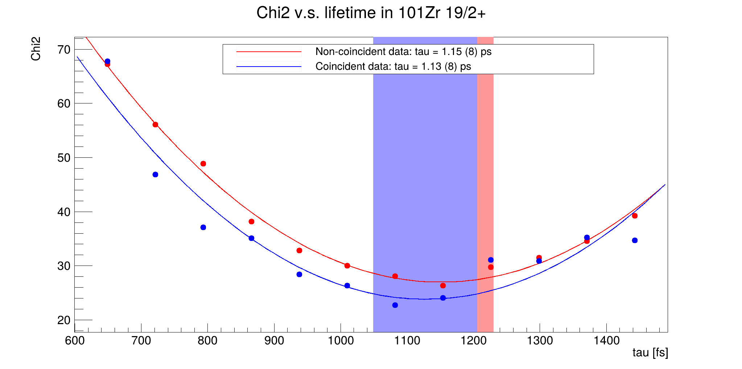
¹⁰¹Zr 19/2⁺ state 629 keV chi²

Slide 21
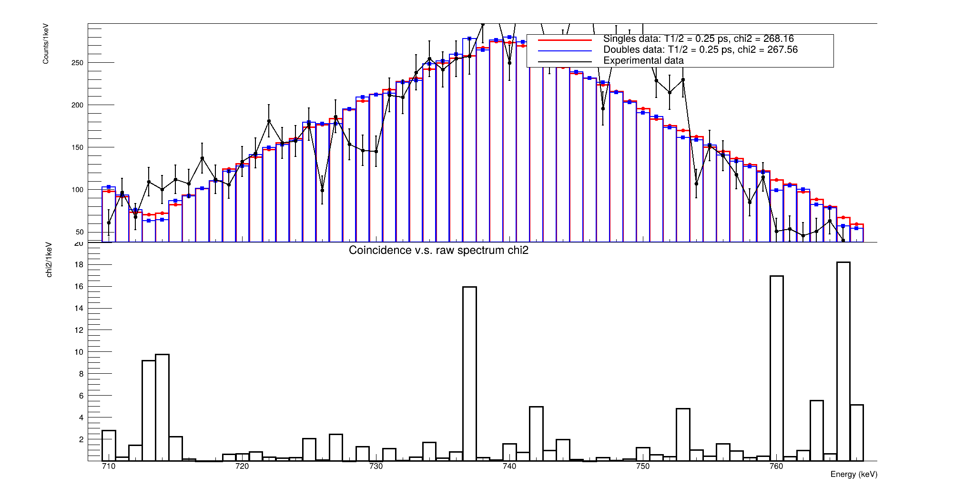
¹⁰⁰Zr 10⁺ state 739 keV lifetime

Slide 22
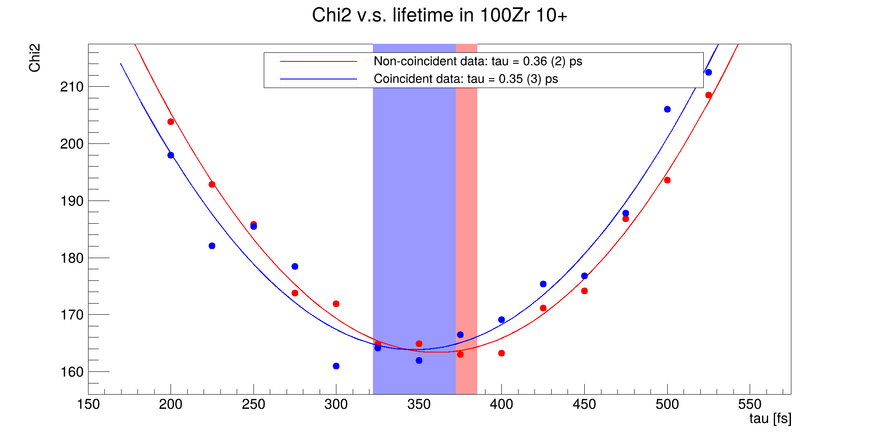
¹⁰⁰Zr 10⁺ state 739 keV lifetime chi²

Slide 23
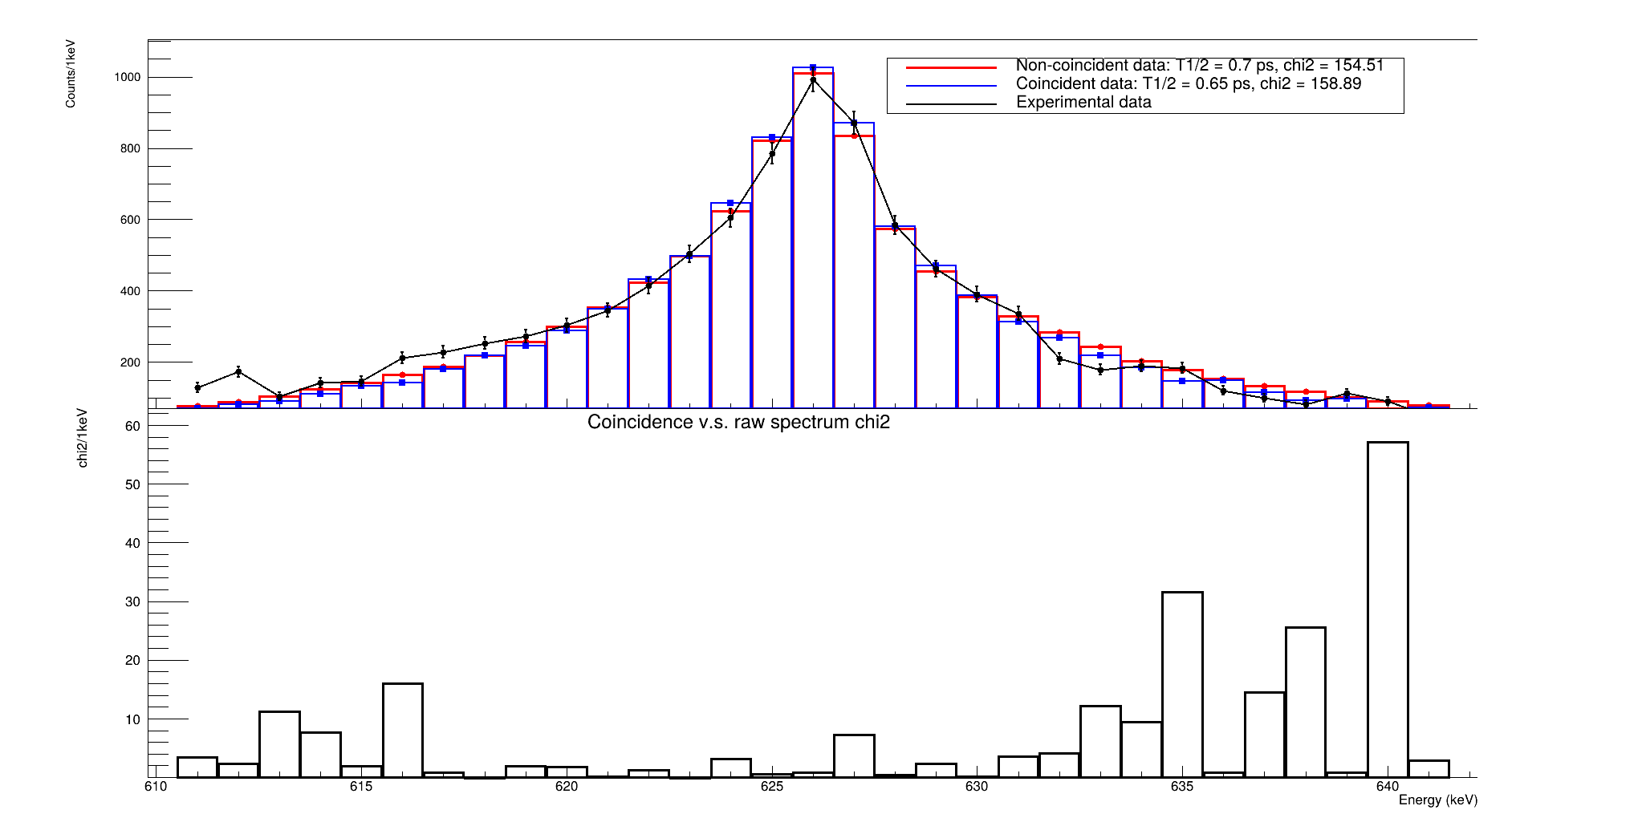
¹⁰⁰Zr 8⁺ state 626 keV lifetime

Slide 24
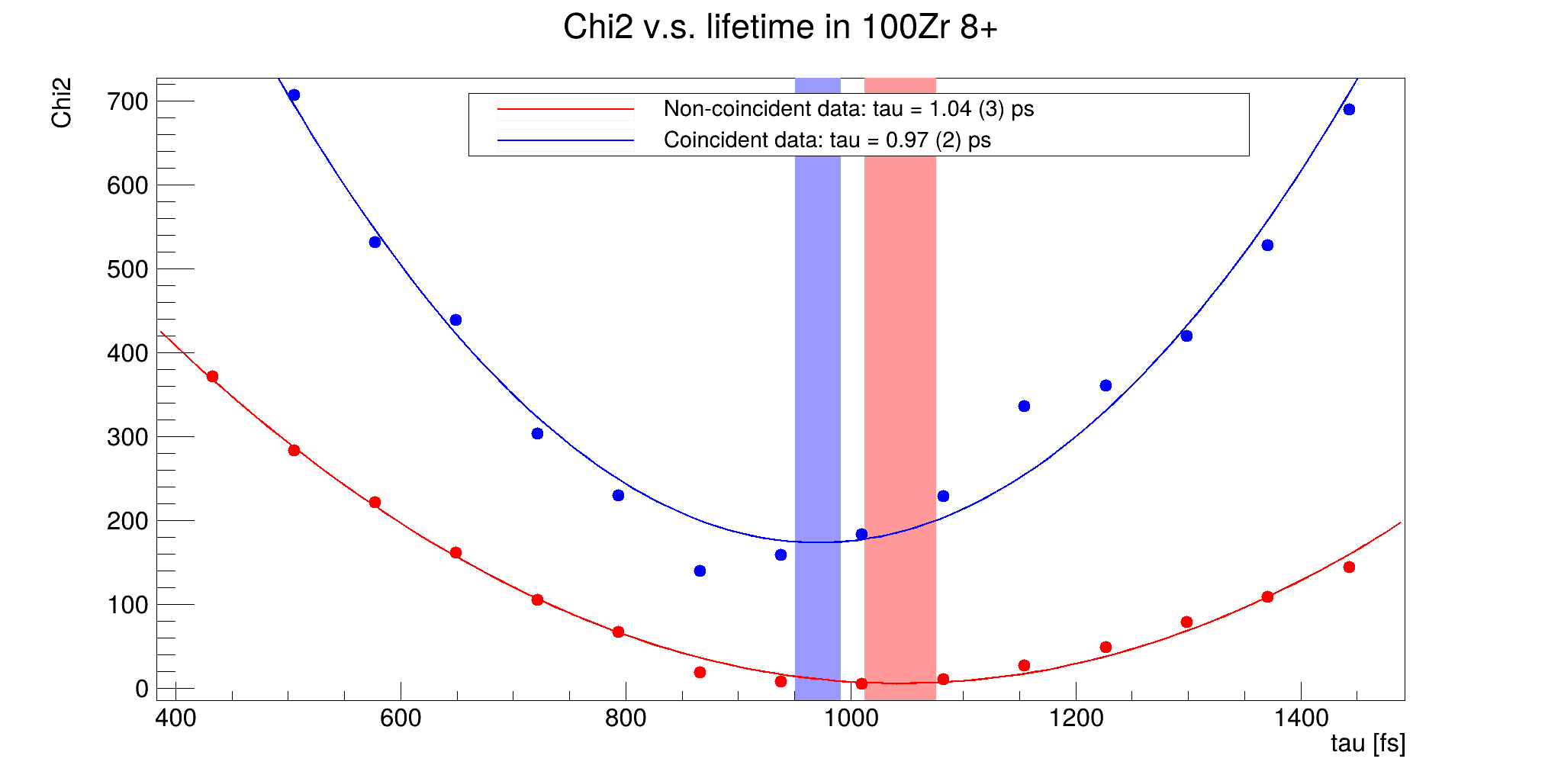
¹⁰⁰Zr 8⁺ state 626 keV chi²

Slide 25
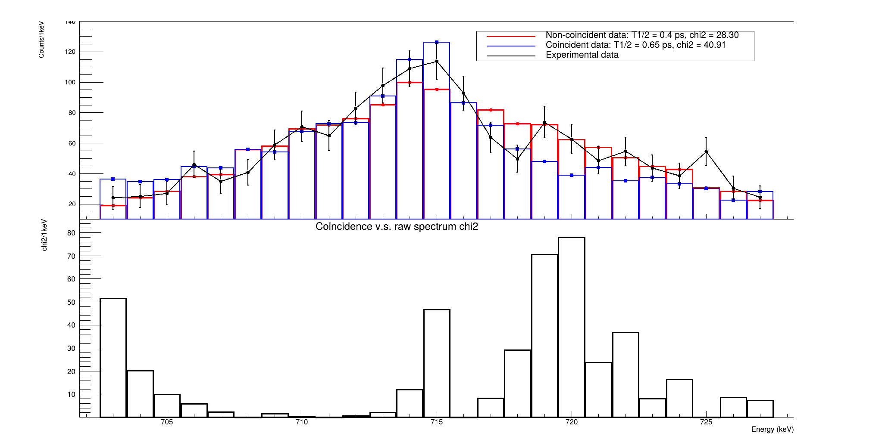
⁹⁹Zr 23/2⁻ state 714 keV lifetime

Slide 26
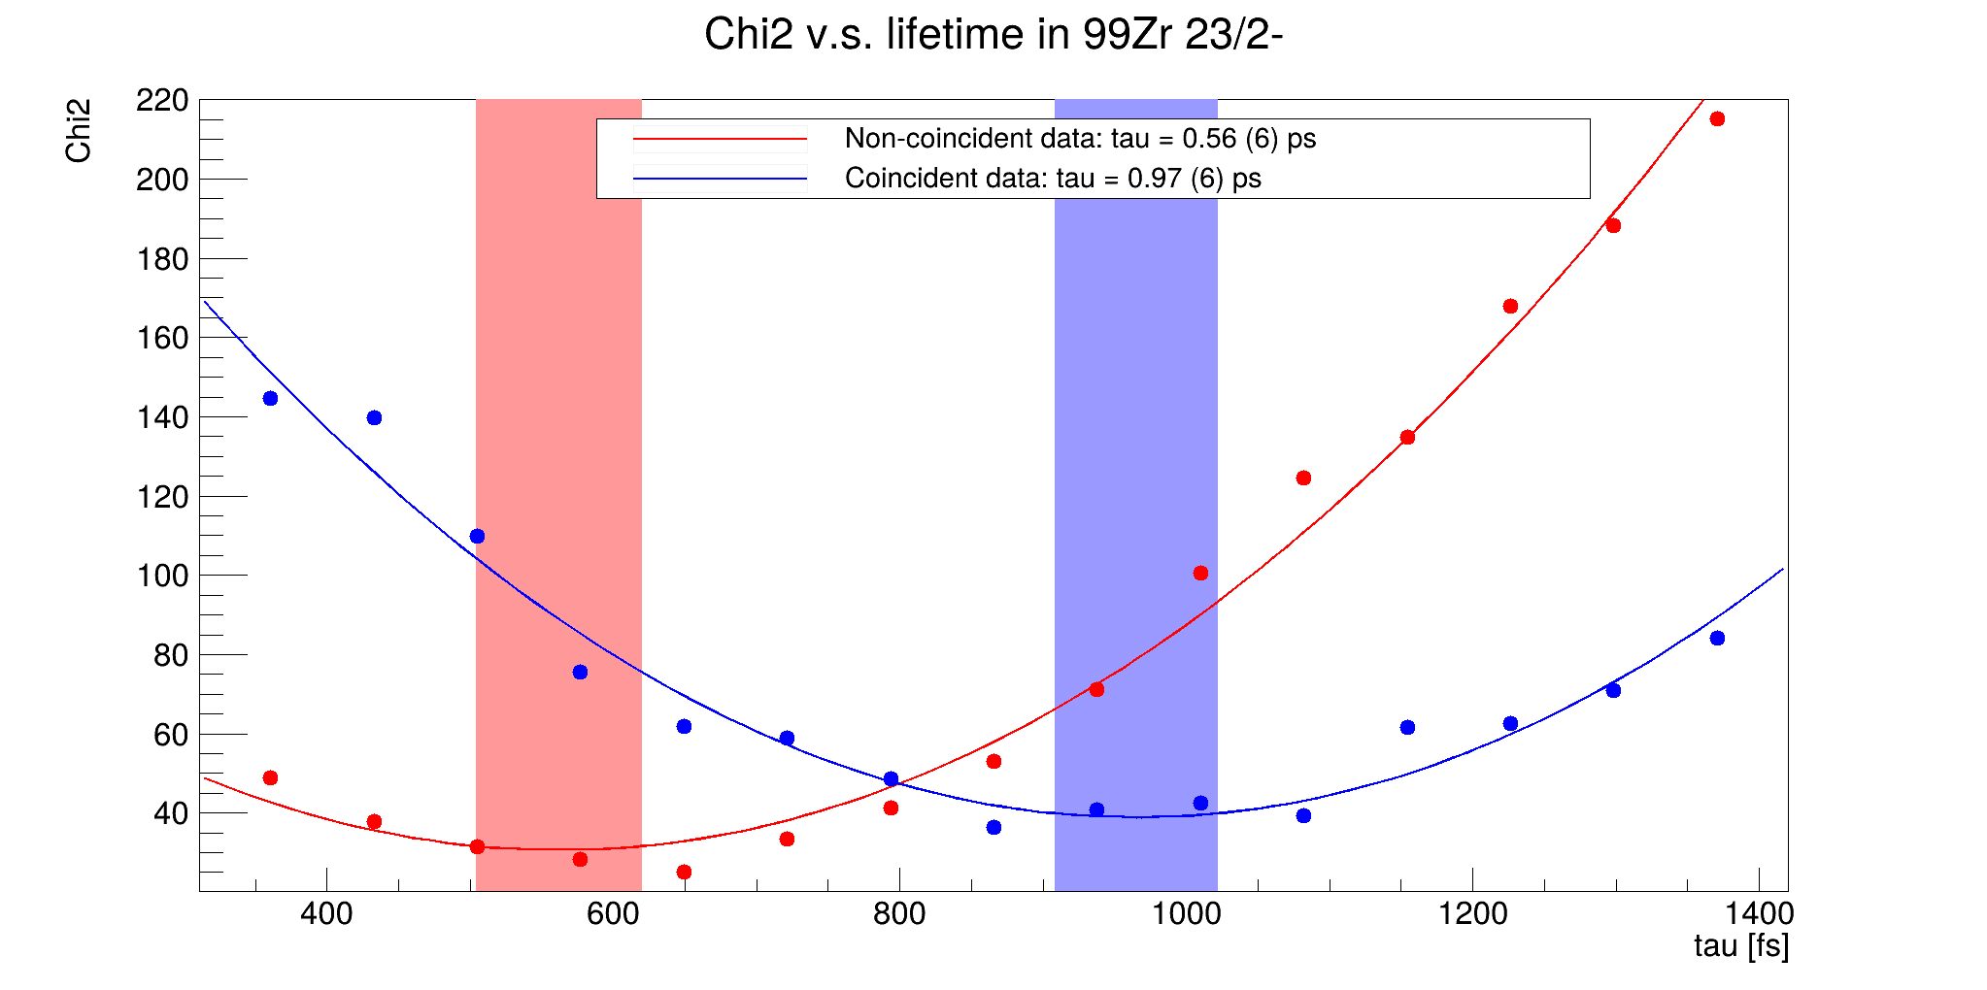
⁹⁹Zr 23/2⁻ state 714 keV chi²

Slide 27
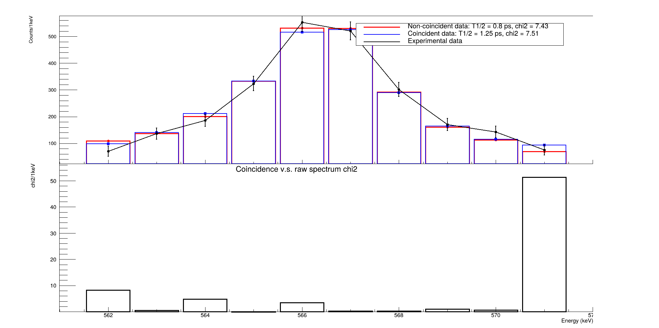
⁹⁹Zr 19/2⁻ state 566 keV lifetime comparison

Slide 28
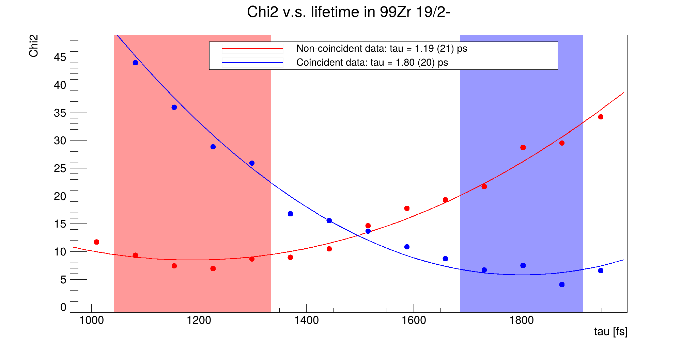
⁹⁹Zr 19/2⁻ state 566 keV chi²

Slide 29
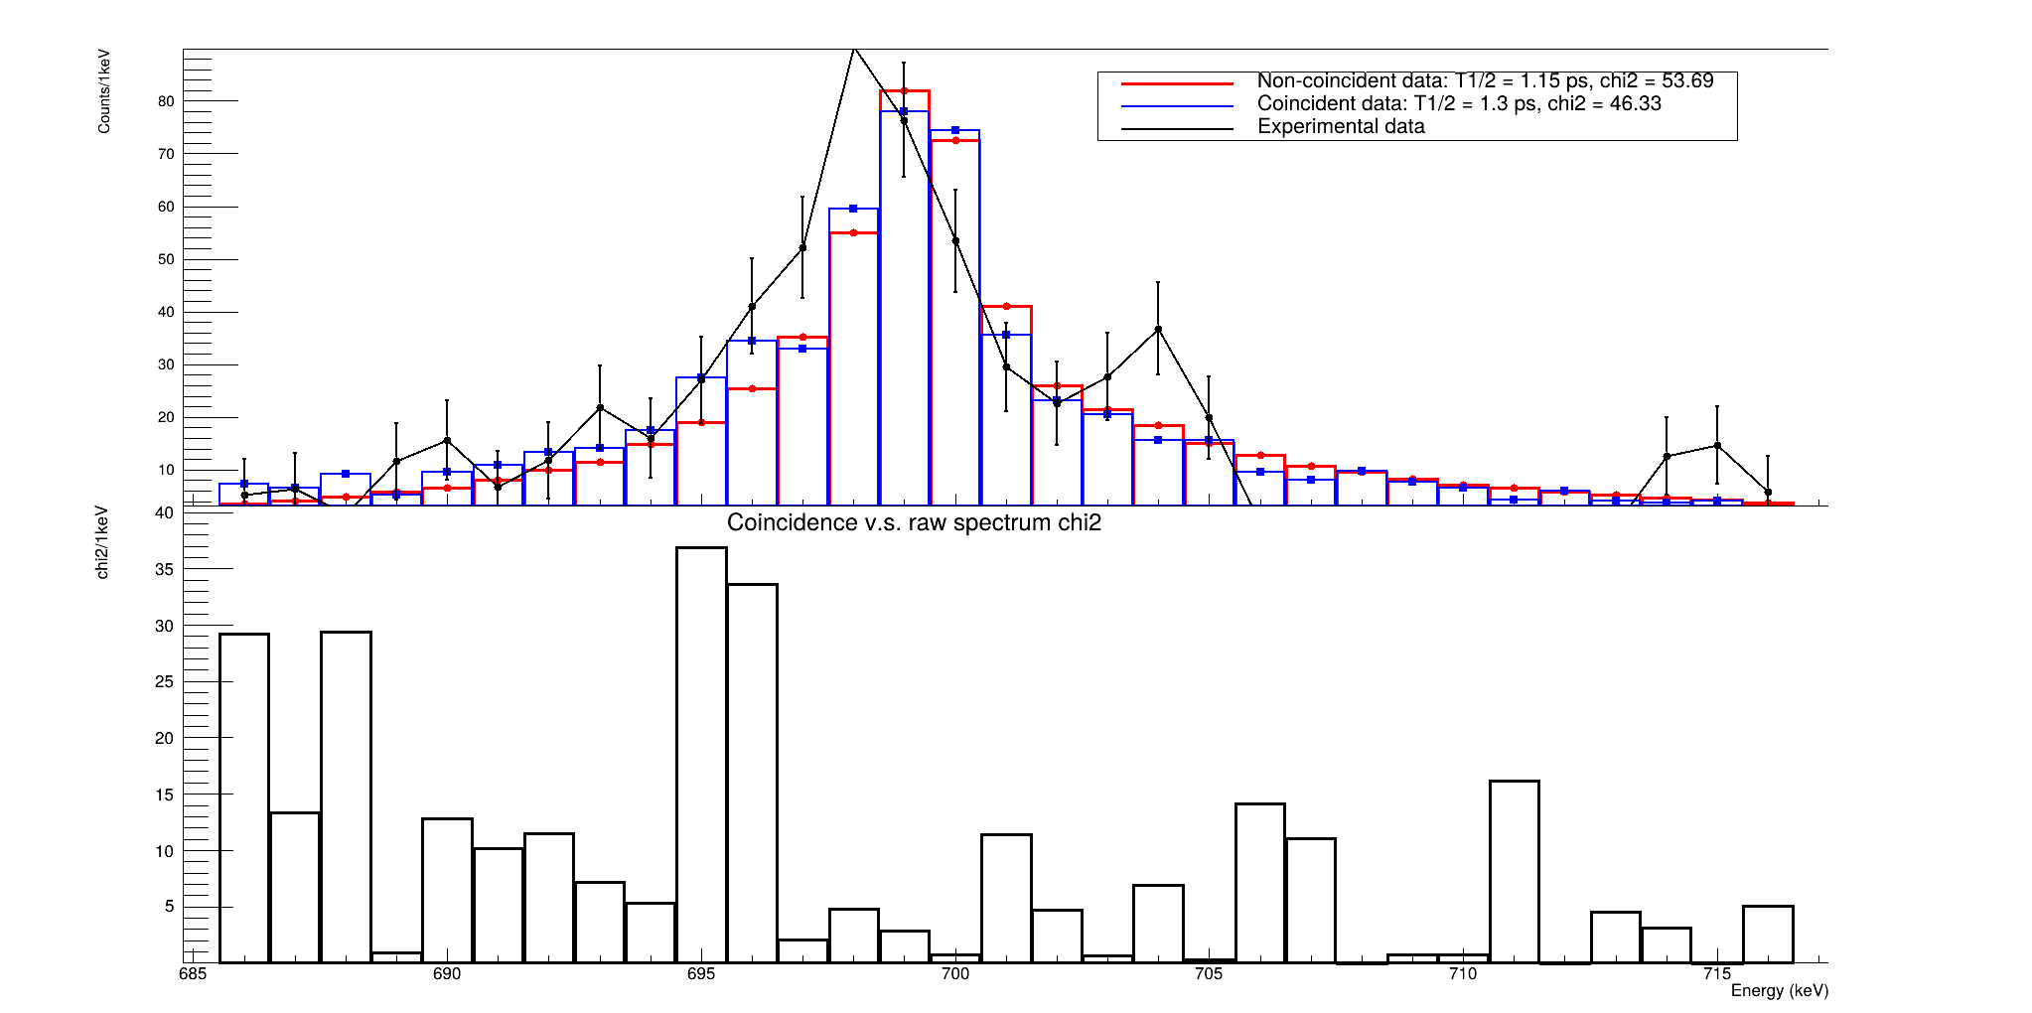
⁹⁷Zr 19/2⁻ state 699 keV lifetime comparaison
Peak energy is off center

Slide 30
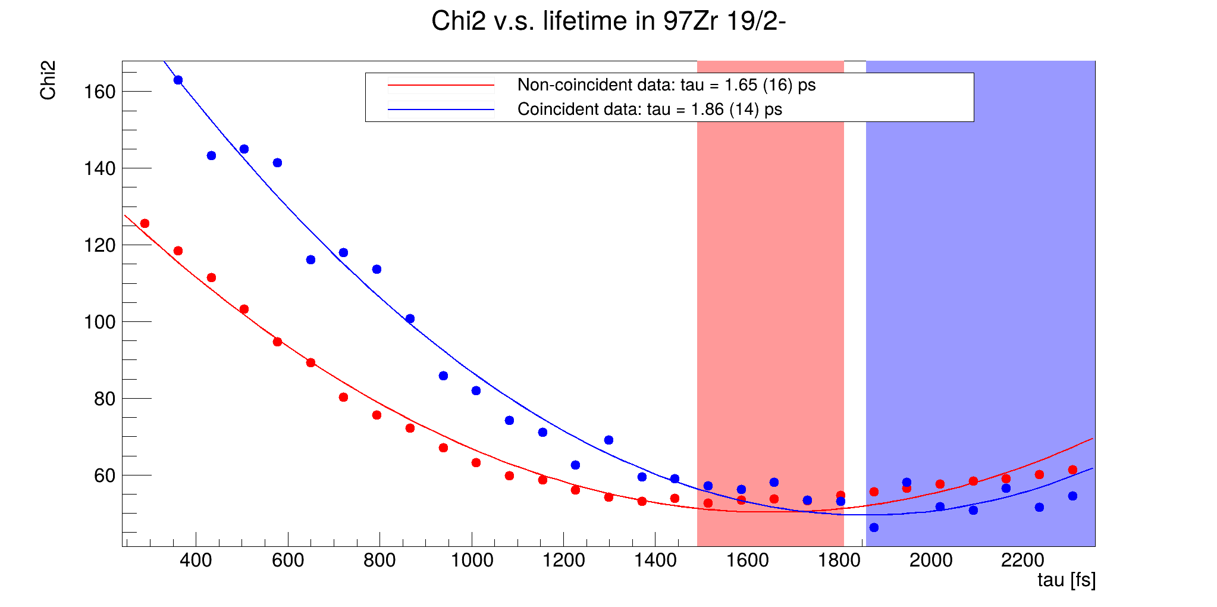
⁹⁷Zr 19/2⁻ state 699 keV chi²
We are reaching the upper limit of the DSAM method here

Slide 31
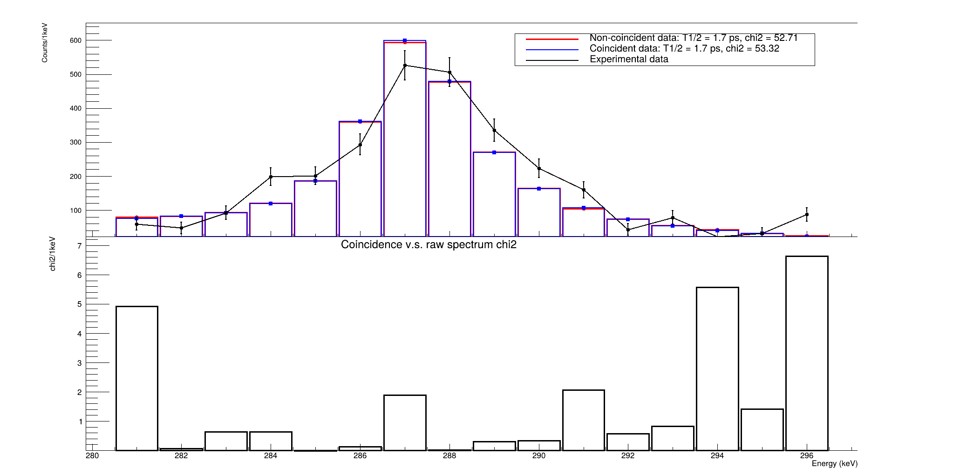
¹⁰⁰Nb 8⁺ state 287 keV lifetime

Slide 32
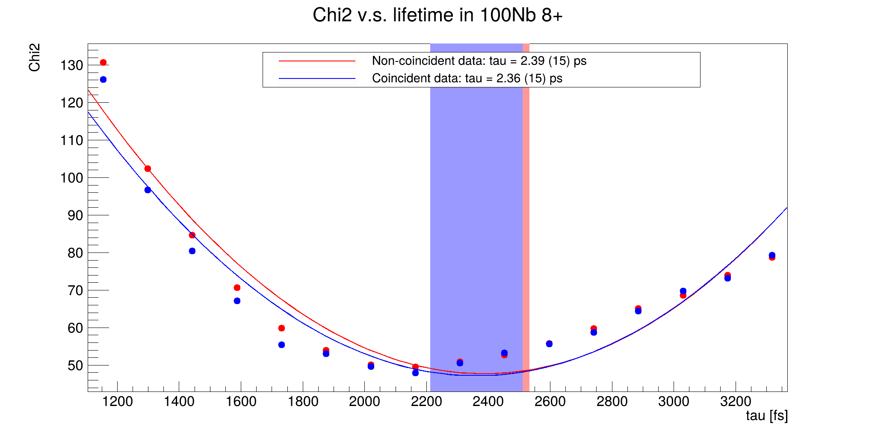
¹⁰⁰Nb 8⁺ state 287 keV chi²

