Slide 1

Fission with PARIS @ VAMOS
MichaŁ CiemaŁa
IFJ PAN, Kraków
12/03/2026, Chamrousse, France, Fission 2026

Slide 2
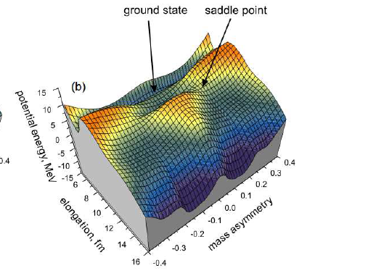



What do we talk about?
Gradual elongation of a nucleus up to scission in two fragments
Re-arrangement of a many-body quantum system of protons and neutrons
≈ (10⁻²¹ - 10⁻¹⁸ s)
≈ (10⁻¹⁹ - 10⁻¹² s)
≈ (ms - s)
Saddle point
Ground state
Primary fragments
Secondary fragments
PARIS@VAMOS
n
A₁’, Z₁’, E _{1 kin}’
A₂, Z₂ , E_{2 kin},’
A_{1,2}, Z_{1,2,}
E_{kin1,2} , E*_{1,2} , L_{1,2}
γ
Radioactive
decay (e.g. β )
>
>
A_{1,2} , Z_{1,2}
E_{kin1,2} , E*_{1,2} , L_{1,2}
n
γ
 Potential Energy
Landscape (mainly CN)
PEL (mainly fragment shell effects)
Dynamics (inertia, friction)
Generation of E* and L and sharing at scission
Nuclear Level Density
γ Strength Function

Slide 3

How to probe fission? What are “good” signatures?
Various and many observables:
- fission cross sections/probabilities
- fragment A, Z, and Total Kinetic Energy distributions
- fragment anisotropy
- fragment isomeric ratios
- multiplicity, energy and angular, inclusive and exclusive,
distributions of the promptly emitted neutrons and γ-rays
- multiplicity and energy of delayed neutrons and γ-ray
- …
T
O
D
A
Y
„Fragment A and Z yields”
Prompt γ-ray spectrum
Crucial developments in
detection and computing
“Shaking” decades
of knowledge!

Slide 4
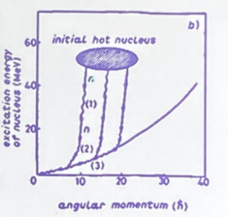
Prompt de-excitation of the fragments after scission
Generation of E* and L in fission
Sharing at scission
 Depends on the dynamics of fission:
Depends on fundamental nuclear properties:
Nuclear level density
γ strength function
De-excitation of a fission fragment after scission
Complete
Fission
ExpEriments
Measurement of the properties of
the prompt neutrons and γ rays in
coincidence with fragment (A, Z)
Reconstruct the de-excitation path
Deduce the primary fragment E* and L

Slide 5
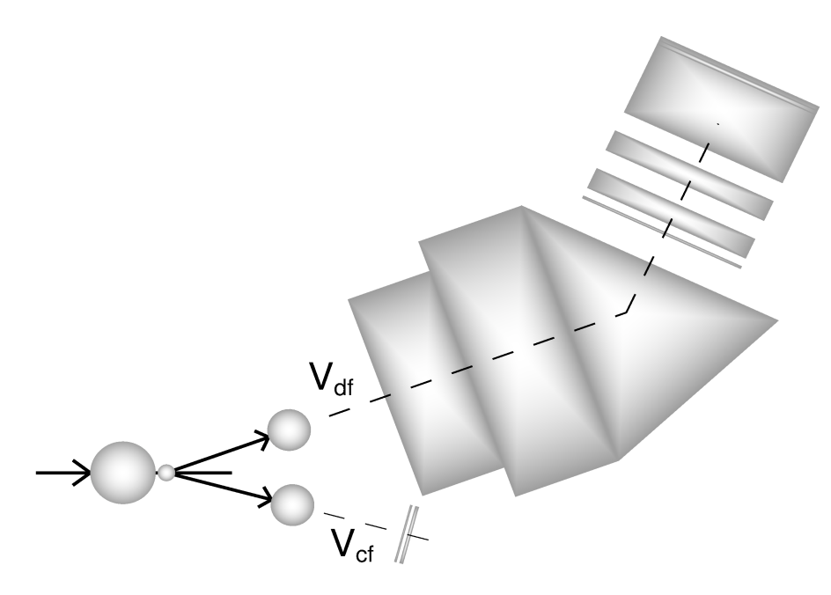

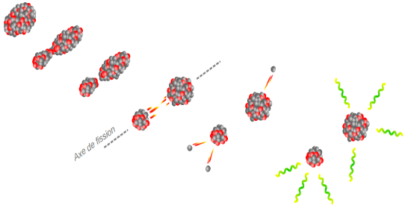
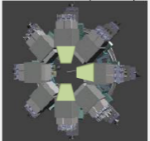
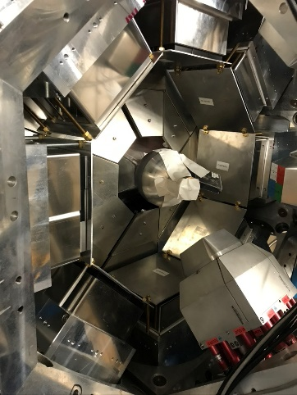

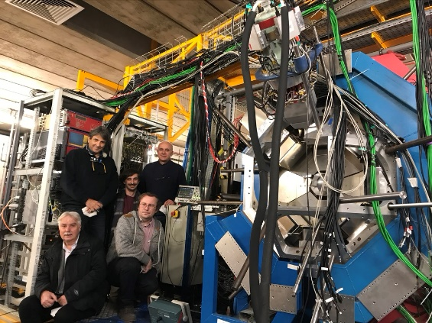
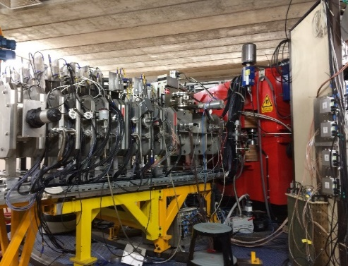
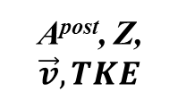
Experimental approach and Set Up at GANIL
Fusion-fission in inverse kinematics
A^{post}, Z,
$$\vec{v}, TKE$$
²³⁸U + ⁹Be →²⁴⁷Cm* (E*~ 43MeV)
^{(5.88MeV/u) (500μg/cm2)}
Ff1
Ff2
VAMOS++
γ
^{target}
Ff1
γ
Ff2
^{beam}
PFGS,
E_{γ}^{sum}, M_{γ} ,
M_{n}
PARIS
event
by
event
 Accurate Ff’s (A, Z, v, TKE)
 PFGS and properties (E_{γ}^{sum}, M_{γ} )
 Neutron multiplicity
8 clusters
Exogam

Slide 6
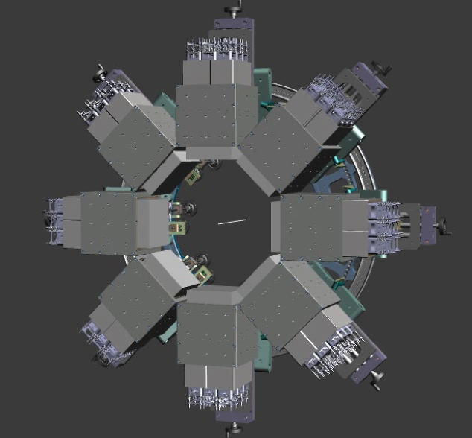
PARIS array properties
Good energy resolution for low and high energy γ-rays
35 keV @ 1.332 MeV
Excellent Time resolution (below ∼ 1 ns)
Measurement of γ multiplicity from frontal LaBr₃ or CeBr₃
Large efficiency for high energy γ-rays (∼ 5% at 10 MeV for 8 clusters)
72 phoswiches in 8 clusters
72 LaBr3:Ce or CeBre 2”x2” crystals in 8 clusters
∼ 28 liters of NaI in 8 clusters
Previous use of PARIS in PFGS/PFNS:
E. Kozulin et al., Eur. Phys. J A 56 (2020) 6
E. Vardaci et al., Phys. Rev. C 101 (2020) 064612
L. Qi et al., Eur. Phys. J A 56 (2020) 98

Slide 7
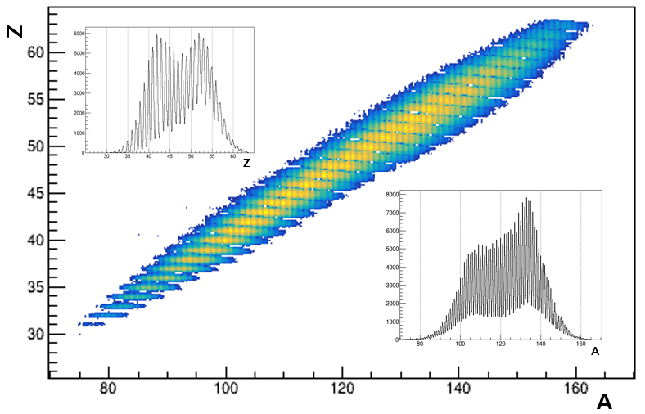
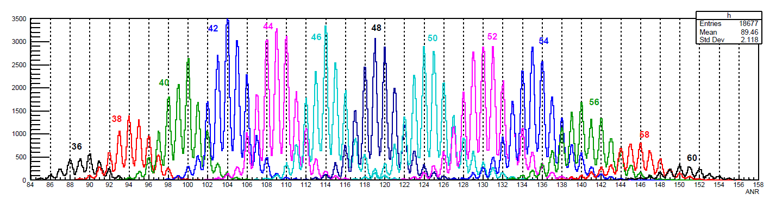
N, Z, identification VAMOS++ spectrometer
The resolution achieved in the present experiment was 1/200 in mass and 1/68 in charge.
Detected post-neutron mass spectrum

Slide 8
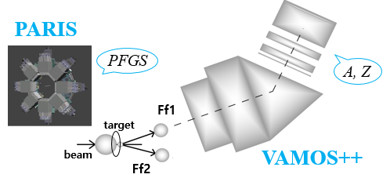
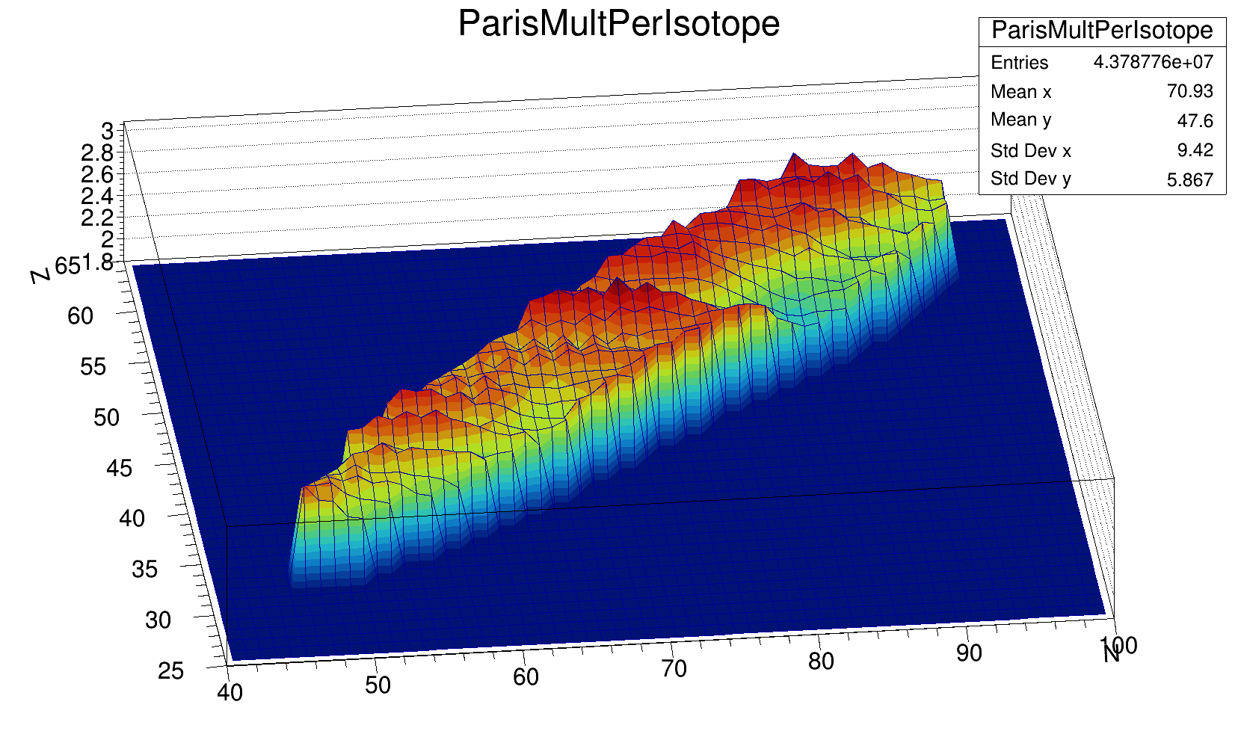
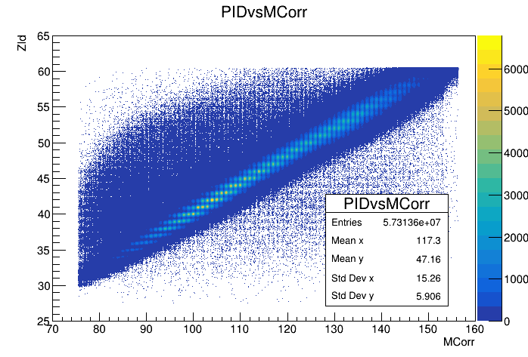
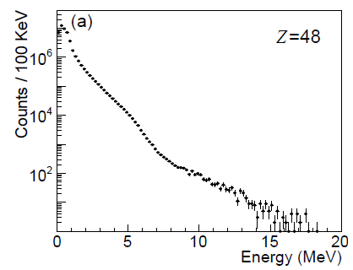
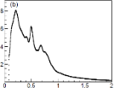
Towards a complete measurement with PARIS@VAMOS++
γ fold in PARIS vs. (Z,N) in VAMOS++
²³⁸U + ⁹Be →²⁴⁷Cm*
P R E L I M I N A R Y
Fragment (Z,N) in VAMOS++
Prompt Fission γ Spectrum in PARIS
Available data set:
 ~ 500 PFGS (Z,N) tagged in VAMOS++
 M_{γ} , <E_{γ} >, E_{γ}^{sum}
 Exponential tail = f (NLD, T)
 Neutrons

Slide 9

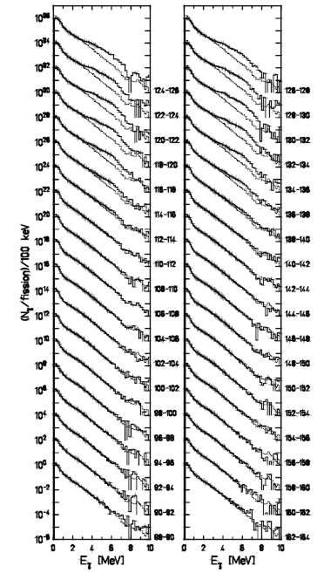
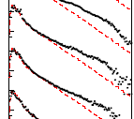


A singular phenomenon: The fission “ γ bump ”
1980’s: Evidence of an excess
of γ’s at high E_{γ} for some splits
2019 onwards: γ bump profile
²⁵²Cf (sf)
VAMOS++ + PARIS
HIGHER SENSIVITY
Francheteau et al., PRC (2025)
Early 2025: Heated debate about origin
Structural? Statistical?
Collective or Single-particle nature?
Due to n (N~68,82) and/or p (Z~40,50)?
Need of A and Z
identification of the emitter
Holtzel et al., Z Phys. (1996)

Slide 10
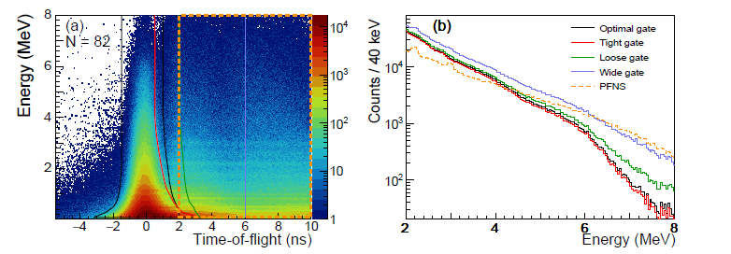
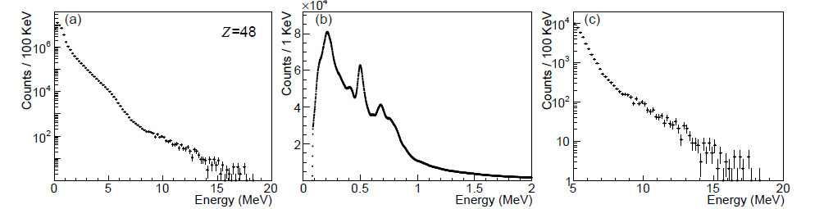
Neutron/γ discrimination
Dynamical range covered by the measured γ spectrum

Slide 11
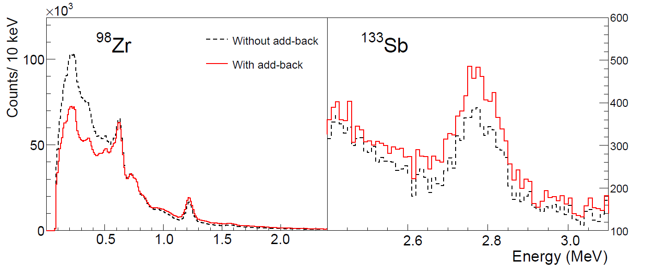
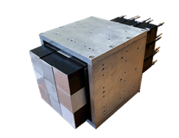
Energy resolution and Add back
Energy resolution: ~30 keV around 1.2 MeV, ~50 keV around 2.7 MeV.
Addback: Summing of Energy deposits inside PARIS cluster
Cluster of phoswiches “advantage”

Slide 12
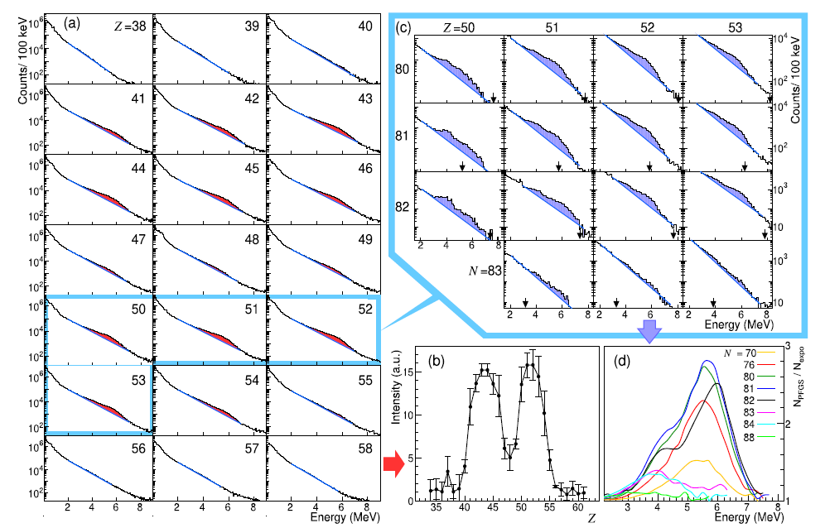

Pygmy “strength” … in fission: Isotopic mapping of the γ bump with PARIS @ VAMOS++

Slide 13
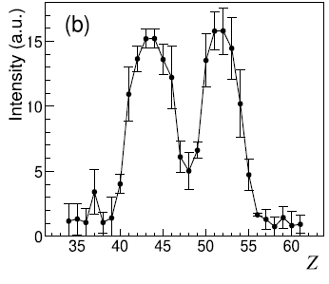
N,Z gated γ properties – PFGS, origin: distributions
Current VAMOS++ + PARIS setup cannot separate γ-rays originating from the two fission fragments.
Spectra labeled with charge Z include contributions from both the detected fragment (Z)
and its complementary partner (ZFS​−Z).
Detected Z=52 contains γ-rays from partners Z=44, 42, 40 (from Cm, Pu, and U fission).
Detected Z=42 contains γ-rays from partners Z=54, 52, 50.
The "bump" intensity peak is distributed over a wider range of Z values on the light
fragment side compared to the heavy fragment side.
The γ-bump originates from the heavy fragments.

Slide 14
N,Z gated γ properties – PFGS, origin: Doppler
a) and b): PFGS for ¹³⁴Te in VAMOS++, in the low and higher E range.
Red and black refer to the spectrum defined as forward and backward, respectively. Blue arrows show transitions from ¹³⁴Te, while green points the region characteristic of the light partners.
c) and d): Same for ¹⁰⁴Mo in VAMOS++. Green arrows show transitions from ¹⁰⁴Mo.
Conclusion: Emission from heavy partner

Slide 15
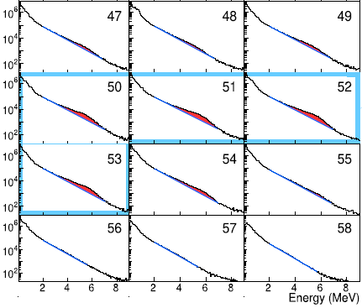
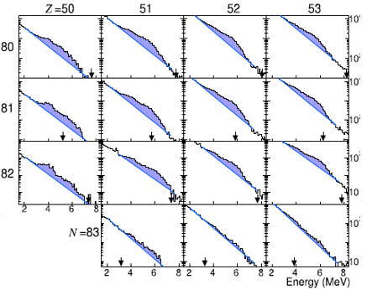
Isotopic mapping of the γ bump with PARIS @ VAMOS++
Z-gated PFGS
(Z, N)-gated PFGS
Z=
 Delimitation of the γ bump island on the fission population:
50 ≤ Z ≤ 53 and 78 ≤ N ≤ 83
 Double-humped profile for N~ 82

Slide 16
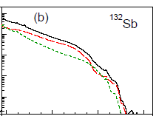
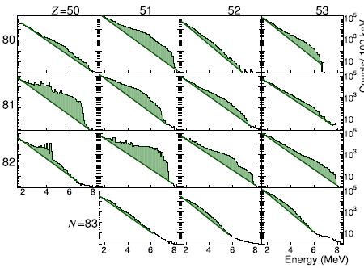

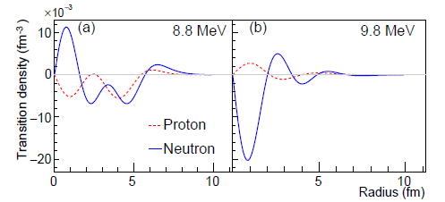



Origin of the γ bump
Dedicated (fission+fragment deexcitation) calculations with the FIFRELIN code using
microscopic nuclear level densities (D1M) and γ strength functions (D1M+QRPA)
with O. Litaize, S. Péru
Calculated PFGS
Fission populates states in the low-energy tail of the Giant Dipole Resonance between ~ 5 and 10 MeV
! PYGMY RESONANCE !
Total E1
M1
Fission and Soft/Giant Resonances
physics
Two-fold impact:
 Insight into the post-scission dynamics of the fragments
 Insight into the nature of « Pygmy states »
R
R
Calculations by S. Péru (2025)
 Main contribution due to the decay from E1 states
 Both IsoScalar (IS) and Isovector (IV) nature
 IS component enhanced at N~82 due to vibration
of the « stiff » neutron skin about the core
Neeraj Kumar, C.Schmitt, M. C., A. Maj, et al., submitted (2026)

Slide 17
Summary
Unique dataset for the PFGS together with isotopically identified fission fragments was collected during experiment at GANIL with use of coupled VAMOS++ and PARIS.
Scanning of the " γ-bump" for entire fission fragment production and identification of its emitters in Z and N in the model-independent way was achieved for the first time.
Its existence was predominantly attributed to the proton composition of the fragment near the Z = 50 shell closure, whereas its characteristics were influenced by the proximity to the N = 82 neutron shell.
For entry point for the nuclei is at lower L around Z = 50 and N = 82, we see high energy structures in the γ-ray spectrum which may be interpret as PDR γ-ray decay E1 type.
Fission process can be another probe to investigate hard to reach neutron rich nuclides (otherwise accessible with huge difficulties with radioactive beams).

Slide 18
Acknowledgements
Christelle Schmitt, M.C., Neeraj Kumar,
Piotr Bednarczyk, Sergio Brambilla, Manuel Caamano, Stefana Calinescu, Abdelhazize Chebboubi, Emmanuel Clement, Dominique Curien, Olivier Dorvaux, Gilles De France, François Didierjean, Gilbert Duchêne, Alain Goasduff, Iulia Harca, Yung Hee Kim, Grégoire Kessedjian, Maria Kmiecik, Antoine Lemasson, Silvia Leoni, Marek Lewitowicz, Olivier Litaize, Adam Maj, Iolanda Matea, Katarzyna Mazurek, Alahari Navin, Andreas Oberstedt, Stephan Oberstedt, Piot Julien, Diego Ramos, Maurycy Rejmund, Mihail Stanoiu, Louise Stuttge
and VAMOS, PARIS, EXOGAM collaborations

Slide 19
Backup

Slide 20
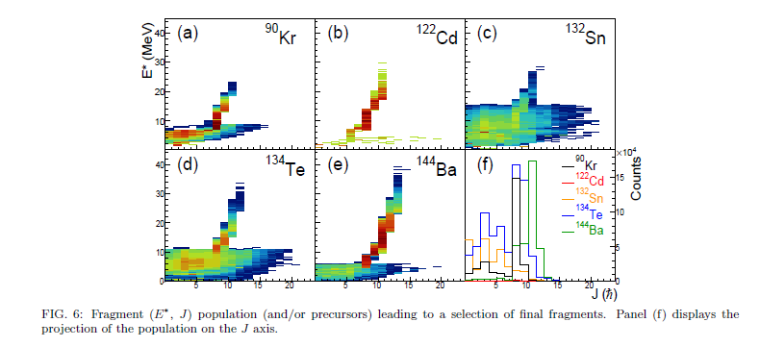
Pygmy “selective” population in fission

Slide 21
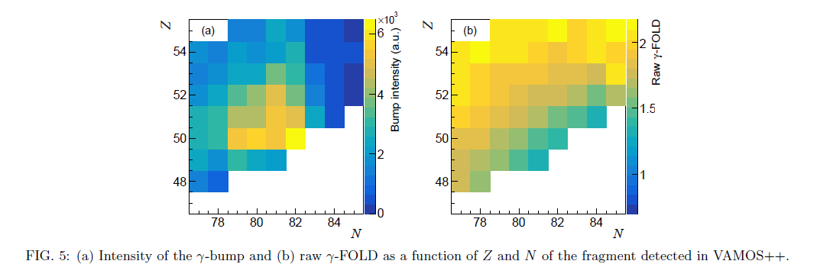
Consistency with other observables

Slide 22
¹²⁰Cd example FF discrete gamma and FOLD equivalance
FF120Cd gated <FOLD_{PARIS}> = 2.66(1)
DC, ¹²⁰Cd gated
2⁺ →g.s.
4⁺ →2⁺
FF120Cd &&FF₁ L≥2 < FOLD_{PARIS} > = 2.94(1)
6⁺ →4⁺
FF120Cd &&FF₁ L≥4 < FOLD_{PARIS} > = 3.07(1)
FF120Cd &&FF₁ L≥6 < FOLD_{PARIS} > = 3.31(1)
E in EXOGAM [keV]

Slide 23
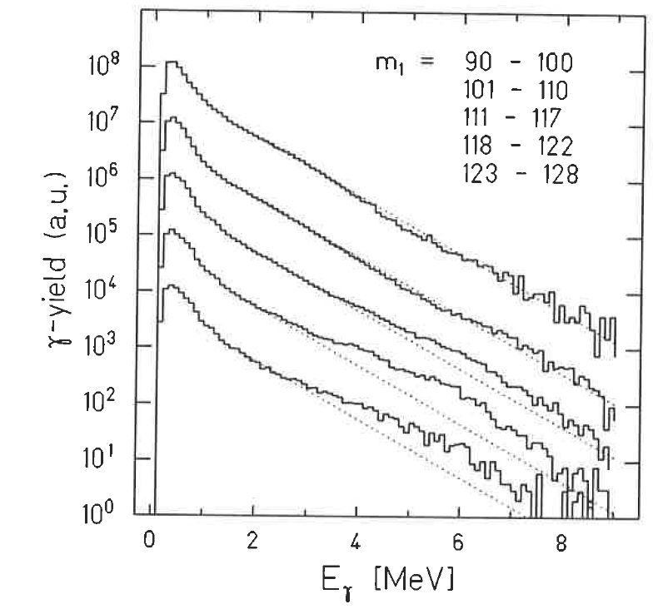
Prompt fission gamma-rays (PFGS)
Non-statistical high energy gamma's
"These high-energy tails exhibit a marked dependence on fragment mass."
²⁵²Cf fission revisited - new insights into the fission process
Detectors: NaI, Crystall Ball
P. Glässel, et al., Nuclear Physics A, 502, 1989, 315.

Slide 24
Prompt fission gamma-rays (PFGS)
Makii et al., conclude that the bump at around 4MeV is created by the transitions between the discrete levels in the fragments around ¹³²Sn, and the bump at around 6MeV mostly comes from the complementary light fragments.
Effects of the nuclear structure of fission fragments on the high-energy prompt fission 𝛾-ray spectrum in ²³⁵U(n,f)
H. Makii, et al., Phys. Rev. C 100 (2019) 044610.
Detectors: LaBr₃

Slide 25
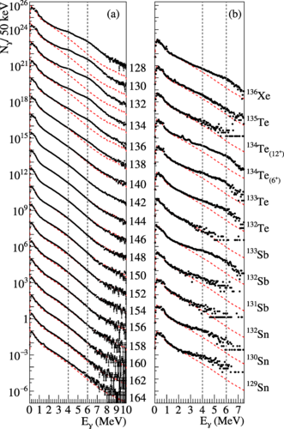
Prompt fission gamma-rays (PFGS)
"Enhanced production of prompt 𝛾 rays peaked at 4 and 6 MeV in the mass region of fission fragments around 132Sn is a known phenomenon for 30 years. Various contradictory interpretations of their origin can be found in the literature: either discrete or statistical 𝛾 rays originating from the light or heavy fragment."
Conclusion:
"From the study of the photon emission probability we interpret these structures as arising from the competition between the “strength-driven” decay of the heavy fragments and the “density-driven” decay of the light fragments."
Origin of the high-energy structures in the prompt-fission 𝛾-ray spectrum of 252Cf
Detectors: NaI
A. Francheteau, et al., Phys. Rev. C 111, 034608, march 2025

Slide 26
PARIS add-back
132Sn
Summing of Energy deposits inside PARIS cluster
2⁺ -> g.s.
3⁽⁻⁾ -> g.s.

Slide 27
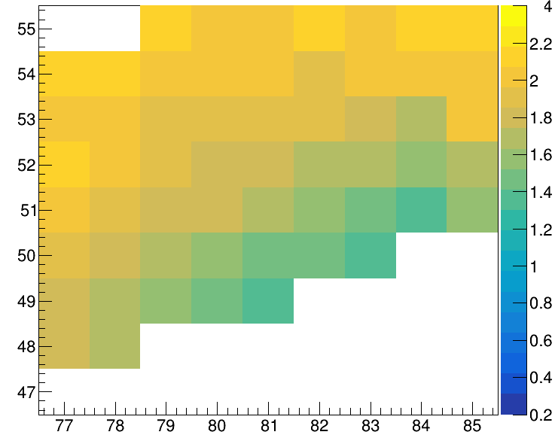
FIFRELIN code calculations, entry point
CALC
Mean FOLD, EXP

Slide 28
¹²⁰Cd example FF discrete gamma and FOLD equivalance
FF120Cd gated <FOLD_{PARIS}> = 2.66(1)
DC, ¹²⁰Cd gated
2⁺ →g.s.
4⁺ →2⁺
FF120Cd &&FF₁ L≥2 < FOLD_{PARIS} > = 2.94(1)
6⁺ →4⁺
FF120Cd &&FF₁ L≥4 < FOLD_{PARIS} > = 3.07(1)
FF120Cd &&FF₁ L≥6 < FOLD_{PARIS} > = 3.31(1)
E in EXOGAM [keV]

Slide 29
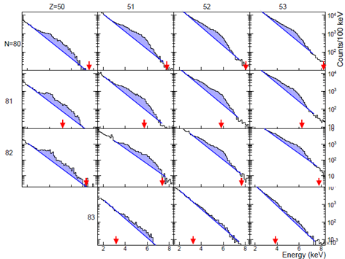
FIFRELIN code calculations, PFGS
EXP
CALC

Slide 30
Z and A gated γ properties – FOLD of PFGS, ²⁴⁷Cm*
FOLD → gamma multiplicity → summ of fission fragment L₁ and L₂
Z gated
A gated
FOLD
FOLD

Slide 31
Z gated neutron properties – FOLD of PFNS, ²⁴⁷Cm*
FOLD

Slide 32
A gated γ properties – FOLD of PFGS, ²⁴⁷Cm*
FOLD

Slide 33
A gated neutron properties – FOLD of PFNS, ²⁴⁷Cm*
FOLD

Slide 34
Isotopic identification in VAMOS++
⁹⁸Zr
⁹⁸Zr
1223 keV
before stability tune
after stability tune
Prompt γ spectrum in PARIS
¹⁰⁴Mo
¹⁰⁴Mo
after tuned callibration after stability tune based on 511 keV line

Slide 35
Gamma GDR Decay prompt gated
Use of the statistical model codes like
CASCADE, GEMINI++ make possibility to
extract fission time scale.
Methods described by example in:
R. Butsch, et al., Phys. Rev. C 44 (1991), 1515-1527.
G. van't Hof, et al. Nucl. Phys. A 638 (1998) 613-661.
gamma GDR decay
Statistical gamma
background

