Slide 1











Improvements of the knowledge of actinides on the HPRL for nuclear energy
Carole Chatel^{1, 2, 3, 4, 5, 6}
Jonathan Wilson⁷, Philippe Dessagne¹, Greg Henning¹, Maëlle Kerveno¹, Olivier Bouland†⁵, Gilles Noguère⁵ and Maria Diakaki⁵, Ludovic Mathieu⁶, Mourad Aïche⁶, Peter Möller⁸
¹Université de Strasbourg, CNRS, IPHC/DRS UMR 7178, 23 Rue du Loess, F-67037 Strasbourg, France
²Technische Universität Darmstadt, Fachbereich Physik, Institut für Kernphysik, Schlossgartenstrasse 9, 64289, Darmstadt, Germany
³GSI Helmholtzzentrum für Schwerionenforschung, 64291, Darmstadt, Germany
⁴Helmholtz Forschungsakademie Hessen für FAIR (HFHF)
⁵CEA, CAD, DES, IRESNE, DER, SPRC, Physics Studies Laboratory, F-13108 Saint-Paul-lez-Durance, France
⁶Univ. Bordeaux, CNRS, CENBG, UMR 5797, F-33170 Gradignan, France
⁷CNRS, IJClab Orsay, bât 100, 15 rue G. Clemenceau, 91406 Orsay Cedex, France
⁸P. Moller Scientific Computing and Graphics, 1888 Kalakaua Ave, Suite 3104, Honolulu, HI 96815

Slide 2
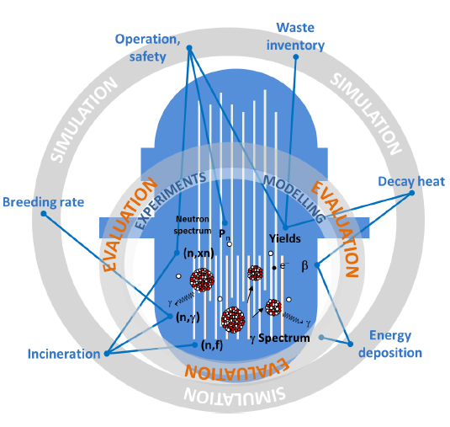
Nuclear reactions on the HPRL
Neutronics codes for fast neutron reactors or large core reactors:
Use evaluated nuclear data files as input based on:
experimental data
state of the art of theoretical modeling
Two examples:
²³⁸U(n,n’):
Codes have uncertainties mainly due to ²³⁸U(n, n’)
XS uncertainties target: 2-3% (HPRL); currently overestimated ~10% in the 2–5 MeV energy region (source: A. Santamarina, et al., Nucl. Data Sheet 118, (2014))
²⁴²Pu(n,f)
Candidate for the fission chamber to monitor the RJH reactor (CEA Cadarache)
Disregarded in previous evaluation because of the fertile character
Source : M. Kerveno et al. ND2022 - presentation
2

Slide 3
²³⁸U(n,n’)

Slide 4
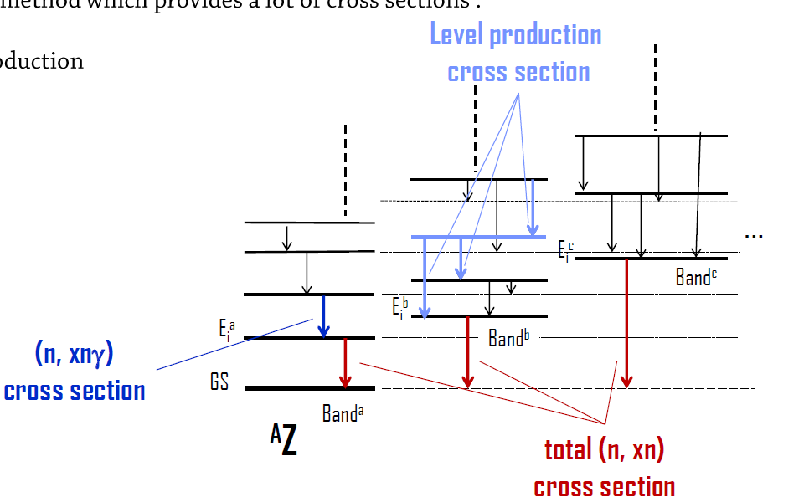
Why studying the ²³⁸U level scheme
Prompt γ-ray spectroscopy is a powerful method which provides a lot of cross sections:
(n, xnγ)
Level production
Total (n, xn)
Source : M. Kerveno et al. ND2022 - presentation
Large uncertainties in the current modeling are related to the knowledge of the decay scheme: poorly known BR and an incomplete information of the discrete states above 1.3 MeV
Uncertainties in level schemes induce uncertainties in inelastic cross sections (e.g. 10% on BR can have an impact of around 4% on (n, n’γ) XS. Sensitivity analysis made by Greg Henning with the TALYS code, M. Kerveno et al. PRC 104, 044605, 2021))
→ Need to improve the level scheme knowledge to infer the total (n, n’) XS
4
Notes:
IN ENSDF : average uncertainties on BR : 8%

Slide 5
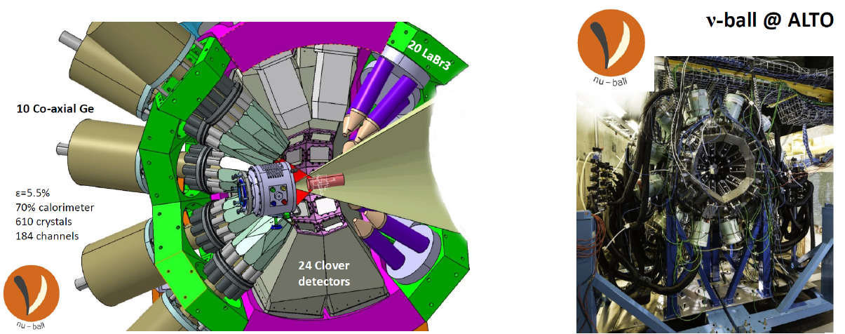

ν-Ball experiments
Realized in 2018 and 2022
ALTO accelerator
Neutrons beam LICORNE (Lithium Inverse Cinematiques ORsay NEutron source) mono-energetic and pulsed (400 ns) focused forward
Comprised 2 rings of 12 Clover HPGe
5

Slide 6
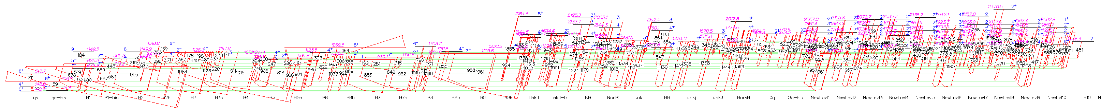
²³⁸U level scheme - obtained results
118 levels identified
Including 60 already listed in ENSDF
Including 92 found with both ν-Ball data
268 γ transitions identified
Including 110 already listed in ENSDF
Including 187 found with both ν-Ball data
43 new γ transitions depopulating levels already known in ENSDF
58 new levels (not known in ENSDF)
115 new γ transitions (de)populating these new levels
6

Slide 7
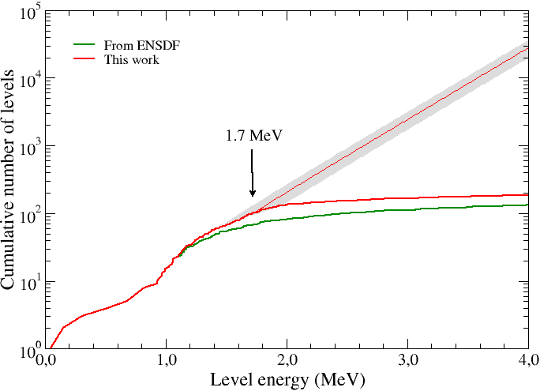
²³⁸U level scheme - obtained results
Branching ratios calculated
J^{π} deduced by
completing bands
Selection rules allowing maximum E2 transitions
Completness verified
7

Slide 8
²⁴²Pu(n,f)

Slide 9
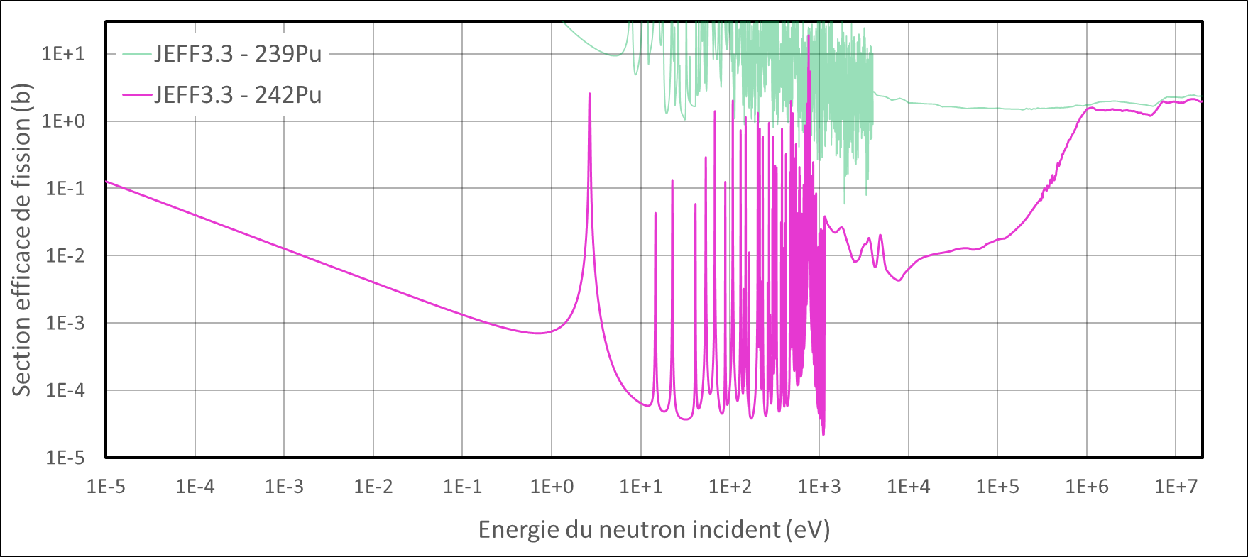

²⁴²Pu(n,f) - Nuclear structure background
Fission cross section (b)
$\frac{1}{v}$ thermal slope
Unresolved Resonance Range (URR)
Neutron continuum
Resolved Resonance Range (RRR)
1 eV
1 keV
10 keV
Neutron Energy (eV)
9
Notes:
Donner les énergies des régions

Slide 10
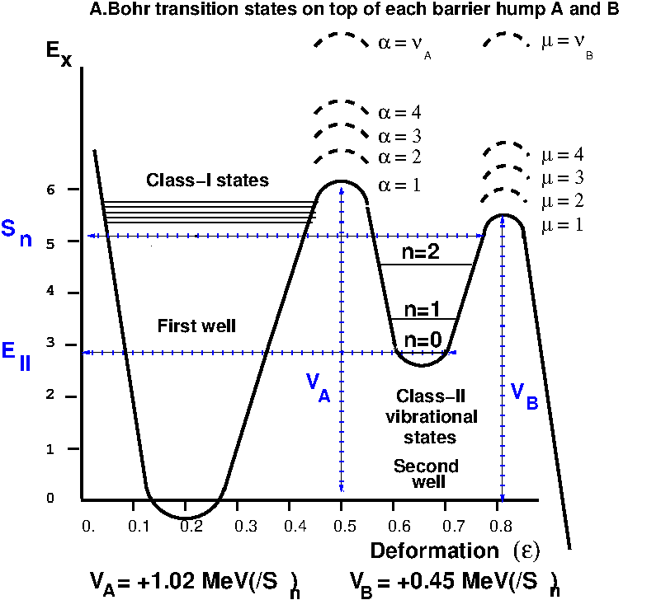
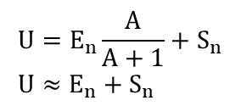
Nuclear structure background
Sn(²⁴²Pu) = 6,309 MeV
Sn(²⁴²Pu) = 6,309 MeV
²⁴¹Pu well
Neutrons
(n,n’f) : second chance fission
n + ²⁴²Pu
Low lying levels
Sn(²⁴³Pu) = 5,031 MeV
²⁴²Pu well
(n,f) : first chance fission
fission
²⁴²Pu well
Low lying levels
$${U=E}_{n}\frac{A}{A+1}+S_{n} \\ {U≈E}_{n}+S_{n}$$
²⁴³Pu well
10

Slide 11
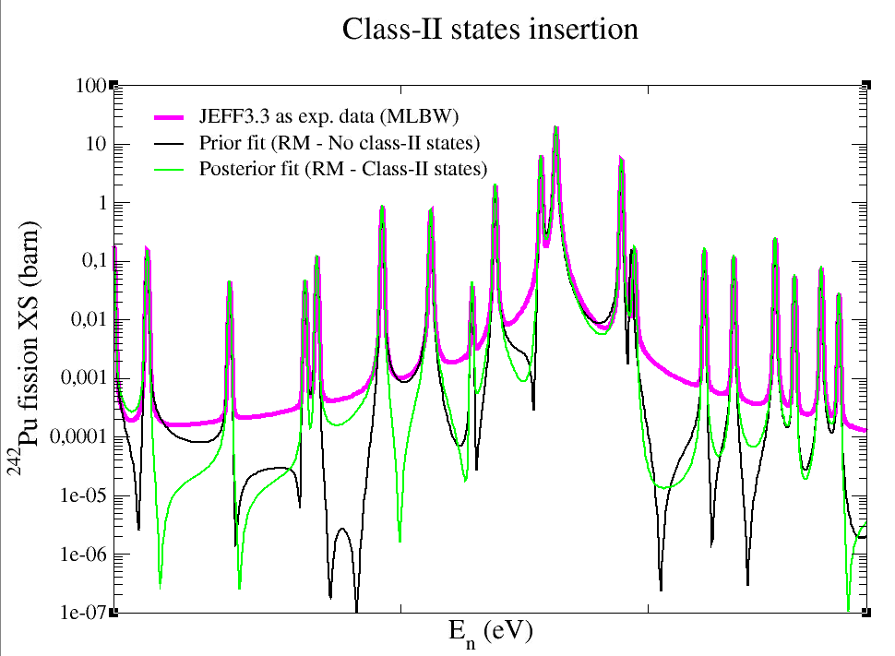
RRR: Work with CONRAD (CEA tool)
Prior state of the art:
Multi level Breit-Wigner (MLBW) approximation : no more mandatory those days
Switch to the RM approximation
Cumulative of fission widths
Working with a Lorentzian in cumulative
700
800
2 Class-II states identified
11

Slide 12
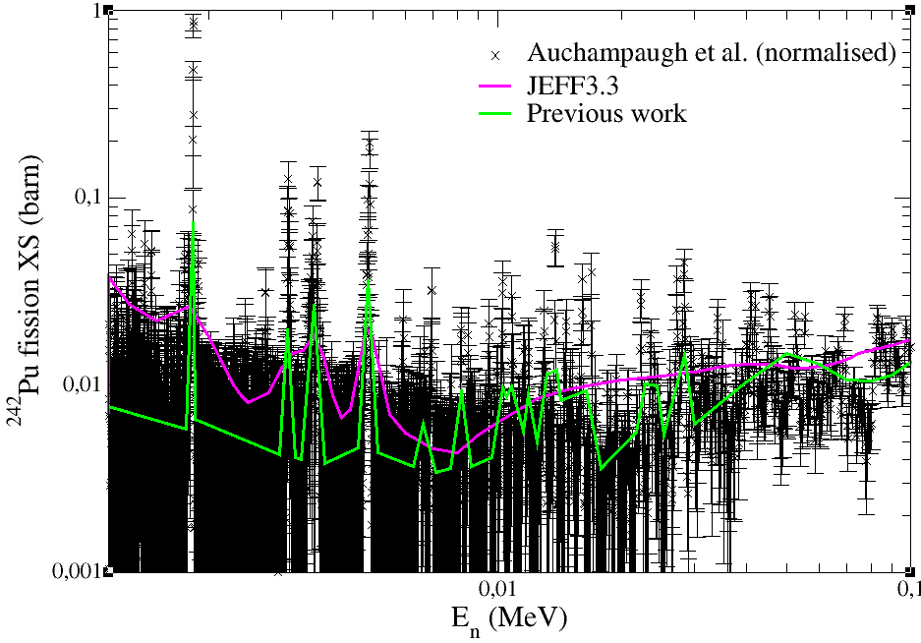
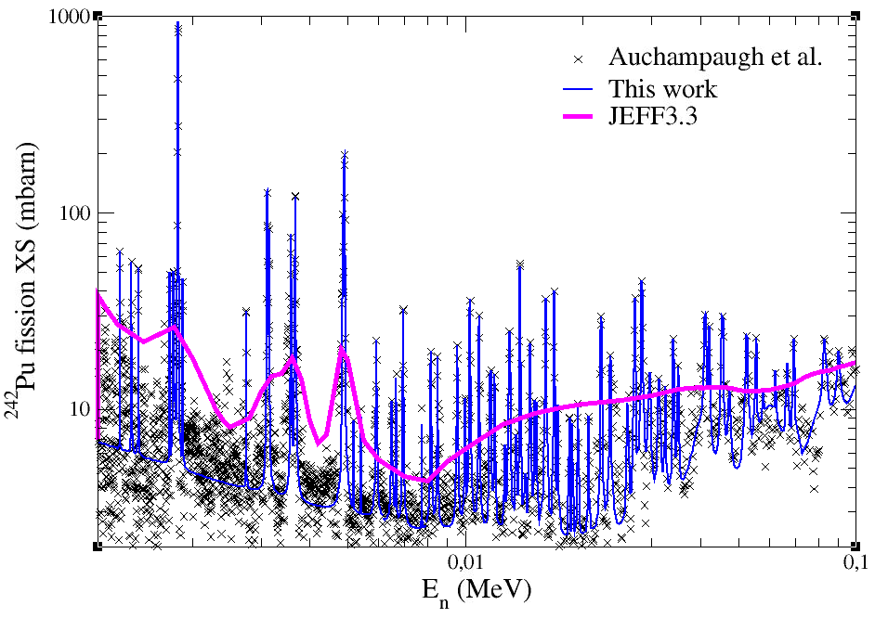
URR: Work with TALYS
→ Reference data: fission cross section measured by Auchampaugh et al. → Hauser-Feshbach (HF) description of fission (TALYS code) combined with Lorentzian penetrability
Still working with a Lorentzian in cumulative Extension of URR from 40 keV to 100 keV
68 Class-II states identified
12

Slide 13
Deduction of the E_{II} value
Class-II states sequences generated by the ”Quasi Particle Vibrational Rotational Level Density” (QPVRLD) of the AVXSF-LNG code
Comparison of truncated sequences with the cumulative curve and average spacing of the identified Class-II states
Comparison of the sequences with CTM curves
Deduction
13

Slide 14
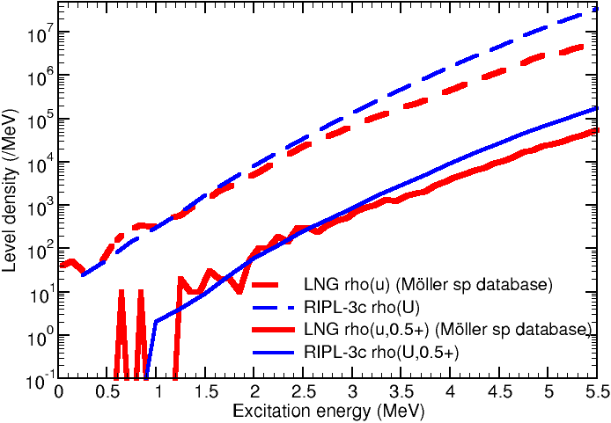
AVXSF-LNG: Generation of sequences
S_{n} = 5.034 MeV [RIPL-3]
E_{II} = 1.53 MeV [RIPL-3]
E_{II} = 1.7 ± 0.3 MeV [S. Bjornholm and J.E. Lynn]
Excitation energy:
S_{n} – E_{II} = 3.334 MeV
Considering uncertainties + study over 100 keV, Class-II states sequence generated between 3.034 Mev and 3.734 MeV
Creation of 13 partial sequences considering E_{II} between 1.4 and 2.0 MeV by steps of 0.05 MeV
14
Notes:
uses a macro-microscopic combinatory method

Slide 15
Use of the truncated sequences Comparison with the identified class-II states
Average spacing:
Low energies: gathering of Class-I states identified as Class-II states
Higher energies: missing Class-II states (most of them above 40 keV)
Between 0 and 10 keV: 28 states → D_{II} = 0.37 keV
Comparing with partial sequences:
possible values of E_{II}: 2.00, 1.90, 1.85, 1.75, 1.70, 1.65 and 1.55 MeV
Between 0 and 20 keV: 28 + 19 = 47 states → D_{II} = 0.43 keV
Comparing with partial sequences:
possible values of E_{II}: 1.95, 1.90, 1.85, 1.80, 1.75, 1.70 and 1.65 MeV
2 studies:
between 0 and 10 keV
between 0 and 20 keV
→ E_{II} values below 1.55 MeV; 1.60 MeV and 2.00 MeV can be excluded
15
Notes:
Comparison with Weigmann: 0.77 keV and 0.67 keV

Slide 16
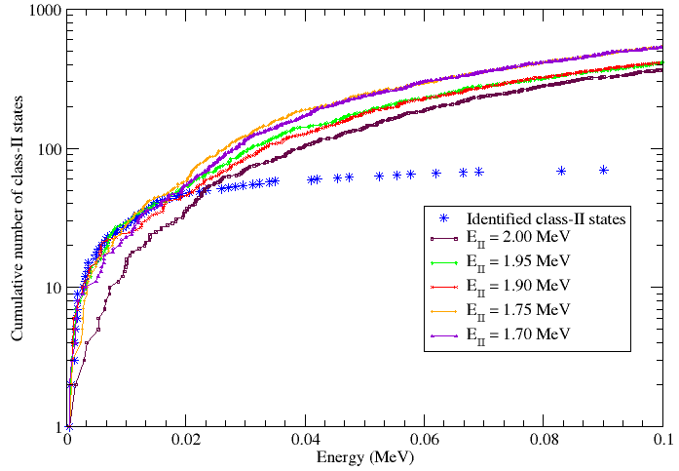
Use of the truncated sequences Comparison with the identified Class-II states
Cumulative number of Class-II states:
RMSD calculated for each sequence & shape of the curve compared
Between 0 and 10 keV:
Comparing with partial sequences:
Best values of E_{II}: 1.90, 1.95 MeV
Possible other values: 1.50, 1.55, 1.60, 1.70 and 1.75 MeV
Between 0 and 20 keV:
Comparing with partial sequences:
Best value of E_{II}: 1.95 MeV
Possible other values: 1.70, 1.75, 1.80, 1.85, 1.90 MeV
→ E_{II} values of 1.45 MeV and 2.00 MeV can be excluded
→ E_{II} values of 1.40 MeV; 1.50; 1.60; 1.65 and 1.85 MeV seems also far away
16
Notes:
Distribution

Slide 17
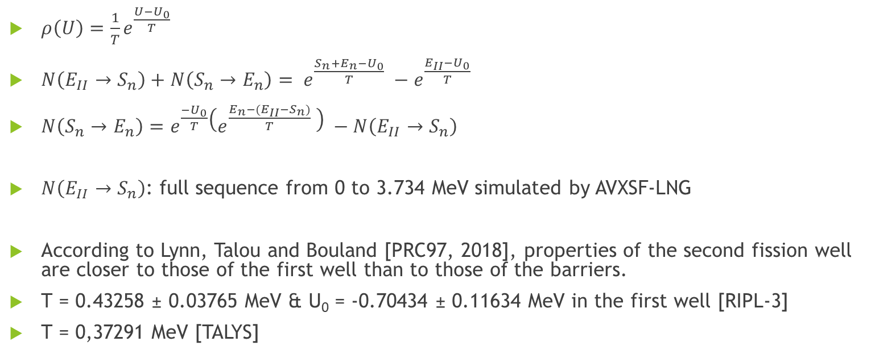
Use of the full sequences Comparision with a CTM
$ρ\left(U\right)=\frac{1}{T}e^{\frac{U−U_{0}}{T}}$
$N\left(E_{II}→S_{n}\right)+N\left(S_{n}→E_{n}\right)= e^{\frac{S_{n}+E_{n}−U_{0}}{T}} −e^{\frac{E_{II}−U_{0}}{T}}$
$N\left(S_{n}→E_{n}\right)=e^{\frac{−U_{0}}{T}}\left(e^{\frac{E_{n}−({E_{II}−S}_{n})}{T}} \right) −N\left(E_{II}→S_{n}\right)$
$N\left(E_{II}→S_{n}\right)$: full sequence from 0 to 3.734 MeV simulated by AVXSF-LNG
According to Lynn, Talou and Bouland [PRC97, 2018], properties of the second fission well are closer to those of the first well than to those of the barriers.
T = 0.43258 ± 0.03765 MeV & U₀ = -0.70434 ± 0.11634 MeV in the first well [RIPL-3]
T = 0,37291 MeV [TALYS]
17
Notes:
Considering En, the energy of the incident neutron and by decoupling N (U ) = N (EII → Sn) + N (Sn → En) and integrating between EII and Sn + En,

Slide 18
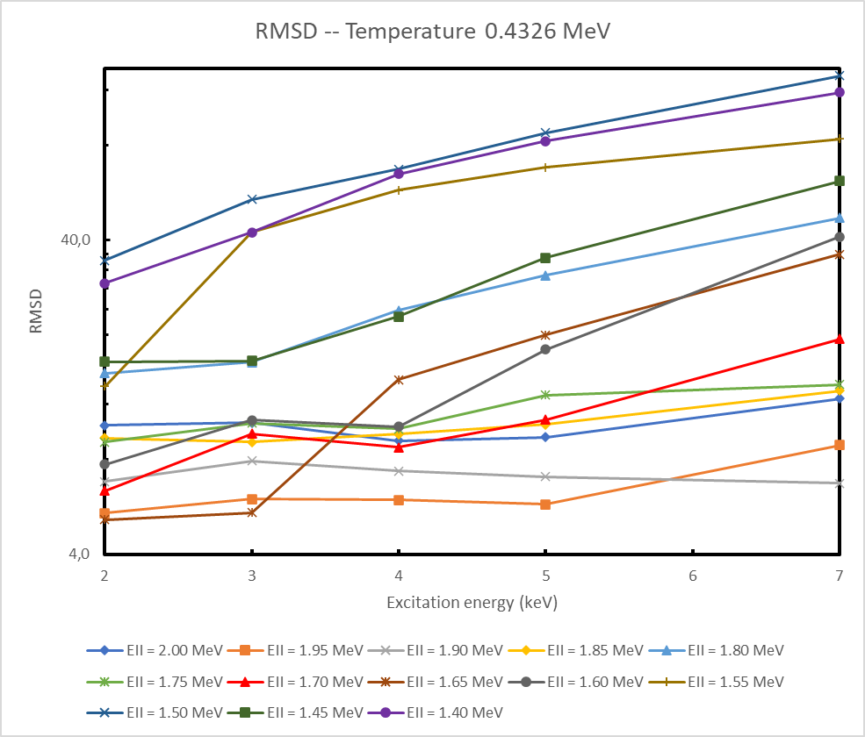
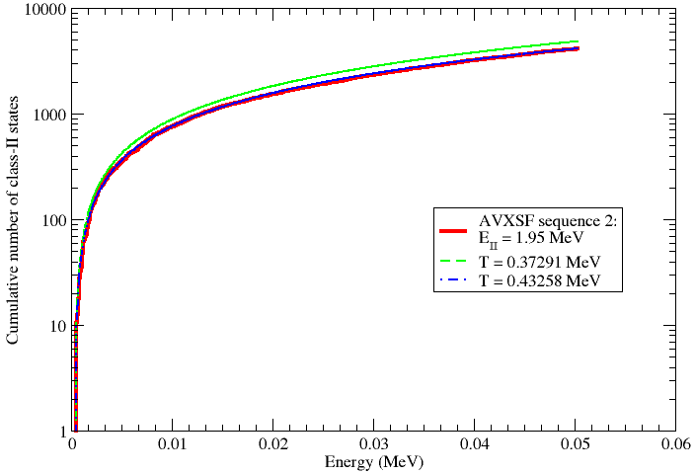
Use of the full sequences Comparision with a CTM
1.90 MeV ≤ E_{II} ≤ 1.95 MeV
18

Slide 19
Conclusion
²³⁸U:
ν-Ball & ν-Ball2 data have been analysed by γ-γ coincidence
118 levels identified
Including 58 not listed in ENSDF
268 γ transitions identified
Including 158 not listed in ENSDF
²⁴²Pu:
70 Class-II states have been identified
E_{II} value deduced from identified Class-II states, AVXSF-LNG sequences & CTM
1.90 MeV ≤ E_{II} ≤ 1.95 MeV
19

Slide 20
Thank you ☺

Slide 21
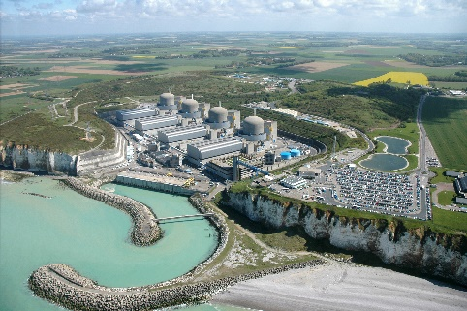
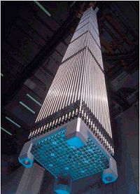
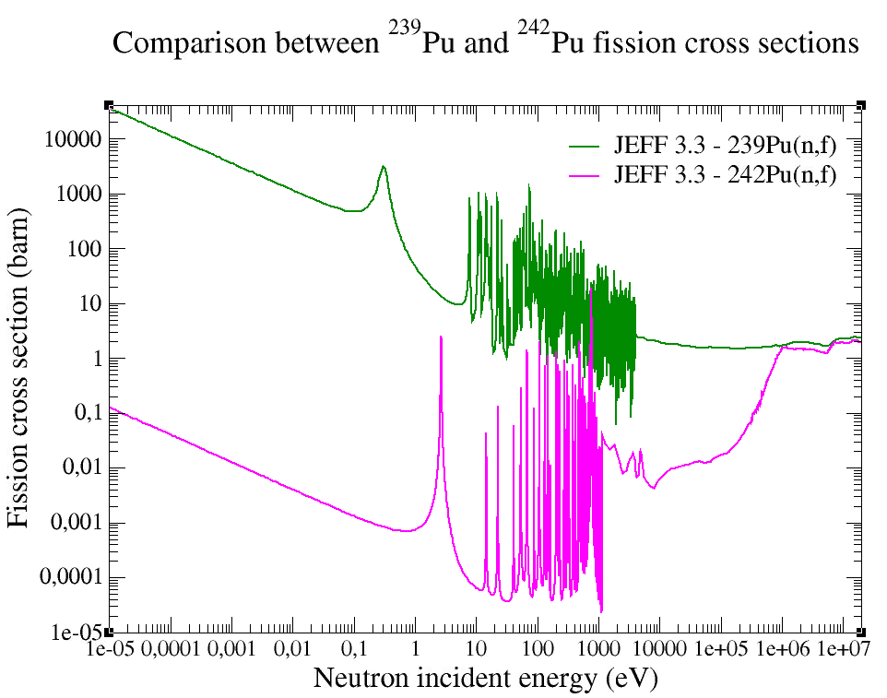
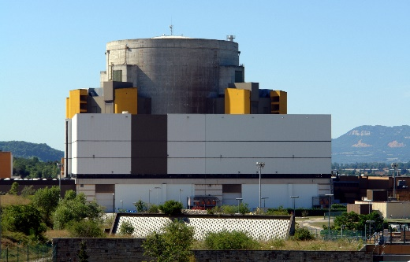
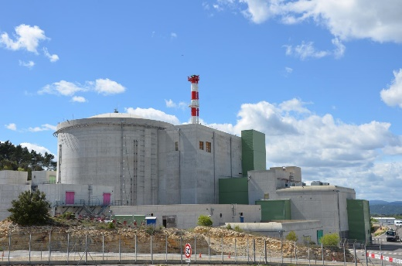
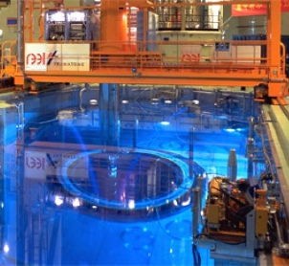
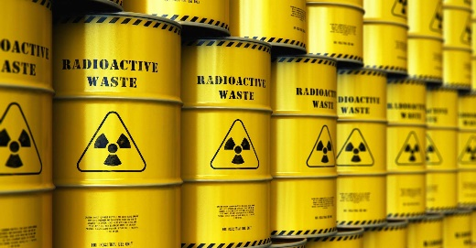
CONTEXT
PWR reactors core : neutron radiation absorptions = Buildup of higher mass actinides
PWR - UOx
MOx
Fast Reactor
RJH : Occitane
Study of ²⁴²Pu fission becomes important
Sub-threshold E_{neutron}: σ_{f}(fissile)>> σ_{f}(fertile)
Above the threshold: σ_{f}(fissile) ≈ σ_{f}(fertile)
Monitoring of:
Disregarded in previous evaluation because of the fertile character
21

Slide 22
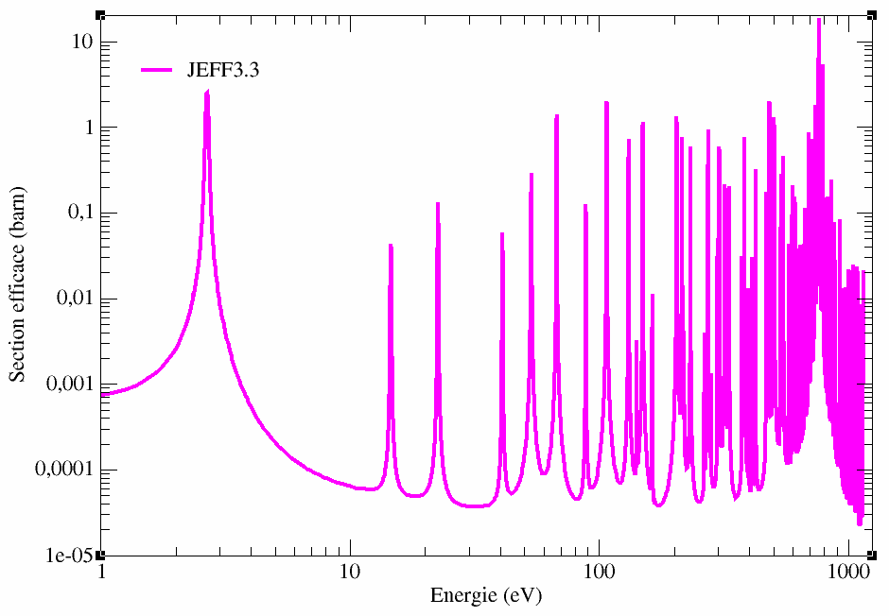
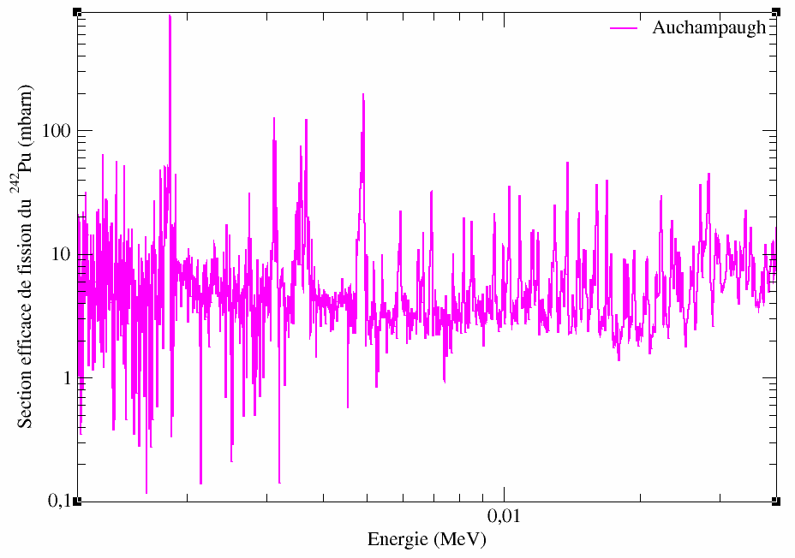
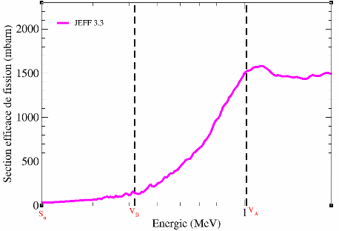
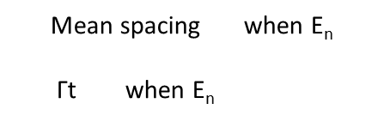


Basics
RRR
URR
Continuum
²⁴²Pu fission cross section (barn)
²⁴²Pu fission cross section (barn)
²⁴²Pu fission cross section (barn)
E_{n} (eV)
Energy (MeV)
E_{n} (eV)
Energy (MeV)
E_{n} (eV)
<< 1 → RRR
Mean spacing when E_{n} $\text{Γ}\text{t}$ when E_{n}
$\frac{\text{Γ}\text{t}}{D}$
$≈$1 → URR
> 1 → Continuum
RRR : Observed class I and class II resonances
Continuum :
Class I resonances fully damped
URR : Observed unresolved class I resonances and resolved class II resonances
Class II resonances partially damped
Class-II states identified during this PhD compared with: - H. Weigmann, J.A. Wartena, C. Bürkholz, Neutron-induced fission cross section of ²⁴²Pu, Nuclear physics A438, 333-353, 1985 - G.F. Auchampaugh, C.D. Bowman, Parameters of the subthreshold fission structure in ²⁴²Pu, Physical Review C, Volume 7 number 5, 1972
22
Notes:
Barrières=seuil

Slide 23
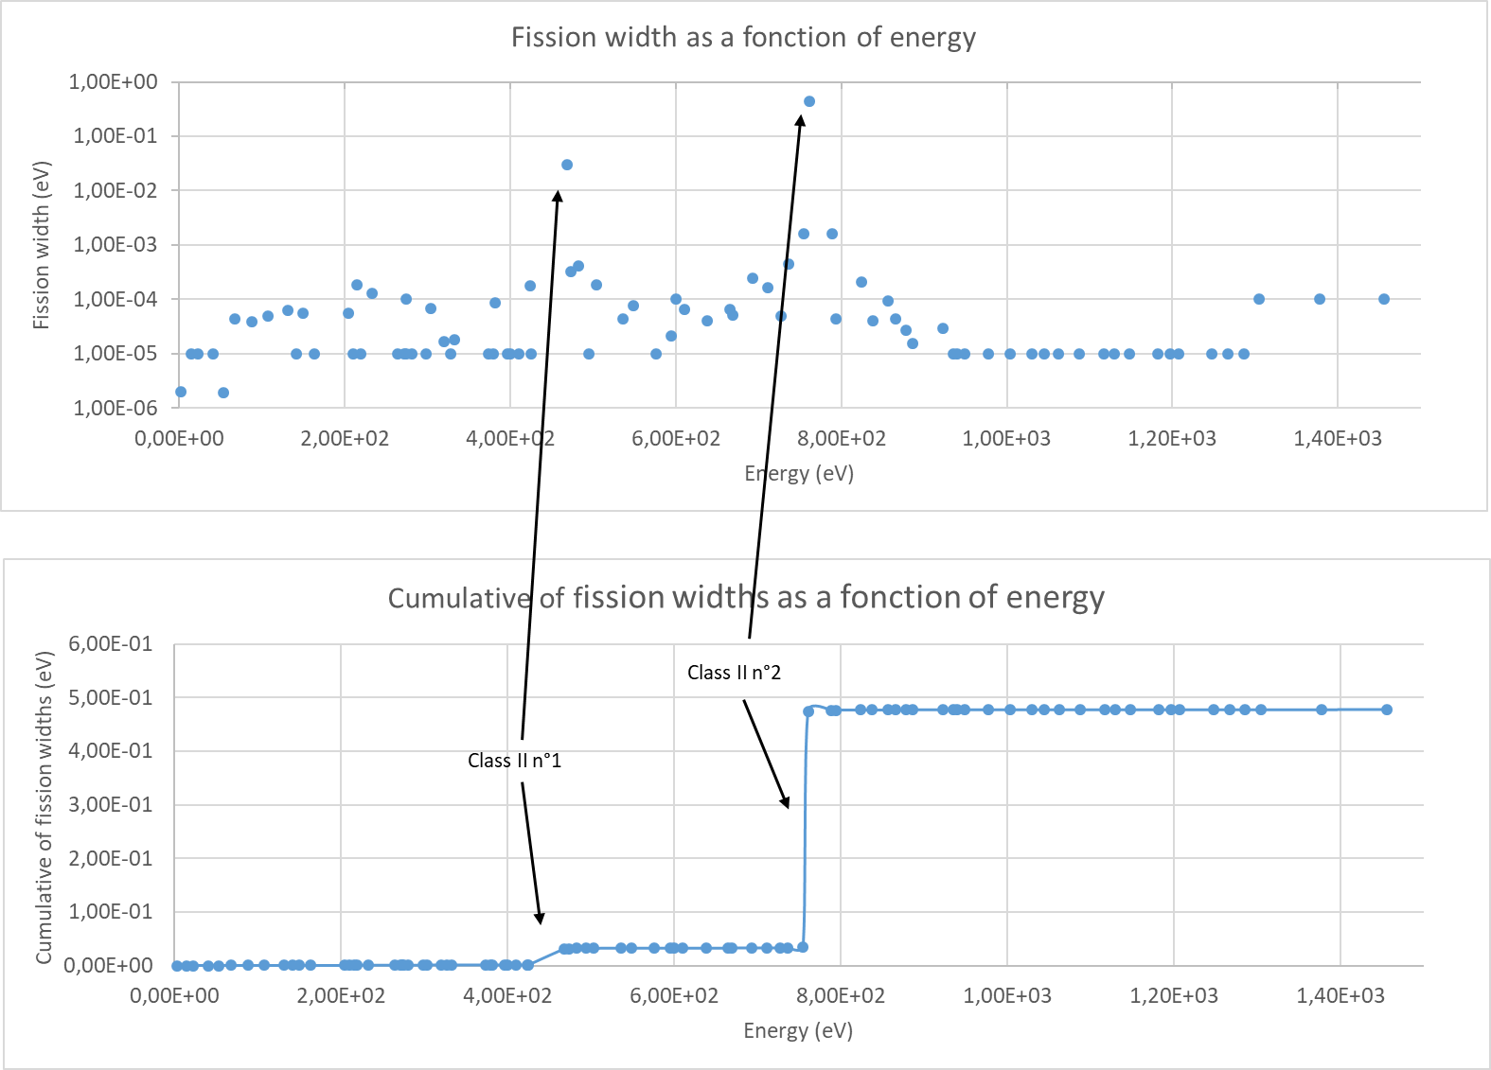



Experimental observation of class II states
Evaluated files: resonances are not identified by their class in ENDF file
$$\text{Common} \text{way}\text{:}$$
$Γ_{f}=2γ_{f}^{2}$
Phenomenological
Reconstructing the observed XS → no information on physics
Best way:
$Γ_{f}=2P_{f}∗γ_{f}^{2}$
Class II states: local amplification with a Lorentzian shape
By identifying, one knows what is reproduced
23

Slide 24
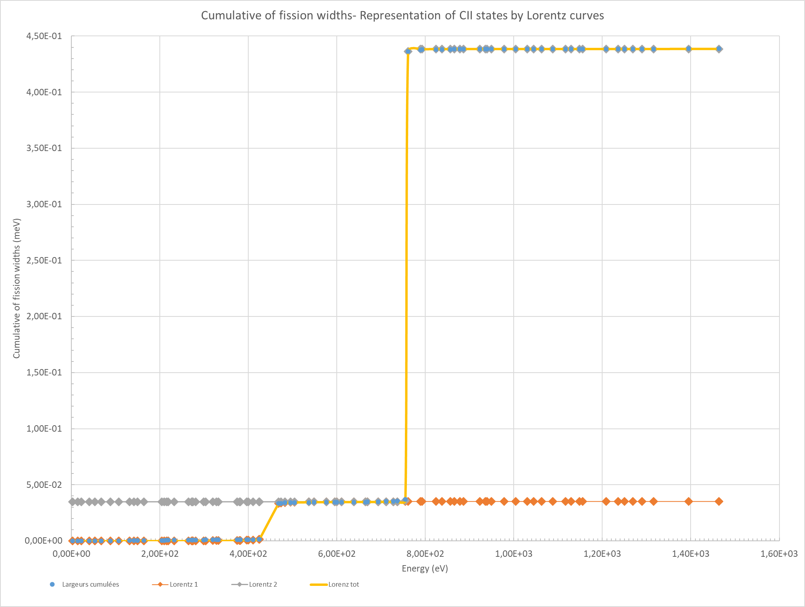

Fitting the cumulative fission widths
Cumulative of fission widths
Based on a Lorentzian approximation:
$$Lz\left(E_{n}\right)= α+A∗Arctan\left(\frac{E_{n}−E_{CII}}{Γ_{II}}\right)$$
E_{CII} the energy of the class-II state Γ_{CII} the width the class-II state σ_{CII} the magnitude of the class-II state
Cumulative of fission widths (meV)
E_{n} (eV)
24

Slide 25
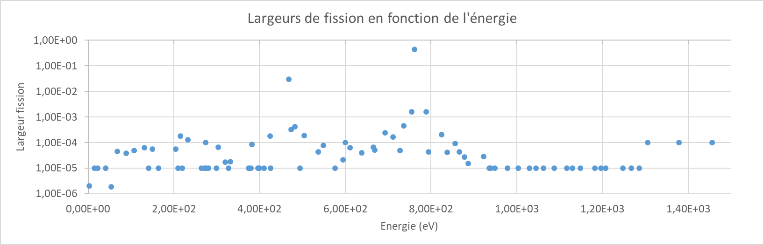
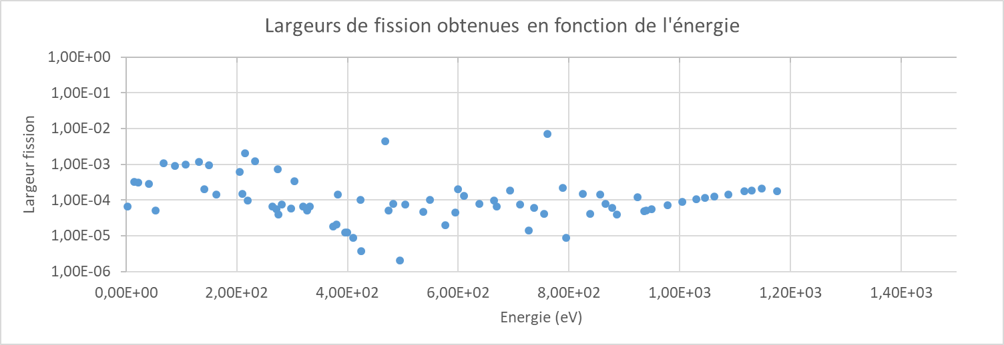
Fitted fission widths
Prior fission widths as a function of energy
Fission widths (eV)
Energy (eV)
Posterior fission widths as a function of energy
More statistically distributed
Fission widths (eV)
Energy (eV)

Slide 26
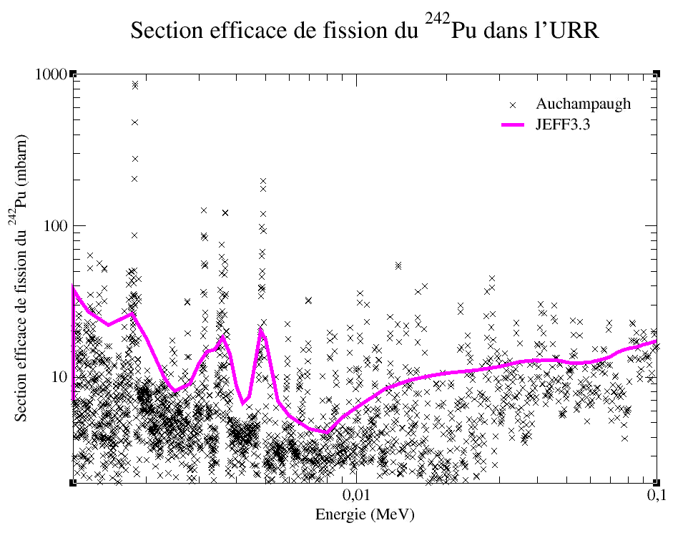
Identification of class II states in urr
Coarse evaluation of the URR fluctuation fission XS in the ENDF file
²⁴²Pu fission XS (mbarn)
²⁴²Pu fission cross section (mbarn)
1 kev
10 kev
100 kev
Energy (keV)
E_{n} (eV)
26

Slide 27
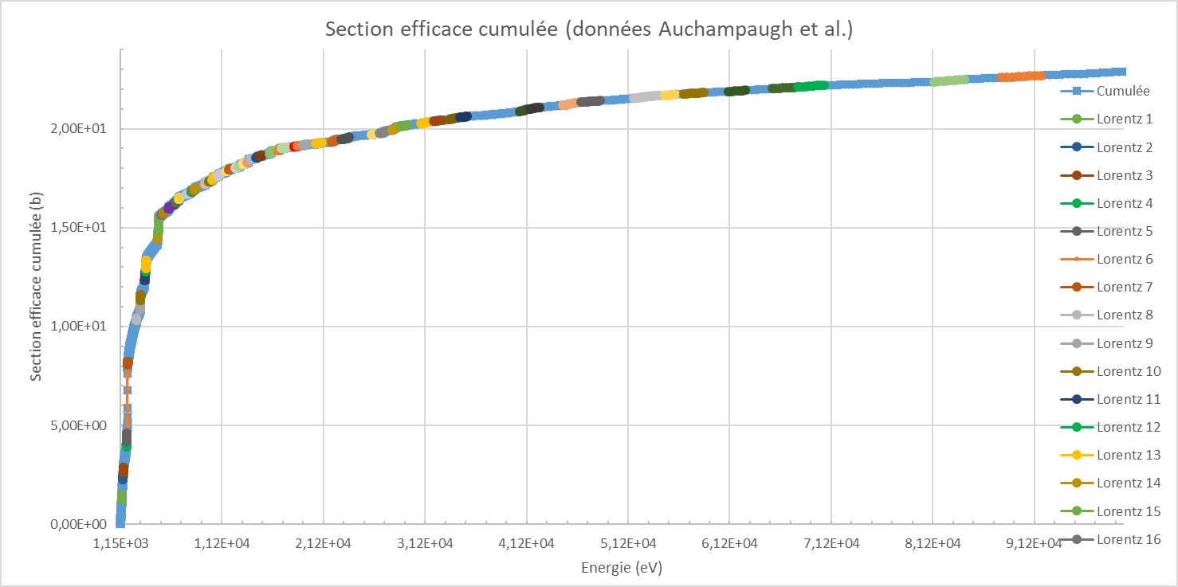
Identification of class II states in URR
Again: no specification of class II states in the ENDF file
Still working with a Lorentzian in cumulative Extension of URR from 40 keV to 100 keV
→ Reference data: fission cross section measured by Auchampaugh et al. → Hauser-Feshbach (HF) description of fission (TALYS code)
Cumulative of fission XS (b)
E_{n} (eV)
→ Resolving 68 class-II states in URR
27

Slide 28
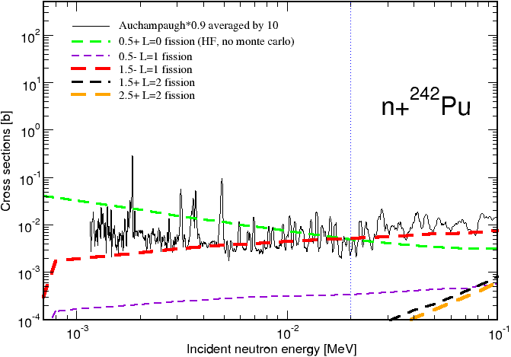
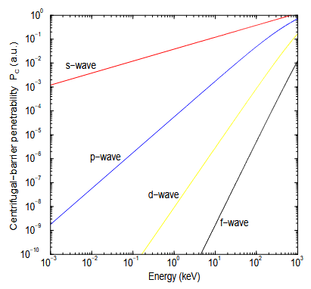
Use of the truncated sequences Comparison with the identified Class-II states
Consideration of the channel opening
Assumption:
s from 0
p from 7 keV
d from 20 keV
13 truncated sequences
Source : G. Noguère PhD (2003)
28

Slide 29
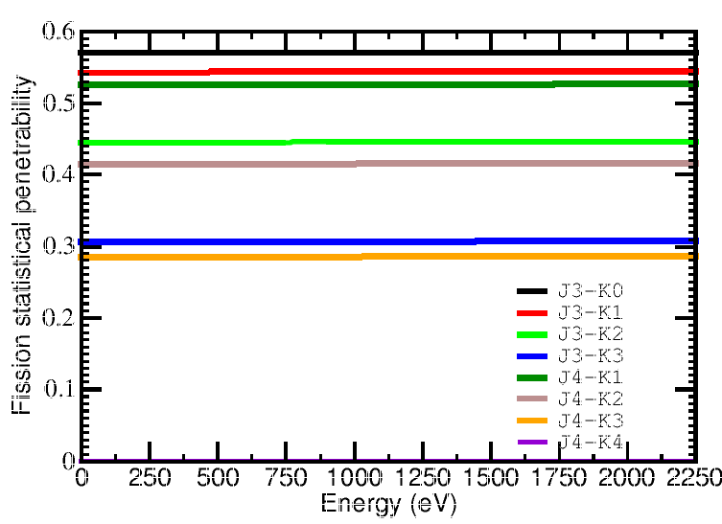


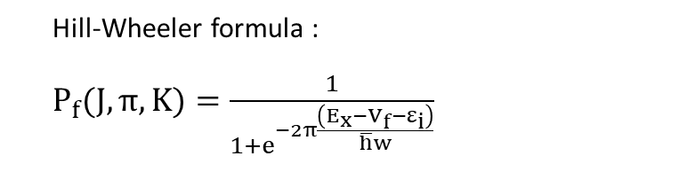
Prospects
From phenomenological to physics R-Matrix fission width amplitudes
How that? $Γ_{f}=2P_{f}∗γ_{f}^{2}$ ≈ 2*P_{overall barrier} * P_{f, class II}$∗γ_{f}^{2}$
Extracted γ_{f} are still biased by P_{f}(J,K,Π) (hopefully constant over the energy range under investigation (0-100 keV))
$$P_{CII}= \frac{\frac{σ_{CII}Γ_{CII}^{2}}{4}}{{\left(E−E_{CII}\right)}^{2}+\frac{Γ_{CII}^{2}}{4}}$$
Hill-Wheeler formula :
$P_{f}(J,π, K)=\frac{1}{1+e^{−2π\frac{\left(E_{x}−V_{f}−ε_{i}\right)}{\overline{h}w}}}$
n+235U
s-waves: two possible resonances Jpi=3- and 4-
RM= 2 fission widths per Jpi
RM extended towards fission axis = 4 fission widths (labeled by J^{π} K) per J^{π} = 4 values of Pfoverall between 0.3 and 0.6

Slide 30
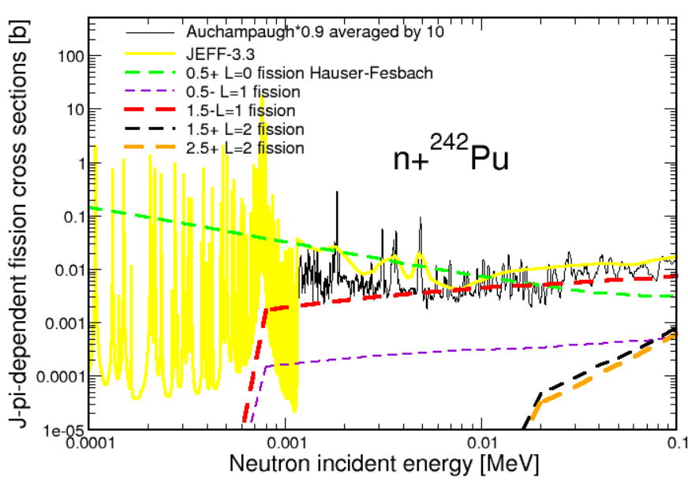
Conclusion
Work done (presented):
Identification of class-II states in RRR assuming Lorentzian penetrability [J^{π} dependence] (R-Matrix framework)
Identification of class-II states in URR assuming Lorentzian penetrability [J^{π} independence] (average XS framework)
Work done (not presented):
[Neutron entrance channel] Identification of class-II states using centrifugal penetrability discrimination
[Fission exit channel] Statistics of class-II states and transition states supported by combinatory nuclear level density calculations (deformation dependent)

Slide 31
Conclusion
Work done:
Actual representation of 2 class-II states in RRR assuming Lorentzian penetrability [J^{π} dependence] (more physical framework)
Identification of 68 class-II states in URR assuming a Lorentzian penetrability [J^{π} independence] (average XS framework) but some might be resolved class-I states
Study feedback:
First input in an evaluated file of class-II states information
Still some missing experimental data for ²⁴²Pu
Remain many RRR evaluated files using MLBW format (technologically obsolete)
How to fit the RM interferences when large experiment fission XS background is included in the observation ?
Need other studies to discriminate resolved class-I states in class-II states over the low energy URR
Parameters of these class-II states require special evaluated data file format to be supplied
31
Notes:
Evaluated files GND

Slide 32
Conclusion
Ongoing :
[Neutron exit channel] Study of the structure (at 1.1 MeV)
Study feedback:
First input in evaluated files of class-II states information
Still some missing experimental data for ²⁴²Pu
Still many RRR evaluated files in MLBW format (technologically obsolete)
How to fit the RM interferences when significant experiment fission XS background is observed ?

Slide 33
Prospects
From phenomenological to physics R-Matrix fission width amplitudes
How that? $Γ_{f}=2P_{f}∗γ_{f}^{2}$ ≈ 2*P_{overall barrier} * P_{f, class II}$∗γ_{f}^{2}$
Extracted γ_{f} are still biased by P_{f}(J,K,Π) (hopefully constant over the energy range under investigation (0-100 keV))
$$P_{CII}= \frac{\frac{σ_{CII}Γ_{CII}^{2}}{4}}{{\left(E−E_{CII}\right)}^{2}+\frac{Γ_{CII}^{2}}{4}}$$
Hill-Wheeler formula :
$P_{f}(J,π, K)=\frac{1}{1+e^{−2π\frac{\left(E_{x}−V_{f}−ε_{i}\right)}{\overline{h}w}}}$
n+235U
s-waves: two possible resonances Jpi=3- and 4-
RM= 2 fission widths per Jpi
RM extended towards fission axis = 4 fission widths (labeled by J^{π} K) per J^{π} = 4 values of Pfoverall between 0.3 and 0.6

Slide 34

Thank you ☺
And thank to :
O. BOULAND
G. NOGUERE
M. DIAKAKI
L. MATHIEU M. AÏCHE

Slide 35
Conclusions
ν-ball & ν-ball2 data have been analysed to complete the ²³⁸U level scheme
117 levels identified, including:
60 already listed in ENSDF and 57 new
92 found with both sets of data
268 γ transitions identified , including:
110 already listed in ENSDF and 158 new
187 found with both sets of data
34 γ transitions listed in ENSDF for which coincidences were impossible to check
53 γ transitions listed in ENSDF for which no coincidences have been found
Most of contaminants have been analysed
Branching ratios have been extracted from the ν-ball2 data set
Spin and parities (J^{π}) have been deduced from the J^{π}s of the final levels and by completing bands

Slide 36
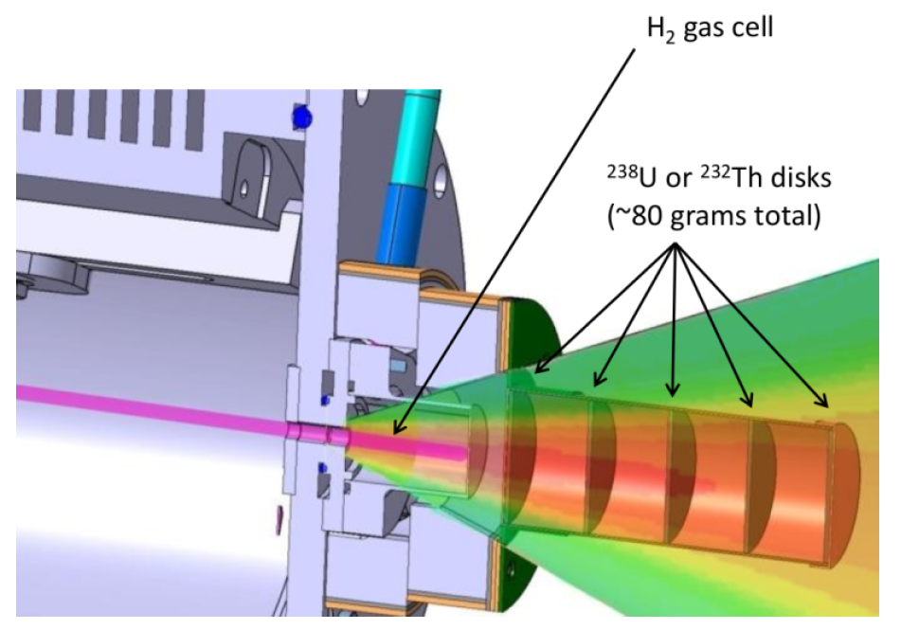
ν-Ball experiment
Detectors around the target 34 HPGe
24 CLOVER
10 HPGe
BGO (scintillators) around each Ge
5 ²³⁸U or ²³²Th disks
Neutron production target: H₂ Pressure: 1.4 bar
3 data set
²³⁸U, E_{n}=1,9 MeV – 9 days of data
²³⁸U, E_{n}=3,3 MeV – 5 days of data
²³²Th, E_{n}=1,9 MeV – 19 days of data

Slide 37
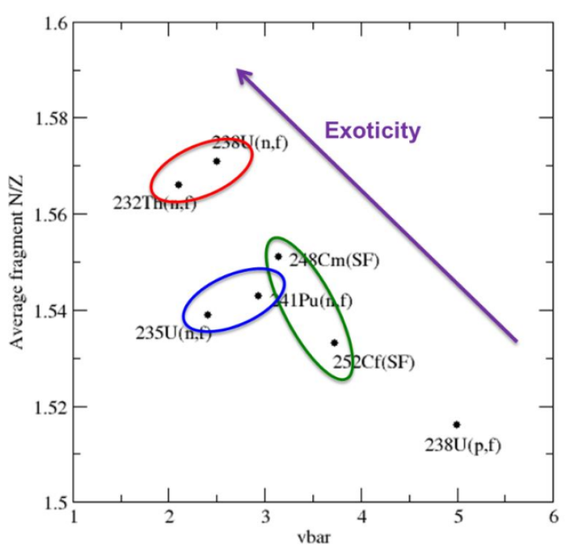
Experiments goal
Neutron-rich fission fragments
Possibility of studying the structure of the target nucleus ²³⁸U
37

Slide 38
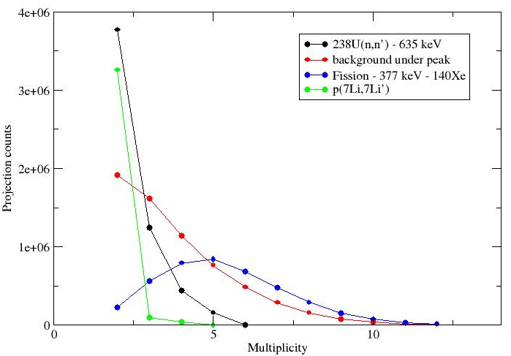
Data used to start the analysis
Coincidences of γ rays with a multiplicity of 2 or 3 selection mostly the γ rays from the (n, n’γ)
Disregard most of the γ rays from fission (mean multiplicity of 5) and other parasitic γ rays
Analysis of the ν-Ball1 data with a multiplicity 2
Analysis of the ν-Ball2 data with a multiplicity 2 to 4; Condition on energy sum ≤ 3300 keV
Courtesy of Jon Wilson
38

Slide 39
Summary
PRC article accepted for publication
C. Chatel et al., Study of inelastic neutron scattering on ²³⁸U with γ ray coincidence spectroscopy
Repository with all the γ-rays expected not coming from ²³⁸U published: C. Chatel et al., Gamma-ray contaminations identified in the study of inelastic neutron scattering on ²³⁸U, repository, DOI: 10.5281/zenodo.18199649 (2026)
²³⁸U + 68 nuclei analyzed
40 fission fragments
1792 γ rays in coincidence
756 γ coming from fission fragments
61 γ in coincidence seen by fission partners
21 potentially new γ not coming from ²³⁸U
Not every γ identified yet !!!
39

Slide 40
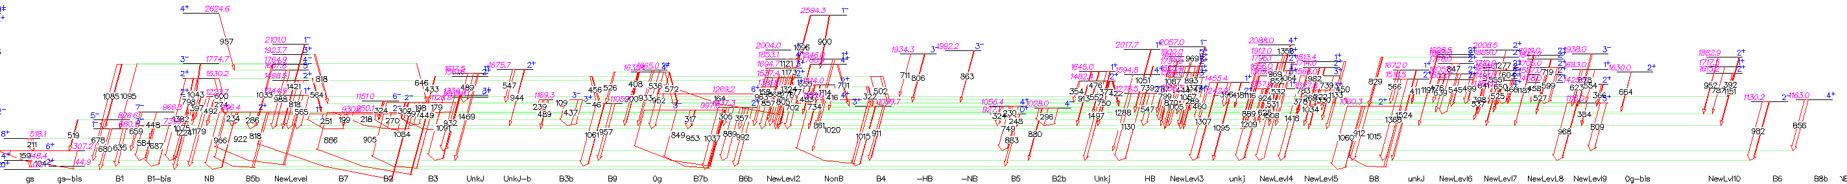
Analysis of the ν-Ball data - ²³⁸U level scheme - obtained results
103 levels identified
Including 52 already listed in ENSDF
211 γ identified
Including 86 already listed in ENSDF
39 new γ depopulating levels already known in ENSDF
51 new levels (not known in ENSDF)
86 new γ (de)populating these new levels
40

Slide 41
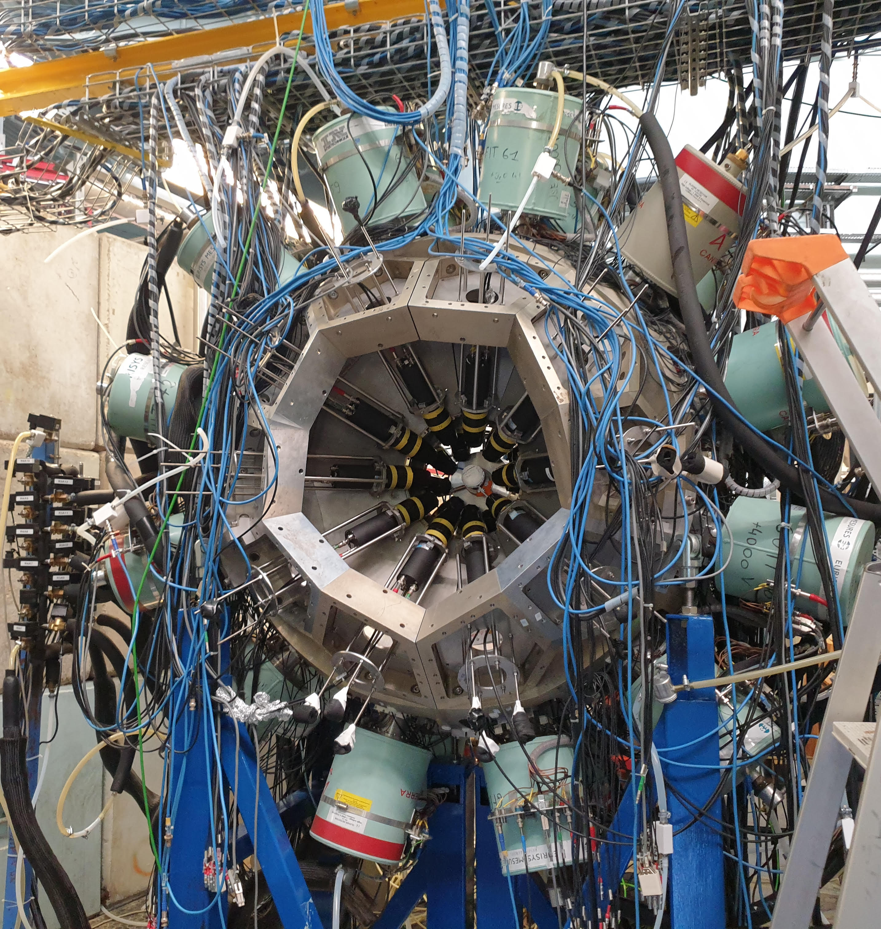
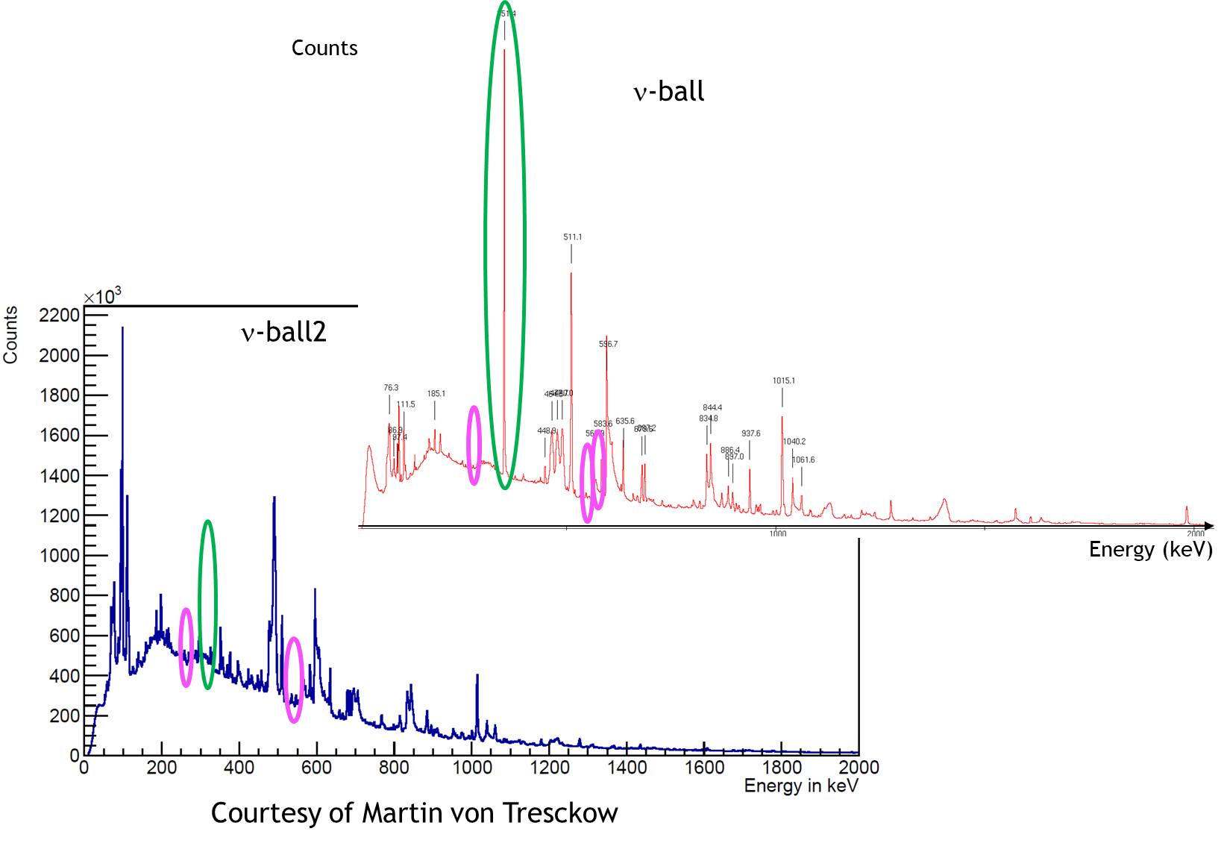
ν-Ball2
Increased statistics (8 times)
Remove of some contamination by changing the beam dump and the target
The main contamination of ν-Ball (²¹Ne) has been deleted in ν-Ball2
3 new rays of contamination appear linked to the Au
41
Notes:
new matrix with about 8 times more statistics in (n,n'). The background is also about half what it was in nu-Ball2. The contamination is less, particular from 21Ne (351 keV) etc.

Slide 42
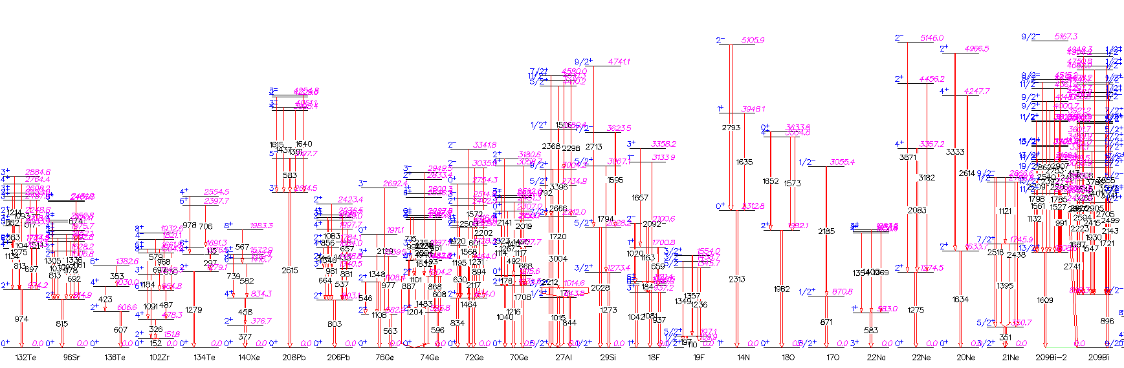
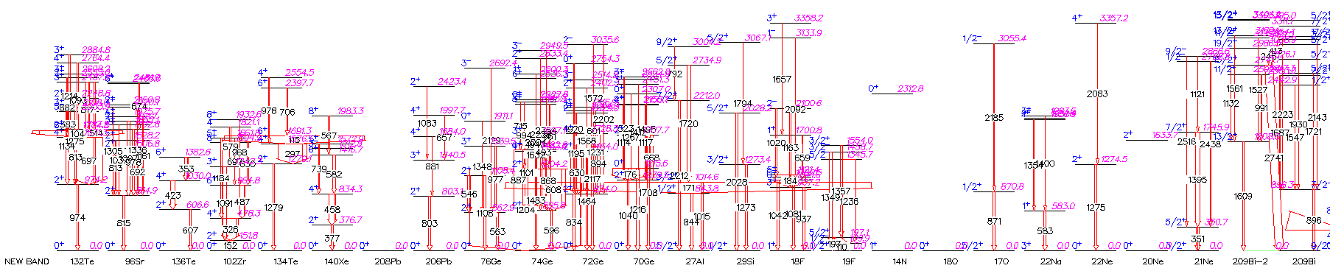
Contamination analysis
υBall
Conditions:
- multiplicity 2
υBall2
Conditions:
- multiplicity 2-4
- E_{tot} ≤ 3300 keV
42
Notes:
Raies or : 279 keV ; 547 keV ; 576 keV

Slide 43


υBall2: Background subtraction spectrum
υBall
Conditions:
- multiplicity 2
υBall2
Conditions:
- multiplicity 2-4
- E_{tot} ≤ 3300 keV
43

Slide 44

Comparison ν-Ball and ν-Ball2– γ 635 keV
υBall Gate on 635 keV
Conditions:
- multiplicity 2
υBall2 Gate on 635 keV
Conditions:
- multiplicity 2-4
E_{tot} ≤ 3300 keV
Statistics: 8 times more!
44
Notes:
new matrix with about 8 times more statistics in (n,n'). The background is also about half what it was in nu-Ball2. The contamination is less, particular from 21Ne (351 keV) etc.

Slide 45

Total γ-spectrum
Counts
Energy (keV)
45
Notes:
matp_px obtenu avec MatProj sur Matp.m4b ; ici result_px

Slide 46

Background profile
Counts
Energy (keV)
46
Notes:
matp_bx obtenu avec MatProj sur Matp.m4b ; ici result_bx

Slide 47

Background subtraction spectrum
Counts
Energy (keV)
47
Notes:
Sp matp_px as -1 matp_bx

Slide 48

238U level scheme – ν-Ball2
Inelastic scattering
Secondary reactions (Coulomb excitation, fusion, oxidation, etc.)
Fission
48

Slide 49
238U level scheme – ν-Ball2
²³⁸U + 68 nuclei
40 fission fragments
1524 parasitic gammas
756 gammas coming from fission fragments
61 gamma in coincidence seen by fission partners
21 potentially new gammas
Not everything analysed
Not every main coincidences found
49

Slide 50

𝜈- Ball2 experiment
Fast neutron source (LICORNE)
High intensity ⁷Li beam: ~ 100 nA pulsed beam (prev. 10 nA)
H gas cell: 1.6 atm (prev. 1.4 atm)
²³⁸U target: ~106 g in chips (prev. 5 disks)
24 clovers + 20 FATIMA detectors
Increase by 4 of the efficiency
2 runs
July: 125 hours
October: 214 hours
Total: ~ 14.1 days
Data clearer
8 times more statistics
50

Slide 51

Cibles ²³⁸U
51

Slide 52

52

Slide 53

Contamination Level Scheme
53

Slide 54

Problems faced: statistics and contaminations
2nd main coincidences: 583 + 687 keV → ²³⁸U
Statistics
Example: gate on 384.5 keV
Main coincidence: 351 keV
Contamination
If we analyze the 384,5 keV γ, we can see that:
The main coincidence is with 351 keV, which belongs to ²¹Ne and is the main contamination of the spectrum
The second main coincidences are the 2 γ de-energizing the 731,93 keV level of the ²³⁸U but the statistics is quite low
New level at 1116 keV (also found thanks to another γ analysis) but a higher statistics would validate it
54
Notes:
Nouveau niveau à 1116 trouvé également par 808 en coïncidence avec 159 (niveau 307)

Slide 55

Gate on contamination rays Example ²⁰⁹Bi - 896 keV
Contamination linked to ²⁰⁹Bi
Contamination linked to wide γ (72Ge γ of 894 keV ; 238U γ of 899 keV)
Contamination linked to fortuitous coincidences
55

