Slide 1




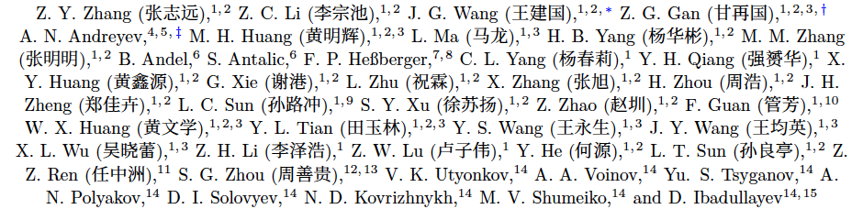
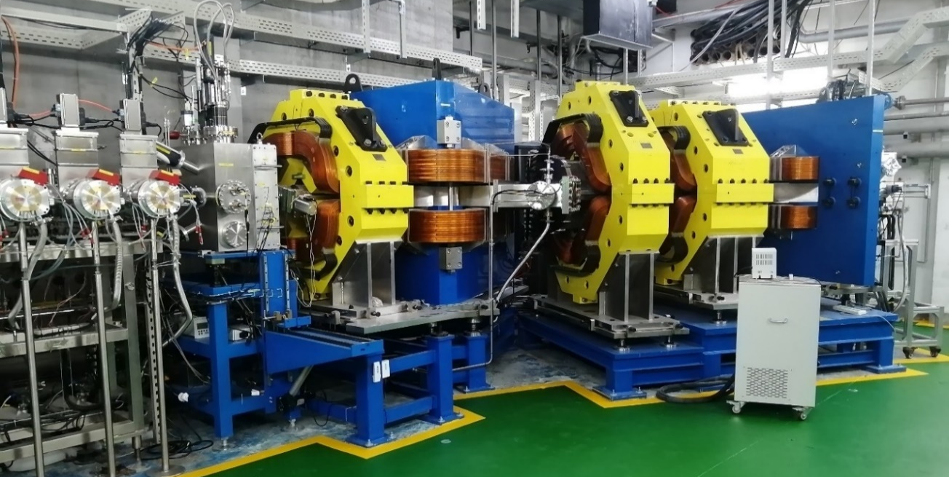
Towards saturation of the ECDF probability in the lightest Bk and Am isotopes
Andrei Andreyev
University of York, UK
On behalf of SHANS2-IMP-York-Bratislava-Dubna collaboration
FISSION2026, Chamrousse, 12th March 2026

Slide 2
Outlook
What is Electron-Capture Delayed Fission (ECDF)
Why ECDF?
Brief introduction on IMP-CAS (China)
SHANS-2 gas filled recoil separator at IMP-Lanzhou
⁴⁰Ar+¹⁹⁷Au->²³⁷Bk* experiment
Results
P_{ECDF} systematics
Summary

Slide 3
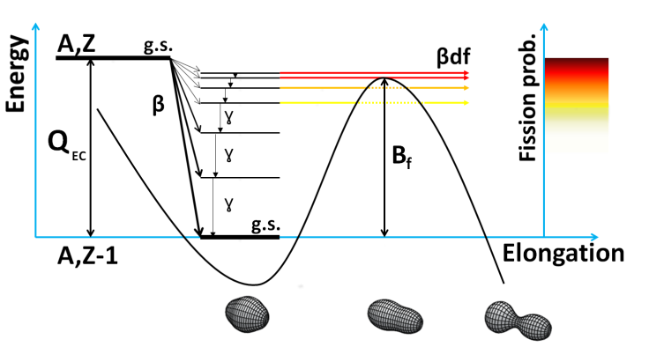

Beta/EC-Delayed Fission (a sub-class of β-delayed particle decays)
²³⁴Bk
P_{ECDF}=1 (’saturation’)
P_{ECDF} low
²³⁴Cm
Necessary conditions: Q_{EC}~B_{f} and a non-zero beta/EC decay branch
Low-energy fission (E*~3-12 MeV, limited by Q_{EC})
e.g. ²³⁴Bk: Q_{EC,exp}=6.5 MeV, B_{f,calc}(²³⁴Cm)~2.5 MeV
A N Andreyev, K. Nishio, K.-H. Schmidt, 2018 Rep. Prog. Phys. 81 016301 (2018)
A.N. Andreyev, M. Huyse, P. Van Duppen, Reviews of Modern Physics, 85, 1541 (2013): ~30 cases known
J.Konki, J. Khuyagbaatar et al, ²⁴⁰Es,²³⁶Bk, PLB764 (2017); J. Khuyagbaatar, EPJA55(2019)

Slide 4
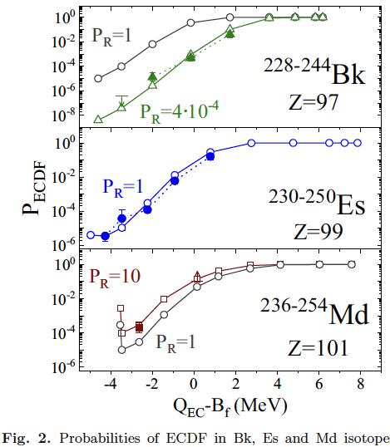
Saturation of ECDF probability
P_{ECDF}=1 (’saturation’)

Slide 5
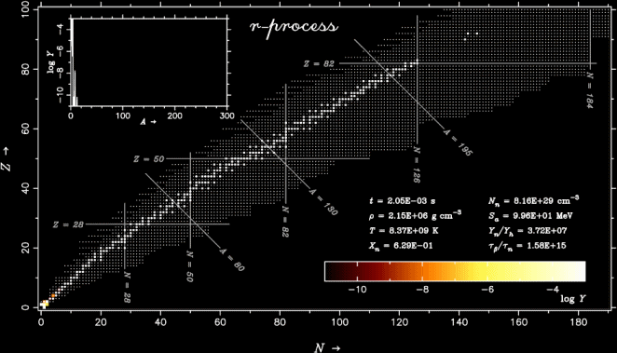
R-process network calculations
r-プロセス元素合成の動画
²³²Th,²³⁸U
¹³²Sn
⁷⁸Ni
R-process termination by fission: need to know fission barriers and FFs mass/charge distributions for Z>82, N>180 nuclei! (hardly ever achievable in the lab?)

Slide 6
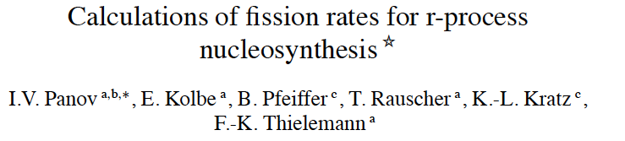
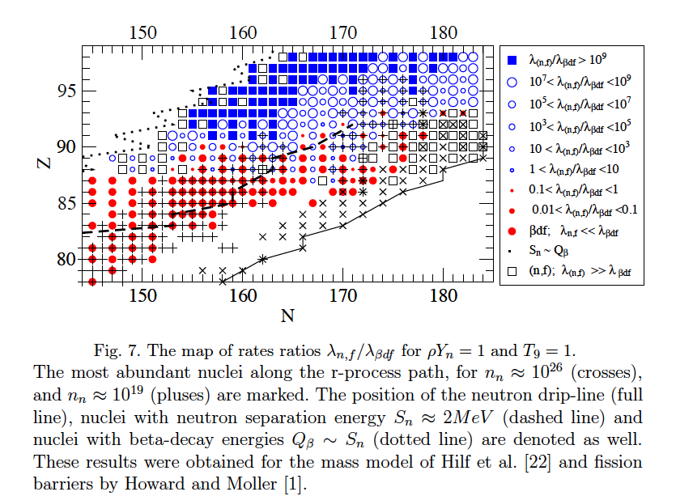

Fission re-cycling in r-process: competition between spontaneous, neutron-induced and beta-delayed fission

Slide 7
R-process network calculations
r-プロセス元素合成の動画
²³²Th,²³⁸U
¹³²Sn
⁷⁸Ni
R-process termination by fission: need to know fission barriers and FFs mass/charge distributions for Z>82, N>180 nuclei! (hardly ever achievable in the lab?)

Slide 8
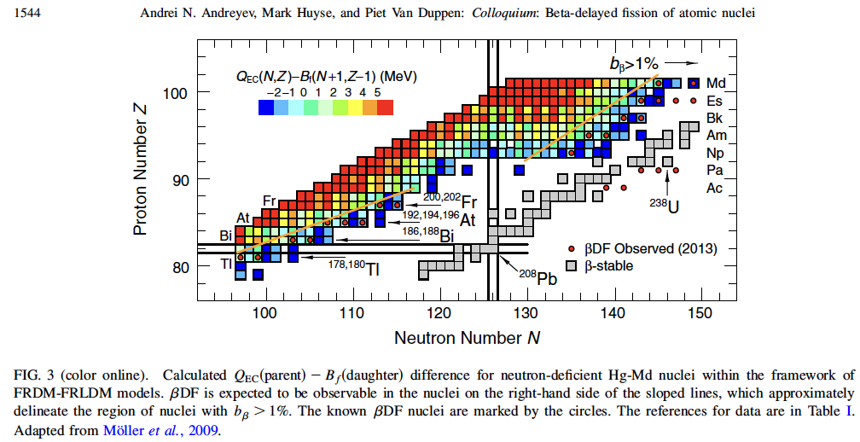
Where to find ECDF in the present experiments?
Necessary conditions: Q_{EC}~B_{f}
non-zero beta/EC decay branch
Neutron-deficient
actinides
Neutron-deficient
lead region

Slide 9
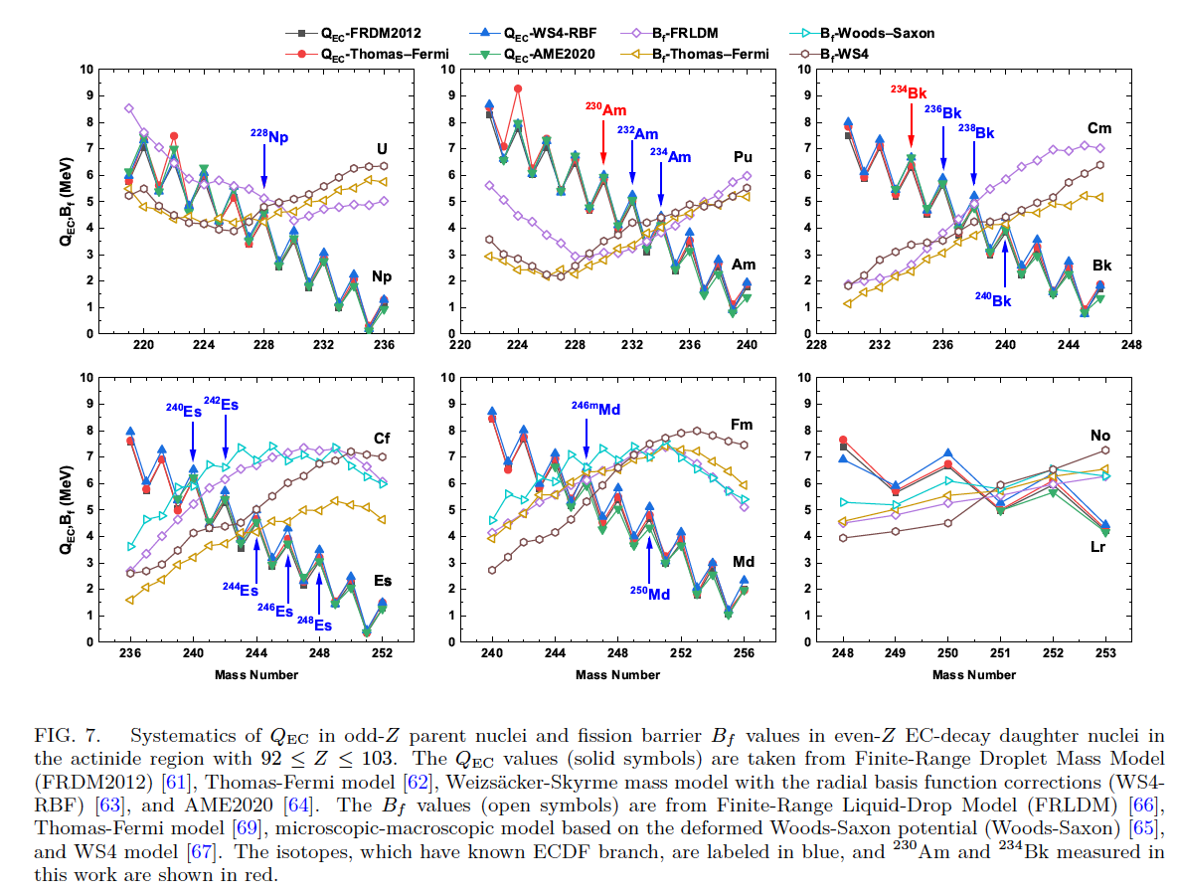
Q_{EC}-B_{f} systematics for heavy actinides
Very favorable conditions for Am and Bk chains
Slide courtesy Z. C. Li

Slide 10
Known ECDF cases (~30)
Bara S, Algora A, Andel B, Andreyev AN, Antalic S, et al. 2025. Physical Review C 111:065803

Slide 11
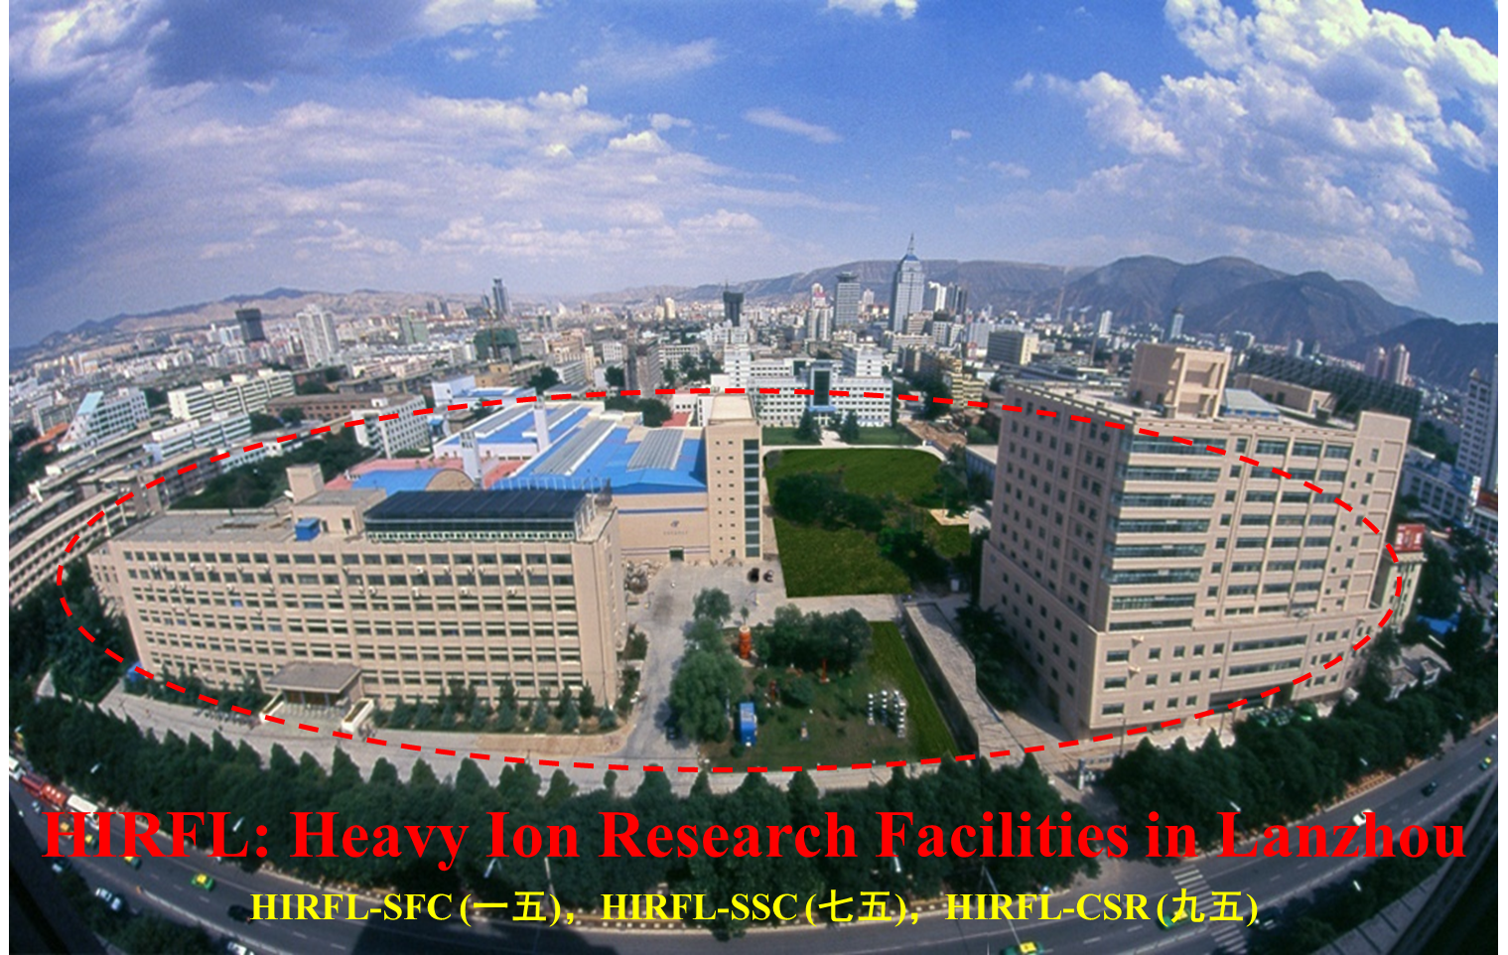
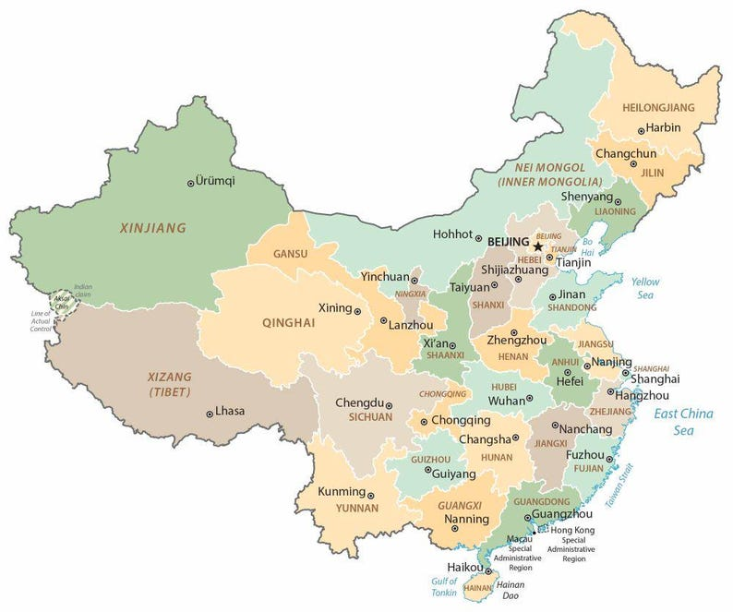
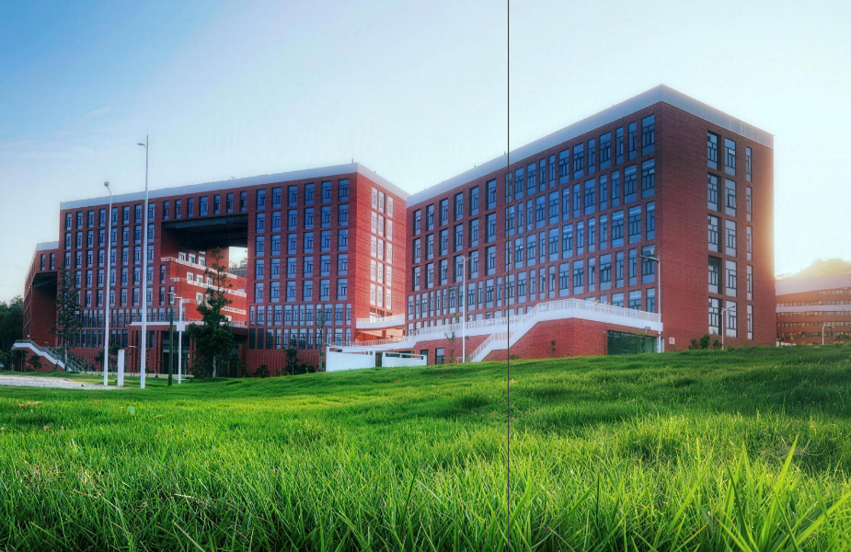
Institute for Modern Physics, Chinese Academy of Sciences (IMP-CAS)
2 sites: IMP-Lanzhou
HIAF-IMP-Huizhou
HIAF-IMP-Huizhou

Slide 12
HIAF: High Intensity Heavy-ion Accelerator Facility (Huizhou)
(commissioned end of 2025)

Slide 13
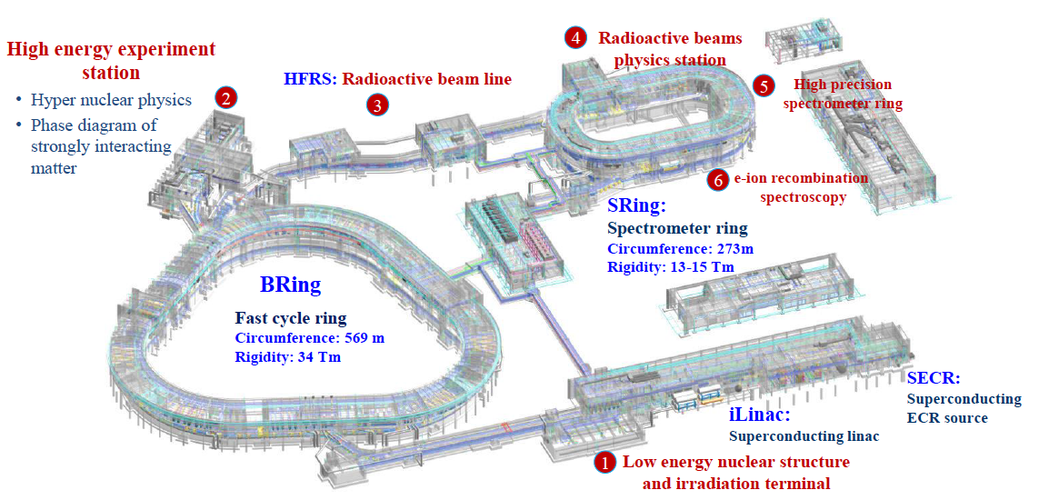
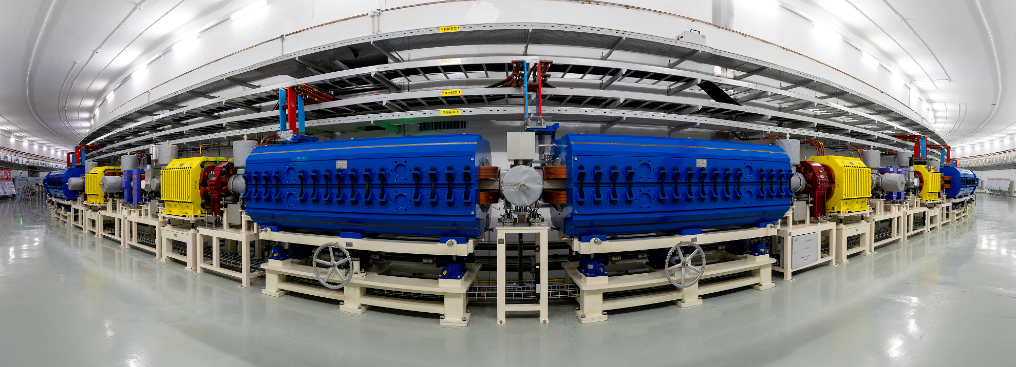
HIAF: High Intensity Heavy-ion Accelerator Facility (Huizhou)
(commissioned end of 2025)
17 AMeV U³⁵⁺
850 AMeV U³⁵⁺
Low-energy physics
Structure/reactions, SHE
SHANS3 gas-filled recoil separator
Slide courtesy He Shao

Slide 14
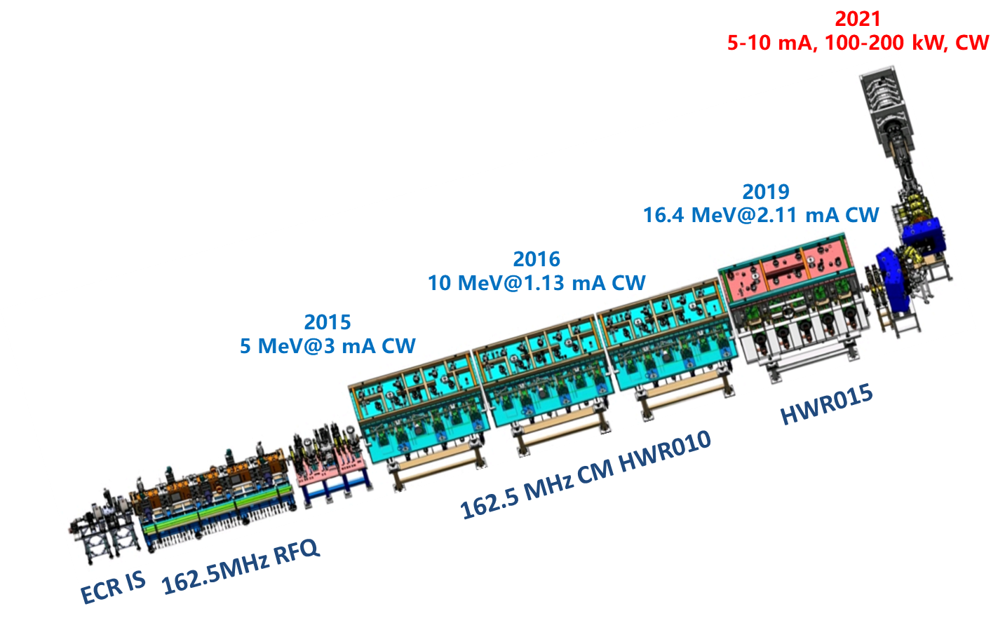
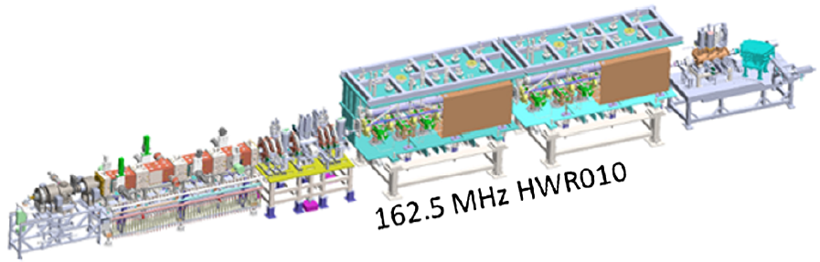
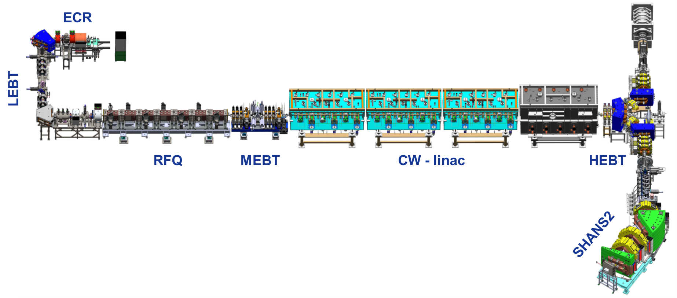
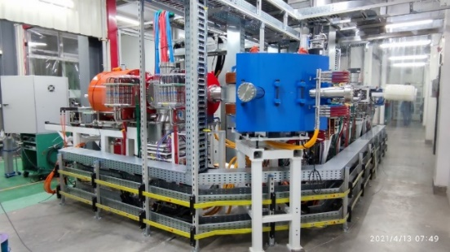
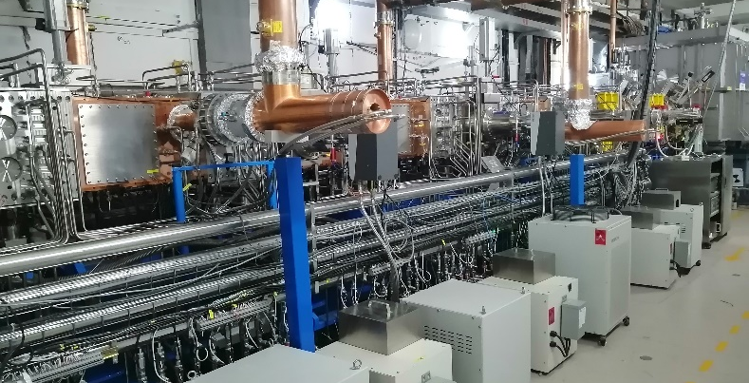
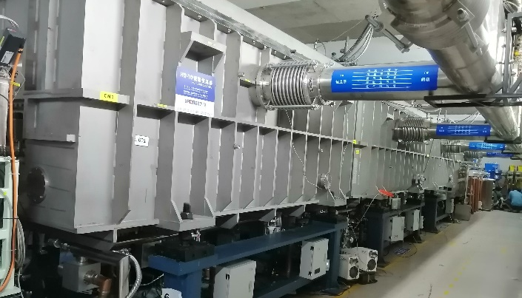
CAFe and CAFE2 at IMP-Lanzhou
CAFe and CAFE2 at IMP-CAS (Lanzhou)
Upgraded in 2019-2022
2015
China ADS Front-end demo linac (CAFe)
China Accelerator Facility for Superheavy Elements (CAFE2)
Electron cyclotron resonance ion source
(ECRIS) (18 GHz)
Radio frequency quadrupole accelerator
(RFQ)
Super-conducting linear accelerator
(CW - Linac)

Slide 15
Present Beam Condition at CAFE2
Designed parameters | Goal
Ions | Ca～Zn
A/Q | ~3
Beam energy | 4.5-7 MeV/u
Beam intensity | 5～10 pμA
Running mode | CW
Beam particles | Highest Beam Intensity at SHANS2 (pμA)
⁴⁰Ar¹²⁺ | 14
⁴⁰Ca¹³⁺ | 3~5
⁴⁸Ca¹⁴⁺ | 1.2
⁵⁵Mn¹⁷⁺ | 3
⁵⁴Cr¹⁷⁺ | 2

Slide 16
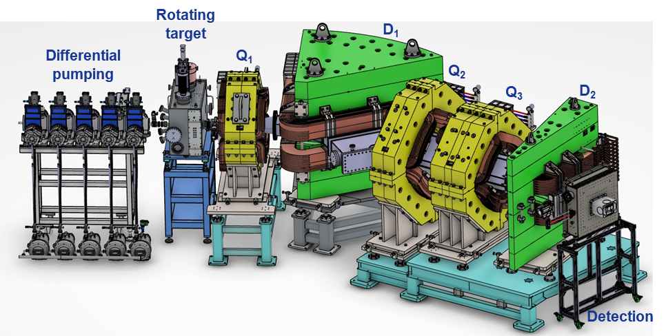
Gas-filled Recoil Separator SHANS2
SHANS2
Characteristics:
Window-less differential pumping system
Helium gas in operation (P~100 Pa)
Rotating target with a diameter of 46 / 20 / 5 cm
Large angle acceptance (horizontal/vertical: ±4°/±6.5°)
QDQQD magnetic configuration with Bρ up to 2.5 Tm
Transmission efficiency: 67(11)% (⁴⁸Ca+²⁰⁸Pb)
Dispersion: 21.1(5) mm/%Bρ
Moveable beam dump

Slide 17
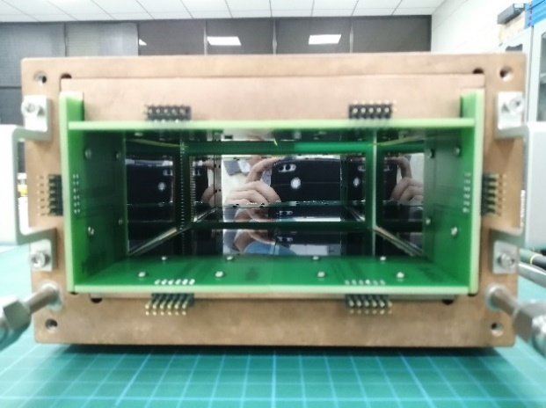
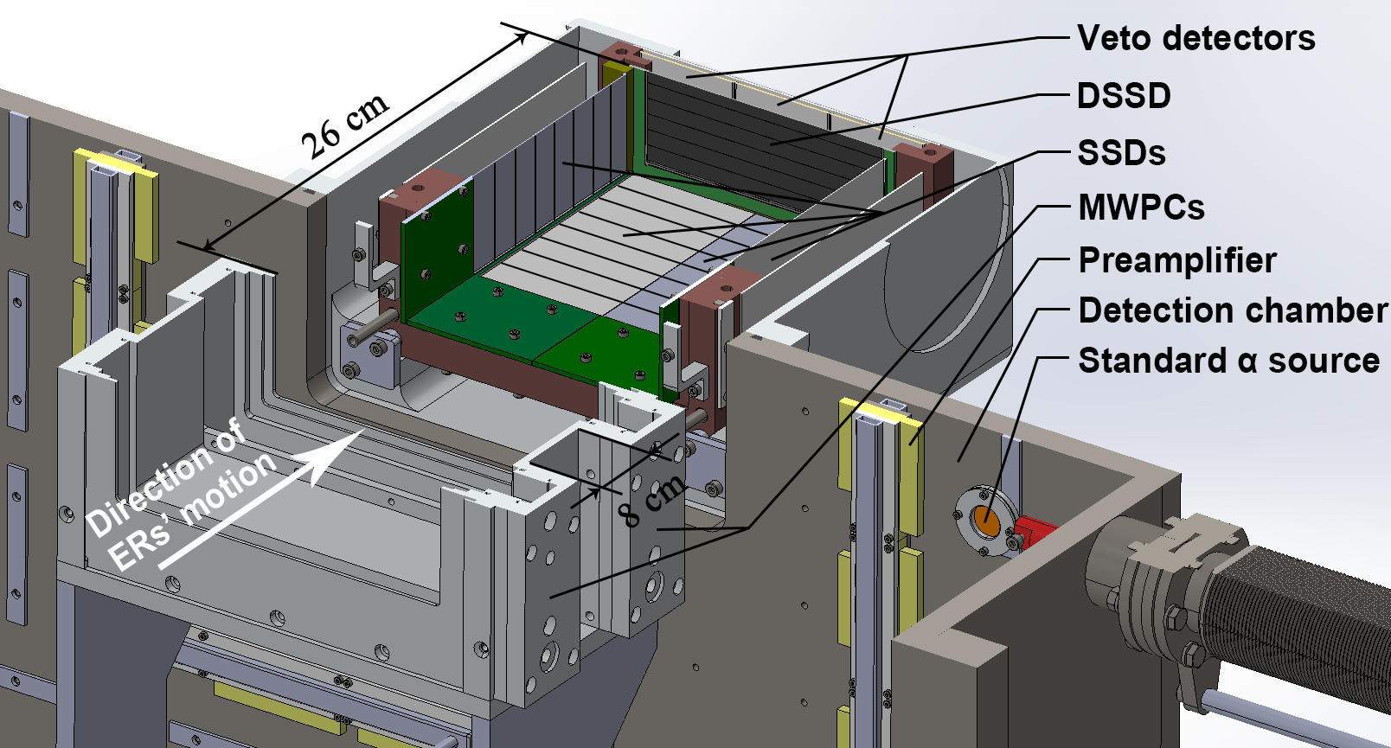
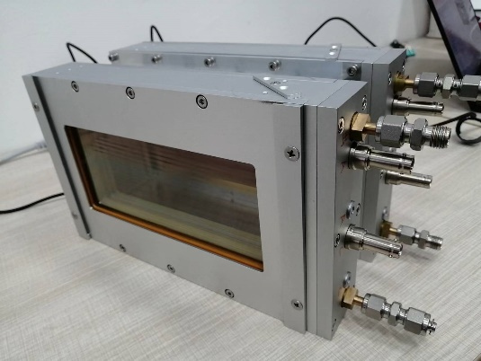
Detection System: MWPC and Si-Box
MWPC
DSSD+SSD detectors
48 mm
128 mm
80 mm
180 mm
Active area: 128 x 48 mm² (DSSD), 120 x 63 mm² x 6 (SSD), 50 x 50 mm² x 3 (Veto)
Thickness: 300 μm (DSSD, Veto), 500 μm (SSD)
Total detection efficiency for α’s: 86(8)%
Energy resolution: 30 keV (DSSD), 80 keV (DSSD+SSD)
Cooling down to -20 ℃ with alcohol
MWPC: 300 Pa isobutane; 0.9 μm-thick Mylar window
Digital electronics: 100 MHz, 14 bit, trace + PHA (FPGA)

Slide 18
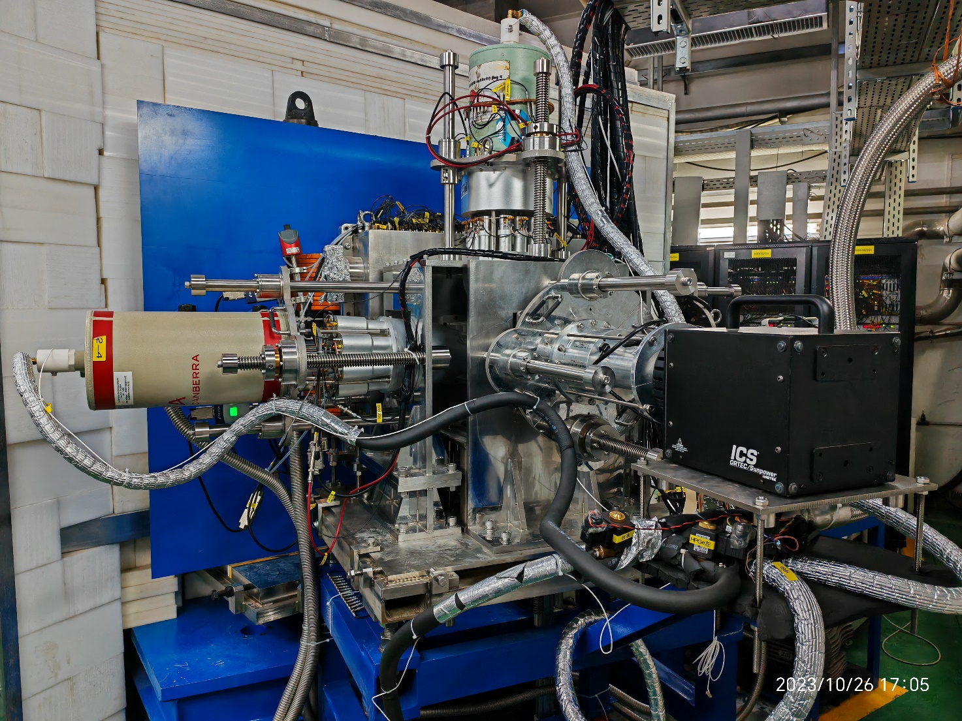
Detection System: Clover and HPGe array
Shielding: 1.5 mm Aluminium
Clover: 4 crystals with 60-mm diameter and 90-mm length, 40% relative efficiency for each
HPGe: 71-mm diameter and 72 mm length, 70% relative efficiency
Absolute eff. : ~11% (63 keV)
Energy resolution: ~3 keV@122 keV
Electrical cooling and liquid nitrogen cooling

Slide 19
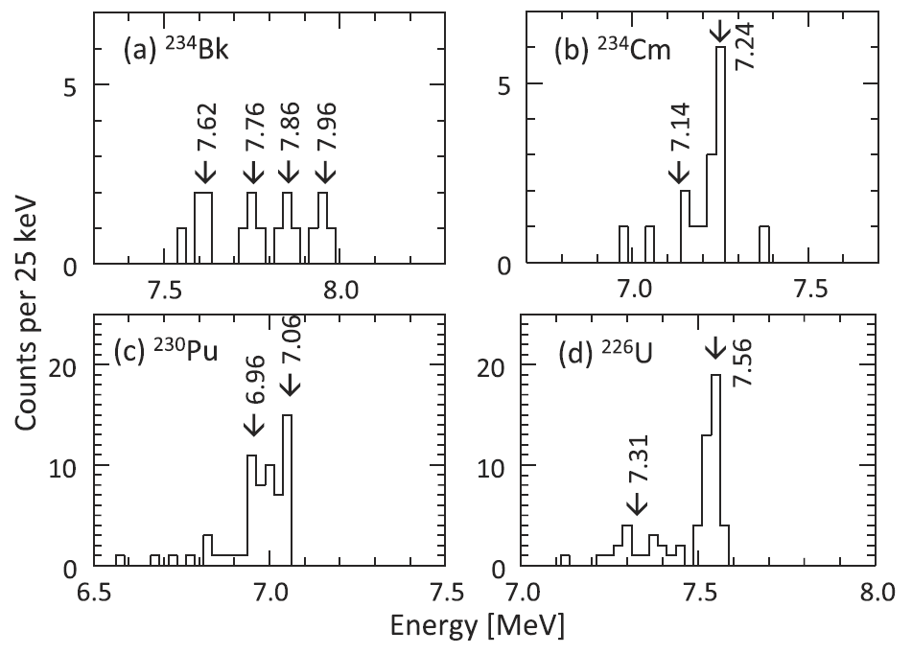
Previous studies of ECDF in ²³⁴Bk and ²³⁰Am GARIS gas—filled recoil separator at RIKEN
234Bk :
Only α decay was observed
Some fission events may belong to ECDF, no details given
E_{α} = 7.62~7.96 MeV
T_{1/2} = 19(+6/-4) s
17 α(²³⁴Bk)-EC(²³⁰Am)-α(²³⁰Pu)-α(²²⁶U) chains
D. Kaji, et al., J. Phys. Soc. Jpn., 85 (2016) 015002.
230Am
Only ECDF was observed, P_{ECDF}>0.3
T_{1/2} = 36(+12/-7) s
19 double-fold fission events
G.L. Wilson, A.N. Andreyev et al., PRC, 96 (2017) 044315

Slide 20
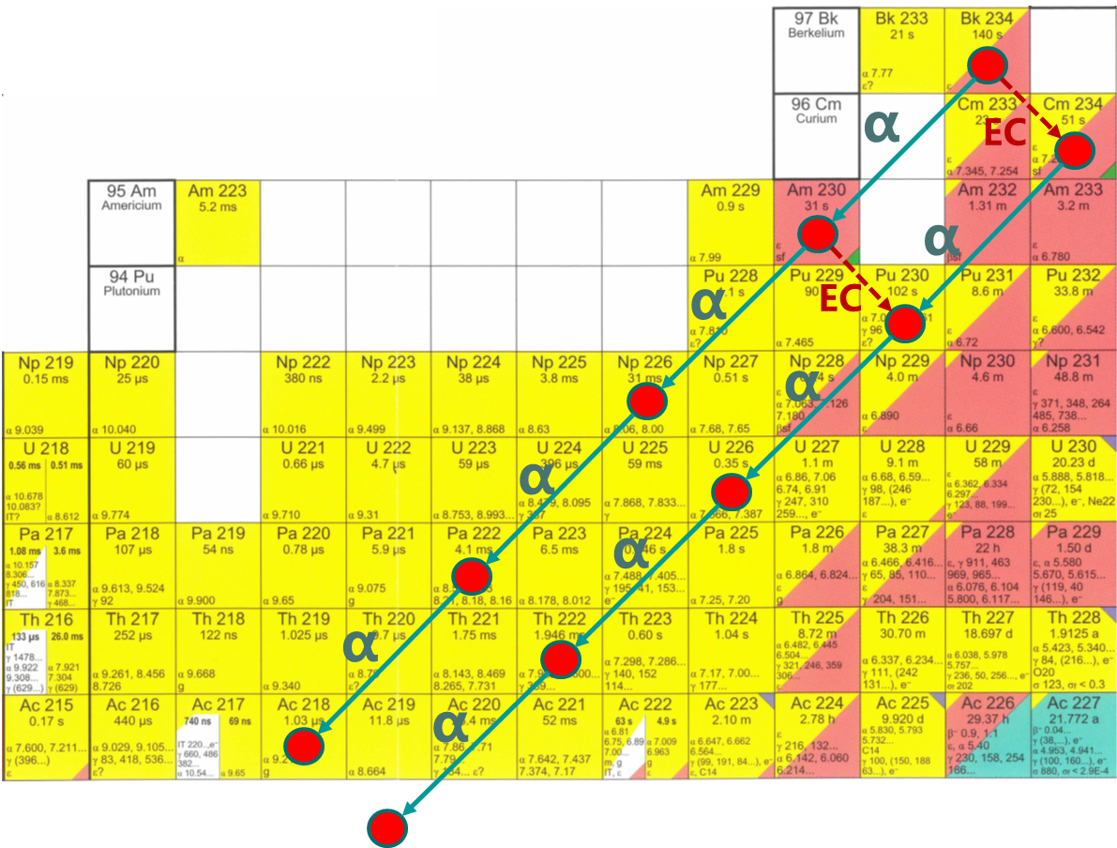
Decay paths of ²³⁴Bk and ²³⁰Am
ECDF
ECDF

Slide 21
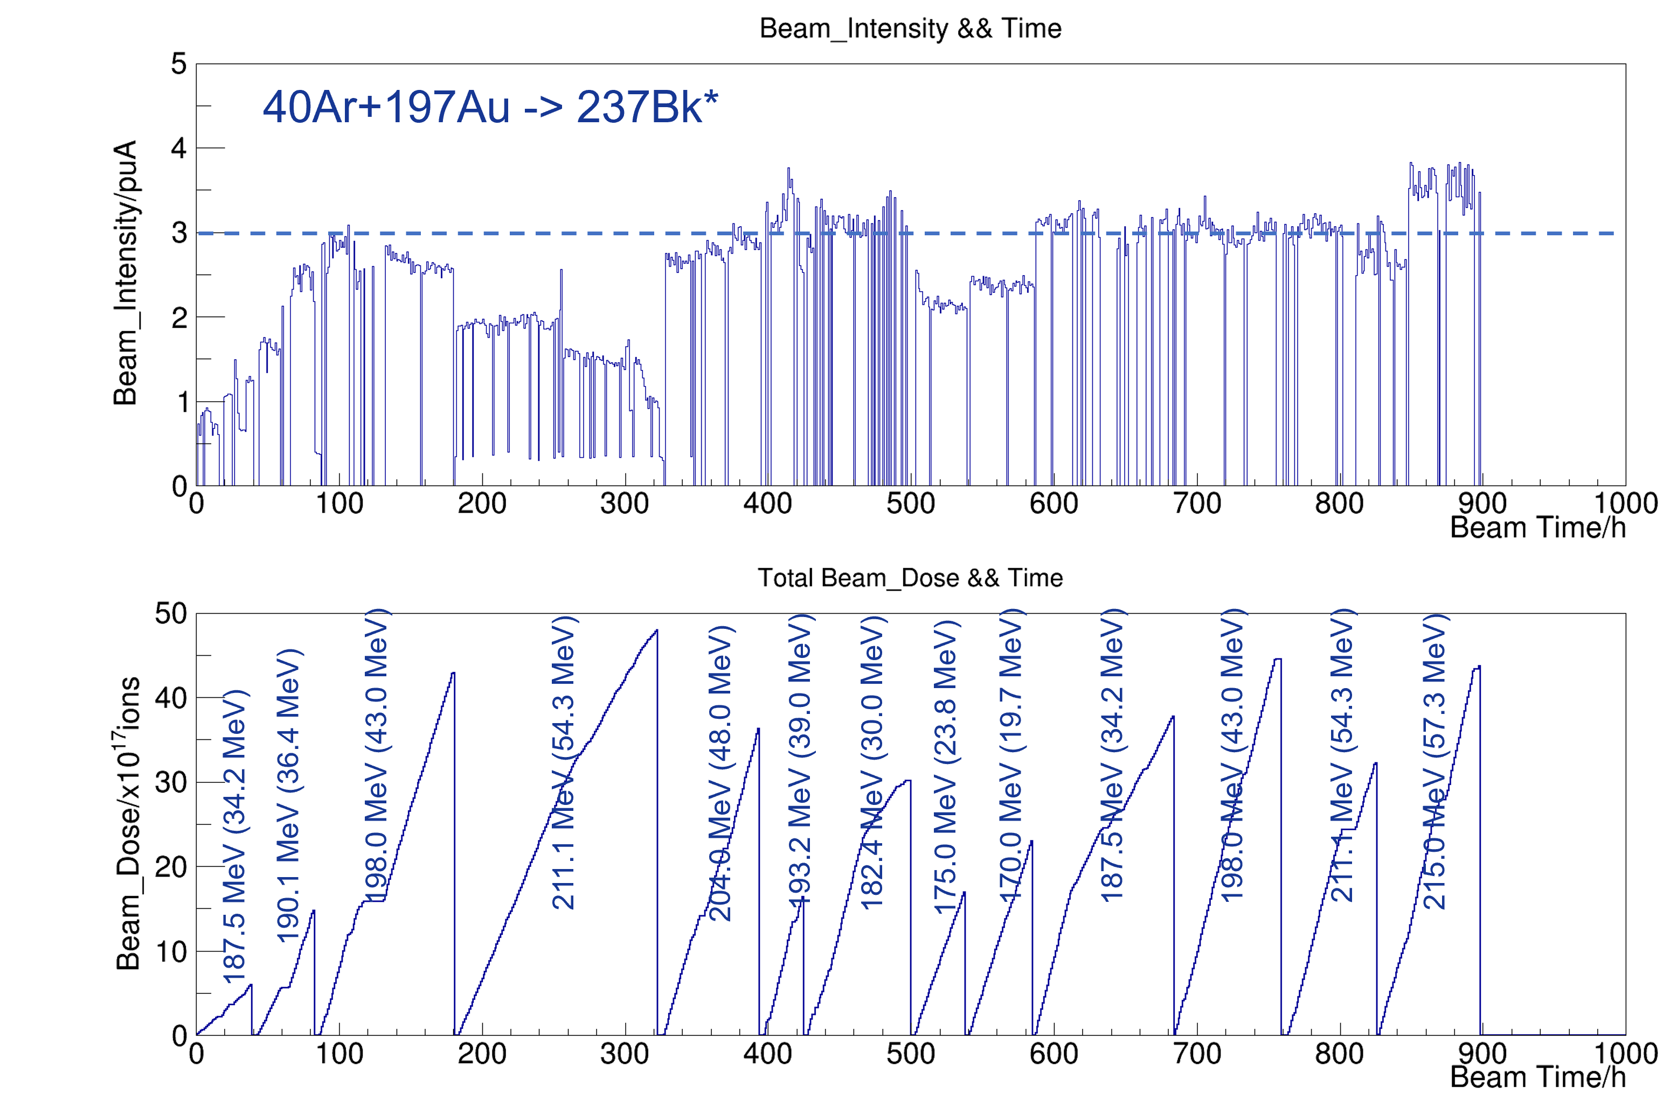
¹⁹⁷Au(⁴⁰Ar, 3n)²³⁴Bk (E_{lab}=175~204 MeV)
(SHE-type experiment, several new isotopes)
3 pμA

Slide 22
Examples of fission and α-decay spectra

Slide 23
Half-lives and cross sections
Halflife of ²³⁴Bk was confirmed by beam-off mode

Slide 24
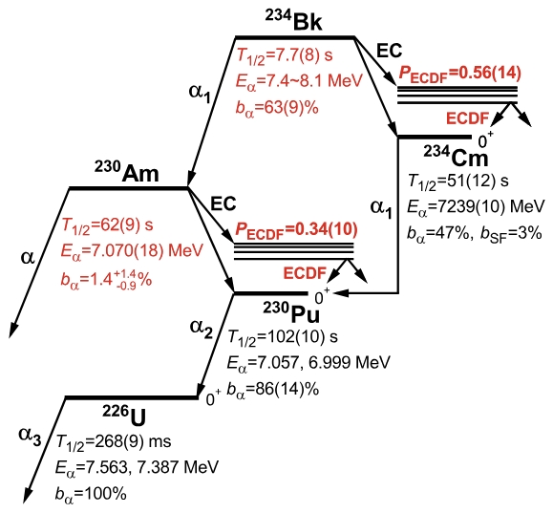
Decay Scheme
Red values – new data from SHANS2

Slide 25
Q_{EC}-B_{f} systematics for heavy actinides
Slide courtesy Z. C. Li

Slide 26

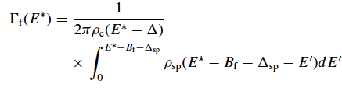
P_{ECDF} systematics
Need:
Q_{β} - ‘easy’, experimental values
S_{β} – beta decay strength function
Statistical model
B_{f} – very uncertain!
Plot courtesy B. Andel

Slide 27
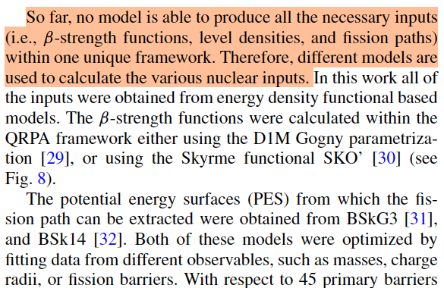
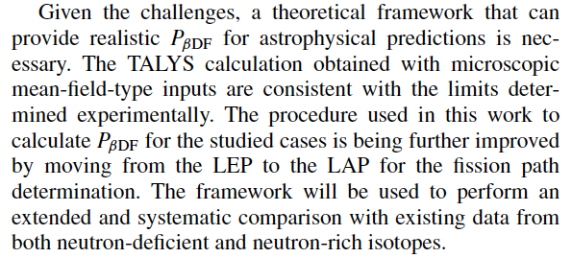
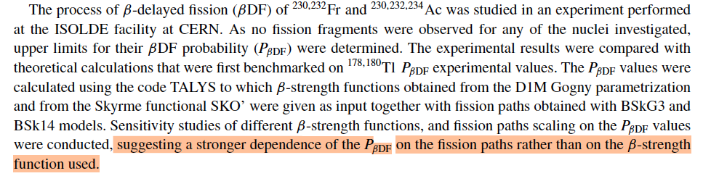
Recent theoretical efforts for P_{ECDF} calculations
S. Bara … S. Goriely et al.,

Slide 28
Summary
Experimentally, the number of ECDF cases is growing
P_{ECDF} does approach the saturation at 1 for some cases
ECDF may allow to probe the validity of fission barrier calculations (theory)
Fission barriers (theory)
Beta strength function (theory)
Statistical part of deexcitation may play a role (theory)

Slide 29
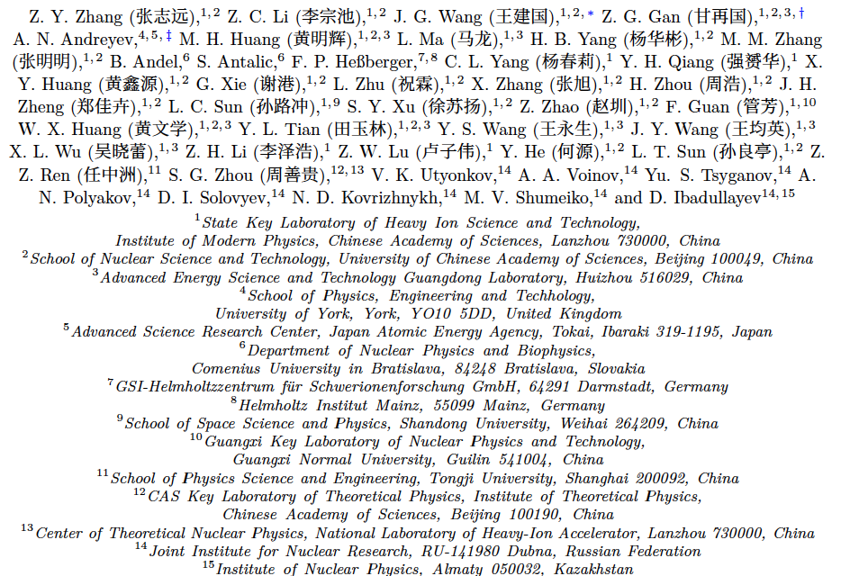
Collaboration

Slide 30
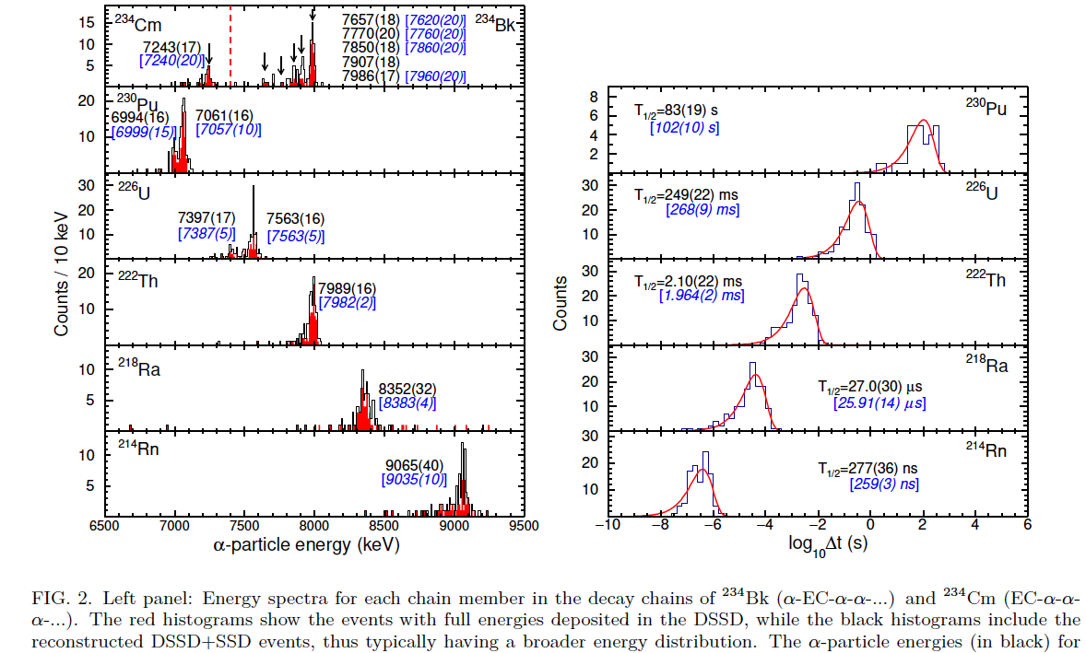
Correlation analysis

