Slide 1
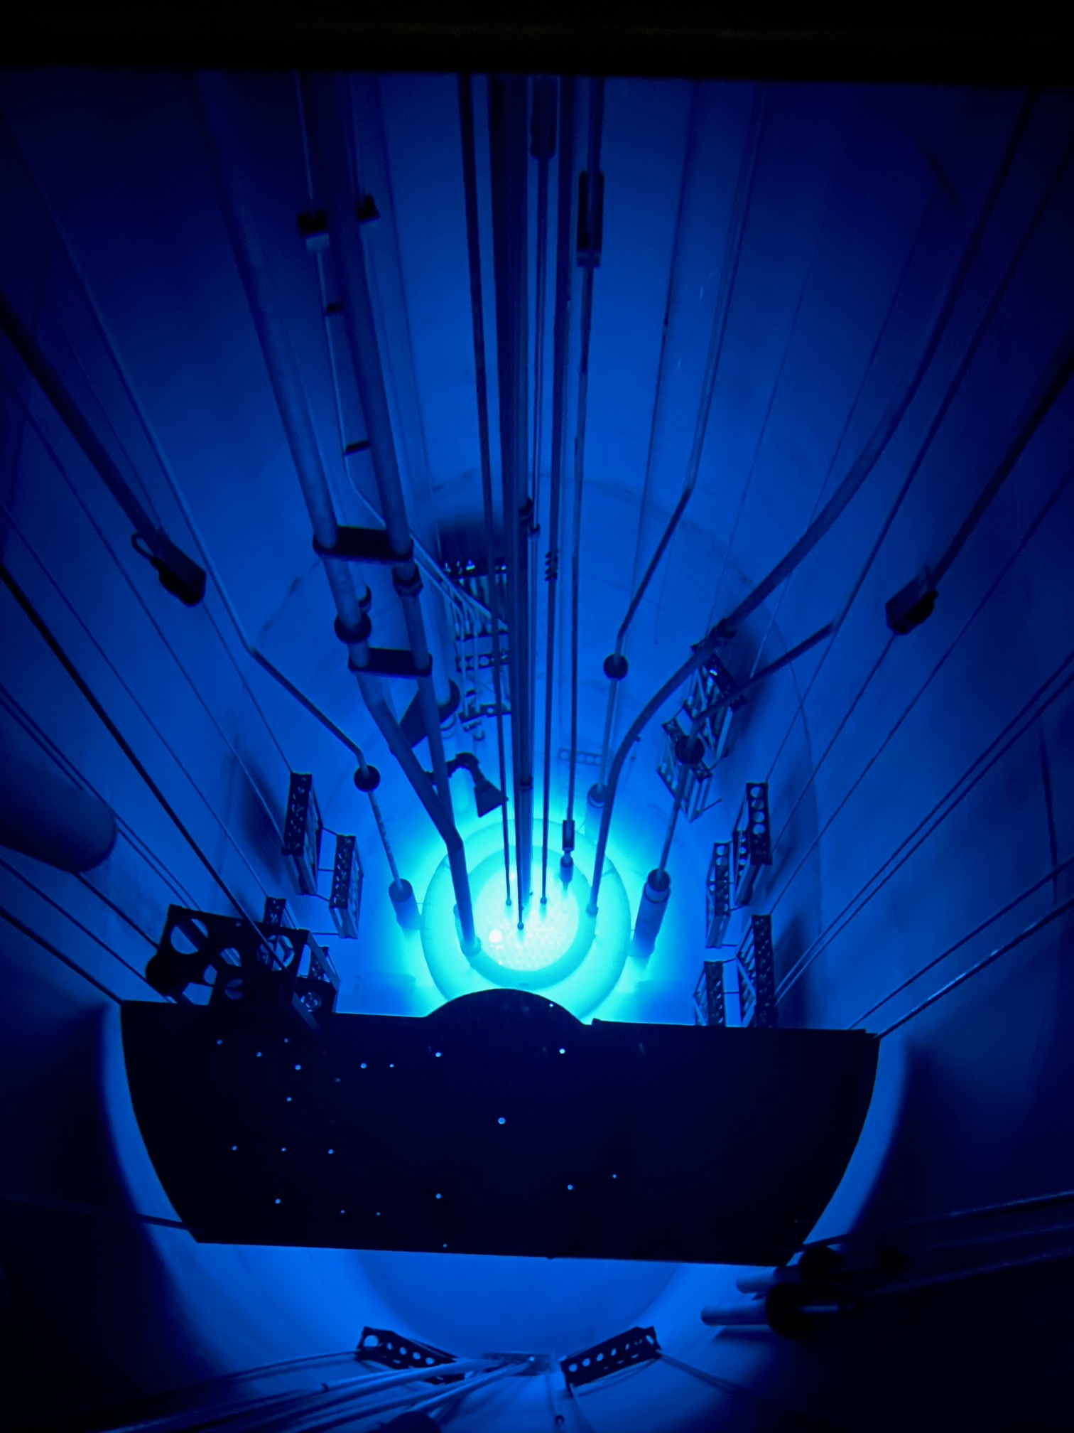
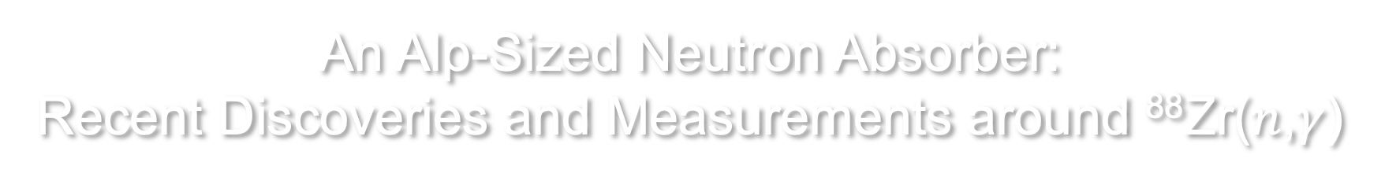
An Alp-Sized Neutron Absorber:
Recent Discoveries and Measurements around ⁸⁸Zr($n$,$γ$)
Dr. Will Flanagan
Research Scientist, University of Texas at Austin
Affiliate Research Assistant Professor, University of Dallas
will.flanagan@austin.utexas.edu

Slide 2
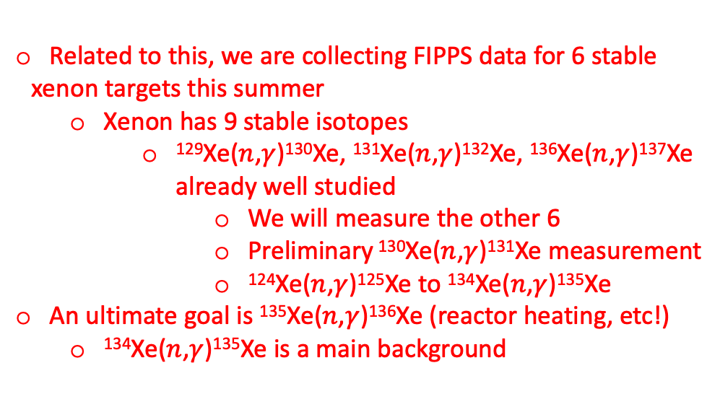
My two main interests : ⁸⁸Zr and ¹³⁵Xe
  ⁸⁸Zr
Second largest thermal neutron capture cross section
Not a fission product
Neutron-Poor
Large neutron absorption cross section discovered in 2019
Radioactive (83.4 days)
¹³⁵Xe
Largest thermal neutron capture cross section
Fission product
Neutron-Rich
Large neutron absorption cross section discovered in 1944
Radioactive (9.14 hours)
Related to this, we are collecting FIPPS data for 6 stable xenon targets this summer
  Xenon has 9 stable isotopes
    ¹²⁹Xe($n$,$γ$)¹³⁰Xe, ¹³¹Xe($n$,$γ$)¹³²Xe, ¹³⁶Xe($n$,$γ$)¹³⁷Xe already well studied
      We will measure the other 6
      Preliminary ¹³⁰Xe($n$,$γ$)¹³¹Xe measurement
      ¹²⁴Xe($n$,$γ$)¹²⁵Xe to ¹³⁴Xe($n$,$γ$)¹³⁵Xe
An ultimate goal is ¹³⁵Xe($n$,$γ$)¹³⁶Xe (reactor heating, etc!)
  ¹³⁴Xe($n$,$γ$)¹³⁵Xe is a main background
This is my talk today

Slide 3
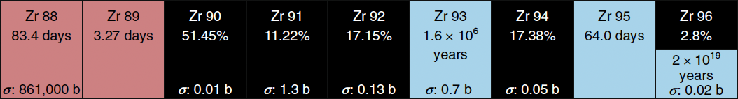
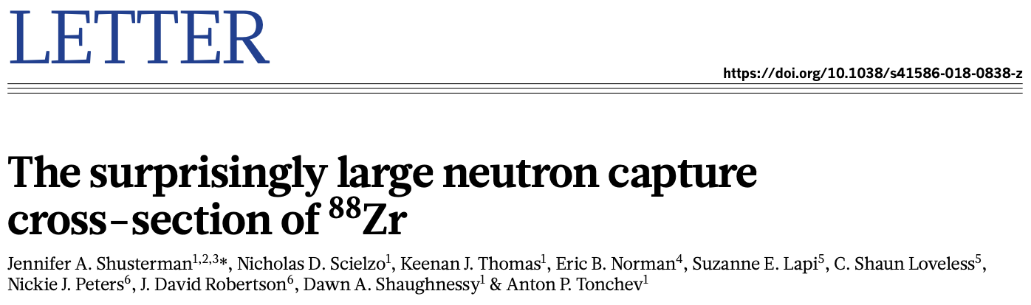
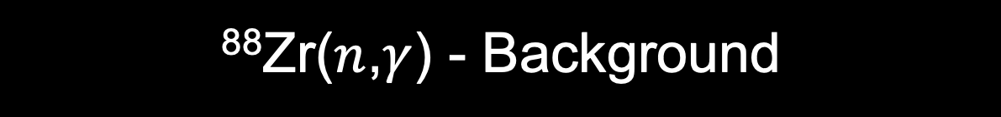
⁸⁸Zr($n$,$γ$) - Background
In 2019, ⁸⁸Zr was discovered to have a thermal neutron absorption cross section of ~800,000 barns (measured) rather than 10 barns (“expected”).
  Larger than ¹⁵⁷Gd, ¹⁰B, ⁶Li, ³He
  Smaller than ¹³⁵Xe
⁸⁸Zr is the only neutron absorber above 10,000 barns with even neutron number
Perhaps more surprising, many argue that thermal neutron cross sections are not able to be predicted!!!
S. Heinitz, U. Köster Nature Physics volume 15, 208–209 (2019)

Slide 4
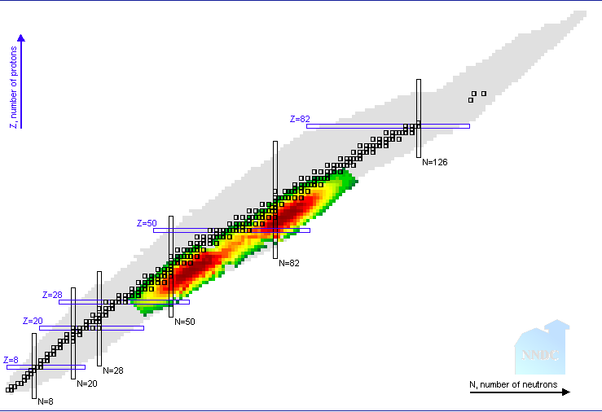

⁸⁸Zr($n$,$γ$) - Background
⁸⁸Zr hidden on other side of mountain range. What else is hiding here?
¹³⁵Xe
¹¹³Cd
¹⁵⁷Gd
(Fission products beta-decay to stability)

Slide 5
⁸⁸Zr is a neutron sponge – Who cares?
Nuclear physicists
  How are we wrong about predicting basic properties by 4 orders of magnitude?
High energy zirconium applications
  Accelerator and spallation sources
Is this massive cross section relating to new fundamental nuclear physics?
Does ⁸⁸Zr ‘feel a tug’ towards the magic number of 50 neutrons (⁹⁰Zr)?
Or was there simply an unexpected resonance at just the right (thermal) energy?
This is what turns out to be true

Slide 6
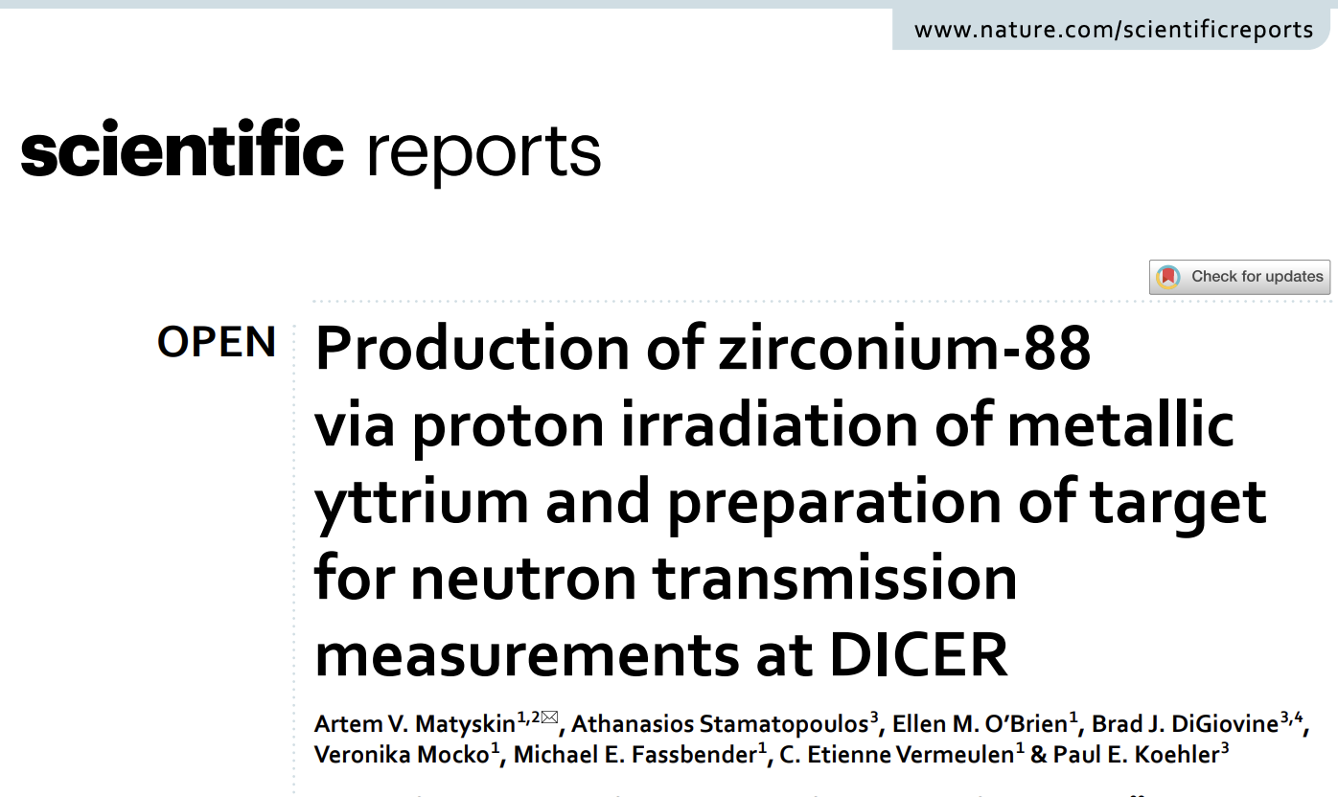
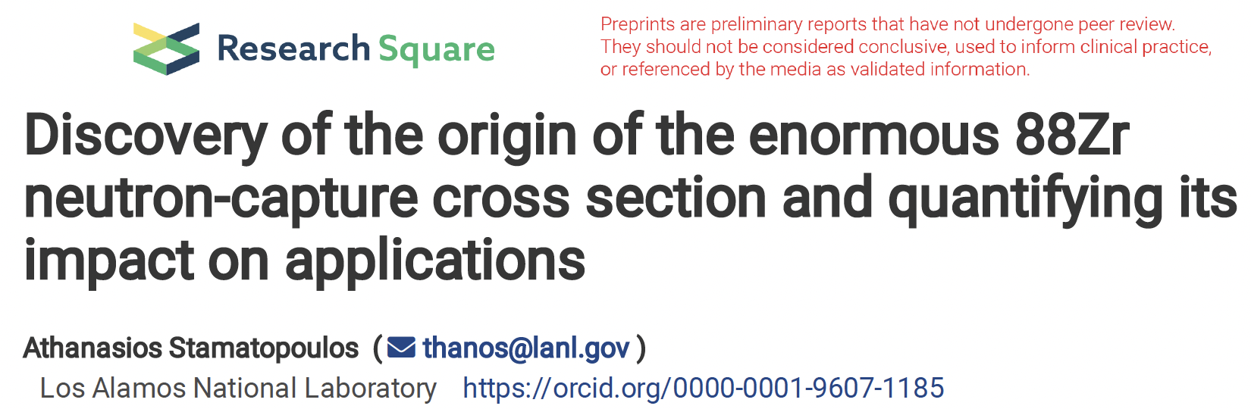
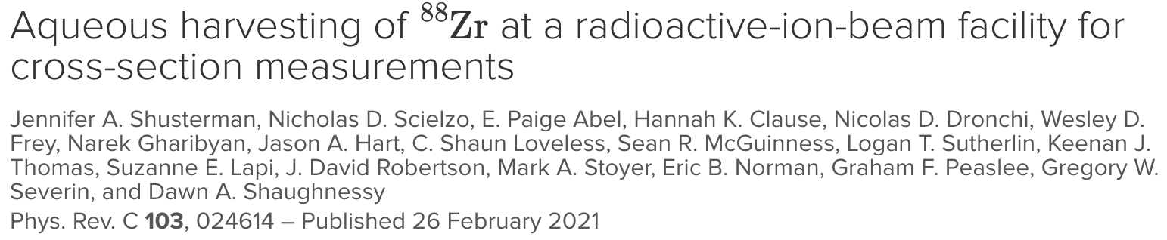
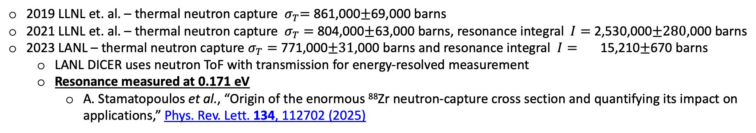
⁸⁸Zr(n,𝜸) – February 2024
2019 LLNL et. al. – thermal neutron capture ${ σ}_{T}=$ 861,000$±$69,000 barns
2021 LLNL et. al. – thermal neutron capture $σ_{T}=$ 804,000$±$63,000 barns, resonance integral $I=$ 2,530,000$±280$,000 barns
2023 LANL – thermal neutron capture $σ_{T}=$ 771,000$±31$,000 barns and resonance integral $I=$ 15,210$±$670 barns
  LANL DICER uses neutron ToF with transmission for energy-resolved measurement
  Resonance measured at 0.171 eV
    A. Stamatopoulos et al., “Origin of the enormous ⁸⁸Zr neutron-capture cross section and quantifying its impact on applications,” Phys. Rev. Lett. 134, 112702 (2025)

Slide 7
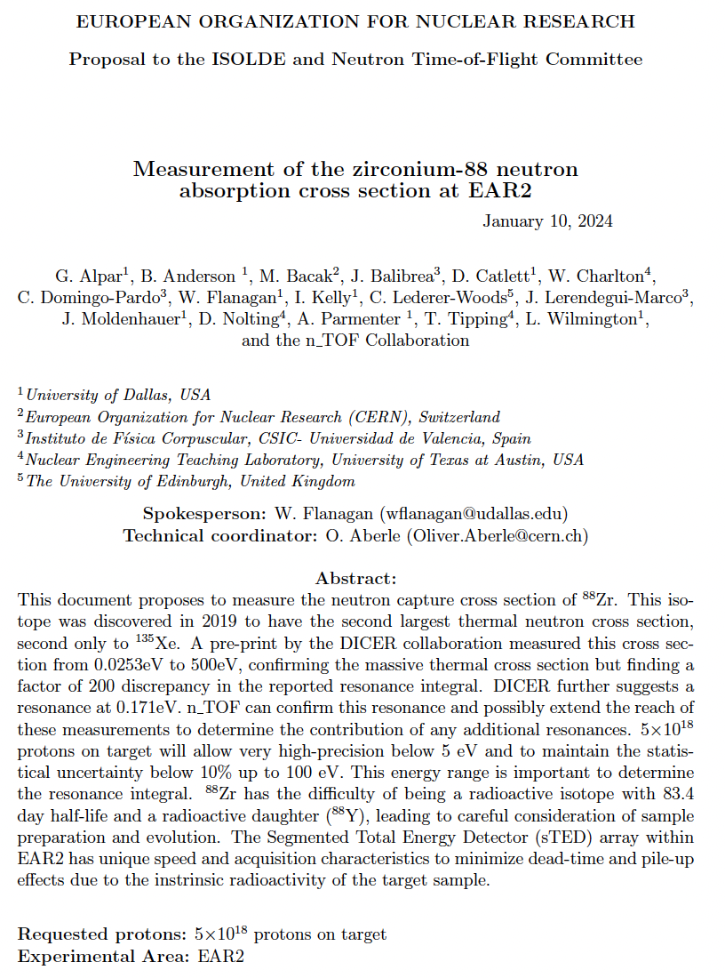
⁸⁸Zr(n,𝜸) – February 2024
2019 LLNL et. al. – thermal neutron capture ${ σ}_{T}=$ 861,000$±$69,000 barns
2021 LLNL et. al. – thermal neutron capture $σ_{T}=$ 804,000$±$63,000 barns, resonance integral $I=$ 2,530,000$±280$,000 barns
2023 LANL – thermal neutron capture $σ_{T}=$ 771,000$±31$,000 barns and resonance integral $I=$ 15,210$±$670 barns
  LANL DICER uses neutron ToF with transmission for energy-resolved measurement
  Resonance measured at 0.171 eV
    A. Stamatopoulos et al., “Origin of the enormous ⁸⁸Zr neutron-capture cross section and quantifying its impact on applications,” Phys. Rev. Lett. 134, 112702 (2025)

Slide 8
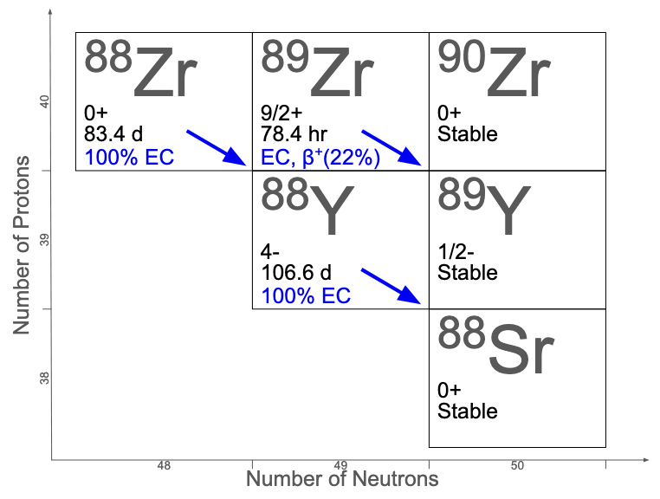
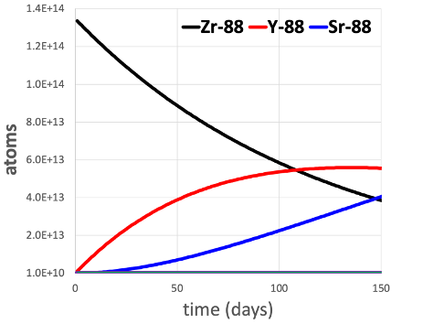
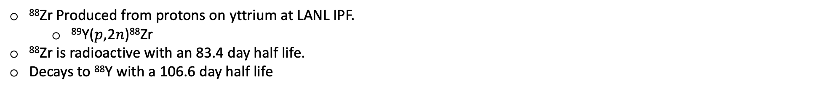
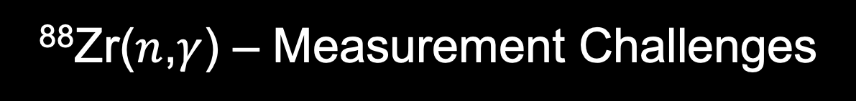
⁸⁸Zr($n$,$γ$) – Measurement Challenges
⁸⁸Zr Produced from protons on yttrium at LANL IPF.
  ⁸⁹Y($p$,2$n$)⁸⁸Zr
⁸⁸Zr is radioactive with an 83.4 day half life.
Decays to ⁸⁸Y with a 106.6 day half life

Slide 9
⁸⁸Zr($n$,$γ$) – Measurement Challenges
⁸⁸Y buildup creates a major background
⁸⁸Zr electron capture produces 393 keV gammas (97% branching ratio)
But ⁸⁸Y electron capture produces 898 keV (93%) and 1.836 MeV (99%) gamma rays.
⁸⁸Zr arrives from LANL in 2M HCl
Developed ⁸⁸Zr/⁸⁸Y chemical separation
⁸⁸Zr metal cation complexes with (HDEHP)₂ and dissolves in the organic layer
  Then digest dodecane with oxalic acid, nitric acid, peroxide
For later ILL FIPPS run, additional water “washes” to rid ³⁵Cl before digesting organic.

Slide 10
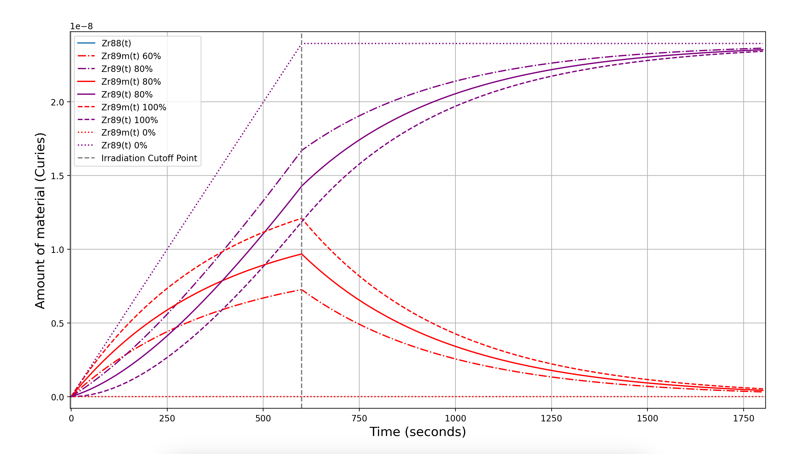
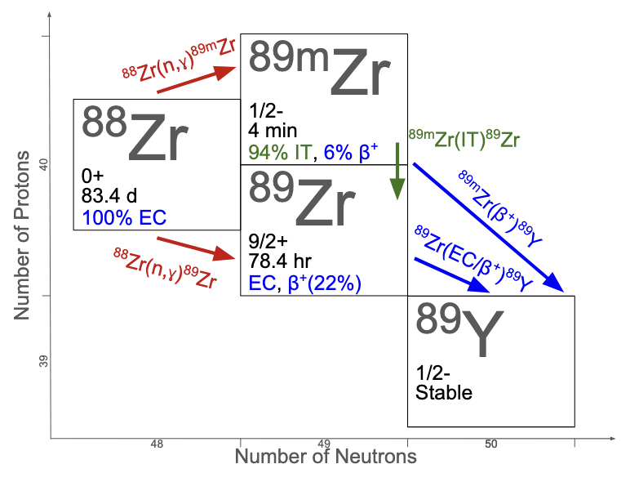
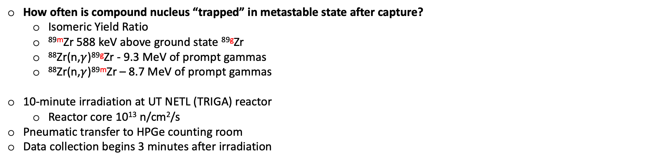
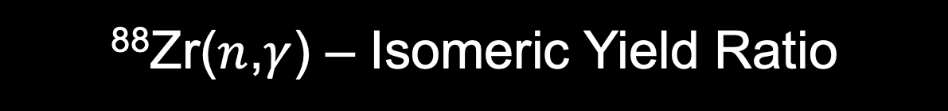
⁸⁸Zr($n$,$γ$) – Isomeric Yield Ratio
How often is compound nucleus “trapped” in metastable state after capture?
  Isomeric Yield Ratio
  ^{89m}Zr 588 keV above ground state ^{89g}Zr
  ⁸⁸Zr(n,$γ$)^{89g}Zr - 9.3 MeV of prompt gammas
  ⁸⁸Zr(n,$γ$)^{89m}Zr – 8.7 MeV of prompt gammas
10-minute irradiation at UT NETL (TRIGA) reactor
  Reactor core 10¹³ n/cm²/s
Pneumatic transfer to HPGe counting room
Data collection begins 3 minutes after irradiation

Slide 11
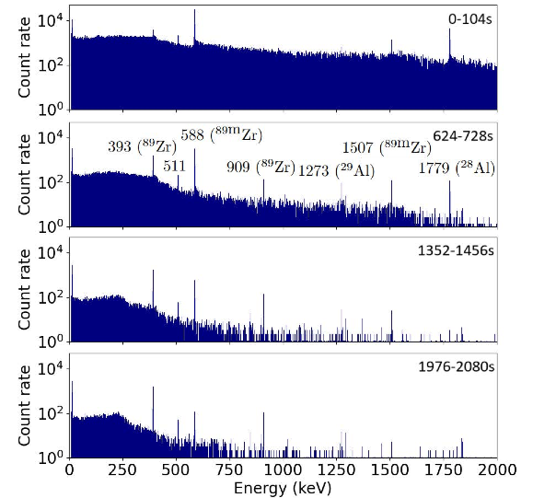
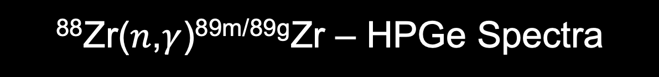
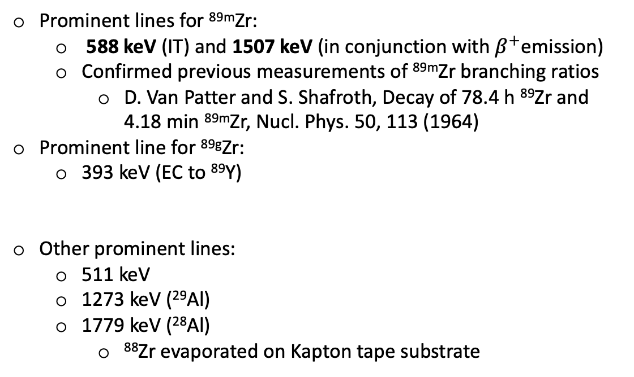
⁸⁸Zr($n$,$γ$)^{89m/89g}Zr – HPGe Spectra
Prominent lines for ^{89m}Zr:
  588 keV (IT) and 1507 keV (in conjunction with $β^{+}$emission)
  Confirmed previous measurements of ^{89m}Zr branching ratios
    D. Van Patter and S. Shafroth, Decay of 78.4 h ⁸⁹Zr and 4.18 min ^{89m}Zr, Nucl. Phys. 50, 113 (1964)
Prominent line for ^{89g}Zr:
  393 keV (EC to ⁸⁹Y)
Other prominent lines:
  511 keV
  1273 keV (²⁹Al)
  1779 keV (²⁸Al)
    ⁸⁸Zr evaporated on Kapton tape substrate

Slide 12
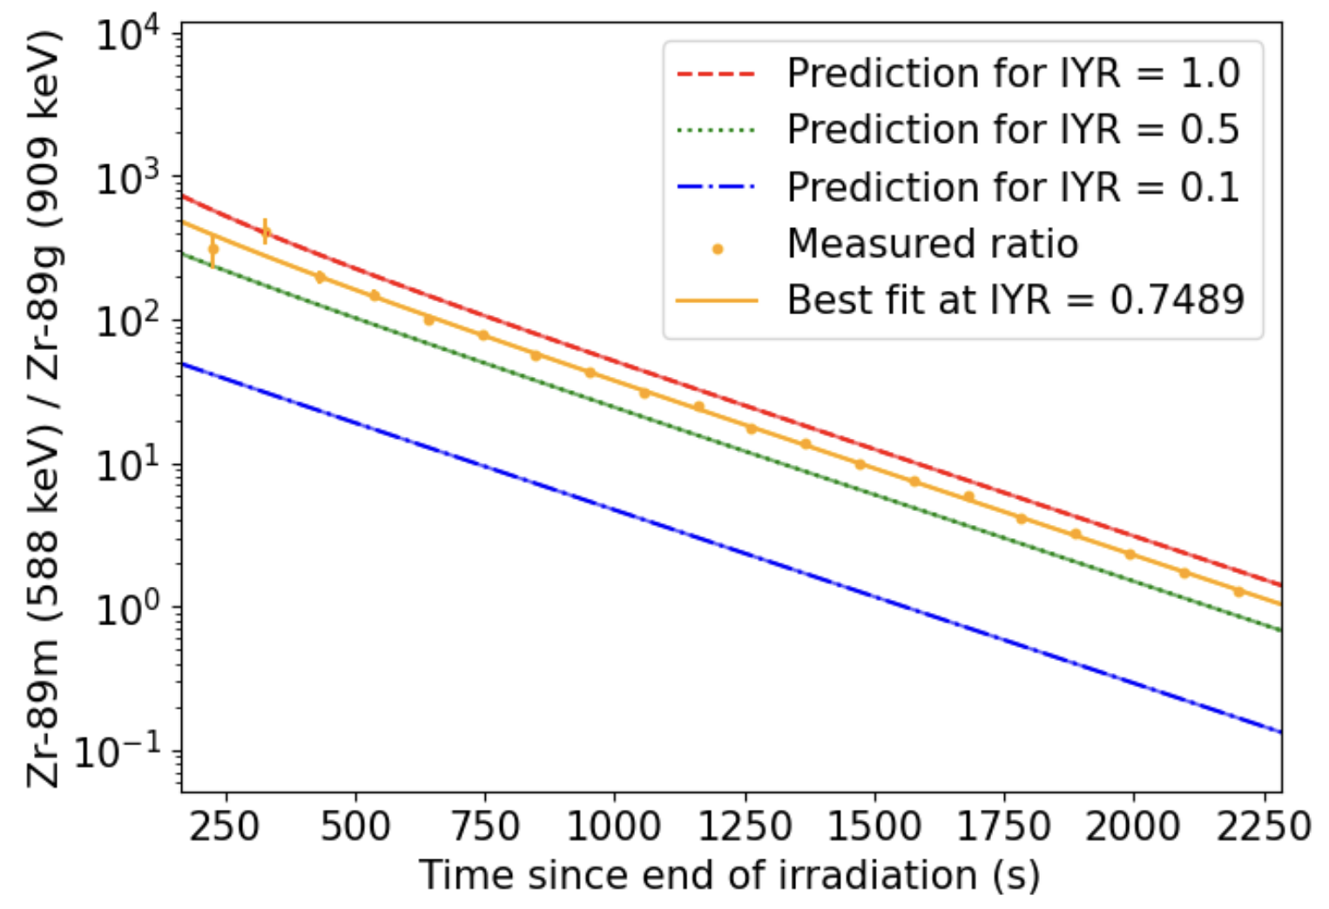

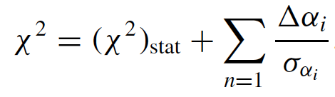
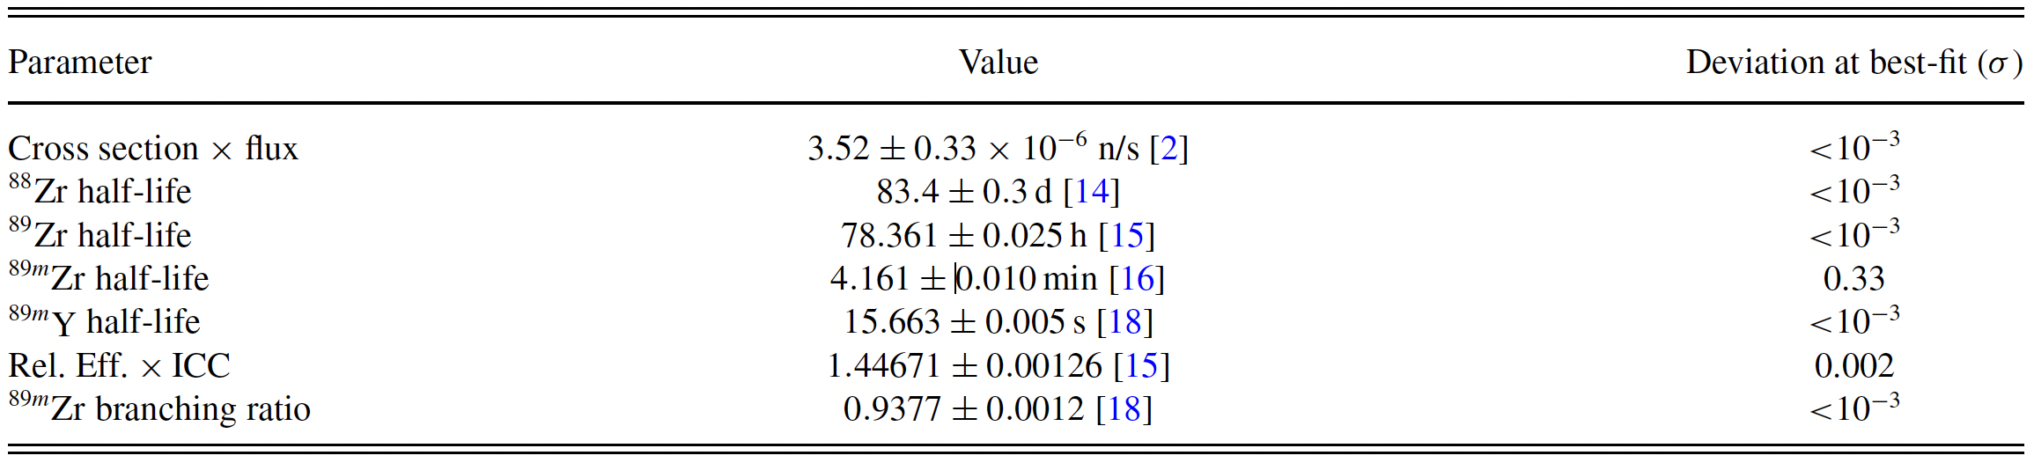
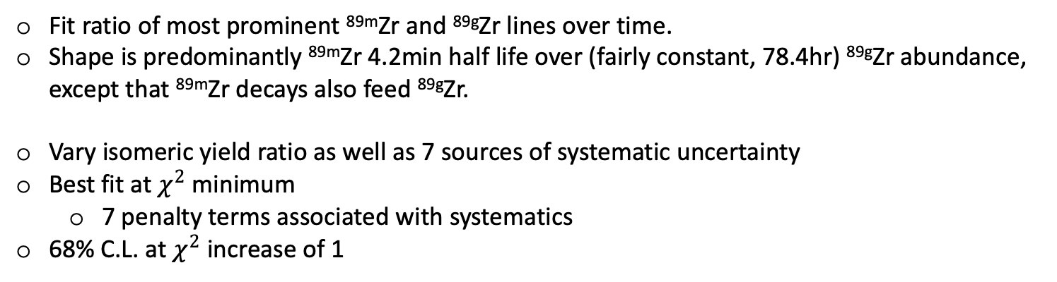
⁸⁸Zr($n$,$γ$) – Isomeric Yield Ratio
Fit ratio of most prominent ^{89m}Zr and ^{89g}Zr lines over time.
Shape is predominantly ^{89m}Zr 4.2min half life over (fairly constant, 78.4hr) ^{89g}Zr abundance, except that ^{89m}Zr decays also feed ^{89g}Zr.
Vary isomeric yield ratio as well as 7 sources of systematic uncertainty
Best fit at $χ^{2}$ minimum
  7 penalty terms associated with systematics
68% C.L. at $χ^{2}$ increase of 1

Slide 13
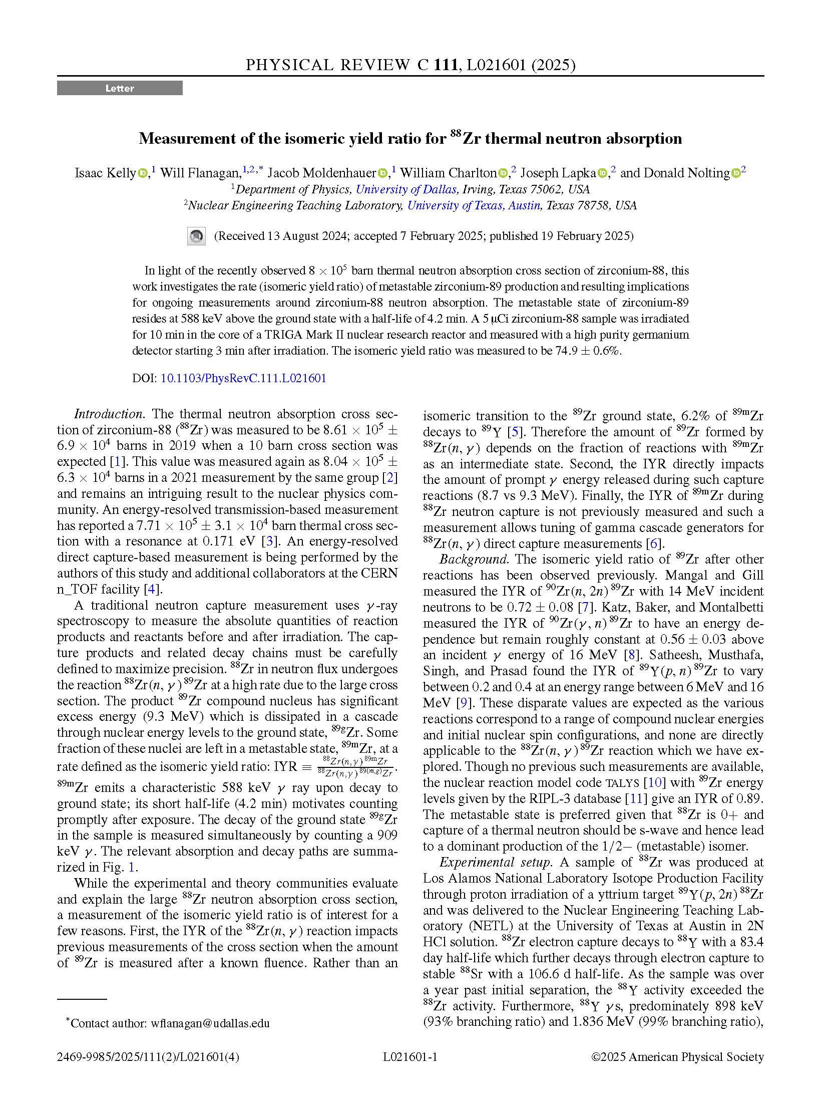
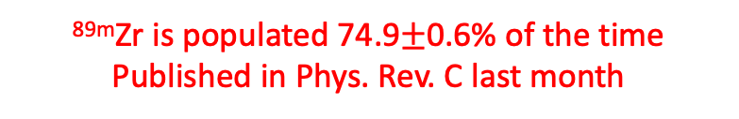
⁸⁸Zr($n$,$γ$) – Isomeric Yield Ratio
Fit ratio of most prominent ^{89m}Zr and ^{89g}Zr lines over time.
Shape is predominantly ^{89m}Zr 4.2min half life over (fairly constant, 78.4hr) ^{89g}Zr abundance, except that ^{89m}Zr decays also feed ^{89g}Zr.
Vary isomeric yield ratio as well as 7 sources of systematic uncertainty
Best fit at $χ^{2}$ minimum
  7 penalty terms associated with systematics
68% C.L. at $χ^{2}$ increase of 1
^{89m}Zr is populated 74.9$±$0.6% of the time
Published in Phys. Rev. C last month

Slide 14
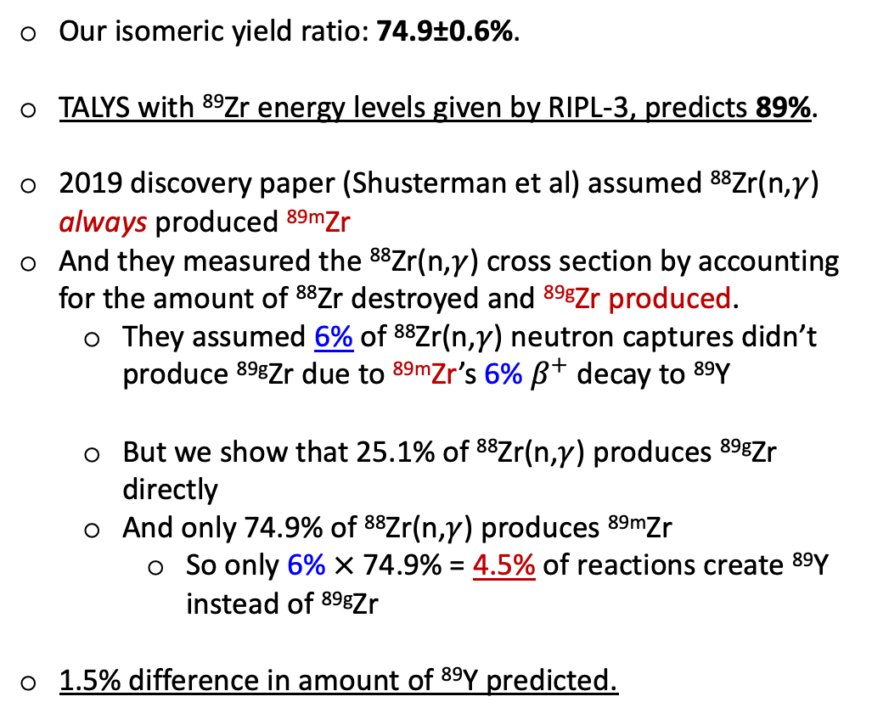
Relevance to Other Measurements
Our isomeric yield ratio: 74.9±0.6%.
TALYS with ⁸⁹Zr energy levels given by RIPL-3, predicts 89%.
2019 discovery paper (Shusterman et al) assumed ⁸⁸Zr(n,$γ$) always produced ^{89m}Zr
And they measured the ⁸⁸Zr(n,$γ$) cross section by accounting for the amount of ⁸⁸Zr destroyed and ^{89g}Zr produced.
  They assumed 6% of ⁸⁸Zr(n,$γ$) neutron captures didn’t produce ^{89g}Zr due to ^{89m}Zr’s 6% $β^{+}$ decay to ⁸⁹Y
  But we show that 25.1% of ⁸⁸Zr(n,$γ$) produces ^{89g}Zr directly
  And only 74.9% of ⁸⁸Zr(n,$γ$) produces ^{89m}Zr
    So only 6%$×$ 74.9% = 4.5% of reactions create ⁸⁹Y instead of ^{89g}Zr
1.5% difference in amount of ⁸⁹Y predicted.
74.9%
25.1%

Slide 15
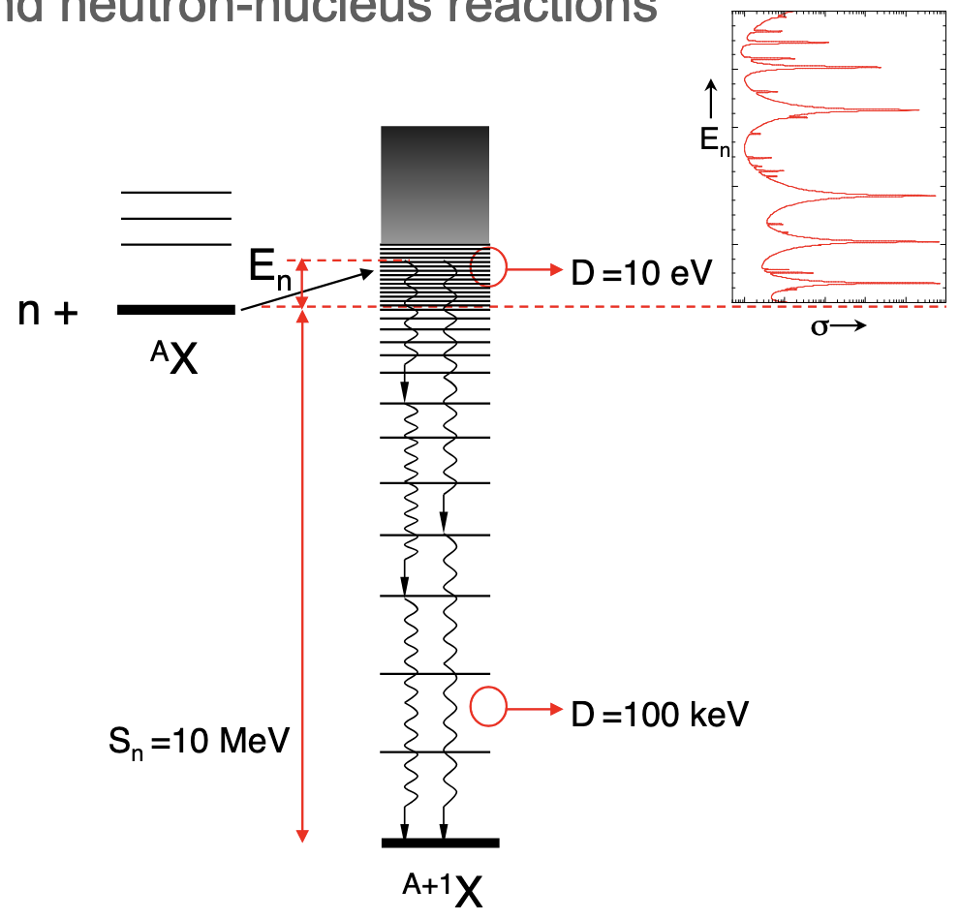
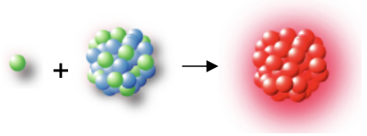
Moving Forward - Neutron Capture
Neutron capture creates compound nucleus
  Excess energy creates prompt gamma rays

Slide 16
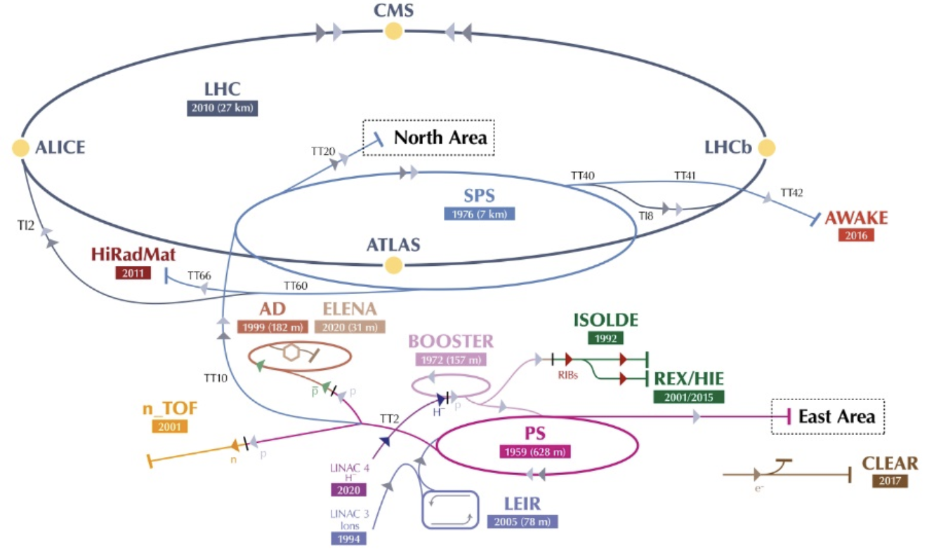

Neutron Time of Flight at CERN
LINAC4 H⁻ $→$ 160 MeV ; Booster H⁺ $→$ 2 GeV ; Proton Synchrotron H⁺ $→$ 25 GeV
7ns proton bunch width, lead spallation target

Slide 17
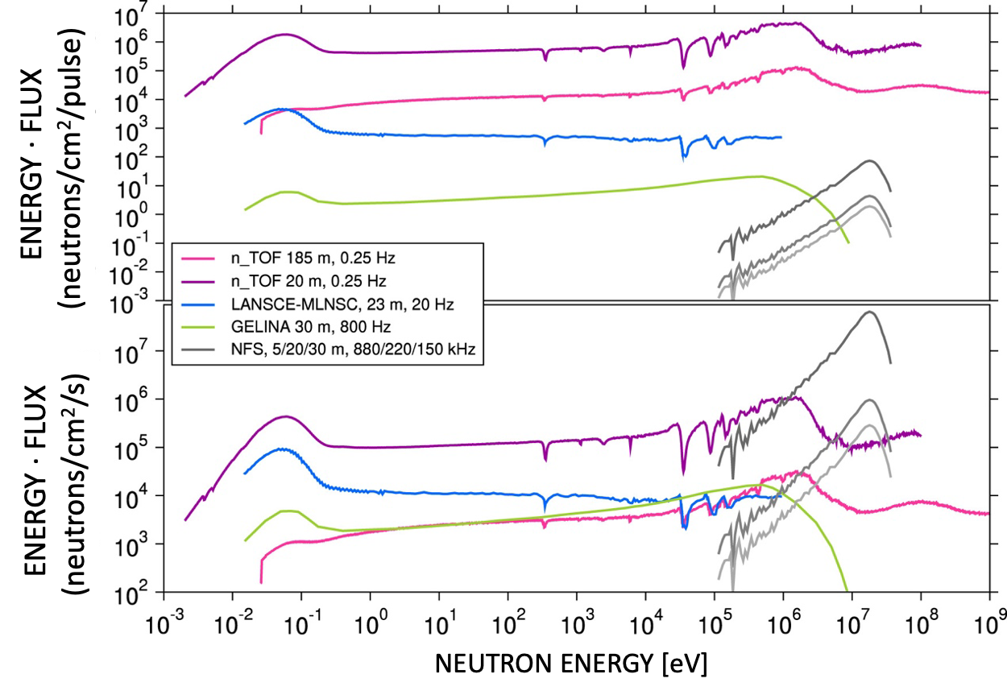
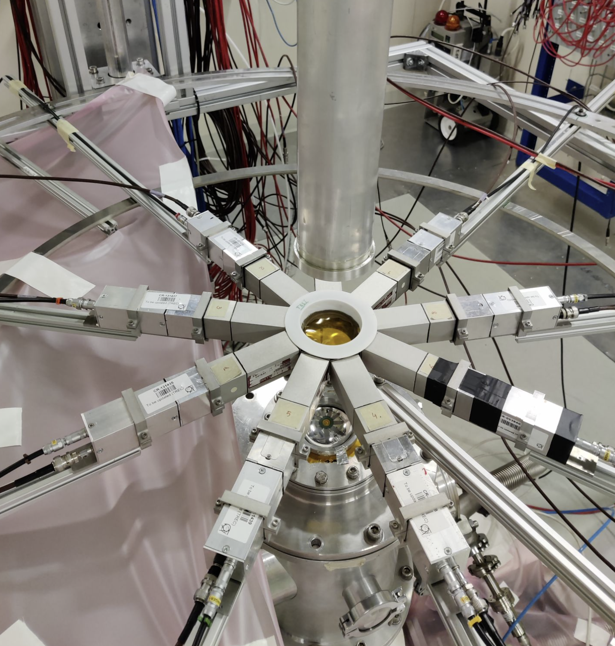
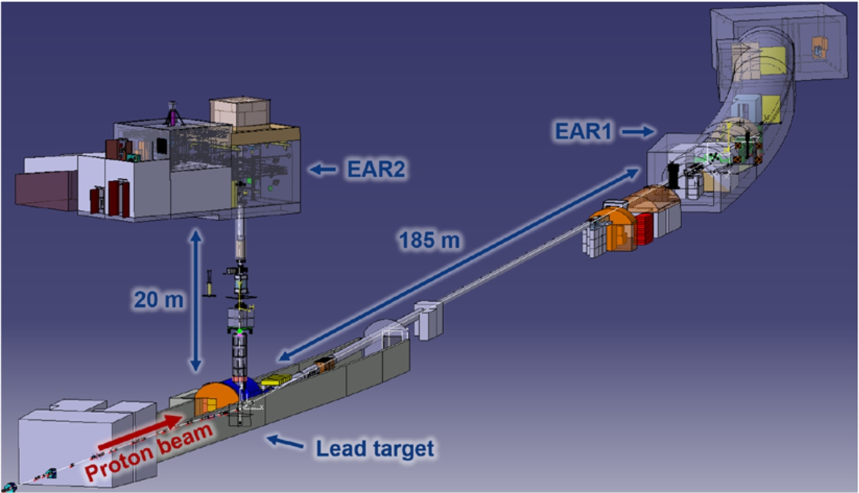
Neutron Time of Flight at CERN
Experimental Area 2 (EAR2) utilized due to higher instantaneous flux, fast segmented Total Energy Detectors (C₆D₆ sTEDs), and “almost dead-time free” DAQ.
Target upgrade

Slide 18
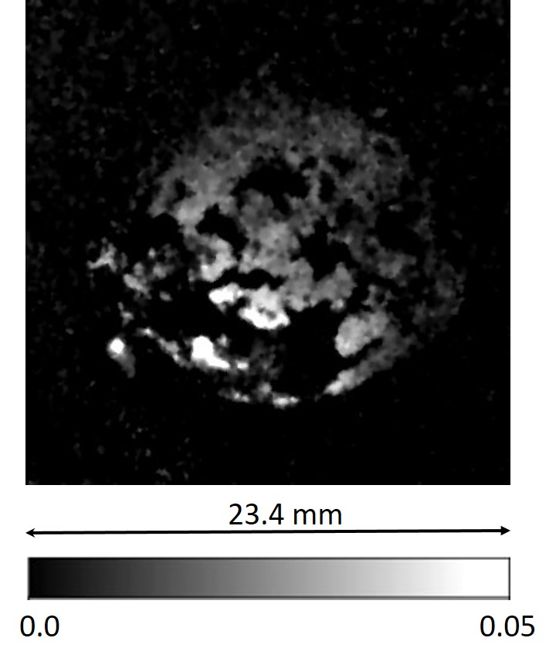
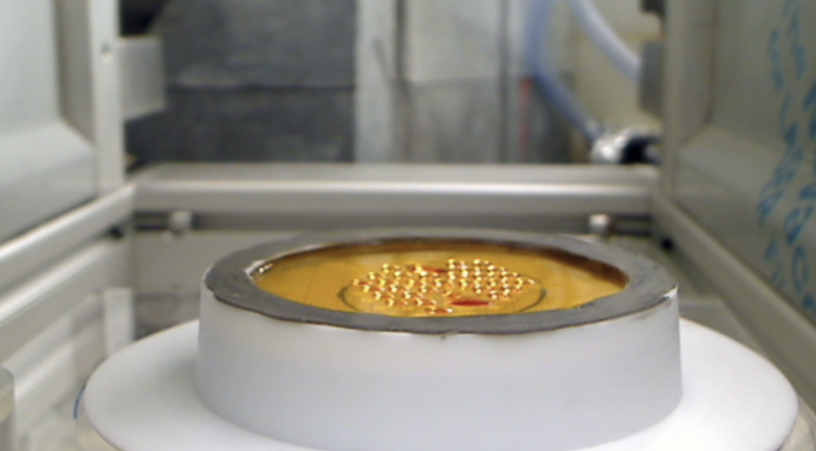
Neutron Time of Flight at CERN
Evaporation of salt not uniform!
  Beam interception factor
Neutron radiograph from NEUTRA at Paul Scherrer Institute.
  March 2024 (test) deposition
  July 2024 image
Lesson learned for (main) August 2024 sample!
More uniform deposition at PSI

Slide 19
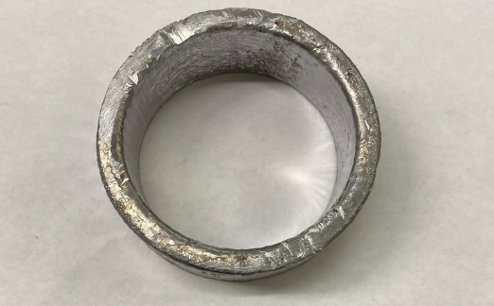
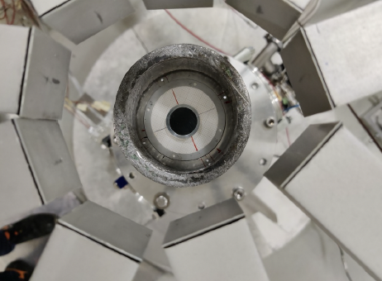
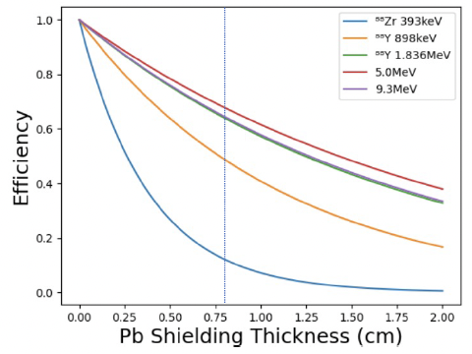
Minimize Detector Rate
Obtained 1mCi ⁸⁸Zr source from LANL IPF for March test exposure at CERN n_TOF
  Allowed us to test shipping logistics to Europe
Obtained 30mCi ⁸⁸Zr source from LANL IPF for August-September beam time.
  5 AUG 24 LANL separation
  12 AUG 24 receipt at PSI
  16 AUG 24 begin irradiation at CERN
Lead shielding to attenuate 85% of ⁸⁸Zr activity while maintaining roughly half of prompt gammas.

Slide 20
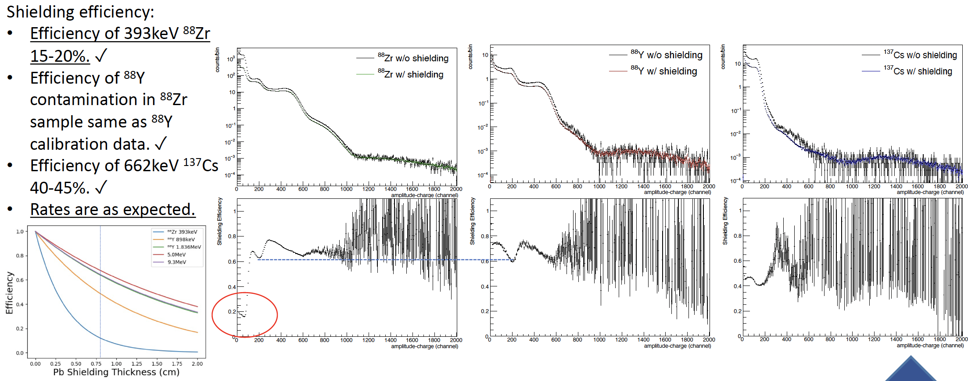
Shielding Validation (March 2024)

Slide 21
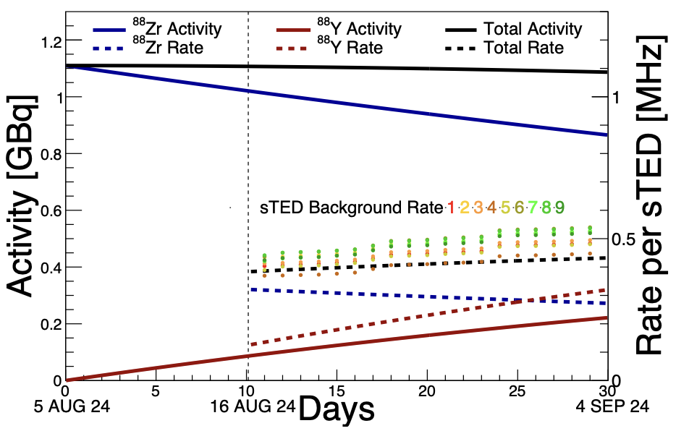
Detector Rates (August 2024)
Maintained a detector rate below 1 MHz to assure detector performance
  Continuous calibrations with ⁸⁸Y

Slide 22
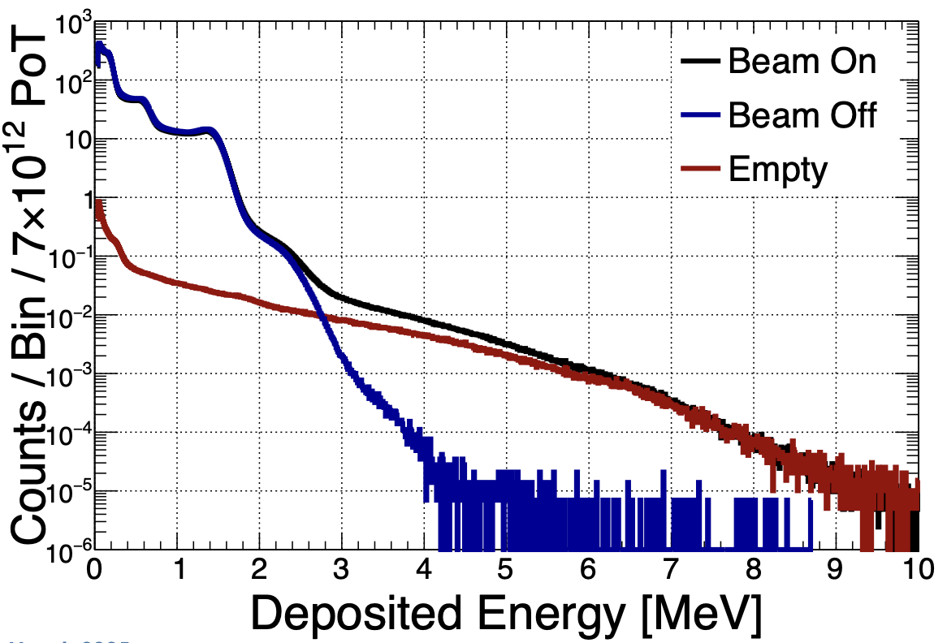
⁸⁸Zr – Deposited Energy (Gammas)
Compton shoulders:
⁸⁸Zr 393 keV (97%)
⁸⁸Y 898 keV (94%)
⁸⁸Y 1.836 MeV (99%)
⁸⁸Y 2.734 MeV (0.6%)
⁸⁸Y 3.218 MeV (0.007%)

Slide 23
⁸⁸Zr – Background Subtraction
Require 3.5 MeV of energy to be deposited in scintillators
  To eliminate ⁸⁸Zr and ⁸⁸Y EC gammas

Slide 24
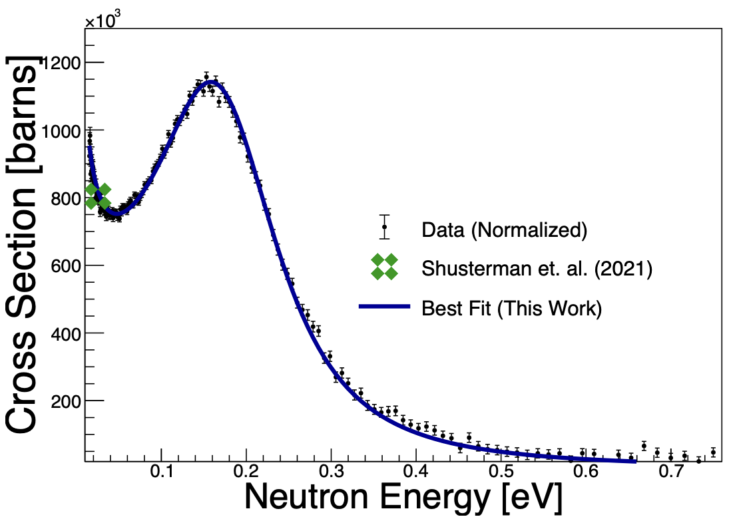
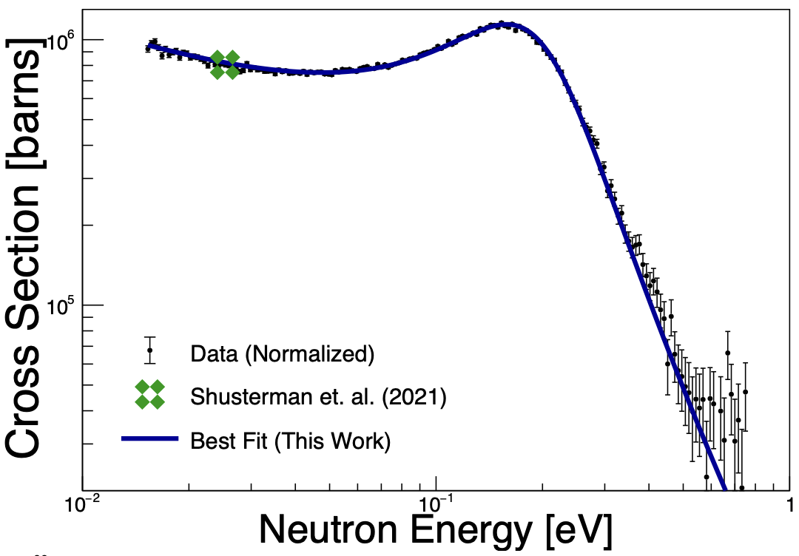
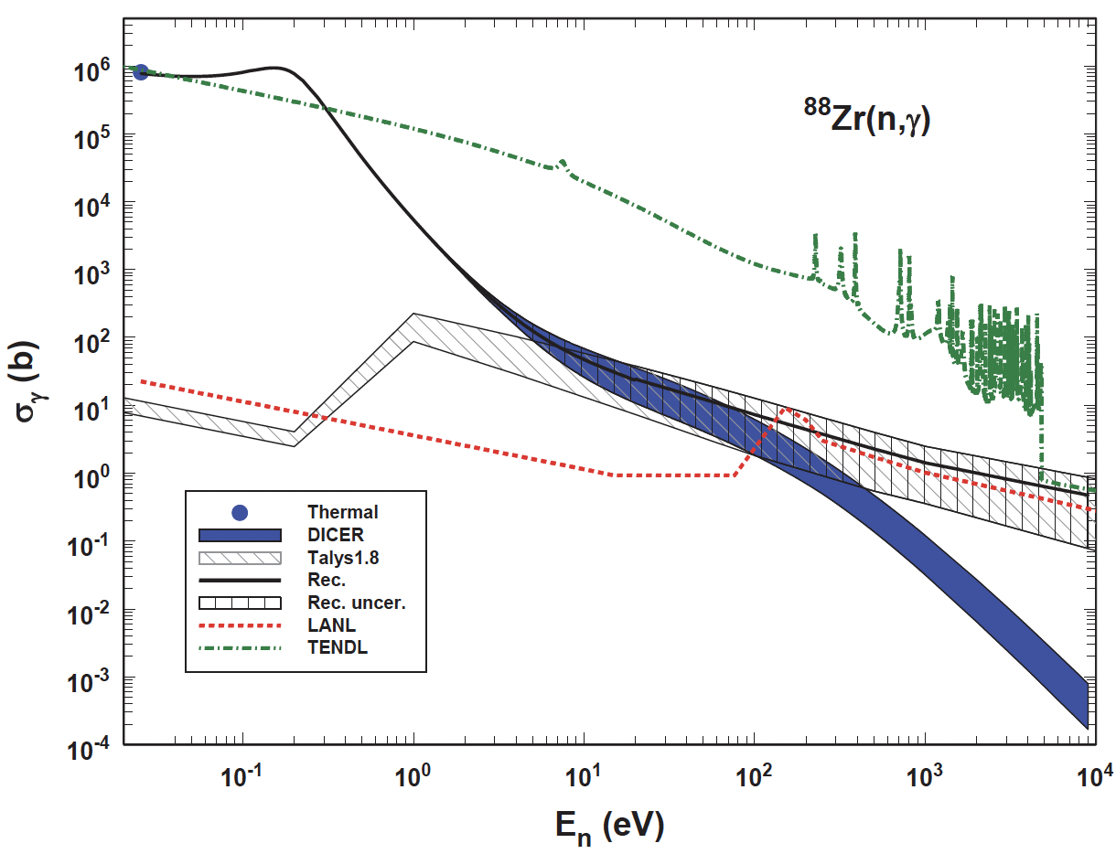
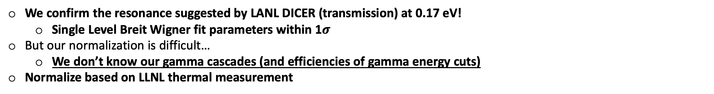
⁸⁸Zr – Resonance Found
We confirm the resonance suggested by LANL DICER (transmission) at 0.17 eV!
  Single Level Breit Wigner fit parameters within 1$σ$
But our normalization is difficult…
  We don’t know our gamma cascades (and efficiencies of gamma energy cuts)
Normalize based on LLNL thermal measurement
Capture (CERN n_TOF)
Transmission (LANL DICER)

Slide 25
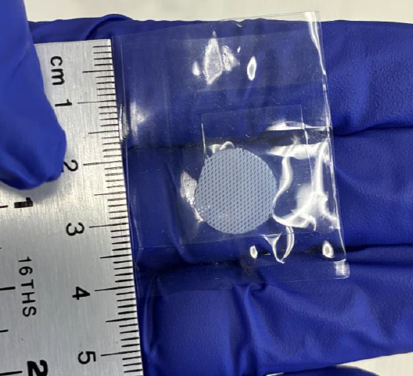
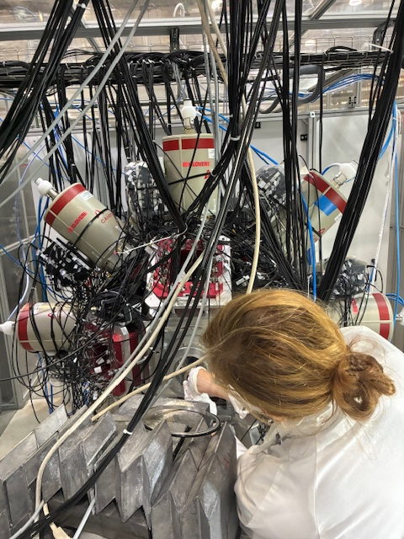

⁸⁸Zr – ILL FIPPS
Next steps - prompt gamma cascades at ILL FIPPS (thermal, 10⁸ neutrons/s/cm², 64 HPGe)
  FIPPS has successful record with radioactive samples (2MBq calcium-41 and 2GBq nickel-63, for example)
  Two Campaigns in Fall 2025

Slide 26


⁸⁸Zr – ILL FIPPS
Promising results so far!
  PRELIMINARY!!!
Red denotes new candidate states/gammas
Black denotes previously known.
Credit: C. Michelagnoli

Slide 27


⁸⁸Zr – Conclusions
The ⁸⁸Zr(n,$γ$) thermal cross section is anomalously large because of a sub-eV resonance.
  We confirm the (transmission-based) DICER 0.17 eV resonance.
CERN INTC approval to measurement was less than 1 year.
  Rapid progress is possible when partners like LANL, PSI, and CERN work together!
And infusion of ILL FIPPS data helps to complete the story!
  Improved understanding of prompt gamma energy deposited in n_TOF scintillators
    FIPPS helps to optimize n_TOF analysis
  Relative $→$ Absolute cross section at n_TOF
Many thanks to brilliant collaborators and students!
UT NETL reactor, radiochemistry – Don Nolting, Joseph Lapka, Bill Charlton, Tracy Tipping, Rodrigo Viveros
^{89m}Zr – Isaac Kelly (undergraduate $→$ PhD student at Notre Dame), Jacob Moldenhauer
CERN n_TOF – Genevieve Alpar (undergraduate $→$ Master at AFIT), Albert Parmenter (undergraduate), Beth Jacoby (undergraduate), Michi Bacak, Javi Balibrea, Claudia Lederer-Woods, Jorge Lerendegui-Marco, Emilio Maugeri, Alberto Mengoni
ILL FIPPS – Caterina Michelagnoli, Marek Stryjczyk and many from n_TOF including Matt Birch, Toby Wright, Fran Garcia-Infantes, Javi Balibrea, Jorge Lerendegui-Marco, Michi Bacak + Andrew Rosen (undergraduate) and Tanner Gordon

